Slide 1
Functions And Graphs
CSE 311 Summer 2025
Lecture 17

Slide 2
Announcements
HW6 is released and due Wednesday, 8/6!
Come to our next lecture on Wednesday for HW3, HW4, and midterm solutions

Slide 3
Announcements
Midterm Retake
  Midterm retake sessions will happen next Monday (8/11) and Tuesday (8/12) outside of our normal class time
  The exam structure will be identical to the midterm, and we aim to make the difficulty about the same
  Your final midterm score will be computed by taking the max score per question between the midterm and the midterm retake
  You’ll indicate all times you would be able to take the midterm retake through a scheduling form that will be posted on the Ed board (due Thursday, 8/7)
  On Friday, Parker will post the midterm retake schedule

Slide 4
Review

Slide 5
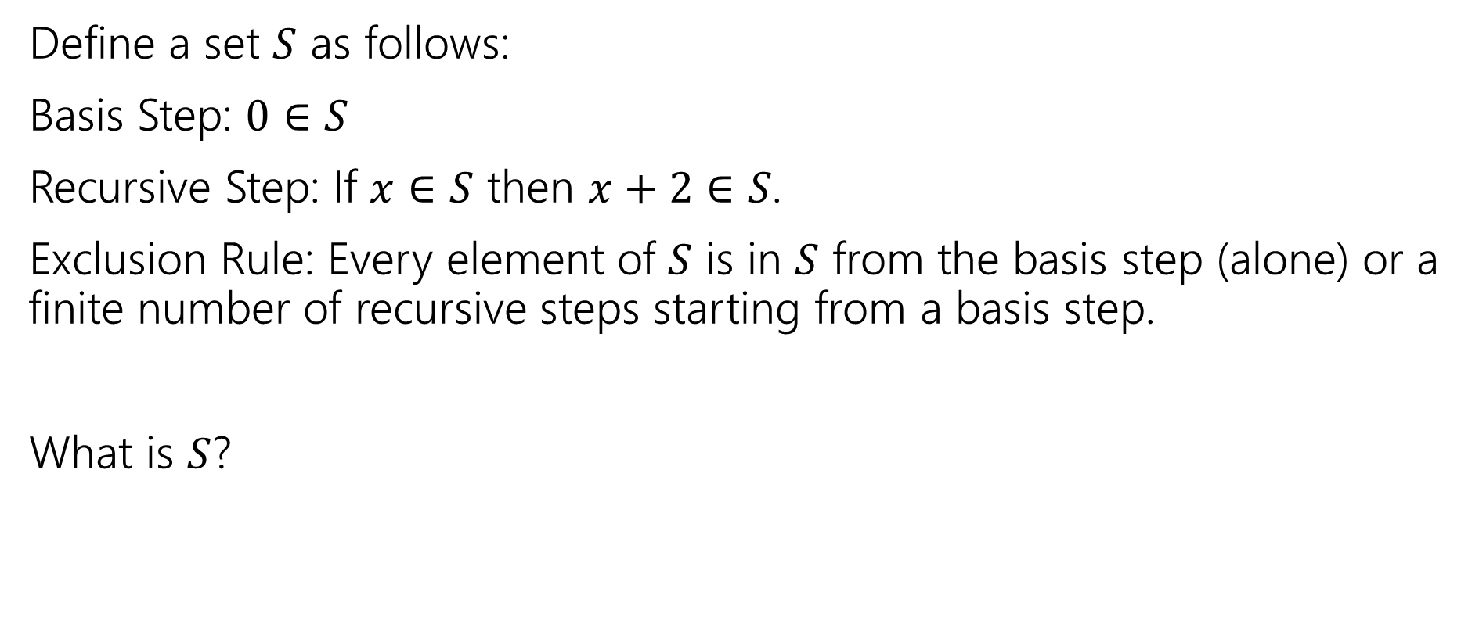

Recursive Definition of Sets
Define a set $S$ as follows:
Basis Step: $0∈S$
Recursive Step: If $x∈S$ then $x+2∈S$.
Exclusion Rule: Every element of $S$ is in $S$ from the basis step (alone) or a finite number of recursive steps starting from a basis step.
What is $S$?

Slide 6
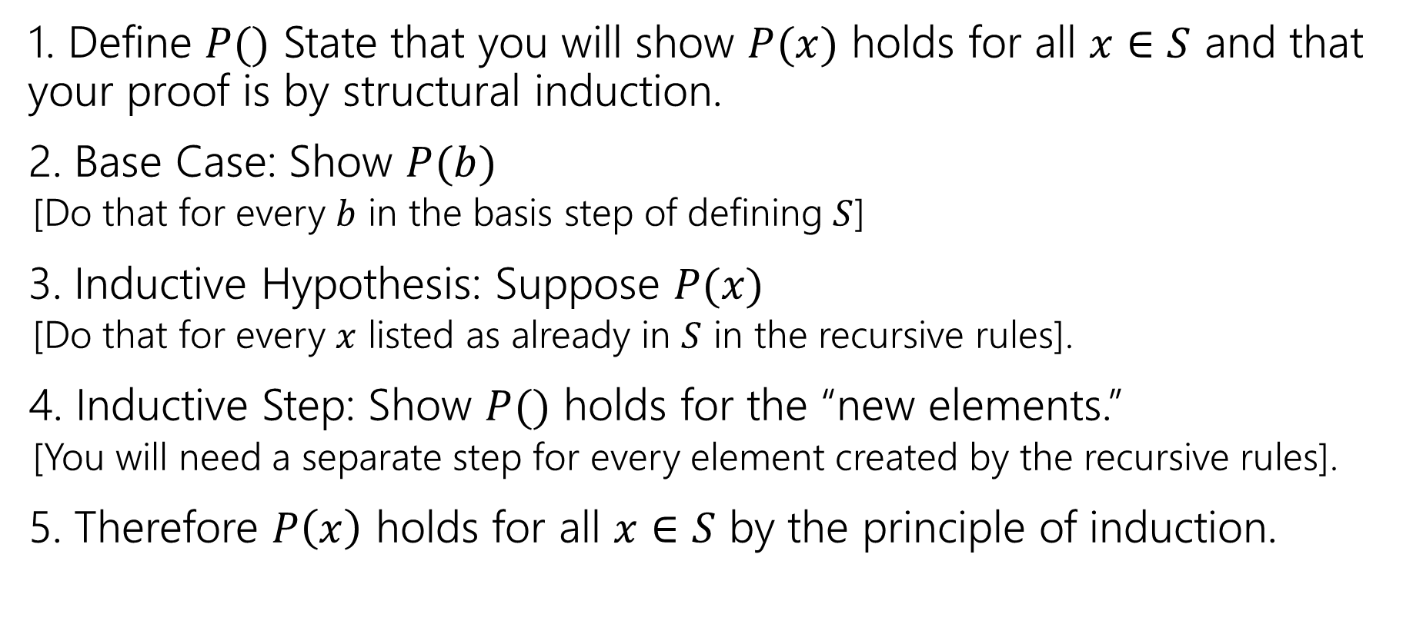

Structural Induction Template
1. Define $P()$ State that you will show $P(x)$ holds for all $x∈S$ and that your proof is by structural induction.
2. Base Case: Show $P(b)$
  [Do that for every $b$ in the basis step of defining $S$]
3. Inductive Hypothesis: Suppose $P(x)$
  [Do that for every $x$ listed as already in $S$ in the recursive rules].
4. Inductive Step: Show $P()$ holds for the “new elements.”
  [You will need a separate step for every element created by the recursive rules].
5. Therefore $P\left(x\right)$ holds for all $x∈S$ by the principle of induction.

Slide 7
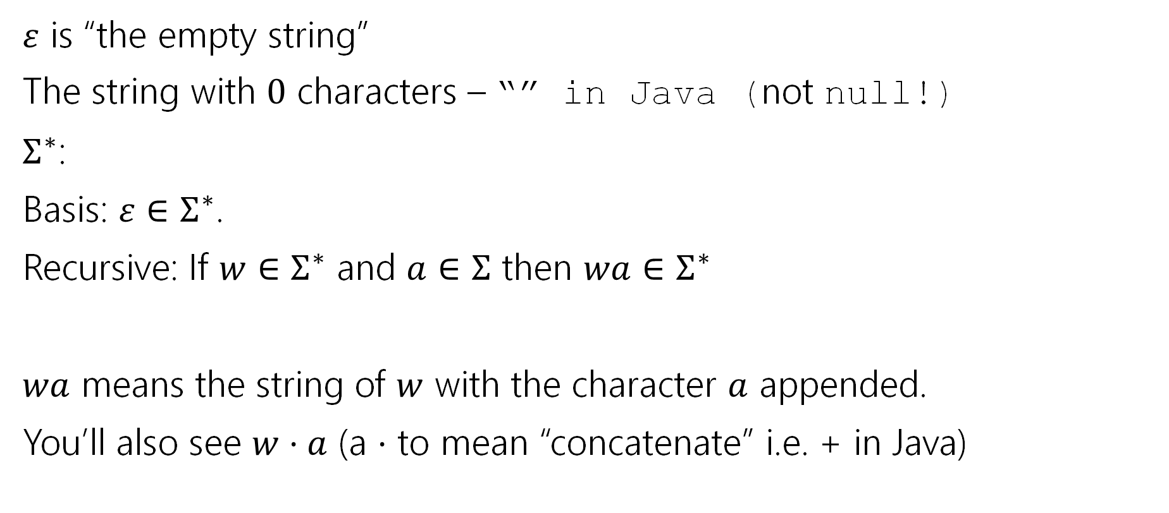
Strings
$ε$ is “the empty string”
The string with $0$ characters – “” in Java (not null!)
$Σ^{∗}$:
Basis: $ε∈Σ^{∗}$.
Recursive: If $w∈Σ^{∗}$ and $a∈Σ$ then $wa∈Σ^{∗}$
$wa$ means the string of $w$ with the character $a$ appended.
You’ll also see $w⋅a$ (a $⋅$ to mean “concatenate” i.e. + in Java)

Slide 8
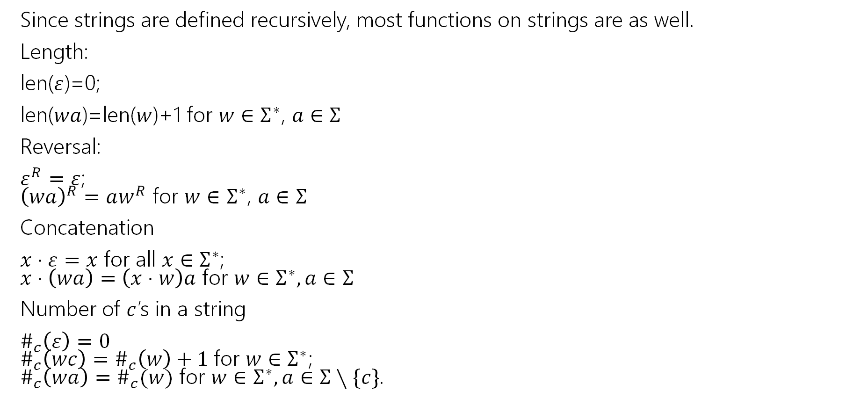
Functions on Strings
Since strings are defined recursively, most functions on strings are as well.
Length:
len($ε$)=0;
len($wa$)=len($w$)+1 for $w∈Σ^{∗}$, $a∈Σ$
Reversal:
$ε^{R}=ε$;
${\left(wa\right)}^{R}=aw^{R}$ for $w∈Σ^{∗}$, $a∈Σ$
Concatenation
$x⋅ε=x$ for all $x∈Σ^{∗}$;
$x⋅\left(wa\right)=\left(x⋅w\right)a$ for $w∈Σ^{∗},a∈Σ$
Number of $c$’s in a string
$\#_{c}\left(ε\right)=0$
$\#_{c}\left(wc\right)=\#_{c}\left(w\right)+1$for $w∈Σ^{∗}$;
$\#_{c}\left(wa\right)=\#_{c}(w)$ for $w∈Σ^{∗},a∈Σ∖\{c\}$.

Slide 9
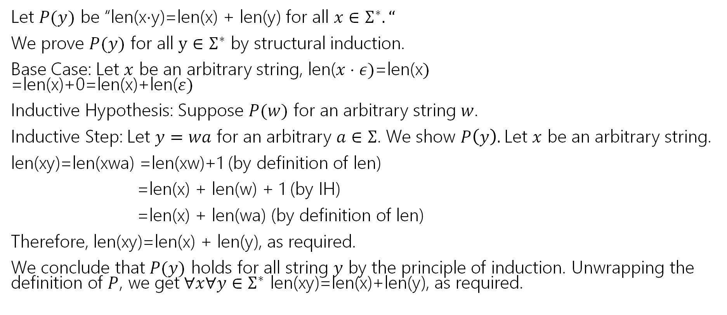
Claim for all $x,y∈Σ^{∗}$len(x$⋅$y)=len(x) + len(y).
Let $P(y)$ be “len(x$⋅$y)=len(x) + len(y) for all $x∈Σ^{∗}.“$
We prove $P(y)$ for all $y∈Σ^{∗}$ by structural induction.
Base Case: Let $x$ be an arbitrary string, len($x⋅ε)$=len(x$)$
=len(x)+0=len(x)+len($ε)$
Inductive Hypothesis: Suppose $P(w)$ for an arbitrary string $w$.
Inductive Step: Let $y=wa$ for an arbitrary $a∈Σ$. We show $P\left(y\right).$Let $x$ be an arbitrary string.
len(xy)=len(xwa) =len(xw)+1 (by definition of len)
=len(x) + len(w) + 1 (by IH)
=len(x) + len(wa) (by definition of len)
Therefore, len(xy)=len(x) + len(y), as required.
We conclude that $P(y)$ holds for all string $y$ by the principle of induction. Unwrapping the definition of $P$, we get $∀x∀y∈Σ^{∗}$ len(xy)=len(x)+len(y), as required.

Slide 10

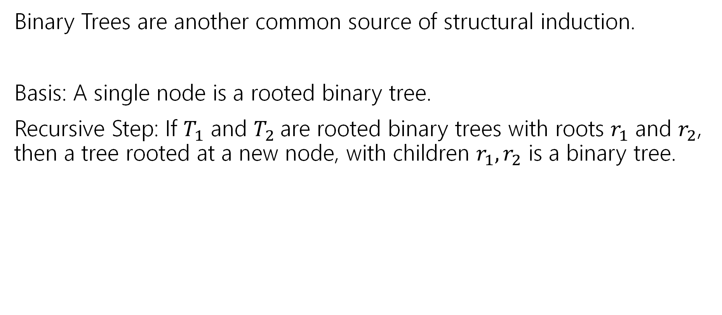

More Structural Sets
Binary Trees are another common source of structural induction.
Basis: A single node is a rooted binary tree.
Recursive Step: If $T_{1}$ and $T_{2}$are rooted binary trees with roots $r_{1}$ and $r_{2}$, then a tree rooted at a new node, with children $r_{1},r_{2}$ is a binary tree.
$$T_{1}$$
$$T_{2}$$

Slide 11





Functions on Binary Trees
size( )=1
size( ) = size($T_{1}$) + size($T_{2}$) + 1
height( ) = 0
height( ) = 1+$max⁡($height($T_{1}$),height($T_{2}$)$)$
$$T_{1}$$
$$T_{2}$$
$$T_{1}$$
$$T_{2}$$

Slide 12

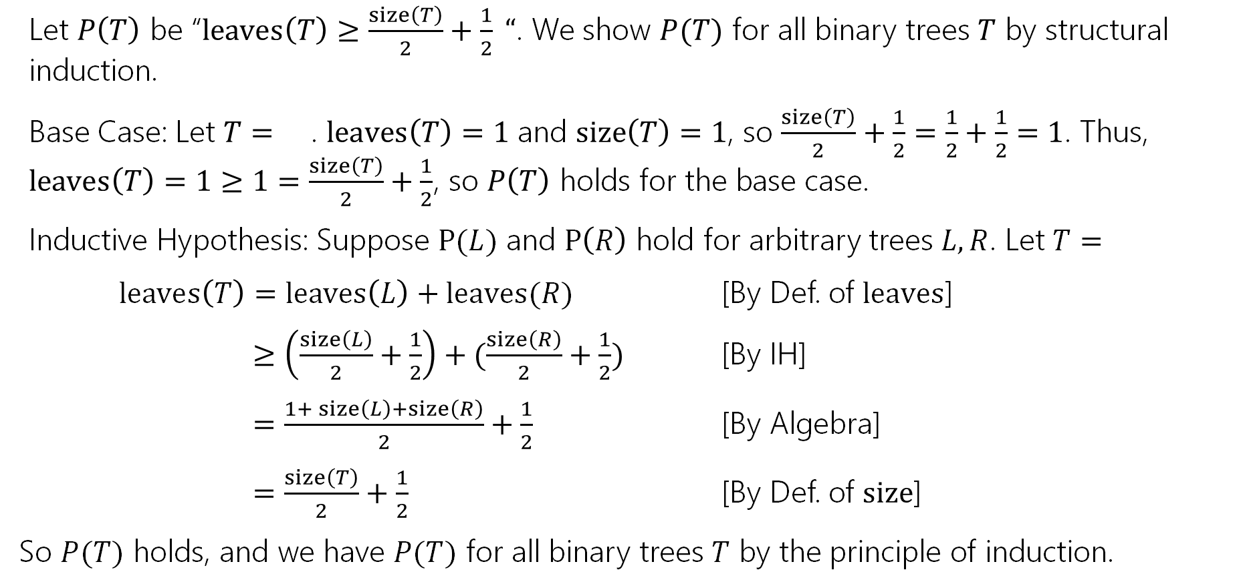

Practice: Structural Induction on Trees
Let $P\left(T\right)$ be “$leaves\left(T\right)≥\frac{size\left(T\right)}{2}+\frac{1}{2} “$. We show $P(T)$ for all binary trees $T$ by structural induction.
Base Case: Let $T=$ . $leaves\left(T\right)=1$ and $size\left(T\right)=1$, so $\frac{size\left(T\right)}{2}+\frac{1}{2}=\frac{1}{2}+\frac{1}{2}=1$. Thus, $leaves\left(T\right)=1≥1=\frac{size\left(T\right)}{2}+\frac{1}{2}$, so $P\left(T\right)$ holds for the base case.
Inductive Hypothesis: Suppose $P(L)$ and $P\left(R\right)$ hold for arbitrary trees $L,R$. Let $T=$
$leaves\left(T\right)=leaves\left(L\right)+leaves(R)$ [By Def. of $leaves$]
$≥\left(\frac{size\left(L\right)}{2}+\frac{1}{2}\right)+(\frac{size\left(R\right)}{2}+\frac{1}{2})$ [By IH]
$=\frac{1+ size\left(L\right)+size\left(R\right)}{2}+\frac{1}{2}$ [By Algebra]
$=\frac{size\left(T\right)}{2}+\frac{1}{2}$ [By Def. of $size$]
So $P(T)$ holds, and we have $P(T)$ for all binary trees $T$ by the principle of induction.
$$L$$
$$R$$

Slide 13
Proof Strategies Complete List
Direct Proof
Proof by Contrapositive
Proof of Biconditional
Proof by Cases
Proof of Existence
Proof by Counterexample
Proof by Contradiction
Proof by Weak/Strong/Structural Induction

Slide 14
Functions

Slide 15

Some types of functions
Why?
We’ll want to talk about sizes of infinite sets during the last week of classes. It’ll help us find problems our computers can’t solve.
Ok, but why now?
It’ll let us practice set proofs a bit more over the next few weeks!

Slide 16
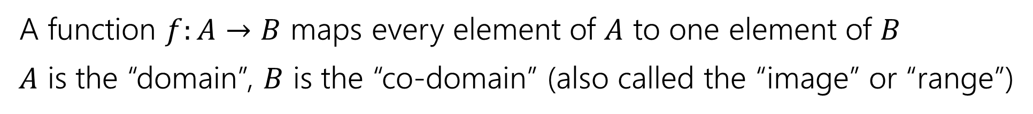
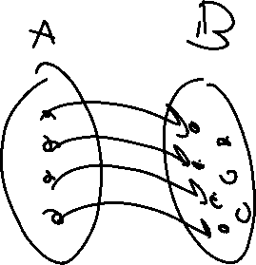
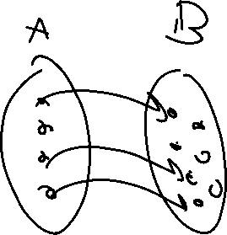
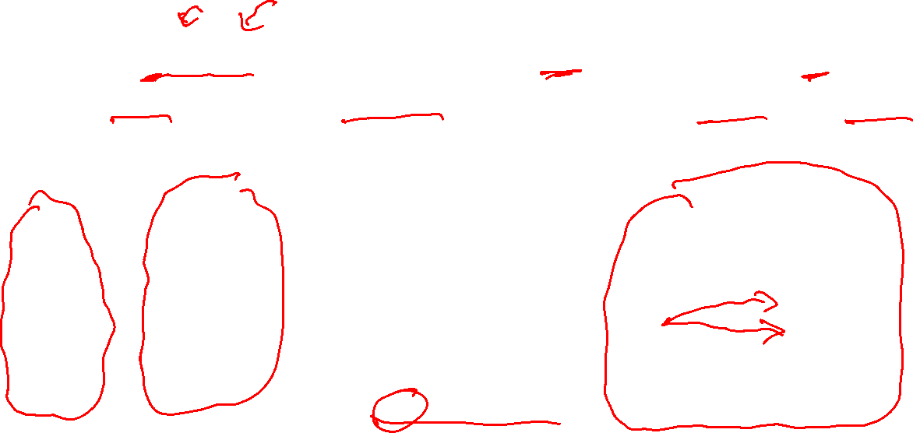
Functions!
A function $f:A→B$ maps every element of $A$ to one element of $B$
$A$ is the “domain”, $B$ is the “co-domain” (also called the “image” or “range”)
Good function
Not a function

Slide 17


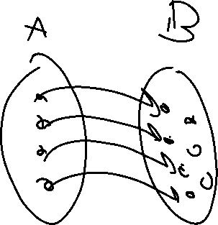

Two Requirements for a Bijection
A function $f:A→B$ maps every element of $A$ to one element of $B$
$A$ is the “domain”, $B$ is the “co-domain”
That is, every output has at most one possible input.
A function $f$ is one-to-one iff
$$∀a∀b(f\left(a\right)=f\left(b\right)→a=b)$$
One-to-one (aka injection)

Slide 18
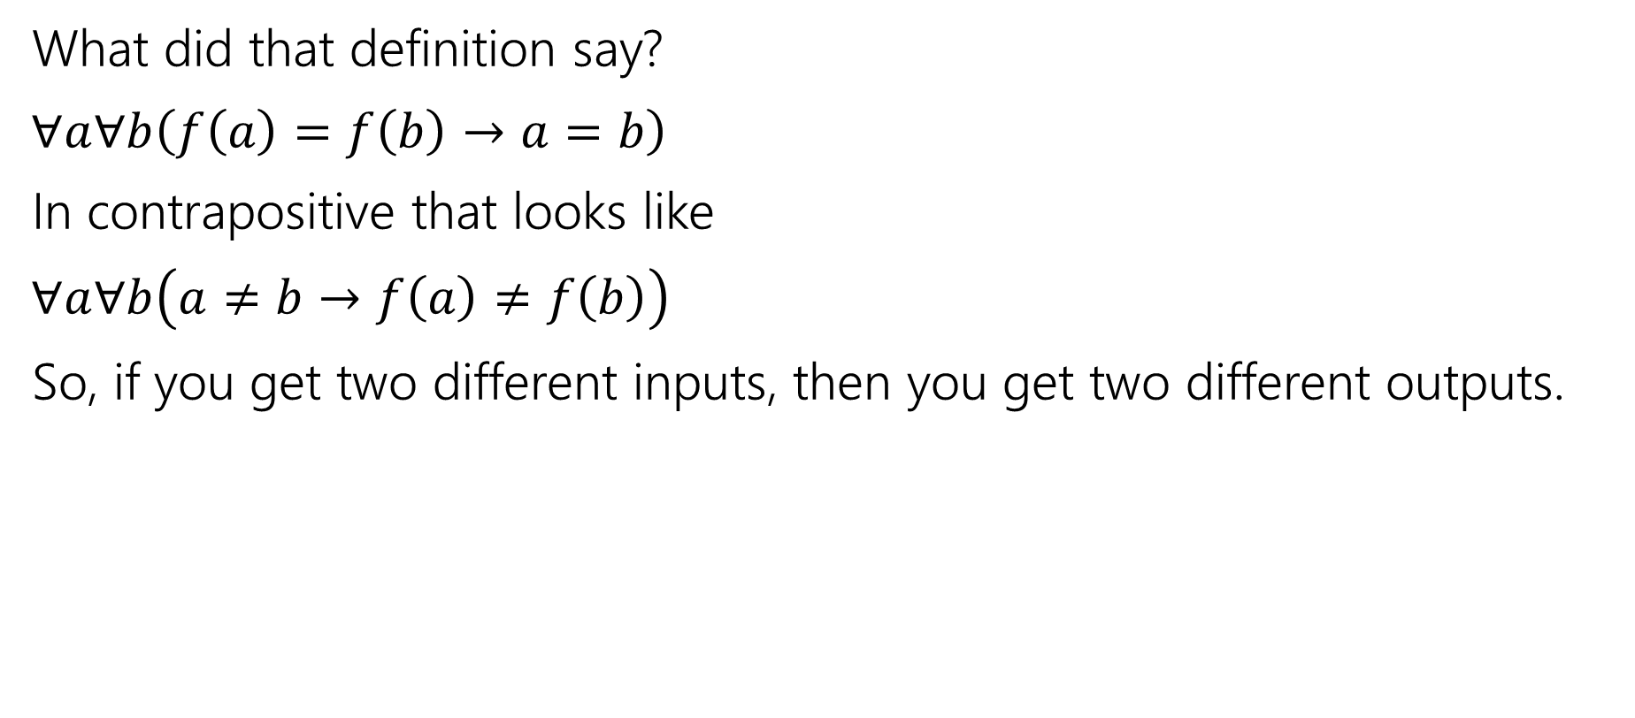
One-to-one (injection)
What did that definition say?
$∀a∀b\left(f\left(a\right)=f\left(b\right)→a=b\right)$
In contrapositive that looks like
$∀a∀b\left(a≠b→f\left(a\right)≠f\left(b\right)\right)$
So, if you get two different inputs, then you get two different outputs.

Slide 19
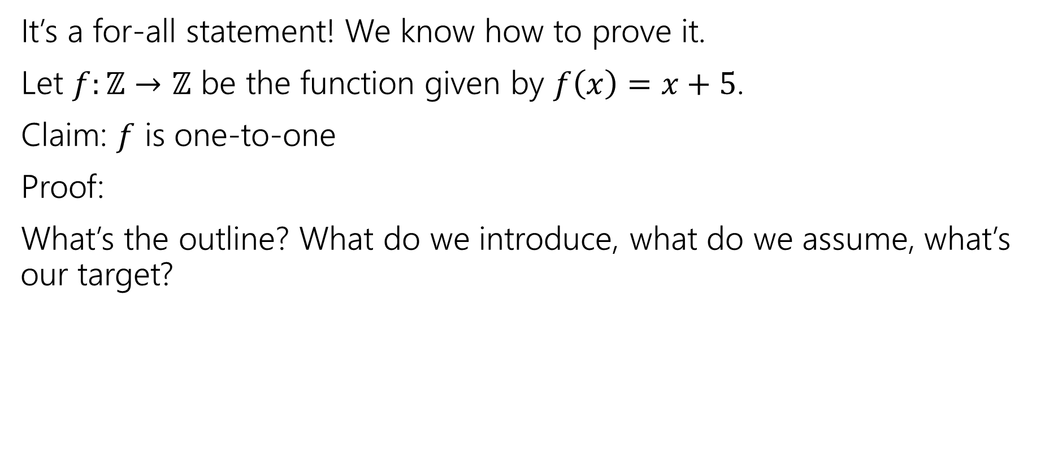


One-to-one proofs
A function $f$ is one-to-one iff
$$∀a∀b(f\left(a\right)=f\left(b\right)→a=b)$$
One-to-one (aka injection)
It’s a for-all statement! We know how to prove it.
Let $f:ℤ→ℤ$ be the function given by $f\left(x\right)=x+5$.
Claim: $f$ is one-to-one
Proof:
What’s the outline? What do we introduce, what do we assume, what’s our target?

Slide 20
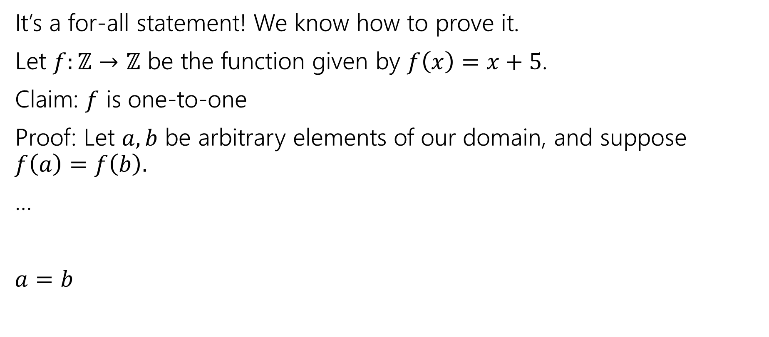

One-to-one proofs
A function $f$ is one-to-one iff
$$∀a∀b(f\left(a\right)=f\left(b\right)→a=b)$$
One-to-one (aka injection)
It’s a for-all statement! We know how to prove it.
Let $f:ℤ→ℤ$ be the function given by $f\left(x\right)=x+5$.
Claim: $f$ is one-to-one
Proof: Let $a,b$ be arbitrary elements of our domain, and suppose $f\left(a\right)=f\left(b\right).$
…
$a=b$

Slide 21
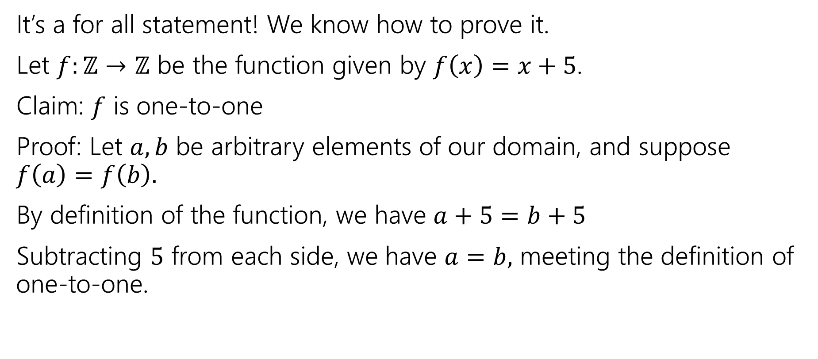

One-to-one proofs
A function $f$ is one-to-one iff
$$∀a∀b(f\left(a\right)=f\left(b\right)→a=b)$$
One-to-one (aka injection)
It’s a for all statement! We know how to prove it.
Let $f:ℤ→ℤ$ be the function given by $f\left(x\right)=x+5$.
Claim: $f$ is one-to-one
Proof: Let $a,b$ be arbitrary elements of our domain, and suppose $f\left(a\right)=f\left(b\right).$
By definition of the function, we have $a+5=b+5$
Subtracting $5$ from each side, we have $a=b,$ meeting the definition of one-to-one.

Slide 22
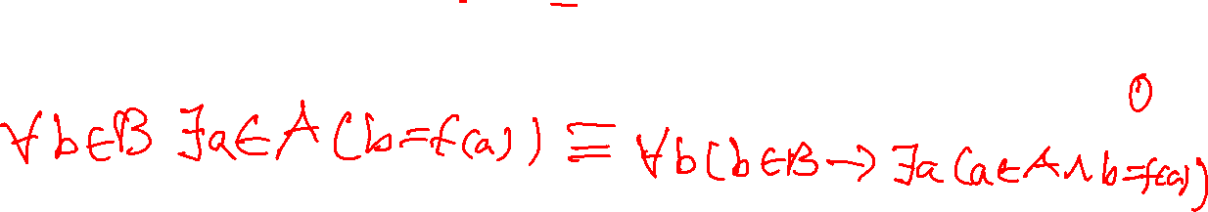

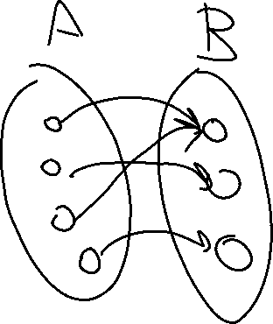

Two Requirements for a Bijection
A function $f:A→B$ maps every element of $A$ to one element of $B$
$A$ is the “domain”, $B$ is the “co-domain”
Every output has at least one input that maps to it.
A function $f:A→B$ is onto iff
$$∀b∈B∃a∈A(b=f(a))$$
Onto (aka surjection)

Slide 23
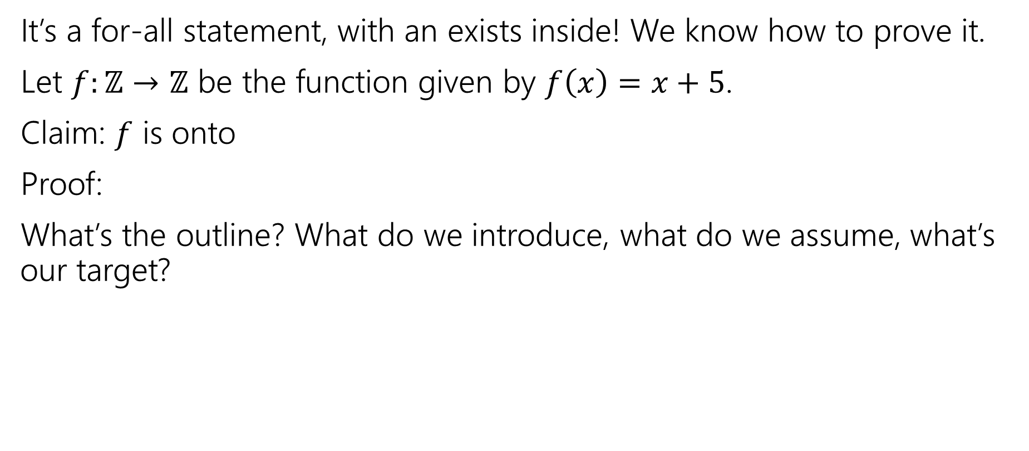


Onto proofs
A function $f:A→B$ is onto iff
$$∀b∈B∃a∈A(b=f(a))$$
Onto (aka surjection)
It’s a for-all statement, with an exists inside! We know how to prove it.
Let $f:ℤ→ℤ$ be the function given by $f\left(x\right)=x+5$.
Claim: $f$ is onto
Proof:
What’s the outline? What do we introduce, what do we assume, what’s our target?

Slide 24
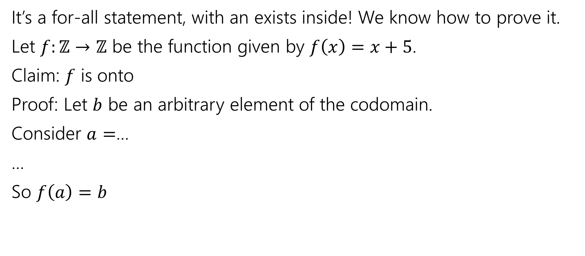

Onto proofs
A function $f:A→B$ is onto iff
$$∀b∈B∃a∈A(b=f(a))$$
Onto (aka surjection)
It’s a for-all statement, with an exists inside! We know how to prove it.
Let $f:ℤ→ℤ$ be the function given by $f\left(x\right)=x+5$.
Claim: $f$ is onto
Proof: Let $b$ be an arbitrary element of the codomain.
Consider $a=$…
…
So $f\left(a\right)=b$

Slide 25
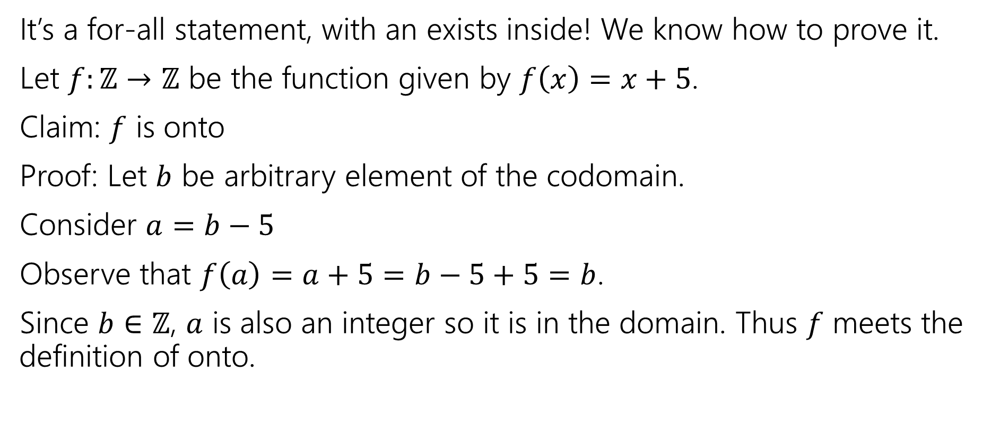

Onto proofs
A function $f:A→B$ is onto iff
$$∀b∈B∃a∈A(b=f(a))$$
Onto (aka surjection)
It’s a for-all statement, with an exists inside! We know how to prove it.
Let $f:ℤ→ℤ$ be the function given by $f\left(x\right)=x+5$.
Claim: $f$ is onto
Proof: Let $b$ be arbitrary element of the codomain.
Consider $a=b−5$
Observe that $f\left(a\right)=a+5=b−5+5=b$.
Since $b∈ℤ$, $a$ is also an integer so it is in the domain. Thus $f$ meets the definition of onto.

Slide 26



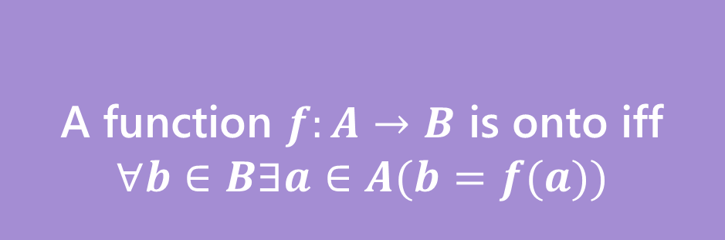
Bijection
A function $f$ is one-to-one iff
$$∀a∀b(f\left(a\right)=f\left(b\right)→a=b)$$
A function $f:A→B$ is onto iff
$$∀b∈B∃a∈A(b=f(a))$$
One-to-one (aka injection)
Onto (aka surjection)
A function $f:A→B$ is a bijection iff
$f$ is one-to-one and onto
Bijection
A bijection maps every element of the domain to exactly one element of the co-domain, and every element of the codomain to exactly one element of the domain.

Slide 27

Sizes of sets
How do we know two sets are the same size?
Easy. Count the number of elements in both.
That works great for finite sets, but $∞$ isn’t really a number we get to count to…

Slide 28











More Practical
What does it mean that two sets have the same size?

Slide 29


More Practical
What does it mean that two sets have the same size?

Slide 30
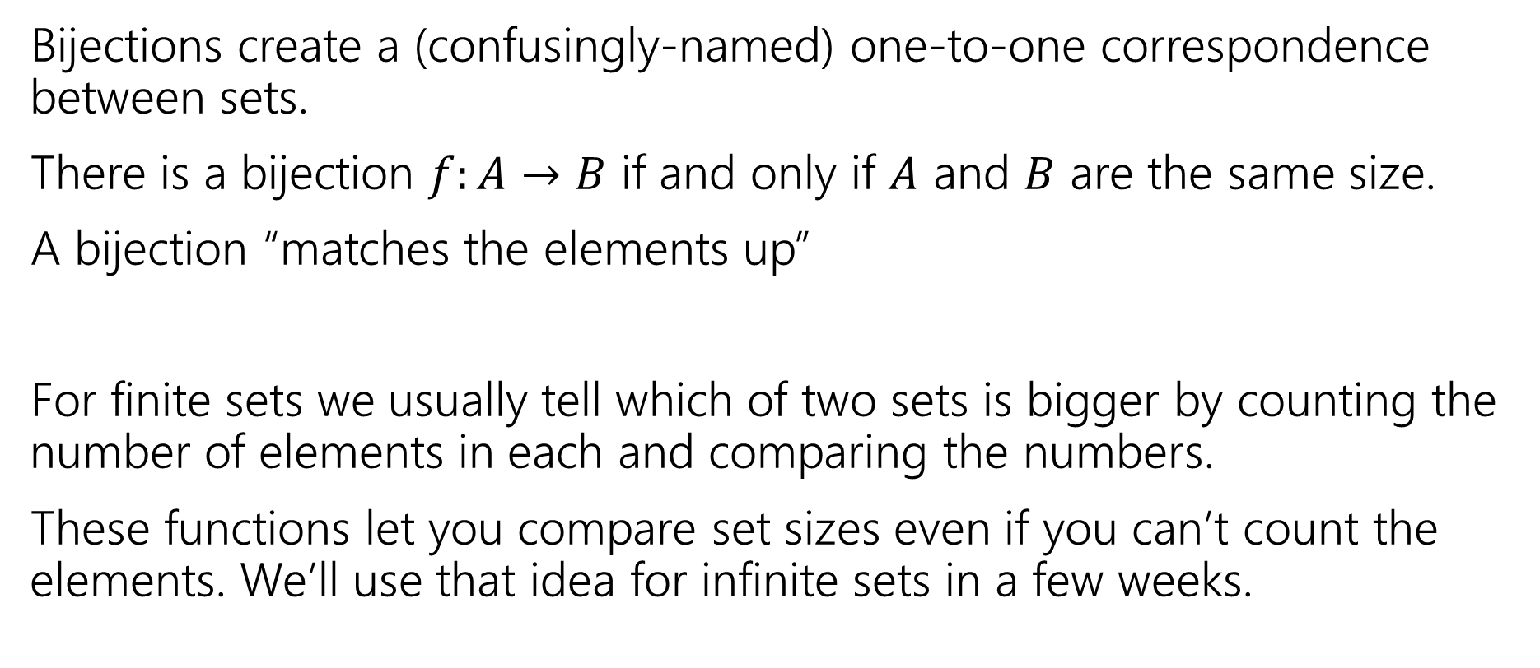

Why do we care about bijections?
Bijections create a (confusingly-named) one-to-one correspondence between sets.
There is a bijection $f:A→B$ if and only if $A$ and $B$ are the same size.
A bijection “matches the elements up”
For finite sets we usually tell which of two sets is bigger by counting the number of elements in each and comparing the numbers.
These functions let you compare set sizes even if you can’t count the elements. We’ll use that idea for infinite sets in a few weeks.

Slide 31
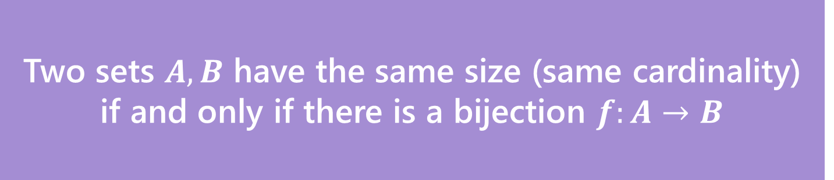

Definition
Two sets $A,B$ have the same size (same cardinality) if and only if there is a bijection $f:A→B$
This matches our intuition on finite sets.
But it also works for infinite sets!
Let’s see just how infinite these sets are.

Slide 32
Some infinite sets
Two sets $A,B$ have the same size (same cardinality) if and only if there is a bijection $f:A→B$
Let’s compare the sizes of: $ℕ$, $ℤ,$ $\{x :x$is an even integer$\}$

Slide 33



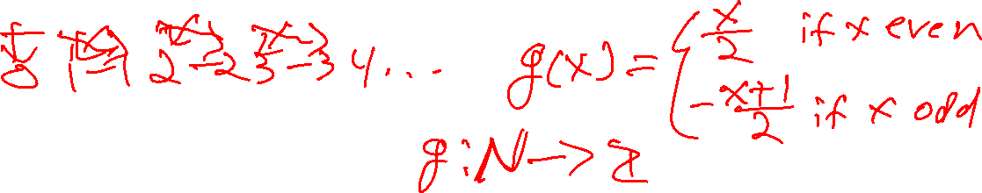
Some infinite sets
Two sets $A,B$ have the same size (same cardinality) if and only if there is a bijection $f:A→B$
Let’s compare the sizes of: $ℕ$, $ℤ,$ $\{x :x$is an even integer$\}$
$$ℕ$$
$$0 1 2 3 4 5 6 7 …$$
$$ℤ$$

Slide 34



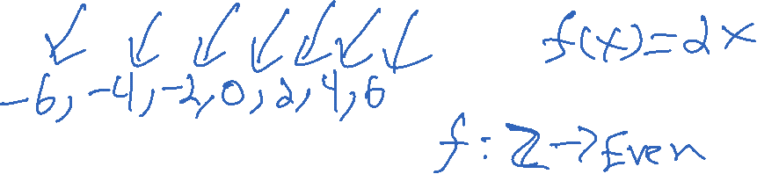
Some infinite sets
Two sets $A,B$ have the same size (same cardinality) if and only if there is a bijection $f:A→B$
Let’s compare the sizes of: $ℕ$, $ℤ,$ $\{x :x$is an even integer$\}$
$$ℤ$$
$$…,−3, −2, −1, 0, 1, 2, 3,…$$
$$Even$$

Slide 35
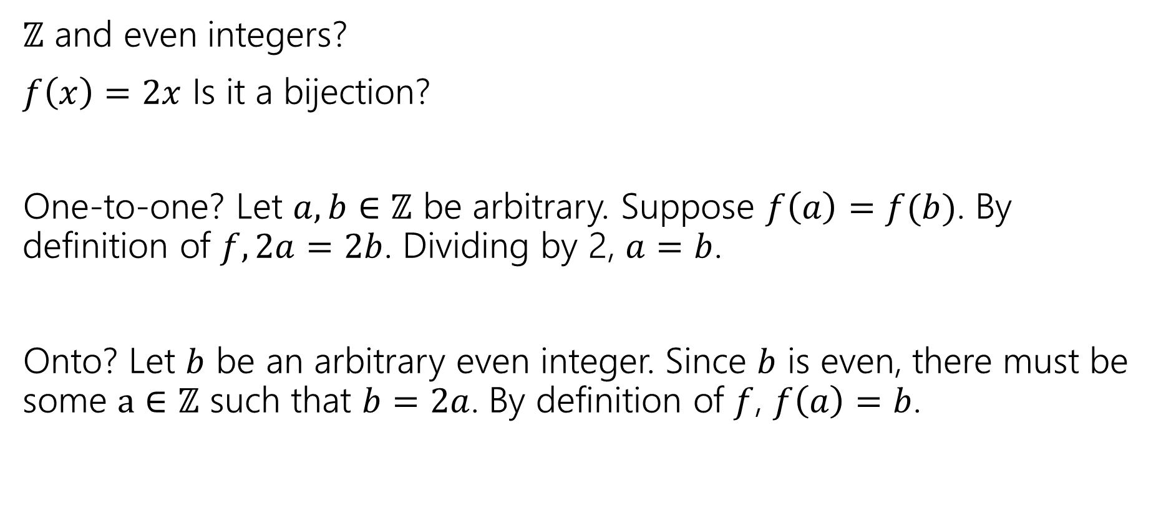

They’re all the same size.
$ℤ$ and even integers?
$f\left(x\right)=2x$ Is it a bijection?
One-to-one? Let $a,b∈ℤ$ be arbitrary. Suppose $f\left(a\right)=f(b)$. By definition of $f, 2a=2b$. Dividing by 2, $a=b$.
Onto? Let $b$ be an arbitrary even integer. Since $b$ is even, there must be some $a∈ℤ$ such that $b=2a$. By definition of $f$, $f\left(a\right)=b$.

Slide 36

They’re all the same size.
$ℤ$ and even integers?
$f\left(x\right)=2x$ Is it a bijection?
  YES
$ℕ$ and $ℤ$?

Slide 37


They’re all the same size.
$ℤ$ and even integers?
$f\left(x\right)=2x$ Is it a bijection?
  YES
$ℕ$ and $ℤ$
$g\left(x\right)= \left\{\begin{aligned}\frac{x}{2} if x is even \\ −\frac{x+1}{2} if x is odd\end{aligned}\right.$

Slide 38

They’re all the same size…
$ℕ$ and even integers?
$f(g\left(x\right))$ will work nicely. You can also build one explicitly.
Good exercise: show that if $f$ and $g$ are bijections then $f∘g$ is also a bijection.

Slide 39





They’re all the same size…
$ℕ$ and even integers?
$f(g\left(x\right))$ will work nicely. You can also build one explicitly.
Good exercise: show that if $f$ and $g$ are bijections then $f∘g$ is also a bijection.

Slide 40
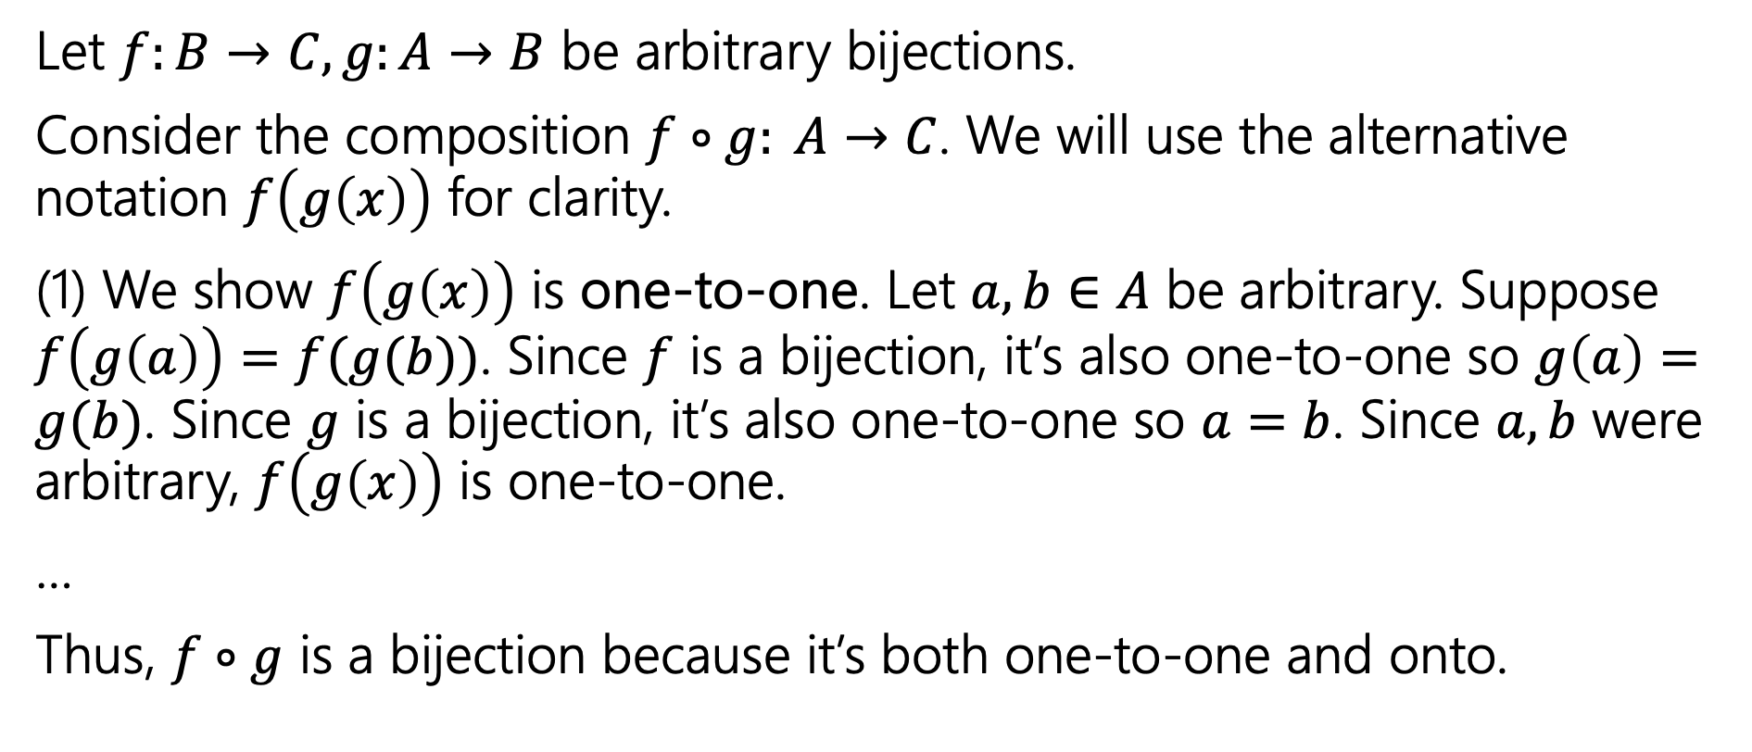
Composition of 2 bijections is a bijection.
Let $f:B→C, g:A→B$ be arbitrary bijections.
Consider the composition $f∘g: A→C$. We will use the alternative notation $f\left(g\left(x\right)\right)$ for clarity.
(1) We show $f\left(g\left(x\right)\right)$ is one-to-one. Let $a, b∈A$ be arbitrary. Suppose $f\left(g\left(a\right)\right)=f(g(b))$. Since $f$ is a bijection, it’s also one-to-one so $g\left(a\right)=g(b)$. Since $g$ is a bijection, it’s also one-to-one so $a=b$. Since $a, b$ were arbitrary, $f\left(g\left(x\right)\right)$ is one-to-one.
…
Thus, $f∘g$ is a bijection because it’s both one-to-one and onto.

Slide 41
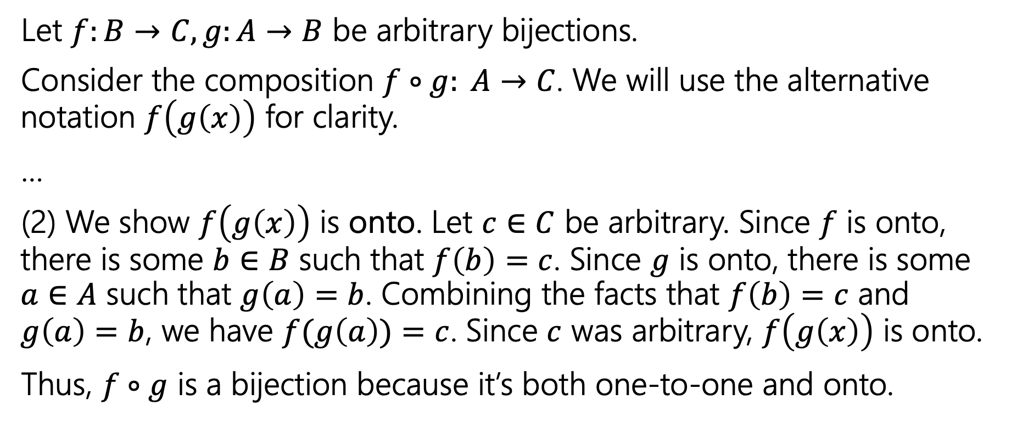
Composition of 2 bijections is a bijection.
Let $f:B→C, g:A→B$ be arbitrary bijections.
Consider the composition $f∘g: A→C$. We will use the alternative notation $f\left(g\left(x\right)\right)$ for clarity.
…
(2) We show $f\left(g\left(x\right)\right)$ is onto. Let $c∈C$ be arbitrary. Since $f$ is onto, there is some $b∈B$ such that $f\left(b\right)=c$. Since $g$ is onto, there is some $a∈A$ such that $g\left(a\right)=b$. Combining the facts that $f\left(b\right)=c$ and $g\left(a\right)=b$, we have $f(g\left(a\right))=c$. Since $c$ was arbitrary, $f\left(g\left(x\right)\right)$ is onto.
Thus, $f∘g$ is a bijection because it’s both one-to-one and onto.

Slide 42
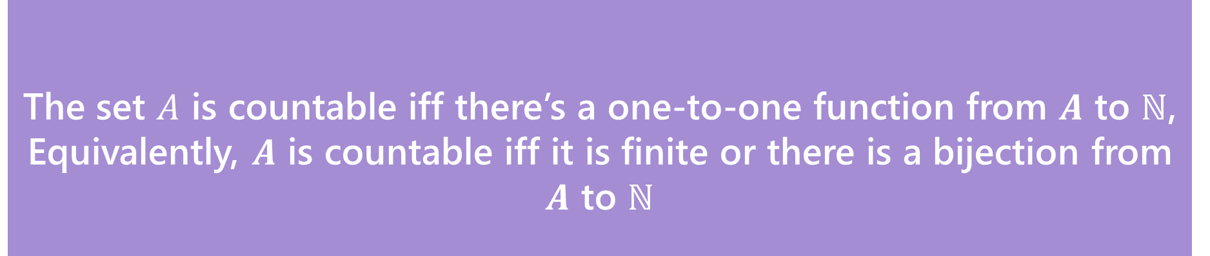
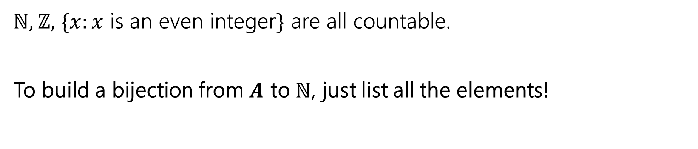

Countable
The set $A$ is countable iff there’s a one-to-one function from $A$ to $ℕ$,
Equivalently, $A$ is countable iff it is finite or there is a bijection from $A$ to $ℕ$
Countable
$ℕ,ℤ,$ $\{x:x$ is an even integer$\}$ are all countable.
To build a bijection from $A$ to $ℕ$, just list all the elements!

Slide 43
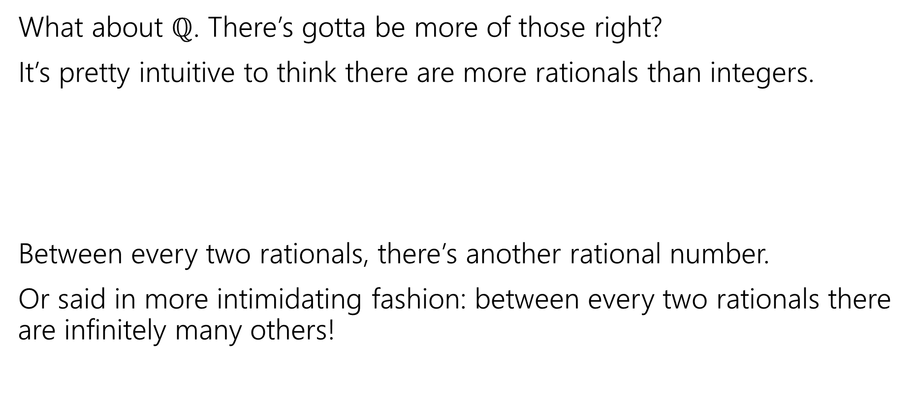
Let’s Try one that’s a little harder
What about $ℚ$. There’s gotta be more of those right?
It’s pretty intuitive to think there are more rationals than integers.
Between every two rationals, there’s another rational number.
Or said in more intimidating fashion: between every two rationals there are infinitely many others!
0
1

Slide 44

The set of positive rational numbers
1/1 | 1/2 | 1/3 | 1/4 | 1/5 | 1/6 | 1/7 | 1/8 | ...
2/1 | 2/2 | 2/3 | 2/4 | 2/5 | 2/6 | 2/7 | 2/8 | ...
3/1 | 3/2 | 3/3 | 3/4 | 3/5 | 3/6 | 3/7 | 3/8 | ...
4/1 | 4/2 | 4/3 | 4/4 | 4/5 | 4/6 | 4/7 | 4/8 | ...
5/1 | 5/2 | 5/3 | 5/4 | 5/5 | 5/6 | 5/7 | ...
6/1 | 6/2 | 6/3 | 6/4 | 6/5 | 6/6 | ...
7/1 | 7/2 | 7/3 | 7/4 | 7/5 | ....
... | ... | ... | ... | ...

Slide 45
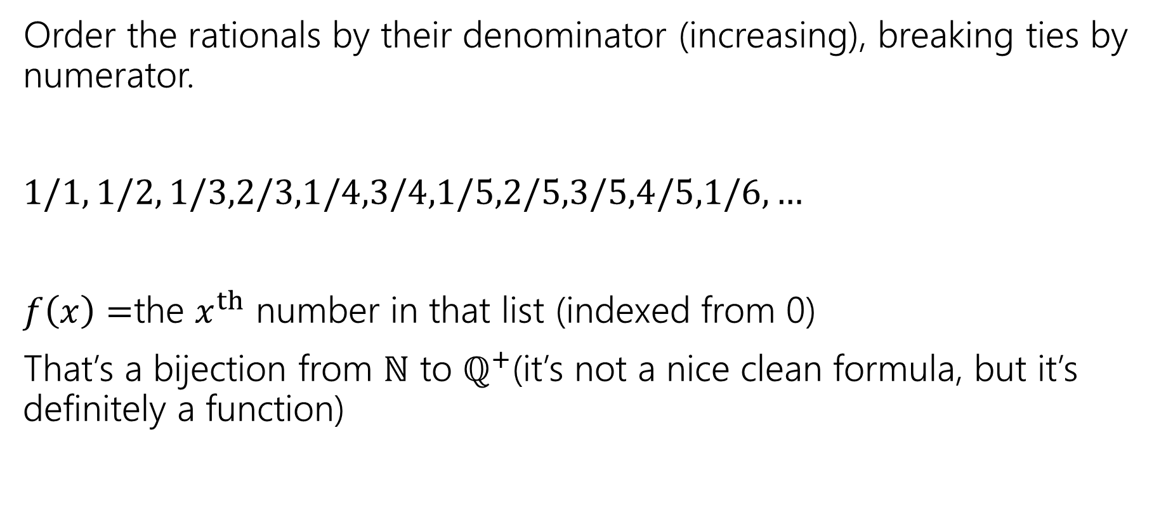

In bijection with the natural numbers
Order the rationals by their denominator (increasing), breaking ties by numerator.
$1/1, 1/2, 1/3,2/3,1/4,3/4,1/5,2/5,3/5,4/5,1/6,…$
$f\left(x\right)=$the $x^{th}$ number in that list (indexed from 0)
That’s a bijection from $ℕ$ to $ℚ^{+}$(it’s not a nice clean formula, but it’s definitely a function)

Slide 46

Are all infinite sets countable?
No. We will prove this in a few weeks.
$ℝ$ is uncountable

Slide 47
Graphs

Slide 48


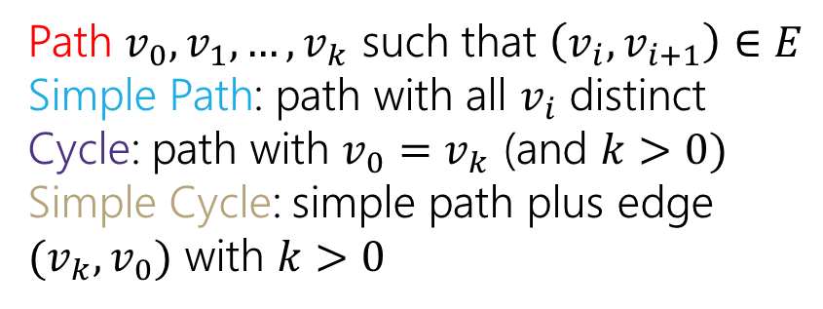
Directed Graphs
$G=(V,E)$
$V$is a set of vertices (an underlying set of elements)
$E$ is a set of edges (ordered pairs of vertices; i.e. connections from one to the next).
Path $v_{0},v_{1},…,v_{k}$ such that $\left(v_{i},v_{i+1}\right)∈E$
Simple Path: path with all $v_{i}$ distinct
Cycle: path with $v_{0}=v_{k}$ (and $k>0)$
Simple Cycle: simple path plus edge ${(v}_{k},v_{0})$ with $k>0$

Slide 49

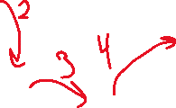

Directed Graphs
$G=(V,E)$
$V$is a set of vertices (an underlying set of elements)
$E$ is a set of edges (ordered pairs of vertices; i.e. connections from one to the next).
Path $v_{0},v_{1},…,v_{k}$ such that $\left(v_{i},v_{i+1}\right)∈E$
Simple Path: path with all $v_{i}$ distinct
Cycle: path with $v_{0}=v_{k}$ (and $k>0)$
Simple Cycle: simple path plus edge ${(v}_{k},v_{0})$ with $k>0$

Slide 50

Directed Graphs
$G=(V,E)$
$V$is a set of vertices (an underlying set of elements)
$E$ is a set of edges (ordered pairs of vertices; i.e. connections from one to the next).
Path $v_{0},v_{1},…,v_{k}$ such that $\left(v_{i},v_{i+1}\right)∈E$
Simple Path: path with all $v_{i}$ distinct
Cycle: path with $v_{0}=v_{k}$ (and $k>0)$
Simple Cycle: simple path plus edge ${(v}_{k},v_{0})$ with $k>0$

Slide 51

Directed Graphs
$G=(V,E)$
$V$is a set of vertices (an underlying set of elements)
$E$ is a set of edges (ordered pairs of vertices; i.e. connections from one to the next).
Path $v_{0},v_{1},…,v_{k}$ such that $\left(v_{i},v_{i+1}\right)∈E$
Simple Path: path with all $v_{i}$ distinct
Cycle: path with $v_{0}=v_{k}$ (and $k>0)$
Simple Cycle: simple path plus edge ${(v}_{k},v_{0})$ with $k>0$

Slide 52


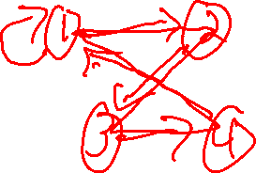
Directed Graphs
$G=(V,E)$
$V$is a set of vertices (an underlying set of elements)
$E$ is a set of edges (ordered pairs of vertices; i.e. connections from one to the next).
Path $v_{0},v_{1},…,v_{k}$ such that $\left(v_{i},v_{i+1}\right)∈E$
Simple Path: path with all $v_{i}$ distinct
Cycle: path with $v_{0}=v_{k}$ (and $k>0)$
Simple Cycle: simple path plus edge ${(v}_{k},v_{0})$ with $k>0$

Slide 53
Extra examples

Slide 54
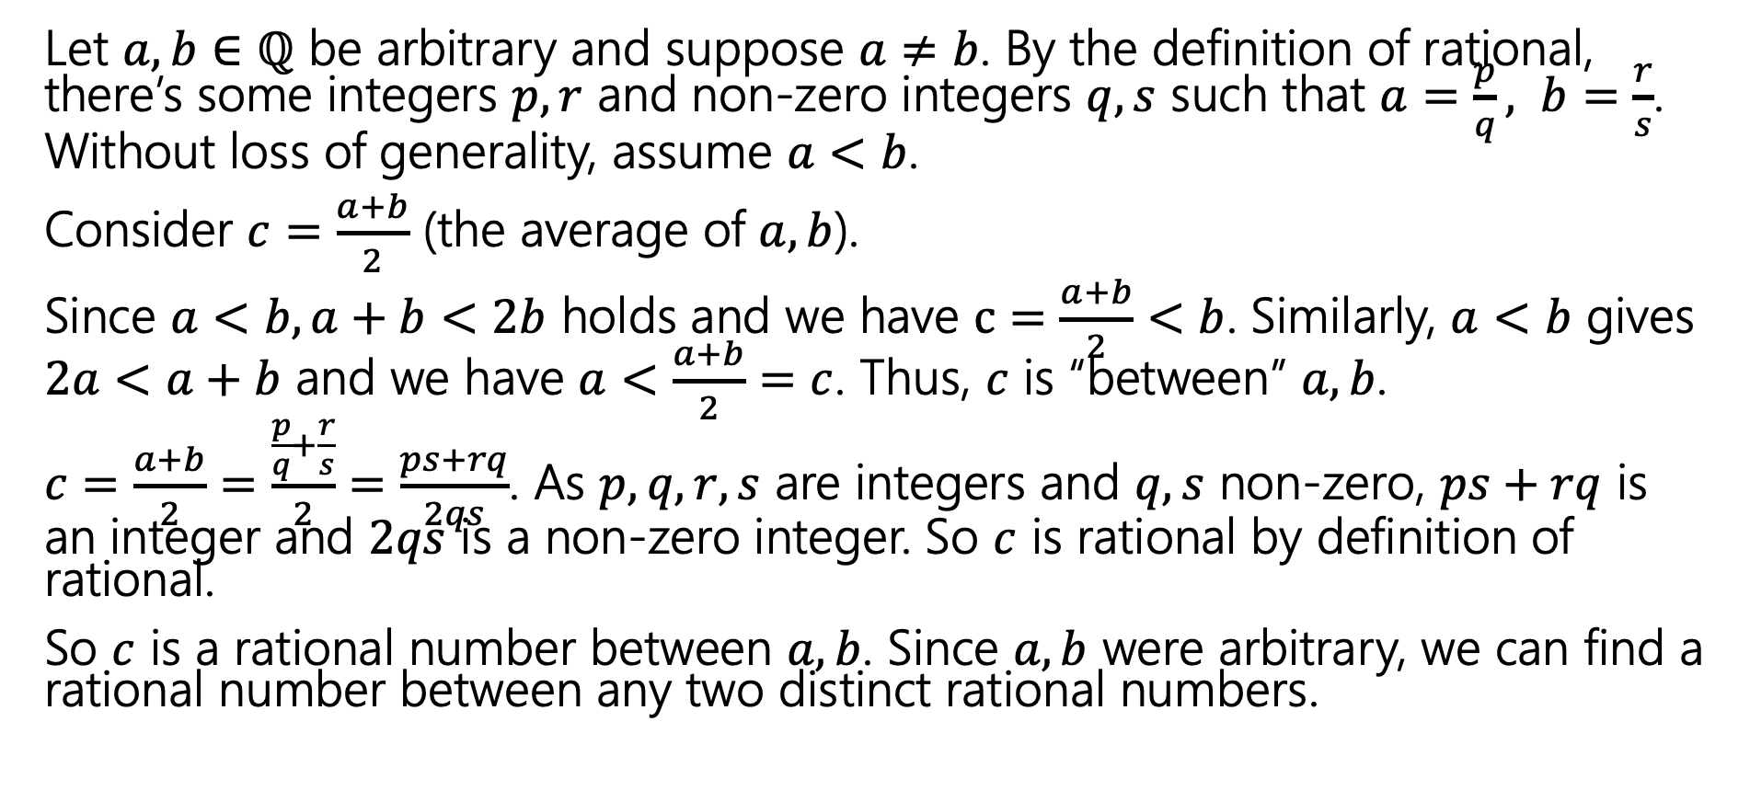
Between every two distinct rationals, there’s another rational number.
Let $a, b∈ℚ$ be arbitrary and suppose $a≠b$. By the definition of rational, there’s some integers $p,r$ and non-zero integers $q, s$ such that $a=\frac{p}{q}, b=\frac{r}{s}$. Without loss of generality, assume $a<b$.
Consider $c=\frac{a+b}{2}$ (the average of $a, b$).
Since $a<b, a+b<2b$ holds and we have $c=\frac{a+b}{2}<b$. Similarly, $a<b$ gives $2a<a+b$ and we have $a<\frac{a+b}{2}=c$. Thus, $c$ is “between” $a, b$.
$c=\frac{a+b}{2}=\frac{\frac{p}{q}+\frac{r}{s}}{2}=\frac{ps+rq}{2qs}$. As $p,q, r,s$ are integers and $q,s$ non-zero, $ps+rq$ is an integer and $2qs$ is a non-zero integer. So $c$ is rational by definition of rational.
So $c$ is a rational number between $a, b$. Since $a, b$ were arbitrary, we can find a rational number between any two distinct rational numbers.

Slide 55
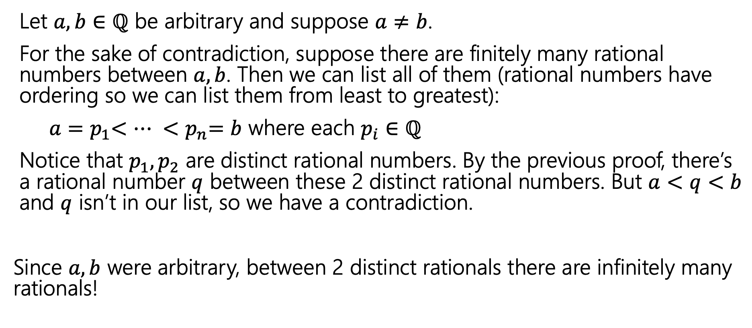
There are infinitely many rational numbers between any two distinct rational numbers.
Let $a, b∈ℚ$ be arbitrary and suppose $a≠b$.
For the sake of contradiction, suppose there are finitely many rational numbers between $a, b$. Then we can list all of them (rational numbers have ordering so we can list them from least to greatest):
$a{=p}_{1}<… {<p}_{n}=b$ where each $p_{i}∈ℚ$
Notice that $p_{1}, p_{2}$ are distinct rational numbers. By the previous proof, there’s a rational number $q$ between these 2 distinct rational numbers. But $a<q<b$ and $q$ isn’t in our list, so we have a contradiction.
Since $a, b$ were arbitrary, between 2 distinct rationals there are infinitely many rationals!

Slide 56
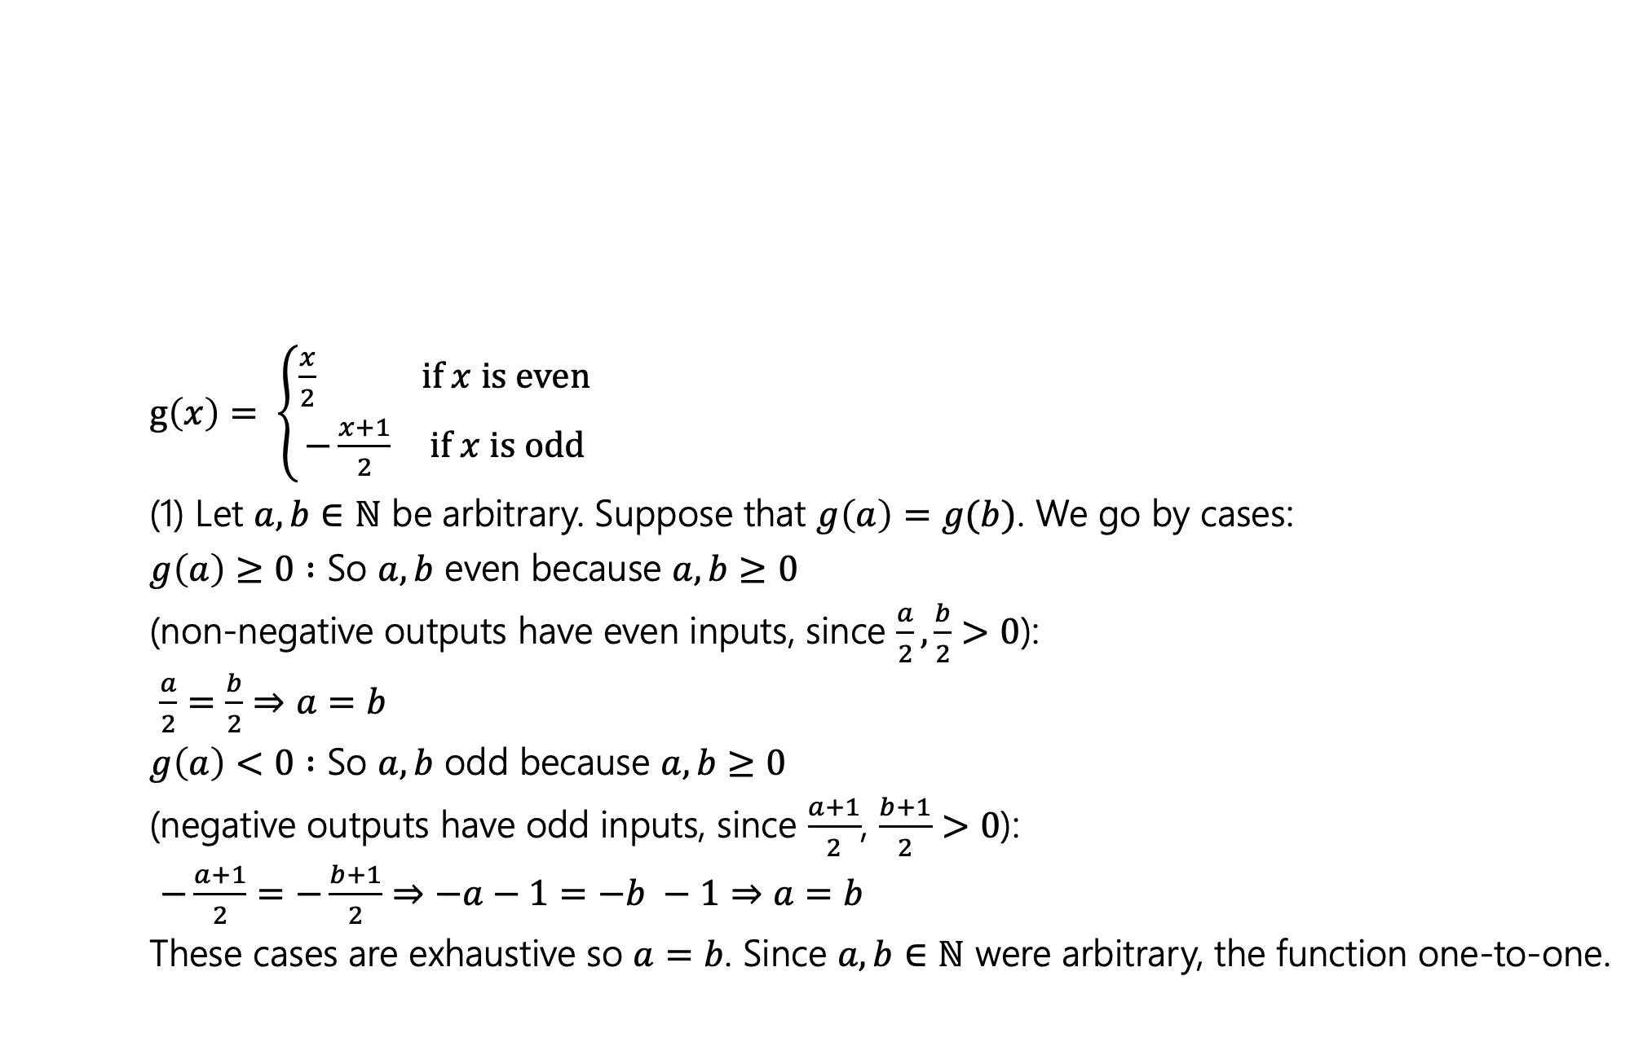
Show that the following function is a bijection.
$g\left(x\right)= \left\{\begin{aligned}\frac{x}{2} if x is even \\ −\frac{x+1}{2} if x is odd\end{aligned}\right.$
(1) Let $a, b∈ℕ$ be arbitrary. Suppose that $g\left(a\right)=g(b)$. We go by cases:
$g\left(a\right)≥0 :$ So $a, b$ even because $a, b≥0$
(non-negative outputs have even inputs, since $\frac{a}{2},\frac{b}{2}>0$):
$\frac{a}{2}=\frac{b}{2}⇒a=b$
$g\left(a\right)<0 :$ So $a, b$ odd because $a, b≥0$
(negative outputs have odd inputs, since $\frac{a+1}{2}$, $\frac{b+1}{2}>0$):
$−\frac{a+1}{2}=−\frac{b+1}{2}⇒−a−1=−b −1⇒a=b$
These cases are exhaustive so $a=b$. Since $a, b∈ℕ$ were arbitrary, the function one-to-one.

Slide 57
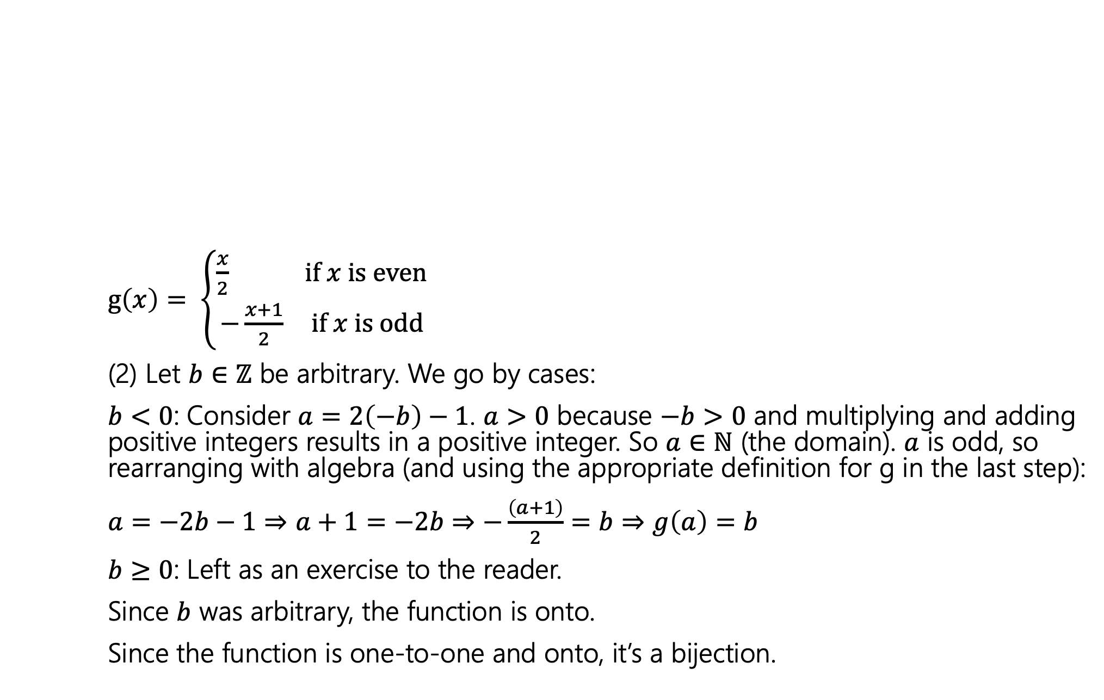
Show that the following function is a bijection.
$g\left(x\right)= \left\{\begin{aligned}\frac{x}{2} if x is even \\ −\frac{x+1}{2} if x is odd\end{aligned}\right.$
(2) Let $b∈ℤ$ be arbitrary. We go by cases:
$b<0$: Consider $a=2\left(−b\right)−1$. $a>0$ because $−b>0$ and multiplying and adding positive integers results in a positive integer. So $a∈ℕ$ (the domain). $a$ is odd, so rearranging with algebra (and using the appropriate definition for g in the last step):
$a=−2b−1⇒a+1=−2b⇒−\frac{\left(a+1\right)}{2}=b⇒g\left(a\right)=b$
$b≥0$: Left as an exercise to the reader.
Since $b$ was arbitrary, the function is onto.
Since the function is one-to-one and onto, it’s a bijection.

Slide 58
Todo
Tonight:
CC 17 is out and due Wednesday at noon
Look out for the midterm retake sign-up form on the Ed board and fill it out
Start working on HW6 after lecture if you haven’t already

