Slide 1
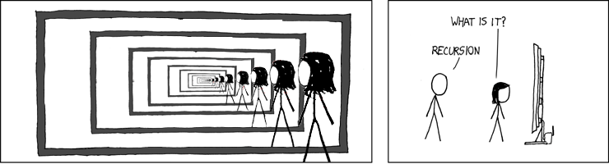
Structural Induction
CSE 311 Summer 25
Lecture 15

Slide 2
Announcements
HW5 is released!
We’ve extended the due date for this assignment from Wednesday, 7/30, to the late due date of Saturday, 8/2, so you can focus on studying for the midterm
You cannot use any late days to submit HW5 after Saturday
Our Midterm is this Friday (8/1) in class!
Exam logistics and practice exams are posted on the “Exams” page of the course website

Slide 3
Announcements
There will be 5 problems in total on the midterm (with potentially multiple parts):
Logic Translation: Translating between English & predicate logic
Number Theory: Proving claims relating to integers using the number theory definitions and theorems we’ve learned in class.
Set Theory: Proving claims using the set theory definitions we’ve learned in class.
Induction: Proving claims using weak or strong induction.
Miscellaneous MCQ/Short Answer Questions: Short answer or multiple-choice questions about any topic we’ve learned in class (besides writing symbolic logic proofs, though individual rules are still fair game).

Slide 4
Review

Slide 5
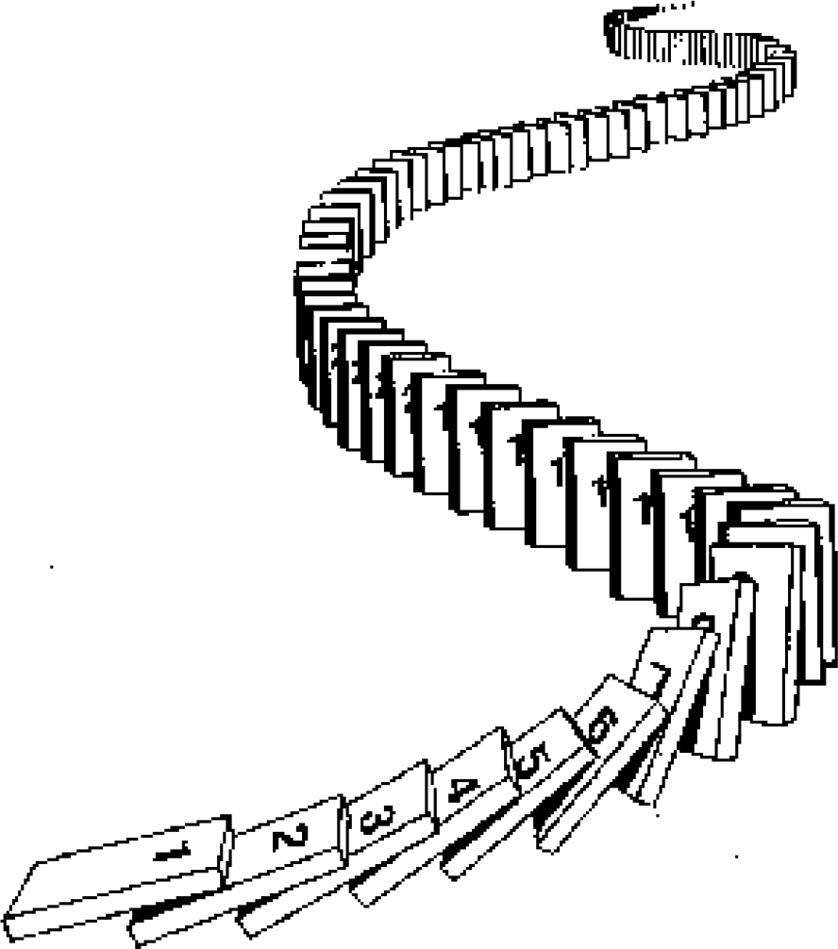
The Principle of Mathematical Induction
P 0 ∧ ∀𝑘 P 𝑘 → P 𝑘 + 1
Base Case Prove P(0) holds.
Inductive Hypothesis Let 𝑘 ≥ 0 be an arbitrary integer.
Suppose P(𝑘) holds.
Inductive Step Prove that P(𝑘 + 1) holds (using P(𝑘))

Slide 6
The Principle of Strong Induction
P 0 ∧ ∀𝑘 P 0 ∧ ⋯ ∧ P 𝑘
→ P 𝑘 + 1
Base Case Prove P(0) holds.
Inductive Hypothesis Let 𝑘 ≥ 0 be an
arbitrary integer. Suppose
P 0 ∧ ⋯ ∧ P(𝑘) hold.
Inductive Step Prove that P(𝑘 + 1) holds

Slide 7
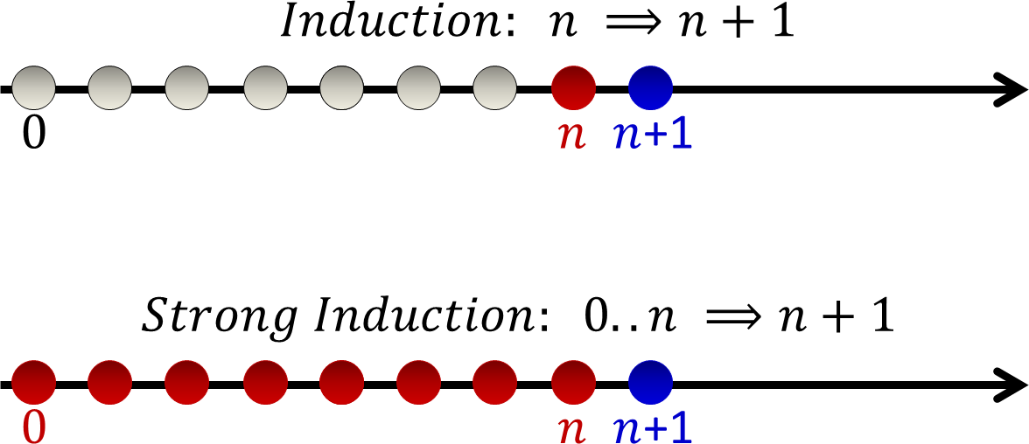

Strong Induction
𝑘 𝑘
𝑘 𝑘 + 1
𝑘
𝑘
𝑘
𝑘 + 1

Slide 8
Structural Induction

Slide 9
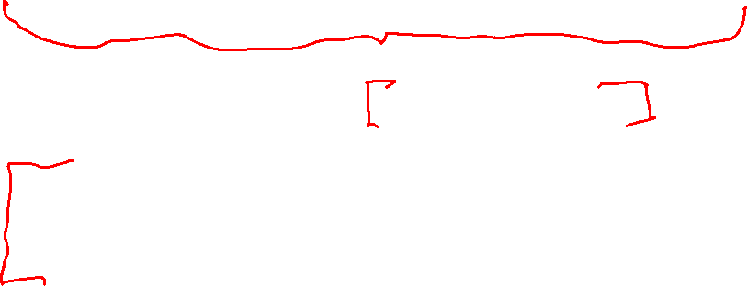
Induction Big Picture
So far: We used induction to prove a statement over the natural numbers.
“Prove that P(n) holds for all natural numbers n.”
Next goal: In CS, we deal with Strings, Lists, Trees, and other recursively defined sets. Would like to prove statements over these sets.
“Prove that P(T) holds for all trees T.”
“Prove that P(x) holds for all strings x.”

Slide 10
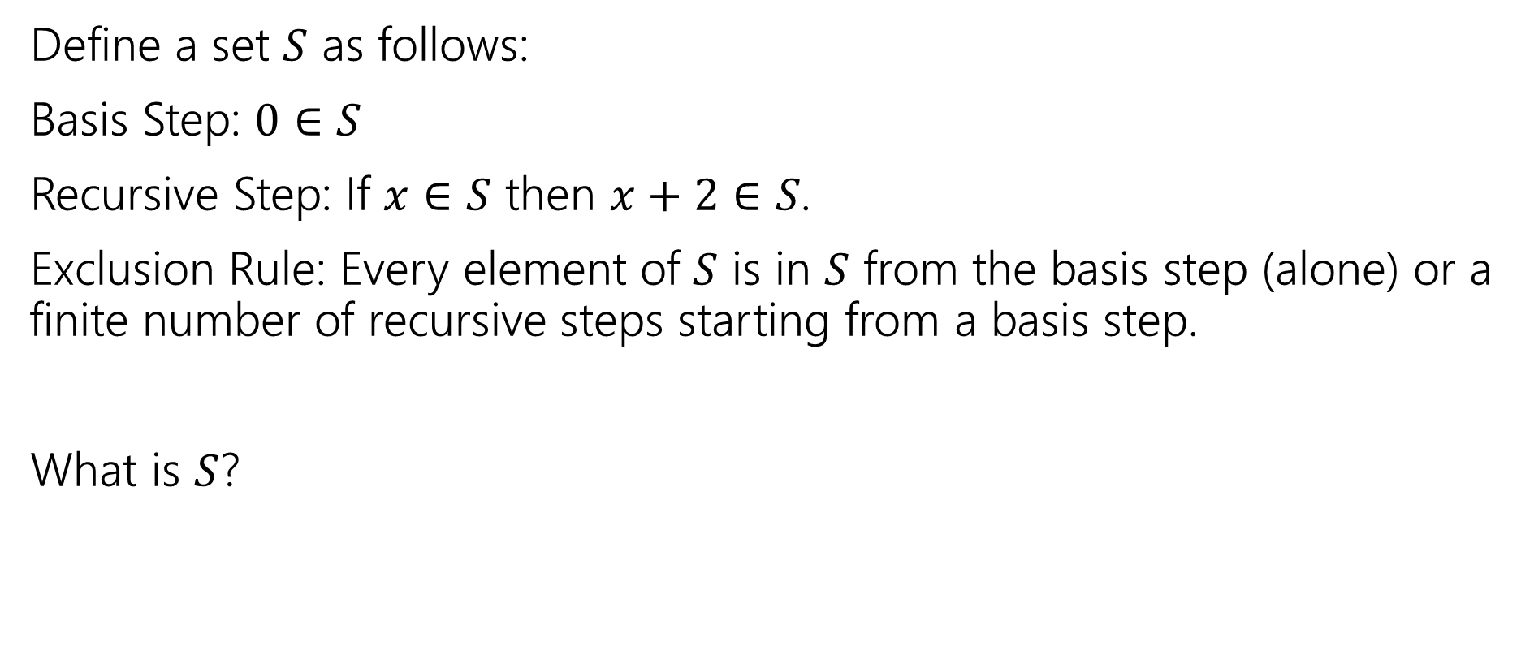
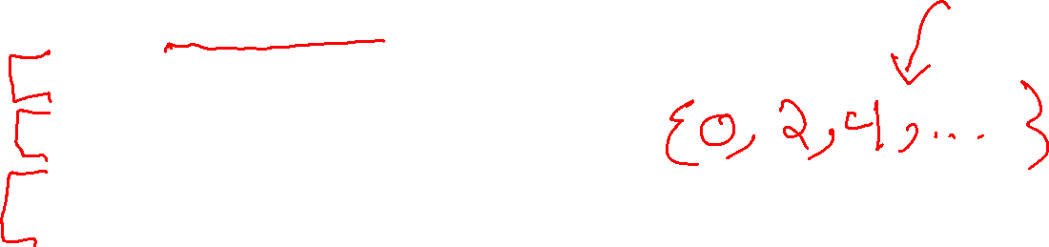
Recursive Definition of Sets
Define a set $S$ as follows:
Basis Step: $0∈S$
Recursive Step: If $x∈S$ then $x+2∈S$.
Exclusion Rule: Every element of $S$ is in $S$ from the basis step (alone) or a finite number of recursive steps starting from a basis step.
What is $S$?

Slide 11
Recursive Definitions of Sets
We’ll always list the Basis and Recursive parts of the definition.
Starting…now…we’re going to be lazy and skip writing the “exclusion” rule. It’s still part of the definition.

Slide 12
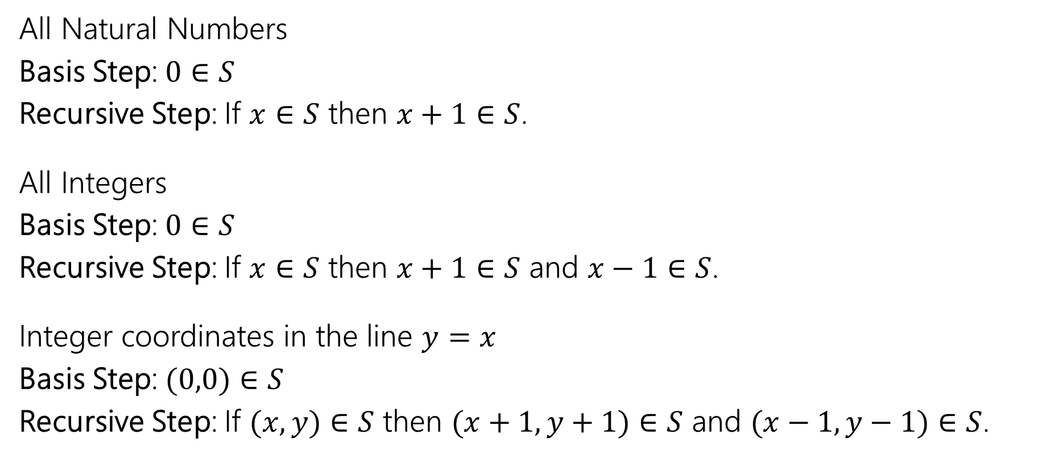

Recursive Definitions of Sets
All Natural Numbers
Basis Step: $0∈S$
Recursive Step: If $x∈S$ then $x+1∈S$.
All Integers
Basis Step: $0∈S$
Recursive Step: If $x∈S$ then $x+1∈S$ and $x−1∈S$.
Integer coordinates in the line $y=x$
Basis Step: $(0,0)∈S$
Recursive Step: If $(x,y)∈S$ then $(x+1,y+1)∈S$ and $(x−1,y−1)∈S$.
Notes:
Mention what happens to all integers if you change it to 5 in S (answer: nothing. Many different possible recursive definitions)

Slide 13
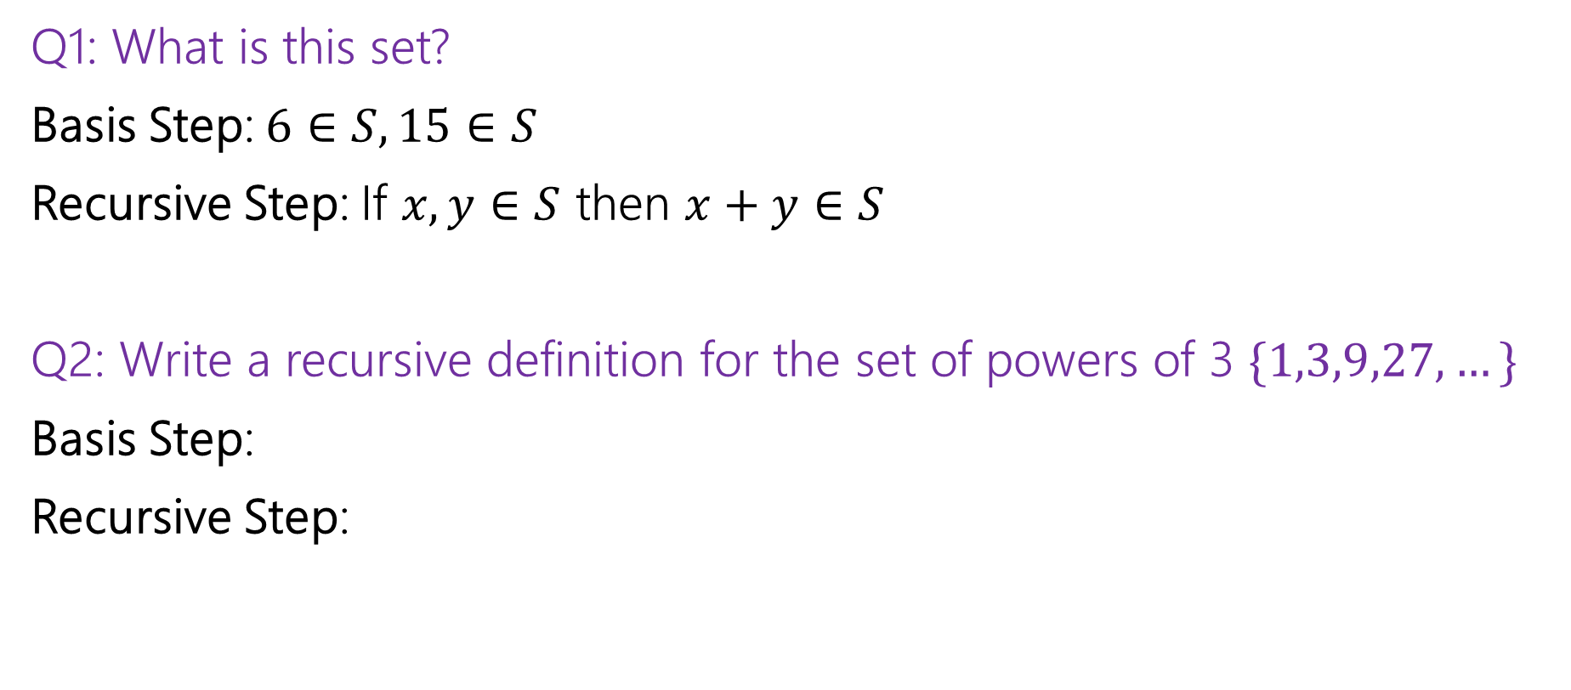
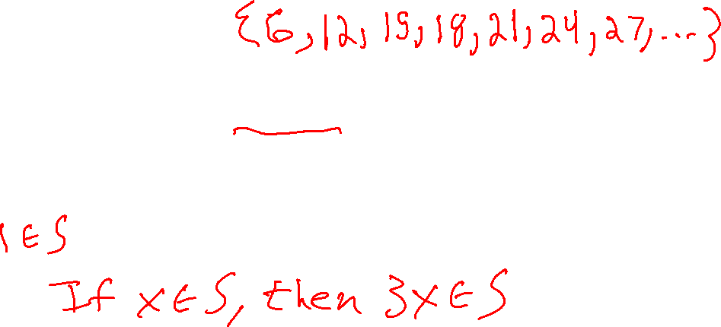
Recursive Definitions of Sets
Q1: What is this set?
Basis Step: $6∈S, 15∈S$
Recursive Step: If $x,y∈S$ then $x+y∈S$
Q2: Write a recursive definition for the set of powers of 3 $\{1,3,9,27,…\}$
Basis Step:
Recursive Step:

Slide 14
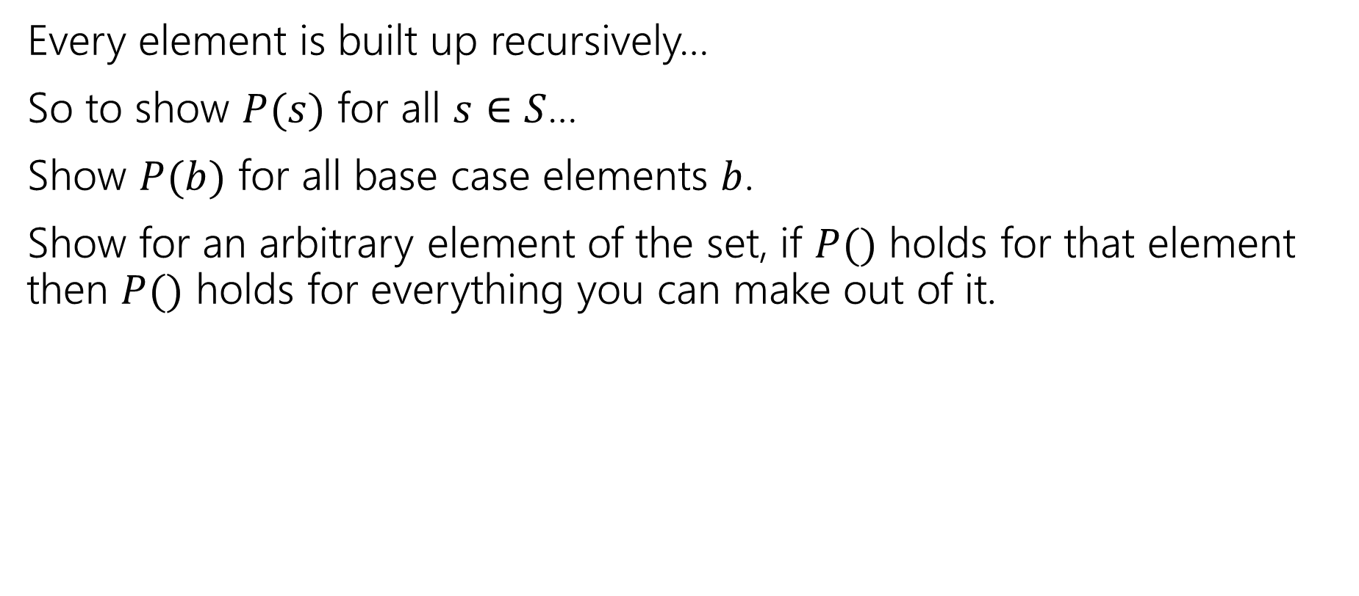

Structural Induction
Every element is built up recursively…
So to show $P(s)$ for all $s∈S$…
Show $P(b)$ for all base case elements $b$.
Show for an arbitrary element of the set, if $P()$ holds for that element then $P()$ holds for everything you can make out of it.

Slide 15

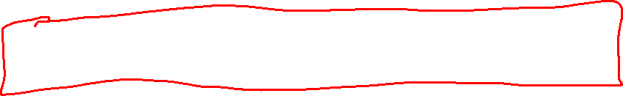
Structural Induction Example
Let $S$ be: Basis: $6∈S, 15∈S$ Recursive: if $x,y∈S$ then $x+y∈S$.
Show that every element of $S$ is divisible by $3$.

Slide 16
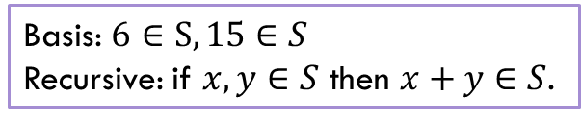


Structural Induction
Let $P(x)$ be “$x$ is divisible by $3$.”
We show $P(x)$ holds for all $x∈S$ by structural induction.
Base Cases:
Inductive Hypothesis:
Inductive Step:
We conclude $P\left(x\right)∀x∈S by$the principle of induction.
Basis: $6∈S, 15∈S$ Recursive: if $x,y∈S$ then $x+y∈S$.

Slide 17
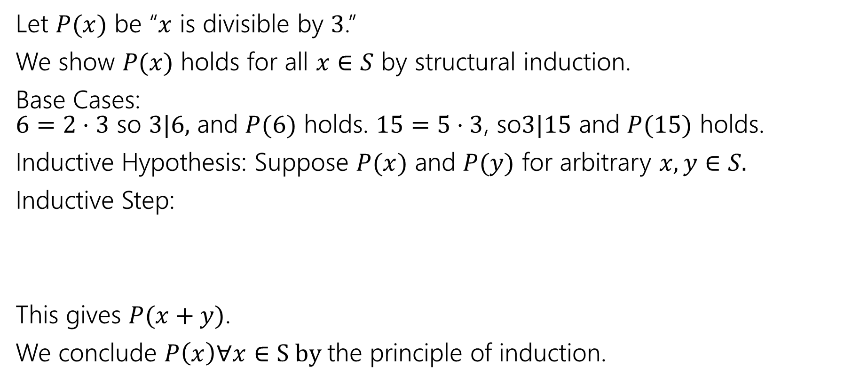

Structural Induction
Let $P(x)$ be “$x$ is divisible by $3$.”
We show $P(x)$ holds for all $x∈S$ by structural induction.
Base Cases: $6=2⋅3$ so $3|6,$ and $P(6)$ holds. $15=5⋅3$, so$3|15$ and $P(15)$ holds.
Inductive Hypothesis: Suppose $P(x)$ and $P(y)$ for arbitrary $x,y∈S.$
Inductive Step:
This gives $P(x+y)$.
We conclude $P\left(x\right)∀x∈S by$the principle of induction.
Basis: $6∈S, 15∈S$ Recursive: if $x,y∈S$ then $x+y∈S$.

Slide 18
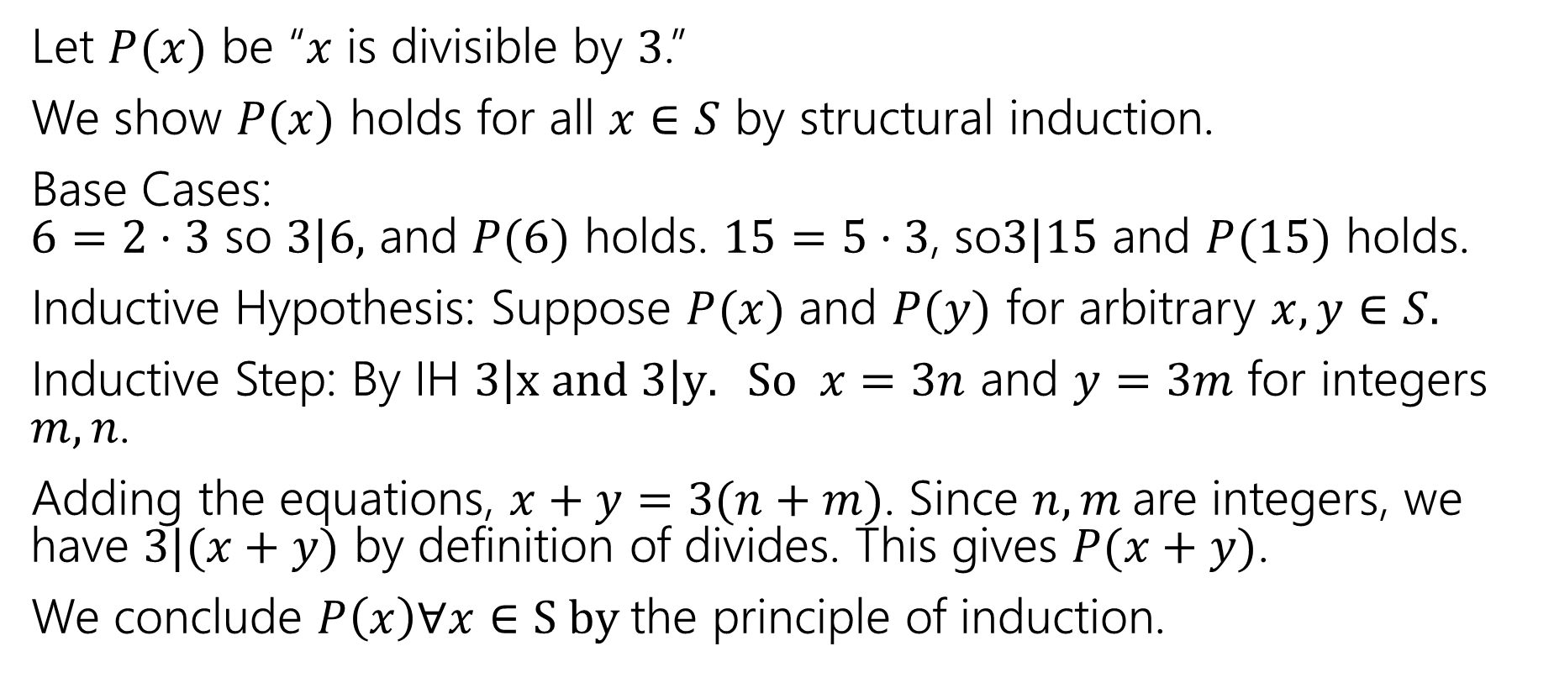

Structural Induction
Let $P(x)$ be “$x$ is divisible by $3$.”
We show $P(x)$ holds for all $x∈S$ by structural induction.
Base Cases: $6=2⋅3$ so $3|6,$ and $P(6)$ holds. $15=5⋅3$, so$3|15$ and $P(15)$ holds.
Inductive Hypothesis: Suppose $P(x)$ and $P(y)$ for arbitrary $x,y∈S.$
Inductive Step: By IH $3\left|x and 3\right|y. So x=3n$ and $y=3m$ for integers $m,n$.
Adding the equations, $x+y=3(n+m)$. Since $n,m$are integers, we have $3|(x+y)$ by definition of divides. This gives $P(x+y)$.
We conclude $P\left(x\right)∀x∈S by$the principle of induction.
Basis: $6∈S, 15∈S$ Recursive: if $x,y∈S$ then $x+y∈S$.

Slide 19
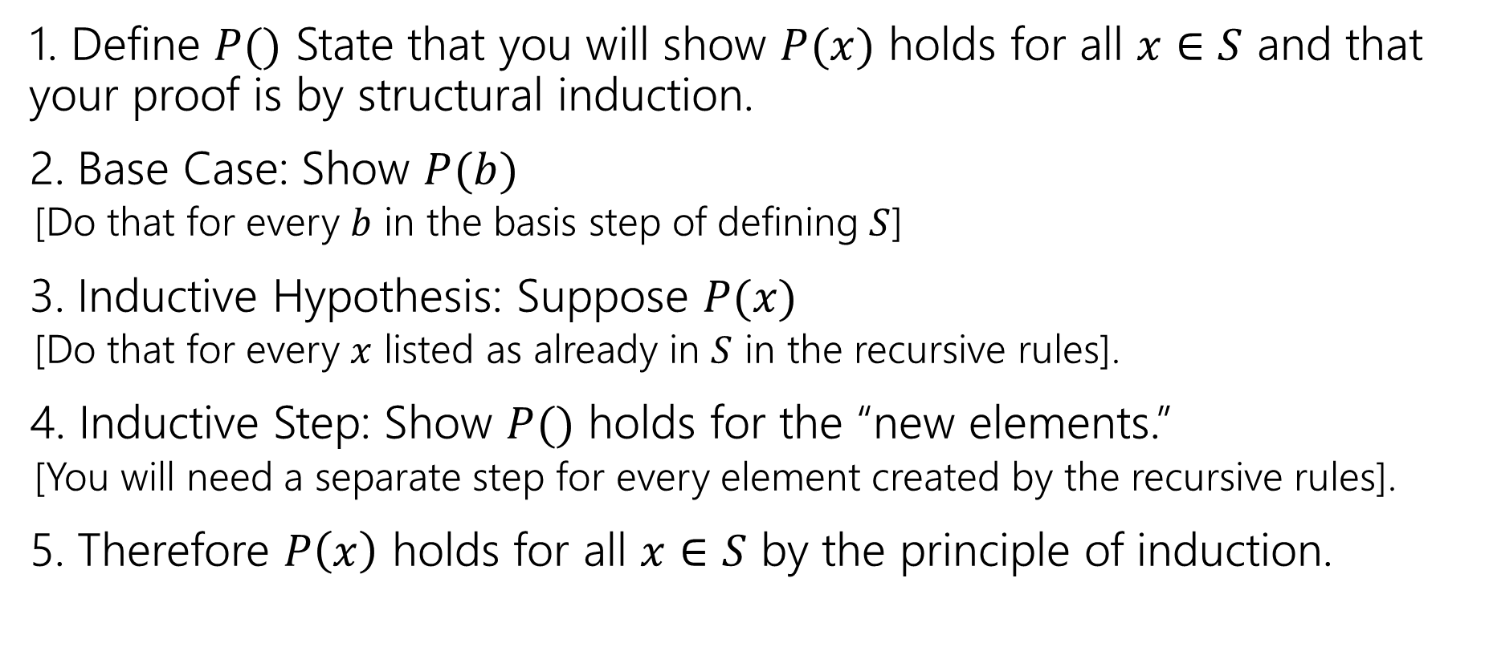
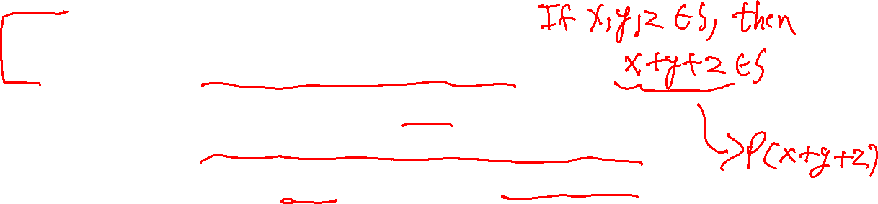
Structural Induction Template
1. Define $P()$ State that you will show $P(x)$ holds for all $x∈S$ and that your proof is by structural induction.
2. Base Case: Show $P(b)$
[Do that for every $b$ in the basis step of defining $S$]
3. Inductive Hypothesis: Suppose $P(x)$
[Do that for every $x$ listed as already in $S$ in the recursive rules].
4. Inductive Step: Show $P()$ holds for the “new elements.”
[You will need a separate step for every element created by the recursive rules].
5. Therefore $P\left(x\right)$ holds for all $x∈S$ by the principle of induction.

Slide 20

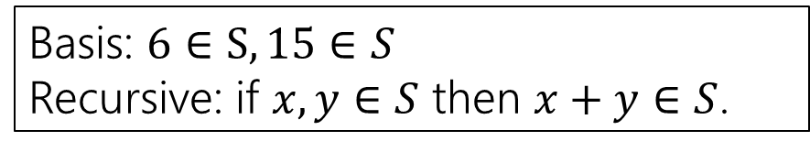
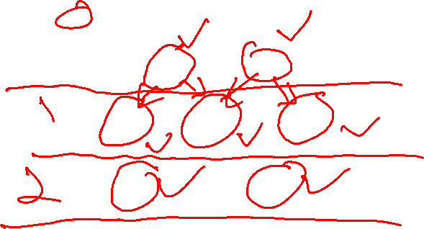
Wait a minute! Why can we do this?
S
Basis: $6∈S, 15∈S$ Recursive: if $x,y∈S$ then $x+y∈S$.
6
15
We proved:
Base Case: P(6) and P(15)
IH $→$ IS: If P(x) and P(y), then P(x+y)
12
21
30
18
27
24…

Slide 21
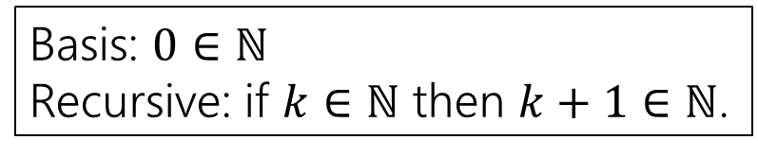

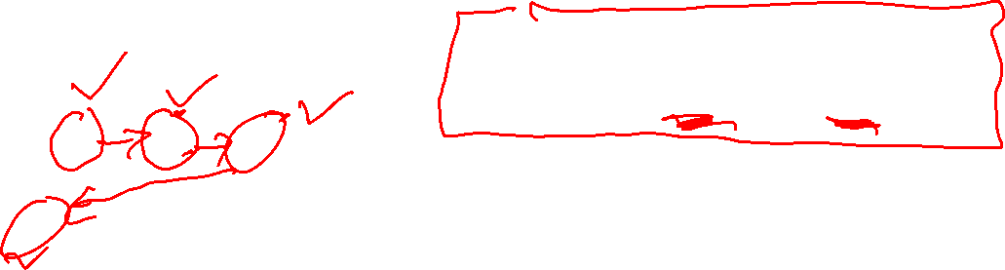

Weak Induction is a special case of Structural
$ℕ$
Basis: $0∈ℕ$
Recursive: if $k∈ℕ$ then $k+1∈ℕ$.
0
1
2
We proved:
Base Case: P(0)
IH $→$ IS: If P(k), then P(k+1)
3
4
5
6
7
8…

Slide 22
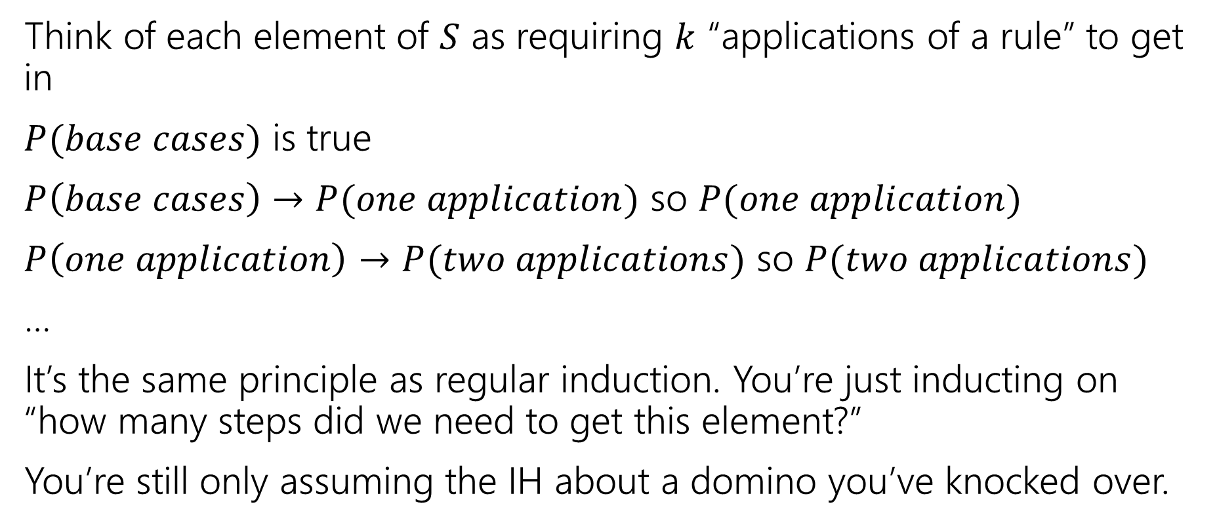

Wait a minute! Why can we do this?
Think of each element of $S$ as requiring $k$ “applications of a rule” to get in
$P(base cases)$ is true
$P\left(base cases\right)→P(one application)$ so $P(one application)$
$P\left(one application\right)→P(two applications)$ so $P(two applications)$
…
It’s the same principle as regular induction. You’re just inducting on “how many steps did we need to get this element?”
You’re still only assuming the IH about a domino you’ve knocked over.

Slide 23
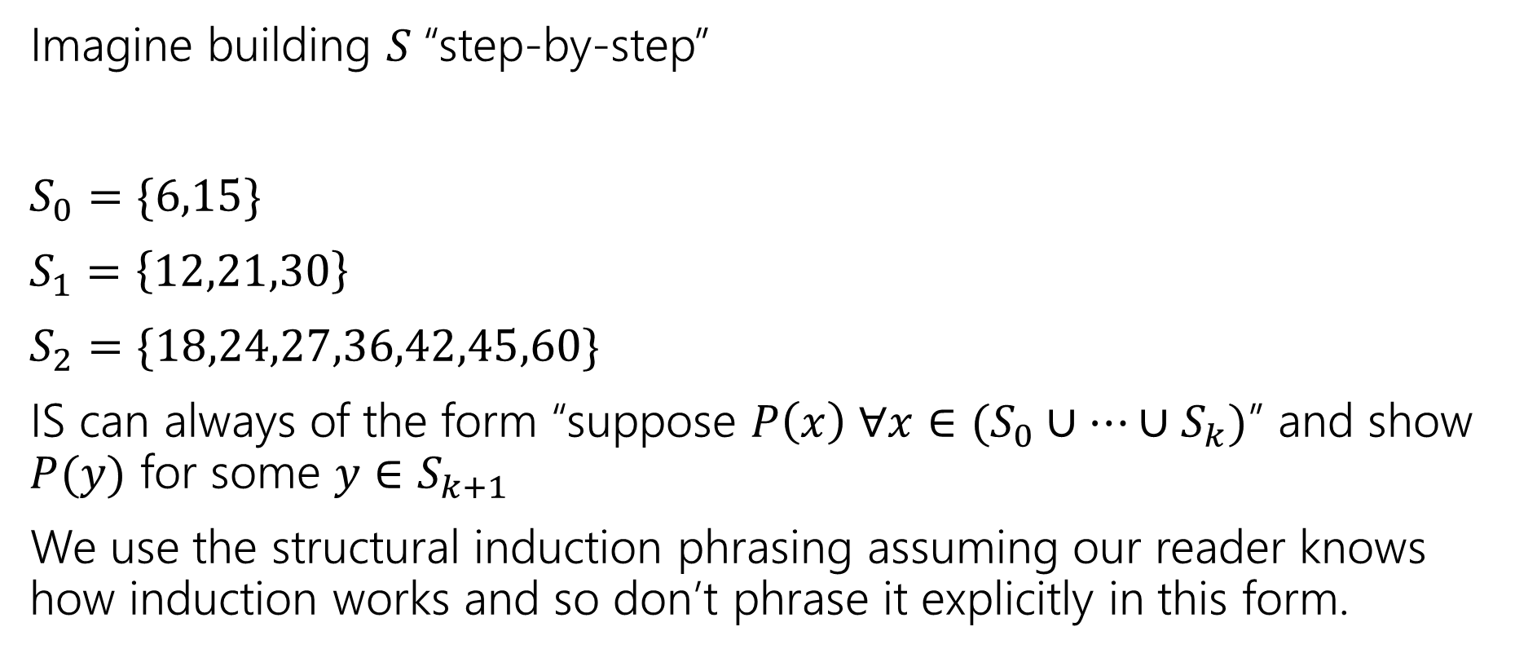
Wait a minute! Why can we do this?
Imagine building $S$“step-by-step”
$S_{0}=\{6,15\}$
$S_{1}=\left\{12,21,30\right\}$
$S_{2}=\{18,24,27,36,42,45,60\}$
IS can always of the form “suppose $P\left(x\right) ∀x∈(S_{0}∪…∪S_{k})$” and show $P(y)$ for some $y∈S_{k+1}$
We use the structural induction phrasing assuming our reader knows how induction works and so don’t phrase it explicitly in this form.

Slide 24
Strings!

Slide 25
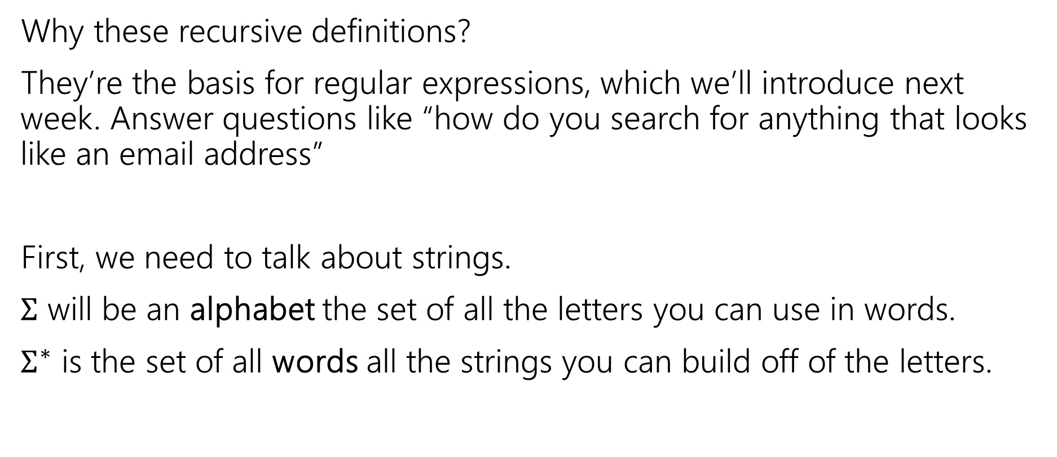
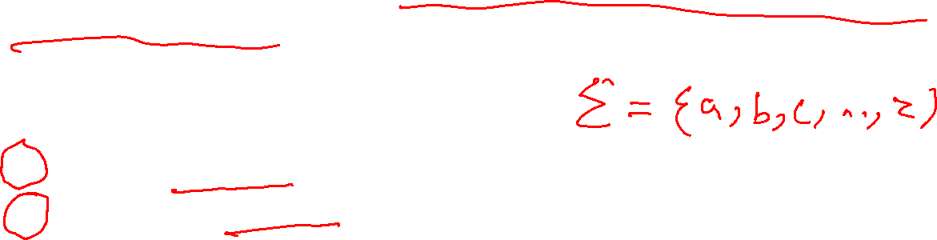
Strings
Why these recursive definitions?
They’re the basis for regular expressions, which we’ll introduce next week. Answer questions like “how do you search for anything that looks like an email address”
First, we need to talk about strings.
$Σ$ will be an alphabet the set of all the letters you can use in words.
$Σ^{∗}$ is the set of all words all the strings you can build off of the letters.

Slide 26
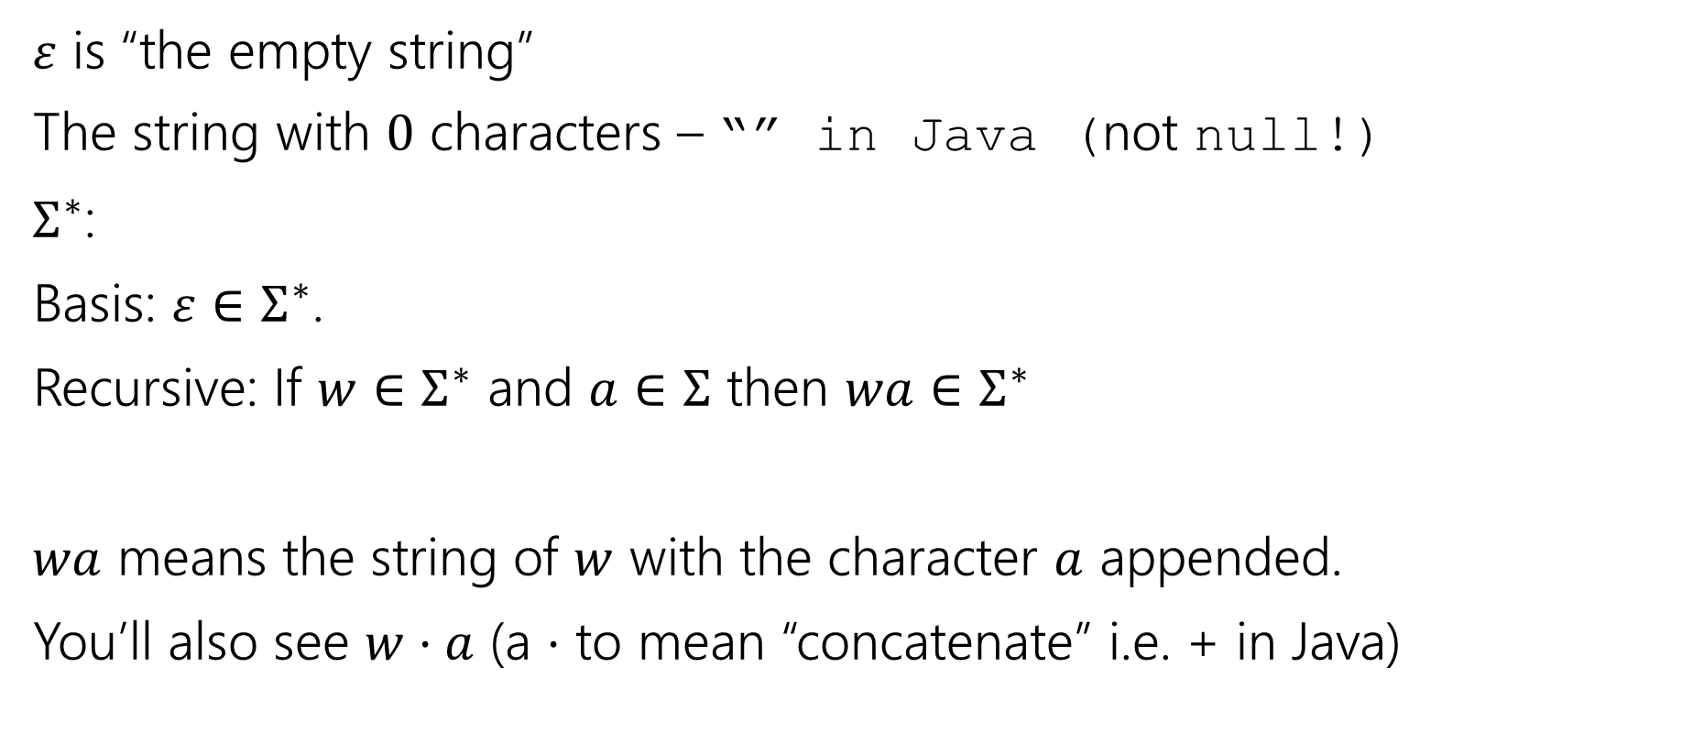

Strings
$ε$ is “the empty string”
The string with $0$ characters – “” in Java (not null!)
$Σ^{∗}$:
Basis: $ε∈Σ^{∗}$.
Recursive: If $w∈Σ^{∗}$ and $a∈Σ$ then $wa∈Σ^{∗}$
$wa$ means the string of $w$ with the character $a$ appended.
You’ll also see $w⋅a$ (a $⋅$ to mean “concatenate” i.e. + in Java)

Slide 27
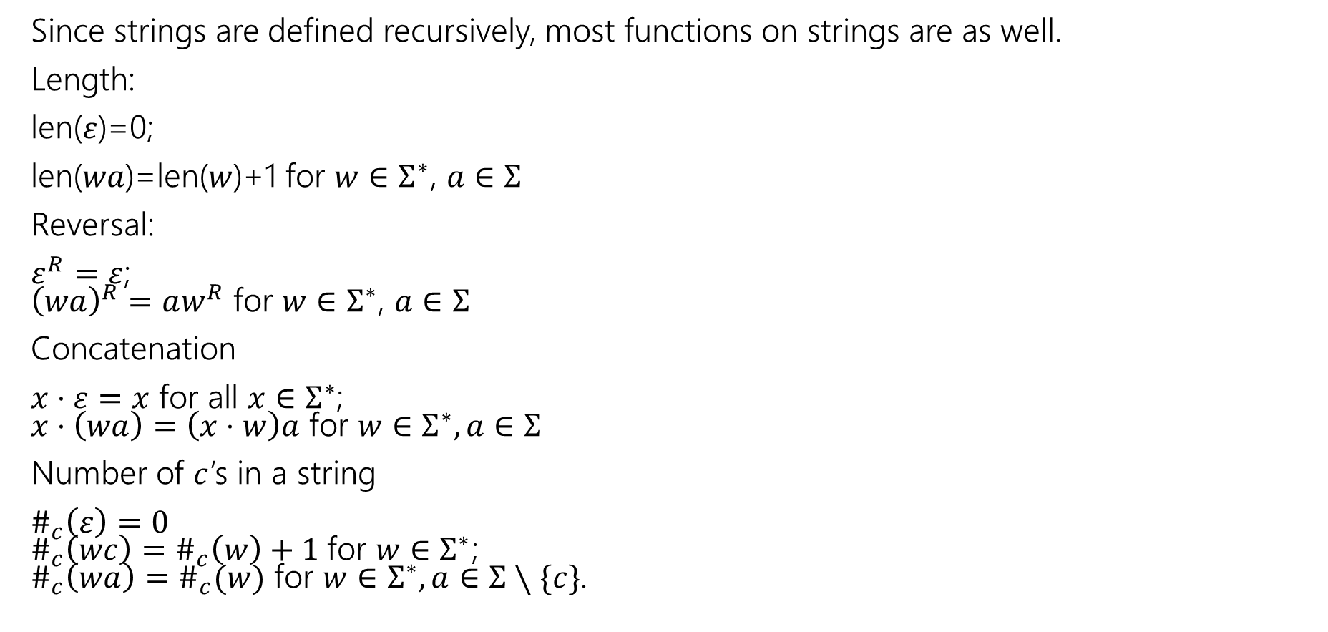
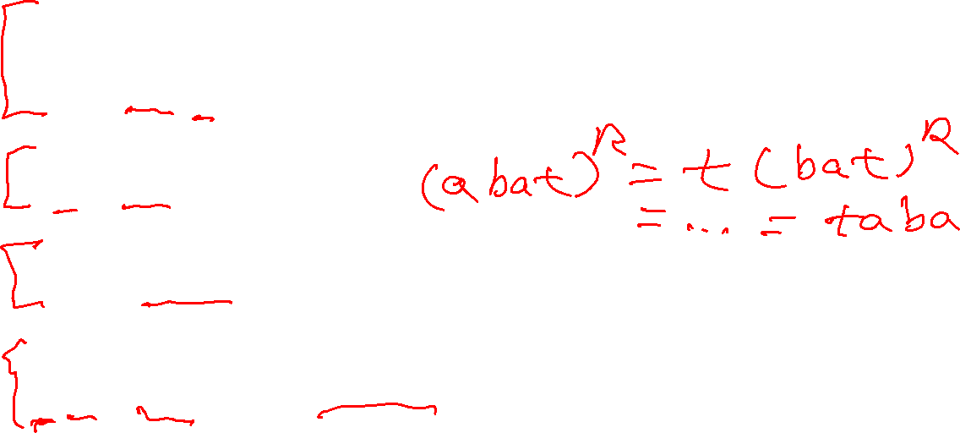
Functions on Strings
Since strings are defined recursively, most functions on strings are as well.
Length:
len($ε$)=0;
len($wa$)=len($w$)+1 for $w∈Σ^{∗}$, $a∈Σ$
Reversal:
$ε^{R}=ε$; ${\left(wa\right)}^{R}=aw^{R}$ for $w∈Σ^{∗}$, $a∈Σ$
Concatenation
$x⋅ε=x$ for all $x∈Σ^{∗}$; $x⋅\left(wa\right)=\left(x⋅w\right)a$ for $w∈Σ^{∗},a∈Σ$
Number of $c$’s in a string
$\#_{c}\left(ε\right)=0$ $\#_{c}\left(wc\right)=\#_{c}\left(w\right)+1$for $w∈Σ^{∗}$; $\#_{c}\left(wa\right)=\#_{c}(w)$ for $w∈Σ^{∗},a∈Σ∖\{c\}$.

Slide 28
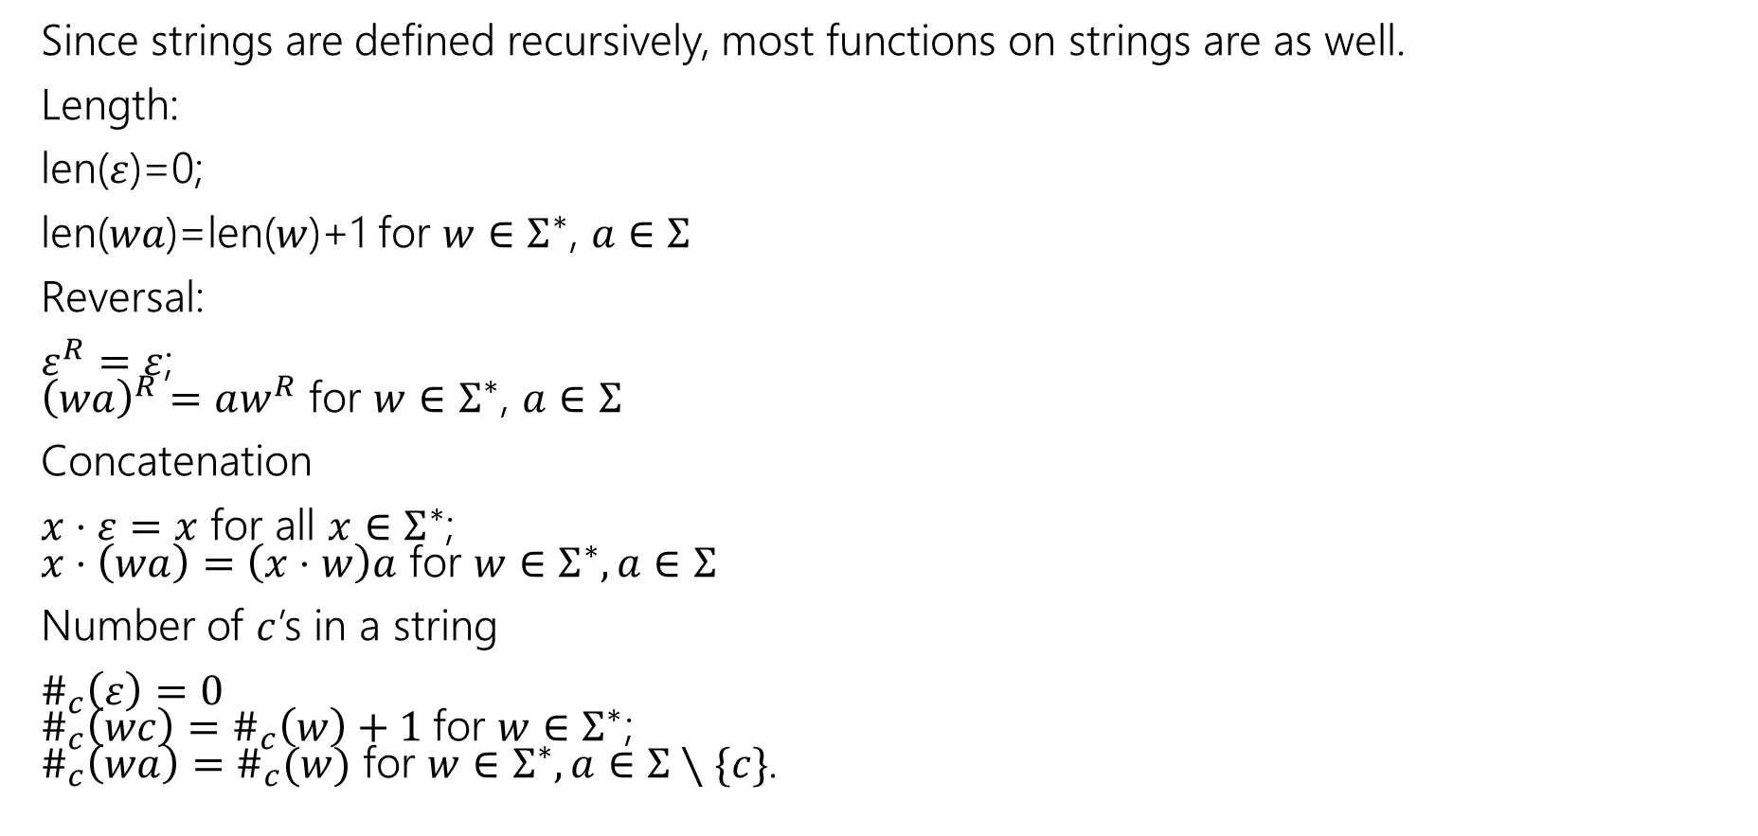
Functions on Strings
Since strings are defined recursively, most functions on strings are as well.
Length:
len($ε$)=0;
len($wa$)=len($w$)+1 for $w∈Σ^{∗}$, $a∈Σ$
Reversal:
$ε^{R}=ε$; ${\left(wa\right)}^{R}=aw^{R}$ for $w∈Σ^{∗}$, $a∈Σ$
Concatenation
$x⋅ε=x$ for all $x∈Σ^{∗}$; $x⋅\left(wa\right)=\left(x⋅w\right)a$ for $w∈Σ^{∗},a∈Σ$
Number of $c$’s in a string
$\#_{c}\left(ε\right)=0$ $\#_{c}\left(wc\right)=\#_{c}\left(w\right)+1$for $w∈Σ^{∗}$; $\#_{c}\left(wa\right)=\#_{c}(w)$ for $w∈Σ^{∗},a∈Σ∖\{c\}$.

Slide 29

Claim about Strings
Claim: For any string 𝑠 ∈ Σ∗, len(𝑠^{𝑅}) = len(s)

Slide 30
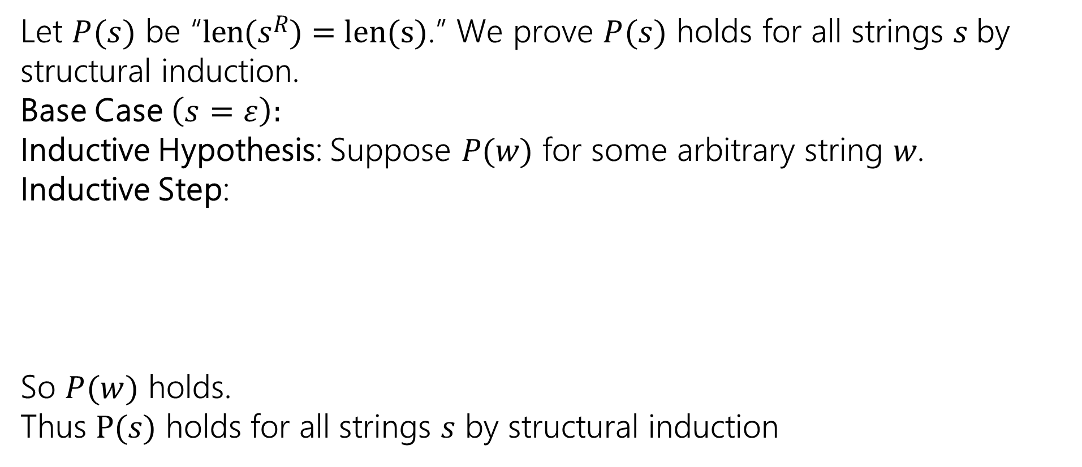

Claim: For any string 𝑠 ∈ Σ∗, len(𝑠^{𝑅}) = len(s)
len 𝜀 = 0
len 𝑤𝑎 = len 𝑤 + 1
𝜀^{𝑅} = 𝜀
𝑤𝑎 ^{𝑅} = 𝑎𝑤^{𝑅}
Basis: 𝜀 ∈ Σ∗
Recursive: If 𝑤 ∈ Σ∗ and 𝑎 ∈ Σ,
then 𝑤𝑎 ∈ Σ∗
Let $P(s)$ be “len(𝑠^{𝑅}) = len(s).” We prove $P(s)$ holds for all strings $s$by structural induction.
Base Case $\left(\text{s} \text{=} \text{ε}\right):$
Inductive Hypothesis: Suppose 𝑃(𝑤) for some arbitrary string 𝑤.
Inductive Step:
So $P(w)$ holds.
Thus P(𝑠) holds for all strings 𝑠 by structural induction

Slide 31
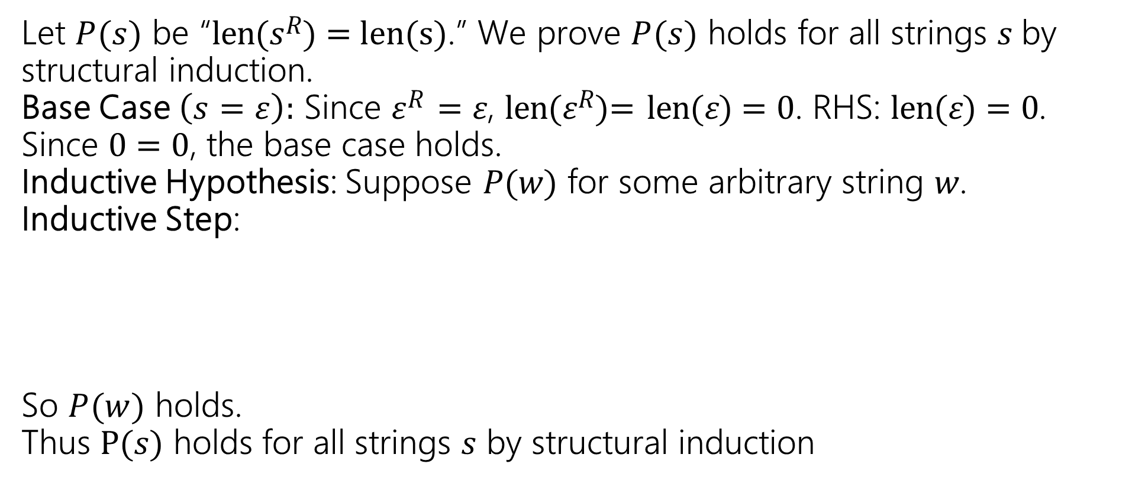
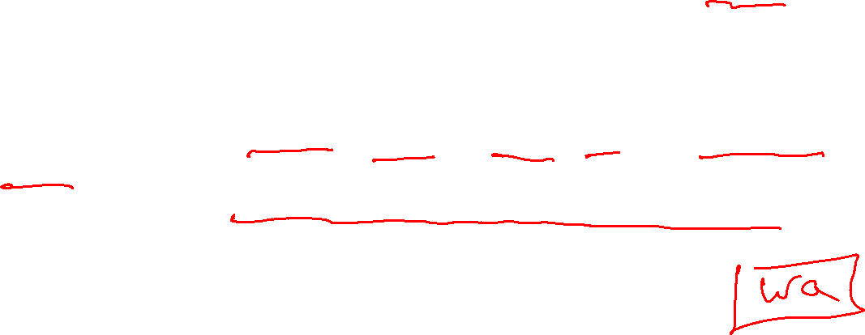
len 𝜀 = 0
len 𝑤𝑎 = len 𝑤 + 1
𝜀^{𝑅} = 𝜀
𝑤𝑎 ^{𝑅} = 𝑎𝑤^{𝑅}
Basis: 𝜀 ∈ Σ∗
Recursive: If 𝑤 ∈ Σ∗ and 𝑎 ∈ Σ,
then 𝑤𝑎 ∈ Σ∗
Claim: For any string 𝑠 ∈ Σ∗, len(𝑠^{𝑅}) = len(s)
Let $P(s)$ be “len(𝑠^{𝑅}) = len(s).” We prove $P(s)$ holds for all strings $s$by structural induction.
Base Case $\left(\text{s} \text{=} \text{ε}\right):$ Since 𝜀^{𝑅} = 𝜀, len(𝜀^{𝑅})= len(𝜀) = 0. RHS: len(𝜀) = 0. Since 0 = 0, the base case holds.
Inductive Hypothesis: Suppose 𝑃(𝑤) for some arbitrary string 𝑤.
Inductive Step:
So $P(w)$ holds.
Thus P(𝑠) holds for all strings 𝑠 by structural induction

Slide 32
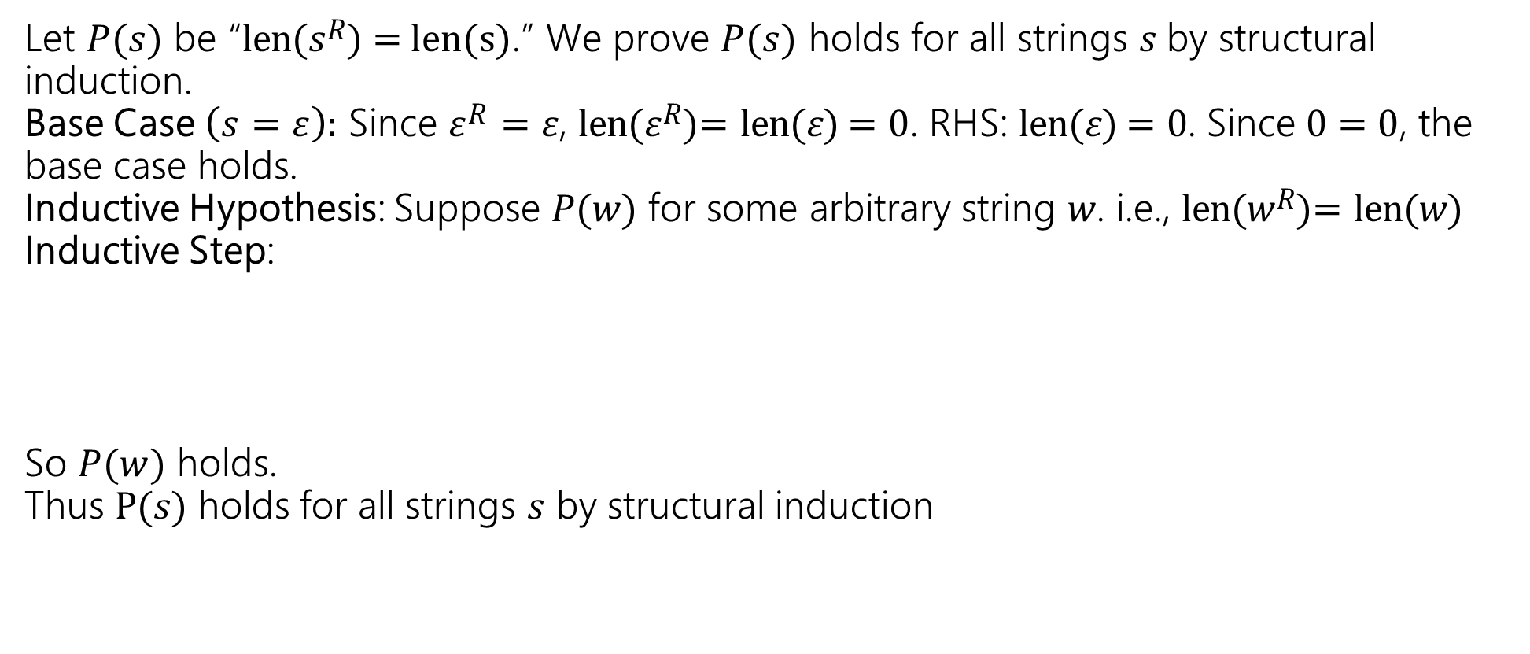
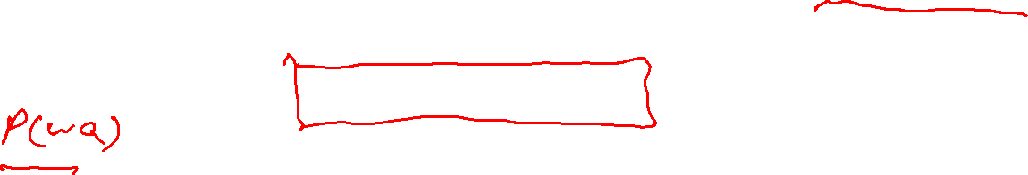
len 𝜀 = 0
len 𝑤𝑎 = len 𝑤 + 1
𝜀^{𝑅} = 𝜀
𝑤𝑎 ^{𝑅} = 𝑎𝑤^{𝑅}
Basis: 𝜀 ∈ Σ∗
Recursive: If 𝑤 ∈ Σ∗ and 𝑎 ∈ Σ,
then 𝑤𝑎 ∈ Σ∗
Claim: For any string 𝑠 ∈ Σ∗, len(𝑠^{𝑅}) = len(s)
Let $P(s)$ be “len(𝑠^{𝑅}) = len(s).” We prove $P(s)$ holds for all strings $s$by structural induction.
Base Case $\left(\text{s} \text{=} \text{ε}\right):$ Since 𝜀^{𝑅} = 𝜀, len(𝜀^{𝑅})= len(𝜀) = 0. RHS: len(𝜀) = 0. Since 0 = 0, the base case holds.
Inductive Hypothesis: Suppose 𝑃(𝑤) for some arbitrary string 𝑤. i.e., len(𝑤^{𝑅})= len(𝑤)
Inductive Step:
So $P(w)$ holds.
Thus P(𝑠) holds for all strings 𝑠 by structural induction
[Goal: len((𝑤𝑎)^{𝑅})= len(𝑤𝑎)]

Slide 33
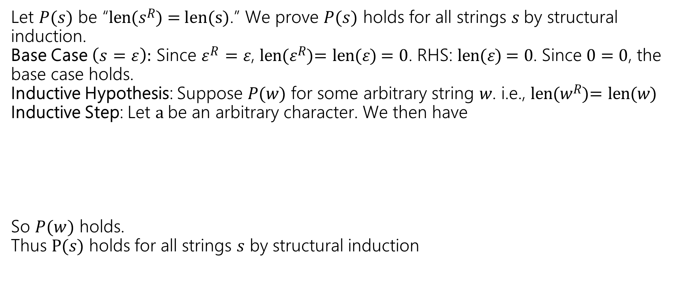
len 𝜀 = 0
len 𝑤𝑎 = len 𝑤 + 1
𝜀^{𝑅} = 𝜀
𝑤𝑎 ^{𝑅} = 𝑎𝑤^{𝑅}
Basis: 𝜀 ∈ Σ∗
Recursive: If 𝑤 ∈ Σ∗ and 𝑎 ∈ Σ,
then 𝑤𝑎 ∈ Σ∗
Claim: For any string 𝑠 ∈ Σ∗, len(𝑠^{𝑅}) = len(s)
Let $P(s)$ be “len(𝑠^{𝑅}) = len(s).” We prove $P(s)$ holds for all strings $s$by structural induction.
Base Case $\left(\text{s} \text{=} \text{ε}\right):$ Since 𝜀^{𝑅} = 𝜀, len(𝜀^{𝑅})= len(𝜀) = 0. RHS: len(𝜀) = 0. Since 0 = 0, the base case holds.
Inductive Hypothesis: Suppose 𝑃(𝑤) for some arbitrary string 𝑤. i.e., len(𝑤^{𝑅})= len(𝑤)
Inductive Step: Let a be an arbitrary character. We then have
So $P(w)$ holds.
Thus P(𝑠) holds for all strings 𝑠 by structural induction

Slide 34
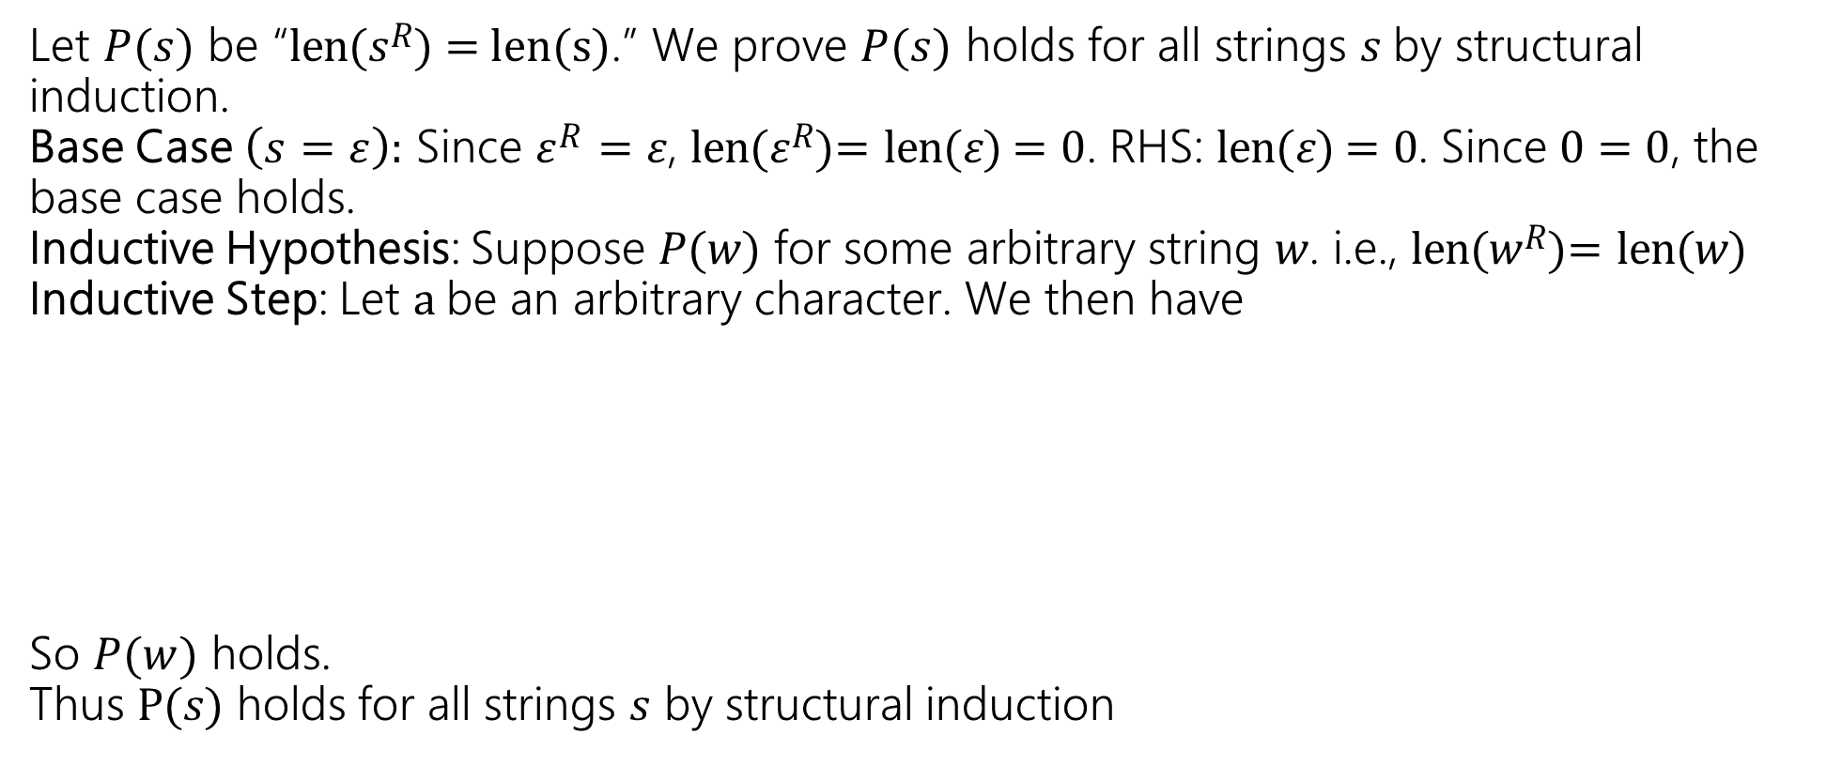
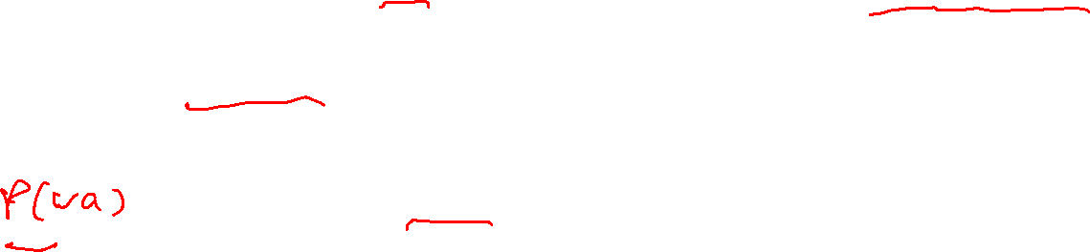
len 𝜀 = 0
len 𝑤𝑎 = len 𝑤 + 1
𝜀^{𝑅} = 𝜀
𝑤𝑎 ^{𝑅} = 𝑎𝑤^{𝑅}
Basis: 𝜀 ∈ Σ∗
Recursive: If 𝑤 ∈ Σ∗ and 𝑎 ∈ Σ,
then 𝑤𝑎 ∈ Σ∗
Claim: For any string 𝑠 ∈ Σ∗, len(𝑠^{𝑅}) = len(s)
Let $P(s)$ be “len(𝑠^{𝑅}) = len(s).” We prove $P(s)$ holds for all strings $s$by structural induction.
Base Case $\left(\text{s} \text{=} \text{ε}\right):$ Since 𝜀^{𝑅} = 𝜀, len(𝜀^{𝑅})= len(𝜀) = 0. RHS: len(𝜀) = 0. Since 0 = 0, the base case holds.
Inductive Hypothesis: Suppose 𝑃(𝑤) for some arbitrary string 𝑤. i.e., len(𝑤^{𝑅})= len(𝑤)
Inductive Step: Let a be an arbitrary character. We then have
So $P(w)$ holds.
Thus P(𝑠) holds for all strings 𝑠 by structural induction
len((𝑤𝑎)^{𝑅}) = len(𝑎𝑤^{𝑅})
By definition of reverse
= len(𝑤^{𝑅}) + 1
By definition of length
= len(𝑤) + 1
By IH
= len(𝑤𝑎)
By definition of length

Slide 35
Trees!

Slide 36

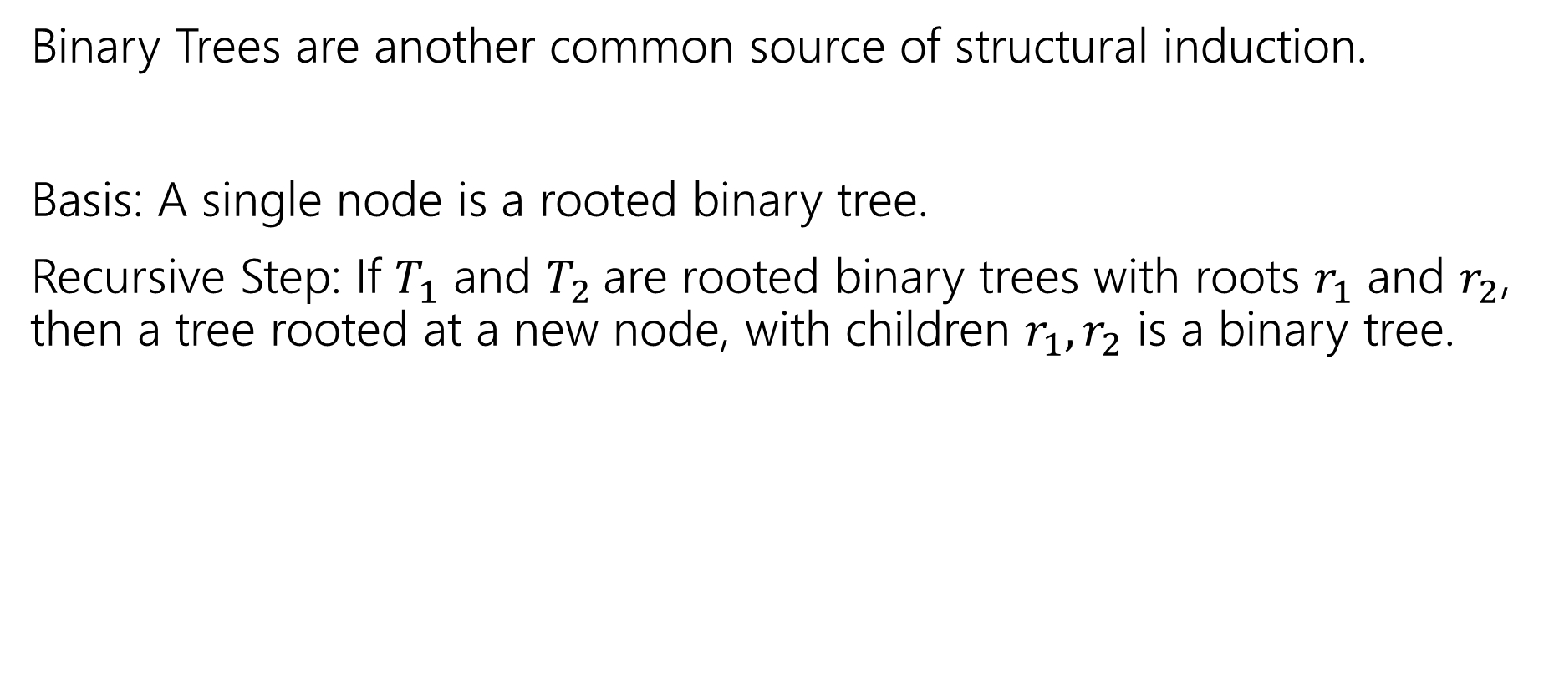
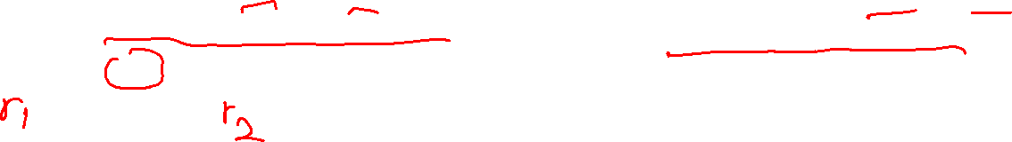

More Structural Sets
Binary Trees are another common source of structural induction.
Basis: A single node is a rooted binary tree.
Recursive Step: If $T_{1}$ and $T_{2}$are rooted binary trees with roots $r_{1}$ and $r_{2}$, then a tree rooted at a new node, with children $r_{1},r_{2}$ is a binary tree.
$$T_{1}$$
$$T_{2}$$

Slide 37






Functions on Binary Trees
size( )=1
size( ) = size($T_{1}$) + size($T_{2}$) + 1
height( ) = 0
height( ) = 1+$max⁡($height($T_{1}$),height($T_{2}$)$)$
$$T_{1}$$
$$T_{2}$$
$$T_{1}$$
$$T_{2}$$

Slide 38
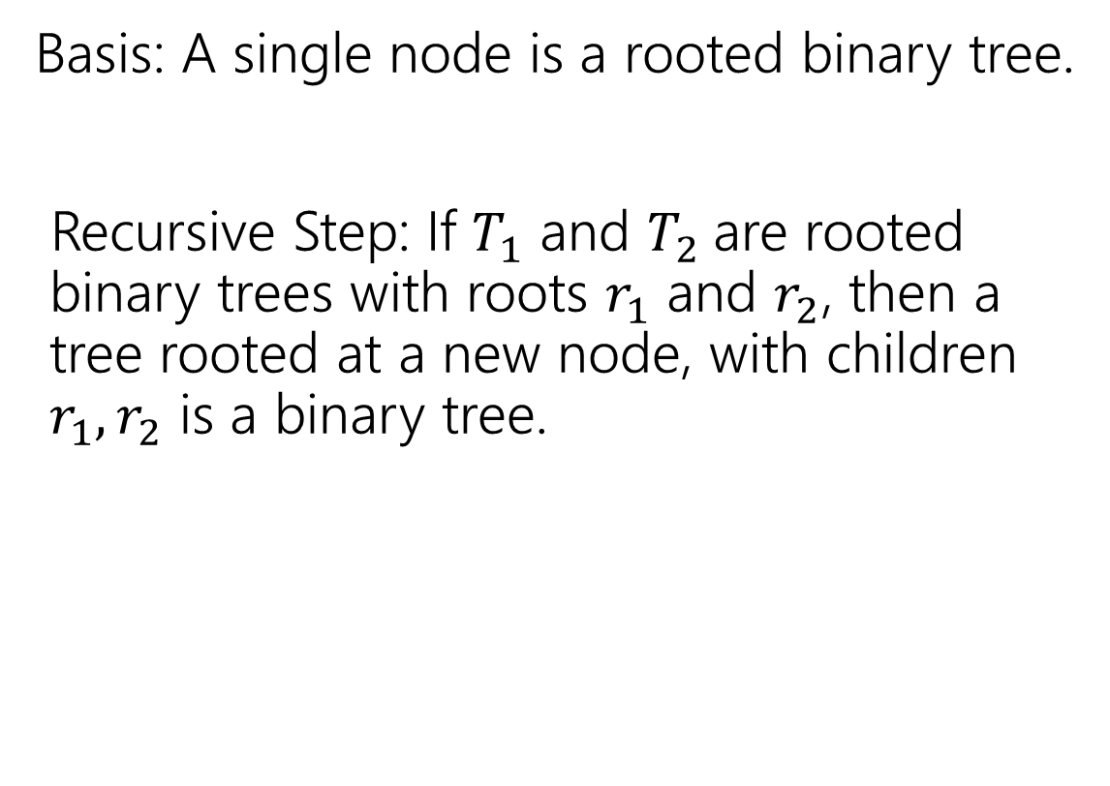
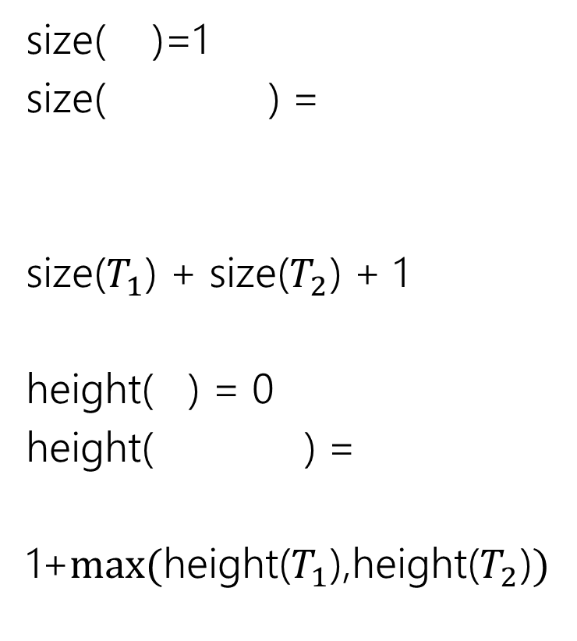
Binary Trees
size( )=1
size( ) =
size($T_{1}$) + size($T_{2}$) + 1
height( ) = 0
height( ) =
1+$max⁡($height($T_{1}$),height($T_{2}$)$)$
Basis: A single node is a rooted binary tree.
Recursive Step: If $T_{1}$ and $T_{2}$are rooted binary trees with roots $r_{1}$ and $r_{2}$, then a tree rooted at a new node, with children $r_{1},r_{2}$ is a binary tree.
$$T_{1}$$
$$T_{2}$$
$$T_{1}$$
$$T_{2}$$
$$T_{1}$$
$$T_{2}$$

Slide 39
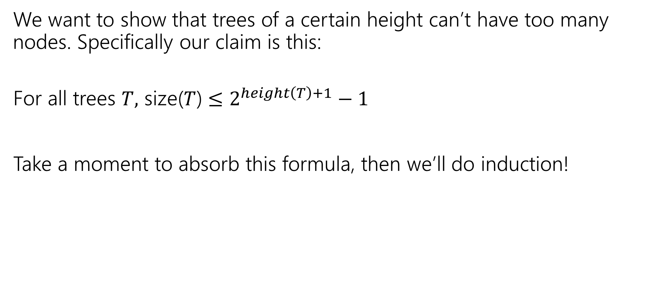
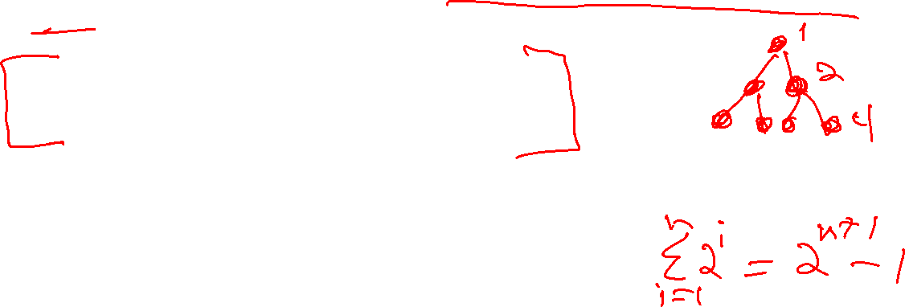
Claim
We want to show that trees of a certain height can’t have too many nodes. Specifically our claim is this:
For all trees $T,$ size($T$) $≤2^{height\left(T\right)+1}−1$
Take a moment to absorb this formula, then we’ll do induction!

Slide 40

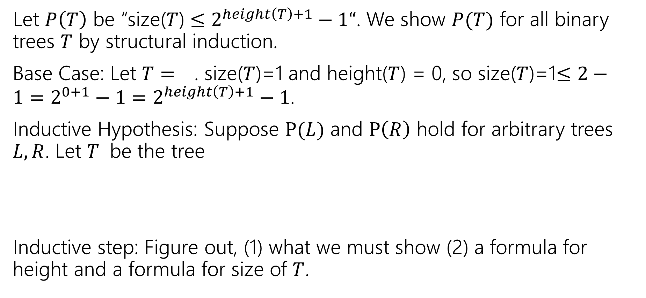
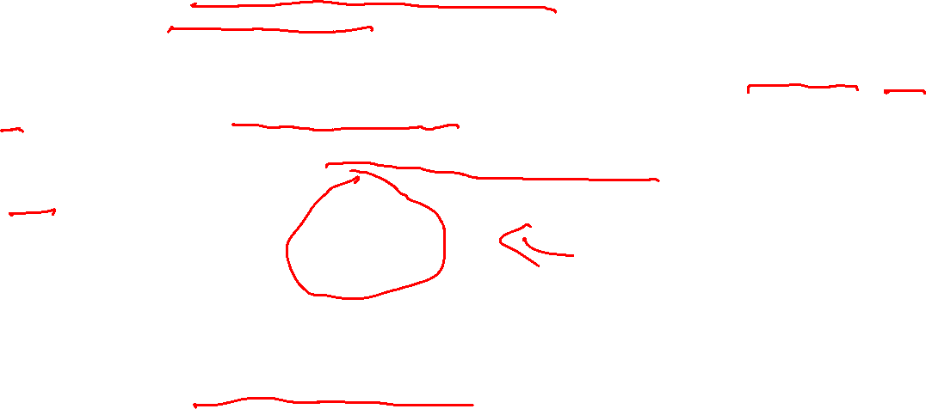

Structural Induction on Binary Trees
Let $P\left(T\right)$ be “size($T$) $≤2^{height\left(T\right)+1}−1“$. We show $P(T)$ for all binary trees $T$ by structural induction.
Base Case: Let $T=$ . size($T$)=1 and height($T$) = 0, so size($T$)=1$≤2−1=2^{0+1}−1=2^{height\left(T\right)+1}−1$.
Inductive Hypothesis: Suppose $P(L)$ and $P\left(R\right)$ hold for arbitrary trees $L,R$. Let $T$ be the tree
Inductive step: Figure out, (1) what we must show (2) a formula for height and a formula for size of $T$.
$$L$$
$$R$$

Slide 41




Structural Induction on Binary Trees (cont.)
Let $P\left(T\right)$ be “size($T$) $≤2^{height\left(T\right)+1}−1“$. We show $P(T)$ for all binary trees $T$ by structural induction.
$T=$ .
height$(T)$=$1+max⁡\{height\left(L\right),height\left(R\right)\}$
size($T)$= $1+$size($L$)+size$(R)$
So $P(T)$ holds, and we have $P(T)$ for all binary trees $T$ by the principle of induction.
$$L$$
$$R$$

Slide 42










How do heights compare?
If $L$ is taller than $R$?
If $L,R$ same height?
If $R$ is taller than $L$?
$$L$$
$$R$$
$$L$$
$$R$$
$$L$$
$$R$$
height( ) = 0
height( ) =
1+$max⁡($height($T_{1}$),height($T_{2}$)$)$
$$T_{1}$$
$$T_{2}$$

Slide 43




How do heights compare?
If $L$ is taller than $R$?
height$\left(T\right)=$height$\left(L\right)+1$
height$(T)>$height($R)+1$
If $L,R$ same height?
height$\left(T\right)=$height$\left(L\right)+1$
height$\left(T\right)=$height($R)+1$
If $R$ is taller than $L$?
height$\left(T\right)>$height$\left(L\right)+1$
height$\left(T\right)=$height($R)+1$
$$L$$
$$R$$
$$L$$
$$R$$
$$L$$
$$R$$
In all cases: height($T$)$≥$height($L$)+1, height($T$)$≥$height($R$)+1

Slide 44




Structural Induction on Binary Trees (cont.)
Let $P\left(T\right)$ be “size($T$) $≤2^{height\left(T\right)+1}−1“$. We show $P(T)$ for all binary trees $T$ by structural induction.
$T=$ .
height$(T)$=$1+max⁡\{height\left(L\right),height\left(R\right)\}$
size($T)$= $1+$size($L$)+size$(R)$
size($T)$=1$+$size($L$)+size$\left(R\right)≤{1+2}^{height\left(L\right)+1}−1{+2}^{height\left(R\right)+1}−1$ (by IH)
$≤2^{height\left(L\right)+1}{+2}^{height\left(R\right)+1}−1$ (cancel 1’s)
$≤$ $2^{height(T)}+2^{height(T)}−1=2^{height\left(T\right)+1}−1$ ($T$ taller than subtrees)
So $P(T)$ holds, and we have $P(T)$ for all binary trees $T$ by the principle of induction.
$$L$$
$$R$$

Slide 45
Todo
Tonight:
CC 15 is out and due Wednesday at noon
Start reviewing for the midterm if you haven’t already!

