Slide 1
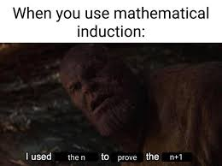
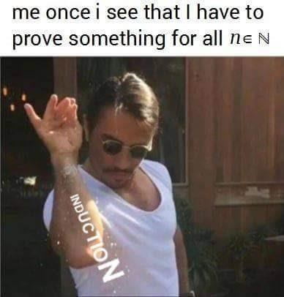
Induction practice
CSE 311 Summer 2025 Lecture 14

Slide 2
Announcements
HW5 has been released!
HW4 was due on Wednesday (7/23)
Late submissions open until Saturday 7/25
HW3 Feedback and resubmission is out
Due today at 11:59pm—no late submissions!
Our Midterm is next Friday (8/1) in class!
Exam logistics and practice exams are posted on the “Exams” page of the course website

Slide 3
Practice

Slide 4
Induction Template
Define P(𝑛). State that your proof is by induction on 𝑛.
Base Case: Show P(𝑏) is true for your base case 𝑏.
Inductive Hypothesis: Suppose P(𝑘) holds for an arbitrary integer 𝑘 ≥ 𝑏.
Inductive Step: Prove P(𝑘 + 1) (using the Inductive Hypothesis).
Conclusion: Conclude by saying P(𝑛) holds for all integers 𝑛 ≥ 𝑏
by induction.

Slide 5
Problem 1: Induction with Sums

Slide 6
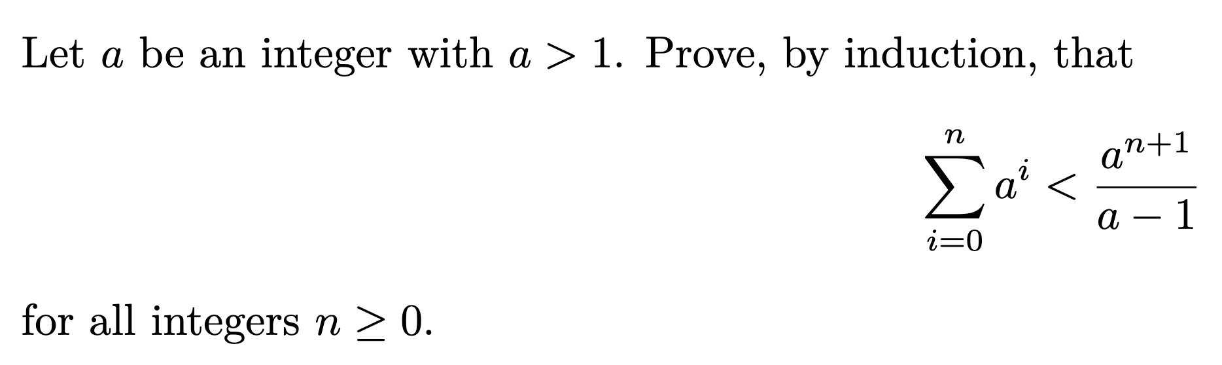

Slide 8
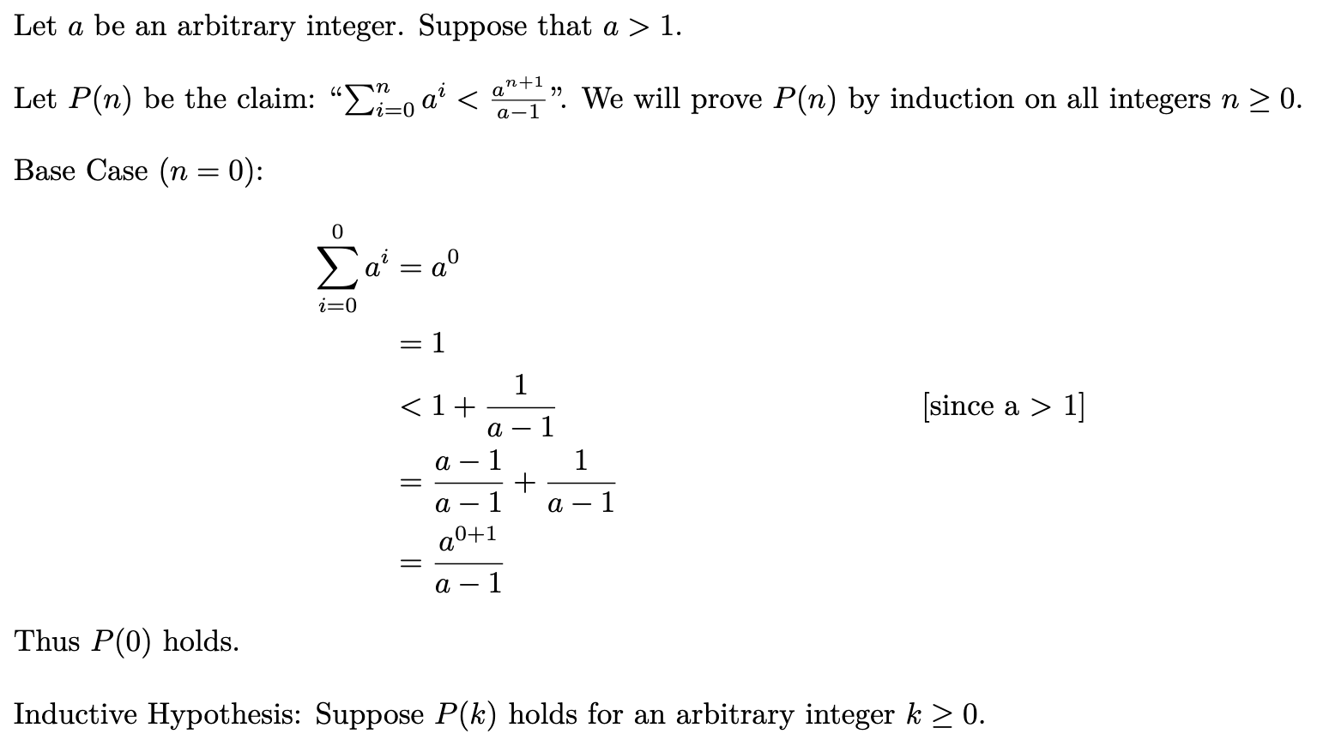

Slide 9
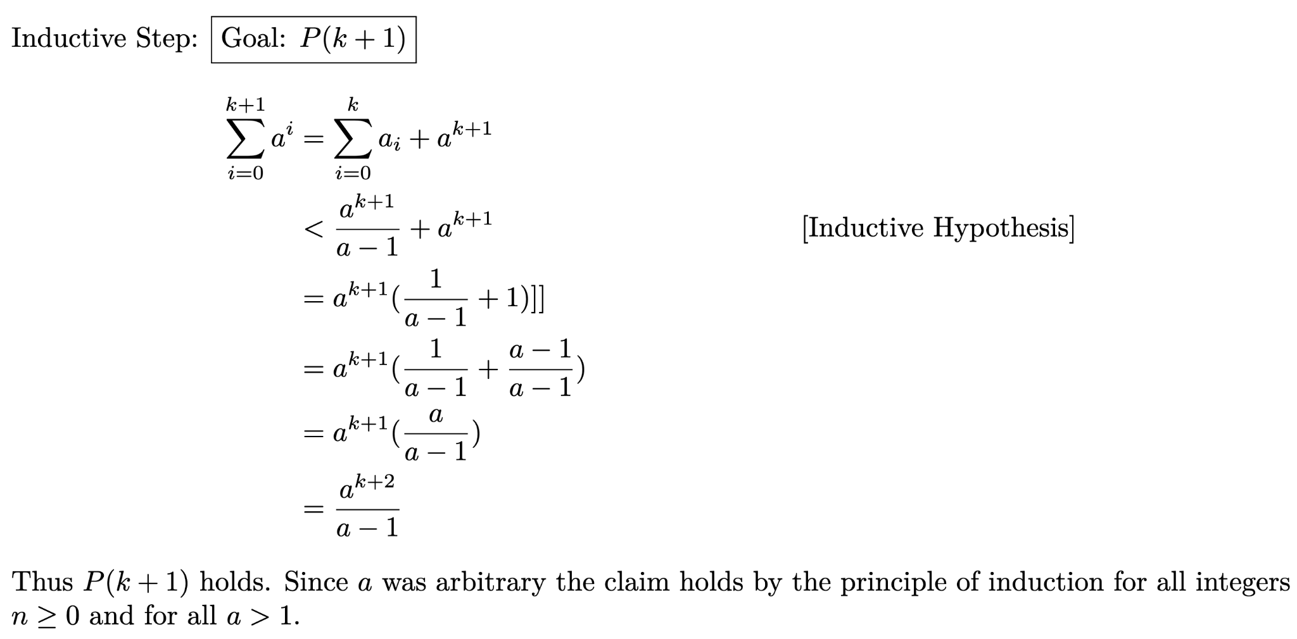

Slide 10
Problem 2: Fibonacci Inequality

Slide 11
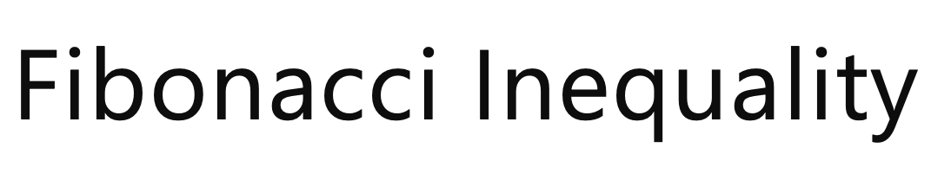
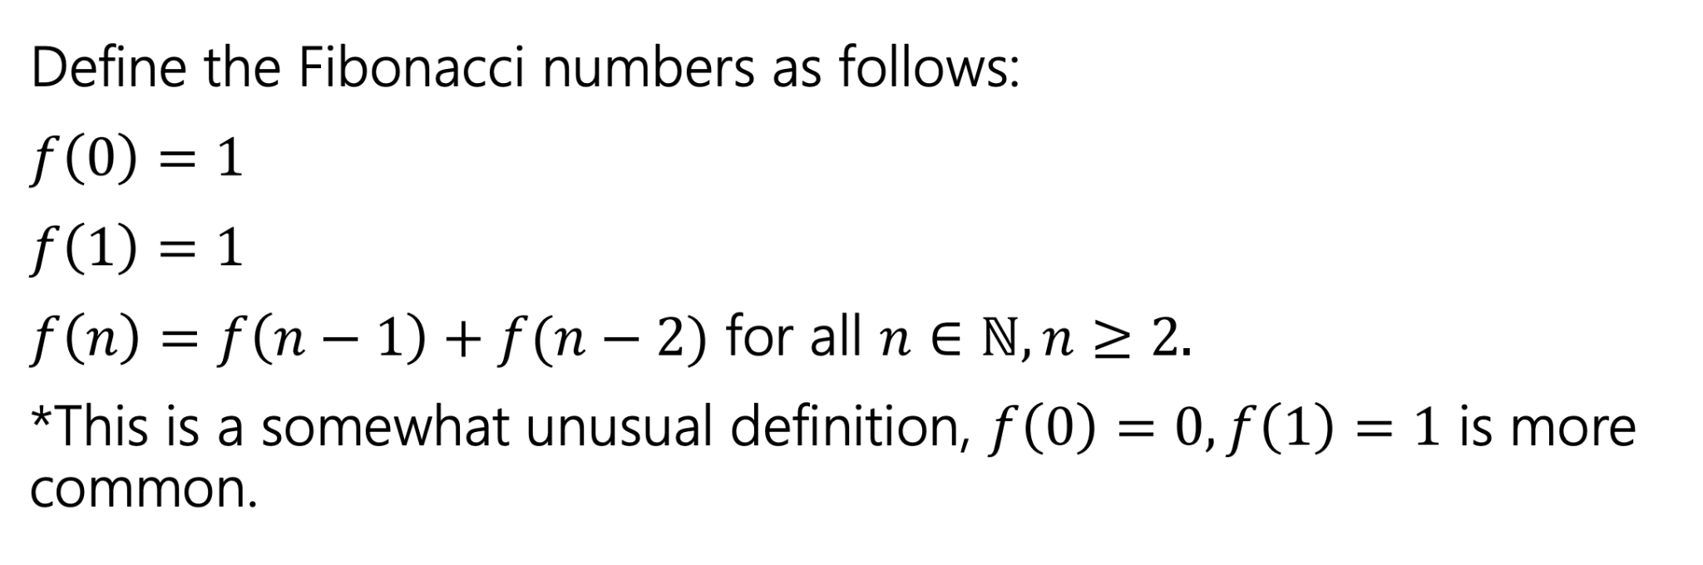

Slide 12

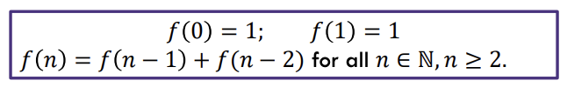
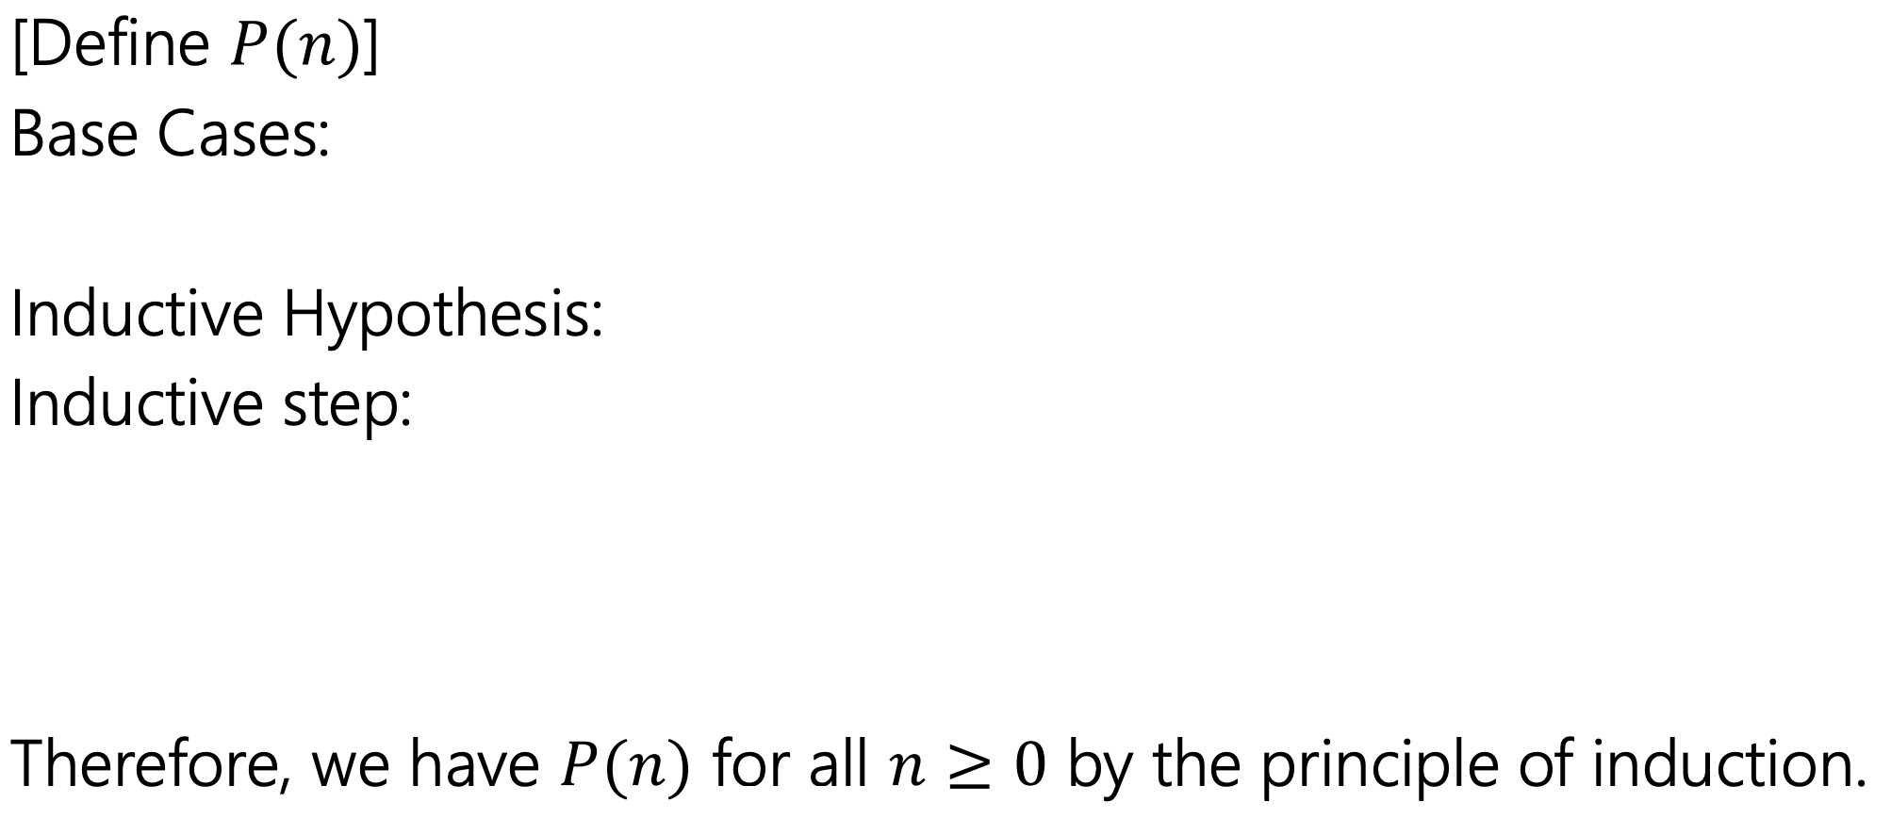


Slide 14
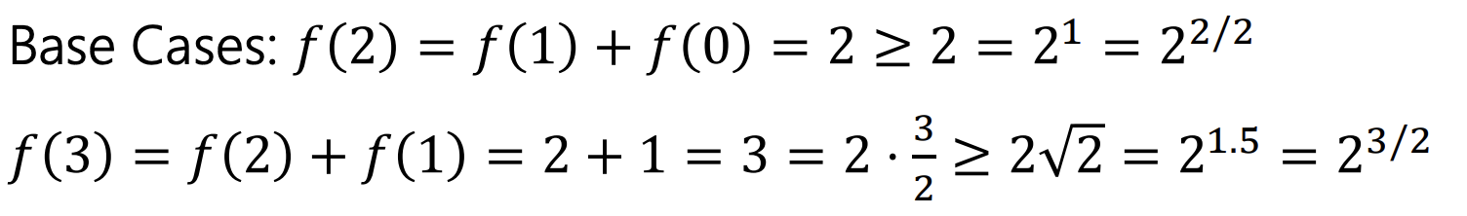

Slide 16
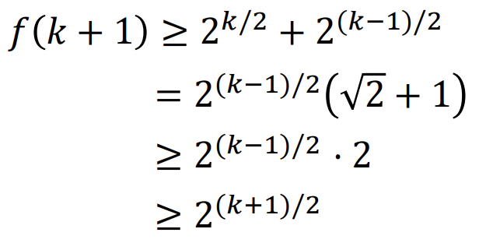

Slide 17
Problem 3: Sharing Chocolate

Slide 18
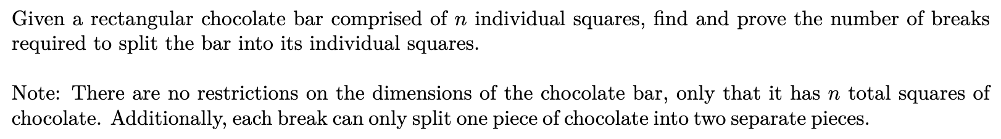

Slide 19
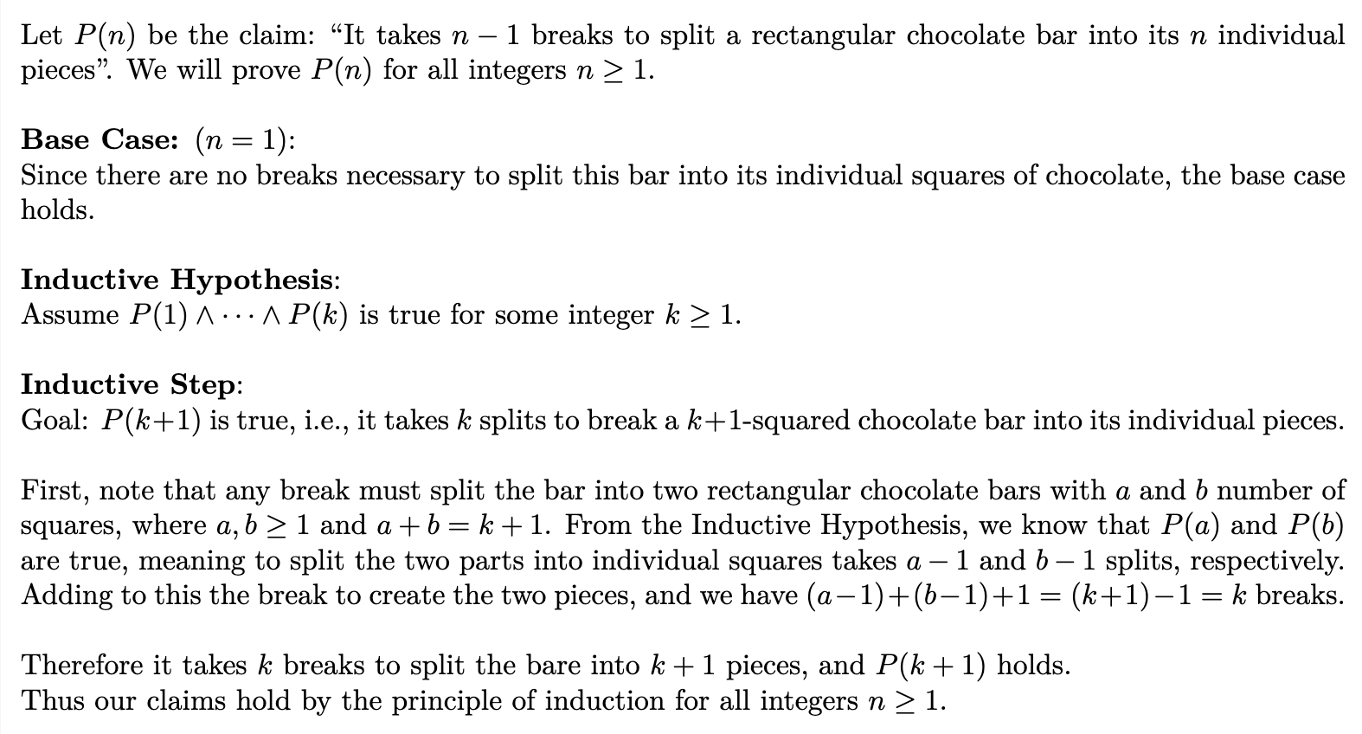

Slide 20
Todo
Tonight:
HW3 resubmissions are due tonight!
Submit HW4 late if needed
CC 17 is out and due Friday at noon
Read the midterm logistics on the Exams page of the course website and post on the Ed board if you have any questions

