Slide 1
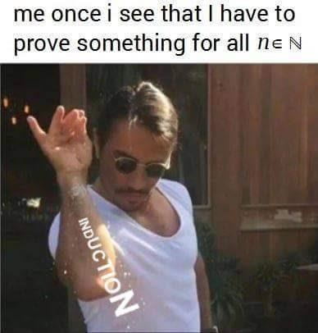
Strong Induction
CSE 311 Summer 2025
Lecture 13

Slide 2
Announcements
HW4 is due tonight!
HW3 Feedback and resubmission is out
HW5 will be released tonight
Our Midterm is next Friday (8/1) in class!
  Exam logistics and practice exams are posted on the “Exams” page of the course website

Slide 3
Review

Slide 4
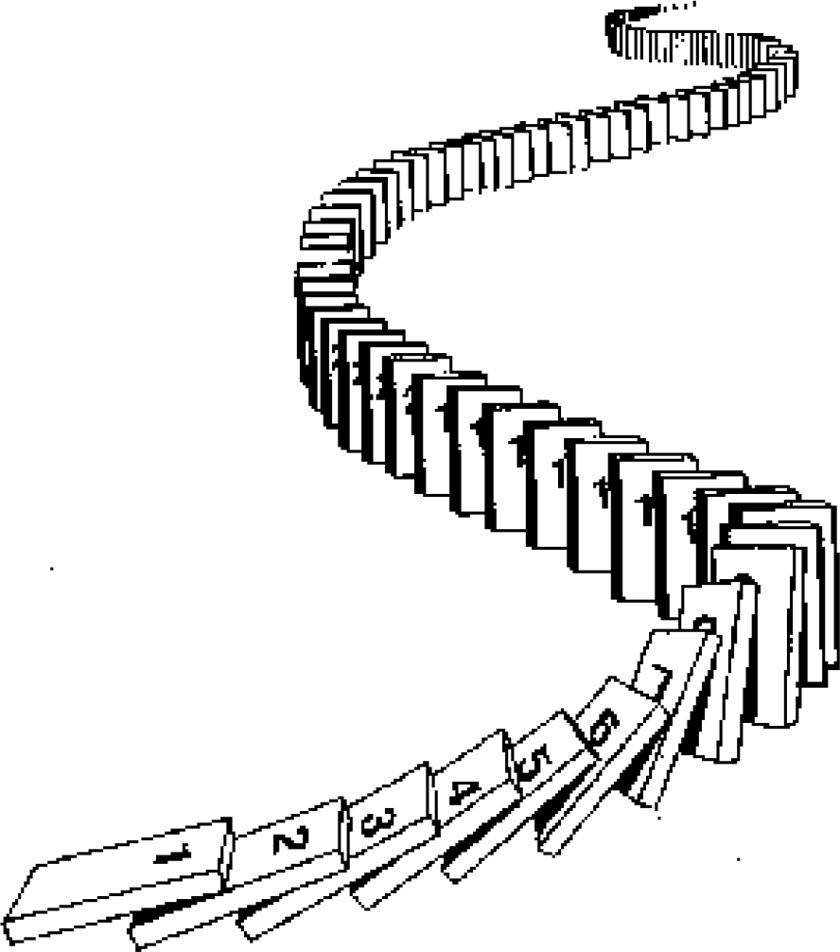
The Principle of Mathematical Induction
P 0 ∧ ∀𝑘 P 𝑘 → P 𝑘 + 1
Base Case Prove P(0) holds.
Inductive Hypothesis Let 𝑘 ≥ 0 be an arbitrary integer.
Suppose P(𝑘) holds.
Inductive Step Prove that P(𝑘 + 1) holds (using P(𝑘))

Slide 5
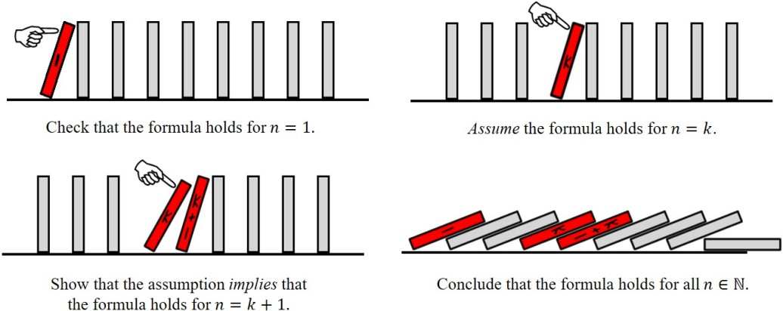


Recall: Induction
0

Slide 6
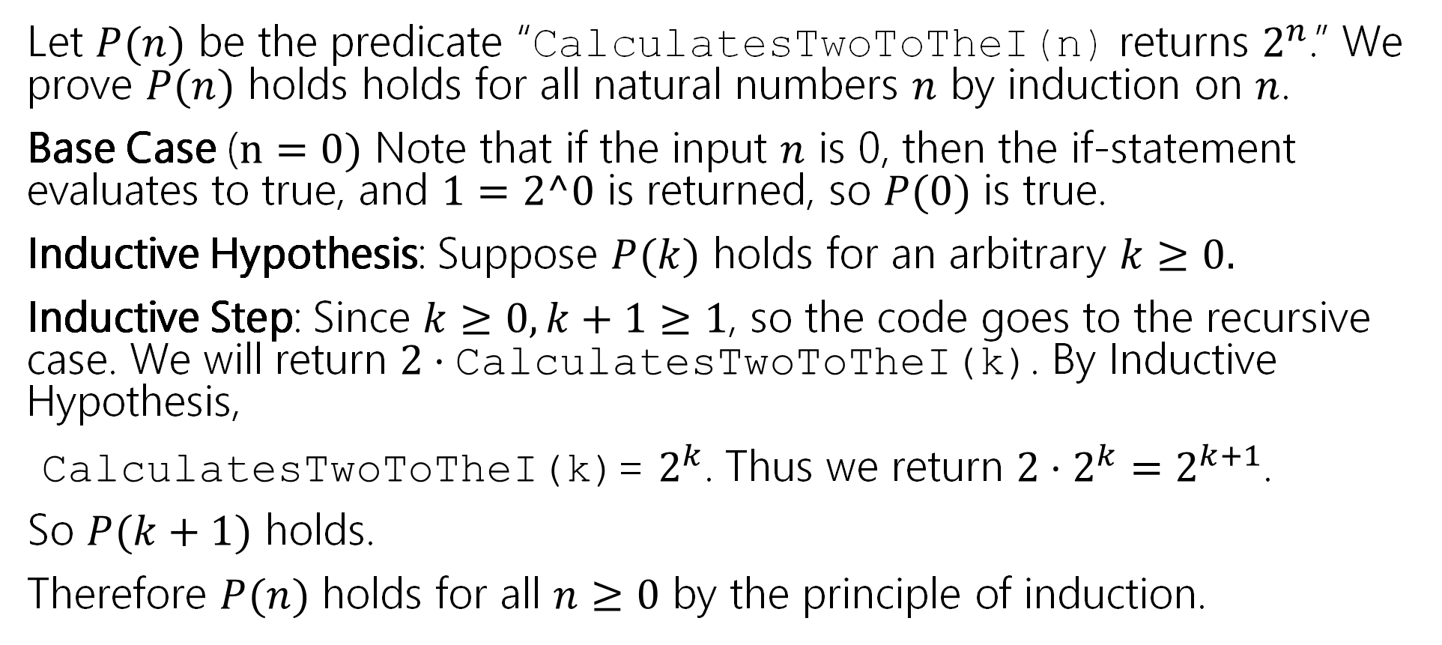
Making Induction Proofs Pretty
Let $P(n)$ be the predicate “CalculatesTwoToTheI(n) returns $2^{n}$.” We prove $P(n)$ holds holds for all natural numbers $n$ by induction on $n$.
Base Case ($n=0)$ Note that if the input $n$ is 0, then the if-statement evaluates to true, and $1=2^0$ is returned, so $P(0)$ is true.
Inductive Hypothesis: Suppose $P(k)$ holds for an arbitrary $k≥0.$
Inductive Step: Since $k≥0, k+1≥1$, so the code goes to the recursive case. We will return $2⋅\text{CalculatesTwoToTheI}\text{(}\text{k}\text{)}$. By Inductive Hypothesis,
$\text{CalculatesTwoToTheI}\text{(}\text{k}\text{)}$= $2^{k}$. Thus we return $2⋅2^{k}=2^{k+1}$.
So $P(k+1)$ holds.
Therefore $P(n)$ holds for all $n≥0$ by the principle of induction.

Slide 7
Induction Template
Define P(𝑛). State that your proof is by induction on 𝑛.
Base Case: Show P(𝑏) is true for your base case 𝑏.
Inductive Hypothesis: Suppose P(𝑘) holds for an arbitrary integer 𝑘 ≥ 𝑏.
Inductive Step: Prove P(𝑘 + 1) (using the Inductive Hypothesis).
Conclusion: Conclude by saying P(𝑛) holds for all integers 𝑛 ≥ 𝑏
by induction.

Slide 8
Warm Up: Induction with Inequality

Slide 9
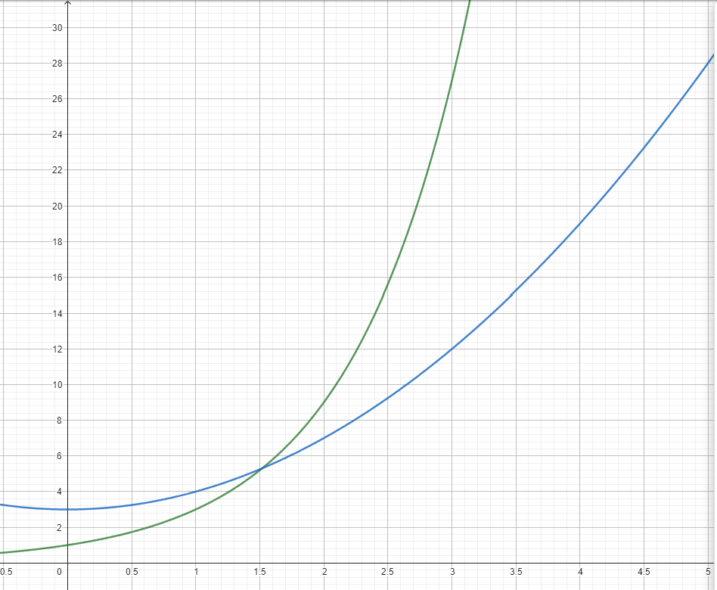


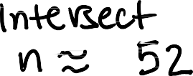

Prove that 3^{𝑛} ≥ 𝑛² + 3 for all integers 𝑛 ≥ 2.
Not a proof!

Slide 10
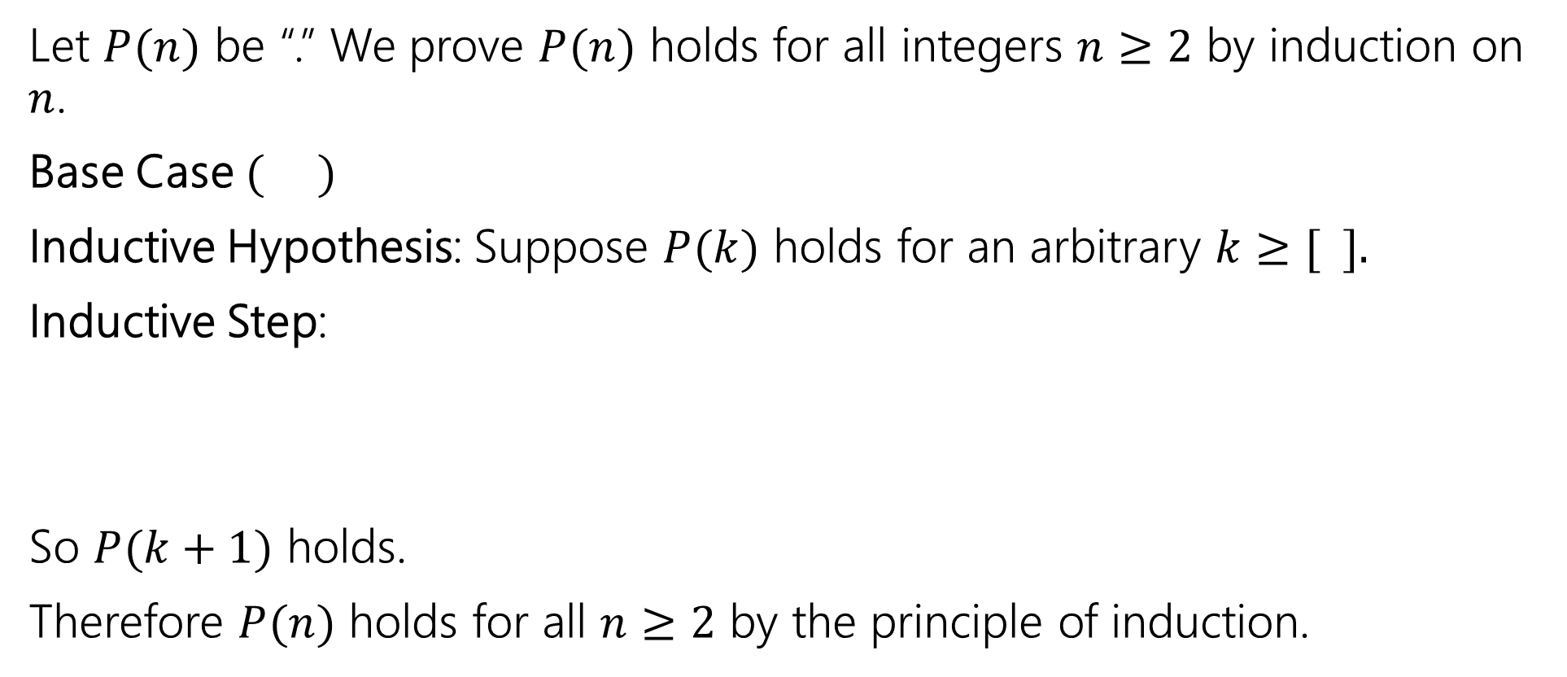
Prove that 3^{𝑛} ≥ 𝑛² + 3 for all integers 𝑛 ≥ 2.
Let $P(n)$ be “.” We prove $P(n)$ holds for all integers $n≥2$ by induction on $n$.
Base Case $( )$
Inductive Hypothesis: Suppose $P(k)$ holds for an arbitrary $k≥[ ].$
Inductive Step:
So $P(k+1)$ holds.
Therefore $P(n)$ holds for all $n≥2$ by the principle of induction.

Slide 11
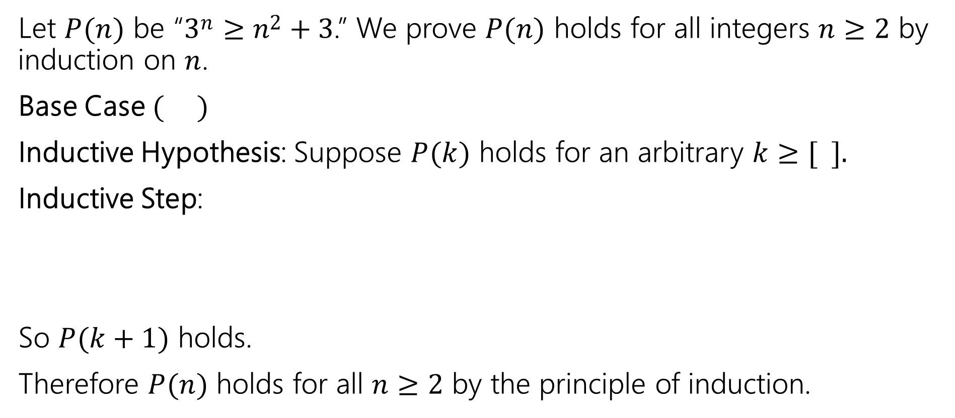
Prove that 3^{𝑛} ≥ 𝑛² + 3 for all integers 𝑛 ≥ 2.
Let $P(n)$ be “3^{𝑛} ≥ 𝑛² + 3.” We prove $P(n)$ holds for all integers $n≥2$ by induction on $n$.
Base Case $( )$
Inductive Hypothesis: Suppose $P(k)$ holds for an arbitrary $k≥[ ].$
Inductive Step:
So $P(k+1)$ holds.
Therefore $P(n)$ holds for all $n≥2$ by the principle of induction.

Slide 12
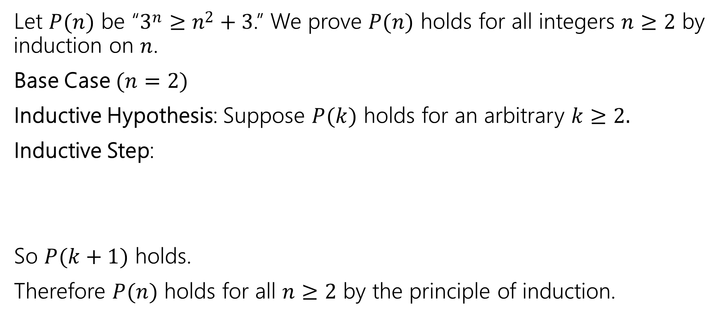
Prove that 3^{𝑛} ≥ 𝑛² + 3 for all integers 𝑛 ≥ 2.
Let $P(n)$ be “3^{𝑛} ≥ 𝑛² + 3.” We prove $P(n)$ holds for all integers $n≥2$ by induction on $n$.
Base Case $(n=2)$
Inductive Hypothesis: Suppose $P(k)$ holds for an arbitrary $k≥2.$
Inductive Step:
So $P(k+1)$ holds.
Therefore $P(n)$ holds for all $n≥2$ by the principle of induction.

Slide 13
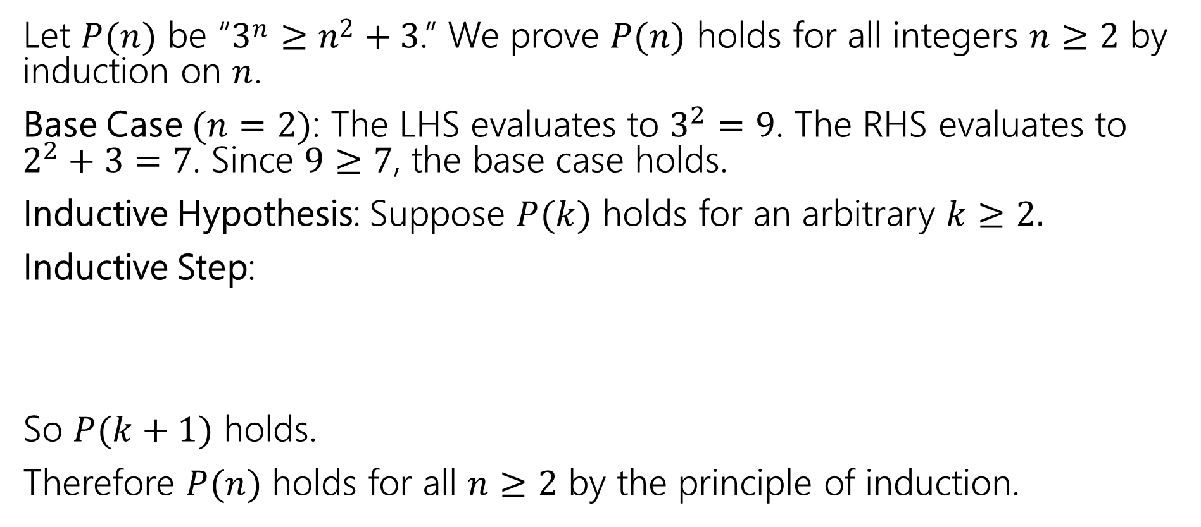
Prove that 3^{𝑛} ≥ 𝑛² + 3 for all integers 𝑛 ≥ 2.
Let $P(n)$ be “3^{𝑛} ≥ 𝑛² + 3.” We prove $P(n)$ holds for all integers $n≥2$ by induction on $n$.
Base Case $(n=2)$: The LHS evaluates to $3^{2}=9$. The RHS evaluates to $2^{2}+3=7$. Since $9≥7$, the base case holds.
Inductive Hypothesis: Suppose $P(k)$ holds for an arbitrary $k≥2.$
Inductive Step:
So $P(k+1)$ holds.
Therefore $P(n)$ holds for all $n≥2$ by the principle of induction.

Slide 14
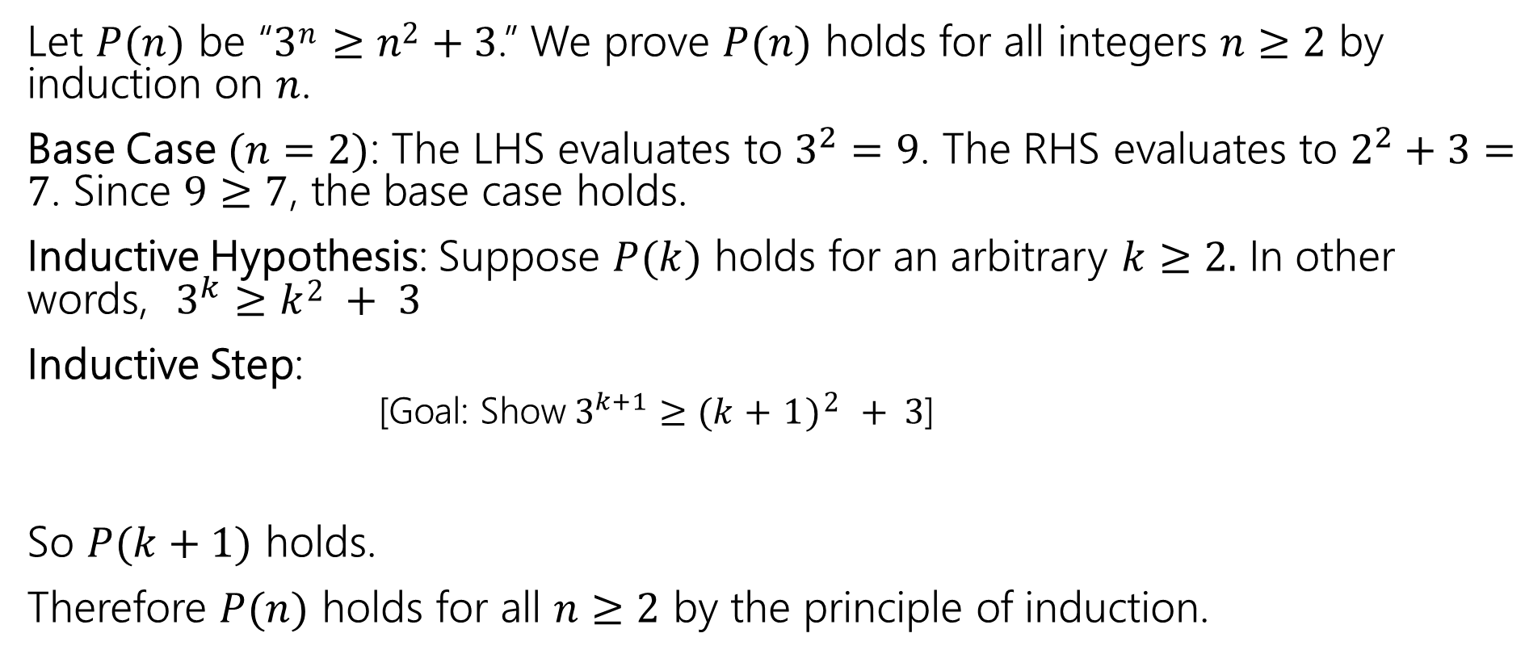
Prove that 3^{𝑛} ≥ 𝑛² + 3 for all integers 𝑛 ≥ 2.
Let $P(n)$ be “3^{𝑛} ≥ 𝑛² + 3.” We prove $P(n)$ holds for all integers $n≥2$ by induction on $n$.
Base Case $(n=2)$: The LHS evaluates to $3^{2}=9$. The RHS evaluates to $2^{2}+3=7$. Since $9≥7$, the base case holds.
Inductive Hypothesis: Suppose $P(k)$ holds for an arbitrary $k≥2.$ In other words, $3^{k}≥k2 + 3$
Inductive Step:
  [Goal: Show$3^{k+1}≥(k+1)2 + 3$]
So $P(k+1)$ holds.
Therefore $P(n)$ holds for all $n≥2$ by the principle of induction.

Slide 15
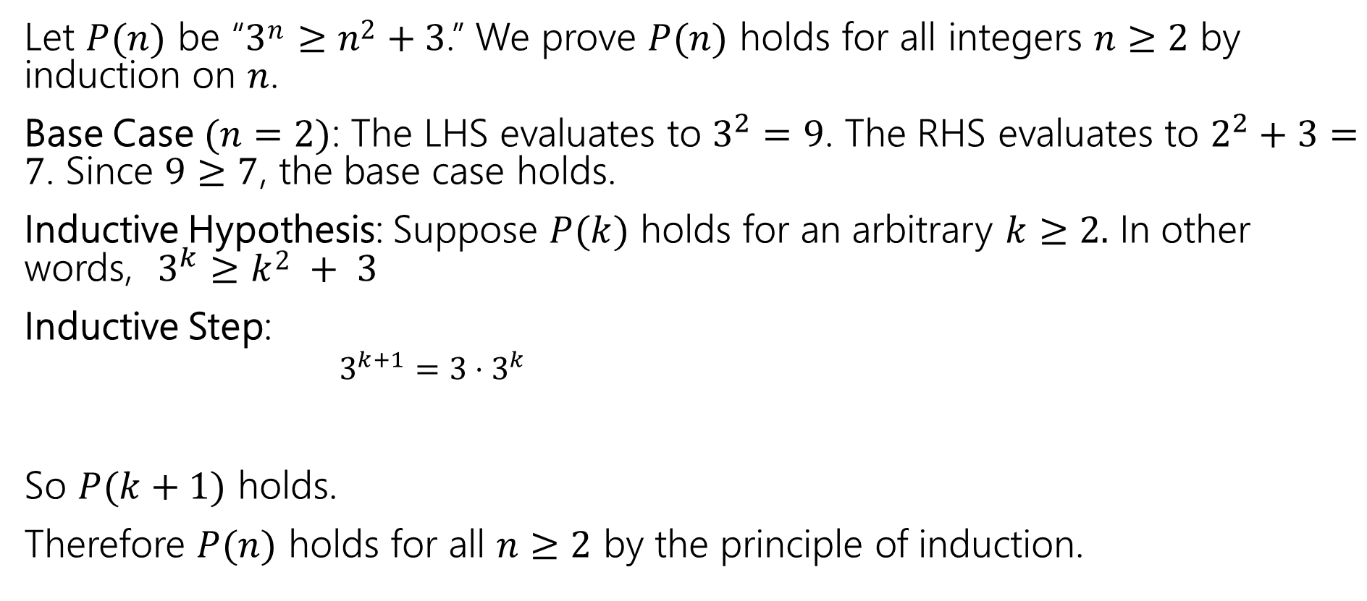
Prove that 3^{𝑛} ≥ 𝑛² + 3 for all integers 𝑛 ≥ 2.
Let $P(n)$ be “3^{𝑛} ≥ 𝑛² + 3.” We prove $P(n)$ holds for all integers $n≥2$ by induction on $n$.
Base Case $(n=2)$: The LHS evaluates to $3^{2}=9$. The RHS evaluates to $2^{2}+3=7$. Since $9≥7$, the base case holds.
Inductive Hypothesis: Suppose $P(k)$ holds for an arbitrary $k≥2.$ In other words, $3^{k}≥k2 + 3$
Inductive Step:
  $3^{k+1}=3⋅3^{k}$
So $P(k+1)$ holds.
Therefore $P(n)$ holds for all $n≥2$ by the principle of induction.

Slide 16
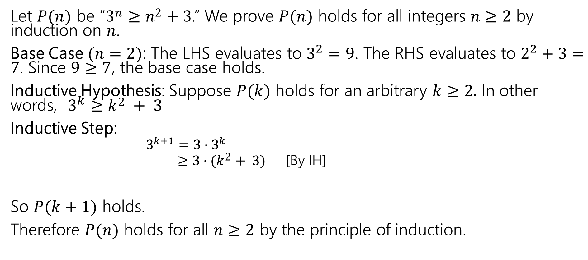
Prove that 3^{𝑛} ≥ 𝑛² + 3 for all integers 𝑛 ≥ 2.
Let $P(n)$ be “3^{𝑛} ≥ 𝑛² + 3.” We prove $P(n)$ holds for all integers $n≥2$ by induction on $n$.
Base Case $(n=2)$: The LHS evaluates to $3^{2}=9$. The RHS evaluates to $2^{2}+3=7$. Since $9≥7$, the base case holds.
Inductive Hypothesis: Suppose $P(k)$ holds for an arbitrary $k≥2.$ In other words, $3^{k}≥k2 + 3$
Inductive Step:
  $3^{k+1}=3⋅3^{k}$
  $≥3⋅(k2+ 3)$ [By IH]
So $P(k+1)$ holds.
Therefore $P(n)$ holds for all $n≥2$ by the principle of induction.

Slide 17
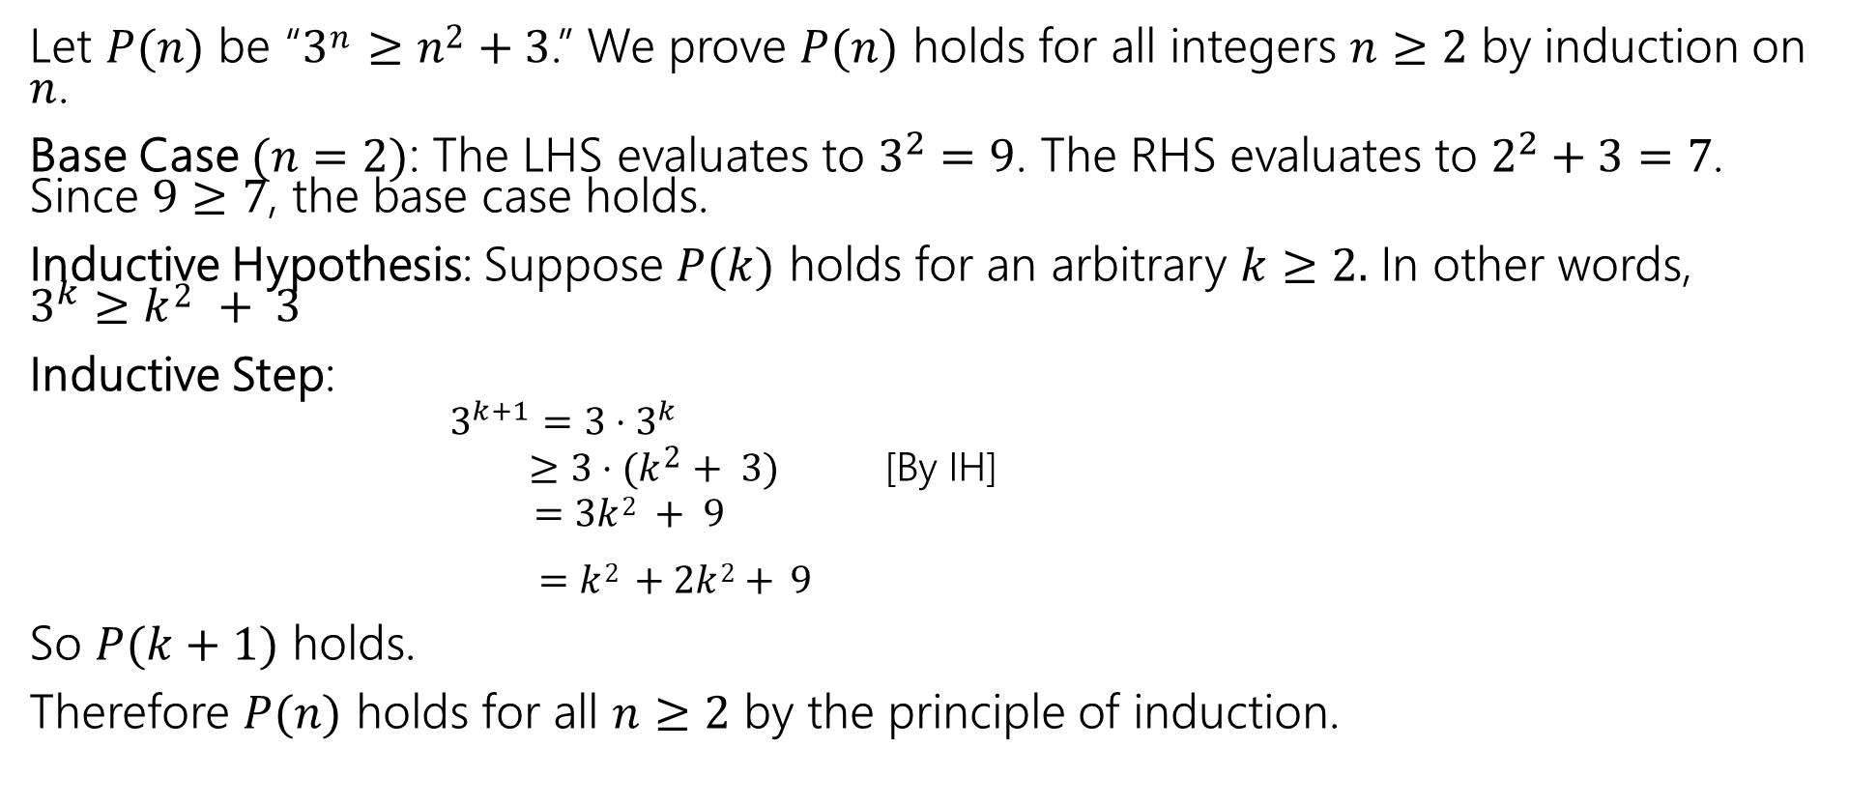
Prove that 3^{𝑛} ≥ 𝑛² + 3 for all integers 𝑛 ≥ 2.
Let $P(n)$ be “3^{𝑛} ≥ 𝑛² + 3.” We prove $P(n)$ holds for all integers $n≥2$ by induction on $n$.
Base Case $(n=2)$: The LHS evaluates to $3^{2}=9$. The RHS evaluates to $2^{2}+3=7$. Since $9≥7$, the base case holds.
Inductive Hypothesis: Suppose $P(k)$ holds for an arbitrary $k≥2.$ In other words, $3^{k}≥k2 + 3$
Inductive Step:
  $3^{k+1}=3⋅3^{k}$
  $≥3⋅(k2+ 3)$ [By IH]
  $=3k2 + 9$
$=k2 +2k2+ 9$
So $P(k+1)$ holds.
Therefore $P(n)$ holds for all $n≥2$ by the principle of induction.

Slide 18
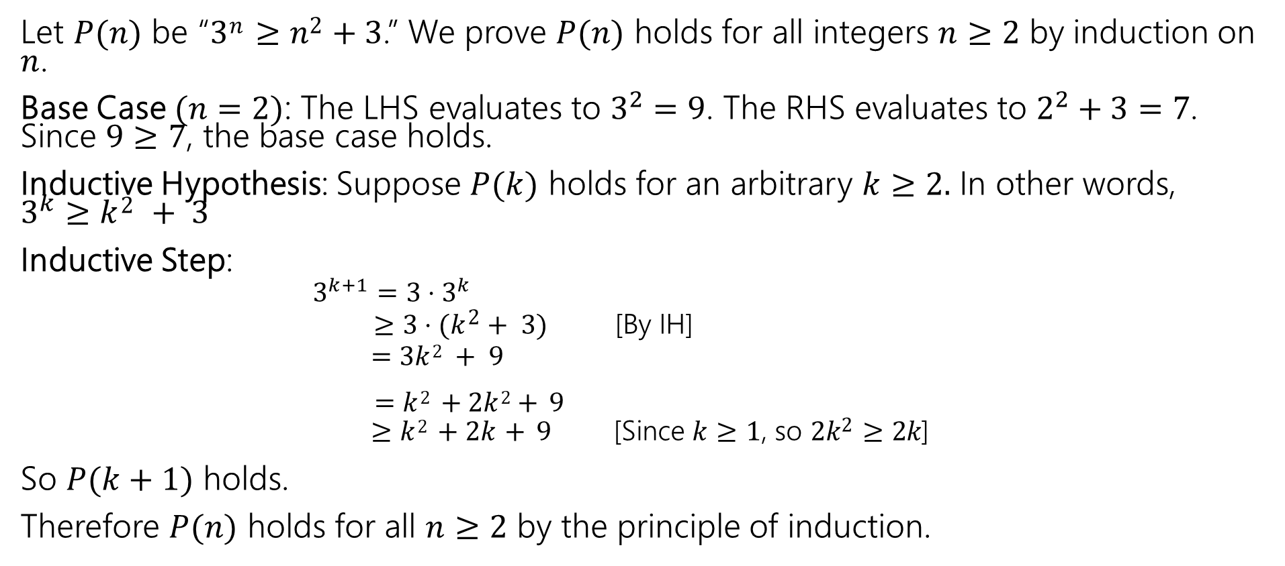
Prove that 3^{𝑛} ≥ 𝑛² + 3 for all integers 𝑛 ≥ 2.
Let $P(n)$ be “3^{𝑛} ≥ 𝑛² + 3.” We prove $P(n)$ holds for all integers $n≥2$ by induction on $n$.
Base Case $(n=2)$: The LHS evaluates to $3^{2}=9$. The RHS evaluates to $2^{2}+3=7$. Since $9≥7$, the base case holds.
Inductive Hypothesis: Suppose $P(k)$ holds for an arbitrary $k≥2.$ In other words, $3^{k}≥k2 + 3$
Inductive Step:
  $3^{k+1}=3⋅3^{k}$
  $≥3⋅(k2+ 3)$ [By IH]
  $=3k2 + 9$
$=k2 +2k2+ 9$
  $≥k2 +2k+ 9$ [Since 𝑘 ≥ 1, so 2𝑘² ≥ 2𝑘]
So $P(k+1)$ holds.
Therefore $P(n)$ holds for all $n≥2$ by the principle of induction.

Slide 19
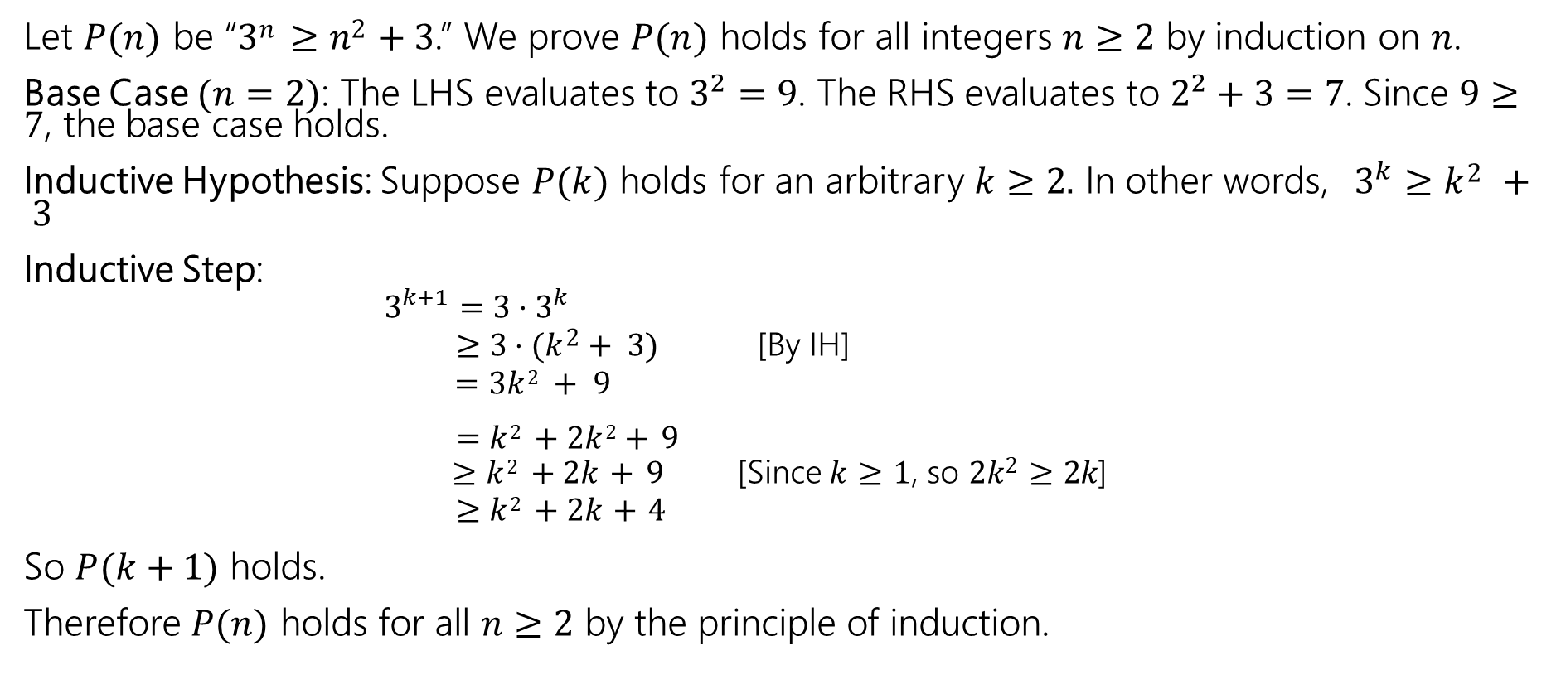
Prove that 3^{𝑛} ≥ 𝑛² + 3 for all integers 𝑛 ≥ 2.
Let $P(n)$ be “3^{𝑛} ≥ 𝑛² + 3.” We prove $P(n)$ holds for all integers $n≥2$ by induction on $n$.
Base Case $(n=2)$: The LHS evaluates to $3^{2}=9$. The RHS evaluates to $2^{2}+3=7$. Since $9≥7$, the base case holds.
Inductive Hypothesis: Suppose $P(k)$ holds for an arbitrary $k≥2.$ In other words, $3^{k}≥k2 + 3$
Inductive Step:
  $3^{k+1}=3⋅3^{k}$
  $≥3⋅(k2+ 3)$ [By IH]
  $=3k2 + 9$
$=k2 +2k2+ 9$
  $≥k2 +2k+ 9$ [Since 𝑘 ≥ 1, so 2𝑘² ≥ 2𝑘]
  $≥k2 +2k+4$
So $P(k+1)$ holds.
Therefore $P(n)$ holds for all $n≥2$ by the principle of induction.

Slide 20
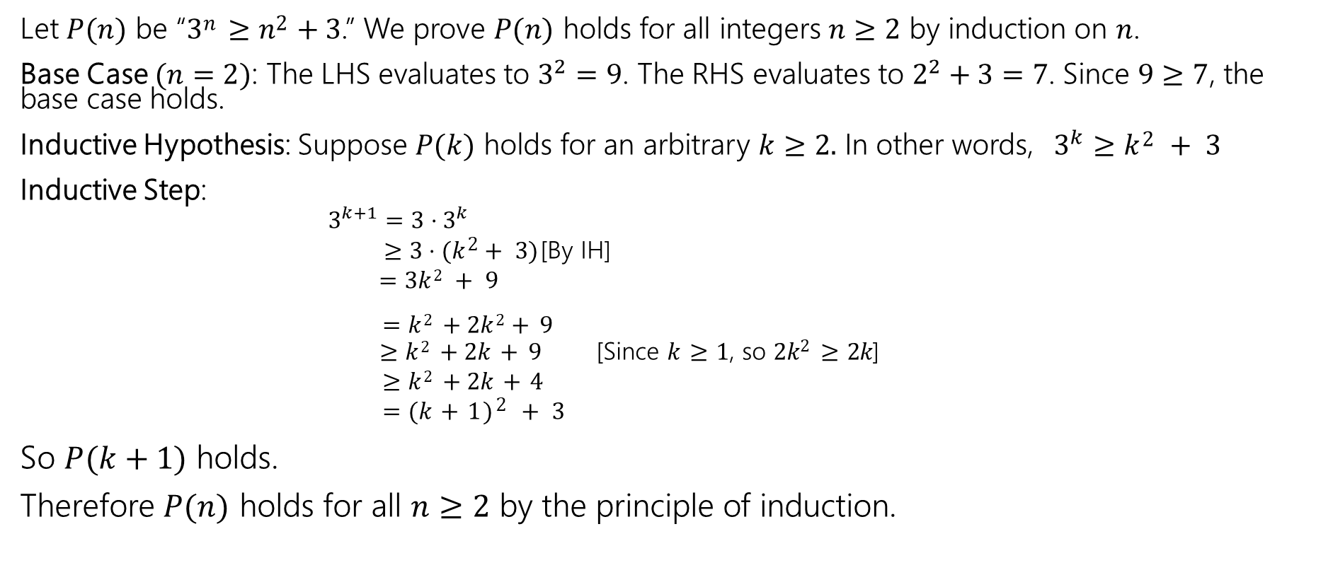
Prove that 3^{𝑛} ≥ 𝑛² + 3 for all integers 𝑛 ≥ 2.
Let $P(n)$ be “3^{𝑛} ≥ 𝑛² + 3.” We prove $P(n)$ holds for all integers $n≥2$ by induction on $n$.
Base Case $(n=2)$: The LHS evaluates to $3^{2}=9$. The RHS evaluates to $2^{2}+3=7$. Since $9≥7$, the base case holds.
Inductive Hypothesis: Suppose $P(k)$ holds for an arbitrary $k≥2.$ In other words, $3^{k}≥k2 + 3$
Inductive Step:
  $3^{k+1}=3⋅3^{k}$
  $≥3⋅(k2+ 3)$ [By IH]
  $=3k2 + 9$
$=k2 +2k2+ 9$
  $≥k2 +2k+ 9$ [Since 𝑘 ≥ 1, so 2𝑘² ≥ 2𝑘]
  $≥k2 +2k+4$
  $=(k+1)2 + 3$
So $P(k+1)$ holds.
Therefore $P(n)$ holds for all $n≥2$ by the principle of induction.

Slide 21
Even More Induction

Slide 22
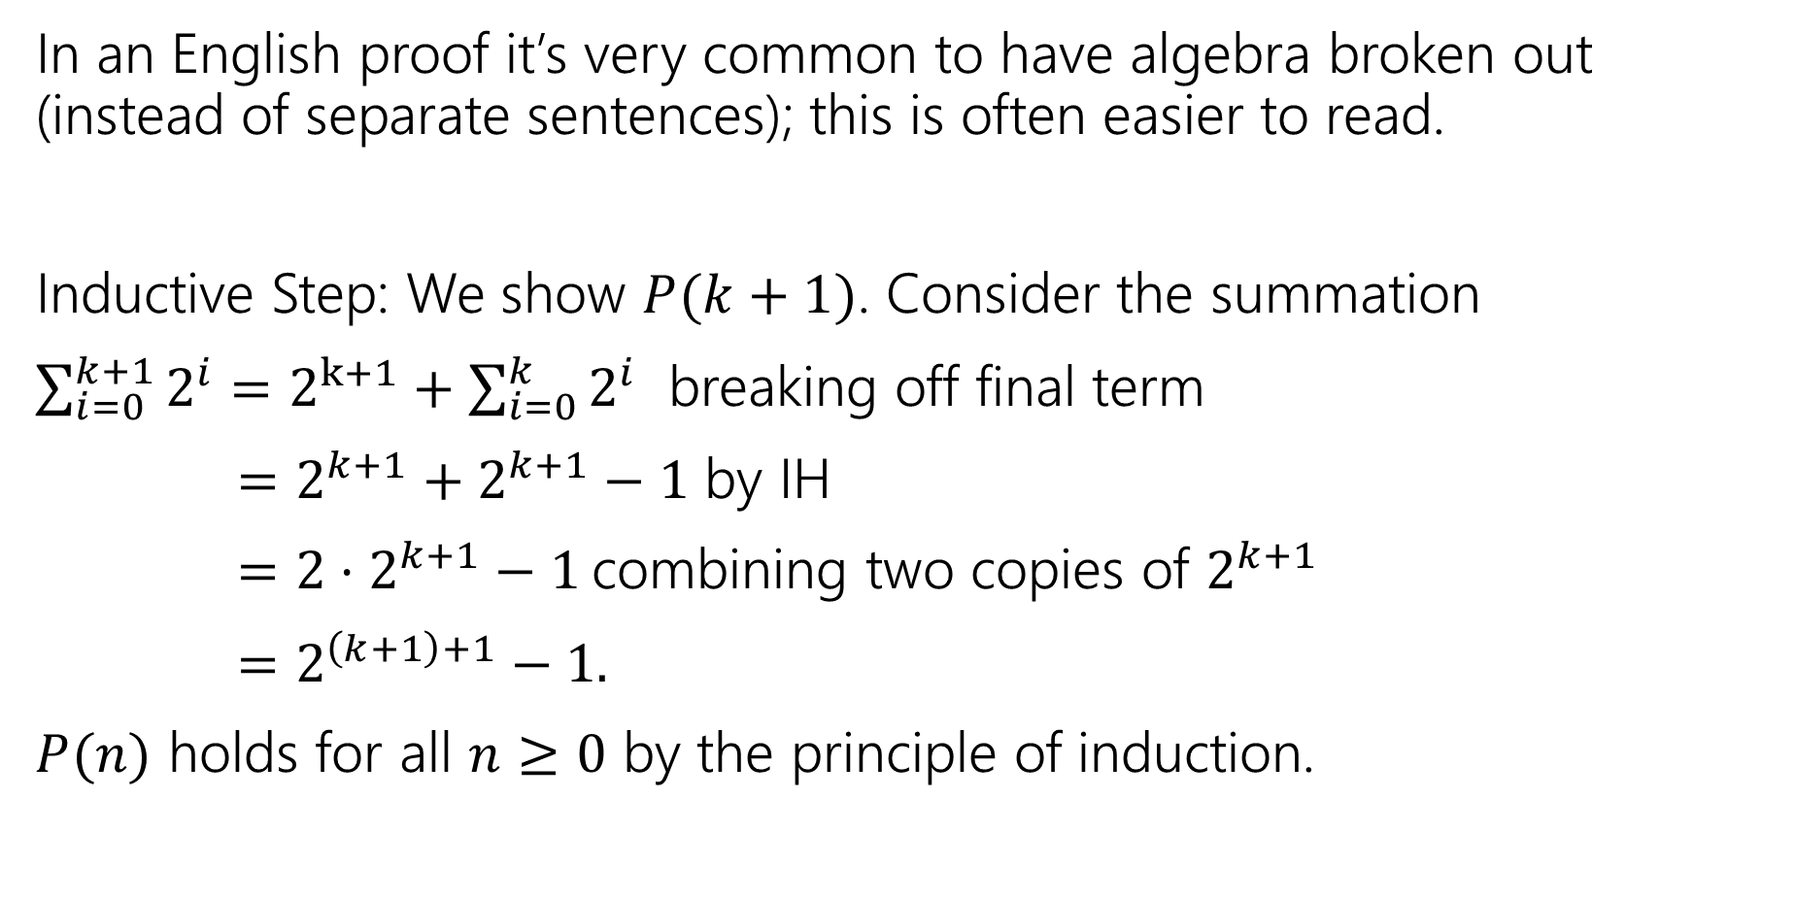
Algebra Block Formatting
In an English proof it’s very common to have algebra broken out (instead of separate sentences); this is often easier to read.
Inductive Step: We show $P(k+1)$. Consider the summation
$\sum_{i=0}^{k+1}{2^{i}}=2^{k+1}+\sum_{i=0}^{k}{2^{i}}$ breaking off final term
$=2^{k+1}+2^{k+1}−1$ by IH
$=2⋅2^{k+1}−1$ combining two copies of $2^{k+1}$
$=2^{\left(k+1\right)+1}−1.$
$P(n)$ holds for all $n≥0$ by the principle of induction.

Slide 23

Let’s Try Another Induction Proof
Let $g\left(n\right)= \left\{\begin{aligned}2 if n=2 \\ {g(n−1)}^{2}+3g\left(n−1\right) if n>2\end{aligned}\right.$
Prove $g(n)$ is even for all $n≥2$ by induction on $n$.
Let’s just set this one up, we’ll leave the individual pieces as exercises.

Slide 24
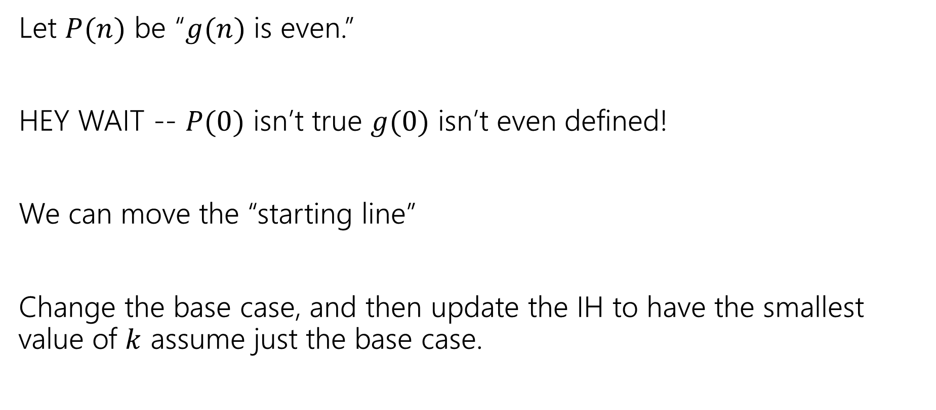
Setup
Let $P(n)$ be “$g(n)$ is even.”
HEY WAIT -- $P(0)$ isn’t true $g(0)$ isn’t even defined!
We can move the “starting line”
Change the base case, and then update the IH to have the smallest value of $k$ assume just the base case.

Slide 25
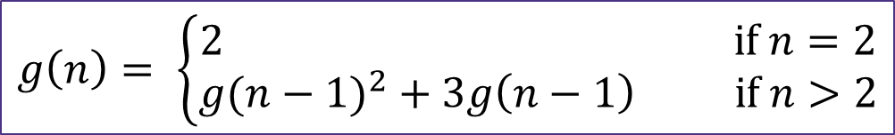
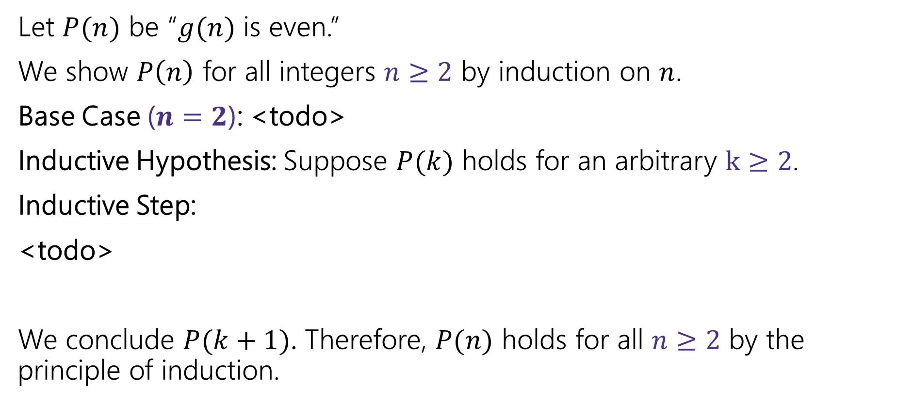
Setup
$$g\left(n\right)= \left\{\begin{aligned}2 if n=2 \\ {g(n−1)}^{2}+3g\left(n−1\right) if n>2\end{aligned}\right.$$
Let $P(n)$ be “$g(n)$ is even.”
We show $P\left(n\right)$ for all integers $n≥2$ by induction on $n$.
Base Case ($n=2$): <todo>
Inductive Hypothesis: Suppose $P(k)$ holds for an arbitrary $k≥2$.
Inductive Step:
<todo>
We conclude $P(k+1)$. Therefore, $P(n)$ holds for all $n≥2$ by the principle of induction.

Slide 26
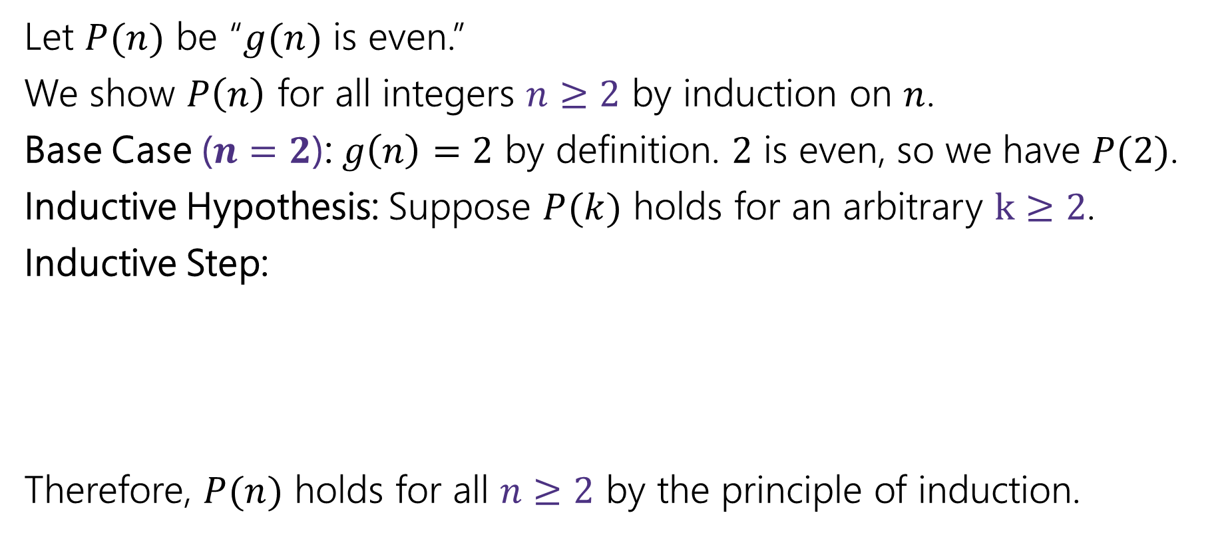
Setup
Let $P(n)$ be “$g(n)$ is even.”
We show $P\left(n\right)$ for all integers $n≥2$ by induction on $n$.
Base Case ($n=2$): $g\left(n\right)=2$ by definition. $2$ is even, so we have $P(2)$.
Inductive Hypothesis: Suppose $P(k)$ holds for an arbitrary $k≥2$.
Inductive Step:
Therefore, $P(n)$ holds for all $n≥2$ by the principle of induction.

Slide 27
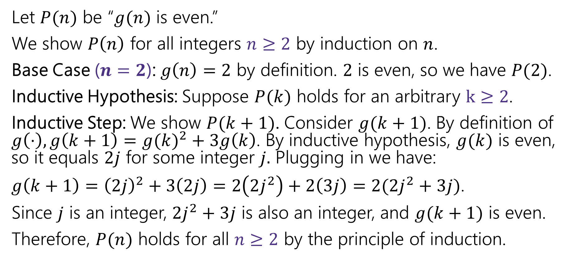
Setup
Let $P(n)$ be “$g(n)$ is even.”
We show $P\left(n\right)$ for all integers $n≥2$ by induction on $n$.
Base Case ($n=2$): $g\left(n\right)=2$ by definition. $2$ is even, so we have $P(2)$.
Inductive Hypothesis: Suppose $P(k)$ holds for an arbitrary $k≥2$.
Inductive Step: We show $P(k+1)$. Consider $g(k+1)$. By definition of $g\left(⋅\right), g\left(k+1\right)={g(k)}^{2}+3g\left(k\right)$. By inductive hypothesis, $g(k)$ is even, so it equals $2j$ for some integer $j.$ Plugging in we have:
$g\left(k+1\right)={\left(2j\right)}^{2}+3\left(2j\right)=2\left(2j^{2}\right)+2\left(3j\right)=2(2j^{2}+3j)$.
Since $j$ is an integer, $2j^{2}+3j$ is also an integer, and $g(k+1)$ is even.
Therefore, $P(n)$ holds for all $n≥2$ by the principle of induction.

Slide 28
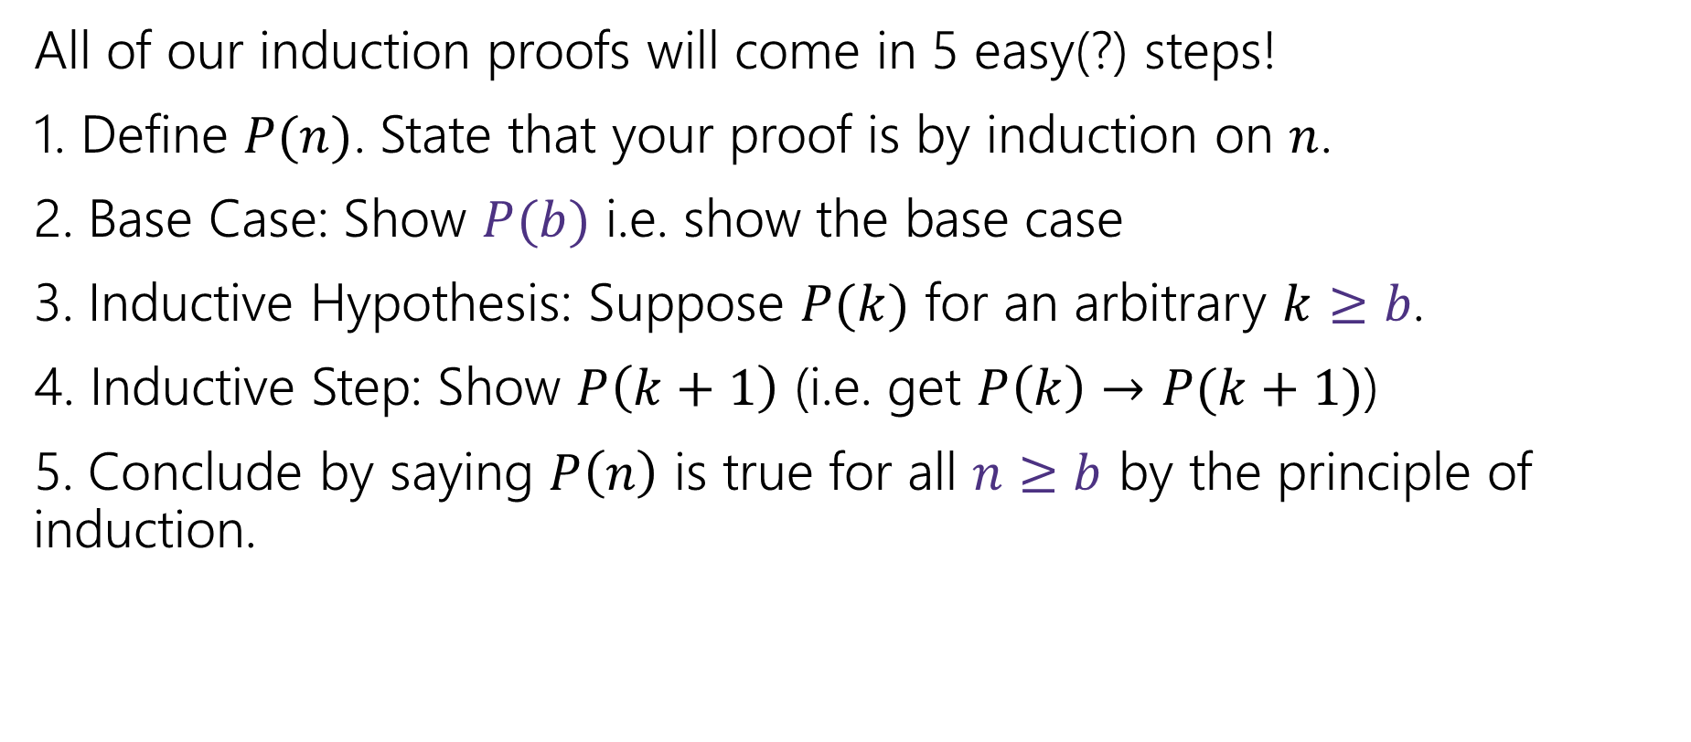
Making Induction Proofs Pretty
All of our induction proofs will come in 5 easy(?) steps!
1. Define $P(n)$. State that your proof is by induction on $n$.
2. Base Case: Show $P(b)$ i.e. show the base case
3. Inductive Hypothesis: Suppose $P(k)$ for an arbitrary $k≥b$.
4. Inductive Step: Show $P\left(k+1\right)$ (i.e. get $P\left(k\right)→P(k+1)$)
5. Conclude by saying $P\left(n\right)$ is true for all $n≥b$ by the principle of induction.

Slide 29
Strong Induction

Slide 30
Let’s Try Another Induction Proof
Every positive integer greater than 1 has a unique
prime factorization.
Fundamental Theorem of Arithmetic
Uniqueness is hard. Let’s just show existence.
I.e.
Claim: Every positive integer greater than 1 can be written as a product of primes.

Slide 31

Prime Factorizations
Some examples
$12=2^{2}⋅3$
$35=5⋅7$
$36=2^{2}⋅3^{2}$
$7=7$
Notice, for prime numbers the product is just the one number.

Slide 32
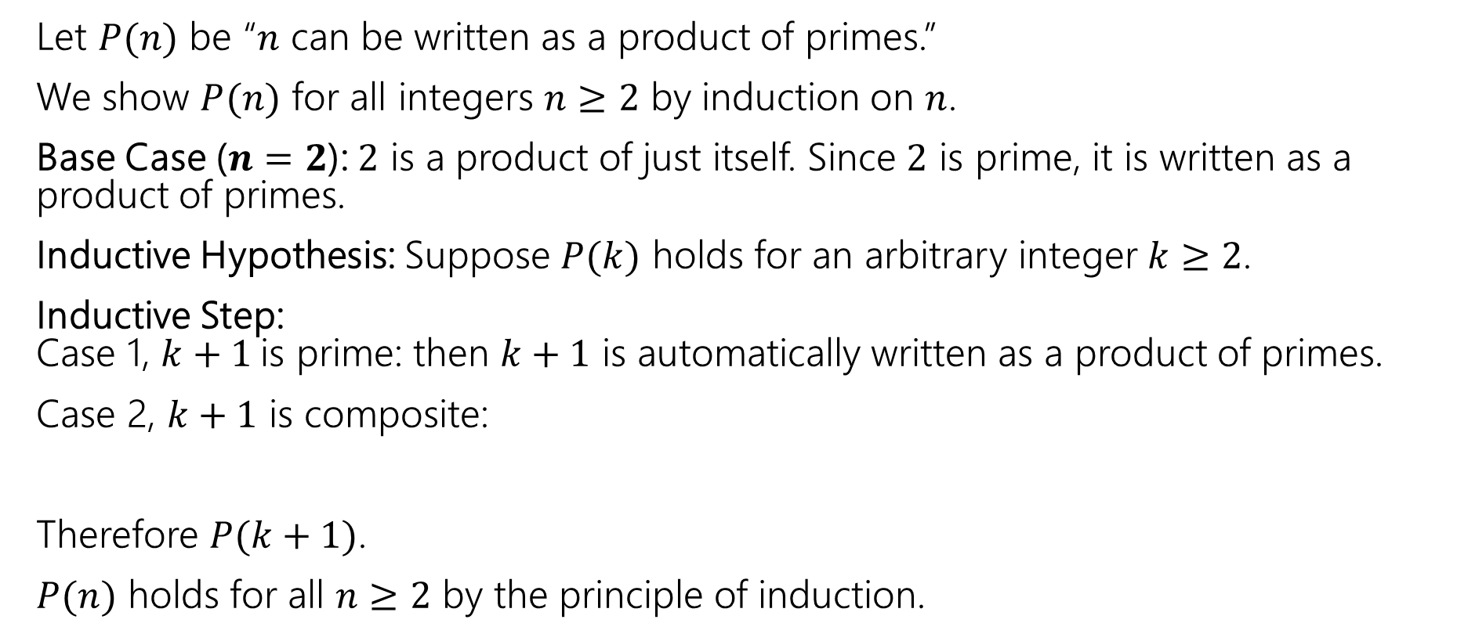
Induction on Primes.
Let $P(n)$ be “$n$ can be written as a product of primes.”
We show $P(n)$ for all integers $n≥2$ by induction on $n$.
Base Case ($n=2$): $2$ is a product of just itself. Since $2$ is prime, it is written as a product of primes.
Inductive Hypothesis: Suppose $P(k)$ holds for an arbitrary integer $k≥2$.
Inductive Step:
Case 1, $k+1$is prime: then $k+1$ is automatically written as a product of primes.
Case 2, $k+1$ is composite:
Therefore $P(k+1)$.
$P(n)$ holds for all $n≥2$ by the principle of induction.

Slide 33
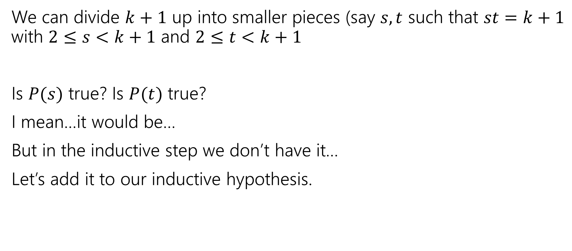
We’re Stuck
We can divide $k+1$ up into smaller pieces (say $s,t$ such that $st=k+1$ with $2≤s<k+1$ and $2≤t<k+1$
Is $P(s)$ true? Is $P(t)$ true?
I mean…it would be…
But in the inductive step we don’t have it…
Let’s add it to our inductive hypothesis.

Slide 34
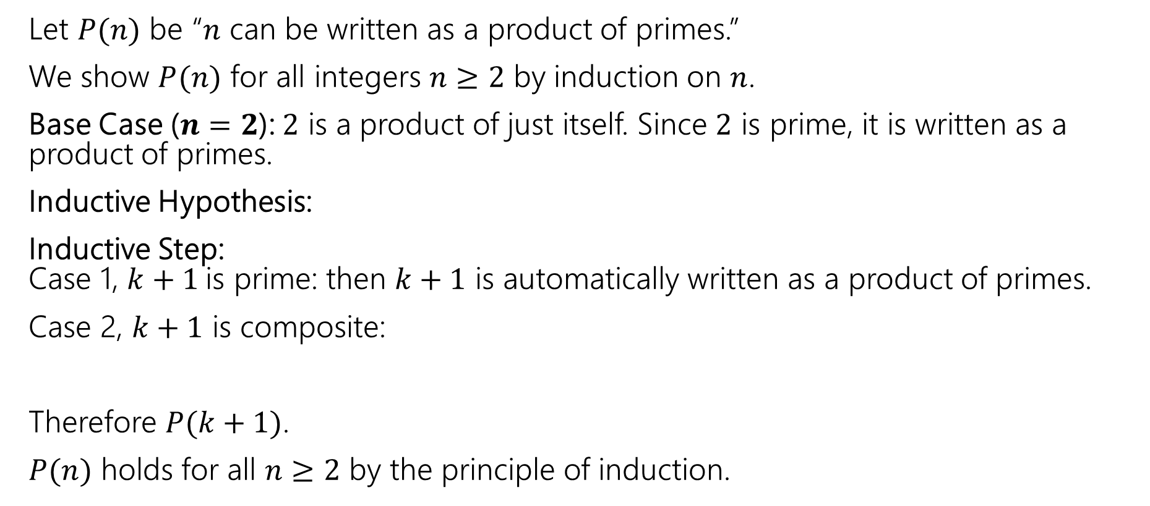
Induction on Primes
Let $P(n)$ be “$n$ can be written as a product of primes.”
We show $P(n)$ for all integers $n≥2$ by induction on $n$.
Base Case ($n=2$): $2$ is a product of just itself. Since $2$ is prime, it is written as a product of primes.
Inductive Hypothesis:
Inductive Step:
Case 1, $k+1$is prime: then $k+1$ is automatically written as a product of primes.
Case 2, $k+1$ is composite:
Therefore $P(k+1)$.
$P(n)$ holds for all $n≥2$ by the principle of induction.

Slide 35
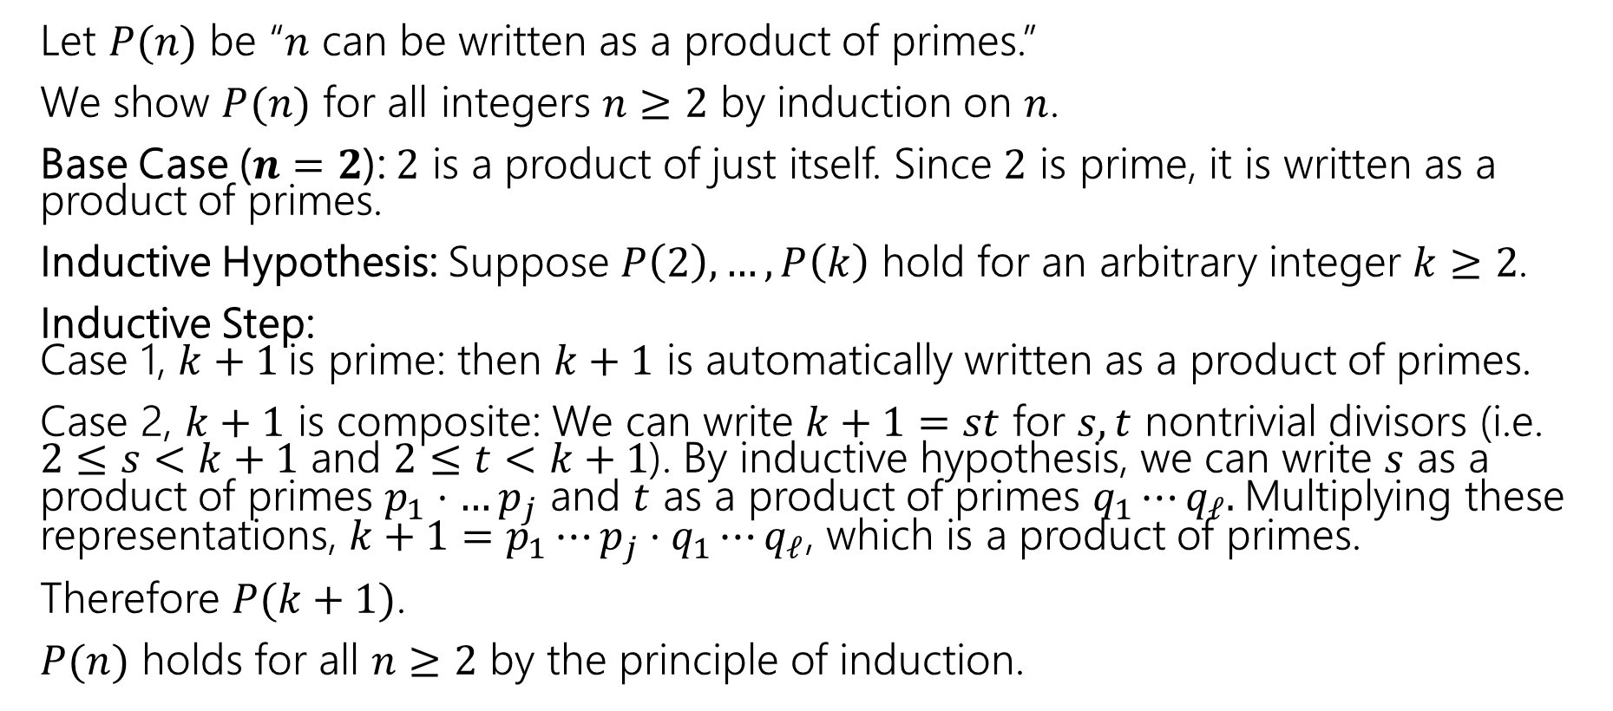
Induction on Primes
Let $P(n)$ be “$n$ can be written as a product of primes.”
We show $P(n)$ for all integers $n≥2$ by induction on $n$.
Base Case ($n=2$): $2$ is a product of just itself. Since $2$ is prime, it is written as a product of primes.
Inductive Hypothesis: Suppose $P\left(2\right),…,P\left(k\right)$ hold for an arbitrary integer $k≥2$.
Inductive Step:
Case 1, $k+1$is prime: then $k+1$ is automatically written as a product of primes.
Case 2, $k+1$ is composite: We can write $k+1=st$ for $s,t$ nontrivial divisors (i.e. $2≤s<k+1$ and $2≤t<k+1$). By inductive hypothesis, we can write $s$ as a product of primes $p_{1}⋅…p_{j}$ and $t$ as a product of primes $q_{1}⋯q_{ℓ}.$Multiplying these representations, $k+1=p_{1}⋯p_{j}⋅q_{1}⋯q_{ℓ}$, which is a product of primes.
Therefore $P(k+1)$.
$P(n)$ holds for all $n≥2$ by the principle of induction.

Slide 36
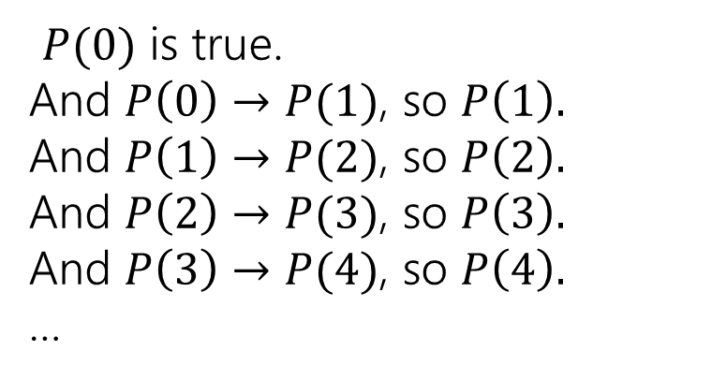


Strong Induction
That hypothesis where we assume $P\left(base case\right),…,P(k)$ instead of just $P(k)$ is called a strong inductive hypothesis.
Strong induction is the same fundamental idea as weak (“regular”) induction.
$P(0)$ is true.
And $P\left(0\right)→P(1)$, so $P\left(1\right).$
And $P\left(1\right)→P(2)$, so $P\left(2\right).$
And $P\left(2\right)→P(3)$, so $P\left(3\right).$
And $P\left(3\right)→P(4)$, so $P\left(4\right).$
…
$P(0)$ is true.
And $P\left(0\right)→P(1)$, so $P\left(1\right).$
And [$P\left(0\right)∧P\left(1\right)]→P(2)$, so $P\left(2\right).$
And $[P\left(0\right)∧⋯∧P\left(2\right)]→P(3)$, so $P\left(3\right).$
And$[P\left(0\right)∧⋯∧P\left(3\right)]→P(4)$, so $P\left(4\right).$
…

Slide 37
The Principle of Strong Induction
P 0 ∧ ∀𝑘 P 0 ∧ ⋯ ∧ P 𝑘
→ P 𝑘 + 1
Base Case Prove P(0) holds.
Inductive Hypothesis Let 𝑘 ≥ 0 be an
arbitrary integer. Suppose
P 0 ∧ ⋯ ∧ P(𝑘) hold.
Inductive Step Prove that P(𝑘 + 1) holds

Slide 38
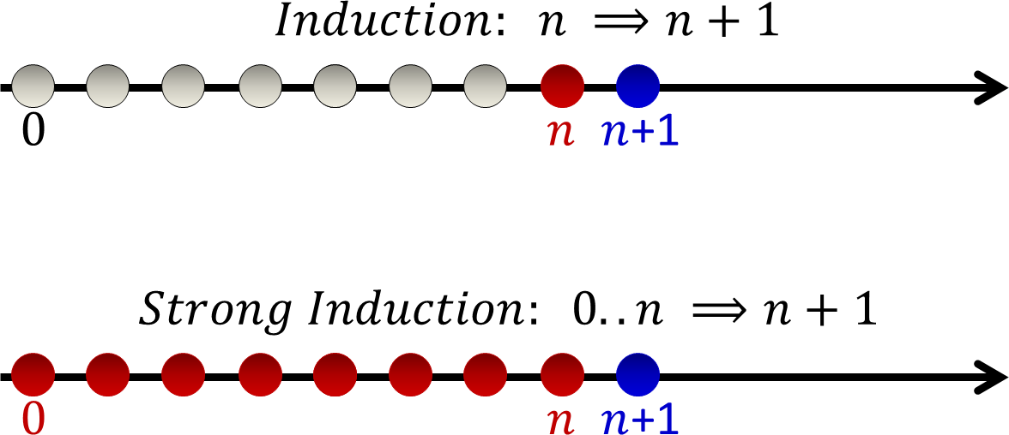
Strong Induction
𝑘 𝑘
𝑘 𝑘 + 1
𝑘
𝑘
𝑘
𝑘 + 1

Slide 39
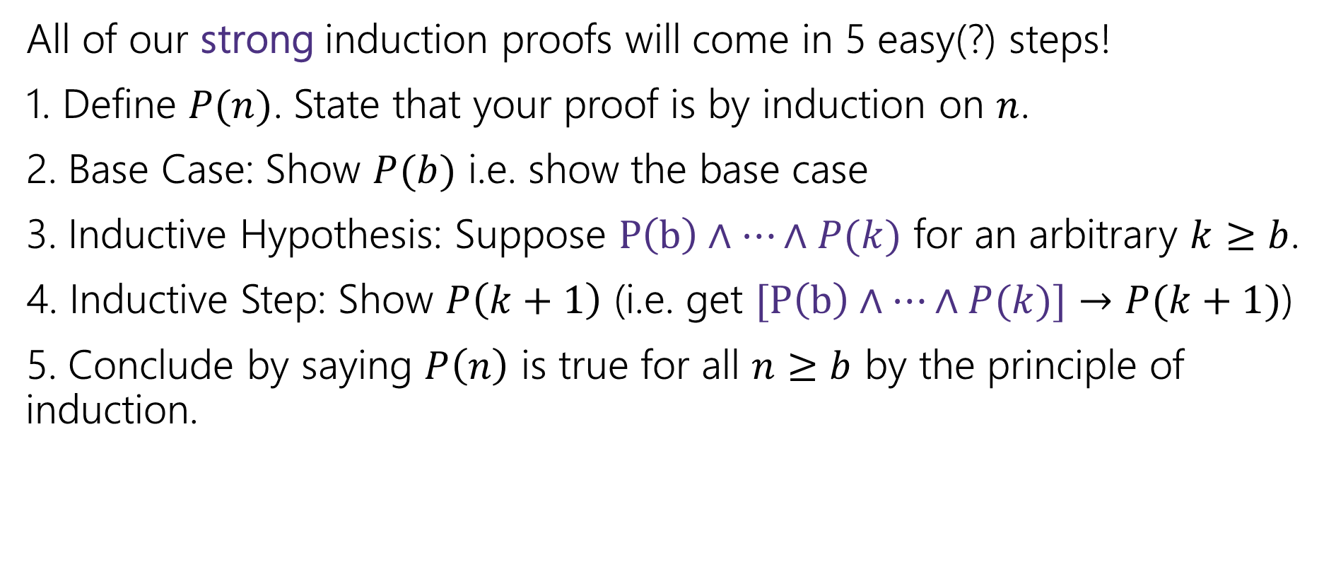
Making Induction Proofs Pretty
All of our strong induction proofs will come in 5 easy(?) steps!
1. Define $P(n)$. State that your proof is by induction on $n$.
2. Base Case: Show $P(b)$ i.e. show the base case
3. Inductive Hypothesis: Suppose $P\left(b\right)∧⋯∧P(k)$ for an arbitrary $k≥b$.
4. Inductive Step: Show $P\left(k+1\right)$ (i.e. get $[P\left(b\right)∧⋯∧P(k)]→P(k+1)$)
5. Conclude by saying $P\left(n\right)$ is true for all $n≥b$ by the principle of induction.

Slide 40
Strong Induction vs. Weak Induction
Think of strong induction as “my recursive call might be on LOTS of smaller values” (like mergesort – you cut your array in half)
Think of weak induction as “my recursive call is always on one step smaller.”
Practical advice:
A strong hypothesis isn’t wrong when you only need a weak one (but a weak one is wrong when you need a strong one). Some people just always write strong hypotheses. But it’s easier to typo a strong hypothesis.
A tip is to leave a blank spot where the IH is, and fills it in after the step.

Slide 41

Practical Advice
How many base cases do you need?
  Always at least one.
  If you’re analyzing recursive code or a recursive function, at least one for each base case of the code/function.
  If you always go back $s$ steps, at least $s$ consecutive base cases.
  Enough to make sure every case is handled.

Slide 42
More Strong Induction

Slide 43
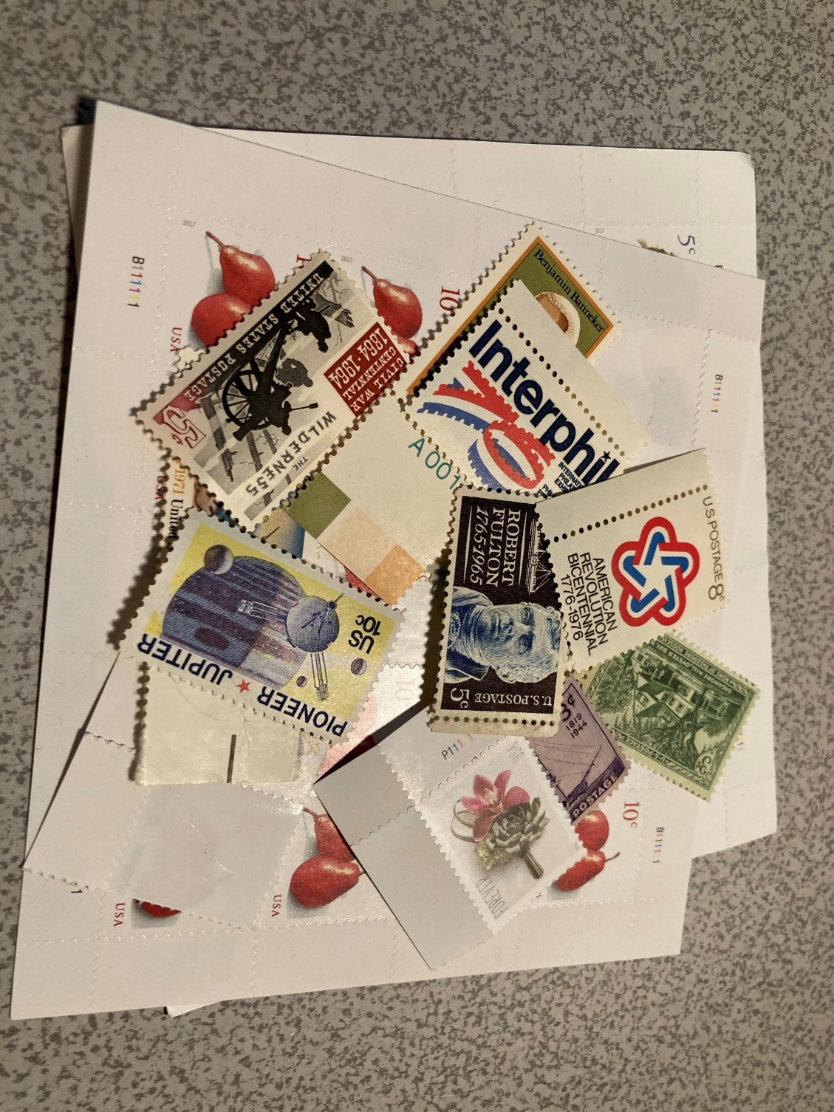
Let’s Try Another! Stamp Collecting
I have 4 cent stamps and 5 cent stamps (as many as I want of each). Prove that I can make exactly $n$ cents worth of stamps for all $n≥12$.
Try for a few values.
Then think…how would the inductive step go?

Slide 44
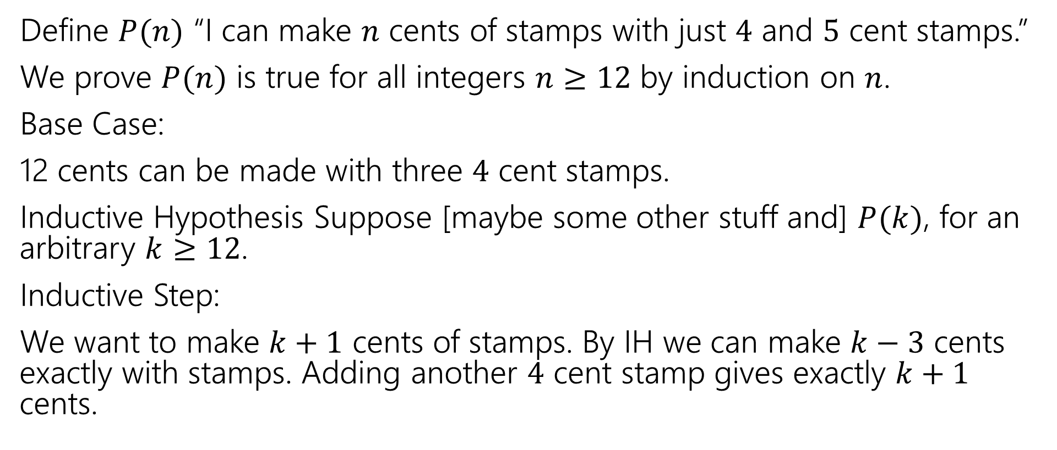
Stamp Collection (attempt)
Define $P(n)$ “I can make $n$ cents of stamps with just $4$ and $5$ cent stamps.”
We prove $P(n)$ is true for all integers $n≥12$ by induction on $n$.
Base Case:
12 cents can be made with three $4$ cent stamps.
Inductive Hypothesis Suppose [maybe some other stuff and] $P(k)$, for an arbitrary $k≥12$.
Inductive Step:
We want to make $k+1$ cents of stamps. By IH we can make $k−3$ cents exactly with stamps. Adding another $4$ cent stamp gives exactly $k+1$ cents.

Slide 45
Stamp Collection
Is the proof right?
How do we know $P(13)$
We’re not the base case, so our inductive hypothesis assumes $P(12)$, and then we say if $P\left(9\right)$ then $P(13)$.
Wait a second….
If you go back $s$ steps every time, you need $s$ base cases.
Or else the first few values aren’t proven.

Slide 46
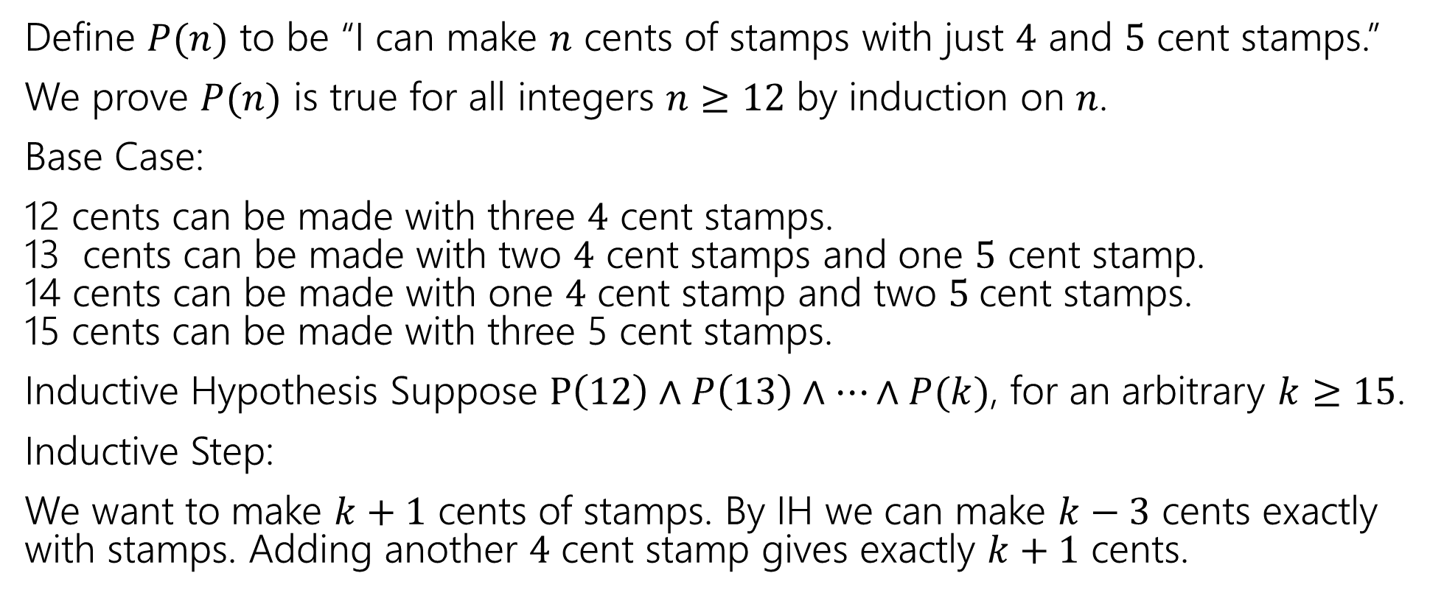
Stamp Collection
Define $P(n)$ to be “I can make $n$ cents of stamps with just $4$ and $5$ cent stamps.”
We prove $P(n)$ is true for all integers $n≥12$ by induction on $n$.
Base Case:
12 cents can be made with three $4$ cent stamps.
13 cents can be made with two $4$ cent stamps and one $5$ cent stamp.
14 cents can be made with one $4$ cent stamp and two $5$cent stamps.
15 cents can be made with three 5 cent stamps.
Inductive Hypothesis Suppose $P\left(12\right)∧P\left(13\right)∧…∧P(k)$, for an arbitrary $k≥15$.
Inductive Step:
We want to make $k+1$ cents of stamps. By IH we can make $k−3$ cents exactly with stamps. Adding another $4$ cent stamp gives exactly $k+1$ cents.

Slide 47
A good last check
After you’ve finished writing an inductive proof, pause.
If your inductive step always goes back $s$ steps, you need $s$ base cases (otherwise $b+1$ will go back before the base cases you’ve shown). And make sure your inductive hypothesis is strong enough.
If your inductive step is going back a varying (unknown) number of steps, check the first few values above the base case, make sure your cases are really covered. And make sure your IH is strong.

Slide 48
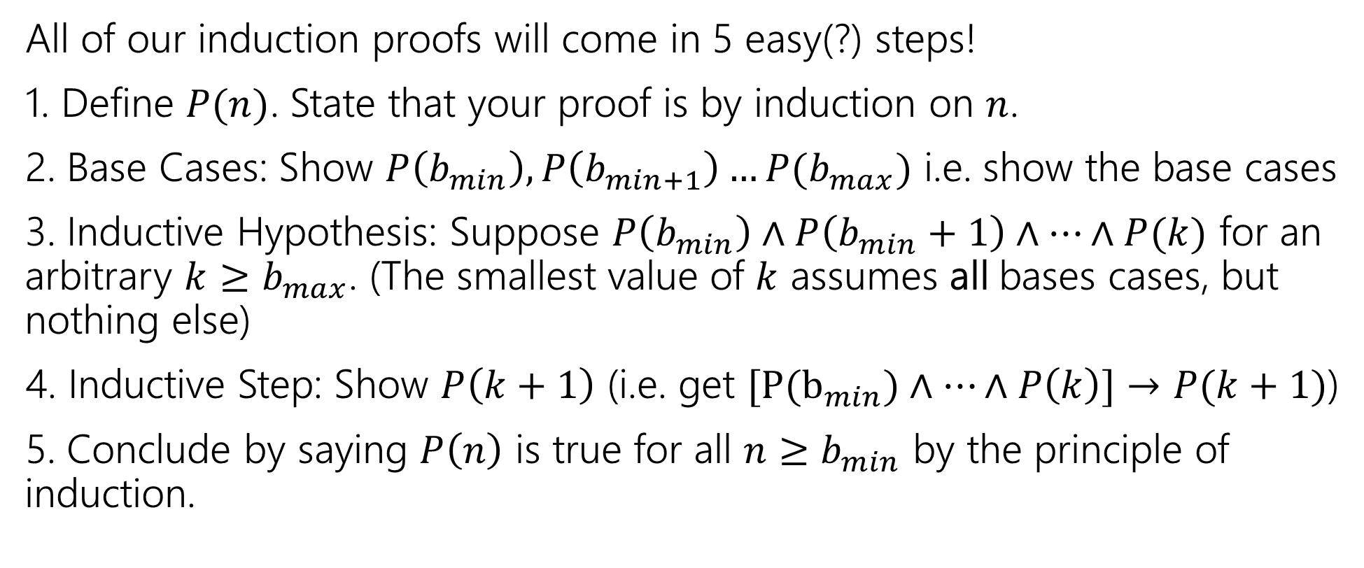
Making Induction Proofs Pretty
All of our induction proofs will come in 5 easy(?) steps!
1. Define $P(n)$. State that your proof is by induction on $n$.
2. Base Cases: Show $P\left(b_{min}\right), P\left(b_{min+1}\right)…P(b_{max})$ i.e. show the base cases
3. Inductive Hypothesis: Suppose $P\left(b_{min}\right)∧P\left(b_{min}+1\right)∧…∧P(k)$ for an arbitrary $k≥b_{max}$. (The smallest value of $k$ assumes all bases cases, but nothing else)
4. Inductive Step: Show $P\left(k+1\right)$ (i.e. get $[P(b_{min})∧…∧P\left(k\right)]→P(k+1)$)
5. Conclude by saying $P\left(n\right)$ is true for all $n≥b_{min}$ by the principle of induction.

Slide 49

Stamp Collection, Done Wrong
Define $P(n)$ to be “I can make $n$ cents of stamps with just $4$ and $5$ cent stamps.”
We prove $P(n)$ is true for all integers $n≥12$ by induction on $n$.
Base Case:
12 cents can be made with three $4$ cent stamps.
Inductive Hypothesis Suppose $P(k)$, $k≥12$.
Inductive Step:
We want to make $k+1$ cents of stamps. By IH we can make $k$ cents exactly with stamps. Replace one of the 4 cent stamps with a 5 cent stamp.
$P(n)$ holds for all $n$ by the principle of induction.

Slide 50
Stamp Collection, Done Wrong
What if the starting point doesn’t have any 4 cent stamps?
Like, say, 15 cents = 5+5+5.

Slide 51
More Strong Induction Examples

Slide 52


Claim: $3|{(2}^{2n}−1)$ for all natural numbers
[Define $P(n)$]
Base Case
Inductive Hypothesis
Inductive Step
[conclusion]

Slide 53
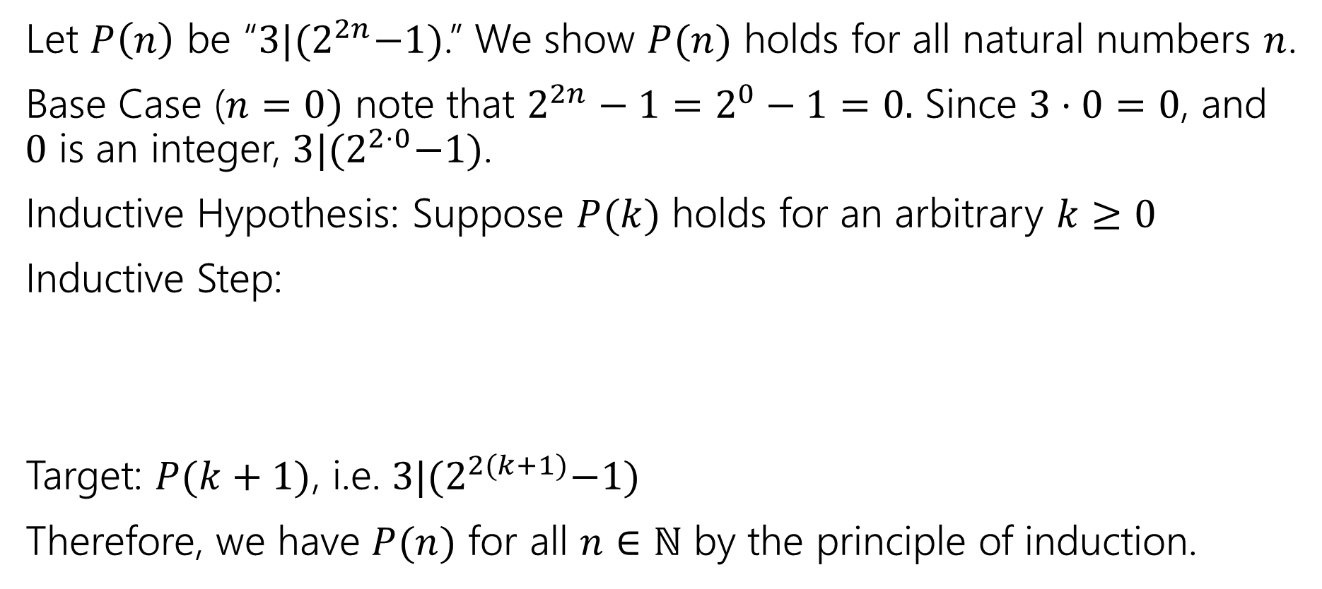
Claim: $3|{(2}^{2n}−1)$ for all natural numbers
Let $P\left(n\right)$ be “$3|{(2}^{2n}−1)$.” We show $P(n)$ holds for all natural numbers $n$.
Base Case ($n=0)$ note that $2^{2n}−1=2^{0}−1=0.$ Since $3⋅0=0$, and $0$ is an integer, $3|{(2}^{2⋅0}−1)$.
Inductive Hypothesis: Suppose $P(k)$ holds for an arbitrary $k≥0$
Inductive Step:
Target: $P(k+1)$, i.e. $3|{(2}^{2(k+1)}−1)$
Therefore, we have $P(n)$ for all $n∈ℕ$ by the principle of induction.

Slide 54
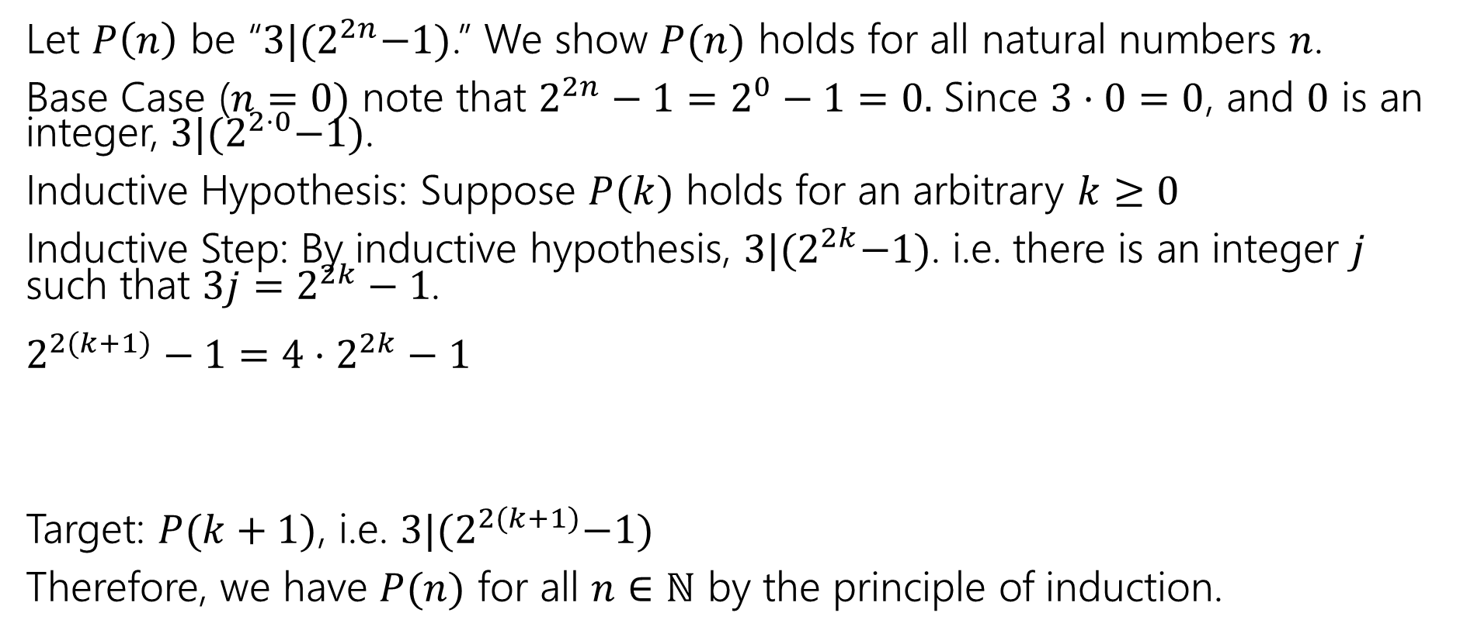
Claim: $3|{(2}^{2n}−1)$ for all natural numbers
Let $P\left(n\right)$ be “$3|{(2}^{2n}−1)$.” We show $P(n)$ holds for all natural numbers $n$.
Base Case ($n=0)$ note that $2^{2n}−1=2^{0}−1=0.$ Since $3⋅0=0$, and $0$ is an integer, $3|{(2}^{2⋅0}−1)$.
Inductive Hypothesis: Suppose $P(k)$ holds for an arbitrary $k≥0$
Inductive Step: By inductive hypothesis, $3|{(2}^{2k}−1)$. i.e. there is an integer $j$ such that $3j=2^{2k}−1$.
$2^{2(k+1)}−1=4⋅2^{2k}−1$
Target: $P(k+1)$, i.e. $3|{(2}^{2(k+1)}−1)$
Therefore, we have $P(n)$ for all $n∈ℕ$ by the principle of induction.
FORCE the expression in your IH to appear

Slide 55
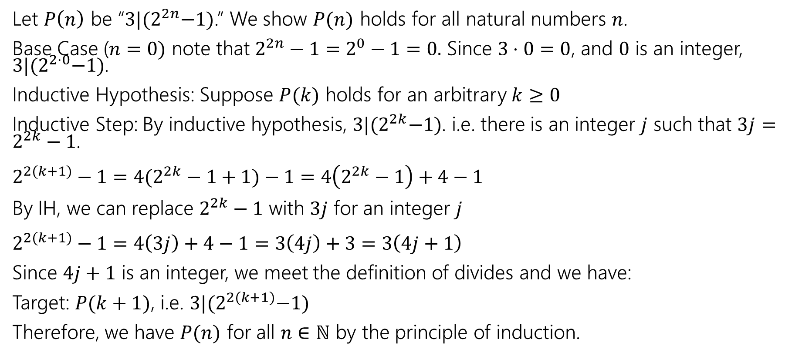
Claim: $3|{(2}^{2n}−1)$ for all natural numbers
Let $P\left(n\right)$ be “$3|{(2}^{2n}−1)$.” We show $P(n)$ holds for all natural numbers $n$.
Base Case ($n=0)$ note that $2^{2n}−1=2^{0}−1=0.$ Since $3⋅0=0$, and $0$ is an integer, $3|{(2}^{2⋅0}−1)$.
Inductive Hypothesis: Suppose $P(k)$ holds for an arbitrary $k≥0$
Inductive Step: By inductive hypothesis, $3|{(2}^{2k}−1)$. i.e. there is an integer $j$ such that $3j=2^{2k}−1$.
$2^{2(k+1)}−1=4(2^{2k}−1+1)−1=4\left(2^{2k}−1\right)+4−1$
By IH, we can replace $2^{2k}−1$ with $3j$ for an integer $j$
$2^{2(k+1)}−1=4\left(3j\right)+4−1=3\left(4j\right)+3=3\left(4j+1\right)$
Since $4j+1$ is an integer, we meet the definition of divides and we have:
Target: $P(k+1)$, i.e. $3|{(2}^{2(k+1)}−1)$
Therefore, we have $P(n)$ for all $n∈ℕ$ by the principle of induction.

Slide 56
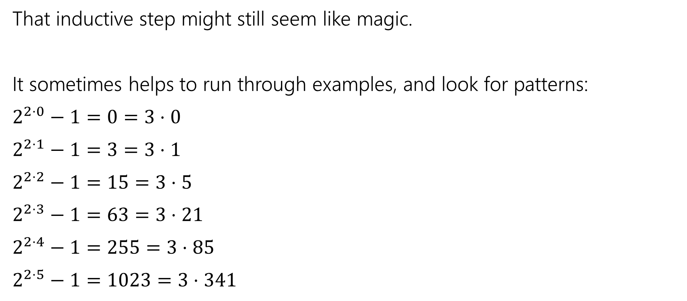

Claim: $3|{(2}^{2n}−1)$ for all natural numbers
That inductive step might still seem like magic.
It sometimes helps to run through examples, and look for patterns:
$2^{2⋅0}−1=0=3⋅0$
$2^{2⋅1}−1=3=3⋅1$
$2^{2⋅2}−1=15=3⋅5$
$2^{2⋅3}−1=63=3⋅21$
$2^{2⋅4}−1=255=3⋅85$
$2^{2⋅5}−1=1023=3⋅341$
The divisor goes from $k$to $4k+1$
$$0→4⋅0+1=1$$
$$1→4⋅1+1=5$$
$$5→4⋅5+1=21$$
…
That might give us a hint that $4k+1$ will be in the algebra somewhere, and give us another intermediate target.

Slide 57

Even more practice
I’ve got a bunch of these 3 piece tiles.
I want to fill a $2^{n}$x$2^{n}$ grid ($n≥1)$with the pieces, except for a $1$x$1$ spot in a corner.

Slide 58

Gridding (not a full proof, just intuition)
Base Case: $n=1$
Inductive hypothesis: Suppose you can tile a $2^{k}$x$2^{k}$ grid, except for a corner.
Inductive step: $2^{k+1}$x$2^{k+1}$, divide into quarters. By IH can tile…

Slide 59
Todo
Tonight:
HW4 is due tonight!
CC 13 is out and due Friday at noon
Read the midterm logistics on the Exams page of the course website and post on the Ed board if you have any questions

