Slide 1
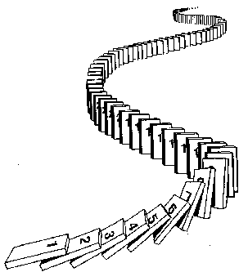
Induction
CSE 311 Summer 2025
Lecture 12

Slide 2
Announcements
HW4 is released!
Start today if you have not already
Our Midterm is next Friday (8/1) in class!
Exam logistics and practice exams are posted on the “Exams” page of the course website
HW2 solutions are out!

Slide 3
Review

Slide 4
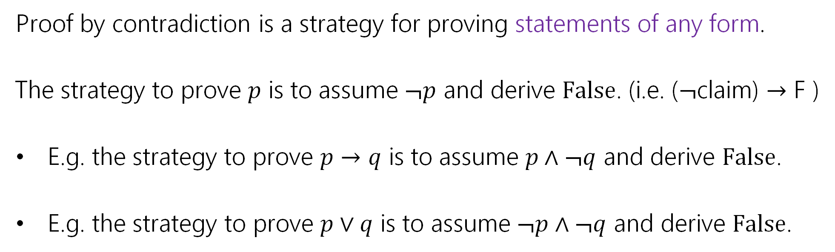
Proof by Contradiction
Proof by contradiction is a strategy for proving statements of any form.
The strategy to prove 𝑝 is to assume ¬𝑝 and derive False. (i.e. ($¬$claim) $→$ F )
E.g. the strategy to prove 𝑝 → 𝑞 is to assume 𝑝 ∧ ¬𝑞 and derive False.
E.g. the strategy to prove 𝑝 ∨ 𝑞 is to assume ¬𝑝 ∧ ¬𝑞 and derive False.

Slide 5
Proof by Contradiction Skeleton
Suppose for the sake of contradiction ¬𝑝.
…
Then some statement 𝑠 must hold.
…
And some statement ¬𝑠 must hold.
But 𝑠 and ¬𝑠 is a contradiction. So 𝑝 must be true.

Slide 6

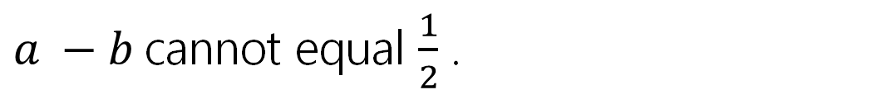
Claim: No integer is even and odd.
Suppose for the sake of contradiction that there exists an integer 𝑥 that is both even and odd.
Then 𝑥 = 2𝑎 for some integer 𝑎, and 𝑥 = 2𝑏 + 1 for some integer 𝑏.
Then:
$2a = 2b + 1$
$2a − 2b = 1$
$a −b= \frac{1}{2}$
Since 𝑎, 𝑏 are integers, 𝑎 − 𝑏 is an integer. But $\frac{1}{2}$ is not an integer, so
$a −b$cannot equal $\frac{1}{2}$ .
This is a contradiction!
Thus no integer can be even and odd.

Slide 7

Proof by Contradiction: Remarks
Unlike other proof techniques, we don’t know where we’re going. We’re trying to find any contradiction. That can make it harder.
Contradiction is a sledge-hammer.
It can be used to prove many things. But it makes a mess.
Use contradiction as a last-resort.
Contradiction is a sledge-hammer

Slide 8
Another Proof by Contradiction

Slide 9
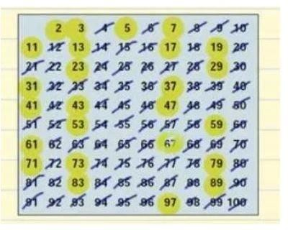
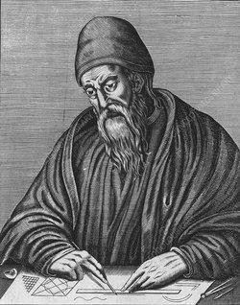
Euclid’s Theorem: There are infinitely many prime numbers.
2, 3, 5, 7, 11, 13, …
Euclid ~300 BC

Slide 10
Euclid’s Theorem: There are infinitely many prime numbers.
Assume for the sake of contradiction that there are finitely many prime numbers. Call them 𝑝₁, 𝑝₂, … , 𝑝_{𝑘}.
In either case, we have a contradiction. Thus there must be infinitely many primes.

Slide 11
Euclid’s Theorem: There are infinitely many prime numbers.
Assume for the sake of contradiction that there are finitely many prime numbers. Call them 𝑝₁, 𝑝₂, … , 𝑝_{𝑘}.
Consider the number 𝑞 = 𝑝₁ ⋅ 𝑝₂ ⋯ 𝑝_{𝑘} + 1.
In either case, we have a contradiction. Thus there must be infinitely many primes.

Slide 12
Euclid’s Theorem: There are infinitely many prime numbers.
Assume for the sake of contradiction that there are finitely many prime numbers. Call them 𝑝₁, 𝑝₂, … , 𝑝_{𝑘}.
Consider the number 𝑞 = 𝑝₁ ⋅ 𝑝₂ ⋯ 𝑝_{𝑘} + 1.
Case 1: 𝑞 is prime.
Case 2: 𝑞 is composite.
In either case, we have a contradiction. Thus there must be infinitely many primes.

Slide 13
Euclid’s Theorem: There are infinitely many prime numbers.
Assume for the sake of contradiction that there are finitely many prime numbers. Call them 𝑝₁, 𝑝₂, … , 𝑝_{𝑘}.
Consider the number 𝑞 = 𝑝₁ ⋅ 𝑝₂ ⋯ 𝑝_{𝑘} + 1.
Case 1: 𝑞 is prime. Then 𝑞 is a prime that is larger than 𝑝_{𝑖} for all 𝑖 ∈ {1, … , 𝑘}. But every prime was supposed to in the list 𝑝₁, … , 𝑝_{𝑘}. This is a contradiction.
Case 2: 𝑞 is composite.
In either case, we have a contradiction. Thus there must be infinitely many primes.

Slide 14
Euclid’s Theorem: There are infinitely many prime numbers.
Assume for the sake of contradiction that there are finitely many prime numbers. Call them 𝑝₁, 𝑝₂, … , 𝑝_{𝑘}.
Consider the number 𝑞 = 𝑝₁ ⋅ 𝑝₂ ⋯ 𝑝_{𝑘} + 1.
Case 1: 𝑞 is prime. Then 𝑞 is a prime that is larger than 𝑝_{𝑖} for all 𝑖 ∈ {1, … , 𝑘}. But every prime was supposed to in the list 𝑝₁, … , 𝑝_{𝑘}. This is a contradiction.
Case 2: 𝑞 is composite. Then 𝑞 must have some prime factor. So there exists
some 𝑖 such that 𝑝_{𝑖} | 𝑞.
In either case, we have a contradiction. Thus there must be infinitely many primes.

Slide 15
Euclid’s Theorem: There are infinitely many prime numbers.
Assume for the sake of contradiction that there are finitely many prime numbers. Call them 𝑝₁, 𝑝₂, … , 𝑝_{𝑘}.
Consider the number 𝑞 = 𝑝₁ ⋅ 𝑝₂ ⋯ 𝑝_{𝑘} + 1.
Case 1: 𝑞 is prime. Then 𝑞 is a prime that is larger than 𝑝_{𝑖} for all 𝑖 ∈ {1, … , 𝑘}. But every prime was supposed to in the list 𝑝₁, … , 𝑝_{𝑘}. This is a contradiction.
Case 2: 𝑞 is composite. Then 𝑞 must have some prime factor. So there exists
some 𝑖 such that 𝑝_{𝑖} | 𝑞. Then 𝑞 % 𝑝_{𝑖} = 0. But
𝑞 % 𝑝_{𝑖} = (𝑝₁ ⋅ 𝑝₂ ⋯ 𝑝_{𝑘} + 1) % 𝑝_{𝑖} = 1
So we have 𝑞 % 𝑝_{𝑖} = 0 and 𝑞 % 𝑝_{𝑖} = 1. This is a contradiction.
In either case, we have a contradiction. Thus there must be infinitely many primes.

Slide 16
Proof by Induction

Slide 17
Proof Strategies so Far
Direct Proof
Proof by Contrapositive
Proof of Biconditional
Proof by Cases
Existence Proof
Proof by Contradiction
There are claims we cannot prove using these strategies!

Slide 18
How do we know recursion works?
//Assume i is a nonnegative integer
//returns 2^i.
public int CalculatesTwoToTheI(int i){
if(i == 0)
return 1;
else
return 2*CaclulatesTwoToTheI(i-1);
}
Why does CalculatesTwoToTheI(4) calculate 2^4?
Convince the people around you!

Slide 19
How do we know recursion works?
Something like this:
Well, as long as CalculatesTwoToTheI(3) = 8, we get 16…
Which happens as long as CalculatesTwoToTheI(2) = 4
Which happens as long as CalculatesTwoToTheI(1) = 2
Which happens as long as CalculatesTwoToTheI(0) = 1
And it is! Because that’s what the base case says.

Slide 20
How do we know recursion works?
There are really only two cases.
CalculatesTwoToTheI(0) = 1 (which it should!)
And that means CalculatesTwoToTheI(1) = 2, (like it should)
And that means CalculatesTwoToTheI(2) = 4, (like it should)
And that means CalculatesTwoToTheI(3) = 8, (like it should)
And that means CalculatesTwoToTheI(4) = 16, (like it should)
The Base Case is Correct
IF the recursive call we make is correct THEN our value is correct.

Slide 21
How do we know recursion works?
The code has two big cases,
So our proof had two big cases
“The base case of the code produces the correct output”
“IF the calls we rely on produce the correct output THEN the current call produces the right output”

Slide 22
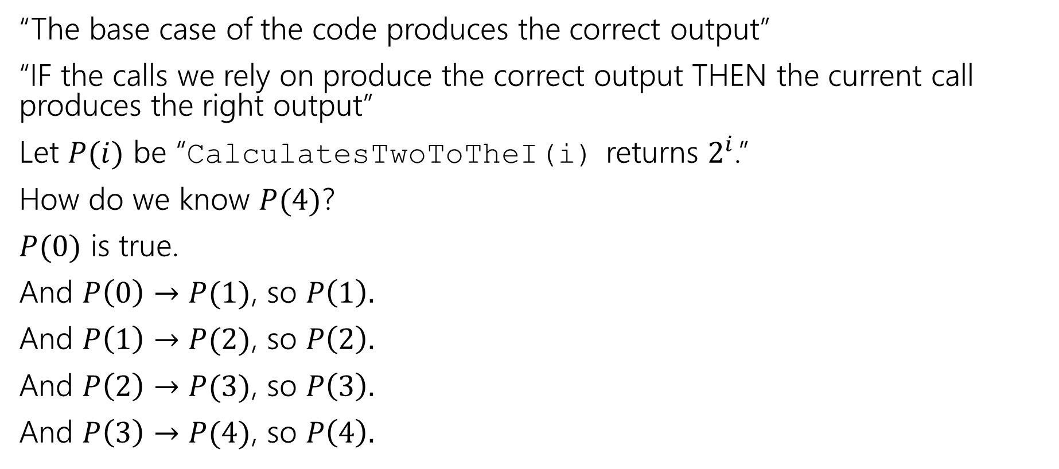
A bit more formally…
“The base case of the code produces the correct output”
“IF the calls we rely on produce the correct output THEN the current call produces the right output”
Let $P(i)$ be “CalculatesTwoToTheI(i) returns $2^{i}$.”
How do we know $P(4)$?
$P(0)$ is true.
And $P\left(0\right)→P(1)$, so $P\left(1\right).$
And $P\left(1\right)→P(2)$, so $P\left(2\right).$
And $P\left(2\right)→P(3)$, so $P\left(3\right).$
And $P\left(3\right)→P(4)$, so $P\left(4\right).$

Slide 23
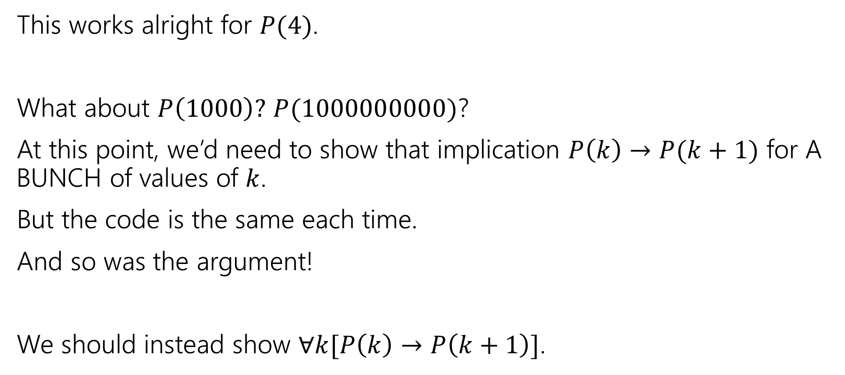
A bit more formally…
This works alright for $P(4)$.
What about $P\left(1000\right)?$ $P(1000000000)$?
At this point, we’d need to show that implication $P\left(k\right)→P(k+1)$ for A BUNCH of values of $k$.
But the code is the same each time.
And so was the argument!
We should instead show $∀k[P\left(k\right)→P\left(k+1\right)]$.

Slide 24
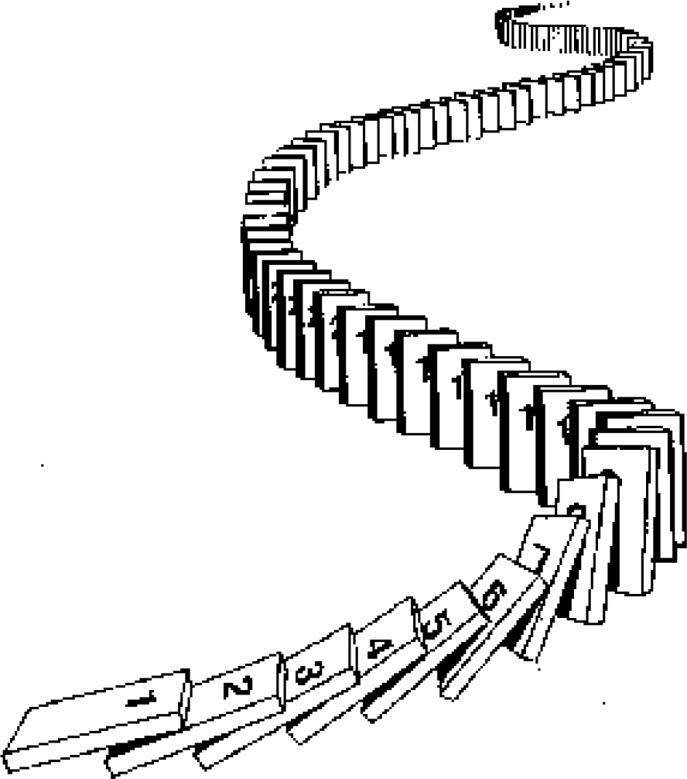
The Principle of Mathematical Induction
P 0 ∧ ∀𝑘 P 𝑘 → P 𝑘 + 1
Base Case Prove P(0) holds.
Inductive Hypothesis Let 𝑘 ≥ 0 be an arbitrary integer.
Suppose P(𝑘) holds.
Inductive Step Prove that P(𝑘 + 1) holds (using P(𝑘))

Slide 25
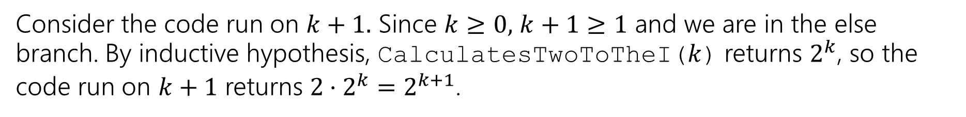
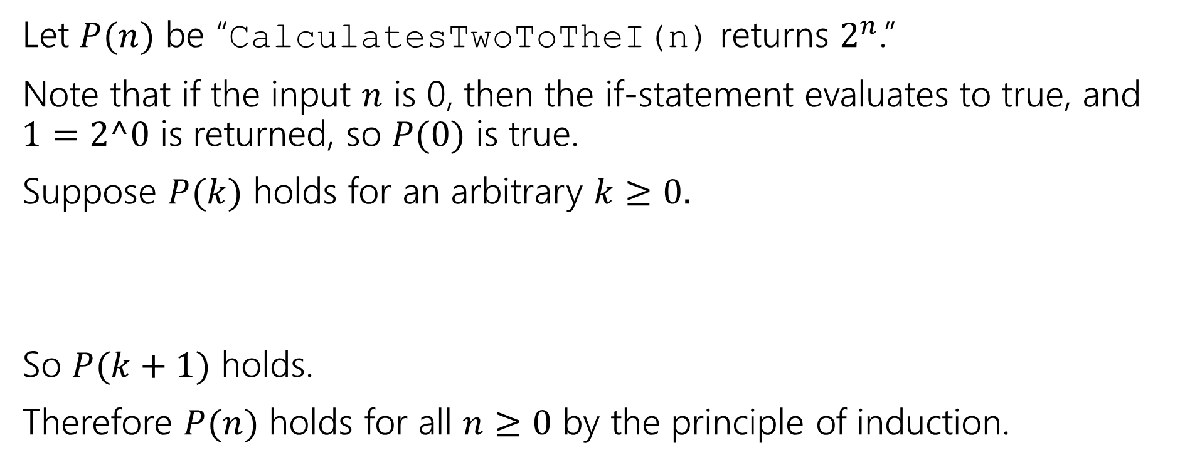
Induction
//Assume i is a nonnegative integer
public int CalculatesTwoToTheI(int i){
if(i == 0)
return 1;
else
return 2*CaclulatesTwoToTheI(i-1);
}
Let $P(n)$ be “CalculatesTwoToTheI(n) returns $2^{n}$.”
Note that if the input $n$ is 0, then the if-statement evaluates to true, and $1=2^0$ is returned, so $P(0)$ is true.
Suppose $P(k)$ holds for an arbitrary $k≥0.$
So $P(k+1)$ holds.
Therefore $P(n)$ holds for all $n≥0$ by the principle of induction.
Consider the code run on $k+1.$ Since $k≥0,$ $k+1≥1$ and we are in the else branch. By inductive hypothesis, CalculatesTwoToTheI($k$) returns $2^{k}$, so the code run on $k+1$ returns $2⋅2^{k}=2^{k+1}$.

Slide 26
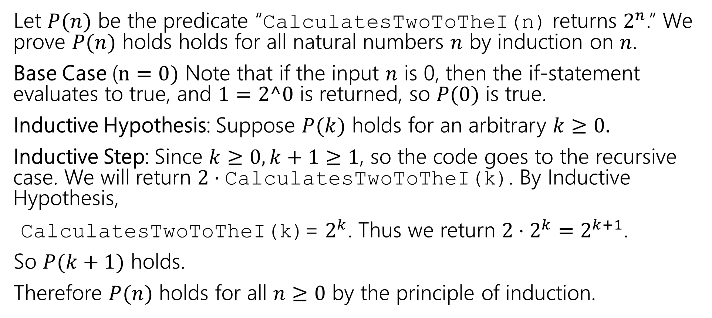
Making Induction Proofs Pretty
Let $P(n)$ be the predicate “CalculatesTwoToTheI(n) returns $2^{n}$.” We prove $P(n)$ holds holds for all natural numbers $n$ by induction on $n$.
Base Case ($n=0)$ Note that if the input $n$ is 0, then the if-statement evaluates to true, and $1=2^0$ is returned, so $P(0)$ is true.
Inductive Hypothesis: Suppose $P(k)$ holds for an arbitrary $k≥0.$
Inductive Step: Since $k≥0, k+1≥1$, so the code goes to the recursive case. We will return $2⋅\text{CalculatesTwoToTheI}\text{(}\text{k}\text{)}$. By Inductive Hypothesis,
$\text{CalculatesTwoToTheI}\text{(}\text{k}\text{)}$= $2^{k}$. Thus we return $2⋅2^{k}=2^{k+1}$.
So $P(k+1)$ holds.
Therefore $P(n)$ holds for all $n≥0$ by the principle of induction.

Slide 27
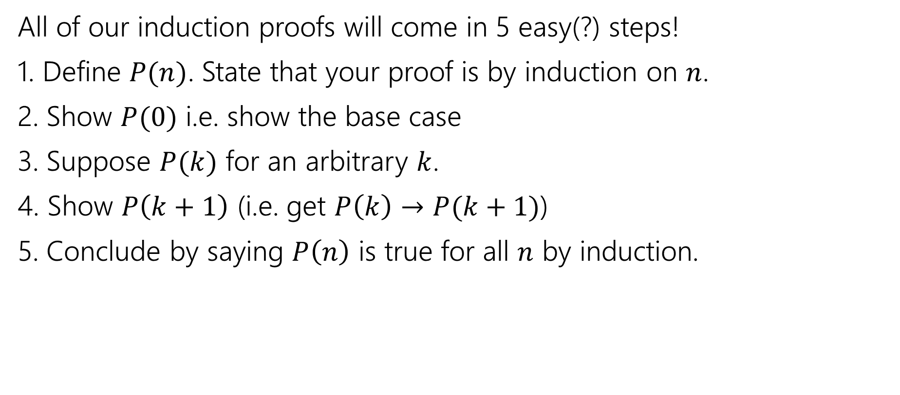
Making Induction Proofs Pretty
All of our induction proofs will come in 5 easy(?) steps!
1. Define $P(n)$. State that your proof is by induction on $n$.
2. Show $P(0)$ i.e. show the base case
3. Suppose $P(k)$ for an arbitrary $k$.
4. Show $P\left(k+1\right)$ (i.e. get $P\left(k\right)→P(k+1)$)
5. Conclude by saying $P\left(n\right)$ is true for all $n$ by induction.

Slide 28
Induction Template
Define P(𝑛). State that your proof is by induction on 𝑛.
Base Case: Show P(𝑏) is true for your base case 𝑏.
Inductive Hypothesis: Suppose P(𝑘) holds for an arbitrary integer 𝑘 ≥ 𝑏.
Inductive Step: Prove P(𝑘 + 1) (using the Inductive Hypothesis).
Conclusion: Conclude by saying P(𝑛) holds for all integers 𝑛 ≥ 𝑏
by induction.

Slide 29
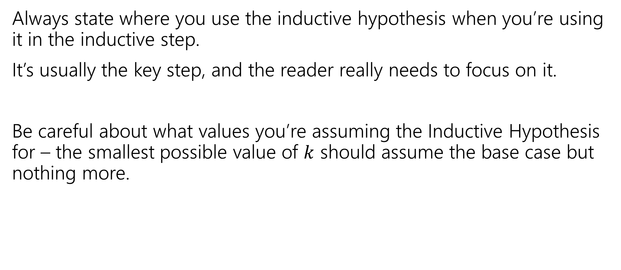
Some Other Notes
Always state where you use the inductive hypothesis when you’re using it in the inductive step.
It’s usually the key step, and the reader really needs to focus on it.
Be careful about what values you’re assuming the Inductive Hypothesis for – the smallest possible value of $k$ should assume the base case but nothing more.

Slide 30
More induction!

Slide 31
Find an expression in 𝑛 for the sum 1 + 2 + 4 + ⋯ + 2^{𝑛}
𝑛 = 0 | 1 | = 1
𝑛 = 1 | 1 + 2 | = 3
𝑛 = 2 | 1 + 2 + 4 | = 7
𝑛 = 3 | 1 + 2 + 4 + 8 | = 15
𝑛 = 4 | 1 + 2 + 4 + 8 + 16 | = 31

Slide 32
Find an expression in 𝑛 for the sum 1 + 2 + 4 + ⋯ + 2^{𝑛}
𝑛 = 0 | 1 | = 1
𝑛 = 1 | 1 + 2 | = 3
𝑛 = 2 | 1 + 2 + 4 | = 7
𝑛 = 3 | 1 + 2 + 4 + 8 | = 15
𝑛 = 4 | 1 + 2 + 4 + 8 + 16 | = 31
It looks like this sum is 2^{𝑛+1} − 1.

Slide 33

More Induction
Induction doesn’t only work for code!
Show that $\sum_{i=0}^{n}{2^{i}}=1+2+4+…+2^{n}=2^{n+1}−1$.

Slide 34
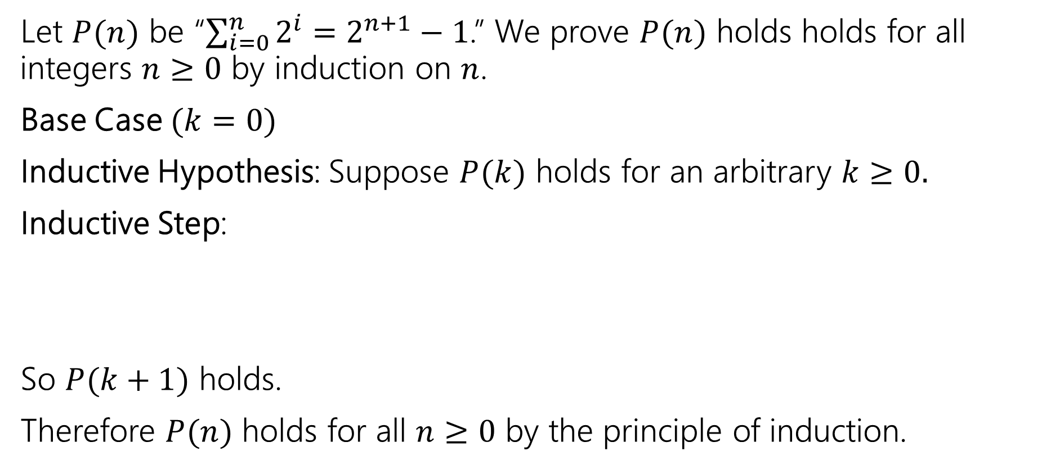
Show that $\sum_{i=0}^{n}{2^{i}}=1+2+4+…+2^{n}=2^{n+1}−1$.
Let $P(n)$ be “$\sum_{i=0}^{n}{2^{i}}=$ $2^{n+1}−1$.” We prove $P(n)$ holds holds for all integers $n≥0$ by induction on $n$.
Base Case $(k=0)$
Inductive Hypothesis: Suppose $P(k)$ holds for an arbitrary $k≥0.$
Inductive Step:
So $P(k+1)$ holds.
Therefore $P(n)$ holds for all $n≥0$ by the principle of induction.

Slide 35
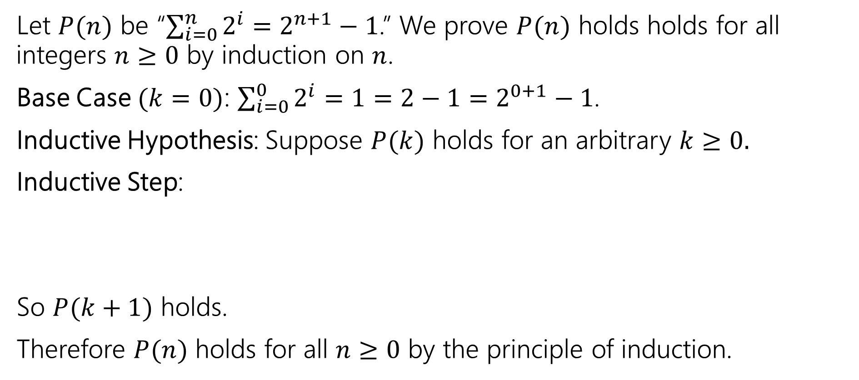
Show that $\sum_{i=0}^{n}{2^{i}}=1+2+4+…+2^{n}=2^{n+1}−1$.
Let $P(n)$ be “$\sum_{i=0}^{n}{2^{i}}=$ $2^{n+1}−1$.” We prove $P(n)$ holds holds for all integers $n≥0$ by induction on $n$.
Base Case $(k=0)$: $\sum_{i=0}^{0}{2^{i}}=1=2−1=2^{0+1}−1$.
Inductive Hypothesis: Suppose $P(k)$ holds for an arbitrary $k≥0.$
Inductive Step:
So $P(k+1)$ holds.
Therefore $P(n)$ holds for all $n≥0$ by the principle of induction.

Slide 36
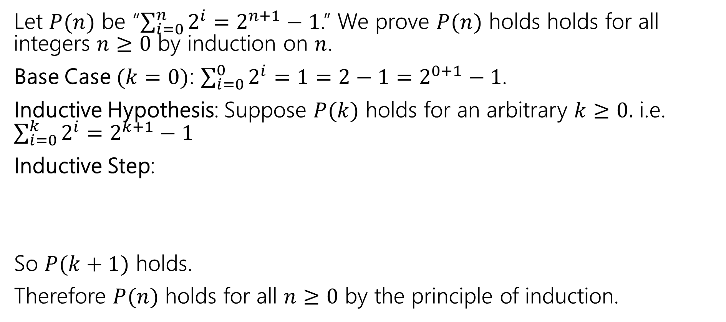
Show that $\sum_{i=0}^{n}{2^{i}}=1+2+4+…+2^{n}=2^{n+1}−1$.
Let $P(n)$ be “$\sum_{i=0}^{n}{2^{i}}=$ $2^{n+1}−1$.” We prove $P(n)$ holds holds for all integers $n≥0$ by induction on $n$.
Base Case $(k=0)$: $\sum_{i=0}^{0}{2^{i}}=1=2−1=2^{0+1}−1$.
Inductive Hypothesis: Suppose $P(k)$ holds for an arbitrary $k≥0.$ i.e. $\sum_{i=0}^{k}{2^{i}}=$ $2^{k+1}−1$
Inductive Step:
So $P(k+1)$ holds.
Therefore $P(n)$ holds for all $n≥0$ by the principle of induction.

Slide 37
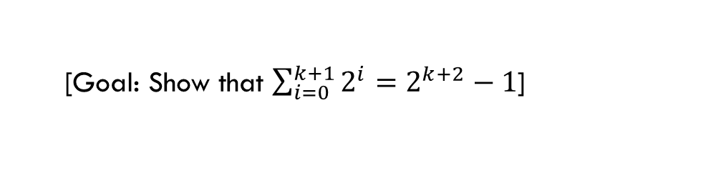
Show that $\sum_{i=0}^{n}{2^{i}}=1+2+4+…+2^{n}=2^{n+1}−1$.
Let $P(n)$ be “$\sum_{i=0}^{n}{2^{i}}=$ $2^{n+1}−1$.” We prove $P(n)$ holds holds for all integers $n≥0$ by induction on $n$.
Base Case $(k=0)$: $\sum_{i=0}^{0}{2^{i}}=1=2−1=2^{0+1}−1$.
Inductive Hypothesis: Suppose $P(k)$ holds for an arbitrary $k≥0.$ i.e. $\sum_{i=0}^{k}{2^{i}}=$ $2^{k+1}−1$
Inductive Step:
So $P(k+1)$ holds.
Therefore $P(n)$ holds for all $n≥0$ by the principle of induction.
[Goal: Show that $\sum_{i=0}^{k+1}{2^{i}}=$ $2^{k+2}−1$]

Slide 38

Show that $\sum_{i=0}^{n}{2^{i}}=1+2+4+…+2^{n}=2^{n+1}−1$.
Let $P(n)$ be “$\sum_{i=0}^{n}{2^{i}}=$ $2^{n+1}−1$.” We prove $P(n)$ holds holds for all integers $n≥0$ by induction on $n$.
Base Case $(k=0)$: $\sum_{i=0}^{0}{2^{i}}=1=2−1=2^{0+1}−1$.
Inductive Hypothesis: Suppose $P(k)$ holds for an arbitrary $k≥0.$ i.e. $\sum_{i=0}^{k}{2^{i}}=$ $2^{k+1}−1$
Inductive Step:
So $P(k+1)$ holds.
Therefore $P(n)$ holds for all $n≥0$ by the principle of induction.
$$\sum_{i=0}^{k+1}{2^{i}}=2^{k+1}+\sum_{i=0}^{k}{2^{i}}$$

Slide 39

Show that $\sum_{i=0}^{n}{2^{i}}=1+2+4+…+2^{n}=2^{n+1}−1$.
Let $P(n)$ be “$\sum_{i=0}^{n}{2^{i}}=$ $2^{n+1}−1$.” We prove $P(n)$ holds holds for all integers $n≥0$ by induction on $n$.
Base Case $(k=0)$: $\sum_{i=0}^{0}{2^{i}}=1=2−1=2^{0+1}−1$.
Inductive Hypothesis: Suppose $P(k)$ holds for an arbitrary $k≥0.$ i.e. $\sum_{i=0}^{k}{2^{i}}=$ $2^{k+1}−1$
Inductive Step:
So $P(k+1)$ holds.
Therefore $P(n)$ holds for all $n≥0$ by the principle of induction.
$$\sum_{i=0}^{k+1}{2^{i}}=2^{k+1}+\sum_{i=0}^{k}{2^{i}}$$
$=2^{k+1}+2^{k+1}−1$ [By IH]

Slide 40

Show that $\sum_{i=0}^{n}{2^{i}}=1+2+4+…+2^{n}=2^{n+1}−1$.
Let $P(n)$ be “$\sum_{i=0}^{n}{2^{i}}=$ $2^{n+1}−1$.” We prove $P(n)$ holds holds for all integers $n≥0$ by induction on $n$.
Base Case $(k=0)$: $\sum_{i=0}^{0}{2^{i}}=1=2−1=2^{0+1}−1$.
Inductive Hypothesis: Suppose $P(k)$ holds for an arbitrary $k≥0.$ i.e. $\sum_{i=0}^{k}{2^{i}}=$ $2^{k+1}−1$
Inductive Step:
So $P(k+1)$ holds.
Therefore $P(n)$ holds for all $n≥0$ by the principle of induction.
$$\sum_{i=0}^{k+1}{2^{i}}=2^{k+1}+\sum_{i=0}^{k}{2^{i}}$$
$=2^{k+1}+2^{k+1}−1$ [By IH]
$={2⋅2}^{k+1}−1$

Slide 41

Show that $\sum_{i=0}^{n}{2^{i}}=1+2+4+…+2^{n}=2^{n+1}−1$.
Let $P(n)$ be “$\sum_{i=0}^{n}{2^{i}}=$ $2^{n+1}−1$.” We prove $P(n)$ holds holds for all integers $n≥0$ by induction on $n$.
Base Case $(k=0)$: $\sum_{i=0}^{0}{2^{i}}=1=2−1=2^{0+1}−1$.
Inductive Hypothesis: Suppose $P(k)$ holds for an arbitrary $k≥0.$ i.e. $\sum_{i=0}^{k}{2^{i}}=$ $2^{k+1}−1$
Inductive Step:
So $P(k+1)$ holds.
Therefore $P(n)$ holds for all $n≥0$ by the principle of induction.
$$\sum_{i=0}^{k+1}{2^{i}}=2^{k+1}+\sum_{i=0}^{k}{2^{i}}$$
$=2^{k+1}+2^{k+1}−1$ [By IH]
$={2⋅2}^{k+1}−1$
$=2^{k+2}−1$

Slide 42
Even More Induction Examples

Slide 43
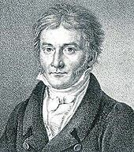
Prove that the sum of the first 𝑛 positive integers is ^{𝑛(𝑛+1)}.
2
Examples
𝑛 = 3
Sum: 1 + 2 + 3 = 6
₌ 3⋅4 ₌ ₆
Formula: ³ ³⁺¹
2
2
𝑛 = 5
Sum: 1 + 2 + 3 + 4 + 5 = 15
Formula: ⁵ ⁵⁺¹ = ^{5⋅6} = 15
2 2
Carl Friedrich Gauss
(1777-1855)

Slide 44
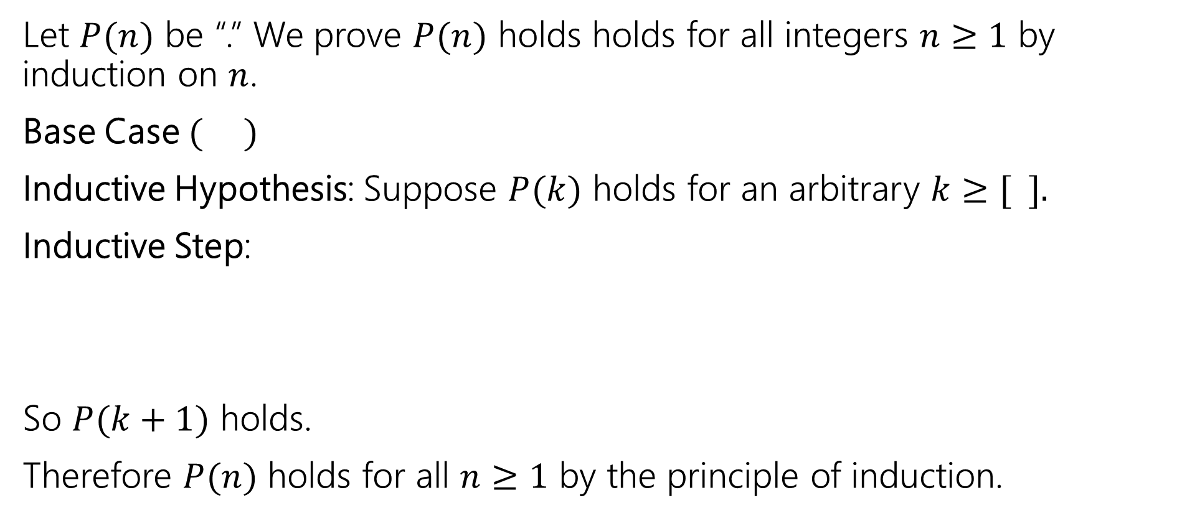
Prove that the sum of the first 𝑛 positive integers is $\frac{n(n+1)}{2}$.
Let $P(n)$ be “.” We prove $P(n)$ holds holds for all integers $n≥1$ by induction on $n$.
Base Case $( )$
Inductive Hypothesis: Suppose $P(k)$ holds for an arbitrary $k≥[ ].$
Inductive Step:
So $P(k+1)$ holds.
Therefore $P(n)$ holds for all $n≥1$ by the principle of induction.

Slide 45
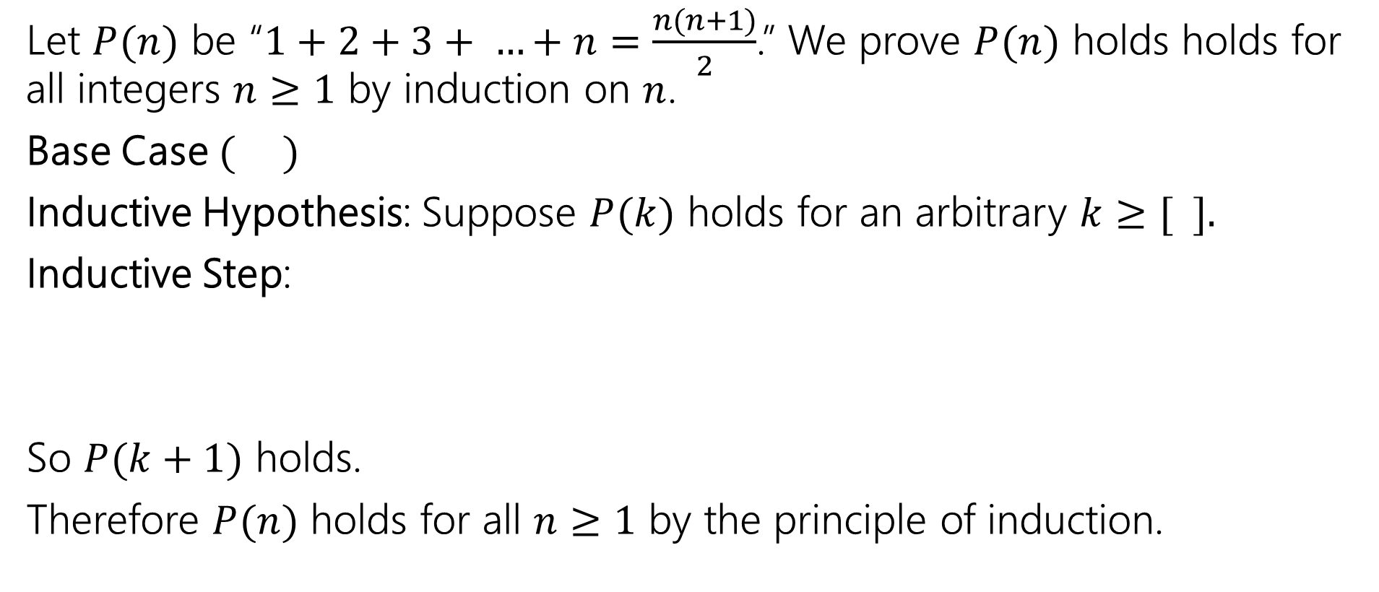
Prove that the sum of the first 𝑛 positive integers is $\frac{n(n+1)}{2}$.
Let $P(n)$ be “$1+2+3+ …+n=\frac{n(n+1)}{2}$.” We prove $P(n)$ holds holds for all integers $n≥1$ by induction on $n$.
Base Case $( )$
Inductive Hypothesis: Suppose $P(k)$ holds for an arbitrary $k≥[ ].$
Inductive Step:
So $P(k+1)$ holds.
Therefore $P(n)$ holds for all $n≥1$ by the principle of induction.

Slide 46
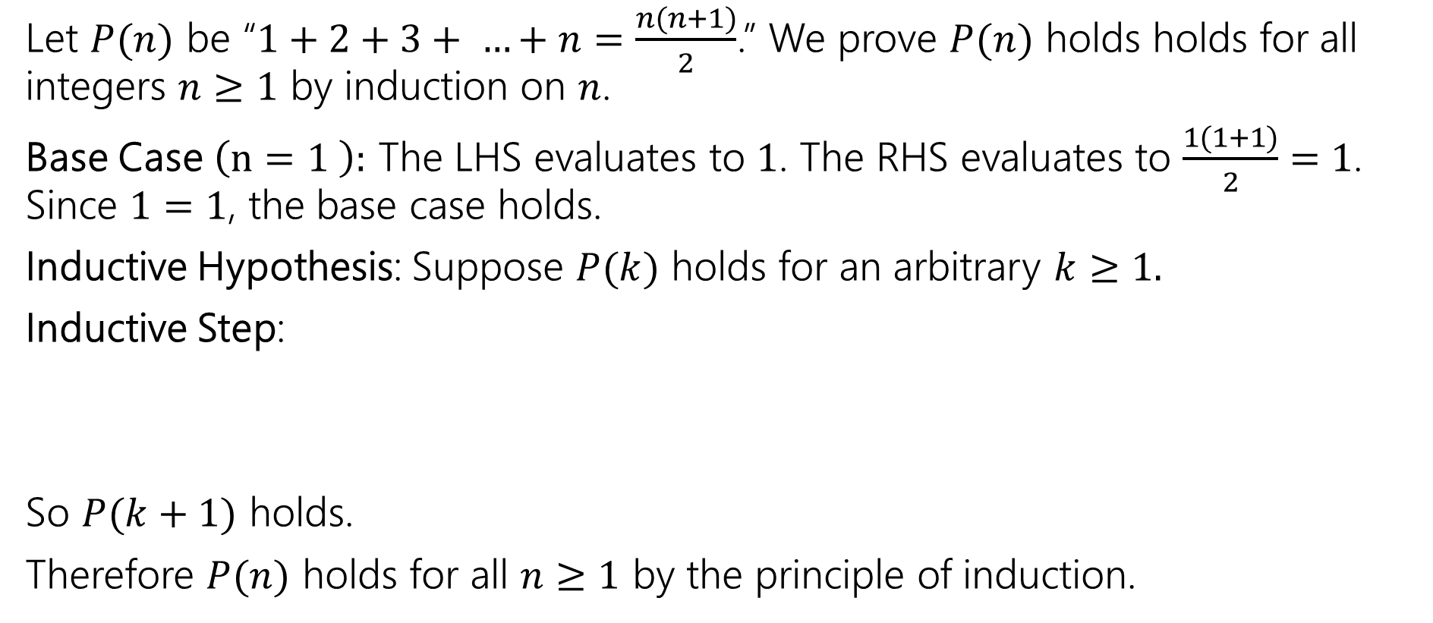
Prove that the sum of the first 𝑛 positive integers is $\frac{n(n+1)}{2}$.
Let $P(n)$ be “$1+2+3+ …+n=\frac{n(n+1)}{2}$.” We prove $P(n)$ holds holds for all integers $n≥1$ by induction on $n$.
Base Case $\left(n=1 \right):$ The LHS evaluates to $1$. The RHS evaluates to $\frac{1(1+1)}{2}=1$. Since $1=1$, the base case holds.
Inductive Hypothesis: Suppose $P(k)$ holds for an arbitrary $k≥1.$
Inductive Step:
So $P(k+1)$ holds.
Therefore $P(n)$ holds for all $n≥1$ by the principle of induction.

Slide 47
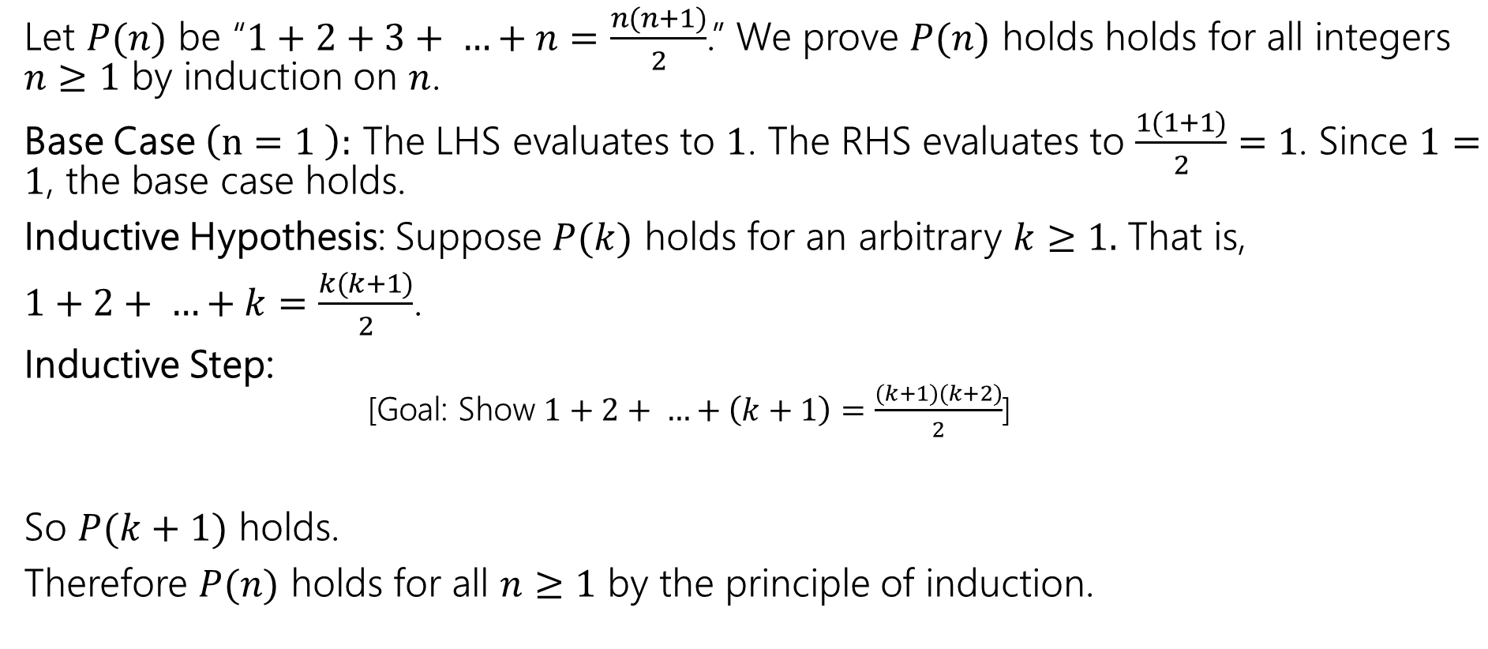
Prove that the sum of the first 𝑛 positive integers is $\frac{n(n+1)}{2}$.
Let $P(n)$ be “$1+2+3+ …+n=\frac{n(n+1)}{2}$.” We prove $P(n)$ holds holds for all integers $n≥1$ by induction on $n$.
Base Case $\left(n=1 \right):$ The LHS evaluates to $1$. The RHS evaluates to $\frac{1(1+1)}{2}=1$. Since $1=1$, the base case holds.
Inductive Hypothesis: Suppose $P(k)$ holds for an arbitrary $k≥1.$ That is,
$1+2+ …+k=\frac{k(k+1)}{2}$.
Inductive Step:
[Goal: Show $1+2+ …+\left(k+1\right)=\frac{(k+1)(k+2)}{2}$]
So $P(k+1)$ holds.
Therefore $P(n)$ holds for all $n≥1$ by the principle of induction.

Slide 48
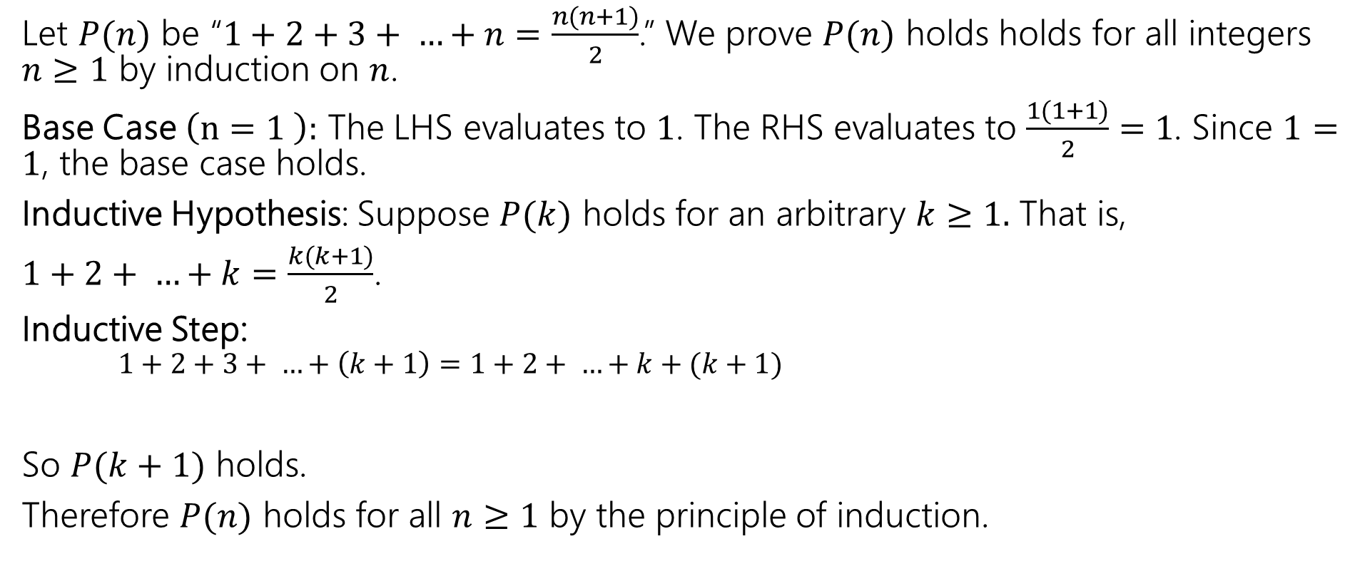
Prove that the sum of the first 𝑛 positive integers is $\frac{n(n+1)}{2}$.
Let $P(n)$ be “$1+2+3+ …+n=\frac{n(n+1)}{2}$.” We prove $P(n)$ holds holds for all integers $n≥1$ by induction on $n$.
Base Case $\left(n=1 \right):$ The LHS evaluates to $1$. The RHS evaluates to $\frac{1(1+1)}{2}=1$. Since $1=1$, the base case holds.
Inductive Hypothesis: Suppose $P(k)$ holds for an arbitrary $k≥1.$ That is,
$1+2+ …+k=\frac{k(k+1)}{2}$.
Inductive Step:
$1+2+3+ …+\left(k+1\right)=1+2+ …+k+(k+1)$
So $P(k+1)$ holds.
Therefore $P(n)$ holds for all $n≥1$ by the principle of induction.

Slide 49
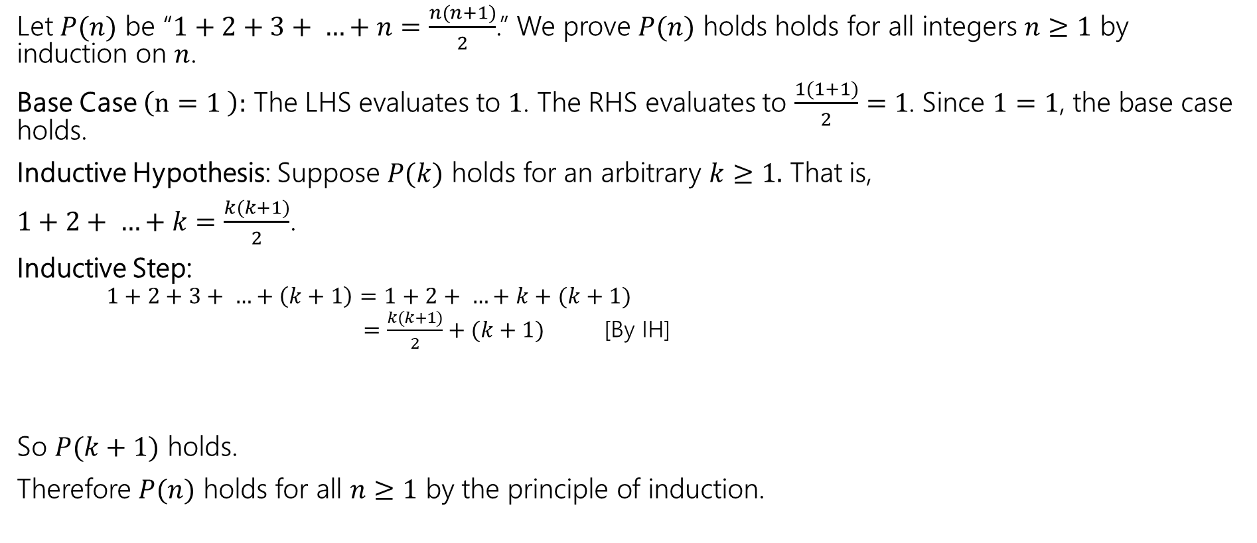
Prove that the sum of the first 𝑛 positive integers is $\frac{n(n+1)}{2}$.
Let $P(n)$ be “$1+2+3+ …+n=\frac{n(n+1)}{2}$.” We prove $P(n)$ holds holds for all integers $n≥1$ by induction on $n$.
Base Case $\left(n=1 \right):$ The LHS evaluates to $1$. The RHS evaluates to $\frac{1(1+1)}{2}=1$. Since $1=1$, the base case holds.
Inductive Hypothesis: Suppose $P(k)$ holds for an arbitrary $k≥1.$ That is,
$1+2+ …+k=\frac{k(k+1)}{2}$.
Inductive Step:
$1+2+3+ …+\left(k+1\right)=1+2+ …+k+(k+1)$
$=\frac{k(k+1)}{2}+(k+1)$ [By IH]
So $P(k+1)$ holds.
Therefore $P(n)$ holds for all $n≥1$ by the principle of induction.

Slide 50
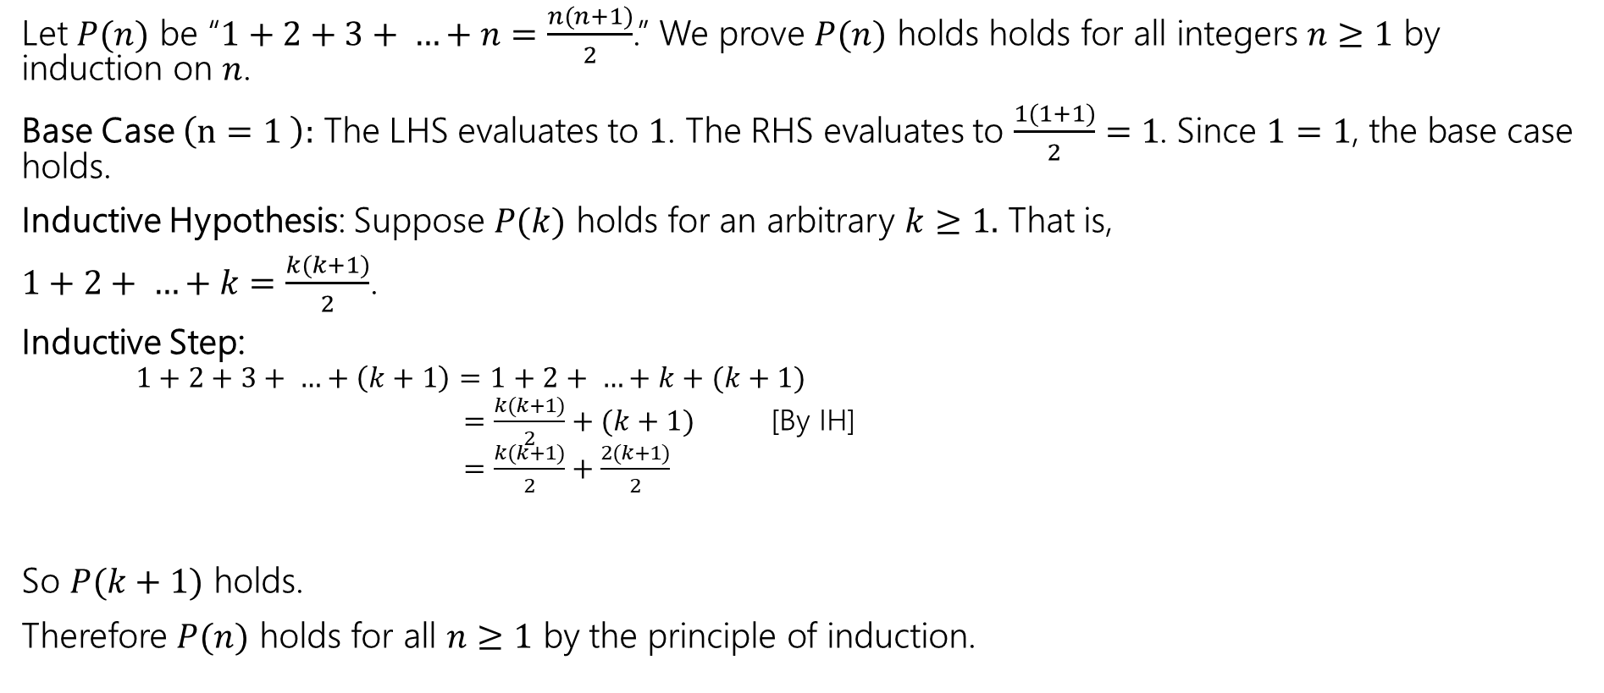
Prove that the sum of the first 𝑛 positive integers is $\frac{n(n+1)}{2}$.
Let $P(n)$ be “$1+2+3+ …+n=\frac{n(n+1)}{2}$.” We prove $P(n)$ holds holds for all integers $n≥1$ by induction on $n$.
Base Case $\left(n=1 \right):$ The LHS evaluates to $1$. The RHS evaluates to $\frac{1(1+1)}{2}=1$. Since $1=1$, the base case holds.
Inductive Hypothesis: Suppose $P(k)$ holds for an arbitrary $k≥1.$ That is,
$1+2+ …+k=\frac{k(k+1)}{2}$.
Inductive Step:
$1+2+3+ …+\left(k+1\right)=1+2+ …+k+(k+1)$
$=\frac{k(k+1)}{2}+(k+1)$ [By IH]
$=\frac{k(k+1)}{2}+\frac{2(k+1)}{2}$
So $P(k+1)$ holds.
Therefore $P(n)$ holds for all $n≥1$ by the principle of induction.

Slide 51
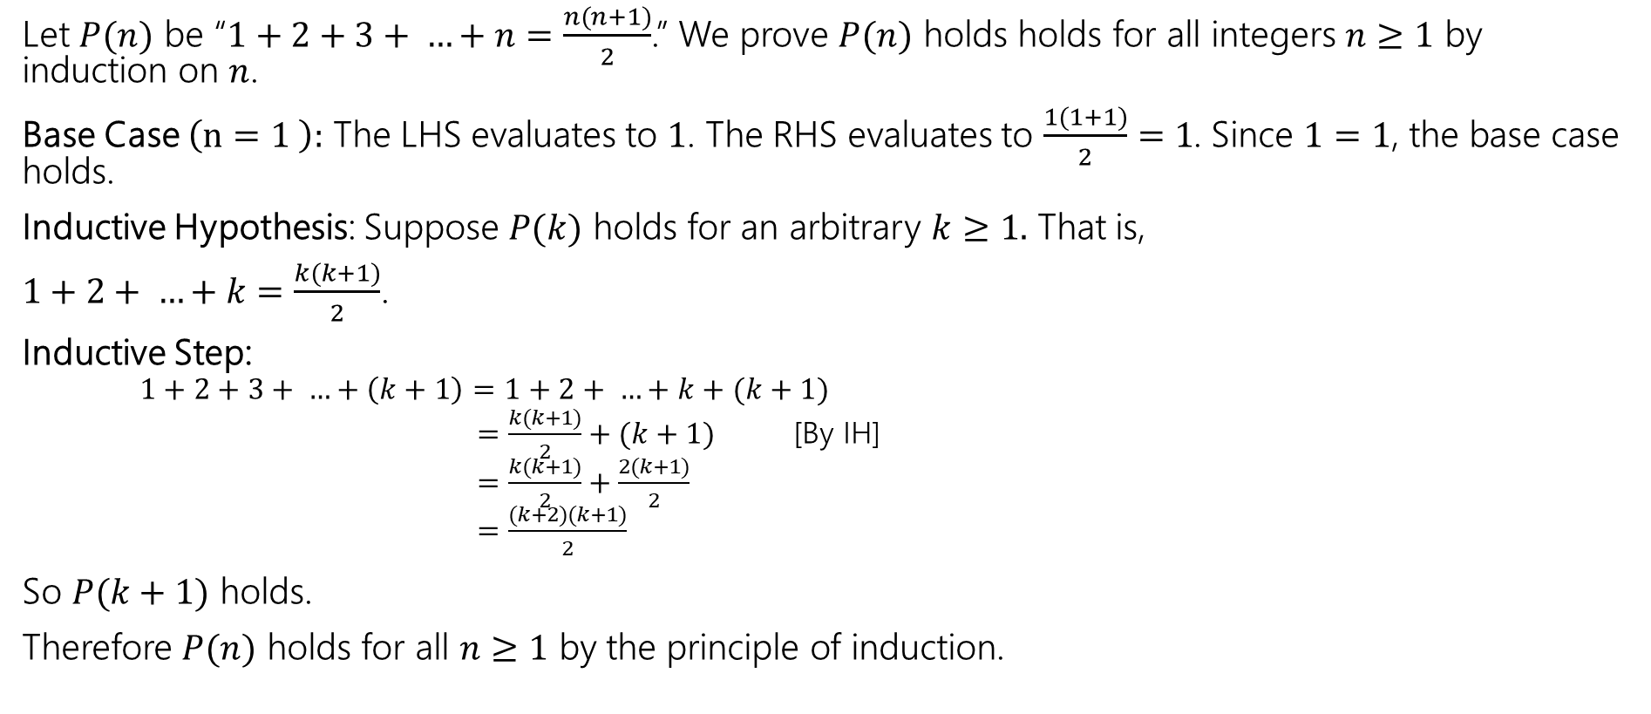
Prove that the sum of the first 𝑛 positive integers is $\frac{n(n+1)}{2}$.
Let $P(n)$ be “$1+2+3+ …+n=\frac{n(n+1)}{2}$.” We prove $P(n)$ holds holds for all integers $n≥1$ by induction on $n$.
Base Case $\left(n=1 \right):$ The LHS evaluates to $1$. The RHS evaluates to $\frac{1(1+1)}{2}=1$. Since $1=1$, the base case holds.
Inductive Hypothesis: Suppose $P(k)$ holds for an arbitrary $k≥1.$ That is,
$1+2+ …+k=\frac{k(k+1)}{2}$.
Inductive Step:
$1+2+3+ …+\left(k+1\right)=1+2+ …+k+(k+1)$
$=\frac{k(k+1)}{2}+(k+1)$ [By IH]
$=\frac{k(k+1)}{2}+\frac{2(k+1)}{2}$
$=\frac{(k+2)(k+1)}{2}$
So $P(k+1)$ holds.
Therefore $P(n)$ holds for all $n≥1$ by the principle of induction.

Slide 52
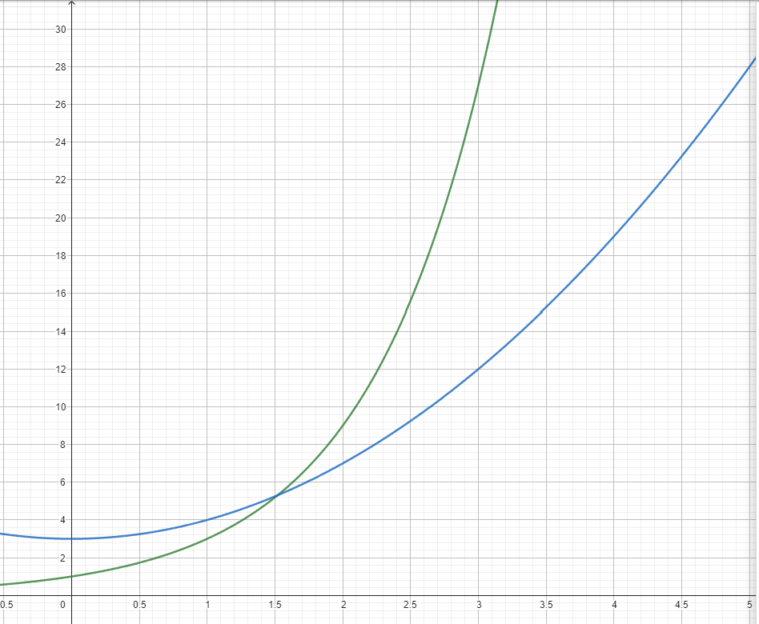


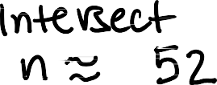

Prove that 3^{𝑛} ≥ 𝑛² + 3 for all integers 𝑛 ≥ 2.
Not a proof!

Slide 53
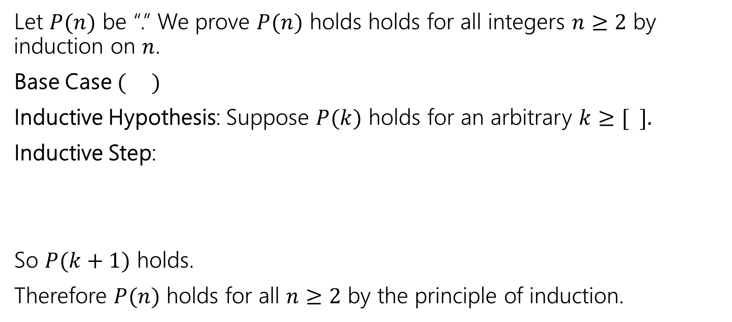
Prove that 3^{𝑛} ≥ 𝑛² + 3 for all integers 𝑛 ≥ 2.
Let $P(n)$ be “.” We prove $P(n)$ holds holds for all integers $n≥2$ by induction on $n$.
Base Case $( )$
Inductive Hypothesis: Suppose $P(k)$ holds for an arbitrary $k≥[ ].$
Inductive Step:
So $P(k+1)$ holds.
Therefore $P(n)$ holds for all $n≥2$ by the principle of induction.

Slide 54
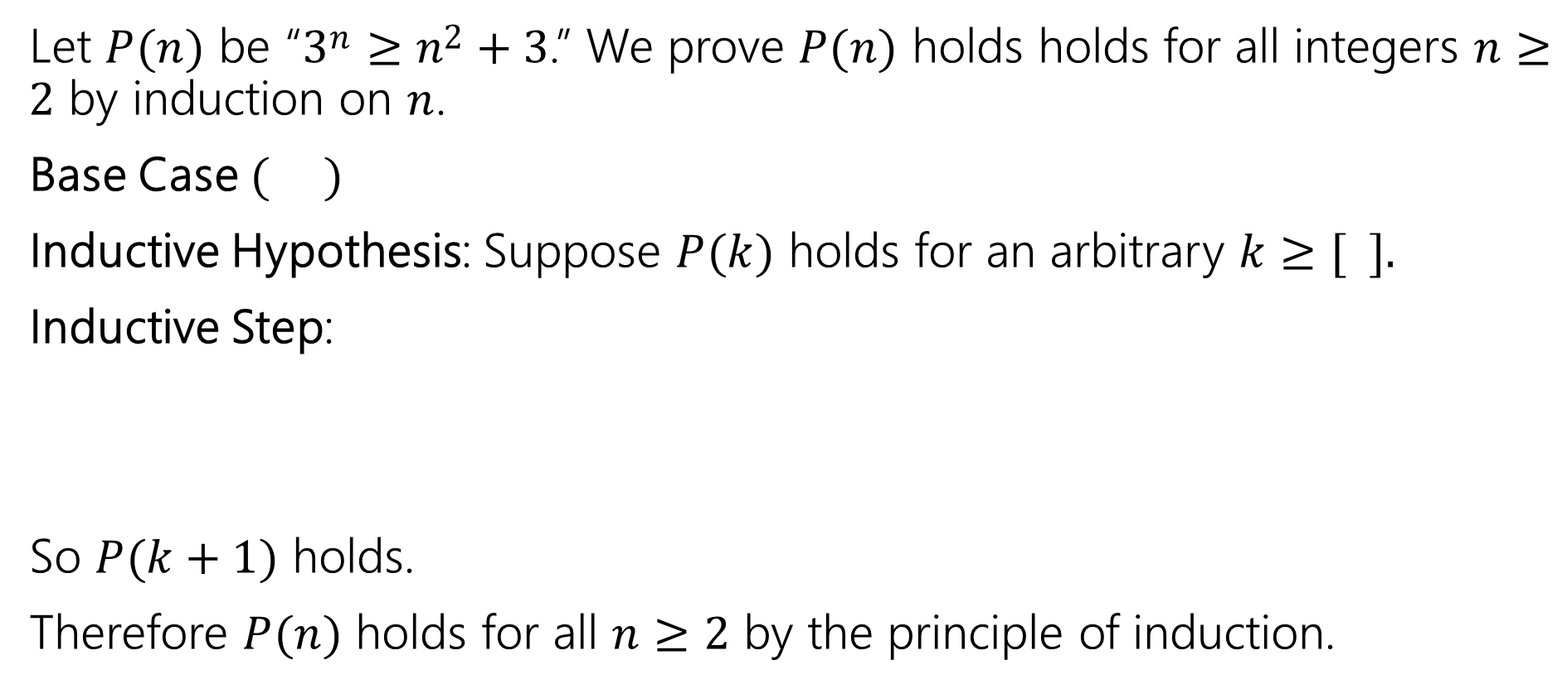
Prove that 3^{𝑛} ≥ 𝑛² + 3 for all integers 𝑛 ≥ 2.
Let $P(n)$ be “3^{𝑛} ≥ 𝑛² + 3.” We prove $P(n)$ holds holds for all integers $n≥2$ by induction on $n$.
Base Case $( )$
Inductive Hypothesis: Suppose $P(k)$ holds for an arbitrary $k≥[ ].$
Inductive Step:
So $P(k+1)$ holds.
Therefore $P(n)$ holds for all $n≥2$ by the principle of induction.

Slide 55
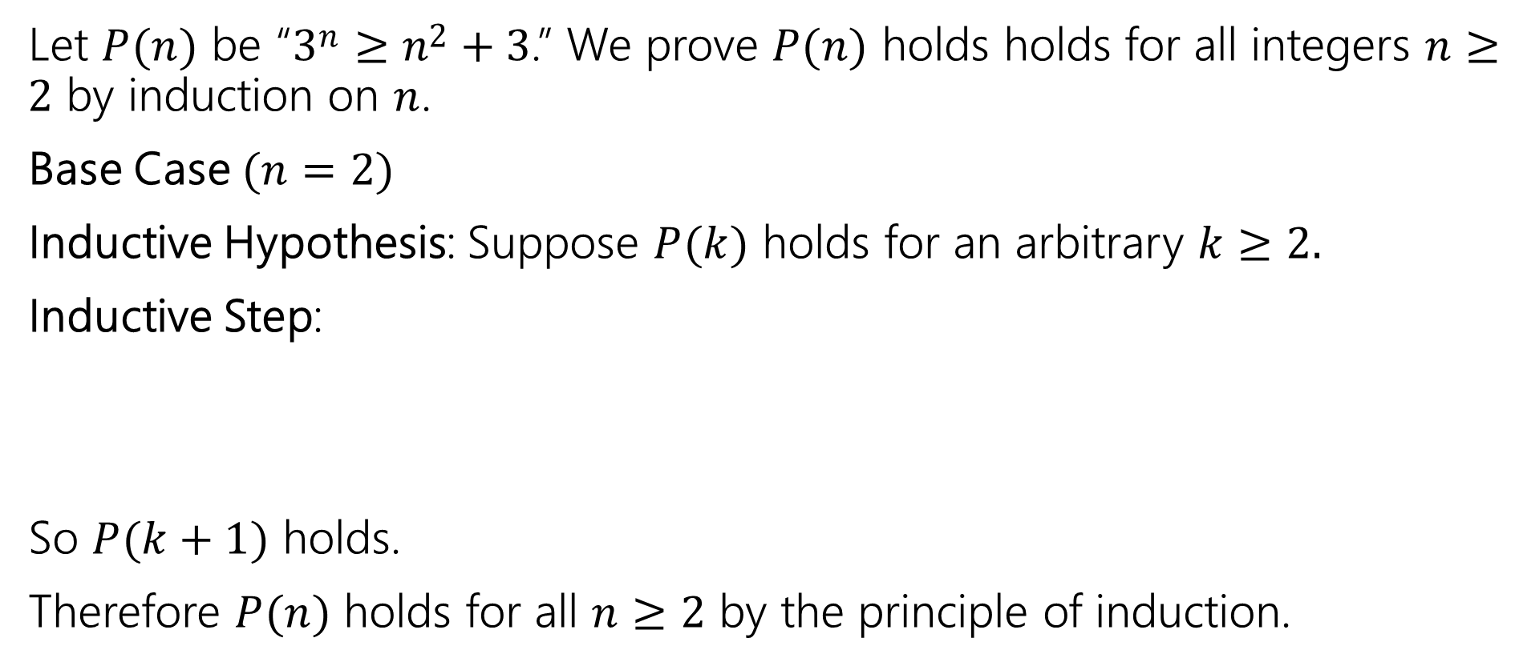
Prove that 3^{𝑛} ≥ 𝑛² + 3 for all integers 𝑛 ≥ 2.
Let $P(n)$ be “3^{𝑛} ≥ 𝑛² + 3.” We prove $P(n)$ holds holds for all integers $n≥2$ by induction on $n$.
Base Case $(n=2)$
Inductive Hypothesis: Suppose $P(k)$ holds for an arbitrary $k≥2.$
Inductive Step:
So $P(k+1)$ holds.
Therefore $P(n)$ holds for all $n≥2$ by the principle of induction.

Slide 56
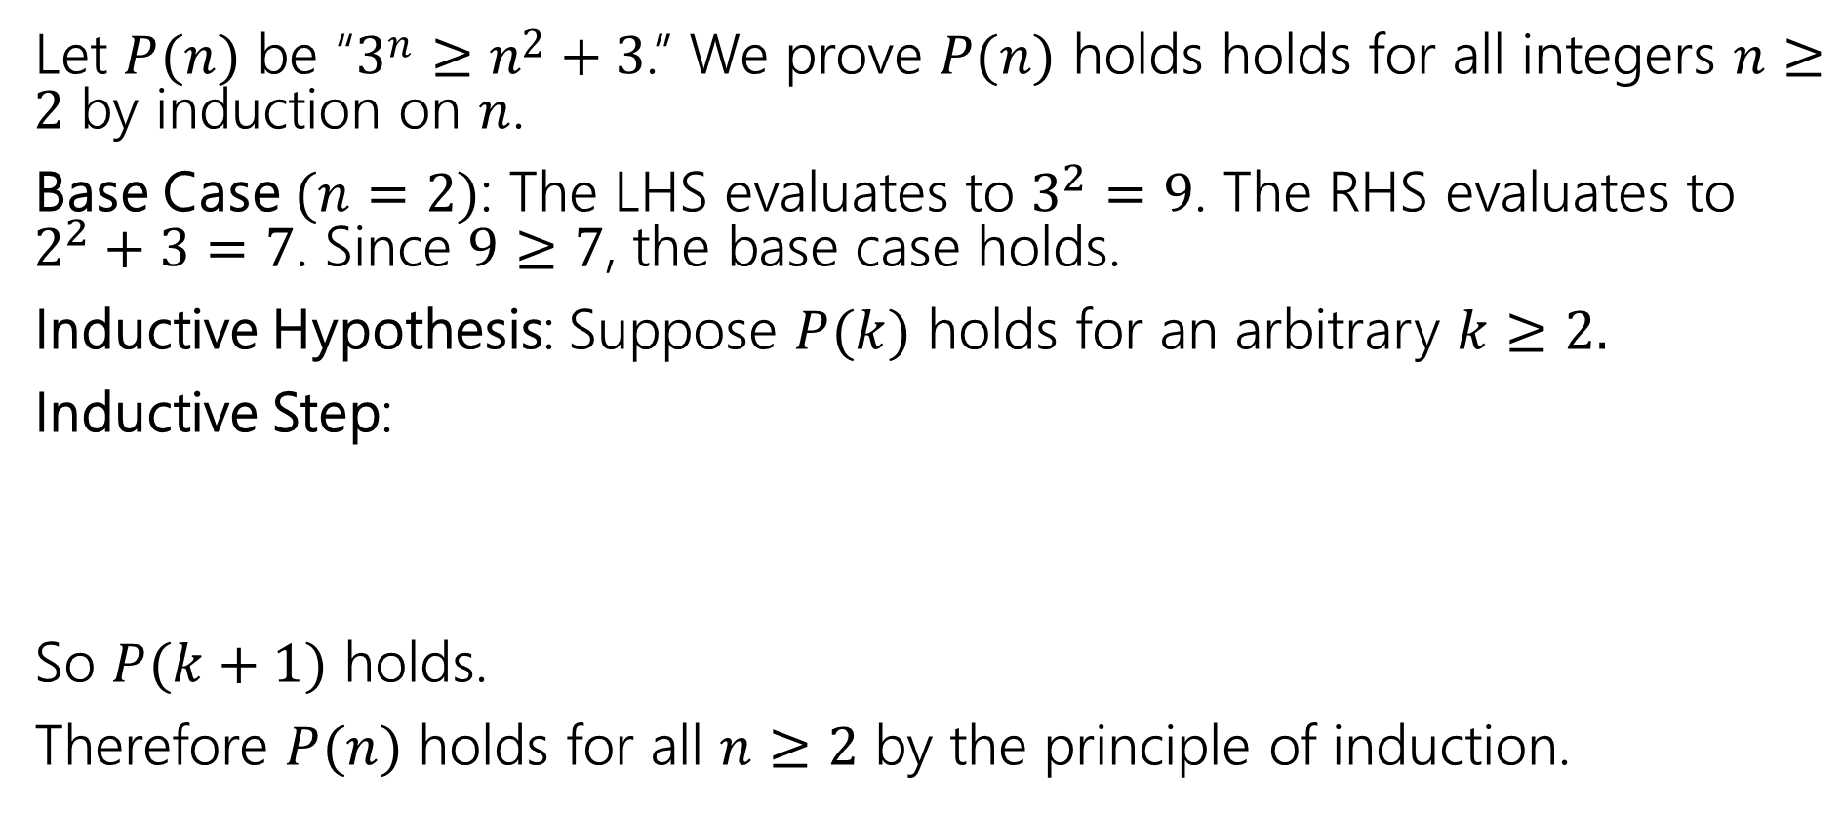
Prove that 3^{𝑛} ≥ 𝑛² + 3 for all integers 𝑛 ≥ 2.
Let $P(n)$ be “3^{𝑛} ≥ 𝑛² + 3.” We prove $P(n)$ holds holds for all integers $n≥2$ by induction on $n$.
Base Case $(n=2)$: The LHS evaluates to $3^{2}=9$. The RHS evaluates to $2^{2}+3=7$. Since $9≥7$, the base case holds.
Inductive Hypothesis: Suppose $P(k)$ holds for an arbitrary $k≥2.$
Inductive Step:
So $P(k+1)$ holds.
Therefore $P(n)$ holds for all $n≥2$ by the principle of induction.

Slide 57
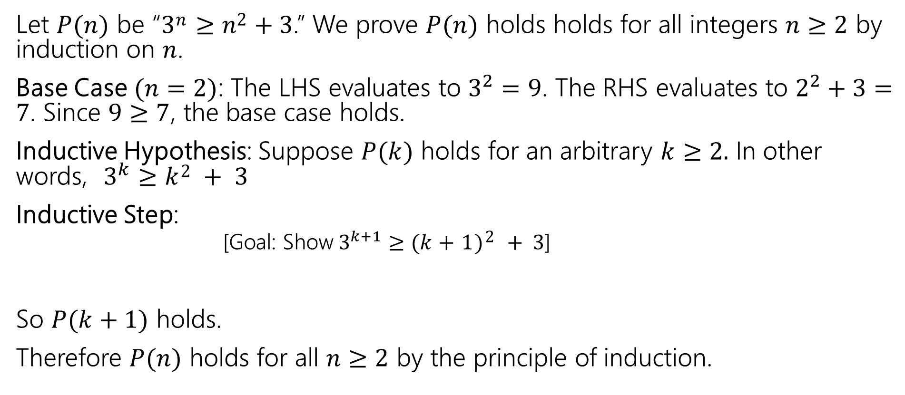
Prove that 3^{𝑛} ≥ 𝑛² + 3 for all integers 𝑛 ≥ 2.
Let $P(n)$ be “3^{𝑛} ≥ 𝑛² + 3.” We prove $P(n)$ holds holds for all integers $n≥2$ by induction on $n$.
Base Case $(n=2)$: The LHS evaluates to $3^{2}=9$. The RHS evaluates to $2^{2}+3=7$. Since $9≥7$, the base case holds.
Inductive Hypothesis: Suppose $P(k)$ holds for an arbitrary $k≥2.$ In other words, $3^{k}≥k2 + 3$
Inductive Step:
[Goal: Show$3^{k+1}≥(k+1)2 + 3$]
So $P(k+1)$ holds.
Therefore $P(n)$ holds for all $n≥2$ by the principle of induction.

Slide 58
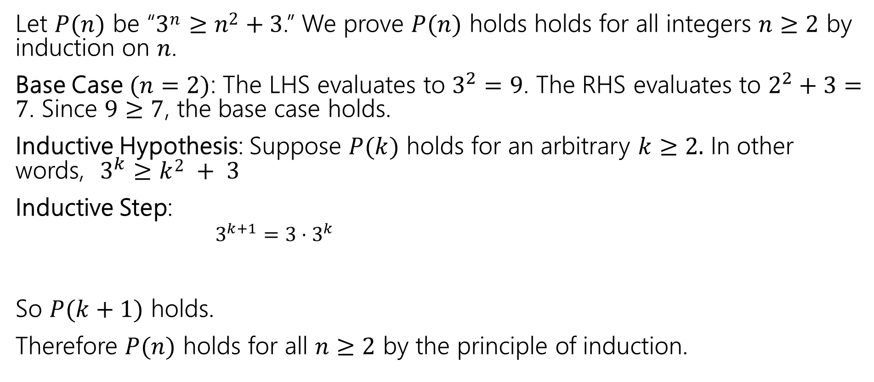
Prove that 3^{𝑛} ≥ 𝑛² + 3 for all integers 𝑛 ≥ 2.
Let $P(n)$ be “3^{𝑛} ≥ 𝑛² + 3.” We prove $P(n)$ holds holds for all integers $n≥2$ by induction on $n$.
Base Case $(n=2)$: The LHS evaluates to $3^{2}=9$. The RHS evaluates to $2^{2}+3=7$. Since $9≥7$, the base case holds.
Inductive Hypothesis: Suppose $P(k)$ holds for an arbitrary $k≥2.$ In other words, $3^{k}≥k2 + 3$
Inductive Step:
$3^{k+1}=3⋅3^{k}$
So $P(k+1)$ holds.
Therefore $P(n)$ holds for all $n≥2$ by the principle of induction.

Slide 59
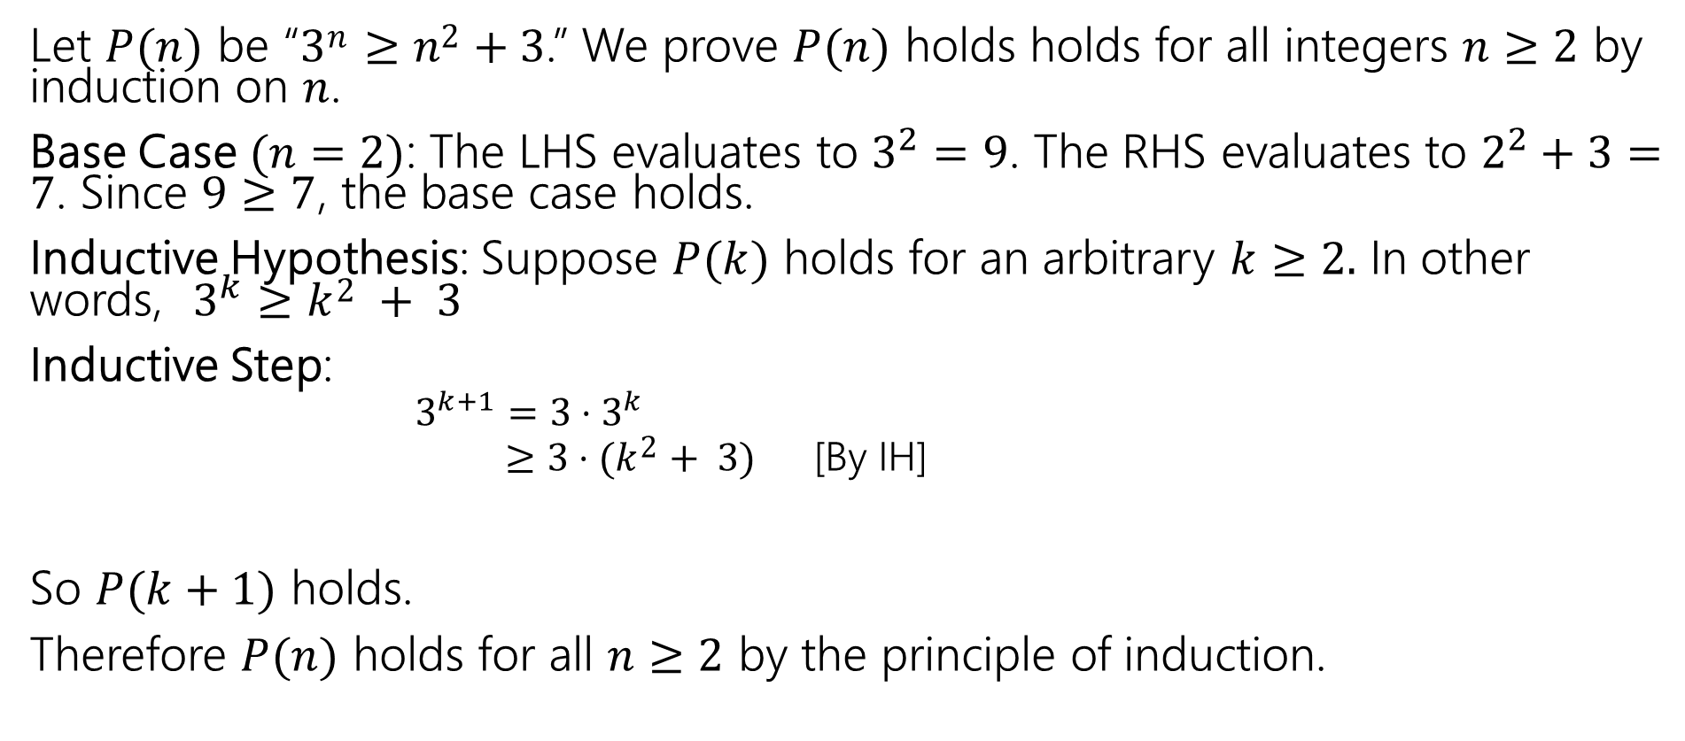
Prove that 3^{𝑛} ≥ 𝑛² + 3 for all integers 𝑛 ≥ 2.
Let $P(n)$ be “3^{𝑛} ≥ 𝑛² + 3.” We prove $P(n)$ holds holds for all integers $n≥2$ by induction on $n$.
Base Case $(n=2)$: The LHS evaluates to $3^{2}=9$. The RHS evaluates to $2^{2}+3=7$. Since $9≥7$, the base case holds.
Inductive Hypothesis: Suppose $P(k)$ holds for an arbitrary $k≥2.$ In other words, $3^{k}≥k2 + 3$
Inductive Step:
$3^{k+1}=3⋅3^{k}$
$≥3⋅(k2+ 3)$ [By IH]
So $P(k+1)$ holds.
Therefore $P(n)$ holds for all $n≥2$ by the principle of induction.

Slide 60
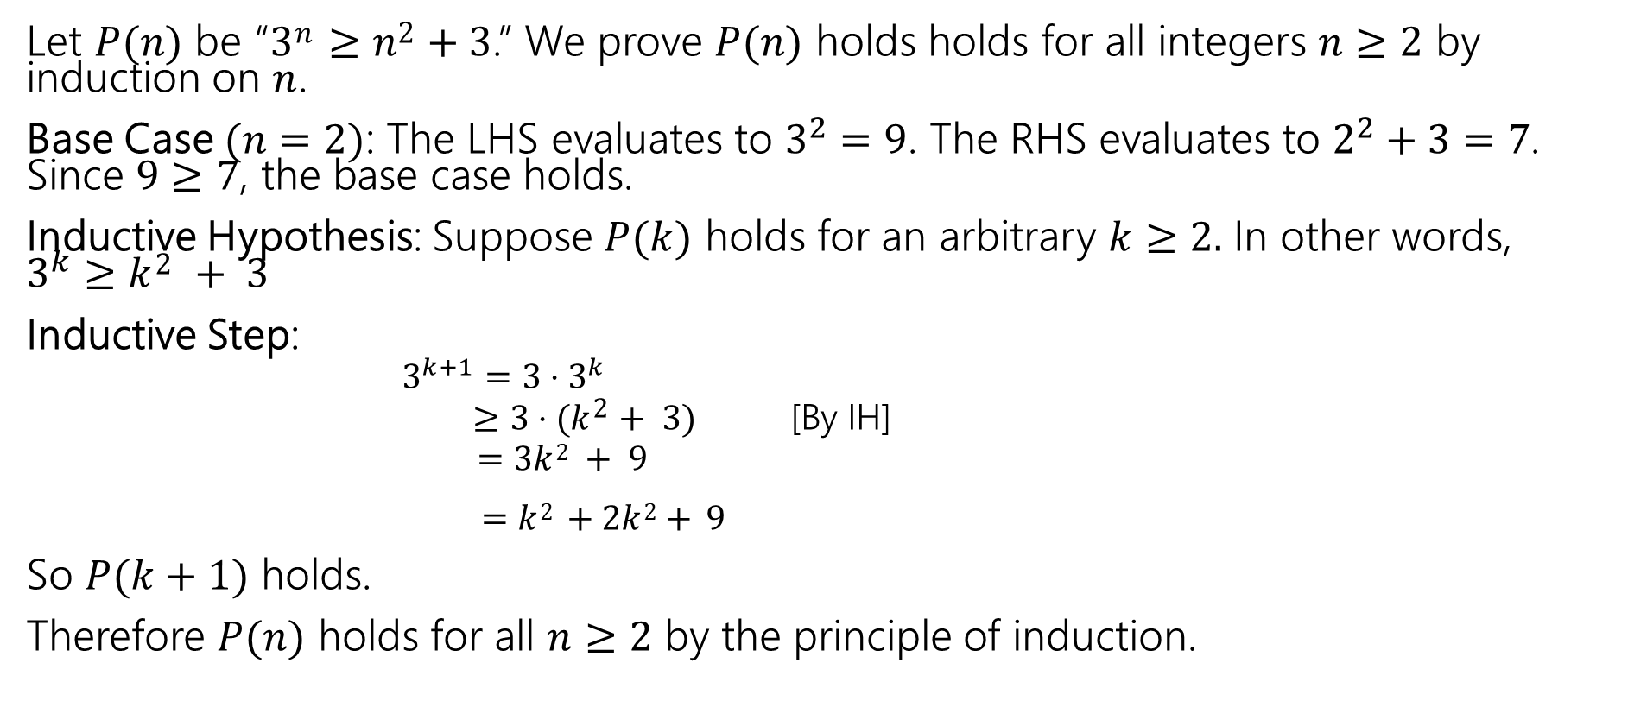
Prove that 3^{𝑛} ≥ 𝑛² + 3 for all integers 𝑛 ≥ 2.
Let $P(n)$ be “3^{𝑛} ≥ 𝑛² + 3.” We prove $P(n)$ holds holds for all integers $n≥2$ by induction on $n$.
Base Case $(n=2)$: The LHS evaluates to $3^{2}=9$. The RHS evaluates to $2^{2}+3=7$. Since $9≥7$, the base case holds.
Inductive Hypothesis: Suppose $P(k)$ holds for an arbitrary $k≥2.$ In other words, $3^{k}≥k2 + 3$
Inductive Step:
$3^{k+1}=3⋅3^{k}$
$≥3⋅(k2+ 3)$ [By IH]
$=3k2 + 9$
$=k2 +2k2+ 9$
So $P(k+1)$ holds.
Therefore $P(n)$ holds for all $n≥2$ by the principle of induction.

Slide 61
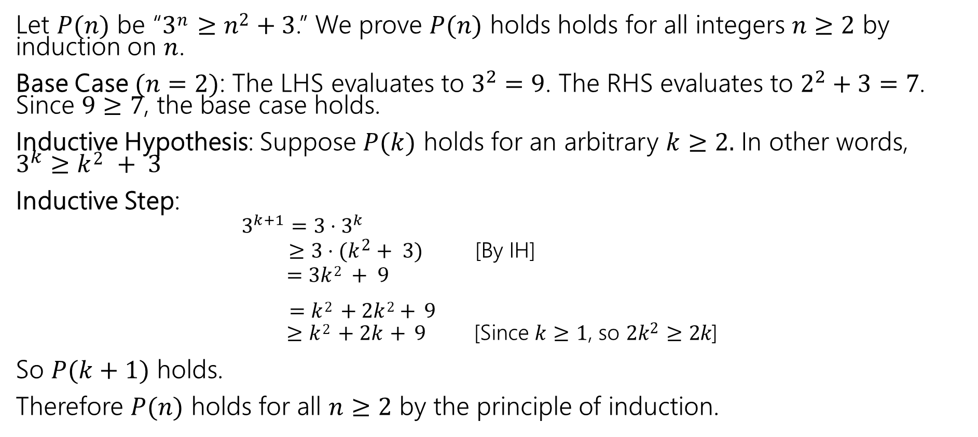
Prove that 3^{𝑛} ≥ 𝑛² + 3 for all integers 𝑛 ≥ 2.
Let $P(n)$ be “3^{𝑛} ≥ 𝑛² + 3.” We prove $P(n)$ holds holds for all integers $n≥2$ by induction on $n$.
Base Case $(n=2)$: The LHS evaluates to $3^{2}=9$. The RHS evaluates to $2^{2}+3=7$. Since $9≥7$, the base case holds.
Inductive Hypothesis: Suppose $P(k)$ holds for an arbitrary $k≥2.$ In other words, $3^{k}≥k2 + 3$
Inductive Step:
$3^{k+1}=3⋅3^{k}$
$≥3⋅(k2+ 3)$ [By IH]
$=3k2 + 9$
$=k2 +2k2+ 9$
$≥k2 +2k+ 9$ [Since 𝑘 ≥ 1, so 2𝑘² ≥ 2𝑘]
So $P(k+1)$ holds.
Therefore $P(n)$ holds for all $n≥2$ by the principle of induction.

Slide 62
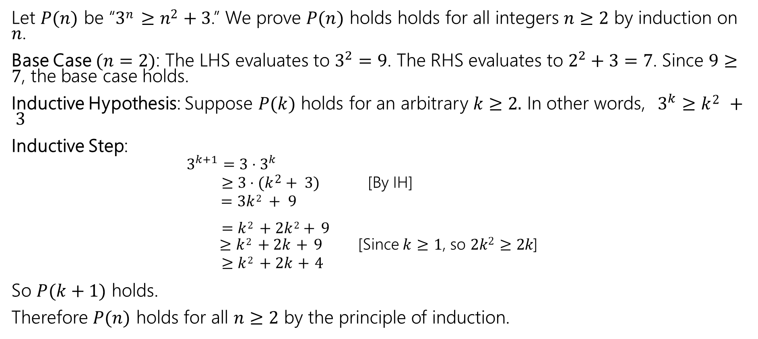
Prove that 3^{𝑛} ≥ 𝑛² + 3 for all integers 𝑛 ≥ 2.
Let $P(n)$ be “3^{𝑛} ≥ 𝑛² + 3.” We prove $P(n)$ holds holds for all integers $n≥2$ by induction on $n$.
Base Case $(n=2)$: The LHS evaluates to $3^{2}=9$. The RHS evaluates to $2^{2}+3=7$. Since $9≥7$, the base case holds.
Inductive Hypothesis: Suppose $P(k)$ holds for an arbitrary $k≥2.$ In other words, $3^{k}≥k2 + 3$
Inductive Step:
$3^{k+1}=3⋅3^{k}$
$≥3⋅(k2+ 3)$ [By IH]
$=3k2 + 9$
$=k2 +2k2+ 9$
$≥k2 +2k+ 9$ [Since 𝑘 ≥ 1, so 2𝑘² ≥ 2𝑘]
$≥k2 +2k+4$
So $P(k+1)$ holds.
Therefore $P(n)$ holds for all $n≥2$ by the principle of induction.

Slide 63
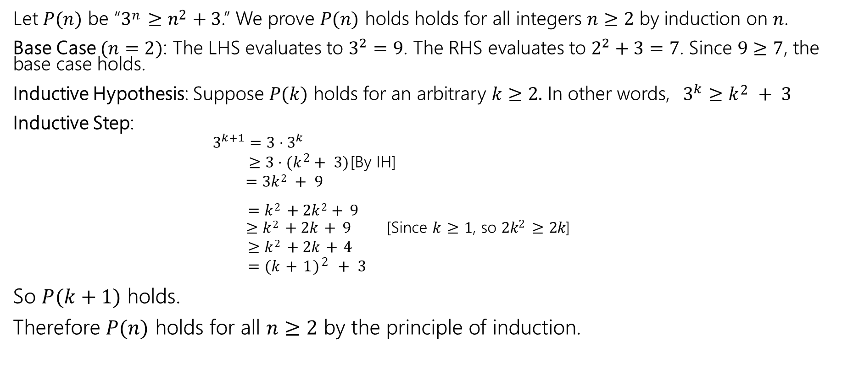
Prove that 3^{𝑛} ≥ 𝑛² + 3 for all integers 𝑛 ≥ 2.
Let $P(n)$ be “3^{𝑛} ≥ 𝑛² + 3.” We prove $P(n)$ holds holds for all integers $n≥2$ by induction on $n$.
Base Case $(n=2)$: The LHS evaluates to $3^{2}=9$. The RHS evaluates to $2^{2}+3=7$. Since $9≥7$, the base case holds.
Inductive Hypothesis: Suppose $P(k)$ holds for an arbitrary $k≥2.$ In other words, $3^{k}≥k2 + 3$
Inductive Step:
$3^{k+1}=3⋅3^{k}$
$≥3⋅(k2+ 3)$ [By IH]
$=3k2 + 9$
$=k2 +2k2+ 9$
$≥k2 +2k+ 9$ [Since 𝑘 ≥ 1, so 2𝑘² ≥ 2𝑘]
$≥k2 +2k+4$
$=(k+1)2 + 3$
So $P(k+1)$ holds.
Therefore $P(n)$ holds for all $n≥2$ by the principle of induction.

Slide 64
Todo
Tonight:
CC 12 is out and due Wednesday at noon
Start HW4 if you have not already!
Read the midterm logistics on the Exams page of the course website and post on the Ed board if you have any questions

Slide 65
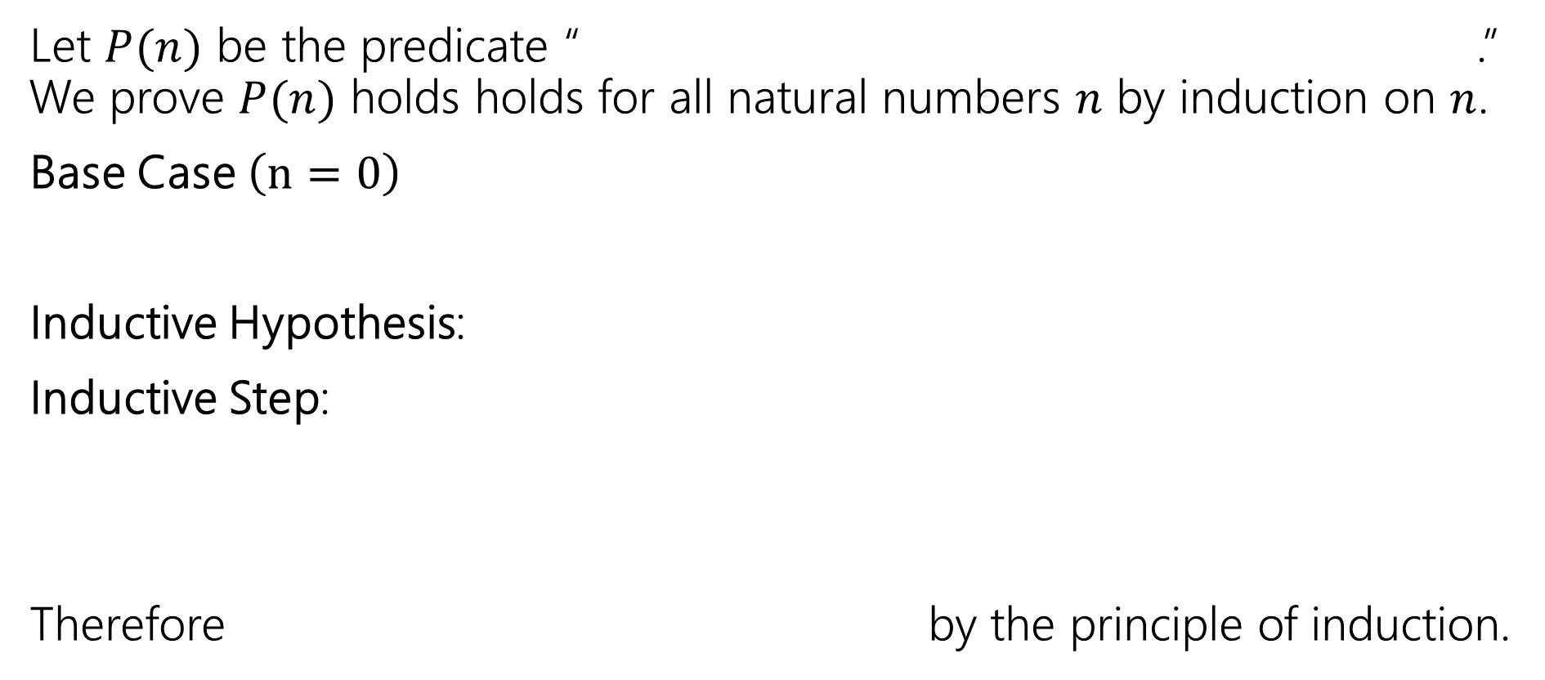
Making Induction Proofs Pretty
Let $P(n)$ be the predicate “ .” We prove $P(n)$ holds holds for all natural numbers $n$ by induction on $n$.
Base Case $\left(n=0\right)$
Inductive Hypothesis:
Inductive Step:
Therefore by the principle of induction.

