Slide 1
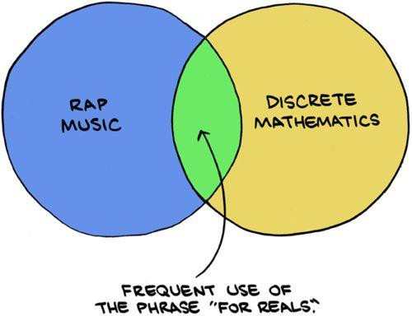
Set Theory Continued
CSE 311 Summer 25
Lecture 11

Slide 2
Announcements
HW4 is released!
Make sure to start this one early. You’ll be writing more complex set and number theory proofs.
HW2 Feedback is out
HW2 Resubmission is due tonight!

Slide 3
Review

Slide 4
Sets
A set is an unordered collection of distinct objects, called elements.
The cardinality of a set is the number of elements in the set, denote
|𝑆| for a set 𝑆.
Sets 𝐴 and 𝐵 are equal if they have the same elements.
Set 𝐴 is a subset of 𝐵 if every element of 𝐴 is also in 𝐵.
B
A
is a subset of B
A

Slide 5
Common Sets
ℝ is the set of Real Numbers.
ℤ is the set of Integers.
ℕ is the set of Natural Numbers.
ℚ is the set of Rational Numbers (fractions)
∅ = {} is the Empty Set
E.g. 1, −17, 𝜋, 2
ℤ = {… , −2, −1, 0, 1, 2, … }
ℕ = {0, 1, 2, 3, … }
E.g. ¹ , − ¹¹ , 17
2 3
∅ has no elements

Slide 6
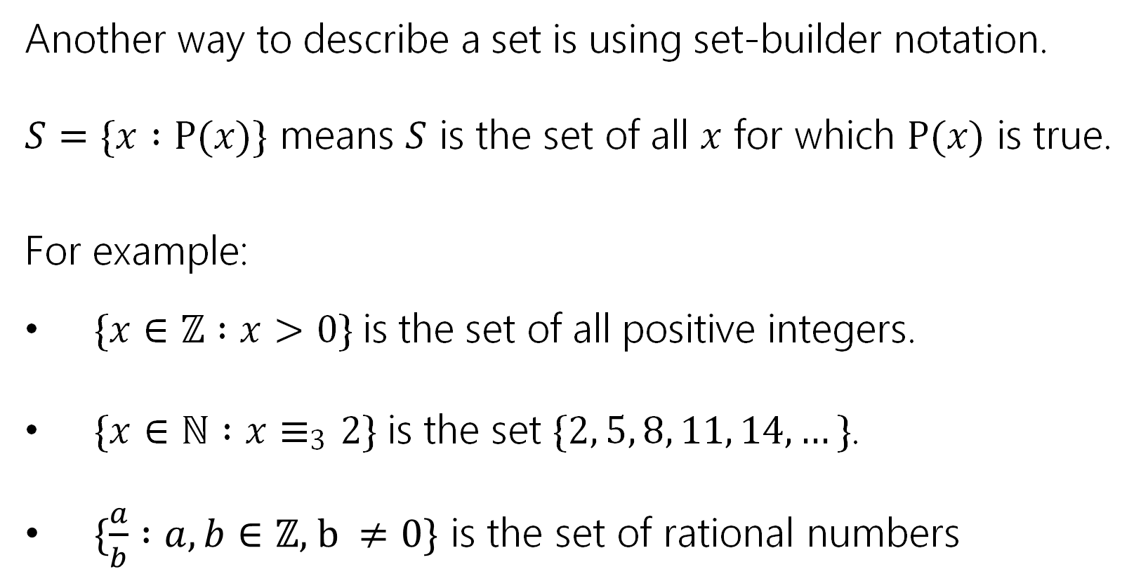
Sets Builder Notation
Another way to describe a set is using set-builder notation.
𝑆 = {𝑥 ∶ P(𝑥)} means 𝑆 is the set of all 𝑥 for which P(𝑥) is true. For example:
{𝑥 ∈ ℤ ∶ 𝑥 > 0} is the set of all positive integers.
{𝑥 ∈ ℕ ∶ 𝑥 ≡₃ 2} is the set {2, 5, 8, 11, 14, … }.
$\{\frac{a}{b} :a, b∈\text{ℤ}\text{, }\text{b} ≠0\}$ is the set of rational numbers

Slide 7
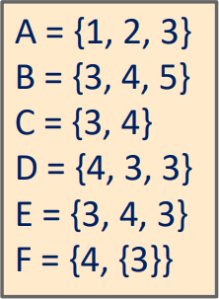
Set Equality
Sets 𝐴 and 𝐵 are equal iff they have the same elements.
In predicate logic, 𝐴 = 𝐵 is defined as:
∀𝑥 𝑥 ∈ 𝐴 ↔ 𝑥 ∈ 𝐵
Which sets are equal?
𝐶 = 𝐷 = 𝐸

Slide 8
Subset
Set 𝐴 is a subset of 𝐵 if every element of 𝐴 is also in 𝐵.
In predicate logic, 𝐴 ⊆ 𝐵 is defined as:
∀𝑥(𝑥 ∈ 𝐴 → 𝑥 ∈ 𝐵)
Which sets are subsets?
𝐶 ⊆ 𝐵, 𝐷 ⊆ 𝐸, 𝐸 ⊆ 𝐷, etc.

Slide 9
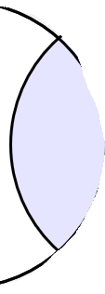
Set Operations
Union: 𝐴 ∪ 𝐵
Intersection: 𝐴 ∩ 𝐵
𝐴 ∪ 𝐵 = {𝑥 ∶ 𝑥 ∈ 𝐴 ∨ 𝑥 ∈ 𝐵}
𝐴 ∩ 𝐵 = {𝑥 ∶ 𝑥 ∈ 𝐴 ∧ 𝑥 ∈ 𝐵}
A B
A B

Slide 10
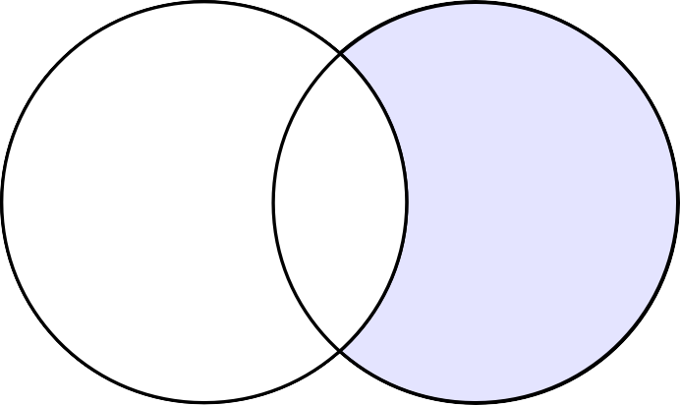
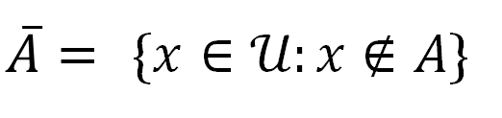
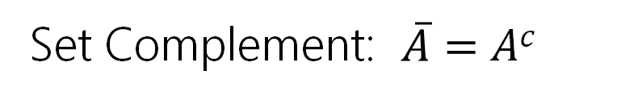
Set Operations
Set Difference: 𝐴 \ 𝐵
Set Complement: $\overline{A}=$ 𝐴^{𝑐}
(with respect to the universe 𝒰)
𝐴 \ 𝐵 = {𝑥 ∶ 𝑥 ∈ 𝐴 ∧ 𝑥 ∉ 𝐵}
$\overline{A}$ = {𝑥 ∈ 𝒰: 𝑥 ∉ 𝐴}
A B
A B

Slide 11
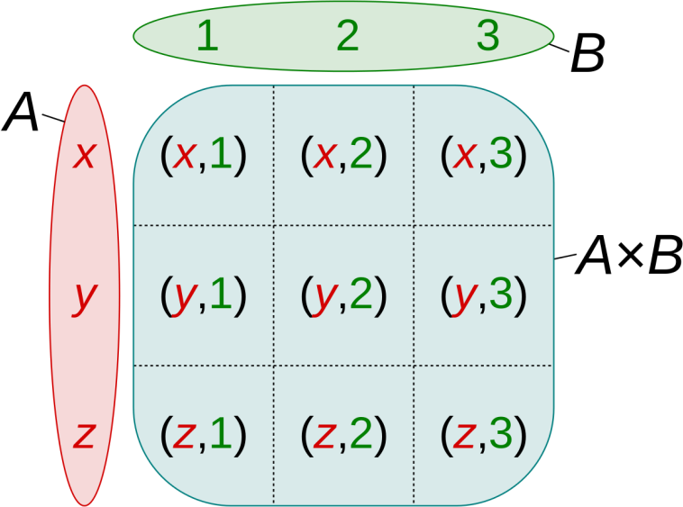
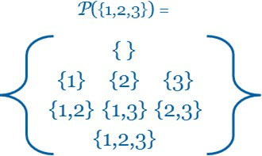
Set Operations
Powerset: 𝒫(𝐴)
𝒫 𝐴 = {𝐵 ∶ 𝐵 ⊆ 𝐴}
Cartesian Product: 𝐴 × 𝐵
𝐴 × 𝐵 = 𝑎, 𝑏 : 𝑎 ∈ 𝐴, 𝑏 ∈ 𝐵

Slide 12
Warm Up: Two Claims

Slide 13
Two Claims
Determine if the following claims are true or false.
Claim 1: For all sets 𝐴, 𝐵, 𝐶, if 𝐴 ⊆ (𝐵 ∪ 𝐶) then 𝐴 ⊆ 𝐵 or 𝐴 ⊆ 𝐶.
Claim 2: For all sets 𝐴, 𝐵, 𝐶 it holds that 𝐴 ∩ 𝐵 ∩ 𝐶 ⊆ 𝐴 ∪ 𝐵.

Slide 14
Two Claims
Determine if the following claims are true or false.
Claim 1: For all sets 𝐴, 𝐵, 𝐶, if 𝐴 ⊆ (𝐵 ∪ 𝐶) then 𝐴 ⊆ 𝐵 or 𝐴 ⊆ 𝐶.
Claim 2: For all sets 𝐴, 𝐵, 𝐶 it holds that 𝐴 ∩ 𝐵 ∩ 𝐶 ⊆ 𝐴 ∪ 𝐵.
False.
True.

Slide 15
Claim 1
Claim 1: For all sets 𝐴, 𝐵, 𝐶, if 𝐴 ⊆ (𝐵 ∪ 𝐶) then 𝐴 ⊆ 𝐵 or 𝐴 ⊆ 𝐶.
We disprove this claim with a counterexample.
Let 𝐴 = {1,2}, let 𝐵 = {1} and 𝐶 = {2}. Then
𝐴 ⊆ (𝐵 ∪ 𝐶), but 𝐴 ⊈ 𝐵 and 𝐴 ⊈ 𝐶.

Slide 16
Claim 2
Definition
𝐴 ⊆ 𝐵 ≡ ∀𝑥(𝑥 ∈ 𝐴 → 𝑥 ∈ 𝐵)
Claim 2: For all sets 𝐴, 𝐵, 𝐶 it holds that 𝐴 ∩ 𝐵 ∩ 𝐶 ⊆ 𝐴 ∪ 𝐵. Proof Strategy
Let 𝐴, 𝐵, 𝐶 be arbitrary sets.
Let 𝑥 ∈ 𝐴 ∩ 𝐵 ∩ 𝐶 be arbitrary.
Prove that 𝑥 ∈ 𝐴 ∪ 𝐵.

Slide 17
Claim 2
Definition
𝐴 ⊆ 𝐵 ≡ ∀𝑥(𝑥 ∈ 𝐴 → 𝑥 ∈ 𝐵)
Claim 2: For all sets 𝐴, 𝐵, 𝐶 it holds that 𝐴 ∩ 𝐵 ∩ 𝐶 ⊆ 𝐴 ∪ 𝐵. Proof
Let sets 𝐴, 𝐵, 𝐶 be arbitrary. Let 𝑥 ∈ 𝐴 ∩ 𝐵 ∩ 𝐶 be an arbitrary element.
So 𝑥 ∈ 𝐴 ∪ 𝐵. Since 𝑥 was arbitrary, 𝐴 ∩ 𝐵 ∩ 𝐶 ⊆ 𝐴 ∪ 𝐵.

Slide 18
Claim 2
Definition
𝐴 ⊆ 𝐵 ≡ ∀𝑥(𝑥 ∈ 𝐴 → 𝑥 ∈ 𝐵)
Claim 2: For all sets 𝐴, 𝐵, 𝐶 it holds that 𝐴 ∩ 𝐵 ∩ 𝐶 ⊆ 𝐴 ∪ 𝐵. Proof
Let sets 𝐴, 𝐵, 𝐶 be arbitrary. Let 𝑥 ∈ 𝐴 ∩ 𝐵 ∩ 𝐶 be an arbitrary element.
[Unroll definitions]
[Use facts to move towards goal]
[Reroll definitions]
So 𝑥 ∈ 𝐴 ∪ 𝐵. Since 𝑥 was arbitrary, 𝐴 ∩ 𝐵 ∩ 𝐶 ⊆ 𝐴 ∪ 𝐵.

Slide 19
Claim 2
Definition
𝐴 ⊆ 𝐵 ≡ ∀𝑥(𝑥 ∈ 𝐴 → 𝑥 ∈ 𝐵)
Claim 2: For all sets 𝐴, 𝐵, 𝐶 it holds that 𝐴 ∩ 𝐵 ∩ 𝐶 ⊆ 𝐴 ∪ 𝐵. Proof
Let sets 𝐴, 𝐵, 𝐶 be arbitrary. Let 𝑥 ∈ 𝐴 ∩ 𝐵 ∩ 𝐶 be an arbitrary element.
Then by definition of intersection, 𝑥 ∈ 𝐴 and 𝑥 ∈ 𝐵 and 𝑥 ∈ 𝐶.
[Use facts to move towards goal]
[Reroll definitions]
So 𝑥 ∈ 𝐴 ∪ 𝐵. Since 𝑥 was arbitrary, 𝐴 ∩ 𝐵 ∩ 𝐶 ⊆ 𝐴 ∪ 𝐵.

Slide 20
Claim 2
Definition
𝐴 ⊆ 𝐵 ≡ ∀𝑥(𝑥 ∈ 𝐴 → 𝑥 ∈ 𝐵)
Claim 2: For all sets 𝐴, 𝐵, 𝐶 it holds that 𝐴 ∩ 𝐵 ∩ 𝐶 ⊆ 𝐴 ∪ 𝐵. Proof
Let sets 𝐴, 𝐵, 𝐶 be arbitrary. Let 𝑥 ∈ 𝐴 ∩ 𝐵 ∩ 𝐶 be an arbitrary element.
Then by definition of intersection, 𝑥 ∈ 𝐴 and 𝑥 ∈ 𝐵 and 𝑥 ∈ 𝐶.
Then certainly 𝑥 ∈ 𝐴. So 𝑥 ∈ 𝐴 or 𝑥 ∈ 𝐵.
[Reroll definitions]
So 𝑥 ∈ 𝐴 ∪ 𝐵. Since 𝑥 was arbitrary, 𝐴 ∩ 𝐵 ∩ 𝐶 ⊆ 𝐴 ∪ 𝐵.

Slide 21
Claim 2
Definition
𝐴 ⊆ 𝐵 ≡ ∀𝑥(𝑥 ∈ 𝐴 → 𝑥 ∈ 𝐵)
Claim 2: For all sets 𝐴, 𝐵, 𝐶 it holds that 𝐴 ∩ 𝐵 ∩ 𝐶 ⊆ 𝐴 ∪ 𝐵. Proof
Let sets 𝐴, 𝐵, 𝐶 be arbitrary. Let 𝑥 ∈ 𝐴 ∩ 𝐵 ∩ 𝐶 be an arbitrary element.
Then by definition of intersection, 𝑥 ∈ 𝐴 and 𝑥 ∈ 𝐵 and 𝑥 ∈ 𝐶.
Then certainly 𝑥 ∈ 𝐴. So 𝑥 ∈ 𝐴 or 𝑥 ∈ 𝐵.
By definition of union, 𝑥 ∈ 𝐴 ∪ 𝐵.
Since 𝑥 was arbitrary, 𝐴 ∩ 𝐵 ∩ 𝐶 ⊆ 𝐴 ∪ 𝐵.

Slide 22
Subset Proofs

Slide 23
Definitions
𝐴 ⊆ 𝐵 ≡ ∀𝑥(𝑥 ∈ 𝐴 → 𝑥 ∈ 𝐵)
𝐴 ∪ 𝐵 = {𝑥 ∶ 𝑥 ∈ 𝐴 ∨ 𝑥 ∈ 𝐵}
𝐴 ∩ 𝐵 = {𝑥 ∶ 𝑥 ∈ 𝐴 ∧ 𝑥 ∈ 𝐵}
Claim 1
Claim 1: For all sets 𝐴, 𝐵, we have 𝐴 ∩ 𝐵 ⊆ 𝐴 ∪ 𝐵.
Intuition (Venn Diagram)
A B
A B
⊆

Slide 24
Claim 1
Definitions
𝐴 ⊆ 𝐵 ≡ ∀𝑥(𝑥 ∈ 𝐴 → 𝑥 ∈ 𝐵)
𝐴 ∪ 𝐵 = {𝑥 ∶ 𝑥 ∈ 𝐴 ∨ 𝑥 ∈ 𝐵}
𝐴 ∩ 𝐵 = {𝑥 ∶ 𝑥 ∈ 𝐴 ∧ 𝑥 ∈ 𝐵}
Claim 1: For all sets 𝐴, 𝐵, we have 𝐴 ∩ 𝐵 ⊆ 𝐴 ∪ 𝐵.

Slide 25
Claim 1
Definitions
𝐴 ⊆ 𝐵 ≡ ∀𝑥(𝑥 ∈ 𝐴 → 𝑥 ∈ 𝐵)
𝐴 ∪ 𝐵 = {𝑥 ∶ 𝑥 ∈ 𝐴 ∨ 𝑥 ∈ 𝐵}
𝐴 ∩ 𝐵 = {𝑥 ∶ 𝑥 ∈ 𝐴 ∧ 𝑥 ∈ 𝐵}
Claim 1: For all sets 𝐴, 𝐵, we have 𝐴 ∩ 𝐵 ⊆ 𝐴 ∪ 𝐵.
Proof:
Let 𝐴, 𝐵 be arbitrary sets. Let 𝑥 ∈ 𝐴 ∩ 𝐵 be arbitrary.
[Unroll definitions]
[Apply facts to move towards our goal]
[Reroll definitions]
Since 𝑥 was arbitrary, 𝐴 ∩ 𝐵 ⊆ 𝐴 ∪ 𝐵.
Since 𝐴, 𝐵 were arbitrary sets, the claim holds for all sets 𝐴, 𝐵.

Slide 26
Claim 1
Definitions
𝐴 ⊆ 𝐵 ≡ ∀𝑥(𝑥 ∈ 𝐴 → 𝑥 ∈ 𝐵)
𝐴 ∪ 𝐵 = {𝑥 ∶ 𝑥 ∈ 𝐴 ∨ 𝑥 ∈ 𝐵}
𝐴 ∩ 𝐵 = {𝑥 ∶ 𝑥 ∈ 𝐴 ∧ 𝑥 ∈ 𝐵}
Claim 1: For all sets 𝐴, 𝐵, we have 𝐴 ∩ 𝐵 ⊆ 𝐴 ∪ 𝐵.
Proof:
Let 𝐴, 𝐵 be arbitrary sets. Let 𝑥 ∈ 𝐴 ∩ 𝐵 be arbitrary.
Then by definition of intersection, 𝑥 ∈ 𝐴 and 𝑥 ∈ 𝐵.
Since 𝑥 was arbitrary, 𝐴 ∩ 𝐵 ⊆ 𝐴 ∪ 𝐵.
Since 𝐴, 𝐵 were arbitrary sets, the claim holds for all sets 𝐴, 𝐵.

Slide 27
Claim 1
Definitions
𝐴 ⊆ 𝐵 ≡ ∀𝑥(𝑥 ∈ 𝐴 → 𝑥 ∈ 𝐵)
𝐴 ∪ 𝐵 = {𝑥 ∶ 𝑥 ∈ 𝐴 ∨ 𝑥 ∈ 𝐵}
𝐴 ∩ 𝐵 = {𝑥 ∶ 𝑥 ∈ 𝐴 ∧ 𝑥 ∈ 𝐵}
Claim 1: For all sets 𝐴, 𝐵, we have 𝐴 ∩ 𝐵 ⊆ 𝐴 ∪ 𝐵.
Proof:
Let 𝐴, 𝐵 be arbitrary sets. Let 𝑥 ∈ 𝐴 ∩ 𝐵 be arbitrary.
Then by definition of intersection, 𝑥 ∈ 𝐴 and 𝑥 ∈ 𝐵.
Since 𝑥 was arbitrary, 𝐴 ∩ 𝐵 ⊆ 𝐴 ∪ 𝐵.
Since 𝐴, 𝐵 were arbitrary sets, the claim holds for all sets 𝐴, 𝐵.

Slide 28
Claim 1
Definitions
𝐴 ⊆ 𝐵 ≡ ∀𝑥(𝑥 ∈ 𝐴 → 𝑥 ∈ 𝐵)
𝐴 ∪ 𝐵 = {𝑥 ∶ 𝑥 ∈ 𝐴 ∨ 𝑥 ∈ 𝐵}
𝐴 ∩ 𝐵 = {𝑥 ∶ 𝑥 ∈ 𝐴 ∧ 𝑥 ∈ 𝐵}
Claim 1: For all sets 𝐴, 𝐵, we have 𝐴 ∩ 𝐵 ⊆ 𝐴 ∪ 𝐵.
Proof:
Let 𝐴, 𝐵 be arbitrary sets. Let 𝑥 ∈ 𝐴 ∩ 𝐵 be arbitrary.
Then by definition of intersection, 𝑥 ∈ 𝐴 and 𝑥 ∈ 𝐵.
Thus by definition of union, 𝑥 ∈ 𝐴 ∪ 𝐵.
Since 𝑥 was arbitrary, 𝐴 ∩ 𝐵 ⊆ 𝐴 ∪ 𝐵.
Since 𝐴, 𝐵 were arbitrary sets, the claim holds for all sets 𝐴, 𝐵.

Slide 29
Claim 1
Definitions
𝐴 ⊆ 𝐵 ≡ ∀𝑥(𝑥 ∈ 𝐴 → 𝑥 ∈ 𝐵)
𝐴 ∪ 𝐵 = {𝑥 ∶ 𝑥 ∈ 𝐴 ∨ 𝑥 ∈ 𝐵}
𝐴 ∩ 𝐵 = {𝑥 ∶ 𝑥 ∈ 𝐴 ∧ 𝑥 ∈ 𝐵}
Claim 1: For all sets 𝐴, 𝐵, we have 𝐴 ∩ 𝐵 ⊆ 𝐴 ∪ 𝐵.
Proof:
Let 𝐴, 𝐵 be arbitrary sets. Let 𝑥 ∈ 𝐴 ∩ 𝐵 be arbitrary.
Then by definition of intersection, 𝑥 ∈ 𝐴 and 𝑥 ∈ 𝐵.
So certainly 𝑥 ∈ 𝐴 or 𝑥 ∈ 𝐵.
Thus by definition of union, 𝑥 ∈ 𝐴 ∪ 𝐵.
Since 𝑥 was arbitrary, 𝐴 ∩ 𝐵 ⊆ 𝐴 ∪ 𝐵.
Since 𝐴, 𝐵 were arbitrary sets, the claim holds for all sets 𝐴, 𝐵.

Slide 30
Proving Subsets
To prove that 𝑋 ⊆ 𝑌, we let 𝑥 ∈ 𝑋 be arbitrary and prove that 𝑥 ∈ 𝑌.

Slide 31

Claim 2
Claim 2: For all sets 𝐴, 𝐵 if 𝐴 ⊆ 𝐵 then 𝒫 𝐴
⊆ 𝒫 𝐵 .
Intuition (Example)
𝐴 = {1,2} ℬ = {1,2,3}
𝒫 | 𝐴 | = | ∅, | 1 , | 2 , | 1,2
𝒫 | 𝐵 | = | ∅, | 1 , | 2 , | 3 , | 1,2 , | 2,3 , | 1,3

Slide 32
Claim 2
Definitions
𝐴 ⊆ 𝐵 ≡ ∀𝑥(𝑥 ∈ 𝐴 → 𝑥 ∈ 𝐵)
𝒫(𝐴) = {𝐵 ∶ 𝐵 ⊆ 𝐴}
Claim 2: For all sets 𝐴, 𝐵 if 𝐴 ⊆ 𝐵 then 𝒫 𝐴
Proof
⊆ 𝒫 𝐵 .
Let 𝐴, 𝐵 be arbitrary sets. Suppose 𝐴 ⊆ 𝐵. Let 𝑋 ∈ 𝒫(𝐴) be arbitrary.
Thus, 𝑋 ∈ 𝒫(𝐵). Since 𝑋 was arbitrary, we have shown that 𝒫(𝐴) ⊆ 𝒫(𝐵)

Slide 33
Claim 2
Definitions
𝐴 ⊆ 𝐵 ≡ ∀𝑥(𝑥 ∈ 𝐴 → 𝑥 ∈ 𝐵)
𝒫(𝐴) = {𝐵 ∶ 𝐵 ⊆ 𝐴}
Claim 2: For all sets 𝐴, 𝐵 if 𝐴 ⊆ 𝐵 then 𝒫 𝐴
Proof
⊆ 𝒫 𝐵 .
Let 𝐴, 𝐵 be arbitrary sets. Suppose 𝐴 ⊆ 𝐵. Let 𝑋 ∈ 𝒫(𝐴) be arbitrary.
Then by definition of powerset, 𝑋 ⊆ 𝐴.
Thus, 𝑋 ∈ 𝒫(𝐵). Since 𝑋 was arbitrary, we have shown that 𝒫(𝐴) ⊆ 𝒫(𝐵)

Slide 34
Claim 2
Definitions
𝐴 ⊆ 𝐵 ≡ ∀𝑥(𝑥 ∈ 𝐴 → 𝑥 ∈ 𝐵)
𝒫(𝐴) = {𝐵 ∶ 𝐵 ⊆ 𝐴}
Claim 2: For all sets 𝐴, 𝐵 if 𝐴 ⊆ 𝐵 then 𝒫 𝐴
Proof
⊆ 𝒫 𝐵 .
Let 𝐴, 𝐵 be arbitrary sets. Suppose 𝐴 ⊆ 𝐵. Let 𝑋 ∈ 𝒫(𝐴) be arbitrary.
Then by definition of powerset, 𝑋 ⊆ 𝐴.
Starting Point: 𝑋 ⊆ 𝐴
Goal: Show 𝑋 ∈ 𝒫(𝐵). i.e. show that 𝑋 ⊆ 𝐵
Available Facts: 𝑋 ⊆ 𝐴 and 𝐴 ⊆ 𝐵
Thus, 𝑋 ∈ 𝒫(𝐵). Since 𝑋 was arbitrary, we have shown that 𝒫(𝐴) ⊆ 𝒫(𝐵)

Slide 35
Claim 2
Definitions
𝐴 ⊆ 𝐵 ≡ ∀𝑥(𝑥 ∈ 𝐴 → 𝑥 ∈ 𝐵)
𝒫(𝐴) = {𝐵 ∶ 𝐵 ⊆ 𝐴}
Claim 2: For all sets 𝐴, 𝐵 if 𝐴 ⊆ 𝐵 then 𝒫 𝐴
Proof
⊆ 𝒫 𝐵 .
Let 𝐴, 𝐵 be arbitrary sets. Suppose 𝐴 ⊆ 𝐵. Let 𝑋 ∈ 𝒫(𝐴) be arbitrary.
Then by definition of powerset, 𝑋 ⊆ 𝐴.
Let 𝑥 ∈ 𝑋 be arbitrary. Since 𝑥 ∈ 𝑋 and 𝑋 ⊆ 𝐴, then 𝑥 ∈ 𝐴.
Available Facts: 𝑋 ⊆ 𝐴 and 𝐴 ⊆ 𝐵
Goal: Show 𝑋 ∈ 𝒫(𝐵). . i.e. show that 𝑋 ⊆ 𝐵
Thus, 𝑋 ∈ 𝒫(𝐵). Since 𝑋 was arbitrary, we have shown that 𝒫(𝐴) ⊆ 𝒫(𝐵)

Slide 36
Claim 2
Definitions
𝐴 ⊆ 𝐵 ≡ ∀𝑥(𝑥 ∈ 𝐴 → 𝑥 ∈ 𝐵)
𝒫(𝐴) = {𝐵 ∶ 𝐵 ⊆ 𝐴}
Claim 2: For all sets 𝐴, 𝐵 if 𝐴 ⊆ 𝐵 then 𝒫 𝐴
Proof
⊆ 𝒫 𝐵 .
Let 𝐴, 𝐵 be arbitrary sets. Suppose 𝐴 ⊆ 𝐵. Let 𝑋 ∈ 𝒫(𝐴) be arbitrary.
Then by definition of powerset, 𝑋 ⊆ 𝐴.
Let 𝑥 ∈ 𝑋 be arbitrary. Since 𝑥 ∈ 𝑋 and 𝑋 ⊆ 𝐴, then 𝑥 ∈ 𝐴.
Since 𝑥 ∈ 𝐴 and 𝐴 ⊆ 𝐵, then 𝑥 ∈ 𝐵. Since 𝑥 was arbitrary, 𝑋 ⊆ 𝐵.
Available Facts: 𝑋 ⊆ 𝐴 and 𝐴 ⊆ 𝐵
Goal: Show 𝑋 ∈ 𝒫(𝐵) . i.e. show that 𝑋 ⊆ 𝐵
Thus, 𝑋 ∈ 𝒫(𝐵). Since 𝑋 was arbitrary, we have shown that 𝒫(𝐴) ⊆ 𝒫(𝐵)

Slide 37
Claim 2
Definitions
𝐴 ⊆ 𝐵 ≡ ∀𝑥(𝑥 ∈ 𝐴 → 𝑥 ∈ 𝐵)
𝒫(𝐴) = {𝐵 ∶ 𝐵 ⊆ 𝐴}
Claim 2: For all sets 𝐴, 𝐵 if 𝐴 ⊆ 𝐵 then 𝒫 𝐴
Proof
⊆ 𝒫 𝐵 .
Let 𝐴, 𝐵 be arbitrary sets. Suppose 𝐴 ⊆ 𝐵. Let 𝑋 ∈ 𝒫(𝐴) be arbitrary.
Then by definition of powerset, 𝑋 ⊆ 𝐴.
Let 𝑥 ∈ 𝑋 be arbitrary. Since 𝑥 ∈ 𝑋 and 𝑋 ⊆ 𝐴, then 𝑥 ∈ 𝐴.
Since 𝑥 ∈ 𝐴 and 𝐴 ⊆ 𝐵, then 𝑥 ∈ 𝐵. Since 𝑥 was arbitrary, 𝑋 ⊆ 𝐵.
Now since we have that 𝑋 ⊆ 𝐵, by definition of powerset, 𝑋 ∈ 𝒫(𝐵)
Since 𝑋 was arbitrary, we have shown that 𝒫(𝐴) ⊆ 𝒫(𝐵)

Slide 38
Symbols and Sets
Note that when writing set proofs, we follow various conventions.
We DO tend use symbols like ∈, ⊆, ∪, ∩, × etc. (instead of writing out the symbol in English).
E.g. “Let 𝑥 ∈ 𝐴 be arbitrary”
We DO NOT tend to use symbols like ∧, ∨, ¬ (but rather write them out in English).**
E.g. “Then 𝑥 ∈ 𝐴 and 𝑥 ∈ 𝐵”
**There are exceptions to this if logical symbols provide clarity when applying equivalence rules (Absorption, DeMorgan’s Laws, etc.). The proof of Claim 3 will be an example of that.

Slide 39
Exercises
Which of the following statements are true?
If 𝑥 ∈ 𝐴 ∩ 𝐵 then (𝑥 ∈ 𝐴) ∩ (𝑥 ∈ 𝐵).
If 𝑥 ∈ 𝐶\𝐷 then 𝑥 ∈ 𝐶 ∧ ¬(𝑥 ∈ 𝐷).
If 𝑋 ⊆ 𝒫(𝐴) then 𝑋 ∈ 𝐴.
If (𝑎, 𝑏) ∈ 𝐸 × 𝐹 then 𝑎 ∈ 𝐸 and 𝑏 ∈ 𝐹.

Slide 40
Exercises
Which of the following statements are true?
If 𝑥 ∈ 𝐴 ∩ 𝐵 then (𝑥 ∈ 𝐴) ∩ (𝑥 ∈ 𝐵).
If 𝑥 ∈ 𝐶\𝐷 then 𝑥 ∈ 𝐶 ∧ ¬(𝑥 ∈ 𝐷).
If 𝑋 ⊆ 𝒫(𝐴) then 𝑋 ∈ 𝐴.
If (𝑎, 𝑏) ∈ 𝐸 × 𝐹 then 𝑎 ∈ 𝐸 and 𝑏 ∈ 𝐹.
False. This should be (𝑥 ∈ 𝐴) ∧ (𝑥 ∈ 𝐵).
True.
False. This should be if 𝑋 ∈ 𝒫(𝐴) then 𝑋 ⊆ 𝐴.
True.

Slide 41
Set Equality Proofs

Slide 42
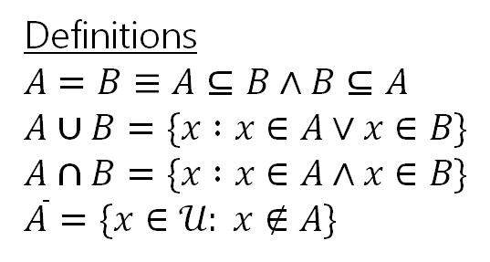

Claim 3 (DeMorgan’s Law for Sets)
Definitions
𝐴 = 𝐵 ≡ 𝐴 ⊆ 𝐵 ∧ 𝐵 ⊆ 𝐴
𝐴 ∪ 𝐵 = {𝑥 ∶ 𝑥 ∈ 𝐴 ∨ 𝑥 ∈ 𝐵}
𝐴 ∩ 𝐵 = {𝑥 ∶ 𝑥 ∈ 𝐴 ∧ 𝑥 ∈ 𝐵}
$\overline{A}$ = {𝑥 ∈ 𝒰: 𝑥 ∉ 𝐴}
Claim 3: For all sets 𝐴, 𝐵, $\overline{A∪B} =\overline{A}∩\overline{B}$

Slide 43






Claim 3 (DeMorgan’s Law for Sets)
Definitions
𝐴 = 𝐵 ≡ 𝐴 ⊆ 𝐵 ∧ 𝐵 ⊆ 𝐴
𝐴 ∪ 𝐵 = {𝑥 ∶ 𝑥 ∈ 𝐴 ∨ 𝑥 ∈ 𝐵}
𝐴 ∩ 𝐵 = {𝑥 ∶ 𝑥 ∈ 𝐴 ∧ 𝑥 ∈ 𝐵}
$\overline{A}$ = {𝑥 ∈ 𝒰: 𝑥 ∉ 𝐴}
Claim 3: For all sets 𝐴, 𝐵, $\overline{A∪B} =\overline{A}∩\overline{B}$
Intuition (Venn Diagram)
𝐴 ∪ 𝐵
$\overline{A} ∩\overline{B}$
A B
A B

Slide 44
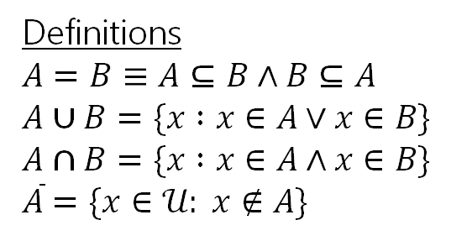
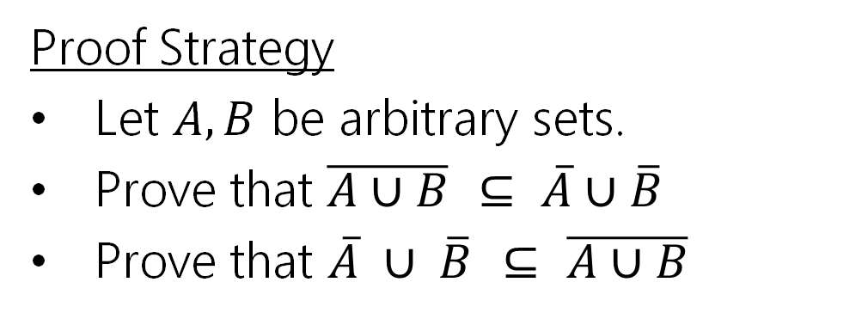
Claim 3 (DeMorgan’s Law for Sets)
Definitions
𝐴 = 𝐵 ≡ 𝐴 ⊆ 𝐵 ∧ 𝐵 ⊆ 𝐴
𝐴 ∪ 𝐵 = {𝑥 ∶ 𝑥 ∈ 𝐴 ∨ 𝑥 ∈ 𝐵}
𝐴 ∩ 𝐵 = {𝑥 ∶ 𝑥 ∈ 𝐴 ∧ 𝑥 ∈ 𝐵}
$\overline{A}$ = {𝑥 ∈ 𝒰: 𝑥 ∉ 𝐴}
Claim 3: For all sets 𝐴, 𝐵, $\overline{A∪B} =\overline{A}∩\overline{B}$
Proof Strategy
Let 𝐴, 𝐵 be arbitrary sets.
Prove that $\overline{A∪B} ⊆ \overline{A}∪\overline{B}$
Prove that $\overline{A} ∪ \overline{B} ⊆ \overline{A∪B}$

Slide 45
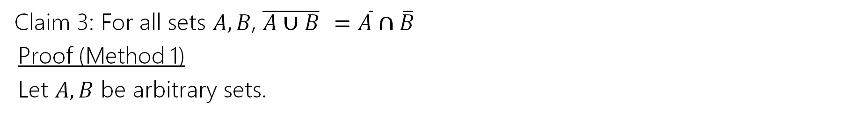
Claim 3
Definitions
𝐴 = 𝐵 ≡ 𝐴 ⊆ 𝐵 ∧ 𝐵 ⊆ 𝐴
𝐴 ∪ 𝐵 = {𝑥 ∶ 𝑥 ∈ 𝐴 ∨ 𝑥 ∈ 𝐵}
𝐴 ∩ 𝐵 = {𝑥 ∶ 𝑥 ∈ 𝐴 ∧ 𝑥 ∈ 𝐵}
$\overline{A}$ = {𝑥 ∈ 𝒰: 𝑥 ∉ 𝐴}
Claim 3: For all sets 𝐴, 𝐵, $\overline{A∪B} =\overline{A}∩\overline{B}$
Proof (Method 1)
Let 𝐴, 𝐵 be arbitrary sets.

Slide 46
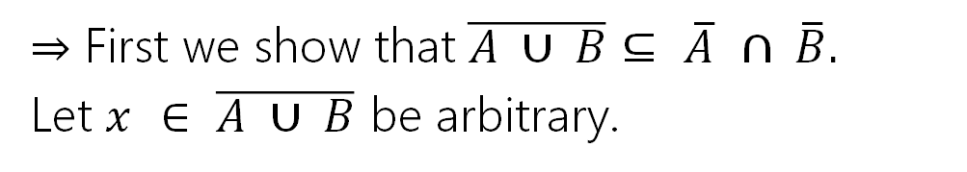
Claim 3
Definitions
𝐴 = 𝐵 ≡ 𝐴 ⊆ 𝐵 ∧ 𝐵 ⊆ 𝐴
𝐴 ∪ 𝐵 = {𝑥 ∶ 𝑥 ∈ 𝐴 ∨ 𝑥 ∈ 𝐵}
𝐴 ∩ 𝐵 = {𝑥 ∶ 𝑥 ∈ 𝐴 ∧ 𝑥 ∈ 𝐵}
$\overline{A}$ = {𝑥 ∈ 𝒰: 𝑥 ∉ 𝐴}
Claim 3: For all sets 𝐴, 𝐵, $\overline{A∪B} =\overline{A}∩\overline{B}$
Proof (Method 1)
Let 𝐴, 𝐵 be arbitrary sets.
⇒ First we show that $\overline{A ∪ B}⊆ \overline{A} ∩ \overline{B}$.
Let $x ∈ \overline{A ∪ B}$be arbitrary.
By definition of intersection, $x ∈ \overline{A}∩\overline{B}$. Since 𝑥 was arbitrary, $\overline{A ∪ B}⊆ \overline{A} ∩ \overline{B}$.

Slide 47
Claim 3
Definitions
𝐴 = 𝐵 ≡ 𝐴 ⊆ 𝐵 ∧ 𝐵 ⊆ 𝐴
𝐴 ∪ 𝐵 = {𝑥 ∶ 𝑥 ∈ 𝐴 ∨ 𝑥 ∈ 𝐵}
𝐴 ∩ 𝐵 = {𝑥 ∶ 𝑥 ∈ 𝐴 ∧ 𝑥 ∈ 𝐵}
$\overline{A}$ = {𝑥 ∈ 𝒰: 𝑥 ∉ 𝐴}
Claim 3: For all sets 𝐴, 𝐵, $\overline{A∪B} =\overline{A}∩\overline{B}$
Proof (Method 1)
Let 𝐴, 𝐵 be arbitrary sets.
⇒ First we show that $\overline{A ∪ B}⊆ \overline{A} ∩ \overline{B}$.
Let $x ∈ \overline{A ∪ B}$be arbitrary.
By definition of complement, we have that ¬(𝑥 ∈ 𝐴 ∪ 𝐵).
By definition of intersection, $x ∈ \overline{A}∩\overline{B}$. Since 𝑥 was arbitrary, $\overline{A ∪ B}⊆ \overline{A} ∩ \overline{B}$.

Slide 48
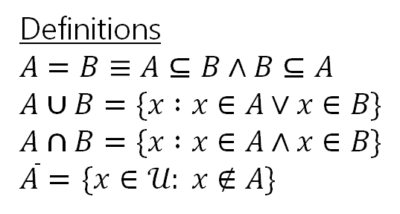
Claim 3
Definitions
𝐴 = 𝐵 ≡ 𝐴 ⊆ 𝐵 ∧ 𝐵 ⊆ 𝐴
𝐴 ∪ 𝐵 = {𝑥 ∶ 𝑥 ∈ 𝐴 ∨ 𝑥 ∈ 𝐵}
𝐴 ∩ 𝐵 = {𝑥 ∶ 𝑥 ∈ 𝐴 ∧ 𝑥 ∈ 𝐵}
$\overline{A}$ = {𝑥 ∈ 𝒰: 𝑥 ∉ 𝐴}
Claim 3: For all sets 𝐴, 𝐵, $\overline{A∪B} =\overline{A}∩\overline{B}$
Proof (Method 1)
Let 𝐴, 𝐵 be arbitrary sets.
⇒ First we show that $\overline{A ∪ B}⊆ \overline{A} ∩ \overline{B}$.
Let $x ∈ \overline{A ∪ B}$be arbitrary.
By definition of complement, we have that ¬(𝑥 ∈ 𝐴 ∪ 𝐵).
Then by definition of union, ¬(𝑥 ∈ 𝐴 ∨ 𝑥 ∈𝐵).
By definition of intersection, $x ∈ \overline{A}∩\overline{B}$. Since 𝑥 was arbitrary, $\overline{A ∪ B}⊆ \overline{A} ∩ \overline{B}$.

Slide 49
Claim 3
Definitions
𝐴 = 𝐵 ≡ 𝐴 ⊆ 𝐵 ∧ 𝐵 ⊆ 𝐴
𝐴 ∪ 𝐵 = {𝑥 ∶ 𝑥 ∈ 𝐴 ∨ 𝑥 ∈ 𝐵}
𝐴 ∩ 𝐵 = {𝑥 ∶ 𝑥 ∈ 𝐴 ∧ 𝑥 ∈ 𝐵}
$\overline{A}$ = {𝑥 ∈ 𝒰: 𝑥 ∉ 𝐴}
Claim 3: For all sets 𝐴, 𝐵, $\overline{A∪B} =\overline{A}∩\overline{B}$
Proof (Method 1)
Let 𝐴, 𝐵 be arbitrary sets.
⇒ First we show that $\overline{A ∪ B}⊆ \overline{A} ∩ \overline{B}$.
Let $x ∈ \overline{A ∪ B}$be arbitrary.
By definition of complement, we have that ¬(𝑥 ∈ 𝐴 ∪ 𝐵).
Then by definition of union, ¬(𝑥 ∈ 𝐴 ∨ 𝑥 ∈𝐵).
So by DeMorgan’s Law, 𝑥 ∉ 𝐴 ∧ 𝑥 ∉ 𝐵.
By definition of intersection, $x ∈ \overline{A}∩\overline{B}$. Since 𝑥 was arbitrary, $\overline{A ∪ B}⊆ \overline{A} ∩ \overline{B}$.

Slide 50
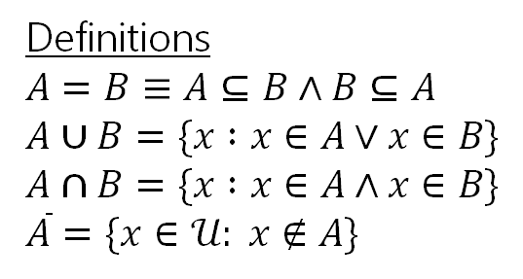
Claim 3
Definitions
𝐴 = 𝐵 ≡ 𝐴 ⊆ 𝐵 ∧ 𝐵 ⊆ 𝐴
𝐴 ∪ 𝐵 = {𝑥 ∶ 𝑥 ∈ 𝐴 ∨ 𝑥 ∈ 𝐵}
𝐴 ∩ 𝐵 = {𝑥 ∶ 𝑥 ∈ 𝐴 ∧ 𝑥 ∈ 𝐵}
$\overline{A}$ = {𝑥 ∈ 𝒰: 𝑥 ∉ 𝐴}
Claim 3: For all sets 𝐴, 𝐵, $\overline{A∪B} =\overline{A}∩\overline{B}$
Proof (Method 1)
Let 𝐴, 𝐵 be arbitrary sets.
⇒ First we show that $\overline{A ∪ B}⊆ \overline{A} ∩ \overline{B}$.
Let $x ∈ \overline{A ∪ B}$be arbitrary.
By definition of complement, we have that ¬(𝑥 ∈ 𝐴 ∪ 𝐵).
Then by definition of union, ¬(𝑥 ∈ 𝐴 ∨ 𝑥 ∈𝐵).
So by DeMorgan’s Law, 𝑥 ∉ 𝐴 ∧ 𝑥 ∉ 𝐵.
Then by definition of complement, $x∈\overline{A}$and $x∈\overline{B}$
By definition of intersection, $x ∈ \overline{A}∩\overline{B}$. Since 𝑥 was arbitrary, $\overline{A ∪ B}⊆ \overline{A} ∩ \overline{B}$.

Slide 51
Claim 3
Definitions
𝐴 = 𝐵 ≡ 𝐴 ⊆ 𝐵 ∧ 𝐵 ⊆ 𝐴
𝐴 ∪ 𝐵 = {𝑥 ∶ 𝑥 ∈ 𝐴 ∨ 𝑥 ∈ 𝐵}
𝐴 ∩ 𝐵 = {𝑥 ∶ 𝑥 ∈ 𝐴 ∧ 𝑥 ∈ 𝐵}
$\overline{A}$ = {𝑥 ∈ 𝒰: 𝑥 ∉ 𝐴}
Claim 3: For all sets 𝐴, 𝐵, $\overline{A∪B} =\overline{A}∩\overline{B}$
Proof (Method 1)
Let 𝐴, 𝐵 be arbitrary sets.
⇐ Now we show $\overline{A}∩\overline{B}⊆\overline{A∪B}$

Slide 52


Claim 3
Definitions
𝐴 = 𝐵 ≡ 𝐴 ⊆ 𝐵 ∧ 𝐵 ⊆ 𝐴
𝐴 ∪ 𝐵 = {𝑥 ∶ 𝑥 ∈ 𝐴 ∨ 𝑥 ∈ 𝐵}
𝐴 ∩ 𝐵 = {𝑥 ∶ 𝑥 ∈ 𝐴 ∧ 𝑥 ∈ 𝐵}
$\overline{A}$ = {𝑥 ∈ 𝒰: 𝑥 ∉ 𝐴}
Claim 3: For all sets 𝐴, 𝐵, $\overline{A∪B} =\overline{A}∩\overline{B}$
Proof (Method 1)
Let 𝐴, 𝐵 be arbitrary sets.
⇐ Now we show $\overline{A}∩\overline{B}⊆\overline{A∪B}$
Let $x$ be an arbitrary element of $\overline{A}∩\overline{B}.$
Since $x$ was arbitrary, $\overline{A}∩\overline{B}⊆\overline{A∪B}$.

Slide 53
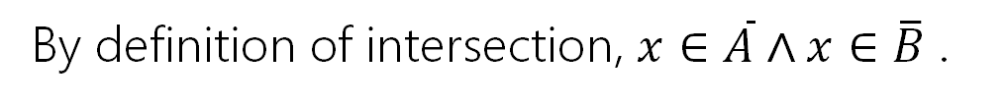
Claim 3
Definitions
𝐴 = 𝐵 ≡ 𝐴 ⊆ 𝐵 ∧ 𝐵 ⊆ 𝐴
𝐴 ∪ 𝐵 = {𝑥 ∶ 𝑥 ∈ 𝐴 ∨ 𝑥 ∈ 𝐵}
𝐴 ∩ 𝐵 = {𝑥 ∶ 𝑥 ∈ 𝐴 ∧ 𝑥 ∈ 𝐵}
$\overline{A}$ = {𝑥 ∈ 𝒰: 𝑥 ∉ 𝐴}
Claim 3: For all sets 𝐴, 𝐵, $\overline{A∪B} =\overline{A}∩\overline{B}$
Proof (Method 1)
Let 𝐴, 𝐵 be arbitrary sets.
⇐ Now we show $\overline{A}∩\overline{B}⊆\overline{A∪B}$
Let $x$ be an arbitrary element of $\overline{A}∩\overline{B}.$
By definition of intersection, $x∈\overline{A}∧x∈\overline{B}$.
Since $x$ was arbitrary, $\overline{A}∩\overline{B}⊆\overline{A∪B}$.

Slide 54
Claim 3
Definitions
𝐴 = 𝐵 ≡ 𝐴 ⊆ 𝐵 ∧ 𝐵 ⊆ 𝐴
𝐴 ∪ 𝐵 = {𝑥 ∶ 𝑥 ∈ 𝐴 ∨ 𝑥 ∈ 𝐵}
𝐴 ∩ 𝐵 = {𝑥 ∶ 𝑥 ∈ 𝐴 ∧ 𝑥 ∈ 𝐵}
$\overline{A}$ = {𝑥 ∈ 𝒰: 𝑥 ∉ 𝐴}
Claim 3: For all sets 𝐴, 𝐵, $\overline{A∪B} =\overline{A}∩\overline{B}$
Proof (Method 1)
Let 𝐴, 𝐵 be arbitrary sets.
⇐ Now we show $\overline{A}∩\overline{B}⊆\overline{A∪B}$
Let $x$ be an arbitrary element of $\overline{A}∩\overline{B}.$
By definition of intersection, $x∈\overline{A}∧x∈\overline{B}$.
By definition of complement, $x∉A$and $x∉B.$
Since $x$ was arbitrary, $\overline{A}∩\overline{B}⊆\overline{A∪B}$.

Slide 55
Claim 3
Definitions
𝐴 = 𝐵 ≡ 𝐴 ⊆ 𝐵 ∧ 𝐵 ⊆ 𝐴
𝐴 ∪ 𝐵 = {𝑥 ∶ 𝑥 ∈ 𝐴 ∨ 𝑥 ∈ 𝐵}
𝐴 ∩ 𝐵 = {𝑥 ∶ 𝑥 ∈ 𝐴 ∧ 𝑥 ∈ 𝐵}
$\overline{A}$ = {𝑥 ∈ 𝒰: 𝑥 ∉ 𝐴}
Claim 3: For all sets 𝐴, 𝐵, $\overline{A∪B} =\overline{A}∩\overline{B}$
Proof (Method 1)
Let 𝐴, 𝐵 be arbitrary sets.
⇐ Now we show $\overline{A}∩\overline{B}⊆\overline{A∪B}$
Let $x$ be an arbitrary element of $\overline{A}∩\overline{B}.$
By definition of intersection, $x∈\overline{A}∧x∈\overline{B}$.
By definition of complement, $x∉A$and $x∉B.$
Applying DeMorgan’s Law, we get $¬(x∈A∨x∈B)$.
Since $x$ was arbitrary, $\overline{A}∩\overline{B}⊆\overline{A∪B}$.

Slide 56
Claim 3
Definitions
𝐴 = 𝐵 ≡ 𝐴 ⊆ 𝐵 ∧ 𝐵 ⊆ 𝐴
𝐴 ∪ 𝐵 = {𝑥 ∶ 𝑥 ∈ 𝐴 ∨ 𝑥 ∈ 𝐵}
𝐴 ∩ 𝐵 = {𝑥 ∶ 𝑥 ∈ 𝐴 ∧ 𝑥 ∈ 𝐵}
$\overline{A}$ = {𝑥 ∈ 𝒰: 𝑥 ∉ 𝐴}
Claim 3: For all sets 𝐴, 𝐵, $\overline{A∪B} =\overline{A}∩\overline{B}$
Proof (Method 1)
Let 𝐴, 𝐵 be arbitrary sets.
⇐ Now we show $\overline{A}∩\overline{B}⊆\overline{A∪B}$
Let $x$ be an arbitrary element of $\overline{A}∩\overline{B}.$
By definition of intersection, $x∈\overline{A}∧x∈\overline{B}$.
By definition of complement, $x∉A$and $x∉B.$
Applying DeMorgan’s Law, we get $¬(x∈A∨x∈B)$.
By the definition of union, we get:$¬\left(x∈A∪B\right)$, so $x∉A∪B$.
Since $x$ was arbitrary, $\overline{A}∩\overline{B}⊆\overline{A∪B}$.

Slide 57
Claim 3
Definitions
𝐴 = 𝐵 ≡ 𝐴 ⊆ 𝐵 ∧ 𝐵 ⊆ 𝐴
𝐴 ∪ 𝐵 = {𝑥 ∶ 𝑥 ∈ 𝐴 ∨ 𝑥 ∈ 𝐵}
𝐴 ∩ 𝐵 = {𝑥 ∶ 𝑥 ∈ 𝐴 ∧ 𝑥 ∈ 𝐵}
$\overline{A}$ = {𝑥 ∈ 𝒰: 𝑥 ∉ 𝐴}
Claim 3: For all sets 𝐴, 𝐵, $\overline{A∪B} =\overline{A}∩\overline{B}$
Proof (Method 1)
Let 𝐴, 𝐵 be arbitrary sets.
⇐ Now we show $\overline{A}∩\overline{B}⊆\overline{A∪B}$
Let $x$ be an arbitrary element of $\overline{A}∩\overline{B}.$
By definition of intersection, $x∈\overline{A}∧x∈\overline{B}$.
By definition of complement, $x∉A$and $x∉B.$
Applying DeMorgan’s Law, we get $¬(x∈A∨x∈B)$.
By the definition of union, we get:$¬\left(x∈A∪B\right)$, so $x∉A∪B$.
From the definition of complement, we get $x∈\overline{A∪B},$ as required.
Since $x$ was arbitrary, $\overline{A}∩\overline{B}⊆\overline{A∪B}$.

Slide 58
Claim 3
Definitions
𝐴 = 𝐵 ≡ 𝐴 ⊆ 𝐵 ∧ 𝐵 ⊆ 𝐴
𝐴 ∪ 𝐵 = {𝑥 ∶ 𝑥 ∈ 𝐴 ∨ 𝑥 ∈ 𝐵}
𝐴 ∩ 𝐵 = {𝑥 ∶ 𝑥 ∈ 𝐴 ∧ 𝑥 ∈ 𝐵}
$\overline{A}$ = {𝑥 ∈ 𝒰: 𝑥 ∉ 𝐴}
Claim 3: For all sets 𝐴, 𝐵, $\overline{A∪B} =\overline{A}∩\overline{B}$
Proof (Method 1)
Since the subset relation holds in both directions, we have $\overline{A}∩\overline{B}=\overline{A∪B}$.

Slide 59
Proving Set Equality: Method 1
One way to prove that 𝑋 = 𝑌 is to show that 𝑋 ⊆ 𝑌 by one subset proof, and 𝑌 ⊆ 𝑋 by another subset proof.

Slide 60
Proving Set Equality: Method 2
Another way to prove that 𝑋 = 𝑌 is to show that for arbitrary element 𝑥,
𝑥 ∈ 𝑋 ≡ ⋯ ≡ 𝑥 ∈ 𝑌 by a chain of equivalences.

Slide 61













Claim 4
Definitions
𝐴 × 𝐵 = 𝑎, 𝑏 : 𝑎 ∈ 𝐴, 𝑏 ∈ 𝐵
𝐴 ∪ 𝐵 = {𝑥 ∶ 𝑥 ∈ 𝐴 ∨ 𝑥 ∈ 𝐵}
Claim 4: For all sets 𝐴, 𝐵, 𝐶, 𝐴 ×
Intuition (Diagram)
𝐴 × 𝐵 ∩ 𝐶
𝐵 ∩ 𝐶 = 𝐴 × 𝐵 ∩ (𝐴 × 𝐶)
𝐴 × 𝐵
∩ (𝐴 × 𝐶)

Slide 62
Claim 4
Definitions
𝐴 × 𝐵 = 𝑎, 𝑏 : 𝑎 ∈ 𝐴, 𝑏 ∈ 𝐵
𝐴 ∪ 𝐵 = {𝑥 ∶ 𝑥 ∈ 𝐴 ∨ 𝑥 ∈ 𝐵}
Claim 4: For all sets 𝐴, 𝐵, 𝐶, 𝐴 × 𝐵 ∩ 𝐶 = 𝐴 × 𝐵 ∩ (𝐴 × 𝐶). Proof (Method 2)
Let 𝐴, 𝐵, 𝐶 be arbitrary sets. Let (𝑦, 𝑧) be an arbitrary pair. Then:
𝑦, 𝑧 ∈ 𝐴 × 𝐵 ∩ 𝐶 ≡ (𝑦 ∈ 𝐴) ∧ (𝑧 ∈ 𝐵 ∩ 𝐶)
≡ (𝑦 ∈ 𝐴) ∧ 𝑧 ∈ 𝐵 ∧ 𝑧 ∈ 𝐶
Def. of × Def. of ∩ Idempotency
Assoc. and Commutativity Def of ×
Def of ∩
𝑧 ∈ 𝐵 ∧ 𝑧 ∈ 𝐶
≡ 𝑦 ∈ 𝐴 ∧ 𝑧 ∈ 𝐵 ∧ 𝑦 ∈ 𝐴 ∧ 𝑧 ∈ 𝐶
≡
≡
≡ (𝑦 ∈ 𝐴) ∧ (𝑦 ∈ 𝐴) ∧
𝑦, 𝑧 ∈ 𝐴 × 𝐵 ∧ 𝑦, 𝑧 ∈ 𝐴 × 𝐶
𝑦, 𝑧 ∈ 𝐴 × 𝐵 ∩ ( 𝐴 × 𝐶)
Since (𝑦, 𝑧) was arbitrary, we have shown that 𝐴 × 𝐵 ∩ 𝐶 = 𝐴 × 𝐵 ∩ (𝐴 × 𝐶). Since
𝐴, 𝐵, 𝐶 were arbitrary sets, the claim holds.

Slide 63
Proof by Contradiction

Slide 64
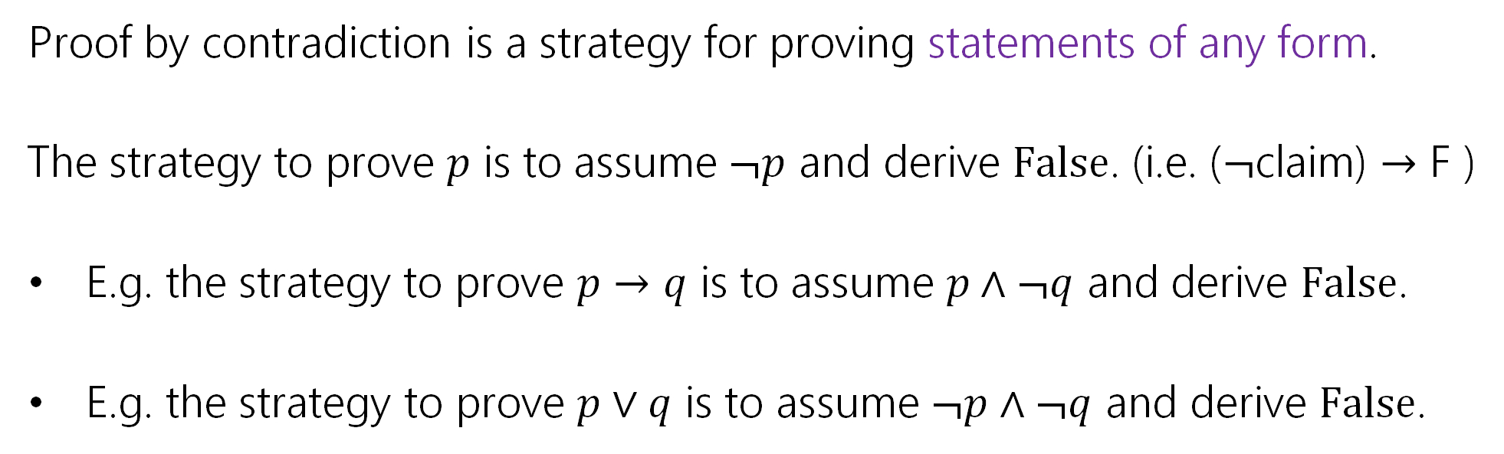
Proof by Contradiction
Proof by contradiction is a strategy for proving statements of any form.
The strategy to prove 𝑝 is to assume ¬𝑝 and derive False. (i.e. ($¬$claim) $→$ F )
E.g. the strategy to prove 𝑝 → 𝑞 is to assume 𝑝 ∧ ¬𝑞 and derive False.
E.g. the strategy to prove 𝑝 ∨ 𝑞 is to assume ¬𝑝 ∧ ¬𝑞 and derive False.

Slide 65
Why does that work?
Observe from our logical equivalences:
¬𝑝 → F ≡ ¬¬𝑝 ∨ F
≡ 𝑝 ∨ F
≡ 𝑝
Law of Implication Double Negation Identity

Slide 66
Proof by Contradiction Skeleton
Suppose for the sake of contradiction ¬𝑝.
…
Then some statement 𝑠 must hold.
…
And some statement ¬𝑠 must hold.
But 𝑠 and ¬𝑠 is a contradiction. So 𝑝 must be true.

Slide 67
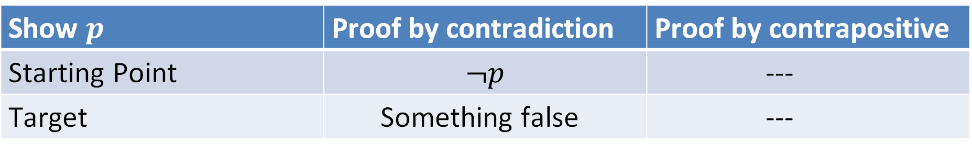
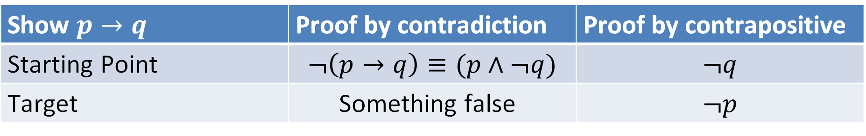
What’s the difference?
What’s the difference between proof by contrapositive and proof by contradiction?
Show $p→q$ | Proof by contradiction | Proof by contrapositive
Starting Point | $$¬\left(p→q\right)≡(p∧¬q)$$ | $$¬q$$
Target | Something false | $$¬p$$
Show $p$ | Proof by contradiction | Proof by contrapositive
Starting Point | $$¬p$$ | ---
Target | Something false | ---

Slide 68

Proof by Contradiction: Remarks
Unlike other proof techniques, we don’t know where we’re going. We’re trying to find any contradiction. That can make it harder.
Contradiction is a sledge-hammer.
It can be used to prove many things. But it makes a mess.
Use contradiction as a last-resort.
Contradiction is a sledge-hammer

Slide 69
Claim: No integer is even and odd.
Suppose for the sake of contradiction that there exists an integer 𝑥 that is both even and odd.
This is a contradiction!
Thus no integer can be even and odd.

Slide 70
Claim: No integer is even and odd.
Suppose for the sake of contradiction that there exists an integer 𝑥 that is both even and odd.
[Show there exists some contradiction if we make this assumption]
This is a contradiction!
Thus no integer can be even and odd.

Slide 71
Claim: No integer is even and odd.
Suppose for the sake of contradiction that there exists an integer 𝑥 that is both even and odd.
Then 𝑥 = 2𝑎 for some integer 𝑎, and 𝑥 = 2𝑏 + 1 for some integer 𝑏.
This is a contradiction!
Thus no integer can be even and odd.

Slide 72

Claim: No integer is even and odd.
Suppose for the sake of contradiction that there exists an integer 𝑥 that is both even and odd.
Then 𝑥 = 2𝑎 for some integer 𝑎, and 𝑥 = 2𝑏 + 1 for some integer 𝑏.
Then:
$2a = 2b + 1$
$2a − 2b = 1$
$a −b= \frac{1}{2}$
This is a contradiction!
Thus no integer can be even and odd.

Slide 73

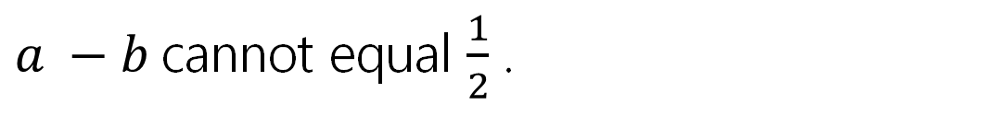
Claim: No integer is even and odd.
Suppose for the sake of contradiction that there exists an integer 𝑥 that is both even and odd.
Then 𝑥 = 2𝑎 for some integer 𝑎, and 𝑥 = 2𝑏 + 1 for some integer 𝑏.
Then:
$2a = 2b + 1$
$2a − 2b = 1$
$a −b= \frac{1}{2}$
Since 𝑎, 𝑏 are integers, 𝑎 − 𝑏 is an integer. But $\frac{1}{2}$ is not an integer, so
$a −b$cannot equal $\frac{1}{2}$ .
This is a contradiction!
Thus no integer can be even and odd.

Slide 74
Proof By Contradiction
How in the world did we know how to do that?
In real life…lots of attempts that didn’t work.
Be very careful with proof by contradiction – without a clear target, you can easily end up in a loop of trying random things and getting nowhere.

Slide 75
Another Proof by Contradiction

Slide 76
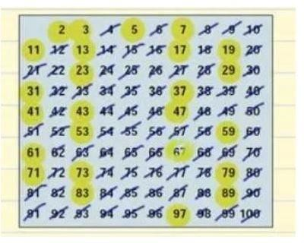
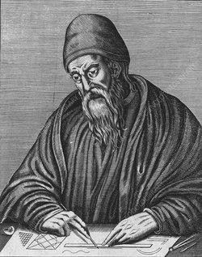
Euclid’s Theorem: There are infinitely many prime numbers.
2, 3, 5, 7, 11, 13, …
Euclid ~300 BC

Slide 77
Euclid’s Theorem: There are infinitely many prime numbers.
Assume for the sake of contradiction that there are finitely many prime numbers. Call them 𝑝₁, 𝑝₂, … , 𝑝_{𝑘}.
In either case, we have a contradiction. Thus there must be infinitely many primes.

Slide 78
Euclid’s Theorem: There are infinitely many prime numbers.
Assume for the sake of contradiction that there are finitely many prime numbers. Call them 𝑝₁, 𝑝₂, … , 𝑝_{𝑘}.
Consider the number 𝑞 = 𝑝₁ ⋅ 𝑝₂ ⋯ 𝑝_{𝑘} + 1.
In either case, we have a contradiction. Thus there must be infinitely many primes.

Slide 79
Euclid’s Theorem: There are infinitely many prime numbers.
Assume for the sake of contradiction that there are finitely many prime numbers. Call them 𝑝₁, 𝑝₂, … , 𝑝_{𝑘}.
Consider the number 𝑞 = 𝑝₁ ⋅ 𝑝₂ ⋯ 𝑝_{𝑘} + 1.
Case 1: 𝑞 is prime.
Case 2: 𝑞 is composite.
In either case, we have a contradiction. Thus there must be infinitely many primes.

Slide 80
Euclid’s Theorem: There are infinitely many prime numbers.
Assume for the sake of contradiction that there are finitely many prime numbers. Call them 𝑝₁, 𝑝₂, … , 𝑝_{𝑘}.
Consider the number 𝑞 = 𝑝₁ ⋅ 𝑝₂ ⋯ 𝑝_{𝑘} + 1.
Case 1: 𝑞 is prime. Then 𝑞 is a prime that is larger than 𝑝_{𝑖} for all 𝑖 ∈ {1, … , 𝑘}. But every prime was supposed to in the list 𝑝₁, … , 𝑝_{𝑘}. This is a contradiction.
Case 2: 𝑞 is composite.
In either case, we have a contradiction. Thus there must be infinitely many primes.

Slide 81
Euclid’s Theorem: There are infinitely many prime numbers.
Assume for the sake of contradiction that there are finitely many prime numbers. Call them 𝑝₁, 𝑝₂, … , 𝑝_{𝑘}.
Consider the number 𝑞 = 𝑝₁ ⋅ 𝑝₂ ⋯ 𝑝_{𝑘} + 1.
Case 1: 𝑞 is prime. Then 𝑞 is a prime that is larger than 𝑝_{𝑖} for all 𝑖 ∈ {1, … , 𝑘}. But every prime was supposed to in the list 𝑝₁, … , 𝑝_{𝑘}. This is a contradiction.
Case 2: 𝑞 is composite. Then 𝑞 must have some prime factor. So there exists
some 𝑖 such that 𝑝_{𝑖} | 𝑞.
In either case, we have a contradiction. Thus there must be infinitely many primes.

Slide 82
Euclid’s Theorem: There are infinitely many prime numbers.
Assume for the sake of contradiction that there are finitely many prime numbers. Call them 𝑝₁, 𝑝₂, … , 𝑝_{𝑘}.
Consider the number 𝑞 = 𝑝₁ ⋅ 𝑝₂ ⋯ 𝑝_{𝑘} + 1.
Case 1: 𝑞 is prime. Then 𝑞 is a prime that is larger than 𝑝_{𝑖} for all 𝑖 ∈ {1, … , 𝑘}. But every prime was supposed to in the list 𝑝₁, … , 𝑝_{𝑘}. This is a contradiction.
Case 2: 𝑞 is composite. Then 𝑞 must have some prime factor. So there exists
some 𝑖 such that 𝑝_{𝑖} | 𝑞. Then 𝑞 % 𝑝_{𝑖} = 0. But
𝑞 % 𝑝_{𝑖} = (𝑝₁ ⋅ 𝑝₂ ⋯ 𝑝_{𝑘} + 1) % 𝑝_{𝑖} = 1
So we have 𝑞 % 𝑝_{𝑖} = 0 and 𝑞 % 𝑝_{𝑖} = 1. This is a contradiction.
In either case, we have a contradiction. Thus there must be infinitely many primes.

Slide 83
Extra Practice: Proof by Contradiction

Slide 84

Just the Skeleton
“For all integers $x$, if $x^{2}$ is even, then $x$ is even.”

Slide 85
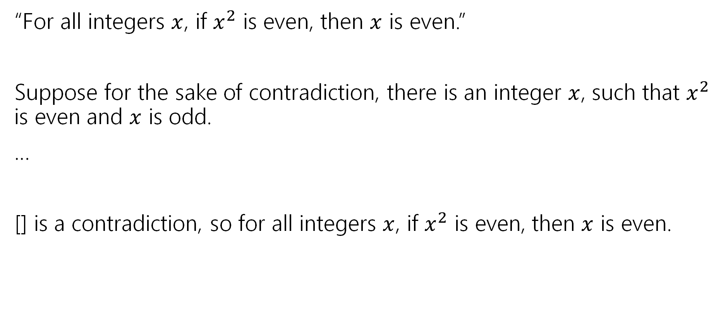
Just the Skeleton
“For all integers $x$, if $x^{2}$ is even, then $x$ is even.”
Suppose for the sake of contradiction, there is an integer $x$, such that $x^{2}$ is even and $x$ is odd.
…
[] is a contradiction, so for all integers $x$, if $x^{2}$ is even, then $x$ is even.

Slide 86

Just the Skeleton
“There is not an integer $k$ such that for all integers $n$, $k≥n$.

Slide 87
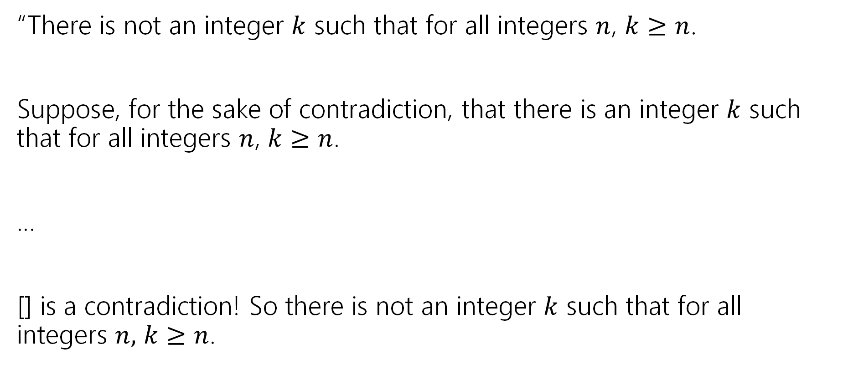
Just the Skeleton
“There is not an integer $k$ such that for all integers $n$, $k≥n$.
Suppose, for the sake of contradiction, that there is an integer $k$ such that for all integers $n$, $k≥n$.
…
[] is a contradiction! So there is not an integer $k$ such that for all integers $n,$ $k≥n$.

Slide 88
Todo
Tonight:
HW2 Resubmissions due tonight!
CC 11 is out and due Monday at noon
Take a look at HW4 today or over the weekend!

