Slide 1
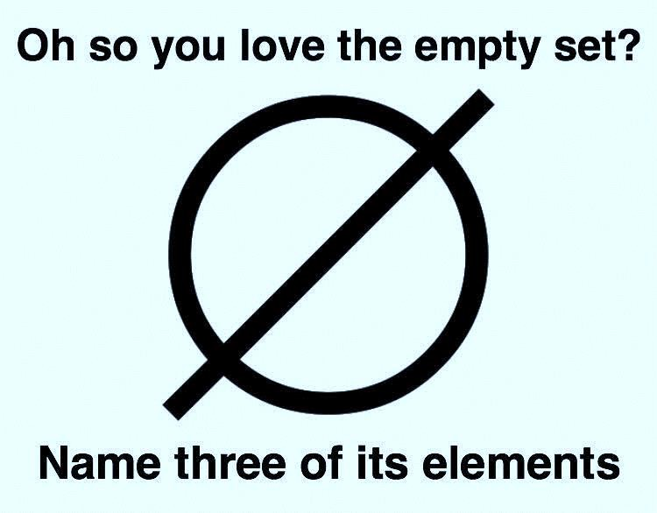
Set Theory
CSE 311 Summer 25
Lecture 10

Slide 2
Announcements
HW3 is due tonight!
HW2 Feedback is out
HW2 Resubmission is out and due Friday
HW4 will be released today!

Slide 3
Review

Slide 4
The Properties of Congruence We’ve Proven
If 𝑎 ≡ 𝑏 (mod m), then 𝑏 ≡ 𝑎 (mod m).
If 𝑎 ≡ 𝑏 (mod m) and 𝑐 ≡ 𝑑 (mod m), then 𝑎 + 𝑐 ≡ 𝑏 + 𝑑 (mod m).
If 𝑎 ≡ 𝑏 (mod m) and 𝑐 ≡ 𝑑 (mod m), then 𝑎𝑐 ≡ 𝑏𝑑 (mod m).
If 𝑎 ≡ 𝑏 (mod m) and 𝑏 ≡ 𝑐 (mod m), then 𝑎 ≡ 𝑐 (mod m).
You may use these properties in your homework without re-proving them!

Slide 5
Prime and Composite
Definition:
An integer 𝑝 > 1 is prime iff its only positive divisors are 1 and 𝑝.
An integer 𝑝 > 1 is composite iff it is not prime.

Slide 6
Least Common Multiple
Definition:
The Least Common Multiple of integers 𝑎 and 𝑏 (denoted lcm(𝑎, 𝑏)) is the smallest positive integer 𝑐 such that a | c and b | c.
For Example:
lcm(4, 6) = 12
lcm(14, 20) = 140
lcm(45, 60) = 180
lcm(13, 1) = 13

Slide 7
Greatest Common Divisor
Definition:
The Greatest Common Divisor of integers 𝑎 and 𝑏 (denoted gcd(𝑎, 𝑏)) is the largest integer 𝑐 such that 𝑐 | 𝑎 and 𝑐 | 𝑏.
For Example:
gcd 99,18 = 9
gcd 100, 125 = 25
gcd 7,11 = 1
gcd 13,0 = 13

Slide 8
Calculating the GCD: Approach 1
Fundamental Theorem of Arithmetic: Every positive integer greater than
1 has a unique prime factorization.
Approach 1 to finding gcd(𝑎, 𝑏):
Find the prime factorization of 𝑎
Find the prime factorization of 𝑏
Identify all common prime factors.
Multiply the common prime factors together. This is the GCD.
VERY
INEFFICIENT

Slide 9
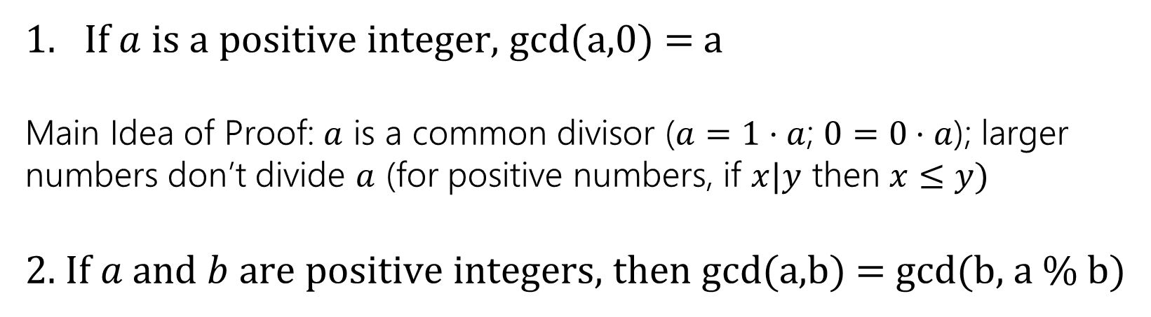
GCD facts
If $a$is a positive integer, gcd(a,0) = a
Main Idea of Proof: $a$ is a common divisor ($a=1⋅a$; $0=0⋅a$); larger numbers don’t divide $a$ (for positive numbers, if $x|y$ then $x≤y)$
2. If $a$ and $b$ are positive integers, then gcd(a,b) = gcd(b, a % b)
For example:
gcd 10, 6
gcd 110,30
= gcd(6,4)
= gcd(30,20)
Why is 2 true? The proof isn’t easy, it’s at the end of this deck.
Why should you care?

Slide 10
Calculating the GCD: Approach 2
Euclid’s Algorithm. To find gcd(𝑎, 𝑏):
Repeatedly use gcd 𝑎, 𝑏 = gcd(𝑏, 𝑎 % 𝑏) to reduce numbers
Stop once you reach gcd(c, 0). Return c.
For Example:
gcd(660,126)
= gcd(126,30)
= gcd(30,6)
= gcd(6,0)
Efficient
= 6

Slide 11
Euclid’s Algorithm in Java
// assumes a >= 0 and b >= 0 public int gcd(int a, int b) {
if (b == 0) {
return a;
} else {
return gcd(b, a % b);
}
}

Slide 12
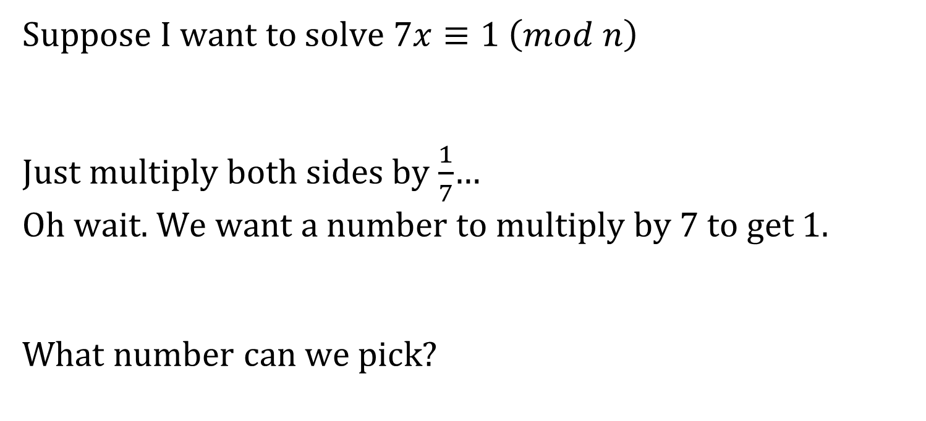
So…what’s it good for?
Remember everything we’re learning contributes to us eventually understanding RSA.
This is a key step in generating keys.
Suppose I want to solve $7x≡1 \left(mod n\right)$
Just multiply both sides by $\frac{1}{7}$…
Oh wait. We want a number to multiply by $7$ to get $1.$
What number can we pick?
Notes:
Rules for mod arithmetic are different! Addition and multiplication match really closely to regular rules. Division (i.e. multiplying by 1/number) is much more complicated.

Slide 13
Solving in Modular Arithmetic
Solve: 7𝑥 ≡ 1 (mod 10)
Solution: 𝑥 ≡ 3 (mod 10) (Guess and check)
None of our properties so far help us solve this.
3 is called the multiplicative inverse of 7 modulo 10, i.e. the value 𝑥 such that 7𝑥 ≡ 1 (mod 10).
We will use something called Bézout’s Theorem to extend the Euclidean Algorithm to find multiplicative inverses.

Slide 14
Warm Up: Proving Another
Mod Property

Slide 15
Warm Up: Claim 5
Definitions:
𝑎 | 𝑏 iff ∃𝑘 ∈ ℤ 𝑏 = 𝑘𝑎
𝑎 ≡ 𝑏 (mod m) iff 𝑚 | (𝑎 − 𝑏)
Claim 5: For integers 𝑎, 𝑏 and 𝑚 > 0, 𝑎 ≡ 𝑏 (mod m) if and only if 𝑎 % 𝑚 = 𝑏 % 𝑚.

Slide 16
Warm Up: Claim 5
Definitions:
𝑎 | 𝑏 iff ∃𝑘 ∈ ℤ 𝑏 = 𝑘𝑎
𝑎 ≡ 𝑏 (mod m) iff 𝑚 | (𝑎 − 𝑏)
Claim 5: For integers 𝑎, 𝑏 and 𝑚 > 0, 𝑎 ≡ 𝑏 (mod m) if and only if 𝑎 % 𝑚 = 𝑏 % 𝑚.
⇒ Let 𝑎, 𝑏, 𝑚 > 0 be arbitrary integers, and suppose 𝑎 ≡ 𝑏 (mod m).
[Unroll definitions]
[Manipulate towards goal]
[Reroll definitions]
Thus, 𝑏 % 𝑚 = 𝑎 % 𝑚. Since 𝑎, 𝑏, 𝑚 were arbitrary, the claim holds.

Slide 17
Warm Up: Claim 5
Definitions:
𝑎 | 𝑏 iff ∃𝑘 ∈ ℤ 𝑏 = 𝑘𝑎
𝑎 ≡ 𝑏 (mod m) iff 𝑚 | (𝑎 − 𝑏)
Claim 5: For integers 𝑎, 𝑏 and 𝑚 > 0, 𝑎 ≡ 𝑏 (mod m) if and only if 𝑎 % 𝑚 = 𝑏 % 𝑚.
⇒ Let 𝑎, 𝑏, 𝑚 > 0 be arbitrary integers, and suppose 𝑎 ≡ 𝑏 (mod m).
Then 𝑚 | (𝑎− 𝑏). So there exists some integer 𝑘 such that 𝑎 − 𝑏 = 𝑘𝑚.
[Manipulate towards goal]
[Reroll definitions]
Thus, 𝑏 % 𝑚 = 𝑎 % 𝑚. Since 𝑎, 𝑏, 𝑚 were arbitrary, the claim holds.

Slide 18
Warm Up: Claim 5
Definitions:
𝑎 | 𝑏 iff ∃𝑘 ∈ ℤ 𝑏 = 𝑘𝑎
𝑎 ≡ 𝑏 (mod m) iff 𝑚 | (𝑎 − 𝑏)
Claim 5: For integers 𝑎, 𝑏 and 𝑚 > 0, 𝑎 ≡ 𝑏 (mod m) if and only if 𝑎 % 𝑚 = 𝑏 % 𝑚.
⇒ Let 𝑎, 𝑏, 𝑚 > 0 be arbitrary integers, and suppose 𝑎 ≡ 𝑏 (mod m).
Then 𝑚 | (𝑎− 𝑏). So there exists some integer 𝑘 such that 𝑎 − 𝑏 = 𝑘𝑚.
Starting Point: 𝑎 – b = km $→a=km+b$
Goal: Show that $a \% m=b \% m$
(we’ll need someway to get $a \% m$ and $b \% m$ from our starting point)
Available Facts & Theorems: $a≡b (mod m)$, The Division Theorem,
Definition of Divides, Definition of Congruence (mod m)
[Reroll definitions]
Thus, 𝑏 % 𝑚 = 𝑎 % 𝑚. Since 𝑎, 𝑏, 𝑚 were arbitrary, the claim holds.

Slide 19
Warm Up: Claim 5
Definitions:
𝑎 | 𝑏 iff ∃𝑘 ∈ ℤ 𝑏 = 𝑘𝑎
𝑎 ≡ 𝑏 (mod m) iff 𝑚 | (𝑎 − 𝑏)
Claim 5: For integers 𝑎, 𝑏 and 𝑚 > 0, 𝑎 ≡ 𝑏 (mod m) if and only if 𝑎 % 𝑚 = 𝑏 % 𝑚.
⇒ Let 𝑎, 𝑏, 𝑚 > 0 be arbitrary integers, and suppose 𝑎 ≡ 𝑏 (mod m).
Then 𝑚 | (𝑎− 𝑏). So there exists some integer 𝑘 such that 𝑎 − 𝑏 = 𝑘𝑚.
So 𝑎 = 𝑘𝑚 + 𝑏. By the Division Theorem, 𝑎 = 𝑞𝑚 + (𝑎 % 𝑚) for some integer 𝑞, where 0 ≤ 𝑎 % 𝑚 < 𝑚.
Goal: Show that $a \% m=b \% m$
[Reroll definitions]
Thus, 𝑏 % 𝑚 = 𝑎 % 𝑚. Since 𝑎, 𝑏, 𝑚 were arbitrary, the claim holds.

Slide 20
Warm Up: Claim 5
Definitions:
𝑎 | 𝑏 iff ∃𝑘 ∈ ℤ 𝑏 = 𝑘𝑎
𝑎 ≡ 𝑏 (mod m) iff 𝑚 | (𝑎 − 𝑏)
Claim 5: For integers 𝑎, 𝑏 and 𝑚 > 0, 𝑎 ≡ 𝑏 (mod m) if and only if 𝑎 % 𝑚 = 𝑏 % 𝑚.
⇒ Let 𝑎, 𝑏, 𝑚 > 0 be arbitrary integers, and suppose 𝑎 ≡ 𝑏 (mod m).
Then 𝑚 | (𝑎− 𝑏). So there exists some integer 𝑘 such that 𝑎 − 𝑏 = 𝑘𝑚.
So 𝑎 = 𝑘𝑚 + 𝑏. By the Division Theorem, 𝑎 = 𝑞𝑚 + (𝑎 % 𝑚) for some integer 𝑞, where 0 ≤ 𝑎 % 𝑚 < 𝑚. Thus:
𝑘𝑚 + 𝑏 = 𝑞𝑚 + (𝑎 % 𝑚)
𝑏 = 𝑞𝑚 − 𝑘𝑚 + (a % 𝑚)
𝑏 = (𝑞 − 𝑘) 𝑚 + (𝑎 % 𝑚)
[Reroll definitions]
Thus, 𝑏 % 𝑚 = 𝑎 % 𝑚. Since 𝑎, 𝑏, 𝑚 were arbitrary, the claim holds.

Slide 21
Warm Up: Claim 5
Definitions:
𝑎 | 𝑏 iff ∃𝑘 ∈ ℤ 𝑏 = 𝑘𝑎
𝑎 ≡ 𝑏 (mod m) iff 𝑚 | (𝑎 − 𝑏)
Claim 5: For integers 𝑎, 𝑏 and 𝑚 > 0, 𝑎 ≡ 𝑏 (mod m) if and only if 𝑎 % 𝑚 = 𝑏 % 𝑚.
⇒ Let 𝑎, 𝑏, 𝑚 > 0 be arbitrary integers, and suppose 𝑎 ≡ 𝑏 (mod m).
Then 𝑚 | (𝑎− 𝑏). So there exists some integer 𝑘 such that 𝑎 − 𝑏 = 𝑘𝑚.
So 𝑎 = 𝑘𝑚 + 𝑏. By the Division Theorem, 𝑎 = 𝑞𝑚 + (𝑎 % 𝑚) for some integer 𝑞, where 0 ≤ 𝑎 % 𝑚 < 𝑚. Thus:
𝑘𝑚 + 𝑏 = 𝑞𝑚 + (𝑎 % 𝑚)
𝑏 = 𝑞𝑚 − 𝑘𝑚 + (a % 𝑚)
𝑏 = (𝑞 − 𝑘) 𝑚 + (𝑎 % 𝑚)
By the Division Theorem again, 𝑎 % 𝑚 is the remainder of b when divided by m.
Thus, 𝑏 % 𝑚 = 𝑎 % 𝑚. Since 𝑎, 𝑏, 𝑚 were arbitrary, the claim holds.

Slide 22
Warm Up: Claim 5
Definitions:
𝑎 | 𝑏 iff ∃𝑘 ∈ ℤ 𝑏 = 𝑘𝑎
𝑎 ≡ 𝑏 (mod m) iff 𝑚 | (𝑎 − 𝑏)
Claim 5: For integers 𝑎, 𝑏 and 𝑚 > 0, 𝑎 ≡ 𝑏 (mod m) if and only if 𝑎 % 𝑚 = 𝑏 % 𝑚.
⇐ Let 𝑎, 𝑏, 𝑚 > 0 be arbitrary integers, and suppose 𝑎 % 𝑚 = 𝑏 % 𝑚.
[Unroll definitions]
[Manipulate towards goal]
[Reroll definitions]
So 𝑎 ≡ 𝑏 (mod m). Since 𝑎, 𝑏, 𝑚 were arbitrary, the claim holds.

Slide 23
Warm Up: Claim 5
Definitions:
𝑎 | 𝑏 iff ∃𝑘 ∈ ℤ 𝑏 = 𝑘𝑎
𝑎 ≡ 𝑏 (mod m) iff 𝑚 | (𝑎 − 𝑏)
Claim 5: For integers 𝑎, 𝑏 and 𝑚 > 0, 𝑎 ≡ 𝑏 (mod m) if and only if 𝑎 % 𝑚 = 𝑏 % 𝑚.
⇐ Let 𝑎, 𝑏, 𝑚 > 0 be arbitrary integers, and suppose 𝑎 % 𝑚 = 𝑏 % 𝑚.
(There are no definitions to unwind, but we’ll use the fact that 𝑎 % 𝑚 = 𝑏 % 𝑚)
[Manipulate towards goal]
[Reroll definitions]
So 𝑎 ≡ 𝑏 (mod m). Since 𝑎, 𝑏, 𝑚 were arbitrary, the claim holds.

Slide 24
Warm Up: Claim 5
Definitions:
𝑎 | 𝑏 iff ∃𝑘 ∈ ℤ 𝑏 = 𝑘𝑎
𝑎 ≡ 𝑏 (mod m) iff 𝑚 | (𝑎 − 𝑏)
Claim 5: For integers 𝑎, 𝑏 and 𝑚 > 0, 𝑎 ≡ 𝑏 (mod m) if and only if 𝑎 % 𝑚 = 𝑏 % 𝑚.
⇐ Let 𝑎, 𝑏, 𝑚 > 0 be arbitrary integers, and suppose 𝑎 % 𝑚 = 𝑏 % 𝑚.
[Manipulate towards goal]
[Reroll definitions]
So 𝑎 ≡ 𝑏 (mod m). Since 𝑎, 𝑏, 𝑚 were arbitrary, the claim holds.

Slide 25
Warm Up: Claim 5
Definitions:
𝑎 | 𝑏 iff ∃𝑘 ∈ ℤ 𝑏 = 𝑘𝑎
𝑎 ≡ 𝑏 (mod m) iff 𝑚 | (𝑎 − 𝑏)
Claim 5: For integers 𝑎, 𝑏 and 𝑚 > 0, 𝑎 ≡ 𝑏 (mod m) if and only if 𝑎 % 𝑚 = 𝑏 % 𝑚.
⇐ Let 𝑎, 𝑏, 𝑚 > 0 be arbitrary integers, and suppose 𝑎 % 𝑚 = 𝑏 % 𝑚.
Starting Point: 𝑎 % 𝑚 = 𝑏 % 𝑚
Goal: Show that 𝑚 | (𝑎 − 𝑏). i.e. find an integer $x$ such that $a −b=mx$
(we’ll need someway to find values for $a$and $b$from our starting point)
Available Facts & Theorems: 𝑎 % 𝑚 = 𝑏 % 𝑚, The Division Theorem, Definition of Divides
[Reroll definitions]
So 𝑎 ≡ 𝑏 (mod m). Since 𝑎, 𝑏, 𝑚 were arbitrary, the claim holds.

Slide 26
Warm Up: Claim 5
Definitions:
𝑎 | 𝑏 iff ∃𝑘 ∈ ℤ 𝑏 = 𝑘𝑎
𝑎 ≡ 𝑏 (mod m) iff 𝑚 | (𝑎 − 𝑏)
Claim 5: For integers 𝑎, 𝑏 and 𝑚 > 0, 𝑎 ≡ 𝑏 (mod m) if and only if 𝑎 % 𝑚 = 𝑏 % 𝑚.
⇐ Let 𝑎, 𝑏, 𝑚 > 0 be arbitrary integers, and suppose 𝑎 % 𝑚 = 𝑏 % 𝑚.
By the Division Theorem, 𝑎 = 𝑚𝑞 + (𝑎 % 𝑚) for some integer 𝑞, and 𝑏 = 𝑚𝑠 + (𝑏 % 𝑚) for some integer 𝑠.
Goal: Show that 𝑚 | (𝑎 − 𝑏). i.e. find an integer $x$ such that $a −b=mx$
[Reroll definitions]
So 𝑎 ≡ 𝑏 (mod m). Since 𝑎, 𝑏, 𝑚 were arbitrary, the claim holds.

Slide 27
Warm Up: Claim 5
Definitions:
𝑎 | 𝑏 iff ∃𝑘 ∈ ℤ 𝑏 = 𝑘𝑎
𝑎 ≡ 𝑏 (mod m) iff 𝑚 | (𝑎 − 𝑏)
Claim 5: For integers 𝑎, 𝑏 and 𝑚 > 0, 𝑎 ≡ 𝑏 (mod m) if and only if 𝑎 % 𝑚 = 𝑏 % 𝑚.
⇐ Let 𝑎, 𝑏, 𝑚 > 0 be arbitrary integers, and suppose 𝑎 % 𝑚 = 𝑏 % 𝑚.
By the Division Theorem, 𝑎 = 𝑚𝑞 + (𝑎 % 𝑚) for some integer 𝑞, and 𝑏 = 𝑚𝑠 + (𝑏 % 𝑚) for some integer 𝑠. Thus:
𝑎 − 𝑏 = (𝑚𝑞 + (𝑎 % 𝑚)) − (𝑚𝑠 + 𝑏 % 𝑚)
𝑎 − 𝑏 = 𝑚𝑞 − 𝑚𝑠 + (𝑎 % 𝑚) − (𝑏 % 𝑚)
𝑎 − 𝑏 = 𝑚x
Goal: Show that 𝑚 | (𝑎 − 𝑏). i.e. find an integer $x$ such that $a −b=mx$
[Reroll definitions]
So 𝑎 ≡ 𝑏 (mod m). Since 𝑎, 𝑏, 𝑚 were arbitrary, the claim holds.

Slide 28
Warm Up: Claim 5
Definitions:
𝑎 | 𝑏 iff ∃𝑘 ∈ ℤ 𝑏 = 𝑘𝑎
𝑎 ≡ 𝑏 (mod m) iff 𝑚 | (𝑎 − 𝑏)
Claim 5: For integers 𝑎, 𝑏 and 𝑚 > 0, 𝑎 ≡ 𝑏 (mod m) if and only if 𝑎 % 𝑚 = 𝑏 % 𝑚.
⇐ Let 𝑎, 𝑏, 𝑚 > 0 be arbitrary integers, and suppose 𝑎 % 𝑚 = 𝑏 % 𝑚.
By the Division Theorem, 𝑎 = 𝑚𝑞 + (𝑎 % 𝑚) for some integer 𝑞, and 𝑏 = 𝑚𝑠 + (𝑏 % 𝑚) for some integer 𝑠. Thus:
𝑎 − 𝑏 = (𝑚𝑞 + (𝑎 % 𝑚)) − (𝑚𝑠 + 𝑏 % 𝑚)
𝑎 − 𝑏 = 𝑚𝑞 − 𝑚𝑠 + (𝑎 % 𝑚) − (𝑏 % 𝑚)
𝑎 − 𝑏 = 𝑚(𝑞 − 𝑠)
Goal: Show that 𝑚 | (𝑎 − 𝑏). i.e. find an integer $x$ such that $a −b=mx$
[Reroll definitions]
So 𝑎 ≡ 𝑏 (mod m). Since 𝑎, 𝑏, 𝑚 were arbitrary, the claim holds.

Slide 29
Warm Up: Claim 5
Definitions:
𝑎 | 𝑏 iff ∃𝑘 ∈ ℤ 𝑏 = 𝑘𝑎
𝑎 ≡ 𝑏 (mod m) iff 𝑚 | (𝑎 − 𝑏)
Claim 5: For integers 𝑎, 𝑏 and 𝑚 > 0, 𝑎 ≡ 𝑏 (mod m) if and only if 𝑎 % 𝑚 = 𝑏 % 𝑚.
⇐ Let 𝑎, 𝑏, 𝑚 > 0 be arbitrary integers, and suppose 𝑎 % 𝑚 = 𝑏 % 𝑚.
By the Division Theorem, 𝑎 = 𝑚𝑞 + (𝑎 % 𝑚) for some integer 𝑞, and 𝑏 = 𝑚𝑠 + (𝑏 % 𝑚) for some integer 𝑠. Thus:
𝑎 − 𝑏 = (𝑚𝑞 + (𝑎 % 𝑚)) − (𝑚𝑠 + 𝑏 % 𝑚)
𝑎 − 𝑏 = 𝑚𝑞 − 𝑚𝑠 + (𝑎 % 𝑚) − (𝑏 % 𝑚)
𝑎 − 𝑏 = 𝑚(𝑞 − 𝑠)
Since 𝑞, 𝑠 are integers, 𝑞 − 𝑠 is an integer. So 𝑚 | (𝑎 − 𝑏).
So 𝑎 ≡ 𝑏 (mod m). Since 𝑎, 𝑏, 𝑚 were arbitrary, the claim holds.

Slide 30
Summary: Properties of Mod
If 𝑎 ≡ 𝑏 (mod m), then 𝑏 ≡ 𝑎 (mod m).
If 𝑎 ≡ 𝑏 (mod m) and 𝑐 ≡ 𝑑 (mod m), then 𝑎 + 𝑐 ≡ 𝑏 + 𝑑 (mod m).
If 𝑎 ≡ 𝑏 (mod m) and 𝑐 ≡ 𝑑 (mod m), then 𝑎𝑐 ≡ 𝑏𝑑 (mod m).
If 𝑎 ≡ 𝑏 (mod m) and 𝑏 ≡ 𝑐 (mod m), then 𝑎 ≡ 𝑐 (mod m).
𝑎 ≡ 𝑏 (mod m) if and only if 𝑎 % 𝑚 = 𝑏 % 𝑚.
You may use these properties in your homework without re-proving them!

Slide 31
Bézout’s Theorem

Slide 32
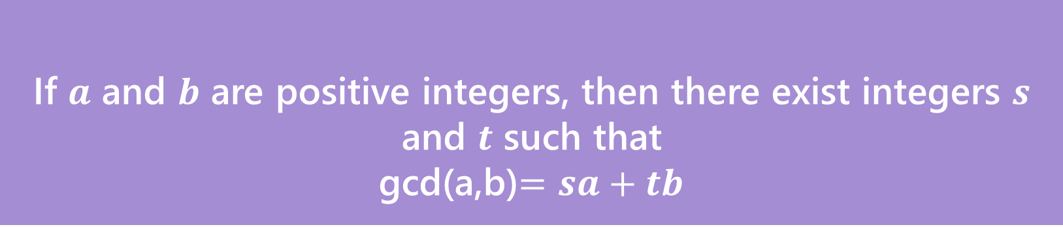
Bézout’s Theorem
If $a$ and $b$ are positive integers, then there exist integers $s$ and $t$ such that
gcd(a,b)$=sa+tb$
Bézout’s Theorem

Slide 33
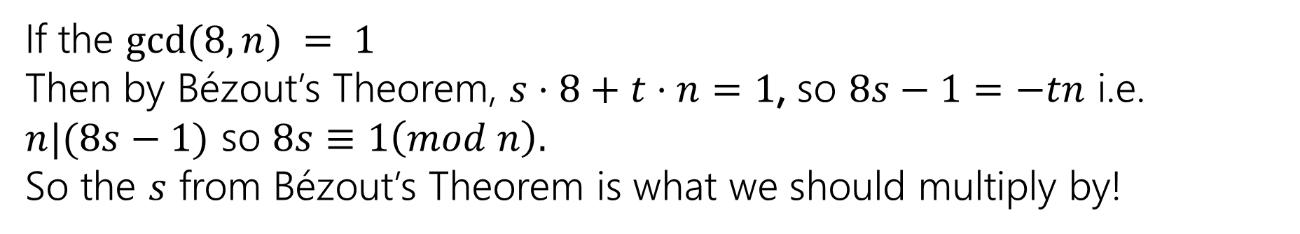
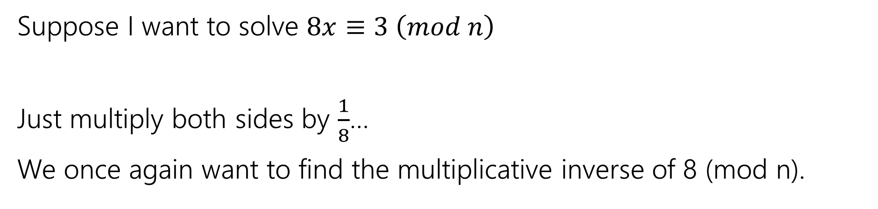
So…what’s it good for?
Suppose I want to solve $8x≡3 \left(mod n\right)$
Just multiply both sides by $\frac{1}{8}$…
We once again want to find the multiplicative inverse of 8 (mod n).
If the $gcd⁡(8,n) = 1$
Then by Bézout’s Theorem, $s⋅8+t⋅n=1$, so $8s−1=−tn$ i.e. $n|(8s−1)$ so $8s≡1\left(mod n\right).$
So the $s$ from Bézout’s Theorem is what we should multiply by!

Slide 34


Ok…how am I supposed to find $s,t$?
It turns out that while you’re calculating the GCD (using Euclid’s Algorithm), you can keep some extra information recorded, and end up with the $s,t$ for Bézout’s Theorem
This is called the “Extended Euclidian algorithm”

Slide 35
Extended Euclidean Algorithm

Slide 36
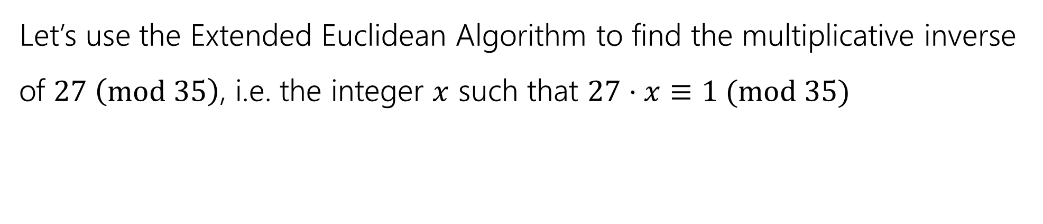
Extended Euclidean Algorithm
Let’s use the Extended Euclidean Algorithm to find the multiplicative inverse of $27 \left(mod 35\right)$, i.e. the integer $x$ such that $27⋅x≡1 (mod 35)$

Slide 37
Extended Euclidian Algorithm
Step 1 compute gcd(a,b); keep tableau information.
Step 2 solve all equations for the remainder.
Step 3 substitute backward
gcd(35,27)

Slide 38




Extended Euclidian Algorithm
Step 1 compute gcd(a,b); keep tableau information.
Step 2 solve all equations for the remainder.
Step 3 substitute backward
Tablaeu
gcd(35,27) =
gcd(27, 35%27) = gcd(27,8)
$35=1⋅ 27 +8$
= gcd(8, 27%8) = gcd(8, 3)
$27=3⋅ 8 +3$
= gcd(3, 8%3) = gcd(3, 2)
$8 =2⋅ 3 +2$
$3 =$ $1⋅ 2 +1$
= gcd(2, 3%2) = gcd(2,1)
= gcd(1, 2%1) = gcd(1,0)

Slide 39

Extended Euclidian Algorithm
Step 1 compute gcd(a,b); keep tableau information.
Step 2 solve all equations for the remainder.
Step 3 substitute backward
$35=1⋅ 27 +8$
$27=3⋅ 8 +3$
$8 =2⋅ 3 +2$
$3 =$ $1⋅ 2 +1$

Slide 40

Extended Euclidian Algorithm
Step 1 compute gcd(a,b); keep tableau information.
Step 2 solve all equations for the remainder.
Step 3 substitute backward
$35=1⋅ 27 +8$
$27=3⋅ 8 +3$
$8 =2⋅ 3 +2$
$3 =$ $1⋅ 2 +1$
$8=35 − 1⋅ 27$
$$3=27 − 3⋅ 8$$
$2 =8 − 2⋅ 3$
$1 =$ $3 − 1⋅ 2$

Slide 41

Extended Euclidian Algorithm
Step 1 compute gcd(a,b); keep tableau information.
Step 2 solve all equations for the remainder.
Step 3 substitute backward
$8=35 − 1⋅ 27$
$$3=27 − 3⋅ 8$$
$2 =8 − 2⋅ 3$
$1 =$ $3 − 1⋅ 2$

Slide 42
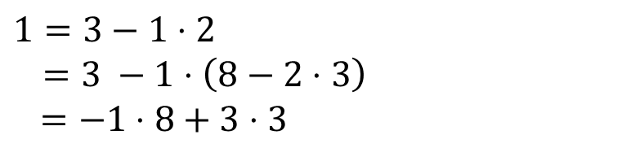
Extended Euclidian Algorithm
Step 1 compute gcd(a,b); keep tableau information.
Step 2 solve all equations for the remainder.
Step 3 substitute backward
$1=3−1⋅2$
$=3 −1⋅\left(8−2⋅3\right)$
$=−1⋅8+3⋅3$
$8=35 − 1⋅ 27$
$$3=27 − 3⋅ 8$$
$2 =8 − 2⋅ 3$
$1 =$ $3 − 1⋅ 2$

Slide 43

Extended Euclidian Algorithm
Step 1 compute gcd(a,b); keep tableau information.
Step 2 solve all equations for the remainder.
Step 3 substitute backward
$1=3−1⋅2$
$=3 −1⋅\left(8−2⋅3\right)$
$=−1⋅8+3⋅3$
$=−1⋅8+3⋅\left(27−3⋅8\right)$
$=3⋅27−10⋅8$
$8=35 − 1⋅ 27$
$$3=27 − 3⋅ 8$$
$2 =8 − 2⋅ 3$
$1 =$ $3 − 1⋅ 2$

Slide 44


Extended Euclidian Algorithm
Step 1 compute gcd(a,b); keep tableau information.
Step 2 solve all equations for the remainder.
Step 3 substitute backward
When substituting back, you keep the larger of $m,n$ and the number you just substituted.
Don’t simplify further! (or you lose the form you need)
$1=3−1⋅2$
$=3 −1⋅\left(8−2⋅3\right)$
$=−1⋅8+3⋅3$
$=−1⋅8+3⋅\left(27−3⋅8\right)$
$=3⋅27−10⋅8$
$=3⋅27−10⋅(35−1⋅27)$
$=13⋅27−10⋅35$
$8=35 − 1⋅ 27$
$$3=27 − 3⋅ 8$$
$2 =8 − 2⋅ 3$
$1 =$ $3 − 1⋅ 2$
gcd(27,35) = $13⋅27+\left(−10\right)⋅35$ = 1

Slide 45
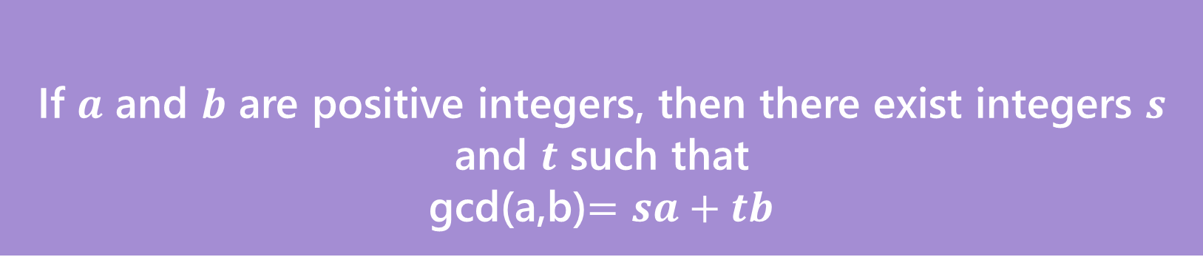
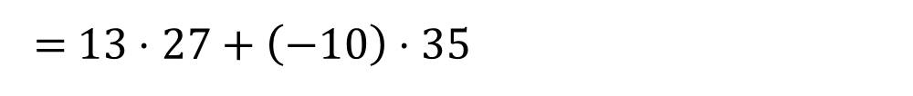
Extended Euclidian Algorithm
If $a$ and $b$ are positive integers, then there exist integers $s$ and $t$ such that
gcd(a,b)$=sa+tb$
Bézout’s Theorem
gcd(27,35) = $1=s⋅27+t⋅35$
= $13⋅27+\left(−10\right)⋅35$
We’ve found our s and t! s = 13 and t = -10

Slide 46
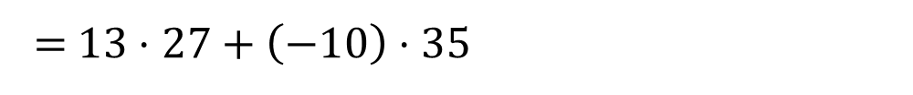
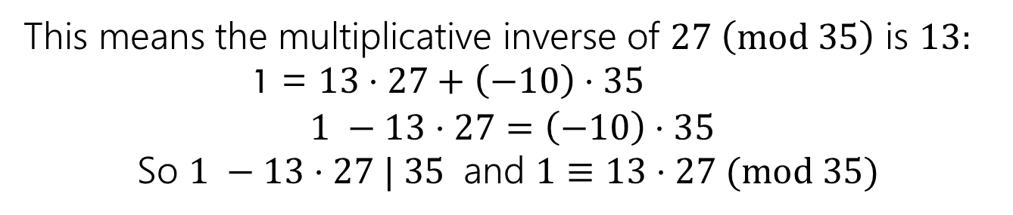
Extended Euclidian Algorithm
gcd(27,35) = $1=s⋅27+t⋅35$
= $13⋅27+\left(−10\right)⋅35$
We’ve found our s and t! s = 13 and t = -10
This means the multiplicative inverse of $27 \left(mod 35\right)$ is 13:
1 = $13⋅27+\left(−10\right)⋅35$
$$1 −13⋅27=\left(−10\right)⋅35$$
So $1 −13⋅27 | 35$ and $1≡13⋅27 (mod 35)$

Slide 47
Set Theory

Slide 48
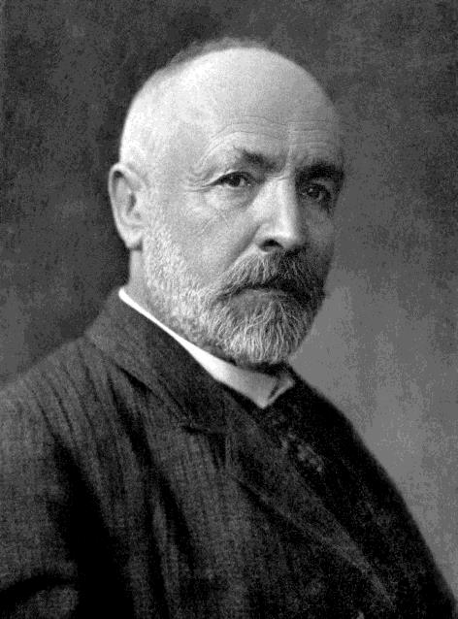
Motivation
Set theory is widely regarded as the foundation for all of mathematics.
In computing, there are applications in:
Data Structures
Databases
Programming Languages
Father of Modern Set Theory Georg Cantor (1845 – 1918)

Slide 49
Sets
Definition:
A set is an unordered collection of distinct objects, called elements.
We write 𝑥 ∈ 𝐴 to say that 𝑥 is an element of the set 𝐴.
We write 𝑥 ∉ 𝐴 to say that 𝑥 is not an element of the set 𝐴.

Slide 50
Set Notation
We’ll write a set as a collection of elements inside curly braces {}. Sets are often given variable names with capital letters.
𝐴 = 0,5,8,10 = 5,8,0,10
Sets are unordered
𝐵 = {watermelon, apple, pineapple}
𝐶 = 𝑎, 𝑏, 𝑐, 𝑐, 𝑏, 𝑎 = {𝑎, 𝑏, 𝑐}
Sets can contain any type of object
Repeat elements are listed once
𝐷 = {0,1,2,3,4,5, … }
Sets can be finite or infinite

Slide 51
Common Sets
ℝ is the set of Real Numbers.
ℤ is the set of Integers.
ℕ is the set of Natural Numbers.
ℚ is the set of Rational Numbers (fractions)
∅ = {} is the Empty Set
E.g. 1, −17, 𝜋, 2
ℤ = {… , −2, −1, 0, 1, 2, … }
ℕ = {0, 1, 2, 3, … }
E.g. ¹ , − ¹¹ , 17
2 3
∅ has no elements

Slide 52
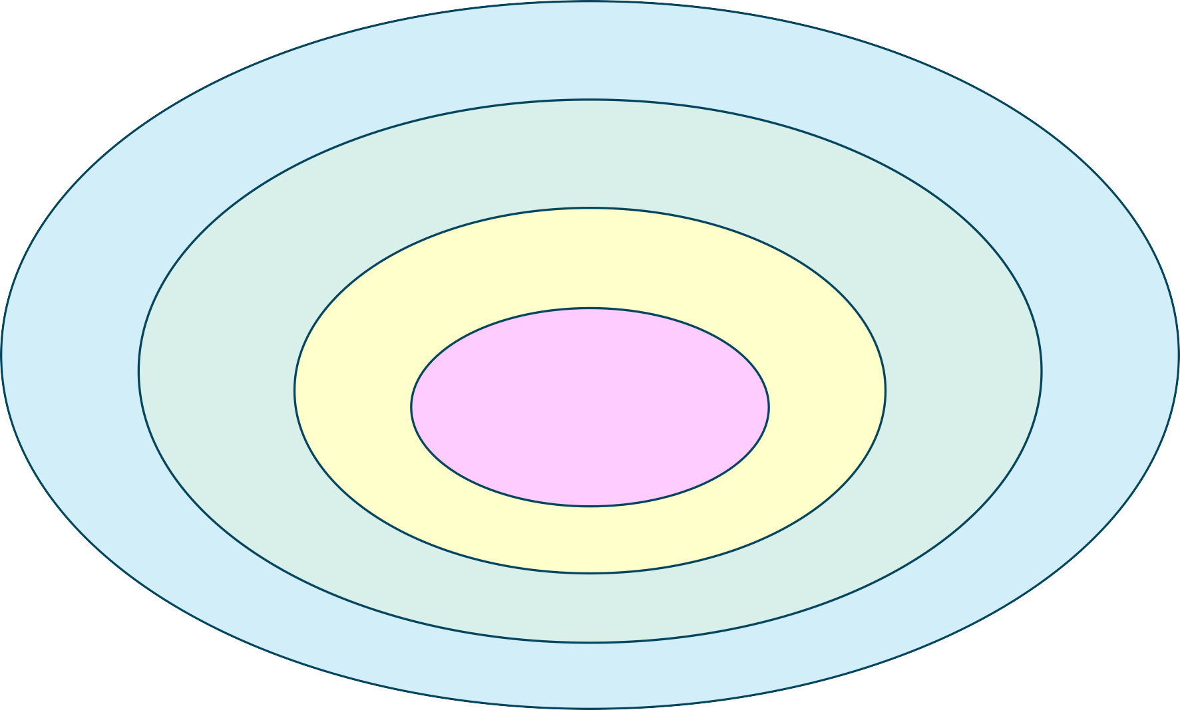
Common Sets
ℝ Real Numbers
ℚ Rational Numbers
ℤ Integers
ℕ Natural Numbers

Slide 53
Sets can be elements of other sets
For example:
𝐴 = { 1 , 2 , 1,2 , ∅}
𝐵 = {1, 2}
Then 1 ∈ 𝐵, 2 ∈ 𝐵. And ∅ ∈ 𝐴, 𝐵 ∈ 𝐴.

Slide 54
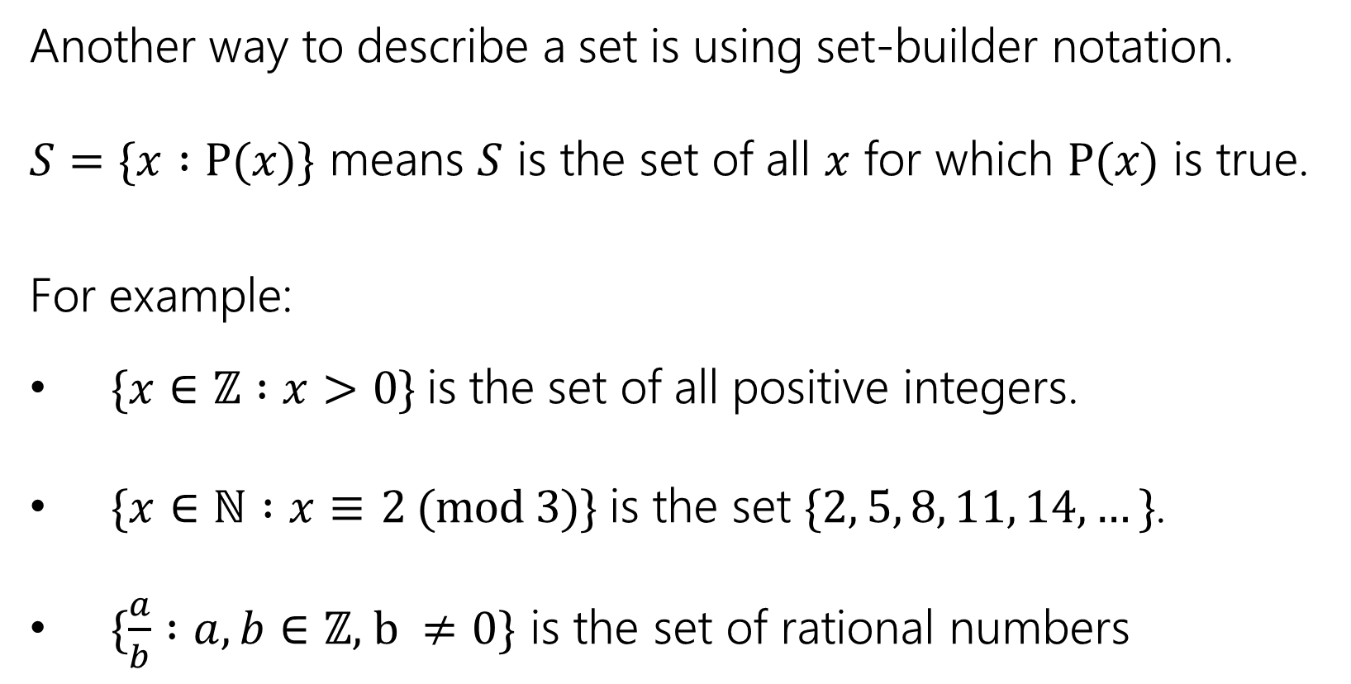
Sets Builder Notation
Another way to describe a set is using set-builder notation.
𝑆 = {𝑥 ∶ P(𝑥)} means 𝑆 is the set of all 𝑥 for which P(𝑥) is true. For example:
{𝑥 ∈ ℤ ∶ 𝑥 > 0} is the set of all positive integers.
{𝑥 ∈ ℕ ∶ 𝑥 ≡ 2 (mod 3)} is the set {2, 5, 8, 11, 14, … }.
$\{\frac{a}{b} :a, b∈\text{ℤ}\text{, }\text{b} ≠0\}$ is the set of rational numbers

Slide 55
Set Cardinality
The cardinality of a set is the number of elements in a set (its size). The cardinality of a set 𝐴 is often denoted |𝐴| .
What is the cardinality of the following sets?
𝐴 = {𝑥 ∈ ℤ ∶ 𝑥 ≡ 1 (mod 4) and − 10 ≤ 𝑥 ≤ 10}
𝐵 = ∅
𝐶 = {∅}
= {−7, −3, 1, 5, 9}
|A| = 5
|B| = 0
|𝐶| = 1

Slide 56
Relationships Between Sets

Slide 57
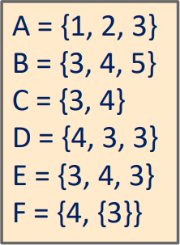
Set Equality
Sets 𝐴 and 𝐵 are equal iff they have the same elements.
In predicate logic, 𝐴 = 𝐵 is defined as:
∀𝑥 𝑥 ∈ 𝐴 ↔ 𝑥 ∈ 𝐵
Which sets are equal?
𝐶 = 𝐷 = 𝐸

Slide 58
Subset
Set 𝐴 is a subset of 𝐵 if every element of 𝐴 is also in 𝐵.
In predicate logic, 𝐴 ⊆ 𝐵 is defined as:
∀𝑥(𝑥 ∈ 𝐴 → 𝑥 ∈ 𝐵)
Which sets are subsets?
𝐶 ⊆ 𝐵, 𝐷 ⊆ 𝐸, 𝐸 ⊆ 𝐷, etc.

Slide 59
Set Equality and Subsets
𝐴 = 𝐵 ≡ 𝐴 ⊆ 𝐵 ∧ 𝐵 ⊆ 𝐴
A
is a subset of B
B is a subset of
A
B
A
A
B

Slide 60
∈ vs. ⊆
𝐴 = {1, 2, 3}
𝐵 = {2} 𝐶 = ∅, {2}
∅ ⊆ 𝐴?
∅ ∈ 𝐴?
2 ⊆ 𝐵?
2 ∈ 𝐵?
𝐵 ∈ 𝐴?
𝐵 ∈ 𝐶?
Yes.
No. ∅ ∈ 𝐶 though!
No. {2} ⊆ 𝐵 though!
Yes.
No. 𝐵 ⊆ 𝐴 though!
Yes.

Slide 61


Proof Skeleton
How would we show $A⊆B?$
Let $x$ be an arbitrary element of $A$
…
So $x$ is also in $B$.
Since $x$ was an arbitrary element of $A,$ we have that $A⊆B$.
$A⊆B≡∀x(x∈A→x∈B)$

Slide 62
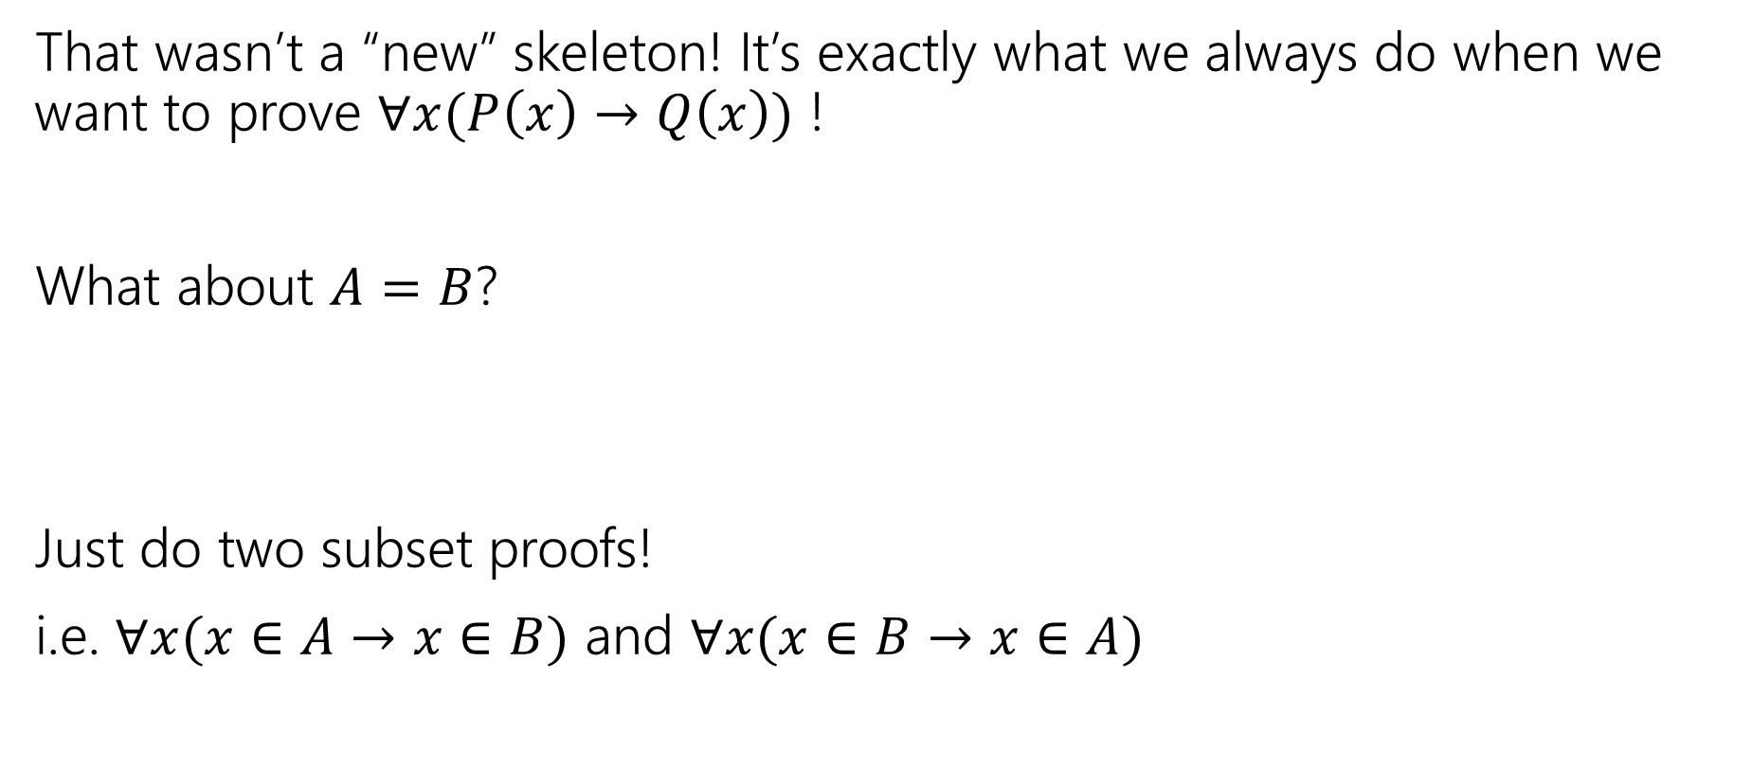
Proof Skeleton
That wasn’t a “new” skeleton! It’s exactly what we always do when we want to prove $∀x(P\left(x\right)→Q\left(x\right))$ !
What about $A=B$?
Just do two subset proofs!
i.e. $∀x(x∈A→x∈B)$ and $∀x(x∈B→x∈A)$
$A=B≡∀x\left(x∈A↔x∈B\right)≡$ $A⊆B∧B⊆A$

Slide 63
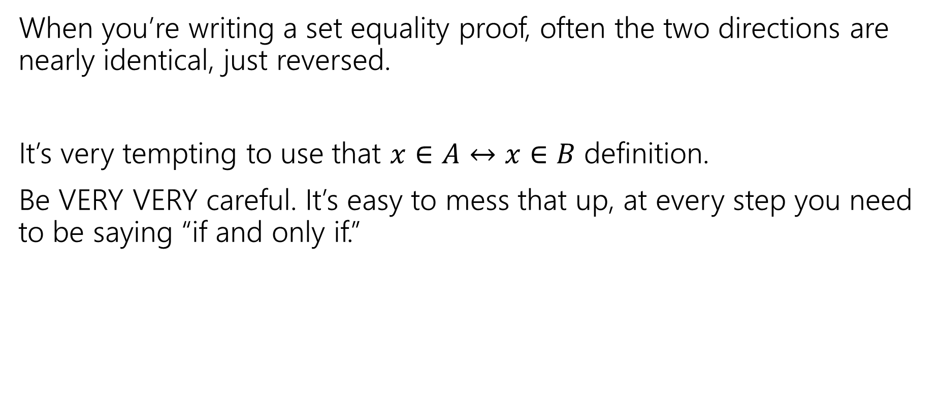
Proof-writing advice
When you’re writing a set equality proof, often the two directions are nearly identical, just reversed.
It’s very tempting to use that $x∈A↔x∈B$ definition.
Be VERY VERY careful. It’s easy to mess that up, at every step you need to be saying “if and only if.”

Slide 64
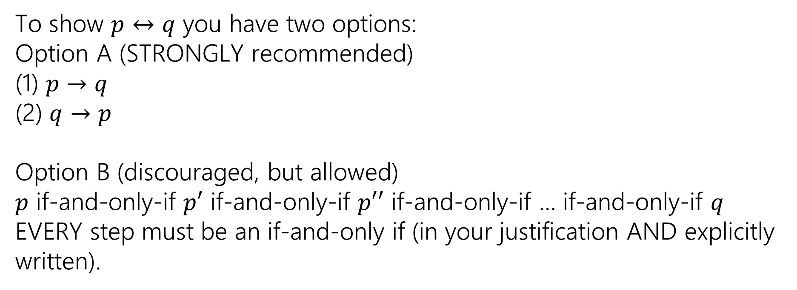
Review : How to show an if and only if
To show $p↔q$ you have two options:
Option A (STRONGLY recommended)
(1) $p→q$
(2) $q→p$
Option B (discouraged, but allowed)
$p$ if-and-only-if $p′$ if-and-only-if $p′′$ if-and-only-if … if-and-only-if $q$
EVERY step must be an if-and-only if (in your justification AND explicitly written).

Slide 65
Set Operations
Combining Sets

Slide 66
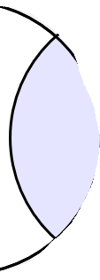
Set Operations
Union: 𝐴 ∪ 𝐵
Intersection: 𝐴 ∩ 𝐵
𝐴 ∪ 𝐵 = {𝑥 ∶ 𝑥 ∈ 𝐴 ∨ 𝑥 ∈ 𝐵}
𝐴 ∩ 𝐵 = {𝑥 ∶ 𝑥 ∈ 𝐴 ∧ 𝑥 ∈ 𝐵}
A B
A B

Slide 67
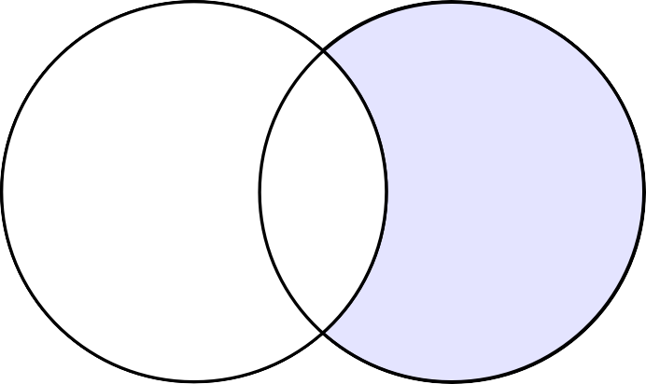
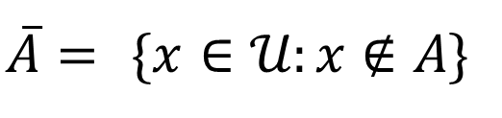
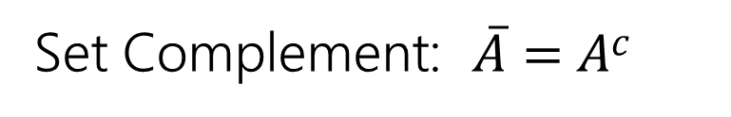
Set Operations
Set Difference: 𝐴 \ 𝐵
Set Complement: $\overline{A}=$ 𝐴^{𝑐}
(with respect to the universe 𝒰)
𝐴 \ 𝐵 = {𝑥 ∶ 𝑥 ∈ 𝐴 ∧ 𝑥 ∉ 𝐵}
$\overline{A}$ = {𝑥 ∈ 𝒰: 𝑥 ∉ 𝐴}
A B
A B

Slide 68
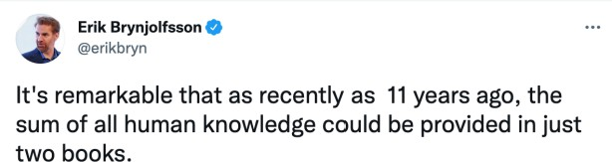

Set Operations

Slide 69


Exercises
Definitions
𝐴 ∪ 𝐵 = 𝑥 ∶ 𝑥 ∈ 𝐴 ∨ 𝑥 ∈ 𝐵
𝐴 ∩ 𝐵 = {𝑥 ∶ 𝑥 ∈ 𝐴 ∧ 𝑥 ∈ 𝐵}
𝐴 \ 𝐵 = {𝑥 ∶ 𝑥 ∈ 𝐴 ∧ 𝑥 ∉ 𝐵}
𝐴 = {1, 2, 3} 𝐵 = {3, 5, 6} 𝐶 = {3, 4}
$\overline{A}$= 𝑥 ∶ 𝑥 ∉ 𝐴
Using only 𝐴, 𝐵, 𝐶 and set operations, make the following sets. The universe is all integers.
{1, 2, 3, 4, 5, 6} =
{3} =
{1, 2} =
𝐴 ∪ 𝐵 ∪ 𝐶
𝐴 ∩ 𝐵
𝐴 \ 𝐵 = 𝐴 ∩ $\overline{B}$

Slide 70

Powerset
Powerset: 𝒫{𝐴}
𝒫(𝐴) = {𝑋 ∶ 𝑋 ⊆ 𝐴}
The powerset of 𝐴 is the set of all subsets of 𝐴.
𝒫 1,2 = ∅, 1 , 2 , 1,2
𝒫 {𝑎, 𝑏, 𝑐} = ∅, 𝑎 , 𝑏 , 𝑐 , 𝑎, 𝑏 , 𝑎, 𝑐 , 𝑏, 𝑐 , 𝑎, 𝑏, 𝑐

Slide 71
Cartesian Product
Cartesian Product: 𝐴 × 𝐵
𝐴 × 𝐵 = { 𝑎, 𝑏 ∶ 𝑎 ∈ 𝐴, 𝑏 ∈ 𝐵}
The cartesian product of 𝐴 with 𝐵 is the set of ordered pairs of the form
(𝑎, 𝑏), where 𝑎 ∈ 𝐴 and 𝑏 ∈ 𝐵.
If 𝐴 = {1,2} and 𝐵 = {𝑎, 𝑏, 𝑐} then:
𝐴 × 𝐵 = { 1, 𝑎 , 1, 𝑏 , 1, 𝑐 , 2, 𝑎 , 2, 𝑏 , (2, 𝑐)}
ℝ × ℝ = the real plane. This is often denoted ℝ².

Slide 72
Exercises
Compute the following:
{1,2} × ∅ =
𝒫 2 × 1, 3 =
∅
𝒫({(2, 1), (2, 3)}) = {∅, {(2,1), {(2,3)}, {(2,1), (2,3)}}
{∅, {∅}}
𝒫 ∅ =
𝒫 {1, 2}
× 𝒫 {3, 4, 5} =
32

Slide 73
Todo
Tonight:
HW3 is due tonight!
Friday:
CC 10 due Friday at noon
HW2 Resubmission is due Friday!

