Slide 1
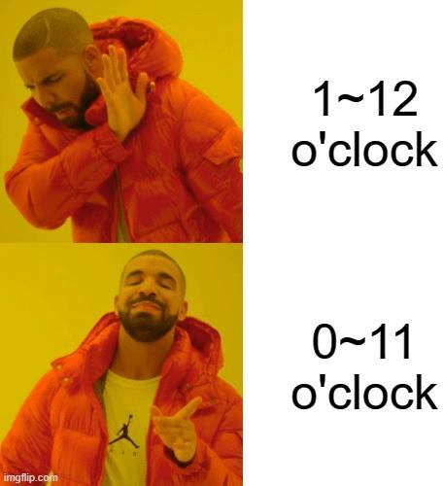
Number Theory Continued
CSE 311 25Su
Lecture 9

Slide 2
Announcements
HW3 is out and due Wednesday!
Start today if you haven’t already
Pick up HW1 solutions at the front of the room or during Parker’s OH this week.

Slide 3
Review

Slide 4
Why Number Theory?
Applicable in Computer Science
“hash functions” (you’ll see them in 332) commonly use modular arithmetic
Much of classical cryptography is based on prime numbers.
More importantly, a great playground for writing English proofs.

Slide 5
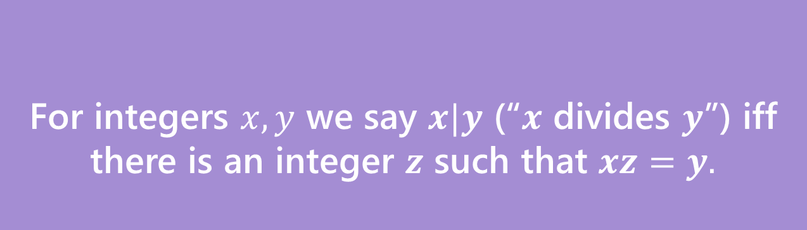
Divides
For integers $x,y$ we say $x|y$ (“$x$ divides $y$”) iff there is an integer $z$ such that $xz=y.$
Divides
Informally: “𝑎 fits into 𝑏” or “𝑎 is a factor of 𝑏”
“The small number goes first*” *when both are positive integers
Examples: 5 | 15
−3 | 9
5 ∤ 21

Slide 6
Division Theorem
Division Theorem:
For any integer 𝑎 and positive integer 𝑑, there exist unique integers 𝑞, 𝑟
with 0 ≤ 𝑟 < 𝑑 such that 𝑎 = 𝑞𝑑 + 𝑟.
In Java, 𝑞 is the result of the operation 𝑎/𝑑
In Java, 𝑟 is the result of the operation 𝑎 % 𝑑
Warning
When dealing with
negative numbers, Java’s
% may behave differently!

Slide 7
The mod (%) operator
Division Theorem
𝑎 = 𝑞𝑑 + 𝑟 with 0 ≤ 𝑟 < 𝑑
The % operator is often referred to as “mod”
𝑎 % 𝑑 returns the remainder 𝑟 when you divide 𝑎 by 𝑑
22 % 5 = 2
25 % 5 = 0
22 = 4 ⋅ 5 + 𝟐
25 = 5 ⋅ 5 + 𝟎
0 % 5 = 0
−1 % 4 = 3
0 = 0 ⋅ 5 + 𝟎
−1 = −1 ⋅ 4 + 𝟑

Slide 8
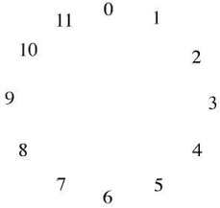
Modular Arithmetic: Like a Clock
Imagine you can only represent numbers 0, … , 11. We call this
“arithmetic mod 12”.
What’s 8 + 7?
3
Observation
The solution is 𝑎 % 12.

Slide 9
Congruence
We need a formal definition of 𝑎 ≡ 𝑏 (mod m).
We can’t just say “𝑎 and 𝑏 are on the same place in the 𝑚 clock ☺”
Definition:
For integers 𝑎, 𝑏 and positive integer 𝑚, we say 𝑎 ≡ 𝑏 (mod m)iff 𝑚 | (𝑎− 𝑏).
Note: 𝑎 ≡ 𝑏 (mod m) is equivalent to 𝑎 % 𝑚 = 𝑏 % 𝑚.
We will actually prove that the two notions are the same. But, the formal definition is much easier to use in proofs.

Slide 10
Intuition
Definition: 𝑎 ≡ 𝑏 (mod m)
is defined as 𝑚 | (𝑎 − 𝑏)
Intuition: Equivalently, 𝑎 ≡ 𝑏 (mod m)
means 𝑎 % 𝑚 = 𝑏 % 𝑚
Here we have some groups of numbers that are congruent mod 10.
0
3
8
23
18
10
20
13
28
130
53
−2
−10
68
−7
128
70
Congruent to 0
Congruent to 3
Congruent to 8

Slide 11
Warm Up: (Does Not) Divides Proof

Slide 12

Warm Up: (Does Not) Divides Proof
For all integers, $a,b,c:$Show that if $a∤(bc)$ then $a∤b$ or $a∤c$.

Slide 13
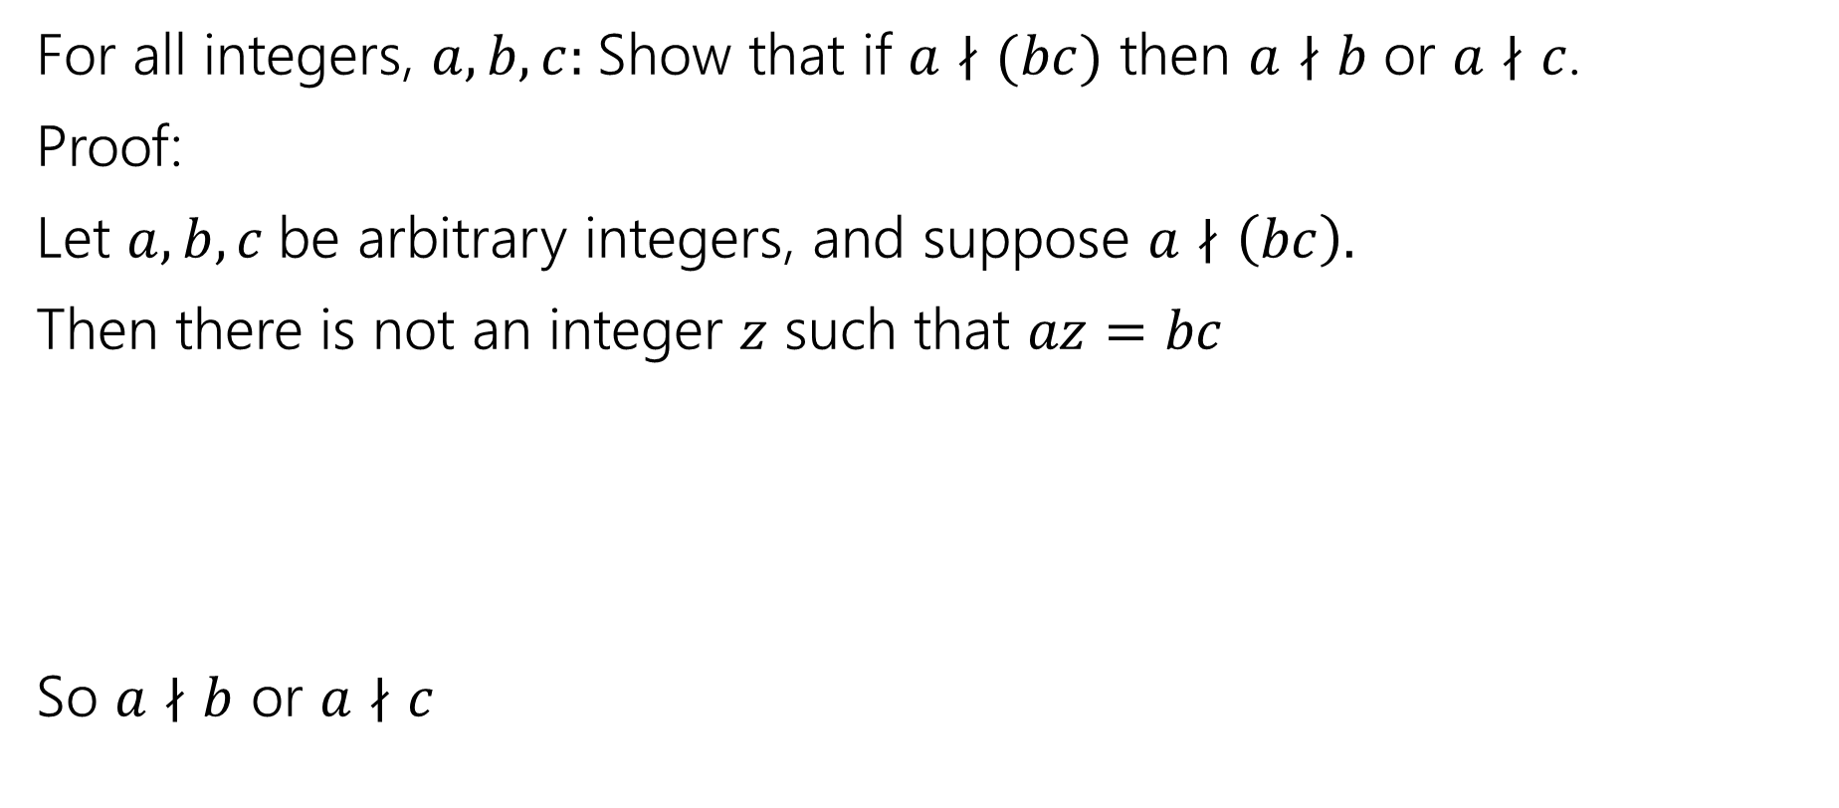
Warm Up: (Does Not) Divides Proof
For all integers, $a,b,c:$Show that if $a∤(bc)$ then $a∤b$ or $a∤c$.
Proof:
Let $a,b,c$be arbitrary integers, and suppose $a∤\left(bc\right).$
Then there is not an integer $z$ such that $az=bc$
So $a∤b$ or $a∤c$

Slide 14
Warm Up: (Does Not) Divides Proof
For all integers, $a,b,c:$Show that if $a∤(bc)$ then $a∤b$ or $a∤c$.
Proof:
Let $a,b,c$be arbitrary integers, and suppose $a∤\left(bc\right).$
Then there is not an integer $z$ such that $az=bc$
So $a∤b$ or $a∤c$
DEAD END

Slide 15
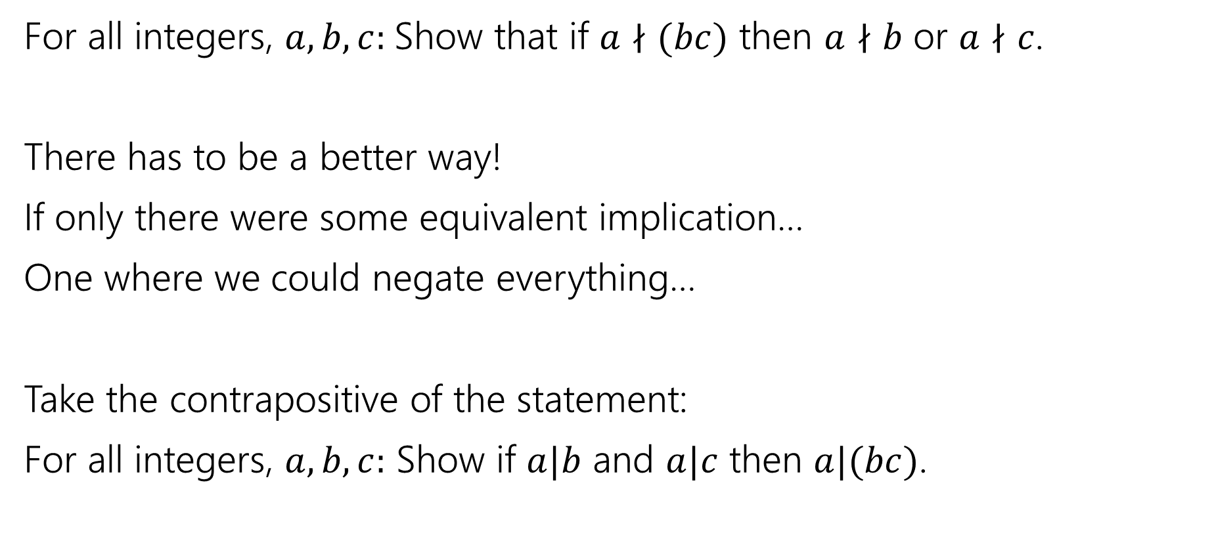
Warm Up: (Does Not) Divides Proof
For all integers, $a,b,c:$Show that if $a∤(bc)$ then $a∤b$ or $a∤c$.
There has to be a better way!
If only there were some equivalent implication…
One where we could negate everything…
Take the contrapositive of the statement:
For all integers, $a,b,c:$ Show if $a|b$ and $a|c$ then $a|(bc)$.

Slide 16

By contrapositive
Claim: For all integers, $a,b,c:$Show that if $a∤(bc)$ then $a∤b$ or $a∤c$.
We argue by contrapositive.
Let $a,b,c$be arbitrary integers, and suppose $a|b$ and $a|c$.
Therefore $a|bc$

Slide 17
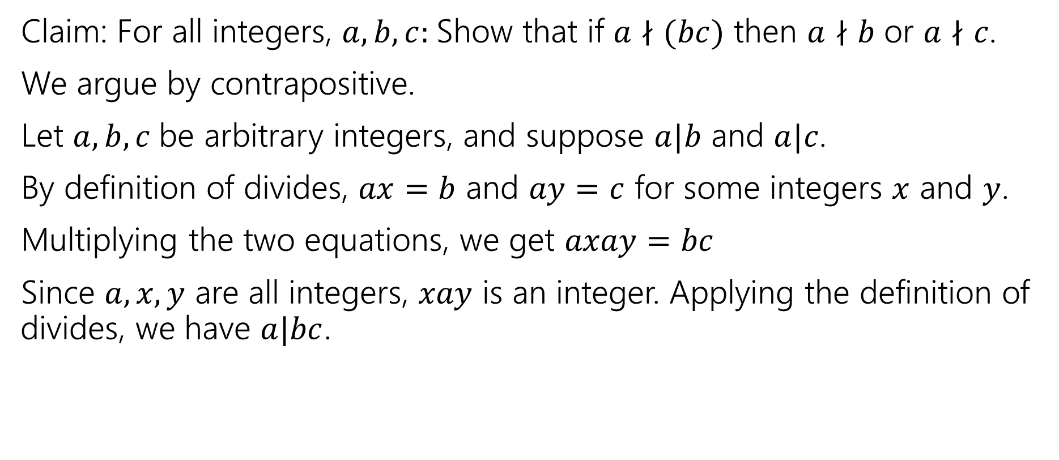
By contrapositive
Claim: For all integers, $a,b,c:$Show that if $a∤(bc)$ then $a∤b$ or $a∤c$.
We argue by contrapositive.
Let $a,b,c$be arbitrary integers, and suppose $a|b$ and $a|c$.
By definition of divides, $ax=b$ and $ay=c$ for some integers $x$ and $y$.
Multiplying the two equations, we get $axay=bc$
Since $a,x,y$ are all integers, $xay$ is an integer. Applying the definition of divides, we have $a|bc$.

Slide 18
Properties of Congruence

Slide 19
Recall: Familiar Properties of = in algebra
If 𝑎 = 𝑏, then 𝑏 = 𝑎.
If 𝑎 = 𝑏 and 𝑐 = 𝑑, then 𝑎 + 𝑐 = 𝑏 + 𝑑.
If 𝑎 = 𝑏 and 𝑐 = 𝑑, then 𝑎𝑐 = 𝑏𝑑.
If 𝑎 = 𝑏 and 𝑏 = 𝑐, then 𝑎 = 𝑐.
These are the facts that allow us to use algebra to solve problems. We will prove analogous facts for modular arithmetic.

Slide 20
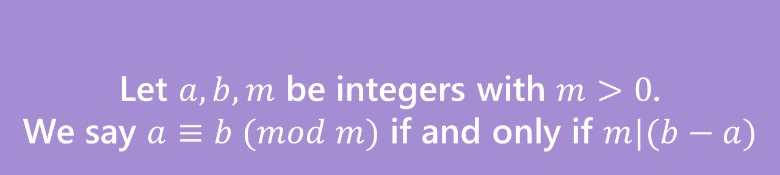
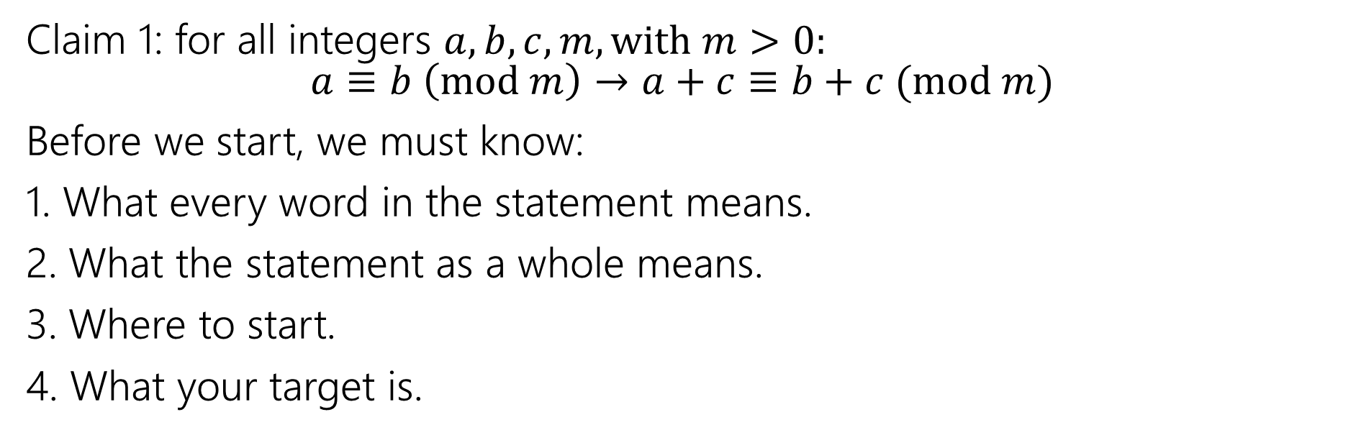
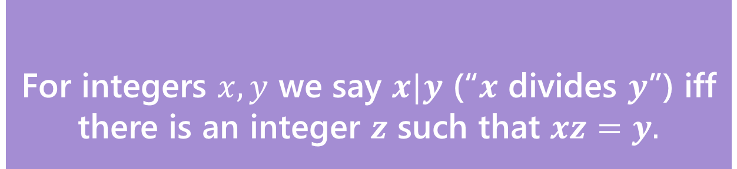
Claim 1: for all integers $a,b,c,m,with m>0:$ $a≡b \left(mod m\right)→a+c≡b+c (mod m)$
Before we start, we must know:
1. What every word in the statement means.
2. What the statement as a whole means.
3. Where to start.
4. What your target is.
For integers $x,y$ we say $x|y$ (“$x$ divides $y$”) iff there is an integer $z$ such that $xz=y.$
Divides
Let $a,b,m$ be integers with $m>0$.
We say $a≡b (mod m)$ if and only if $m|(b−a)$
Equivalence in modular arithmetic

Slide 21
Claim 1
Definitions:
𝑎 | 𝑏 iff ∃𝑘 ∈ ℤ 𝑏 = 𝑘𝑎
𝑎 ≡ 𝑏 (mod m) iff 𝑚 | (𝑎 − 𝑏)
Claim 1: For integers 𝑎, 𝑏 and positive integer 𝑚, if 𝑎 ≡ 𝑏 (mod m) then 𝑏 ≡ 𝑎 (mod m).

Slide 22
Claim 1
Definitions:
𝑎 | 𝑏 iff ∃𝑘 ∈ ℤ 𝑏 = 𝑘𝑎
𝑎 ≡ 𝑏 (mod m) iff 𝑚 | (𝑎 − 𝑏)
Claim 1: For integers 𝑎, 𝑏 and positive integer 𝑚, if 𝑎 ≡ 𝑏 (mod m) then 𝑏 ≡ 𝑎 (mod m).
Proof: Let 𝑎, 𝑏 be arbitrary integers and let 𝑚 be an arbitrary positive integer. Suppose that 𝑎 ≡ 𝑏 (mod m).
Then by definition of congruence, 𝑏 ≡ 𝑎 (mod m). Since 𝑎, 𝑏, 𝑚 were arbitrary, the claim holds.

Slide 23
Claim 1
Definitions:
𝑎 | 𝑏 iff ∃𝑘 ∈ ℤ 𝑏 = 𝑘𝑎
𝑎 ≡ 𝑏 (mod m) iff 𝑚 | (𝑎 − 𝑏)
Claim 1: For integers 𝑎, 𝑏 and positive integer 𝑚, if 𝑎 ≡ 𝑏 (mod m) then 𝑏 ≡ 𝑎 (mod m).
Proof: Let 𝑎, 𝑏 be arbitrary integers and let 𝑚 be an arbitrary positive integer. Suppose that 𝑎 ≡ 𝑏 (mod m).
[Unroll definitions]
[Manipulate towards goal]
[Reroll definitions]
Then by definition of congruence, 𝑏 ≡ 𝑎 (mod m). Since 𝑎, 𝑏, 𝑚 were arbitrary, the claim holds.

Slide 24
Claim 1
Definitions:
𝑎 | 𝑏 iff ∃𝑘 ∈ ℤ 𝑏 = 𝑘𝑎
𝑎 ≡ 𝑏 (mod m) iff 𝑚 | (𝑎 − 𝑏)
Claim 1: For integers 𝑎, 𝑏 and positive integer 𝑚, if 𝑎 ≡ 𝑏 (mod m) then 𝑏 ≡ 𝑎 (mod m).
Proof: Let 𝑎, 𝑏 be arbitrary integers and let 𝑚 be an arbitrary positive integer. Suppose that 𝑎 ≡ 𝑏 (mod m).
Then by definition of congruence, 𝑚 | (𝑎 − 𝑏).
[Manipulate towards goal]
[Reroll definitions]
Then by definition of congruence, 𝑏 ≡ 𝑎 (mod m). Since 𝑎, 𝑏, 𝑚 were arbitrary, the claim holds.

Slide 25
Claim 1
Definitions:
𝑎 | 𝑏 iff ∃𝑘 ∈ ℤ 𝑏 = 𝑘𝑎
𝑎 ≡ 𝑏 (mod m) iff 𝑚 | (𝑎 − 𝑏)
Claim 1: For integers 𝑎, 𝑏 and positive integer 𝑚, if 𝑎 ≡ 𝑏 (mod m) then 𝑏 ≡ 𝑎 (mod m).
Proof: Let 𝑎, 𝑏 be arbitrary integers and let 𝑚 be an arbitrary positive integer. Suppose that 𝑎 ≡ 𝑏 (mod m).
Then by definition of congruence, 𝑚 | (𝑎 − 𝑏).
Then by definition of divides, there exists some integer 𝑘 such that 𝑎 − 𝑏 = 𝑚𝑘.
[Manipulate towards goal]
[Reroll definitions]
Then by definition of congruence, 𝑏 ≡ 𝑎 (mod m). Since 𝑎, 𝑏, 𝑚 were arbitrary, the claim holds.

Slide 26
Claim 1
Definitions:
𝑎 | 𝑏 iff ∃𝑘 ∈ ℤ 𝑏 = 𝑘𝑎
𝑎 ≡ 𝑏 (mod m) iff 𝑚 | (𝑎 − 𝑏)
Claim 1: For integers 𝑎, 𝑏 and positive integer 𝑚, if 𝑎 ≡ 𝑏 (mod m) then 𝑏 ≡ 𝑎 (mod m).
Proof: Let 𝑎, 𝑏 be arbitrary integers and let 𝑚 be an arbitrary positive integer. Suppose that 𝑎 ≡ 𝑏 (mod m).
Then by definition of congruence, 𝑚 | (𝑎 − 𝑏).
Then by definition of divides, there exists some integer 𝑘 such that 𝑎 − 𝑏 = 𝑚𝑘.
Multiplying both sides by − 1, we have 𝑏 − 𝑎 = −𝑚𝑘 = 𝑚(−𝑘). Since 𝑘 is an integer, −𝑘 is an integer.
So by definition of divides, 𝑚 | (𝑏 − 𝑎).
Then by definition of congruence, 𝑏 ≡ 𝑎 (mod m). Since 𝑎, 𝑏, 𝑚 were arbitrary, the claim holds.

Slide 27
Note on Claim 1
You’ll see 𝑎 ≡ 𝑏 (mod m) defined as 𝑚 | (𝑎 − 𝑏) or 𝑚 | (𝑏 − 𝑎) depending on where you look.
Claim 1 proves these definitions are equivalent. From now on, you can use either definition in your proofs.
In general, once we have proved claims in class, you can use those claims in your
homework without proof.

Slide 28
Claim 2
Definitions:
𝑎 | 𝑏 iff ∃𝑘 ∈ ℤ 𝑏 = 𝑘𝑎
𝑎 ≡ 𝑏 (mod m) iff 𝑚 | (𝑎 − 𝑏)
Claim 2: For integers 𝑎, 𝑏, 𝑐, 𝑑 and positive integer 𝑚, if 𝑎 ≡ 𝑏 (mod m)
and 𝑐 ≡ 𝑑 (mod m). then 𝑎 + 𝑐 ≡ 𝑏 + 𝑑 (mod m).
Intuition
3 ≡ 13 (mod 10) and 14 ≡ 24 (mod 10) ⇒ 17 ≡ 37 (mod 10)

Slide 29
Claim 2
Definitions:
𝑎 | 𝑏 iff ∃𝑘 ∈ ℤ 𝑏 = 𝑘𝑎
𝑎 ≡ 𝑏 (mod m) iff 𝑚 | (𝑎 − 𝑏)
Claim 2: For integers 𝑎, 𝑏, 𝑐, 𝑑 and positive integer 𝑚, if 𝑎 ≡ 𝑏 (mod m)
and 𝑐 ≡ 𝑑 (mod m). then 𝑎 + 𝑐 ≡ 𝑏 + 𝑑 (mod m).

Slide 30
Claim 2
Definitions:
𝑎 | 𝑏 iff ∃𝑘 ∈ ℤ 𝑏 = 𝑘𝑎
𝑎 ≡ 𝑏 (mod m) iff 𝑚 | (𝑎 − 𝑏)
Claim 2: For integers 𝑎, 𝑏, 𝑐, 𝑑 and positive integer 𝑚, if 𝑎 ≡ 𝑏 (mod m)
and 𝑐 ≡ 𝑑 (mod m). then 𝑎 + 𝑐 ≡ 𝑏 + 𝑑 (mod m).
Proof: Let 𝑎, 𝑏, 𝑐, 𝑑 and 𝑚 > 0 be arbitrary integers. Suppose that 𝑎 ≡ 𝑏 (mod m) and 𝑐 ≡ 𝑑 (mod m).
Then by definition of congruence, 𝑎 + 𝑐 ≡ 𝑏 + 𝑑 (mod m). Since 𝑎, 𝑏, 𝑐, 𝑑, 𝑚 were arbitrary, the claim holds.

Slide 31
Claim 2
Definitions:
𝑎 | 𝑏 iff ∃𝑘 ∈ ℤ 𝑏 = 𝑘𝑎
𝑎 ≡ 𝑏 (mod m) iff 𝑚 | (𝑎 − 𝑏)
Claim 2: For integers 𝑎, 𝑏, 𝑐, 𝑑 and positive integer 𝑚, if 𝑎 ≡ 𝑏 (mod m)
and 𝑐 ≡ 𝑑 (mod m). then 𝑎 + 𝑐 ≡ 𝑏 + 𝑑 (mod m).
Proof: Let 𝑎, 𝑏, 𝑐, 𝑑 and 𝑚 > 0 be arbitrary integers. Suppose that 𝑎 ≡ 𝑏 (mod m) and 𝑐 ≡ 𝑑 (mod m).
[Unroll definitions]
[Manipulate towards goal]
[Reroll definitions]
Then by definition of congruence, 𝑎 + 𝑐 ≡ 𝑏 + 𝑑 (mod m). Since 𝑎, 𝑏, 𝑐, 𝑑, 𝑚 were arbitrary, the claim holds.

Slide 32
Claim 2
Definitions:
𝑎 | 𝑏 iff ∃𝑘 ∈ ℤ 𝑏 = 𝑘𝑎
𝑎 ≡ 𝑏 (mod m) iff 𝑚 | (𝑎 − 𝑏)
Claim 2: For integers 𝑎, 𝑏, 𝑐, 𝑑 and positive integer 𝑚, if 𝑎 ≡ 𝑏 (mod m)
and 𝑐 ≡ 𝑑 (mod m). then 𝑎 + 𝑐 ≡ 𝑏 + 𝑑 (mod m).
Proof: Let 𝑎, 𝑏, 𝑐, 𝑑 and 𝑚 > 0 be arbitrary integers. Suppose that 𝑎 ≡ 𝑏 (mod m) and 𝑐 ≡ 𝑑 (mod m).
Then by definition of congruence, 𝑚 | (𝑎 − 𝑏) and 𝑚 | (𝑐 − 𝑑). Then by definition of divides, there exists some integers 𝑘, 𝑗 such that 𝑎 − 𝑏 = 𝑚𝑘 and 𝑐 − 𝑑 = 𝑚𝑗.
[Manipulate towards goal]
[Reroll definitions]
Then by definition of congruence, 𝑎 + 𝑐 ≡ 𝑏 + 𝑑 (mod m). Since 𝑎, 𝑏, 𝑐, 𝑑, 𝑚 were arbitrary, the claim holds.

Slide 33
Claim 2
Definitions:
𝑎 | 𝑏 iff ∃𝑘 ∈ ℤ 𝑏 = 𝑘𝑎
𝑎 ≡ 𝑏 (mod m) iff 𝑚 | (𝑎 − 𝑏)
Claim 2: For integers 𝑎, 𝑏, 𝑐, 𝑑 and positive integer 𝑚, if 𝑎 ≡ 𝑏 (mod m)
and 𝑐 ≡ 𝑑 (mod m). then 𝑎 + 𝑐 ≡ 𝑏 + 𝑑 (mod m).
Proof: Let 𝑎, 𝑏, 𝑐, 𝑑 and 𝑚 > 0 be arbitrary integers. Suppose that 𝑎 ≡ 𝑏 (mod m) and 𝑐 ≡ 𝑑 (mod m).
Then by definition of congruence, 𝑚 | (𝑎 − 𝑏) and 𝑚 | (𝑐 − 𝑑). Then by definition of divides, there exists some integers 𝑘, 𝑗 such that 𝑎 − 𝑏 = 𝑚𝑘 and 𝑐 − 𝑑 = 𝑚𝑗.
Then adding both expressions, we have:
𝑎 − 𝑏 + 𝑐 − 𝑑 = 𝑚𝑘 + 𝑚𝑗
𝑎 + 𝑐 − (𝑏 + 𝑑) = 𝑚(𝑘 + 𝑗)
[Reroll definitions]
Then by definition of congruence, 𝑎 + 𝑐 ≡ 𝑏 + 𝑑 (mod m). Since 𝑎, 𝑏, 𝑐, 𝑑, 𝑚 were arbitrary, the claim holds.

Slide 34
Claim 2
Definitions:
𝑎 | 𝑏 iff ∃𝑘 ∈ ℤ 𝑏 = 𝑘𝑎
𝑎 ≡ 𝑏 (mod m) iff 𝑚 | (𝑎 − 𝑏)
Claim 2: For integers 𝑎, 𝑏, 𝑐, 𝑑 and positive integer 𝑚, if 𝑎 ≡ 𝑏 (mod m)
and 𝑐 ≡ 𝑑 (mod m). then 𝑎 + 𝑐 ≡ 𝑏 + 𝑑 (mod m).
Proof: Let 𝑎, 𝑏, 𝑐, 𝑑 and 𝑚 > 0 be arbitrary integers. Suppose that 𝑎 ≡ 𝑏 (mod m) and 𝑐 ≡ 𝑑 (mod m).
Then by definition of congruence, 𝑚 | (𝑎 − 𝑏) and 𝑚 | (𝑐 − 𝑑). Then by definition of divides, there exists some integers 𝑘, 𝑗 such that 𝑎 − 𝑏 = 𝑚𝑘 and 𝑐 − 𝑑 = 𝑚𝑗.
Then adding both expressions, we have:
𝑎 − 𝑏 + 𝑐 − 𝑑 = 𝑚𝑘 + 𝑚𝑗
𝑎 + 𝑐 − (𝑏 + 𝑑) = 𝑚(𝑘 + 𝑗)
So by definition of divides, 𝑚 |(𝑎 + 𝑐) − (𝑏 + 𝑑).
Then by definition of congruence, 𝑎 + 𝑐 ≡ 𝑏 + 𝑑 (mod m). Since 𝑎, 𝑏, 𝑐, 𝑑, 𝑚 were arbitrary, the claim holds.

Slide 35
Claim 3
Definitions:
𝑎 | 𝑏 iff ∃𝑘 ∈ ℤ 𝑏 = 𝑘𝑎
𝑎 ≡ 𝑏 (mod m) iff 𝑚 | (𝑎 − 𝑏)
Claim 3: For integers 𝑎, 𝑏, 𝑐, 𝑑 and positive integer 𝑚, if 𝑎 ≡ 𝑏 (mod m)
and 𝑐 ≡ 𝑑 (mod m) then 𝑎𝑐 ≡ 𝑏𝑑 (mod m).
Intuition
2 ≡ 12 (mod 10) and 3 ≡ 13 (mod 10) ⇒ 6 ≡ 156 (mod 10)

Slide 36
Claim 3
Definitions:
𝑎 | 𝑏 iff ∃𝑘 ∈ ℤ 𝑏 = 𝑘𝑎
𝑎 ≡ 𝑏 (mod m) iff 𝑚 | (𝑎 − 𝑏)
Claim 3: For integers 𝑎, 𝑏, 𝑐, 𝑑 and positive integer 𝑚, if 𝑎 ≡ 𝑏 (mod m)
and 𝑐 ≡ 𝑑 (mod m) then 𝑎𝑐 ≡ 𝑏𝑑 (mod m).

Slide 37
Claim 3
Definitions:
𝑎 | 𝑏 iff ∃𝑘 ∈ ℤ 𝑏 = 𝑘𝑎
𝑎 ≡ 𝑏 (mod m) iff 𝑚 | (𝑎 − 𝑏)
Claim 3: For integers 𝑎, 𝑏, 𝑐, 𝑑 and positive integer 𝑚, if 𝑎 ≡ 𝑏 (mod m)
and 𝑐 ≡ 𝑑 (mod m) then 𝑎𝑐 ≡ 𝑏𝑑 (mod m).
Proof (Attempt 1): Let 𝑎, 𝑏, 𝑐, 𝑑 and 𝑚 > 0 be arbitrary integers. Suppose that 𝑎 ≡ 𝑏 (mod m) and 𝑐 ≡ 𝑑 (mod m).
[Unroll definitions]
[Manipulate towards goal]
[Reroll definitions]
Then by definition of congruence, 𝑎𝑐 ≡ 𝑏𝑑 (mod m). Since 𝑎, 𝑏, 𝑐, 𝑑, 𝑚 were arbitrary, the claim holds.

Slide 38
Claim 3
Definitions:
𝑎 | 𝑏 iff ∃𝑘 ∈ ℤ 𝑏 = 𝑘𝑎
𝑎 ≡ 𝑏 (mod m) iff 𝑚 | (𝑎 − 𝑏)
Claim 3: For integers 𝑎, 𝑏, 𝑐, 𝑑 and positive integer 𝑚, if 𝑎 ≡ 𝑏 (mod m)
and 𝑐 ≡ 𝑑 (mod m) then 𝑎𝑐 ≡ 𝑏𝑑 (mod m).
Proof (Attempt 1): Let 𝑎, 𝑏, 𝑐, 𝑑 and 𝑚 > 0 be arbitrary integers. Suppose that 𝑎 ≡ 𝑏 (mod m) and 𝑐 ≡ 𝑑 (mod m).
Then by definition of congruence, 𝑚 | (𝑎 − 𝑏) and 𝑚 | (𝑐 − 𝑑). Then by definition of divides, there exists some integers 𝑘, 𝑗 such that 𝑎 − 𝑏 = 𝑚𝑘 and 𝑐 − 𝑑 = 𝑚𝑗.
[Manipulate towards goal]
[Reroll definitions]
Then by definition of congruence, 𝑎𝑐 ≡ 𝑏𝑑 (mod m). Since 𝑎, 𝑏, 𝑐, 𝑑, 𝑚 were arbitrary, the claim holds.

Slide 39
Claim 3
Definitions:
𝑎 | 𝑏 iff ∃𝑘 ∈ ℤ 𝑏 = 𝑘𝑎
𝑎 ≡ 𝑏 (mod m) iff 𝑚 | (𝑎 − 𝑏)
Claim 3: For integers 𝑎, 𝑏, 𝑐, 𝑑 and positive integer 𝑚, if 𝑎 ≡ 𝑏 (mod m)
and 𝑐 ≡ 𝑑 (mod m) then 𝑎𝑐 ≡ 𝑏𝑑 (mod m).
Proof (Attempt 1): Let 𝑎, 𝑏, 𝑐, 𝑑 and 𝑚 > 0 be arbitrary integers. Suppose that 𝑎 ≡ 𝑏 (mod m) and 𝑐 ≡ 𝑑 (mod m).
Then by definition of congruence, 𝑚 | (𝑎 − 𝑏) and 𝑚 | (𝑐 − 𝑑). Then by definition of divides, there exists some integers 𝑘, 𝑗 such that 𝑎 − 𝑏 = 𝑚𝑘 and 𝑐 − 𝑑 = 𝑚𝑗.
Starting Point: 𝑎 − 𝑏 = 𝑚𝑘 and 𝑐 − 𝑑 = 𝑚𝑗
Goal: 𝑎𝑐 − 𝑏𝑑 = 𝑚𝑥
[Reroll definitions]
Then by definition of congruence, 𝑎𝑐 ≡ 𝑏𝑑 (mod m). Since 𝑎, 𝑏, 𝑐, 𝑑, 𝑚 were arbitrary, the claim holds.

Slide 40
Claim 3
Definitions:
𝑎 | 𝑏 iff ∃𝑘 ∈ ℤ 𝑏 = 𝑘𝑎
𝑎 ≡ 𝑏 (mod m) iff 𝑚 | (𝑎 − 𝑏)
Claim 3: For integers 𝑎, 𝑏, 𝑐, 𝑑 and positive integer 𝑚, if 𝑎 ≡ 𝑏 (mod m)
and 𝑐 ≡ 𝑑 (mod m) then 𝑎𝑐 ≡ 𝑏𝑑 (mod m).
Proof (Attempt 1): Let 𝑎, 𝑏, 𝑐, 𝑑 and 𝑚 > 0 be arbitrary integers. Suppose that 𝑎 ≡ 𝑏 (mod m) and 𝑐 ≡ 𝑑 (mod m).
Then by definition of congruence, 𝑚 | (𝑎 − 𝑏) and 𝑚 | (𝑐 − 𝑑). Then by definition of divides, there exists some integers 𝑘, 𝑗 such that 𝑎 − 𝑏 = 𝑚𝑘 and 𝑐 − 𝑑 = 𝑚𝑗.
Then multiplying both expressions, we have:
(𝑎 − 𝑏)(𝑐 − 𝑑) = 𝑚𝑘 ⋅ 𝑚𝑗
𝑎𝑐 − 𝑏𝑐 − 𝑎𝑑 + 𝑏𝑑 = 𝑚²𝑘𝑗
DEAD END
Goal: 𝑎𝑐 − 𝑏𝑑 = 𝑚𝑥
? ?
Then by definition of congruence, 𝑎𝑐 ≡ 𝑏𝑑 (mod m). Since 𝑎, 𝑏, 𝑐, 𝑑, 𝑚 were arbitrary, the claim holds.

Slide 41
Claim 3
Definitions:
𝑎 | 𝑏 iff ∃𝑘 ∈ ℤ 𝑏 = 𝑘𝑎
𝑎 ≡ 𝑏 (mod m) iff 𝑚 | (𝑎 − 𝑏)
Claim 3: For integers 𝑎, 𝑏, 𝑐, 𝑑 and positive integer 𝑚, if 𝑎 ≡ 𝑏 (mod m)
and 𝑐 ≡ 𝑑 (mod m) then 𝑎𝑐 ≡ 𝑏𝑑 (mod m).
Proof (Attempt 2): Let 𝑎, 𝑏, 𝑐, 𝑑 and 𝑚 > 0 be arbitrary integers. Suppose that 𝑎 ≡ 𝑏 (mod m) and 𝑐 ≡ 𝑑 (mod m).
Then by definition of congruence, 𝑚 | (𝑎 − 𝑏) and 𝑚 | (𝑐 − 𝑑). Then by definition of divides, there exists some integers 𝑘, 𝑗 such that 𝑎 − 𝑏 = 𝑚𝑘 and 𝑐 − 𝑑 = 𝑚𝑗.
Rearranging, we have 𝑎 = 𝑚𝑘 + 𝑏 and 𝑐 = 𝑚𝑗 + 𝑑. Multiplying both expressions, we have:
𝑎𝑐 = (𝑚𝑘 + 𝑏)(𝑚𝑗 + 𝑑)
𝑎𝑐 = 𝑚²𝑘𝑗 + 𝑚𝑏𝑗 + 𝑚𝑑𝑘 + 𝑏𝑑
Goal: 𝑎𝑐 − 𝑏𝑑 = 𝑚𝑥
𝑎𝑐 − 𝑏𝑑 = 𝑚²𝑘𝑗 + 𝑚𝑏𝑗 + 𝑚𝑑𝑘
𝑎𝑐 − 𝑏𝑑 = 𝑚(𝑚𝑘𝑗 + 𝑏𝑗 + 𝑑𝑘)
[Reroll definitions]
Then by definition of congruence, 𝑎𝑐 ≡ 𝑏𝑑 (mod m). Since 𝑎, 𝑏, 𝑐, 𝑑, 𝑚 were arbitrary, the claim holds.

Slide 42
Claim 3
Definitions:
𝑎 | 𝑏 iff ∃𝑘 ∈ ℤ 𝑏 = 𝑘𝑎
𝑎 ≡ 𝑏 (mod m) iff 𝑚 | (𝑎 − 𝑏)
Claim 3: For integers 𝑎, 𝑏, 𝑐, 𝑑 and positive integer 𝑚, if 𝑎 ≡ 𝑏 (mod m)
and 𝑐 ≡ 𝑑 (mod m) then 𝑎𝑐 ≡ 𝑏𝑑 (mod m).
Proof (Attempt 2): Let 𝑎, 𝑏, 𝑐, 𝑑 and 𝑚 > 0 be arbitrary integers. Suppose that 𝑎 ≡ 𝑏 (mod m) and 𝑐 ≡ 𝑑 (mod m).
Then by definition of congruence, 𝑚 | (𝑎 − 𝑏) and 𝑚 | (𝑐 − 𝑑). Then by definition of divides, there exists some integers 𝑘, 𝑗 such that 𝑎 − 𝑏 = 𝑚𝑘 and 𝑐 − 𝑑 = 𝑚𝑗.
Rearranging, we have 𝑎 = 𝑚𝑘 + 𝑏 and 𝑐 = 𝑚𝑗 + 𝑑. Multiplying both expressions, we have:
𝑎𝑐 = (𝑚𝑘 + 𝑏)(𝑚𝑗 + 𝑑)
𝑎𝑐 = 𝑚²𝑘𝑗 + 𝑚𝑏𝑗 + 𝑚𝑑𝑘 + 𝑏𝑑
𝑎𝑐 − 𝑏𝑑 = 𝑚²𝑘𝑗 + 𝑚𝑏𝑗 + 𝑚𝑑𝑘
𝑎𝑐 − 𝑏𝑑 = 𝑚(𝑚𝑘𝑗 + 𝑏𝑗 + 𝑑𝑘)
Since 𝑚, 𝑘, 𝑗, 𝑏, 𝑑 are integers, 𝑚𝑘𝑗 + 𝑏𝑗 + 𝑑𝑘 is an integer. Thus by definition of divides,
𝑚 | (𝑎𝑐 − 𝑏𝑑). Then by definition of congruence, 𝑎𝑐 ≡ 𝑏𝑑 (mod m). Since 𝑎, 𝑏, 𝑐, 𝑑, 𝑚 were arbitrary, the claim holds.

Slide 43
Claim 4
Definitions:
𝑎 | 𝑏 iff ∃𝑘 ∈ ℤ 𝑏 = 𝑘𝑎
𝑎 ≡ 𝑏 (mod m) iff 𝑚 | (𝑎 − 𝑏)
Claim 4: For integers 𝑎, 𝑏, 𝑐 and positive integer 𝑚, if 𝑎 ≡ 𝑏 (mod m) and 𝑏 ≡ 𝑐 (mod m) then 𝑎 ≡ 𝑐 (mod m).
Proof
Let 𝑎, 𝑏, 𝑐 and 𝑚 > 0 be arbitrary integers. Suppose that 𝑎 ≡ 𝑏 (mod m) and 𝑏 ≡ 𝑐 (mod m). Then by definition of congruence, 𝑚 | (𝑎 − 𝑏) and 𝑚 | (𝑏 − 𝑐). Then by definition of divides, there exists some integers 𝑘, 𝑗 such that 𝑎 − 𝑏 = 𝑚𝑘 and 𝑏 − 𝑐 = 𝑚𝑗. Adding the expressions, we have:
(𝑎 − 𝑏) + (𝑏 − 𝑐) = 𝑚𝑘 + 𝑚𝑗
𝑎 − 𝑐 = 𝑚(𝑘 + 𝑗)
Since 𝑘, 𝑗 are integers, 𝑘 + 𝑗 is an integer. Thus by definition of divides, 𝑚 | 𝑎 − 𝑐. Then by
definition of congruence, 𝑎 ≡ 𝑐 (mod m). Since 𝑎, 𝑏, 𝑐, 𝑚 were arbitrary, the claim holds.

Slide 44
The Properties of Congruence We’ve Proven
If 𝑎 ≡ 𝑏 (mod m), then 𝑏 ≡ 𝑎 (mod m).
If 𝑎 ≡ 𝑏 (mod m) and 𝑐 ≡ 𝑑 (mod m), then 𝑎 + 𝑐 ≡ 𝑏 + 𝑑 (mod m).
If 𝑎 ≡ 𝑏 (mod m) and 𝑐 ≡ 𝑑 (mod m), then 𝑎𝑐 ≡ 𝑏𝑑 (mod m).
If 𝑎 ≡ 𝑏 (mod m) and 𝑏 ≡ 𝑐 (mod m), then 𝑎 ≡ 𝑐 (mod m).
You may use these properties in your homework without re-proving them!

Slide 45
Primes, GCD, & LCM

Slide 46
Prime and Composite
Definition:
An integer 𝑝 > 1 is prime iff its only positive divisors are 1 and 𝑝.
An integer 𝑝 > 1 is composite iff it is not prime.

Slide 47
Least Common Multiple
Definition:
The Least Common Multiple of integers 𝑎 and 𝑏 (denoted lcm(𝑎, 𝑏)) is the smallest positive integer 𝑐 such that a | c and b | c.
For Example:
lcm(4, 6) = 12
lcm(14, 20) = 140
lcm(45, 60) = 180
lcm(13, 1) = 13

Slide 48
Greatest Common Divisor
Definition:
The Greatest Common Divisor of integers 𝑎 and 𝑏 (denoted gcd(𝑎, 𝑏)) is the largest integer 𝑐 such that 𝑐 | 𝑎 and 𝑐 | 𝑏.
For Example:
gcd 99,18 = 9
gcd 100, 125 = 25
gcd 7,11 = 1
gcd 13,0 = 13

Slide 49
Calculating the GCD: Approach 1
Fundamental Theorem of Arithmetic: Every positive integer greater than
1 has a unique prime factorization.
Approach 1 to finding gcd(𝑎, 𝑏):
Find the prime factorization of 𝑎
Find the prime factorization of 𝑏
Identify all common prime factors.
Multiply the common prime factors together. This is the GCD.
VERY
INEFFICIENT

Slide 50
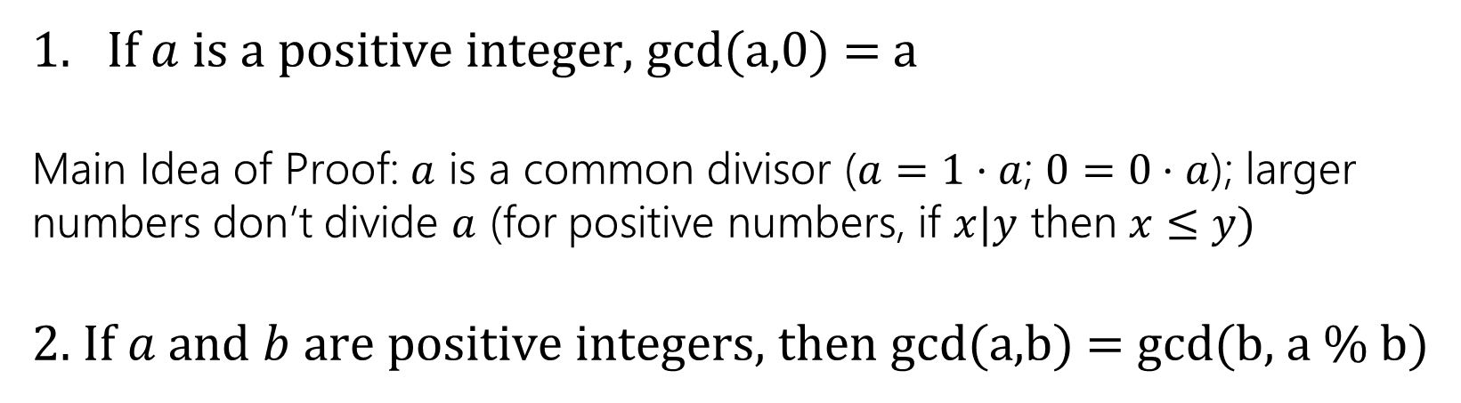
GCD facts
If $a$is a positive integer, gcd(a,0) = a
Main Idea of Proof: $a$ is a common divisor ($a=1⋅a$; $0=0⋅a$); larger numbers don’t divide $a$ (for positive numbers, if $x|y$ then $x≤y)$
2. If $a$ and $b$ are positive integers, then gcd(a,b) = gcd(b, a % b)
For example:
gcd 10, 6
gcd 110,30
= gcd(6,4)
= gcd(30,20)
Why is 2 true? The proof isn’t easy, it’s at the end of this deck.
Why should you care?

Slide 51
Calculating the GCD: Approach 2
Euclid’s Algorithm. To find gcd(𝑎, 𝑏):
Repeatedly use gcd 𝑎, 𝑏 = gcd(𝑏, 𝑎 % 𝑏) to reduce numbers
Stop once you reach gcd(c, 0). Return c.
For Example:
gcd(660,126)
= gcd(126,30)
= gcd(30,6)
= gcd(6,0)
Efficient
= 6

Slide 52
Euclid’s Algorithm in Java
// assumes a >= 0 and b >= 0 public int gcd(int a, int b) {
if (b == 0) {
return a;
} else {
return gcd(b, a % b);
}
}

Slide 53
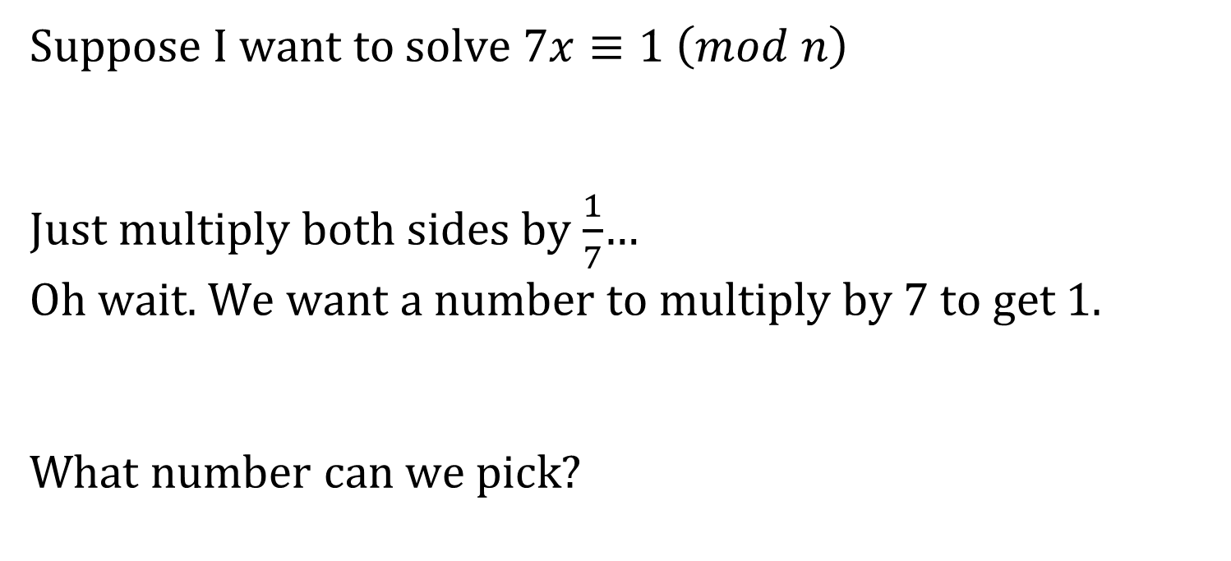
So…what’s it good for?
Remember everything we’re learning contributes to us eventually understanding RSA.
This is a key step in generating keys.
Suppose I want to solve $7x≡1 \left(mod n\right)$
Just multiply both sides by $\frac{1}{7}$…
Oh wait. We want a number to multiply by $7$ to get $1.$
What number can we pick?
Notes:
Rules for mod arithmetic are different! Addition and multiplication match really closely to regular rules. Division (i.e. multiplying by 1/number) is much more complicated.

Slide 54
Solving in Modular Arithmetic
Solve: 7𝑥 ≡ 1 (mod 10)
Solution: 𝑥 ≡ 3 (mod 10) (Guess and check)
None of our properties so far help us solve this.
3 is called the multiplicative inverse of 7 modulo 10, i.e. the value 𝑥 such that 7𝑥 ≡ 1 (mod 10).
We will use something called Bézout’s Theorem to extend the Euclidean Algorithm to find multiplicative inverses.

Slide 55
Bézout’s Theorem

Slide 56
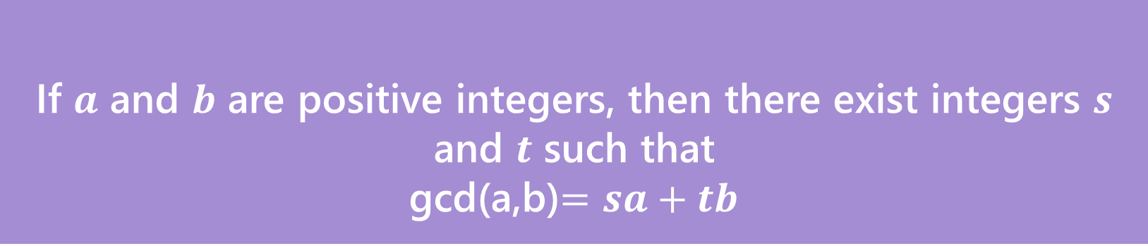
Bézout’s Theorem
If $a$ and $b$ are positive integers, then there exist integers $s$ and $t$ such that
gcd(a,b)$=sa+tb$
Bézout’s Theorem

Slide 57
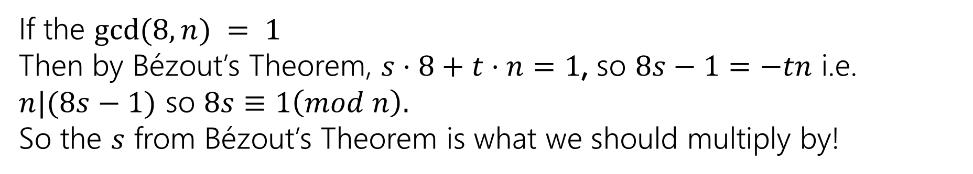
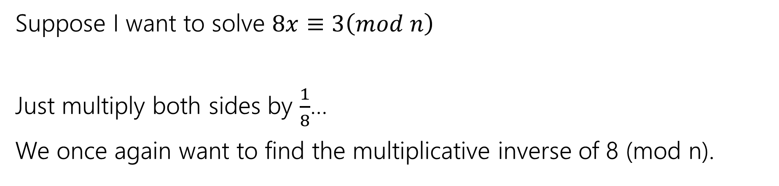
So…what’s it good for?
Suppose I want to solve $8x≡3\left(mod n\right)$
Just multiply both sides by $\frac{1}{8}$…
We once again want to find the multiplicative inverse of 8 (mod n).
If the $gcd⁡(8,n) = 1$
Then by Bézout’s Theorem, $s⋅8+t⋅n=1$, so $8s−1=−tn$ i.e. $n|(8s−1)$ so $8s≡1\left(mod n\right).$
So the $s$ from Bézout’s Theorem is what we should multiply by!

Slide 58
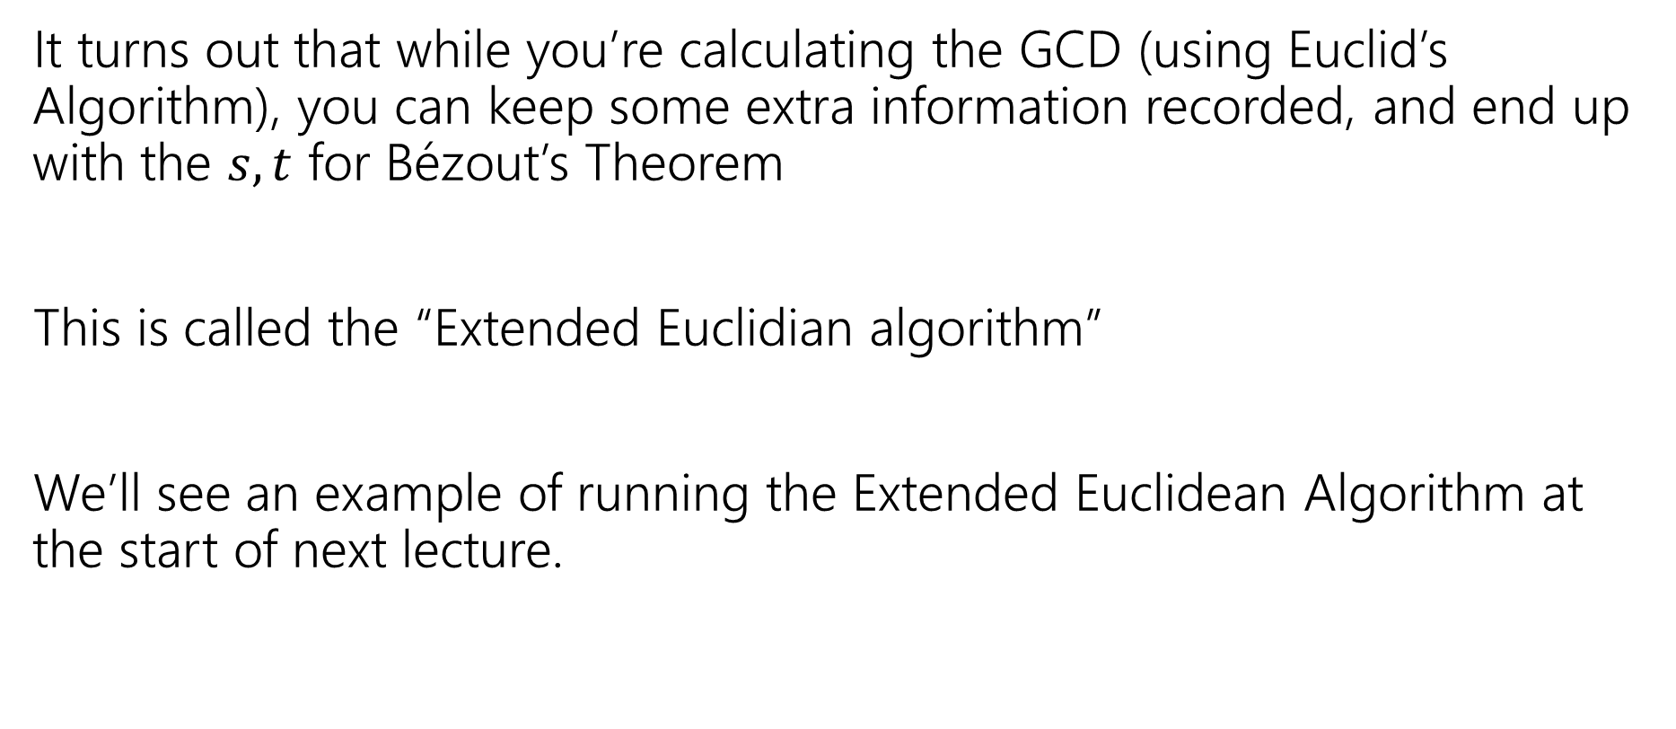

Ok…how am I supposed to find $s,t$?
It turns out that while you’re calculating the GCD (using Euclid’s Algorithm), you can keep some extra information recorded, and end up with the $s,t$ for Bézout’s Theorem
This is called the “Extended Euclidian algorithm”
We’ll see an example of running the Extended Euclidean Algorithm at the start of next lecture.

Slide 59
Todo
Tonight:
Start HW3 Today if you haven’t already!
CC 9 due Wednesday at noon
HW2 Feedback will be released soon!

Slide 60
[Extra Material] Proving a key fact about GCDs

Slide 61
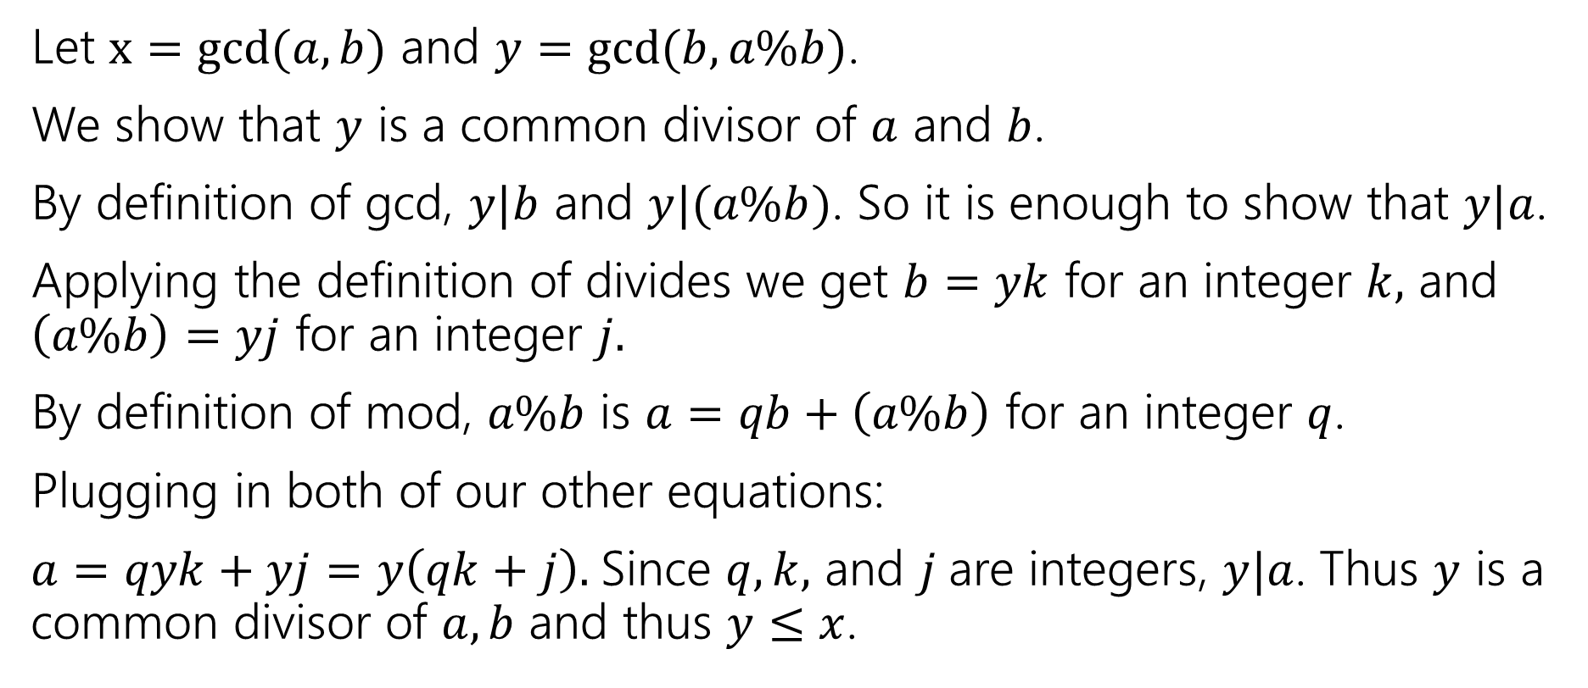
gcd(a,b) = gcd(b, a % b)
Let $x=gcd⁡(a,b)$ and $y=gcd⁡(b,a\%b)$.
We show that $y$ is a common divisor of $a$ and $b$.
By definition of gcd, $y|b$ and $y|(a\%b)$. So it is enough to show that $y|a$.
Applying the definition of divides we get $b=yk$ for an integer $k,$ and $\left(a\%b\right)=yj$ for an integer $j.$
By definition of mod, $a\%b$ is $a=qb+\left(a\%b\right)$ for an integer $q$.
Plugging in both of our other equations:
$a=qyk+yj=y\left(qk+j\right).$Since $q,k,$ and $j$are integers, $y|a$. Thus $y$ is a common divisor of $a,b$ and thus $y≤x$.

Slide 62
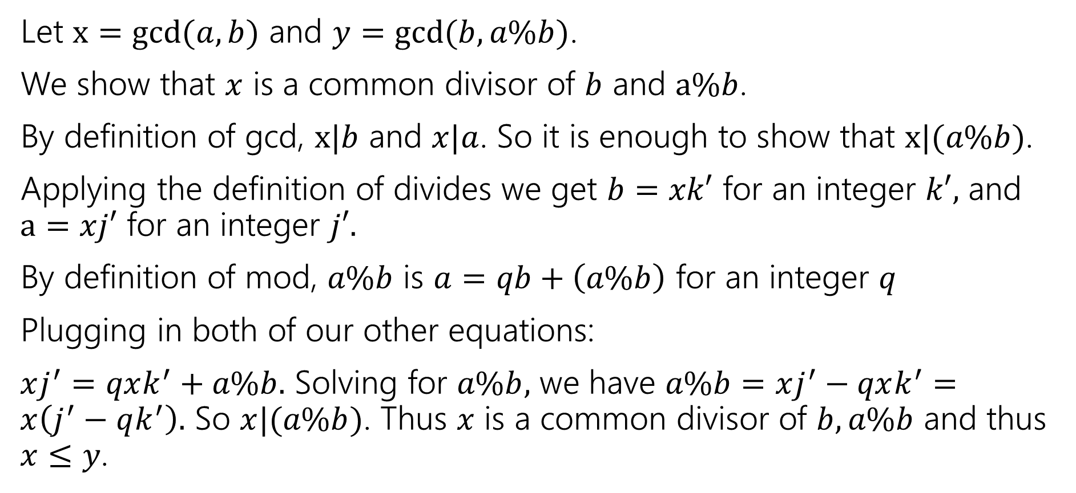
gcd(a,b) = gcd(b, a % b)
Let $x=gcd⁡(a,b)$ and $y=gcd⁡(b,a\%b)$.
We show that $x$ is a common divisor of $b$ and $a\%b$.
By definition of gcd, $x|b$ and $x|a$. So it is enough to show that $x|(a\%b)$.
Applying the definition of divides we get $b=xk′$ for an integer $k′,$ and $a=xj′$ for an integer $j′.$
By definition of mod, $a\%b$ is $a=qb+\left(a\%b\right)$ for an integer $q$
Plugging in both of our other equations:
$xj^{′}=qxk^{′}+a\%b.$ Solving for $a\%b,$ we have $a\%b=xj^{′}−qxk^{′}=x\left(j^{′}−qk^{′}\right).$ So $x|(a\%b)$. Thus $x$ is a common divisor of $b,a\%b$ and thus $x≤y$.

Slide 63

gcd(a,b) = gcd(b, a % b)
Let $x=gcd⁡(a,b)$ and $y=gcd⁡(b,a\%b)$.
We show that $x$ is a common divisor of $b$ and $a\%b$.
We have shown $x≤y$ and $y≤x$.
Thus $x=y,$ and $\gcd\left(a,b\right)=\gcd\left(b,a\%b\right).$

