Slide 1
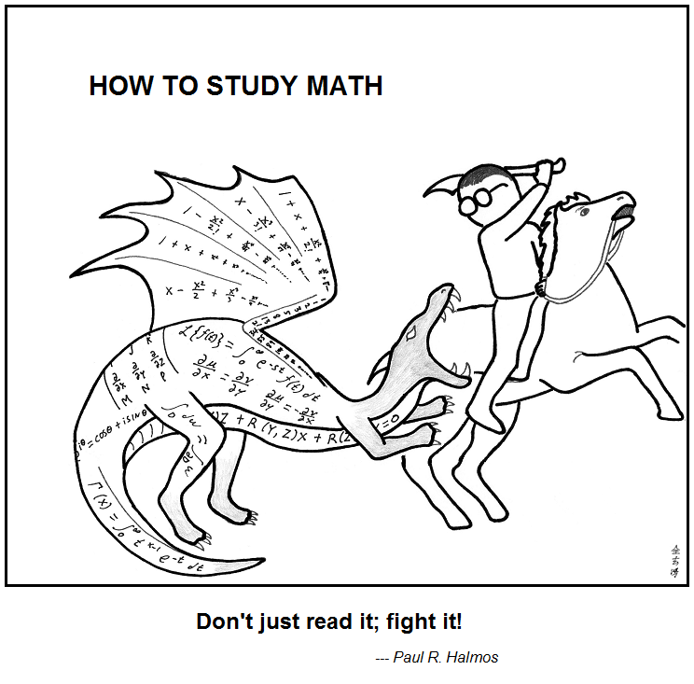
Number Theory
https://abstrusegoose.com/353
CSE 311 Summer 2025
Lecture 8

Slide 2
Announcements
HW3 is out and due Wednesday!
Please start early- this HW is a significant step up from HW1 and HW2
HW1 Resubmission is due tonight
Make sure to follow all resubmission directions to ensure your revised work is graded

Slide 3
Review

Slide 4
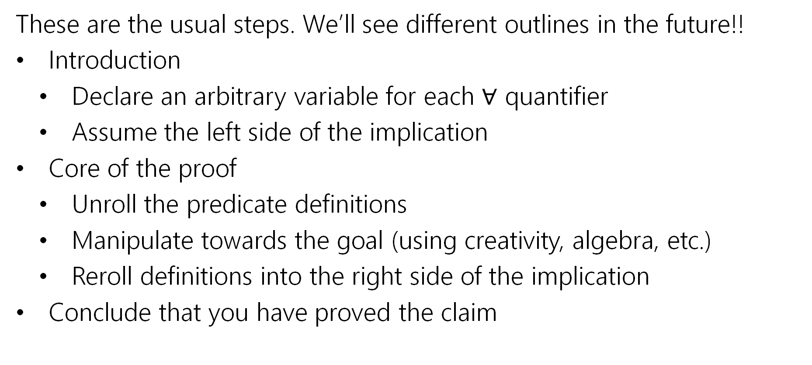
Direct Proof Steps
These are the usual steps. We’ll see different outlines in the future!!
Introduction
Declare an arbitrary variable for each $∀$ quantifier
Assume the left side of the implication
Core of the proof
Unroll the predicate definitions
Manipulate towards the goal (using creativity, algebra, etc.)
Reroll definitions into the right side of the implication
Conclude that you have proved the claim

Slide 5
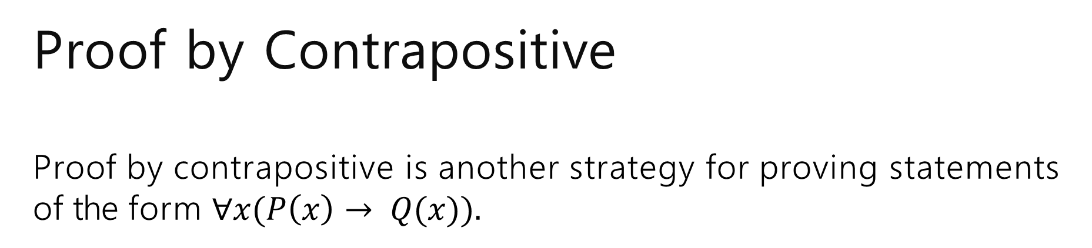
Proof by Contrapositive Proof by contrapositive is another strategy for proving statements of the form $∀x(P\left(x\right)→ Q(x)).$
The strategy is to prove the contrapositive, i.e. prove ∀𝑥 ¬Q 𝑥
→ ¬P 𝑥
Remember, an implication is equivalent to its contrapositive!

Slide 6
Signs you might want to use proof by contrapositive
1. The hypothesis of the implication you’re proving has a “not” in it (that you think is making things difficult)
2. The target of the implication you’re proving has an “or” or “not” in it.
3. There’s a step that is difficult forward, but easy backwards
e.g., taking a square-root forward, squaring backwards.
4. You get halfway through the proof and you can’t “get ahold of” what you’re trying to show.
e.g., you’re working with a “not equal” instead of an “equals” or “every thing doesn’t have this property” instead of “some thing does have that property”
All of these are reasons you might want contrapositive. Sometimes you just have to try and see what happens!

Slide 7
Proof of a Biconditional
Recall that biconditionals are statements of the form:
∀𝑥 P 𝑥 ↔ Q 𝑥
The strategy is to prove such statements is to prove an implication in both directions. I.e. prove ∀𝑥(P(𝑥) → Q(𝑥))∧ ∀𝑥(Q(𝑥) → P(𝑥)).
$$∀x \left(P\left(x\right)↔Q\left(x\right)\right)≡∀x \left(P\left(x\right)→Q\left(x\right)∧Q\left(x\right)→P\left(x\right)\right)$$
$≡∀x\left(P\left(x\right)→Q\left(x\right)\right)∧∀x(Q\left(x\right)→P\left(x\right))$

Slide 8
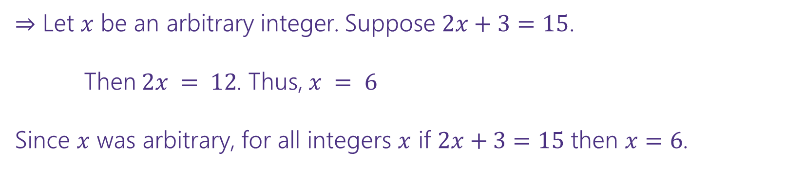
Proof of a Biconditional
Prove: For an integer 𝑥, 2𝑥 + 3 = 15 if and only if 𝑥 = 6.
⇒ Let 𝑥 be an arbitrary integer. Suppose 2𝑥 + 3 = 15.
Then $2x = 12$. Thus, $x = 6$
Since 𝑥 was arbitrary, for all integers 𝑥 if 2𝑥 + 3 = 15 then 𝑥 = 6.
⇐ Let 𝑥 be an arbitrary integer. Suppose 𝑥 = 6.
Consider 2𝑥 + 3:
2𝑥 + 3 = 2(6) + 3 = 12 + 3 = 15
Since 𝑥 was arbitrary, for all integers 𝑥 if 𝑥 = 6 then 2𝑥 + 3 = 15.

Slide 9
Proof by Cases
Proof by cases is the strategy of:
Breaking your assumption(s) into smaller cases.
Be careful to make sure that your cases are exhaustive (cover all of the possible scenarios). It’s ok if they have overlap though.
Proving that the claim holds in all of these cases.
Formally: (P ∨ Q)→ R ≡ (P → R) ∧ (Q → R).

Slide 10
5 numbers: Proof by Cases
Suppose that 𝑥₁, … , 𝑥₅ are real numbers such that 𝑥₁ ≤ 𝑥₂ ≤ 𝑥₃ ≤ 𝑥₄ ≤ 𝑥₅ and
𝑥₁ + 𝑥₂ + 𝑥₃ + 𝑥₄ + 𝑥₅ = 50. Prove that 𝑥₁ + 𝑥₂ ≤ 20.
Let 𝑥₁, 𝑥₂, 𝑥₃, 𝑥₄, 𝑥₅ be arbitrary real numbers such that 𝑥₁ ≤ 𝑥₂ ≤ 𝑥₃ ≤ 𝑥₄ ≤ 𝑥₅ and 𝑥₁ + 𝑥₂ + 𝑥₃ + 𝑥₄ + 𝑥₅ = 50.
Case 1: 𝑥₂ ≤ 10. Then since 𝑥₁ ≤ 𝑥₂, 𝑥₁ ≤ 10. So 𝑥₁ + 𝑥₂ ≤ 20, as desired.
Case 2: 𝑥₂ > 10. Then since 𝑥₃, 𝑥₄, 𝑥₅ ≥ 𝑥₂, we have that 𝑥₃ > 10, 𝑥₄ > 10, 𝑥₅ > 10. So 𝑥₃ + 𝑥₄ + 𝑥₅ > 30. Thus 𝑥₁ + 𝑥₂ < 20, as desired.
Since 𝑥₁, … , 𝑥₅ were arbitrary, our cases were exhaustive, and the claim holds in each case, we’ve proven our claim.

Slide 11
Existence Proof
Prove: There is some prime number 𝑝 such that 𝑝 + 6 and 𝑝 + 8 are also prime.
What’s the claim in logic?
∃𝑝(Prime(𝑝) ∧ Prime(𝑝 + 6) ∧ Prime(𝑝 + 8))
How would we prove this claim?
Provide such a prime number.

Slide 12
Existence Proof
Prove: There is some prime number 𝑝 such that 𝑝 + 6 and 𝑝 + 8 are also prime.
Consider 𝑝 = 5. Then 𝑝 + 6 = 11 is also prime, as is 𝑝 + 8 = 13.

Slide 13





Proof by Counterexample
A single example can’t prove a ∀ statement.
A single counterexample can disprove a ∀ statement.
For example, to disprove “all professors like pizza”, you must find a professor
who does not like pizza.
In formal logic:
$$¬∀x \left(P\left(x\right)→Q\left(x\right)\right)$$
$$≡∃x ¬\left(P\left(x\right)→Q\left(x\right)\right)$$
DeMorgan’s Law for Quantifiers
$$≡∃x ¬\left(¬P\left(x\right)∨Q\left(x\right)\right)$$
Law of Implication
$$≡∃x \left(¬¬P\left(x\right)∧¬Q\left(x\right)\right)$$
DeMorgan’s Law
$$≡∃x \left(P\left(x\right)∧¬Q\left(x\right)\right)$$
Double Negation

Slide 14
Proof by Counterexample
For all real numbers 𝑎, 𝑏, 𝑐, if 𝑎 + 𝑐 = 𝑏 + 𝑐 , then 𝑎 = |𝑏|.
This claim is false. Disprove!
Consider 𝑎 = −6, 𝑏 = 4, 𝑐 = 1. Certainly 𝑎 ≠ |𝑏|. Observe that:
𝑎 + 𝑐 = −6 + 1 = −5 = 5
𝑏 + 𝑐 = 4 + 1 = 5 = 5
So this is a counterexample to the claim.

Slide 15
Proof Strategies So Far
Direct Proof
Proof by Contrapositive
Proof of Biconditional
Proof by Cases
Proof of Existence
Proof by Counterexample

Slide 16
Warm Up: Prove or Disprove

Slide 17
Prove or Disprove
In practice, we don’t usually know if a claim is true or false beforehand
We want to prove the statement if it’s true, and disprove it if it’s false.
Strategy:
Play around with many examples in an attempt to show that the claim is false
If the claim is false, hopefully you’ll find a counterexample
If the claim is true, you’ll gain intuition for why from the examples

Slide 18
Prove or Disprove
Identify if the following claims are true or false, and then prove or disprove.
1. For all positive integers 𝑛, 𝑛² + 3𝑛 + 1 is always prime.
2. For all positive integers 𝑛, the sum 1 + 2 + ⋯ + 𝑛 is equal to ^{𝑛 𝑛+1} .
2
For every real number 𝑛, 𝑛² ≥ 𝑛.
For an integer 𝑛, 3𝑛² + 𝑛 + 10 is always even.

Slide 19
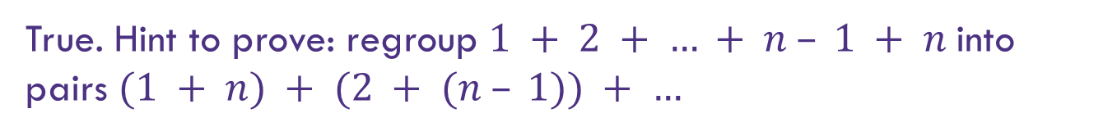
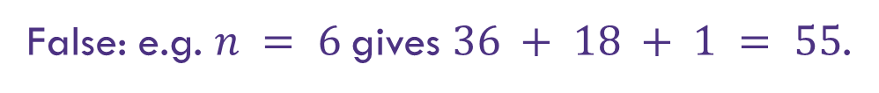
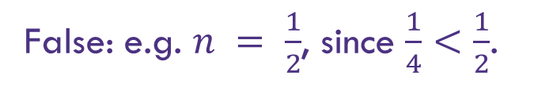
Prove or Disprove
Identify if the following claims are true or false, and then prove or disprove.
1. For all positive integers 𝑛, 𝑛² + 3𝑛 + 1 is always prime.
False: e.g. $n = 6$gives $36 + 18 + 1 = 55$.
2. For all positive integers 𝑛, the sum 1 + 2 + ⋯ + 𝑛 is equal to ^{𝑛 𝑛+1} .
2
True. Hint to prove: regroup $1 + 2 + … + n – 1 + n$into pairs $(1 + n) + (2 + (n – 1)) + …$
For every real number 𝑛, 𝑛² ≥ 𝑛.
For an integer 𝑛, 3𝑛² + 𝑛 + 10 is always even.
False: e.g. $n = \frac{1}{2}$, since $\frac{1}{4}<\frac{1}{2}$.
True. Hint to prove: break into the cases that $n$ is even and $n$ is false.

Slide 20
Some Final Proof Tips

Slide 21
Proof Style
We use predicate logic to make the proof claim very precise. However, please write the actual proofs in English, not logic!
E.g. for all integers 𝑥, if 𝑥 is odd then 𝑥 + 1 is even.
Good: Let 𝑥 be arbitrary. Suppose 𝑥 is odd. Then 𝑥 = 2𝑘 + 1 for some integer 𝑘 …
Bad: Let 𝑥 be arbitrary. Suppose Odd(𝑥). Then ∃𝑘 (𝑥 = 2𝑘 + 1)…

Slide 22
Proof Tip: Without Loss of Generality
If you’re writing a proof with 2+ very similar cases, you can use the phrase:
Assume without loss of generality that we are in Case 1....
For example:
Case 1: 𝑥 is red and 𝑦 is blue, we want to show 𝑥 + 𝑦 is purple.
Case 2: 𝑥 is blue, 𝑦 is red, we want to show 𝑥 + 𝑦 is purple.
In my proof: “Observe that there are two cases. We can assume without loss of
generality that 𝑥 is red and 𝑦 is blue”

Slide 23
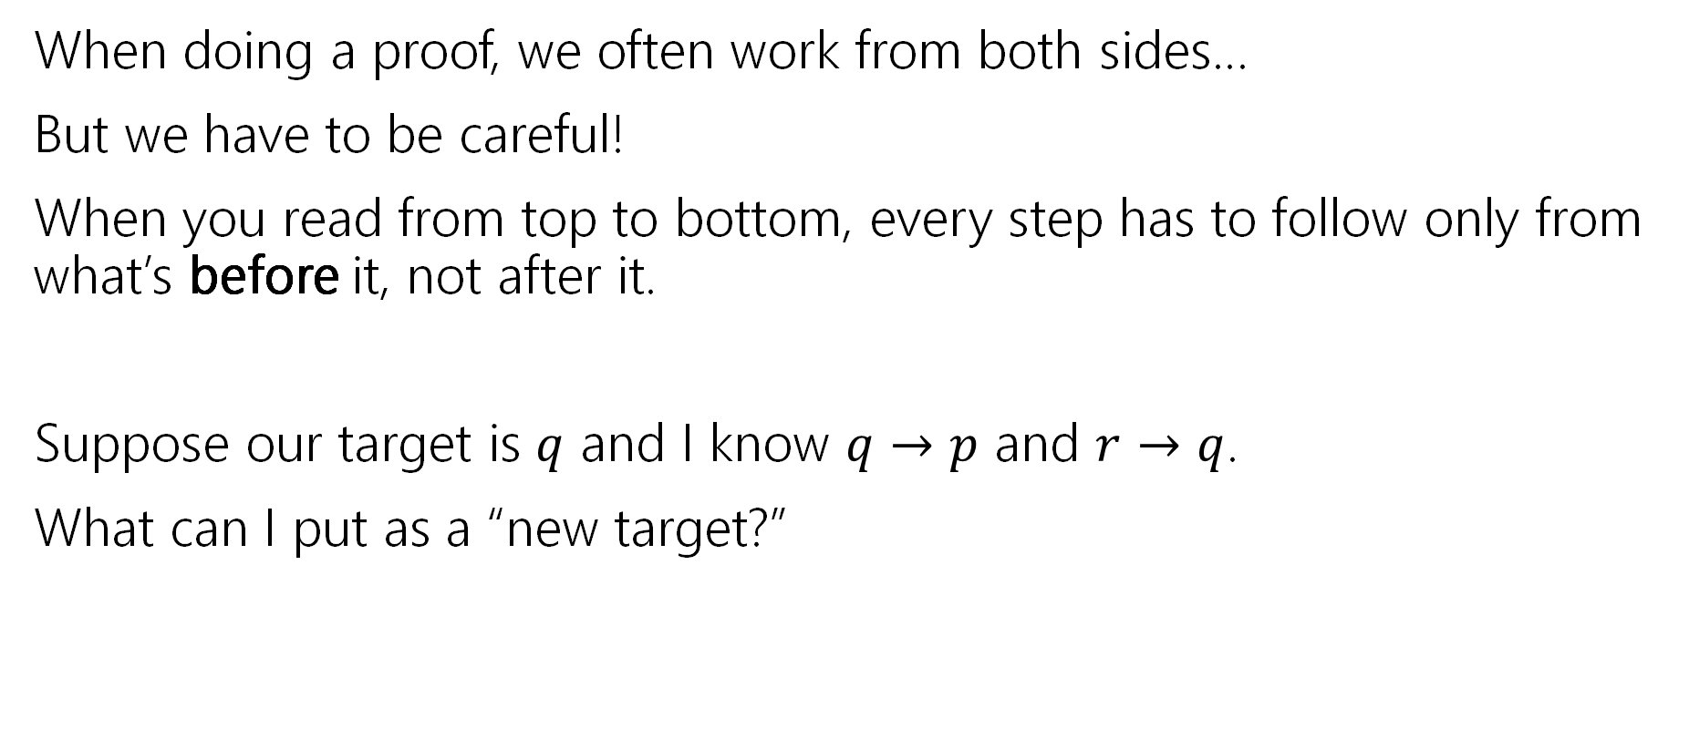
Logical Ordering
When doing a proof, we often work from both sides…
But we have to be careful!
When you read from top to bottom, every step has to follow only from what’s before it, not after it.
Suppose our target is $q$ and I know $q→p$ and $r→q$.
What can I put as a “new target?”

Slide 24
Logical Ordering
So why have all our prior steps been ok backward?
They’ve all been either:
A definition (which is always an “if and only if”)
An algebra step that is an “if and only if”
Even if your steps are “if and only if” you still have to put everything in order – start from your assumptions, and only assert something once it can be shown.

Slide 25
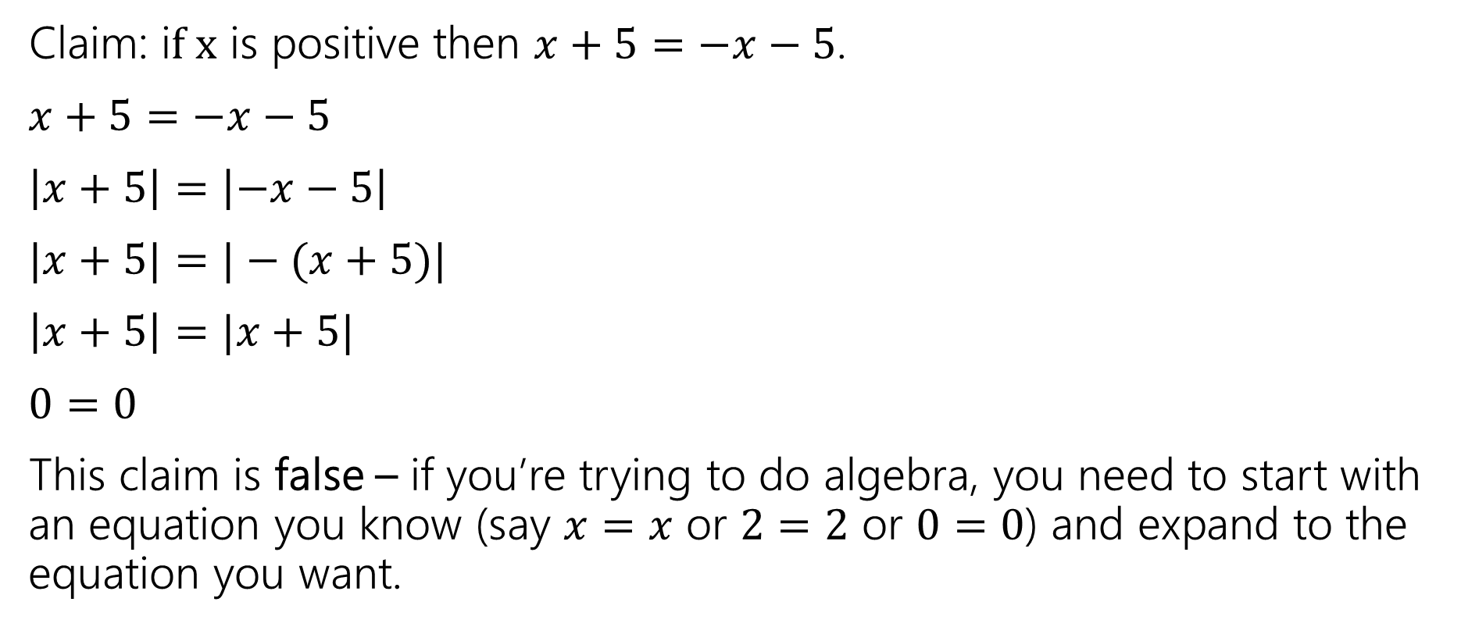
A bad proof
Claim: i$f x$ is positive then $x+5=−x−5$.
$x+5=−x−5$
$\left|x+5\right|=\left|−x−5\right|$
$|x+5|=|−(x+5)|$
$\left|x+5\right|=|x+5|$
$0=0$
This claim is false – if you’re trying to do algebra, you need to start with an equation you know (say $x=x$ or $2=2$ or $0=0$) and expand to the equation you want.

Slide 26
Computer-Verifiable Proofs

Slide 27
Recall: Proofs are written for an audience
Computer Science Theorist
“The proof is clear ☺”
Computer
Possibly many steps to show 1 + 1 = 2

Slide 28
Computer-Verifiable Proofs
How do they work?
Write down all the facts that we know.
Combine facts into new facts using a set of known rules. Example Rule: Modus Ponens
If 𝑝 → 𝑞 and 𝑝 are known, then 𝑞 is known
Continue until we reach what we want to show.

Slide 29
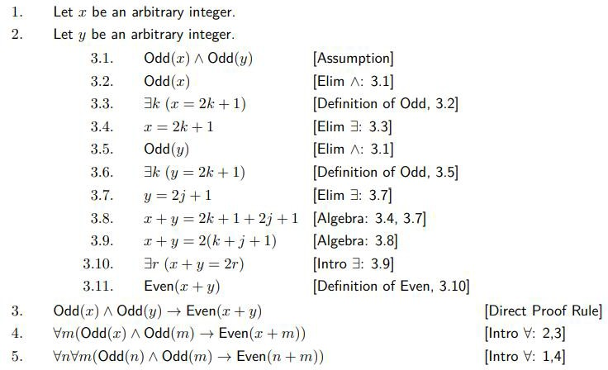
Computer-Verifiable Proofs
If 𝑛 and 𝑚 are odd, then 𝑛 + 𝑚 is even.

Slide 30
Number Theory

Slide 31
Why Number Theory?
Applicable in Computer Science
“hash functions” (you’ll see them in 332) commonly use modular arithmetic
Much of classical cryptography is based on prime numbers.
More importantly, a great playground for writing English proofs.

Slide 32
Modular Arithmetic
Arithmetic over a finite domain
In computing, almost all computations are over a finite domain

Slide 33

Modular Arithmetic
public class Test {
final static int SEC_IN_YEAR = 365*24*60*60;
public static void main(String args[]) {
System.out.println( “I will be alive for at least ” + SEC_IN_YEAR * 100 + “ seconds.” );
}
}

Slide 34
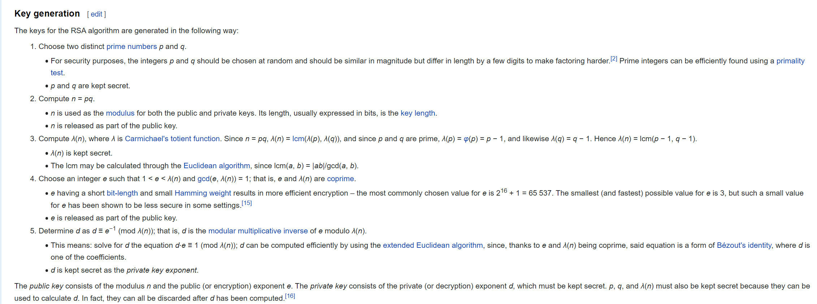
Framing Device
We’re going to give you enough background to (mostly) understand the RSA encryption system.

Slide 35
Framing Device
We’re going to give you enough background to (mostly) understand the RSA encryption system.
Prime Numbers
Modular Arithmetic
Modular Multiplicative Inverse
Bezout’s Theorem
Extended Euclidian Algorithm

Slide 36
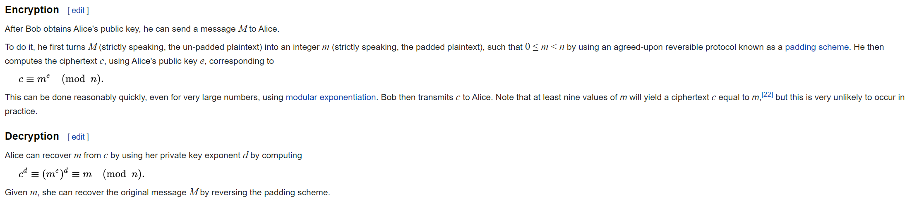
Framing Device
We’re going to give you enough background to (mostly) understand the RSA encryption system.

Slide 37
Framing Device
We’re going to give you enough background to (mostly) understand the RSA encryption system.
Modular Exponentiation

Slide 38
Divisibility

Slide 39
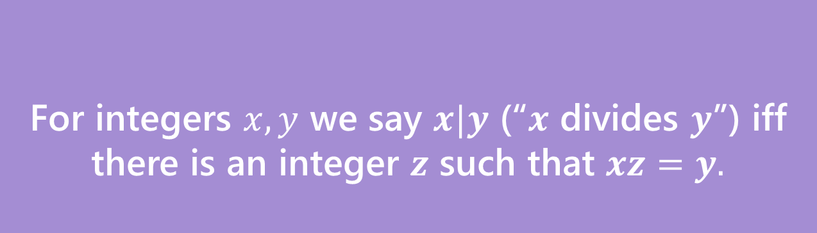
Divides
For integers $x,y$ we say $x|y$ (“$x$ divides $y$”) iff there is an integer $z$ such that $xz=y.$
Divides
Informally: “𝑎 fits into 𝑏” or “𝑎 is a factor of 𝑏”
“The small number goes first*” *when both are positive integers
Examples: 5 | 15
−3 | 9
5 ∤ 21

Slide 40
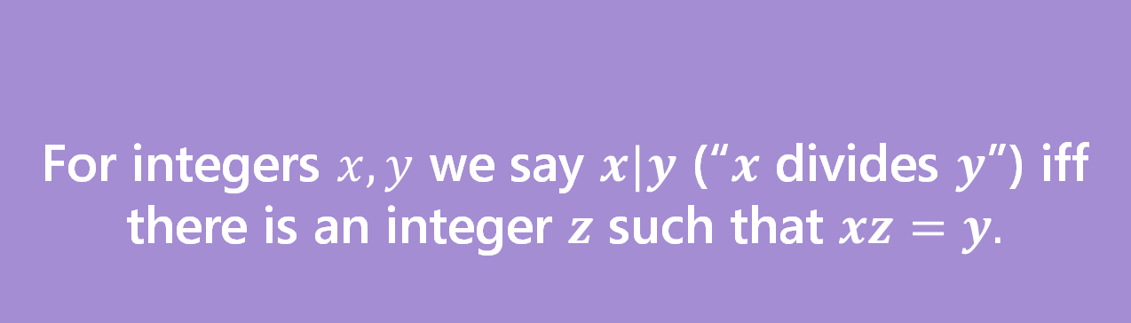
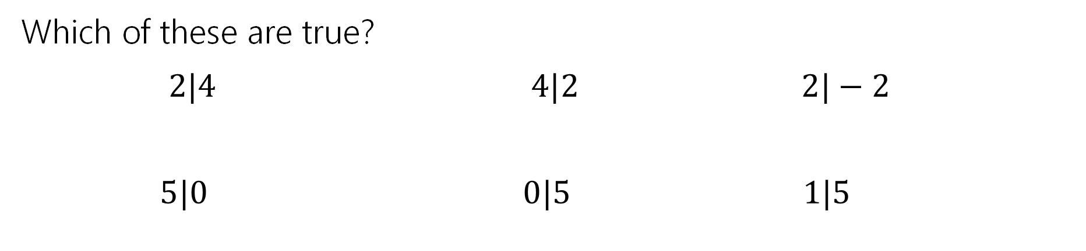
Divides
For integers $x,y$ we say $x|y$ (“$x$ divides $y$”) iff there is an integer $z$ such that $xz=y.$
Divides
Which of these are true?
$2|4$ $4|2$ $2|−2$
$5|0$ $0|5$ $1|5$

Slide 41


Divides
For integers $x,y$ we say $x|y$ (“$x$ divides $y$”) iff there is an integer $z$ such that $xz=y.$
Divides
Which of these are true?
$2|4$ $4|2$ $2|−2$
$5|0$ $0|5$ $1|5$
$$True$$
$$False$$
$$True$$
$$True$$
$$False$$
$$True$$

Slide 42
Division Theorem
Division Theorem:
For any integer 𝑎 and positive integer 𝑑, there exist unique integers 𝑞, 𝑟
with 0 ≤ 𝑟 < 𝑑 such that 𝑎 = 𝑞𝑑 + 𝑟.

Slide 43
Division Theorem
Division Theorem:
For any integer 𝑎 and positive integer 𝑑, there exist unique integers 𝑞, 𝑟
with 0 ≤ 𝑟 < 𝑑 such that 𝑎 = 𝑞𝑑 + 𝑟.
𝑞 is referred to as the quotient
𝑟 is referred to as the remainder

Slide 44
Division Theorem
Division Theorem:
For any integer 𝑎 and positive integer 𝑑, there exist unique integers 𝑞, 𝑟
with 0 ≤ 𝑟 < 𝑑 such that 𝑎 = 𝑞𝑑 + 𝑟.
In Java, 𝑞 is the result of the operation 𝑎/𝑑
In Java, 𝑟 is the result of the operation 𝑎 % 𝑑
Warning
When dealing with
negative numbers, Java’s
% may behave differently!

Slide 45
The mod (%) operator
Division Theorem
𝑎 = 𝑞𝑑 + 𝑟 with 0 ≤ 𝑟 < 𝑑
The % operator is often referred to as “mod”
𝑎 % 𝑑 returns the remainder 𝑟 when you divide 𝑎 by 𝑑
22 % 5 = 2
25 % 5 = 0
22 = 4 ⋅ 5 + 𝟐
25 = 5 ⋅ 5 + 𝟎
0 % 5 = 0
−1 % 4 = 3
0 = 0 ⋅ 5 + 𝟎
−1 = −1 ⋅ 4 + 𝟑

Slide 46
Modular Arithmetic

Slide 47
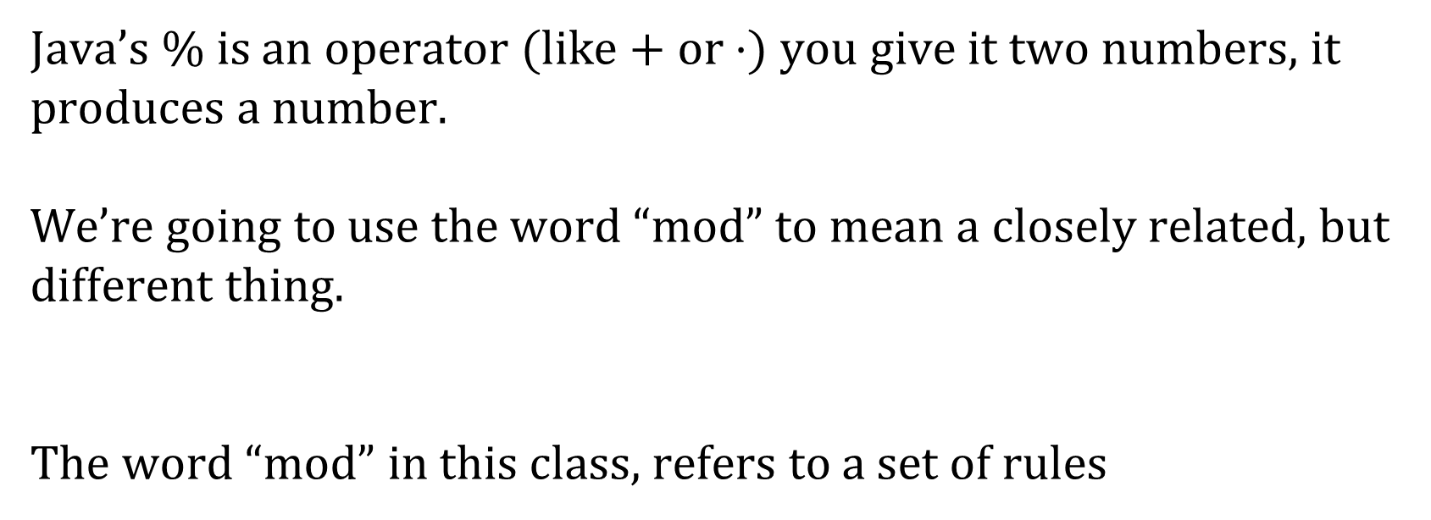
Terminology
Java’s % is an operator (like + or $⋅)$ you give it two numbers, it produces a number.
We’re going to use the word “mod” to mean a closely related, but different thing.
The word “mod” in this class, refers to a set of rules

Slide 48
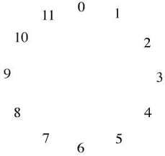
Modular Arithmetic: Like a Clock
Imagine you can only represent numbers 0, … , 11. We call this
“arithmetic mod 12”.
What’s 8 + 7?
3
Observation
The solution is 𝑎 % 12.

Slide 49
Modular Arithmetic: Like a Clock
Imagine you can only represent numbers 0, … , 11. We call this
“arithmetic mod 12”.
What’s 3 − 5?
10
Observation
The solution is 𝑎 % 12.

Slide 50
Modular Arithmetic: Like a Clock
Imagine you can only represent numbers 0, … , 11. We call this
“arithmetic mod 12”.
What’s 3 ⋅ 7?
9
Observation
The solution is 𝑎 % 12.

Slide 51
Modular Arithmetic: Generalizing
We can extend modular arithmetic to clocks of any positive integer size.
E.g. 3 + 6 in arithmetic mod 7 is 2
0
6
1
5
2
4
3

Slide 52
“Sameness”
In modular arithmetic, many numbers have a notion of “sameness”.
Arithmetic mod 12:
1, 13, 25
Arithmetic mod 7:
0
6
1
5
2
−5, 2, 9, 16
4
3
−5, 7, 19

Slide 53
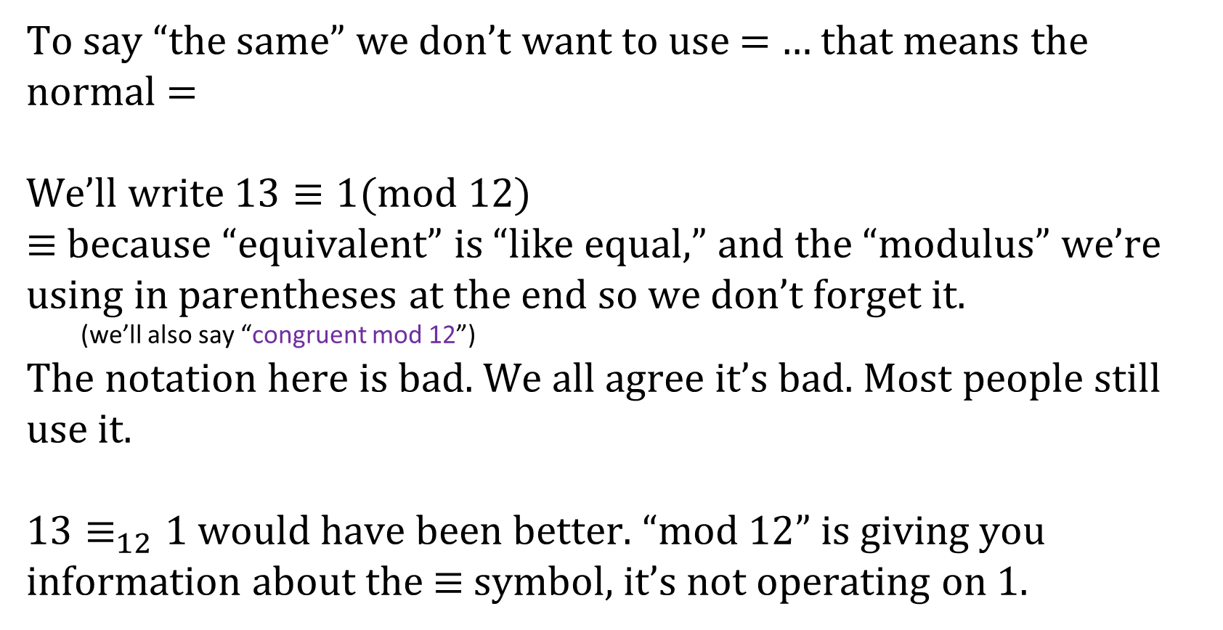
Modular Arithmetic
To say “the same” we don’t want to use $=$ … that means the normal $=$
We’ll write $13≡1(mod 12)$
$≡$ because “equivalent” is “like equal,” and the “modulus” we’re using in parentheses at the end so we don’t forget it.
(we’ll also say “congruent mod 12”)
The notation here is bad. We all agree it’s bad. Most people still use it.
$13≡_{12}1$ would have been better. “mod $12$” is giving you information about the $≡$ symbol, it’s not operating on $1.$

Slide 54
Congruence
We need a formal definition of 𝑎 ≡ 𝑏 (mod m).
We can’t just say “𝑎 and 𝑏 are on the same place in the 𝑚 clock ☺”
Definition:
For integers 𝑎, 𝑏 and positive integer 𝑚, we say 𝑎 ≡ 𝑏 (mod m)iff 𝑚 | (𝑎− 𝑏).
Note: 𝑎 ≡ 𝑏 (mod m) is equivalent to 𝑎 % 𝑚 = 𝑏 % 𝑚.
We will actually prove that the two notions are the same. But, the formal definition is much easier to use in proofs.

Slide 55
Intuition
Definition: 𝑎 ≡ 𝑏 (mod m)
is defined as 𝑚 | (𝑎 − 𝑏)
Intuition: Equivalently, 𝑎 ≡ 𝑏 (mod m)
means 𝑎 % 𝑚 = 𝑏 % 𝑚
Here we have some groups of numbers that are congruent mod 10.
0
3
8
23
18
10
20
13
28
130
53
−2
−10
68
−7
128
70
Congruent to 0
Congruent to 3
Congruent to 8

Slide 56

Don’t lose your intuition!
Let’s check that we understand “intuitively” what mod means:
$$x≡0 (mod 2)$$
$$−1≡19 (mod 5)$$
$$y≡2 (mod 7)$$
“$x$is even” Note that negative (even) $x$ values also make this true.
This is true! They both have remainder $4$ when divided by $5$.
This is true as long as $y=2+7k$ for some integer $k$

Slide 57
Properties of Congruence

Slide 58
Recall: Familiar Properties of = in algebra
If 𝑎 = 𝑏, then 𝑏 = 𝑎.
If 𝑎 = 𝑏 and 𝑐 = 𝑑, then 𝑎 + 𝑐 = 𝑏 + 𝑑.
If 𝑎 = 𝑏 and 𝑐 = 𝑑, then 𝑎𝑐 = 𝑏𝑑.
If 𝑎 = 𝑏 and 𝑏 = 𝑐, then 𝑎 = 𝑐.
These are the facts that allow us to use algebra to solve problems. We will prove analogous facts for modular arithmetic.

Slide 59
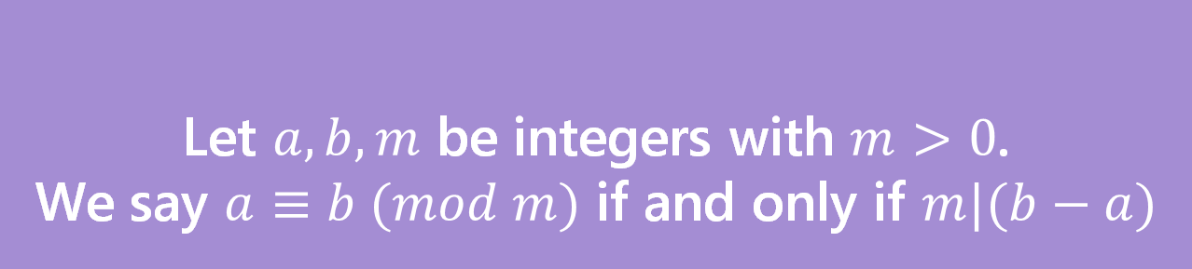
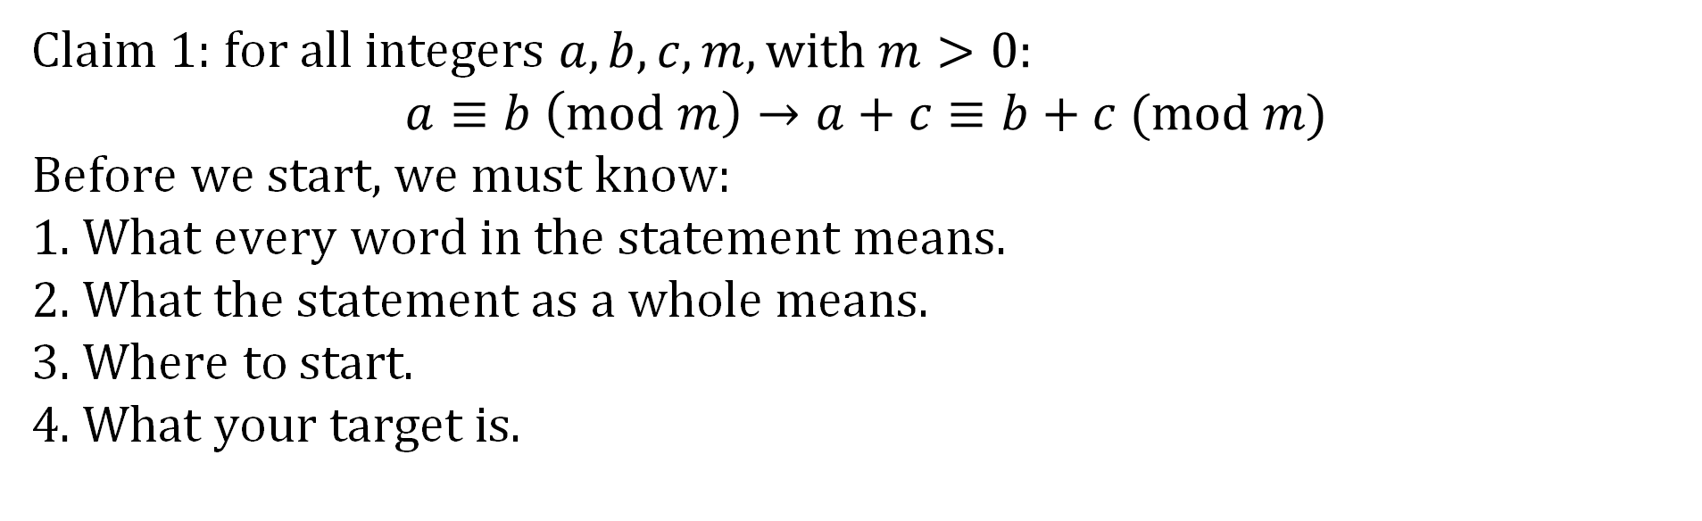
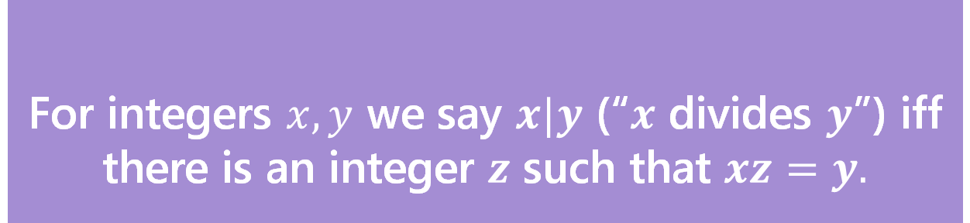
Claim 1: for all integers $a,b,c,m,with m>0:$ $$a≡b \left(mod m\right)→a+c≡b+c (mod m)$$
Before we start, we must know:
1. What every word in the statement means.
2. What the statement as a whole means.
3. Where to start.
4. What your target is.
For integers $x,y$ we say $x|y$ (“$x$ divides $y$”) iff there is an integer $z$ such that $xz=y.$
Divides
Let $a,b,m$ be integers with $m>0$.
We say $a≡b (mod m)$ if and only if $m|(b−a)$
Equivalence in modular arithmetic

Slide 60
Claim 1
Definitions:
𝑎 | 𝑏 iff ∃𝑘 ∈ ℤ 𝑏 = 𝑘𝑎
𝑎 ≡ 𝑏 (mod m) iff 𝑚 | (𝑎 − 𝑏)
Claim 1: For integers 𝑎, 𝑏 and positive integer 𝑚, if 𝑎 ≡ 𝑏 (mod m) then 𝑏 ≡ 𝑎 (mod m).

Slide 61
Claim 1
Definitions:
𝑎 | 𝑏 iff ∃𝑘 ∈ ℤ 𝑏 = 𝑘𝑎
𝑎 ≡ 𝑏 (mod m) iff 𝑚 | (𝑎 − 𝑏)
Claim 1: For integers 𝑎, 𝑏 and positive integer 𝑚, if 𝑎 ≡ 𝑏 (mod m) then 𝑏 ≡ 𝑎 (mod m).
Proof: Let 𝑎, 𝑏 be arbitrary integers and let 𝑚 be an arbitrary positive integer. Suppose that 𝑎 ≡ 𝑏 (mod m).
Then by definition of congruence, 𝑏 ≡ 𝑎 (mod m). Since 𝑎, 𝑏, 𝑚 were arbitrary, the claim holds.

Slide 62
Claim 1
Definitions:
𝑎 | 𝑏 iff ∃𝑘 ∈ ℤ 𝑏 = 𝑘𝑎
𝑎 ≡ 𝑏 (mod m) iff 𝑚 | (𝑎 − 𝑏)
Claim 1: For integers 𝑎, 𝑏 and positive integer 𝑚, if 𝑎 ≡ 𝑏 (mod m) then 𝑏 ≡ 𝑎 (mod m).
Proof: Let 𝑎, 𝑏 be arbitrary integers and let 𝑚 be an arbitrary positive integer. Suppose that 𝑎 ≡ 𝑏 (mod m).
[Unroll definitions]
[Manipulate towards goal]
[Reroll definitions]
Then by definition of congruence, 𝑏 ≡ 𝑎 (mod m). Since 𝑎, 𝑏, 𝑚 were arbitrary, the claim holds.

Slide 63
Claim 1
Definitions:
𝑎 | 𝑏 iff ∃𝑘 ∈ ℤ 𝑏 = 𝑘𝑎
𝑎 ≡ 𝑏 (mod m) iff 𝑚 | (𝑎 − 𝑏)
Claim 1: For integers 𝑎, 𝑏 and positive integer 𝑚, if 𝑎 ≡ 𝑏 (mod m) then 𝑏 ≡ 𝑎 (mod m).
Proof: Let 𝑎, 𝑏 be arbitrary integers and let 𝑚 be an arbitrary positive integer. Suppose that 𝑎 ≡ 𝑏 (mod m).
Then by definition of congruence, 𝑚 | (𝑎 − 𝑏).
[Manipulate towards goal]
[Reroll definitions]
Then by definition of congruence, 𝑏 ≡ 𝑎 (mod m). Since 𝑎, 𝑏, 𝑚 were arbitrary, the claim holds.

Slide 64
Claim 1
Definitions:
𝑎 | 𝑏 iff ∃𝑘 ∈ ℤ 𝑏 = 𝑘𝑎
𝑎 ≡ 𝑏 (mod m) iff 𝑚 | (𝑎 − 𝑏)
Claim 1: For integers 𝑎, 𝑏 and positive integer 𝑚, if 𝑎 ≡ 𝑏 (mod m) then 𝑏 ≡ 𝑎 (mod m).
Proof: Let 𝑎, 𝑏 be arbitrary integers and let 𝑚 be an arbitrary positive integer. Suppose that 𝑎 ≡ 𝑏 (mod m).
Then by definition of congruence, 𝑚 | (𝑎 − 𝑏).
Then by definition of divides, there exists some integer 𝑘 such that 𝑎 − 𝑏 = 𝑚𝑘.
[Manipulate towards goal]
[Reroll definitions]
Then by definition of congruence, 𝑏 ≡ 𝑎 (mod m). Since 𝑎, 𝑏, 𝑚 were arbitrary, the claim holds.

Slide 65
Claim 1
Definitions:
𝑎 | 𝑏 iff ∃𝑘 ∈ ℤ 𝑏 = 𝑘𝑎
𝑎 ≡ 𝑏 (mod m) iff 𝑚 | (𝑎 − 𝑏)
Claim 1: For integers 𝑎, 𝑏 and positive integer 𝑚, if 𝑎 ≡ 𝑏 (mod m) then 𝑏 ≡ 𝑎 (mod m).
Proof: Let 𝑎, 𝑏 be arbitrary integers and let 𝑚 be an arbitrary positive integer. Suppose that 𝑎 ≡ 𝑏 (mod m).
Then by definition of congruence, 𝑚 | (𝑎 − 𝑏).
Then by definition of divides, there exists some integer 𝑘 such that 𝑎 − 𝑏 = 𝑚𝑘.
Multiplying both sides by − 1, we have 𝑏 − 𝑎 = −𝑚𝑘 = 𝑚(−𝑘). Since 𝑘 is an integer, −𝑘 is an integer.
So by definition of divides, 𝑚 | (𝑏 − 𝑎).
Then by definition of congruence, 𝑏 ≡ 𝑎 (mod m). Since 𝑎, 𝑏, 𝑚 were arbitrary, the claim holds.

Slide 66
Note on Claim 1
You’ll see 𝑎 ≡ 𝑏 (mod m) defined as 𝑚 | (𝑎 − 𝑏) or 𝑚 | (𝑏 − 𝑎) depending on where you look.
Claim 1 proves these definitions are equivalent. From now on, you can use either definition in your proofs.
In general, once we have proved claims in class, you can use those claims in your
homework without proof.

Slide 67
Claim 2
Definitions:
𝑎 | 𝑏 iff ∃𝑘 ∈ ℤ 𝑏 = 𝑘𝑎
𝑎 ≡ 𝑏 (mod m) iff 𝑚 | (𝑎 − 𝑏)
Claim 2: For integers 𝑎, 𝑏, 𝑐, 𝑑 and positive integer 𝑚, if 𝑎 ≡ 𝑏 (mod m)
and 𝑐 ≡ 𝑑 (mod m). then 𝑎 + 𝑐 ≡ 𝑏 + 𝑑 (mod m).
Intuition
3 ≡ 13 (mod m) and 14 ≡ 24 (mod m) ⇒ 17 ≡ 37 (mod m)

Slide 68
Claim 2
Definitions:
𝑎 | 𝑏 iff ∃𝑘 ∈ ℤ 𝑏 = 𝑘𝑎
𝑎 ≡ 𝑏 (mod m) iff 𝑚 | (𝑎 − 𝑏)
Claim 2: For integers 𝑎, 𝑏, 𝑐, 𝑑 and positive integer 𝑚, if 𝑎 ≡ 𝑏 (mod m)
and 𝑐 ≡ 𝑑 (mod m). then 𝑎 + 𝑐 ≡ 𝑏 + 𝑑 (mod m).

Slide 69
Claim 2
Definitions:
𝑎 | 𝑏 iff ∃𝑘 ∈ ℤ 𝑏 = 𝑘𝑎
𝑎 ≡ 𝑏 (mod m) iff 𝑚 | (𝑎 − 𝑏)
Claim 2: For integers 𝑎, 𝑏, 𝑐, 𝑑 and positive integer 𝑚, if 𝑎 ≡ 𝑏 (mod m)
and 𝑐 ≡ 𝑑 (mod m). then 𝑎 + 𝑐 ≡ 𝑏 + 𝑑 (mod m).
Proof: Let 𝑎, 𝑏, 𝑐, 𝑑 and 𝑚 > 0 be arbitrary integers. Suppose that 𝑎 ≡ 𝑏 (mod m) and 𝑐 ≡ 𝑑 (mod m).
Then by definition of congruence, 𝑎 + 𝑐 ≡ 𝑏 + 𝑑 (mod m). Since 𝑎, 𝑏, 𝑐, 𝑑, 𝑚 were arbitrary, the claim holds.

Slide 70
Claim 2
Definitions:
𝑎 | 𝑏 iff ∃𝑘 ∈ ℤ 𝑏 = 𝑘𝑎
𝑎 ≡ 𝑏 (mod m) iff 𝑚 | (𝑎 − 𝑏)
Claim 2: For integers 𝑎, 𝑏, 𝑐, 𝑑 and positive integer 𝑚, if 𝑎 ≡ 𝑏 (mod m)
and 𝑐 ≡ 𝑑 (mod m). then 𝑎 + 𝑐 ≡ 𝑏 + 𝑑 (mod m).
Proof: Let 𝑎, 𝑏, 𝑐, 𝑑 and 𝑚 > 0 be arbitrary integers. Suppose that 𝑎 ≡ 𝑏 (mod m) and 𝑐 ≡ 𝑑 (mod m).
[Unroll definitions]
[Manipulate towards goal]
[Reroll definitions]
Then by definition of congruence, 𝑎 + 𝑐 ≡ 𝑏 + 𝑑 (mod m). Since 𝑎, 𝑏, 𝑐, 𝑑, 𝑚 were arbitrary, the claim holds.

Slide 71
Claim 2
Definitions:
𝑎 | 𝑏 iff ∃𝑘 ∈ ℤ 𝑏 = 𝑘𝑎
𝑎 ≡ 𝑏 (mod m) iff 𝑚 | (𝑎 − 𝑏)
Claim 2: For integers 𝑎, 𝑏, 𝑐, 𝑑 and positive integer 𝑚, if 𝑎 ≡ 𝑏 (mod m)
and 𝑐 ≡ 𝑑 (mod m). then 𝑎 + 𝑐 ≡ 𝑏 + 𝑑 (mod m).
Proof: Let 𝑎, 𝑏, 𝑐, 𝑑 and 𝑚 > 0 be arbitrary integers. Suppose that 𝑎 ≡ 𝑏 (mod m) and 𝑐 ≡ 𝑑 (mod m).
Then by definition of congruence, 𝑚 | (𝑎 − 𝑏) and 𝑚 | (𝑐 − 𝑑). Then by definition of divides, there exists some integers 𝑘, 𝑗 such that 𝑎 − 𝑏 = 𝑚𝑘 and 𝑐 − 𝑑 = 𝑚𝑗.
[Manipulate towards goal]
[Reroll definitions]
Then by definition of congruence, 𝑎 + 𝑐 ≡ 𝑏 + 𝑑 (mod m). Since 𝑎, 𝑏, 𝑐, 𝑑, 𝑚 were arbitrary, the claim holds.

Slide 72
Claim 2
Definitions:
𝑎 | 𝑏 iff ∃𝑘 ∈ ℤ 𝑏 = 𝑘𝑎
𝑎 ≡ 𝑏 (mod m) iff 𝑚 | (𝑎 − 𝑏)
Claim 2: For integers 𝑎, 𝑏, 𝑐, 𝑑 and positive integer 𝑚, if 𝑎 ≡ 𝑏 (mod m)
and 𝑐 ≡ 𝑑 (mod m). then 𝑎 + 𝑐 ≡ 𝑏 + 𝑑 (mod m).
Proof: Let 𝑎, 𝑏, 𝑐, 𝑑 and 𝑚 > 0 be arbitrary integers. Suppose that 𝑎 ≡ 𝑏 (mod m) and 𝑐 ≡ 𝑑 (mod m).
Then by definition of congruence, 𝑚 | (𝑎 − 𝑏) and 𝑚 | (𝑐 − 𝑑). Then by definition of divides, there exists some integers 𝑘, 𝑗 such that 𝑎 − 𝑏 = 𝑚𝑘 and 𝑐 − 𝑑 = 𝑚𝑗.
Then adding both expressions, we have:
𝑎 − 𝑏 + 𝑐 − 𝑑 = 𝑚𝑘 + 𝑚𝑗
𝑎 + 𝑐 − (𝑏 + 𝑑) = 𝑚(𝑘 + 𝑗)
[Reroll definitions]
Then by definition of congruence, 𝑎 + 𝑐 ≡ 𝑏 + 𝑑 (mod m). Since 𝑎, 𝑏, 𝑐, 𝑑, 𝑚 were arbitrary, the claim holds.

Slide 73
Claim 2
Definitions:
𝑎 | 𝑏 iff ∃𝑘 ∈ ℤ 𝑏 = 𝑘𝑎
𝑎 ≡ 𝑏 (mod m) iff 𝑚 | (𝑎 − 𝑏)
Claim 2: For integers 𝑎, 𝑏, 𝑐, 𝑑 and positive integer 𝑚, if 𝑎 ≡ 𝑏 (mod m)
and 𝑐 ≡ 𝑑 (mod m). then 𝑎 + 𝑐 ≡ 𝑏 + 𝑑 (mod m).
Proof: Let 𝑎, 𝑏, 𝑐, 𝑑 and 𝑚 > 0 be arbitrary integers. Suppose that 𝑎 ≡ 𝑏 (mod m) and 𝑐 ≡ 𝑑 (mod m).
Then by definition of congruence, 𝑚 | (𝑎 − 𝑏) and 𝑚 | (𝑐 − 𝑑). Then by definition of divides, there exists some integers 𝑘, 𝑗 such that 𝑎 − 𝑏 = 𝑚𝑘 and 𝑐 − 𝑑 = 𝑚𝑗.
Then adding both expressions, we have:
𝑎 − 𝑏 + 𝑐 − 𝑑 = 𝑚𝑘 + 𝑚𝑗
𝑎 + 𝑐 − (𝑏 + 𝑑) = 𝑚(𝑘 + 𝑗)
So by definition of divides, 𝑚 |(𝑎 + 𝑐) − (𝑏 + 𝑑).
Then by definition of congruence, 𝑎 + 𝑐 ≡ 𝑏 + 𝑑 (mod m). Since 𝑎, 𝑏, 𝑐, 𝑑, 𝑚 were arbitrary, the claim holds.

Slide 74
Claim 3
Definitions:
𝑎 | 𝑏 iff ∃𝑘 ∈ ℤ 𝑏 = 𝑘𝑎
𝑎 ≡ 𝑏 (mod m) iff 𝑚 | (𝑎 − 𝑏)
Claim 3: For integers 𝑎, 𝑏, 𝑐, 𝑑 and positive integer 𝑚, if 𝑎 ≡ 𝑏 (mod m)
and 𝑐 ≡ 𝑑 (mod m) then 𝑎𝑐 ≡ 𝑏𝑑 (mod m).
Intuition
2 ≡ 12 (mod 10) and 3 ≡ 13 (mod 10) ⇒ 6 ≡ 156 (mod 10)

Slide 75
Claim 3
Definitions:
𝑎 | 𝑏 iff ∃𝑘 ∈ ℤ 𝑏 = 𝑘𝑎
𝑎 ≡ 𝑏 (mod m) iff 𝑚 | (𝑎 − 𝑏)
Claim 3: For integers 𝑎, 𝑏, 𝑐, 𝑑 and positive integer 𝑚, if 𝑎 ≡ 𝑏 (mod m)
and 𝑐 ≡ 𝑑 (mod m) then 𝑎𝑐 ≡ 𝑏𝑑 (mod m).

Slide 76
Claim 3
Definitions:
𝑎 | 𝑏 iff ∃𝑘 ∈ ℤ 𝑏 = 𝑘𝑎
𝑎 ≡ 𝑏 (mod m) iff 𝑚 | (𝑎 − 𝑏)
Claim 3: For integers 𝑎, 𝑏, 𝑐, 𝑑 and positive integer 𝑚, if 𝑎 ≡ 𝑏 (mod m)
and 𝑐 ≡ 𝑑 (mod m) then 𝑎𝑐 ≡ 𝑏𝑑 (mod m).
Proof (Attempt 1): Let 𝑎, 𝑏, 𝑐, 𝑑 and 𝑚 > 0 be arbitrary integers. Suppose that 𝑎 ≡ 𝑏 (mod m) and 𝑐 ≡ 𝑑 (mod m).
[Unroll definitions]
[Manipulate towards goal]
[Reroll definitions]
Then by definition of congruence, 𝑎𝑐 ≡ 𝑏𝑑 (mod m). Since 𝑎, 𝑏, 𝑐, 𝑑, 𝑚 were arbitrary, the claim holds.

Slide 77
Claim 3
Definitions:
𝑎 | 𝑏 iff ∃𝑘 ∈ ℤ 𝑏 = 𝑘𝑎
𝑎 ≡ 𝑏 (mod m) iff 𝑚 | (𝑎 − 𝑏)
Claim 3: For integers 𝑎, 𝑏, 𝑐, 𝑑 and positive integer 𝑚, if 𝑎 ≡ 𝑏 (mod m)
and 𝑐 ≡ 𝑑 (mod m) then 𝑎𝑐 ≡ 𝑏𝑑 (mod m).
Proof (Attempt 1): Let 𝑎, 𝑏, 𝑐, 𝑑 and 𝑚 > 0 be arbitrary integers. Suppose that 𝑎 ≡ 𝑏 (mod m) and 𝑐 ≡ 𝑑 (mod m).
Then by definition of congruence, 𝑚 | (𝑎 − 𝑏) and 𝑚 | (𝑐 − 𝑑). Then by definition of divides, there exists some integers 𝑘, 𝑗 such that 𝑎 − 𝑏 = 𝑚𝑘 and 𝑐 − 𝑑 = 𝑚𝑗.
[Manipulate towards goal]
[Reroll definitions]
Then by definition of congruence, 𝑎𝑐 ≡ 𝑏𝑑 (mod m). Since 𝑎, 𝑏, 𝑐, 𝑑, 𝑚 were arbitrary, the claim holds.

Slide 78
Claim 3
Definitions:
𝑎 | 𝑏 iff ∃𝑘 ∈ ℤ 𝑏 = 𝑘𝑎
𝑎 ≡ 𝑏 (mod m) iff 𝑚 | (𝑎 − 𝑏)
Claim 3: For integers 𝑎, 𝑏, 𝑐, 𝑑 and positive integer 𝑚, if 𝑎 ≡ 𝑏 (mod m)
and 𝑐 ≡ 𝑑 (mod m) then 𝑎𝑐 ≡ 𝑏𝑑 (mod m).
Proof (Attempt 1): Let 𝑎, 𝑏, 𝑐, 𝑑 and 𝑚 > 0 be arbitrary integers. Suppose that 𝑎 ≡ 𝑏 (mod m) and 𝑐 ≡ 𝑑 (mod m).
Then by definition of congruence, 𝑚 | (𝑎 − 𝑏) and 𝑚 | (𝑐 − 𝑑). Then by definition of divides, there exists some integers 𝑘, 𝑗 such that 𝑎 − 𝑏 = 𝑚𝑘 and 𝑐 − 𝑑 = 𝑚𝑗.
Starting Point: 𝑎 − 𝑏 = 𝑚𝑘 and 𝑐 − 𝑑 = 𝑚𝑗
Goal: 𝑎𝑐 − 𝑏𝑑 = 𝑚𝑥
Then by definition of congruence, 𝑎𝑐 ≡ 𝑏𝑑 (mod m). Since 𝑎, 𝑏, 𝑐, 𝑑, 𝑚 were arbitrary, the claim holds.

Slide 79
Claim 3
Definitions:
𝑎 | 𝑏 iff ∃𝑘 ∈ ℤ 𝑏 = 𝑘𝑎
𝑎 ≡ 𝑏 (mod m) iff 𝑚 | (𝑎 − 𝑏)
Claim 3: For integers 𝑎, 𝑏, 𝑐, 𝑑 and positive integer 𝑚, if 𝑎 ≡ 𝑏 (mod m)
and 𝑐 ≡ 𝑑 (mod m) then 𝑎𝑐 ≡ 𝑏𝑑 (mod m).
Proof (Attempt 1): Let 𝑎, 𝑏, 𝑐, 𝑑 and 𝑚 > 0 be arbitrary integers. Suppose that 𝑎 ≡ 𝑏 (mod m) and 𝑐 ≡ 𝑑 (mod m).
Then by definition of congruence, 𝑚 | (𝑎 − 𝑏) and 𝑚 | (𝑐 − 𝑑). Then by definition of divides, there exists some integers 𝑘, 𝑗 such that 𝑎 − 𝑏 = 𝑚𝑘 and 𝑐 − 𝑑 = 𝑚𝑗.
Starting Point: 𝑎 − 𝑏 = 𝑚𝑘 and 𝑐 − 𝑑 = 𝑚𝑗
Goal: 𝑎𝑐 − 𝑏𝑑 = 𝑚𝑥
[Reroll definitions]
Then by definition of congruence, 𝑎𝑐 ≡ 𝑏𝑑 (mod m). Since 𝑎, 𝑏, 𝑐, 𝑑, 𝑚 were arbitrary, the claim holds.

Slide 80
Claim 3
Definitions:
𝑎 | 𝑏 iff ∃𝑘 ∈ ℤ 𝑏 = 𝑘𝑎
𝑎 ≡ 𝑏 (mod m) iff 𝑚 | (𝑎 − 𝑏)
Claim 3: For integers 𝑎, 𝑏, 𝑐, 𝑑 and positive integer 𝑚, if 𝑎 ≡ 𝑏 (mod m)
and 𝑐 ≡ 𝑑 (mod m) then 𝑎𝑐 ≡ 𝑏𝑑 (mod m).
Proof (Attempt 1): Let 𝑎, 𝑏, 𝑐, 𝑑 and 𝑚 > 0 be arbitrary integers. Suppose that 𝑎 ≡ 𝑏 (mod m) and 𝑐 ≡ 𝑑 (mod m).
Then by definition of congruence, 𝑚 | (𝑎 − 𝑏) and 𝑚 | (𝑐 − 𝑑). Then by definition of divides, there exists some integers 𝑘, 𝑗 such that 𝑎 − 𝑏 = 𝑚𝑘 and 𝑐 − 𝑑 = 𝑚𝑗.
Starting Point: 𝑎 − 𝑏 = 𝑚𝑘 and 𝑐 − 𝑑 = 𝑚𝑗
Goal: 𝑎𝑐 − 𝑏𝑑 = 𝑚𝑥
[Reroll definitions]
Then by definition of congruence, 𝑎𝑐 ≡ 𝑏𝑑 (mod m). Since 𝑎, 𝑏, 𝑐, 𝑑, 𝑚 were arbitrary, the claim holds.

Slide 81
Claim 3
Definitions:
𝑎 | 𝑏 iff ∃𝑘 ∈ ℤ 𝑏 = 𝑘𝑎
𝑎 ≡ 𝑏 (mod m) iff 𝑚 | (𝑎 − 𝑏)
Claim 3: For integers 𝑎, 𝑏, 𝑐, 𝑑 and positive integer 𝑚, if 𝑎 ≡ 𝑏 (mod m)
and 𝑐 ≡ 𝑑 (mod m) then 𝑎𝑐 ≡ 𝑏𝑑 (mod m).
Proof (Attempt 1): Let 𝑎, 𝑏, 𝑐, 𝑑 and 𝑚 > 0 be arbitrary integers. Suppose that 𝑎 ≡ 𝑏 (mod m) and 𝑐 ≡ 𝑑 (mod m).
Then by definition of congruence, 𝑚 | (𝑎 − 𝑏) and 𝑚 | (𝑐 − 𝑑). Then by definition of divides, there exists some integers 𝑘, 𝑗 such that 𝑎 − 𝑏 = 𝑚𝑘 and 𝑐 − 𝑑 = 𝑚𝑗.
Then multiplying both expressions, we have:
(𝑎 − 𝑏)(𝑐 − 𝑑) = 𝑚𝑘 ⋅ 𝑚𝑗
𝑎𝑐 − 𝑏𝑐 − 𝑎𝑑 + 𝑏𝑑 = 𝑚²𝑘𝑗
DEAD END
Goal: 𝑎𝑐 − 𝑏𝑑 = 𝑚𝑥
? ?
Then by definition of congruence, 𝑎𝑐 ≡ 𝑏𝑑 (mod m). Since 𝑎, 𝑏, 𝑐, 𝑑, 𝑚 were arbitrary, the claim holds.

Slide 82
Claim 3
Definitions:
𝑎 | 𝑏 iff ∃𝑘 ∈ ℤ 𝑏 = 𝑘𝑎
𝑎 ≡ 𝑏 (mod m) iff 𝑚 | (𝑎 − 𝑏)
Claim 3: For integers 𝑎, 𝑏, 𝑐, 𝑑 and positive integer 𝑚, if 𝑎 ≡ 𝑏 (mod m)
and 𝑐 ≡ 𝑑 (mod m) then 𝑎𝑐 ≡ 𝑏𝑑 (mod m).
Proof (Attempt 2): Let 𝑎, 𝑏, 𝑐, 𝑑 and 𝑚 > 0 be arbitrary integers. Suppose that 𝑎 ≡ 𝑏 (mod m) and 𝑐 ≡ 𝑑 (mod m).
Then by definition of congruence, 𝑚 | (𝑎 − 𝑏) and 𝑚 | (𝑐 − 𝑑). Then by definition of divides, there exists some integers 𝑘, 𝑗 such that 𝑎 − 𝑏 = 𝑚𝑘 and 𝑐 − 𝑑 = 𝑚𝑗.
Rearranging, we have 𝑎 = 𝑚𝑘 + 𝑏 and 𝑐 = 𝑚𝑗 + 𝑑. Multiplying both expressions, we have:
𝑎𝑐 = (𝑚𝑘 + 𝑏)(𝑚𝑗 + 𝑑)
𝑎𝑐 = 𝑚²𝑘𝑗 + 𝑚𝑏𝑗 + 𝑚𝑑𝑘 + 𝑏𝑑
Goal: 𝑎𝑐 − 𝑏𝑑 = 𝑚𝑥
𝑎𝑐 − 𝑏𝑑 = 𝑚²𝑘𝑗 + 𝑚𝑏𝑗 + 𝑚𝑑𝑘
𝑎𝑐 − 𝑏𝑑 = 𝑚(𝑚𝑘𝑗 + 𝑏𝑗 + 𝑑𝑘)
[Reroll definitions]
Then by definition of congruence, 𝑎𝑐 ≡ 𝑏𝑑 (mod m). Since 𝑎, 𝑏, 𝑐, 𝑑, 𝑚 were arbitrary, the claim holds.

Slide 83
Claim 3
Definitions:
𝑎 | 𝑏 iff ∃𝑘 ∈ ℤ 𝑏 = 𝑘𝑎
𝑎 ≡ 𝑏 (mod m) iff 𝑚 | (𝑎 − 𝑏)
Claim 3: For integers 𝑎, 𝑏, 𝑐, 𝑑 and positive integer 𝑚, if 𝑎 ≡ 𝑏 (mod m)
and 𝑐 ≡ 𝑑 (mod m) then 𝑎𝑐 ≡ 𝑏𝑑 (mod m).
Proof (Attempt 2): Let 𝑎, 𝑏, 𝑐, 𝑑 and 𝑚 > 0 be arbitrary integers. Suppose that 𝑎 ≡ 𝑏 (mod m) and 𝑐 ≡ 𝑑 (mod m).
Then by definition of congruence, 𝑚 | (𝑎 − 𝑏) and 𝑚 | (𝑐 − 𝑑). Then by definition of divides, there exists some integers 𝑘, 𝑗 such that 𝑎 − 𝑏 = 𝑚𝑘 and 𝑐 − 𝑑 = 𝑚𝑗.
Rearranging, we have 𝑎 = 𝑚𝑘 + 𝑏 and 𝑐 = 𝑚𝑗 + 𝑑. Multiplying both expressions, we have:
𝑎𝑐 = (𝑚𝑘 + 𝑏)(𝑚𝑗 + 𝑑)
𝑎𝑐 = 𝑚²𝑘𝑗 + 𝑚𝑏𝑗 + 𝑚𝑑𝑘 + 𝑏𝑑
𝑎𝑐 − 𝑏𝑑 = 𝑚²𝑘𝑗 + 𝑚𝑏𝑗 + 𝑚𝑑𝑘
𝑎𝑐 − 𝑏𝑑 = 𝑚(𝑚𝑘𝑗 + 𝑏𝑗 + 𝑑𝑘)
Since 𝑚, 𝑘, 𝑗, 𝑏, 𝑑 are integers, 𝑚𝑘𝑗 + 𝑏𝑗 + 𝑑𝑘 is an integer. Thus by definition of divides,
𝑚 | (𝑎𝑐 − 𝑏𝑑). Then by definition of congruence, 𝑎𝑐 ≡ 𝑏𝑑 (mod m). Since 𝑎, 𝑏, 𝑐, 𝑑, 𝑚 were arbitrary, the claim holds.

Slide 84
Claim 4
Definitions:
𝑎 | 𝑏 iff ∃𝑘 ∈ ℤ 𝑏 = 𝑘𝑎
𝑎 ≡ 𝑏 (mod m) iff 𝑚 | (𝑎 − 𝑏)
Claim 4: For integers 𝑎, 𝑏, 𝑐 and positive integer 𝑚, if 𝑎 ≡ 𝑏 (mod m) and 𝑏 ≡ 𝑐 (mod m) then 𝑎 ≡ 𝑐 (mod m).
Proof
Let 𝑎, 𝑏, 𝑐 and 𝑚 > 0 be arbitrary integers. Suppose that 𝑎 ≡ 𝑏 (mod m) and 𝑏 ≡ 𝑐 (mod m). Then by definition of congruence, 𝑚 | (𝑎 − 𝑏) and 𝑚 | (𝑏 − 𝑐). Then by definition of divides, there exists some integers 𝑘, 𝑗 such that 𝑎 − 𝑏 = 𝑚𝑘 and 𝑏 − 𝑐 = 𝑚𝑗. Adding the expressions, we have:
(𝑎 − 𝑏) + (𝑏 − 𝑐) = 𝑚𝑘 + 𝑚𝑗
𝑎 − 𝑐 = 𝑚(𝑘 + 𝑗)
Since 𝑘, 𝑗 are integers, 𝑘 + 𝑗 is an integer. Thus by definition of divides, 𝑚 | 𝑎 − 𝑐. Then by
definition of congruence, 𝑎 ≡ 𝑐 (mod m). Since 𝑎, 𝑏, 𝑐, 𝑚 were arbitrary, the claim holds.

Slide 85
The Properties of Congruence We’ve Proven
If 𝑎 ≡ 𝑏 (mod m), then 𝑏 ≡ 𝑎 (mod m).
If 𝑎 ≡ 𝑏 (mod m) and 𝑐 ≡ 𝑑 (mod m), then 𝑎 + 𝑐 ≡ 𝑏 + 𝑑 (mod m).
If 𝑎 ≡ 𝑏 (mod m) and 𝑐 ≡ 𝑑 (mod m), then 𝑎𝑐 ≡ 𝑏𝑑 (mod m).
If 𝑎 ≡ 𝑏 (mod m) and 𝑏 ≡ 𝑐 (mod m), then 𝑎 ≡ 𝑐 (mod m).
You may use these properties in your homework without re-proving them!

Slide 86
Todo
Tonight:
Take a look at HW3 today or over the weekend- plan ahead for this HW taking longer
Finish your HW1 resubmissions by 11:59 pm tonight!
CC8 due Monday at noon

