Slide 1
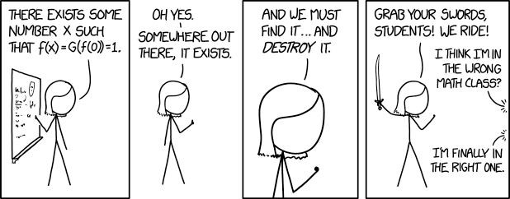
More Proof Strategies
CSE 311 Summer 25
Lecture 7

Slide 2
Announcements
HW2 is due tonight!
Stop by OH for support while finishing the assignment!
HW3 is released!
Please start early- this HW is a significant step up from HW1 and HW2
HW1 feedback is out!
Make sure to read all of your feedback!
HW1 Regrade requests are open for one week
Submit your regrade request(s) by Thursday EOD if you want your request to be responded to before the resubmission window closes

Slide 3

Announcements
Homework Resubmissions
For each homework, you may resubmit up to 2 problems for an improved grade
Three steps to resubmit your work
1) Revise your work using the feedback on your original submission
2) Submit your revised work using the “Homework 1 Resubmission” assignment on Gradescope
3) Fill out the HW1 Resubmission form on the Ed board
Both steps 2 and 3 must be completed for your resubmission to be graded
Resubmissions are open from Wednesday at noon until 11:59 pm on Friday
Late days cannot be used on resubmissions (unless there are extenuating circumstances)

Slide 4
Review

Slide 5

Theorems and Proofs
Theorem: A statement that has been proven to be true.
Proof: A valid argument that establishes a statement to be true.
You’ll also see
“claim” (the statement we’re about to prove)
“lemma” (small theorem, used to prove a bigger theorem)
“corollary” (small theorem, proven using a bigger theorem)
Notes:
Definition:
A theorem is a statement that can be shown to be true.
A proof is a valid argument that establishes a statement to be true.

Slide 6



Integer
We need a basic starting point to be able to prove things.
Objects to work with.
Some definitions to analyze
An integer: is any real number with no fractional part.
Even(x) := An integer, $x,$ is even if and only if there is an integer $k$such that $x=2k.$
Odd(x) := An integer, $x,$ is odd if and only if there is an integer $k$such that $x=2k+1.$
Even
Odd
Notes:
This isn’t the “real” definition of integer---it relies on real numbers! Which we haven’t defined (go visit the math department)
For our purposes, there’s no need to dig deeper

Slide 7
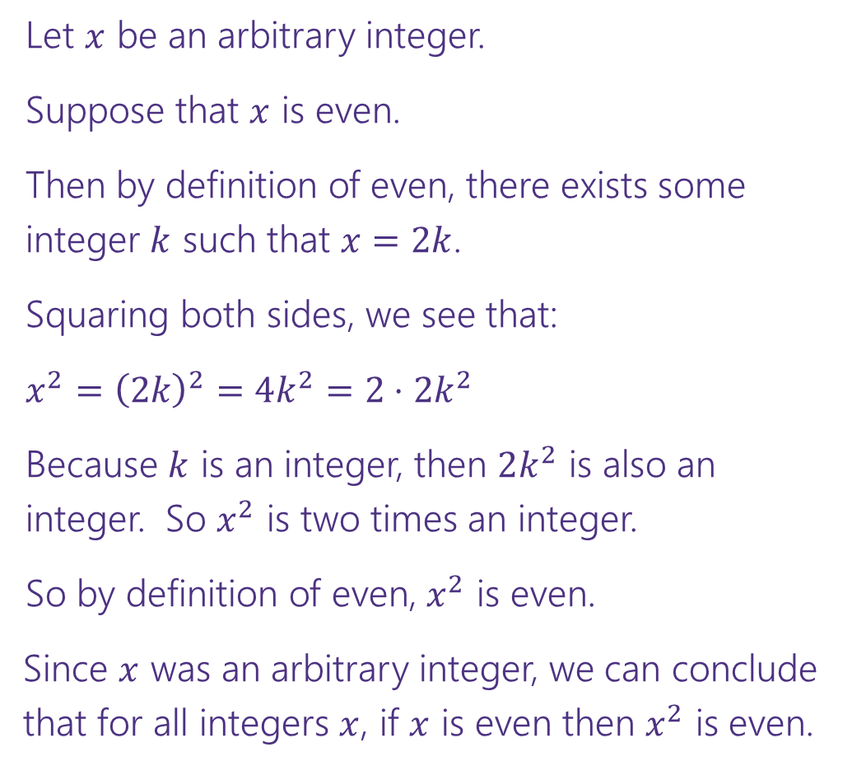



Direct Proof Template
Prove: $∀x\left(Even\left(x\right)→Even\left(x^{2}\right)\right)$
Declare an arbitrary variable for each $∀$.
Let $x$ be an arbitrary integer.
Suppose that $x$ is even.
Then by definition of even, there exists some integer $k$ such that $x=2k$.
Squaring both sides, we see that:
$x^{2}={\left(2k\right)}^{2}=4k^{2}=2⋅2k^{2}$
Because $k$ is an integer, then $2k^{2}$ is also an integer. So $x^{2}$ is two times an integer.
So by definition of even, $x^{2}$ is even.
Since $x$ was an arbitrary integer, we can conclude that for all integers $x$, if $x$ is even then $x^{2}$ is even.
Assume the left side of the implication.
Unroll the predicate definitions.
Manipulate towards the goal.
Reroll definitions into the right side of the implication.
Conclude that you have proved the claim.

Slide 8
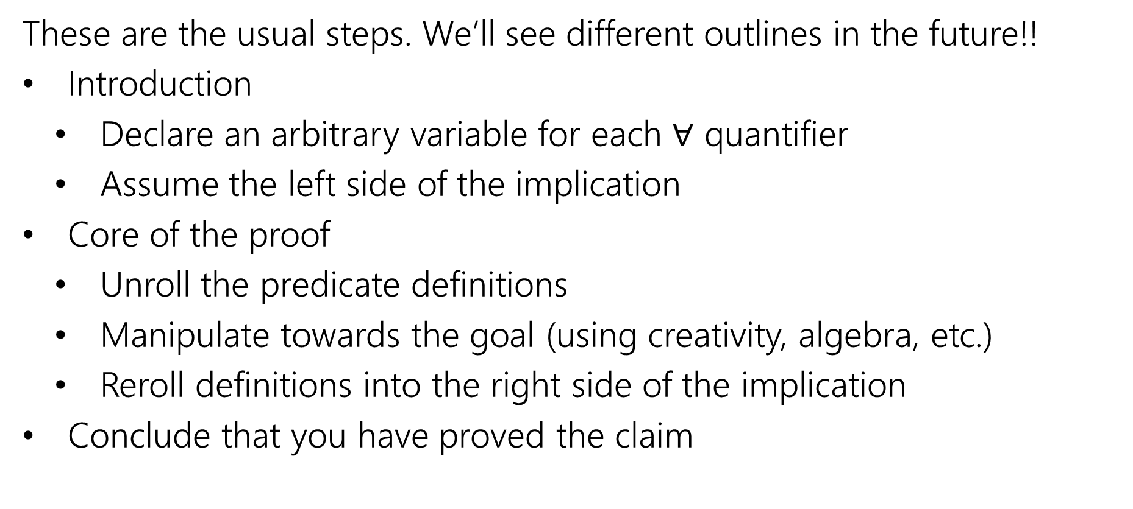

Direct Proof Steps
These are the usual steps. We’ll see different outlines in the future!!
Introduction
Declare an arbitrary variable for each $∀$ quantifier
Assume the left side of the implication
Core of the proof
Unroll the predicate definitions
Manipulate towards the goal (using creativity, algebra, etc.)
Reroll definitions into the right side of the implication
Conclude that you have proved the claim

Slide 9
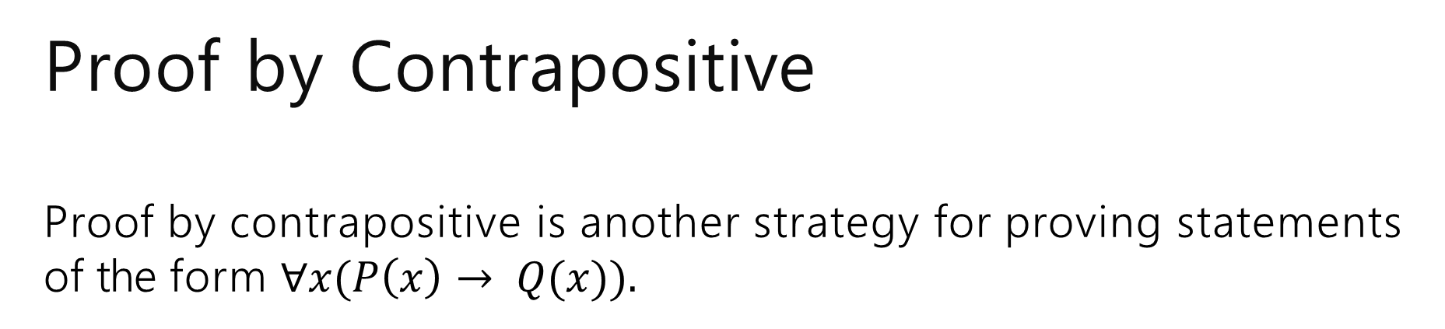

Proof by Contrapositive Proof by contrapositive is another strategy for proving statements of the form $∀x(P\left(x\right)→ Q(x)).$
The strategy is to prove the contrapositive, i.e. prove ∀𝑥 ¬Q 𝑥
→ ¬P 𝑥
Remember, an implication is equivalent to its contrapositive!

Slide 10

Proof by Contrapositive
Definitions
Odd 𝑥 ≔ ∃𝑘(𝑥 = 2𝑘 + 1)
Prove: For an integer 𝑥, if 3𝑥 + 2 is odd, then 𝑥 is odd.
$$∀x \left(Odd\left(3x+2\right)→Odd\left(x\right)\right)≡∀x (Even\left(x\right)→Even\left(3x+2\right))$$
We prove by contrapositive.
Let 𝑥 be an arbitrary integer. Suppose that 𝑥 is even.
Then by definition of even, 𝑥 = 2𝑘 for some integer 𝑘.
Consider 3𝑥 + 2:
3𝑥 + 2 = 3(2𝑘) + 2 = 6𝑘 + 2 = 2(3𝑘 + 1)
Since 𝑘 is an integer, 3𝑘 + 1 is an integer. So by definition of even, 3𝑥 + 2 is even.
Since 𝑥 was arbitrary, we have shown that for all integers 𝑥, if 𝑥 is even then 3𝑥 + 2 is even. Thus the contrapositive also holds: for all integers 𝑥, if 3𝑥 + 2 is odd, then 𝑥 is odd.

Slide 11
Warm Up

Slide 12
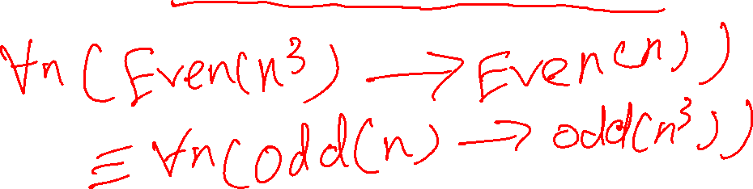
Another Proof by Contrapositive
Definitions
Even 𝑥 ≔ ∃𝑘(𝑥 = 2𝑘)
Prove by Contrapositive: For an integer 𝑛, if 𝑛³ is even, then 𝑛 is even.

Slide 13
Another Proof by Contrapositive
Definitions
Even 𝑥 ≔ ∃𝑘(𝑥 = 2𝑘)
Prove by Contrapositive: For an integer 𝑛, if 𝑛³ is even, then 𝑛 is even.
$$∀n \left(Even\left(n^{3}\right)→Even\left(n\right)\right)≡∀n(Odd\left(n\right)→Odd\left(n^{3}\right))$$

Slide 14

Another Proof by Contrapositive
Definitions
Even 𝑥 ≔ ∃𝑘(𝑥 = 2𝑘)
Prove by Contrapositive: For an integer 𝑛, if 𝑛³ is even, then 𝑛 is even.
$$∀n \left(Even\left(n^{3}\right)→Even\left(n\right)\right)≡∀n(Odd\left(n\right)→Odd\left(n^{3}\right))$$
We prove by contrapositive.
Let 𝑛 be an arbitrary integer. Suppose that 𝑛 is odd.
Thus by definition of odd, 𝑛³ is odd. Since 𝑛 was arbitrary, we have shown that for all integers 𝑛, if 𝑛 is odd then 𝑛³ is odd. Thus the contrapositive also holds: for all integers 𝑛, if 𝑛³ is even, then 𝑛 is even.

Slide 15
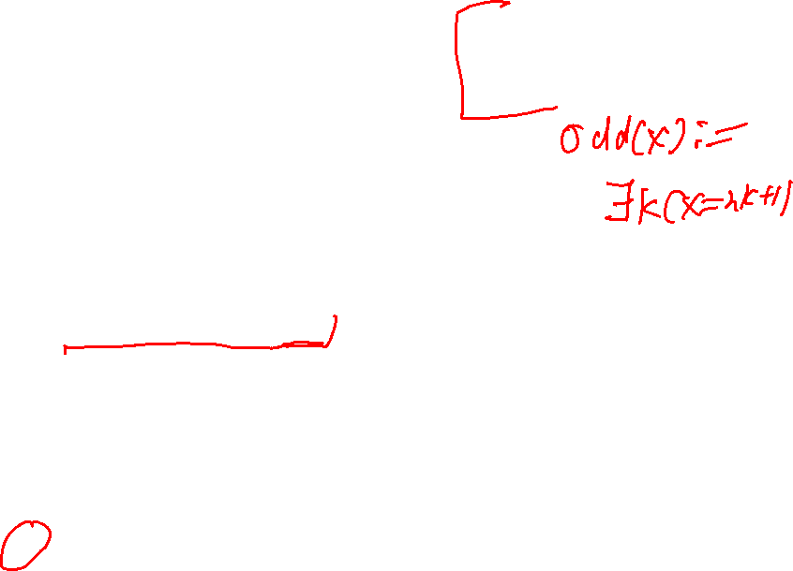
Another Proof by Contrapositive
Definitions
Even 𝑥 ≔ ∃𝑘(𝑥 = 2𝑘)
Prove by Contrapositive: For an integer 𝑛, if 𝑛³ is even, then 𝑛 is even.
$$∀n \left(Even\left(n^{3}\right)→Even\left(n\right)\right)≡∀n(Odd\left(n\right)→Odd\left(n^{3}\right))$$
We prove by contrapositive.
Let 𝑛 be an arbitrary integer. Suppose that 𝑛 is odd.
[Unroll predicate definitions]
[Manipulate towards goal]
Thus by definition of odd, 𝑛³ is odd. Since 𝑛 was arbitrary, we have shown that for all integers 𝑛, if 𝑛 is odd then 𝑛³ is odd. Thus the contrapositive also holds: for all integers 𝑛, if 𝑛³ is even, then 𝑛 is even.

Slide 16

Another Proof by Contrapositive
Definitions
Even 𝑥 ≔ ∃𝑘(𝑥 = 2𝑘)
Prove by Contrapositive: For an integer 𝑛, if 𝑛³ is even, then 𝑛 is even.
$$∀n \left(Even\left(n^{3}\right)→Even\left(n\right)\right)≡∀n(Odd\left(n\right)→Odd\left(n^{3}\right))$$
We prove by contrapositive.
Let 𝑛 be an arbitrary integer. Suppose that 𝑛 is odd.
Then by definition of odd, 𝑛 = 2𝑘 + 1 for some integer 𝑘.
[Manipulate towards goal]
Thus by definition of odd, 𝑛³ is odd. Since 𝑛 was arbitrary, we have shown that for all integers 𝑛, if 𝑛 is odd then 𝑛³ is odd. Thus the contrapositive also holds: for all integers 𝑛, if 𝑛³ is even, then 𝑛 is even.

Slide 17
Another Proof by Contrapositive
Definitions
Even 𝑥 ≔ ∃𝑘(𝑥 = 2𝑘)
Prove by Contrapositive: For an integer 𝑛, if 𝑛³ is even, then 𝑛 is even.
$$∀n \left(Even\left(n^{3}\right)→Even\left(n\right)\right)≡∀n(Odd\left(n\right)→Odd\left(n^{3}\right))$$
We prove by contrapositive.
Let 𝑛 be an arbitrary integer. Suppose that 𝑛 is odd.
Then by definition of odd, 𝑛 = 2𝑘 + 1 for some integer 𝑘.
Consider 𝑛³:
𝑛³ = (2𝑘 + 1)³ = 8𝑘³ + 8𝑘² + 4𝑘 + 1 = 2 (4𝑘³ + 4𝑘² + 2𝑘) + 1
Since 𝑘 is an integer, 4𝑘³ + 4𝑘² + 2𝑘 is an integer. Thus by definition of odd, 𝑛³ is odd. Since 𝑛 was arbitrary, we have shown that for all integers 𝑛, if 𝑛 is odd then 𝑛³ is odd. Thus the contrapositive also holds: for all integers 𝑛, if 𝑛³ is even, then 𝑛 is even.

Slide 18
Proof Strategy: Biconditional

Slide 19
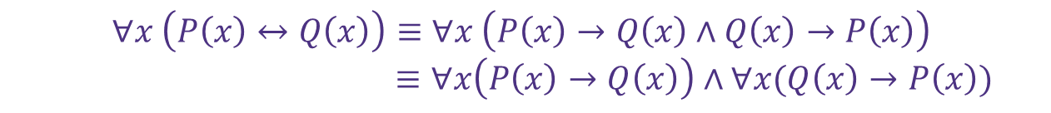
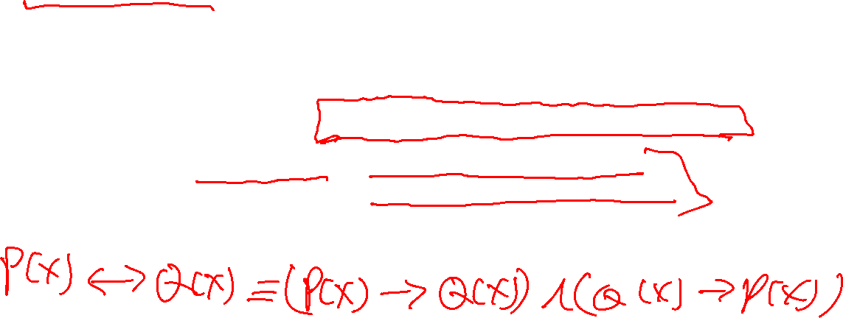
Proof of a Biconditional
Recall that biconditionals are statements of the form:
∀𝑥 P 𝑥 ↔ Q 𝑥
The strategy is to prove such statements is to prove an implication in both directions. I.e. prove ∀𝑥(P(𝑥) → Q(𝑥))∧ ∀𝑥(Q(𝑥) → P(𝑥)).
$$∀x \left(P\left(x\right)↔Q\left(x\right)\right)≡∀x \left(P\left(x\right)→Q\left(x\right)∧Q\left(x\right)→P\left(x\right)\right)$$
$≡∀x\left(P\left(x\right)→Q\left(x\right)\right)∧∀x(Q\left(x\right)→P\left(x\right))$

Slide 20
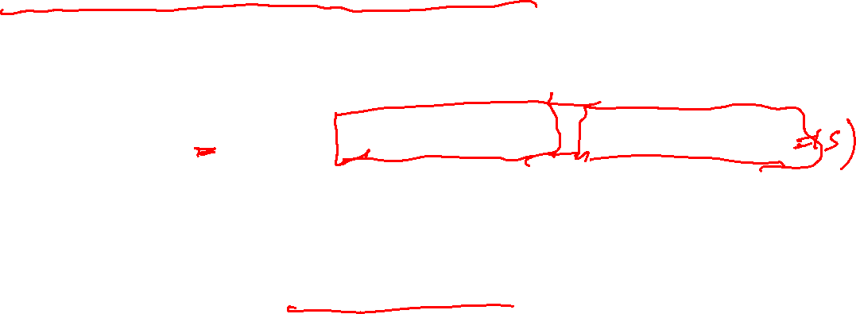
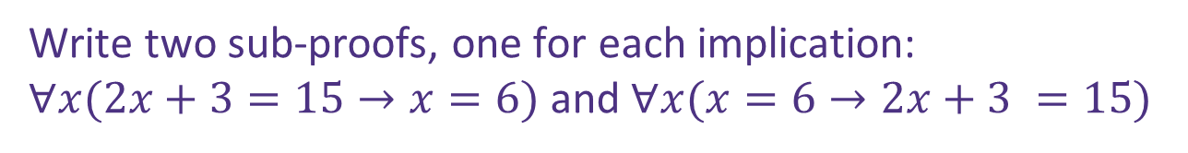
Proof of a Biconditional
Prove: “For an integer 𝑥, 2𝑥 + 3 = 15 if and only if 𝑥 = 6.”
What’s the claim in logic?
How would we prove this claim?
$$∀x\left(2x+3=15↔x=6\right)≡∀x\left(2x+3→x=6\right)∧∀x(x=6→2x+3)$$
Write two sub-proofs, one for each implication:
$∀x(2x+3=15→x=6)$ and$∀x(x=6→2x+3 =15$)
Notes:
Have a 5 minute discussion on this
Intuition: is this true?
Write out scratchwork

Slide 21
Proof of a Biconditional
Prove: For an integer 𝑥, 2𝑥 + 3 = 15 if and only if 𝑥 = 6.

Slide 22
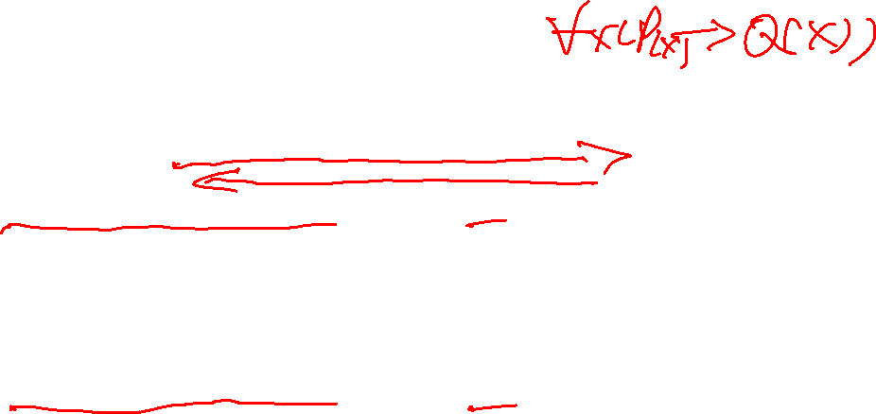
Proof of a Biconditional
Prove: For an integer 𝑥, 2𝑥 + 3 = 15 if and only if 𝑥 = 6.
[Proof that $∀x(2x+3=15→x=6)$, called the $⇒$ direction ]
[Proof that $∀x(x=6→2x+3=15$), called the $⇐$ direction ]

Slide 23

Proof of a Biconditional
Prove: For an integer 𝑥, 2𝑥 + 3 = 15 if and only if 𝑥 = 6.
⇒ Let 𝑥 be an arbitrary integer. Suppose 2𝑥 + 3 = 15.
[Proof that x = 6]
Since 𝑥 was arbitrary, for all integers 𝑥 if 2𝑥 + 3 = 15 then 𝑥 = 6.
[Proof that $∀x(x=6→2x+3=15$), called the $⇐$ direction ]

Slide 24
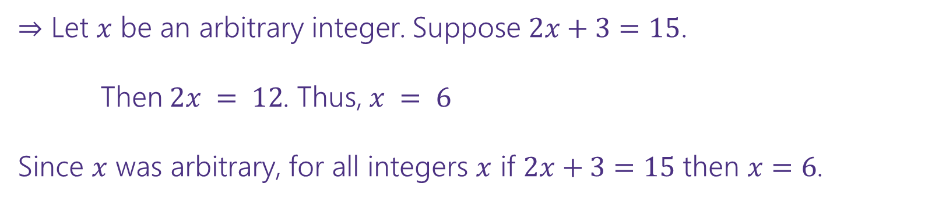

Proof of a Biconditional
Prove: For an integer 𝑥, 2𝑥 + 3 = 15 if and only if 𝑥 = 6.
⇒ Let 𝑥 be an arbitrary integer. Suppose 2𝑥 + 3 = 15.
Then $2x = 12$. Thus, $x = 6$
Since 𝑥 was arbitrary, for all integers 𝑥 if 2𝑥 + 3 = 15 then 𝑥 = 6.
[Proof that $∀x(x=6→2x+3=15$), called the $⇐$ direction ]

Slide 25
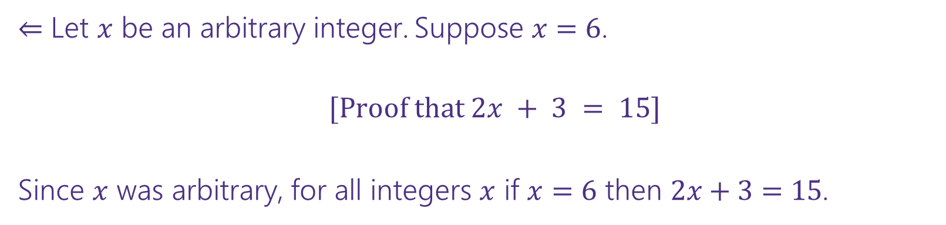
Proof of a Biconditional
Prove: For an integer 𝑥, 2𝑥 + 3 = 15 if and only if 𝑥 = 6.
⇒ Let 𝑥 be an arbitrary integer. Suppose 2𝑥 + 3 = 15.
Then $2x = 12$. Thus, $x = 6$
Since 𝑥 was arbitrary, for all integers 𝑥 if 2𝑥 + 3 = 15 then 𝑥 = 6.
⇐ Let 𝑥 be an arbitrary integer. Suppose 𝑥 = 6.
[Proof that $2x + 3 = 15$]
Since 𝑥 was arbitrary, for all integers 𝑥 if 𝑥 = 6 then 2𝑥 + 3 = 15.

Slide 26

Proof of a Biconditional
Prove: For an integer 𝑥, 2𝑥 + 3 = 15 if and only if 𝑥 = 6.
⇒ Let 𝑥 be an arbitrary integer. Suppose 2𝑥 + 3 = 15.
Then $2x = 12$. Thus, $x = 6$
Since 𝑥 was arbitrary, for all integers 𝑥 if 2𝑥 + 3 = 15 then 𝑥 = 6.
⇐ Let 𝑥 be an arbitrary integer. Suppose 𝑥 = 6.
Consider 2𝑥 + 3:
2𝑥 + 3 = 2(6) + 3 = 12 + 3 = 15
Since 𝑥 was arbitrary, for all integers 𝑥 if 𝑥 = 6 then 2𝑥 + 3 = 15.

Slide 27
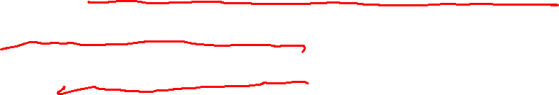
Remark: Biconditional Proofs
Each direction of the biconditional proof can use whichever proof type fits best (direct, contrapositive, etc.).
Consider the claim: For an integer 𝑛, 3𝑛 + 3 is odd iff 𝑛 is even.
⇐ Prove that ∀𝑛(Even(𝑛) → Odd(3𝑛 + 3))
. Use a direct proof.
⇒ Prove that ∀𝑛(Odd(3𝑛 + 3) → Even(𝑛))
. Use contrapositive. I.e. prove
that ∀𝑛(Odd(𝑛) → Even(3𝑛 + 3))

Slide 28
More Practice: Another Proof of a Biconditional
Definitions
Even 𝑥 ≔ ∃𝑘(𝑥 = 2𝑘)
Odd 𝑥 ≔ ∃𝑘(𝑥 = 2𝑘 + 1)
Prove: For an integer 𝑛, 3𝑛 + 3 is odd iff 𝑛 is even.

Slide 29
More Practice: Another Proof of a Biconditional
Definitions
Even 𝑥 ≔ ∃𝑘(𝑥 = 2𝑘)
Odd 𝑥 ≔ ∃𝑘(𝑥 = 2𝑘 + 1)
Prove: For an integer 𝑛, 3𝑛 + 3 is odd iff 𝑛 is even.
[Proof that $∀x(Odd(3n+3)→Even(n))$]
[Proof that $∀x(Even(n)→Odd(3n+3)$)]

Slide 30
More Practice: Another Proof of a Biconditional
Definitions
Even 𝑥 ≔ ∃𝑘(𝑥 = 2𝑘)
Odd 𝑥 ≔ ∃𝑘(𝑥 = 2𝑘 + 1)
Prove: For an integer 𝑛, 3𝑛 + 3 is odd iff 𝑛 is even.
⇐ Let 𝑛 be an arbitrary integer. Suppose 𝑛 is even. Then by definition of even, 𝑛 = 2𝑘 for
some integer 𝑘. Then consider 3𝑛 + 3:
3𝑛 + 3 = 3 2𝑘 + 3 = 6𝑘 + 3 = 2 3𝑘 + 1 + 1
Since 𝑘 is an integer, 3𝑘 + 1 is an integer. So 3𝑛 + 3 is 2 times an integer plus 1. So by definition of odd, 3𝑛 + 3 is odd. Since 𝑛 was arbitrary, this shows that for all integers 𝑛 if 𝑛 is even then 3𝑛 + 3 is odd.
⇒ We prove by contrapositive. Let 𝑛 be an arbitrary integer. Suppose that 𝑛 is odd. Then by definition of odd, 𝑛 = 2𝑘 + 1 for some integer 𝑘. Then consider 3𝑛 + 3:
3𝑛 + 3 = 3 2𝑘 + 1 + 3 = 6𝑘 + 3 + 3 = 6𝑘 + 6 = 2(3𝑘 + 3)
Since 𝑘 is an integer, 3𝑘 + 3 is an integer. So 3𝑛 + 3 is 2 times an integer. So by definition of even, 3𝑛 + 3 is even. Since 𝑛 was arbitrary, this shows that for all integers 𝑛, if 𝑛 is odd then 3𝑛 + 3 is even. Then the contrapositive also holds: for all integers 𝑛, if 3𝑛 + 3 is odd then 𝑛 is even.

Slide 31
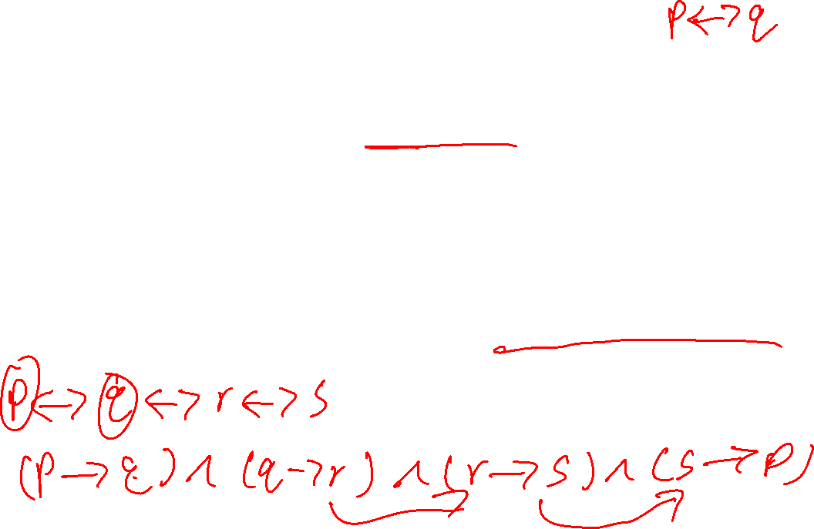
Remark: Multiple Biconditionals
Suppose you wanted to prove 𝑝 ↔ 𝑞 ↔ 𝑟.
How many sub-proofs would you need?
We could do every pair: $\left(p→q\right)∧\left(q→p\right)∧\left(q→r\right)∧\left(r→q\right)∧\left(p→r\right)∧(r→p)$
But it turns out we only need 3. For instance, $\left(p→q\right)∧$ $\left(q→r\right)$ $∧(r→p)$
Any chain of conditional statements work so long as you can follow the chain of implications to get from any statement to any other.

Slide 32
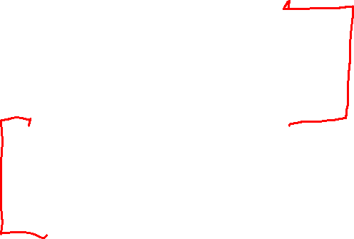
Proof Strategies So Far
Direct Proof
Proof by Contrapositive
Proof of Biconditional
Proof by Cases
Proof of Existence
Proof by Counterexample

Slide 33
Proof by Cases

Slide 34

Shaking Hands
Suppose there are six people in a room. Some of them shake hands. Consider the claim:
There are at least three people who all shook each other’s hands, or three
people such that no pair of them shook hands.
Is it true? Can you prove or disprove it?

Slide 35
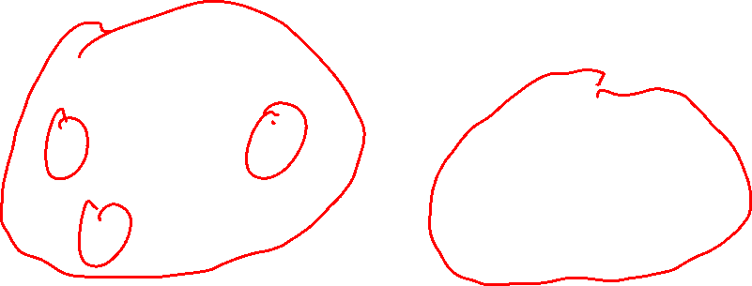
Shaking Hands
Suppose there are six people in a room. Some of them shake hands. Consider the claim:
There are at least three people who all shook each other’s hands, or three
people such that no pair of them shook hands.
Not obvious! Doesn’t work
with 5 people.
A
A F
B
E
B
E
C
D
C
D

Slide 36
There are six people in a room. Prove that there are at least three people who all
shook each other’s hands, or three people such that no pair of them shook hands.

Slide 37
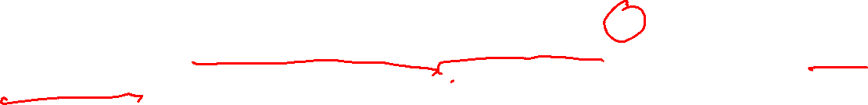
There are six people in a room. Prove that there are at least three people who all
shook each other’s hands, or three people such that no pair of them shook hands.
Idea behind proof: We will choose one person, call them 𝐴. They must have either shook hands with 3 or more other people in the room or shook hands with 2 or fewer people. In both cases, we will show our claim holds.

Slide 38
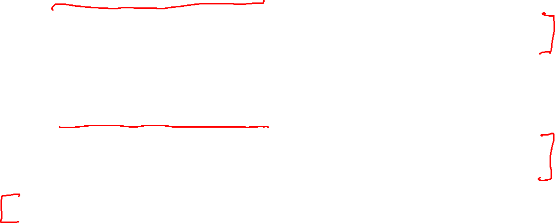
There are six people in a room. Prove that there are at least three people who all
shook each other’s hands, or three people such that no pair of them shook hands.
Choose one person, call them 𝐴. Note that 𝐴 has 5 people around them in the room.
Case 1: 𝐴 shook 3 or more of the others’ hands.
[Proof that there are at least three people who shook each other’s hands, or three people such that no pair of them shook hands]
Case 2: 𝐴 shook 2 or fewer of the others’ hands.
[Proof that there are at least three people who shook each other’s hands, or three people such that no pair of them shook hands]
Because the claim holds in both cases and our cases are exhaustive, we’ve proven our claim.

Slide 39
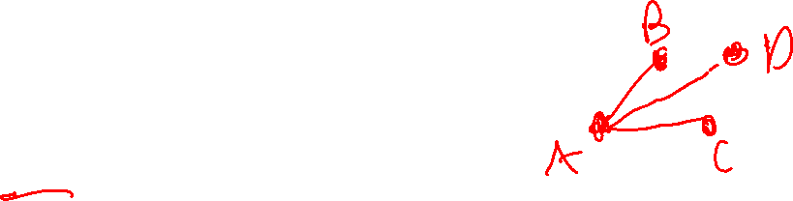
There are six people in a room. Prove that there are at least three people who all
shook each other’s hands, or three people such that no pair of them shook hands.
Choose one person, call them 𝐴. Note that 𝐴 has 5 people around them in the room.
Case 1: 𝐴 shook 3 or more of the others’ hands.
Pick three of them, call them 𝐵,𝐶,𝐷.
[There are two cases for 𝐵,𝐶,𝐷: either two of 𝐵,𝐶,𝐷 shook hands with each other (proving our claim) or none of them shook hands with each other (also proving our claim)]
Case 2: 𝐴 shook 2 or fewer of the others’ hands.
[Proof that there are at least three people who shook each other’s hands, or three people such that no pair of them shook hands]
Because the claim holds in both cases and our cases are exhaustive, we’ve proven our claim.

Slide 40

There are six people in a room. Prove that there are at least three people who all
shook each other’s hands, or three people such that no pair of them shook hands.
Choose one person, call them 𝐴. Note that 𝐴 has 5 people around them in the room.
Case 1: 𝐴 shook 3 or more of the others’ hands.
Pick three of them, call them 𝐵,𝐶,𝐷.
Then if any of 𝐵, 𝐶 or 𝐷 shook hands with each other, we have 3 people who have all shaken hands. If none of 𝐵, 𝐶, or 𝐷 shook hands with each other, then we have 3 people who have not shaken any hands.
Case 2: 𝐴 shook 2 or fewer of the others’ hands.
[Proof that there are at least three people who shook each other’s hands, or three people such that no pair of them shook hands]
Because the claim holds in both cases and our cases are exhaustive, we’ve proven our claim.

Slide 41
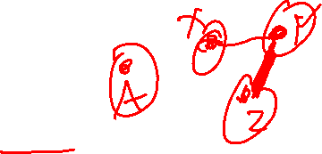
There are six people in a room. Prove that there are at least three people who all
shook each other’s hands, or three people such that no pair of them shook hands.
Choose one person, call them 𝐴. Note that 𝐴 has 5 people around them in the room.
Case 1: 𝐴 shook 3 or more of the others’ hands.
Pick three of them, call them 𝐵,𝐶,𝐷.
Then if any of 𝐵, 𝐶 or 𝐷 shook hands with each other, we have 3 people who have all shaken hands. If none of 𝐵, 𝐶, or 𝐷 shook hands with each other, then we have 3 people who have not shaken any hands.
Case 2: 𝐴 shook 2 or fewer of the others’ hands.
Pick three of the people 𝐴 did not shake hands with, and call them 𝑋, 𝑌, 𝑍.
[There are two cases for 𝑋, 𝑌, 𝑍 : either they all shook hands (proving our claim) or at least two of them did not shake hands (also proving our claim)]
Because the claim holds in both cases and our cases are exhaustive, we’ve proven our claim.

Slide 42
There are six people in a room. Prove that there are at least three people who all
shook each other’s hands, or three people such that no pair of them shook hands.
Choose one person, call them 𝐴. Note that 𝐴 has 5 people around them in the room.
Case 1: 𝐴 shook 3 or more of the others’ hands.
Pick three of them, call them 𝐵,𝐶,𝐷.
Then if any of 𝐵, 𝐶 or 𝐷 shook hands with each other, we have 3 people who have all shaken hands. If none of 𝐵, 𝐶, or 𝐷 shook hands with each other, then we have 3 people who have not shaken any hands.
Case 2: 𝐴 shook 2 or fewer of the others’ hands.
Pick three of the people 𝐴 did not shake hands with, and call them 𝑋, 𝑌, 𝑍.
Then if any of 𝑋, 𝑌, 𝑍 also did not shake with each other, we have 3 people who have all not shaken hands. If all of 𝑋, 𝑌, or 𝑍 shook hands with each other, then we have 3 people who have all shaken hands.
Because the claim holds in both cases and our cases are exhaustive, we’ve proven our claim.

Slide 43
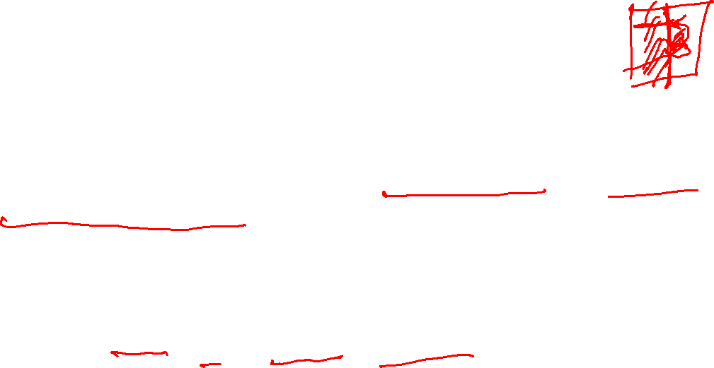
Proof by Cases
Proof by cases is the strategy of:
Breaking your assumption(s) into smaller cases.
Be careful to make sure that your cases are exhaustive (cover all of the possible scenarios). It’s ok if they have overlap though.
Proving that the claim holds in all of these cases.
Formally: (P ∨ Q)→ R ≡ (P → R) ∧ (Q → R).

Slide 44
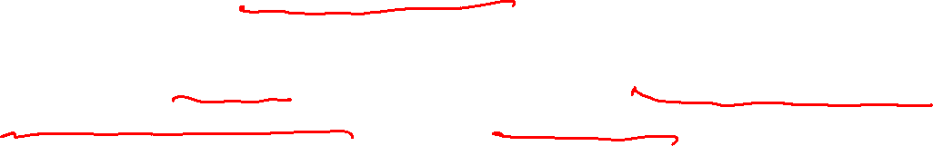
5 numbers: Proof by Cases
Suppose that 𝑥₁, … , 𝑥₅ are real numbers such that 𝑥₁ ≤ 𝑥₂ ≤ 𝑥₃ ≤ 𝑥₄ ≤ 𝑥₅ and
𝑥₁ + 𝑥₂ + 𝑥₃ + 𝑥₄ + 𝑥₅ = 50. Prove that 𝑥₁ + 𝑥₂ ≤ 20.

Slide 45

5 numbers: Proof by Cases
Suppose that 𝑥₁, … , 𝑥₅ are real numbers such that 𝑥₁ ≤ 𝑥₂ ≤ 𝑥₃ ≤ 𝑥₄ ≤ 𝑥₅ and
𝑥₁ + 𝑥₂ + 𝑥₃ + 𝑥₄ + 𝑥₅ = 50. Prove that 𝑥₁ + 𝑥₂ ≤ 20.
Let 𝑥₁, 𝑥₂, 𝑥₃, 𝑥₄, 𝑥₅ be arbitrary real numbers such that 𝑥₁ ≤ 𝑥₂ ≤ 𝑥₃ ≤ 𝑥₄ ≤ 𝑥₅ and 𝑥₁ + 𝑥₂ + 𝑥₃ + 𝑥₄ + 𝑥₅ = 50.
Since 𝑥₁, … , 𝑥₅ were arbitrary, our cases were exhaustive, and the claim holds in each case, we’ve proven our claim.

Slide 46

5 numbers: Proof by Cases
Suppose that 𝑥₁, … , 𝑥₅ are real numbers such that 𝑥₁ ≤ 𝑥₂ ≤ 𝑥₃ ≤ 𝑥₄ ≤ 𝑥₅ and
𝑥₁ + 𝑥₂ + 𝑥₃ + 𝑥₄ + 𝑥₅ = 50. Prove that 𝑥₁ + 𝑥₂ ≤ 20.
Let 𝑥₁, 𝑥₂, 𝑥₃, 𝑥₄, 𝑥₅ be arbitrary real numbers such that 𝑥₁ ≤ 𝑥₂ ≤ 𝑥₃ ≤ 𝑥₄ ≤ 𝑥₅ and 𝑥₁ + 𝑥₂ + 𝑥₃ + 𝑥₄ + 𝑥₅ = 50.
[We can split into two cases based on the value of $x_{2}$: when 𝑥₂ ≤ 10 (our claim immediately follows) and when 𝑥₂ >10]
Since 𝑥₁, … , 𝑥₅ were arbitrary, our cases were exhaustive, and the claim holds in each case, we’ve proven our claim.

Slide 47
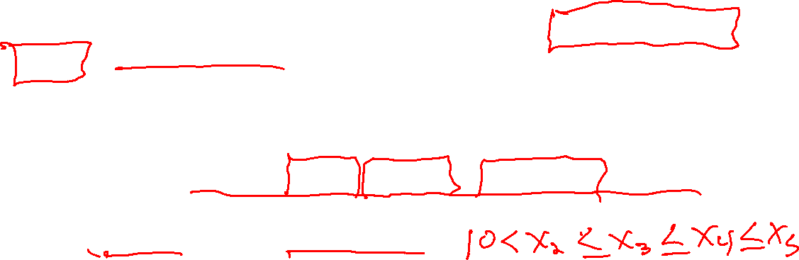
5 numbers: Proof by Cases
Suppose that 𝑥₁, … , 𝑥₅ are real numbers such that 𝑥₁ ≤ 𝑥₂ ≤ 𝑥₃ ≤ 𝑥₄ ≤ 𝑥₅ and
𝑥₁ + 𝑥₂ + 𝑥₃ + 𝑥₄ + 𝑥₅ = 50. Prove that 𝑥₁ + 𝑥₂ ≤ 20.
Let 𝑥₁, 𝑥₂, 𝑥₃, 𝑥₄, 𝑥₅ be arbitrary real numbers such that 𝑥₁ ≤ 𝑥₂ ≤ 𝑥₃ ≤ 𝑥₄ ≤ 𝑥₅ and 𝑥₁ + 𝑥₂ + 𝑥₃ + 𝑥₄ + 𝑥₅ = 50.
Case 1: 𝑥₂ ≤ 10. Then since 𝑥₁ ≤ 𝑥₂, 𝑥₁ ≤ 10. So 𝑥₁ + 𝑥₂ ≤ 20, as desired.
Case 2: 𝑥₂ > 10. [Proof that 𝑥₁ + 𝑥₂ ≤ 20]
Since 𝑥₁, … , 𝑥₅ were arbitrary, our cases were exhaustive, and the claim holds in each case, we’ve proven our claim.

Slide 48

5 numbers: Proof by Cases
Suppose that 𝑥₁, … , 𝑥₅ are real numbers such that 𝑥₁ ≤ 𝑥₂ ≤ 𝑥₃ ≤ 𝑥₄ ≤ 𝑥₅ and
𝑥₁ + 𝑥₂ + 𝑥₃ + 𝑥₄ + 𝑥₅ = 50. Prove that 𝑥₁ + 𝑥₂ ≤ 20.
Let 𝑥₁, 𝑥₂, 𝑥₃, 𝑥₄, 𝑥₅ be arbitrary real numbers such that 𝑥₁ ≤ 𝑥₂ ≤ 𝑥₃ ≤ 𝑥₄ ≤ 𝑥₅ and 𝑥₁ + 𝑥₂ + 𝑥₃ + 𝑥₄ + 𝑥₅ = 50.
Case 1: 𝑥₂ ≤ 10. Then since 𝑥₁ ≤ 𝑥₂, 𝑥₁ ≤ 10. So 𝑥₁ + 𝑥₂ ≤ 20, as desired.
Case 2: 𝑥₂ > 10. Then since 𝑥₃, 𝑥₄, 𝑥₅ ≥ 𝑥₂, we have that 𝑥₃ > 10, 𝑥₄ > 10, 𝑥₅ > 10. So 𝑥₃ + 𝑥₄ + 𝑥₅ > 30. Thus 𝑥₁ + 𝑥₂ < 20, as desired.
Since 𝑥₁, … , 𝑥₅ were arbitrary, our cases were exhaustive, and the claim holds in each case, we’ve proven our claim.

Slide 49
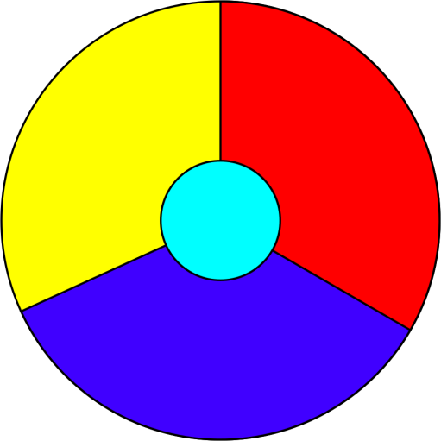
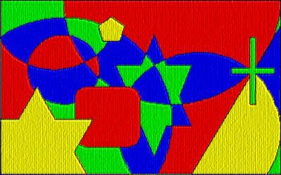

Four Color Theorem: Proof by Cases
Theorem (Four Color): Any plane surface with regions in it can be colored in four colors or less. Two regions that have a common border must not get the same color.
The first proof had 1,936 cases. The shortest known proof today has over 600 cases.

Slide 50
Existence Proof

Slide 51

Existence Proof
To prove a statement of the form ∃𝑥 P(𝑥), we give one example of 𝑥 in the domain that makes P(𝑥) true.

Slide 52
Existence Proof
Prove: There is some prime number 𝑝 such that 𝑝 + 6 and 𝑝 + 8 are also prime.
What’s the claim in logic?
∃𝑝(Prime(𝑝) ∧ Prime(𝑝 + 6) ∧ Prime(𝑝 + 8))
How would we prove this claim?
Provide such a prime number.

Slide 53
Existence Proof
Prove: There is some prime number 𝑝 such that 𝑝 + 6 and 𝑝 + 8 are also prime.
Consider 𝑝 = 5. Then 𝑝 + 6 = 11 is also prime, as is 𝑝 + 8 = 13.

Slide 54
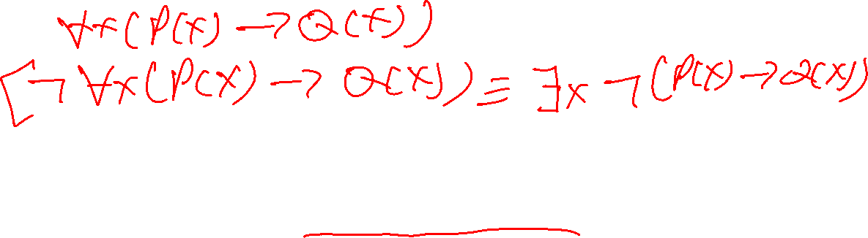
When are Existence Proofs often helpful?
To disprove a claim, we prove the negation of the claim.
Existence proofs are often helpful to disprove “for all” claims.
Another term for this is proof by counterexample.

Slide 55






Proof by Counterexample
A single example can’t prove a ∀ statement.
A single counterexample can disprove a ∀ statement.
For example, to disprove “all professors like pizza”, you must find a professor
who does not like pizza.
In formal logic:
$$¬∀x \left(P\left(x\right)→Q\left(x\right)\right)$$
$$≡∃x ¬\left(P\left(x\right)→Q\left(x\right)\right)$$
DeMorgan’s Law for Quantifiers
$$≡∃x ¬\left(¬P\left(x\right)∨Q\left(x\right)\right)$$
Law of Implication
$$≡∃x \left(¬¬P\left(x\right)∧¬Q\left(x\right)\right)$$
DeMorgan’s Law
$$≡∃x \left(P\left(x\right)∧¬Q\left(x\right)\right)$$
Double Negation

Slide 56
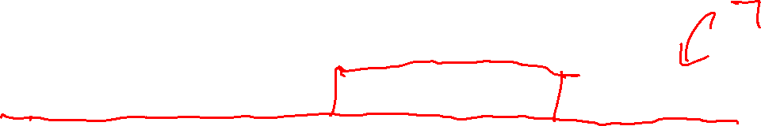
Proof by Counterexample
For all real numbers 𝑎, 𝑏, 𝑐, if 𝑎 + 𝑐 = 𝑏 + 𝑐 , then 𝑎 = |𝑏|.
This claim is false. Disprove!

Slide 57

Proof by Counterexample
For all real numbers 𝑎, 𝑏, 𝑐, if 𝑎 + 𝑐 = 𝑏 + 𝑐 , then 𝑎 = |𝑏|.
This claim is false. Disprove!
Consider 𝑎 = −6, 𝑏 = 4, 𝑐 = 1. Certainly 𝑎 ≠ |𝑏|. Observe that:
𝑎 + 𝑐 = −6 + 1 = −5 = 5
𝑏 + 𝑐 = 4 + 1 = 5 = 5
So this is a counterexample to the claim.

Slide 58
Practice: Proof by Counterexample
You are given 1¢, 5¢, 10¢, 12¢ and 25¢ coins.
Your boss says the following process will always make change with the least amount of coins: first use as many 25¢ coins that will fit, then 12¢ coins, then 10¢, then 5¢, then 1¢ cent.
Disprove this with a counterexample.

Slide 59
Practice: Proof by Counterexample
You are given 1¢, 5¢, 10¢, 12¢ and 25¢ coins.
Your boss says the following process will always make change with the least amount of coins: first use as many 25¢ coins that will fit, then 12¢ coins, then 10¢, then 5¢, then 1¢ cent.
Disprove this with a counterexample.
Consider making 21¢ of change. Your boss’s strategy would involve using 12¢, 5¢, 1¢, 1¢, 1¢, 1¢ coins, i.e. 6 coins. However you can make this much change using only 3 coins: 10¢, 10¢, 1¢.

Slide 60
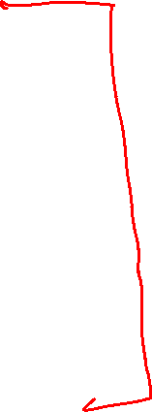
Proof Strategies So Far
Direct Proof
Proof by Contrapositive
Proof of Biconditional
Proof by Cases
Proof of Existence
Proof by Counterexample

Slide 61
Todo
Tonight:
Come to OH today if need extra support while finishing HW2
Read your HW1 feedback and revise your work with it in mind if you’re resubmitting
CC7 due Friday at noon

