Slide 1

Direct Proofs and Proof by Contrapositive
CSE 311: Summer 25 Lecture 6

Slide 2
Announcements
HW2 is out!
Due Wednesday @ 11:59 pm
Come by OH for extra support!
HW1 feedback will be released shortly
Please read all feedback that’s left on your assignment
Regrade requests will be open for one week
More info on how to resubmit your work on Wednesday

Slide 3
Review

Slide 4
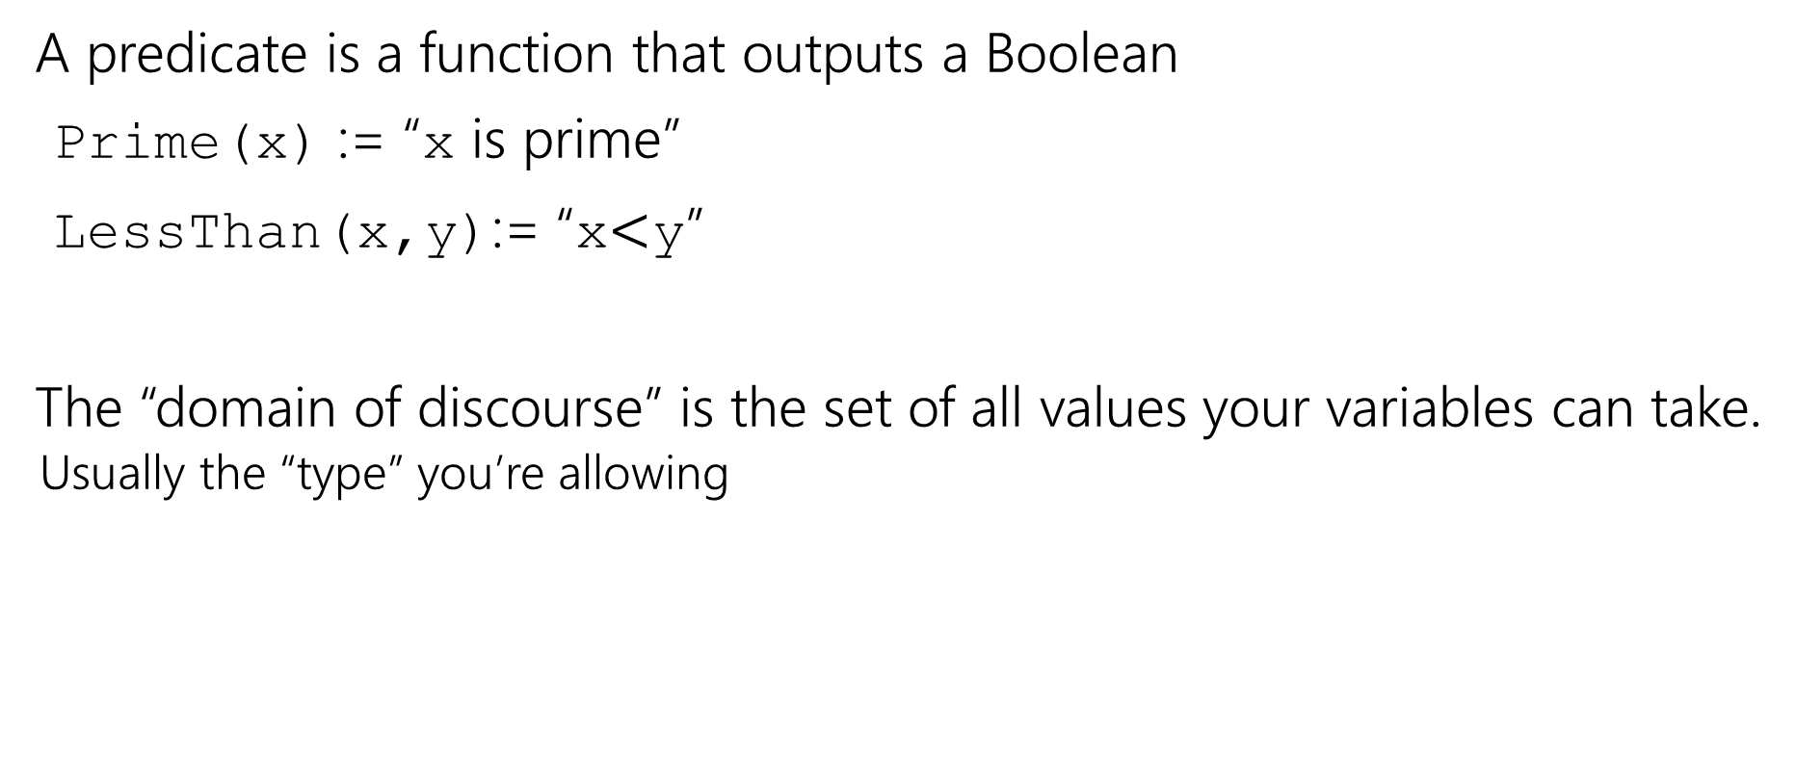
Where were we?
A predicate is a function that outputs a Boolean
Prime(x) := “x is prime”
LessThan(x,y):= “x$<$y”
The “domain of discourse” is the set of all values your variables can take.
Usually the “type” you’re allowing

Slide 5
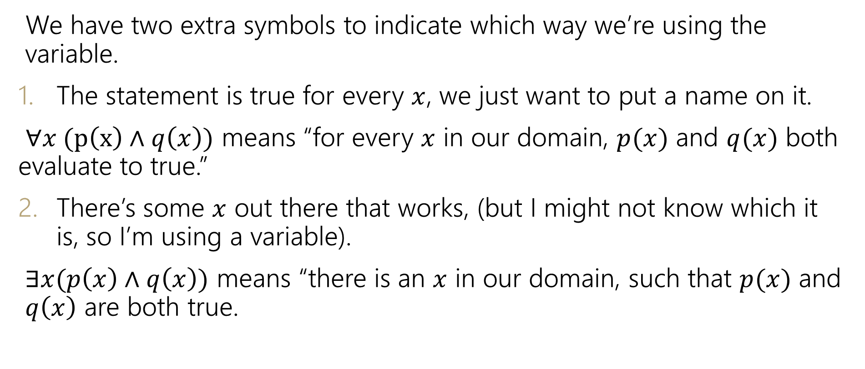
Quantifiers
We have two extra symbols to indicate which way we’re using the variable.
The statement is true for every $x$, we just want to put a name on it.
$∀x (p\left(x\right)∧q\left(x\right))$ means “for every $x$ in our domain, $p(x)$ and $q(x)$ both evaluate to true.”
There’s some $x$ out there that works, (but I might not know which it is, so I’m using a variable).
$∃x(p\left(x\right)∧q\left(x\right))$ means “there is an $x$ in our domain, such that $p(x)$ and $q\left(x\right)$ are both true.

Slide 6
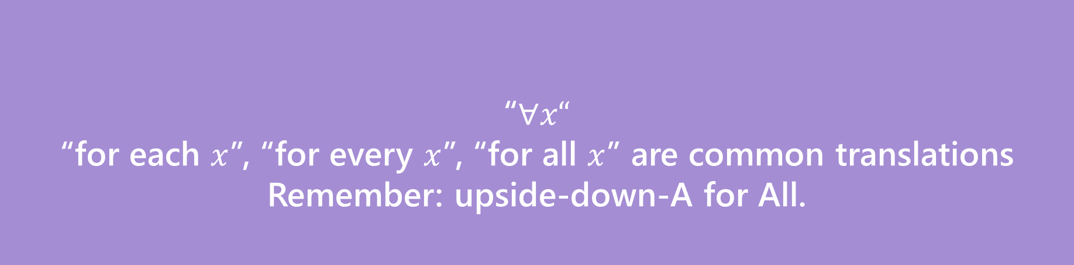

Quantifiers
We have two extra symbols to indicate which way we’re using the variable.
The statement is true for every $x$, we just want to put a name on it.
$∀x (p\left(x\right)∧q\left(x\right))$ means “for every $x$ in our domain, $p(x)$ and $q(x)$ both evaluate to true.”
There’s some $x$ out there that works, (but I might not know which it is, so I’m using a variable).
$∃x(p\left(x\right)∧q\left(x\right))$ means “there is an $x$ in our domain, $p(x)$ and $q\left(x\right)$ are both true.
“$∀x“$
“for each $x$”, “for every $x$”, “for all $x$” are common translations
Remember: upside-down-A for All.
Universal Quantifier

Slide 7
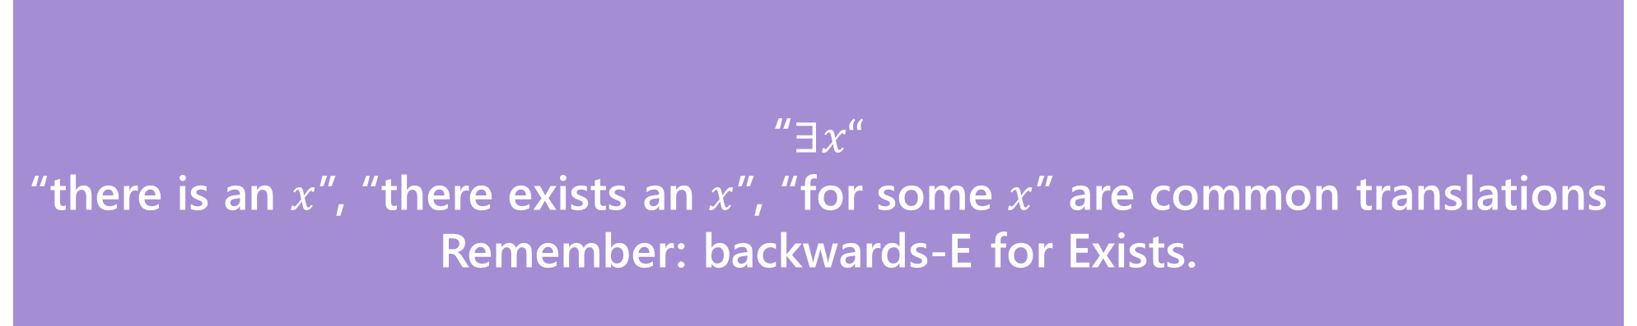

Quantifiers
“$∃x“$
“there is an $x$”, “there exists an $x$”, “for some $x$” are common translations
Remember: backwards-E for Exists.
Existential Quantifier
We have two extra symbols to indicate which way we’re using the variable.
The statement is true for every $x$, we just want to put a name on it.
$∀x (p\left(x\right)∧q\left(x\right))$ means “for every $x$ in our domain, $p(x)$ and $q(x)$ both evaluate to true.”
There’s some $x$ out there that works, (but I might not know which it is, so I’m using a variable).
$∃x(p\left(x\right)∧q\left(x\right))$ means “there is an $x$ in our domain, for which $p(x)$ and $q\left(x\right)$ are both true.

Slide 8
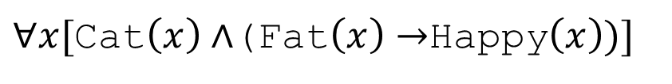
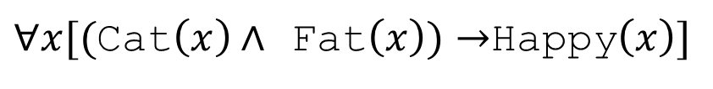
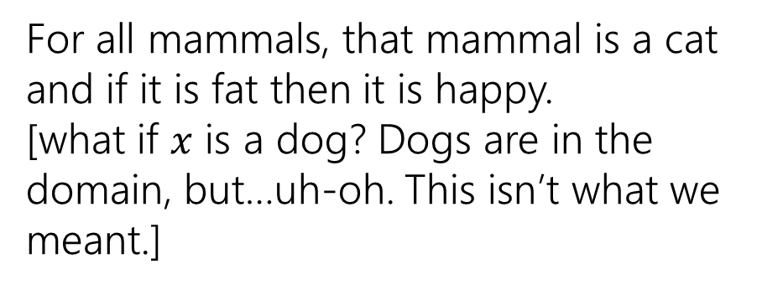
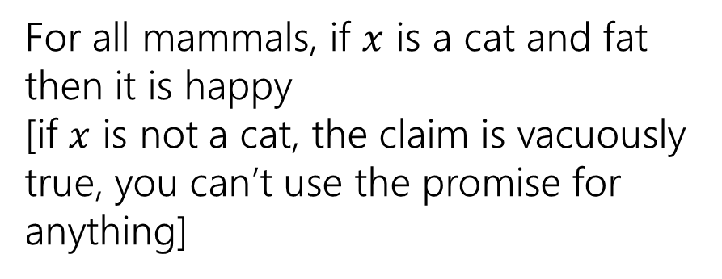
Quantifiers
Which of these translates “For every cat: if a cat is fat then it is happy.” when our domain of discourse is “mammals”?
$∀x[($Cat$\left(x\right)∧$ Fat$\left(x\right))→$Happy$\left(x\right)]$
$∀x[$Cat$\left(x\right)∧$(Fat$\left(x\right)→$Happy$\left(x\right))]$
For all mammals, if $x$ is a cat and fat then it is happy
[if $x$ is not a cat, the claim is vacuously true, you can’t use the promise for anything]
For all mammals, that mammal is a cat and if it is fat then it is happy.
[what if $x$ is a dog? Dogs are in the domain, but…uh-oh. This isn’t what we meant.]
To “limit” variables to a portion of your domain of discourse under a universal quantifier add a hypothesis to an implication.

Slide 9
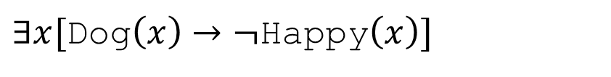
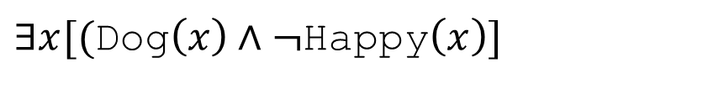
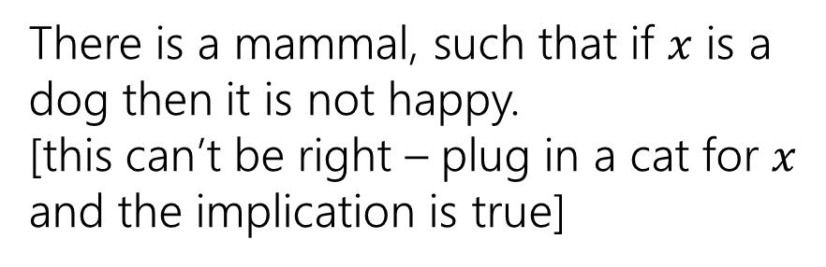
Quantifiers
Which of these translates “There is a dog who is not happy.” when our domain of discourse is “mammals”?
$∃x[$Dog$\left(x\right)→¬$Happy$\left(x\right)]$
$∃x[($Dog$\left(x\right)∧¬$Happy$\left(x\right)]$
There is a mammal, such that if $x$ is a dog then it is not happy.
[this can’t be right – plug in a cat for $x$ and the implication is true]
There is a mammal that is both a dog and not happy.
[this one is correct!]
To “limit” variables to a portion of your domain of discourse under an existential quantifier AND the limitation together with the rest of the statement.

Slide 10
Domain Restriction Translations
Translations often sound more natural if we:
Notice domain restriction patterns.
Avoid using variables when we can.
Drop the “for all” or “there exists” when we can.
For example:
∀𝑥 Cat 𝑥 → Blue 𝑥
For all animals 𝑥, if 𝑥 is a cat then 𝑥 is blue. All cats are blue.

Slide 11
DeMorgan’s Laws for Quantifiers
¬∀𝑥 P 𝑥 ≡ ∃𝑥 ¬P 𝑥
¬∃𝑥 P 𝑥 ≡ ∀𝑥 ¬P 𝑥
I.e. to negate an expression with a quantifier:
Switch the quantifier (∀ becomes ∃, and vice versa).
Negate the expression inside.

Slide 12
Proving Predicate Logic Equivalence
$$¬∃x ∃y (Odd\left(x\right)∧Even\left(y\right)∧\left(x=y\right))$$
$$≡∀x ¬∃y (Odd\left(x\right)∧Even\left(y\right)∧\left(x=y\right))$$
DeMorgan’s Law for Quantifiers
$$≡∀x ∀y ¬(Odd\left(x\right)∧Even\left(y\right)∧\left(x=y\right))$$
DeMorgan’s Law for Quantifiers
$≡∀x ∀y (¬\left(Odd\left(x\right)∧Even\left(y\right)\right)∨¬\left(x=y\right)$)
DeMorgan’s Law
Definition of ≠
$≡∀x ∀y (¬\left(Odd\left(x\right)∧Even\left(y\right)\right)∨\left(x≠y\right)$)
$≡∀x ∀y (\left(Odd\left(x\right)∧Even\left(y\right)\right)→\left(x≠y\right)$)
Law of Implication

Slide 13
Warm Up

Slide 14
Proving Predicate Logic Equivalence Practice
Prove $¬∀x\left(P\left(x\right)→∃y Q\left(x, y\right)\right)$ is equivalent to $∃x ∀y(P\left(x\right)∧¬Q\left(x, y\right))$.

Slide 15






Proving Predicate Logic Equivalence
$$¬∀x(P\left(x\right)→∃y Q\left(x,y\right))$$
Law of Implication
$$≡¬∀x(¬P\left(x\right)∨∃y Q\left(x,y\right))$$
DeMorgan’s Law for Quantifiers
$$≡∃x ¬(¬P\left(x\right)∨∃y Q\left(x,y\right))$$
$$≡∃x (¬¬P\left(x\right)∧¬∃y Q\left(x,y\right))$$
DeMorgan’s Law
$$≡∃x (P\left(x\right)∧¬∃y Q\left(x,y\right))$$
Double Negation
$$≡∃x (P\left(x\right)∧∀y¬Q\left(x,y\right))$$
DeMorgan’s Law for Quantifiers
$$≡∃x ∀y(P\left(x\right)∧¬Q\left(x,y\right))$$

Slide 16
Theorems and Proofs

Slide 17
Theorems and Proofs
Theorem: A statement that has been proven to be true.
Proof: A valid argument that establishes a statement to be true.
You’ll also see
“claim” (the statement we’re about to prove)
“lemma” (small theorem, used to prove a bigger theorem)
“corollary” (small theorem, proven using a bigger theorem)
Notes:
Definition:
A theorem is a statement that can be shown to be true.
A proof is a valid argument that establishes a statement to be true.

Slide 18
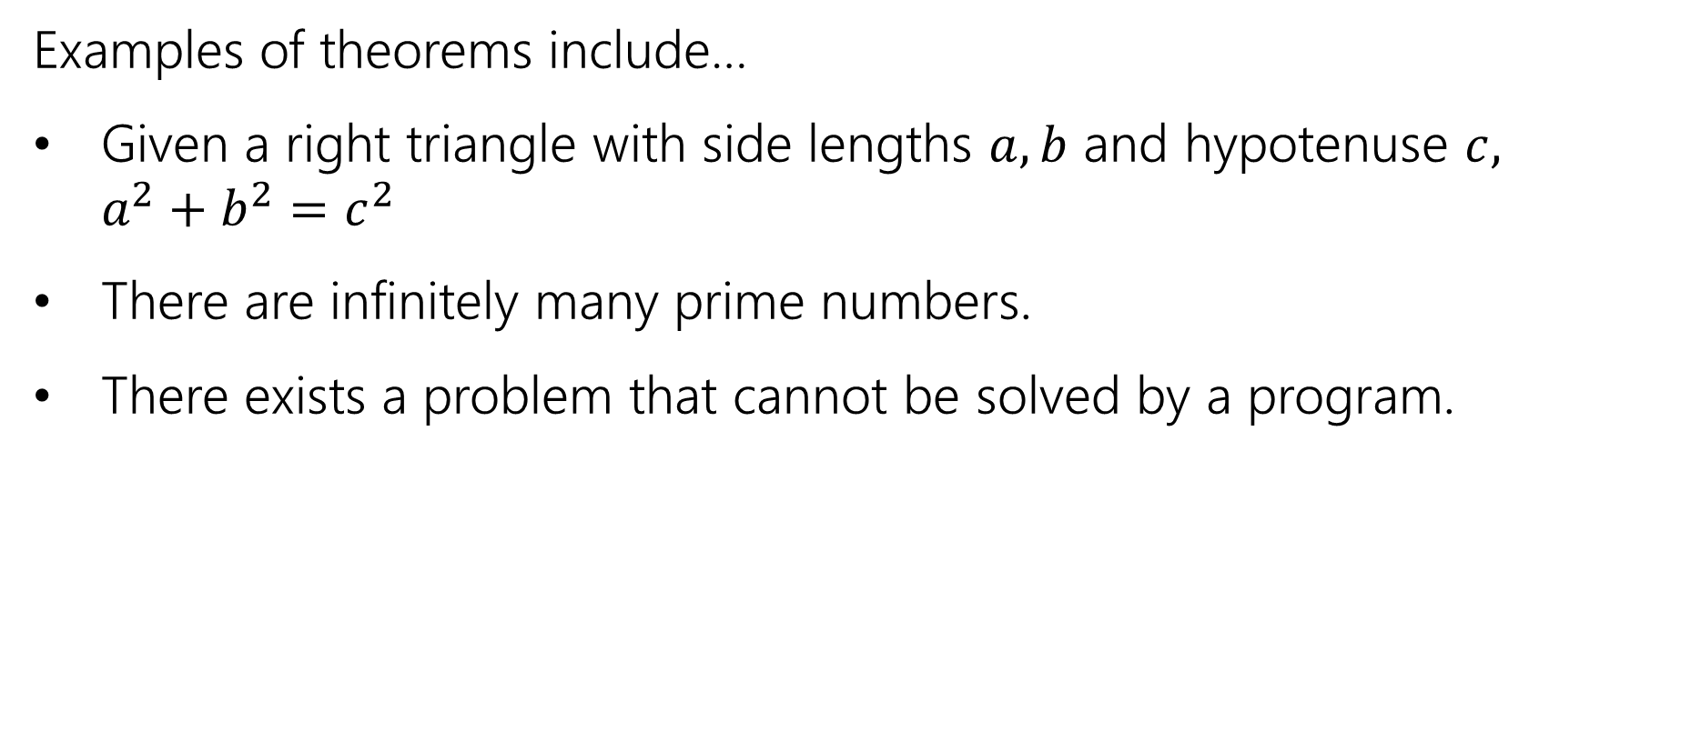
Theorems and Proofs
Examples of theorems include…
Given a right triangle with side lengths $a,b$ and hypotenuse $c,$ $a^{2}+b^{2}=c^{2}$
There are infinitely many prime numbers.
There exists a problem that cannot be solved by a program.
Notes:
We’ll be proving claims.

Slide 19


Integer
We need a basic starting point to be able to prove things.
Objects to work with.
Some definitions to analyze
An integer: is any real number with no fractional part.
Even(x) := An integer, $x,$ is even if and only if there is an integer $k$such that $x=2k.$
Odd(x) := An integer, $x,$ is odd if and only if there is an integer $k$such that $x=2k+1.$
Even
Odd
Notes:
This isn’t the “real” definition of integer---it relies on real numbers! Which we haven’t defined (go visit the math department)
For our purposes, there’s no need to dig deeper

Slide 20

A word on definitions
Definitions are fundamental. Our goal is to communicate precisely.
When you come across an edge case, a definition is the way to solve it.
Is -4 even? Well $∃k(−4=2k)$ (take $k=−2$), so yes it is!
We go to the definition. Not your gut feeling about what feels right.
How do we know something is true? Usually we verify the definition!

Slide 21
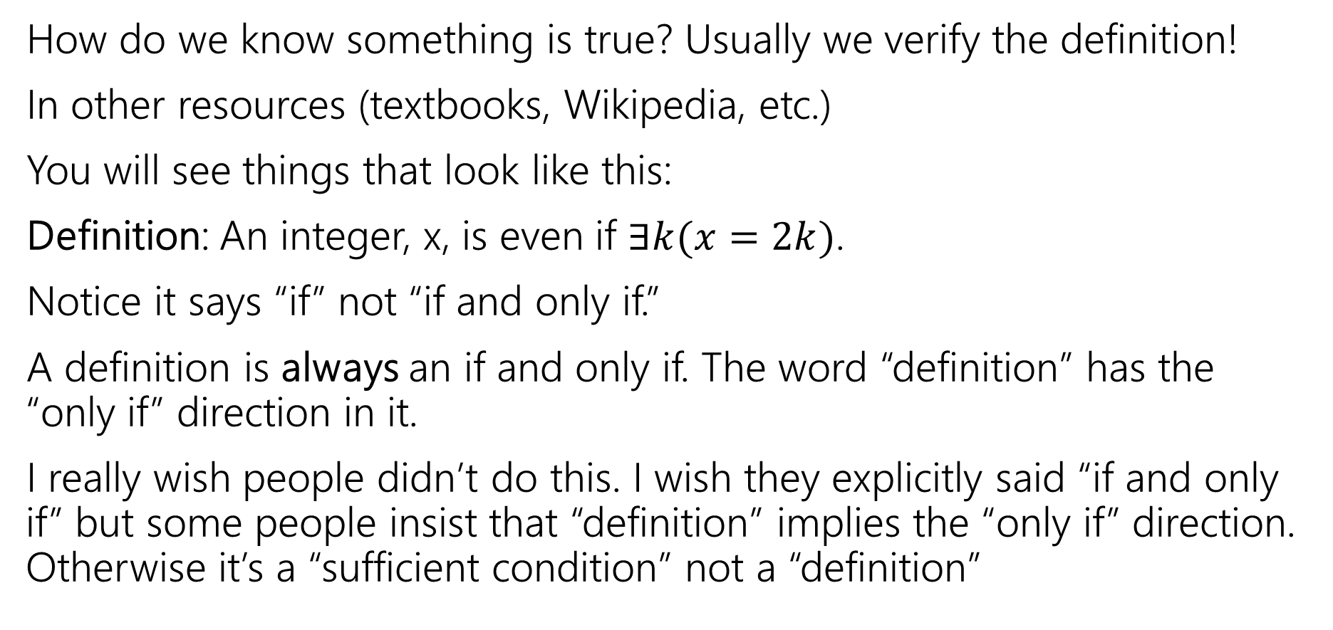
A word on definitions
How do we know something is true? Usually we verify the definition!
In other resources (textbooks, Wikipedia, etc.)
You will see things that look like this:
Definition: An integer, x, is even if $∃k(x=2k)$.
Notice it says “if” not “if and only if.”
A definition is always an if and only if. The word “definition” has the “only if” direction in it.
I really wish people didn’t do this. I wish they explicitly said “if and only if” but some people insist that “definition” implies the “only if” direction. Otherwise it’s a “sufficient condition” not a “definition”

Slide 22
Proof Strategy: Direct Proof

Slide 23

Direct Proof
Direct proof is one strategy for proving statements of the form
$$∀x[P\left(x\right)→Q\left(x\right)]$$
Notes:
Direct proof is one strategy for proving statements of the form $∀x \left(P\left(x\right)→Q\left(x\right)\right)$.

Slide 24
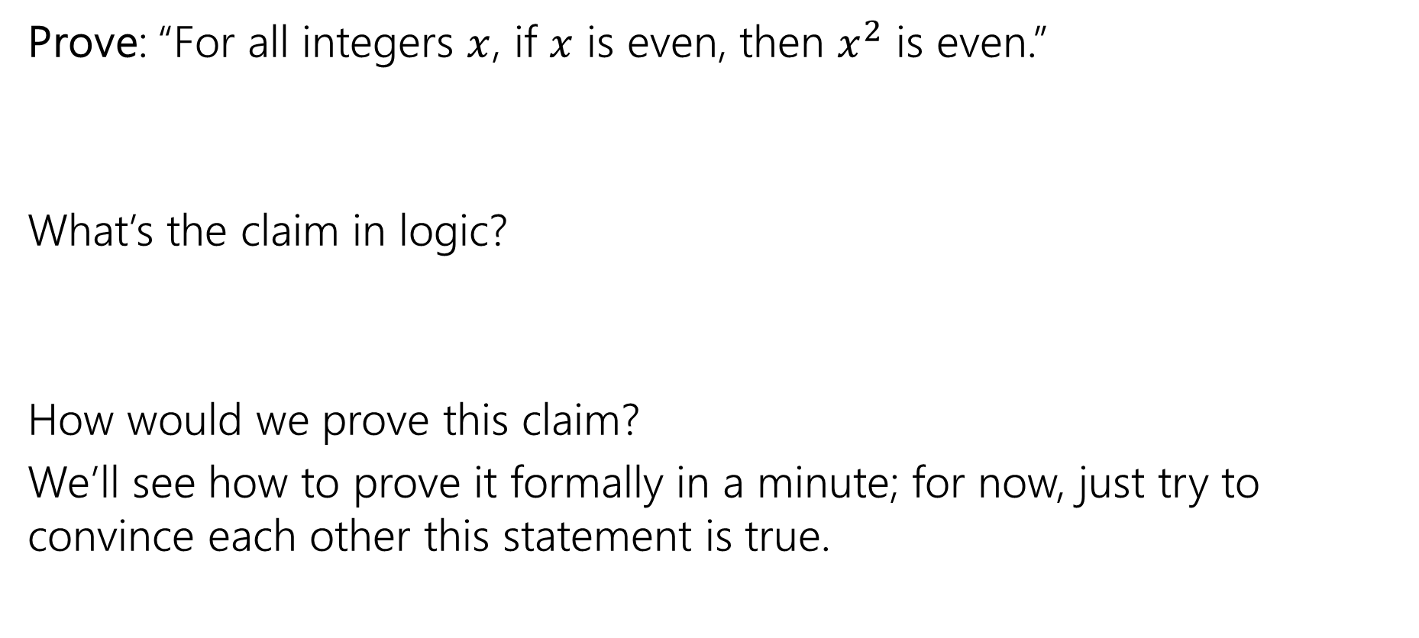
Our First Direct Proof
Prove: “For all integers $x$, if $x$ is even, then $x^{2}$ is even.”
What’s the claim in logic?
How would we prove this claim?
We’ll see how to prove it formally in a minute; for now, just try to convince each other this statement is true.
$$∀x (\text{Even}\text{(}\text{x}\text{) }→\text{Even}\text{(}x^{2}\text{)}$$
Notes:
Have a 5 minute discussion on this
Intuition: is this true?
Write out scratchwork

Slide 25

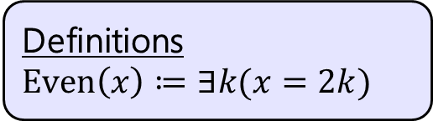
Our First Direct Proof
Definitions
$Even\left(x\right)≔∃k(x=2k)$
Prove: “For all integers $x$, if $x$ is even, then $x^{2}$ is even.” $∀x\left(Even\left(x\right)→Even\left(x^{2}\right)\right)$
Notes:
Let $x$ be an arbitrary integer. Suppose that $x$ is even. Then by definition of even, there exists some integer $k$ such that $x=2k$. Squaring both sides, we see that:
$$x^{2}={\left(2k\right)}^{2}=4k^{2}=2⋅2k^{2}$$
Because $k$ is an integer, then $2k^{2}$ is also an integer. So $x^{2}$ is two times an integer.
So by definition of even, $x^{2}$ is even.
Since $x$ was an arbitrary integer, we can conclude that for all integers $x$, if $x$ is even then $x^{2}$ is even.
Run through with a number

Slide 26
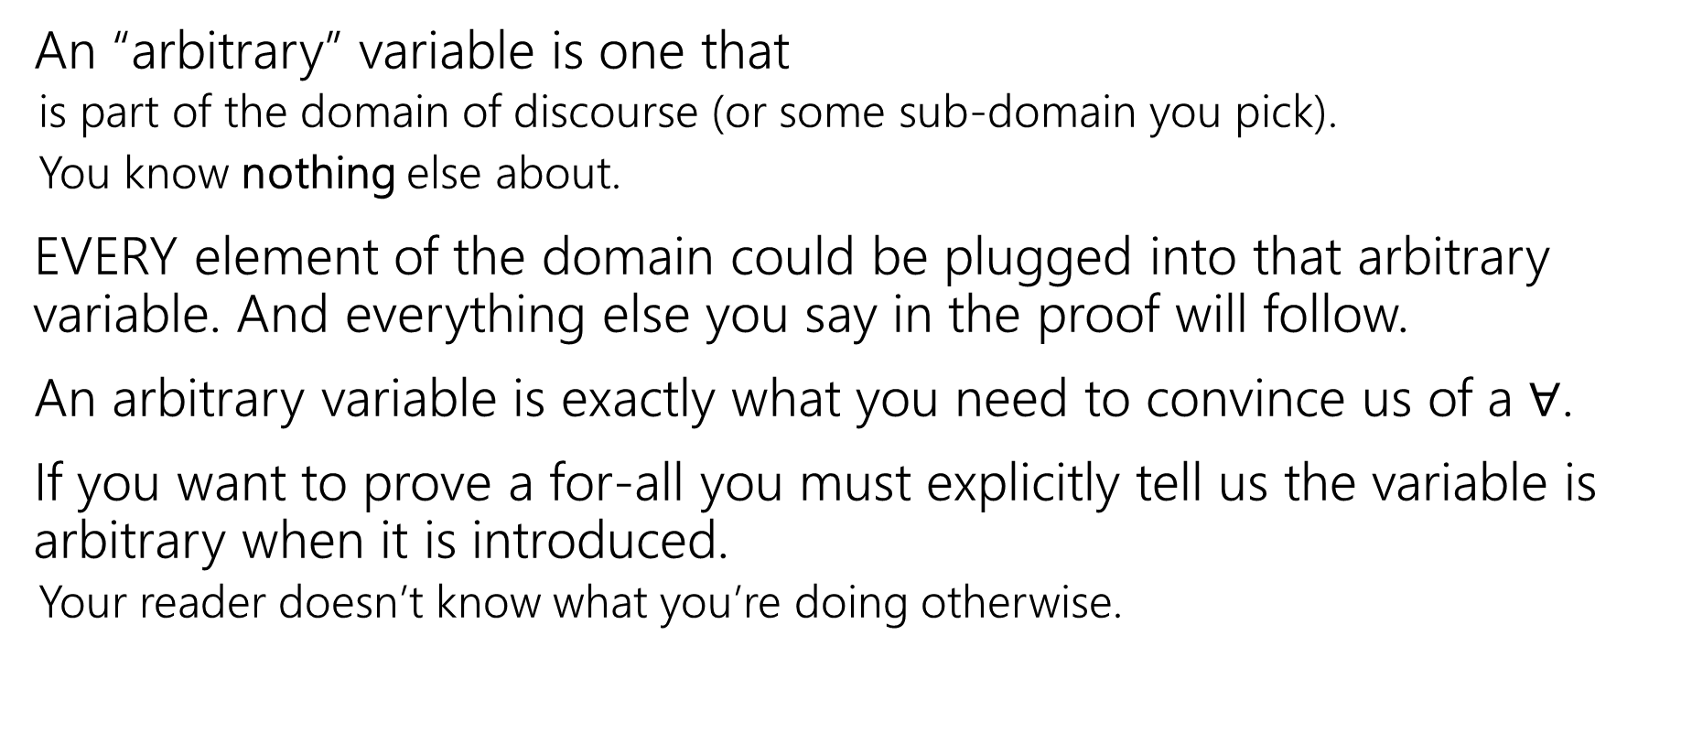
Arbitrary
An “arbitrary” variable is one that
is part of the domain of discourse (or some sub-domain you pick).
You know nothing else about.
EVERY element of the domain could be plugged into that arbitrary variable. And everything else you say in the proof will follow.
An arbitrary variable is exactly what you need to convince us of a $∀$.
If you want to prove a for-all you must explicitly tell us the variable is arbitrary when it is introduced.
Your reader doesn’t know what you’re doing otherwise.

Slide 27

Our First Direct Proof
Definitions
$Even\left(x\right)≔∃k(x=2k)$
Prove: “For all integers $x$, if $x$ is even, then $x^{2}$ is even.” $∀x\left(Even\left(x\right)→Even\left(x^{2}\right)\right)$
Proof: Let $x$ be an arbitrary integer. Suppose that $x$ is even.
Notes:
Let $x$ be an arbitrary integer. Suppose that $x$ is even. Then by definition of even, there exists some integer $k$ such that $x=2k$. Squaring both sides, we see that:
$$x^{2}={\left(2k\right)}^{2}=4k^{2}=2⋅2k^{2}$$
Because $k$ is an integer, then $2k^{2}$ is also an integer. So $x^{2}$ is two times an integer.
So by definition of even, $x^{2}$ is even.
Since $x$ was an arbitrary integer, we can conclude that for all integers $x$, if $x$ is even then $x^{2}$ is even.
Run through with a number

Slide 28

Now What?
Definitions
$Even\left(x\right)≔∃k(x=2k)$
Well….what does it mean to be even?
$x=2k$ for some integer $k$.
Where do we need to end up?
Even$(x^{2})$

Slide 29

Our First Direct Proof
Definitions
$Even\left(x\right)≔∃k(x=2k)$
Prove: “For all integers $x$, if $x$ is even, then $x^{2}$ is even.” $∀x\left(Even\left(x\right)→Even\left(x^{2}\right)\right)$
Proof: Let $x$ be an arbitrary integer. Suppose that $x$ is even.
So $x^{2}$ is even.
Notes:
Let $x$ be an arbitrary integer. Suppose that $x$ is even. Then by definition of even, there exists some integer $k$ such that $x=2k$. Squaring both sides, we see that:
$$x^{2}={\left(2k\right)}^{2}=4k^{2}=2⋅2k^{2}$$
Because $k$ is an integer, then $2k^{2}$ is also an integer. So $x^{2}$ is two times an integer.
So by definition of even, $x^{2}$ is even.
Since $x$ was an arbitrary integer, we can conclude that for all integers $x$, if $x$ is even then $x^{2}$ is even.
Run through with a number

Slide 30

Our First Direct Proof
Definitions
$Even\left(x\right)≔∃k(x=2k)$
Prove: “For all integers $x$, if $x$ is even, then $x^{2}$ is even.” $∀x\left(Even\left(x\right)→Even\left(x^{2}\right)\right)$
Proof: Let $x$ be an arbitrary integer. Suppose that $x$ is even.
By definition of even, $x=2k$ for some integer $k$.
So $x^{2}$ is even.
Notes:
Let $x$ be an arbitrary integer. Suppose that $x$ is even. Then by definition of even, there exists some integer $k$ such that $x=2k$. Squaring both sides, we see that:
$$x^{2}={\left(2k\right)}^{2}=4k^{2}=2⋅2k^{2}$$
Because $k$ is an integer, then $2k^{2}$ is also an integer. So $x^{2}$ is two times an integer.
So by definition of even, $x^{2}$ is even.
Since $x$ was an arbitrary integer, we can conclude that for all integers $x$, if $x$ is even then $x^{2}$ is even.
Run through with a number

Slide 31
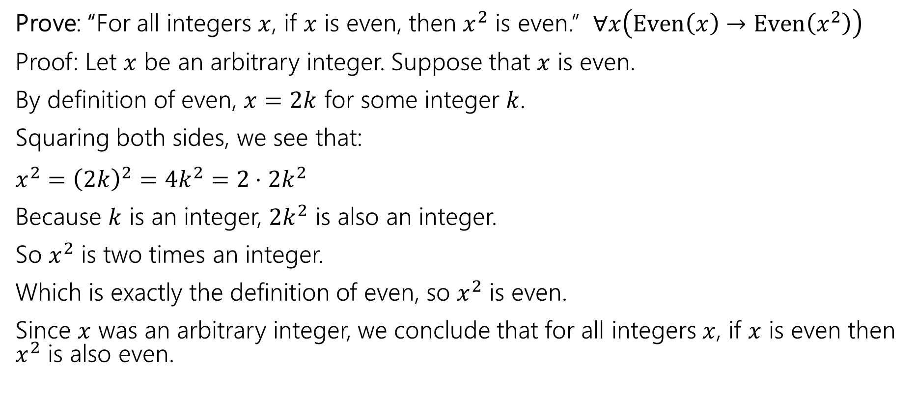
Our First Direct Proof
Definitions
$Even\left(x\right)≔∃k(x=2k)$
Prove: “For all integers $x$, if $x$ is even, then $x^{2}$ is even.” $∀x\left(Even\left(x\right)→Even\left(x^{2}\right)\right)$
Proof: Let $x$ be an arbitrary integer. Suppose that $x$ is even.
By definition of even, $x=2k$ for some integer $k$.
Squaring both sides, we see that:
$x^{2}={\left(2k\right)}^{2}=4k^{2}=2⋅2k^{2}$
Because $k$ is an integer, $2k^{2}$ is also an integer.
So $x^{2}$ is two times an integer.
Which is exactly the definition of even, so $x^{2}$ is even.
Since $x$ was an arbitrary integer, we conclude that for all integers $x$, if $x$ is even then $x^{2}$ is also even.
Notes:
Let $x$ be an arbitrary integer. Suppose that $x$ is even. Then by definition of even, there exists some integer $k$ such that $x=2k$. Squaring both sides, we see that:
$$x^{2}={\left(2k\right)}^{2}=4k^{2}=2⋅2k^{2}$$
Because $k$ is an integer, then $2k^{2}$ is also an integer. So $x^{2}$ is two times an integer.
So by definition of even, $x^{2}$ is even.
Since $x$ was an arbitrary integer, we can conclude that for all integers $x$, if $x$ is even then $x^{2}$ is even.
Run through with a number

Slide 32
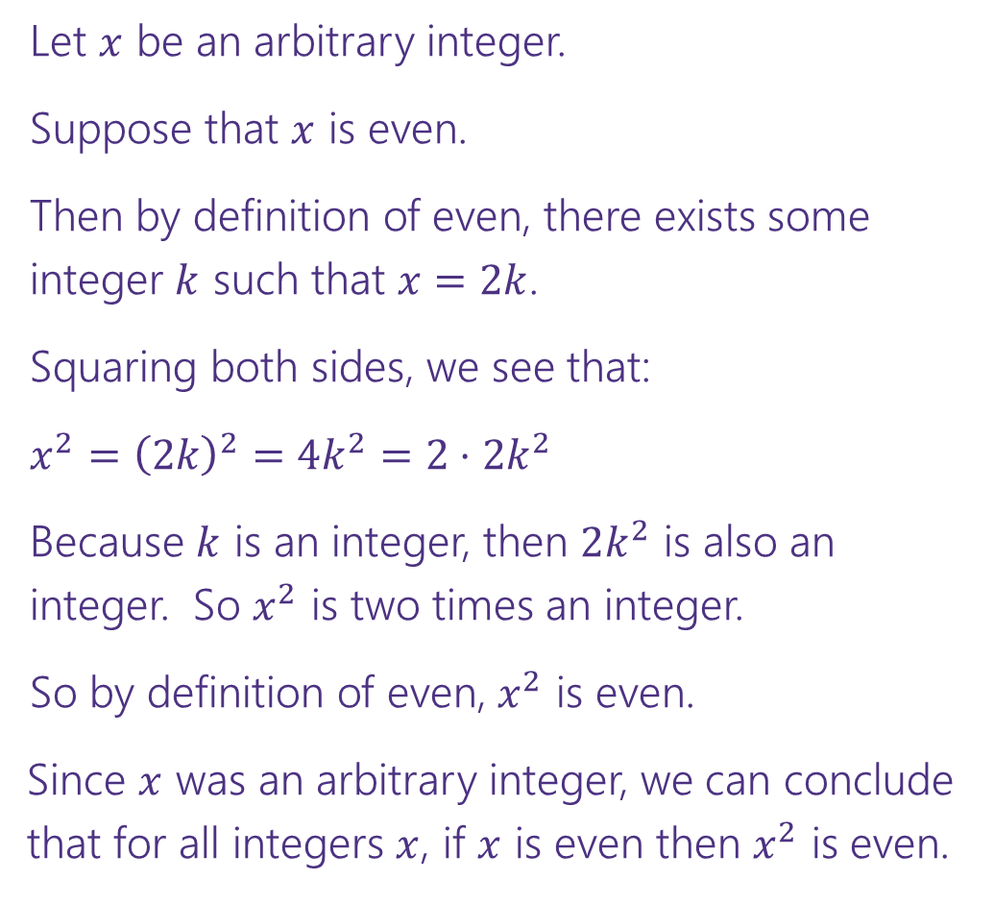


Direct Proof Template
Prove: $∀x\left(Even\left(x\right)→Even\left(x^{2}\right)\right)$
Declare an arbitrary variable for each $∀$.
Let $x$ be an arbitrary integer.
Suppose that $x$ is even.
Then by definition of even, there exists some integer $k$ such that $x=2k$.
Squaring both sides, we see that:
$x^{2}={\left(2k\right)}^{2}=4k^{2}=2⋅2k^{2}$
Because $k$ is an integer, then $2k^{2}$ is also an integer. So $x^{2}$ is two times an integer.
So by definition of even, $x^{2}$ is even.
Since $x$ was an arbitrary integer, we can conclude that for all integers $x$, if $x$ is even then $x^{2}$ is even.
Assume the left side of the implication.
Unroll the predicate definitions.
Manipulate towards the goal.
Reroll definitions into the right side of the implication.
Conclude that you have proved the claim.

Slide 33
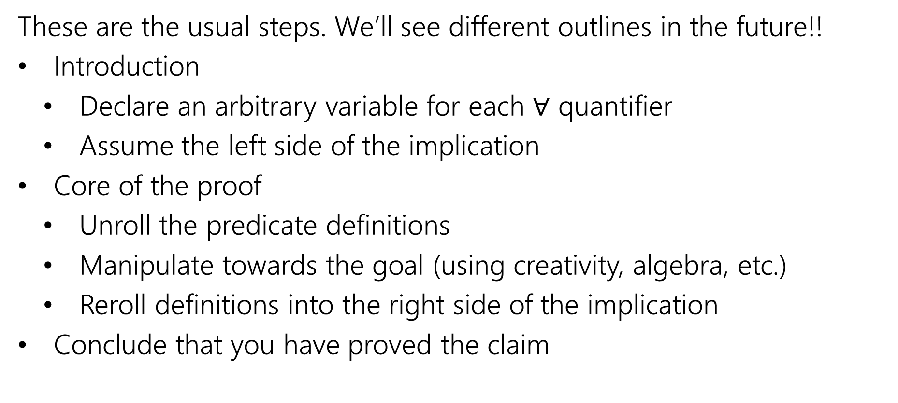
Direct Proof Steps
These are the usual steps. We’ll see different outlines in the future!!
Introduction
Declare an arbitrary variable for each $∀$ quantifier
Assume the left side of the implication
Core of the proof
Unroll the predicate definitions
Manipulate towards the goal (using creativity, algebra, etc.)
Reroll definitions into the right side of the implication
Conclude that you have proved the claim

Slide 34
Another Direct Proof
Prove: “The product of two odd integers is odd.”
What’s the claim in logic?
$$∀x ∀y ((Odd\left(x\right)∧Odd\left(y\right))→Odd\left(xy)\right)$$
How would we prove this claim?
Direct Proof. In particular, we’ll let 𝑥, 𝑦 be arbitrary integers.
We’ll suppose 𝑥, 𝑦 are odd. We’ll show that 𝑥 ⋅ 𝑦 is odd.

Slide 35
Another Direct Proof
Definitions
Odd 𝑥 ≔ ∃𝑘(𝑥 = 2𝑘 + 1)
Prove: “The product of two odd integers is odd.”
∀𝑥∀𝑦 Odd 𝑥 ∧ Odd 𝑦
→ Odd 𝑥𝑦

Slide 36
Another Direct Proof
Definitions
Odd 𝑥 ≔ ∃𝑘(𝑥 = 2𝑘 + 1)
Prove: “The product of two odd integers is odd.”
∀𝑥∀𝑦 Odd 𝑥 ∧ Odd 𝑦
→ Odd 𝑥𝑦
Let 𝑥 and 𝑦 be arbitrary integers. Suppose that 𝑥 and 𝑦 are odd.
[Unroll predicate definitions]
[Manipulate towards goal]
So by definition of odd, 𝑥𝑦 is odd. Since 𝑥, 𝑦 were arbitrary, we have shown that the product of two odd integers is odd.

Slide 37
Another Direct Proof
Definitions
Odd 𝑥 ≔ ∃𝑘(𝑥 = 2𝑘 + 1)
Prove: “The product of two odd integers is odd.”
∀𝑥∀𝑦 Odd 𝑥 ∧ Odd 𝑦
→ Odd 𝑥𝑦
Let 𝑥 and 𝑦 be arbitrary integers. Suppose that 𝑥 and 𝑦 are odd.
Then by definition of odd, there exists some integer 𝑘 such that 𝑥 = 2𝑘 + 1, and some integer 𝑗 such that 𝑦 = 2𝑗 + 1.
[Manipulate towards goal]
So by definition of odd, 𝑥𝑦 is odd. Since 𝑥, 𝑦 were arbitrary, we have shown that the product of two odd integers is odd.

Slide 38
Another Direct Proof
Definitions
Odd 𝑥 ≔ ∃𝑘(𝑥 = 2𝑘 + 1)
Prove: “The product of two odd integers is odd.”
∀𝑥∀𝑦 Odd 𝑥 ∧ Odd 𝑦
→ Odd 𝑥𝑦
Let 𝑥 and 𝑦 be arbitrary integers. Suppose that 𝑥 and 𝑦 are odd.
Then by definition of odd, there exists some integer 𝑘 such that 𝑥 = 2𝑘 + 1, and some integer 𝑗 such that 𝑦 = 2𝑗 + 1.
Then multiplying 𝑥 and 𝑦, we can see that:
𝑥𝑦 = (2𝑘 + 1) ⋅ (2𝑗 + 1) = 4𝑘𝑗 + 2𝑗 + 2𝑘 + 1 = 2(2𝑘𝑗 + 𝑗 + 𝑘) + 1
Since 𝑘, 𝑗 are integers, 2𝑘𝑗 + 𝑗 + 𝑘 is an integer.
So by definition of odd, 𝑥𝑦 is odd. Since 𝑥, 𝑦 were arbitrary, we have shown that the product of two odd integers is odd.

Slide 39
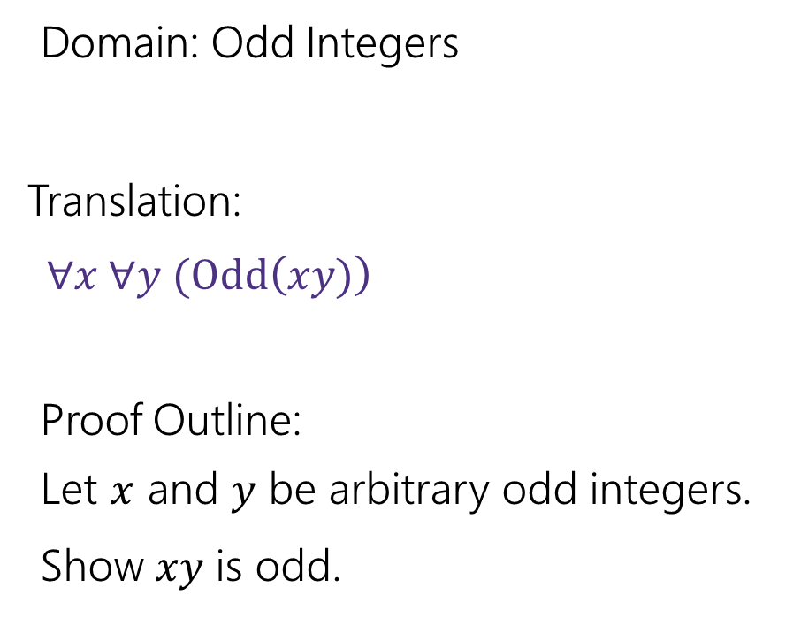
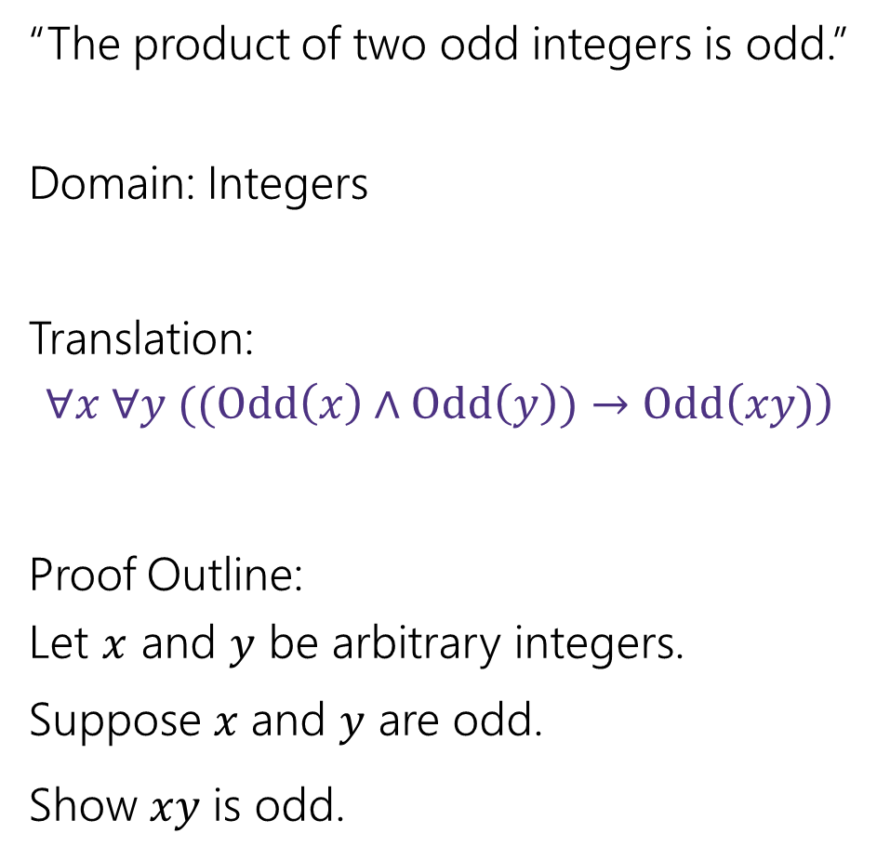
A note on Domain of Discourse
“The product of two odd integers is odd.”
Domain: Integers
Translation:
$$∀x ∀y ((Odd\left(x\right)∧Odd\left(y\right))→Odd\left(xy)\right)$$
Proof Outline:
Let 𝑥 and 𝑦 be arbitrary integers. Suppose 𝑥 and 𝑦 are odd.
Show 𝑥𝑦 is odd.
Domain: Odd Integers
Translation:$∀x ∀y (Odd\left(xy)\right)$
Proof Outline:
Let 𝑥 and 𝑦 be arbitrary odd integers.
Show 𝑥𝑦 is odd.

Slide 40
A note on Translation to Logic
We first translate the claim to predicate logic because:
The translation makes it precise what we are proving
The translation hints at the structure of the proof
e.g. for each ∀, introduce an arbitrary variable
In practice, computer scientists identify the proof claim and structure without predicate logic translation
Eventually we’ll stop asking you to translate to logic first

Slide 41
Square
Definition:
An integer 𝑥 is square iff there exists an integer 𝑘 such that 𝑥 = 𝑘².
Square(𝑥) ≔ ∃𝑘(𝑥 = 𝑘²)

Slide 42
Yet Another Direct Proof
Definitions
Square 𝑥
≔ ∃𝑘 𝑥 = 𝑘²
Prove: The product of two square integers is square.
What’s the claim in logic?
Prove this claim.

Slide 43
Yet Another Direct Proof
Definitions
Square 𝑥
≔ ∃𝑘 𝑥 = 𝑘²
Prove: The product of two square integers is square.
What’s the claim in logic?
$$∀n∀m [\left(Square\left(n\right)∧Square\left(m\right)\right)→Square\left(nm\right)]$$
Prove this claim.

Slide 44
Yet Another Direct Proof
Definitions
Square 𝑥
≔ ∃𝑘 𝑥 = 𝑘²
Prove: “The product of two square integers is square.”
∀𝑛∀𝑚 Square 𝑛 ∧ Square 𝑚 → Square 𝑛𝑚

Slide 45
Yet Another Direct Proof
Definitions
Square 𝑥
≔ ∃𝑘 𝑥 = 𝑘²
Prove: “The product of two square integers is square.”
∀𝑛∀𝑚 Square 𝑛 ∧ Square 𝑚 → Square 𝑛𝑚
Let 𝑛 and 𝑚 be arbitrary integers.
Suppose that 𝑛 and 𝑚 are square.
So by definition of square, 𝑛𝑚 is square.
Since 𝑛 and 𝑚 were arbitrary, we have shown that the product of two square integers is square.

Slide 46
Yet Another Direct Proof
Definitions
Square 𝑥
≔ ∃𝑘 𝑥 = 𝑘²
Prove: “The product of two square integers is square.”
∀𝑛∀𝑚 Square 𝑛 ∧ Square 𝑚 → Square 𝑛𝑚
Let 𝑛 and 𝑚 be arbitrary integers.
Suppose that 𝑛 and 𝑚 are square.
[Unroll predicate definitions]
[Manipulate towards goal]
So by definition of square, 𝑛𝑚 is square.
Since 𝑛 and 𝑚 were arbitrary, we have shown that the product of two square integers is square.

Slide 47
Yet Another Direct Proof
Definitions
Square 𝑥
≔ ∃𝑘 𝑥 = 𝑘²
Prove: “The product of two square integers is square.”
∀𝑛∀𝑚 Square 𝑛 ∧ Square 𝑚 → Square 𝑛𝑚
Let 𝑛 and 𝑚 be arbitrary integers.
Suppose that 𝑛 and 𝑚 are square.
Then by definition of square, 𝑛 = 𝑘² for some integer 𝑘, and 𝑚 = 𝑗² for some integer 𝑗.
[Manipulate towards goal]
So by definition of square, 𝑛𝑚 is square.
Since 𝑛 and 𝑚 were arbitrary, we have shown that the product of two square integers is square.

Slide 48
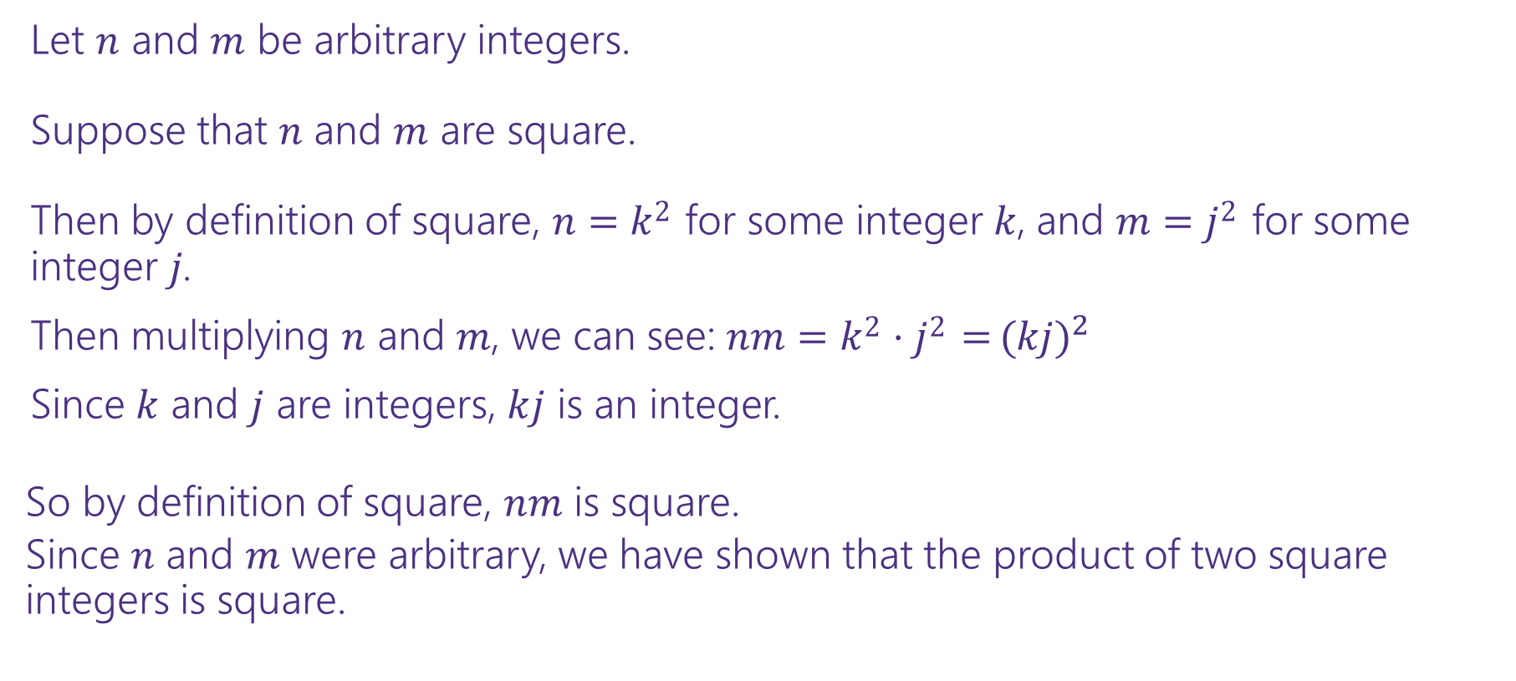
Yet Another Direct Proof
Definitions
Square 𝑥
≔ ∃𝑘 𝑥 = 𝑘²
Prove: “The product of two square integers is square.”
∀𝑛∀𝑚 Square 𝑛 ∧ Square 𝑚 → Square 𝑛𝑚
Let 𝑛 and 𝑚 be arbitrary integers.
Suppose that 𝑛 and 𝑚 are square.
Then by definition of square, 𝑛 = 𝑘² for some integer 𝑘, and 𝑚 = 𝑗² for some integer 𝑗.
Then multiplying 𝑛 and 𝑚, we can see: 𝑛𝑚 = 𝑘² ⋅ 𝑗² = (${kj)}^{2}$
Since 𝑘 and 𝑗 are integers, 𝑘𝑗 is an integer.
So by definition of square, 𝑛𝑚 is square.
Since 𝑛 and 𝑚 were arbitrary, we have shown that the product of two square integers is square.

Slide 49
Proof Strategy: Contrapositive

Slide 50
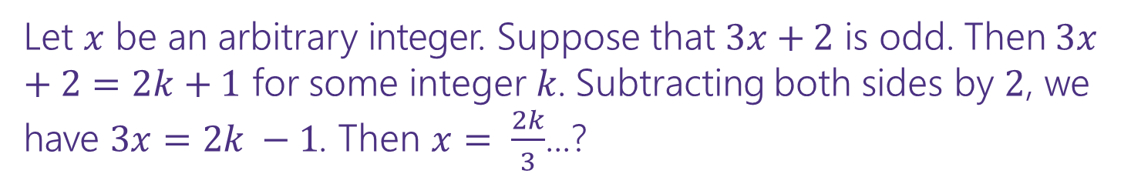

A Direct Proof?
Definitions
Odd 𝑥 ≔ ∃𝑘(𝑥 = 2𝑘 + 1)
Prove: For an integer 𝑥, if 3𝑥 + 2 is odd, then 𝑥 is odd.
What’s the claim in logic?
Prove this claim.
$$∀x(Odd\left(3x+2\right)→Odd\left(x\right))$$
Let 𝑥 be an arbitrary integer. Suppose that 3𝑥 + 2 is odd. Then 3𝑥 + 2 = 2𝑘 + 1 for some integer 𝑘. Subtracting both sides by 2, we have $3x=2k −1$. Then $x= \frac{2k}{3}$...?

Slide 51
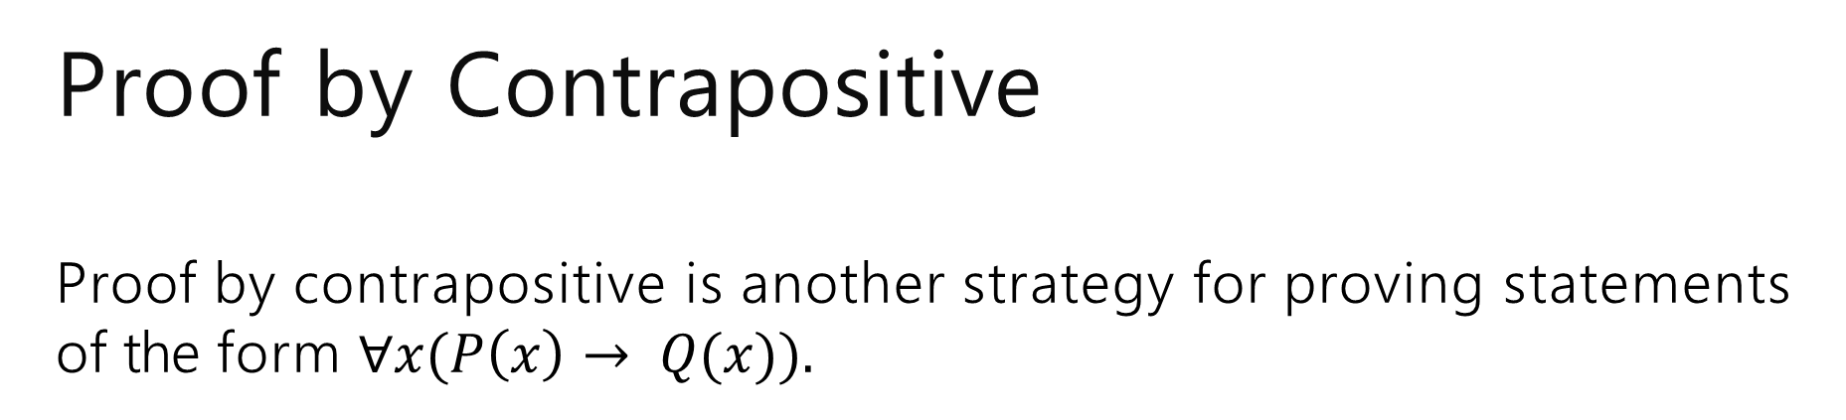
Proof by Contrapositive Proof by contrapositive is another strategy for proving statements of the form $∀x(P\left(x\right)→ Q(x)).$
The strategy is to prove the contrapositive, i.e. prove ∀𝑥 ¬Q 𝑥
→ ¬P 𝑥
Remember, an implication is equivalent to its contrapositive!

Slide 52
Proof by Contrapositive
Definitions
Odd 𝑥 ≔ ∃𝑘(𝑥 = 2𝑘 + 1)
Prove: For an integer 𝑥, if 3𝑥 + 2 is odd, then 𝑥 is odd.

Slide 53
Proof by Contrapositive
Definitions
Odd 𝑥 ≔ ∃𝑘(𝑥 = 2𝑘 + 1)
Prove: For an integer 𝑥, if 3𝑥 + 2 is odd, then 𝑥 is odd.
$$∀x \left(Odd\left(3x+2\right)→Odd\left(x\right)\right)≡∀x (Even\left(x\right)→Even\left(3x+2\right))$$

Slide 54
Proof by Contrapositive
Definitions
Odd 𝑥 ≔ ∃𝑘(𝑥 = 2𝑘 + 1)
Prove: For an integer 𝑥, if 3𝑥 + 2 is odd, then 𝑥 is odd.
$$∀x \left(Odd\left(3x+2\right)→Odd\left(x\right)\right)≡∀x (Even\left(x\right)→Even\left(3x+2\right))$$
We prove by contrapositive.
Let 𝑥 be an arbitrary integer. Suppose that 𝑥 is even.
So by definition of even, 3𝑥 + 2 is even.
Since 𝑥 was arbitrary, we have shown that for all integers 𝑥, if 𝑥 is even then 3𝑥 + 2 is even. Thus the contrapositive also holds: for all integers 𝑥, if 3𝑥 + 2 is odd, then 𝑥 is odd.

Slide 55
Proof by Contrapositive
Definitions
Odd 𝑥 ≔ ∃𝑘(𝑥 = 2𝑘 + 1)
Prove: For an integer 𝑥, if 3𝑥 + 2 is odd, then 𝑥 is odd.
$$∀x \left(Odd\left(3x+2\right)→Odd\left(x\right)\right)≡∀x (Even\left(x\right)→Even\left(3x+2\right))$$
We prove by contrapositive.
Let 𝑥 be an arbitrary integer. Suppose that 𝑥 is even.
[Unroll predicate definitions]
[Manipulate towards goal]
So by definition of even, 3𝑥 + 2 is even.
Since 𝑥 was arbitrary, we have shown that for all integers 𝑥, if 𝑥 is even then 3𝑥 + 2 is even. Thus the contrapositive also holds: for all integers 𝑥, if 3𝑥 + 2 is odd, then 𝑥 is odd.

Slide 56
Proof by Contrapositive
Definitions
Odd 𝑥 ≔ ∃𝑘(𝑥 = 2𝑘 + 1)
Prove: For an integer 𝑥, if 3𝑥 + 2 is odd, then 𝑥 is odd.
$$∀x \left(Odd\left(3x+2\right)→Odd\left(x\right)\right)≡∀x (Even\left(x\right)→Even\left(3x+2\right))$$
We prove by contrapositive.
Let 𝑥 be an arbitrary integer. Suppose that 𝑥 is even.
Then by definition of even, 𝑥 = 2𝑘 for some integer 𝑘.
[Manipulate towards goal]
So by definition of even, 3𝑥 + 2 is even.
Since 𝑥 was arbitrary, we have shown that for all integers 𝑥, if 𝑥 is even then 3𝑥 + 2 is even. Thus the contrapositive also holds: for all integers 𝑥, if 3𝑥 + 2 is odd, then 𝑥 is odd.

Slide 57
Proof by Contrapositive
Definitions
Odd 𝑥 ≔ ∃𝑘(𝑥 = 2𝑘 + 1)
Prove: For an integer 𝑥, if 3𝑥 + 2 is odd, then 𝑥 is odd.
$$∀x \left(Odd\left(3x+2\right)→Odd\left(x\right)\right)≡∀x (Even\left(x\right)→Even\left(3x+2\right))$$
We prove by contrapositive.
Let 𝑥 be an arbitrary integer. Suppose that 𝑥 is even.
Then by definition of even, 𝑥 = 2𝑘 for some integer 𝑘.
Consider 3𝑥 + 2:
3𝑥 + 2 = 3(2𝑘) + 2 = 6𝑘 + 2 = 2(3𝑘 + 1)
Since 𝑘 is an integer, 3𝑘 + 1 is an integer. So by definition of even, 3𝑥 + 2 is even.
Since 𝑥 was arbitrary, we have shown that for all integers 𝑥, if 𝑥 is even then 3𝑥 + 2 is even. Thus the contrapositive also holds: for all integers 𝑥, if 3𝑥 + 2 is odd, then 𝑥 is odd.

Slide 58
More Practice

Slide 59
Another Proof by Contrapositive
Definitions
Even 𝑥 ≔ ∃𝑘(𝑥 = 2𝑘)
Prove by Contrapositive: For an integer 𝑛, if 𝑛³ is even, then 𝑛 is even.

Slide 60
Another Proof by Contrapositive
Definitions
Even 𝑥 ≔ ∃𝑘(𝑥 = 2𝑘)
Prove by Contrapositive: For an integer 𝑛, if 𝑛³ is even, then 𝑛 is even.
$$∀n \left(Even\left(n^{3}\right)→Even\left(n\right)\right)≡∀n(Odd\left(n\right)→Odd\left(n^{3}\right))$$

Slide 61
Another Proof by Contrapositive
Definitions
Even 𝑥 ≔ ∃𝑘(𝑥 = 2𝑘)
Prove by Contrapositive: For an integer 𝑛, if 𝑛³ is even, then 𝑛 is even.
$$∀n \left(Even\left(n^{3}\right)→Even\left(n\right)\right)≡∀n(Odd\left(n\right)→Odd\left(n^{3}\right))$$
We prove by contrapositive.
Let 𝑛 be an arbitrary integer. Suppose that 𝑛 is odd.
Thus by definition of odd, 𝑛³ is odd. Since 𝑛 was arbitrary, we have shown that for all integers 𝑛, if 𝑛 is odd then 𝑛³ is odd. Thus the contrapositive also holds: for all integers 𝑛, if 𝑛³ is even, then 𝑛 is even.

Slide 62
Another Proof by Contrapositive
Definitions
Even 𝑥 ≔ ∃𝑘(𝑥 = 2𝑘)
Prove by Contrapositive: For an integer 𝑛, if 𝑛³ is even, then 𝑛 is even.
$$∀n \left(Even\left(n^{3}\right)→Even\left(n\right)\right)≡∀n(Odd\left(n\right)→Odd\left(n^{3}\right))$$
We prove by contrapositive.
Let 𝑛 be an arbitrary integer. Suppose that 𝑛 is odd.
[Unroll predicate definitions]
[Manipulate towards goal]
Thus by definition of odd, 𝑛³ is odd. Since 𝑛 was arbitrary, we have shown that for all integers 𝑛, if 𝑛 is odd then 𝑛³ is odd. Thus the contrapositive also holds: for all integers 𝑛, if 𝑛³ is even, then 𝑛 is even.

Slide 63
Another Proof by Contrapositive
Definitions
Even 𝑥 ≔ ∃𝑘(𝑥 = 2𝑘)
Prove by Contrapositive: For an integer 𝑛, if 𝑛³ is even, then 𝑛 is even.
$$∀n \left(Even\left(n^{3}\right)→Even\left(n\right)\right)≡∀n(Odd\left(n\right)→Odd\left(n^{3}\right))$$
We prove by contrapositive.
Let 𝑛 be an arbitrary integer. Suppose that 𝑛 is odd.
Then by definition of odd, 𝑛 = 2𝑘 + 1 for some integer 𝑘.
[Manipulate towards goal]
Thus by definition of odd, 𝑛³ is odd. Since 𝑛 was arbitrary, we have shown that for all integers 𝑛, if 𝑛 is odd then 𝑛³ is odd. Thus the contrapositive also holds: for all integers 𝑛, if 𝑛³ is even, then 𝑛 is even.

Slide 64
Another Proof by Contrapositive
Definitions
Even 𝑥 ≔ ∃𝑘(𝑥 = 2𝑘)
Prove by Contrapositive: For an integer 𝑛, if 𝑛³ is even, then 𝑛 is even.
$$∀n \left(Even\left(n^{3}\right)→Even\left(n\right)\right)≡∀n(Odd\left(n\right)→Odd\left(n^{3}\right))$$
We prove by contrapositive.
Let 𝑛 be an arbitrary integer. Suppose that 𝑛 is odd.
Then by definition of odd, 𝑛 = 2𝑘 + 1 for some integer 𝑘.
Consider 𝑛³:
𝑛³ = (2𝑘 + 1)³ = 8𝑘³ + 8𝑘² + 4𝑘 + 1 = 2 (4𝑘³ + 4𝑘² + 2𝑘) + 1
Since 𝑘 is an integer, 4𝑘³ + 4𝑘² + 2𝑘 is an integer. Thus by definition of odd, 𝑛³ is odd. Since 𝑛 was arbitrary, we have shown that for all integers 𝑛, if 𝑛 is odd then 𝑛³ is odd. Thus the contrapositive also holds: for all integers 𝑛, if 𝑛³ is even, then 𝑛 is even.

Slide 65
Todo
Tonight:
Come to OH today if need extra support while working on HW2
CC6 due Wednesday at noon

Slide 66


Integer
We need a basic starting point to be able to prove things.
Objects to work with.
Some definitions to analyze
An integer: is any real number with no fractional part.
Even(x) := An integer, $x,$ is even if and only if there is an integer $k$such that $x=2k.$
Odd(x) := An integer, $x,$ is odd if and only if there is an integer $k$such that $x=2k+1.$
Even
Odd
Notes:
This isn’t the “real” definition of integer---it relies on real numbers! Which we haven’t defined (go visit the math department)
For our purposes, there’s no need to dig deeper

