Slide 1

Predicate Logic Continued
CSE 311 Summer 25
Lecture 5

Slide 2
Announcements
HW1
  Due Tonight @ 11:59 pm
  You have 6 late days for the quarter, and can use up to 3 for one assignment
HW2 will be released later today

Slide 3
Review

Slide 4
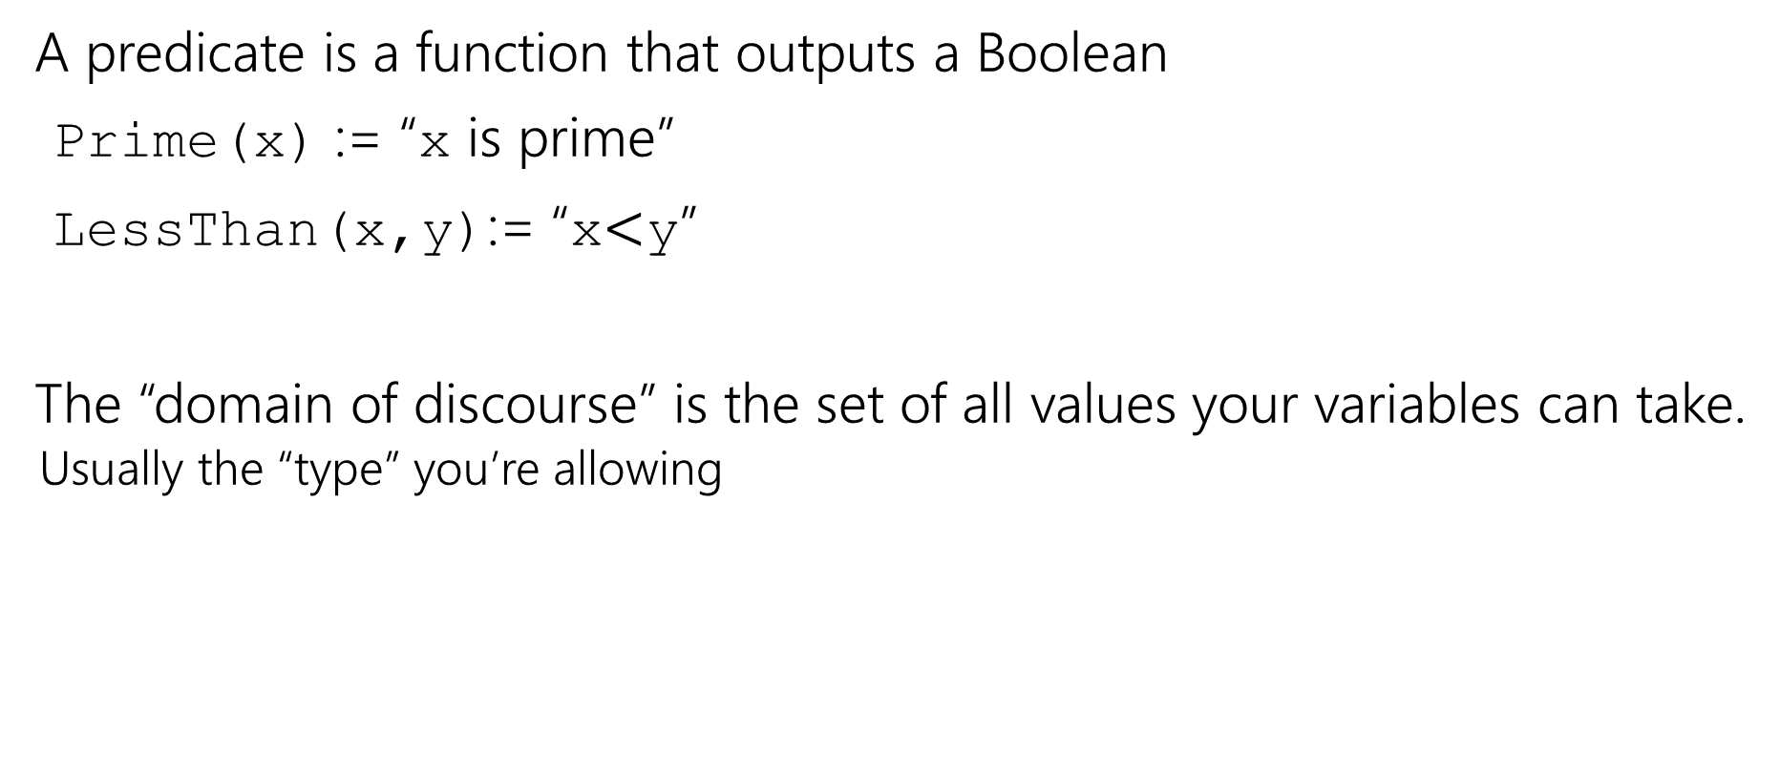
Where were we?
A predicate is a function that outputs a Boolean
Prime(x) := “x is prime”
LessThan(x,y):= “x$<$y”
The “domain of discourse” is the set of all values your variables can take.
  Usually the “type” you’re allowing

Slide 5
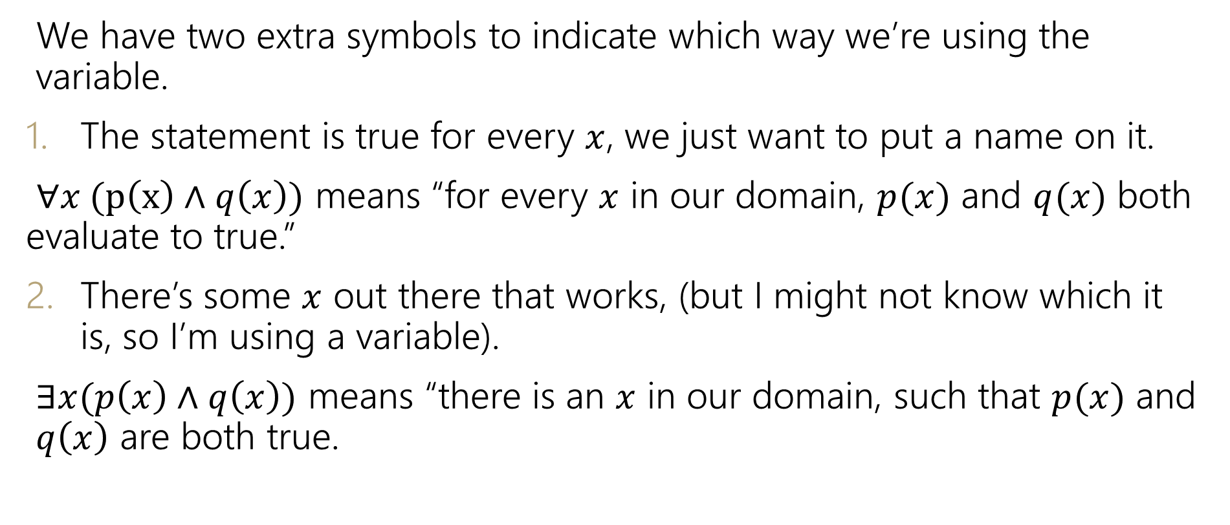
Quantifiers
We have two extra symbols to indicate which way we’re using the variable.
The statement is true for every $x$, we just want to put a name on it.
$∀x (p\left(x\right)∧q\left(x\right))$ means “for every $x$ in our domain, $p(x)$ and $q(x)$ both evaluate to true.”
There’s some $x$ out there that works, (but I might not know which it is, so I’m using a variable).
$∃x(p\left(x\right)∧q\left(x\right))$ means “there is an $x$ in our domain, such that $p(x)$ and $q\left(x\right)$ are both true.

Slide 6
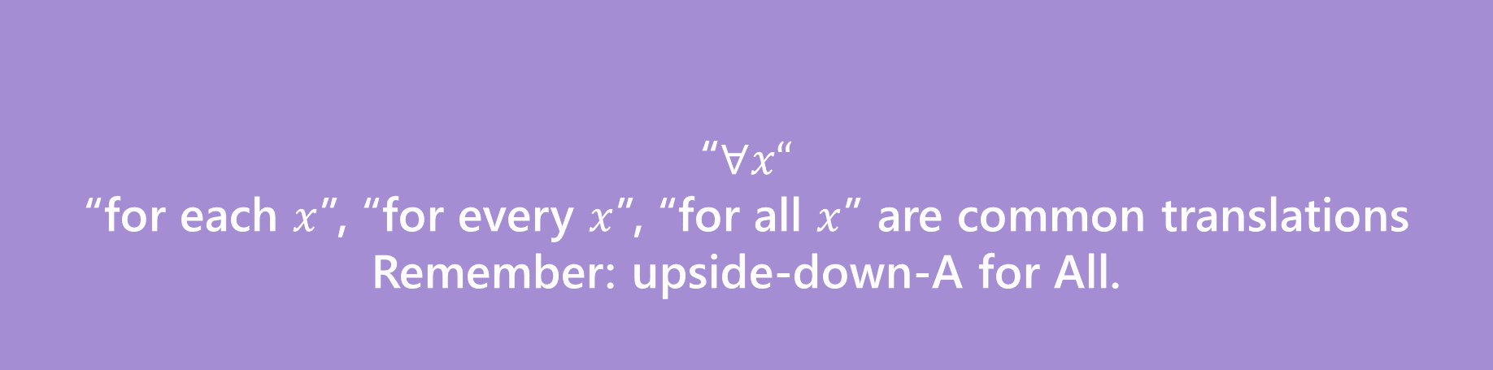

Quantifiers
We have two extra symbols to indicate which way we’re using the variable.
The statement is true for every $x$, we just want to put a name on it.
$∀x (p\left(x\right)∧q\left(x\right))$ means “for every $x$ in our domain, $p(x)$ and $q(x)$ both evaluate to true.”
There’s some $x$ out there that works, (but I might not know which it is, so I’m using a variable).
$∃x(p\left(x\right)∧q\left(x\right))$ means “there is an $x$ in our domain, $p(x)$ and $q\left(x\right)$ are both true.
“$∀x“$
“for each $x$”, “for every $x$”, “for all $x$” are common translations
Remember: upside-down-A for All.
Universal Quantifier

Slide 7
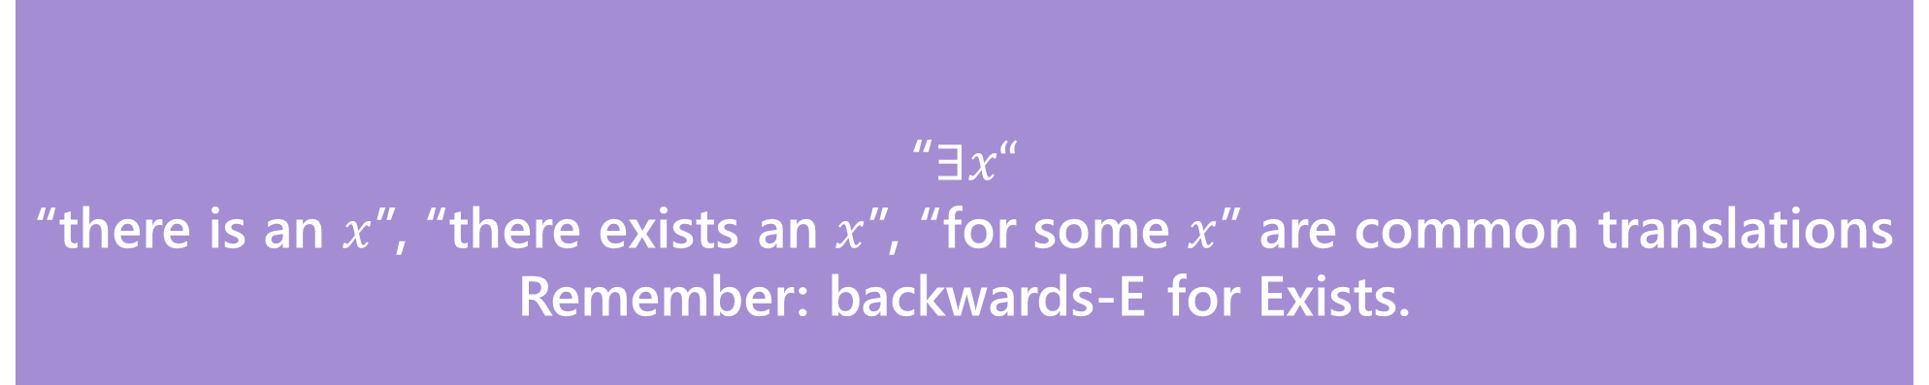

Quantifiers
“$∃x“$
“there is an $x$”, “there exists an $x$”, “for some $x$” are common translations
Remember: backwards-E for Exists.
Existential Quantifier
We have two extra symbols to indicate which way we’re using the variable.
The statement is true for every $x$, we just want to put a name on it.
$∀x (p\left(x\right)∧q\left(x\right))$ means “for every $x$ in our domain, $p(x)$ and $q(x)$ both evaluate to true.”
There’s some $x$ out there that works, (but I might not know which it is, so I’m using a variable).
$∃x(p\left(x\right)∧q\left(x\right))$ means “there is an $x$ in our domain, for which $p(x)$ and $q\left(x\right)$ are both true.

Slide 8
Domain Restriction
Definition:
Domain restriction is the technique of limiting our domain of discourse to a smaller set of objects.

Slide 9
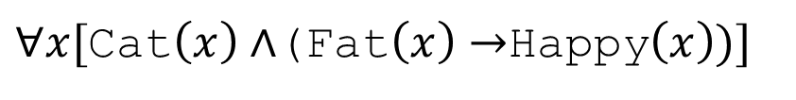
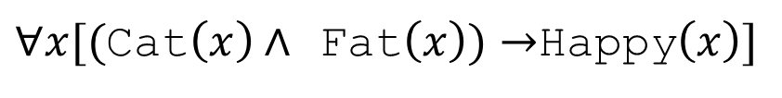
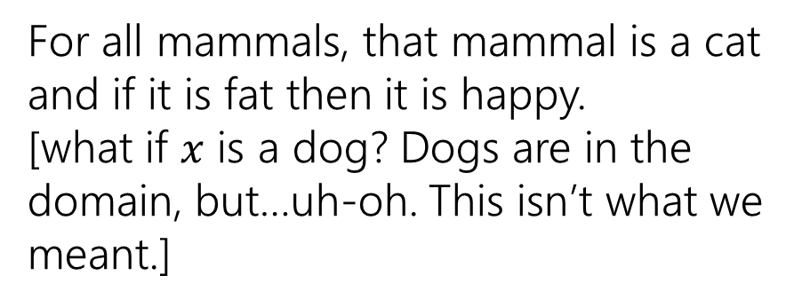
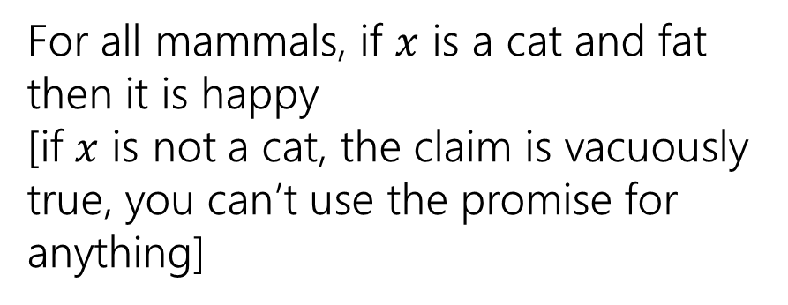
Quantifiers
Which of these translates “For every cat: if a cat is fat then it is happy.” when our domain of discourse is “mammals”?
$∀x[($Cat$\left(x\right)∧$ Fat$\left(x\right))→$Happy$\left(x\right)]$
$∀x[$Cat$\left(x\right)∧$(Fat$\left(x\right)→$Happy$\left(x\right))]$
For all mammals, if $x$ is a cat and fat then it is happy
[if $x$ is not a cat, the claim is vacuously true, you can’t use the promise for anything]
For all mammals, that mammal is a cat and if it is fat then it is happy.
[what if $x$ is a dog? Dogs are in the domain, but…uh-oh. This isn’t what we meant.]
To “limit” variables to a portion of your domain of discourse under a universal quantifier add a hypothesis to an implication.

Slide 10



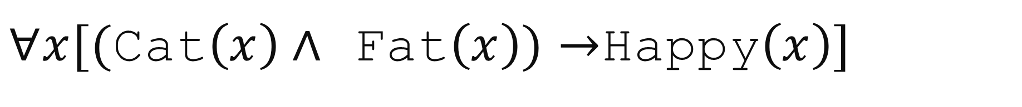
$∀x[($Cat$\left(x\right)∧$ Fat$\left(x\right))→$Happy$\left(x\right)]$
$x$ outside the subdomain
(Cat$\left(x\right)∧$ Fat$\left(x\right))→$Happy$\left(x\right)$
$($F$∧$Fat$\left(x\right))→$Happy$\left(x\right)$
$($F$)→$Happy$\left(x\right)$
T
For $x$ that aren’t cats, the implication is vacuously true.
These won’t affect whether
$∀x[($Cat$\left(x\right)∧$ Fat$\left(x\right))→$Happy$\left(x\right)]$
is true.

Slide 11
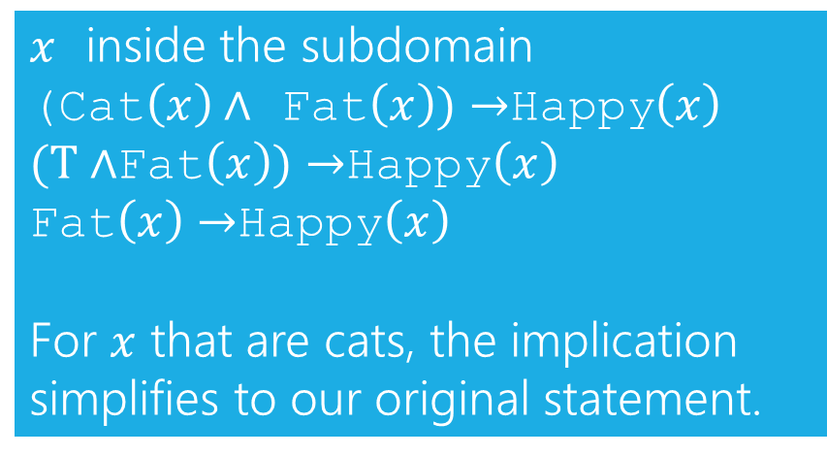
$∀x[($Cat$\left(x\right)∧$ Fat$\left(x\right))→$Happy$\left(x\right)]$
$x$ inside the subdomain
(Cat$\left(x\right)∧$ Fat$\left(x\right))→$Happy$\left(x\right)$
$(T∧$Fat$\left(x\right))→$Happy$\left(x\right)$
Fat$\left(x\right)→$Happy$\left(x\right)$
For $x$ that are cats, the implication simplifies to our original statement.

Slide 12
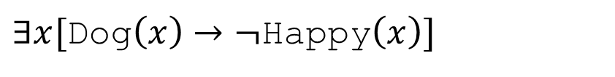
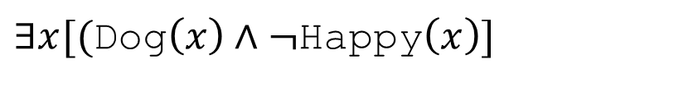
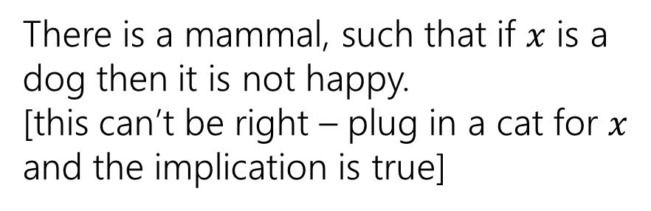
Quantifiers
Which of these translates “There is a dog who is not happy.” when our domain of discourse is “mammals”?
$∃x[$Dog$\left(x\right)→¬$Happy$\left(x\right)]$
$∃x[($Dog$\left(x\right)∧¬$Happy$\left(x\right)]$
There is a mammal, such that if $x$ is a dog then it is not happy.
[this can’t be right – plug in a cat for $x$ and the implication is true]
There is a mammal that is both a dog and not happy.
[this one is correct!]
To “limit” variables to a portion of your domain of discourse under an existential quantifier AND the limitation together with the rest of the statement.

Slide 13
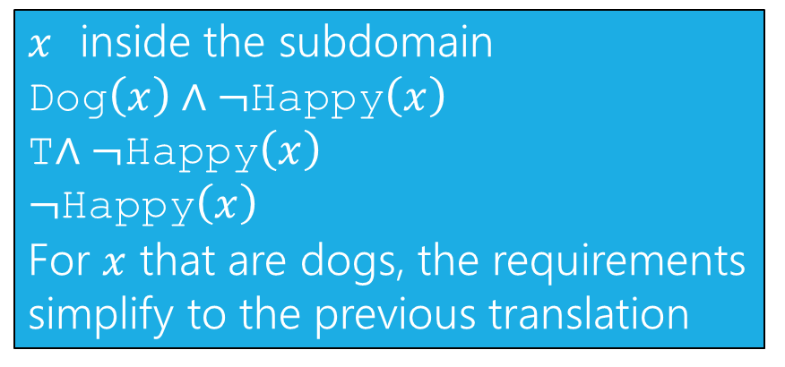
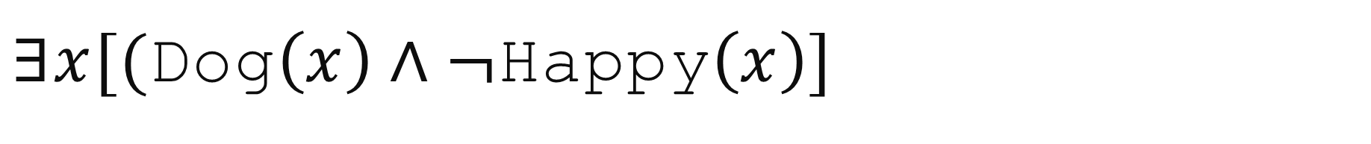
$∃x[($Dog$\left(x\right)∧¬$Happy$\left(x\right)]$
$x$ inside the subdomain
Dog$\left(x\right)∧¬$Happy$\left(x\right)$
T$∧¬$Happy$\left(x\right)$
$¬$Happy$\left(x\right)$
For $x$ that are dogs, the requirements simplify to the previous translation

Slide 14
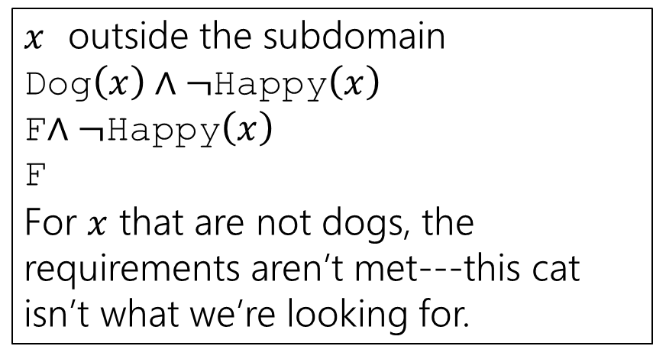
$∃x[($Dog$\left(x\right)∧¬$Happy$\left(x\right)]$
$x$ outside the subdomain
Dog$\left(x\right)∧¬$Happy$\left(x\right)$
F$∧¬$Happy$\left(x\right)$
F
For $x$ that are not dogs, the requirements aren’t met---this cat isn’t what we’re looking for.

Slide 15
Warm Up

Slide 16
More Practice
Let your domain of discourse be fruits. Translate these
There is a fruit that is tasty and ripe.
For every fruit, if it is not ripe then it is not tasty.
There is a fruit that is sliced and diced.

Slide 17
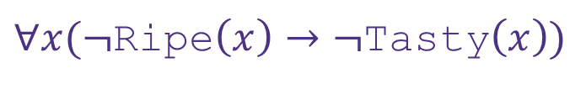
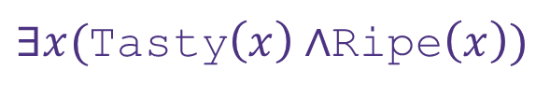
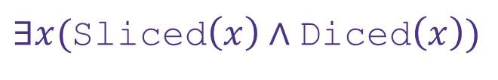
More Practice
Let your domain of discourse be fruits. Translate these
There is a fruit that is tasty and ripe.
For every fruit, if it is not ripe then it is not tasty.
There is a fruit that is sliced and diced.
$∃x($Tasty$\left(x\right)∧$Ripe$\left(x\right))$
$∀x(¬$Ripe$\left(x\right)→¬\text{Tasty}\left(x\right))$
$∃x($Sliced$\left(x\right)∧\text{Diced}\left(x\right))$

Slide 18
Domain Restriction

Slide 19
Domain Restriction Translations
Translations often sound more natural if we:
Notice domain restriction patterns.
Avoid using variables when we can.
Drop the “for all” or “there exists” when we can.
For example:
∀𝑥 Cat 𝑥 → Blue 𝑥
For all animals 𝑥, if 𝑥 is a cat then 𝑥 is blue. All cats are blue.

Slide 20
Translation Practice
Predicate Definitions Fruit 𝑥 ≔ 𝑥 is a fruit Tasty 𝑥 ≔ 𝑥 is tasty Ripe 𝑥 ≔ 𝑥 is ripe
Domain of Discourse_ Food
Translate these sentences using a natural-sounding translation.
∃𝑥(Fruit(𝑥) ∧ Tasty(𝑥))
∀𝑥((Fruit(𝑥) ∧ ¬Ripe(𝑥)) → ¬Tasty(𝑥))
There is a tasty fruit. OR Some fruits are tasty.
All fruits that aren’t ripe aren’t tasty.

Slide 21
Negation

Slide 22
DeMorgan’s Laws for Quantifiers
Consider the following sentences:
There does not exist a green penguin.
Every penguin is a color other than green.
Are they logically equivalent?

Slide 23
DeMorgan’s Laws for Quantifiers
Consider the following sentences:
Not every person can dance.
There is a person that cannot dance.
Are they logically equivalent?

Slide 24
DeMorgan’s Laws for Quantifiers
¬∀𝑥 P 𝑥 ≡ ∃𝑥 ¬P 𝑥
¬∃𝑥 P 𝑥 ≡ ∀𝑥 ¬P 𝑥
I.e. to negate an expression with a quantifier:
Switch the quantifier (∀ becomes ∃, and vice versa).
Negate the expression inside.

Slide 25


Example
Translate to predicate logic & rewrite using DeMorgan’s Laws. There is no integer which is prime and even.
$$¬∃x(Prime\left(x\right)∧Even\left(x\right))$$
$$≡∀x¬(Prime\left(x\right)∧Even\left(x\right))$$
$$≡∀x (¬Prime\left(x\right)∨¬Even\left(x\right))$$
All integers are not prime or not even.

Slide 26
Nested Quantifiers

Slide 27






Nested Quantifiers
Translate these sentences using only quantifiers and the predicate AreFriends$(x,y)$
Everyone is friends with someone.
Someone is friends with everyone.

Slide 28
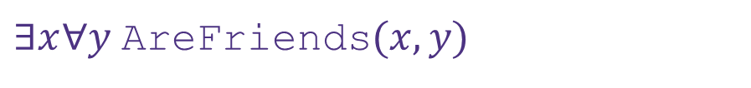

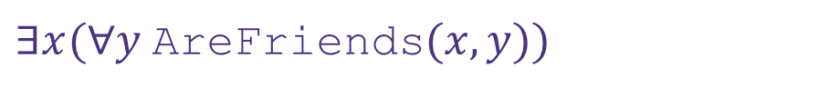
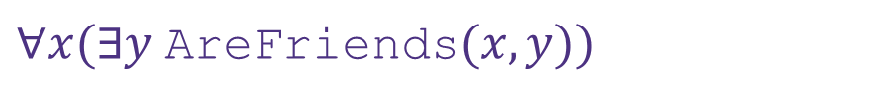
Nested Quantifiers
Translate these sentences using only quantifiers and the predicate AreFriends$(x,y)$
Everyone is friends with someone.
Someone is friends with everyone.
$∀x(∃y$AreFriends$(x,y))$
$∃x(∀y$AreFriends$(x,y))$
$∀x∃y$AreFriends$(x,y)$
$∃x∀y$AreFriends$(x,y)$

Slide 29
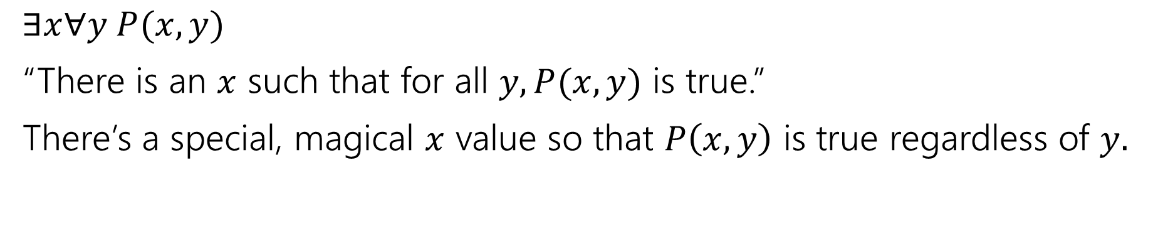
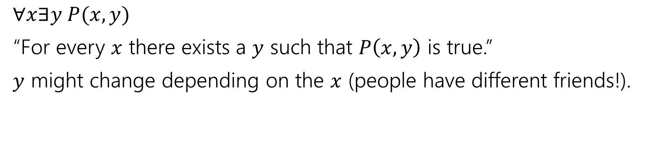
Nested Quantifiers
$∀x∃y P(x,y)$
“For every $x$ there exists a $y$ such that $P\left(x,y\right)$ is true.”
$y$ might change depending on the $x$ (people have different friends!).
$∃x∀y P(x,y)$
“There is an $x$ such that for all $y, P(x,y)$ is true.”
There’s a special, magical $x$ value so that $P\left(x,y\right)$ is true regardless of $y.$

Slide 30
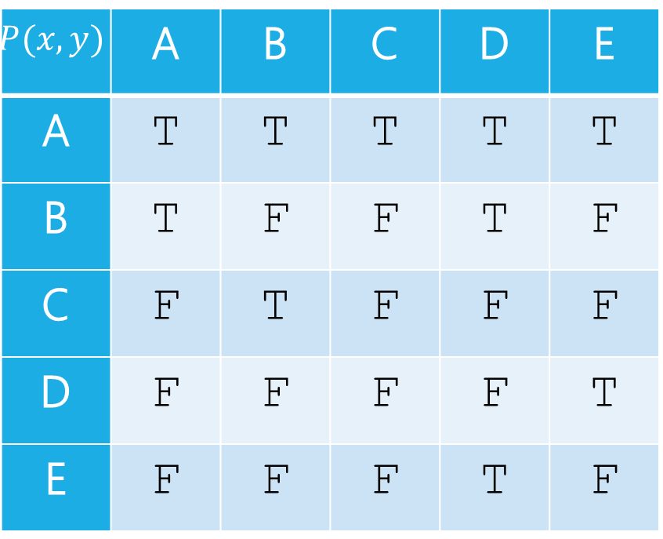
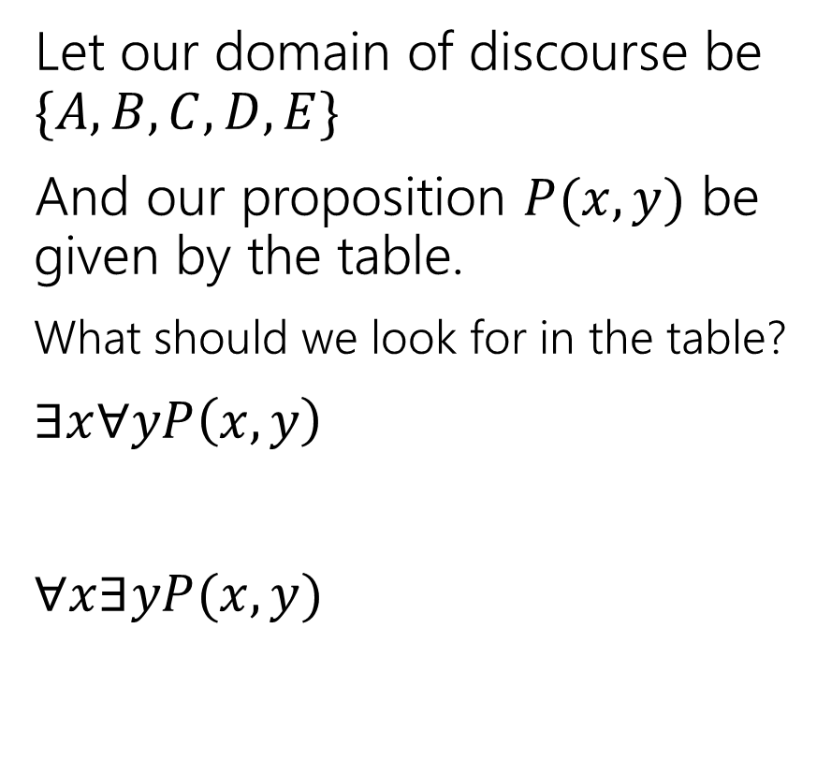


Nested Quantifiers
$$y$$
Let our domain of discourse be $\{A,B,C,D,E\}$
And our proposition $P(x,y)$ be given by the table.
What should we look for in the table?
$∃x∀yP\left(x,y\right)$
$∀x∃yP(x,y)$
$$P(x,y)$$ | A | B | C | D | E
A | T | T | T | T | T
B | T | F | F | T | F
C | F | T | F | F | F
D | F | F | F | F | T
E | F | F | F | T | F
$$x$$

Slide 31
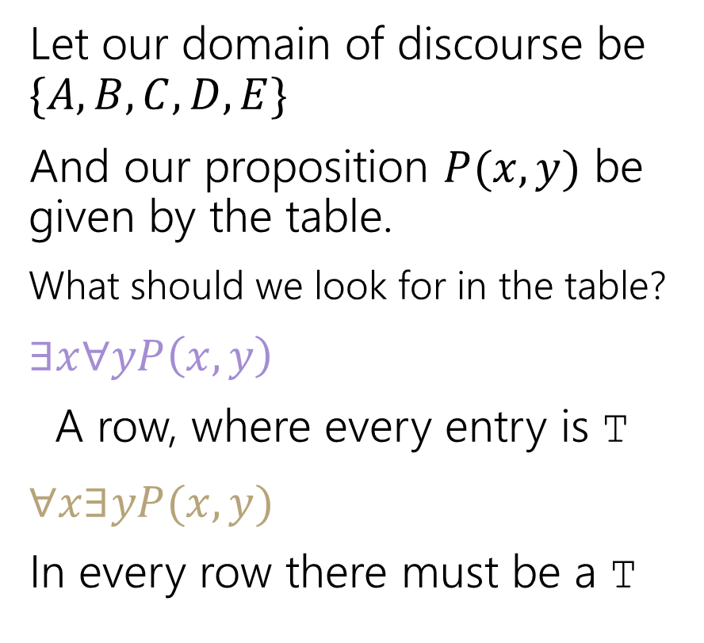


Nested Quantifiers
$$y$$
Let our domain of discourse be $\{A,B,C,D,E\}$
And our proposition $P(x,y)$ be given by the table.
What should we look for in the table?
$∃x∀yP\left(x,y\right)$
A row, where every entry is T
$∀x∃yP(x,y)$
In every row there must be a T
$$P(x,y)$$ | A | B | C | D | E
A | T | T | T | T | T
B | T | F | F | T | F
C | F | T | F | F | F
D | F | F | F | F | T
E | F | F | F | T | F
$$x$$

Slide 32
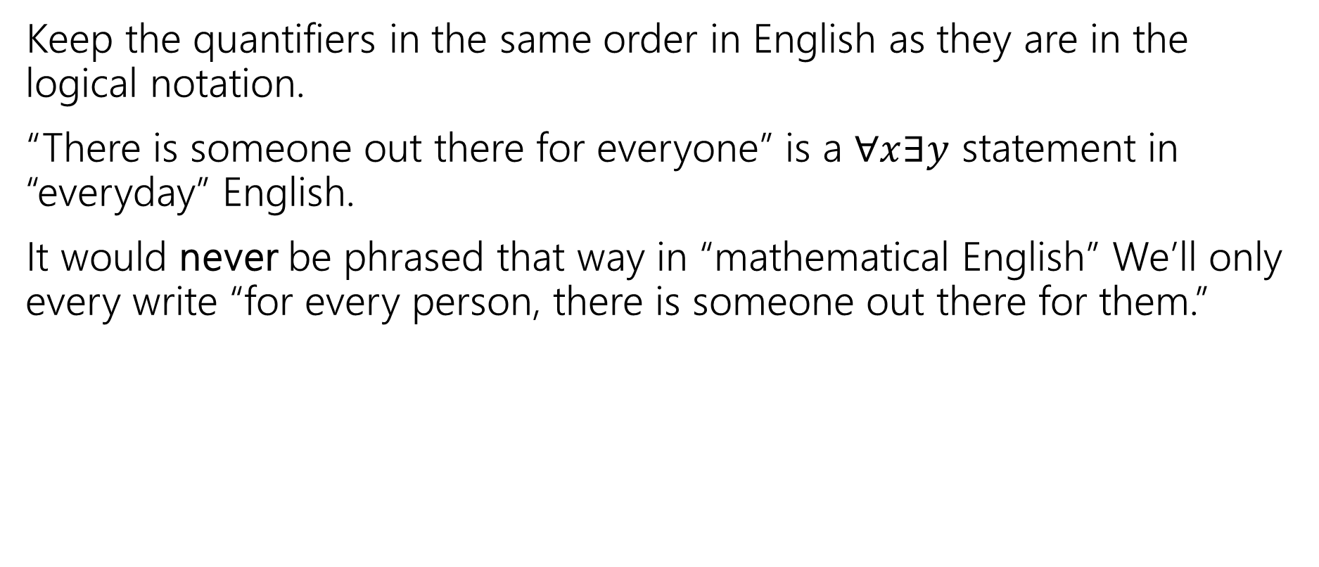
Keep everything in order
Keep the quantifiers in the same order in English as they are in the logical notation.
“There is someone out there for everyone” is a $∀x∃y$ statement in “everyday” English.
It would never be phrased that way in “mathematical English” We’ll only every write “for every person, there is someone out there for them.”

Slide 33





Try it yourselves
Every cat loves some human.
There is a cat that loves every human.
Let your domain of discourse be mammals.
Use the predicates Cat$(x)$, Dog$(x)$, and Loves$(x,y)$ to mean $x$ loves $y$.

Slide 34
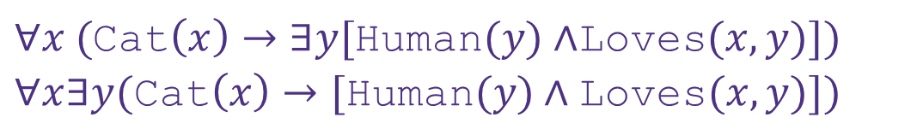
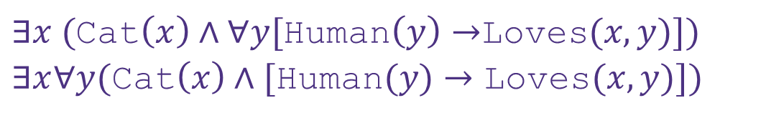
Try it yourselves
Every cat loves some human.
There is a cat that loves every human.
$∀x ($Cat$\left(x\right)→∃y[$Human$(y)∧$Loves$(x,y)])$
$∀x∃y(\text{Cat}\left(x\right)→[\text{Human}(y)∧\text{Loves}(x,y)])$
$∃x ($Cat$\left(x\right)∧∀y[$Human$\left(y\right)→$Loves$(x,y)])$
$∃x∀y(\text{Cat}\left(x\right)∧[\text{Human}(y)→\text{Loves}(x,y)])$

Slide 35


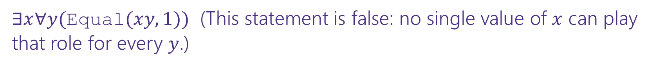
More Translation
For each of the following, translate it, then say whether the statement is true. Let your domain of discourse be integers.
For every integer, there is a greater integer.
There is an integer $x$, such that for all integers $y$, $xy$ is equal to 1.
$∀y∃x($Equal$\left(x+y,1\right))$
$∀x∃y($Greater$(y,x))$ (This statement is true: $y$ can be $x+1$ [$y$ depends on $x]$)
$∃x∀y($Equal$(xy, 1))$ (This statement is false: no single value of $x$ can play that role for every $y$.)
For every integer, $y,$there is an integer $x$ such that $x+y=1$
(This statement is true, $y$ can depend on $x$)

Slide 36
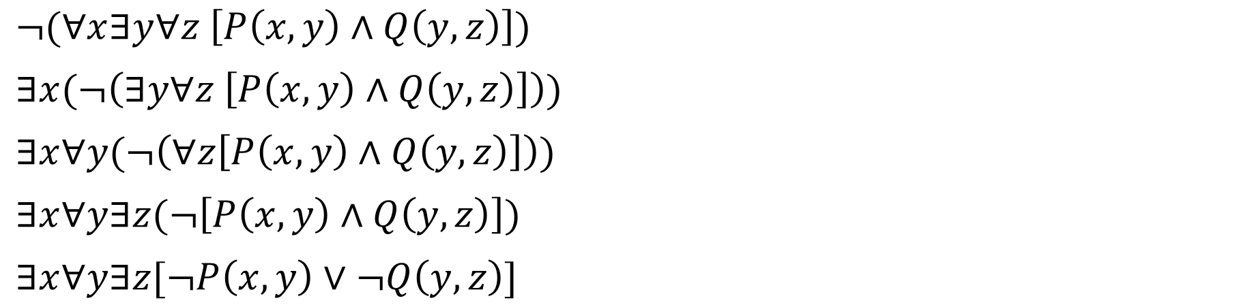
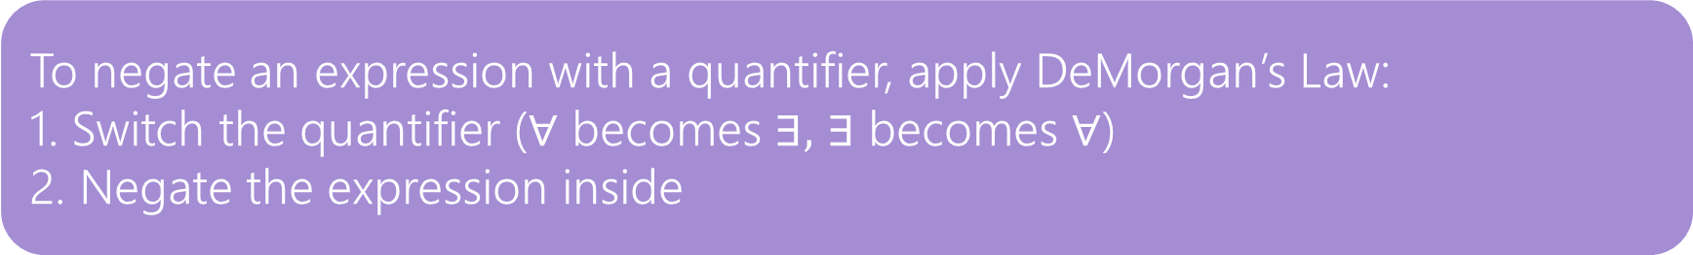
Negation
How do we negate nested quantifiers?
The old rule still applies.
To negate an expression with a quantifier, apply DeMorgan’s Law:
1. Switch the quantifier ($∀$ becomes $∃,$ $∃$ becomes $∀$)
2. Negate the expression inside
$¬(∀x∃y∀z \left[P\left(x,y\right)∧Q\left(y,z\right)\right])$
$∃x(¬\left(∃y∀z \left[P\left(x,y\right)∧Q\left(y,z\right)\right]\right))$
$∃x∀y(¬\left(∀z\left[P\left(x,y\right)∧Q\left(y,z\right)\right]\right))$
$∃x∀y∃z(¬\left[P\left(x,y\right)∧Q\left(y,z\right)\right])$
$∃x∀y∃z[¬P\left(x,y\right)∨¬Q\left(y,z\right)]$

Slide 37

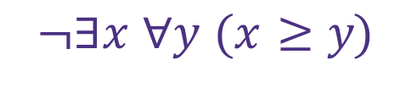

Practice
Translate to predicate logic & rewrite using DeMorgan’s Law. There is no integer greater than or equal to every other integer.
$$\text{¬∃}\text{x} \text{∀}\text{y} \text{(}\text{x} \text{≥} \text{y}\text{)}$$
$$\text{≡} \text{∀}\text{x} \text{¬} \text{∀}\text{y} \text{(}\text{x} \text{≥} \text{y}\text{)}$$
≡ ∀𝑥 ∃𝑦 ¬(𝑥 ≥ 𝑦)
$$\text{≡} \text{∀}\text{x} \text{∃}\text{y} \text{(}\text{x} \text{<} \text{y}\text{)}$$
For every integer, there is an integer greater than it.

Slide 38


Translating
“Exactly one”
Predicate Definitions
Walks 𝑥, 𝑦 ≔ 𝑥 walks 𝑦
Friends 𝑥, 𝑦 ≔ 𝑥 and 𝑦 are friends
Human 𝑥 ≔ 𝑥 is a human
Dog 𝑥 ≔ 𝑥 is a dog
Domain of Discourse_ Mammals
Every human walks exactly one dog.
$$∀x[Human\left(x\right)→∃y \left(Dog\left(y\right)∧Walks\left(x, y\right)∧∀z\left((Dog\left(z\right)∧\left(z≠y\right))→¬Walks\left(x, z\right)\right)\right)]$$
All humans walk a dog $y$
For all other dogs that aren’t a human’s dog $y$,
the human does not walk it

Slide 39
Predicate Logic Equivalence

Slide 40
Motivation
We saw in our last practice example that there may be different predicate logic expressions that have the same meaning
We can prove logical equivalence of Predicate Logic statements like we did for Propositional Logic
Same equivalence rules still apply, in addition to DeMorgan’s Law for Quantifiers

Slide 41
Proving Predicate Logic Equivalence
“No odd integer is equal to an even integer.”
Alice translated this as: ¬∃𝑥∃𝑦 Odd 𝑥 ∧ Even 𝑦 ∧ 𝑥 = 𝑦
Bob translated this as: ∀𝑥∀𝑦 Odd 𝑥 ∧ Even 𝑦 → 𝑥 ≠ 𝑦
Prove that these translations are logically equivalent.

Slide 42
Proving Predicate Logic Equivalence
$$¬∃x ∃y (Odd\left(x\right)∧Even\left(y\right)∧\left(x=y\right))$$
$$≡∀x ¬∃y (Odd\left(x\right)∧Even\left(y\right)∧\left(x=y\right))$$
DeMorgan’s Law for Quantifiers
$$≡∀x ∀y ¬(Odd\left(x\right)∧Even\left(y\right)∧\left(x=y\right))$$
DeMorgan’s Law for Quantifiers
$≡∀x ∀y (¬\left(Odd\left(x\right)∧Even\left(y\right)\right)∨¬\left(x=y\right)$)
DeMorgan’s Law
Definition of ≠
$≡∀x ∀y (¬\left(Odd\left(x\right)∧Even\left(y\right)\right)∨\left(x≠y\right)$)
$≡∀x ∀y (\left(Odd\left(x\right)∧Even\left(y\right)\right)→\left(x≠y\right)$)
Law of Implication

Slide 43
More Practice

Slide 44
Proving Predicate Logic Equivalence Practice
Prove $¬∀x\left(P\left(x\right)→∃y Q\left(x, y\right)\right)$ is equivalent to $∃x ∀y(P\left(x\right)∧¬Q\left(x, y\right))$.

Slide 45
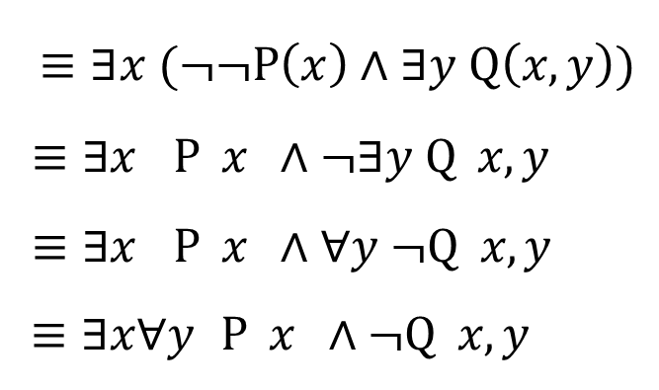
Proving Predicate Logic Equivalence
¬∀𝑥 P 𝑥 → ∃𝑦 Q 𝑥, 𝑦
∨ ∃𝑦 Q 𝑥, 𝑦
∨ ∃𝑦 Q 𝑥, 𝑦
Law of Implication
DeMorgan’s Law for Quantifiers
DeMorgan’s Law
Double Negation
DeMorgan’s Law for Quantifiers
≡ ¬∀𝑥 ¬P 𝑥
≡ ∃𝑥 ¬ ¬P 𝑥
$$≡∃x (¬¬P\left(x\right)∧∃y Q\left(x, y\right))$$
≡ ∃𝑥 P 𝑥 ∧ ¬∃𝑦 Q 𝑥, 𝑦
≡ ∃𝑥 P 𝑥 ∧ ∀𝑦 ¬Q 𝑥, 𝑦
≡ ∃𝑥∀𝑦 P 𝑥 ∧ ¬Q 𝑥, 𝑦

Slide 46
Todo
Tonight:
Come to OH today if you get stuck while working on HW1
CC5 due Monday at noon

Slide 47
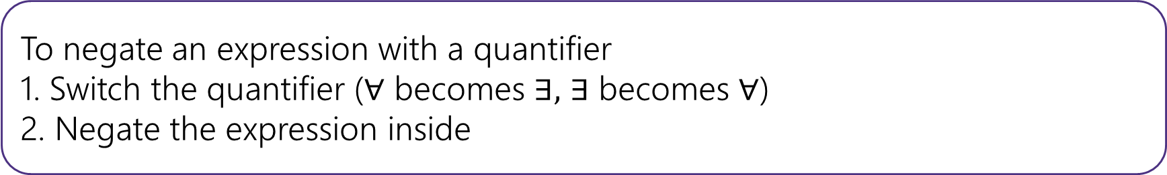
To “limit” variables to a portion of your domain of discourse under a universal quantifier add a hypothesis to an implication.
To “limit” variables to a portion of your domain of discourse under an existential quantifier AND the limitation together with the rest of the statement.
To negate an expression with a quantifier
1. Switch the quantifier ($∀$ becomes $∃,$ $∃$ becomes $∀$)
2. Negate the expression inside

Slide 48



The statement is true for every $x$, we just want to put a name on it.
$∀x (p\left(x\right)∧q\left(x\right))$ means “for every $x$ in our domain, $p(x)$ and $q(x)$ both evaluate to true.”
There’s some $x$ out there that works, (but I might not know which it is, so I’m using a variable).
$∃x(p\left(x\right)∧q\left(x\right))$ means “there is an $x$ in our domain, $p(x)$ and $q\left(x\right)$ are both true.
Universal Quantifier
“$∀x“$
“for each $x$”, “for every $x$”, “for all $x$” are common translations
Remember: upside-down-A for All.
“$∃x“$
“there is an $x$”, “there exists an $x$”, “for some $x$” are common translations
Remember: backwards-E for Exists.
Existential Quantifier

