Slide 1
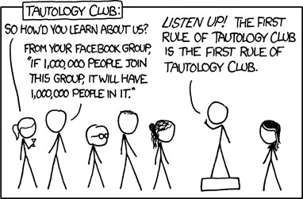
Predicates and Quantifiers
CSE 311 Summer 25
Lecture 4

Slide 2
Announcements
HW1
Due Wednesday, 11:59 pm

Slide 3
Review

Slide 4
Notation
Logic is fundamental
Computer scientists use it in programs
Mathematicians use it in proofs
Engineers use it in hardware
Philosophers use it in arguments
Consequently, everyone has their own notation

Slide 5


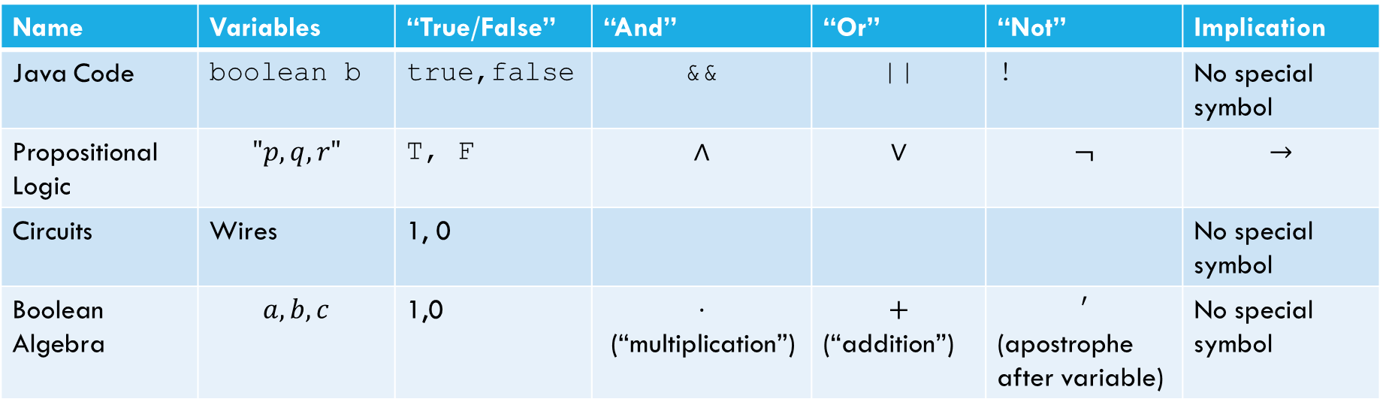

Meet Boolean Algebra
Name | Variables | “True/False” | “And” | “Or” | “Not” | Implication
Java Code | boolean b | true,false | && | || | ! | No special symbol
Propositional Logic | $$"p,q,r"$$ | T, F | $$∧$$ | $$∨$$ | $$¬$$ | $$→$$
Circuits | Wires | 1, 0 |  |  |  | No special symbol
Boolean Algebra | $$a,b,c$$ | 1,0 | $$⋅$$ (“multiplication”) | $$+$$ (“addition”) | $$′$$ (apostrophe after variable) | No special symbol
Propositional logic
Boolean Algebra
$$\left(p∧q∧r\right)∨s∨¬t$$
$$pqr+s+t′$$

Slide 6
Canonical Forms
A truth table is a unique representation of a Boolean Function.
If you describe a function, there’s only one possible truth table for it.
Given a truth table you can find many circuits and many compound prepositions to represent it.
Think back to when we were developing the law of implication…
It would be nice to have a “standard” proposition (or standard circuit) we could always write as a starting point.
So we have a (possibly) shorter way of telling if we have the same function.

Slide 7
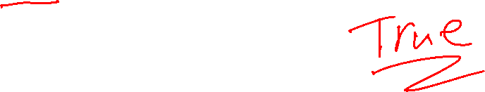
Disjunctive Normal Form (DNF)
a.k.a. OR of ANDs
a.k.a Sum-of-Products Form
a.k.a. Minterm Expansion
Read the true rows of the truth table
AND together all the settings in a given (true) row.
OR together the true rows.

Slide 8
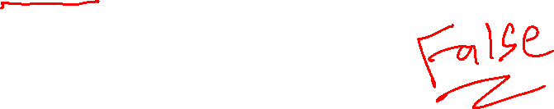
Conjunctive Normal Form (CNF)
a.k.a. AND of ORs
a.k.a. Product-of-Sums Form
a.k.a. Maxterm Expansion
Read the false rows of the truth table
OR together the negations of all the settings in the false rows.
AND together the false rows.
Or take the DNF of the negation of the function you care about, and distribute the negation.

Slide 9
Warm Up

Slide 10
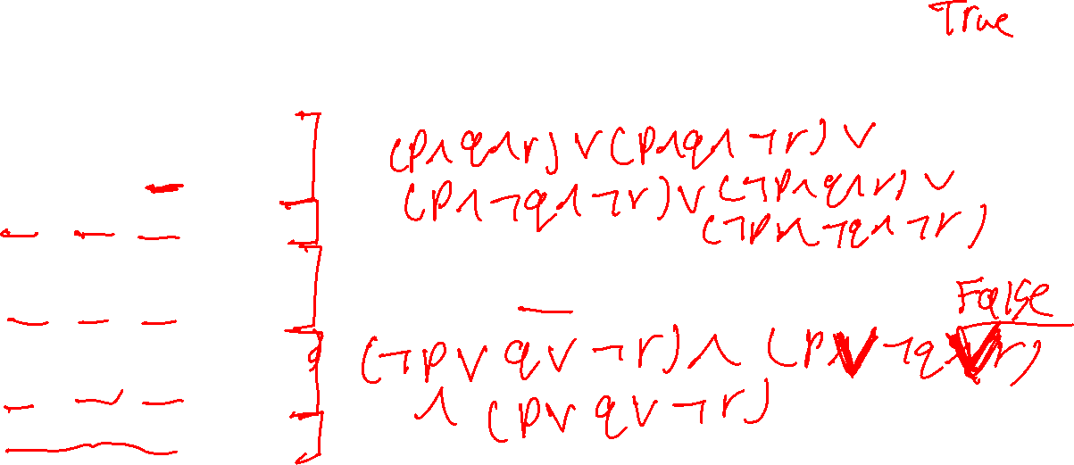
Warm Up
1. Write a propositional logic expression for 𝐹 in DNF (ORs of ANDs) form
𝑝 | 𝑞 | 𝑟 | 𝐹(𝑝, 𝑞, 𝑟)
T | T | T | T
T | T | F | T
T | F | T | F
T | F | F | T
F | T | T | T
F | T | F | F
F | F | T | F
F | F | F | T
2. Write a propositional logic expression for 𝐹 in CNF (ANDs of ORs) form

Slide 11
Predicate Logic

Slide 12

Motivation
Often we will work with statements of the form:
If 𝑥 > 10, then 𝑥² > 100.
If 𝑥 is even, 𝑥² is even.
Can you translate these to propositional logic?
No. We need a function that is true or false depending on the value of 𝑥.

Slide 13

Motivation
Propositional Logic
Lets us break down complex true or false statements into atomic parts joined by connectives.
Predicate Logic
Lets us analyze complex true or false statements that are functions of some underlying objects.

Slide 14
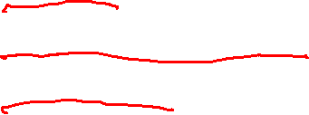
Predicate Logic
3 Parts
Predicate
Domain of Discourse
Quantifiers

Slide 15
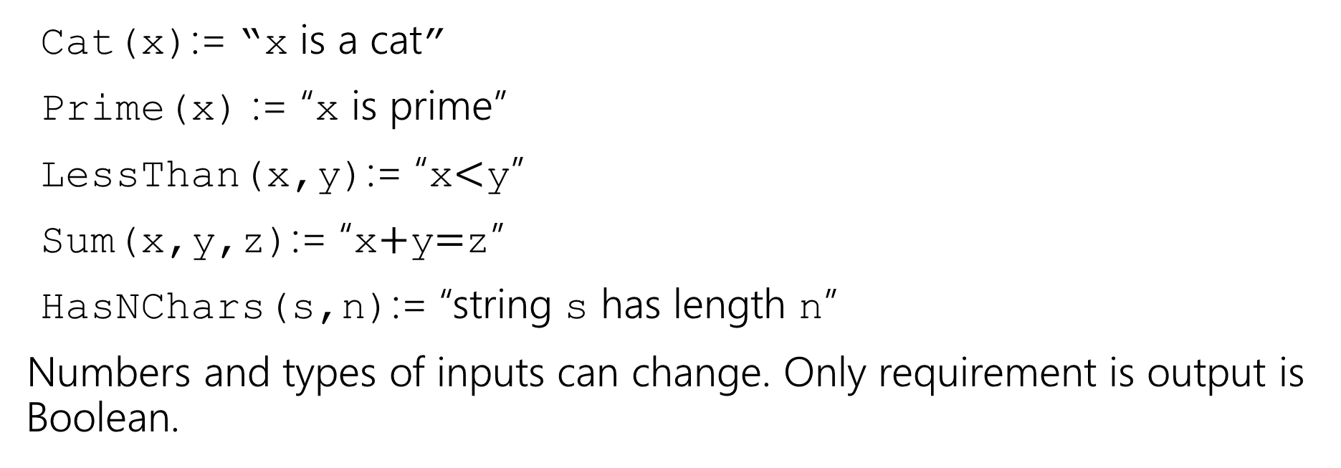
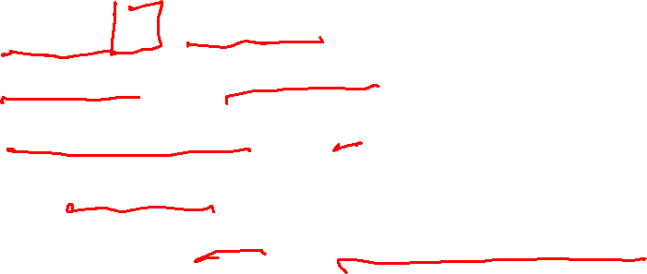
Predicates
A function that outputs true or false.
Predicate
Cat(x):= “x is a cat”
Prime(x) := “x is prime”
LessThan(x,y):= “x$<$y”
Sum(x,y,z):= “x$+$y$=$z”
HasNChars(s,n):= “string s has length n”
Numbers and types of inputs can change. Only requirement is output is Boolean.

Slide 16

Analogy
Propositions were like Boolean variables.
boolean itIsRaining = true
Predicates are like functions that return Boolean values.
public boolean Even(int x) {…}

Slide 17
Predicate Translation
Translation works a lot like when we just had propositions.
Let’s try it…

Slide 18
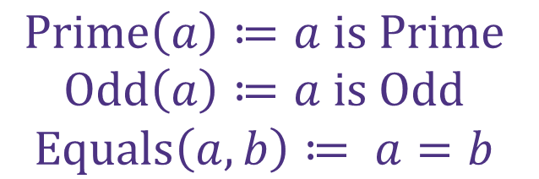
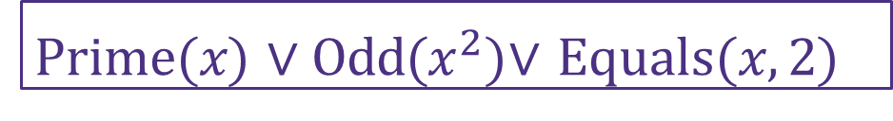
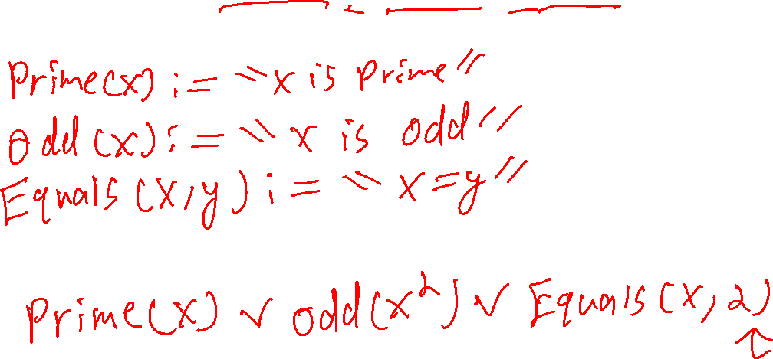
Predicate Translation: Example
𝑥 is prime or 𝑥² is odd, or 𝑥 = 2
$$Prime\left(a\right)≔a is Prime$$
$$Odd\left(a\right)≔a is Odd$$
$$Equals\left(a, b\right)≔ a=b$$
Prime(𝑥) ∨ Odd($x^{2}$)∨ Equals(𝑥, 2)

Slide 19
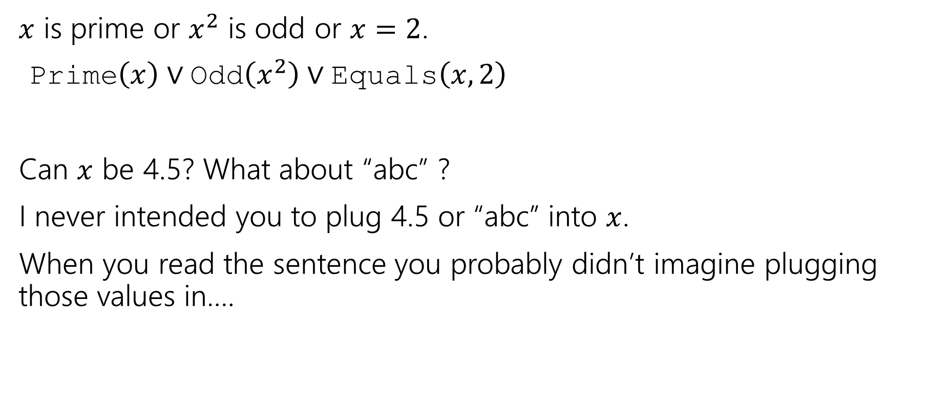
Domain of Discourse
$x$ is prime or $x^{2}$ is odd or $x=2$.
Prime$\left(x\right)∨$Odd$\left(x^{2}\right)∨$Equals$\left(x,2\right)$
Can $x$ be 4.5? What about “abc” ?
I never intended you to plug 4.5 or “abc” into $x$.
When you read the sentence you probably didn’t imagine plugging those values in….

Slide 20

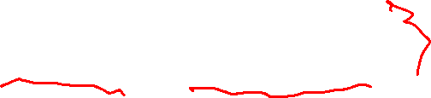
Domain of Discourse
$x$ is prime or $x^{2}$ is odd or $x=2$.
Prime$\left(x\right)∨$Odd$\left(x^{2}\right)∨$Equals$\left(x,2\right)$
To make sure we can’t plug in 4.5 for $x,$predicate logic requires deciding on the types we’ll allow
The set of all inputs allowed as inputs to our predicates.
Domain of Discourse
Often we give the type(s) of allowed inputs, like “all integers” or “all real numbers.

Slide 21
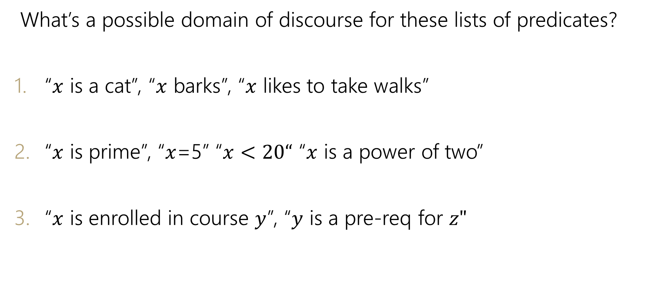
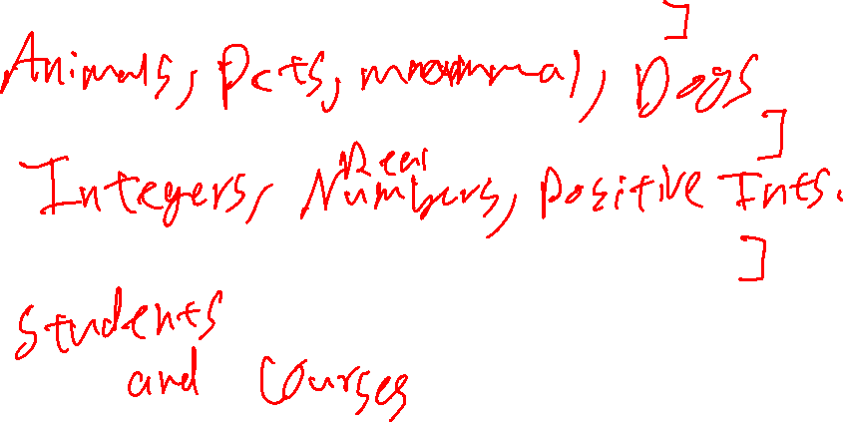
Try it…
What’s a possible domain of discourse for these lists of predicates?
“$x$ is a cat”, “$x$ barks”, “$x$ likes to take walks”
“$x$ is prime”, “$x$=5” “$x<20“$ “$x$ is a power of two”
“$x$ is enrolled in course $y$”, “$y$ is a pre-req for $z"$

Slide 22


Try it…
What’s a possible domain of discourse for these lists of predicates?
“$x$ is a cat”, “$x$ barks”, “$x$ likes to take walks”
“$x$ is prime”, “$x$=5” “$x<20“$ “$x$ is a power of two”
“$x$ is enrolled in course $y$”, “$y$ is a pre-req for $z"$
“Mammals”, “pets”, “dogs and cats”, …
“positive integers”, “integers”, “numbers”, …
“objects in the university course enrollment system”, “university entities”, “students and courses”, …
More than one domain of discourse might be reasonable…if it might affect the meaning of the statement, we specify it.

Slide 23
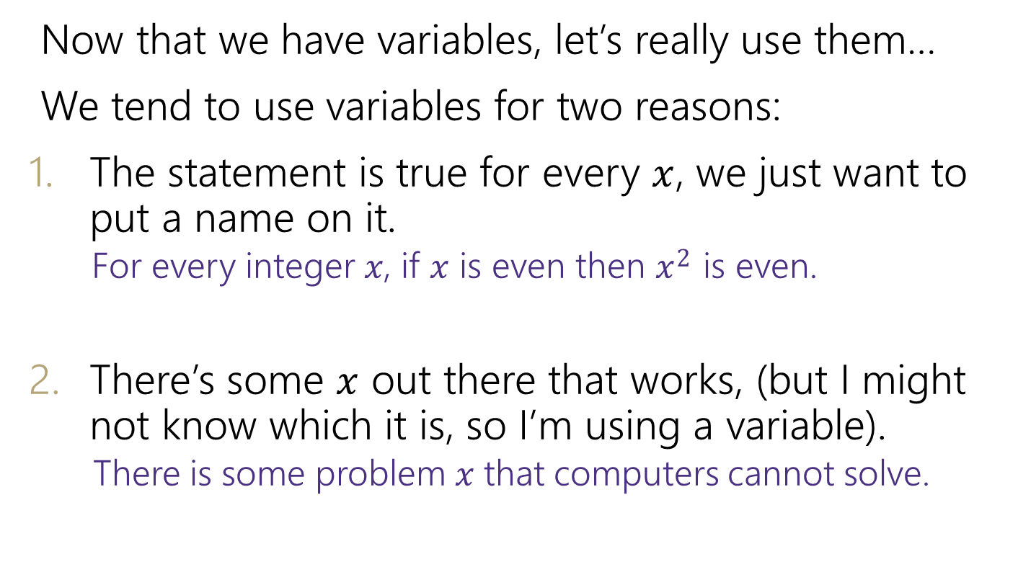

Quantifiers: Motivation
Now that we have variables, let’s really use them…
We tend to use variables for two reasons:
The statement is true for every $x$, we just want to put a name on it.
For every integer 𝑥, if 𝑥 is even then 𝑥² is even.
There’s some $x$ out there that works, (but I might not know which it is, so I’m using a variable).
There is some problem 𝑥 that computers cannot solve.

Slide 24
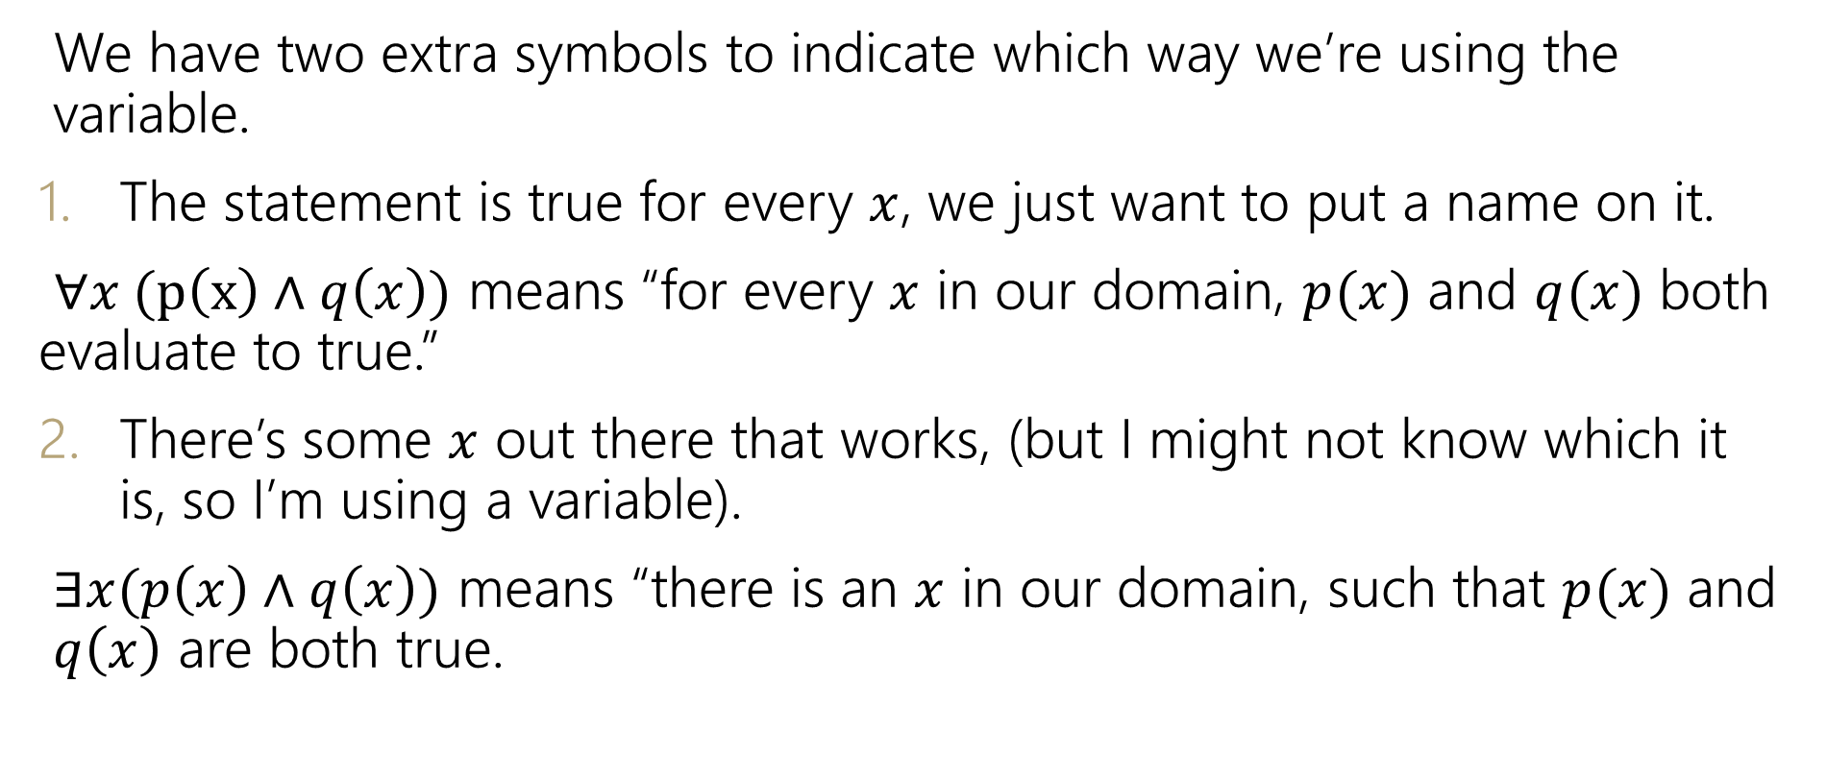
Quantifiers
We have two extra symbols to indicate which way we’re using the variable.
The statement is true for every $x$, we just want to put a name on it.
$∀x (p\left(x\right)∧q\left(x\right))$ means “for every $x$ in our domain, $p(x)$ and $q(x)$ both evaluate to true.”
There’s some $x$ out there that works, (but I might not know which it is, so I’m using a variable).
$∃x(p\left(x\right)∧q\left(x\right))$ means “there is an $x$ in our domain, such that $p(x)$ and $q\left(x\right)$ are both true.

Slide 25
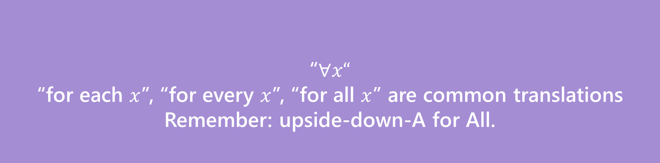


Quantifiers
We have two extra symbols to indicate which way we’re using the variable.
The statement is true for every $x$, we just want to put a name on it.
$∀x (p\left(x\right)∧q\left(x\right))$ means “for every $x$ in our domain, $p(x)$ and $q(x)$ both evaluate to true.”
There’s some $x$ out there that works, (but I might not know which it is, so I’m using a variable).
$∃x(p\left(x\right)∧q\left(x\right))$ means “there is an $x$ in our domain, $p(x)$ and $q\left(x\right)$ are both true.
“$∀x“$
“for each $x$”, “for every $x$”, “for all $x$” are common translations
Remember: upside-down-A for All.
Universal Quantifier

Slide 26
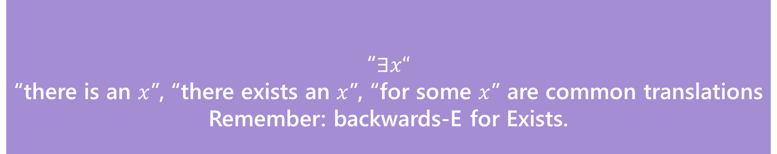

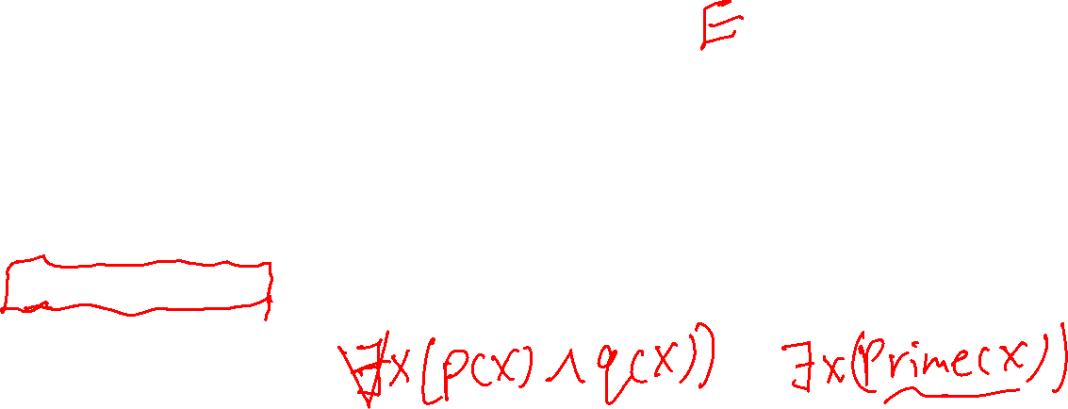
Quantifiers
“$∃x“$
“there is an $x$”, “there exists an $x$”, “for some $x$” are common translations
Remember: backwards-E for Exists.
Existential Quantifier
We have two extra symbols to indicate which way we’re using the variable.
The statement is true for every $x$, we just want to put a name on it.
$∀x (p\left(x\right)∧q\left(x\right))$ means “for every $x$ in our domain, $p(x)$ and $q(x)$ both evaluate to true.”
There’s some $x$ out there that works, (but I might not know which it is, so I’m using a variable).
$∃x(p\left(x\right)∧q\left(x\right))$ means “there is an $x$ in our domain, for which $p(x)$ and $q\left(x\right)$ are both true.

Slide 27

Predicate Logic Summary
3 Parts
Predicate – Function that outputs true or false.
Domain of Discourse – Set of possible inputs to a predicate.
Quantifiers – A statement about when a predicate is true: ∀ or ∃

Slide 28
Predicate Logic Translation

Slide 29

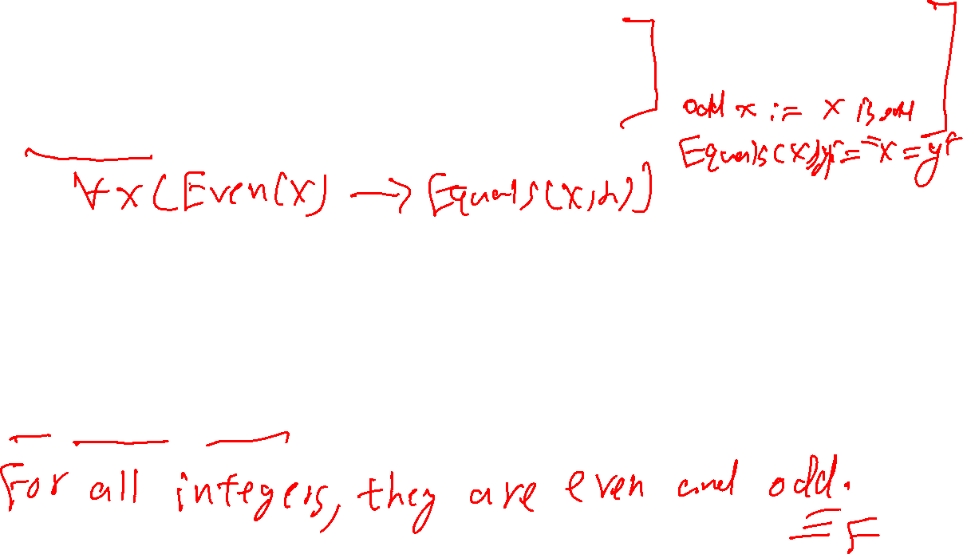
Translations
Predicate Definitions
Even 𝑥 ≔ 𝑥 is even
Domain of Discourse Integers
LessThan 𝑥, 𝑦 ≔ 𝑥 < 𝑦
“For every $x$, if $x$ is even, then $x=2$.”
“There are $x,y$ such that $x<y$.”
$∃x ($Odd$\left(x\right)∧$LessThan$\left(x,5\right))$
$∀y ($Even$\left(y\right)∧$Odd$\left(y\right))$

Slide 30
Translations
Predicate Definitions
Even 𝑥 ≔ 𝑥 is even
Domain of Discourse Integers
LessThan 𝑥, 𝑦 ≔ 𝑥 < 𝑦
“For every $x$, if $x$ is even, then $x=2$.”
“There are $x,y$ such that $x<y$.”
$∃x ($Odd$\left(x\right)∧$LessThan$\left(x,5\right))$
$∀y ($Even$\left(y\right)∧$Odd$\left(y\right))$
$∀x($Even$\left(x\right)→$Equal$\left(x,2\right))$
$∃x∃y($LessThan$\left(x,y\right))$
There is an odd number that is less than 5.
All numbers are both even and odd.

Slide 31
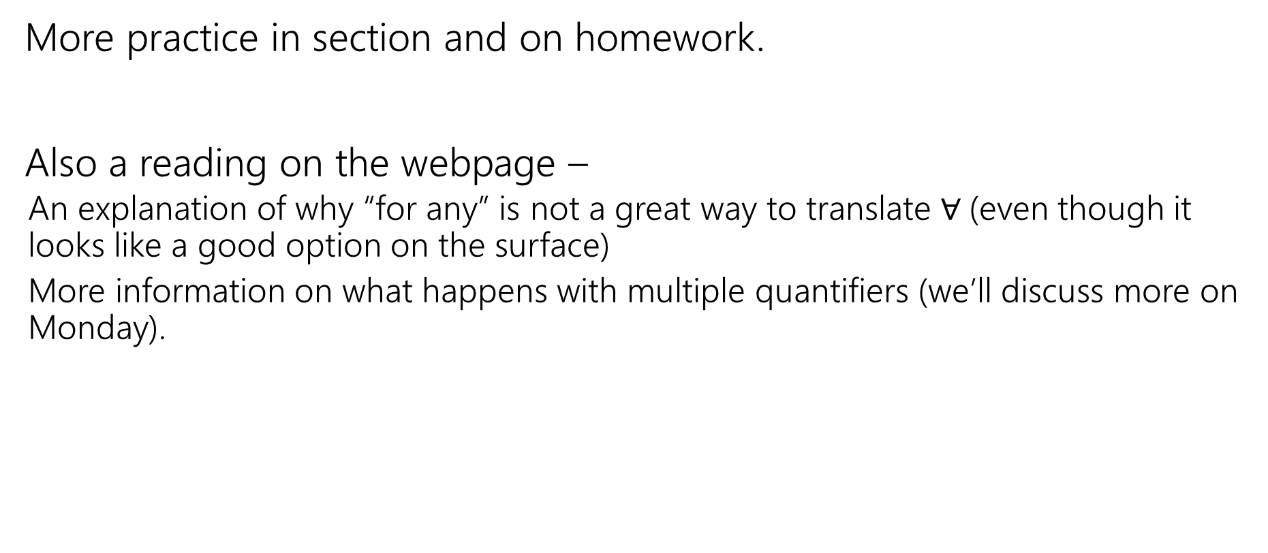

Translations
More practice in section and on homework.
Also a reading on the webpage –
An explanation of why “for any” is not a great way to translate $∀$(even though it looks like a good option on the surface)
More information on what happens with multiple quantifiers (we’ll discuss more on Monday).

Slide 32

Evaluating Predicate Logic
“For every $x$, if $x$ is even, then $x=2$.” / $∀x($Even$\left(x\right)→$Equal$\left(x,2\right))$
Is this true?

Slide 33
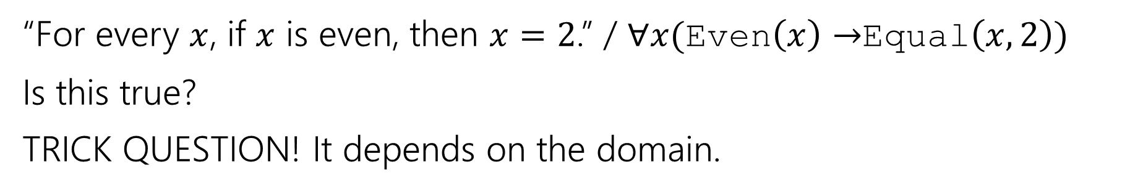

Evaluating Predicate Logic
“For every $x$, if $x$ is even, then $x=2$.” / $∀x($Even$\left(x\right)→$Equal$\left(x,2\right))$
Is this true?
TRICK QUESTION! It depends on the domain.
Prime Numbers | Positive Integers | Odd integers
True | False | True (vacuously)

Slide 34
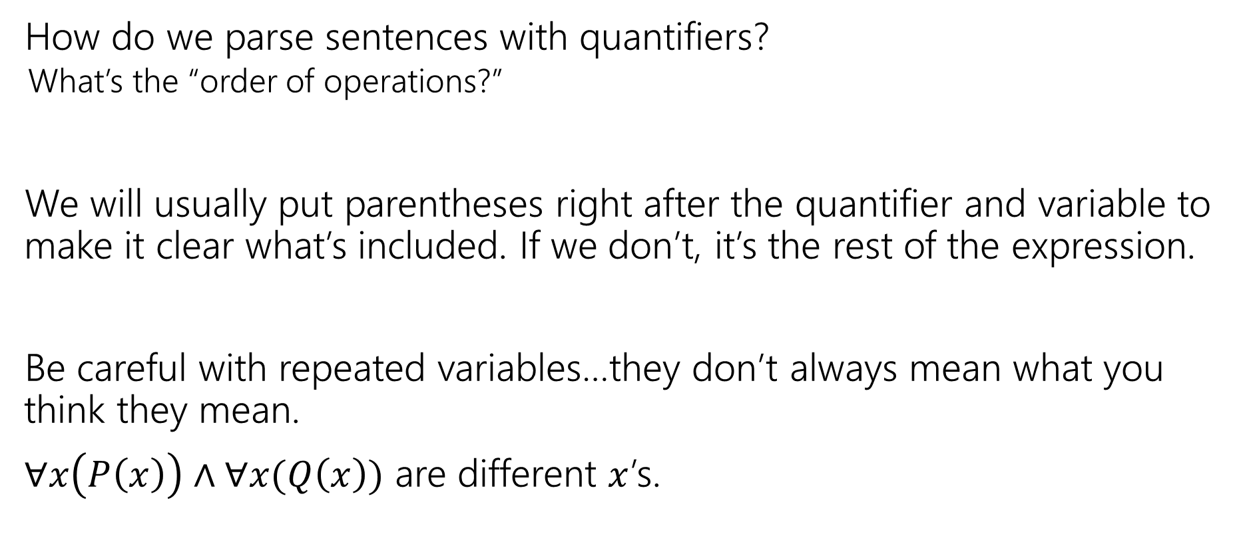
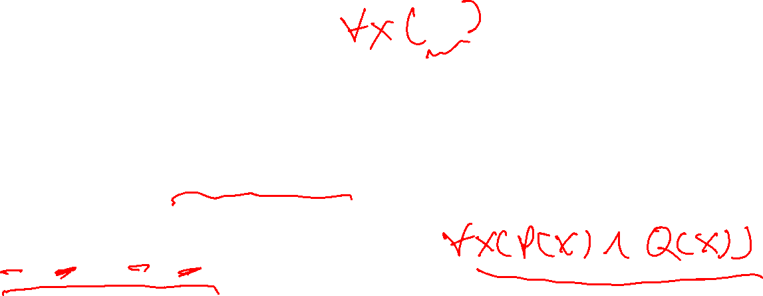
One Technical Matter
How do we parse sentences with quantifiers?
What’s the “order of operations?”
We will usually put parentheses right after the quantifier and variable to make it clear what’s included. If we don’t, it’s the rest of the expression.
Be careful with repeated variables…they don’t always mean what you think they mean.
$∀x\left(P\left(x\right)\right)∧∀x(Q\left(x\right))$ are different $x$’s.

Slide 35
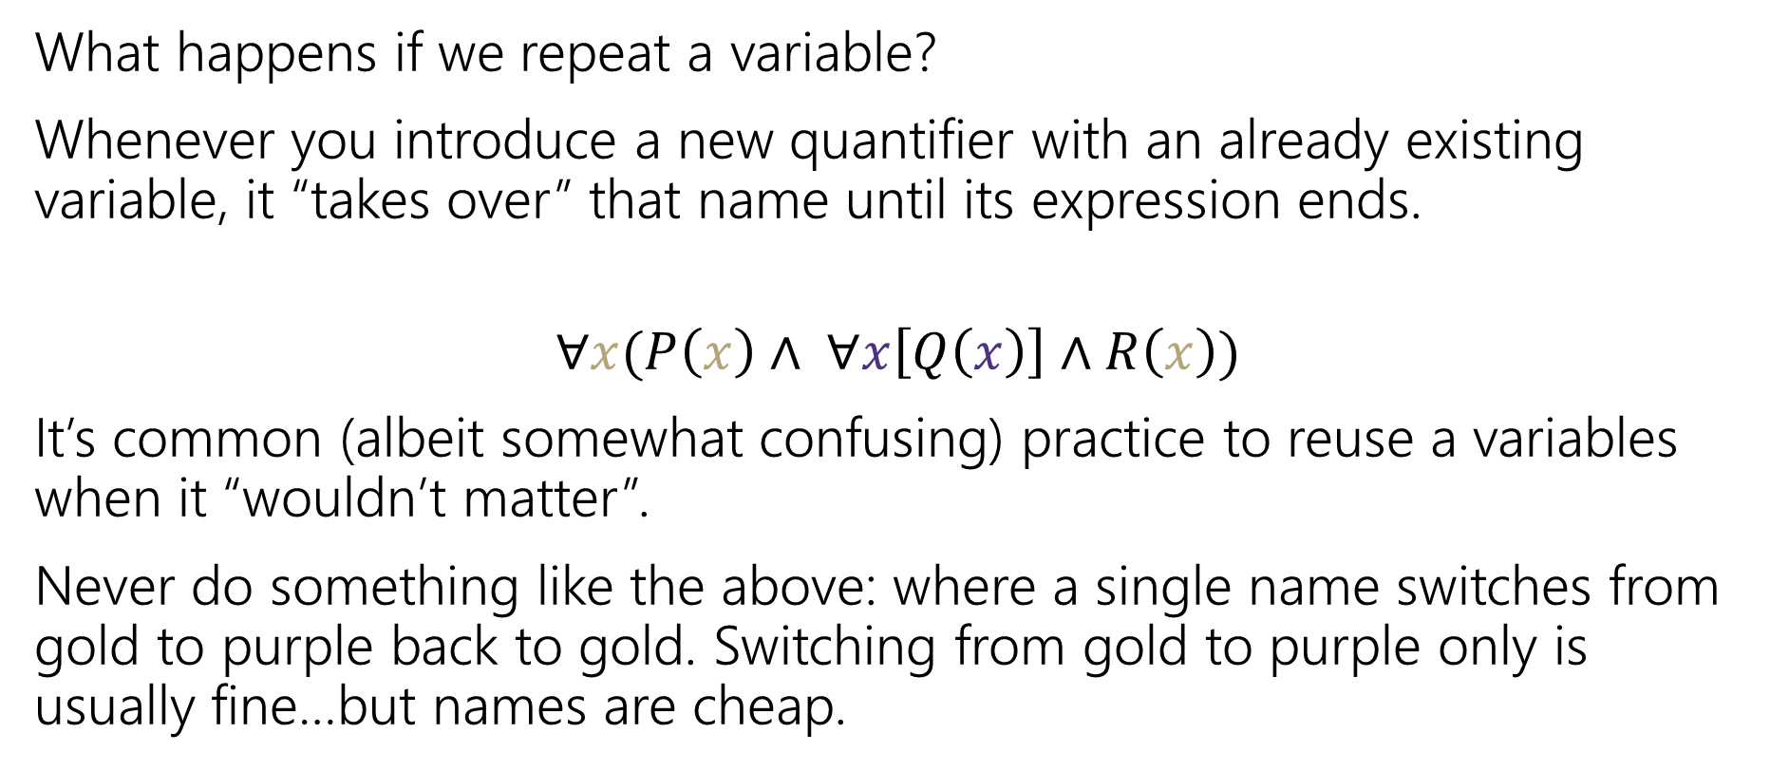

Bound Variables
What happens if we repeat a variable?
Whenever you introduce a new quantifier with an already existing variable, it “takes over” that name until its expression ends.
$$∀x(P\left(x\right)∧ ∀x\left[Q\left(x\right)\right]∧R\left(x\right))$$
It’s common (albeit somewhat confusing) practice to reuse a variables when it “wouldn’t matter”.
Never do something like the above: where a single name switches from gold to purple back to gold. Switching from gold to purple only is usually fine…but names are cheap.

Slide 36
More Practice
Predicate Definitions
Even 𝑥 ≔ 𝑥 is even
Domain of Discourse Integers
LessThan 𝑥, 𝑦 ≔ 𝑥 < 𝑦
Odd 𝑥 ≔ 𝑥 is odd
Translate to English. Then evaluate if the statement is T or F.
∃𝑥(Odd(𝑥) ∧ LessThan(𝑥, 5))
∀𝑦(Even(𝑦) ∧ Odd(𝑦))
There is an odd integer less than 5. True, e.g., x = 3.
All integers are even and odd. False.

Slide 37
Examples
Domain of Discourse_ Integers
Predicate Definitions
Even 𝑥 ≔ 𝑥 is even Greater 𝑥, 𝑦 ≔ 𝑥 > 𝑦
Odd 𝑥 ≔ 𝑥 is odd Prime 𝑥 ≔ 𝑥 is prime
Translate to English. Then evaluate if the statement is T or F.
∃𝑥 Even(𝑥)
There is an even integer.
All integers are odd.
T
∀𝑥 Odd(𝑥)
∀𝑥 Even 𝑥
∃𝑥 Even 𝑥
F
∨ Odd 𝑥
All integers are even or odd.
There’s an integer that’s even and odd.
For all integers 𝑥, 𝑥 + 1 > 𝑥
There is an integer that’s even and prime. T
T
∧ Odd 𝑥
F
∀𝑥 Greater(𝑥 + 1, 𝑥)
∃𝑥 Even 𝑥 ∧ Prime 𝑥
T

Slide 38
Domain Restriction

Slide 39
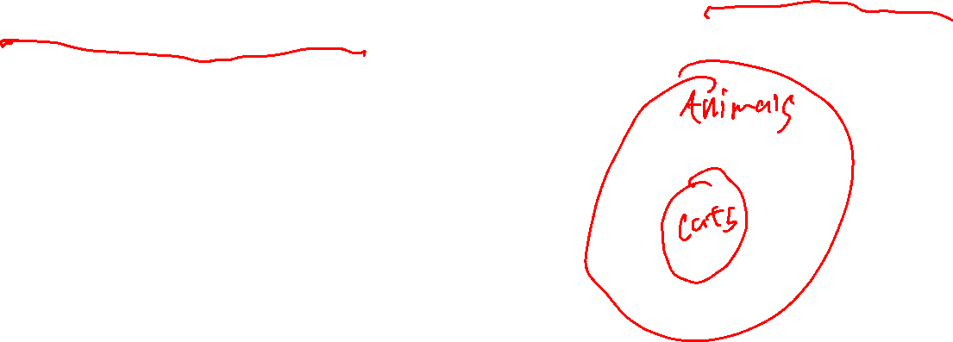
Domain Restriction
Definition:
Domain restriction is the technique of limiting our domain of discourse to a smaller set of objects.

Slide 40


Quantifiers
$∀$ (for All) and $∃$ (there Exists)
Write these statements in predicate logic with quantifiers. Let your domain of discourse be “cats”
If a cat is fat, then it is happy.
This sentence implicitly makes a statement about all cats!
$∀x[$Fat$\left(x\right)→$ Happy$\left(x\right)]$

Slide 41
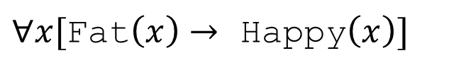

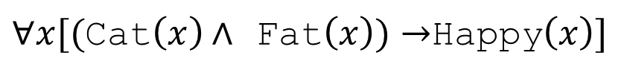
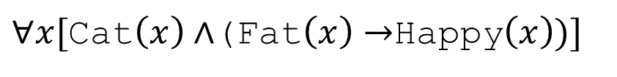

Quantifiers
Writing implications can be tricky when we change the domain of discourse.
For every cat: if the cat is fat, then it is happy.
Domain of Discourse: cats
$∀x[$Fat$\left(x\right)→$ Happy$\left(x\right)]$
What if we change our domain of discourse to be all mammals?
We need to limit $x$ to be a cat. How do we do that?
$∀x[($Cat$\left(x\right)∧$ Fat$\left(x\right))→$Happy$\left(x\right)]$
$∀x[$Cat$\left(x\right)∧$(Fat$\left(x\right)→$Happy$\left(x\right))]$

Slide 42
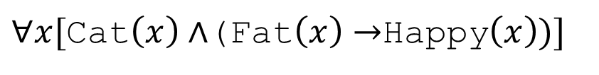
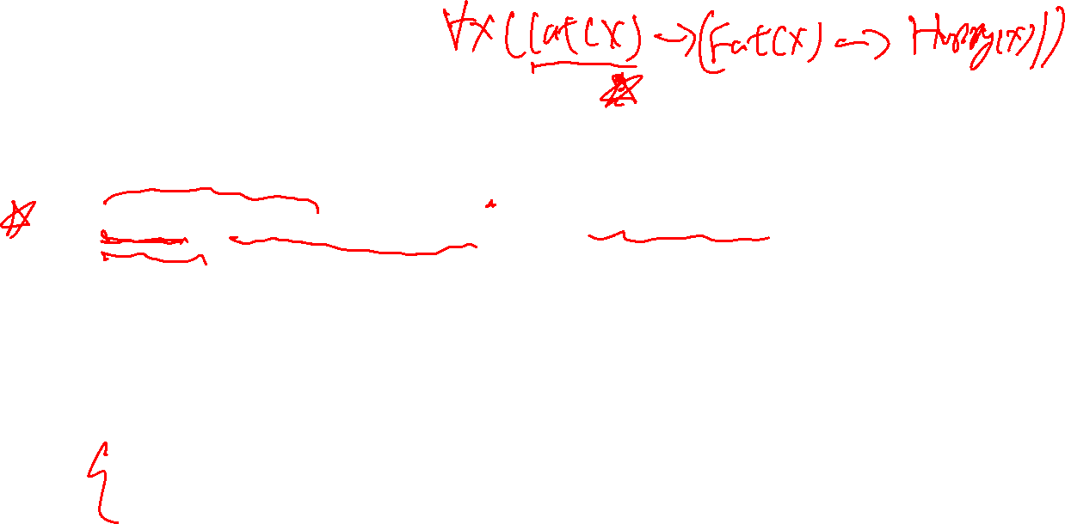
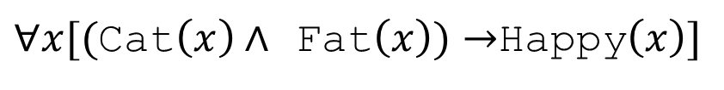
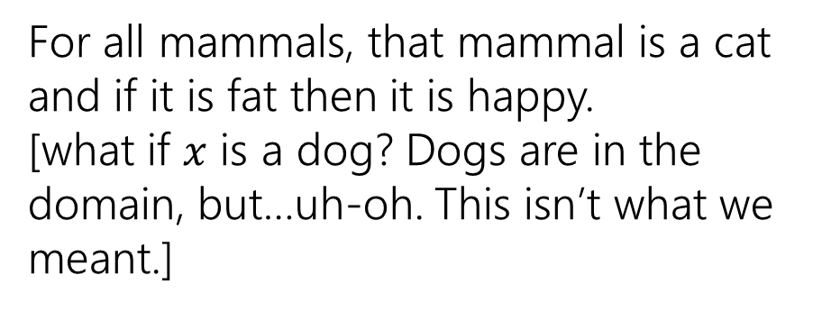
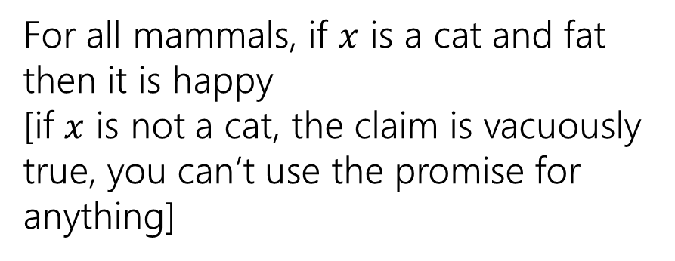
Quantifiers
Which of these translates “For every cat: if a cat is fat then it is happy.” when our domain of discourse is “mammals”?
$∀x[($Cat$\left(x\right)∧$ Fat$\left(x\right))→$Happy$\left(x\right)]$
$∀x[$Cat$\left(x\right)∧$(Fat$\left(x\right)→$Happy$\left(x\right))]$
For all mammals, if $x$ is a cat and fat then it is happy
[if $x$ is not a cat, the claim is vacuously true, you can’t use the promise for anything]
For all mammals, that mammal is a cat and if it is fat then it is happy.
[what if $x$ is a dog? Dogs are in the domain, but…uh-oh. This isn’t what we meant.]
To “limit” variables to a portion of your domain of discourse under a universal quantifier add a hypothesis to an implication.

Slide 43



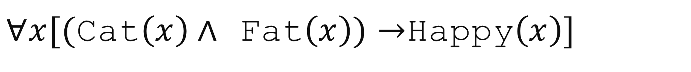
$∀x[($Cat$\left(x\right)∧$ Fat$\left(x\right))→$Happy$\left(x\right)]$
$x$ outside the subdomain
(Cat$\left(x\right)∧$ Fat$\left(x\right))→$Happy$\left(x\right)$
$($F$∧$Fat$\left(x\right))→$Happy$\left(x\right)$
$($F$)→$Happy$\left(x\right)$
T
For $x$ that aren’t cats, the implication is vacuously true.
These won’t affect whether $∀x[($Cat$\left(x\right)∧$ Fat$\left(x\right))→$Happy$\left(x\right)]$ is true.

Slide 44
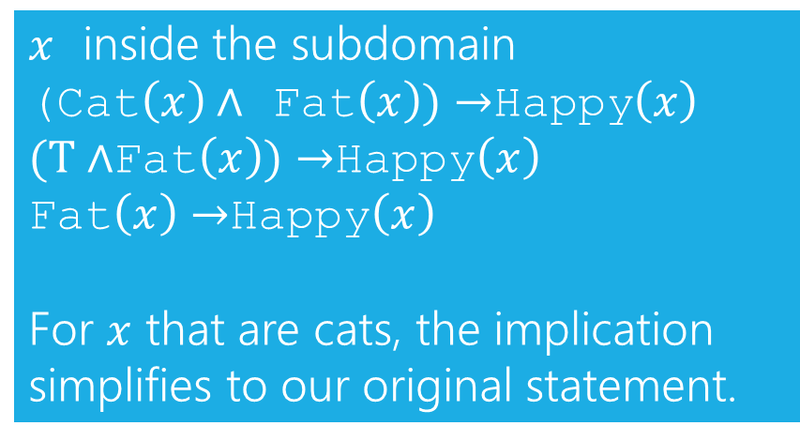
$∀x[($Cat$\left(x\right)∧$ Fat$\left(x\right))→$Happy$\left(x\right)]$
$x$ inside the subdomain (Cat$\left(x\right)∧$ Fat$\left(x\right))→$Happy$\left(x\right)$
$(T∧$Fat$\left(x\right))→$Happy$\left(x\right)$
Fat$\left(x\right)→$Happy$\left(x\right)$
For $x$ that are cats, the implication simplifies to our original statement.

Slide 45
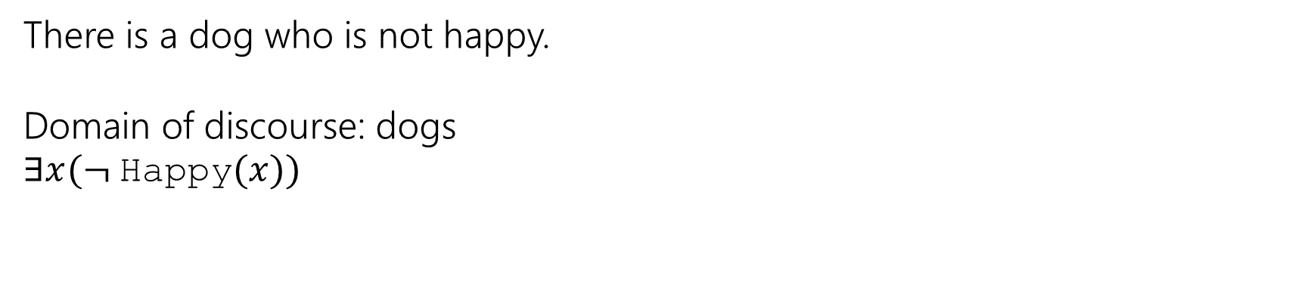

Quantifiers
Existential quantifiers need a different rule:
To “limit” variables to a portion of your domain of discourse under an existential quantifier AND the limitation together with the rest of the statement.
There is a dog who is not happy.
Domain of discourse: dogs
$∃x(¬$Happy$(x))$

Slide 46
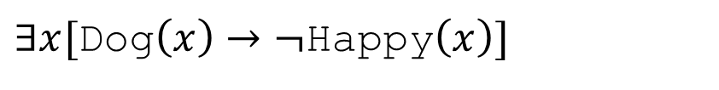
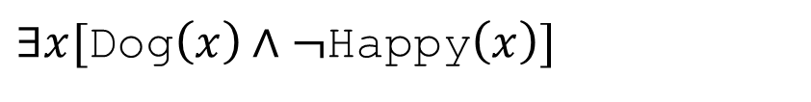

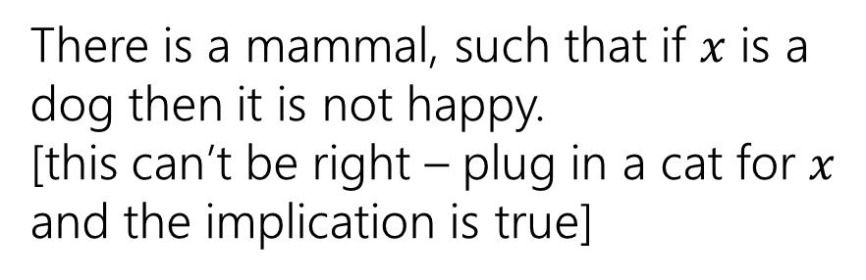
Quantifiers
Which of these translates “There is a dog who is not happy.” when our domain of discourse is “mammals”?
$∃x[$Dog$\left(x\right)→¬$Happy$\left(x\right)]$
$∃x[$Dog$\left(x\right)∧¬$Happy$\left(x\right)]$
There is a mammal, such that if $x$ is a dog then it is not happy.
[this can’t be right – plug in a cat for $x$ and the implication is true]
There is a mammal that is both a dog and not happy.
[this one is correct!]
To “limit” variables to a portion of your domain of discourse under an existential quantifier AND the limitation together with the rest of the statement.

Slide 47
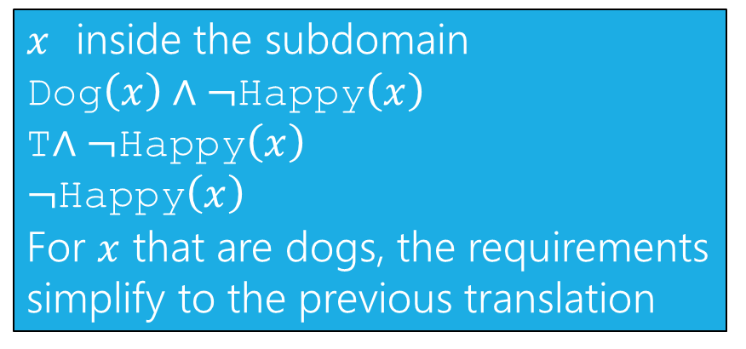
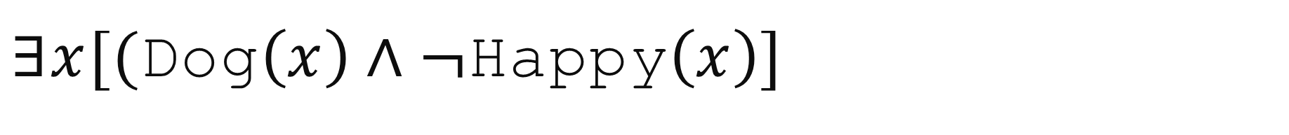
$∃x[($Dog$\left(x\right)∧¬$Happy$\left(x\right)]$
$x$ inside the subdomain
Dog$\left(x\right)∧¬$Happy$\left(x\right)$
T$∧¬$Happy$\left(x\right)$
$¬$Happy$\left(x\right)$
For $x$ that are dogs, the requirements simplify to the previous translation

Slide 48
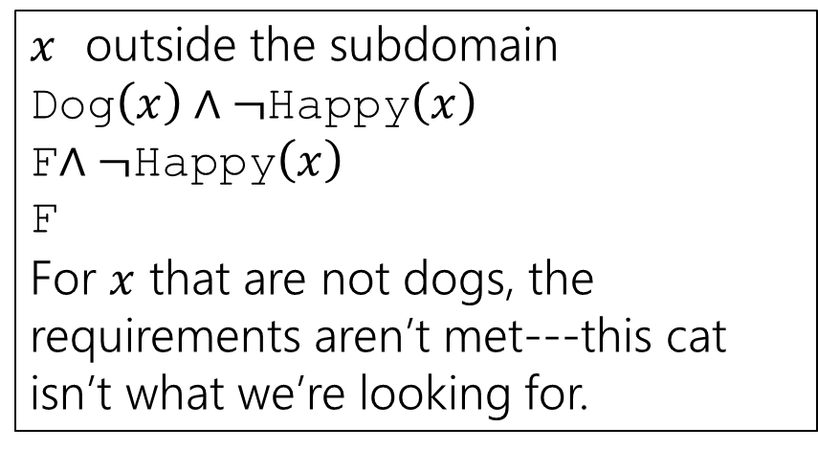
$∃x[($Dog$\left(x\right)∧¬$Happy$\left(x\right)]$
$x$ outside the subdomain
Dog$\left(x\right)∧¬$Happy$\left(x\right)$
F$∧¬$Happy$\left(x\right)$
F
For $x$ that are not dogs, the requirements aren’t met---this cat isn’t what we’re looking for.

Slide 49


Why are the rules what they are?
A universal quantifier is a “Big AND”
For a domain of discourse of $\{e_{1},e_{2},…,e_{k}\}$
$∀x(P\left(x\right))$ means $P\left(e_{1}\right)∧P\left(e_{2}\right)∧…∧P(e_{k})$
Now let’s say our domain is $\{e_{1},e_{2},…,e_{k},f_{1},f_{2},…,f_{j}\}$ where $f_{i}$ are the irrelevant parts of the bigger domain (non-cat-mammals). We want the expression to be
$P\left(e_{1}\right)∧P\left(e_{2}\right)∧…∧P\left(e_{k}\right)∧T∧T…∧T$
$∀x(RightSubDomain\left(x\right)→P\left(x\right))$ does that!

Slide 50


Why are the rules what they are?
An existential quantifier is a “Big OR”
For a domain of discourse of $\{e_{1},e_{2},…,e_{k}\}$
$∃x(P\left(x\right))$ means $P\left(e_{1}\right)∨P\left(e_{2}\right)∨…∨P(e_{k})$
Now let’s say our domain is $\{e_{1},e_{2},…,e_{k},f_{1},f_{2},…,f_{j}\}$ where $f_{i}$ are the irrelevant parts of the bigger domain (non-cat-mammals). We want the expression to be
$P\left(e_{1}\right)∨P\left(e_{2}\right)∨…∨P\left(e_{k}\right)∨F∨F…∨F$
$∃x(RightSubDomain\left(x\right)∧P\left(x\right))$ does that!

Slide 51
Domain Restriction Translations
Translations often sound more natural if we:
Notice domain restriction patterns.
Avoid using variables when we can.
Drop the “for all” or “there exists” when we can.
For example:
∀𝑥 Cat 𝑥 → Blue 𝑥
For all animals 𝑥, if 𝑥 is a cat then 𝑥 is blue. All cats are blue.

Slide 52
Translation Practice
Predicate Definitions Fruit 𝑥 ≔ 𝑥 is a fruit Tasty 𝑥 ≔ 𝑥 is tasty Ripe 𝑥 ≔ 𝑥 is ripe
Domain of Discourse_ Food
Translate these sentences using a natural-sounding translation.
∃𝑥(Fruit(𝑥) ∧ Tasty(𝑥))
∀𝑥(Fruit(𝑥) ∧ ¬Ripe(𝑥)→ ¬Tasty(𝑥))
There is a tasty fruit. OR Some fruits are tasty.
All fruits that aren’t ripe aren’t tasty.

Slide 53
Todo
Tonight:
Get started on HW1 if you haven’t already!
CC4 due Wednesday at noon

Slide 54


“$∀x“$
“for each $x$”, “for every $x$”, “for all $x$” are common translations
Remember: upside-down-A for All.
Universal Quantifier
“$∃x“$
“there is an $x$”, “there exists an $x$”, “for some $x$” are common translations
Remember: backwards-E for Exists.
Existential Quantifier

