Slide 1
Alternate Notation Normal Forms
CSE 311 Summer 2025
Lecture 3

Slide 2

Announcements
Check out the resources page:
The list of logical equivalences
A Translation Tips reading (for going from English to Logic)
Might be useful if you’re still working on homework 1.
There’s a lot of other resources on the page that will be useful as we get further along (e.g. reference sheets for particular topics).
We’ll try to remind you about important ones, but it’s good to keep in mind that it’s there.

Slide 3
Announcements
HW1
Due Wednesday, 11:59 pm
Submit on Gradescope
Resources Page
- Check out the resources page: The list of logical equivalences and a Translation Tips reading (for going from English to Logic) might be useful if you’re still working on homework 1.
- There’s a lot of other resources on the page that will be useful as we get further along (e.g. reference sheets for particular topics).

Slide 4
Review

Slide 5

Logical Equivalence
𝐴 ≡ 𝐵 is an assertion that two propositions 𝐴, 𝐵 always have the same truth values.
There are two generic methods to proving equivalence:
Make a truth table for both propositions
Use a chain of logical equivalences

Slide 6
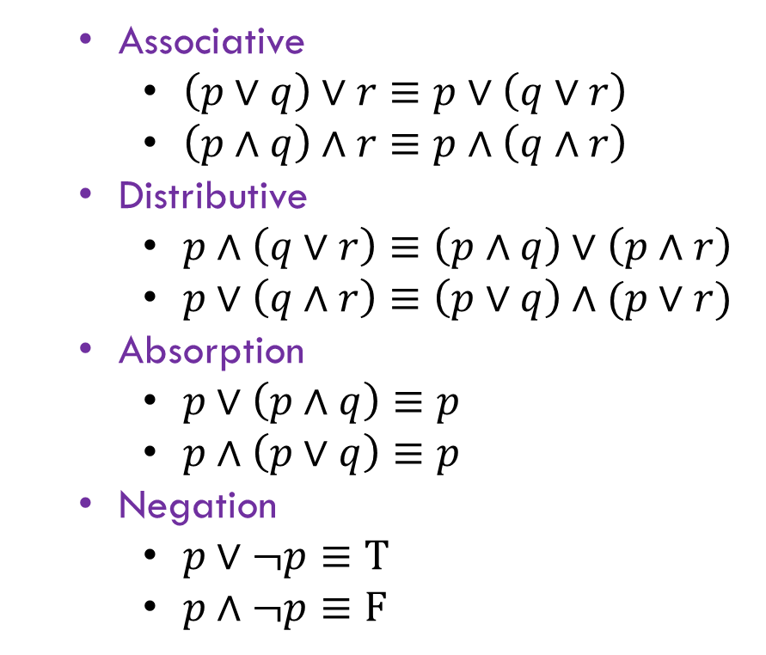


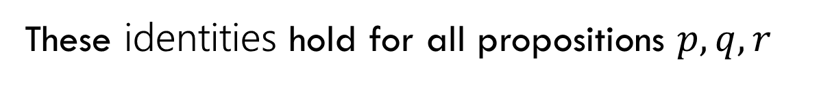
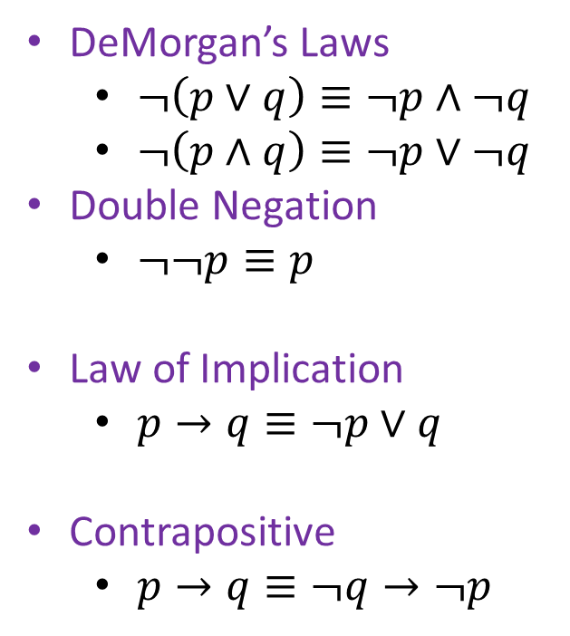
Logical Equivalence Laws
These identities hold for all propositions $p,q,r$
Identity
$p∧T≡p$
$p∨F≡p$
Domination
$p∨T≡T$
$p∧F≡F$
Idempotent
$p∨p≡p$
$p∧p≡p$
Commutative
$p∨q≡q∨p$
$p∧q≡q∧p$
Associative
$\left(p∨q\right)∨r≡p∨\left(q∨r\right)$
$\left(p∧q\right)∧r≡p∧\left(q∧r\right)$
Distributive
$p∧\left(q∨r\right)≡\left(p∧q\right)∨\left(p∧r\right)$
$p∨\left(q∧r\right)≡\left(p∨q\right)∧(p∨r)$
Absorption
$p∨\left(p∧q\right)≡p$
$p∧\left(p∨q\right)≡p$
Negation
$p∨¬p≡T$
$p∧¬p≡F$
DeMorgan’s Laws
$¬\left(p∨q\right)≡¬p∧¬q$
$¬\left(p∧q\right)≡¬p∨¬q$
Double Negation
$¬¬p≡p$
Law of Implication
$p→q≡¬p∨q$
Contrapositive
$p→q≡¬q→¬p$

Slide 7
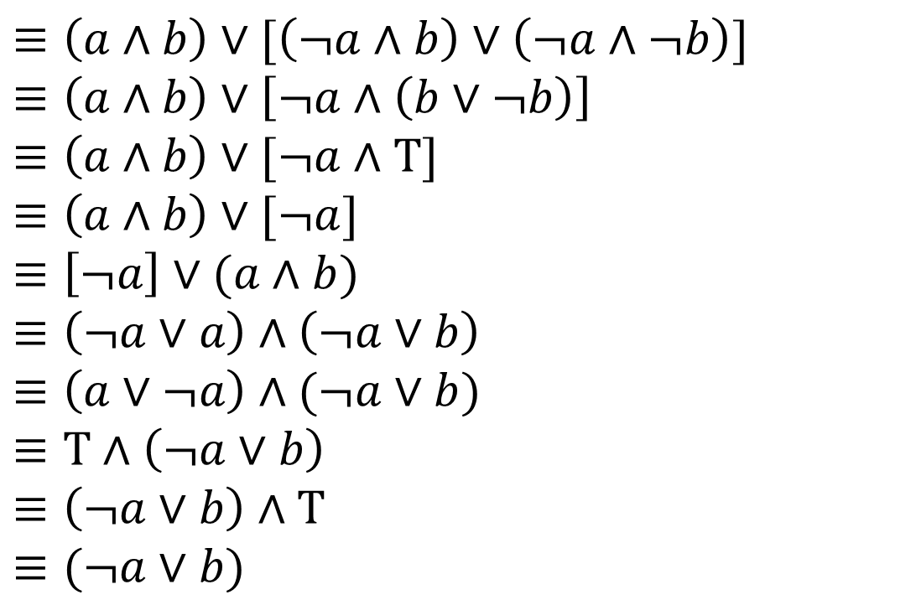



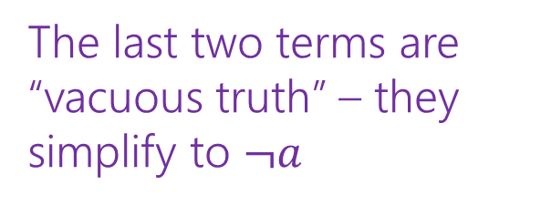
Our First Proof
$\left(a∧b\right)∨\left(¬a∧b\right)∨(¬a∧¬b)$
$≡\left(a∧b\right)∨[\left(¬a∧b\right)∨\left(¬a∧¬b\right)]$
$≡\left(a∧b\right)∨\left[¬a∧\left(b∨¬b\right)\right]$
$≡\left(a∧b\right)∨[¬a∧T]$
$≡\left(a∧b\right)∨[¬a]$
$≡\left[¬a\right]∨(a∧b)$
$≡\left(¬a∨a\right)∧\left(¬a∨b\right)$
$≡\left(a∨¬a\right)∧(¬a∨b)$
$≡T∧\left(¬a∨b\right)$
$≡\left(¬a∨b\right)∧T$
$≡(¬a∨b)$
Associative
Distributive
Negation
Identity
Commutative
Distributive
Commutative
Negation
Commutative
Identity
The last two terms are “vacuous truth” – they simplify to $¬a$
$a$ no longer matters in $a∧b$ if $¬a$ automatically makes the expression true.

Slide 8
More on Our First Proof
With practice (and quite a bit of squinting) you can see not just the ironclad guarantee, but also the reason why something is true.
That’s not easy with a truth table.
Proofs can also communicate intuition about why a statement is true.
We’ll practice extracting intuition from proofs more this quarter.

Slide 9

Converse, Contrapositive
Implication:
p → q
Converse:
q → p
Contrapositive:
¬q → ¬p
Inverse:
¬p → ¬q
An implication and its contrapositive have the same truth value!
p | q | p → q | q → p | ¬p | ¬q | ¬p → ¬q | ¬q → ¬p
T | T | T | T | F | F | T | T
T | F | F | T | F | T | T | F
F | T | T | F | T | F | F | T
F | F | T | T | T | T | T | T

Slide 10
Warm Up

Slide 11
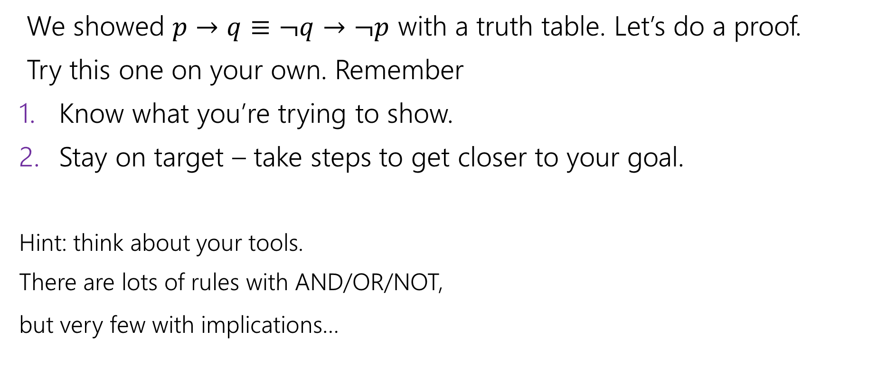

Contrapositive
We showed $p→q≡¬q→¬p$ with a truth table. Let’s do a proof.
Try this one on your own. Remember
Know what you’re trying to show.
Stay on target – take steps to get closer to your goal.
Hint: think about your tools.
There are lots of rules with AND/OR/NOT,
but very few with implications…

Slide 12
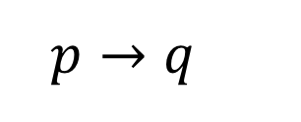

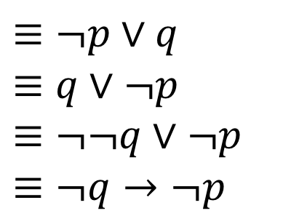
Contrapositive
$p→q$
$≡¬p∨q$
$≡q∨¬p$
$≡¬¬q∨¬p$
$≡¬q→¬p$
[Law of Implication]
[Commutativity]
[Double Negation]
[Law of Implication]
All of our rules deal with ORs and ANDs, let’s switch the implication to just use AND/NOT/OR.
And do the same with our target
It’s ok to work from both ends. In fact it’s a very common strategy!
Now how do we get the top to look like the bottom?
Just a few more rules and we’re done!

Slide 13

Work from both ends, but…
…make sure at the end, if you read from top-to-bottom, every step makes sense.
When proving an equivalence you must: 1. Start with the left side (or right side)
2. Modify what you had in the last step (using an equivalence)
3. Derive the right side (or left side if you started with the right)
You may not start with the equivalence you’re trying to show, and simplify to something “obviously true.”
More on why later in the quarter, but tl;dr for now is you can’t use your goal as a starting assumption (it’s what you’re trying to show! If you knew it, no need to write a proof).

Slide 14
Digital Logic

Slide 15

Tautology, Contradiction, & Contingency
Definition:
A proposition is a tautology if it is always true.
E.g. 𝑝 ∨ ¬𝑝
A proposition is a contradiction if it is always false.
E.g. 𝑝 ⊕ 𝑝
A proposition is a contingency if it can be either true or false.
E.g. 𝑝 ∨ 𝑞

Slide 16
On notation…
Logic is fundamental. Computer scientists use it in programs, mathematicians use it in proofs, engineers use it in hardware, philosophers use it in arguments,….
…so everyone uses different notation to represent the same ideas.
Since we don’t know exactly what you’re doing next, we’re going to show you a bunch of them; but don’t think one is “better” than the others!

Slide 17

Digital Circuits
Computing With Logic
T corresponds to 1 or “high” voltage
F corresponds to 0 or “low” voltage
Gates
Take inputs and produce outputs (functions)
Several kinds of gates
Correspond to propositional connectives (most of them)

Slide 18


And Gate
AND Connective
vs.
AND Gate
p ∧ q
p
AND
OUT
q
p | q | p ∧ q
T | T | T
T | F | F
F | T | F
F | F | F
p | q | OUT
1 | 1 | 1
1 | 0 | 0
0 | 1 | 0
0 | 0 | 0
p
q
AND
OUT
“block looks like D of AND”

Slide 19


Or Gate
OR Connective
vs.
OR Gate
p ∨ q
p
OR
OUT
q
p | q | p ∨ q
T | T | T
T | F | T
F | T | T
F | F | F
p | q | OUT
1 | 1 | 1
1 | 0 | 1
0 | 1 | 1
0 | 0 | 0
p
OR
OUT
q
“arrowhead block looks like V”

Slide 20


Not Gates
NOT Connective
vs.
NOT Gate
¬p
p
NOT
OUT
Also called
inverter
p | ¬ p
T | F
F | T
p | OUT
1 | 0
0 | 1
p
NOT
OUT

Slide 21

Blobs are Okay!
You may write gates using blobs instead of shapes!
p
q
AND
OUT
p
q
OR
OUT
p
NOT
OUT

Slide 22

Combinational Logic Circuits
p
NOT
AND
OUT
q
NOT
AND
r
s
OR
Values get sent along wires connecting gates

Slide 23

Combinational Logic Circuits
p
NOT
AND
OUT
q
NOT
AND
r
s
OR
Values get sent along wires connecting gates

Slide 24

Combinational Logic Circuits
p
AND
q
NOT
OR
OUT
r
AND
Wires can send one value to multiple gates!

Slide 25


Combinational Logic Circuits
p
AND
q
NOT
OR
OUT
r
AND
Wires can send one value to multiple gates!
$$\left(p∧¬q \right)∨(¬q∧r)$$

Slide 26
Digital Logic Practice

Slide 27

Digital Circuits – Practice
p
q
AND
OUT
p q
Write ¬𝑝 ∧ ¬𝑞 ∧ 𝑟 ∨ 𝑠 as a circuit.
OR
OUT
p NOT
OUT

Slide 28
Digital Circuits – Practice
p
q
AND
OUT
p q
Write ¬𝑝 ∧ ¬𝑞 ∧ 𝑟 ∨ 𝑠 as a circuit.
OR
OUT
p NOT
OUT
p
NOT
AND
OUT
q
NOT
AND
r s
OR

Slide 29
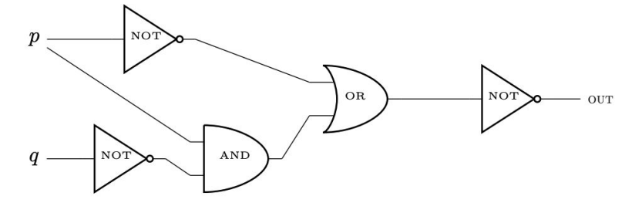

Digital Circuits – Practice
p
q
AND
OUT
p q
Translate the following circuit into logic:
OR
OUT
p NOT
OUT

Slide 30
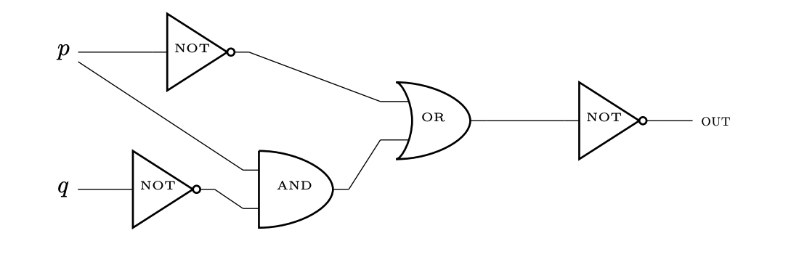
Digital Circuits – Practice
Tip: Think of starting from the end and working back to create the expression.

Slide 31
Digital Circuits – Practice
Tip: Think of starting from the end and working back to create the expression.

Slide 32

Digital Circuits – Practice
Tip: Think of starting from the end and working back to create the expression.

Slide 33
Digital Circuits – Practice
Tip: Think of starting from the end and working back to create the expression.

Slide 34

Digital Circuits – Practice
Tip: Think of starting from the end and working back to create the expression.

Slide 35
Digital Circuits – Practice
Tip: Think of starting from the end and working back to create the expression.

Slide 36

Digital Circuits – Practice
Tip: Think of starting from the end and working back to create the expression.

Slide 37
More Vocabulary

Slide 38
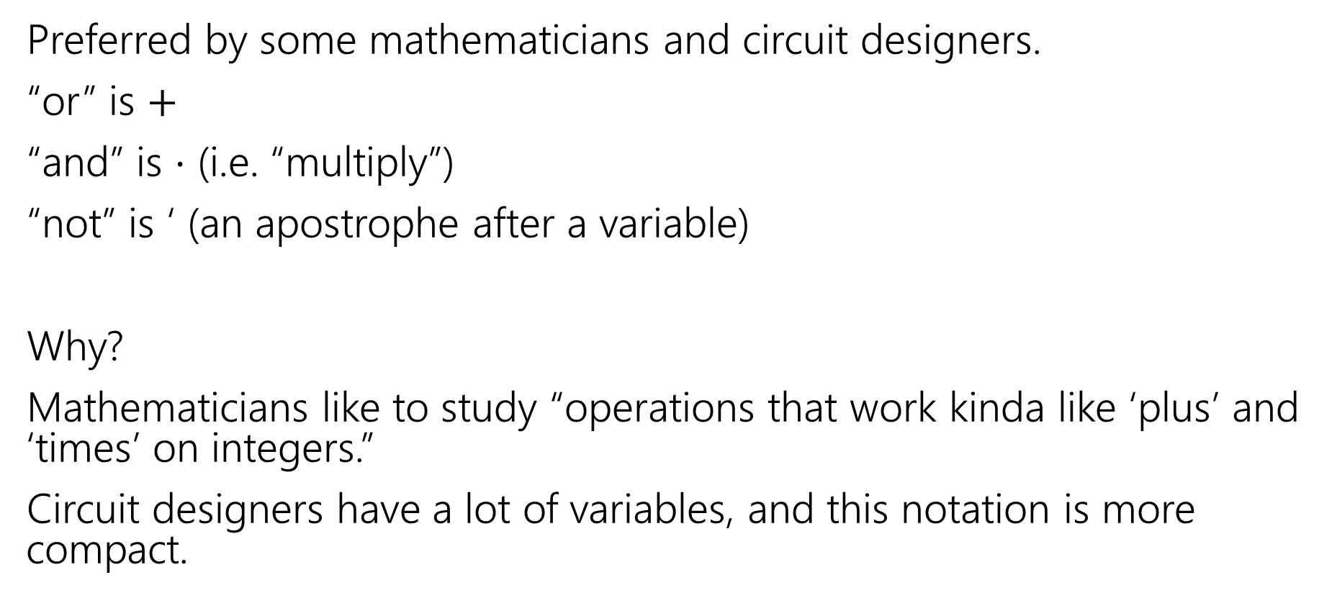

Meet Boolean Algebra
Preferred by some mathematicians and circuit designers.
“or” is $+$
“and” is $⋅$ (i.e. “multiply”)
“not” is ‘ (an apostrophe after a variable)
Why?
Mathematicians like to study “operations that work kinda like ‘plus’ and ‘times’ on integers.”
Circuit designers have a lot of variables, and this notation is more compact.

Slide 39


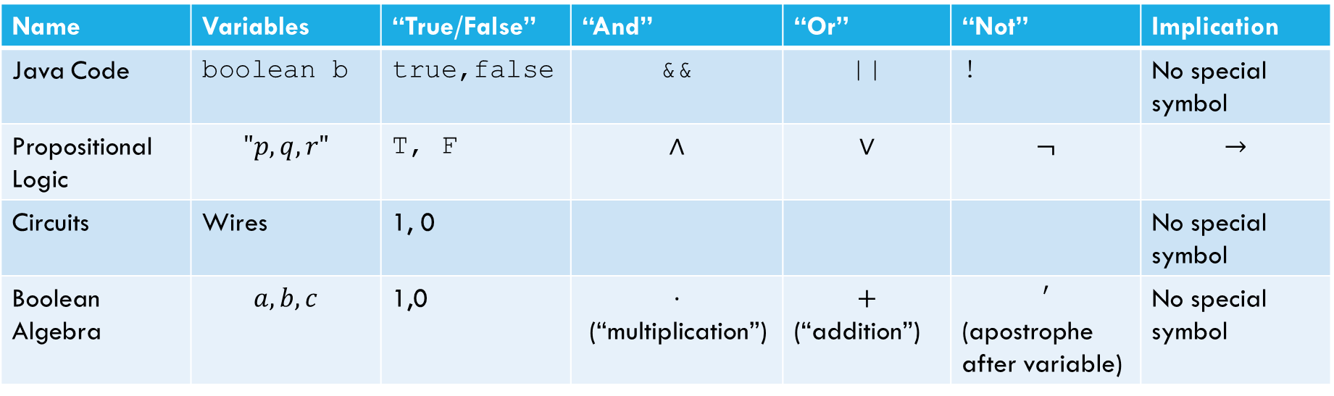


Meet Boolean Algebra
Name | Variables | “True/False” | “And” | “Or” | “Not” | Implication
Java Code | boolean b | true,false | && | || | ! | No special symbol
Propositional Logic | $$"p,q,r"$$ | T, F | $$∧$$ | $$∨$$ | $$¬$$ | $$→$$
Circuits | Wires | 1, 0 |  |  |  | No special symbol
Boolean Algebra | $$a,b,c$$ | 1,0 | $$⋅$$ (“multiplication”) | $$+$$ (“addition”) | $$′$$ (apostrophe after variable) | No special symbol
Propositional logic
Boolean Algebra
$$\left(p∧q∧r\right)∨s∨¬t$$
$$pqr+s+t′$$

Slide 40
Comparison
Propositional logic
Boolean Algebra
$$\left(p∧q∧r\right)∨s∨¬t$$
$$pqr+s+t′$$
Remember this is just an alternate notation for the same underlying ideas.
So that big list of identities? Just change the notation and you get another big list of identities!
Sometimes names are different (“involution” instead of “double negation”), but the core ideas are the same.

Slide 41
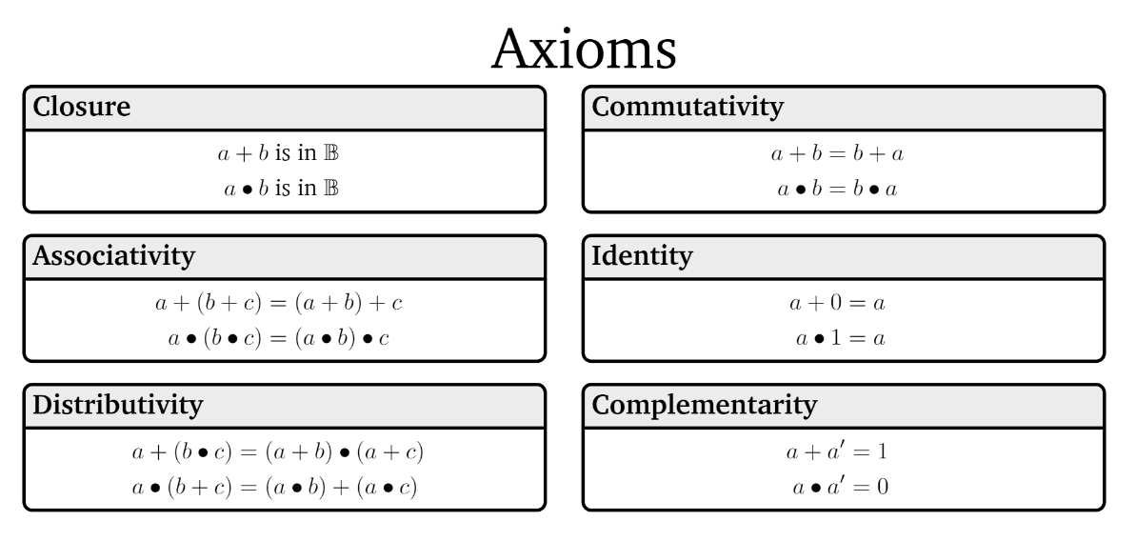

Boolean Algebra

Slide 42
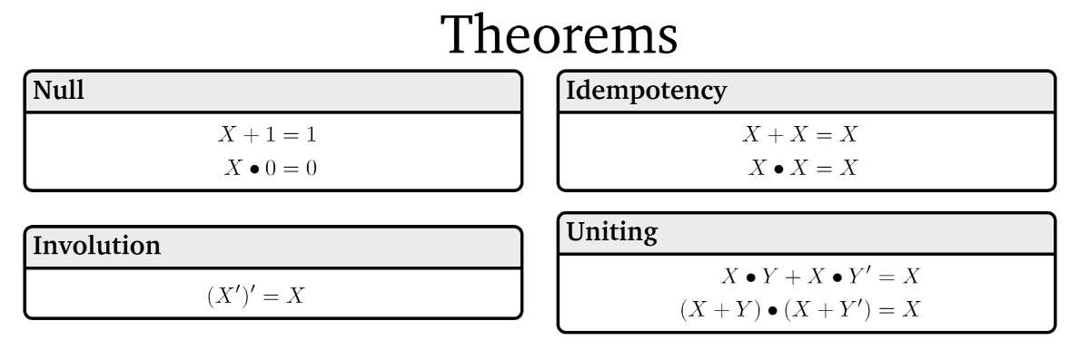
Boolean Algebra

Slide 43
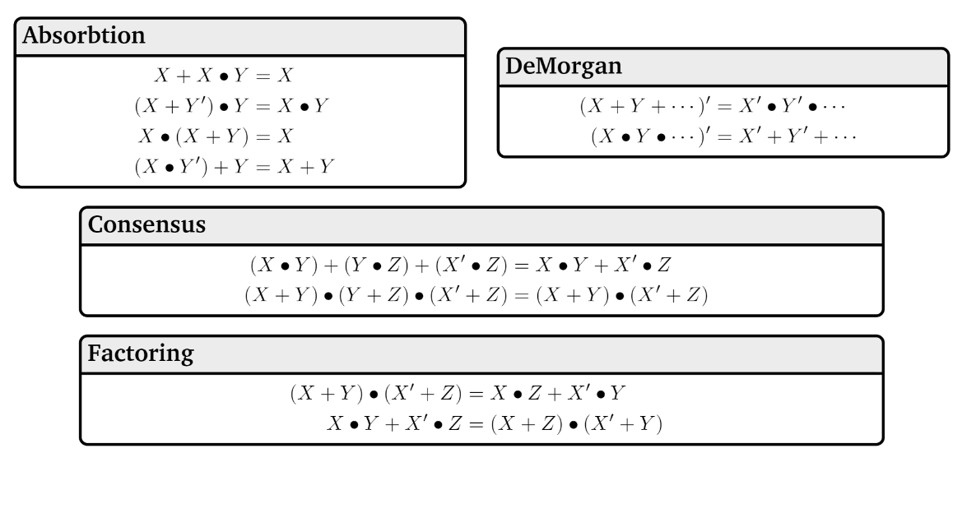
Boolean Algebra

Slide 44
A Few Fun Facts
That you’re not responsible for:
The identities are divided into “axioms” and “theorems”
Mathematicians will sometimes study what minimum starting points (“the axioms”) will be enough to derive all the usual facts we rely on (“the theorems”)
For our purposes, we won’t make a distinction here, but we will use similar thinking later in the course.
Boolean algebra makes things like commutativity axioms (starting points, things we assume) with propositional logic, we start from the truth tables and can derive that commutativity is true. For this class, though, it’s a fact you can use either way.

Slide 45


Why ANOTHER way of writing down logic?
This is the third one!?
Because, in your future courses, you’ll use any/all of them.
Remember there aren’t new concepts here, just new representations.
We mostly use propositional notation ($∧,∨,¬,$etc.) but we’ll use them all a bit so you’re ready for any of them in your future courses.
More practice on the homework.

Slide 46
Normal Forms
Back to the old notation.

Slide 47
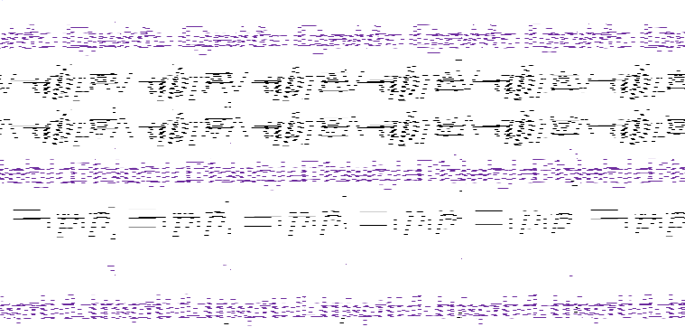
Canonical Forms
A truth table is a unique representation of a Boolean Function.
If you describe a function, there’s only one possible truth table for it.
Given a truth table you can find many circuits and many compound prepositions to represent it.
Think back to when we were developing the law of implication…
It would be nice to have a “standard” proposition (or standard circuit) we could always write as a starting point.
So we have a (possibly) shorter way of telling if we have the same function.

Slide 48
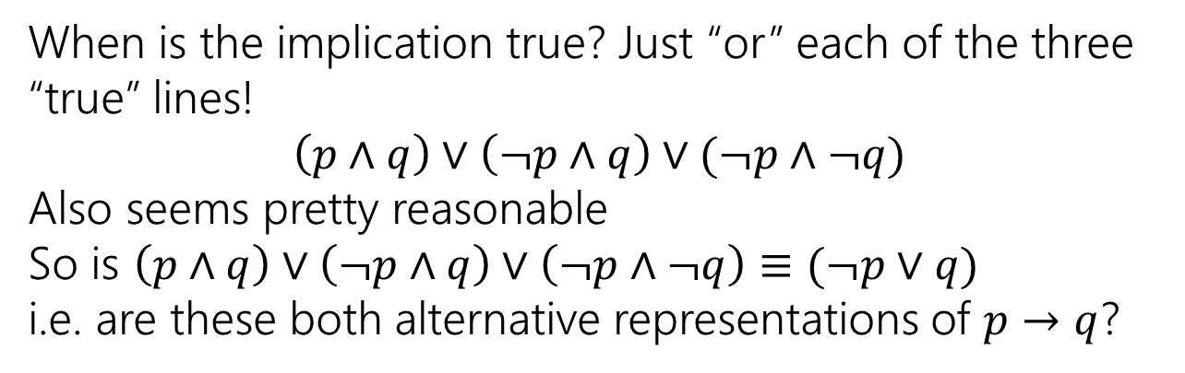
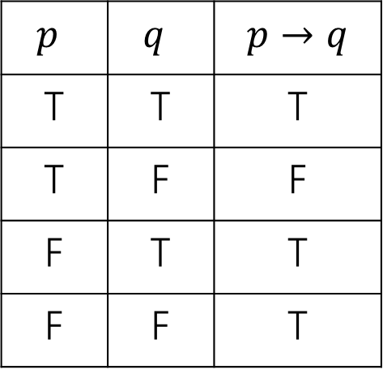
Using Our Rules
WOW that was a lot of rules.
Why do we need them? Simplification!
Let’s go back to the “law of implication” example.
$p$ | $q$ | $$p→q$$
T | T | T
T | F | F
F | T | T
F | F | T
When is the implication true? Just “or” each of the three “true” lines!
$$\left(p∧q\right)∨\left(¬p∧q\right)∨(¬p∧¬q)$$
Also seems pretty reasonable
So is $\left(p∧q\right)∨\left(¬p∧q\right)∨\left(¬p∧¬q\right)≡(¬p∨q)$
i.e. are these both alternative representations of $p→q$?

Slide 49

Disjunctive Normal Form (DNF)
a.k.a. OR of ANDs
a.k.a Sum-of-Products Form
a.k.a. Minterm Expansion
Read the true rows of the truth table
AND together all the settings in a given (true) row.
OR together the true rows.

Slide 50



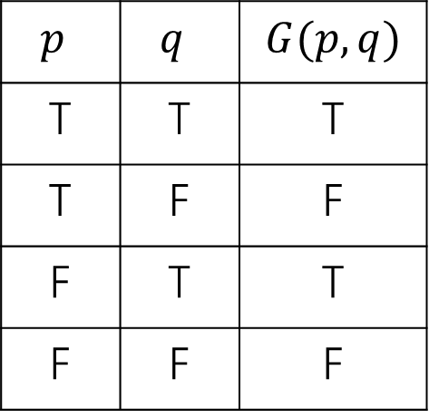

Disjunctive Normal Form
Read the true rows of the truth table
AND together all the settings in a given (true) row.
OR together the true rows.
$p$ | $q$ | $$G(p,q)$$
T | T | T
T | F | F
F | T | T
F | F | F
$$p∧q$$
$$¬p∧q$$
$$G\left(p,q\right)≡\left(p∧q\right)∨(¬p∧q)$$

Slide 51
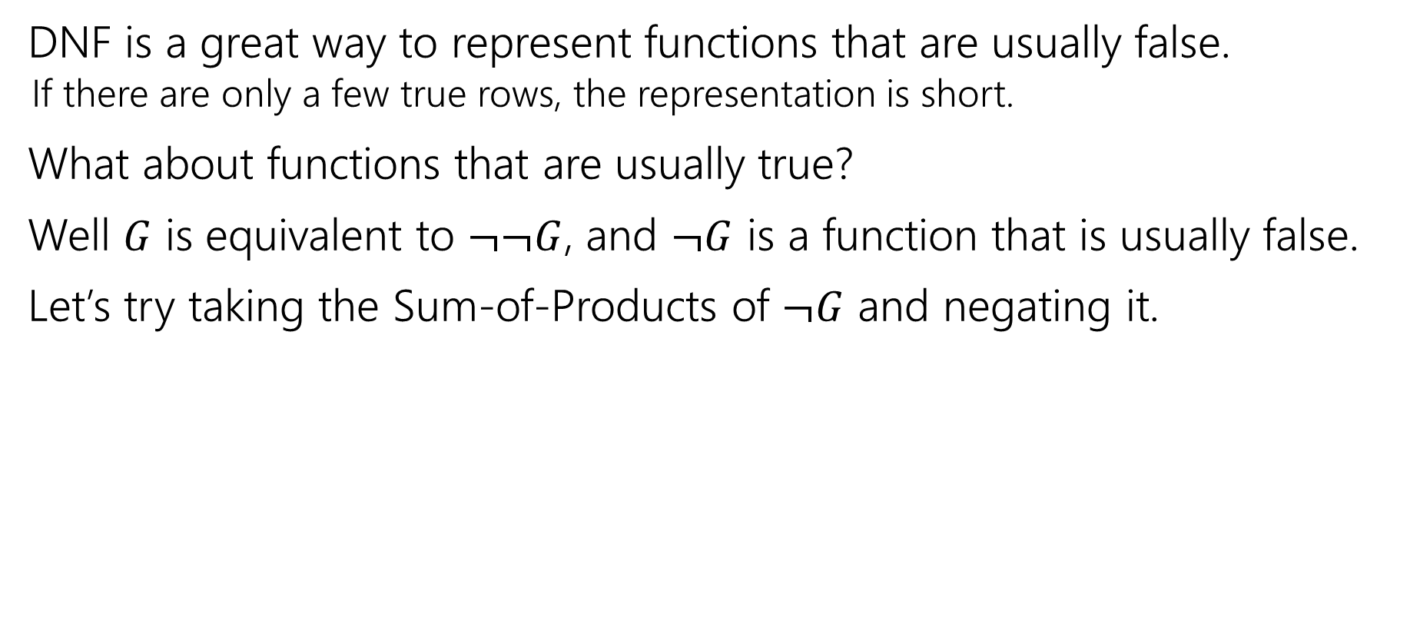

Another Canonical Form
DNF is a great way to represent functions that are usually false.
If there are only a few true rows, the representation is short.
What about functions that are usually true?
Well $G$ is equivalent to $¬¬G$, and $¬G$ is a function that is usually false.
Let’s try taking the Sum-of-Products of $¬G$ and negating it.

Slide 52
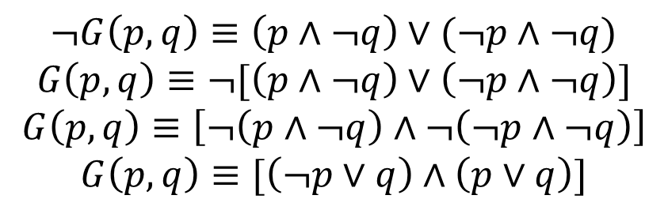


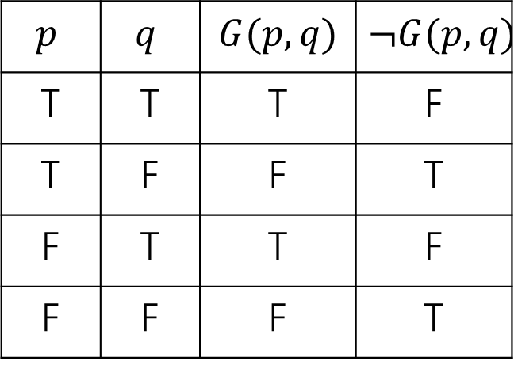

Another Canonical Form
Read the true rows of the truth table
AND together all the settings in a given (true) row.
OR together the true rows.
$p$ | $q$ | $$G(p,q)$$ | $$¬G(p,q)$$
T | T | T | F
T | F | F | T
F | T | T | F
F | F | F | T
$$p∧¬q$$
$$¬p∧¬q$$
$$¬G\left(p,q\right)≡\left(p∧¬q\right)∨(¬p∧¬q)$$
$$G\left(p,q\right)≡¬[\left(p∧¬q\right)∨\left(¬p∧¬q\right)]$$
$$G\left(p,q\right)≡\left[¬\left(p∧¬q\right)∧¬\left(¬p∧¬q\right)\right]$$
$$G\left(p,q\right)≡[\left(¬p∨q\right)∧\left(p∨q\right)]$$
This is not in Disjunctive Normal Form! It’s something else, though…

Slide 53

Conjunctive Normal Form
a.k.a. AND of ORs
a.k.a. Product-of-Sums Form
a.k.a. Maxterm Expansion
Read the false rows of the truth table
OR together the negations of all the settings in the false rows.
AND together the false rows.
Or take the DNF of the negation of the function you care about, and distribute the negation.

Slide 54
Normal Forms
Don’t simplify any further! Don’t factor anything out (even if you can). The point of the canonical form is we know exactly what it looks like, you might simplify differently than someone else.
Why? Easier to understand for people.
Inside the parentheses are only ORs between the parentheses are only ANDs (or vice versa).
You’ll use these more in later courses.

Slide 55
Normal Forms Practice

Slide 56


Normal Forms– Practice
Consider the function $F(A, B, C)$specified by the following truth table:
A | B | C | F(A,B,C)
T | T | T | T
T | T | F | T
T | F | T | F
T | F | F | F
F | T | T | T
F | T | F | T
F | F | T | F
F | F | F | T
Write the DNF and CNF expressions for $F(A, B, C).$

Slide 57
Normal Forms– Practice
Consider the function $F(A, B, C)$specified by the following truth table:
A | B | C | F(A,B,C)
T | T | T | T
T | T | F | T
T | F | T | F
T | F | F | F
F | T | T | T
F | T | F | T
F | F | T | F
F | F | F | T
Write the DNF and CNF expressions for $F(A, B, C).$

Slide 58
Normal Forms– Practice
Consider the function $F(A, B, C)$specified by the following truth table:
A | B | C | F(A,B,C)
T | T | T | T
T | T | F | T
T | F | T | F
T | F | F | F
F | T | T | T
F | T | F | T
F | F | T | F
F | F | F | T
Write the DNF and CNF expressions for $F(A, B, C).$
DNF: (OR of ANDs)

Slide 59





Normal Forms– Practice
Consider the function $F(A, B, C)$specified by the following truth table:
A | B | C | F(A,B,C)
T | T | T | T
T | T | F | T
T | F | T | F
T | F | F | F
F | T | T | T
F | T | F | T
F | F | T | F
F | F | F | T
Write the DNF and CNF expressions for $F(A, B, C).$
DNF: (OR of ANDs)

Slide 60

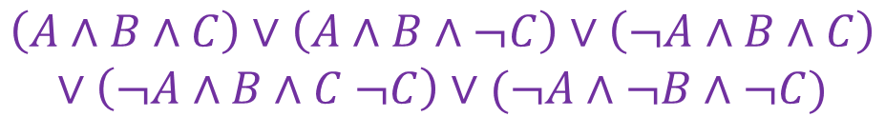
Normal Forms– Practice
Consider the function $F(A, B, C)$specified by the following truth table:
A | B | C | F(A,B,C)
T | T | T | T
T | T | F | T
T | F | T | F
T | F | F | F
F | T | T | T
F | T | F | T
F | F | T | F
F | F | F | T
Write the DNF and CNF expressions for $F(A, B, C).$
$$\left(A∧B∧C\right)∨\left(A∧B∧¬C\right)∨\left(¬A∧B∧C\right)$$
$$∨\left(¬A∧B∧C ¬C\right)∨(¬A∧¬B∧¬C)$$

Slide 61
Normal Forms– Practice
Consider the function $F(A, B, C)$specified by the following truth table:
A | B | C | F(A,B,C)
T | T | T | T
T | T | F | T
T | F | T | F
T | F | F | F
F | T | T | T
F | T | F | T
F | F | T | F
F | F | F | T
Write the DNF and CNF expressions for $F(A, B, C).$
CNF: (AND of ORs)

Slide 62




Normal Forms– Practice
Consider the function $F(A, B, C)$specified by the following truth table:
A | B | C | F(A,B,C)
T | T | T | T
T | T | F | T
T | F | T | F
T | F | F | F
F | T | T | T
F | T | F | T
F | F | T | F
F | F | F | T
Write the DNF and CNF expressions for $F(A, B, C).$
CNF: (AND of ORs)

Slide 63
Normal Forms– Practice
Consider the function $F(A, B, C)$specified by the following truth table:
A | B | C | F(A,B,C)
T | T | T | T
T | T | F | T
T | F | T | F
T | F | F | F
F | T | T | T
F | T | F | T
F | F | T | F
F | F | F | T
Write the DNF and CNF expressions for $F(A, B, C).$
CNF: (AND of ORs)
$$\left(¬A∨B∨¬C\right)∧\left(¬A∨B∨C\right)∧(A∨B∨¬C)$$

Slide 64
Todo
Tonight:
Take a look at HW1 that’s posted on the course website and attempt to get started if you haven’t already
Soon:
Form a study group! Organize on the Ed board!
Complete CC3 (due Monday)

Slide 65
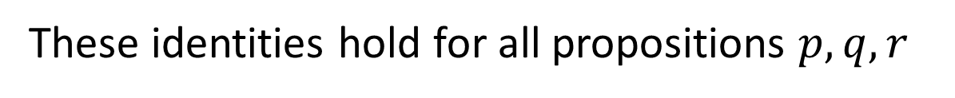
Properties of Logical Connectives
These identities hold for all propositions $p,q,r$
Identity
$p∧T≡p$
$p∨F≡p$
Domination
$p∨T≡T$
$p∧F≡F$
Idempotent
$p∨p≡p$
$p∧p≡p$
Commutative
$p∨q≡q∨p$
$p∧q≡q∧p$
Associative
$\left(p∨q\right)∨r≡p∨\left(q∨r\right)$
$\left(p∧q\right)∧r≡p∧\left(q∧r\right)$
Distributive
$p∧\left(q∨r\right)≡\left(p∧q\right)∨\left(p∧r\right)$
$p∨\left(q∧r\right)≡\left(p∨q\right)∧(p∨r)$
Absorption
$p∨\left(p∧q\right)≡p$
$p∧\left(p∨q\right)≡p$
Negation
$p∨¬p≡T$
$p∧¬p≡F$
DeMorgan’s Laws
$¬\left(p∨q\right)≡¬p∧¬q$
$¬\left(p∧q\right)≡¬p∨¬q$
Double Negation
$¬¬p≡p$
Law of Implication
$p→q≡¬p∨q$
Contrapositive
$p→q≡¬q→¬p$

