Slide 1
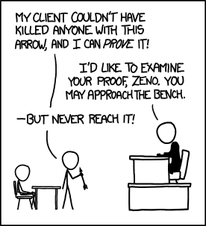
Equivalences and Our First Proof
xkcd.com/1153
CSE 311 Summer 2025
Lecture 2

Slide 2
Announcements
HW1
Posted on the course website
Due Wednesday, 11:59 pm
Submit on Gradescope
OH starts today!
OH times listed on the course calendar on our website
Zoom links are on the Pinned Thread of Important Links on Ed
Go to section tomorrow!
CC1 and CC2 due Friday at noon

Slide 3
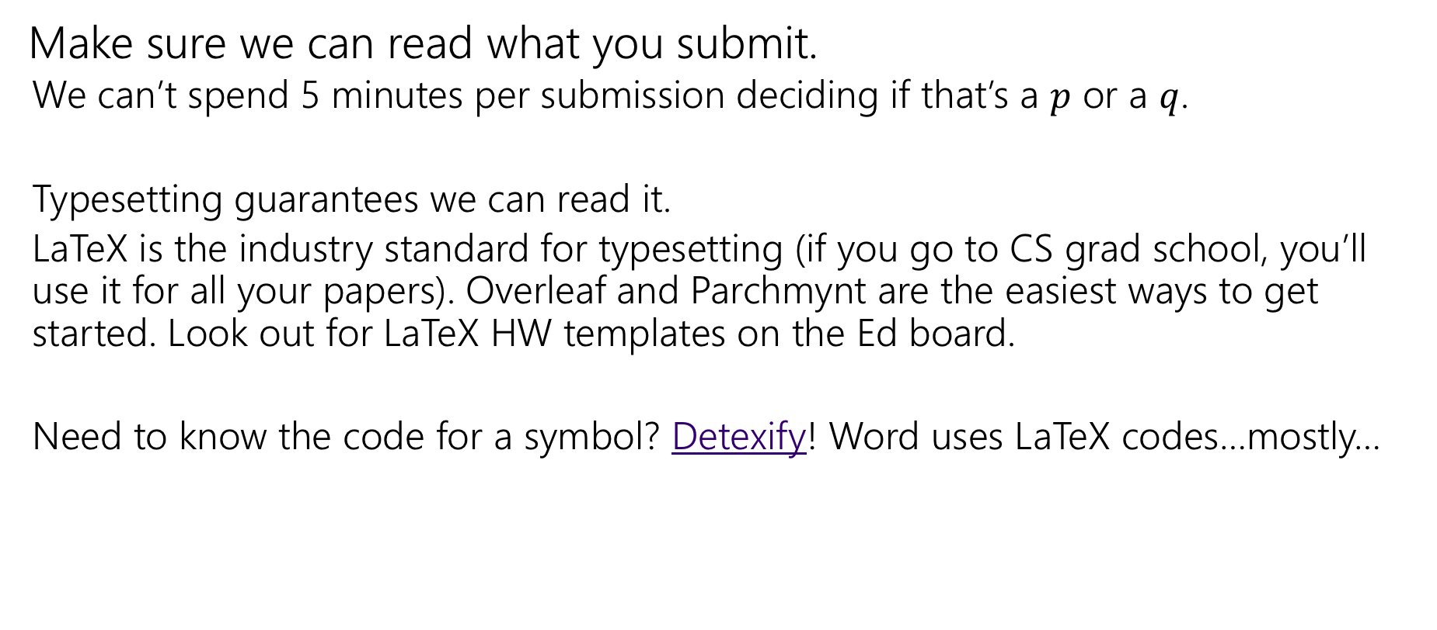
Homework Submissions
Make sure we can read what you submit.
We can’t spend 5 minutes per submission deciding if that’s a $p$ or a $q$.
Typesetting guarantees we can read it.
LaTeX is the industry standard for typesetting (if you go to CS grad school, you’ll use it for all your papers). Overleaf and Parchmynt are the easiest ways to get started. Look out for LaTeX HW templates on the Ed board.
Need to know the code for a symbol? Detexify! Word uses LaTeX codes…mostly…

Slide 4
Announcements: Office Hours
A chance to talk to staff about the class.
Aim early on in the “homework cycle” (i.e., long before the deadline).
We won’t answer every kind of question in office hours:
We don’t “pregrade” homework. We won’t tell you whether something is right or wrong.
We will help on homework, but not usually by “giving hints.” We’ll usually ask questions about what you’ve tried, ask questions to help you decide what to do next, or point you to good examples to look at.
You’re allowed to talk to others at office hours, as long as you’re still following the collaboration policy.

Slide 5
Review

Slide 6

Propositions
Propositions
Propositions are T/F-valued statements
Combine using logical connectives (¬,∨,∧, →,etc.)
Can be described by a truth table
Applications
Understanding complex English sentences
Simplifying Boolean logic in code

Slide 7
Recall: Atomic Propositions
Atomic Propositions are true or false statements that cannot be broken down any further
Compound Propositions can be divided into simpler propositions.
Propositional variables: 𝑝, 𝑞, 𝑟, 𝑠 …

Slide 8

Recall: Logical Connectives
Name Not And Or XOR
Implication Biconditional
Logical Symbol
¬𝑝
𝑝 ∧ 𝑞
𝑝 ∨ 𝑞
𝑝 ⊕ 𝑞
𝑝 → 𝑞
𝑝 ↔ 𝑞

Slide 9

Recall: Truth Tables
𝑝 | 𝑞 | 𝑝 ∧ 𝑞
T | T | T
T | F | F
F | T | F
F | F | F
𝑝 | ¬𝑝
T | F
F | T
𝑝 | 𝑞 | 𝑝 ∨ 𝑞
T | T | T
T | F | T
F | T | T
F | F | F
𝑝 | 𝑞 | 𝑝 ⊕ 𝑞
T | T | F
T | F | T
F | T | T
F | F | F

Slide 10

Recall: Implication
“If it’s raining, then I have my umbrella”
𝑝: It is raining 𝑞: I have my umbrella
𝑝 → 𝑞
𝑝 | 𝑞 | 𝑝 → 𝑞
T | T | T
T | F | F
F | T | T
F | F | T
Equivalently:
Whenever it is raining, I have my umbrella.
It is raining only if I have my umbrella.
For it to be raining, it is necessary that I have my umbrella.

Slide 11
Warm Up

Slide 12

Warm Up
Translate this sentence into symbolic logic, and describe a weather pattern and transportation method that causes the proposition to be false.
It is snowing today, and if it is raining or snowing then we won’t walk to school.

Slide 13
Warm Up – Solution
Translate this sentence into symbolic logic, and describe a weather pattern and transportation method that causes the proposition to be false.
It is snowing today, and if it is raining or snowing then we won’t walk to school.
Parker’s process: identify connecting words, identify propositions, replace English with logic, figure out parentheses

Slide 14

Warm Up – Solution
Translate this sentence into symbolic logic, and describe a weather pattern and transportation method that causes the proposition to be false.
It is snowing today, and if it is raining or snowing then we won’t walk to school.
Identify connecting words: look for and, or, not, if-then, etc.

Slide 15
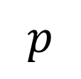


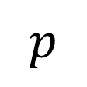
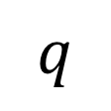
Warm Up – Solution
Translate this sentence into symbolic logic, and describe a weather pattern and transportation method that causes the proposition to be false.
It is snowing today, and if it is raining or snowing then we won’t walk to school.
Identify propositions: What’s left are propositions, look for repeats and hidden negations.
$$p$$
$$q$$
$$¬r$$
$$p$$
$p:$it is snowing today.
$q:$ it is raining.
$r:$ we walk to school.

Slide 16


Warm Up – Solution
Translate this sentence into symbolic logic, and describe a weather pattern and transportation method that causes the proposition to be false.
It is snowing today, and if it is raining or snowing then we won’t walk to school.
Replace English with logic
$$p$$
$$q$$
$$¬r$$
$$p$$
$p:$it is snowing today.
$q:$ it is raining.
$r:$ we walk to school.
$$p∧q∨p→¬r$$

Slide 17

Warm Up – Solution
Translate this sentence into symbolic logic, and describe a weather pattern and transportation method that causes the proposition to be false.
It is snowing today, and if it is raining or snowing then we won’t walk to school.
Figure out parentheses
$$p$$
$$q$$
$$¬r$$
$$p$$
$p:$it is snowing today.
$q:$ it is raining.
$r:$ we walk to school.
$$p∧[(q∨p)→¬r]$$
“raining or snowing” is the condition of the implication, not walking to school is the conclusion. Omitted words in other clauses hint that “It is snowing today” stands on its own.

Slide 18
Today
Logical Equivalences
Simplification Rules
Our first proof!
Modifying Implications

Slide 19
Logical Equivalences

Slide 20

Logical Equivalence
Definition:
Two propositions are logically equivalent if they have identical truth values.
The notation for A and B being logically equivalent is A ≡ B.
Examples:
𝑝 ∨ 𝑞 ≡ 𝑞 ∨ 𝑝
𝑝 ↔ 𝑞 ≡ (𝑝 → 𝑞) ∧ (𝑞 → 𝑝)

Slide 21

= vs. ≡ vs. ↔
A = B means A, B are the exact same string.
E.g. 𝑝 ∨ 𝑞 = 𝑝 ∨ 𝑞, but 𝑝 ∨ 𝑞 ≠ 𝑞 ∨ 𝑝. We hardly use = with propositions!
A ≡ B is an assertion that A, B always have the same truth value.
E.g. 𝑝 ∨ 𝑞 ≡ 𝑞 ∨ 𝑝.
A ↔ B is a proposition that might be true or false.
E.g. 𝑝 ∨ 𝑞 ↔ 𝑝 ∧ 𝑞 is a false proposition.
𝐴 ≡ 𝐵 has the same meaning as 𝐴 ↔ 𝐵 ≡ 𝑇.

Slide 22
Proving Logical Equivalences

Slide 23

Motivation
Given two propositions, we would like to know if they are equivalent.
E.g. one developer wrote if 𝑝 && 𝑝 || 𝑝 {… }. Another developer wrote if (𝑝) {… }.
You want to confirm if those are the same.
Given a complicated proposition, we would like to find a simpler
proposition that it’s equivalent to.
E.g. you see if 𝑝 && 𝑝 || 𝑝 {… } in code. You simplify the code to if 𝑝 {… }.

Slide 24
Strategy 1: Truth Tables
Make a truth table for the two propositions and check if they are the same.
𝑝 vs. 𝑝 ∧ 𝑝 ∨ 𝑝
𝑝 | 𝑝 ∧ 𝑝 | 𝑝 ∧ 𝑝 ∨ 𝑝
T | T | T
F | F | F

Slide 25
Strategy 1: Truth Tables
Truth tables do let us check if two propositions are equivalent.
Truth tables don’t give us a good way to start from a complicated proposition, and simplify it.

Slide 26

Strategy 2: Manipulating Expressions
Instead, we are going to learn logical equivalence rules to help us simplify expressions.
Similar to algebra, where we can apply rules to transform expressions into equivalent expressions:
𝑥 + 3 = 𝑥² + 2𝑥 + 3𝑥 + 6
= 𝑥² + 5𝑥 + 6
Distributivity Adding like terms
𝑥 + 2
By the end of the course, you’ll do these “automatically” on full sentences; for now we’ll practice mechanically on symbolic forms to gain intuition for why these rules work.

Slide 27
Logical Equivalence Rules

Slide 28
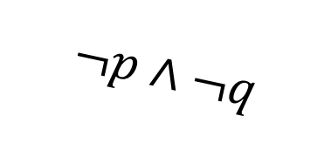
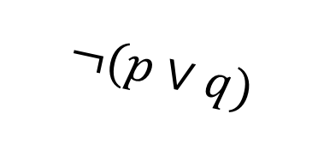

De Morgan’s Laws
Negate the statement
“my code compiles or there is a bug.”
i.e. find a natural English sentence that says
“the following is not true: my code compiles or there is a bug”
Hint: when it the original sentence false?
$$¬(p∨q)$$
‘or’ means ‘at least one is true’ so to negate, we need to say ‘neither is true’ or equivalently ‘both are false’
“my code does not compile and there is not a bug”
$$¬p∧¬q$$

Slide 29
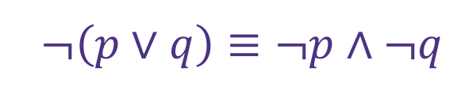

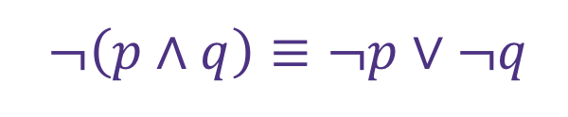

De Morgan’s Laws
$¬\left(p∨q\right)≡¬p∧¬q$
is a general rule. It’s always true for any propositions $p$ and $q$.
This is one of De Morgan’s Laws.
The other is:
$¬\left(p∧q\right)≡¬p∨¬q$

Slide 30

De Morgan’s Laws
Example: $¬\left(p∧q\right)≡¬p∨¬q$
p | q | ¬p | ¬q | ¬p ∨ ¬q | p ∧ q | ¬(p ∧ q)
T | T | F | F | F | T | F
T | F | F | T | T | F | T
F | T | T | F | T | F | T
F | F | T | T | T | F | T
Every line is the same! So these expressions are equivalent.

Slide 31
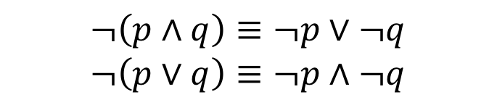

De Morgan’s Laws
$$¬\left(p∧q\right)≡¬p∨¬q$$
$$¬\left(p∨q\right)≡¬p∧¬q$$
if (!(front != null && value > front.data))
front = new ListNode(value, front);
else {
ListNode current = front;
while (current.next != null && current.next.data < value))
current = current.next;
current.next = new ListNode(value, current.next);
}

Slide 32


De Morgan’s Laws
$$¬\left(p∧q\right)≡¬p∨¬q$$
$$¬\left(p∨q\right)≡¬p∧¬q$$
!(front != null && value > front.data)
$$$$
front == null || value <= front.data
You’ve been using these for a while!

Slide 33
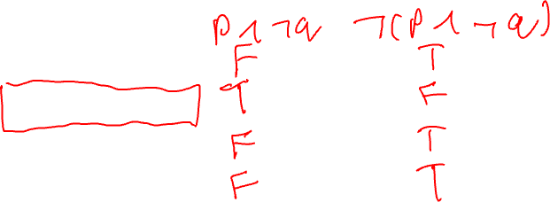
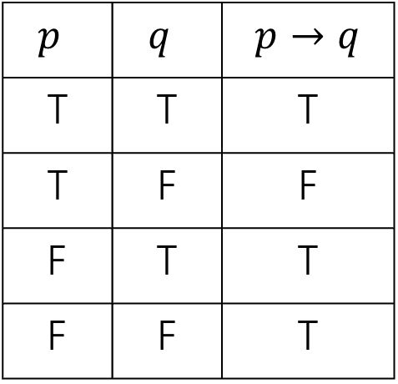
Law of Implication
Implications are hard.
AND/OR/NOT make more intuitive sense to me…
can we rewrite implications using just ANDs ORs and NOTs?
$p$ | $q$ | $$p→q$$
T | T | T
T | F | F
F | T | T
F | F | T
One approach: think “when is this implication false?” then negate it (you might want one of DeMorgan’s Laws!

Slide 34
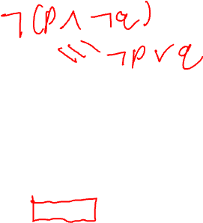

Law of Implication
Implications are hard.
AND/OR/NOT make more intuitive sense to me…
can we rewrite implications using just ANDs ORs and NOTs?
$p$ | $q$ | $$p→q$$
T | T | T
T | F | F
F | T | T
F | F | T
Seems like we might want $¬(p∧¬q)$
$$¬p∨q$$
Seems like a reasonable guess.
So is it true? Is $¬p∨q≡p→q$?

Slide 35

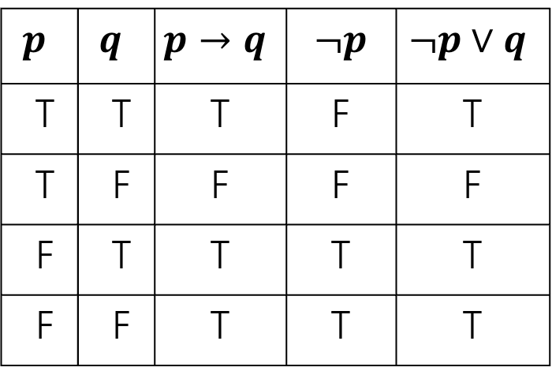
Law of Implication
$$¬p∨q≡p→q$$
$$p$$ | $$q$$ | $$p→q$$ | $¬p$ | $$¬p∨q$$
T | T | T | F | T
T | F | F | F | F
F | T | T | T | T
F | F | T | T | T
Every line is the same! So these expressions are equivalent.

Slide 36
Properties of Logical Connectives
We’ve derived two facts about logical connectives.
There’s a lot more. A LOT more.
The next slide is a list of a bunch of them…
Most of these are much less complicated than the last two, so we won’t go through them in detail.
DO NOT freak out about how many there are. We will always provide you the list on the next slide (no need to memorize).

Slide 37
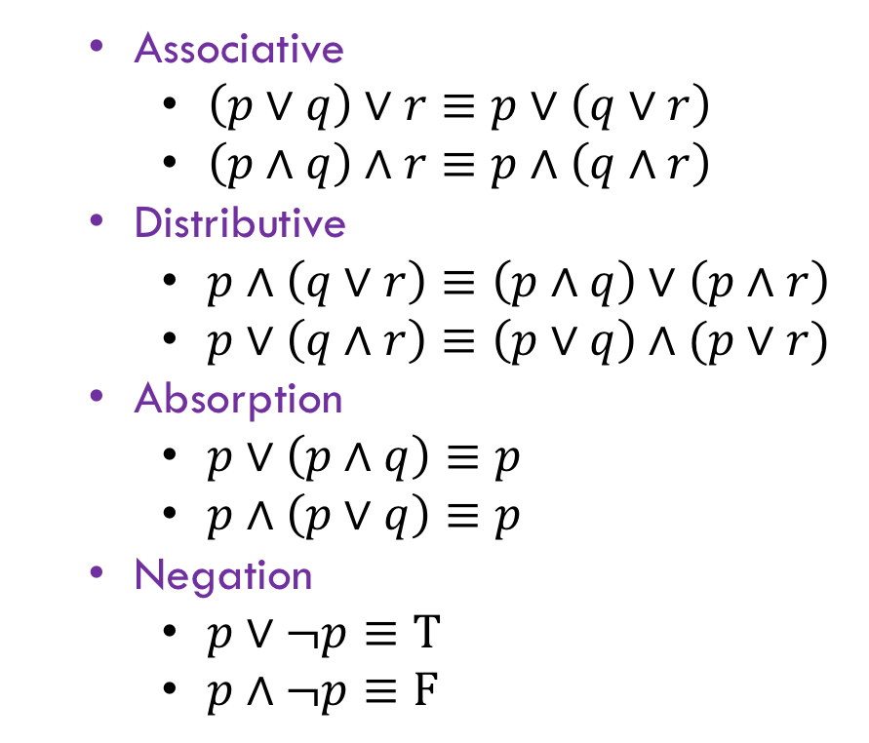
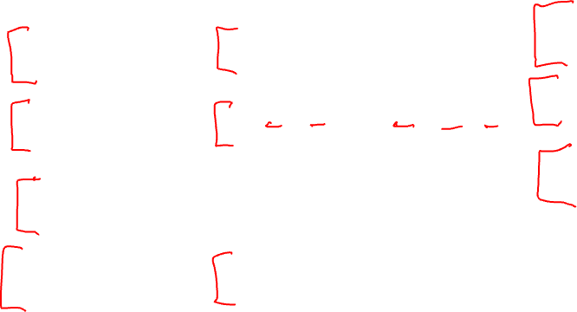
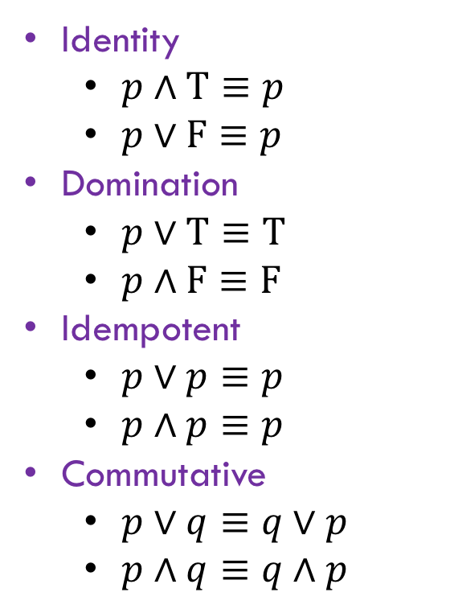
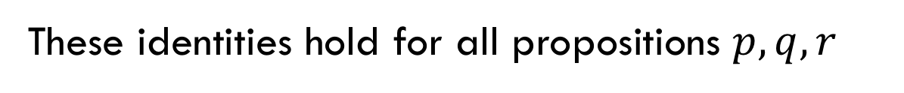
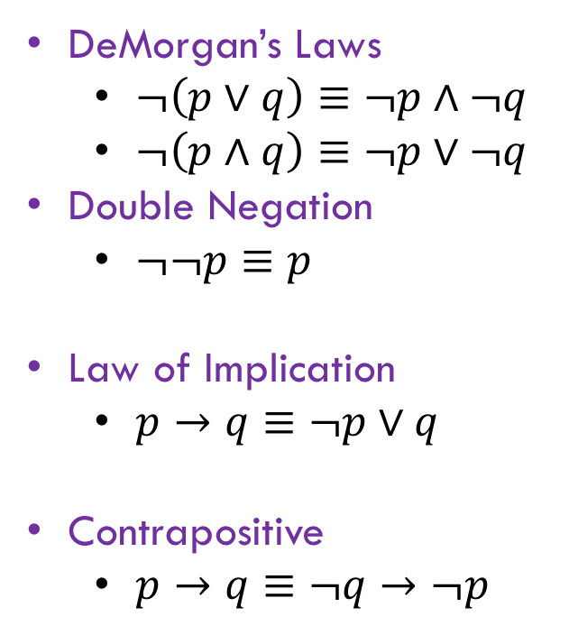
Properties of Logical Connectives
These identities hold for all propositions $p,q,r$
Identity
$p∧T≡p$
$p∨F≡p$
Domination
$p∨T≡T$
$p∧F≡F$
Idempotent
$p∨p≡p$
$p∧p≡p$
Commutative
$p∨q≡q∨p$
$p∧q≡q∧p$
Associative
$\left(p∨q\right)∨r≡p∨\left(q∨r\right)$
$\left(p∧q\right)∧r≡p∧\left(q∧r\right)$
Distributive
$p∧\left(q∨r\right)≡\left(p∧q\right)∨\left(p∧r\right)$
$p∨\left(q∧r\right)≡\left(p∨q\right)∧(p∨r)$
Absorption
$p∨\left(p∧q\right)≡p$
$p∧\left(p∨q\right)≡p$
Negation
$p∨¬p≡T$
$p∧¬p≡F$
DeMorgan’s Laws
$¬\left(p∨q\right)≡¬p∧¬q$
$¬\left(p∧q\right)≡¬p∨¬q$
Double Negation
$¬¬p≡p$
Law of Implication
$p→q≡¬p∨q$
Contrapositive
$p→q≡¬q→¬p$

Slide 38

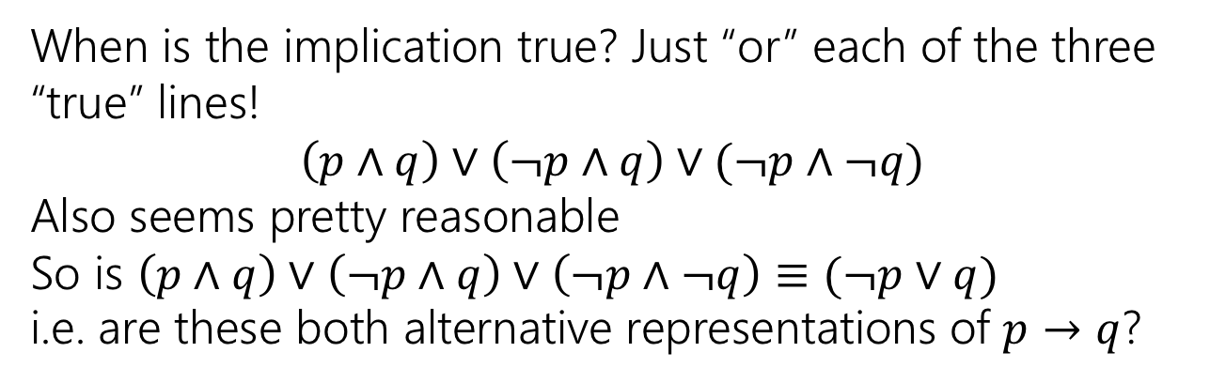
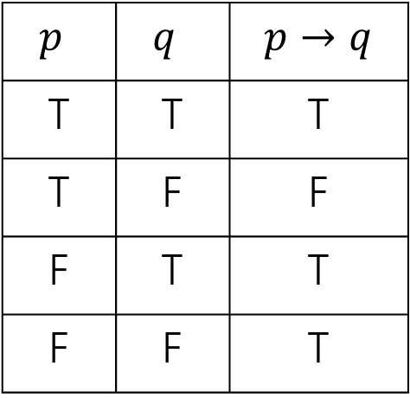
Using Our Rules
WOW that was a lot of rules.
Why do we need them? Simplification!
Let’s go back to the “law of implication” example.
$p$ | $q$ | $$p→q$$
T | T | T
T | F | F
F | T | T
F | F | T
When is the implication true? Just “or” each of the three “true” lines!
$$\left(p∧q\right)∨\left(¬p∧q\right)∨(¬p∧¬q)$$
Also seems pretty reasonable
So is $\left(p∧q\right)∨\left(¬p∧q\right)∨\left(¬p∧¬q\right)≡(¬p∨q)$
i.e. are these both alternative representations of $p→q$?

Slide 39
Our First Proof

Slide 40
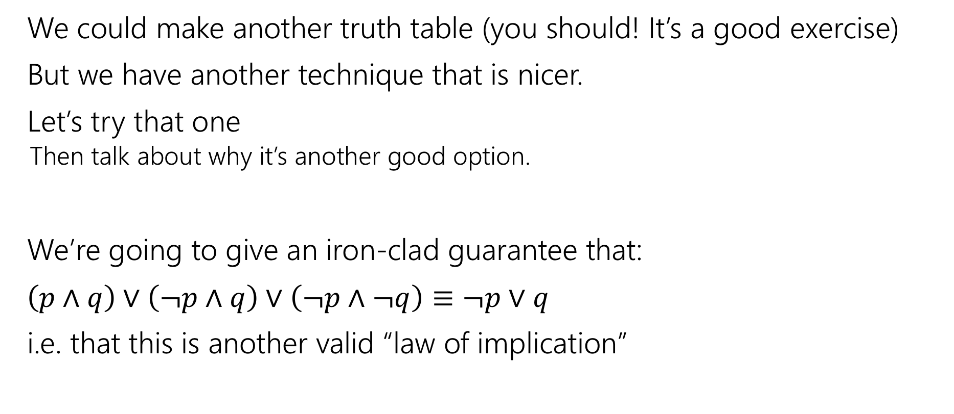
Our First Proof
We could make another truth table (you should! It’s a good exercise)
But we have another technique that is nicer.
Let’s try that one
Then talk about why it’s another good option.
We’re going to give an iron-clad guarantee that:
$\left(p∧q\right)∨\left(¬p∧q\right)∨\left(¬p∧¬q\right)≡¬p∨q$
i.e. that this is another valid “law of implication”

Slide 41
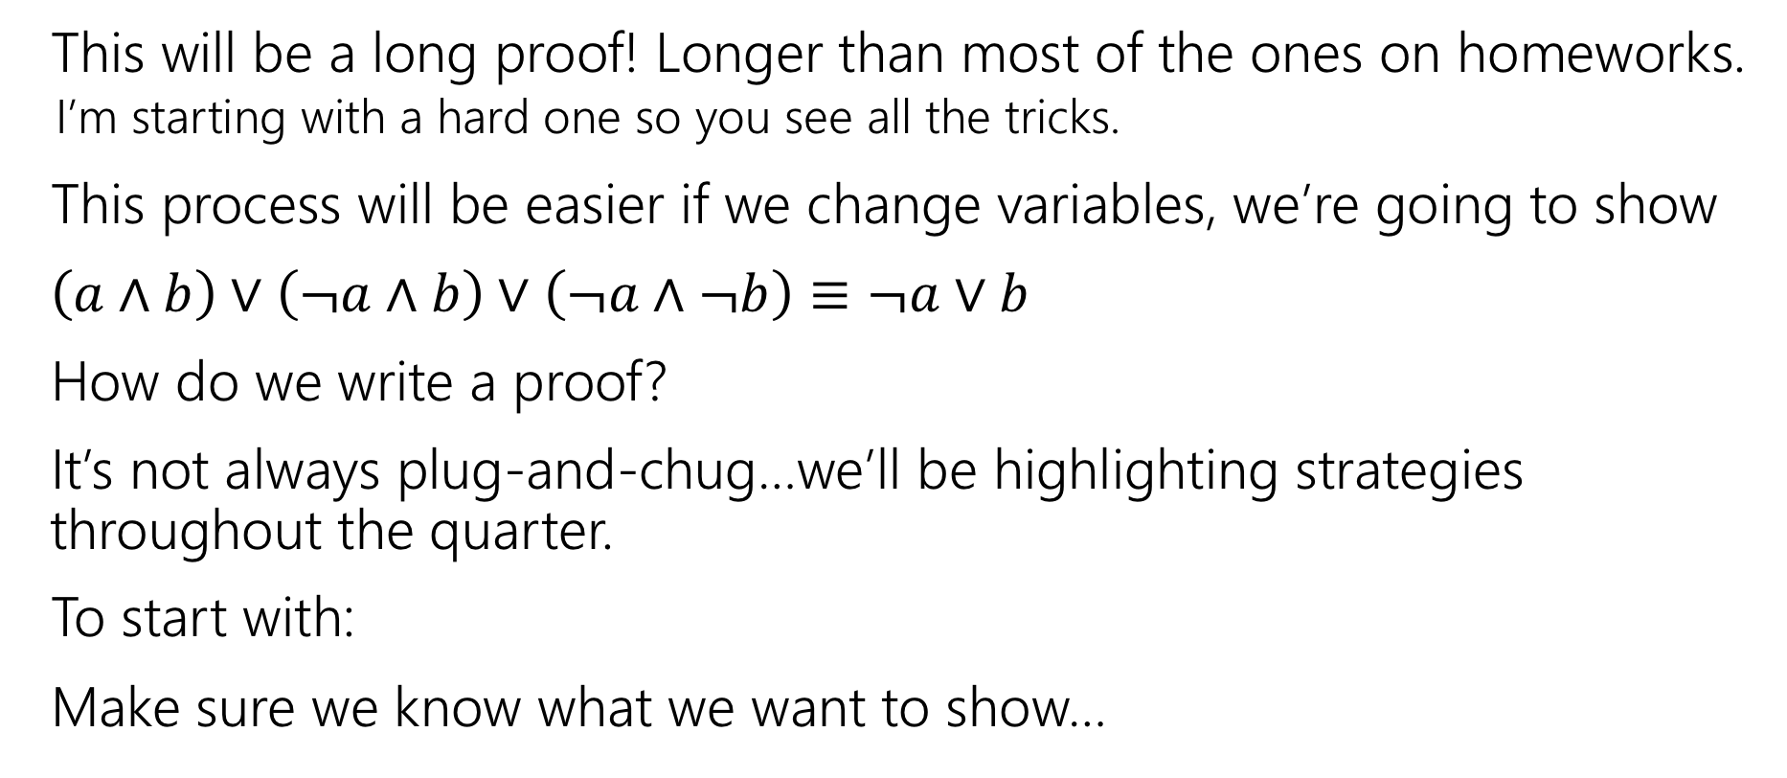
Our First Proof
This will be a long proof! Longer than most of the ones on homeworks.
I’m starting with a hard one so you see all the tricks.
This process will be easier if we change variables, we’re going to show
$\left(a∧b\right)∨\left(¬a∧b\right)∨\left(¬a∧¬b\right)≡¬a∨b$
How do we write a proof?
It’s not always plug-and-chug…we’ll be highlighting strategies throughout the quarter.
To start with:
Make sure we know what we want to show…
Notes:
Just replaced p with a and q with b. Same as if you replaced the “I” in a for-loop with a “j” everywhere in that loop.

Slide 42

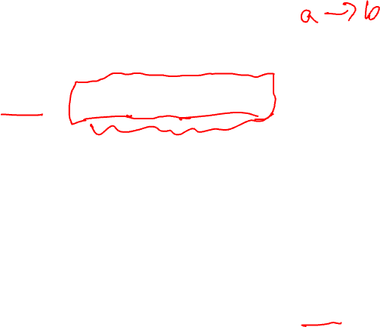


Our First Proof
$\left(a∧b\right)∨\left(¬a∧b\right)∨(¬a∧¬b)$
$≡\left(p∧q\right)∨[\left(¬p∧q\right)∨\left(¬p∧¬q\right)]$
$≡\left(p∧q\right)∨\left[¬p∧\left(q∨¬q\right)\right]$
$≡\left(p∧q\right)∨[¬p∧T]$
$≡\left(p∧q\right)∨[¬p]$
$≡\left[¬p\right]∨(p∧q)$
$≡\left(¬p∨p\right)∧\left(¬p∨q\right)$
$≡T∧\left(¬p∨q\right)$
$≡$ $\left(¬p∨q\right)∧T$
$≡(¬a∨b)$
None of the rules look like this
Practice of Proof-Writing: Big Picture…WHY do we think this might be true?
The last two “pieces” came from the vacuous proof lines…maybe the “$¬a$” came from there? Maybe that simplifies down to $¬a$

Slide 43

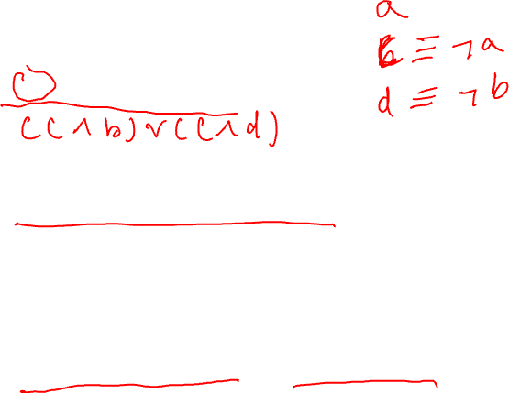
Let’s apply a rule
$\left(¬a∧b\right)∨(¬a∧¬b)$
The law says:
$p∧\left(q∨r\right)≡\left(p∧q\right)∨(p∧r)$
$\left(¬a∧b\right)∨\left(¬a∧¬b\right)≡¬a∧(b∨¬b)$

Slide 44

Our First Proof
$\left(a∧b\right)∨\left(¬a∧b\right)∨(¬a∧¬b)$
$≡\left(p∧q\right)∨[\left(¬p∧q\right)∨\left(¬p∧¬q\right)]$
$≡\left(p∧q\right)∨\left[¬p∧\left(q∨¬q\right)\right]$
$≡\left(p∧q\right)∨[¬p∧T]$
$≡\left(p∧q\right)∨[¬p]$
$≡\left[¬p\right]∨(p∧q)$
$≡\left(¬p∨p\right)∧\left(¬p∨q\right)$
$≡T∧\left(¬p∨q\right)$
$≡$ $\left(¬p∨q\right)∧T$
$≡(¬a∨b)$
None of the rules look like this
Practice of Proof-Writing: Big Picture…WHY do we think this might be true?
The last two “pieces” came from the vacuous proof lines…maybe the “$¬a$” came from there? Maybe that simplifies down to $¬a$

Slide 45

Our First Proof
$\left(a∧b\right)∨\left(¬a∧b\right)∨(¬a∧¬b)$
$≡\left(a∧b\right)∨[\left(¬a∧b\right)∨\left(¬a∧¬b\right)]$
$≡\left[¬p\right]∨(p∧q)$
$≡\left(\begin{aligned}¬p \\ \\ \\ \\ ∨p\end{aligned}\right)∧\left(¬p∨q\right)$
$≡T∧\left(¬p∨q\right)$
$≡$ $\left(¬p∨q\right)∧T$
$≡(¬a∨b)$
Set ourselves an intermediate goal.
Let’s try to simplify those last two pieces
Associative law
Connect up the things we’re working on.

Slide 46


Our First Proof
$\left(a∧b\right)∨\left(¬a∧b\right)∨(¬a∧¬b)$
$≡\left(a∧b\right)∨[\left(¬a∧b\right)∨\left(¬a∧¬b\right)]$
$≡\left(a∧b\right)∨\left[¬a∧\left(b∨¬b\right)\right]$
$≡\left[¬p\right]∨(p∧q)$
$≡\left(¬p∨p\right)∧\left(¬p∨q\right)$
$≡T∧\left(¬p∨q\right)$
$≡$ $\left(¬p∨q\right)∧T$
$≡(¬a∨b)$
Set ourselves an intermediate goal.
Let’s try to simplify those last two pieces
Distributive law
We think $¬a$ is important, let’s isolate it.

Slide 47

Our First Proof
$\left(a∧b\right)∨\left(¬a∧b\right)∨(¬a∧¬b)$
$≡\left(a∧b\right)∨[\left(¬a∧b\right)∨\left(¬a∧¬b\right)]$
$≡\left(a∧b\right)∨\left[¬a∧\left(b∨¬b\right)\right]$
$≡\left(a∧b\right)∨[¬a∧T]$
$≡\left[¬p\right]∨(p∧q)$
$≡\left(¬p∨p\right)∧\left(¬p∨q\right)$
$≡T∧\left(¬p∨q\right)$
$≡$ $\left(¬p∨q\right)∧T$
$≡(¬a∨b)$
Set ourselves an intermediate goal.
Let’s try to simplify those last two pieces
Negation
Should make things simpler.

Slide 48

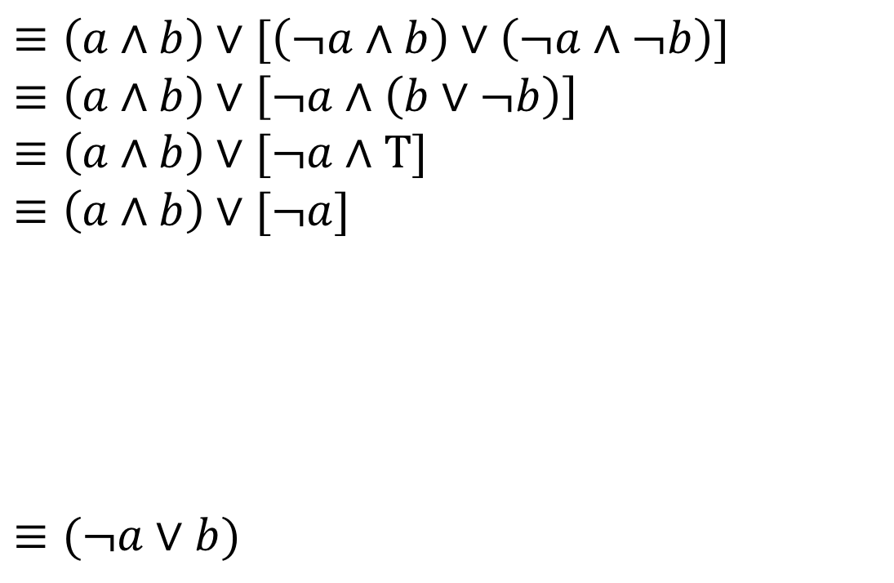
Our First Proof
$\left(a∧b\right)∨\left(¬a∧b\right)∨(¬a∧¬b)$
$≡\left(a∧b\right)∨[\left(¬a∧b\right)∨\left(¬a∧¬b\right)]$
$≡\left(a∧b\right)∨\left[¬a∧\left(b∨¬b\right)\right]$
$≡\left(a∧b\right)∨[¬a∧T]$
$≡\left(a∧b\right)∨[¬a]$
$≡\left[¬p\right]∨(p∧q)$
$≡\left(\begin{aligned}¬p \\ ∨p\end{aligned}\right)∧\left(¬p∨q\right)$
$≡T∧\left(¬p∨q\right)$
$≡$ $\left(¬p∨q\right)∧T$
$≡(¬a∨b)$
Set ourselves an intermediate goal.
Let’s try to simplify those last two pieces
Identity
Should make things simpler.

Slide 49

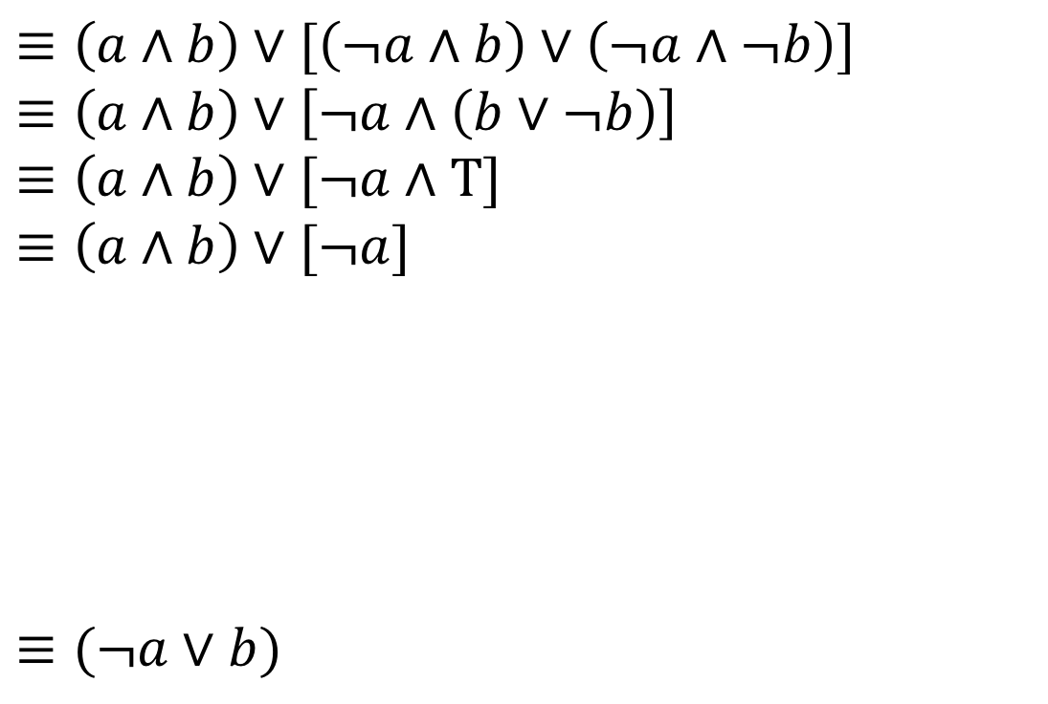
Our First Proof
$\left(a∧b\right)∨\left(¬a∧b\right)∨(¬a∧¬b)$
$≡\left(a∧b\right)∨[\left(¬a∧b\right)∨\left(¬a∧¬b\right)]$
$≡\left(a∧b\right)∨\left[¬a∧\left(b∨¬b\right)\right]$
$≡\left(a∧b\right)∨[¬a∧T]$
$≡\left(a∧b\right)∨[¬a]$
$≡(¬a∨b)$
Stay on target:
We met our intermediate goal.
Don‘t forget the final goal!
We want to end up at $\left(¬a∨b\right)$
If we apply the distribution rule,
We’d get a $(¬a∨b)$

Slide 50
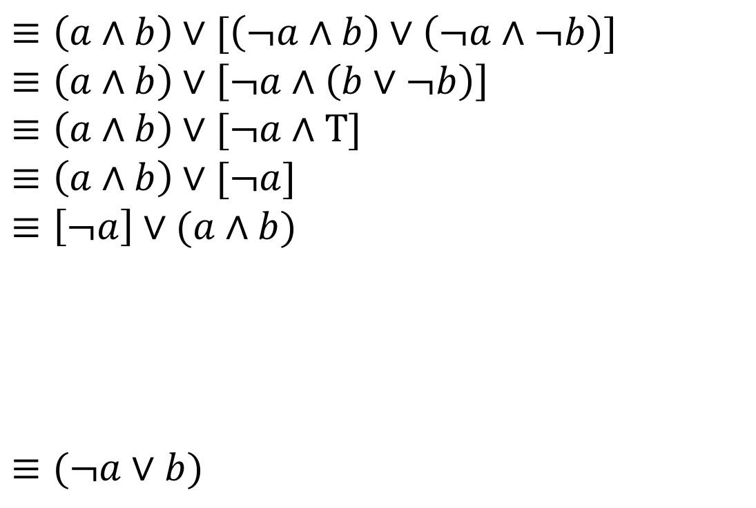
Our First Proof
$\left(a∧b\right)∨\left(¬a∧b\right)∨(¬a∧¬b)$
$≡\left(a∧b\right)∨[\left(¬a∧b\right)∨\left(¬a∧¬b\right)]$
$≡\left(a∧b\right)∨\left[¬a∧\left(b∨¬b\right)\right]$
$≡\left(a∧b\right)∨[¬a∧T]$
$≡\left(a∧b\right)∨[¬a]$
$≡\left[¬a\right]∨(a∧b)$
$≡(¬a∨b)$
Stay on target:
We met our intermediate goal.
Don‘t forget the final goal!
We want to end up at $\left(¬a∨b\right)$
If we apply the distribution rule,
We’d get a $(¬a∨b)$
Commutative
Make the expression look exactly like the law (more on this later)

Slide 51

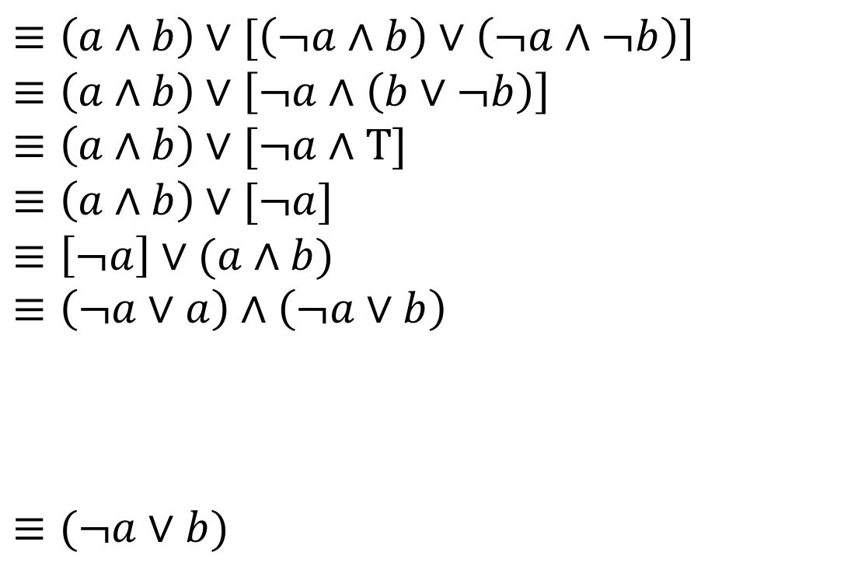
Our First Proof
$\left(a∧b\right)∨\left(¬a∧b\right)∨(¬a∧¬b)$
$≡\left(a∧b\right)∨[\left(¬a∧b\right)∨\left(¬a∧¬b\right)]$
$≡\left(a∧b\right)∨\left[¬a∧\left(b∨¬b\right)\right]$
$≡\left(a∧b\right)∨[¬a∧T]$
$≡\left(a∧b\right)∨[¬a]$
$≡\left[¬a\right]∨(a∧b)$
$≡\left(¬a∨a\right)∧\left(¬a∨b\right)$
$≡(¬a∨b)$
Stay on target:
We met our intermediate goal.
Don‘t forget the final goal!
We want to end up at $\left(¬a∨b\right)$
If we apply the distribution rule,
We’d get a $(¬a∨b)$
Distributive
Creates the $(¬a∨b)$ we were hoping for.

Slide 52

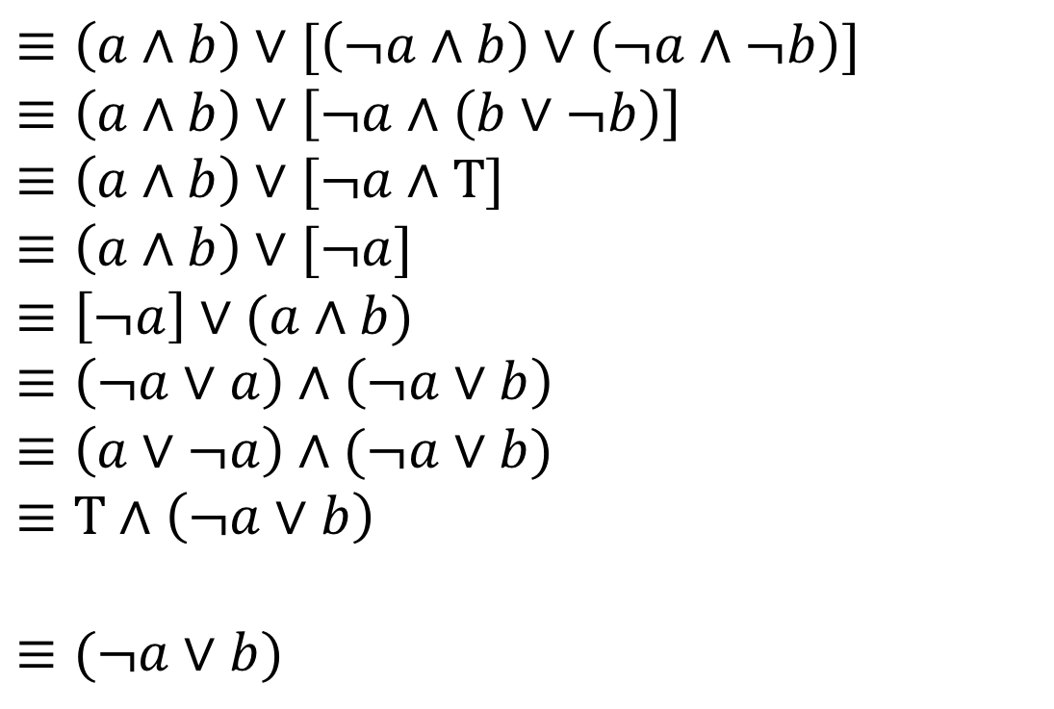
Our First Proof
$\left(a∧b\right)∨\left(¬a∧b\right)∨(¬a∧¬b)$
$≡\left(a∧b\right)∨[\left(¬a∧b\right)∨\left(¬a∧¬b\right)]$
$≡\left(a∧b\right)∨\left[¬a∧\left(b∨¬b\right)\right]$
$≡\left(a∧b\right)∨[¬a∧T]$
$≡\left(a∧b\right)∨[¬a]$
$≡\left[¬a\right]∨(a∧b)$
$≡\left(¬a∨a\right)∧\left(¬a∨b\right)$
$≡\left(a∨¬a\right)∧(¬a∨b)$
$≡T∧\left(¬a∨b\right)$
$≡(¬a∨b)$
Stay on target:
We met our intermediate goal.
Don‘t forget the final goal!
We want to end up at $\left(¬a∨b\right)$
If we apply the distribution rule,
We’d get a $(¬a∨b)$
Commutative
Make the expression look exactly like the law (more on this later)
Negation
Simplifies the part we want to disappear.

Slide 53
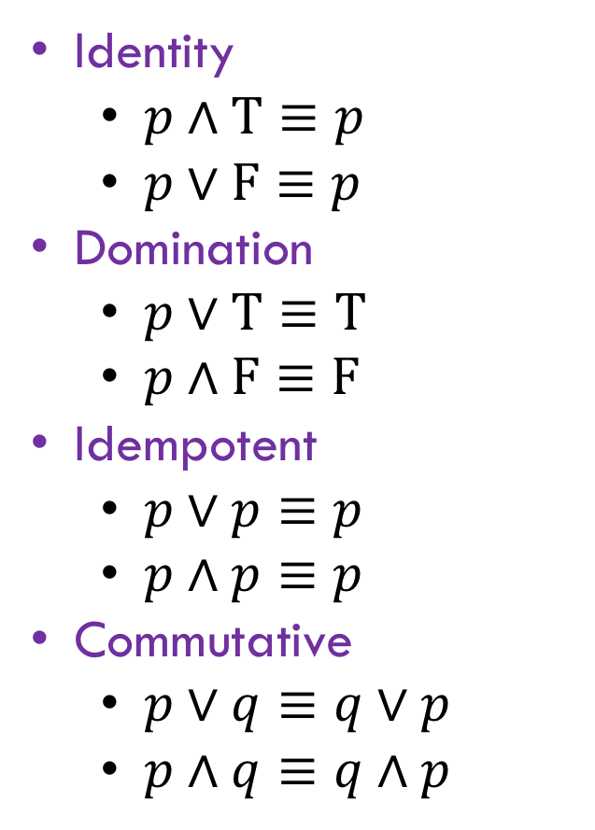

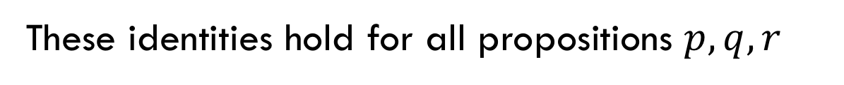
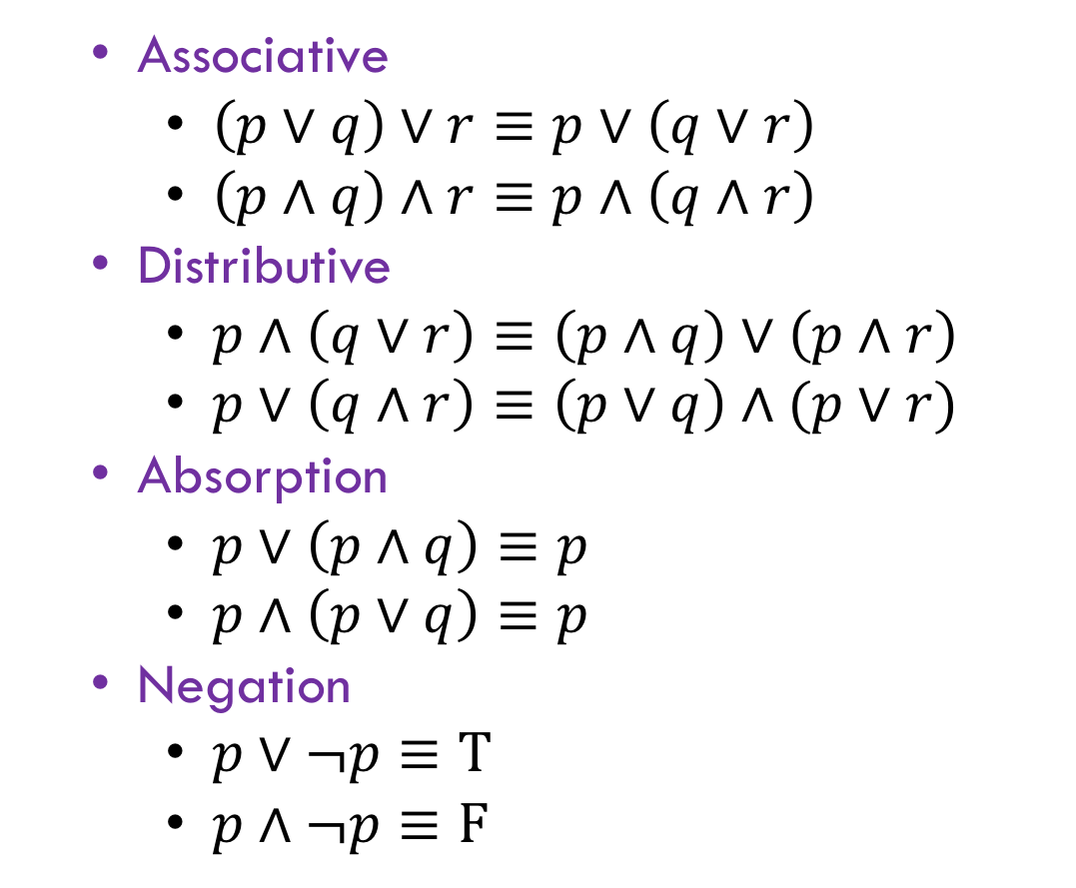
Simplify T$∧(¬a∨b)$ to $(¬a∨b)$
These identities hold for all propositions $p,q,r$
Identity
$p∧T≡p$
$p∨F≡p$
Domination
$p∨T≡T$
$p∧F≡F$
Idempotent
$p∨p≡p$
$p∧p≡p$
Commutative
$p∨q≡q∨p$
$p∧q≡q∧p$
Associative
$\left(p∨q\right)∨r≡p∨\left(q∨r\right)$
$\left(p∧q\right)∧r≡p∧\left(q∧r\right)$
Distributive
$p∧\left(q∨r\right)≡\left(p∧q\right)∨\left(p∧r\right)$
$p∨\left(q∧r\right)≡\left(p∨q\right)∧(p∨r)$
Absorption
$p∨\left(p∧q\right)≡p$
$p∧\left(p∨q\right)≡p$
Negation
$p∨¬p≡T$
$p∧¬p≡F$

Slide 54
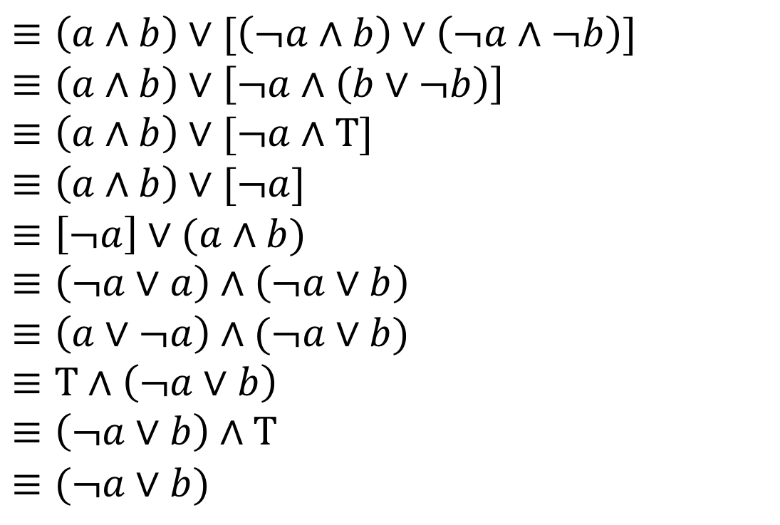
Our First Proof
$\left(a∧b\right)∨\left(¬a∧b\right)∨(¬a∧¬b)$
$≡\left(a∧b\right)∨[\left(¬a∧b\right)∨\left(¬a∧¬b\right)]$
$≡\left(a∧b\right)∨\left[¬a∧\left(b∨¬b\right)\right]$
$≡\left(a∧b\right)∨[¬a∧T]$
$≡\left(a∧b\right)∨[¬a]$
$≡\left[¬a\right]∨(a∧b)$
$≡\left(¬a∨a\right)∧\left(¬a∨b\right)$
$≡\left(a∨¬a\right)∧(¬a∨b)$
$≡T∧\left(¬a∨b\right)$
$≡\left(¬a∨b\right)∧T$
$≡(¬a∨b)$
Stay on target:
We met our intermediate goal.
Don‘t forget the final goal!
We want to end up at $\left(¬a∨b\right)$
If we apply the distribution rule,
We’d get a $(¬a∨b)$
Commutative followed by Identity
Look exactly like the law, then apply it.
We’re done!!!

Slide 55
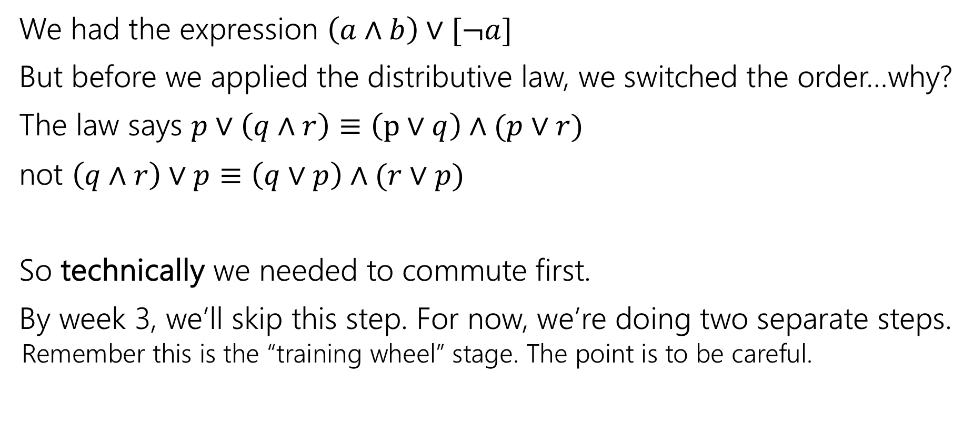
Commutativity
We had the expression $\left(a∧b\right)∨[¬a]$
But before we applied the distributive law, we switched the order…why?
The law says $p∨\left(q∧r\right)≡\left(p∨q\right)∧(p∨r)$
not $\left(q∧r\right)∨p≡\left(q∨p\right)∧(r∨p)$
So technically we needed to commute first.
By week 3, we’ll skip this step. For now, we’re doing two separate steps.
Remember this is the “training wheel” stage. The point is to be careful.

Slide 56
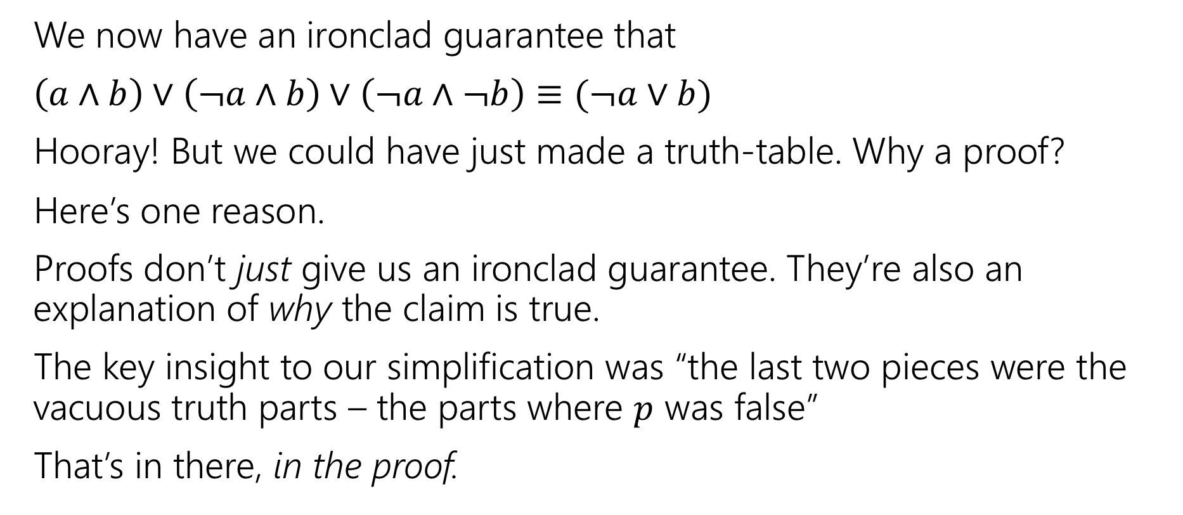
More on Our First Proof
We now have an ironclad guarantee that
$\left(a∧b\right)∨\left(¬a∧b\right)∨\left(¬a∧¬b\right)≡(¬a∨b)$
Hooray! But we could have just made a truth-table. Why a proof?
Here’s one reason.
Proofs don’t just give us an ironclad guarantee. They’re also an explanation of why the claim is true.
The key insight to our simplification was “the last two pieces were the vacuous truth parts – the parts where $p$ was false”
That’s in there, in the proof.

Slide 57



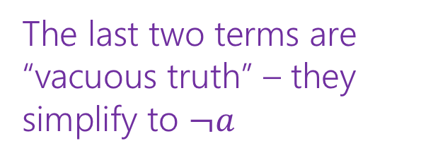
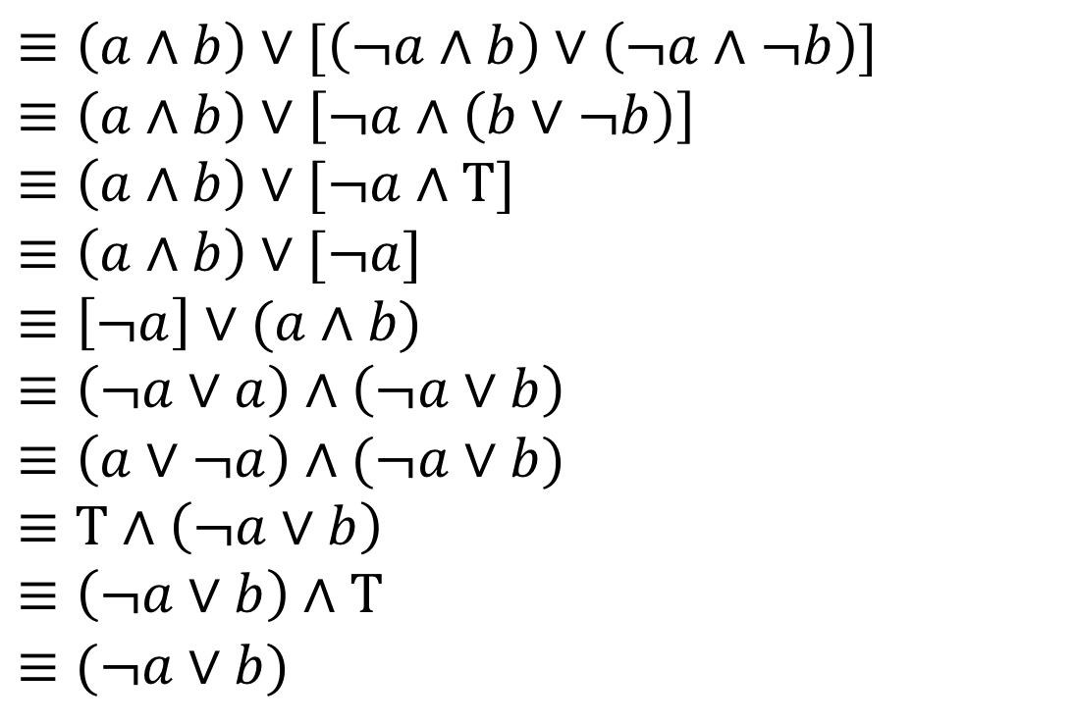
Our First Proof
$\left(a∧b\right)∨\left(¬a∧b\right)∨(¬a∧¬b)$
$≡\left(a∧b\right)∨[\left(¬a∧b\right)∨\left(¬a∧¬b\right)]$
$≡\left(a∧b\right)∨\left[¬a∧\left(b∨¬b\right)\right]$
$≡\left(a∧b\right)∨[¬a∧T]$
$≡\left(a∧b\right)∨[¬a]$
$≡\left[¬a\right]∨(a∧b)$
$≡\left(¬a∨a\right)∧\left(¬a∨b\right)$
$≡\left(a∨¬a\right)∧(¬a∨b)$
$≡T∧\left(¬a∨b\right)$
$≡\left(¬a∨b\right)∧T$
$≡(¬a∨b)$
Associative
Distributive
Negation
Identity
Commutative
Distributive
Commutative
Negation
Commutative
Identity
The last two terms are “vacuous truth” – they simplify to $¬a$
$a$ no longer matters in $a∧b$ if $¬a$ automatically makes the expression true.

Slide 58
More on Our First Proof
With practice (and quite a bit of squinting) you can see not just the ironclad guarantee, but also the reason why something is true.
That’s not easy with a truth table.
Proofs can also communicate intuition about why a statement is true.
We’ll practice extracting intuition from proofs more this quarter.

Slide 59
Modifying Implications

Slide 60

Converse, Contrapositive
Implication:
p → q
Converse:
q → p
Contrapositive:
¬q → ¬p
Inverse:
¬p → ¬q
If it’s raining, then I have my umbrella.
If I don’t have my umbrella, then it is not raining.
If I have my umbrella, then it is raining.
If it is not raining, then I don’t have my umbrella.
How do these relate to each other?
p | q | p → q | q → p | ¬p | ¬q | ¬p → ¬q | ¬q → ¬p
T | T
T | F
F | T
F | F

Slide 61

Converse, Contrapositive
Implication:
p → q
Converse:
q → p
Contrapositive:
¬q → ¬p
Inverse:
¬p → ¬q
An implication and its contrapositive have the same truth value!
p | q | p → q | q → p | ¬p | ¬q | ¬p → ¬q | ¬q → ¬p
T | T | T | T | F | F | T | T
T | F | F | T | F | T | T | F
F | T | T | F | T | F | F | T
F | F | T | T | T | T | T | T

Slide 62
More Practice

Slide 63
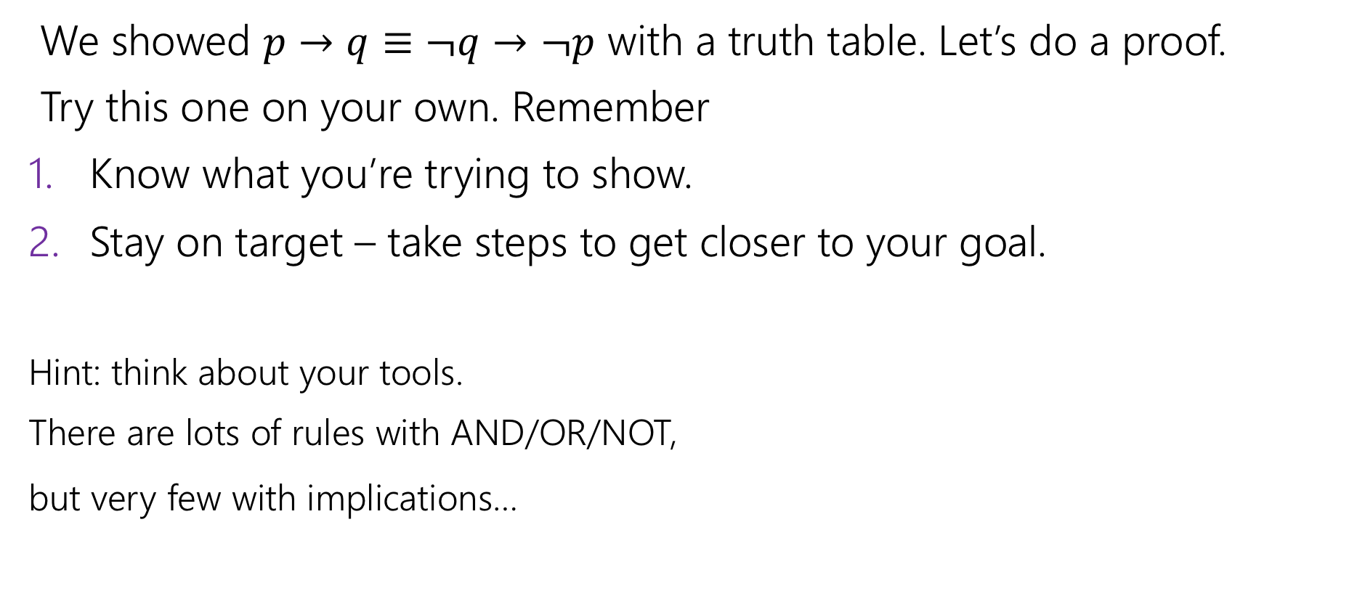
Contrapositive
We showed $p→q≡¬q→¬p$ with a truth table. Let’s do a proof.
Try this one on your own. Remember
Know what you’re trying to show.
Stay on target – take steps to get closer to your goal.
Hint: think about your tools.
There are lots of rules with AND/OR/NOT,
but very few with implications…

Slide 64
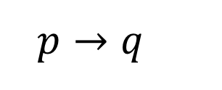

Contrapositive
$p→q$
$≡¬p∨q$
$≡q∨¬p$
$≡¬¬q∨¬p$
$≡¬q→¬p$
Law of Implication
Commutativity
Double Negation
Law of Implication
All of our rules deal with ORs and ANDs, let’s switch the implication to just use AND/NOT/OR.
And do the same with our target
It’s ok to work from both ends. In fact it’s a very common strategy!
Now how do we get the top to look like the bottom?
Just a few more rules and we’re done!

Slide 65
Work from both ends, but…
…make sure at the end, if you read from top-to-bottom, every step makes sense.
When proving an equivalence you must: 1. Start with the left side (or right side)
2. Modify what you had in the last step (using an equivalence)
3. Derive the right side (or left side if you started with the right)
You may not start with the equivalence you’re trying to show, and simplify to something “obviously true.”
More on why later in the quarter, but tl;dr for now is you can’t use your goal as a starting assumption (it’s what you’re trying to show! If you knew it, no need to write a proof).

Slide 66
Todo
Tonight:
Take a look at HW1 that’s posted on the course website
Thursday:
Go to section (in-person) to practice with the material we learned in lecture
Soon:
Form a study group! Threads to organize on the Ed board.
Complete CC1 and CC2 (due Friday)

