Slide 1
Here Early?
Here for CSE 311?
Welcome! You’re early!
Want a copy of these slides to take notes?
  You can download them from the calendar webpage cs.uw.edu/311

Slide 2
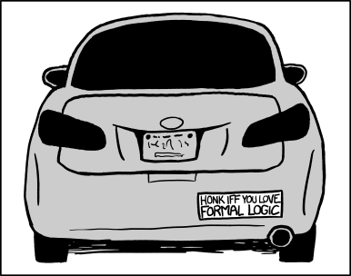
Intro and
Propositional Logic
CSE 311: Foundations of Computing I
Lecture 1

Slide 3
Outline
Course Logistics
Start of Propositional Logic

Slide 4


Staff
TAs
Alice Zhu Emma Huang Evan Wu Lisa Elkin Rushil Arun Zareef Amyeen
Instructor: Parker Gustafson (he/him)
MS student at the Allen School
Undergrad in CS & Math
13-time CSE TA, 2-time 311 TA,
1st time teaching 311 as an instructor
Office: CSE 204
Email: pgusto34@uw.edu

Slide 5
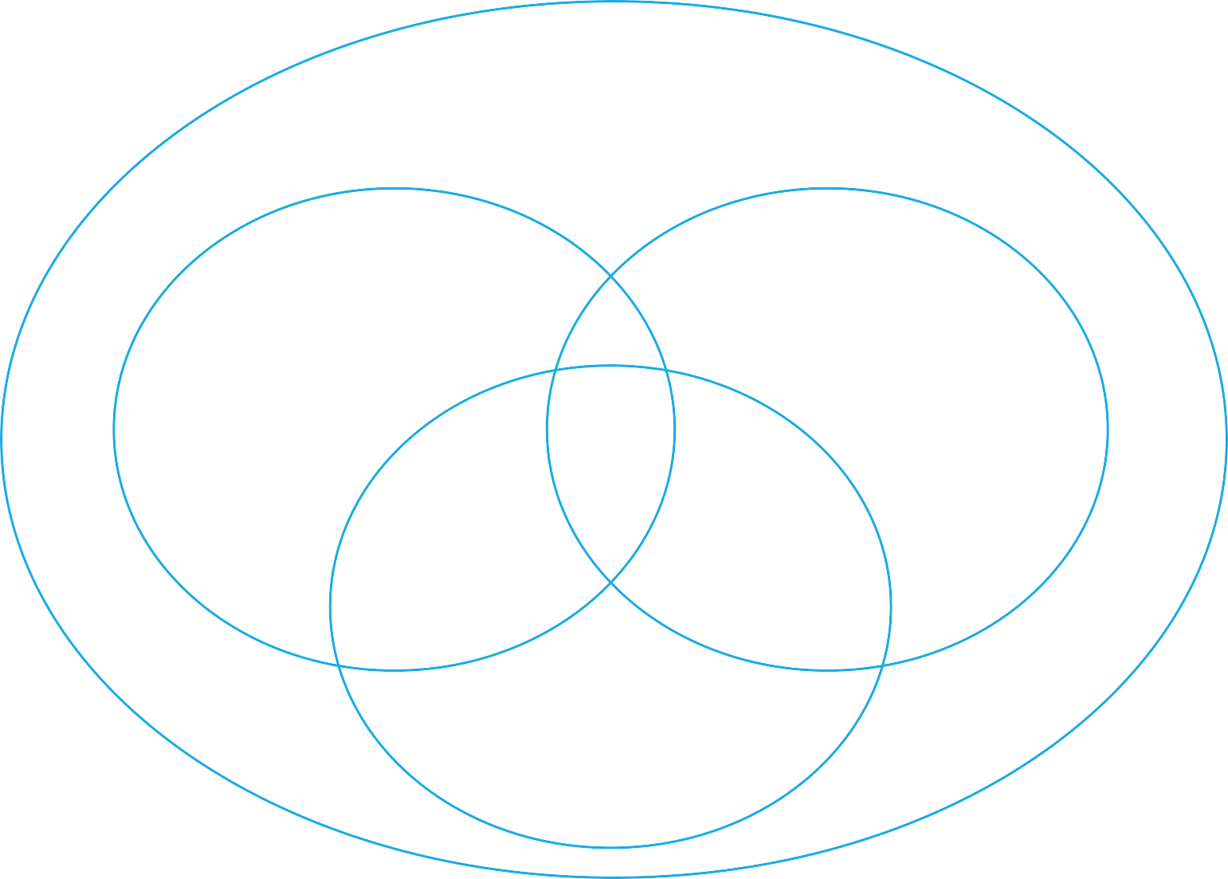
Perspective
Computer Science and Engineering
Programming CSE 12x
Theory
Hardware
CSE 311

Slide 6
Course Goals
Learn to make & clearly communicate rigorous formal arguments
  Mathematical Proofs
Understand mathematical objects that are widely used in CS
  Number Theory, Set Theory, Recursively-Defined Functions
Explore and analyze models of computation
  Regular Expressions, Context Free Grammars, Finite-State Machines
Develop a toolkit for approaching computational problems
  Programmer → Computer Scientist

Slide 7
Lectures
Monday, Wednesday, Friday from 12:00 – 1:00 pm in DEM 102
Recorded!
  - Lecture recordings can be found on Canvas via the Panopto tab
Attendance is highly recommended but not required
Concept Check after every lecture

Slide 8
Concept Checks
Each Lecture will have a “concept check” associated with it.
Goal: Make sure you’ve understood today’s topic before we build on it in the next lecture.
Available on Gradescope at 1:00 pm (after lecture). Due the day of the next lecture at 12:00 pm (start of the lecture).
  - You can submit as many times as you want.
  - When you get an answer correct the explanation will appear.
  Worth a small amount of your grade, and an 80% average for the quarter is all you need for full credit.
  - More details in the syllabus.

Slide 9
Quiz Sections
TA-led sections meet on Thursdays
Opportunity to practice material and ask questions
Materials are posted, but sections aren’t recorded
(sync or async) Participation is required and part of the course grade
You only need to participate in 7/8 sections for full credit

Slide 10
Exams
In-class midterm on August 1st
  - There will be an in-person midterm retake opportunity during
  week 8 (8/11 – 8/15). More details will be announced later.
In-class final on August 21st and 22nd
  - The final will be taken over two days: part 1 will be taken in your
  quiz section and part 2 will be taken in lecture.

Slide 11

Homework
7 written assignments (no programming)
Posted Wednesday evenings, due the follow Wednesday at 11:59 pm
Typesetting is highly recommended
  There are many options: LaTeX (via Overleaf), Parchmynt, Notion
  Start early and try to finish at least one day before the due date to typeset
You will be able to revise and resubmit two questions per homework for an improved grade (more details to come)

Slide 12
Late Policy
You have 6 late days for the quarter
You can use a late day to turn in an assignment up to 24 hours late with no penalty
You can use at most 3 late days per assignment
In the case of extenuating circumstances, please reach out

Slide 13
Collaboration Policy
Collaboration with others is encouraged
  Pro Tip: form study groups for this course ASAP
  Do help other students learn
  Do not help other students avoid learning
Policy:
  List all names of those you worked with
  Don’t take away pictures or notes from discussions
  Write up the final solutions on your own

Slide 14
ChatGPT Policy
You are prohibited from using ChatGPT or other LLMs for your assignments.
  Why?
    - The best way to learn discrete math is by personally working with concepts by solving (and often getting stuck on) related problems.
    - ChatGPT is very good at solving these types of problems, so its use would rob you of tons of learning if we permitted its use.
    - Setting yourself up for academic success down the road.
Permitted uses of ChatGPT for this course
- As a study tool to learn or review course concepts
- Help with typesetting
- Other?

Slide 15
Getting Help
Office Hours
Both in-person and on Zoom
Schedule posted on course website
Begin this Wednesday
Ed Discussion
Post any content, homework, or logistical questions
Study Groups
311 (discrete math) is different than programming

Slide 16
Course Grades
Mastery-Based Grading System
Two components: ESN grading and resubmissions
Instead of a points-based grading, we will be grading on an ESN scale, where each letter reflects a level of mastery of a course topic or skill.
  E – Excellent (Meeting or exceeding all learning objectives)
  S – Satisfactory (Close to mastery, but there may be some minor mistakes or misunderstandings)
  N – Not Yet (Demonstrated significant knowledge gaps or made major mistakes in work)

Slide 17
Course Grades
After receiving feedback, we want to give you an opportunity to learn from it and demonstrate improved mastery of the material through resubmissions
  Everything in this course will have some form of resubmission or reattempt besides the final and section participation
Your accumulated E’s and S’s will determine your course grade
  For example, earning 32 E’s and 10 additional S+ grades will guarantee you a grade of a 2.5
More grading details are on the course syllabus

Slide 18
Textbook
There is no official textbook for this course
Optional: How to Prove It by Daniel Velleman, 3rd edition
  - Good option if you’re looking for a source of additional practice problems or a second set of explanations for the same material

Slide 19




Course Tools
Course Website
(assignments, calendar, resources)
Gradescope
(submissions, feedback)
Canvas
(lecture recordings)
Ed Discussion
(discussion board)

Slide 20
If something unusual happens
In a 50-person class, a few of you will have something significant happen during the quarter.
  Illness or family emergency or something else.
  We can give some kinds of accommodations (e.g., extra late days) in some cases.
  We can only help if you tell us something is going on
  Either email Parker or create an Ed board post to let us know.
Now is a great time to:
  Ask DRS for accommodations if you think you might need formal ones.
  Start forming study groups!

Slide 21
Symbolic Logic

Slide 22

What is logic and why do we need it?
Symbolic Logic (synonymous with propositional logic) is a language, like English or Java, with its own
words and rules for combining words into sentences (syntax)
ways to assign meaning to words and sentences (semantics)
Symbolic Logic will let us mechanically simplify expressions and make precise, concise, and unambiguous arguments.
The new language will let us focus on the (sometimes familiar, sometimes unfamiliar) rules of logic.
Once we have those rules down, we’ll be able to apply them “intuitively” in English and won’t need the symbolic representation as often
but we’ll still go back to it when things get complicated.

Slide 23

Why not use English?
English can be ambiguous or imprecise.
Turn right here.
Does “right” mean the direction, or “right now”?
We saw her duck.
Does “duck” mean the animal, or the action of ducking down?
I saw the man with the long telescope.
Does the man have the long telescope, or did I use the long telescope to see the man?

Slide 24
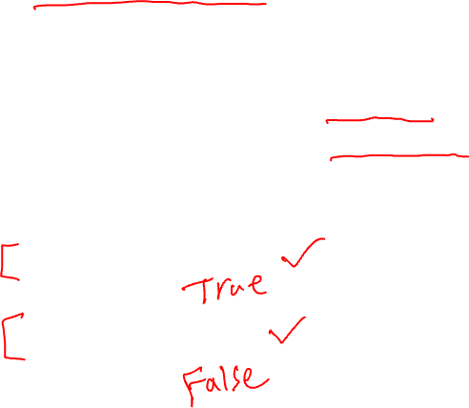
Propositions: building blocks of logic
  Propositions are the basic building blocks in symbolic logic.
  Here are two propositions.
All cats are mammals
  True, (and a proposition)
All mammals are cats
  False, but is well-formed and has a truth value, so still a proposition.
A statement that has a truth value (i.e. is true or false) and is “well-formed”
Proposition

Slide 25
Analogy
In Intro Programming you talked about a variable type that could be either true or false.
You called it a “Boolean”
Boolean variables are a useful analogy for propositions.
  They aren’t identical, but they’re very similar.

Slide 26
Are These Propositions?
2 + 2 = 5
This is a proposition. It’s okay for propositions to be false.
x + 2 = 5
Not a proposition. Doesn’t have a fixed truth value
Akjsdf!
Not a proposition because it’s gibberish.
Who are you?
This is a question which means it doesn’t have a truth value.
There is life on Mars.
This is a proposition. We don’t know if it’s true or false, but we know it’s one of them!

Slide 27
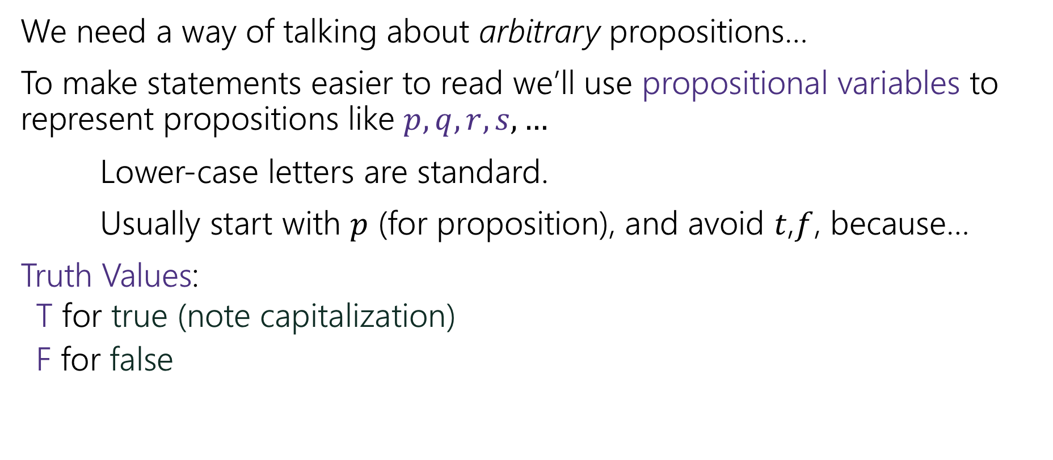
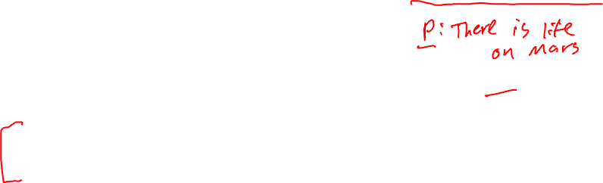
Proposition Notation
We need a way of talking about arbitrary propositions…
To make statements easier to read we’ll use propositional variables to represent propositions like $p, q, r, s,…$
Lower-case letters are standard.
Usually start with $p$ (for proposition), and avoid $t$,$f$, because…
Truth Values:
  T for true (note capitalization)
  F for false

Slide 28
Analogy
We said propositions were a lot like Booleans…
How did you connect Booleans in code?
&&
||
!

Slide 29
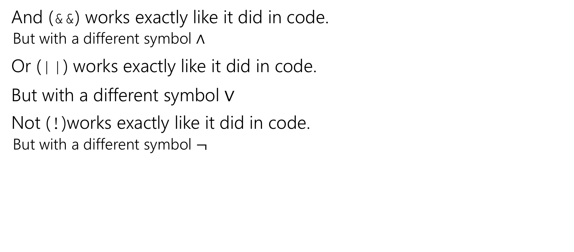
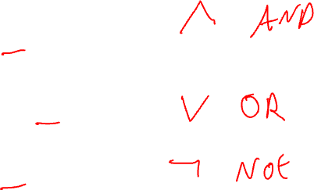
Logical Connectives
And (&&) works exactly like it did in code.
  But with a different symbol $∧$
Or (||) works exactly like it did in code.
But with a different symbol $∨$
Not (!)works exactly like it did in code.
  But with a different symbol $¬$

Slide 30
Some Truth Tables
p | ¬p
p | q | p ∧ q
p | q | p ∨ q
Truth tables are the simplest way to describe how logical connectives operate.

Slide 31
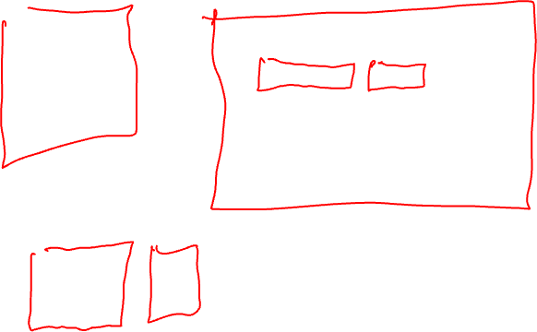
Some Truth Tables
p | ¬p
T | F
F | T
p | q | p ∧ q
T | T | T
T | F | F
F | T | F
F | F | F
p | q | p ∨ q
T | T | T
T | F | T
F | T | T
F | F | F
Truth tables are the simplest way to describe how logical connectives operate.

Slide 32

Atomic and Compound Propositions
Definitions:
An atomic proposition is a proposition that can’t be broken down any further.
A compound proposition is a proposition that can be divided into simpler propositions.
logical connective combines propositions into compound propositions.

Slide 33
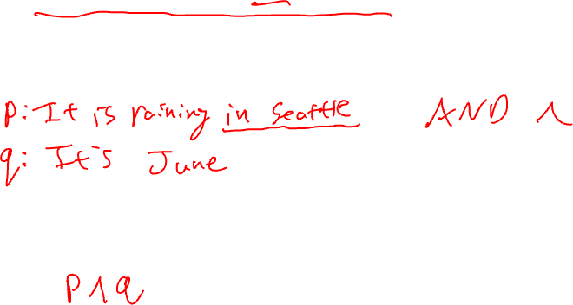
Compound Proposition Example
It is raining in Seattle and it’s June.
Atomic Propositions:
Logical Connectives:
Analogy
Boolean variables 𝑝, 𝑞
Java and connective &&
Translation into Logic:

Slide 34

All Logical Connectives
Name Not And Or XOR
Implication Biconditional
Logical Symbol
¬𝑝
𝑝 ∧ 𝑞
𝑝 ∨ 𝑞
𝑝 ⊕ 𝑞
𝑝 → 𝑞
𝑝 ↔ 𝑞
Java Symbol
!p
𝑝 && 𝑞
𝑝 || 𝑞
𝑝 ^ 𝑞
𝑝 == 𝑞

Slide 35


Implication
Another way to connect propositions
If $p$ then $q$.
“If it is raining, then I have my umbrella.”
$p→q$
Think of an implication as a promise.
$p$ = antecedent, hypothesis
$q$ = consequent, conclusion

Slide 36
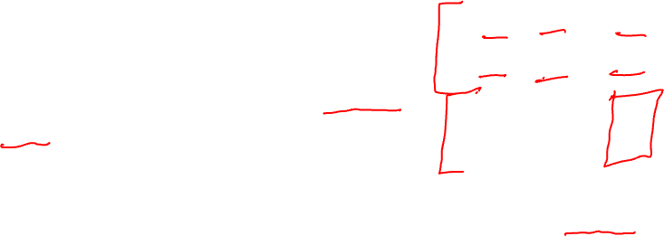
Implication
p | q | p → q
T | T | T
T | F | F
F | T | T
F | F | T
The first two lines should match your intuition.
The last two lines are called “vacuous truth.” For now, they’re the definition. We’ll explain why in a few lectures.
This is the definition of implication.
When you write “if…then…” in a piece of mathematical English, this is how you will be interpreted.

Slide 37

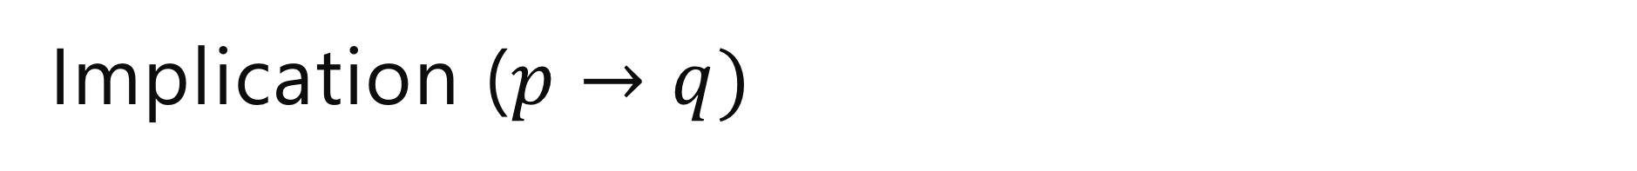
Implication ($p→q)$
“If it’s raining, then I have my umbrella”
It’s useful to think of implications as promises. An implication is false exactly when you can demonstrate I’m lying.
p | q | p → q
T | T | T
T | F | F
F | T | T
F | F | T
 | It’s raining | It’s not raining
I have my umbrella
I do not have my umbrella

Slide 38
Implication ($p→q)$
“If it’s raining, then I have my umbrella”
It’s useful to think of implications as promises. An implication is false exactly when you can demonstrate I’m lying.
p | q | p → q
T | T | T
T | F | F
F | T | T
F | F | T
 | It’s raining | It’s not raining
I have my umbrella | No lie. True | No lie. True
I do not have my umbrella | LIE! False | No lie. True

Slide 39
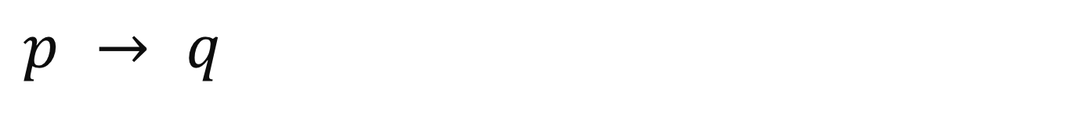
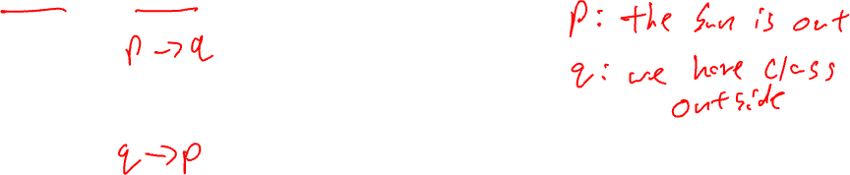
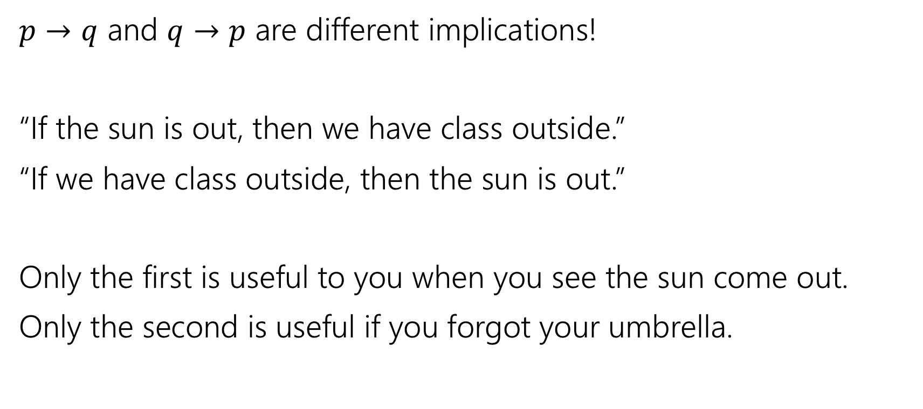
$$p → q$$
$p→q$ and $q→p$ are different implications!
“If the sun is out, then we have class outside.”
“If we have class outside, then the sun is out.”
Only the first is useful to you when you see the sun come out.
Only the second is useful if you forgot your umbrella.

Slide 40
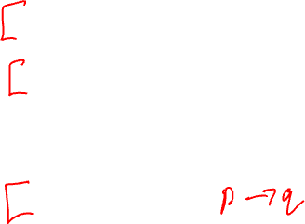
$$p → q$$
p | q | p → q
T | T | T
T | F | F
F | T | T
F | F | T
Implication:
  p implies q
  whenever p is true q must be true
  if p then q
  q if p
  p is sufficient for q
  p only if q
  q is necessary for p
Implications are super useful, so there are LOTS of translations.
You’ll learn these in detail in section.

Slide 41
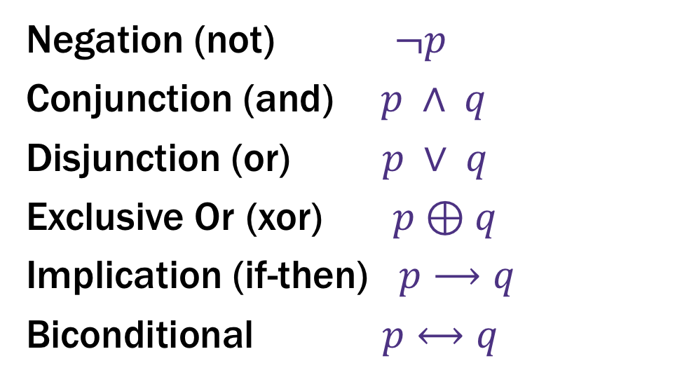

Logical Connectives
Negation (not) $¬p$
Conjunction (and) $p ∧ q$
Disjunction (or) $p ∨ q$
Exclusive Or (xor) $p⊕q$
Implication (if-then) $p⟶q$
Biconditional $p⟷q$
These ideas have been around for so long most have at least two names.
Two more connectives to discuss!

Slide 42
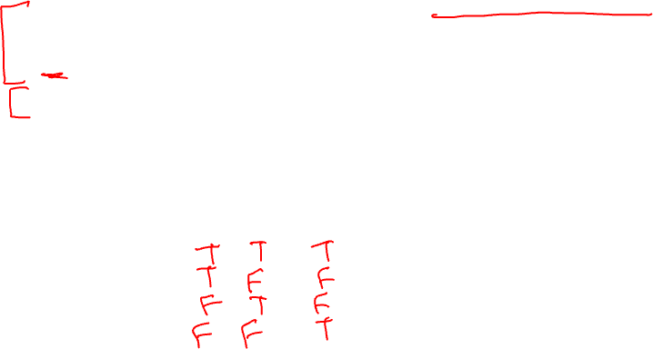
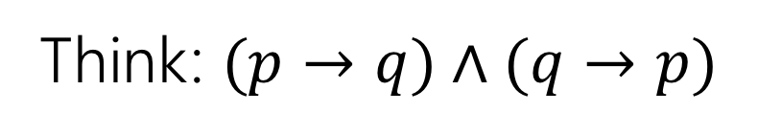

Biconditional: $p ↔ q$
Think: $(p→q)∧(q→p)$
p if and only if q
p iff q
p is equivalent to q
p implies q and q implies p
p is necessary and sufficient for q
p | q | p ↔ q

Slide 43
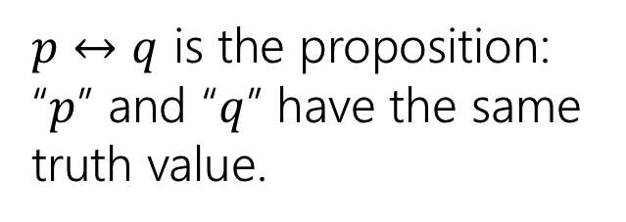
Biconditional: $p ↔ q$
Think: $(p→q)∧(q→p)$
p if and only if q
p iff q
p is equivalent to q
p implies q and q implies p
p is necessary and sufficient for q
p | q | p ↔ q
T | T | T
T | F | F
F | T | F
F | F | T
$p↔q$ is the proposition: “$p$” and “$q$” have the same truth value.

Slide 44
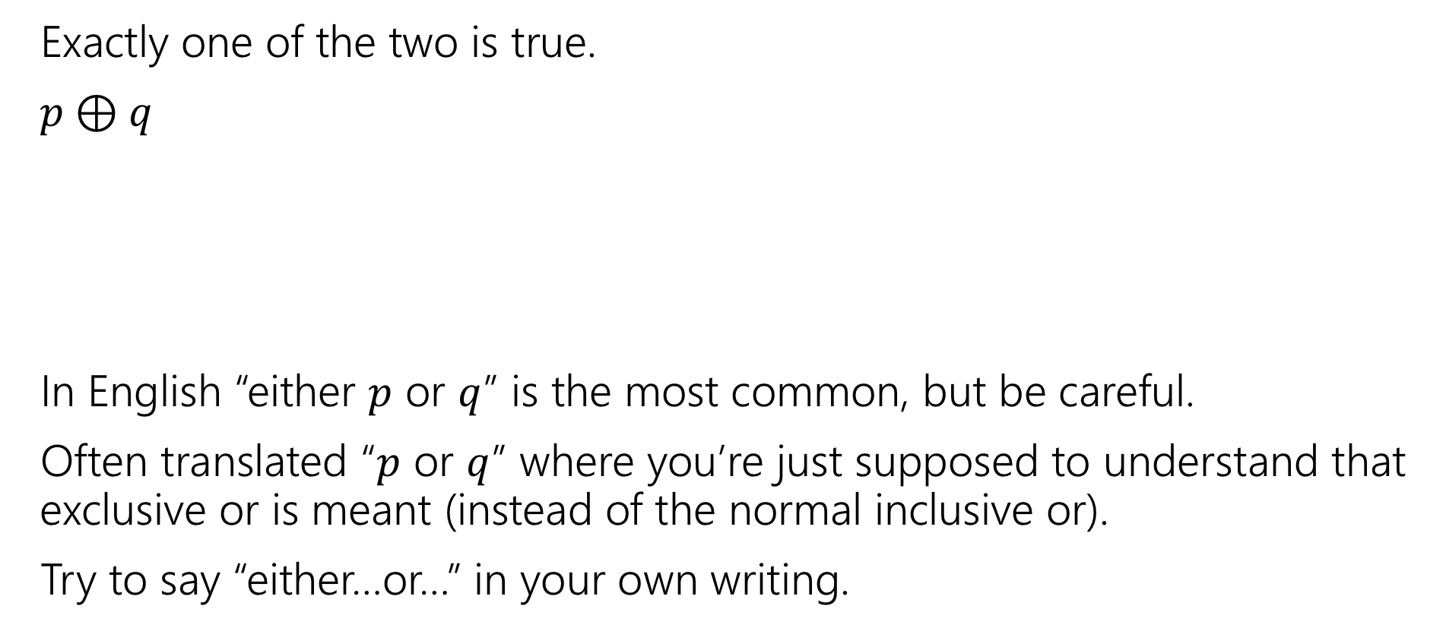
Exclusive Or
Exactly one of the two is true.
$p⊕q$
In English “either $p$ or $q$” is the most common, but be careful.
Often translated “$p$ or $q$” where you’re just supposed to understand that exclusive or is meant (instead of the normal inclusive or).
Try to say “either…or…” in your own writing.
p | q | p ⊕ q

Slide 45

Exclusive Or
Exactly one of the two is true.
$p⊕q$
In English “either $p$ or $q$” is the most common, but be careful.
Often translated “$p$ or $q$” where you’re just supposed to understand that exclusive or is meant (instead of the normal inclusive or).
Try to say “either…or…” in your own writing.
p | q | p ⊕ q
T | T | F
T | F | T
F | T | T
F | F | F

Slide 46
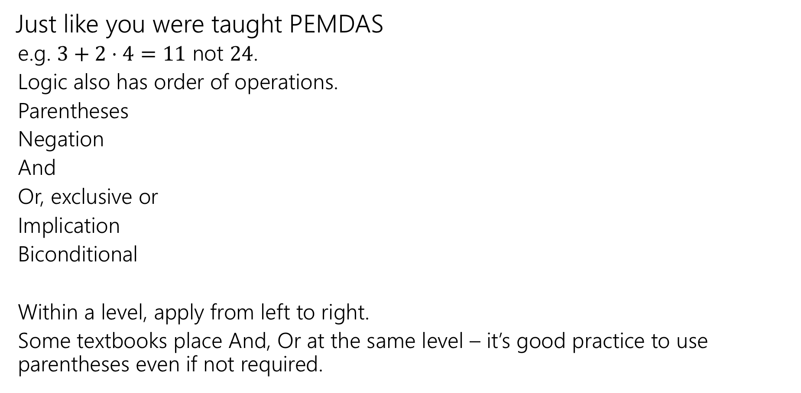
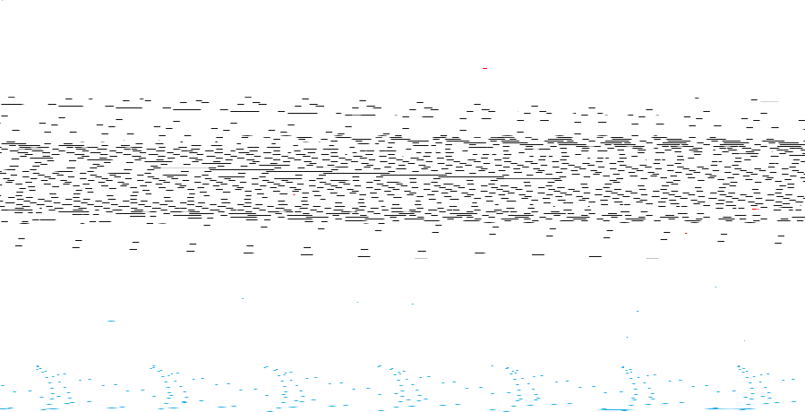
Order of Operations
Just like you were taught PEMDAS
  e.g. $3+2⋅4=11$ not $24$.
  Logic also has order of operations.
  Parentheses
  Negation
  And
  Or, exclusive or
  Implication
  Biconditional
  Within a level, apply from left to right.
  Some textbooks place And, Or at the same level – it’s good practice to use parentheses even if not required.
For this class: each line is its own level!
e.g. “and”s have precedence over “or”s

Slide 47

A More Complicated Statement
“Robbie knows the Pythagorean Theorem if he is a mathematician and took geometry, and he is a mathematician or did not take geometry.”
Is this a proposition?
We’d like to understand what this proposition means.
In particular, is it true?

Slide 48
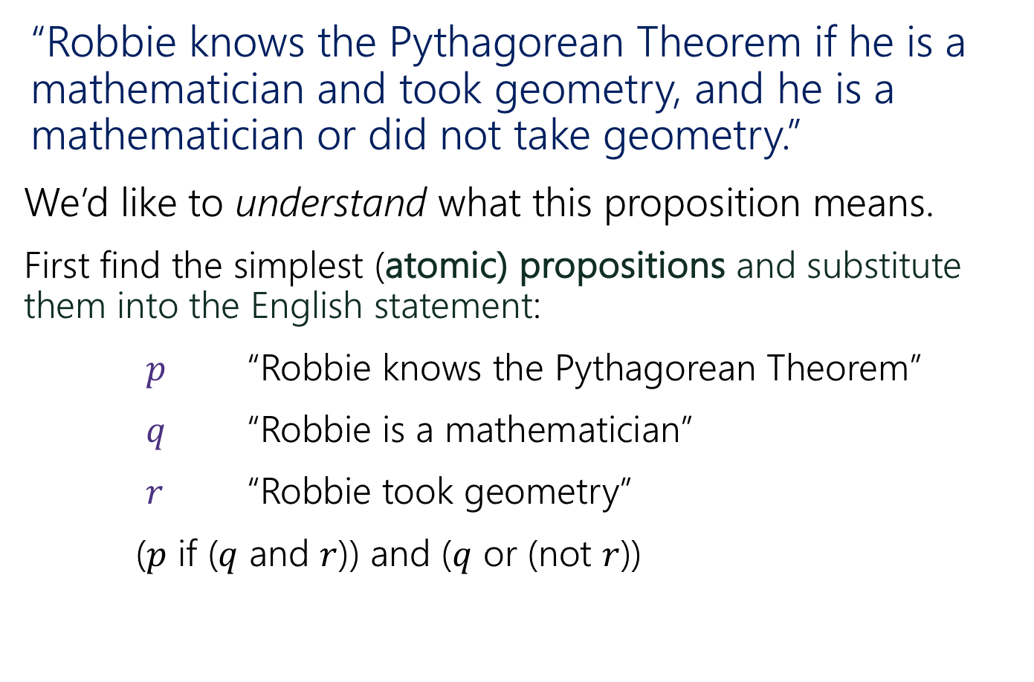

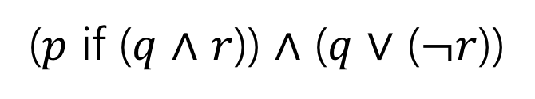
A Compound Proposition
“Robbie knows the Pythagorean Theorem if he is a mathematician and took geometry, and he is a mathematician or did not take geometry.”
We’d like to understand what this proposition means.
First find the simplest (atomic) propositions and substitute them into the English statement:
$p$ “Robbie knows the Pythagorean Theorem”
$q$ “Robbie is a mathematician”
$r$ “Robbie took geometry”
($p$ if ($q$ and $r$)) and ($q$ or (not $r$))
($p$ if ($q$ $∧$ $r$)) $∧$ ($q$ $∨$ ($¬r$))

Slide 49
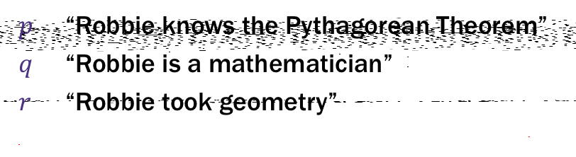
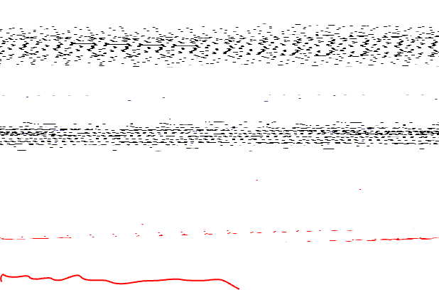
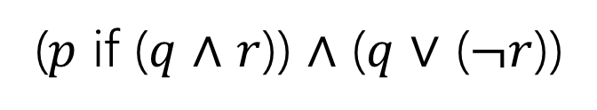
A Compound Proposition
“Robbie knows the Pythagorean Theorem if he is a mathematician and took geometry, and he is a mathematician or did not take geometry.”
$p$ “Robbie knows the Pythagorean Theorem”
$q$ “Robbie is a mathematician”
$r$ “Robbie took geometry”
($p$ if ($q$ $∧$ $r$)) $∧$ ($q$ $∨$ ($¬r$))
How did we know where to put the parentheses?
Subtle English grammar choices (top-level parentheses are independent clauses).
Context/which parsing will make more sense.
Conventions
A reading on this is on the webpage!

Slide 50

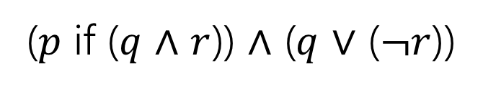

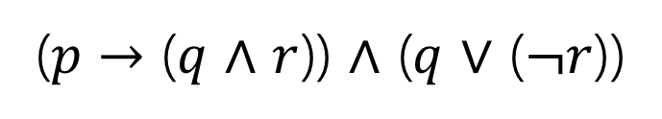
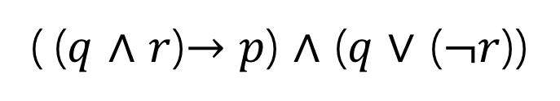
Back to the Compound Proposition…
“Robbie knows the Pythagorean Theorem if he is a mathematician and took geometry, and he is a mathematician or did not take geometry.”
($p$ if ($q$ $∧$ $r$)) $∧$ ($q$ $∨$ ($¬r$))
$p$ “Robbie knows the Pythagorean Theorem”
$q$ “Robbie is a mathematician”
$r$ “Robbie took geometry”
What promise am I making?
( ($q$ $∧$ $r$)$→p$) $∧$ ($q$ $∨$ ($¬r$))
($p$ $→$ ($q$ $∧$ $r$)) $∧$ ($q$ $∨$ ($¬r$))
The first one! Being a mathematician and taking geometry goes with the “if.” Knowing the Pythagorean Theorem is the consequence.

Slide 51
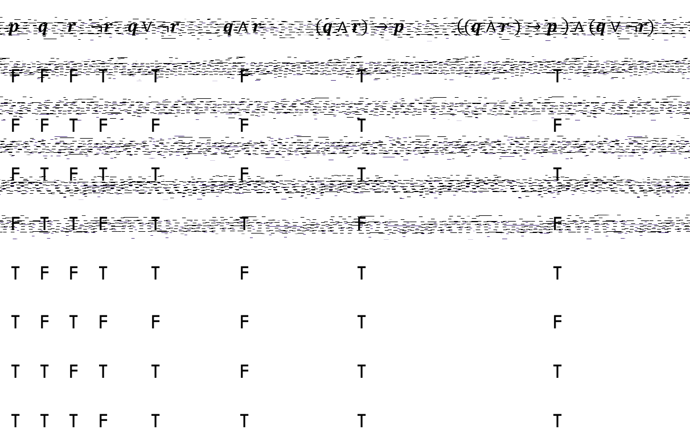
Analyzing the Sentence with a Truth Table
$$p$$ | $$q$$ | $$r$$ | $$¬r$$ | $$q∨¬r$$ | $$q∧r$$ | $$(q∧r)→p$$ | $$\left((q∧r )→p \right)∧(q∨¬r)$$
F | F | F | T | T | F | T | T
F | F | T | F | F | F | T | F
F | T | F | T | T | F | T | T
F | T | T | F | T | T | F | F
T | F | F | T | T | F | T | T
T | F | T | F | F | F | T | F
T | T | F | T | T | F | T | T
T | T | T | F | T | T | T | T

Slide 52
Todo
Tonight:
Make sure you can access the Ed discussion board.
  If you can’t, send an email to Parker.
Make sure you can access Gradescope, and do the concept check (due date is Friday, but we encourage you to check by Wednesday).
  If you can’t, make a private post on Ed.
Thursday:
Go to section (in-person)
Soon:
Form a study group! Threads to organize on the Ed board.

