Slide 1
Uncountability
CSE 311 Autumn 25
Lecture 29

Slide 2
Miscellaneous Announcements

Slide 3
Punchline for Today’s Lecture
There are more functions than there are computer programs.
So for some functions there just isn’t a computer program that computes it.

Slide 4
Outline
Some definitions – what do we mean by “more”?
How many programs are there?
Proving there are more functions.

Slide 5

Sizes of sets
How do we know two sets are the same size?
Easy. Count the number of elements in both.
That works great for finite sets, but $∞$ isn’t really a number we get to count to…

Slide 6










More Practical
What does it mean that two sets have the same size?

Slide 7

More Practical
What does it mean that two sets have the same size?

Slide 8
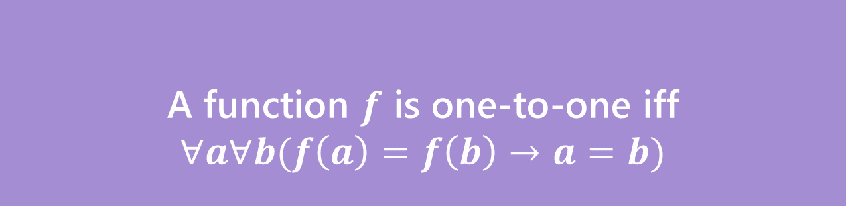
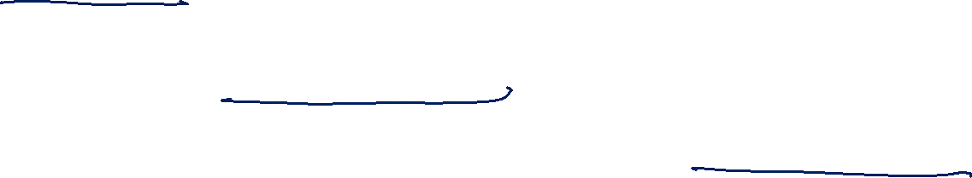

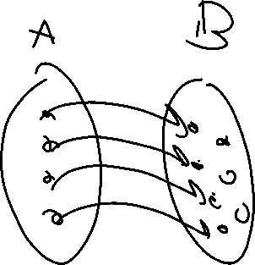
Two Requirements for a Bijection
A function $f:A→B$ maps every element of $A$ to one element of $B$
$A$ is the “domain”, $B$ is the “co-domain”
That is, every output has at most one possible input.
A function $f$ is one-to-one iff
$$∀a∀b(f\left(a\right)=f\left(b\right)→a=b)$$
One-to-one (aka injection)

Slide 9


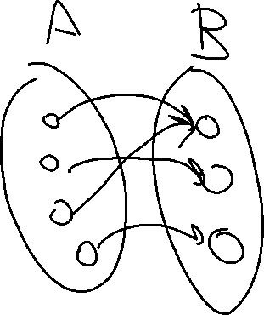
Two Requirements for a Bijection
A function $f:A→B$ maps every element of $A$ to one element of $B$
$A$ is the “domain”, $B$ is the “co-domain”
Every output has at least one input that maps to it.
A function $f:A→B$ is onto iff
$$∀b∈B∃a∈A(b=f(a))$$
Onto (aka surjection)

Slide 10
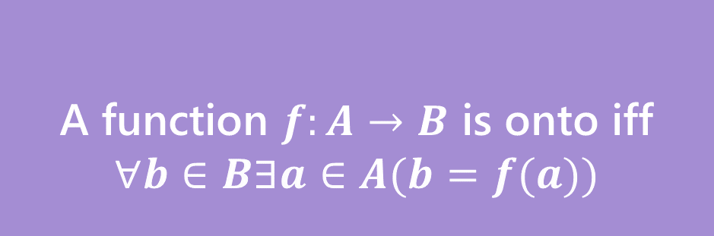


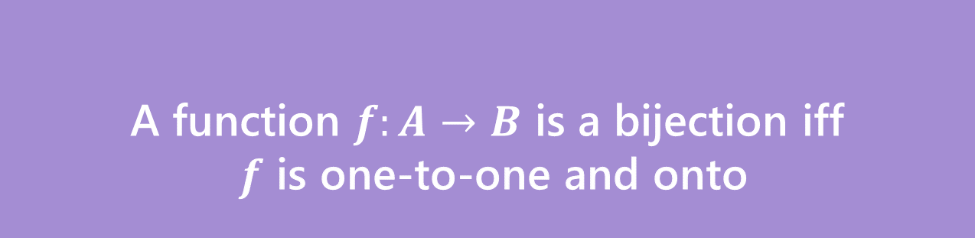
Bijection
A function $f$ is one-to-one iff
$$∀a∀b(f\left(a\right)=f\left(b\right)→a=b)$$
A function $f:A→B$ is onto iff
$$∀b∈B∃a∈A(b=f(a))$$
One-to-one (aka injection)
Onto (aka surjection)
A function $f:A→B$ is a bijection iff
$f$ is one-to-one and onto
Bijection
A bijection maps every element of the domain to exactly one element of the co-domain, and every element of the domain to exactly one element of the domain.

Slide 11
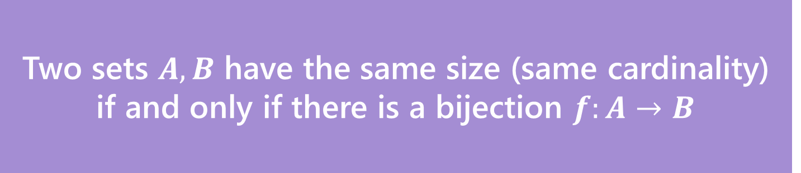
Definition
Two sets $A,B$ have the same size (same cardinality) if and only if there is a bijection $f:A→B$
This matches our intuition on finite sets.
But it also works for infinite sets!
Let’s see just how infinite these sets are.

Slide 12
Some infinite sets
Two sets $A,B$ have the same size (same cardinality) if and only if there is a bijection $f:A→B$
Let’s compare the sizes of: $ℕ$, $ℤ,$ $\{x :x$is an even integer$\}$

Slide 13
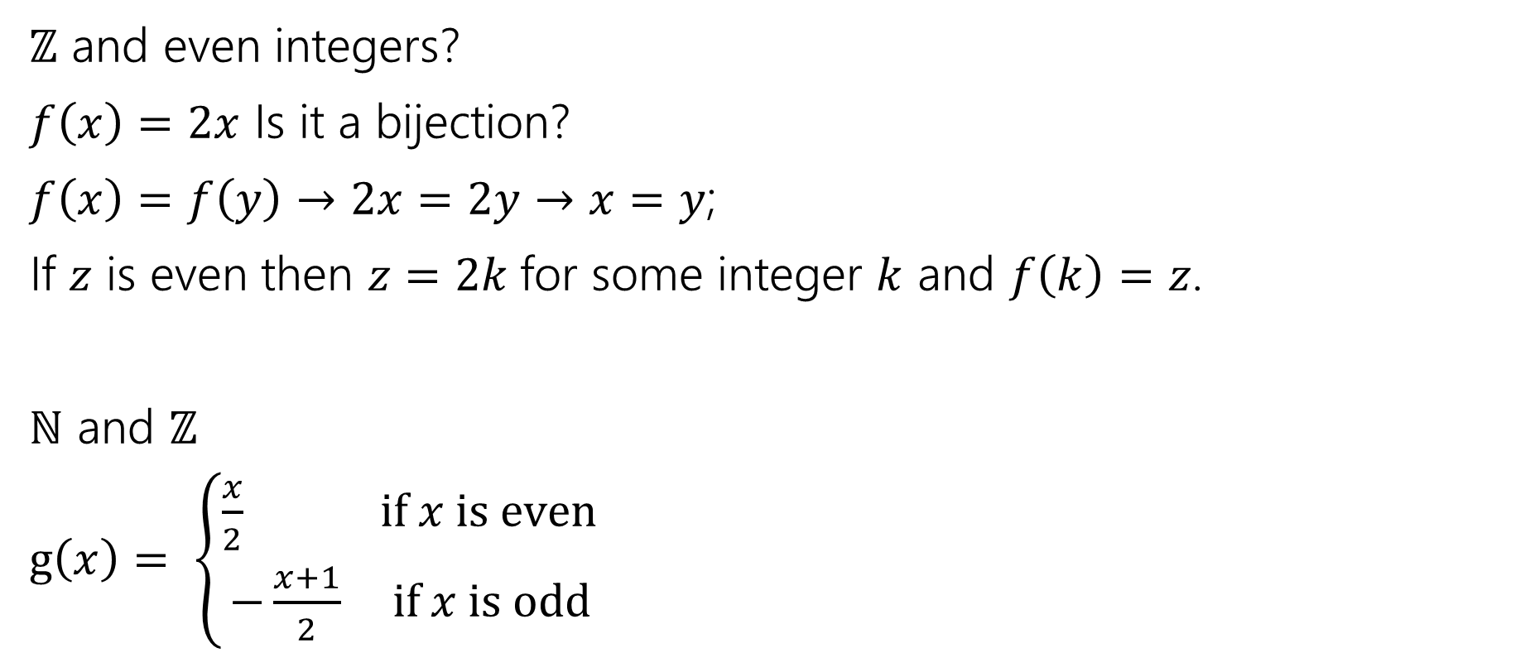
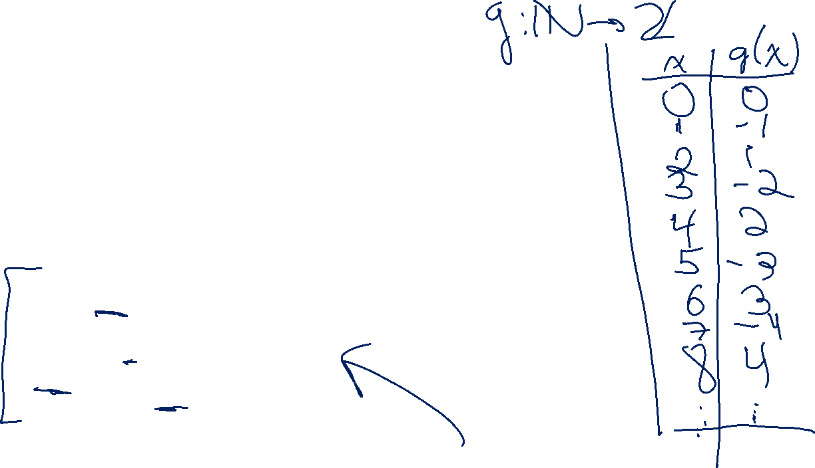
They’re all the same size.
$ℤ$ and even integers?
$f\left(x\right)=2x$ Is it a bijection?
$f\left(x\right)=f\left(y\right)→2x=2y→x=y$;
If $z$ is even then $z=2k$for some integer $k$ and $f\left(k\right)=z$.
$ℕ$ and $ℤ$
$g\left(x\right)= \left\{\begin{aligned}\frac{x}{2} if x is even \\ −\frac{x+1}{2} if x is odd\end{aligned}\right.$

Slide 14

They’re all the same size…
$ℕ$ and even integers?
$g(f\left(x\right))$ will work nicely. You can also build one explicitly.
Good exercise: show that if $f$ and $g$ are bijections then $f∘g$ is also a bijection.

Slide 15
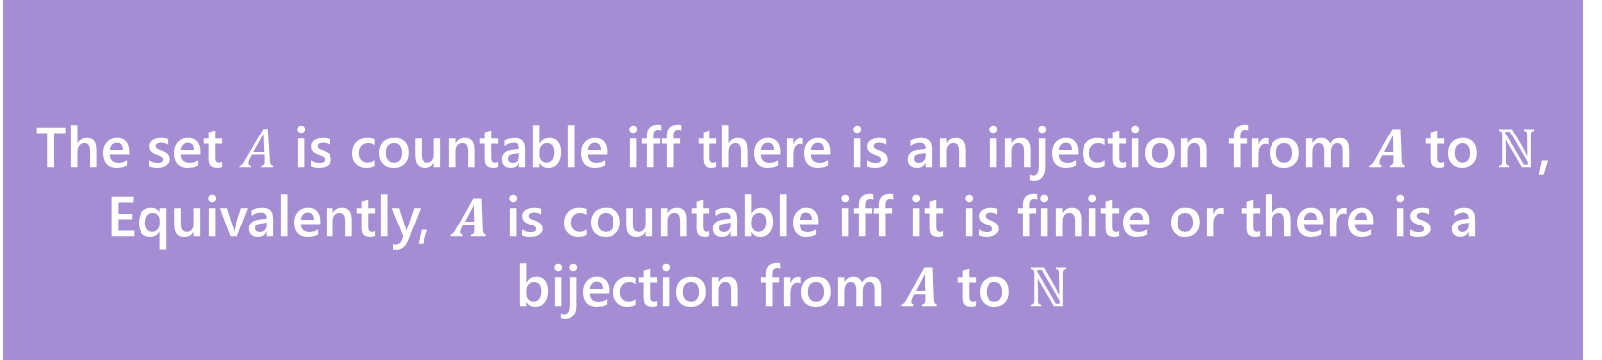
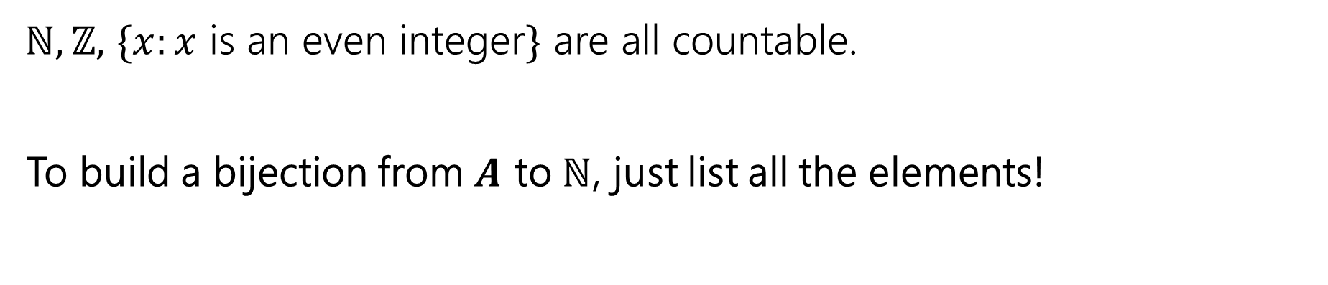
Countable
The set $A$ is countable iff there is an injection from $A$ to $ℕ$,
Equivalently, $A$ is countable iff it is finite or there is a bijection from $A$ to $ℕ$
Countable
$ℕ,ℤ,$ $\{x:x$ is an even integer$\}$ are all countable.
To build a bijection from $A$ to $ℕ$, just list all the elements!

Slide 16
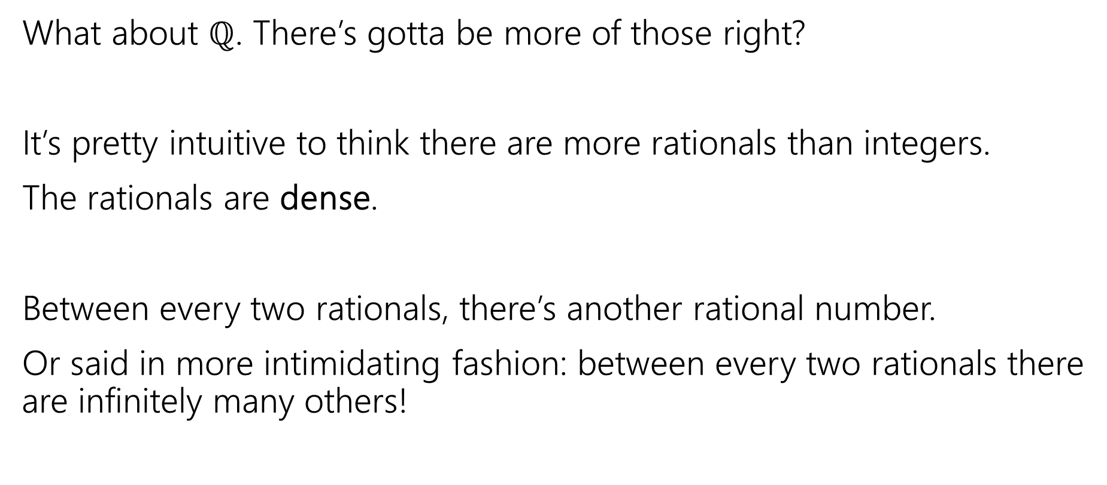
Let’s Try one that’s a little harder
What about $ℚ$. There’s gotta be more of those right?
It’s pretty intuitive to think there are more rationals than integers.
The rationals are dense.
Between every two rationals, there’s another rational number.
Or said in more intimidating fashion: between every two rationals there are infinitely many others!

Slide 17
The set of positive rational numbers
1/1 | 1/2 | 1/3 | 1/4 | 1/5 | 1/6 | 1/7 | 1/8 | ...
2/1 | 2/2 | 2/3 | 2/4 | 2/5 | 2/6 | 2/7 | 2/8 | ...
3/1 | 3/2 | 3/3 | 3/4 | 3/5 | 3/6 | 3/7 | 3/8 | ...
4/1 | 4/2 | 4/3 | 4/4 | 4/5 | 4/6 | 4/7 | 4/8 | ...
5/1 | 5/2 | 5/3 | 5/4 | 5/5 | 5/6 | 5/7 | ...
6/1 | 6/2 | 6/3 | 6/4 | 6/5 | 6/6 | ...
7/1 | 7/2 | 7/3 | 7/4 | 7/5 | ....
... | ... | ... | ... | ...

Slide 18
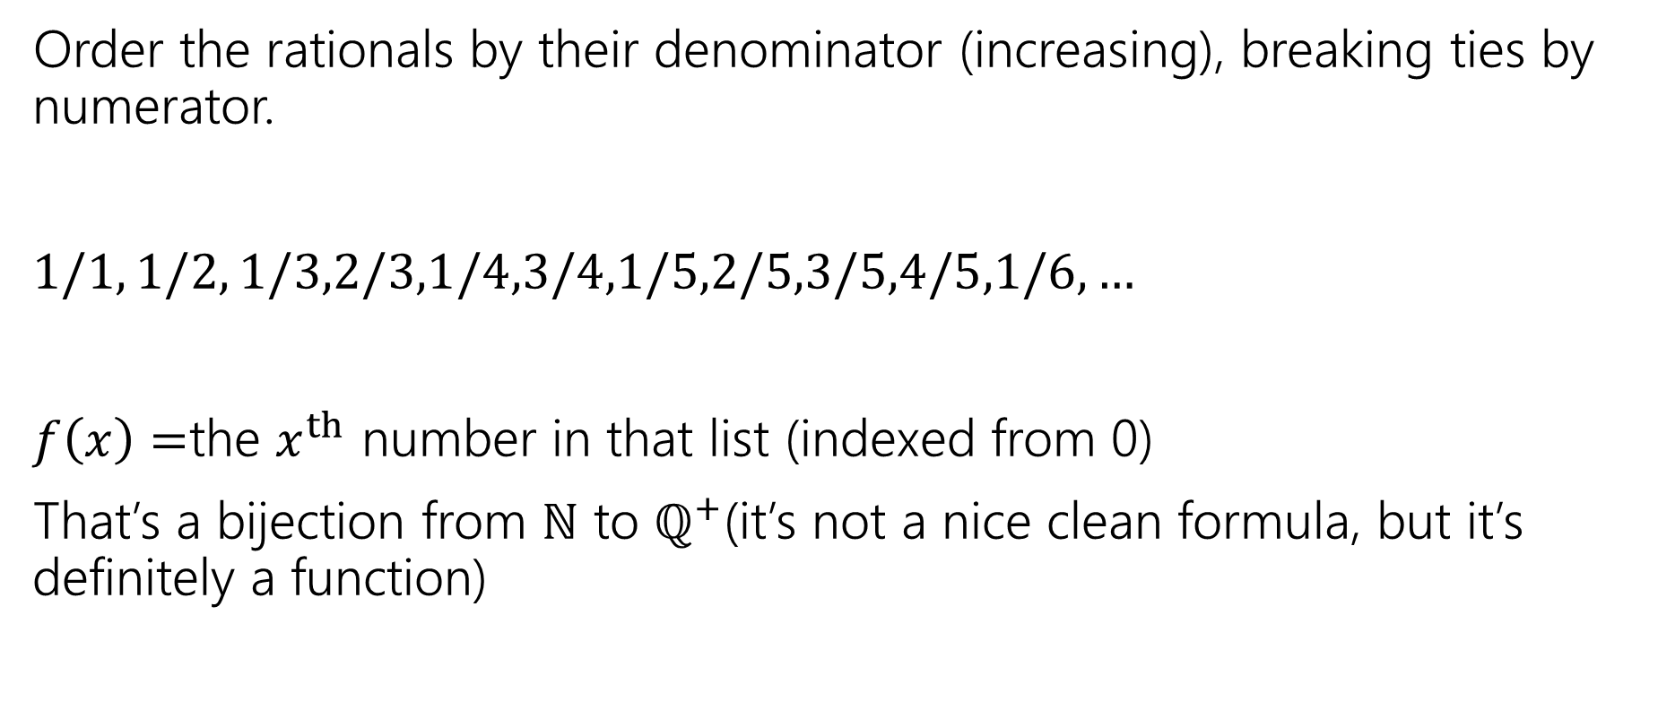
In bijection with the natural numbers
Order the rationals by their denominator (increasing), breaking ties by numerator.
$1/1, 1/2, 1/3,2/3,1/4,3/4,1/5,2/5,3/5,4/5,1/6,…$
$f\left(x\right)=$the $x^{th}$ number in that list (indexed from 0)
That’s a bijection from $ℕ$ to $ℚ^{+}$(it’s not a nice clean formula, but it’s definitely a function)

Slide 19
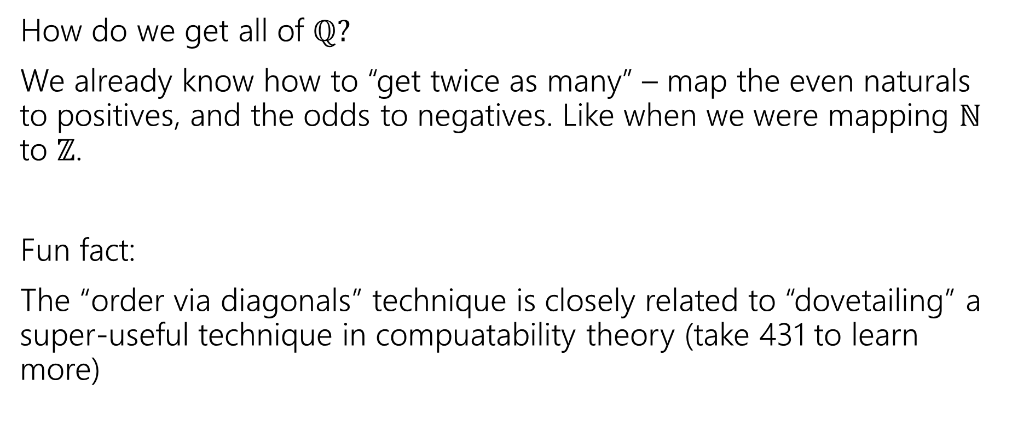
In Bijection with the natural numbers
How do we get all of $ℚ?$
We already know how to “get twice as many” – map the even naturals to positives, and the odds to negatives. Like when we were mapping $ℕ$ to $ℤ$.
Fun fact:
The “order via diagonals” technique is closely related to “dovetailing” a super-useful technique in compuatability theory (take 431 to learn more)

Slide 20

Uncountable
Alright. There are clever ways to build bijections.
Is there anything that’s bigger than $ℕ$?
And…like…how would we prove it?

Slide 21
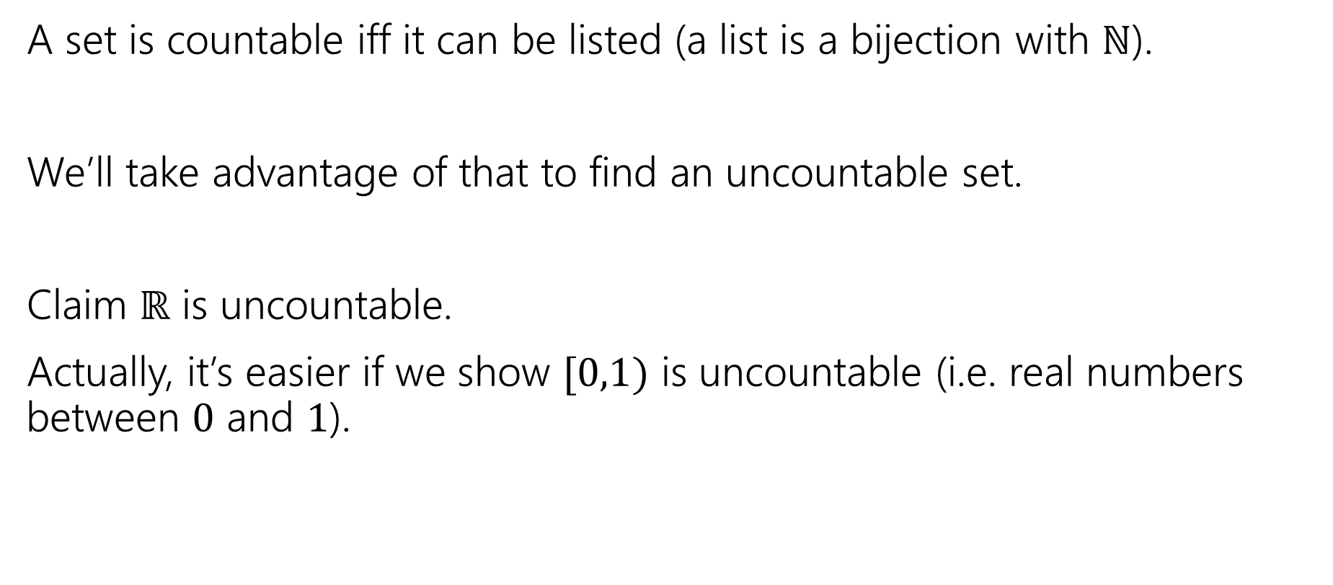
A proof idea
A set is countable iff it can be listed (a list is a bijection with $ℕ$).
We’ll take advantage of that to find an uncountable set.
Claim $ℝ$ is uncountable.
Actually, it’s easier if we show $[0,1)$ is uncountable (i.e. real numbers between $0$ and $1$).

Slide 22
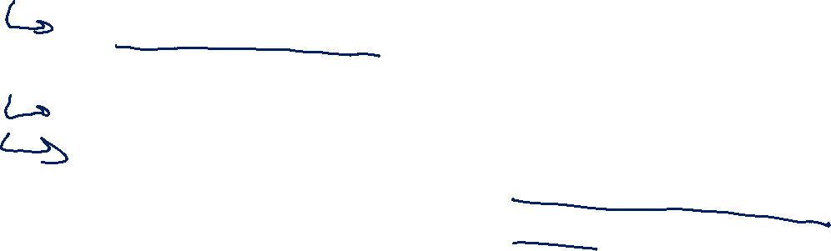
What do real numbers look like
0. | 3 | 3 | 3 | 3 | 3 | 3 | 3 | 3…
0. | 2 | 7 | 2 | 7 | 2 | 8 | 5 | 4…
0. | 1 | 4 | 1 | 5 | 9 | 2 | 6 | 5…
0. | 2 | 2 | 2 | 2 | 2 | 2 | 2 | 2…
0. | 1 | 2 | 3 | 4 | 5 | 6 | 7 | 8…
0. | 9 | 8 | 7 | 6 | 5 | 4 | 3 | 2…
0. | 8 | 2 | 7 | 6 | 4 | 5 | 7 | 4…
0. | 5 | 9 | 4 | 2 | 7 | 5 | 1 | 7…
A string of digits!
Well not a “string” An infinitely long sequence of digits is more accurate.

Slide 23

Uncountable
Suppose, for the sake of contradiction, that $[0,1)$ is countable.
Then there is a bijection $f:ℕ→[0,1)$.
Use that bijection to make the following table…

Slide 24
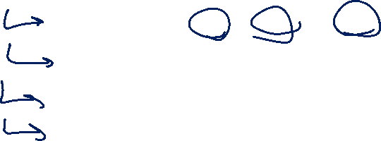
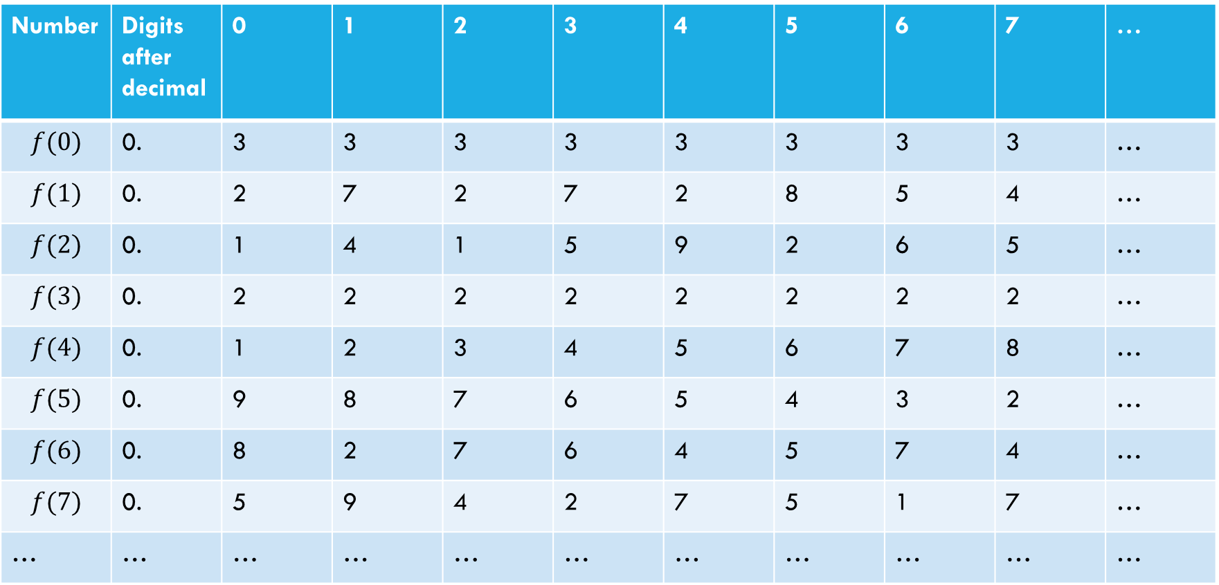
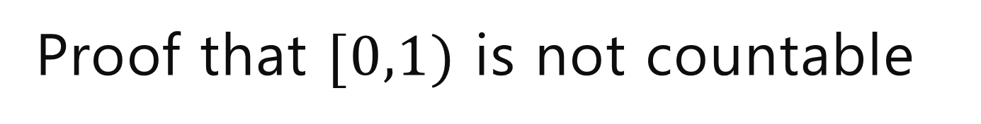
Proof that $[0,1)$ is not countable
Suppose, for the sake of contradiction, that there is a list of them:
Number | Digits after decimal | 0 | 1 | 2 | 3 | 4 | 5 | 6 | 7 | …
$$f(0)$$ | 0. | 3 | 3 | 3 | 3 | 3 | 3 | 3 | 3 | …
$$f(1)$$ | 0. | 2 | 7 | 2 | 7 | 2 | 8 | 5 | 4 | …
$$f(2)$$ | 0. | 1 | 4 | 1 | 5 | 9 | 2 | 6 | 5 | …
$$f(3)$$ | 0. | 2 | 2 | 2 | 2 | 2 | 2 | 2 | 2 | …
$$f(4)$$ | 0. | 1 | 2 | 3 | 4 | 5 | 6 | 7 | 8 | …
$$f(5)$$ | 0. | 9 | 8 | 7 | 6 | 5 | 4 | 3 | 2 | …
$$f(6)$$ | 0. | 8 | 2 | 7 | 6 | 4 | 5 | 7 | 4 | …
$$f(7)$$ | 0. | 5 | 9 | 4 | 2 | 7 | 5 | 1 | 7 | …
… | … | … | … | … | … | … | … | … | … | …

Slide 25
Proof that $[0,1)$ is not countable
Suppose, for the sake of contradiction, that there is a list of them:
Number | Digits after decimal | 0 | 1 | 2 | 3 | 4 | 5 | 6 | 7 | …
$$f(0)$$ | 0. | 3 | 3 | 3 | 3 | 3 | 3 | 3 | 3 | …
$$f(1)$$ | 0. | 2 | 7 | 2 | 7 | 2 | 8 | 5 | 4 | …
$$f(2)$$ | 0. | 1 | 4 | 1 | 5 | 9 | 2 | 6 | 5 | …
$$f(3)$$ | 0. | 2 | 2 | 2 | 2 | 2 | 2 | 2 | 2 | …
$$f(4)$$ | 0. | 1 | 2 | 3 | 4 | 5 | 6 | 7 | 8 | …
$$f(5)$$ | 0. | 9 | 8 | 7 | 6 | 5 | 4 | 3 | 2 | …
$$f(6)$$ | 0. | 8 | 2 | 7 | 6 | 4 | 5 | 7 | 4 | …
$$f(7)$$ | 0. | 5 | 9 | 4 | 2 | 7 | 5 | 1 | 7 | …
… | … | … | … | … | … | … | … | … | … | …
Goal: find a real number between 0 and 1 that isn’t on our table.
(contradiction to bijection)

Slide 26

Proof that $[0,1)$ is not countable
Suppose, for the sake of contradiction, that there is a list of them:
Number | Digits after decimal | 0 | 1 | 2 | 3 | 4 | 5 | 6 | 7 | …
$$f(0)$$ | 0. | 3 | 3 | 3 | 3 | 3 | 3 | 3 | 3 | …
$$f(1)$$ | 0. | 2 | 7 | 2 | 7 | 2 | 8 | 5 | 4 | …
$$f(2)$$ | 0. | 1 | 4 | 1 | 5 | 9 | 2 | 6 | 5 | …
$$f(3)$$ | 0. | 2 | 2 | 2 | 2 | 2 | 2 | 2 | 2 | …
$$f(4)$$ | 0. | 1 | 2 | 3 | 4 | 5 | 6 | 7 | 8 | …
$$f(5)$$ | 0. | 9 | 8 | 7 | 6 | 5 | 4 | 3 | 2 | …
$$f(6)$$ | 0. | 8 | 2 | 7 | 6 | 4 | 5 | 7 | 4 | …
$$f(7)$$ | 0. | 5 | 9 | 4 | 2 | 7 | 5 | 1 | 7 | …
… | … | … | … | … | … | … | … | … | … | …
How do we find a number that’s not in our list?
Well let’s make sure whatever our number is, it’s not $f(0)$

Slide 27
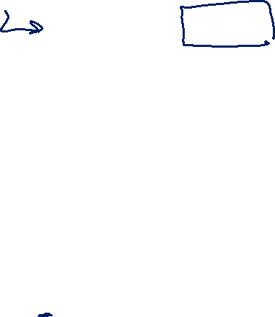
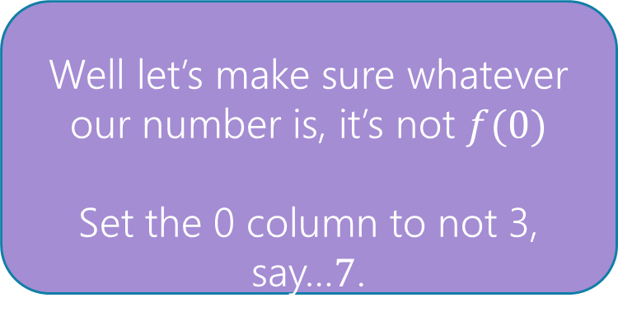
Proof that $[0,1)$ is not countable
Suppose, for the sake of contradiction, that there is a list of them:
Number | Digits after decimal | 0 | 1 | 2 | 3 | 4 | 5 | 6 | 7 | …
$$f(0)$$ | 0. | 3 | 3 | 3 | 3 | 3 | 3 | 3 | 3 | …
$$f(1)$$ | 0. | 2 | 7 | 2 | 7 | 2 | 8 | 5 | 4 | …
$$f(2)$$ | 0. | 1 | 4 | 1 | 5 | 9 | 2 | 6 | 5 | …
$$f(3)$$ | 0. | 2 | 2 | 2 | 2 | 2 | 2 | 2 | 2 | …
$$f(4)$$ | 0. | 1 | 2 | 3 | 4 | 5 | 6 | 7 | 8 | …
$$f(5)$$ | 0. | 9 | 8 | 7 | 6 | 5 | 4 | 3 | 2 | …
$$f(6)$$ | 0. | 8 | 2 | 7 | 6 | 4 | 5 | 7 | 4 | …
$$f(7)$$ | 0. | 5 | 9 | 4 | 2 | 7 | 5 | 1 | 7 | …
… | … | … | … | … | … | … | … | … | … | …
Well let’s make sure whatever our number is, it’s not $f(0)$
Set the 0 column to not 3, say…$7$.
0.7

Slide 28
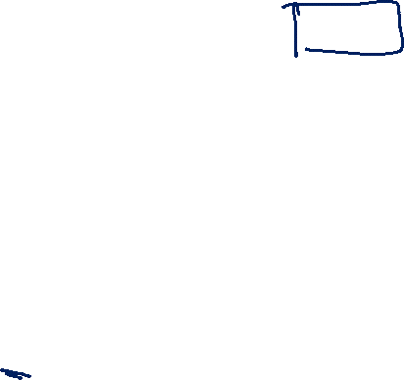
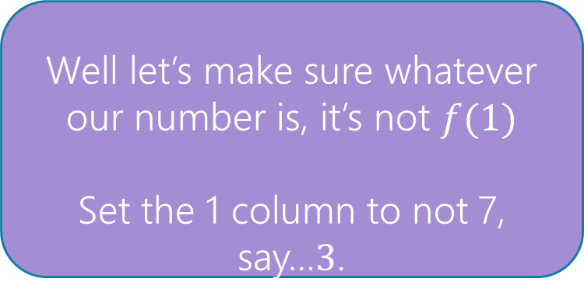
Proof that $[0,1)$ is not countable
Suppose, for the sake of contradiction, that there is a list of them:
Number | Digits after decimal | 0 | 1 | 2 | 3 | 4 | 5 | 6 | 7 | …
$$f(0)$$ | 0. | 3 | 3 | 3 | 3 | 3 | 3 | 3 | 3 | …
$$f(1)$$ | 0. | 2 | 7 | 2 | 7 | 2 | 8 | 5 | 4 | …
$$f(2)$$ | 0. | 1 | 4 | 1 | 5 | 9 | 2 | 6 | 5 | …
$$f(3)$$ | 0. | 2 | 2 | 2 | 2 | 2 | 2 | 2 | 2 | …
$$f(4)$$ | 0. | 1 | 2 | 3 | 4 | 5 | 6 | 7 | 8 | …
$$f(5)$$ | 0. | 9 | 8 | 7 | 6 | 5 | 4 | 3 | 2 | …
$$f(6)$$ | 0. | 8 | 2 | 7 | 6 | 4 | 5 | 7 | 4 | …
$$f(7)$$ | 0. | 5 | 9 | 4 | 2 | 7 | 5 | 1 | 7 | …
… | … | … | … | … | … | … | … | … | … | …
Well let’s make sure whatever our number is, it’s not $f(1)$
Set the 1 column to not 7, say…$3$.
0.73

Slide 29

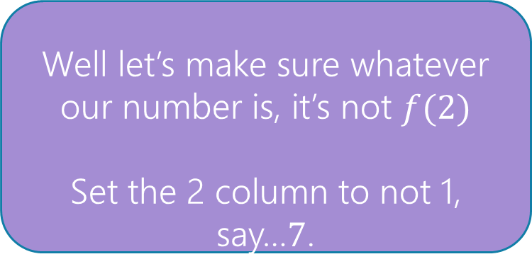
Proof that $[0,1)$ is not countable
Suppose, for the sake of contradiction, that there is a list of them:
Number | Digits after decimal | 0 | 1 | 2 | 3 | 4 | 5 | 6 | 7 | …
$$f(0)$$ | 0. | 3 | 3 | 3 | 3 | 3 | 3 | 3 | 3 | …
$$f(1)$$ | 0. | 2 | 7 | 2 | 7 | 2 | 8 | 5 | 4 | …
$$f(2)$$ | 0. | 1 | 4 | 1 | 5 | 9 | 2 | 6 | 5 | …
$$f(3)$$ | 0. | 2 | 2 | 2 | 2 | 2 | 2 | 2 | 2 | …
$$f(4)$$ | 0. | 1 | 2 | 3 | 4 | 5 | 6 | 7 | 8 | …
$$f(5)$$ | 0. | 9 | 8 | 7 | 6 | 5 | 4 | 3 | 2 | …
$$f(6)$$ | 0. | 8 | 2 | 7 | 6 | 4 | 5 | 7 | 4 | …
$$f(7)$$ | 0. | 5 | 9 | 4 | 2 | 7 | 5 | 1 | 7 | …
… | … | … | … | … | … | … | … | … | … | …
Well let’s make sure whatever our number is, it’s not $f(2)$
Set the 2 column to not 1, say…$7$.
0.737

Slide 30
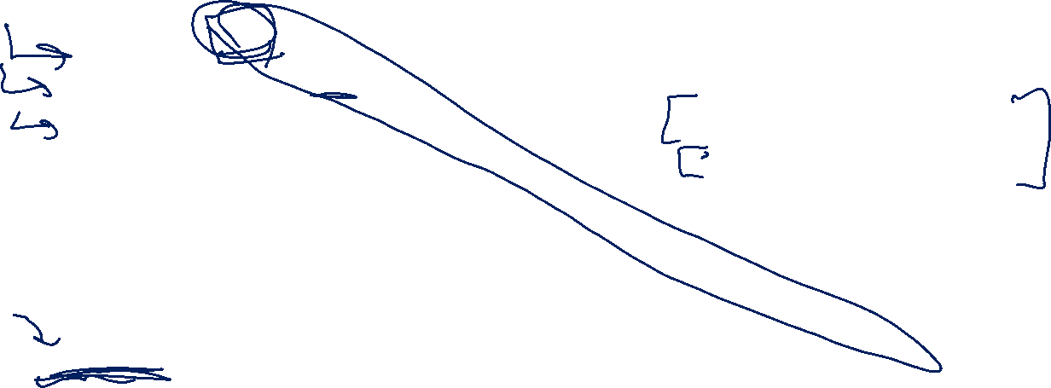


Proof that $[0,1)$ is not countable
Suppose, for the sake of contradiction, that there is a list of them:
Number | Digits after decimal | 0 | 1 | 2 | 3 | 4 | 5 | 6 | 7 | …
$$f(0)$$ | 0. | 3 | 3 | 3 | 3 | 3 | 3 | 3 | 3 | …
$$f(1)$$ | 0. | 2 | 7 | 2 | 7 | 2 | 8 | 5 | 4 | …
$$f(2)$$ | 0. | 1 | 4 | 1 | 5 | 9 | 2 | 6 | 5 | …
$$f(3)$$ | 0. | 2 | 2 | 2 | 2 | 2 | 2 | 2 | 2 | …
$$f(4)$$ | 0. | 1 | 2 | 3 | 4 | 5 | 6 | 7 | 8 | …
$$f(5)$$ | 0. | 9 | 8 | 7 | 6 | 5 | 4 | 3 | 2 | …
$$f(6)$$ | 0. | 8 | 2 | 7 | 6 | 4 | 5 | 7 | 4 | …
$$f(7)$$ | 0. | 5 | 9 | 4 | 2 | 7 | 5 | 1 | 7 | …
… | … | … | … | … | … | … | … | … | … | …
Flipping Rule: let’s set the $i^{th}$ column to:
$7$ if $f(i)$’s $i^{th}$ column is not $7$
$3$if $f{\left(i\right)}^{′}s$ $i^{th}$ column is $7$.
0.73777733…

Slide 31
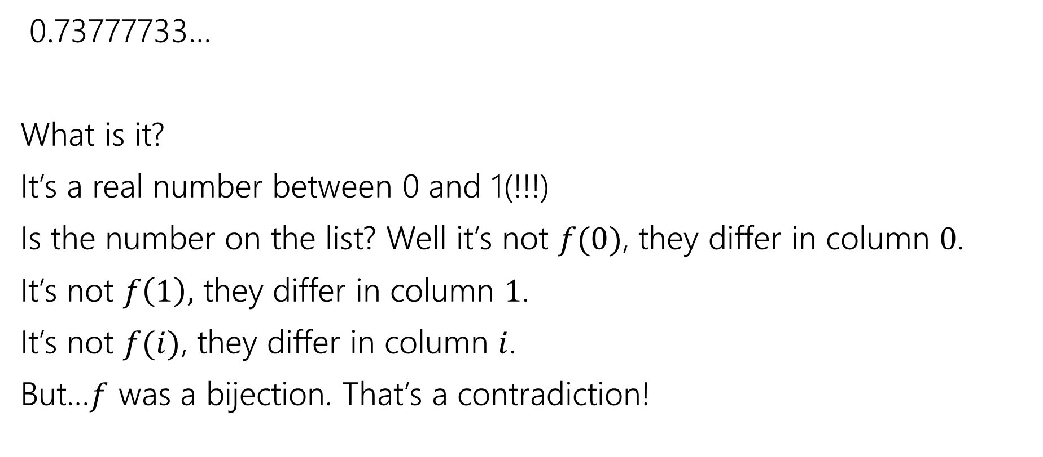
Wrapping Up
0.73777733…
What is it?
It’s a real number between 0 and 1(!!!)
Is the number on the list? Well it’s not $f(0)$, they differ in column $0$.
It’s not $f\left(1\right),$ they differ in column $1$.
It’s not $f(i)$, they differ in column $i$.
But…$f$ was a bijection. That’s a contradiction!

Slide 32
Diagonalization
This proof technique is called diagonalization
Often “Cantor’s Diagonalization” (after Cantor, who developed it).

Slide 33
Takeaway 1
There are differing levels of infinity.
Some infinite sets are equal in size.
Other infinite sets are bigger than others.
If this is mind-bending you’re in good company.
Cantor’s contemporaries accused him of being a “scientific charlatan” and a “corruptor of youth”
But Cantor was right – and his ideas eventually were recognized as correct.

Slide 34
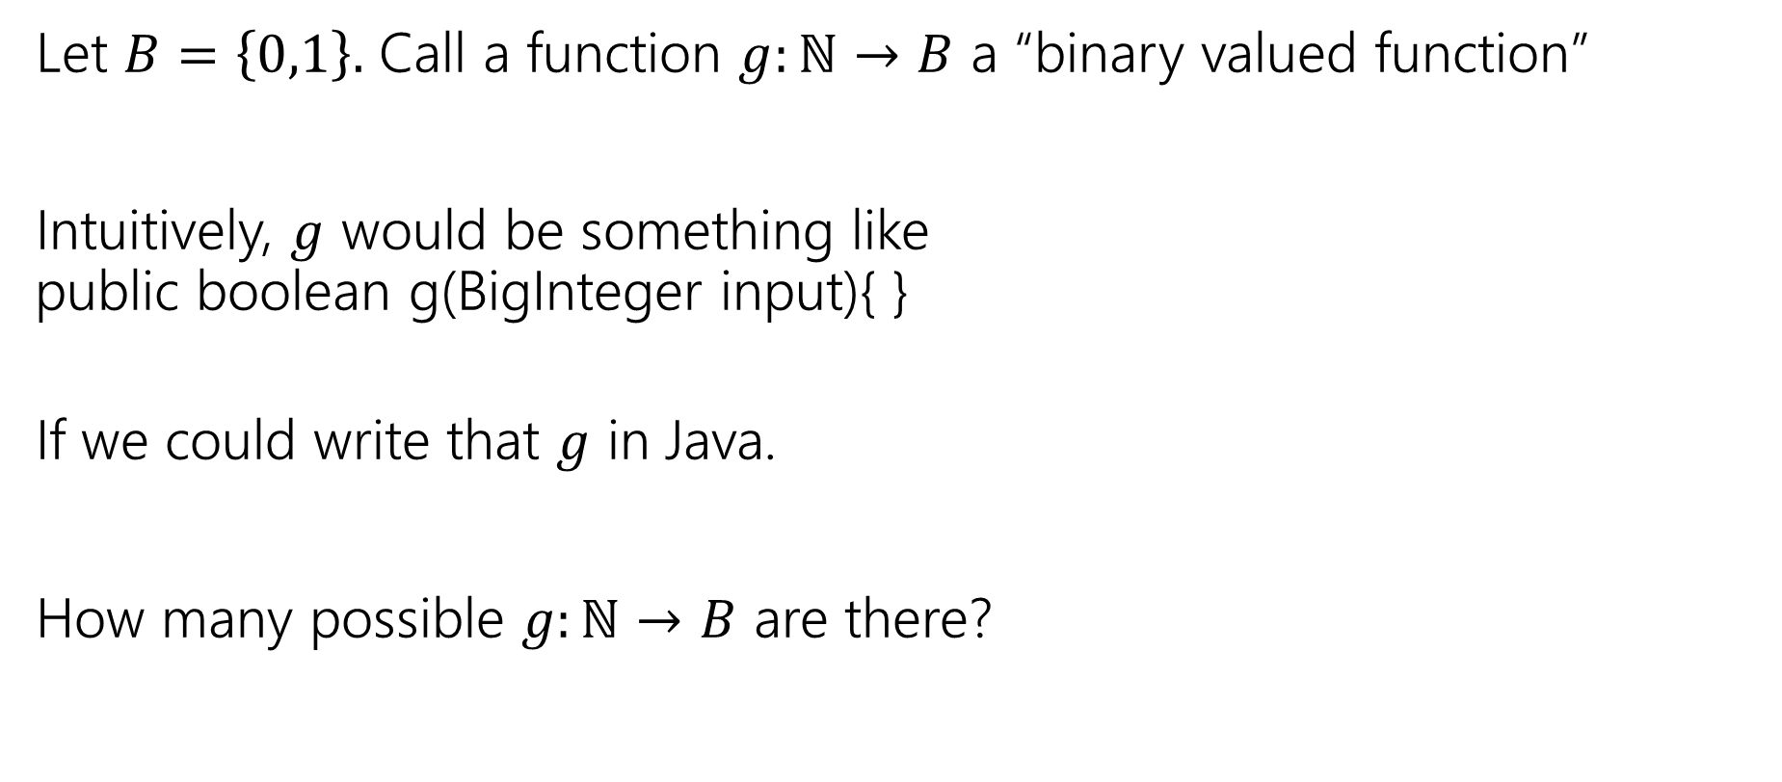
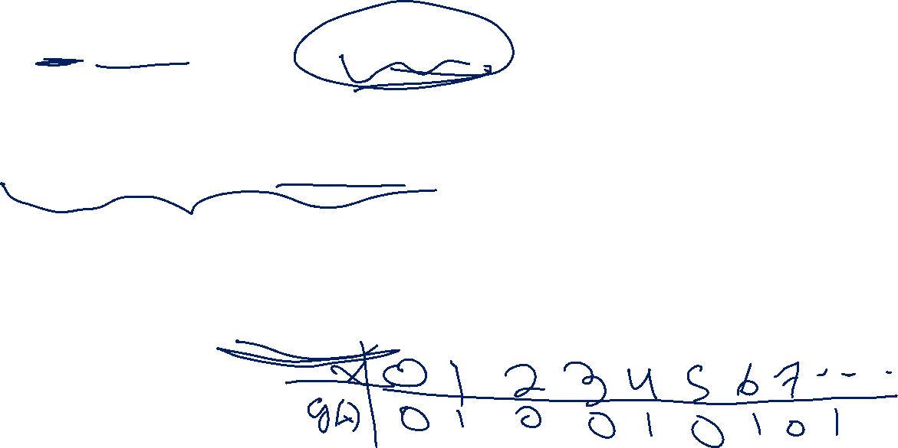
Let’s Do Another!
Let $B=\left\{0,1\right\}.$ Call a function $g:ℕ→B$ a “binary valued function”
Intuitively, $g$ would be something like
public boolean g(BigInteger input){ }
If we could write that $g$ in Java.
How many possible $g:ℕ→B$ are there?

Slide 35
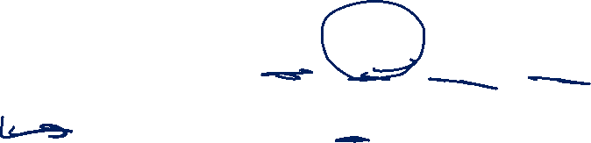
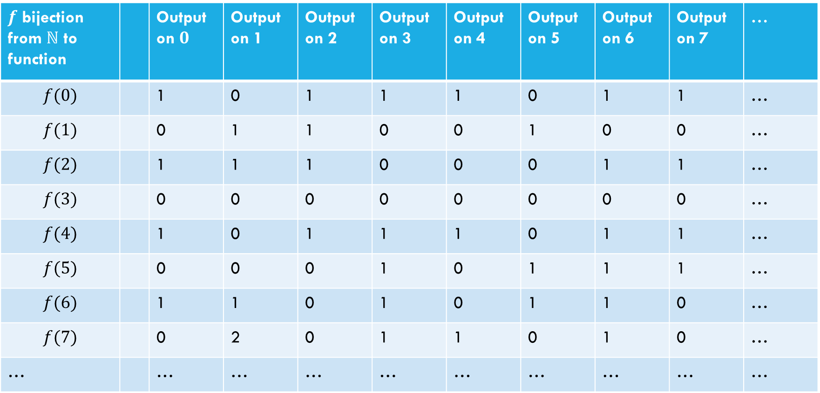
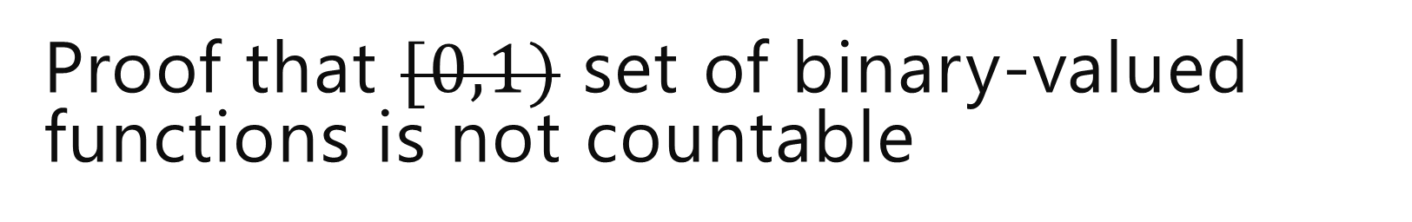
Proof that $[0,1)$ set of binary-valued functions is not countable
Suppose, for the sake of contradiction, that there is a list of them:
$f$ bijection from $ℕ$ to function |  | Output on $0$ | Output on 1 | Output on 2 | Output on 3 | Output on 4 | Output on 5 | Output on 6 | Output on 7 | …
$$f(0)$$ |  | 1 | 0 | 1 | 1 | 1 | 0 | 1 | 1 | …
$$f(1)$$ |  | 0 | 1 | 1 | 0 | 0 | 1 | 0 | 0 | …
$$f(2)$$ |  | 1 | 1 | 1 | 0 | 0 | 0 | 1 | 1 | …
$$f(3)$$ |  | 0 | 0 | 0 | 0 | 0 | 0 | 0 | 0 | …
$$f(4)$$ |  | 1 | 0 | 1 | 1 | 1 | 0 | 1 | 1 | …
$$f(5)$$ |  | 0 | 0 | 0 | 1 | 0 | 1 | 1 | 1 | …
$$f(6)$$ |  | 1 | 1 | 0 | 1 | 0 | 1 | 1 | 0 | …
$$f(7)$$ |  | 0 | 2 | 0 | 1 | 1 | 0 | 1 | 0 | …
… |  | … | … | … | … | … | … | … | … | …

Slide 36


Proof that $[0,1)$ set of binary-valued functions is not countable
Suppose, for the sake of contradiction, that there is a list of them:
$f$ bijection from $ℕ$ to function |  | Output on $0$ | Output on 1 | Output on 2 | Output on 3 | Output on 4 | Output on 5 | Output on 6 | Output on 7 | …
$$f(0)$$ |  | 1 | 0 | 1 | 1 | 1 | 0 | 1 | 1 | …
$$f(1)$$ |  | 0 | 1 | 1 | 0 | 0 | 1 | 0 | 0 | …
$$f(2)$$ |  | 1 | 1 | 1 | 0 | 0 | 0 | 1 | 1 | …
$$f(3)$$ |  | 0 | 0 | 0 | 0 | 0 | 0 | 0 | 0 | …
$$f(4)$$ |  | 1 | 0 | 1 | 1 | 1 | 0 | 1 | 1 | …
$$f(5)$$ |  | 0 | 0 | 0 | 1 | 0 | 1 | 1 | 1 | …
$$f(6)$$ |  | 1 | 1 | 0 | 1 | 0 | 1 | 1 | 0 | …
$$f(7)$$ |  | 0 | 2 | 0 | 1 | 1 | 0 | 1 | 0 | …
… |  | … | … | … | … | … | … | … | … | …
Goal: find a function$g_{diag}:ℕ→\left\{0,1\right\}$ that isn’t on our table.
(contradiction to bijection)

Slide 37


Proof that $[0,1)$ set of binary-valued functions is not countable
Suppose, for the sake of contradiction, that there is a list of them:
$f$ bijection from $ℕ$ to function |  | Output on $0$ | Output on 1 | Output on 2 | Output on 3 | Output on 4 | Output on 5 | Output on 6 | Output on 7 | …
$$f(0)$$ |  | 1 | 0 | 1 | 1 | 1 | 0 | 1 | 1 | …
$$f(1)$$ |  | 0 | 1 | 1 | 0 | 0 | 1 | 0 | 0 | …
$$f(2)$$ |  | 1 | 1 | 1 | 0 | 0 | 0 | 1 | 1 | …
$$f(3)$$ |  | 0 | 0 | 0 | 0 | 0 | 0 | 0 | 0 | …
$$f(4)$$ |  | 1 | 0 | 1 | 1 | 1 | 0 | 1 | 1 | …
$$f(5)$$ |  | 0 | 0 | 0 | 1 | 0 | 1 | 1 | 1 | …
$$f(6)$$ |  | 1 | 1 | 0 | 1 | 0 | 1 | 1 | 0 | …
$$f(7)$$ |  | 0 | 2 | 0 | 1 | 1 | 0 | 1 | 0 | …
… |  | … | … | … | … | … | … | … | … | …
How do we find a function not on our list?
Well to make sure it’s not $f(0)$ (the function in the first row)
Have $g_{diag}\left(0\right)=0$
$$g_{diag}\left(x\right)=\left\{\begin{aligned}0 if x=1 \\ … \\ …\end{aligned}\right.$$

Slide 38

Proof that $[0,1)$ set of binary-valued functions is not countable
Suppose, for the sake of contradiction, that there is a list of them:
$f$ bijection from $ℕ$ to function |  | Output on $0$ | Output on 1 | Output on 2 | Output on 3 | Output on 4 | Output on 5 | Output on 6 | Output on 7 | …
$$f(0)$$ |  | 1 | 0 | 1 | 1 | 1 | 0 | 1 | 1 | …
$$f(1)$$ |  | 0 | 1 | 1 | 0 | 0 | 1 | 0 | 0 | …
$$f(2)$$ |  | 1 | 1 | 1 | 0 | 0 | 0 | 1 | 1 | …
$$f(3)$$ |  | 0 | 0 | 0 | 0 | 0 | 0 | 0 | 0 | …
$$f(4)$$ |  | 1 | 0 | 1 | 1 | 1 | 0 | 1 | 1 | …
$$f(5)$$ |  | 0 | 0 | 0 | 1 | 0 | 1 | 1 | 1 | …
$$f(6)$$ |  | 1 | 1 | 0 | 1 | 0 | 1 | 1 | 0 | …
$$f(7)$$ |  | 0 | 2 | 0 | 1 | 1 | 0 | 1 | 0 | …
… |  | … | … | … | … | … | … | … | … | …
How do we find a function not on our list?
Well to make sure it’s not $f(0)$ (the function in the first row)
Have $g_{diag}\left(0\right)=0$
$$g_{diag}\left(x\right)=\left\{\begin{aligned}0 if x=1 \\ … \\ …\end{aligned}\right.$$

Slide 39
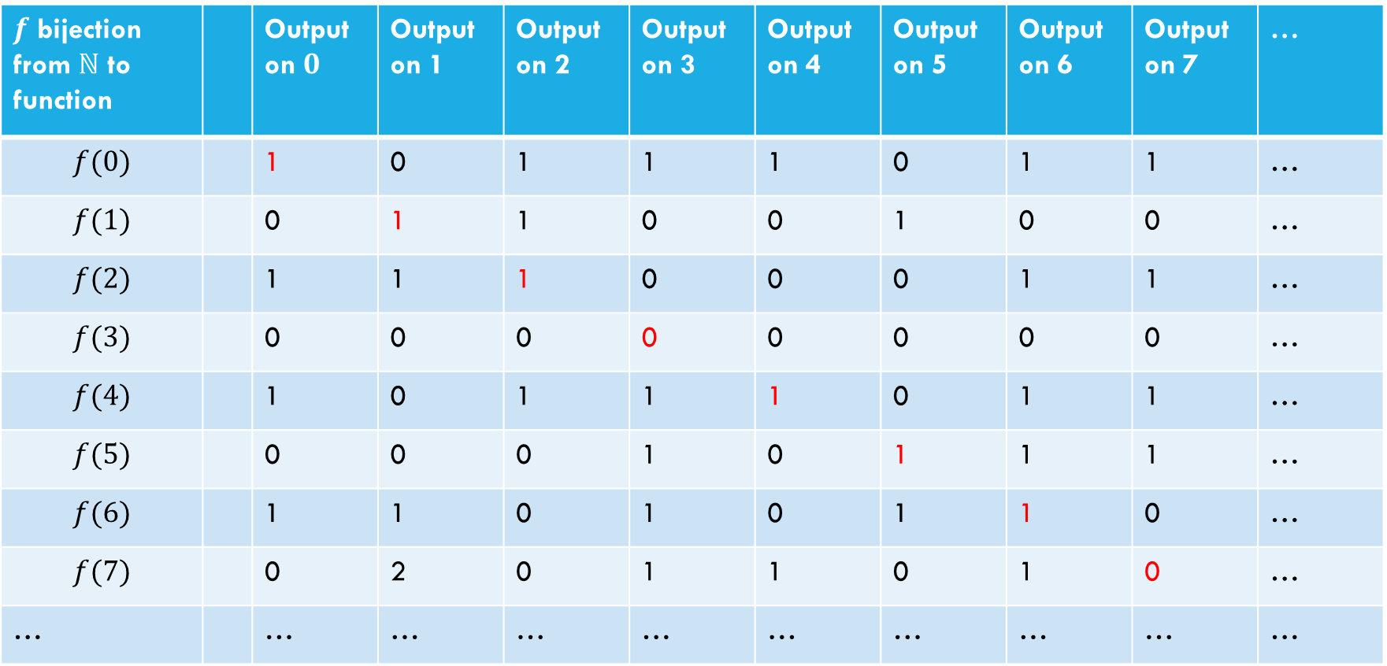

Proof that $[0,1)$ set of binary-valued functions is not countable
Suppose, for the sake of contradiction, that there is a list of them:
$f$ bijection from $ℕ$ to function |  | Output on $0$ | Output on 1 | Output on 2 | Output on 3 | Output on 4 | Output on 5 | Output on 6 | Output on 7 | …
$$f(0)$$ |  | 1 | 0 | 1 | 1 | 1 | 0 | 1 | 1 | …
$$f(1)$$ |  | 0 | 1 | 1 | 0 | 0 | 1 | 0 | 0 | …
$$f(2)$$ |  | 1 | 1 | 1 | 0 | 0 | 0 | 1 | 1 | …
$$f(3)$$ |  | 0 | 0 | 0 | 0 | 0 | 0 | 0 | 0 | …
$$f(4)$$ |  | 1 | 0 | 1 | 1 | 1 | 0 | 1 | 1 | …
$$f(5)$$ |  | 0 | 0 | 0 | 1 | 0 | 1 | 1 | 1 | …
$$f(6)$$ |  | 1 | 1 | 0 | 1 | 0 | 1 | 1 | 0 | …
$$f(7)$$ |  | 0 | 2 | 0 | 1 | 1 | 0 | 1 | 0 | …
… |  | … | … | … | … | … | … | … | … | …
How do we find a function not on our list?
Well to make sure it’s not $f(i)$ (the function in the $i^{th}$ row)
Have $g_{diag}\left(i\right)=1−f\left(i\right)\left(i\right)$
$$g_{diag}\left(x\right)=\left\{\begin{aligned}0 if x=1 \\ … \\ …\end{aligned}\right.$$

Slide 40

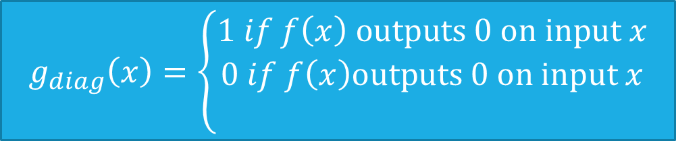
Proof that $[0,1)$ set of binary-valued functions is not countable
Suppose, for the sake of contradiction, that there is a list of them:
$f$ bijection from $ℕ$ to function |  | Output on $0$ | Output on 1 | Output on 2 | Output on 3 | Output on 4 | Output on 5 | Output on 6 | Output on 7 | …
$$f(0)$$ |  | 1 | 0 | 1 | 1 | 1 | 0 | 1 | 1 | …
$$f(1)$$ |  | 0 | 1 | 1 | 0 | 0 | 1 | 0 | 0 | …
$$f(2)$$ |  | 1 | 1 | 1 | 0 | 0 | 0 | 1 | 1 | …
$$f(3)$$ |  | 0 | 0 | 0 | 0 | 0 | 0 | 0 | 0 | …
$$f(4)$$ |  | 1 | 0 | 1 | 1 | 1 | 0 | 1 | 1 | …
$$f(5)$$ |  | 0 | 0 | 0 | 1 | 0 | 1 | 1 | 1 | …
$$f(6)$$ |  | 1 | 1 | 0 | 1 | 0 | 1 | 1 | 0 | …
$$f(7)$$ |  | 0 | 2 | 0 | 1 | 1 | 0 | 1 | 0 | …
… |  | … | … | … | … | … | … | … | … | …
How do we find a function not on our list?
Well to make sure it’s not $f(i)$ (the function in the $i^{th}$ row)
Have $g_{diag}\left(i\right)=1−f\left(i\right)\left(i\right)$
$$g_{diag}\left(x\right)=\left\{\begin{aligned}1 if f\left(x\right) outputs 0 on input x \\ 0 if f\left(x\right)outputs 0 on input x \\ \end{aligned}\right.$$

Slide 41
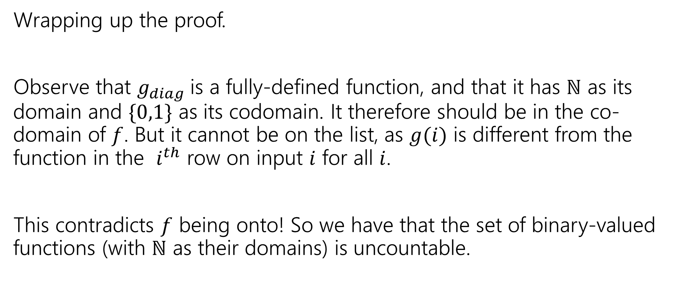
Wrapping up the proof
Wrapping up the proof.
Observe that $g_{diag}$is a fully-defined function, and that it has $ℕ$ as its domain and $\{0,1\}$ as its codomain. It therefore should be in the co-domain of $f$. But it cannot be on the list, as $g(i)$ is different from the function in the $i^{th}$ row on input $i$ for all $i$.
This contradicts $f$ being onto! So we have that the set of binary-valued functions (with $ℕ$ as their domains) is uncountable.

Slide 42
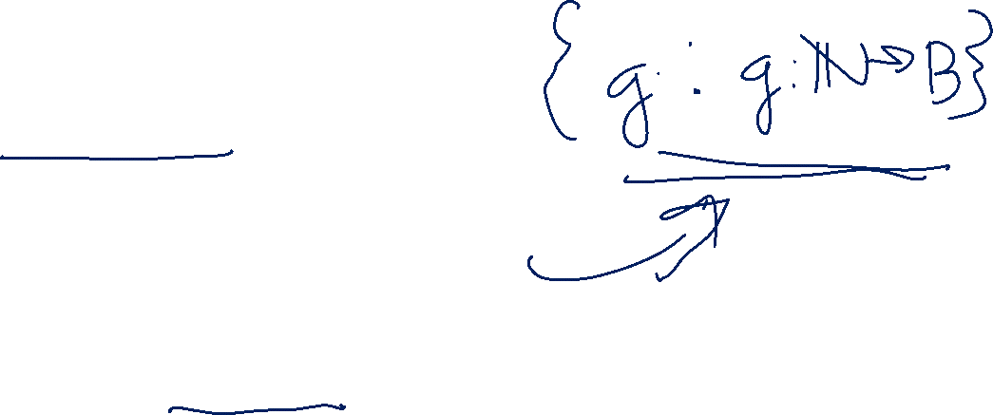
Our Second big takeaway
How many Java methods can we write:
public boolean g(int input) ?
Can you list them?
Yeah!! Put them in lexicographic order
i.e. in increasing order of length, with ties broken by alphabetical order.
Wait…that means the number of such Java programs is countable.
And…the number of functions we’re supposed to write is uncountable.

Slide 43
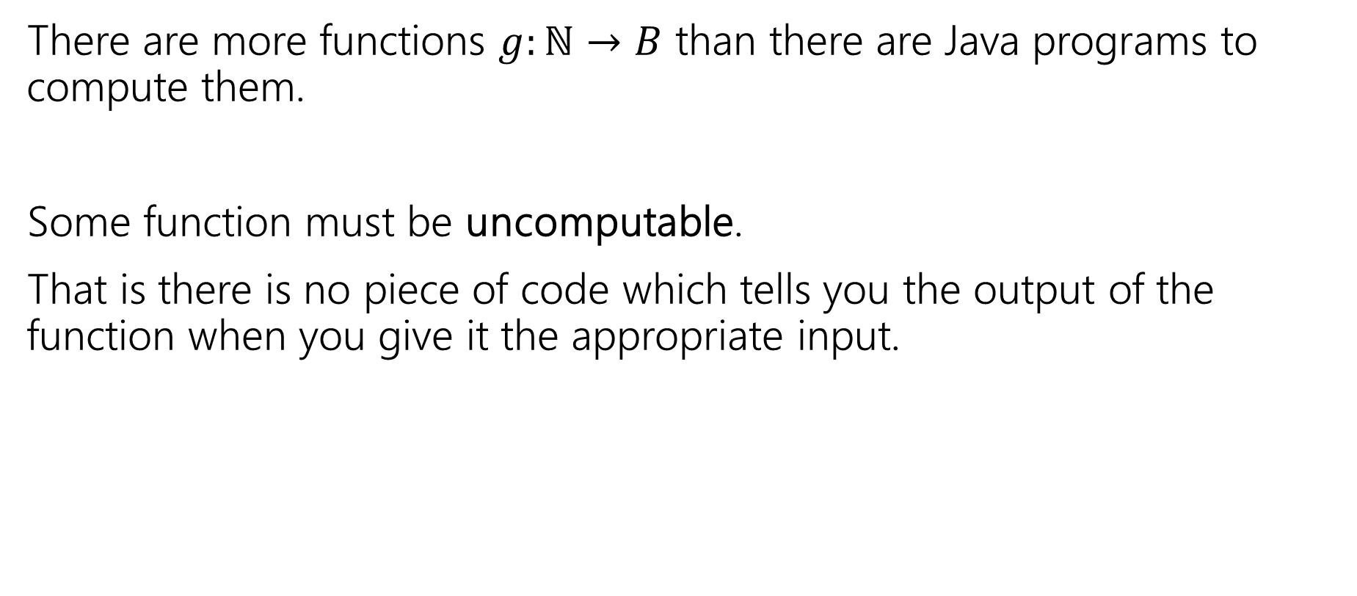
Our Second big takeaway
There are more functions $g:ℕ→B$ than there are Java programs to compute them.
Some function must be uncomputable.
That is there is no piece of code which tells you the output of the function when you give it the appropriate input.

Slide 44

Not just Java
This isn’t just about java programs. (all we used about java was that its programs are strings)…that’s…well every programming language.
There are functions that simply cannot be computed.
Doesn’t matter how clever you are. How fancy your new programming language is. Just doesn’t work.*
*there’s a difference between int and $ℕ$ here, for the proof to work you really need all integers to be valid inputs, not just integers in a certain range.

Slide 45
Does this matter?
It’s even worse than that – almost all functions are not computable.
So…how come this has never happened to you?
This might not be meaningful yet. Almost all functions are also inexpressible in a finite amount of English (English is a language too!)
You’ve probably never decided to write a program that computes a function you couldn’t describe in English…
Are there any problems anyone is interested in solving that aren’t computable?
Notes:
Uncountably infinite isn’t “a little bit bigger” it’s “A LOT bigger”
Slightly misusing the ideas of measure theory, we’d say that 0% of the functions are computable.

Slide 46
The Halting Problem

Slide 47
A Practical Uncomputable Problem
Ever pressed the run button on your code and have it take a long time?
Like an infinitely long time?
What didn’t your compiler…like, tell you not to push the button yet.
It tells you when your code doesn’t compile before it runs it…why doesn’t it check for infinite loops?

Slide 48

The Halting Problem
Given: source code for a program $P$ and $x$ an input we could give to $P$
Return: True if $P$ will halt on $x$, False if it runs forever (e.g. goes in an infinite loop or infinitely recurses)
The Halting Problem
This would be super useful to solve!
We can’t solve it…we’ll find out why on Friday.

Slide 49
Uncountability template

Slide 50


To Show $S$ is uncountable
Suppose, for the sake of contradiction, that $S$ is countable. Then by definition, $S$ can be put in bijection with the natural numbers.
Visualize that bijection as a table: the $i^{th}$ row of the table is the $i^{th}$ element of $S$ in the bijection. Each column of the table contains a <>.
Drawing a doodle of the table is usually helpful here.
Observe that since elements of $S$ are made up of a sequence of infinitely many <>, the table is infinite in both directions.
We now construct an element $e$ of $S$ which is not in the table.
Describe a construction rule, probably by flipping. Notation helps here, “the $i^{th}<>$ of $e$ is …”

Slide 51

To Show $S$ is uncountable
Explain why $e$ really is in $S$, you’ll probably want to mention going on infinitely, and something like: this is an infinitely-long sequence of integers, but that is just the decimal expansion of a real number between 0 and 1.
Note that $e$ cannot be the element in row $i$ of the table for any $i$, as … (refer back to flipping rule to argue you aren’t equal to row $i$).
Thus $e$ is an element of $S$ not on the table. But the table represents a bijection between $S$ and $ℕ$. That’s a contradiction! So $S$ must be uncountably infinite.

Slide 52



Bijection
A function $f$ is one-to-one iff
$$∀a∀b(f\left(a\right)=f\left(b\right)→a=b)$$
A function $f:A→B$ is onto iff
$$∀b∈B∃a∈A(b=f(a))$$
One-to-one (aka injection)
Onto (aka surjection)
A function $f:A→B$ is a bijection iff
$f$ is one-to-one and onto
Bijection
A bijection maps every element of the domain to exactly one element of the co-domain, and every element of the domain to exactly one element of the domain.

