Slide 1
Regular Languages
CSE 311 Autumn 2025
Lecture 26

Slide 2
Announcements (1)
HW8 will be released today or tomorrow.
Due Fri Dec 5th (the last day of the quarter). Maximum 1 late day can be used (to submit on Sat Dec 6th) so we can release solutions on Sunday after the deadline.
Final review materials and logistics on this page.
What’s fair game for the final?
Everything through the end of this slide deck can show up in any way. (cumulative)
Monday you’ll learn how to show a language is “not regular.” Wednesday you’ll learn how to show a set is “uncountable.” There will be a problem on the final “choose one of these two: show a language is irregular; show a set is uncountable”
Last day of class will wrap those topics/talk about the Halting Problem (won’t be tested directly).
If you need a conflict exam fill out the Final Exam form as soon as possible.
(for pre-existing conflicts; for illnesses day-of directions on the exams page)

Slide 3
Announcements (2)
CC26 and 27 are both based on this slide deck.
Both out today, both due Monday (in case you are travelling).
Some OH made remote or cancelled this week (TAs and students travelling)

Slide 4
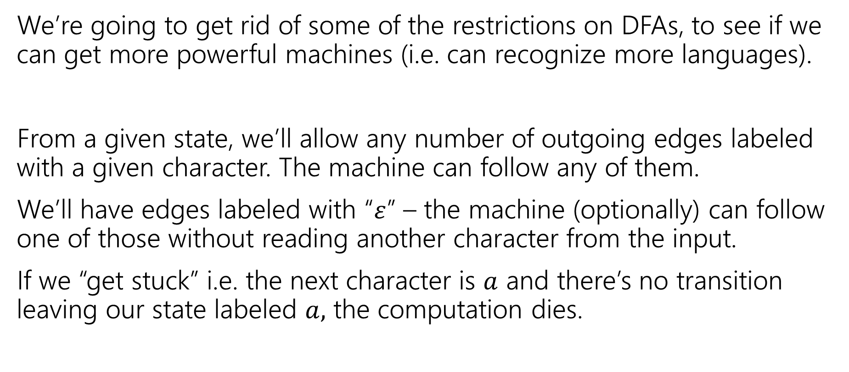
Let’s try to make our more powerful automata
We’re going to get rid of some of the restrictions on DFAs, to see if we can get more powerful machines (i.e. can recognize more languages).
From a given state, we’ll allow any number of outgoing edges labeled with a given character. The machine can follow any of them.
We’ll have edges labeled with “$ε$” – the machine (optionally) can follow one of those without reading another character from the input.
If we “get stuck” i.e. the next character is $a$ and there’s no transition leaving our state labeled $a,$ the computation dies.

Slide 5
So…magic guessing doesn’t exist
I know. The parallel computation view is realistic.
Lets us give simpler descriptions of complicated objects.
This notion of “nondeterminism” is also really useful in more advanced CS theory (you’ll see it again in 421 or 431 if not sooner).
Source of the P vs. NP problem.

Slide 6

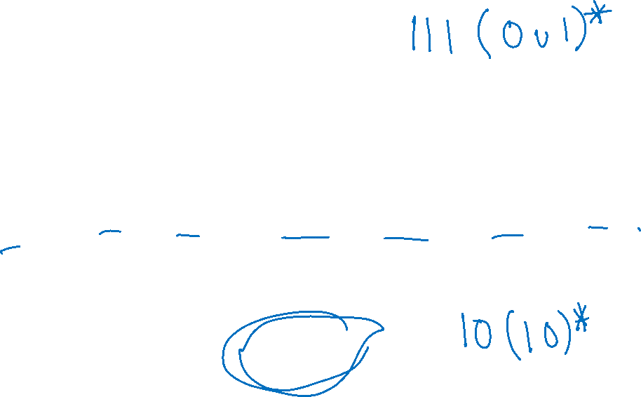
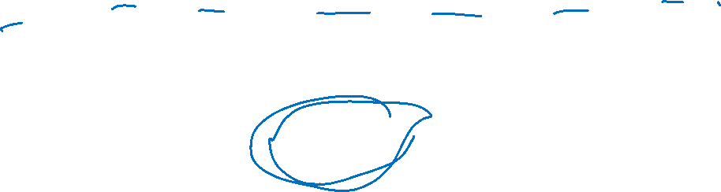
NFA practice
What is the language of this NFA?
0,1
1
1
s₁
s₂
s₃
1
s₀
0
1
s₅
s₄
1
Notes:
Start state: s0
Accept states: s3, s5
Edges:
S0 to s1 on input 1
S0 to s4 on input 1
S1 to s2 on input 1
S2 to s3 on input 1
S3 to s3 on input 0,1
S4 to s5 on input 0
S5 to s4 on input 1

Slide 7

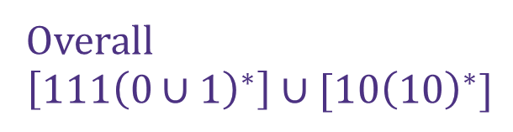

NFA practice (solution)
What is the language of this NFA?
0,1
1
1
s₁
s₂
s₃
$$111{\left(0∪1\right)}^{∗}$$
1
s₀
0
1
s₅
Overall
$$\left[111{\left(0∪1\right)}^{∗}\right]∪[10{\left(10\right)}^{∗}]$$
s₄
$$10{\left(10\right)}^{∗}$$
1
Notes:
Start state: s0
Accept states: s3, s5
Edges:
S0 to s1 on input 1
S0 to s4 on input 1
S1 to s2 on input 1
S2 to s3 on input 1
S3 to s3 on input 0,1
S4 to s5 on input 0
S5 to s4 on input 1

Slide 8

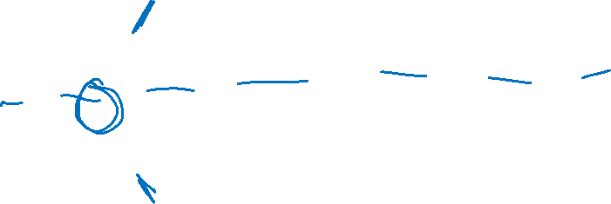
What about those $ε$-transitions?
2
0,1
0,1
s₀
s₁
ε
2
q
0
t₁
1
1
0
ε
2
2
0
t₀
2
t₂
1
Notes:
Start state: q
Accept states: s0, t0
Edges:
Q to s0 on epsilon
Q to t0 on epsilon
S0 to s0 on input 0,1
S0 to s1 on input 2
S1 to s1 on input 0,1
S1 to s2 on input 2
T0 to t0 on input 0
T0 to t1 on input 1
T0 to t2 on input 2
T1 to t1 on input 0
T1 to t2 on input 1
T1 to t0 on input 2
T2 to t2 on input 0
T2 to t0 on input 1
T2 to t1 on input 2

Slide 9
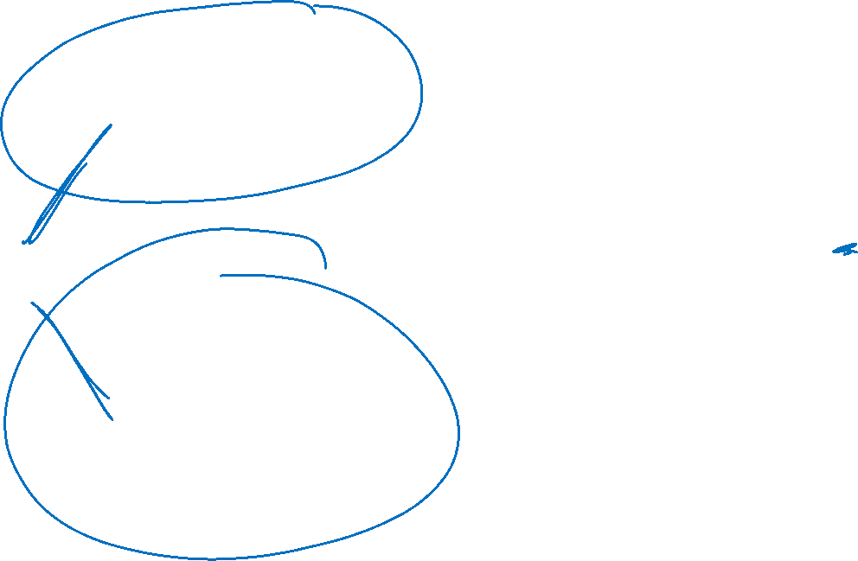
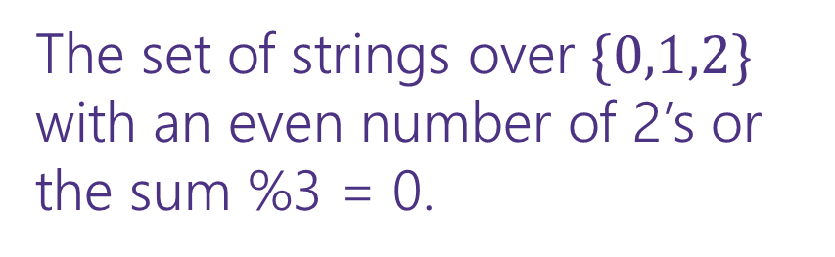
What about those $ε$-transitions? (complete)
2
0,1
0,1
s₀
s₁
ε
2
The set of strings over $\{0,1,2\}$ with an even number of 2’s or the sum %3 = 0.
q
0
t₁
1
1
0
ε
2
2
0
t₀
2
t₂
1
Notes:
Start state: q
Accept states: s0, t0
Edges:
Q to s0 on epsilon
Q to t0 on epsilon
S0 to s0 on input 0,1
S0 to s1 on input 2
S1 to s1 on input 0,1
S1 to s2 on input 2
T0 to t0 on input 0
T0 to t1 on input 1
T0 to t2 on input 2
T1 to t1 on input 0
T1 to t2 on input 1
T1 to t0 on input 2
T2 to t2 on input 0
T2 to t0 on input 1
T2 to t1 on input 2

Slide 10
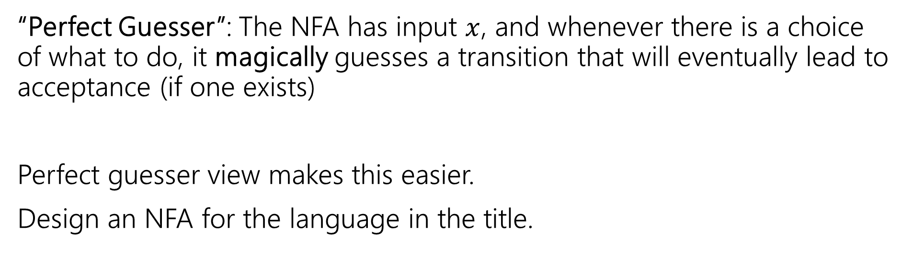
NFA that recognizes “binary strings with a 1 in the third position from the end”
“Perfect Guesser”: The NFA has input $x$, and whenever there is a choice of what to do, it magically guesses a transition that will eventually lead to acceptance (if one exists)
Perfect guesser view makes this easier.
Design an NFA for the language in the title.

Slide 11

NFA that recognizes “binary strings with a 1 in the third position from the end” (solution)
0,1
1
0,1
0,1
s₃
s₂
s₁
s₀
That’s WAY easier than the DFA…
Notes:
Start state: s3
Accept states: s0
Edges:
S3 to s3 on input 0,1
S3 to s2 on input 1
S2 s1 on input 0,1
S1 to s0 on input 0,1

Slide 12
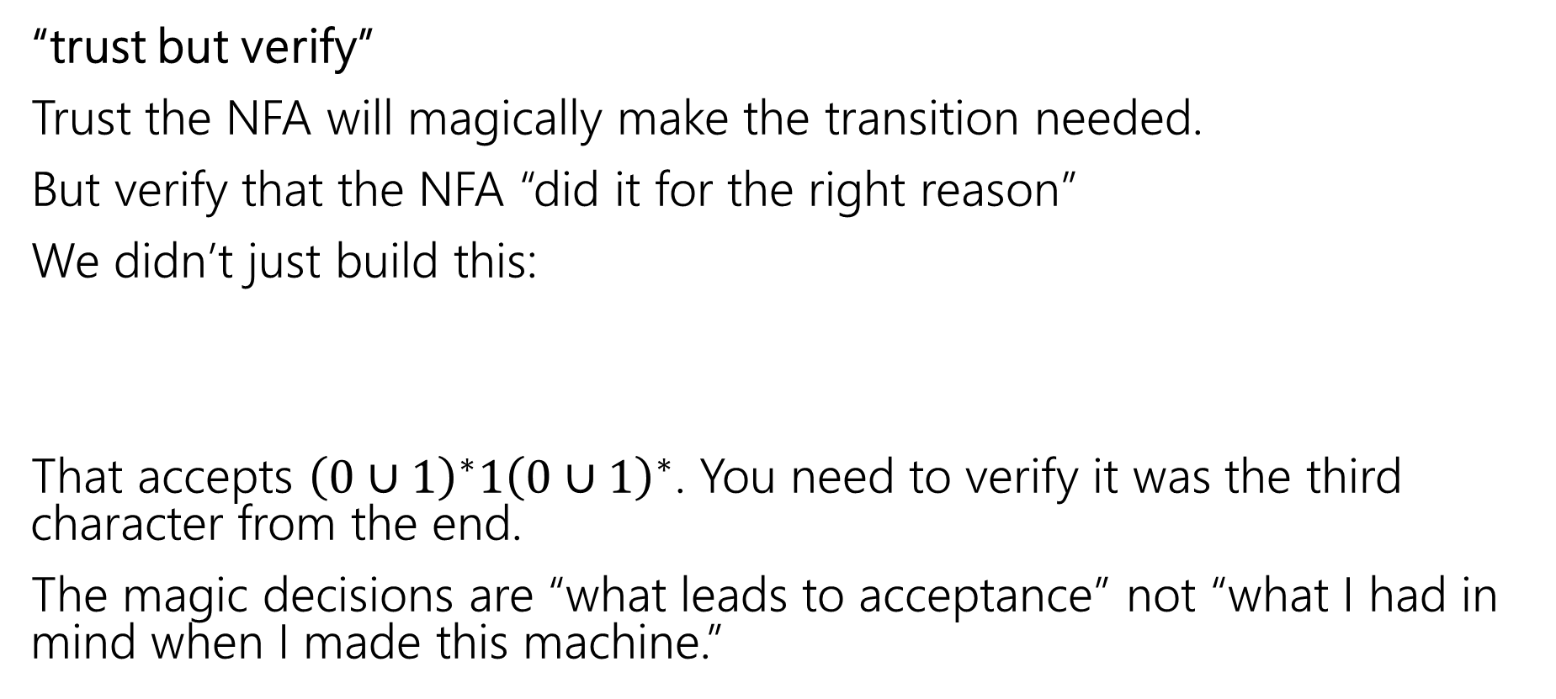
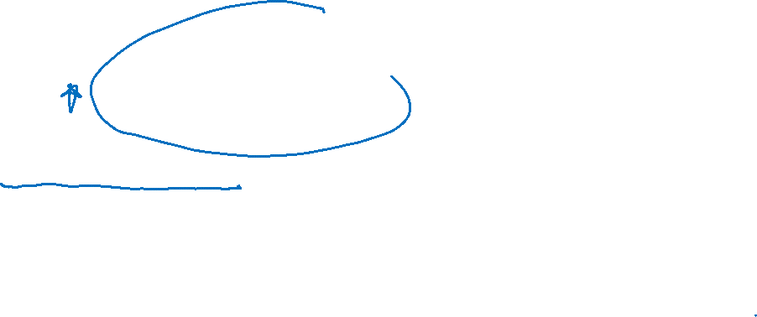
Designing an NFA
“trust but verify”
Trust the NFA will magically make the transition needed.
But verify that the NFA “did it for the right reason”
We didn’t just build this:
That accepts ${\left(0∪1\right)}^{∗}1{\left(0∪1\right)}^{∗}$. You need to verify it was the third character from the end.
The magic decisions are “what leads to acceptance” not “what I had in mind when I made this machine.”
0,1
0,1
1
s₃
s₀
Notes:
See: https://en.wikipedia.org/wiki/Trust,_but_verify

Slide 13
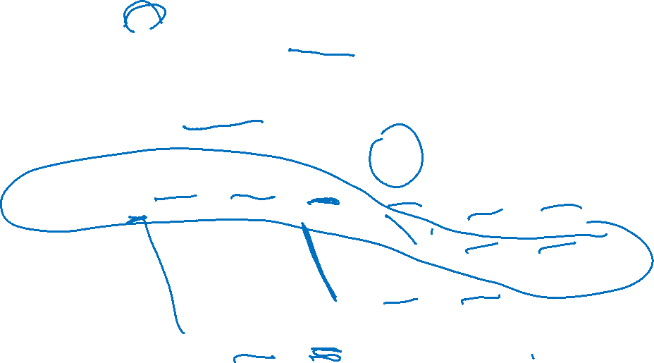
Parallel Exploration view of an NFA
0,1
1
0,1
0,1
s₃
s₂
s₁
s₀
Input string 0101100
0
1
0
1
1
0
0
s₃
s₃
s₃
s₃
s₃
s₃
s₃
s₃
s₂
s₁
s₀
s₂
s₁
s₀
X
s₂
s₁
s₀
X
Notes:
NFA for binary strings with 1
Start state: s3
Accept states: s0
Edges:
S3 to s3 on input 0,1
S3 to s2 on input 1
S2 s1 on input 0,1
S1 to s0 on input 0,1
Visualization of parallel exploration of the NFA
Start state: s3
Paths:
Path 1
S3 to s3 on input 0
S3 to s3 on input 1
S3 to s3 on input 0
S3 to s3 on input 1
S3 to s3 on input 1
S3 to s3 on input 0
S3 to s3 on input 0
(not accepted)
Path 2
S3 to s3 on input 0
S3 to s3 on input 1
S3 to s3 on input 0
S3 to s3 on input 1
S3 to s2 on input 1
S2 to s1 on input 0
S1 to s0 on input 0
(accepted)
Path 3
S3 to s3 on input 0
S3 to s3 on input 1
S3 to s3 on input 0
S3 to s2 on input 1
S2 to s1 on input 1
S1 to s0 on input 0
(not accepted)
Path 4
S3 to s3 on input 0
S3 to s2 on input 1
S2 to s1 on input 0
S1 to s0 on input 1
(not accepted)

Slide 14
Regular Languages

Slide 15
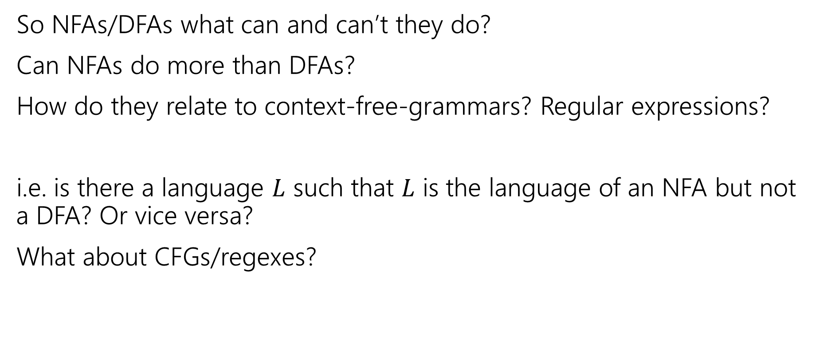
Regularity Idea
So NFAs/DFAs what can and can’t they do?
Can NFAs do more than DFAs?
How do they relate to context-free-grammars? Regular expressions?
i.e. is there a language $L$ such that $L$ is the language of an NFA but not a DFA? Or vice versa?
What about CFGs/regexes?
sli.do and enter cse311

Slide 16
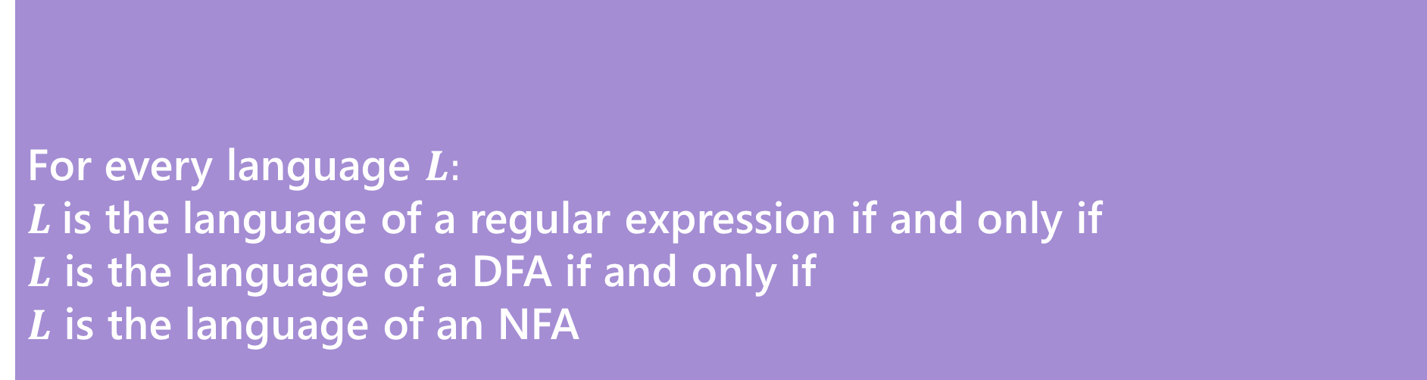
Regularity (Kleene's Theorem)
So NFAs/DFAs what can and can’t they do?
Can NFAs do more than DFAs?
How do they relate to context-free-grammars? Regular expressions?
For every language $L:$
$L$is the language of a regular expression if and only if
$L$ is the language of a DFA if and only if
$L$ is the language of an NFA
Kleene’s Theorem

Slide 17
Regularity
So NFAs, DFAs, and regular expressions are all “equally powerful”
Every language either can be expressed with any of them or none of them.
A set of strings that is recognized by a DFA (equivalently, recognized by an NFA; equivalently, the language of a regular expression) is called a regular language.
So to show a language is “regular” you just need to show one of these and prove it works. There are some “irregular” languages (that don’t have a corresponding NFA/DFA/regex).
CFGs are “more powerful” (every regular language can also be represented with a CFG, but some languages with CFGs have no NFA/DFA/regex).

Slide 18
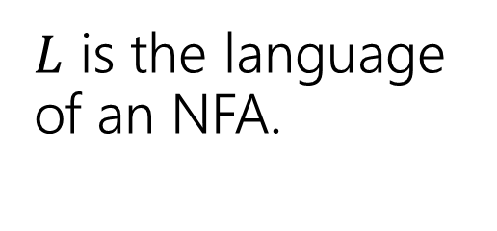
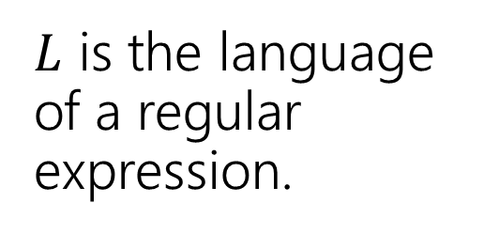
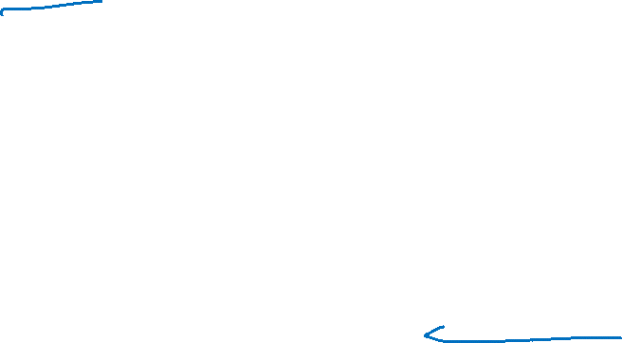
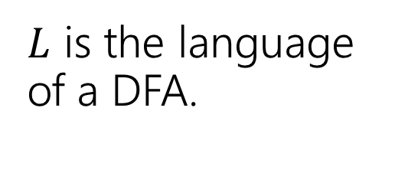
Proof [sketch] (1)
$L$ is the language of an NFA.
$L$ is the language of a regular expression.
This is just a “sketch” of the proof. We want you to get the intuition for why this is true, we’ll go very quickly for some cases.
$L$ is the language of a DFA.

Slide 19
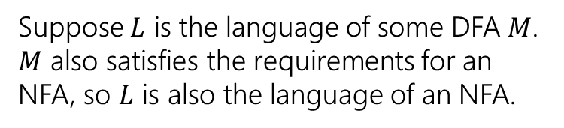
Proof [sketch] (2: every DFA is an NFA)
$L$ is the language of an NFA.
Every DFA is an NFA
$L$ is the language of a regular expression.
$L$ is the language of a DFA.
Suppose $L$ is the language of some DFA $M$. $M$ also satisfies the requirements for an NFA, so $L$ is also the language of an NFA.

Slide 20
Proof [sketch] (3)
$L$ is the language of an NFA.
Every DFA is an NFA
$L$ is the language of a regular expression.
$L$ is the language of a DFA.

Slide 21
Can we convert an NFA to a DFA?
NFAs are magic though! DFAs can’t guess…
Parallel exploration: The NFA computation runs all possible computations on x step-by-step at the same time in parallel
At any step, the set of all possible states we could be in is fixed!
And the update steps are deterministic if we just check all possibilities!

Slide 22
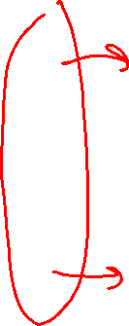
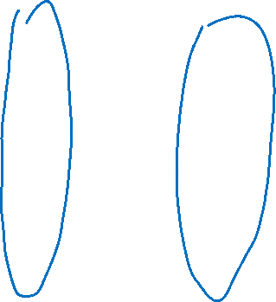
Parallel Exploration view of an NFA (again)
0,1
1
0,1
0,1
s₃
s₂
s₁
s₀
Input string 0101100
0
1
0
1
1
0
0
s₃
s₃
s₃
s₃
s₃
s₃
s₃
s₃
s₂
s₁
s₀
s₂
s₁
s₀
X
s₂
s₁
s₀
X
Notes:
NFA for binary strings with 1
Start state: s3
Accept states: s0
Edges:
S3 to s3 on input 0,1
S3 to s2 on input 1
S2 s1 on input 0,1
S1 to s0 on input 0,1
Visualization of parallel exploration of the NFA
Start state: s3
Paths:
Path 1
S3 to s3 on input 0
S3 to s3 on input 1
S3 to s3 on input 0
S3 to s3 on input 1
S3 to s3 on input 1
S3 to s3 on input 0
S3 to s3 on input 0
(not accepted)
Path 2
S3 to s3 on input 0
S3 to s3 on input 1
S3 to s3 on input 0
S3 to s3 on input 1
S3 to s2 on input 1
S2 to s1 on input 0
S1 to s0 on input 0
(accepted)
Path 3
S3 to s3 on input 0
S3 to s3 on input 1
S3 to s3 on input 0
S3 to s2 on input 1
S2 to s1 on input 1
S1 to s0 on input 0
(not accepted)
Path 4
S3 to s3 on input 0
S3 to s2 on input 1
S2 to s1 on input 0
S1 to s0 on input 1
(not accepted)

Slide 23
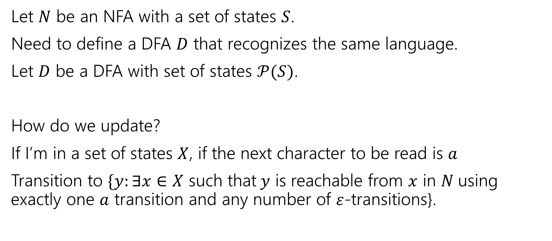
Converting from an NFA to a DFA
Let $N$ be an NFA with a set of states $S$.
Need to define a DFA $D$ that recognizes the same language.
Let $D$ be a DFA with set of states $𝒫(S)$.
How do we update?
If I’m in a set of states $X$, if the next character to be read is $a$
Transition to $\{y:∃x∈X$ such that$y$ is reachable from $x$ in $N$using exactly one $a$ transition and any number of $ε$-transitions}.

Slide 24
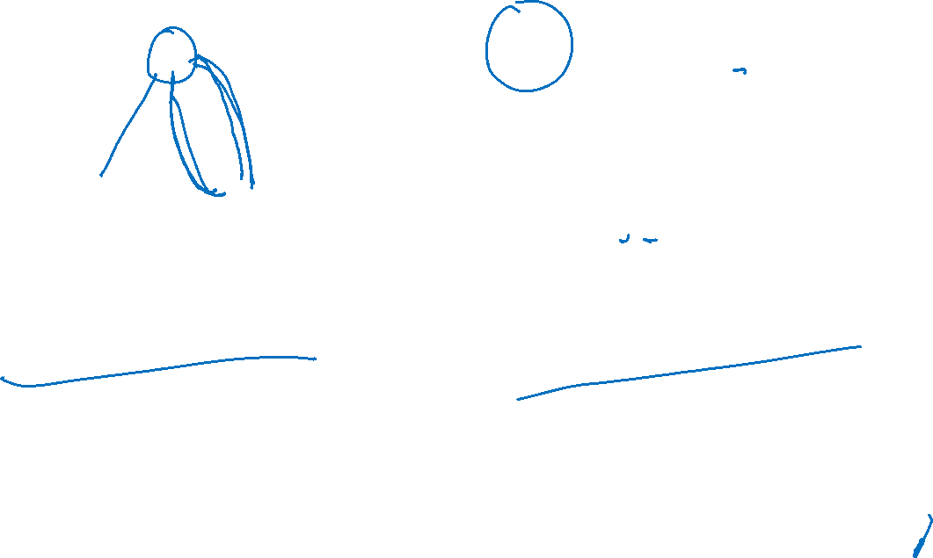

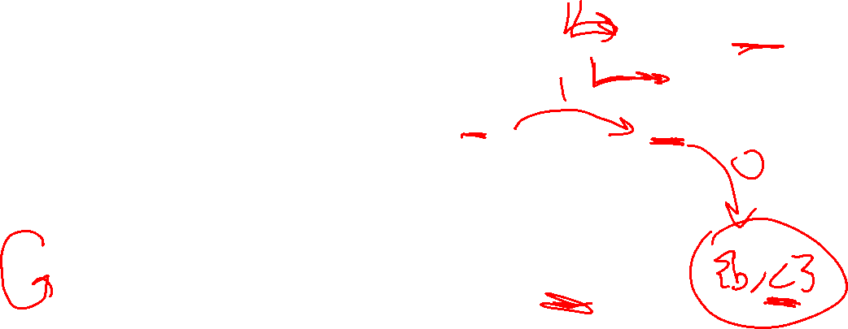


An example (starting point)
{a}
{c}
a
ɛ
1
0
0
1
c
b
{a,b}
0
0,1
$$N$$
$$D$$
Notes:
NFA:
Start state: a
Accept states: a
Edges:
A to b on epsilon
A to c on input 1
B to a on input 0
C to c on input 0
C to b on input 0,1
Partial DFA:
Edges:
{a} to {a,b} on input 0
{a,b} to {c} on input 1

Slide 25
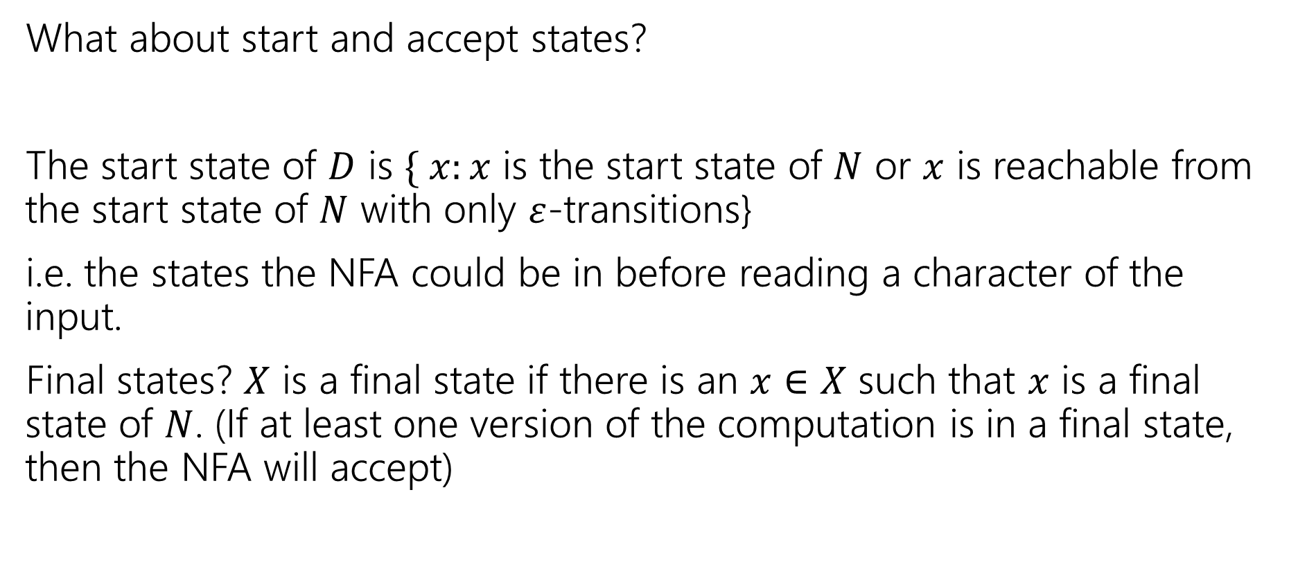
Finishing the DFA
What about start and accept states?
The start state of $D$ is $\{ x:x$ is the start state of $N$ or $x$ is reachable from the start state of $N$ with only $ε$-transitions}
i.e. the states the NFA could be in before reading a character of the input.
Final states? $X$ is a final state if there is an $x∈X$ such that $x$ is a final state of $N$. (If at least one version of the computation is in a final state, then the NFA will accept)

Slide 26
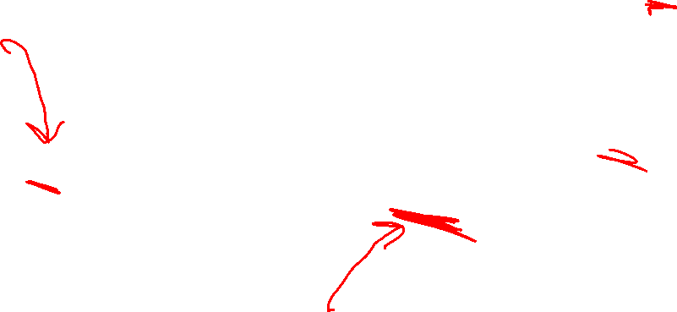
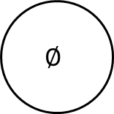

An example (finished)
$$D$$
0
{b,c}
{a}
{c}
1
a
1
0
1
1
{a,b,c}
ɛ
1
0
{b}
0
1
0
0
c
b
{a,b}
1
0
0,1
$$∅$$
$$N$$
0
1
0,1
0
{a,c}
Notes:
NFA:
Start state: a
Accept states: a
Edges:
A to b on epsilon
A to c on input 1
B to a on input 0
C to c on input 0
C to b on input 0,1
DFA:
Start state: {a,b}
Accept states: {a}, {a,b}, {a,c}, {a,b,c}
Edges:
{a} to {a,b} on input 0
{a} to {c} on input 1
{a,b} to {a,b} on input 0
{a,b} to {c} on input 1
{a,c} to {a,b,c} on input 0
{a,c} to {b,c} on input 1
{b} to {a,b} on input 0
{b} to emptyset on input 1
{c} to {b,c} on input 0
{c} to {b} on input 1
{b,c} to {a,b,c} on input 0
{b,c} to {b} on input 1
{a,b,c} to {a,b,c} on input 0
{a,b,c} to {b,c} on input 1
Emptyset to emptyset on input 0,1

Slide 27
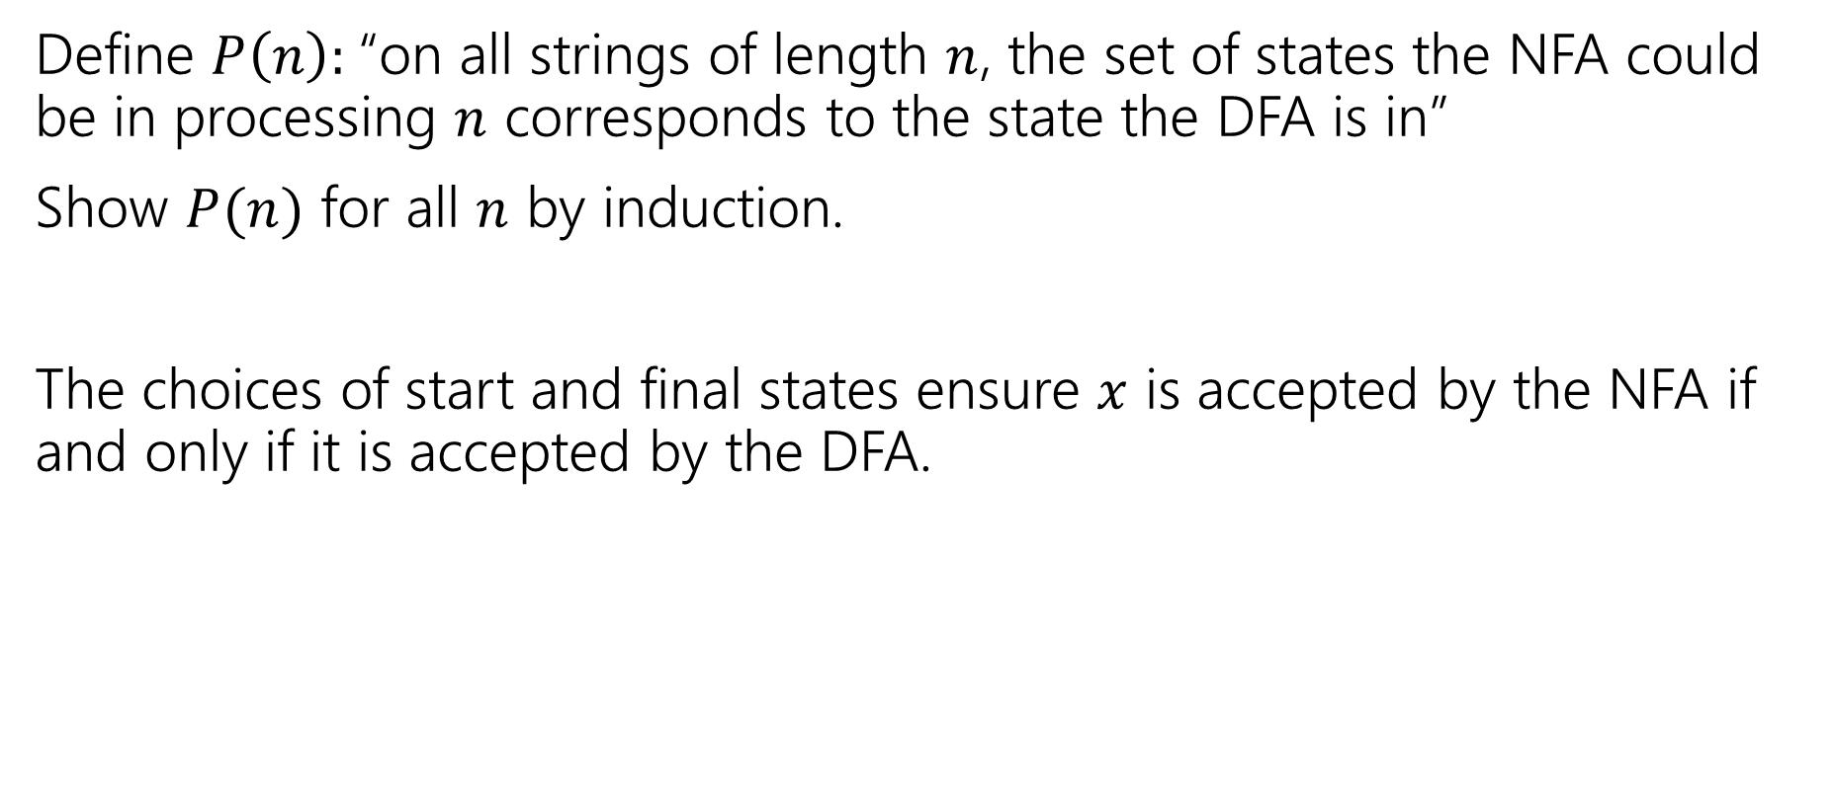
Proof Sketch
Define $P\left(n\right):$“on all strings of length $n$, the set of states the NFA could be in processing $n$ corresponds to the state the DFA is in”
Show $P(n)$ for all $n$ by induction.
The choices of start and final states ensure $x$ is accepted by the NFA if and only if it is accepted by the DFA.

Slide 28
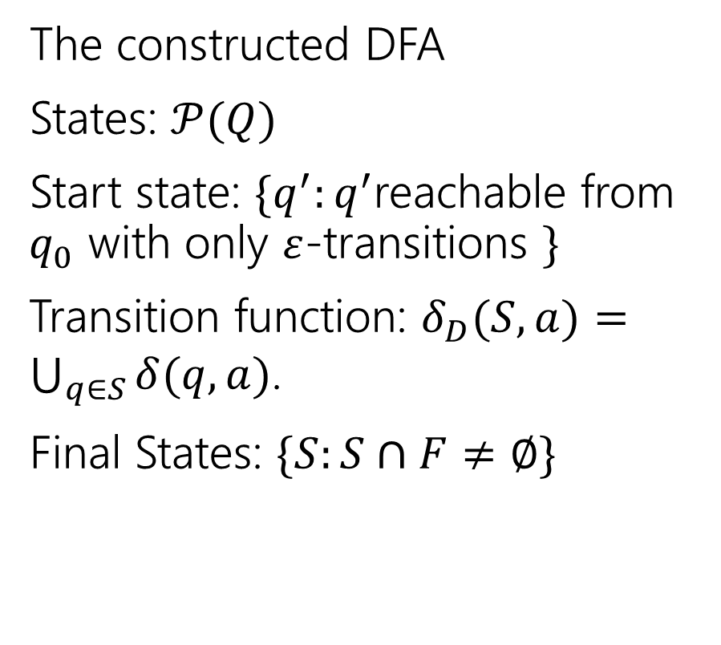
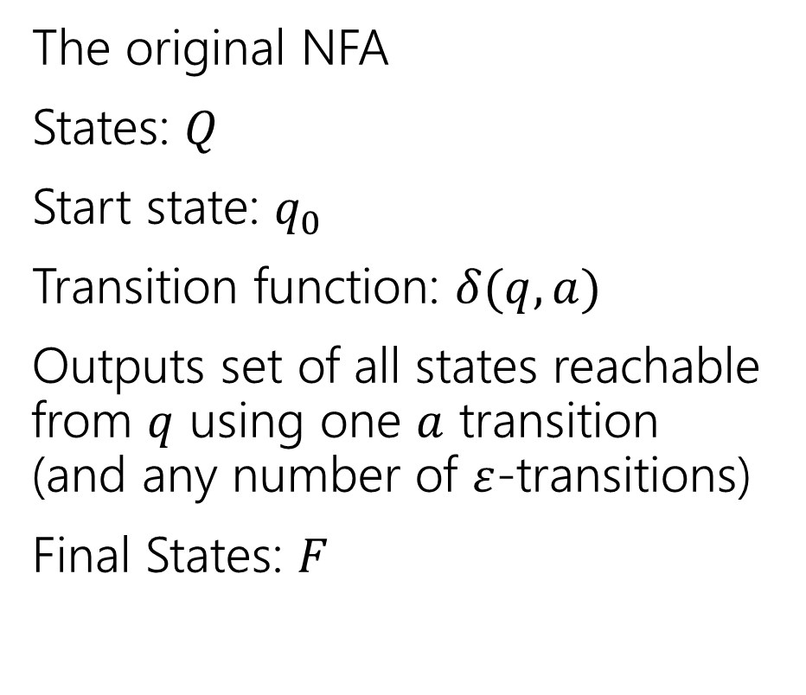
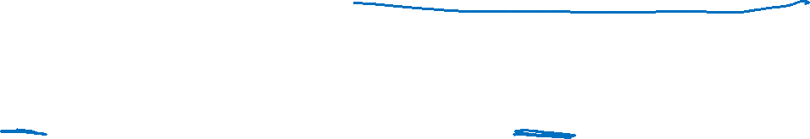
More formally (the “powerset construction”)
The original NFA
States: $Q$
Start state: $q_{0}$
Transition function: $δ(q,a)$
Outputs set of all states reachable from $q$ using one $a$ transition (and any number of $ε$-transitions)
Final States: $F$
The constructed DFA
States: $𝒫(Q)$
Start state: $\{q^{′}:q^{′}$reachable from $q_{0}$ with only $ε$-transitions $\}$
Transition function: $δ_{D}(S,a)=\bigcup_{q∈S}{δ(q,a)}$.
Final States: $\{S:S∩F≠∅\}$

Slide 29
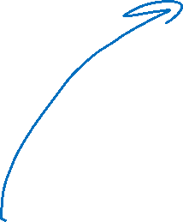
Proof [sketch] (4: powerset construction)
$L$ is the language of an NFA.
Powerset Construction
Every DFA is a NFA
$L$ is the language of a regular expression.
$L$ is the language of a DFA.

Slide 30
Every regular expression has a corresponding NFA.
Proof by…
Structural induction!
Regular expressions are recursively defined, so we can prove something about every regular expression via induction.
What was that definition again…

Slide 31
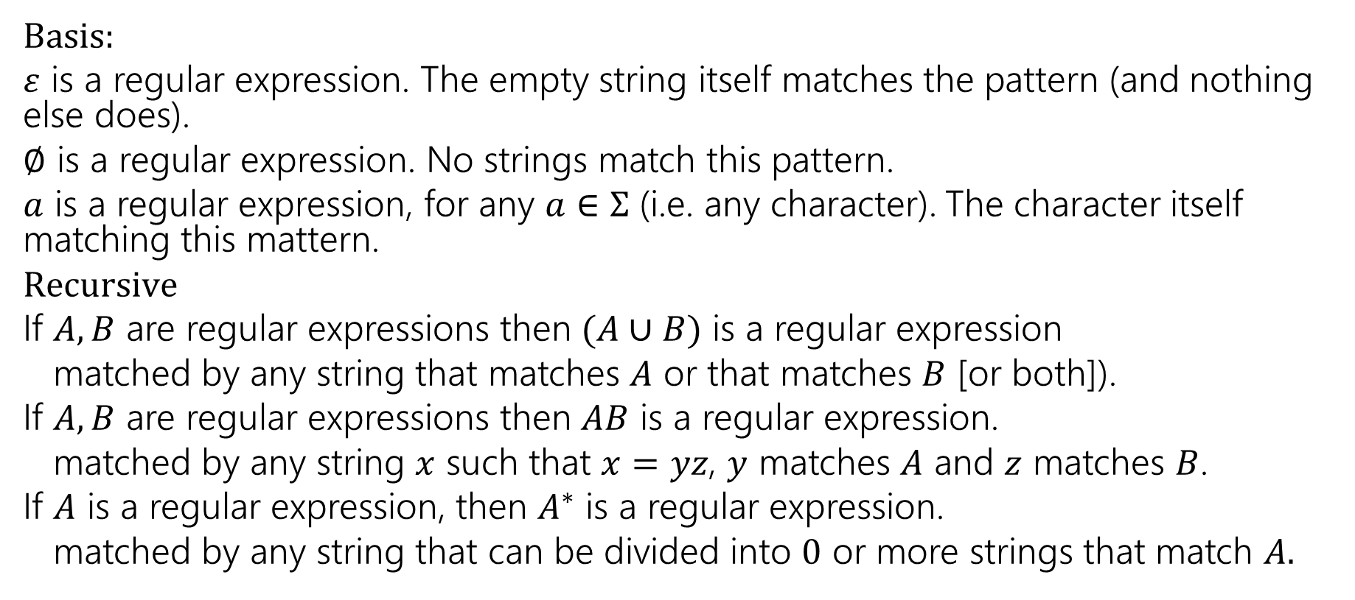
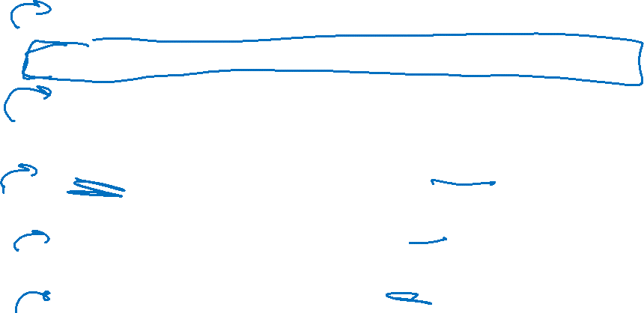
Regular Expressions
Basis:
$ε$ is a regular expression. The empty string itself matches the pattern (and nothing else does).
$∅$ is a regular expression. No strings match this pattern.
$a$ is a regular expression, for any $a∈Σ$ (i.e. any character). The character itself matching this mattern.
$Recursive$
If $A,B$ are regular expressions then $(A∪B)$ is a regular expression
matched by any string that matches $A$ or that matches $B$ [or both]).
If $A,B$ are regular expressions then $AB$ is a regular expression.
matched by any string $x$ such that $x=yz$, $y$ matches $A$ and $z$ matches $B$.
If $A$ is a regular expression, then $A^{∗}$ is a regular expression.
matched by any string that can be divided into $0$ or more strings that match $A.$

Slide 32

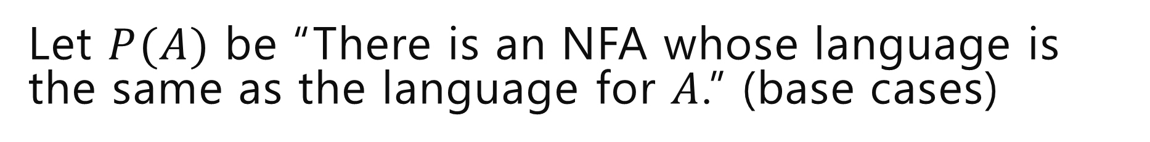
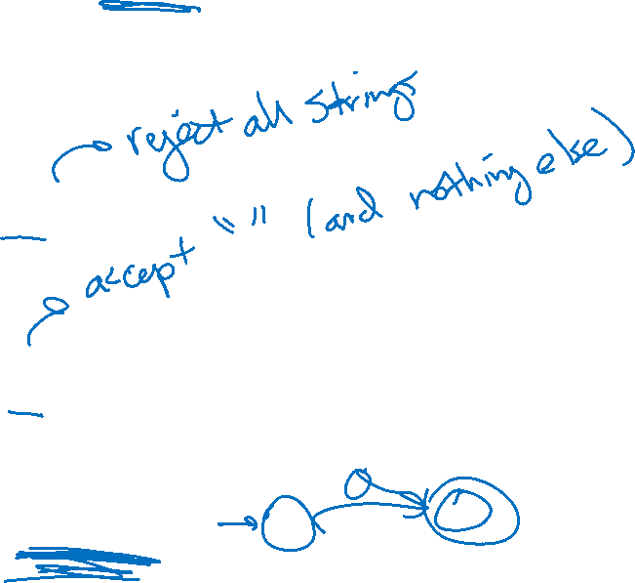
Let $P(A)$ be “There is an NFA whose language is the same as the language for $A$.” (base cases)
Base Cases:
$∅$
$ε$
$a$ ($a∈Σ)$

Slide 33

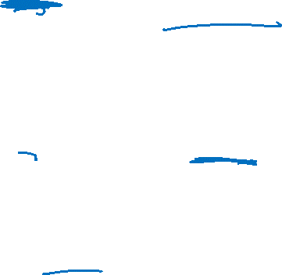
Let $P(A)$ be “There is an NFA whose language is the same as the language for $A$.” (base cases; complete)
Base Cases:
$∅$
$ε$
$a$ ($a∈Σ)$
a

Slide 34

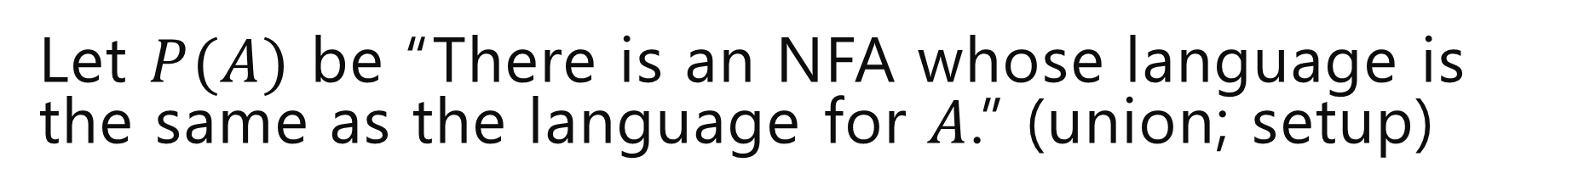

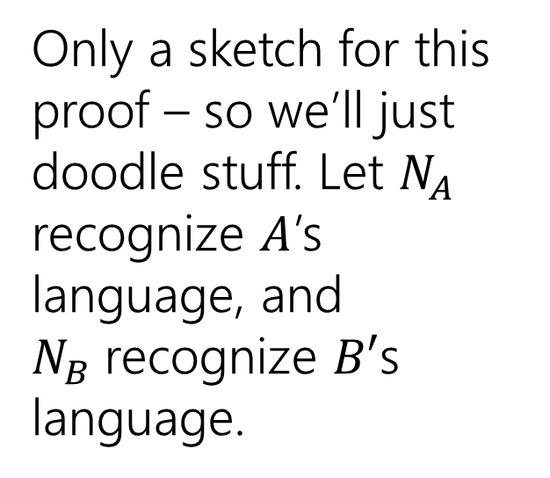
Let $P(A)$ be “There is an NFA whose language is the same as the language for $A$.” (union; setup)
Let $R$ be a regex not covered by the base cases. By the exclusion rule, $R=A∪B$ or $AB$ or $A^{∗}$ from some regexes $A,B$ Inductive Hypothesis: Suppose $P(A)$ and $P\left(B\right).$
Inductive Step: Case 1: $A∪B$
Only a sketch for this proof – so we’ll just doodle stuff. Let $N_{A}$ recognize $A$’s language, and $N_{B}$recognize $B′$s language.
N_{A}
N_{B}

Slide 35
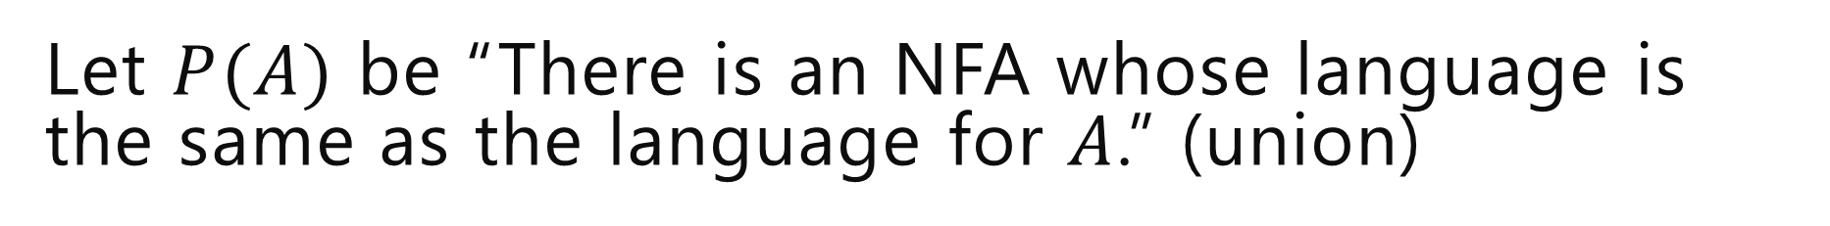
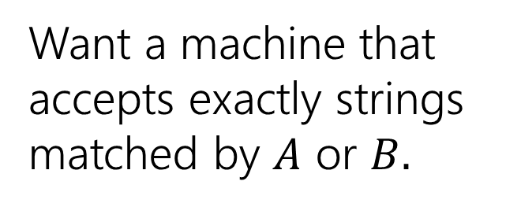
Let $P(A)$ be “There is an NFA whose language is the same as the language for $A$.” (union)
Let $R$ be a regex not covered by the base cases. By the exclusion rule, $R=A∪B$ or $AB$ or $A^{∗}$ from some regexes $A,B$ Inductive Hypothesis: Suppose $P(A)$ and $P\left(B\right).$
Inductive Step: Case 1: $A∪B$
N_{A}
N_{B}
Want a machine that accepts exactly strings matched by $A$ or $B.$

Slide 36
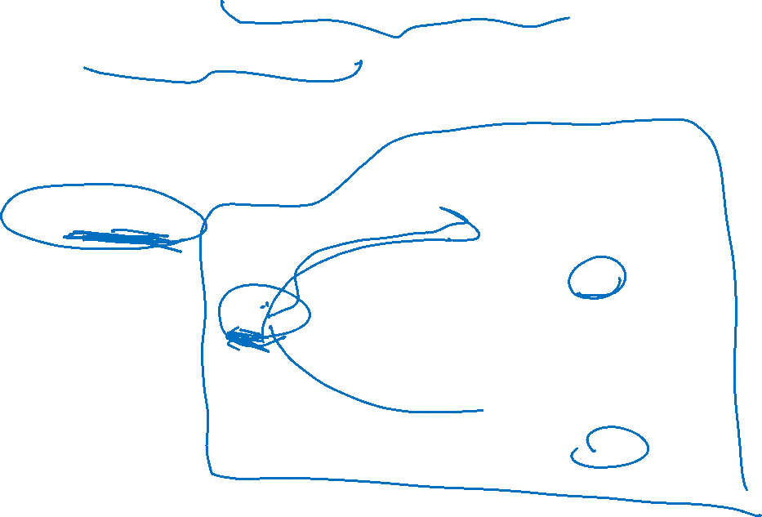
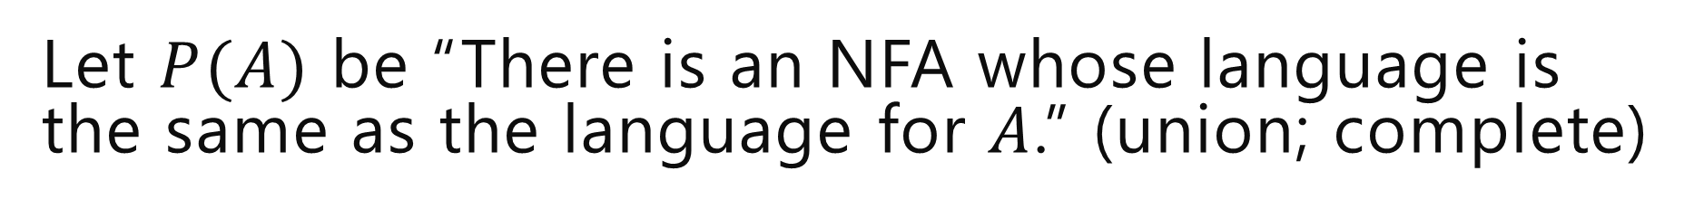
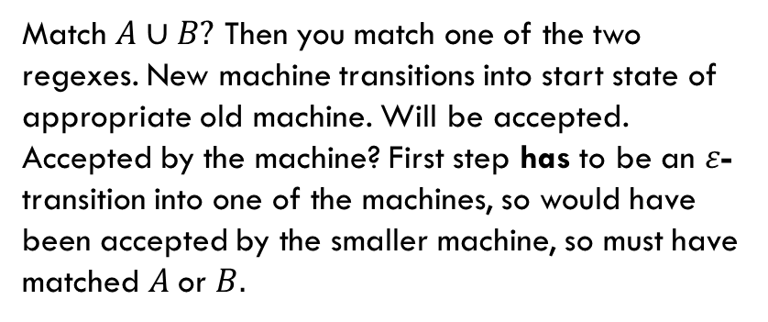
Let $P(A)$ be “There is an NFA whose language is the same as the language for $A$.” (union; complete)
Let $R$ be a regex not covered by the base cases. By the exclusion rule, $R=A∪B$ or $AB$ or $A^{∗}$ from some regexes $A,B$ Inductive Hypothesis: Suppose $P(A)$ and $P\left(B\right).$
Inductive Step: Case 1: $A∪B$
N_{A}
ɛ
Match $A∪B?$ Then you match one of the two regexes. New machine transitions into start state of appropriate old machine. Will be accepted.
Accepted by the machine? First step has to be an $ε$-transition into one of the machines, so would have been accepted by the smaller machine, so must have matched $A$or $B.$
ɛ
N_{B}
Want a machine that accepts exactly strings matched by $A$ or $B.$

Slide 37

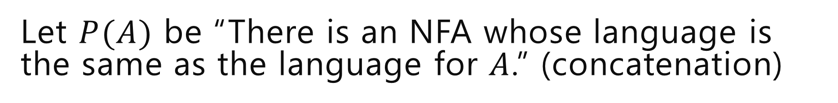
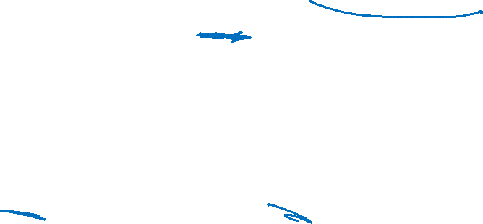
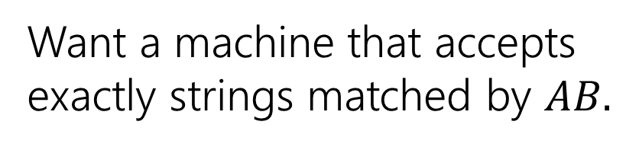
Let $P(A)$ be “There is an NFA whose language is the same as the language for $A$.” (concatenation)
Let $R$ be a regex not covered by the base cases. By the exclusion rule, $R=A∪B$ or $AB$ or $A^{∗}$ from some regexes $A,B$ Inductive Hypothesis: Suppose $P(A)$ and $P\left(B\right).$
Inductive Step: Case 2: $AB$
N_{A}
N_{B}
Want a machine that accepts exactly strings matched by $AB.$

Slide 38
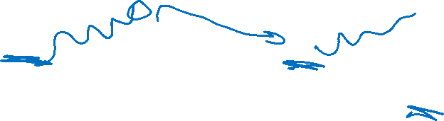


Let $P(A)$ be “There is an NFA whose language is the same as the language for $A$.” (concatenation; complete)
Let $R$ be a regex not covered by the base cases. By the exclusion rule, $R=A∪B$ or $AB$ or $A^{∗}$ from some regexes $A,B$ Inductive Hypothesis: Suppose $P(A)$ and $P\left(B\right).$
Inductive Step: Case 2: $AB$
String $x$ that matches $AB$ can divide into $yz$ where $y$ matches $A$, $z$ matches $B$.
NFA can run as $N_{A}$ would on $y$ take $ε$-transition, then run as $N_{B}$ would on $z$ so accepted by $N$
String $x$ that is accepted?
$N$ must run in $N_{A}$ take $ε$-transition, then run in $N_{B}$until acceptance. Substring read in $N_{A}$ must match $A.$ Substring read in $N_{B}$ must match $B$ (by IH) so string matches $AB.$
ɛ
ɛ
N_{A}
N_{B}
Want a machine that accepts exactly strings matched by $AB.$

Slide 39



Let $P(A)$ be “There is an NFA whose language is the same as the language for $A$.” (Kleene star)
Let $R$ be a regex not covered by the base cases. By the exclusion rule, $R=A∪B$ or $AB$ or $A^{∗}$ from some regexes $A,B$ Inductive Hypothesis: Suppose $P(A)$ and $P\left(B\right).$
Inductive Step: Case 3: $A^{∗}$
N_{A}
Want a machine that accepts exactly strings matched by $A^{∗}.$

Slide 40




Let $P(A)$ be “There is an NFA whose language is the same as the language for $A$.” (Kleene star; complete)
Let $R$ be a regex not covered by the base cases. By the exclusion rule, $R=A∪B$ or $AB$ or $A^{∗}$ from some regexes $A,B$ Inductive Hypothesis: Suppose $P(A)$ and $P\left(B\right).$
Inductive Step: Case 3: $A^{∗}$
If $x$ matches $A^{∗}$, then by def of $∗$ $x=ε$ or $x=x_{1}…x_{k}$ with each $x_{i}$ matching $A$. If $x=ε,$ machine accepts by not transitioning. Otherwise run accepting computation in $N_{A}$ for each $x_{i}$ return to start until $x_{k}$ then end in accept state (all possible by IH)
If accepted by $N$,
Either $ε$ or go from start state of $N_{A}$ to final state and $ε$-transition back to start some number of times. So we can break string into parts accepted by $N_{A}$ by IH we can break string into substrings all matched by $A,$i.e. we match $A^{∗}$.
ɛ
ɛ
N_{A}
ɛ
Want a machine that accepts exactly strings matched by $A^{∗}.$

Slide 41


Let $P(A)$ be “There is an NFA whose language is the same as the language for $A$.” (implication)
By principle of structural induction, $P(A)$ holds for all regular expressions $A.$
Thus every regular expression has an equivalent NFA.
Every regex has an equivalent NFA

Slide 42

An example
(01 ∪1)*0
s2
0
s4
ɛ
s6
1
s7
ɛ
ɛ
ɛ
ɛ
s0
s1
0
s8
s9
ɛ
ɛ
ɛ
s3
s5
ɛ
1
Notes:
Start state: s0
Accept states: s9
Edges:
S0 to s1 on epsilon
S0 to s8 on epsilon
S1 to s2 on epsilon
S1 to s3 on epsilon
S2 to s4 on 0
S3 to s5 on 1
S4 to s6 on epsilon
S5 to s1 on epsilon
S5 to s8 on epsilon
S6 to s7 on 1
S7 to s1 on epsilon
S7 to s8 on epsilon
S8 to s9 on 0

Slide 43

Proof [sketch] (5: regex to equivalent NFA)
$L$ is the language of an NFA.
Regex -> equiv. NFA
Convert NFA to DFA
Every DFA is an NFA
$L$ is the language of a regular expression.
$L$ is the language of a DFA.

Slide 44

Takeaways
Nondeterminism wasn’t magic. It was just efficiency.
The construction we had would turn a $k$ state NFA into a $2^{k}$ state DFA.
For some languages there might be a smaller DFA. But for some it really is (essentially) that big.
“string has a 1 in the $k^{th}$ character from the end” is an example.
The P vs. NP question asks whether nondeterminism is similar for running time on our computers (it doesn’t let you do anything new, but it lets you do it MUCH more efficiently).
Next time: Showing a language is not regular!

Slide 45
Enrichment Content
(optional) sketch that for every NFA there is an equivalent regular expression.

Slide 46
Every NFA has an equivalent regular expression
Not responsible for this, but if you’re curious:

Slide 47
Generalized NFAs
Like NFAs but allow
Parallel edges
Regular Expressions as edge labels
NFAs already have edges labeled ɛ or a
An edge labeled by A can be followed by reading a string of input chars that is in the language represented by A
Defn: A string x is accepted iff there is a path from start to final state labeled by a regular expression whose language contains x

Slide 48
Starting from an NFA
Add new start state and final state
ɛ
ɛ
ɛ
Then eliminate original states one by one, keeping the same language, until it looks like:
Final regular expression will be A
A

Slide 49
Only two simplification rules
Rule 1: For any two states q₁ and q₂ with parallel edges (possibly q₁=q₂), replace
Rule 2: Eliminate non-start/final state q₃ by replacing all
for every pair of states q₁, q₂ (even if q₁=q₂)
A
A⋃B
q₁
q₂
by
q₁
q₂
B
B
q₁
A
q₃
C
q₂
by
AB*C
q₂
q₁

Slide 50
Converting an NFA to a regular expression
Consider the DFA for the mod 3 sum
Accept strings from {0,1,2}* where the mod 3 sum of the digits is 0
0
t₁
1
1
2
2
0
0
t₀
2
t₂
1
Notes:
Start state: t0
Accept states: t0
Edges:
T0 to t0 on input 0
T0 to t1 on input 1
T0 to t2 on input 2
T1 to t1 on input 0
T1 to t2 on input 1
T1 to t0 on input 2
T2 to t2 on input 0
T2 to t0 on input 1
T2 to t1 on input 2

Slide 51
Splicing out a state t₁ (setup)
Regular expressions to add to edges
t₀→t₁→t₀ : 10*2
t₀→t₁→t₂ : 10*1
t₂→t₁→t₀ : 20*2
t₂→t₁→t₂ : 20*1
0
t₁
s
1
1
ɛ
2
2
0
0
t₀
2
t₂
1
ɛ
f
Notes:
Start state: s
Accept states: f
Edges:
S to t0 on epsilon
T0 to t0 on input 0
T0 to t1 on input 1
T0 to f on epsilon
T0 to t2 on input 2
T1 to t1 on input 0
T1 to t2 on input 1
T1 to t0 on input 2
T2 to t2 on input 0
T2 to t0 on input 1
T2 to t1 on input 2

Slide 52
Splicing out a state t₁
Regular expressions to add to edges
t₀→t₁→t₀ : 10*2
t₀→t₁→t₂ : 10*1
t₂→t₁→t₀ : 20*2
t₂→t₁→t₂ : 20*1
s
ɛ
0 ∪ 20*1
t₀
2 ∪ 10*1
t₂
0 ∪ 10*2
1 ∪ 20*2
ɛ
f
Notes:
Start state: s
Accept states: f
Edges:
S to t0 on epsilon
T0 to t0 on input 0 u 10*2
T0 to t2 on input 2 U 10*1
T0 to f on epsilon
T2 to t2 on input 0 u 20*1
T2 to t0 on input 1 u 20*2

Slide 53
Splicing out state t₂ (and then t₀)
s
R₁: 0 ∪ 10*2
R₂: 2 ∪ 10*1
R₃: 1 ∪ 20*2
R₄: 0 ∪ 20*1
ɛ
R₂
R₄
R₁
t₀
t₂
R₃
ɛ
f
s
ɛ
R₅
ɛ
R₅: R₁ ∪ R₂R₄*R₃
t₀
f
Final regular expression: R₅*=
((0 ∪ 10*2) ∪ (2 ∪ 10*1)(0 ∪ 20*1)*(1 ∪ 20*2))*
Notes:
NFA1:
Start state: s
Accept states: f
Edges:
S to t0 on epsilon
T0 to t0 on R1
T0 to t2 on R2
T0 to f on epsilon
T2 to t0 on r3
T2 to t2 on r4
NFA2:
Start state: s
Accept states: f
Edges:
S to t0 on epsilon
T0 to t0 on r5
T0 to f on epsilon

Slide 54

Proof [sketch] (6: complete)
$L$ is the language of an NFA.
GNFA simplified to regex
Regex -> equiv. NFA
Convert NFA to DFA
Every DFA is an NFA
$L$ is the language of a regular expression.
$L$ is the language of a DFA.

