Slide 1
Nondeterministic Finite Automata
CSE 311 Autumn 2025
Lecture 25

Slide 2
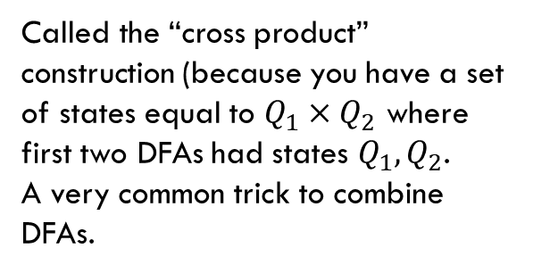
Strings over {0,1,2} w/ even number of 2’s and sum%3=0
Changed notation – final states with bold outlines.
0
0
s₀t₀
s₁t₀
2
2
1
1
0
0
s₀t₁
2
2
s₁t₁
1
1
1
1
Called the “cross product” construction (because you have a set of states equal to $Q_{1}×Q_{2}$ where first two DFAs had states $Q_{1},Q_{2}$.
A very common trick to combine DFAs.
2
2
s₀t₂
s₁t₂
0
0
Notes:
Start state: s0t0
Accept states: s0t0
Edges:
From s0t0 to s0t0 on character 0
From s0t0 to s0t1 on character 1
From s0t0 to s1t2 on character 2
From s0t1 to s0t1 on character 0
From s0t1 to s0t2 on character 1
From s0t1 to s1t0 on character 2
From s0t2 to s0t2 on character 0
From s0t2 to s0t0 on character 1
From s0t2 to s1t1 on character 2
From s1t0 to s1t0 on character 0
From s1t0 to s1t1 on character 1
From s1t0 to s0t2 on character 2
From s1t1 to s1t1 on character 0
From s1t1 to s1t2 on character 1
From s1t1 to s0t0 on character 2
From s1t2 to s1t2 on character 0
From s1t2 to s1t0 on character 1
From s1t2 to s0t1 on character 2

Slide 3
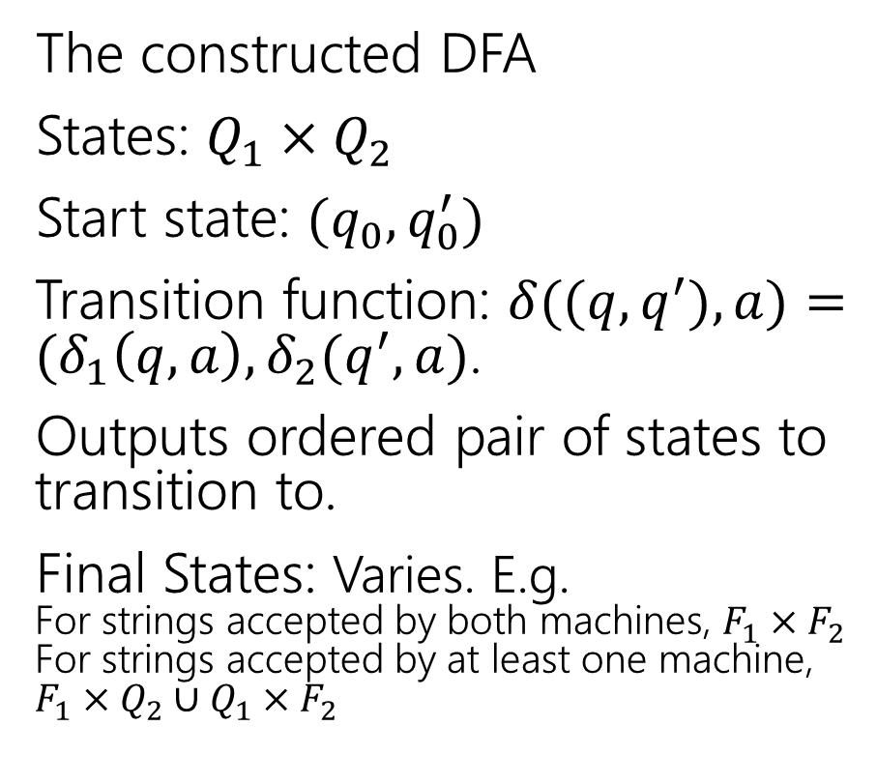
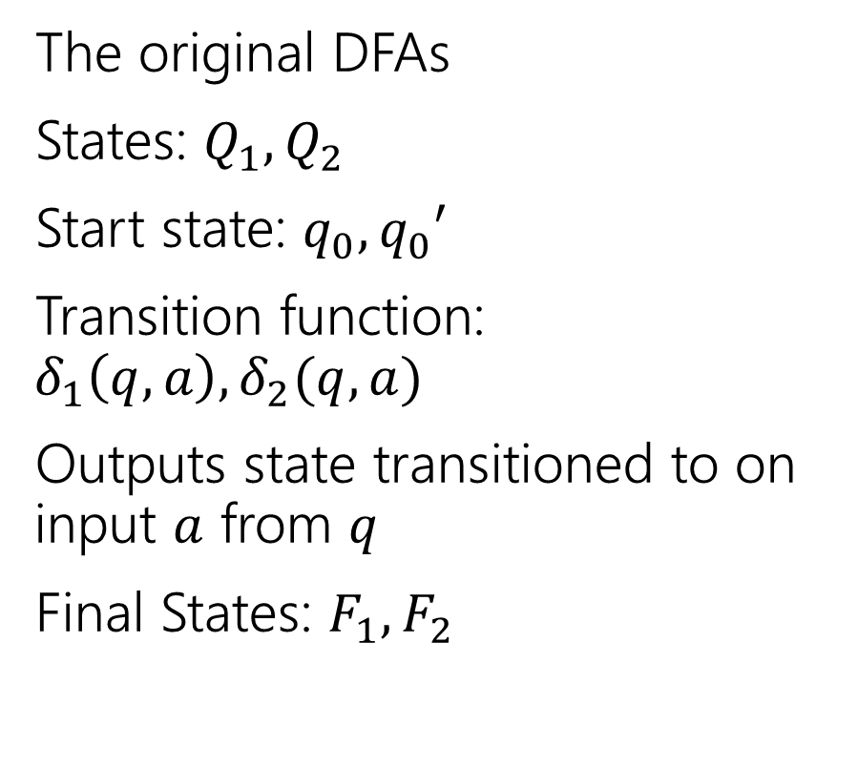
More formally (the “cross product construction”)
The original DFAs
States: $Q_{1},Q_{2}$
Start state: $q_{0}, q_{0}′$
Transition function: $δ_{1}\left(q,a\right),δ_{2}(q,a)$
Outputs state transitioned to on input $a$ from $q$
Final States: $F_{1},F_{2}$
The constructed DFA
States: $Q_{1}×Q_{2}$
Start state: $(q_{0},q_{0}^{′})$
Transition function: $δ((q,q^{′}),a)=(δ_{1}\left(q,a\right), δ_{2}(q^{′},a)$.
Outputs ordered pair of states to transition to.
Final States: Varies. E.g. For strings accepted by both machines, $F_{1}×F_{2}$ For strings accepted by at least one machine, $F_{1}×Q_{2}∪Q_{1}×F_{2}$

Slide 4
The set of binary strings with a 1 in the 3rd position from the start (1)

Slide 5
The set of binary strings with a 1 in the 3rd position from the start (2)
R
0,1
0
s₀
0,1
s₁
0,1
s₂
1
A
0,1
Notes:
Start state: s0
Accept states: A
Edges:
From s0 to s1 on characters 0, 1
From s1 to s2 on characters 0, 1
From s2 to R on character 0
From s2 to A on character 1
From R to R on characters 0, 1
From A to A on characters 0, 1

Slide 6
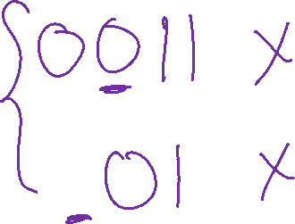
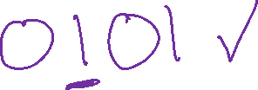
The set of binary strings with a 1 in the 3rd position from the end (setup)
What do we need to remember?

Slide 7
The set of binary strings with a 1 in the 3rd position from the end
What do we need to remember?
We can’t know what string was third from the end until we have read the last character.
So we’ll need to keep track of “the character that was 3 ago” in case this was the end of the string.
But if it’s not…we’ll need the character 2 ago, to update what the character 3 ago becomes. Same with the last character.

Slide 8


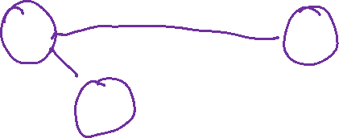
3 bit shift register
“Remember the last three bits”
001
1
011
1
0
1
1
1
0
000
1
010
101
0
111
1
0
0
1
0
0
100
0
110
Notes:
Edges:
000 to 000 on character 0
000 to 001 on character 1
001 to 010 on character 0
001 to 011 on character 1
100 to 000 on character 0
100 to 001 on character 1
010 to 100 on character 0
010 to 101 on character 1
101 to 010 on character 0
101 to 011 on character 1
011 to 110 on character 0
011 to 111 on character 1
110 to 100 on character 0
110 to 101 on character 1
111 t0 110 on character 0
111 to 111 on character 1

Slide 9

The set of binary strings with a 1 in the 3rd position from the end (solution 1)
S
0
1
0
1
0
1
0
1
00
01
10
11
1
1
1
1
0
0
0
0
001
1
011
1
0
1
1
1
0
000
1
010
101
0
111
1
0
0
1
0
0
100
0
110
Notes:
Start state: S
Accept states: 100, 101, 110, 111
Edges:
S to 0 on character 0
S to 1 on character 1
0 to 00 on character 00
0 to 01 on character 1
1 to 10 on character 0
1 to 11 on character 1
00 to 000 on character 0
00 to 001 on character 1
01 to 010 on character 0
01 to 011 on character 1
10 to 100 on character 0
10 to 101 on character 1
11 to 110 on character 0
11 to 111 on character 1
000 to 000 on character 0
000 to 001 on character 1
001 to 010 on character 0
001 to 011 on character 1
100 to 000 on character 0
100 to 001 on character 1
010 to 100 on character 0
010 to 101 on character 1
101 to 010 on character 0
101 to 011 on character 1
011 to 110 on character 0
011 to 111 on character 1
110 to 100 on character 0
110 to 101 on character 1
111 t0 110 on character 0
111 to 111 on character 1

Slide 10

The set of binary strings with a 1 in the 3rd position from the end (solution 2)
001
1
011
1
0
1
1
1
0
000
1
010
101
0
111
1
0
0
1
0
0
100
0
110
Notes:
Start state: 000
Accept states: 100, 101, 110, 111
Edges:
000 to 000 on character 0
000 to 001 on character 1
001 to 010 on character 0
001 to 011 on character 1
100 to 000 on character 0
100 to 001 on character 1
010 to 100 on character 0
010 to 101 on character 1
101 to 010 on character 0
101 to 011 on character 1
011 to 110 on character 0
011 to 111 on character 1
110 to 100 on character 0
110 to 101 on character 1
111 t0 110 on character 0
111 to 111 on character 1

Slide 11
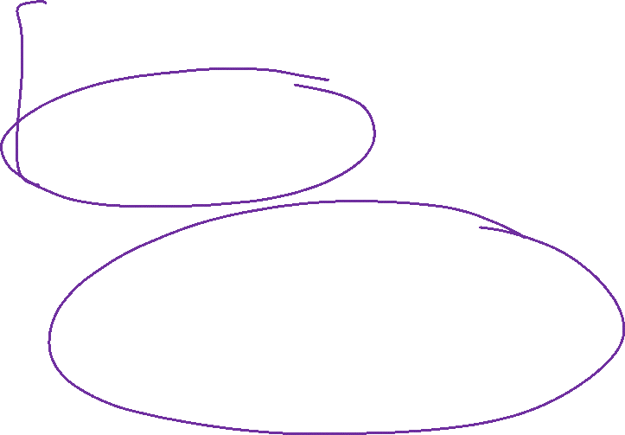
The beginning versus the end
R
0
0,1
s₀
0,1
s₁
0,1
s₂
1
A
0,1
001
1
011
1
0
1
1
1
0
000
1
010
101
0
111
1
0
0
0
1
0
100
0
110

Slide 12
From the beginning was “easier” than “from the end”
At least in the sense that we needed fewer states.
That might be surprising since a java program wouldn’t be much different for those two.
Not being able to access the full input at once limits your abilities somewhat and makes some jobs harder than others.

Slide 13
What language does this machine recognize? (1)
1
s₀
s₁
1
0
0
0
0
1
s₂
s₃
1
Notes:
Start state: s0
Accept states: s0, s3
Edges:
S0 to s2 on input 0
S0 to s1 on input 1
S1 to s3 on input 0
S1 to s0 on input 1
S2 to s0 on input 0
S2 to s3 on input 1
S3 to s1 on input 0
S3 to s2 on input 1

Slide 14
What language does this machine recognize? (2)
1
s₀
s₁
1
0
0
0
0
1
s₂
s₃
1
#1s even
#1s odd
Notes:
Start state: s0
Accept states: s0, s3
Edges:
S0 to s2 on input 0
S0 to s1 on input 1
S1 to s3 on input 0
S1 to s0 on input 1
S2 to s0 on input 0
S2 to s3 on input 1
S3 to s1 on input 0
S3 to s2 on input 1

Slide 15
What language does this machine recognize? (3)
1
s₀
s₁
#0s even
1
0
0
0
0
1
s₂
s₃
#0s odd
1
Notes:
Start state: s0
Accept states: s0, s3
Edges:
S0 to s2 on input 0
S0 to s1 on input 1
S1 to s3 on input 0
S1 to s0 on input 1
S2 to s0 on input 0
S2 to s3 on input 1
S3 to s1 on input 0
S3 to s2 on input 1

Slide 16
What language does this machine recognize? (4)
1
s₀
s₁
1
0
0
#0s is congruent to #1s (mod 2)
Wait…there’s an easier way to describe that….
0
0
1
s₂
s₃
1
Notes:
Start state: s0
Accept states: s0, s3
Edges:
S0 to s2 on input 0
S0 to s1 on input 1
S1 to s3 on input 0
S1 to s0 on input 1
S2 to s0 on input 0
S2 to s3 on input 1
S3 to s1 on input 0
S3 to s2 on input 1

Slide 17
What language does this machine recognize? (5)
1
s₀
s₁
That’s all binary strings of even length.
1
0
0
0,1
0
0
s₀
s₁
1
0,1
s₂
s₃
1
Notes:
DFA 1:
Start state: s0
Accept states: s0, s3
Edges:
S0 to s2 on input 0
S0 to s1 on input 1
S1 to s3 on input 0
S1 to s0 on input 1
S2 to s0 on input 0
S2 to s3 on input 1
S3 to s1 on input 0
S3 to s2 on input 1
DFA 2:
Start state: s0
Accept states: s0
Edges:
S0 to s1 on input 0,1
S1 to s0 on input 0,1

Slide 18
Takeaways
The first DFA might not be the simplest.
Try to think of other descriptions – you might realize you can keep track of fewer things than you thought.
Boy…it’d be nice if we could know that we have the smallest possible DFA for a given language…

Slide 19
DFA Minimization
We can know!
Fun fact: there is a unique minimum DFA for every language (up to renaming the states)
High level idea – final states and non-final states must be different.
Otherwise, hope that states can be the same, and iteratively separate when they have to go to different spots.
Some quarters this covered in detail. But…we ran out of time. Optional slides – won’t be required in HW or final but you might find it useful/interesting for your own learning.

Slide 20
Optional Content: Machines with output

Slide 21
What are FSMs used for? (1)
“Classic” hardware applications:
Anything where you only need to remember a very small amount of information, and have very simple update rules.
Vending machines
Elevators: need to know whether you’re going up or down, where people want to go, where people are waiting, and whether you’re going up or down. Simple rules to transition.
These days…general hardware is cheap, less likely to use custom hardware. BUT the programmer was probably still thinking about FSMs when writing the code.

Slide 22
What are FSMs used for? (2)
Theoretically – still lots of applications.
grep uses FSMs to analyze regular expressions (more on this later).
Useful for modeling situations where you have minimal memory.
Good model for simple AI (say simple NPCs in games).
Technically all of our computers are finite state machines…
But they’re not usually how we think about them…more on this next week.

Slide 23
Adding Output to Finite State Machines
So far we have considered finite state machines that just accept/reject strings
called “Deterministic Finite Automata” or DFAs
One can also consider finite state machines that with output
These are often used as controllers

Slide 24


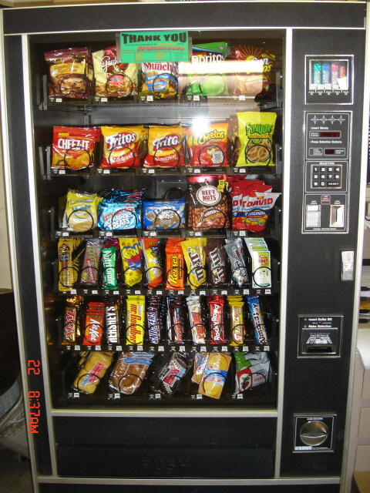
Vending Machine
Enter 15 cents in dimes or nickels
Press S or B for a candy bar

Slide 25
Vending Machine v0.1

Slide 26
Vending Machine, v0.1
D
D
0
N
5
N
10
N, D
15
B, S
Basic transitions on N (nickel), D (dime), B (butterfinger), S (snickers)
Notes:
Start state: 0
Edges:
0 to 5 on input N
0 to 10 on input D
5 to 10 on input N
5 to 15 on input D
10 to 15 on input N,D
15 to 0 on input B, S

Slide 27
Vending Machine v0.2
D
D
0
N
5
N
10
N, D
15
B, S
Notes:
Start state: 0
Edges:
0 to 5 on input N
0 to 10 on input D
5 to 10 on input N
5 to 15 on input D
10 to 15 on input N,D
15 to 0 on input B, S

Slide 28
Vending Machine, v0.2
0
D
N
15
D
D
B
0’ [B]
5
N
S
N
N
10
D
15’ [N]
B
S
N
0” [S]
D
Adding output to states: N – Nickel, S – Snickers, B – Butterfinger
Notes:
Start state: 0
Edges:
0 to 5 on input N
0 to 10 on input D
0'[B] to 5 on input N
0'[B] to 10 on input D
0''[S] to 5 on input N
0''[S] to 10 on input D
5 to 10 on input N
5 to 15 on input D
10 to 15 on input N
10 to 15'[N] on input D
15 to 0' [B] on input B
15 to 0'' [S] on input S
15' [N] to 0' [B] on input B
15' [N] to 0'' [S] on input S

Slide 29
Vending Machine, v1.0
B,S
0
D
N
15
B,S
D
B,S
B
D
B,S
D
N
S
N
0’ [B]
N
5
10
N
D
15’ [N]
B
N
S
D
B,S
N
N
0” [S]
D
B
15” [D]
S
D
Adding additional “unexpected” transitions to cover all symbols for each state
Notes:
Start state: 0
Edges:
0 to 5 on input N
0 to 10 on input D
0 to 0 on input B,S
0'[B] to 5 on input N
0'[B] to 10 on input D
0'[B] to 0 on input B,S
0''[S] to 5 on input N
0''[S] to 10 on input D
0''[S] to 0 on input B,S
5 to 10 on input N
5 to 15 on input D
5 to 5 on input B,S
10 to 15 on input N
10 to 15'[N] on input D
10 to 10 on input B,S
15 to 15'[N] on input N
15 to 15''[D] on input D
15 to 0' [B] on input B
15 to 0'' [S] on input S
15'[N] to 15'[N] on input N
15'[N] t 15''[D] on input D
15' [N] to 0' [B] on input B
15' [N] to 0'' [S] on input S
15''[D] to 15[N] on input N
15''[D] to 15''[D] on input D

Slide 30

NFAs, Power of machines

Slide 31
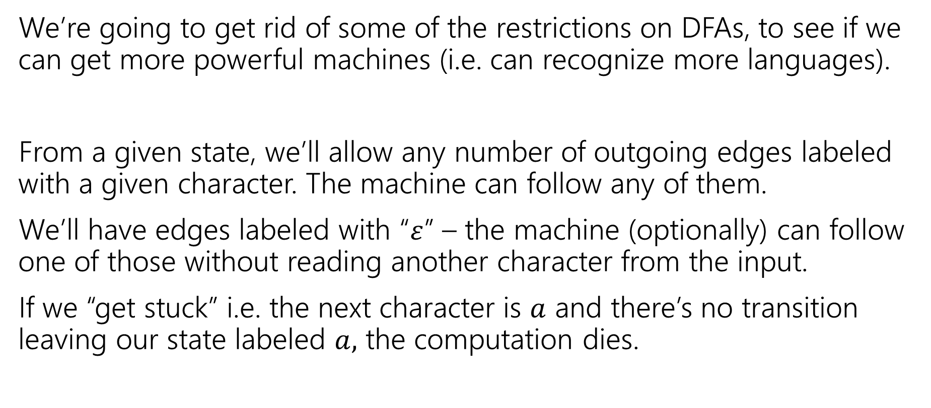
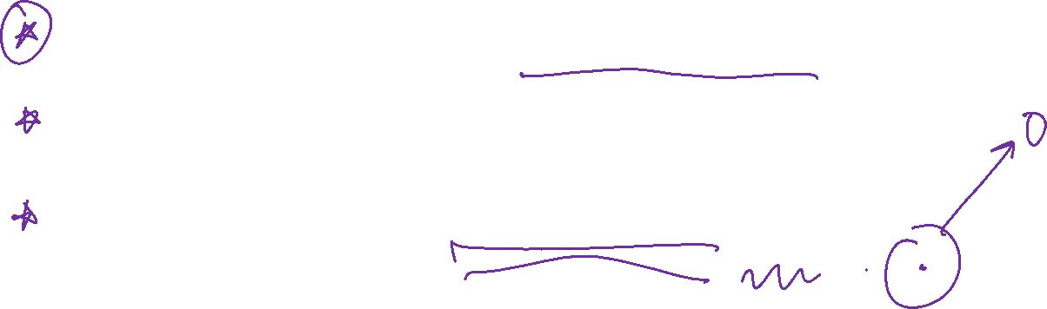
Let’s try to make our more powerful automata
We’re going to get rid of some of the restrictions on DFAs, to see if we can get more powerful machines (i.e. can recognize more languages).
From a given state, we’ll allow any number of outgoing edges labeled with a given character. The machine can follow any of them.
We’ll have edges labeled with “$ε$” – the machine (optionally) can follow one of those without reading another character from the input.
If we “get stuck” i.e. the next character is $a$ and there’s no transition leaving our state labeled $a,$ the computation dies.

Slide 32
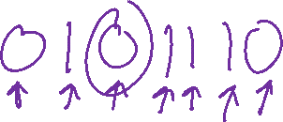



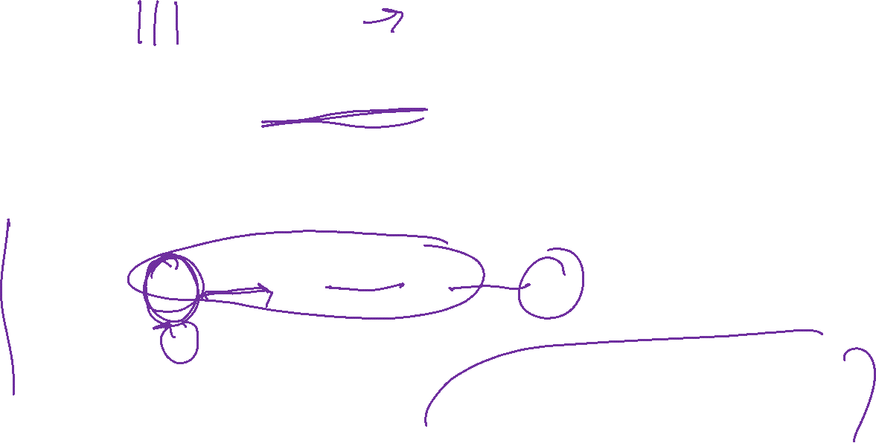
Nondeterministic Finite Automata Intro
An NFA:
Still has exactly one start state and any number of final states.
The NFA accepts $x$ if there is some path from a start state to a final state labeled with $x$.
From a state, you can have 0,1, or many outgoing arrows labeled with a single character. You can choose any of them to build the required path.
s₀
1
s₁
1
s₂
1
s₃
0,1
0,1

Slide 33
Wait a second…
But…how does it know?
Is this realistic?

Slide 34
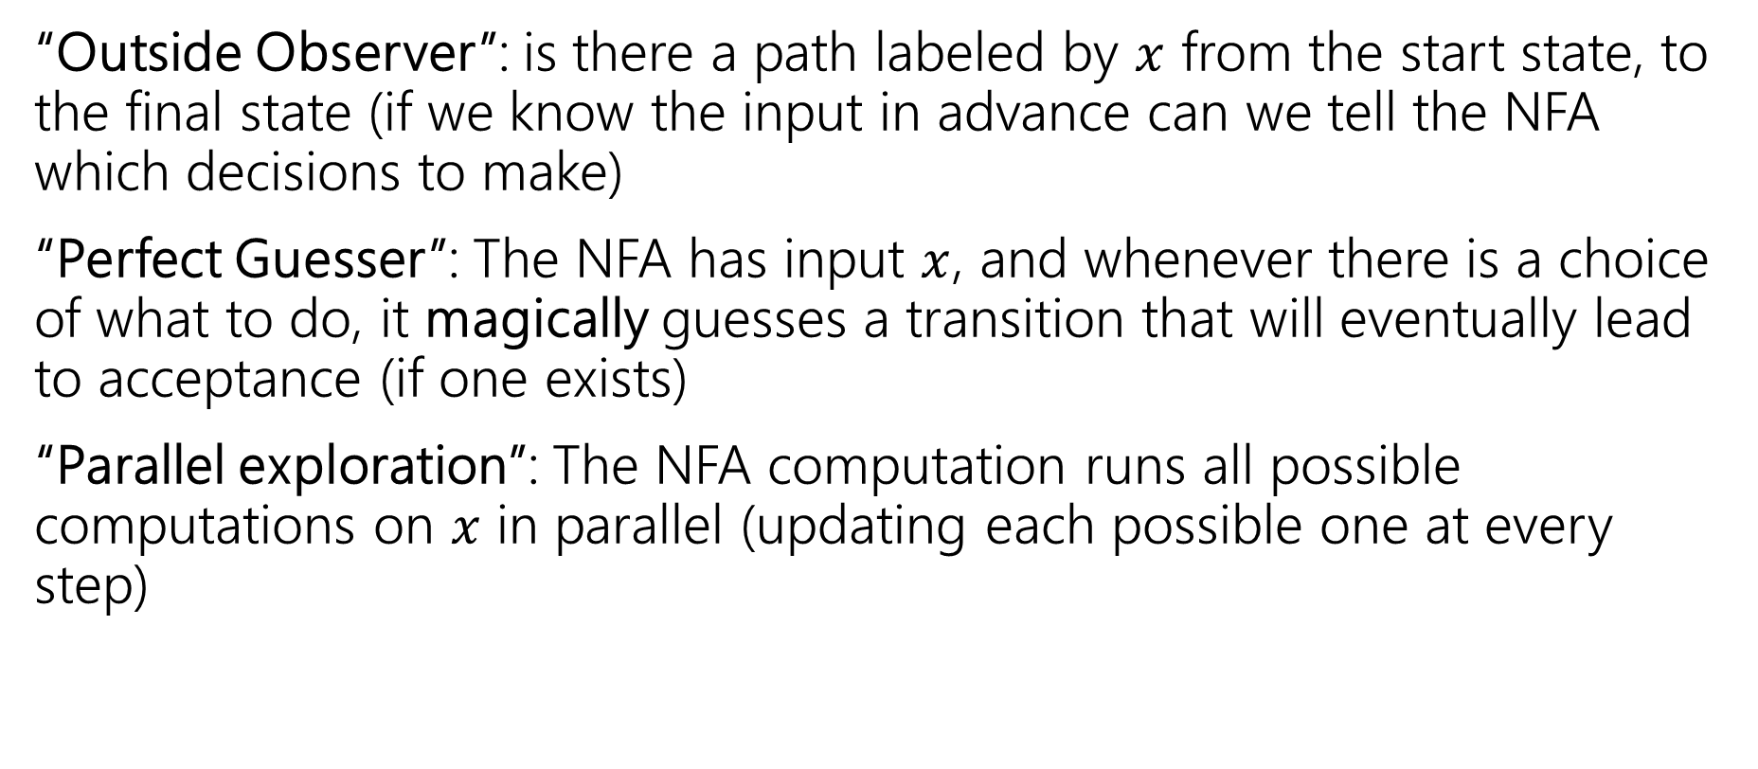
Three ways to think about NFAs
“Outside Observer”: is there a path labeled by $x$ from the start state, to the final state (if we know the input in advance can we tell the NFA which decisions to make)
“Perfect Guesser”: The NFA has input $x$, and whenever there is a choice of what to do, it magically guesses a transition that will eventually lead to acceptance (if one exists)
“Parallel exploration”: The NFA computation runs all possible computations on $x$ in parallel (updating each possible one at every step)

Slide 35
So…magic guessing doesn’t exist
I know. The parallel computation view is realistic.
Lets us give simpler descriptions of complicated objects.
This notion of “nondeterminism” is also really useful in more advanced CS theory (you’ll see it again in 421 or 431 if not sooner).
Source of the P vs. NP problem.

Slide 36
NFA practice
What is the language of this NFA?
0,1
1
1
s₁
s₂
s₃
1
s₀
0
1
s₅
s₄
1
Notes:
Start state: s0
Accept states: s3, s5
Edges:
S0 to s1 on input 1
S0 to s4 on input 1
S1 to s2 on input 1
S2 to s3 on input 1
S3 to s3 on input 0,1
S4 to s5 on input 0
S5 to s4 on input 1

Slide 37

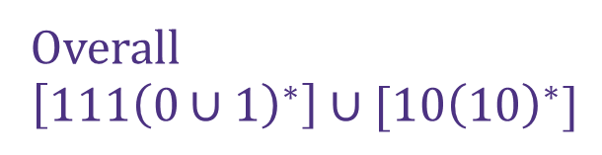

NFA practice (solution)
What is the language of this NFA?
0,1
1
1
s₁
s₂
s₃
$$111{\left(0∪1\right)}^{∗}$$
1
s₀
0
1
s₅
Overall
$$\left[111{\left(0∪1\right)}^{∗}\right]∪[10{\left(10\right)}^{∗}]$$
s₄
$$10{\left(10\right)}^{∗}$$
1
Notes:
Start state: s0
Accept states: s3, s5
Edges:
S0 to s1 on input 1
S0 to s4 on input 1
S1 to s2 on input 1
S2 to s3 on input 1
S3 to s3 on input 0,1
S4 to s5 on input 0
S5 to s4 on input 1

Slide 38


What about those $ε$-transitions?
2
0,1
0,1
s₀
s₁
ε
2
q
0
t₁
1
1
0
ε
2
2
0
t₀
2
t₂
1
Notes:
Start state: q
Accept states: s0, t0
Edges:
Q to s0 on epsilon
Q to t0 on epsilon
S0 to s0 on input 0,1
S0 to s1 on input 2
S1 to s1 on input 0,1
S1 to s2 on input 2
T0 to t0 on input 0
T0 to t1 on input 1
T0 to t2 on input 2
T1 to t1 on input 0
T1 to t2 on input 1
T1 to t0 on input 2
T2 to t2 on input 0
T2 to t0 on input 1
T2 to t1 on input 2

Slide 39
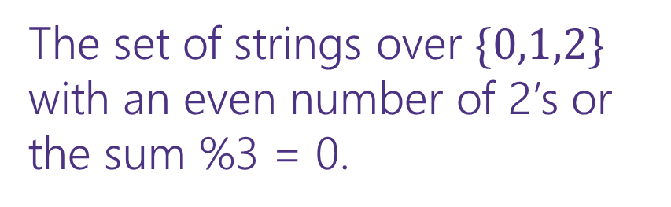
What about those $ε$-transitions? (complete)
2
0,1
0,1
s₀
s₁
ε
2
The set of strings over $\{0,1,2\}$ with an even number of 2’s or the sum %3 = 0.
q
0
t₁
1
1
0
ε
2
2
0
t₀
2
t₂
1
Notes:
Start state: q
Accept states: s0, t0
Edges:
Q to s0 on epsilon
Q to t0 on epsilon
S0 to s0 on input 0,1
S0 to s1 on input 2
S1 to s1 on input 0,1
S1 to s2 on input 2
T0 to t0 on input 0
T0 to t1 on input 1
T0 to t2 on input 2
T1 to t1 on input 0
T1 to t2 on input 1
T1 to t0 on input 2
T2 to t2 on input 0
T2 to t0 on input 1
T2 to t1 on input 2

Slide 40
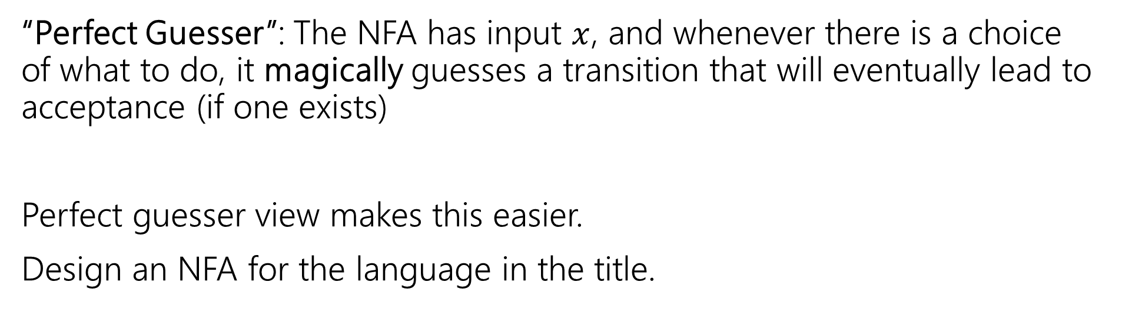
NFA that recognizes “binary strings with a 1 in the third position from the end”
“Perfect Guesser”: The NFA has input $x$, and whenever there is a choice of what to do, it magically guesses a transition that will eventually lead to acceptance (if one exists)
Perfect guesser view makes this easier.
Design an NFA for the language in the title.

Slide 41
NFA that recognizes “binary strings with a 1 in the third position from the end” (solution)
0,1
1
0,1
0,1
s₃
s₂
s₁
s₀
That’s WAY easier than the DFA…
Notes:
Start state: s3
Accept states: s0
Edges:
S3 to s3 on input 0,1
S3 to s2 on input 1
S2 s1 on input 0,1
S1 to s0 on input 0,1

Slide 42
Parallel Exploration view of an NFA
0,1
1
0,1
0,1
s₃
s₂
s₁
s₀
Input string 0101100
0
1
0
1
1
0
0
s₃
s₃
s₃
s₃
s₃
s₃
s₃
s₃
s₂
s₁
s₀
s₂
s₁
s₀
X
s₂
s₁
s₀
X
Notes:
NFA for binary strings with 1
Start state: s3
Accept states: s0
Edges:
S3 to s3 on input 0,1
S3 to s2 on input 1
S2 s1 on input 0,1
S1 to s0 on input 0,1
Visualization of parallel exploration of the NFA
Start state: s3
Paths:
Path 1
S3 to s3 on input 0
S3 to s3 on input 1
S3 to s3 on input 0
S3 to s3 on input 1
S3 to s3 on input 1
S3 to s3 on input 0
S3 to s3 on input 0
(not accepted)
Path 2
S3 to s3 on input 0
S3 to s3 on input 1
S3 to s3 on input 0
S3 to s3 on input 1
S3 to s2 on input 1
S2 to s1 on input 0
S1 to s0 on input 0
(accepted)
Path 3
S3 to s3 on input 0
S3 to s3 on input 1
S3 to s3 on input 0
S3 to s2 on input 1
S2 to s1 on input 1
S1 to s0 on input 0
(not accepted)
Path 4
S3 to s3 on input 0
S3 to s2 on input 1
S2 to s1 on input 0
S1 to s0 on input 1
(not accepted)

Slide 43
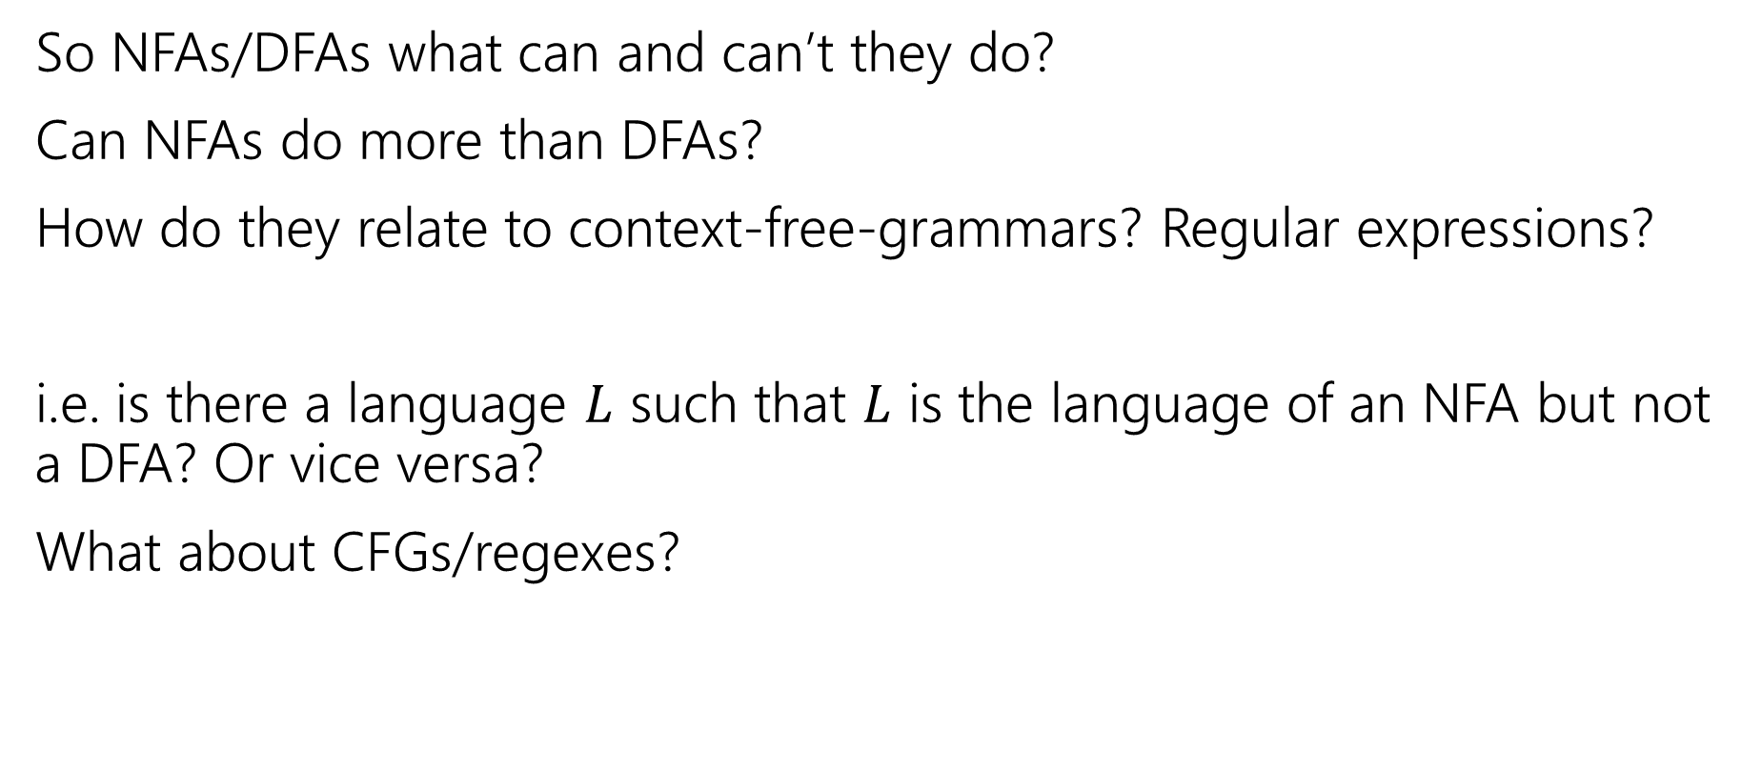
Regularity Idea
So NFAs/DFAs what can and can’t they do?
Can NFAs do more than DFAs?
How do they relate to context-free-grammars? Regular expressions?
i.e. is there a language $L$ such that $L$ is the language of an NFA but not a DFA? Or vice versa?
What about CFGs/regexes?
pollev.com/robbie

Slide 44
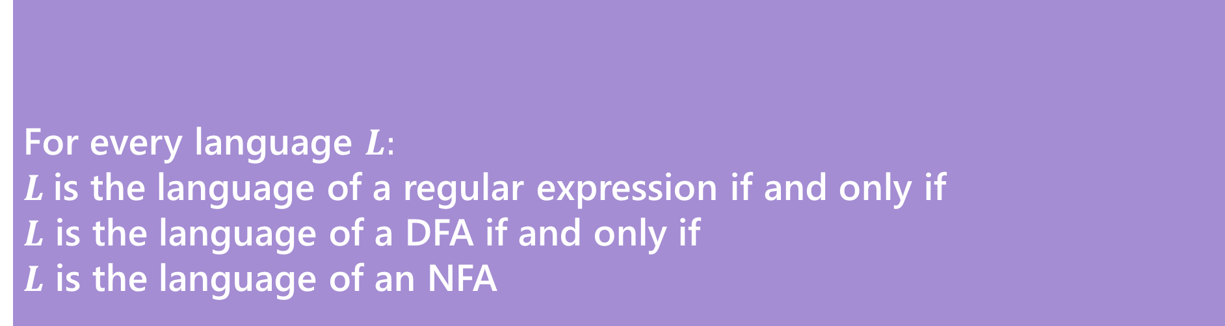
Regularity (definition)
So NFAs/DFAs what can and can’t they do?
Can NFAs do more than DFAs?
How do they relate to context-free-grammars? Regular expressions?
For every language $L:$
$L$is the language of a regular expression if and only if
$L$ is the language of a DFA if and only if
$L$ is the language of an NFA
Kleene’s Theorem

Slide 45
Regularity
So NFAs, DFAs, and regular expressions are all “equally powerful”
Every language either can be expressed with any of them or none of them.
A set of strings that is recognized by a DFA (equivalently, recognized by an NFA; equivalently, the language of a regular expression) is called a regular language.
So to show a language is “regular” you just need to show one of these and prove it works. There are some “irregular” languages (that don’t have a corresponding NFA/DFA/regex).
CFGs are “more powerful” (every regular language can also be represented with a CFG, but some languages with CFGs have not NFA/DFA/regex.

Slide 46
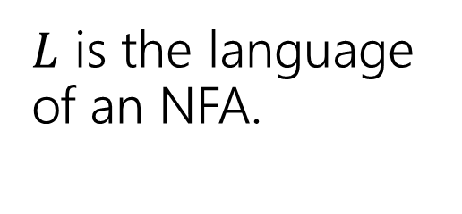
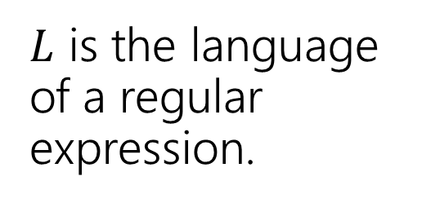
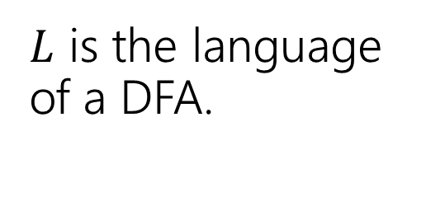
Proof [sketch] (1)
$L$ is the language of an NFA.
$L$ is the language of a regular expression.
This is just a “sketch” of the proof. We want you to get the intuition for why this is true, we’ll go very quickly for some cases.
$L$ is the language of a DFA.

Slide 47
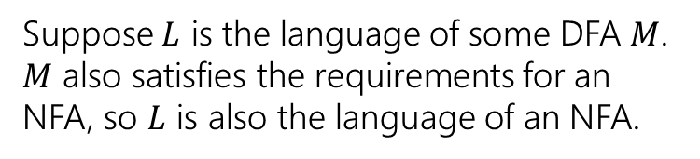
Proof [sketch] (2: every DFA is an NFA)
$L$ is the language of an NFA.
Every DFA is an NFA
$L$ is the language of a regular expression.
$L$ is the language of a DFA.
Suppose $L$ is the language of some DFA $M$. $M$ also satisfies the requirements for an NFA, so $L$ is also the language of an NFA.

Slide 48
Proof [sketch] (3)
$L$ is the language of an NFA.
Every DFA is an NFA
$L$ is the language of a regular expression.
$L$ is the language of a DFA.

Slide 49
Can we convert an NFA to a DFA?
NFAs are magic though! DFAs can’t guess…
Parallel exploration: The NFA computation runs all possible computations on x step-by-step at the same time in parallel
At any step, the set of all possible states we could be in is fixed!
And the update steps are deterministic if we just check all possibilities!

Slide 50
Parallel Exploration view of an NFA (again)
0,1
1
0,1
0,1
s₃
s₂
s₁
s₀
Input string 0101100
0
1
0
1
1
0
0
s₃
s₃
s₃
s₃
s₃
s₃
s₃
s₃
s₂
s₁
s₀
s₂
s₁
s₀
X
s₂
s₁
s₀
X
Notes:
NFA for binary strings with 1
Start state: s3
Accept states: s0
Edges:
S3 to s3 on input 0,1
S3 to s2 on input 1
S2 s1 on input 0,1
S1 to s0 on input 0,1
Visualization of parallel exploration of the NFA
Start state: s3
Paths:
Path 1
S3 to s3 on input 0
S3 to s3 on input 1
S3 to s3 on input 0
S3 to s3 on input 1
S3 to s3 on input 1
S3 to s3 on input 0
S3 to s3 on input 0
(not accepted)
Path 2
S3 to s3 on input 0
S3 to s3 on input 1
S3 to s3 on input 0
S3 to s3 on input 1
S3 to s2 on input 1
S2 to s1 on input 0
S1 to s0 on input 0
(accepted)
Path 3
S3 to s3 on input 0
S3 to s3 on input 1
S3 to s3 on input 0
S3 to s2 on input 1
S2 to s1 on input 1
S1 to s0 on input 0
(not accepted)
Path 4
S3 to s3 on input 0
S3 to s2 on input 1
S2 to s1 on input 0
S1 to s0 on input 1
(not accepted)

Slide 51
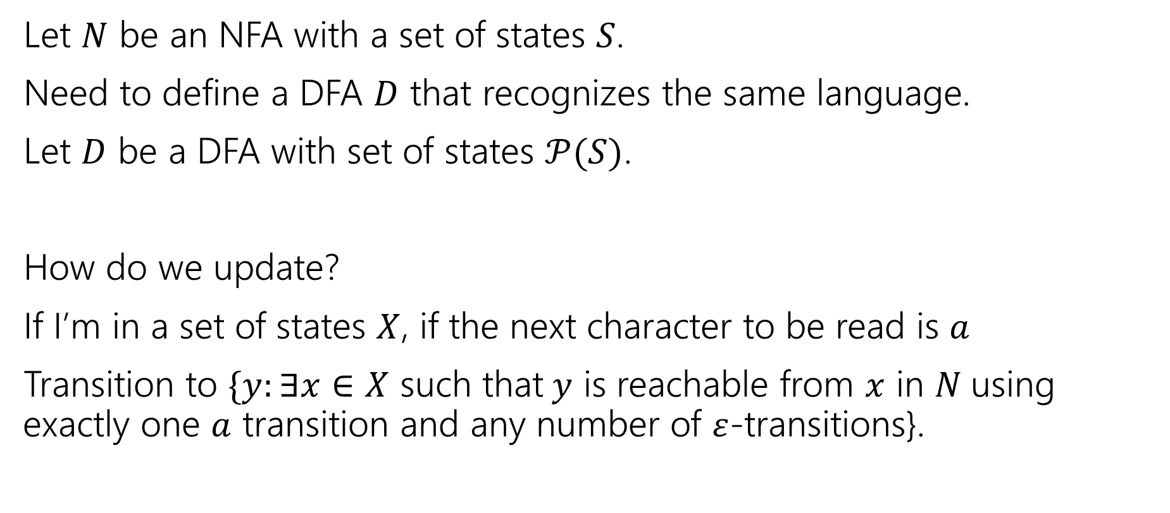
Converting from an NFA to a DFA
Let $N$ be an NFA with a set of states $S$.
Need to define a DFA $D$ that recognizes the same language.
Let $D$ be a DFA with set of states $𝒫(S)$.
How do we update?
If I’m in a set of states $X$, if the next character to be read is $a$
Transition to $\{y:∃x∈X$ such that$y$ is reachable from $x$ in $N$using exactly one $a$ transition and any number of $ε$-transitions}.

Slide 52


An example (starting point)
{a}
{c}
a
ɛ
1
0
0
1
c
b
{a,b}
0
0,1
$$N$$
$$D$$
Notes:
NFA:
Start state: a
Accept states: a
Edges:
A to b on epsilon
A to c on input 1
B to a on input 0
C to c on input 0
C to b on input 0,1
Partial DFA:
Edges:
{a} to {a,b} on input 0
{a,b} to {c} on input 1

Slide 53
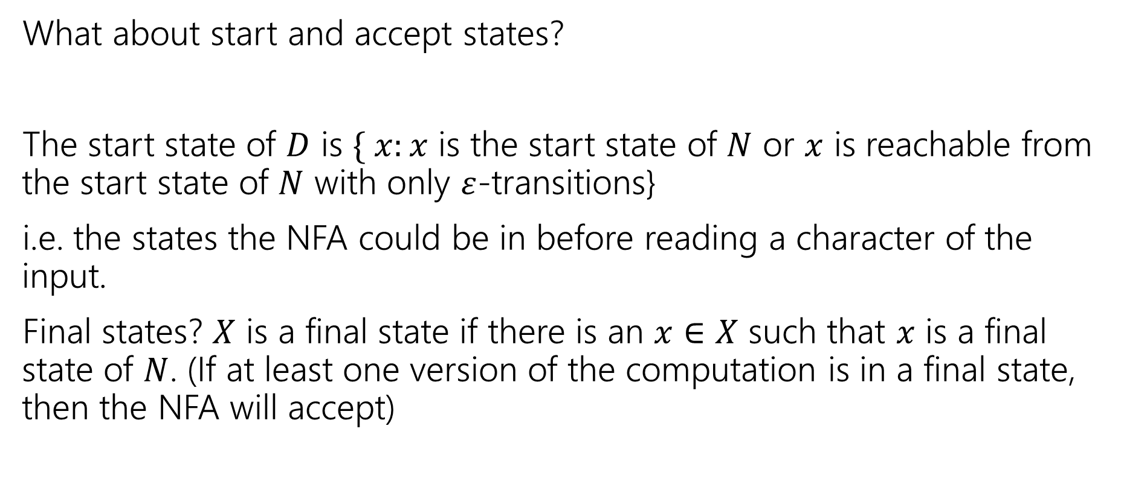
Finishing the DFA
What about start and accept states?
The start state of $D$ is $\{ x:x$ is the start state of $N$ or $x$ is reachable from the start state of $N$ with only $ε$-transitions}
i.e. the states the NFA could be in before reading a character of the input.
Final states? $X$ is a final state if there is an $x∈X$ such that $x$ is a final state of $N$. (If at least one version of the computation is in a final state, then the NFA will accept)

Slide 54
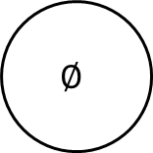

An example
$$D$$
0
{b,c}
{a}
{c}
1
a
0
1
1
1
{a,b,c}
ɛ
1
0
{b}
0
1
0
0
c
b
{a,b}
1
0
0,1
$$∅$$
$$N$$
0
0,1
Notes:
NFA:
Start state: a
Accept states: a
Edges:
A to b on epsilon
A to c on input 1
B to a on input 0
C to c on input 0
C to b on input 0,1
DFA:
Start state: {a,b}
Accept states: {a}, {a,b}, {a,b,c}
Edges:
{a} to {a,b} on input 0
{a} to {c} on input 1
{a,b} to {a,b} on input 0
{a,b} to {c} on input 1
{b} to {a,b} on input 0
{b} to emptyset on input 1
{c} to {b,c} on input 0
{c} to {b} on input 1
{b,c} to {a,b,c} on input 0
{b,c} to {b} on input 1
{a,b,c} to {a,b,c} on input 0
{a,b,c} to {b,c} on input 1
Emptyset to emptyset on input 0,1

Slide 55
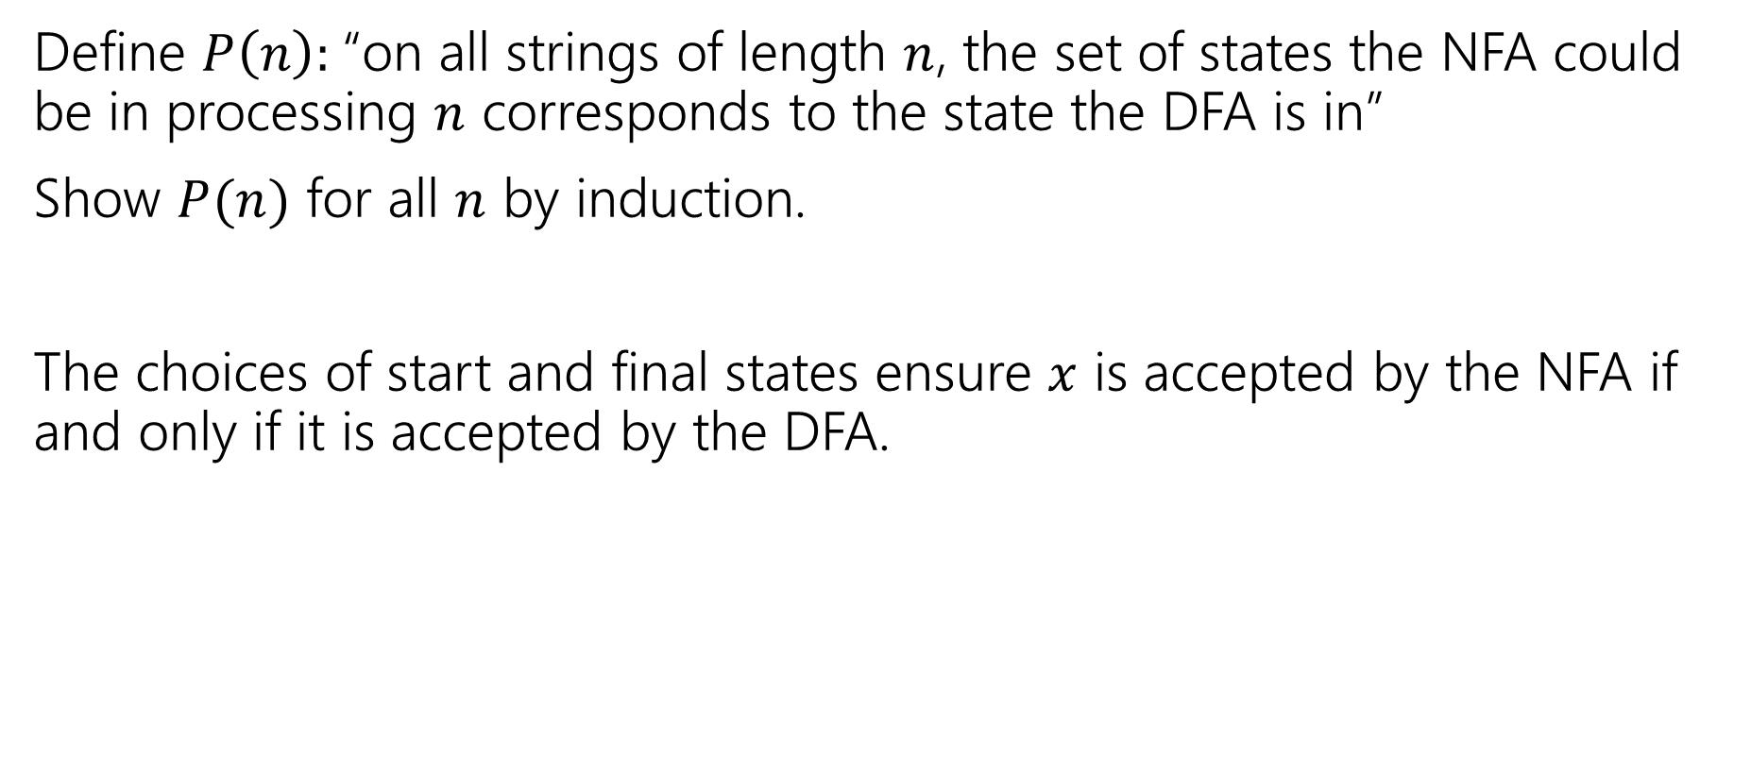
Proof Sketch
Define $P\left(n\right):$“on all strings of length $n$, the set of states the NFA could be in processing $n$ corresponds to the state the DFA is in”
Show $P(n)$ for all $n$ by induction.
The choices of start and final states ensure $x$ is accepted by the NFA if and only if it is accepted by the DFA.

Slide 56
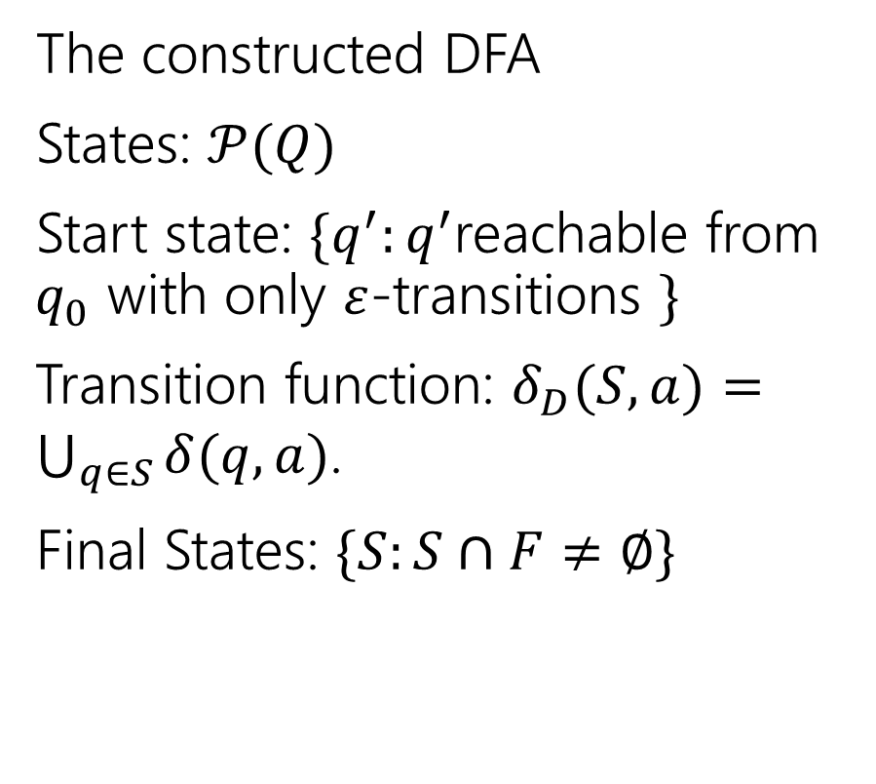
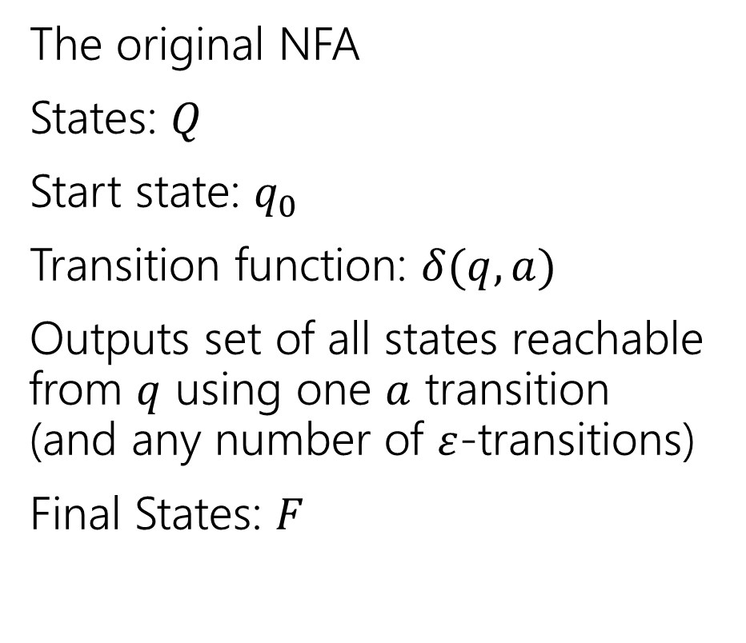
More formally (the “powerset construction”)
The original NFA
States: $Q$
Start state: $q_{0}$
Transition function: $δ(q,a)$
Outputs set of all states reachable from $q$ using one $a$ transition (and any number of $ε$-transitions)
Final States: $F$
The constructed DFA
States: $𝒫(Q)$
Start state: $\{q^{′}:q^{′}$reachable from $q_{0}$ with only $ε$-transitions $\}$
Transition function: $δ_{D}(S,a)=\bigcup_{q∈S}{δ(q,a)}$.
Final States: $\{S:S∩F≠∅\}$

Slide 57
Proof [sketch] (4: powerset construction)
$L$ is the language of an NFA.
Powerset Construction
Every DFA is a NFA
$L$ is the language of a regular expression.
$L$ is the language of a DFA.

