Slide 1
Context Free Grammars
CSE 311 Autumn 2025
Lecture 23

Slide 2
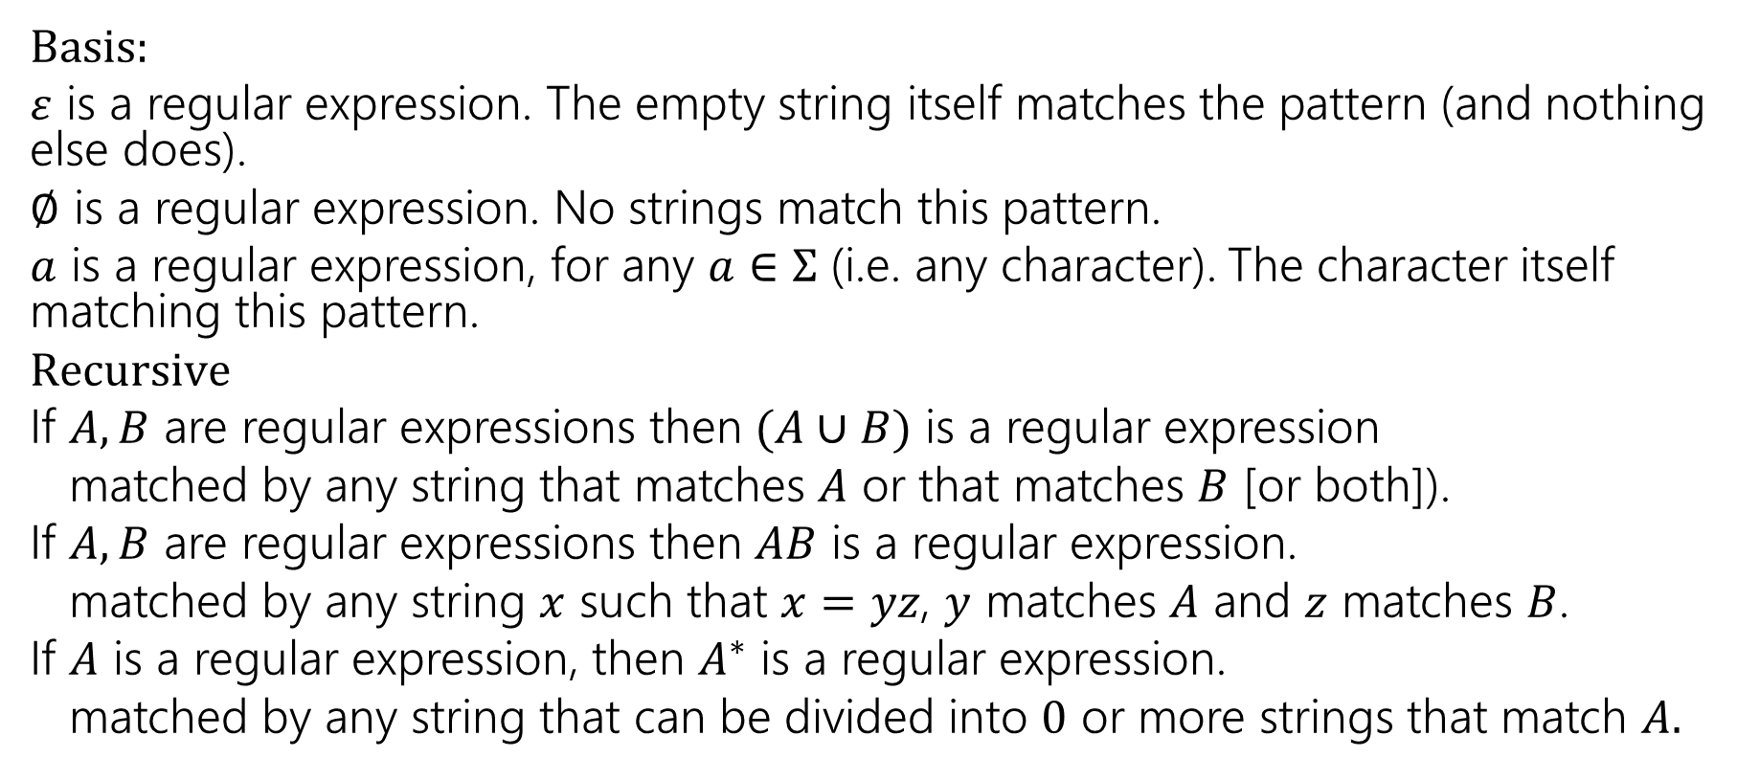
Regular Expressions
Basis:
$ε$ is a regular expression. The empty string itself matches the pattern (and nothing else does).
$∅$ is a regular expression. No strings match this pattern.
$a$ is a regular expression, for any $a∈Σ$ (i.e. any character). The character itself matching this pattern.
$Recursive$
If $A,B$ are regular expressions then $(A∪B)$ is a regular expression
matched by any string that matches $A$ or that matches $B$ [or both]).
If $A,B$ are regular expressions then $AB$ is a regular expression.
matched by any string $x$ such that $x=yz$, $y$ matches $A$ and $z$ matches $B$.
If $A$ is a regular expression, then $A^{∗}$ is a regular expression.
matched by any string that can be divided into $0$ or more strings that match $A.$

Slide 3
What can’t regular expressions do? (1)
Can you write a regular expression for all binary palindromes?
Can you write a regular expression for all binary palindromes of length at most 100?

Slide 4
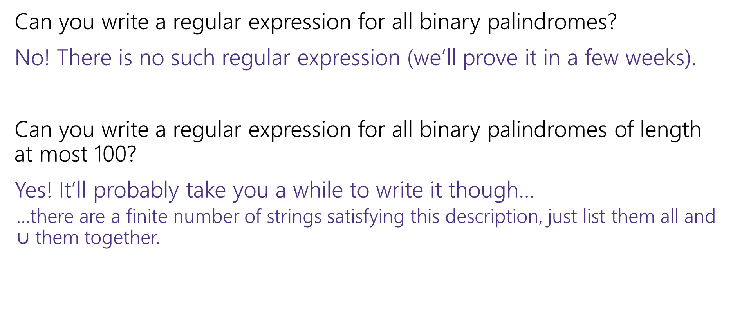
What can’t regular expressions do? (1 answers)
Can you write a regular expression for all binary palindromes?
No! There is no such regular expression (we’ll prove it in a few weeks).
Can you write a regular expression for all binary palindromes of length at most 100?
Yes! It’ll probably take you a while to write it though…
…there are a finite number of strings satisfying this description, just list them all and $∪$ them together.

Slide 5
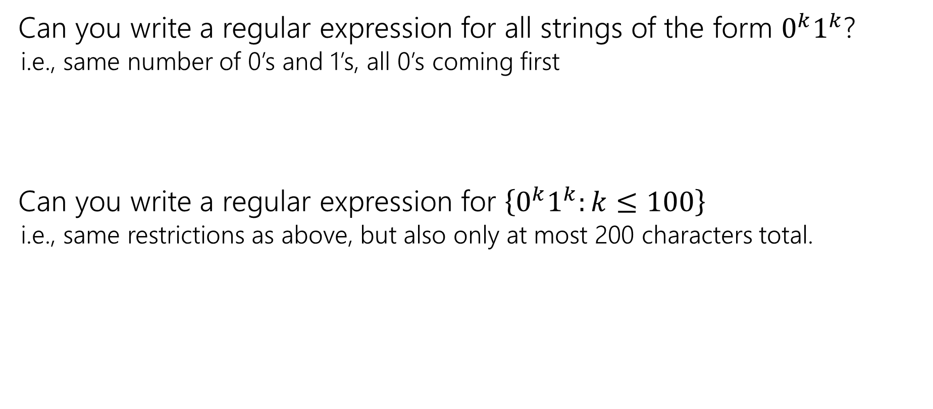
What can’t regular expressions do? (2)
Can you write a regular expression for all strings of the form $0^{k}1^{k}$?
i.e., same number of 0’s and 1’s, all 0’s coming first
Can you write a regular expression for $\left\{0^{k}1^{k}:k≤100\right\}$
i.e., same restrictions as above, but also only at most 200 characters total.

Slide 6
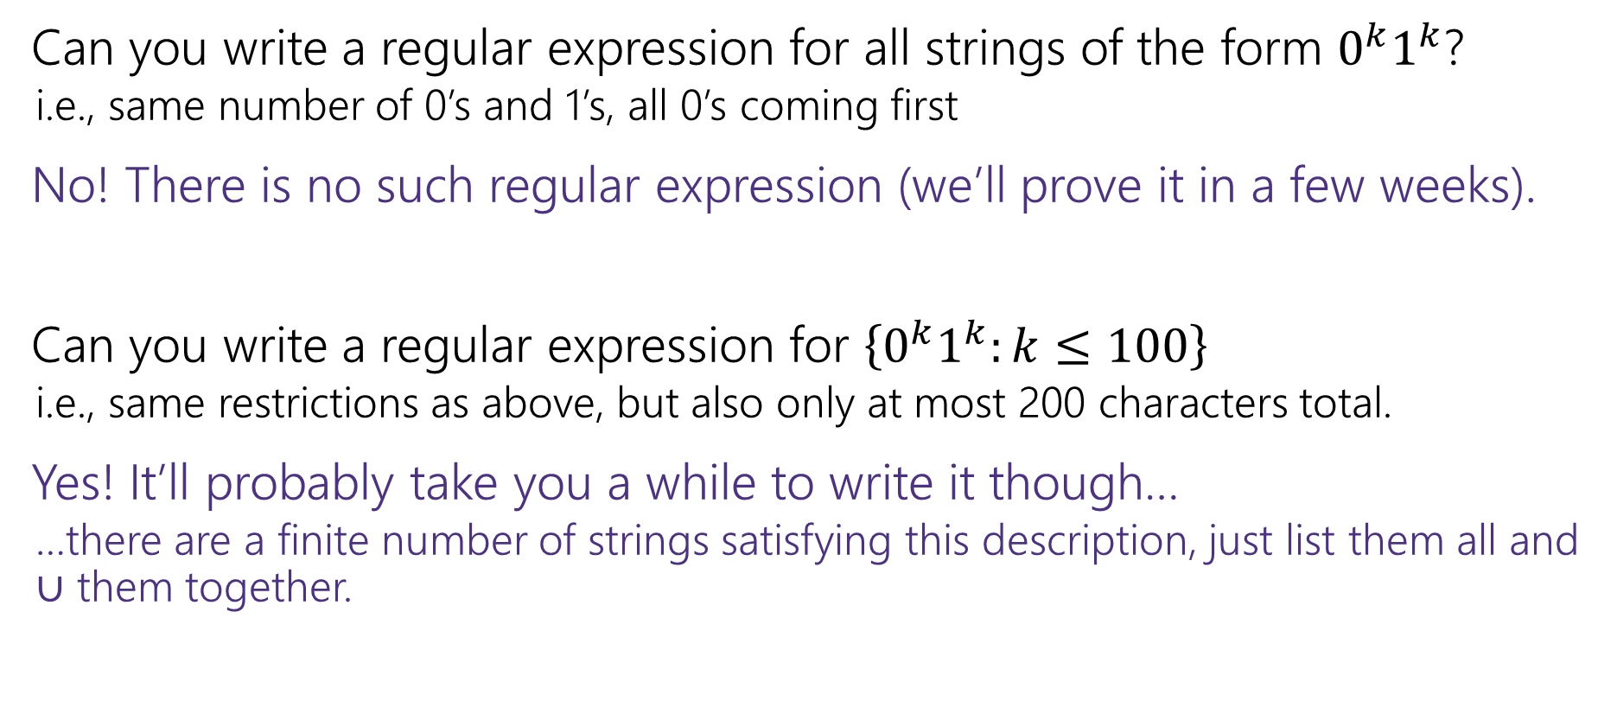
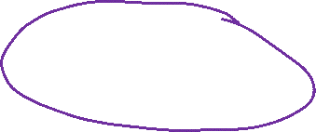
What can’t regular expressions do? (2 answers)
Can you write a regular expression for all strings of the form $0^{k}1^{k}$?
i.e., same number of 0’s and 1’s, all 0’s coming first
No! There is no such regular expression (we’ll prove it in a few weeks).
Can you write a regular expression for $\left\{0^{k}1^{k}:k≤100\right\}$
i.e., same restrictions as above, but also only at most 200 characters total.
Yes! It’ll probably take you a while to write it though…
…there are a finite number of strings satisfying this description, just list them all and $∪$ them together.

Slide 7
A Vocabulary Note
Not everything can be represented as a regular expression.
E.g. “the set of all palindromes” is not the language of any regular expression.
Some programming languages define features in their “regexes” that can’t be represented by our definition of regular expressions.
Things like “match this pattern, then have exactly that substring appear later.
So before you say “ah, you can’t do that with regular expressions, I learned it in 311!” you should make sure you know whether your language is calling a more powerful object “regular expressions”.
But the more “fancy features” beyond regular expressions you use, the slower the checking algorithms run, (and the harder it is to force the expressions to fit into the framework) so this is still very useful theory.

Slide 8
Where Are We?
We’re working our way up to proving theorems about computation
A statement like “there is no Java program that solves this problem”
Before we get there, we’ve got a grab bag of background topics.
The mathematical model for programs is defining a language, so we’re seeing different tools computer scientists use to do that.
The set of all inputs that will cause the program to return true.
Last time: Regular expressions: a common practical tool
Today: CFGs: a key to defining a programming language

Slide 9
Context Free Grammars
Another way of defining a language

Slide 10
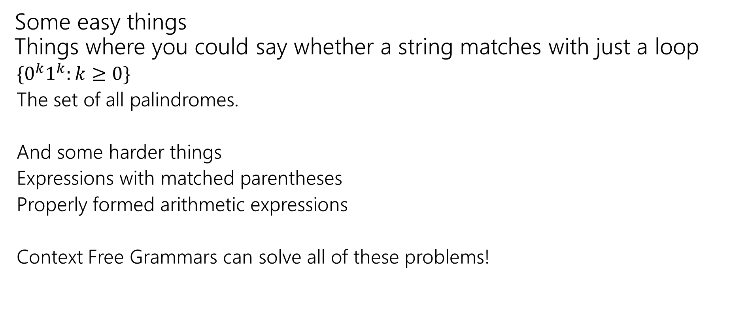
What Can’t Regular Expressions Do?
Some easy things Things where you could say whether a string matches with just a loop
$\{0^{k}1^{k}:k≥0\}$
The set of all palindromes.
And some harder things
Expressions with matched parentheses
Properly formed arithmetic expressions
Context Free Grammars can solve all of these problems!

Slide 11

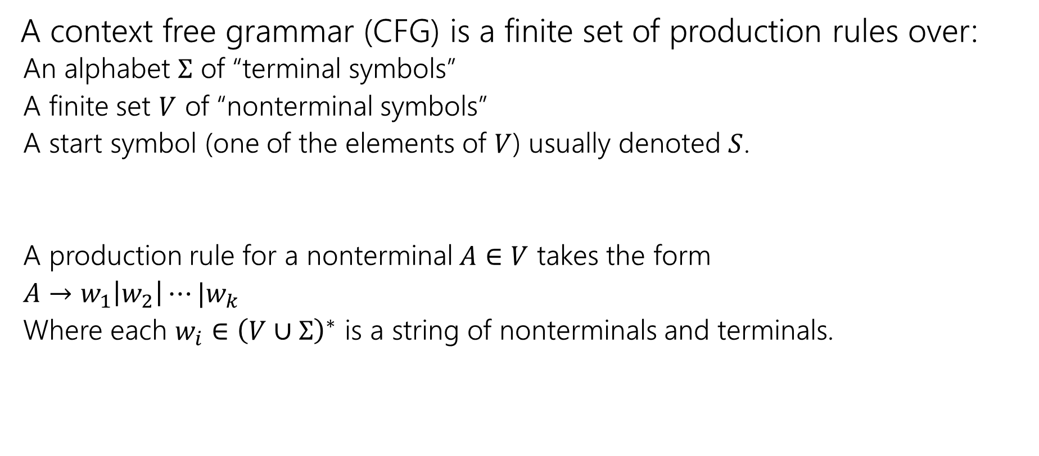

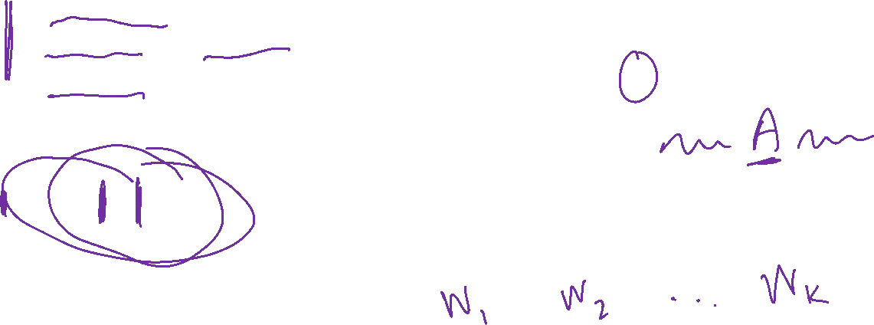
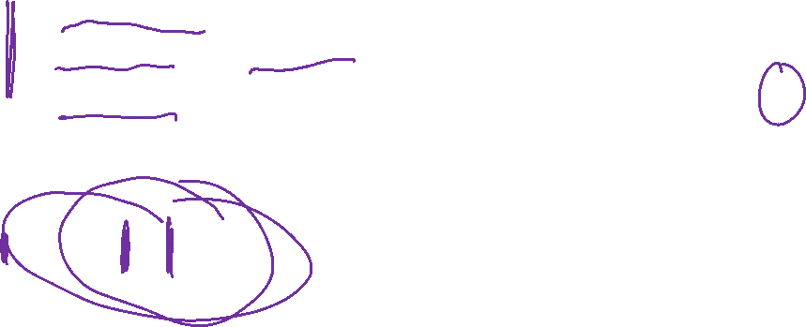
Context Free Grammars (definitions)
A context free grammar (CFG) is a finite set of production rules over:
An alphabet $Σ$ of “terminal symbols”
A finite set $V$ of “nonterminal symbols”
A start symbol (one of the elements of $V$) usually denoted $S$.
A production rule for a nonterminal $A∈V$ takes the form
$A→w_{1}\left|w_{2}\right|⋯|w_{k}$
Where each $w_{i}∈{\left(V∪Σ\right)}^{∗}$ is a string of nonterminals and terminals.

Slide 12
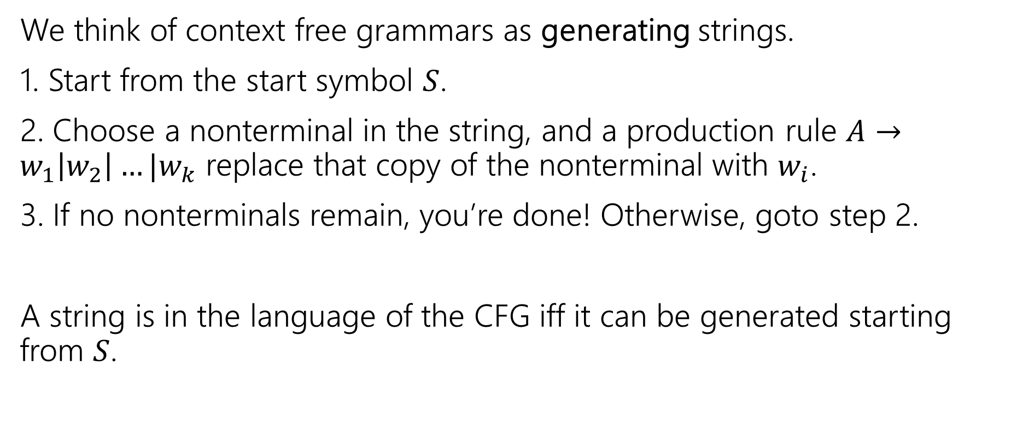
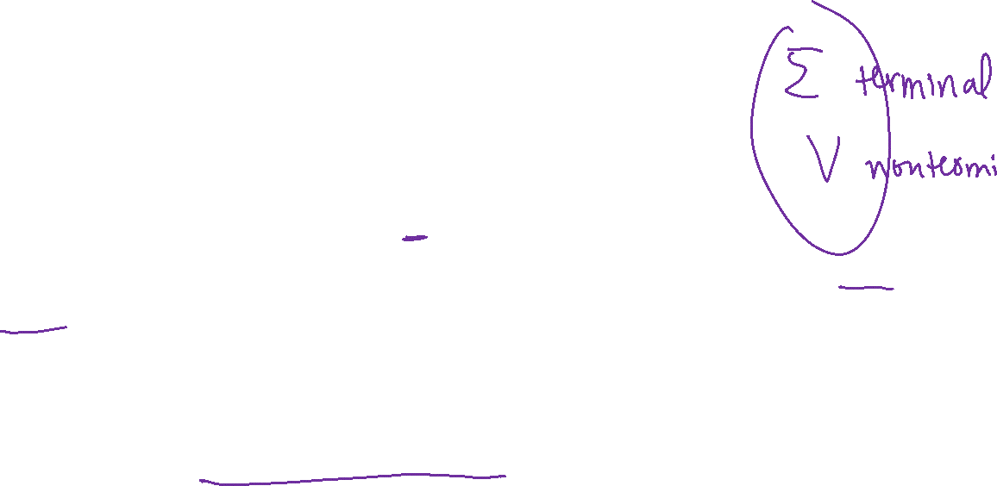
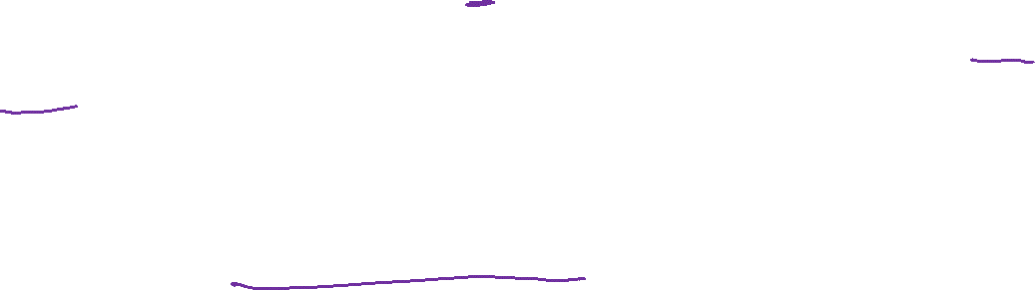
Context Free Grammars (process)
We think of context free grammars as generating strings.
1. Start from the start symbol $S$.
2. Choose a nonterminal in the string, and a production rule $A→w_{1}\left|w_{2}\right|…|w_{k}$ replace that copy of the nonterminal with $w_{i}$.
3. If no nonterminals remain, you’re done! Otherwise, goto step 2.
A string is in the language of the CFG iff it can be generated starting from $S$.

Slide 13



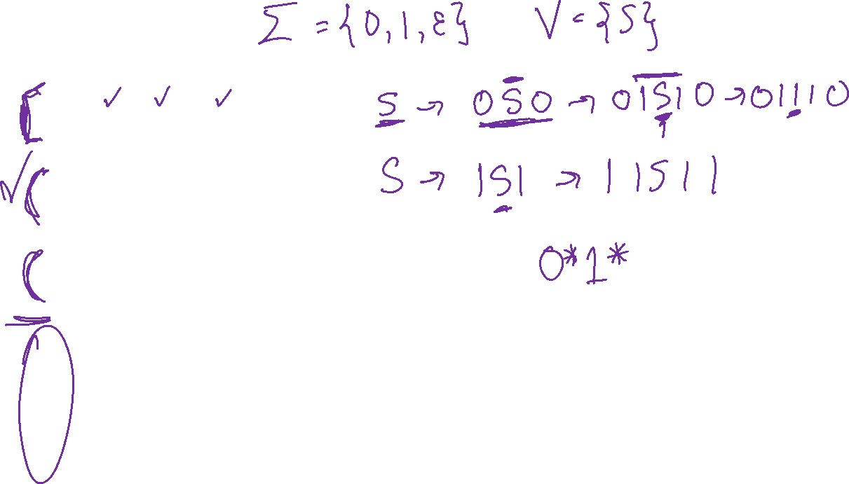

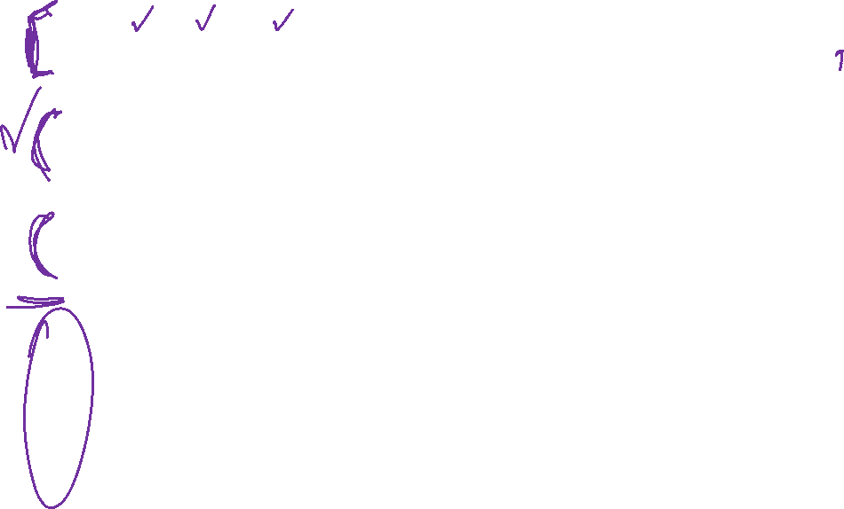
Examples
$S→0S0\left|1S1\right|0|1|ε$
$S→0S|S1|ε$
$S→\left(S\right)\left|SS\right|ε$
$S→AB$
$A→0A1|ε$
$B→1B0|ε$
The alphabet here is {(,)} i.e. parentheses are the characters.

Slide 14
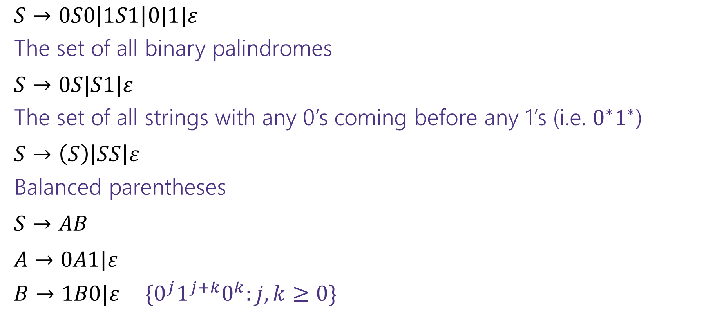
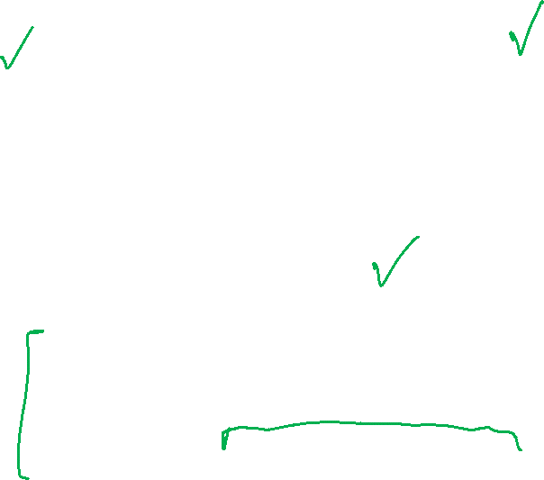
Examples (with answers)
$S→0S0\left|1S1\right|0|1|ε$
The set of all binary palindromes
$S→0S|S1|ε$
The set of all strings with any 0’s coming before any 1’s (i.e. $0^{∗}1^{∗}$)
$S→\left(S\right)\left|SS\right|ε$
Balanced parentheses
$S→AB$
$A→0A1|ε$
$B→1B0|ε$ $\{0^{j}1^{j+k}0^{k}:j,k≥0\}$

Slide 15

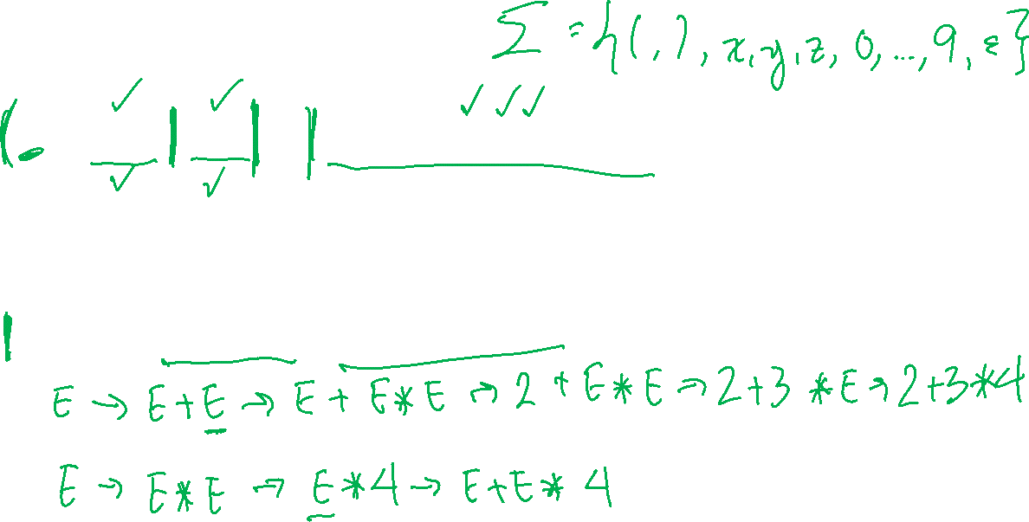

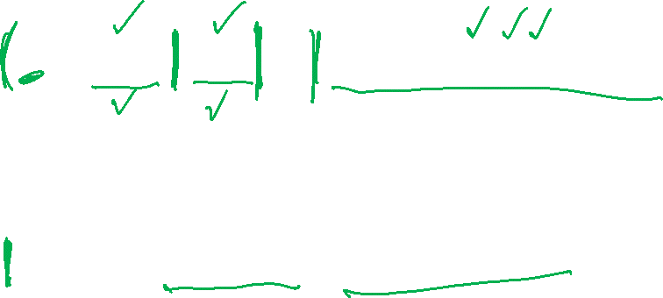
Arithmetic CFG
$E→E+E\left|E∗E\right|\left(E\right)\left|x\right|y\left|z\right|0\left|1\right|2\left|3\right|4\left|5\right|6\left|7\right|8|9$
Generate $\left(2∗x\right)+y$
Generate $2+3∗4$ in two different ways

Slide 16
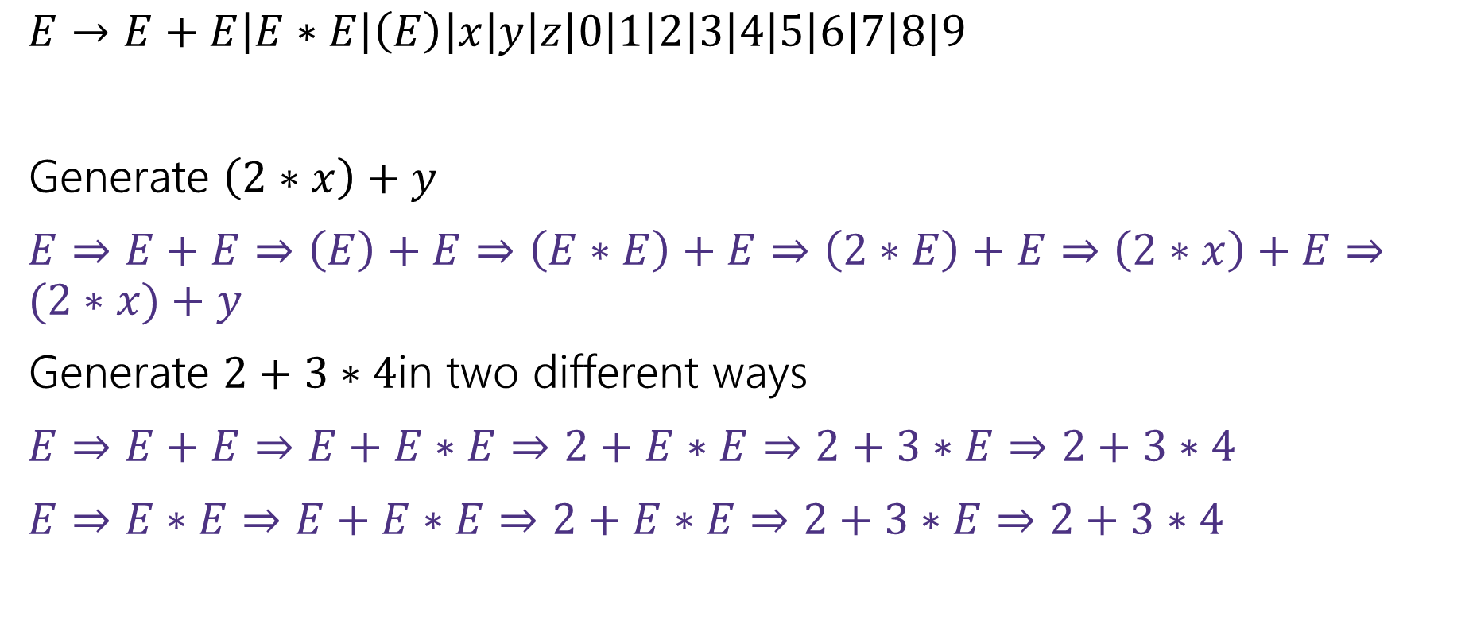
Arithmetic CFG (with answers)
$E→E+E\left|E∗E\right|\left(E\right)\left|x\right|y\left|z\right|0\left|1\right|2\left|3\right|4\left|5\right|6\left|7\right|8|9$
Generate $\left(2∗x\right)+y$
$E⇒E+E⇒\left(E\right)+E⇒\left(E∗E\right)+E⇒\left(2∗E\right)+E⇒\left(2∗x\right)+E⇒(2∗x)+y$
Generate $2+3∗4$in two different ways
$E⇒E+E⇒E+E∗E⇒2+E∗E⇒2+3∗E⇒2+3∗4$
$E⇒E∗E⇒E+E∗E⇒2+E∗E⇒2+3∗E⇒2+3∗4$

Slide 17
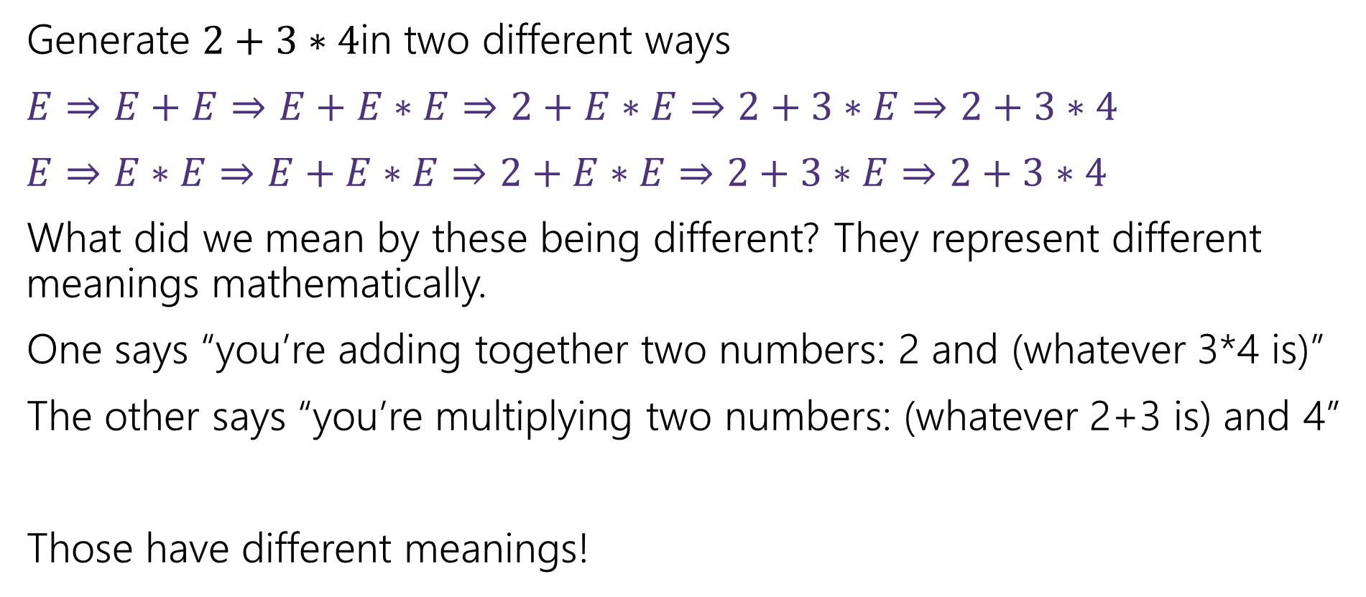
Multiple ways of generating strings
Generate $2+3∗4$in two different ways
$E⇒E+E⇒E+E∗E⇒2+E∗E⇒2+3∗E⇒2+3∗4$
$E⇒E∗E⇒E+E∗E⇒2+E∗E⇒2+3∗E⇒2+3∗4$
What did we mean by these being different? They represent different meanings mathematically.
One says “you’re adding together two numbers: 2 and (whatever 3*4 is)”
The other says “you’re multiplying two numbers: (whatever 2+3 is) and 4”
Those have different meanings!

Slide 18
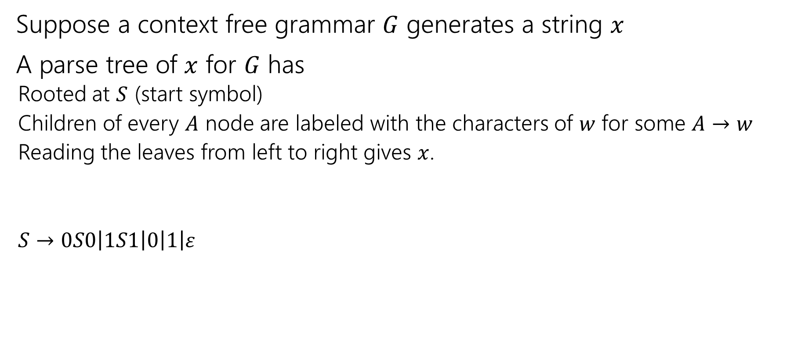
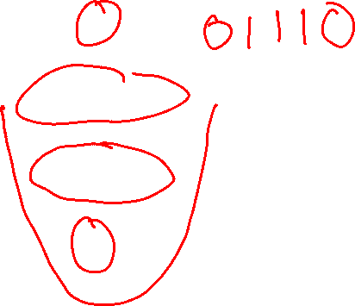
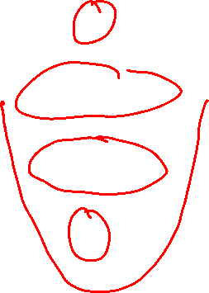
Parse Trees—remember where parentheses go
Suppose a context free grammar $G$ generates a string $x$
A parse tree of $x$ for $G$ has
Rooted at $S$ (start symbol)
Children of every $A$ node are labeled with the characters of $w$ for some $A→w$
Reading the leaves from left to right gives $x$.
$S→0S0\left|1S1\right|0\left|1\right|ε$
S
0
S
0
1
S
1
1

Slide 19




Back to the arithmetic
$E→E+E\left|E∗E\right|\left(E\right)\left|x\right|y\left|z\right|0\left|1\right|2\left|3\right|4\left|5\right|6\left|7\right|8|9$
Two parse trees for $2+3∗4$
E
E
E
+
E
E
$$∗$$
E
E
$$∗$$
E
+
E
4
2
E
3
4
2
3

Slide 20
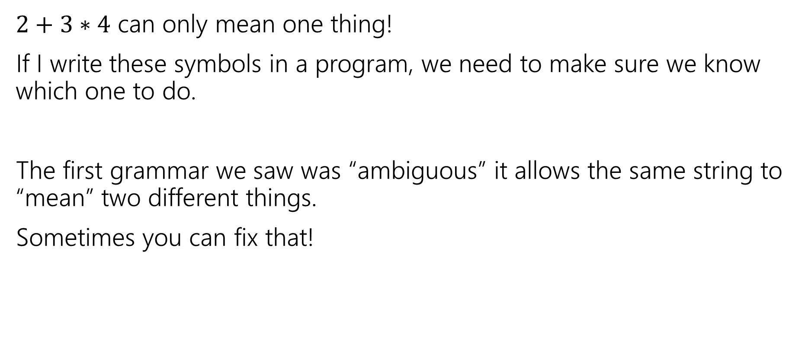
Why do we care about parsing?
$2+3∗4$ can only mean one thing!
If I write these symbols in a program, we need to make sure we know which one to do.
The first grammar we saw was “ambiguous” it allows the same string to “mean” two different things.
Sometimes you can fix that!

Slide 21

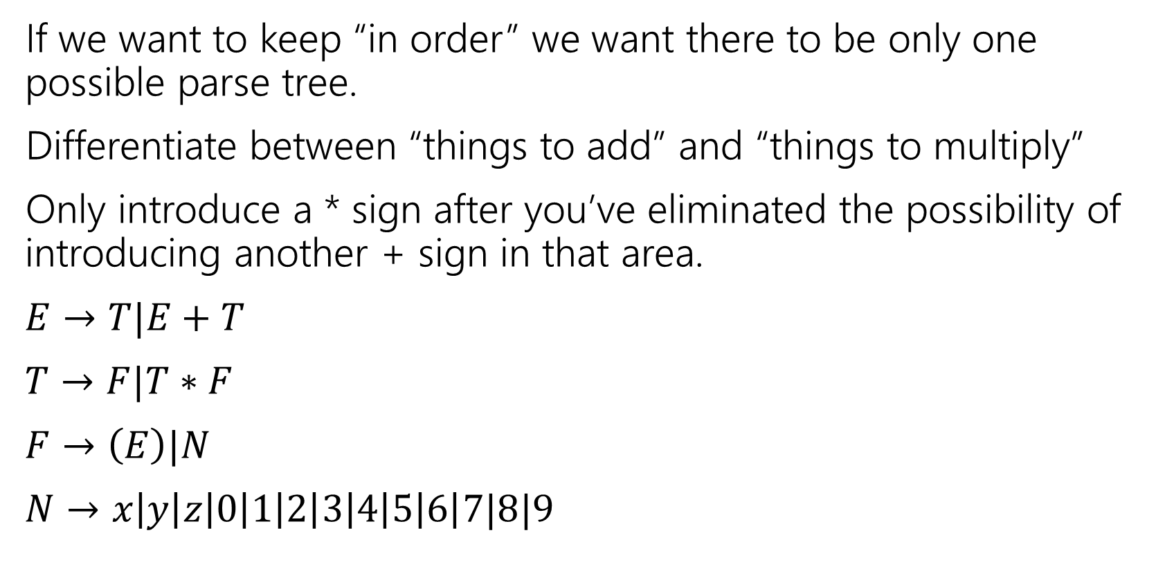
How do we encode order of operations
If we want to keep “in order” we want there to be only one possible parse tree.
Differentiate between “things to add” and “things to multiply”
Only introduce a * sign after you’ve eliminated the possibility of introducing another + sign in that area.
$E→T|E+T$
$T→F|T∗F$
$F→\left(E\right)|N$
$N→x\left|y\right|z\left|0\right|1\left|2\right|3\left|4\right|5\left|6\right|7|8|9$
E
E
+
T
T
T
$$∗$$
F
F
N
F
N
4
N
3
2

Slide 22

How do Computer Scientists use CFGs?
Most programming languages define valid programs as “strings that fit a CFG” That makes sure Java breaks down math expressions correctly! And also code like this:
if(i>0)
if(j>0)
System.out.println(“hi”);
else
System.out.println(“bye”);
if(i>0)
if(j>0)
System.out.println(“hi”);
else
System.out.println(“bye”);
The else could be attached to either “if”! Java needs a rule to decide which it goes with.
Java’s convention makes the one on the left the intuitive whitespace.
(You as a programmer should put braces so the humans reading your code don’t have to wonder!)

Slide 23
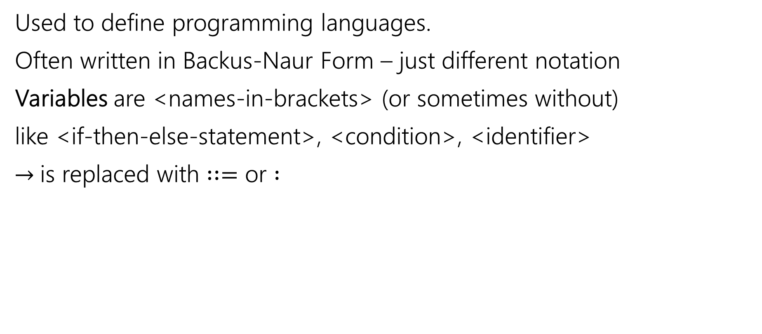
CFGs in practice
Used to define programming languages.
Often written in Backus-Naur Form – just different notation
Variables are <names-in-brackets> (or sometimes without)
like <if-then-else-statement>, <condition>, <identifier>
$→$is replaced with $∷=$ or $:$

Slide 24
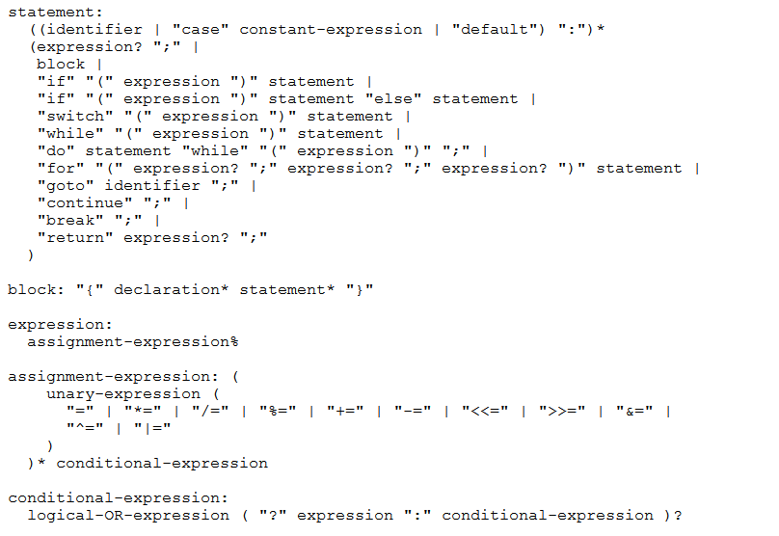

BNF for C (no <...> and uses : instead of ::=)
Notes:
statement:
((identifier | "case" constant-expression | "default") ":")*
(expression? ";" |
block|
"if" "(" expression ")" statement |
"if" "(" expression ")" statement "else" statement |
"switch" "(" expression ")" statement |
"while" "(" expression ")" statement |
"do" statement "while" "(" expression ")" ";" |
"for" "(" expression? ";" expression? ";" expression? ")" statement |
"goto" identifier ";" |
"continue" ";" |
"break" ";" |
"return" expression? ";"
)
block: "{" declaration* statement* "}"
expression:
assignment-expression%
assignment-expression: (
unary-expression (
"=" | "*=" | "/=" | "%=" | "+=" | "-=" | "<<=" | ">>=" | "&=" |
"^=" | "|="
)
)* conditional-expression
Conditional-expression:
logical-OR-expression ( "?" expression ":" conditional-expression )?

Slide 25
Some fun CFG applications
If we have time

Slide 26
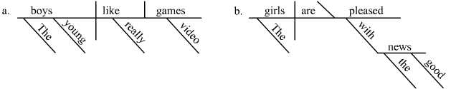
Parse Trees (sentence diagramming)
Remember diagramming sentences in middle school?
<sentence>::=<noun phrase><verb phrase>
<noun phrase>::=<determiner><adjective><noun>
<verb phrase>::=<verb><adverb>|<verb><object>
<object>::=<noun phrase>

Slide 27
Parse Trees (CFG for sentences)
<sentence>::=<noun phrase><verb phrase>
<noun phrase>::=<determiner><adjective><noun>
<verb phrase>::=<verb><adverb>|<verb><object>
<object>::=<noun phrase>
The old man the boat.

Slide 28
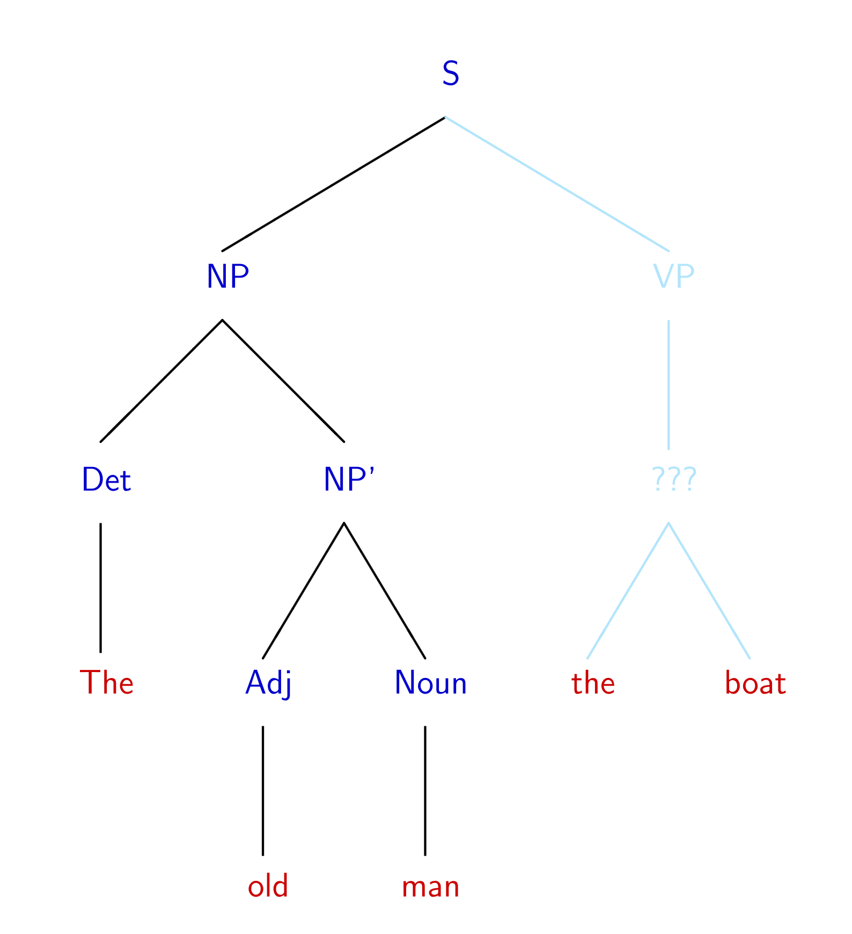
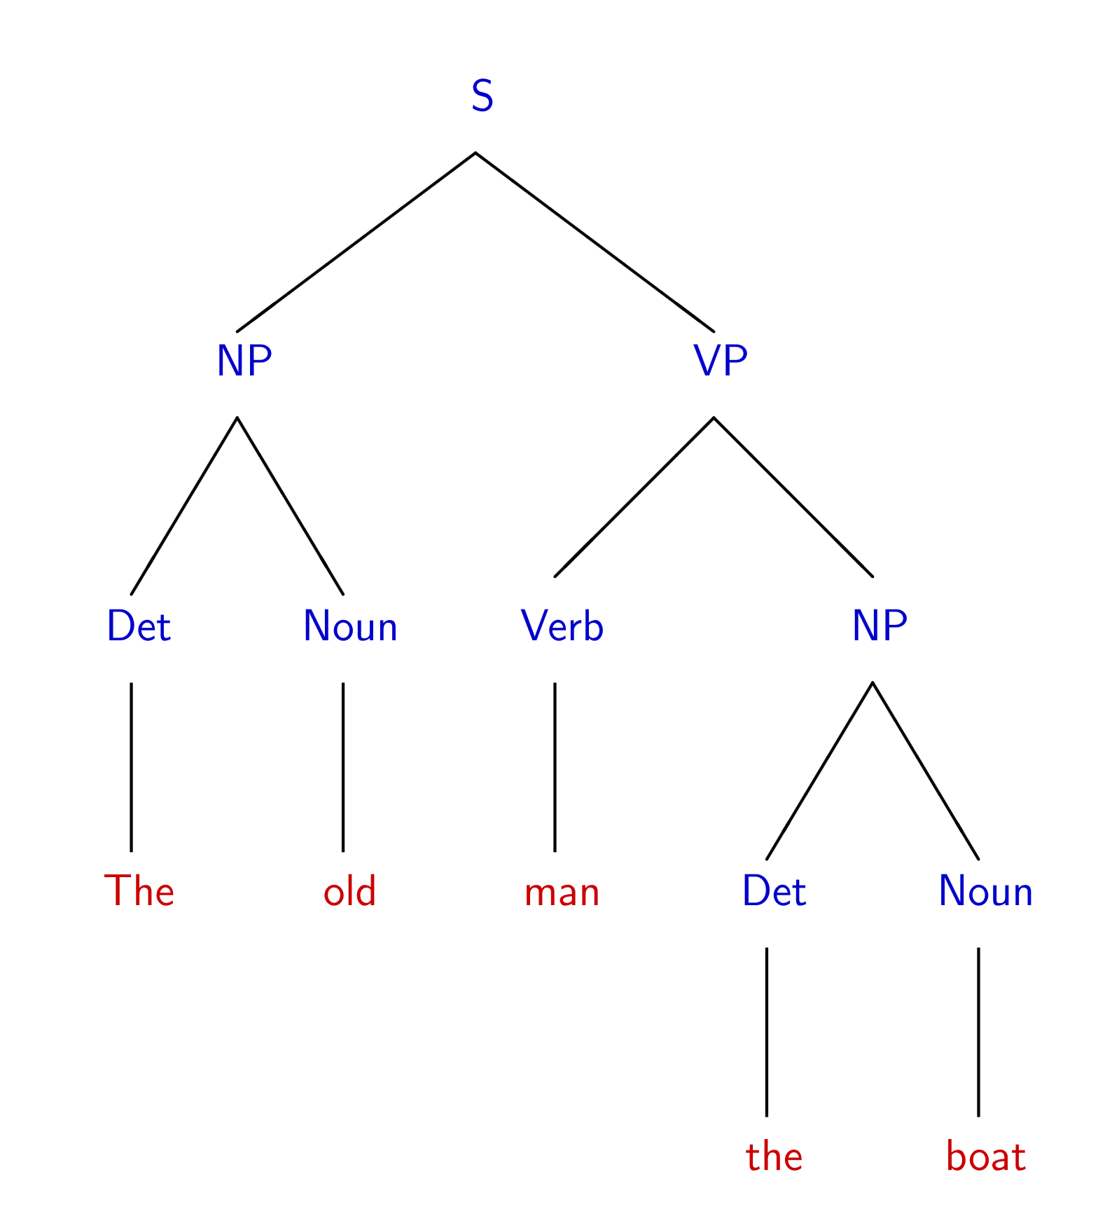
The old man the boat
By Jochen Burghardt - Own work, CC BY-SA 4.0, https://commons.wikimedia.org/w/index.php?curid=92742400

Slide 29
English is ambiguous
(Most of ‘standard’) English can be represented as a context free grammar.
It’s not perfect (ask Robbie details later).
The grammar is ambiguous! That is, there are sentences which have multiple valid parsings (multiple meanings).
Can you find multiple meanings of this sentence: “Place these 3 exercise balls on the mat at the top of the hill.”
See this video

Slide 30
The Important Takeaways

Slide 31
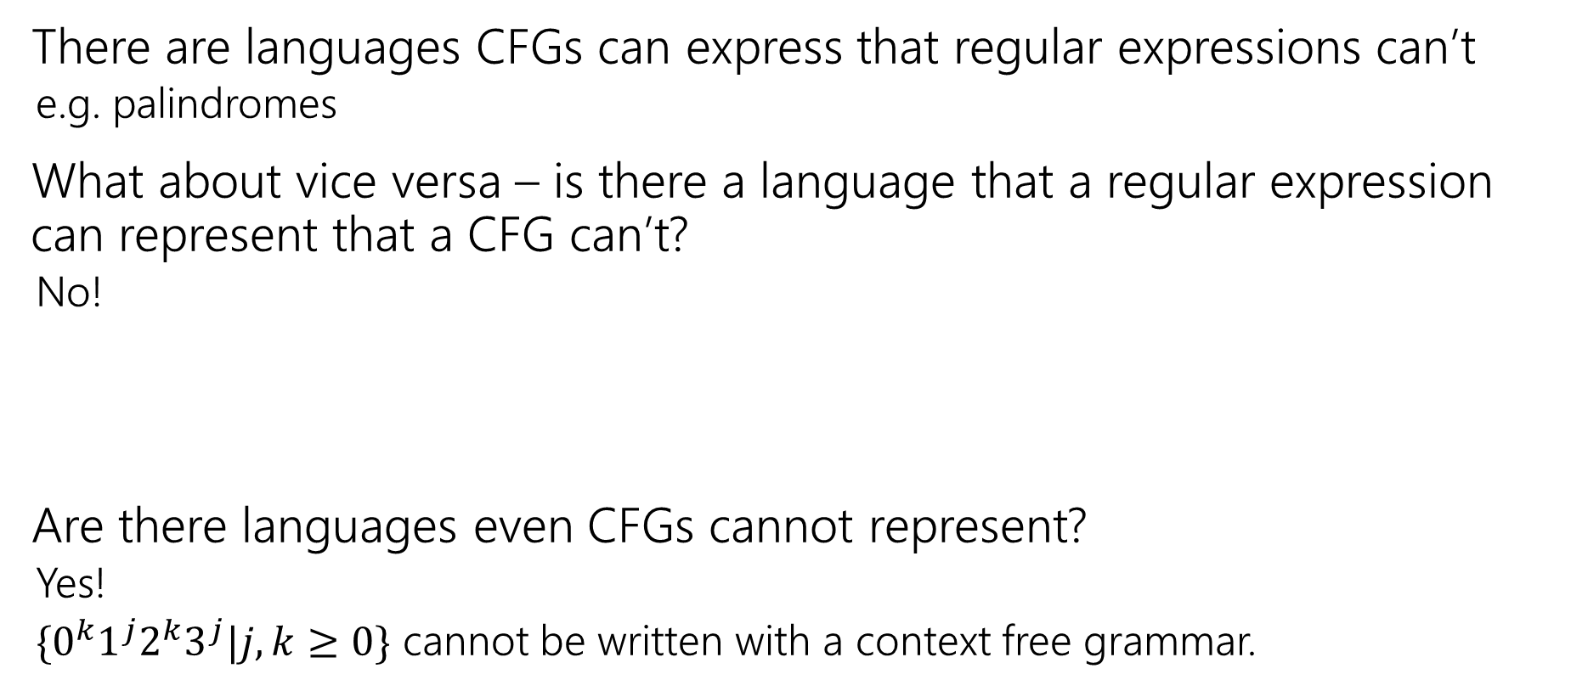
Power of Context Free Languages
There are languages CFGs can express that regular expressions can’t
e.g. palindromes
What about vice versa – is there a language that a regular expression can represent that a CFG can’t?
No!
Are there languages even CFGs cannot represent?
Yes!
$\{0^{k}1^{j}2^{k}3^{j}|j,k≥0\}$ cannot be written with a context free grammar.

Slide 32
Takeaways
CFGs and regular expressions gave us ways of succinctly representing sets of strings
Regular expressions super useful for representing things you need to search for
CFGs represent complicated languages like “java code with valid syntax”
Next: (mathematical representations of) Tiny computers! And how they relate to regular expressions and CFGs.

