Slide 1
Functions And Graphs
CSE 311 Autumn 2025
Lecture 21

Slide 2
Today
Function definitions
Graph definitions

Slide 3
Functions

Slide 4
Some types of functions
Why?
We’ll want to talk about sizes of infinite sets during the last week of classes. It’ll help us find problems our computers can’t solve.
It’ll let us practice set proofs a bit more over the next few weeks!

Slide 5

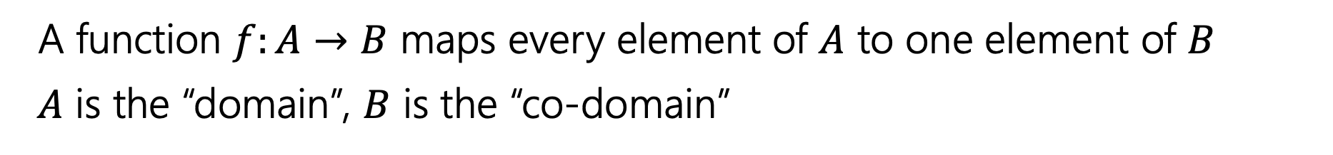
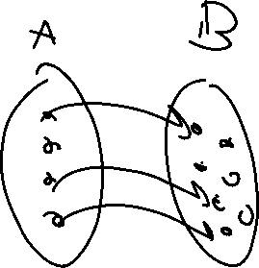
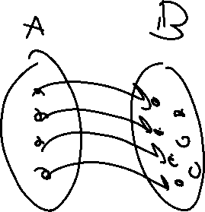
Functions!
A function $f:A→B$ maps every element of $A$ to one element of $B$
$A$ is the “domain”, $B$ is the “co-domain”
b
Function
Not a function

Slide 6


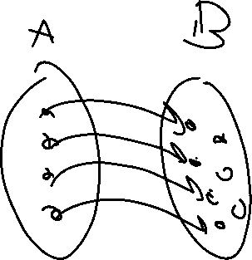

One-to-one (injection) - definition
A function $f:A→B$ maps every element of $A$ to one element of $B$
$A$ is the “domain”, $B$ is the “co-domain”
That is, every output has at most one possible input.
A function $f$ is one-to-one iff
$$∀a∀b(f\left(a\right)=f\left(b\right)→a=b)$$
One-to-one (aka injection)

Slide 7
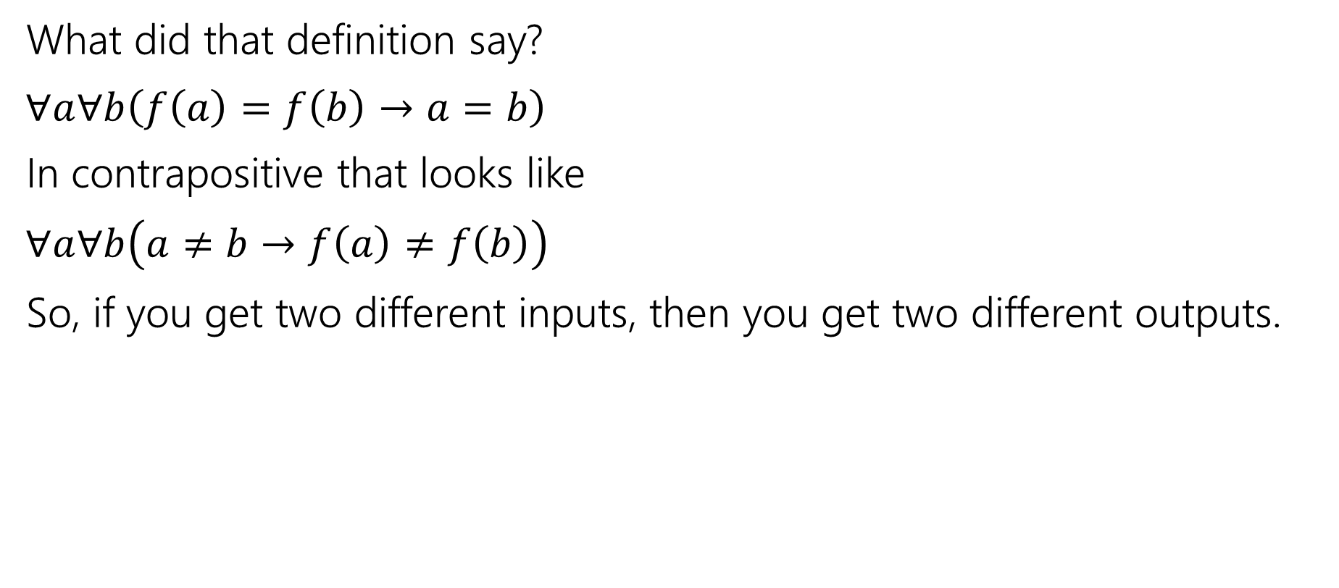

One-to-one (injection) - contrapositive
What did that definition say?
$∀a∀b\left(f\left(a\right)=f\left(b\right)→a=b\right)$
In contrapositive that looks like
$∀a∀b\left(a≠b→f\left(a\right)≠f\left(b\right)\right)$
So, if you get two different inputs, then you get two different outputs.

Slide 8
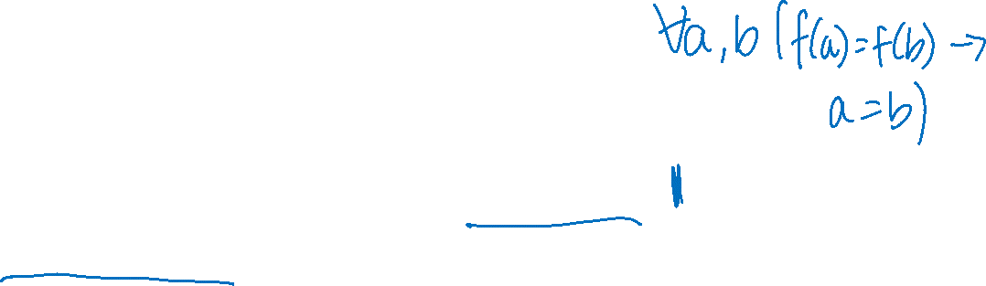
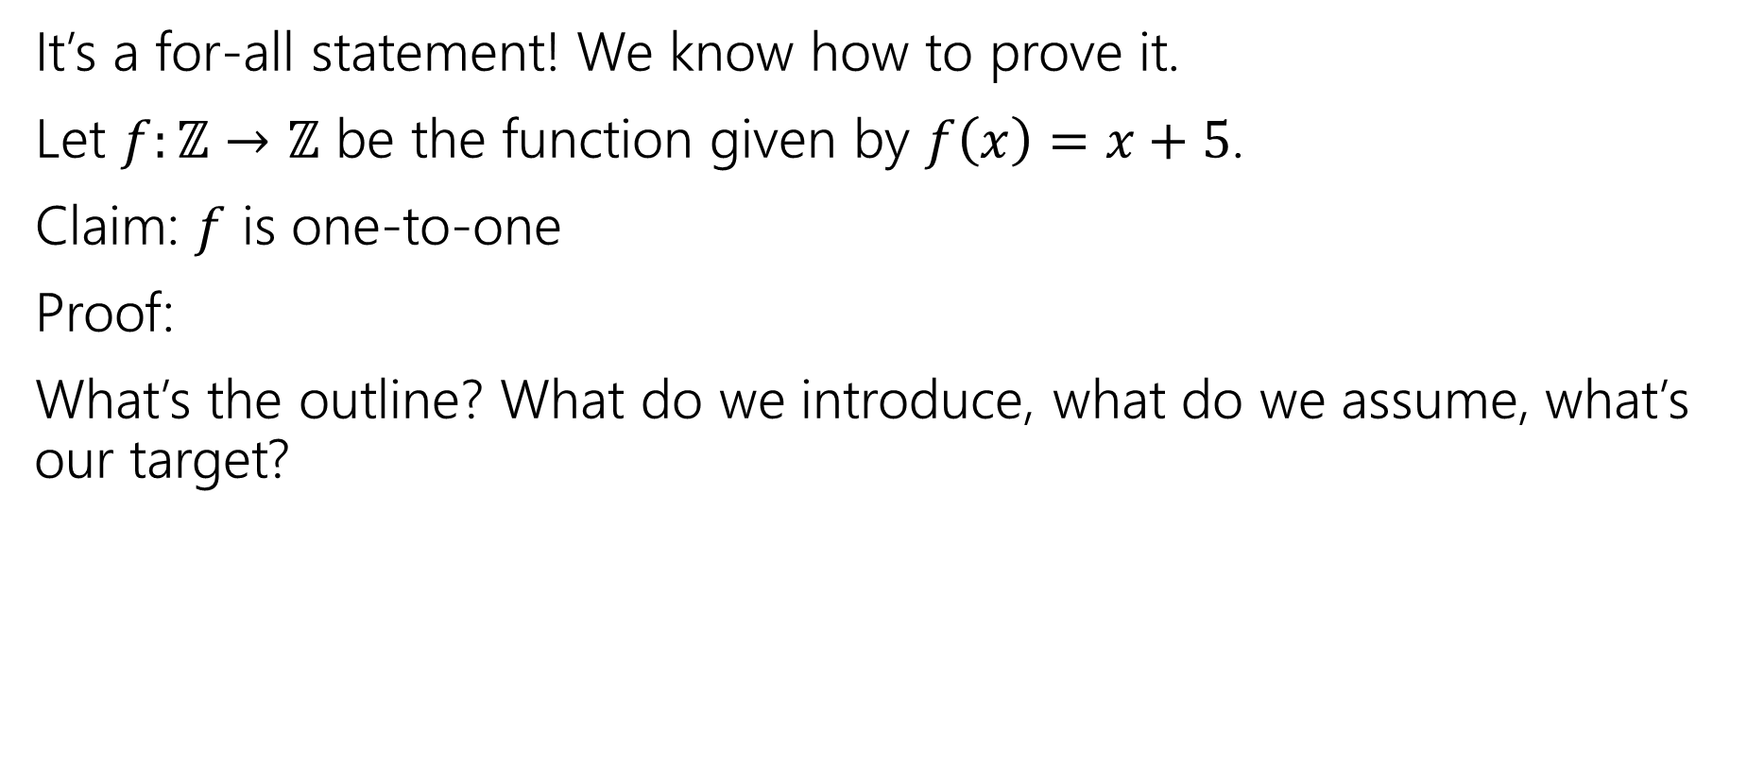


One-to-one proofs - structure
It’s a for-all statement! We know how to prove it.
Let $f:ℤ→ℤ$ be the function given by $f\left(x\right)=x+5$.
Claim: $f$ is one-to-one
Proof:
What’s the outline? What do we introduce, what do we assume, what’s our target?
A function $f$ is one-to-one iff
$$∀a∀b(f\left(a\right)=f\left(b\right)→a=b)$$
One-to-one (aka injection)

Slide 9
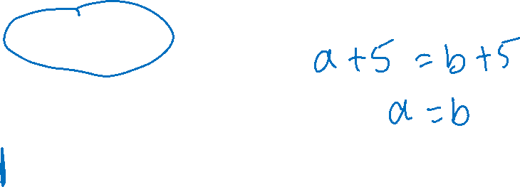
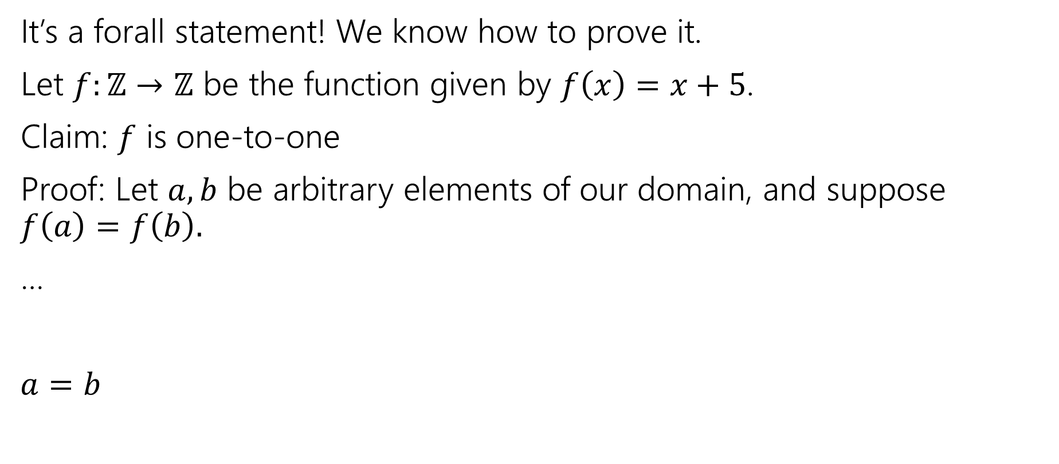

One-to-one proofs - skeleton
It’s a forall statement! We know how to prove it.
Let $f:ℤ→ℤ$ be the function given by $f\left(x\right)=x+5$.
Claim: $f$ is one-to-one
Proof: Let $a,b$ be arbitrary elements of our domain, and suppose $f\left(a\right)=f\left(b\right).$
…
$a=b$
A function $f$ is one-to-one iff
$$∀a∀b(f\left(a\right)=f\left(b\right)→a=b)$$
One-to-one (aka injection)

Slide 10
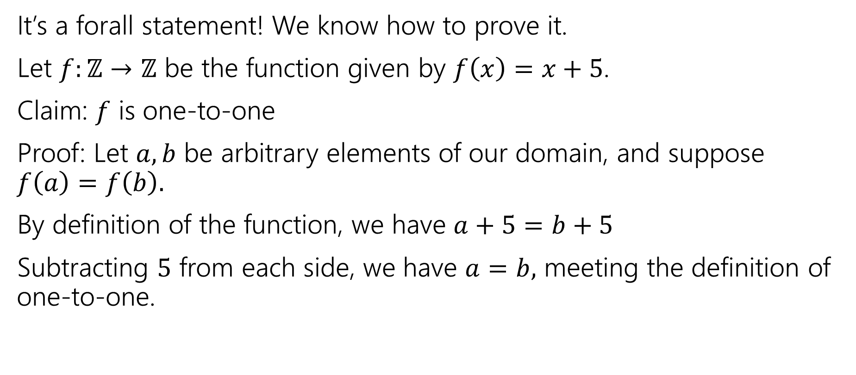
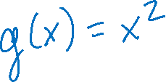
One-to-one proofs - complete
It’s a forall statement! We know how to prove it.
Let $f:ℤ→ℤ$ be the function given by $f\left(x\right)=x+5$.
Claim: $f$ is one-to-one
Proof: Let $a,b$ be arbitrary elements of our domain, and suppose $f\left(a\right)=f\left(b\right).$
By definition of the function, we have $a+5=b+5$
Subtracting $5$ from each side, we have $a=b,$ meeting the definition of one-to-one.
A function $f$ is one-to-one iff
$$∀a∀b(f\left(a\right)=f\left(b\right)→a=b)$$
One-to-one (aka injection)

Slide 11


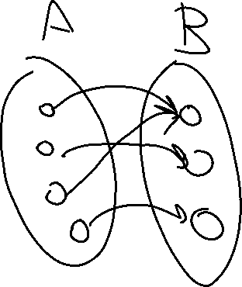

Onto (surjection) - definition
A function $f:A→B$ maps every element of $A$ to one element of $B$
$A$ is the “domain”, $B$ is the “co-domain”
Every output has at least one input that maps to it.
A function $f:A→B$ is onto iff
$$∀b∈B∃a∈A(b=f(a))$$
Onto (aka surjection)

Slide 12
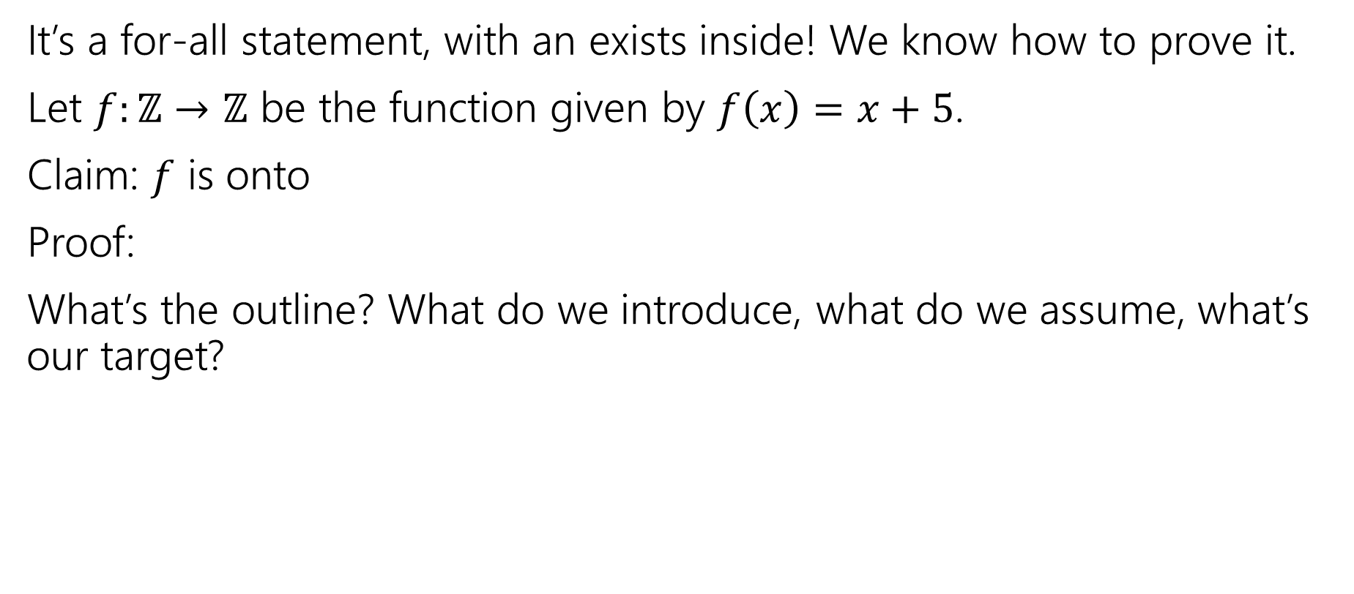
Onto proofs - structure
It’s a for-all statement, with an exists inside! We know how to prove it.
Let $f:ℤ→ℤ$ be the function given by $f\left(x\right)=x+5$.
Claim: $f$ is onto
Proof:
What’s the outline? What do we introduce, what do we assume, what’s our target?
A function $f:A→B$ is onto iff
$$∀b∈B∃a∈A(b=f(a))$$
Onto (aka surjection)

Slide 13
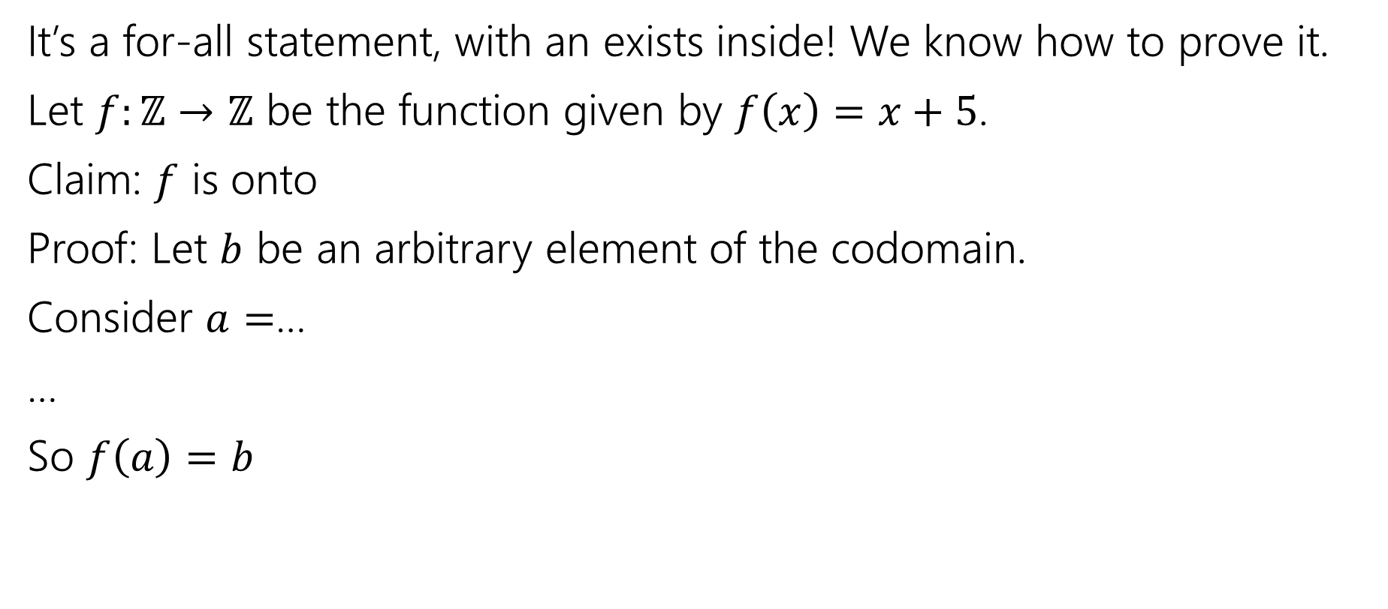
Onto proofs - skeleton
It’s a for-all statement, with an exists inside! We know how to prove it.
Let $f:ℤ→ℤ$ be the function given by $f\left(x\right)=x+5$.
Claim: $f$ is onto
Proof: Let $b$ be an arbitrary element of the codomain.
Consider $a=$…
…
So $f\left(a\right)=b$
A function $f:A→B$ is onto iff
$$∀b∈B∃a∈A(b=f(a))$$
Onto (aka surjection)

Slide 14
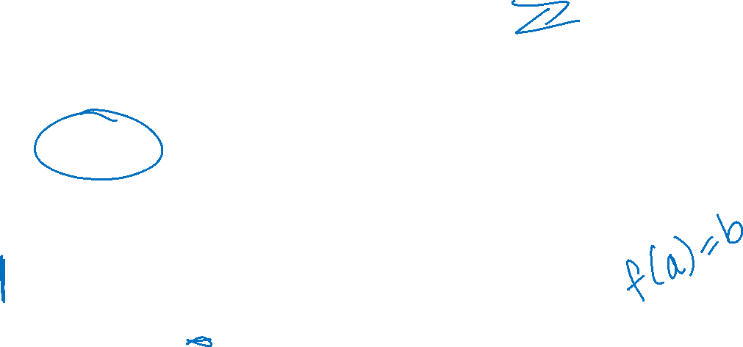
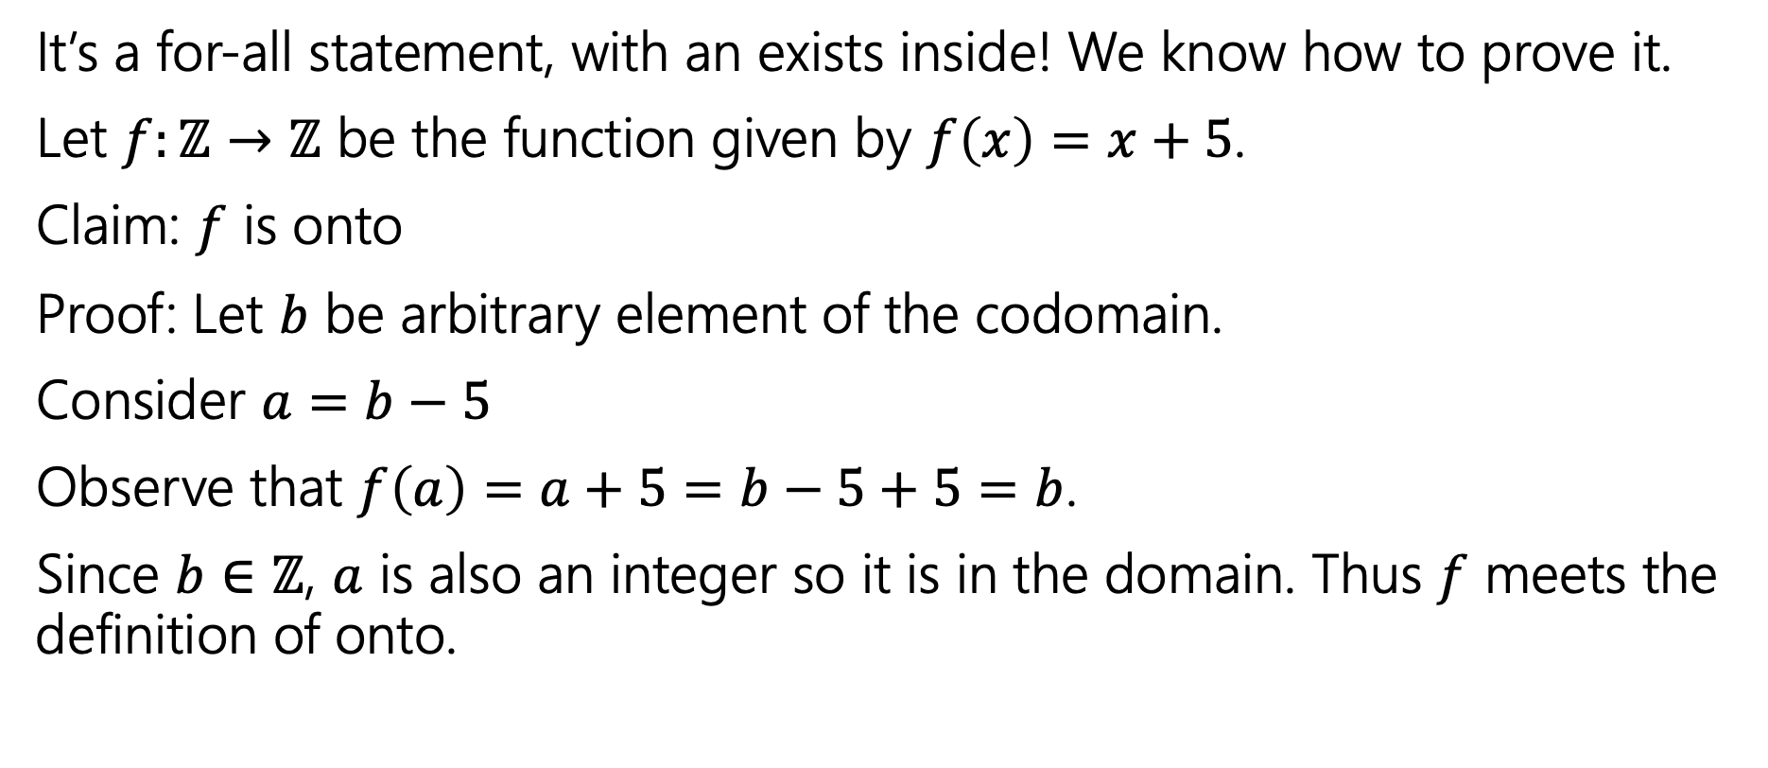

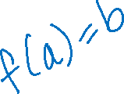
Onto proofs - complete
It’s a for-all statement, with an exists inside! We know how to prove it.
Let $f:ℤ→ℤ$ be the function given by $f\left(x\right)=x+5$.
Claim: $f$ is onto
Proof: Let $b$ be arbitrary element of the codomain.
Consider $a=b−5$
Observe that $f\left(a\right)=a+5=b−5+5=b$.
Since $b∈ℤ$, $a$ is also an integer so it is in the domain. Thus $f$ meets the definition of onto.
A function $f:A→B$ is onto iff
$$∀b∈B∃a∈A(b=f(a))$$
Onto (aka surjection)

Slide 15


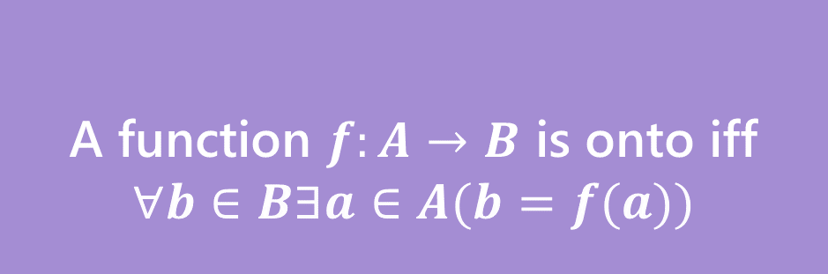
Bijection
A function $f$ is one-to-one iff
$$∀a∀b(f\left(a\right)=f\left(b\right)→a=b)$$
A function $f:A→B$ is onto iff
$$∀b∈B∃a∈A(b=f(a))$$
One-to-one (aka injection)
Onto (aka surjection)
A function $f:A→B$ is a bijection iff
$f$ is one-to-one and onto
Bijection
A bijection maps every element of the domain to exactly one element of the co-domain, and every element of the codomain to exactly one element of the domain.

Slide 16

Sizes of sets
How do we know two sets are the same size?
Easy. Count the number of elements in both.
That works great for finite sets, but $∞$ isn’t really a number we get to count to…

Slide 17










More Practical (setup)
What does it mean that two sets have the same size?

Slide 18


More Practical (mapping)
What does it mean that two sets have the same size?

Slide 19
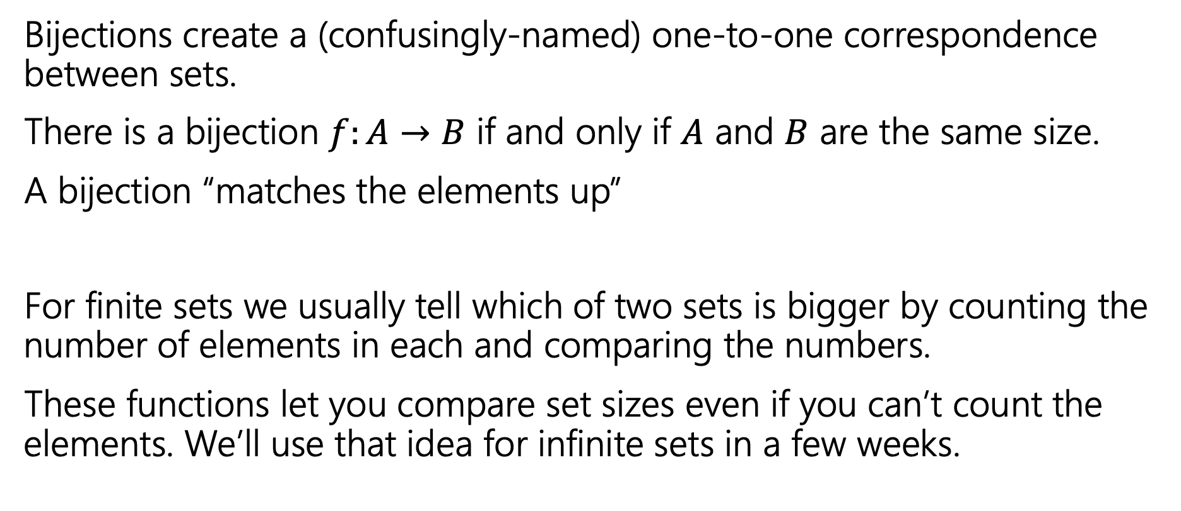
Why do we care about bijections?
Bijections create a (confusingly-named) one-to-one correspondence between sets.
There is a bijection $f:A→B$ if and only if $A$ and $B$ are the same size.
A bijection “matches the elements up”
For finite sets we usually tell which of two sets is bigger by counting the number of elements in each and comparing the numbers.
These functions let you compare set sizes even if you can’t count the elements. We’ll use that idea for infinite sets in a few weeks.

Slide 20
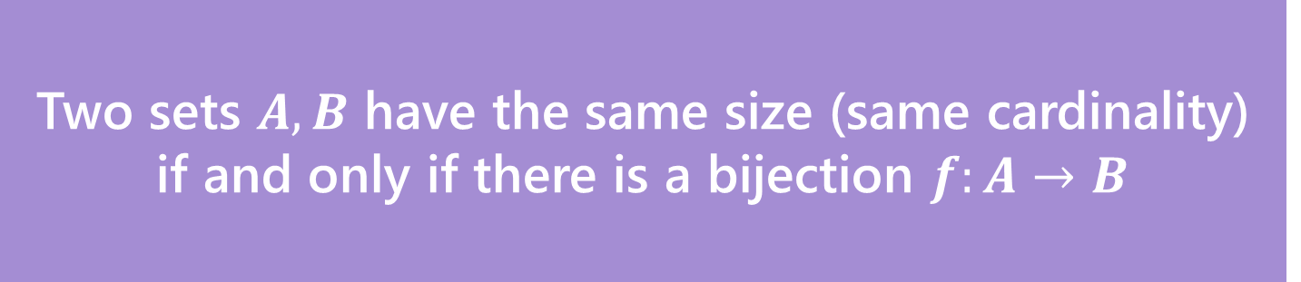
Definition
Two sets $A,B$ have the same size (same cardinality) if and only if there is a bijection $f:A→B$
This matches our intuition on finite sets.
But it also works for infinite sets!
Let’s see just how infinite these sets are.

Slide 21
Some infinite sets - comparisons
Two sets $A,B$ have the same size (same cardinality) if and only if there is a bijection $f:A→B$
Let’s compare the sizes of: $ℕ$, $ℤ,$ $\{x :x$is an even integer$\}$

Slide 22


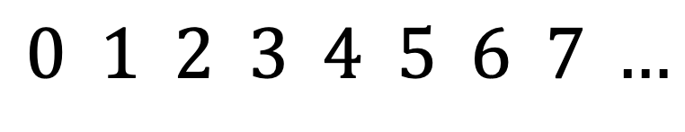

Some infinite sets ($ℕ$, $ℤ$)
Two sets $A,B$ have the same size (same cardinality) if and only if there is a bijection $f:A→B$
Let’s compare the sizes of: $ℕ$, $ℤ,$ $\{x :x$is an even integer$\}$
$$ℕ$$
$$0 1 2 3 4 5 6 7 …$$
$$ℤ$$

Slide 23



Some infinite sets ($ℤ,$ $\{x :x$is an even integer$\}$)
Two sets $A,B$ have the same size (same cardinality) if and only if there is a bijection $f:A→B$
Let’s compare the sizes of: $ℕ$, $ℤ,$ $\{x :x$is an even integer$\}$
$$ℤ$$
$$…,−3, −2, −1, 0, 1, 2, 3,…$$
$$Even$$

Slide 24


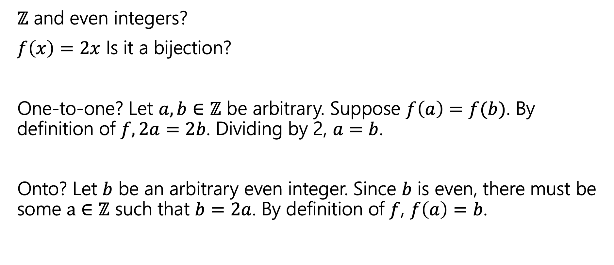
They’re all the same size ($ℤ$ and even integers)
$ℤ$ and even integers?
$f\left(x\right)=2x$ Is it a bijection?
One-to-one? Let $a,b∈ℤ$ be arbitrary. Suppose $f\left(a\right)=f(b)$. By definition of $f, 2a=2b$. Dividing by 2, $a=b$.
Onto? Let $b$ be an arbitrary even integer. Since $b$ is even, there must be some $a∈ℤ$ such that $b=2a$. By definition of $f$, $f\left(a\right)=b$.

Slide 25



They’re all the same size ($ℕ$ and $ℤ$ setup)
$ℤ$ and even integers?
$f\left(x\right)=2x$ Is it a bijection?
YES
$ℕ$ and $ℤ$?

Slide 26


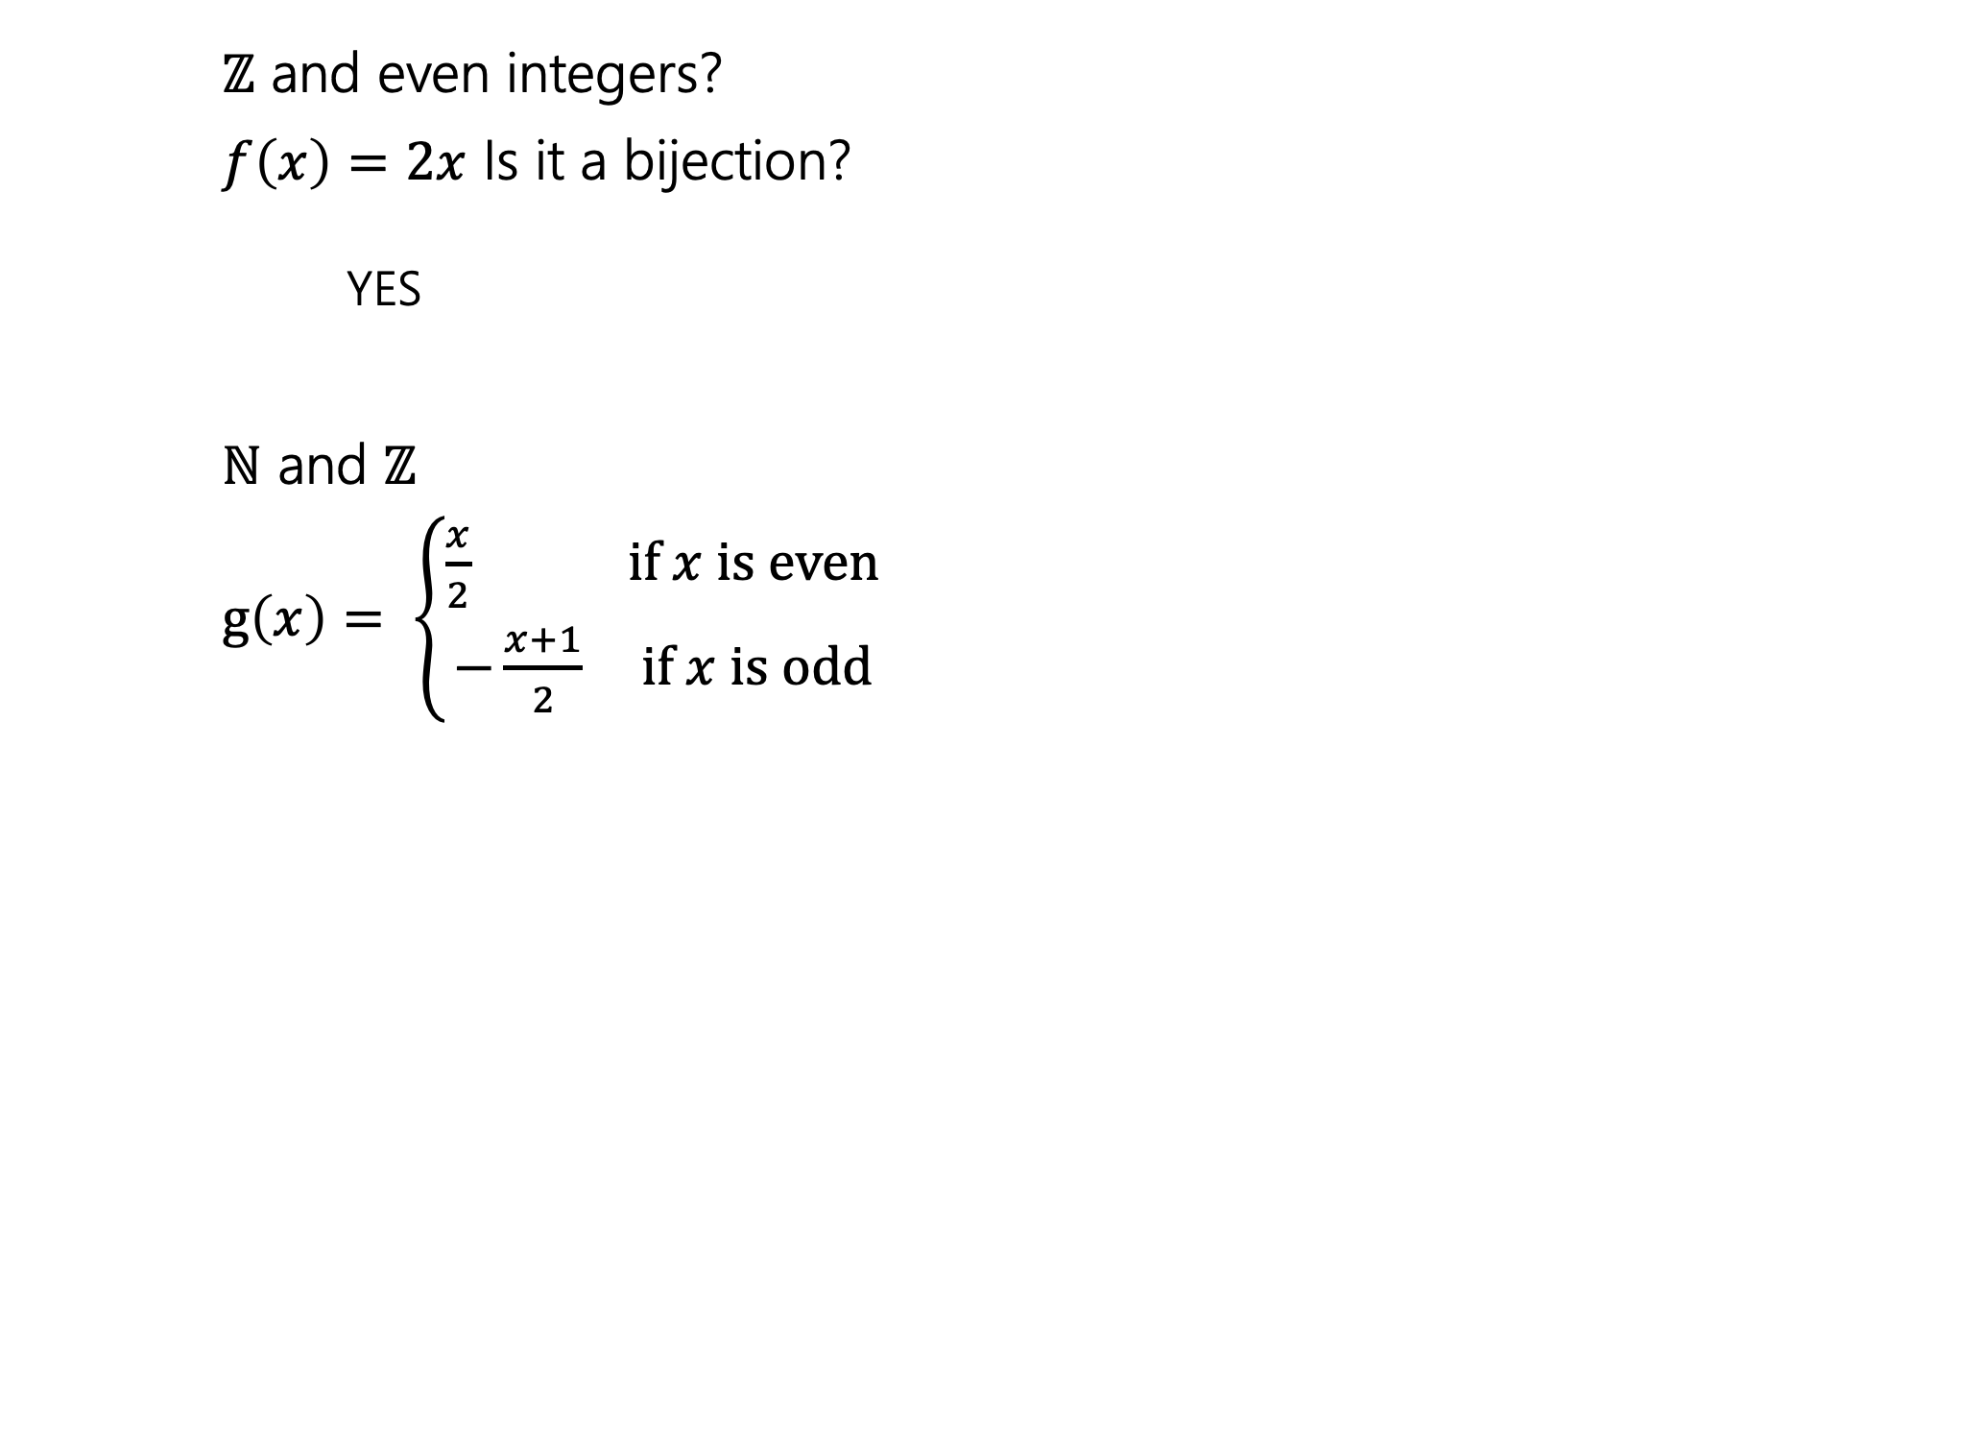
They’re all the same size ($ℕ$ and $ℤ$)
$ℤ$ and even integers?
$f\left(x\right)=2x$ Is it a bijection?
YES
$ℕ$ and $ℤ$
$g\left(x\right)= \left\{\begin{aligned}\frac{x}{2} if x is even \\ −\frac{x+1}{2} if x is odd\end{aligned}\right.$

Slide 27
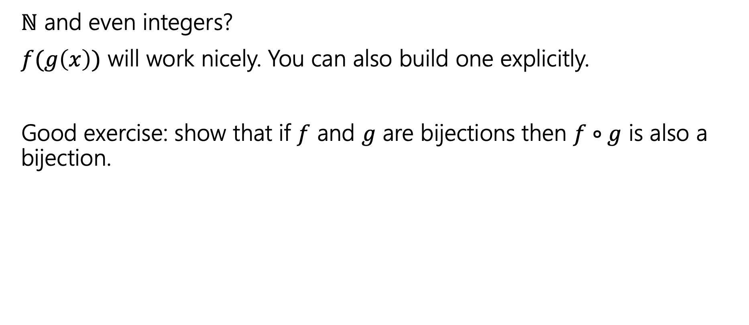
They’re all the same size ($ℕ$ and even integers)
$ℕ$ and even integers?
$f(g\left(x\right))$ will work nicely. You can also build one explicitly.
Good exercise: show that if $f$ and $g$ are bijections then $f∘g$ is also a bijection.

Slide 28




They’re all the same size (composition)
$ℕ$ and even integers?
$f(g\left(x\right))$ will work nicely. You can also build one explicitly.
Good exercise: show that if $f$ and $g$ are bijections then $f∘g$ is also a bijection.

Slide 29
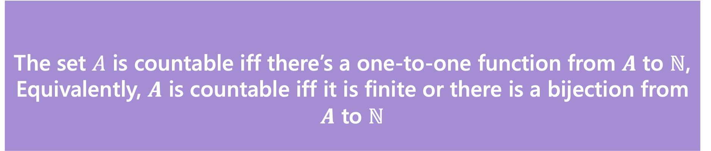
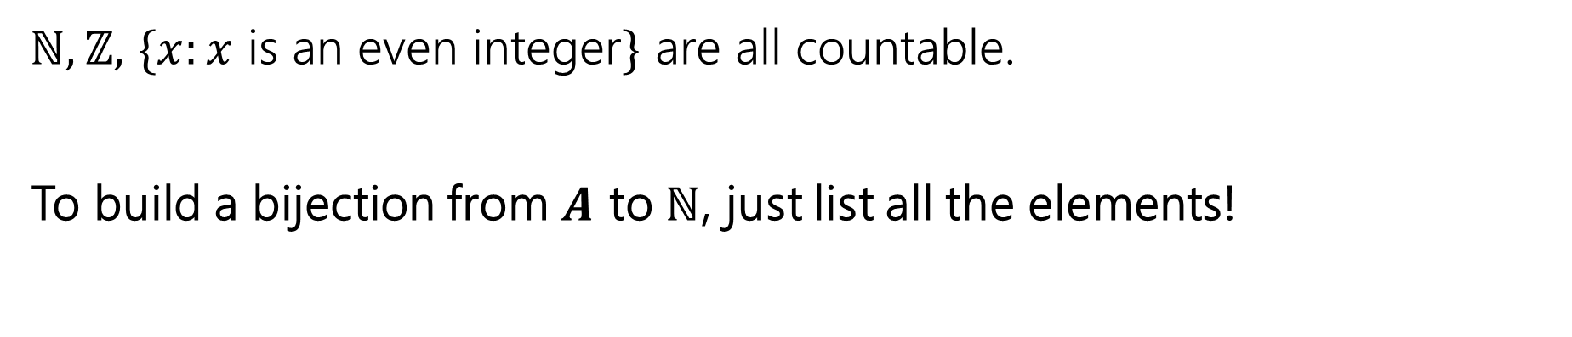
Countable
The set $A$ is countable iff there’s a one-to-one function from $A$ to $ℕ$,
Equivalently, $A$ is countable iff it is finite or there is a bijection from $A$ to $ℕ$
Countable
$ℕ,ℤ,$ $\{x:x$ is an even integer$\}$ are all countable.
To build a bijection from $A$ to $ℕ$, just list all the elements!

Slide 30
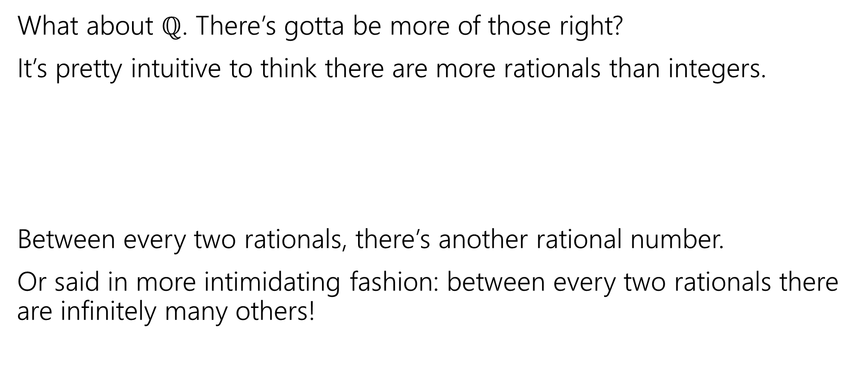
Let’s Try one that’s a little harder
What about $ℚ$. There’s gotta be more of those right?
It’s pretty intuitive to think there are more rationals than integers.
Between every two rationals, there’s another rational number.
Or said in more intimidating fashion: between every two rationals there are infinitely many others!
0
1

Slide 31

The set of positive rational numbers
1/1 | 1/2 | 1/3 | 1/4 | 1/5 | 1/6 | 1/7 | 1/8 | ...
2/1 | 2/2 | 2/3 | 2/4 | 2/5 | 2/6 | 2/7 | 2/8 | ...
3/1 | 3/2 | 3/3 | 3/4 | 3/5 | 3/6 | 3/7 | 3/8 | ...
4/1 | 4/2 | 4/3 | 4/4 | 4/5 | 4/6 | 4/7 | 4/8 | ...
5/1 | 5/2 | 5/3 | 5/4 | 5/5 | 5/6 | 5/7 | ...
6/1 | 6/2 | 6/3 | 6/4 | 6/5 | 6/6 | ...
7/1 | 7/2 | 7/3 | 7/4 | 7/5 | ....
... | ... | ... | ... | ...

Slide 32
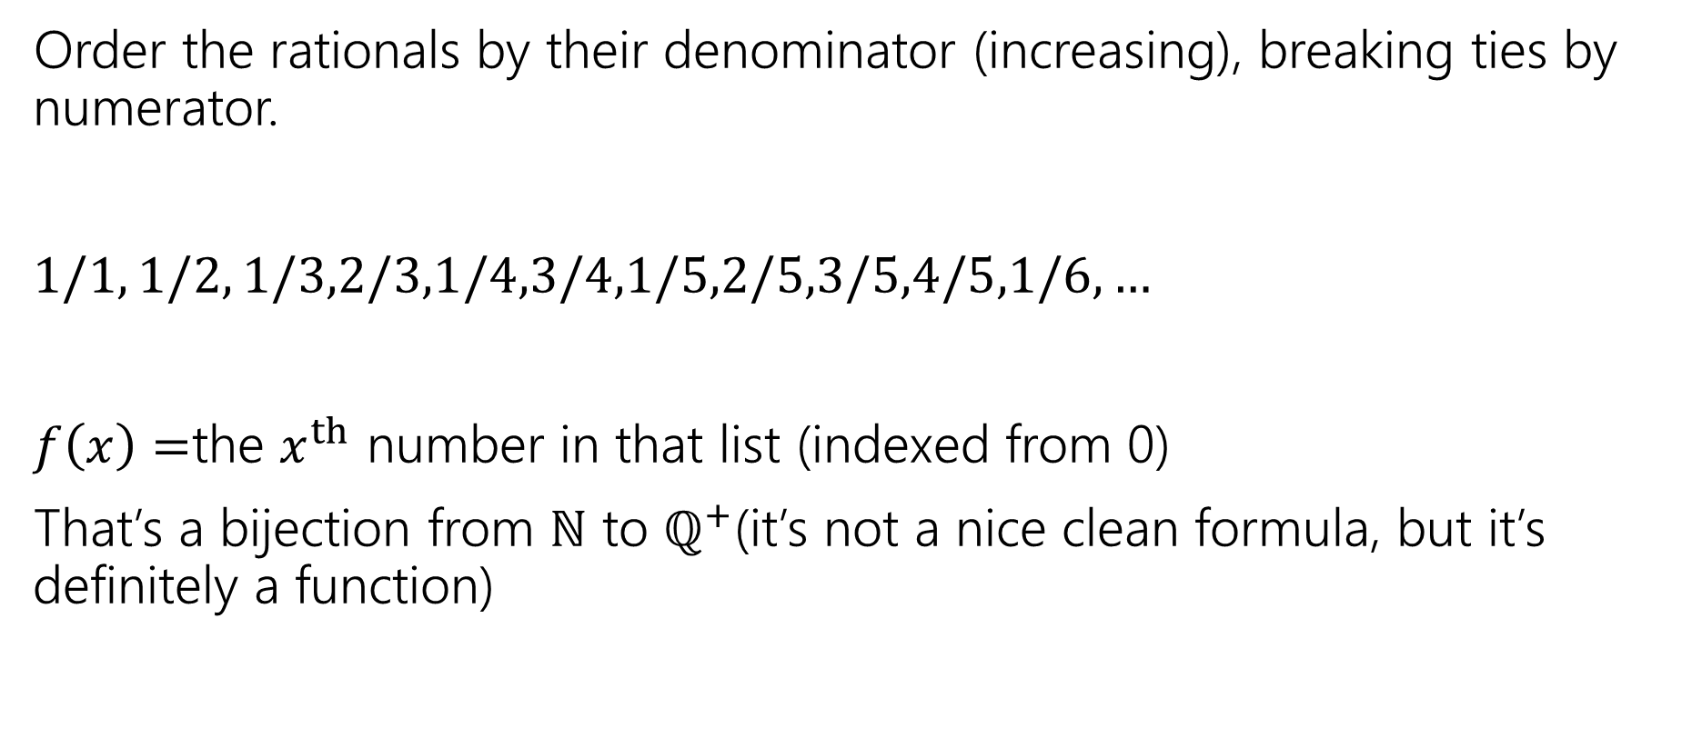
In bijection with the natural numbers
Order the rationals by their denominator (increasing), breaking ties by numerator.
$1/1, 1/2, 1/3,2/3,1/4,3/4,1/5,2/5,3/5,4/5,1/6,…$
$f\left(x\right)=$the $x^{th}$ number in that list (indexed from 0)
That’s a bijection from $ℕ$ to $ℚ^{+}$(it’s not a nice clean formula, but it’s definitely a function)

Slide 33

Are all infinite sets countable?
No. We will prove this in a few weeks.
$ℝ$ is uncountable

Slide 34
Graphs

Slide 35


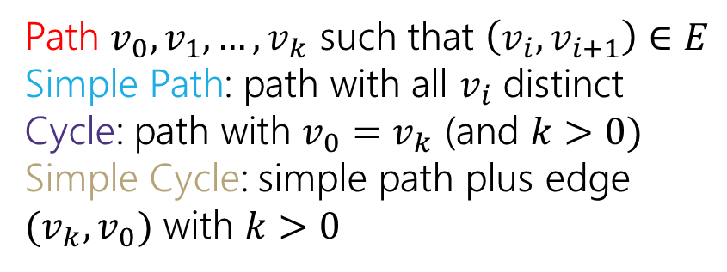
Directed Graphs definitions
$G=(V,E)$
$V$is a set of vertices (an underlying set of elements)
$E$ is a set of edges (ordered pairs of vertices; i.e. connections from one to the next).
Path $v_{0},v_{1},…,v_{k}$ such that $\left(v_{i},v_{i+1}\right)∈E$
Simple Path: path with all $v_{i}$ distinct
Cycle: path with $v_{0}=v_{k}$ (and $k>0)$
Simple Cycle: simple path plus edge ${(v}_{k},v_{0})$ with $k>0$

Slide 36

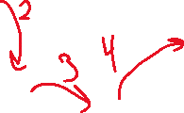


Directed Graphs (path)
$G=(V,E)$
$V$is a set of vertices (an underlying set of elements)
$E$ is a set of edges (ordered pairs of vertices; i.e. connections from one to the next).
Path $v_{0},v_{1},…,v_{k}$ such that $\left(v_{i},v_{i+1}\right)∈E$
Simple Path: path with all $v_{i}$ distinct
Cycle: path with $v_{0}=v_{k}$ (and $k>0)$
Simple Cycle: simple path plus edge ${(v}_{k},v_{0})$ with $k>0$

Slide 37

Directed Graphs (simple path)
$G=(V,E)$
$V$is a set of vertices (an underlying set of elements)
$E$ is a set of edges (ordered pairs of vertices; i.e. connections from one to the next).
Path $v_{0},v_{1},…,v_{k}$ such that $\left(v_{i},v_{i+1}\right)∈E$
Simple Path: path with all $v_{i}$ distinct
Cycle: path with $v_{0}=v_{k}$ (and $k>0)$
Simple Cycle: simple path plus edge ${(v}_{k},v_{0})$ with $k>0$

Slide 38
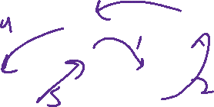

Directed Graphs (cycle)
$G=(V,E)$
$V$is a set of vertices (an underlying set of elements)
$E$ is a set of edges (ordered pairs of vertices; i.e. connections from one to the next).
Path $v_{0},v_{1},…,v_{k}$ such that $\left(v_{i},v_{i+1}\right)∈E$
Simple Path: path with all $v_{i}$ distinct
Cycle: path with $v_{0}=v_{k}$ (and $k>0)$
Simple Cycle: simple path plus edge ${(v}_{k},v_{0})$ with $k>0$

Slide 39


Directed Graphs (simple cycle)
$G=(V,E)$
$V$is a set of vertices (an underlying set of elements)
$E$ is a set of edges (ordered pairs of vertices; i.e. connections from one to the next).
Path $v_{0},v_{1},…,v_{k}$ such that $\left(v_{i},v_{i+1}\right)∈E$
Simple Path: path with all $v_{i}$ distinct
Cycle: path with $v_{0}=v_{k}$ (and $k>0)$
Simple Cycle: simple path plus edge ${(v}_{k},v_{0})$ with $k>0$

Slide 40
Extra examples
The 2nd and 3rd problems might be good review for the midterm ☺

Slide 41

Draw the graph! (setup)
Let $G=\left(V,E\right)$.
V = {1, 2, 3, 4}
E = {(1, 1), (1, 2), (2, 3), (3, 4), (4, 1)}
Is there a cycle?
Is there a simple cycle?

Slide 42

Draw the graph! (complete)
Let $G=\left(V,E\right)$.
V = {1, 2, 3, 4}
E = {(1, 1), (1, 2), (2, 3), (3, 4), (4, 1)}
Is there a cycle?
Is there a simple cycle?
Yes to both! Consider 1, 2, 3, 4, 1.
1
2
3
4

Slide 43
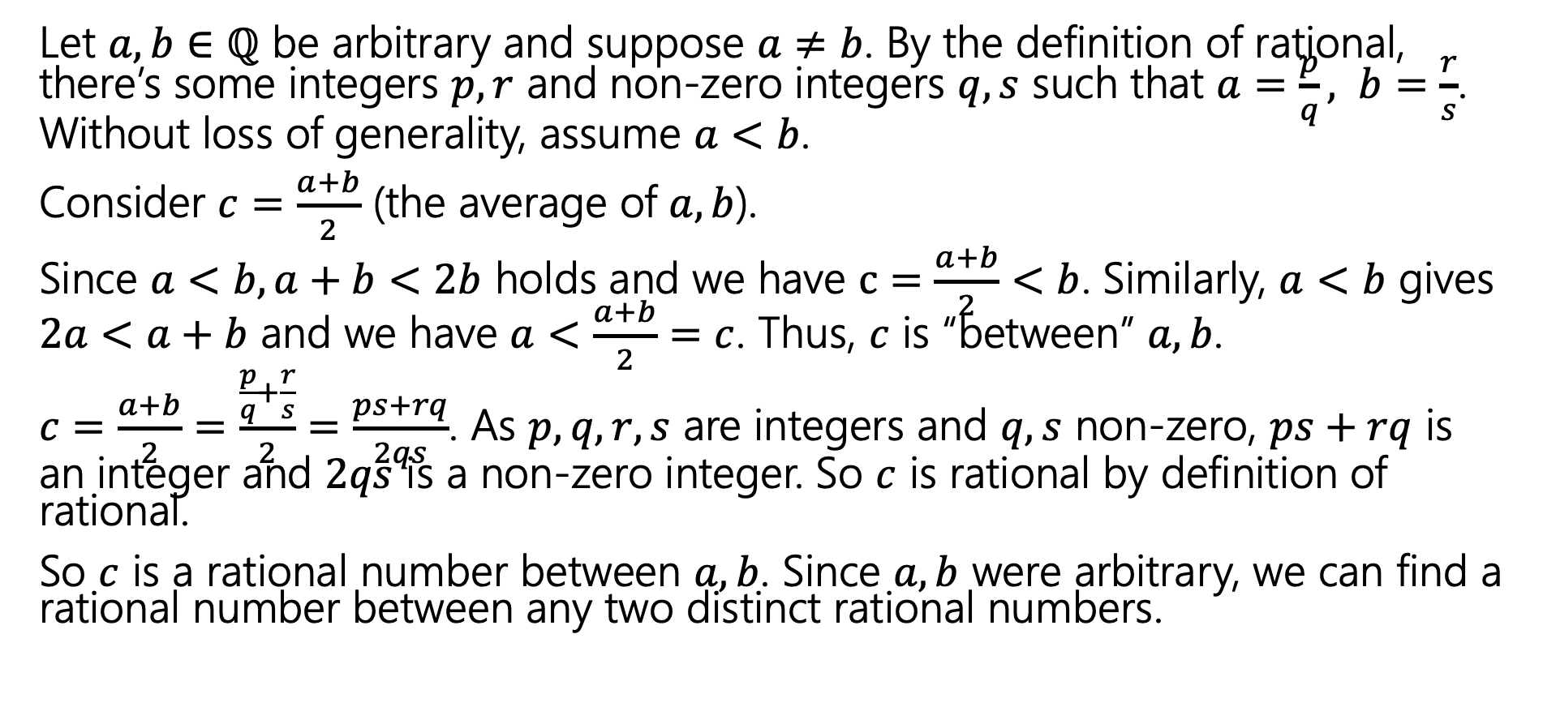
Between every two distinct rationals, there’s another rational number.
Let $a, b∈ℚ$ be arbitrary and suppose $a≠b$. By the definition of rational, there’s some integers $p,r$ and non-zero integers $q, s$ such that $a=\frac{p}{q}, b=\frac{r}{s}$. Without loss of generality, assume $a<b$.
Consider $c=\frac{a+b}{2}$ (the average of $a, b$).
Since $a<b, a+b<2b$ holds and we have $c=\frac{a+b}{2}<b$. Similarly, $a<b$ gives $2a<a+b$ and we have $a<\frac{a+b}{2}=c$. Thus, $c$ is “between” $a, b$.
$c=\frac{a+b}{2}=\frac{\frac{p}{q}+\frac{r}{s}}{2}=\frac{ps+rq}{2qs}$. As $p,q, r,s$ are integers and $q,s$ non-zero, $ps+rq$ is an integer and $2qs$ is a non-zero integer. So $c$ is rational by definition of rational.
So $c$ is a rational number between $a, b$. Since $a, b$ were arbitrary, we can find a rational number between any two distinct rational numbers.

Slide 44
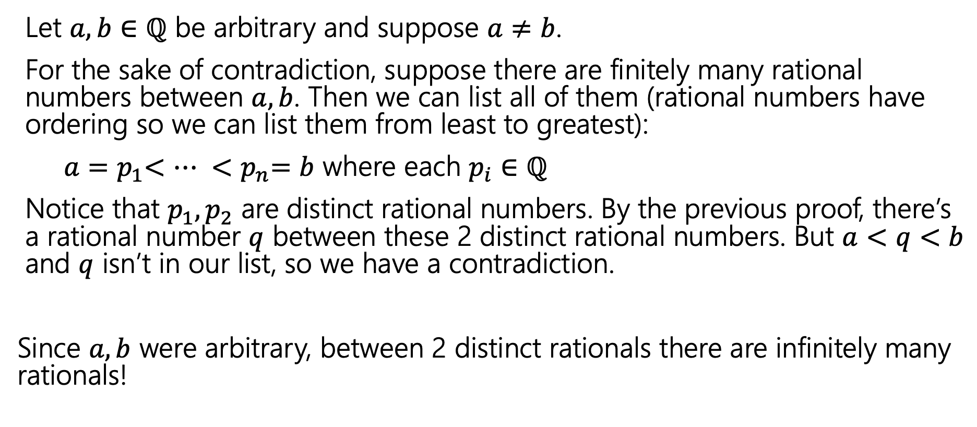
There are infinitely many rational numbers between any two distinct rational numbers.
Let $a, b∈ℚ$ be arbitrary and suppose $a≠b$.
For the sake of contradiction, suppose there are finitely many rational numbers between $a, b$. Then we can list all of them (rational numbers have ordering so we can list them from least to greatest):
$a{=p}_{1}<… {<p}_{n}=b$ where each $p_{i}∈ℚ$
Notice that $p_{1}, p_{2}$ are distinct rational numbers. By the previous proof, there’s a rational number $q$ between these 2 distinct rational numbers. But $a<q<b$ and $q$ isn’t in our list, so we have a contradiction.
Since $a, b$ were arbitrary, between 2 distinct rationals there are infinitely many rationals!

Slide 45
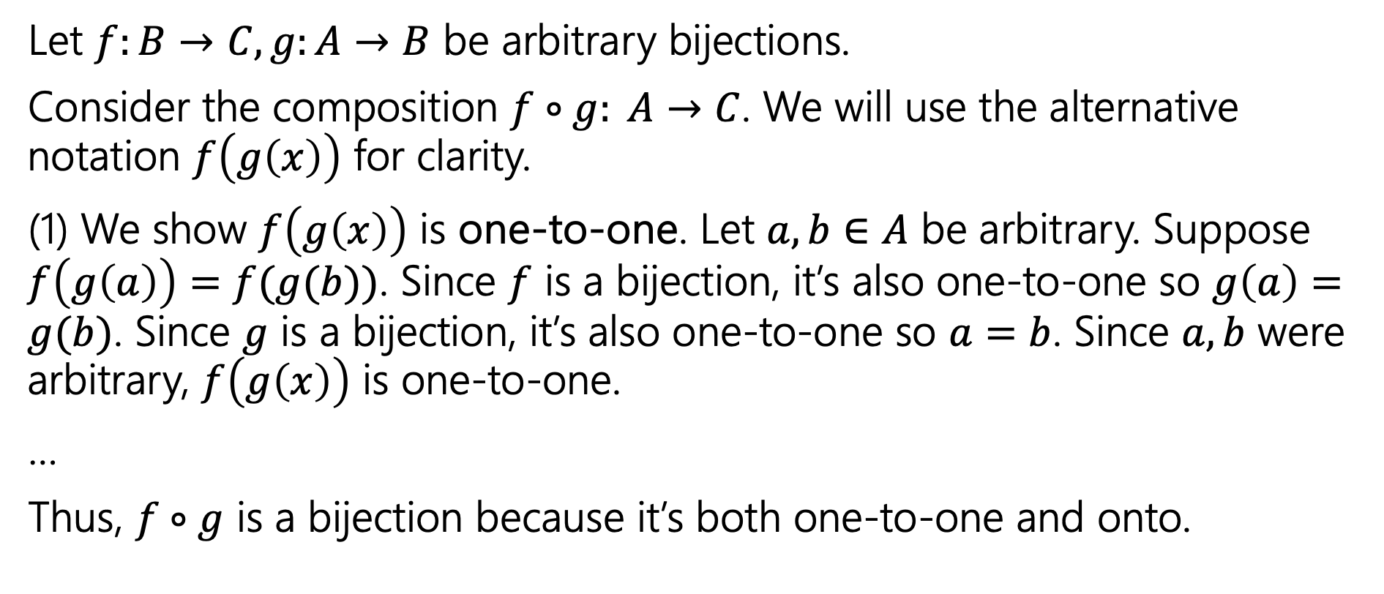
Composition of 2 bijections is a bijection (1)
Let $f:B→C, g:A→B$ be arbitrary bijections.
Consider the composition $f∘g: A→C$. We will use the alternative notation $f\left(g\left(x\right)\right)$ for clarity.
(1) We show $f\left(g\left(x\right)\right)$ is one-to-one. Let $a, b∈A$ be arbitrary. Suppose $f\left(g\left(a\right)\right)=f(g(b))$. Since $f$ is a bijection, it’s also one-to-one so $g\left(a\right)=g(b)$. Since $g$ is a bijection, it’s also one-to-one so $a=b$. Since $a, b$ were arbitrary, $f\left(g\left(x\right)\right)$ is one-to-one.
…
Thus, $f∘g$ is a bijection because it’s both one-to-one and onto.

Slide 46
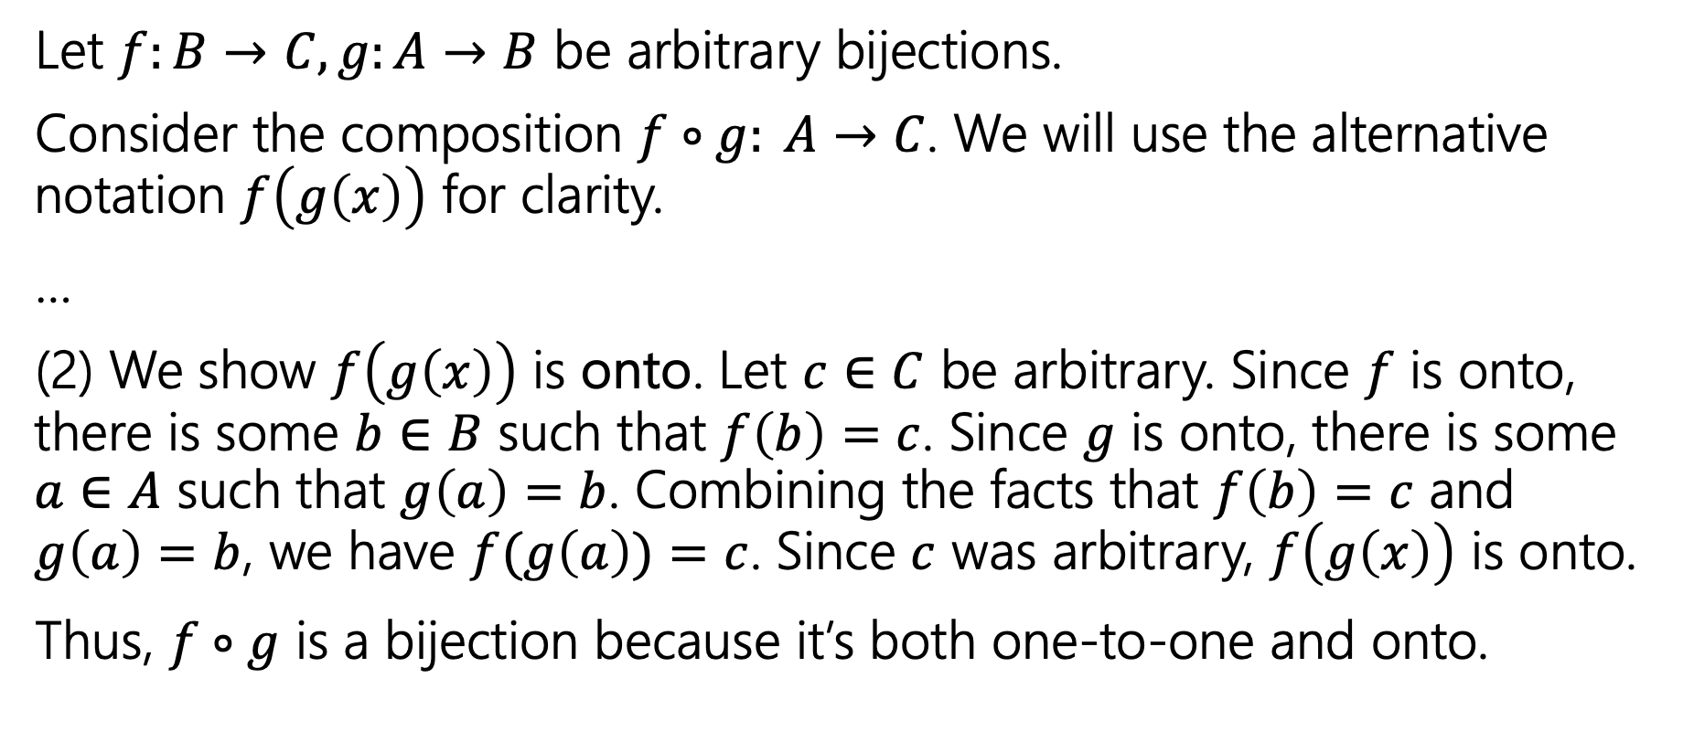
Composition of 2 bijections is a bijection (2)
Let $f:B→C, g:A→B$ be arbitrary bijections.
Consider the composition $f∘g: A→C$. We will use the alternative notation $f\left(g\left(x\right)\right)$ for clarity.
…
(2) We show $f\left(g\left(x\right)\right)$ is onto. Let $c∈C$ be arbitrary. Since $f$ is onto, there is some $b∈B$ such that $f\left(b\right)=c$. Since $g$ is onto, there is some $a∈A$ such that $g\left(a\right)=b$. Combining the facts that $f\left(b\right)=c$ and $g\left(a\right)=b$, we have $f(g\left(a\right))=c$. Since $c$ was arbitrary, $f\left(g\left(x\right)\right)$ is onto.
Thus, $f∘g$ is a bijection because it’s both one-to-one and onto.

Slide 47
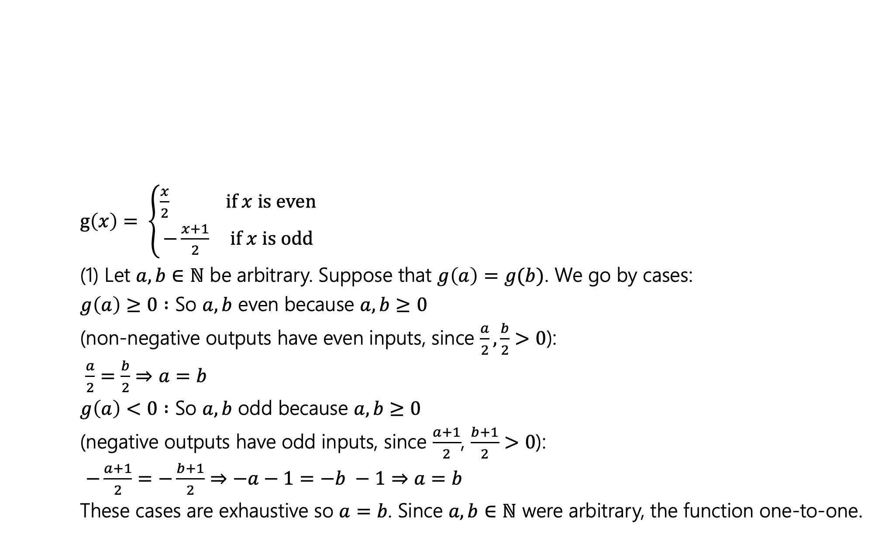
Show that the following function is a bijection (1)
$g\left(x\right)= \left\{\begin{aligned}\frac{x}{2} if x is even \\ −\frac{x+1}{2} if x is odd\end{aligned}\right.$
(1) Let $a, b∈ℕ$ be arbitrary. Suppose that $g\left(a\right)=g(b)$. We go by cases:
$g\left(a\right)≥0 :$ So $a, b$ even because $a, b≥0$
(non-negative outputs have even inputs, since $\frac{a}{2},\frac{b}{2}>0$):
$\frac{a}{2}=\frac{b}{2}⇒a=b$
$g\left(a\right)<0 :$ So $a, b$ odd because $a, b≥0$
(negative outputs have odd inputs, since $\frac{a+1}{2}$, $\frac{b+1}{2}>0$):
$−\frac{a+1}{2}=−\frac{b+1}{2}⇒−a−1=−b −1⇒a=b$
These cases are exhaustive so $a=b$. Since $a, b∈ℕ$ were arbitrary, the function one-to-one.

Slide 48
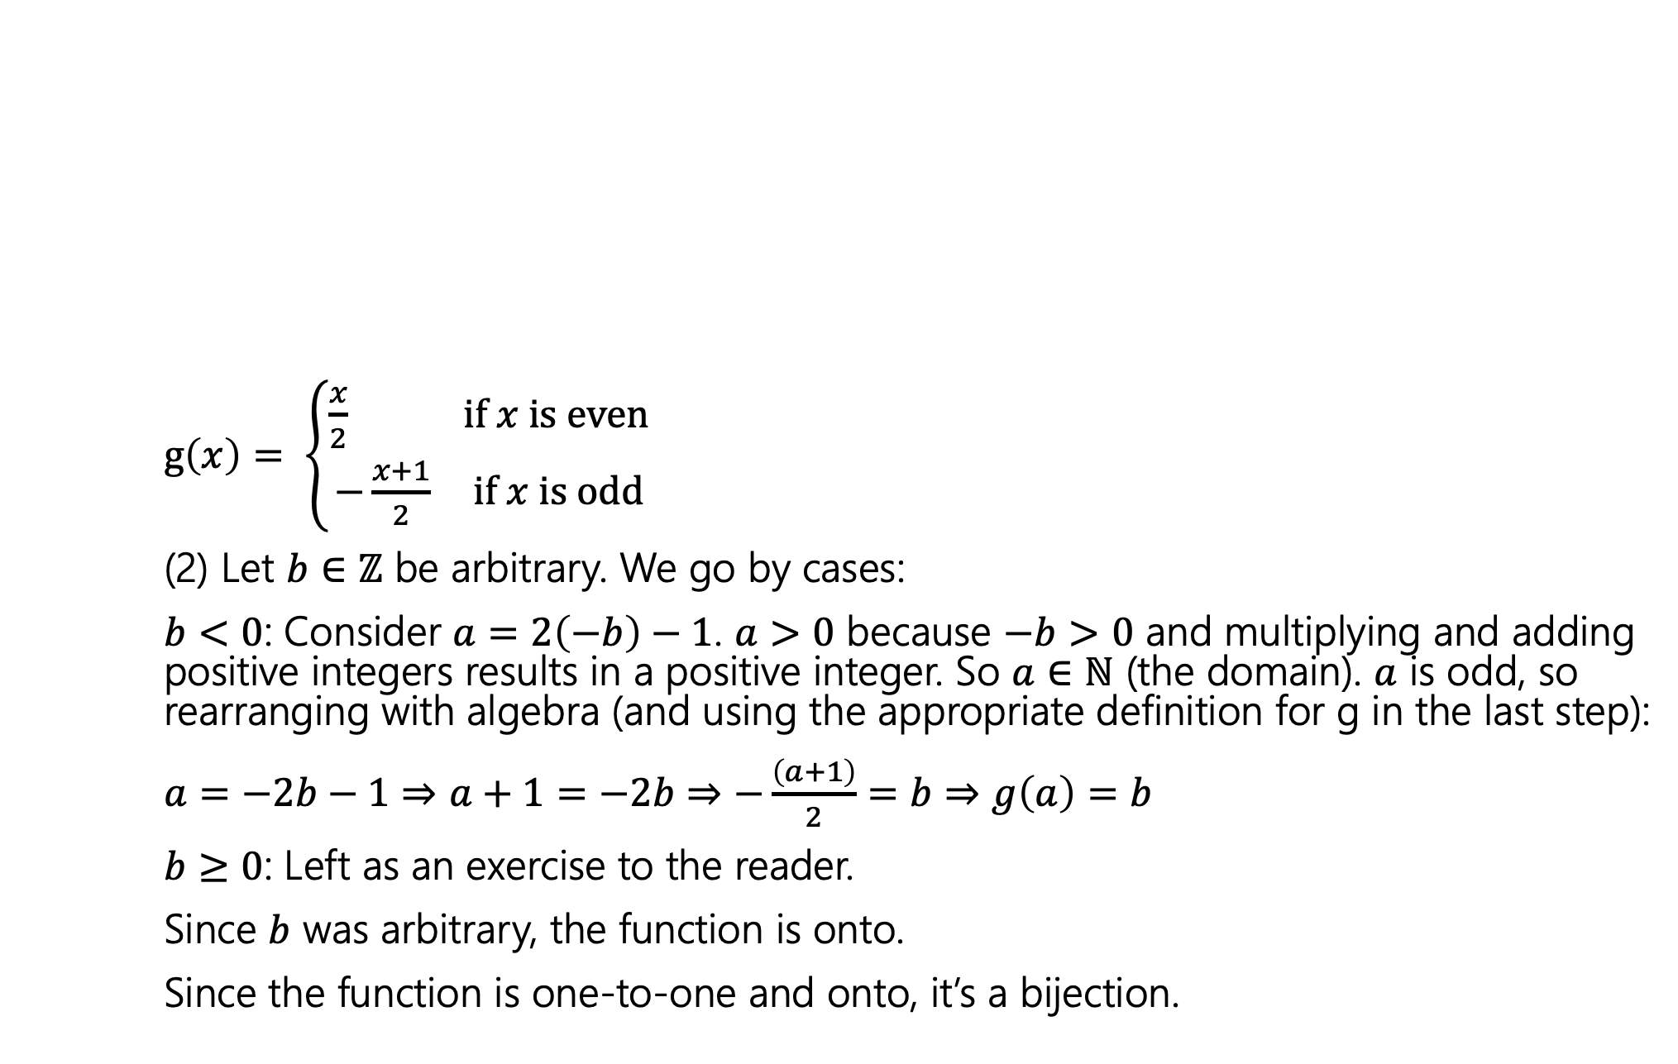
Show that the following function is a bijection (2)
$g\left(x\right)= \left\{\begin{aligned}\frac{x}{2} if x is even \\ −\frac{x+1}{2} if x is odd\end{aligned}\right.$
(2) Let $b∈ℤ$ be arbitrary. We go by cases:
$b<0$: Consider $a=2\left(−b\right)−1$. $a>0$ because $−b>0$ and multiplying and adding positive integers results in a positive integer. So $a∈ℕ$ (the domain). $a$ is odd, so rearranging with algebra (and using the appropriate definition for g in the last step):
$a=−2b−1⇒a+1=−2b⇒−\frac{\left(a+1\right)}{2}=b⇒g\left(a\right)=b$
$b≥0$: Left as an exercise to the reader.
Since $b$ was arbitrary, the function is onto.
Since the function is one-to-one and onto, it’s a bijection.

