Slide 1
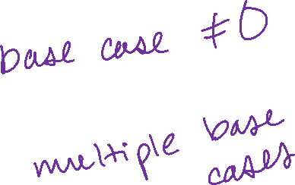
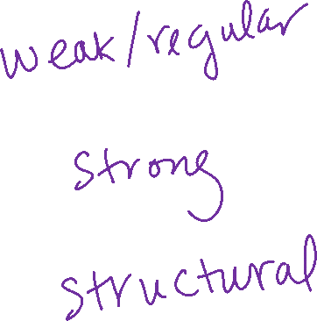
Even More Induction
CSE 311 Autumn 2025
Lecture 20

Slide 2
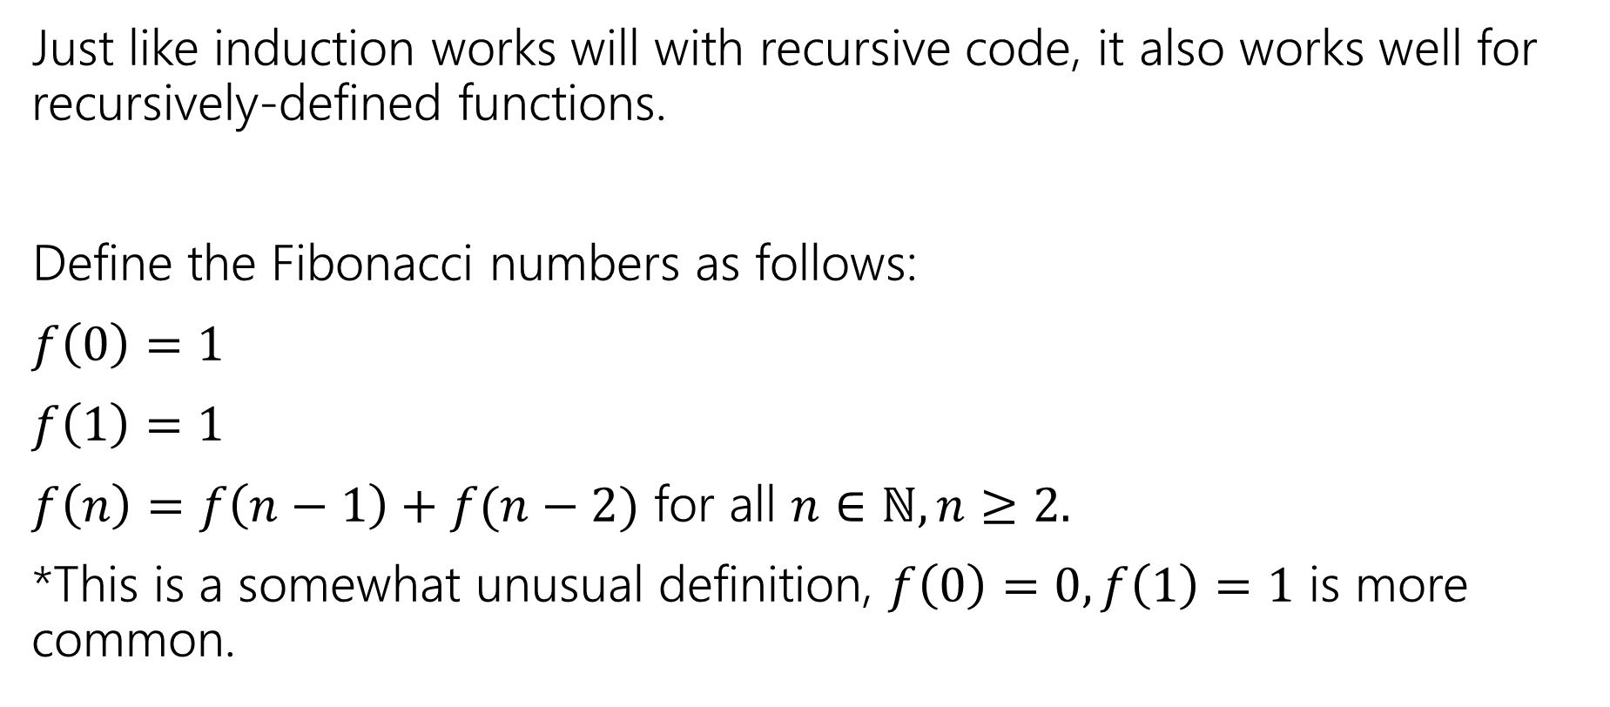

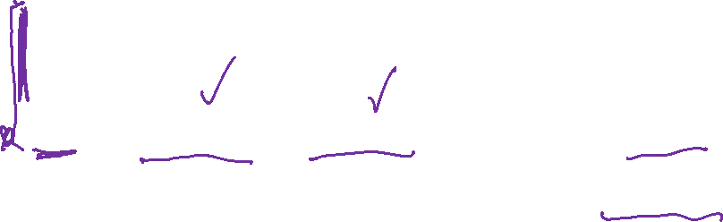
Recursively Defined Functions: Fibonacci
Just like induction works will with recursive code, it also works well for recursively-defined functions.
Define the Fibonacci numbers as follows:
$f\left(0\right)=1$
$f\left(1\right)=1$
$f\left(n\right)=f\left(n−1\right)+f(n−2)$ for all $n∈ℕ, n≥2.$
*This is a somewhat unusual definition, $f\left(0\right)=0, f\left(1\right)=1$ is more common.

Slide 3
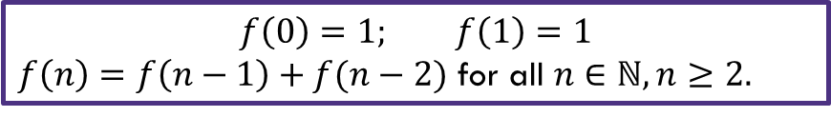

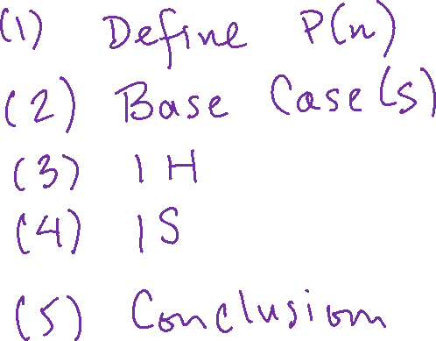
Fibonacci Inequality: goal
Show that $f\left(n\right)≤2^{n}$ for all $n≥0$by induction.
$$f\left(0\right)=1; f\left(1\right)=1$$
$f\left(n\right)=f\left(n−1\right)+f(n−2)$ for all $n∈ℕ, n≥2.$

Slide 4
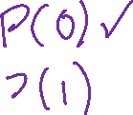
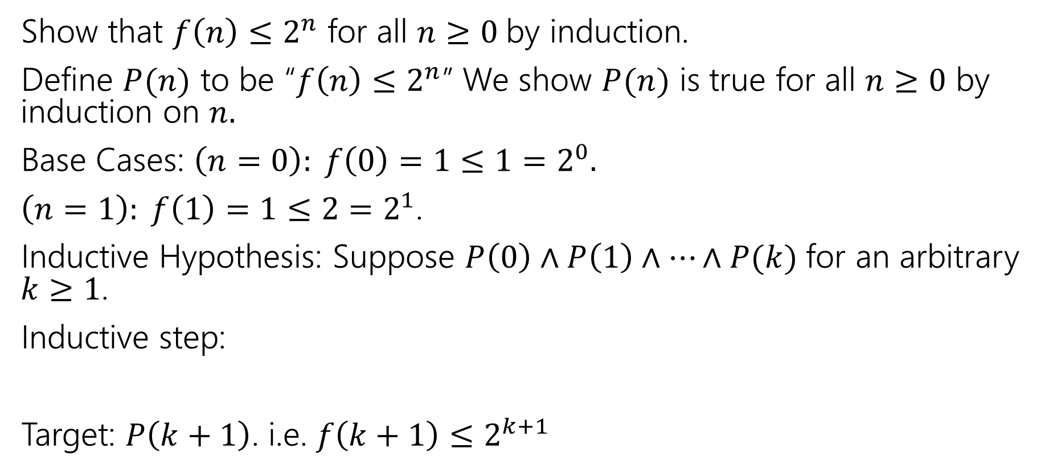
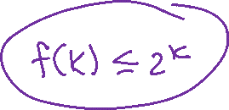
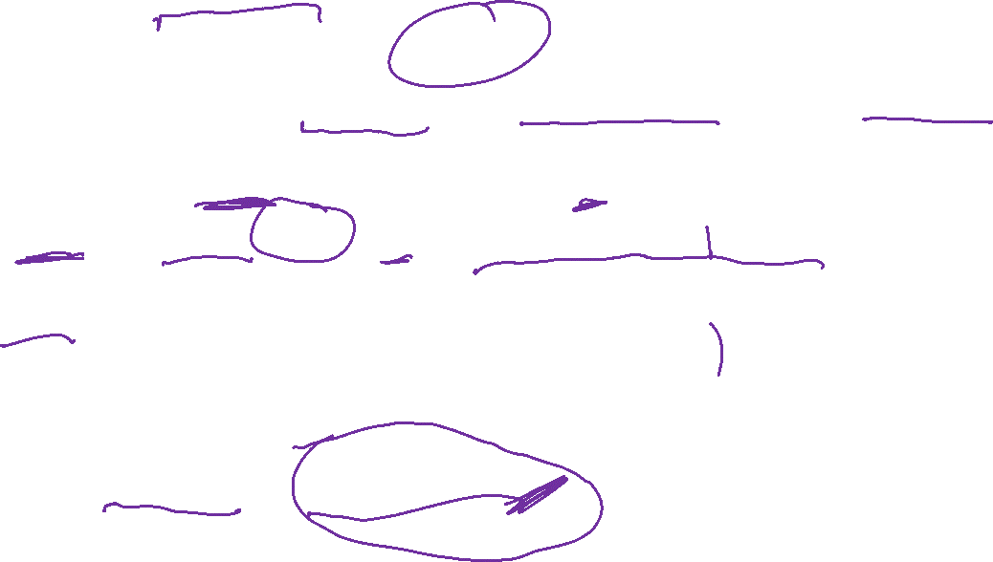
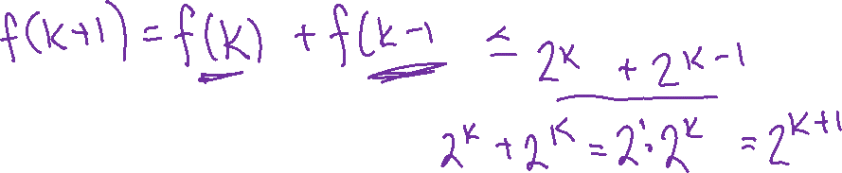
Fibonacci Inequality: skeleton
Show that $f\left(n\right)≤2^{n}$ for all $n≥0$by induction.
Define $P(n)$ to be “$f\left(n\right)≤2^{n}$” We show $P(n)$ is true for all $n≥0$ by induction on $n.$
Base Cases: $\left(n=0\right): f\left(0\right)=1≤1=2^{0}.$
$\left(n=1\right): f\left(1\right)=1≤2=2^{1}$.
Inductive Hypothesis: Suppose $P\left(0\right)∧P\left(1\right)∧⋯∧P(k)$ for an arbitrary $k≥1$.
Inductive step:
Target: $P\left(k+1\right)$. i.e. $f\left(k+1\right)≤2^{k+1}$
$$f\left(0\right)=1; f\left(1\right)=1$$
$f\left(n\right)=f\left(n−1\right)+f(n−2)$ for all $n∈ℕ, n≥2.$

Slide 5
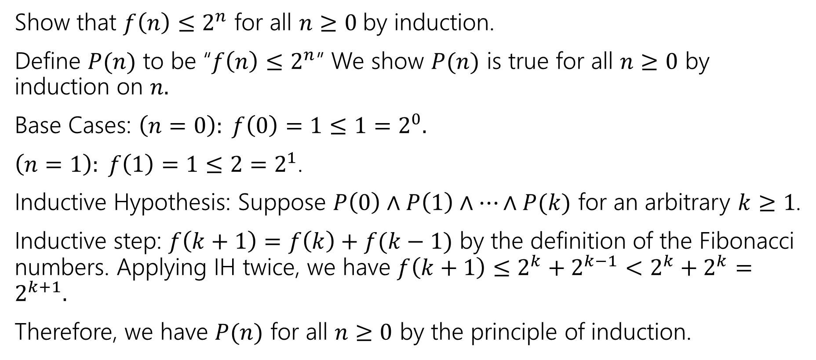
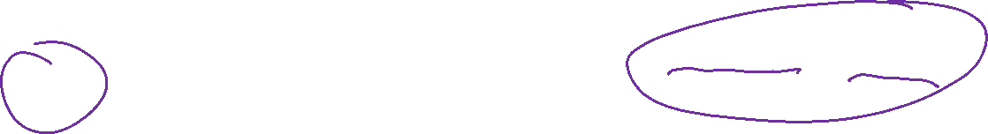
Fibonacci Inequality
Show that $f\left(n\right)≤2^{n}$ for all $n≥0$by induction.
Define $P(n)$ to be “$f\left(n\right)≤2^{n}$” We show $P(n)$ is true for all $n≥0$ by induction on $n.$
Base Cases: $\left(n=0\right): f\left(0\right)=1≤1=2^{0}.$
$\left(n=1\right): f\left(1\right)=1≤2=2^{1}$.
Inductive Hypothesis: Suppose $P\left(0\right)∧P\left(1\right)∧⋯∧P(k)$ for an arbitrary $k≥1$.
Inductive step: $f\left(k+1\right)=f\left(k\right)+f(k−1)$ by the definition of the Fibonacci numbers. Applying IH twice, we have $f\left(k+1\right)≤2^{k}+2^{k−1}<2^{k}+2^{k}=2^{k+1}.$
Therefore, we have $P(n)$ for all $n≥0$ by the principle of induction.
$$f\left(0\right)=1; f\left(1\right)=1$$
$f\left(n\right)=f\left(n−1\right)+f(n−2)$ for all $n∈ℕ, n≥2.$

Slide 6
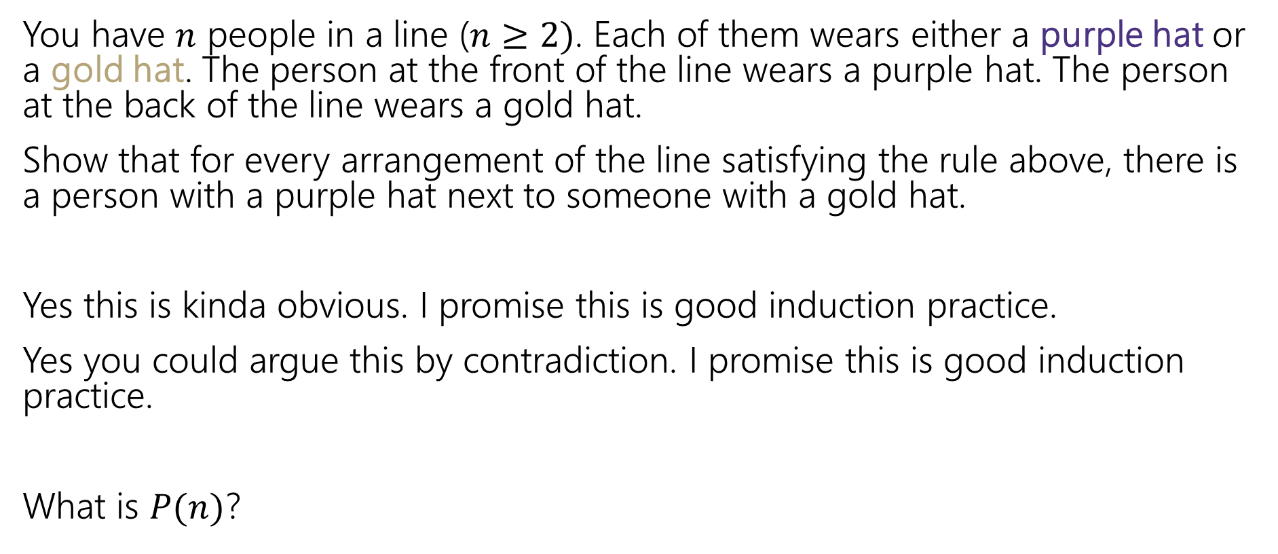
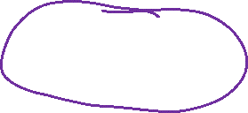
Induction: Hats! (goal)
You have $n$ people in a line ($n≥2)$. Each of them wears either a purple hat or a gold hat. The person at the front of the line wears a purple hat. The person at the back of the line wears a gold hat.
Show that for every arrangement of the line satisfying the rule above, there is a person with a purple hat next to someone with a gold hat.
Yes this is kinda obvious. I promise this is good induction practice.
Yes you could argue this by contradiction. I promise this is good induction practice.
What is $P(n)$?

Slide 7
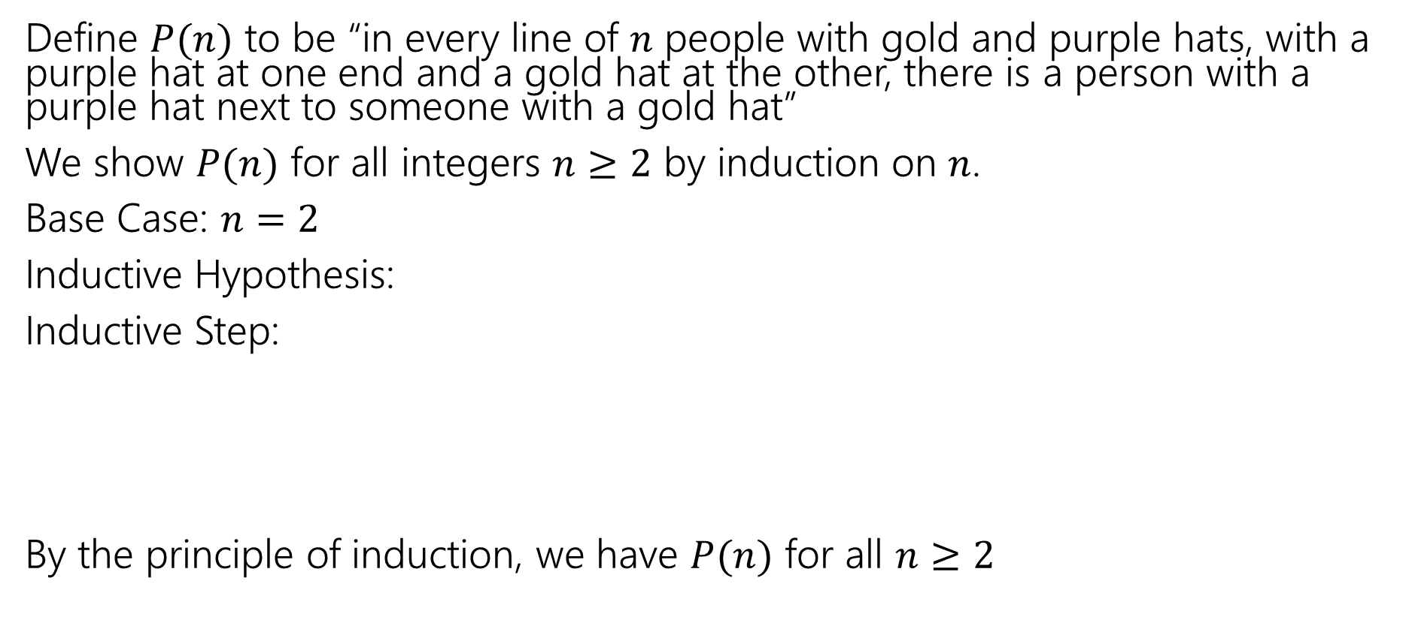


Induction: Hats! ($P(n)$)
Define $P(n)$ to be “in every line of $n$ people with gold and purple hats, with a purple hat at one end and a gold hat at the other, there is a person with a purple hat next to someone with a gold hat”
We show $P(n)$ for all integers $n≥2$ by induction on $n$.
Base Case: $n=2$
Inductive Hypothesis:
Inductive Step:
By the principle of induction, we have $P(n)$ for all $n≥2$

Slide 8
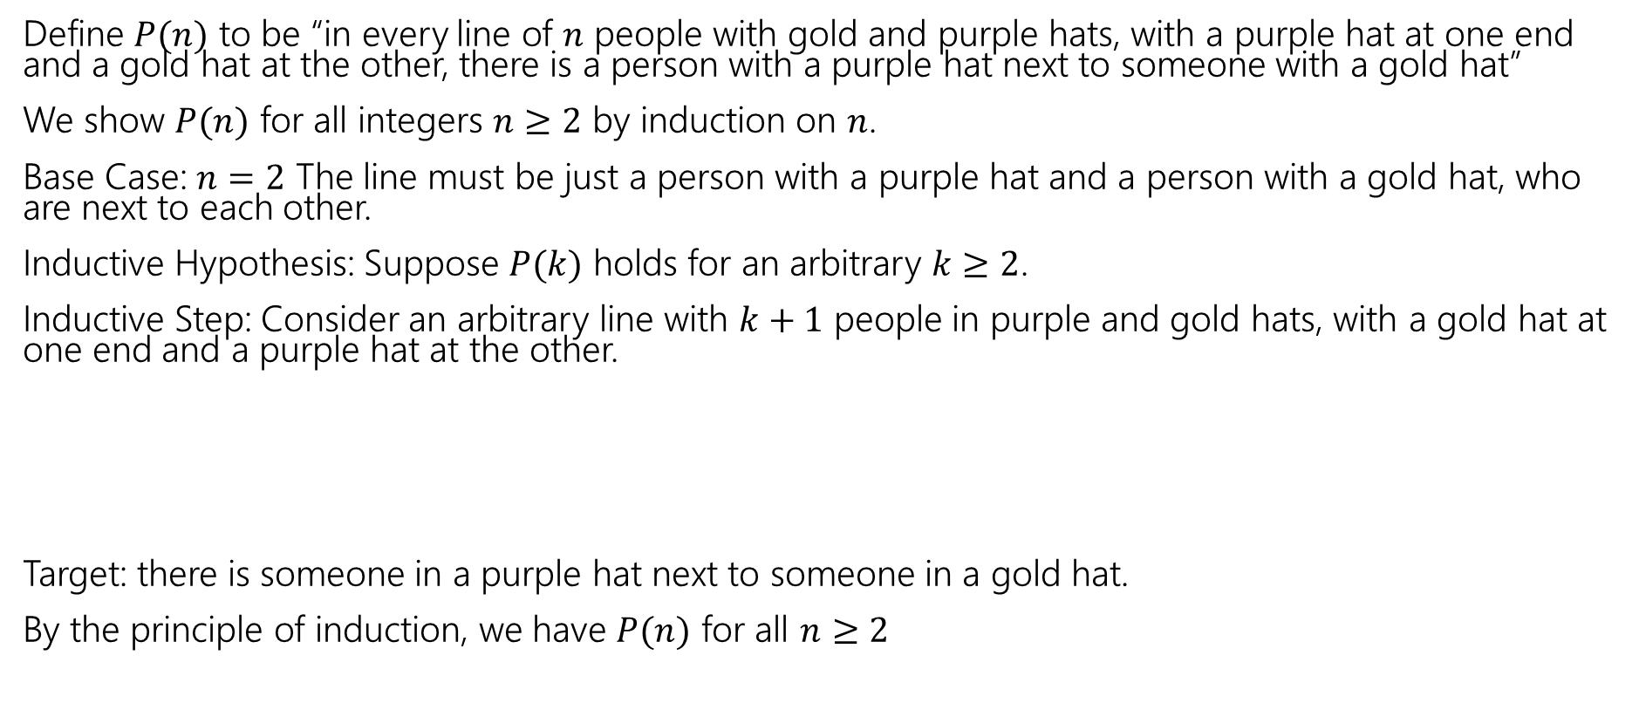
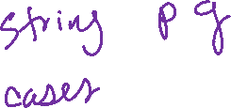

Induction: Hats! (base case, IH)
Define $P(n)$ to be “in every line of $n$ people with gold and purple hats, with a purple hat at one end and a gold hat at the other, there is a person with a purple hat next to someone with a gold hat”
We show $P(n)$ for all integers $n≥2$ by induction on $n$.
Base Case: $n=2$ The line must be just a person with a purple hat and a person with a gold hat, who are next to each other.
Inductive Hypothesis: Suppose $P(k)$ holds for an arbitrary $k≥2$.
Inductive Step: Consider an arbitrary line with $k+1$ people in purple and gold hats, with a gold hat at one end and a purple hat at the other.
Target: there is someone in a purple hat next to someone in a gold hat.
By the principle of induction, we have $P(n)$ for all $n≥2$

Slide 9
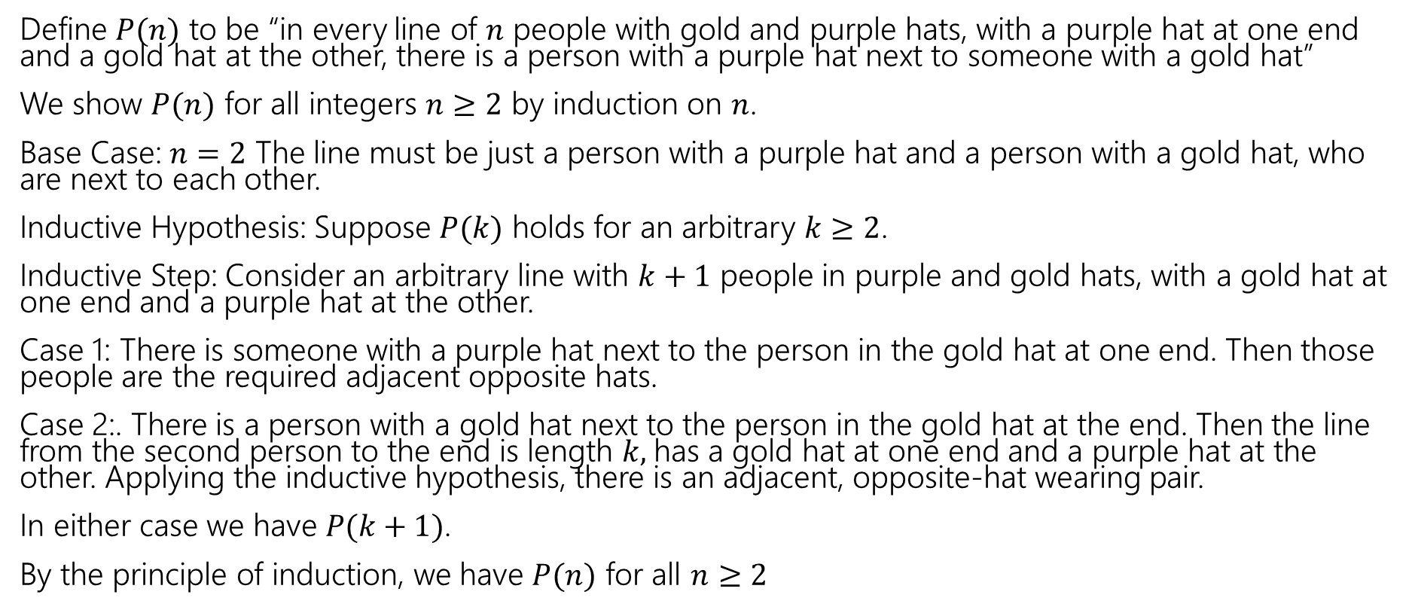

Induction: Hats! (complete)
Define $P(n)$ to be “in every line of $n$ people with gold and purple hats, with a purple hat at one end and a gold hat at the other, there is a person with a purple hat next to someone with a gold hat”
We show $P(n)$ for all integers $n≥2$ by induction on $n$.
Base Case: $n=2$ The line must be just a person with a purple hat and a person with a gold hat, who are next to each other.
Inductive Hypothesis: Suppose $P(k)$ holds for an arbitrary $k≥2$.
Inductive Step: Consider an arbitrary line with $k+1$ people in purple and gold hats, with a gold hat at one end and a purple hat at the other.
Case 1: There is someone with a purple hat next to the person in the gold hat at one end. Then those people are the required adjacent opposite hats.
Case 2:. There is a person with a gold hat next to the person in the gold hat at the end. Then the line from the second person to the end is length $k,$has a gold hat at one end and a purple hat at the other. Applying the inductive hypothesis, there is an adjacent, opposite-hat wearing pair.
In either case we have $P(k+1)$.
By the principle of induction, we have $P(n)$ for all $n≥2$

Slide 10
Structural Induction on Strings

Slide 11

Strings
$ε$ is “the empty string”
The string with $0$ characters – “” in Java (not null!)
$Σ^{∗}$:
Basis: $ε∈Σ^{∗}$.
Recursive: If $w∈Σ^{∗}$ and $a∈Σ$ then $wa∈Σ^{∗}$
$wa$ means the string of $w$ with the character $a$ appended.
You’ll also see $w⋅a$ (a $⋅$ to mean “concatenate” i.e. + in Java)

Slide 12

Functions on Strings
Since strings are defined recursively, most functions on strings are as well.
Length:
len($ε$)=0;
len($wa$)=len($w$)+1 for $w∈Σ^{∗}$, $a∈Σ$
Reversal:
$ε^{R}=ε$; ${\left(wa\right)}^{R}=aw^{R}$ for $w∈Σ^{∗}$, $a∈Σ$
Concatenation
$x⋅ε=x$ for all $x∈Σ^{∗}$; $x⋅\left(wa\right)=\left(x⋅w\right)a$ for $w∈Σ^{∗},a∈Σ$
Number of $c$’s in a string
$\#_{c}\left(ε\right)=0$ $\#_{c}\left(wc\right)=\#_{c}\left(w\right)+1$for $w∈Σ^{∗}$; $\#_{c}\left(wa\right)=\#_{c}(w)$ for $w∈Σ^{∗},a∈Σ∖\{c\}$.

Slide 13

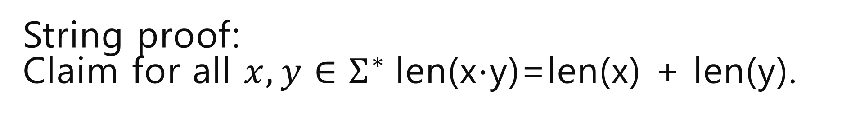
String proof: Claim for all $x,y∈Σ^{∗}$len(x$⋅$y)=len(x) + len(y).
Let $P(y)$ be “for all $x∈Σ^{∗}$len(x$⋅$y)=len(x) + len(y)$.“$
Notice the strangeness of this $P()$ there is a “for all $x“$ inside the definition of $P(y)$.
That means we’ll have to introduce an arbitrary $x$ as part of the base case and the inductive step!

Slide 14
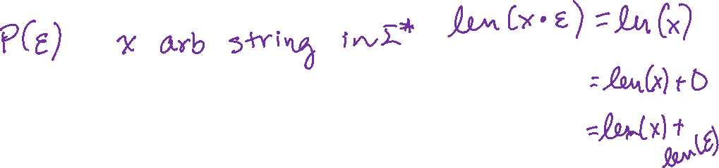
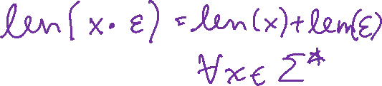
String proof: skeleton
Let $P(y)$ be “len(x$⋅$y)=len(x) + len(y) for all $x∈Σ^{∗}.“$
We prove $P(y)$ for all $x∈Σ^{∗}$ by structural induction.
Base Case:
Inductive Hypothesis
Inductive Step:
We conclude that $P(y)$ holds for all string $y$ by the principle of induction. Unwrapping the definition of $P$, we get $∀x∀y∈Σ^{∗}$ len(xy)=len(x)+len(y), as required.

Slide 15
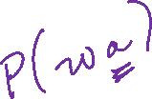

String proof: Base case, IH
Let $P(y)$ be “len(x$⋅$y)=len(x) + len(y) for all $x∈Σ^{∗}.“$
We prove $P(y)$ for all $x∈Σ^{∗}$ by structural induction.
Base Case: Let $x$ be an arbitrary string, len($x⋅ε)$=len(x$)$ =len(x)+0=len(x)+len($ε)$
Inductive Hypothesis: Suppose $P(w)$ for an arbitrary string $w$.
Inductive Step:
We conclude that $P(y)$ holds for all string $y$ by the principle of induction. Unwrapping the definition of $P$, we get $∀x∀y∈Σ^{∗}$ len(xy)=len(x)+len(y), as required.

Slide 16
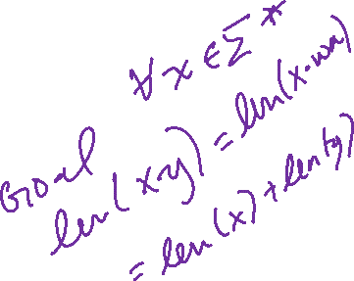
String proof: Inductive Step Setup
Let $P(y)$ be “len(x$⋅$y)=len(x) + len(y) for all $x∈Σ^{∗}.“$
We prove $P(y)$ for all $x∈Σ^{∗}$ by structural induction.
Base Case: Let $x$ be an arbitrary string, len($x⋅ε)$=len(x$)$ =len(x)+0=len(x)+len($ε)$
Inductive Hypothesis: Suppose $P(w)$ for an arbitrary string $w$.
Inductive Step: Let $y=wa$ for an arbitrary $a∈Σ$. We show $P\left(y\right).$Let $x$ be an arbitrary string.
…
Therefore, len(xy)=len(x) + len(y), as required.
We conclude that $P(y)$ holds for all string $y$ by the principle of induction. Unwrapping the definition of $P$, we get $∀x∀y∈Σ^{∗}$ len(xy)=len(x)+len(y), as required.

Slide 17

String proof: complete
Let $P(y)$ be “len(x$⋅$y)=len(x) + len(y) for all $x∈Σ^{∗}.“$
We prove $P(y)$ for all $x∈Σ^{∗}$ by structural induction.
Base Case: Let $x$ be an arbitrary string, len($x⋅ε)$=len(x$)$ =len(x)+0=len(x)+len($ε)$
Inductive Hypothesis: Suppose $P(w)$ for an arbitrary string $w$.
Inductive Step: Let $y=wa$ for an arbitrary $a∈Σ$. We show $P\left(y\right).$Let $x$ be an arbitrary string.
len(xy)=len(xwa) =len(xw)+1 (by definition of len)
=len(x) + len(w) + 1 (by IH)
=len(x) + len(wa) (by definition of len)
Therefore, len(xy)=len(x) + len(y), as required.
We conclude that $P(y)$ holds for all string $y$ by the principle of induction. Unwrapping the definition of $P$, we get $∀x∀y∈Σ^{∗}$ len(xy)=len(x)+len(y), as required.

Slide 18
Why all those arbitraries?
$P(ε)$ is a for-all statement, introduce arbitrary variable to show for-all.
Let $P(y)$ be “len(x$⋅$y)=len(x) + len(y) for all $x∈Σ^{∗}.“$
We prove $P(y)$ for all $x∈Σ^{∗}$ by structural induction.
Base Case: Let $x$ be an arbitrary string, len($x⋅ε)$=len(x$)$ =len(x)+0=len(x)+len($ε)$
Inductive Hypothesis: Suppose $P(w)$ for an arbitrary string $w$.
Inductive Step: Let $y=wa$ for an arbitrary $a∈Σ$. We show $P\left(y\right).$Let $x$ be an arbitrary string.
len(xy)=len(xwa) =len(xw)+1 (by definition of len)
=len(x) + len(w) + 1 (by IH)
=len(x) + len(wa) (by definition of len)
Therefore, len(xy)=len(x) + len(y), as required.
We conclude that $P(y)$ holds for all strings $y$ by the principle of induction. Unwrapping the definition of $P$, we get $∀x∀y∈Σ^{∗}$ len(xy)=len(x)+len(y), as required.
Needs to be arbitrary because it’s in the IH (induction wouldn’t show “all strings” otherwise)
Recursive rule says “every $a∈Σ“$ so we need to argue for every $a$.
$P(y)$ is a for-all statement, introduce arbitrary variable to show for-all.

Slide 19
More Practice

Slide 20

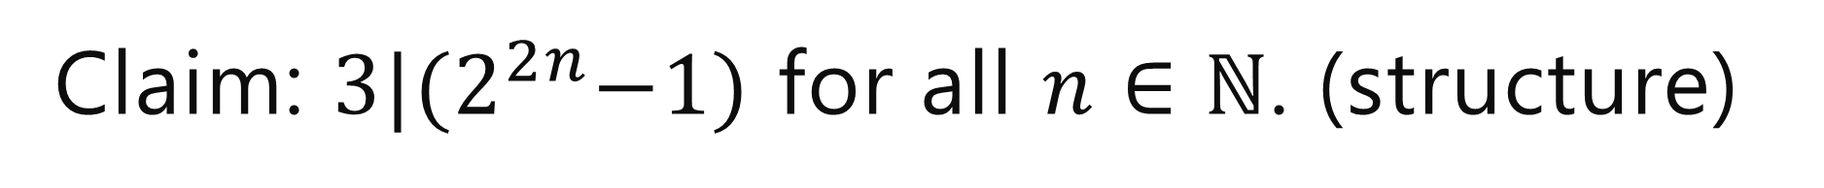
Claim: $3|{(2}^{2n}−1)$ for all $n∈ℕ$. (structure)
[Define $P(n)$]
Base Case
Inductive Hypothesis
Inductive Step
[conclusion]

Slide 21
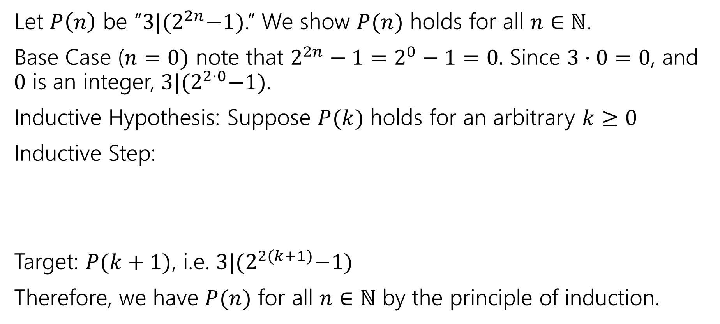

Claim: $3|{(2}^{2n}−1)$ for all $n∈ℕ$. (1)
Let $P\left(n\right)$ be “$3|{(2}^{2n}−1)$.” We show $P(n)$ holds for all $n∈ℕ$.
Base Case ($n=0)$ note that $2^{2n}−1=2^{0}−1=0.$ Since $3⋅0=0$, and $0$ is an integer, $3|{(2}^{2⋅0}−1)$.
Inductive Hypothesis: Suppose $P(k)$ holds for an arbitrary $k≥0$
Inductive Step:
Target: $P(k+1)$, i.e. $3|{(2}^{2(k+1)}−1)$
Therefore, we have $P(n)$ for all $n∈ℕ$ by the principle of induction.

Slide 22
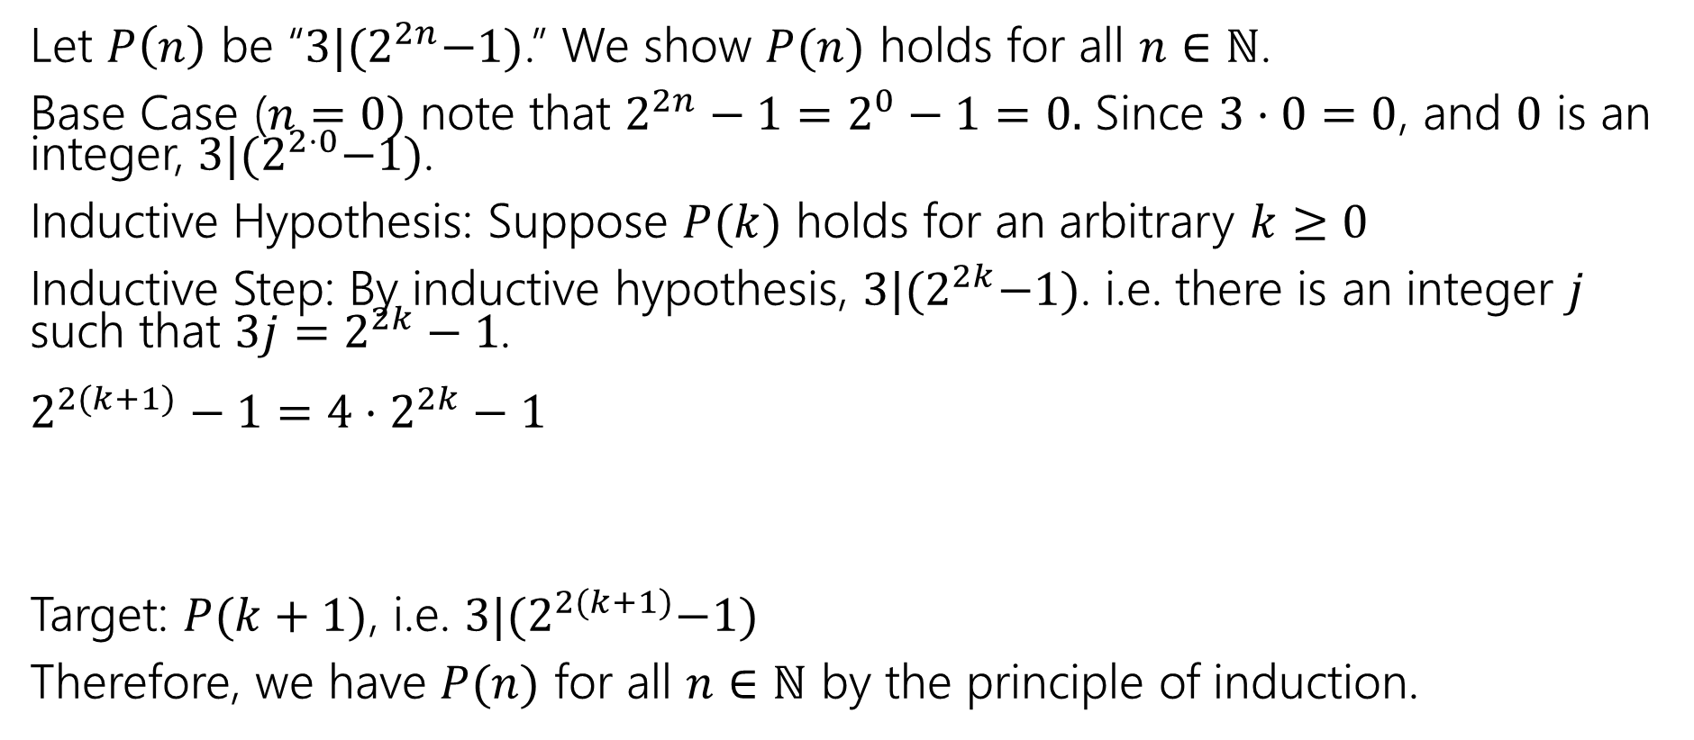

Claim: $3|{(2}^{2n}−1)$ for all $n∈ℕ$. (2)
Let $P\left(n\right)$ be “$3|{(2}^{2n}−1)$.” We show $P(n)$ holds for all $n∈ℕ$.
Base Case ($n=0)$ note that $2^{2n}−1=2^{0}−1=0.$ Since $3⋅0=0$, and $0$ is an integer, $3|{(2}^{2⋅0}−1)$.
Inductive Hypothesis: Suppose $P(k)$ holds for an arbitrary $k≥0$
Inductive Step: By inductive hypothesis, $3|{(2}^{2k}−1)$. i.e. there is an integer $j$ such that $3j=2^{2k}−1$.
$2^{2(k+1)}−1=4⋅2^{2k}−1$
Target: $P(k+1)$, i.e. $3|{(2}^{2(k+1)}−1)$
Therefore, we have $P(n)$ for all $n∈ℕ$ by the principle of induction.
FORCE the expression in your IH to appear

Slide 23
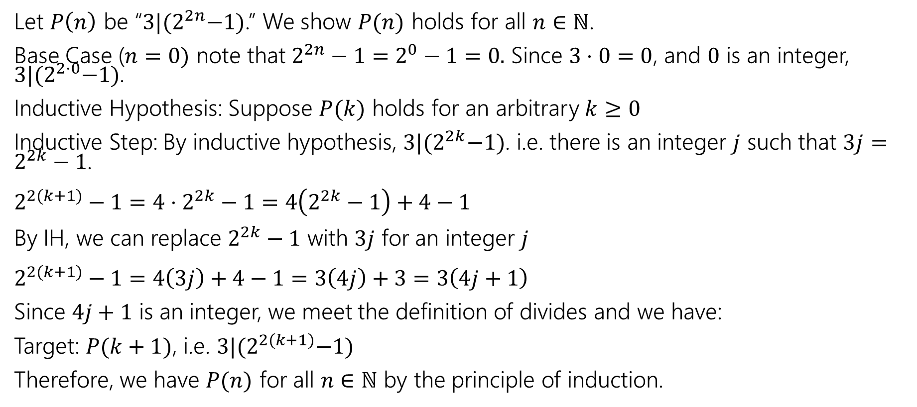

Claim: $3|{(2}^{2n}−1)$ for all $n∈ℕ$. (3)
Let $P\left(n\right)$ be “$3|{(2}^{2n}−1)$.” We show $P(n)$ holds for all $n∈ℕ$.
Base Case ($n=0)$ note that $2^{2n}−1=2^{0}−1=0.$ Since $3⋅0=0$, and $0$ is an integer, $3|{(2}^{2⋅0}−1)$.
Inductive Hypothesis: Suppose $P(k)$ holds for an arbitrary $k≥0$
Inductive Step: By inductive hypothesis, $3|{(2}^{2k}−1)$. i.e. there is an integer $j$ such that $3j=2^{2k}−1$.
$2^{2(k+1)}−1=4⋅2^{2k}−1=4\left(2^{2k}−1\right)+4−1$
By IH, we can replace $2^{2k}−1$ with $3j$ for an integer $j$
$2^{2(k+1)}−1=4\left(3j\right)+4−1=3\left(4j\right)+3=3\left(4j+1\right)$
Since $4j+1$ is an integer, we meet the definition of divides and we have:
Target: $P(k+1)$, i.e. $3|{(2}^{2(k+1)}−1)$
Therefore, we have $P(n)$ for all $n∈ℕ$ by the principle of induction.

Slide 24
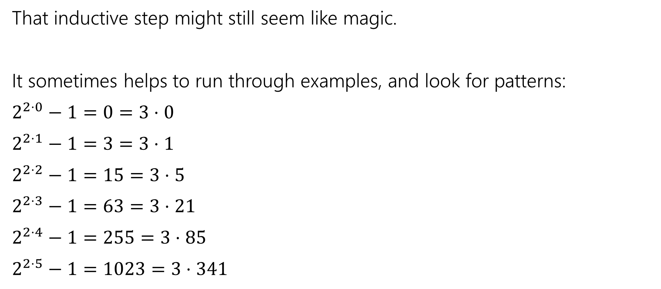
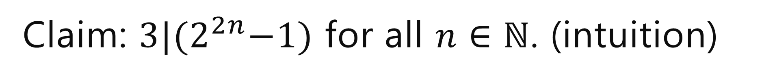

Claim: $3|{(2}^{2n}−1)$ for all $n∈ℕ$. (intuition)
That inductive step might still seem like magic.
It sometimes helps to run through examples, and look for patterns:
$2^{2⋅0}−1=0=3⋅0$
$2^{2⋅1}−1=3=3⋅1$
$2^{2⋅2}−1=15=3⋅5$
$2^{2⋅3}−1=63=3⋅21$
$2^{2⋅4}−1=255=3⋅85$
$2^{2⋅5}−1=1023=3⋅341$
The divisor goes from $k$to $4k+1$ $$0→4⋅0+1=1$$
$$1→4⋅1+1=5$$
$$5→4⋅5+1=21$$
…
That might give us a hint that $4k+1$ will be in the algebra somewhere, and give us another intermediate target.

Slide 25
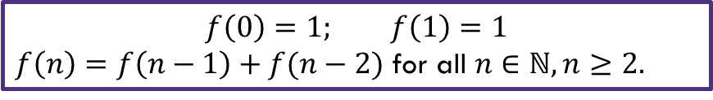

Fibonacci Inequality Two (structure)
Show that $f\left(n\right)≥2^{n/2}$ for all $n≥2$by induction.
[Define $P(n)$]
Base Cases:
Inductive Hypothesis:
Inductive step:
Therefore, we have $P(n)$ for all $n≥0$ by the principle of induction.
$$f\left(0\right)=1; f\left(1\right)=1$$
$f\left(n\right)=f\left(n−1\right)+f(n−2)$ for all $n∈ℕ, n≥2.$

Slide 26
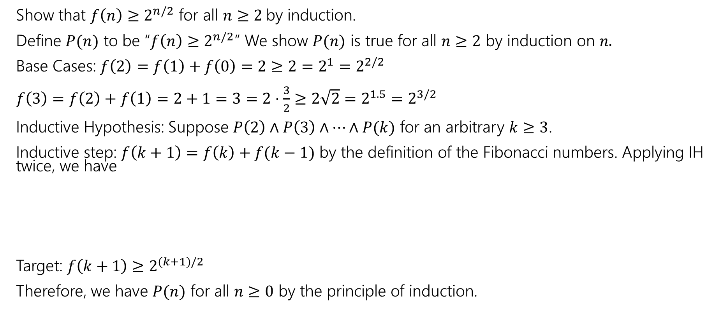
Fibonacci Inequality Two (1)
Show that $f\left(n\right)≥2^{n/2}$ for all $n≥2$by induction.
Define $P(n)$ to be “$f\left(n\right)≥2^{n/2}$” We show $P(n)$ is true for all $n≥2$ by induction on $n.$
Base Cases: $f\left(2\right)=f\left(1\right)+f\left(0\right)=2≥2=2^{1}=2^{2/2}$
$f\left(3\right)=f\left(2\right)+f\left(1\right)=2+1=3=2⋅\frac{3}{2}≥2\sqrt{2}=2^{1.5}=2^{3/2}$
Inductive Hypothesis: Suppose $P\left(2\right)∧P\left(3\right)∧⋯∧P(k)$ for an arbitrary $k≥3$.
Inductive step: $f\left(k+1\right)=f\left(k\right)+f(k−1)$ by the definition of the Fibonacci numbers. Applying IH twice, we have
Target: $f\left(k+1\right)≥2^{(k+1)/2}$
Therefore, we have $P(n)$ for all $n≥0$ by the principle of induction.
$$f\left(0\right)=1; f\left(1\right)=1$$
$f\left(n\right)=f\left(n−1\right)+f(n−2)$ for all $n∈ℕ, n≥2.$

Slide 27
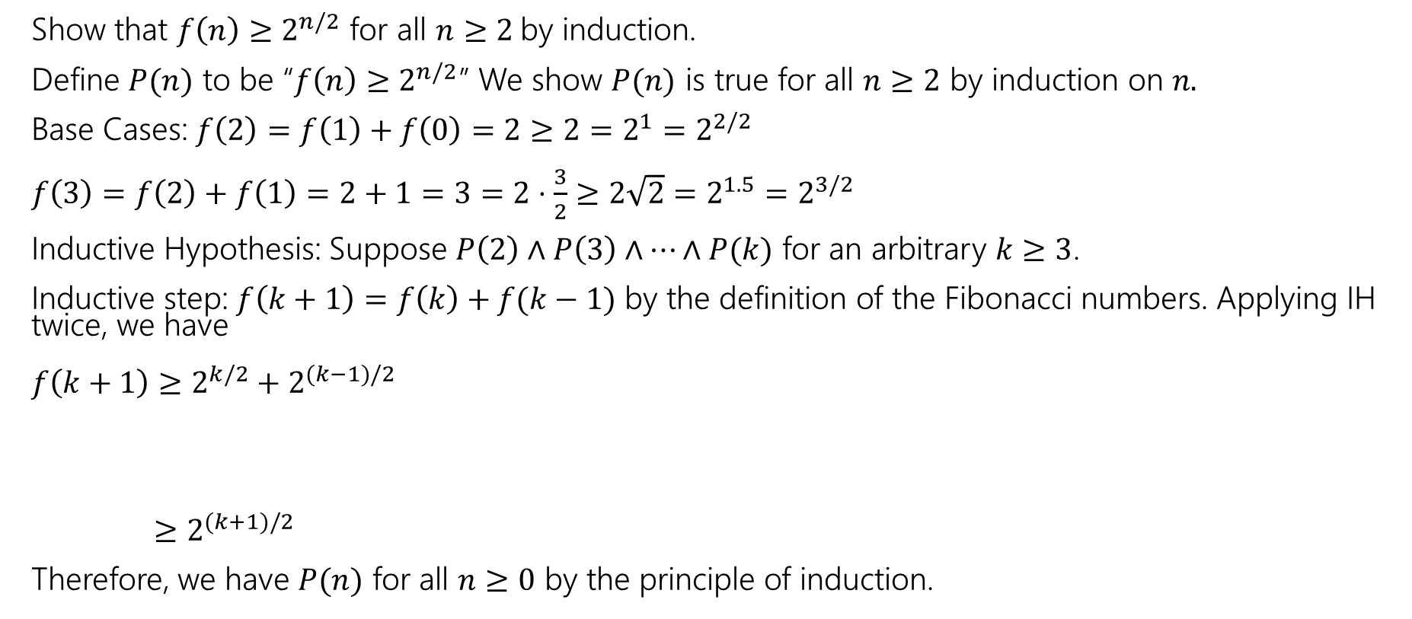
Fibonacci Inequality Two (2)
Show that $f\left(n\right)≥2^{n/2}$ for all $n≥2$by induction.
Define $P(n)$ to be “$f\left(n\right)≥2^{n/2}$” We show $P(n)$ is true for all $n≥2$ by induction on $n.$
Base Cases: $f\left(2\right)=f\left(1\right)+f\left(0\right)=2≥2=2^{1}=2^{2/2}$
$f\left(3\right)=f\left(2\right)+f\left(1\right)=2+1=3=2⋅\frac{3}{2}≥2\sqrt{2}=2^{1.5}=2^{3/2}$
Inductive Hypothesis: Suppose $P\left(2\right)∧P\left(3\right)∧⋯∧P(k)$ for an arbitrary $k≥3$.
Inductive step: $f\left(k+1\right)=f\left(k\right)+f(k−1)$ by the definition of the Fibonacci numbers. Applying IH twice, we have
$f\left(k+1\right)≥2^{k/2}+2^{(k−1)/2}$
$≥2^{(k+1)/2}$
Therefore, we have $P(n)$ for all $n≥0$ by the principle of induction.
$$f\left(0\right)=1; f\left(1\right)=1$$
$f\left(n\right)=f\left(n−1\right)+f(n−2)$ for all $n∈ℕ, n≥2.$

Slide 28
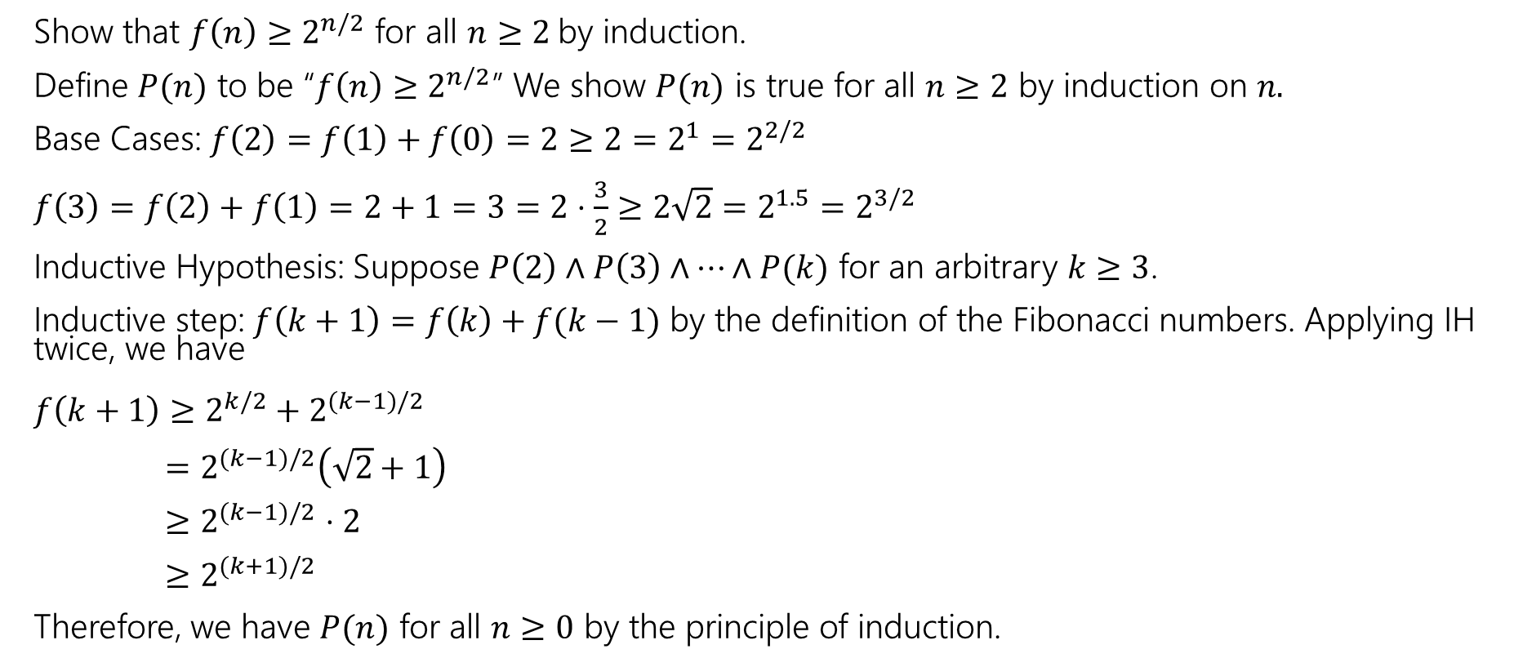
Fibonacci Inequality Two (3)
Show that $f\left(n\right)≥2^{n/2}$ for all $n≥2$by induction.
Define $P(n)$ to be “$f\left(n\right)≥2^{n/2}$” We show $P(n)$ is true for all $n≥2$ by induction on $n.$
Base Cases: $f\left(2\right)=f\left(1\right)+f\left(0\right)=2≥2=2^{1}=2^{2/2}$
$f\left(3\right)=f\left(2\right)+f\left(1\right)=2+1=3=2⋅\frac{3}{2}≥2\sqrt{2}=2^{1.5}=2^{3/2}$
Inductive Hypothesis: Suppose $P\left(2\right)∧P\left(3\right)∧⋯∧P(k)$ for an arbitrary $k≥3$.
Inductive step: $f\left(k+1\right)=f\left(k\right)+f(k−1)$ by the definition of the Fibonacci numbers. Applying IH twice, we have
$f\left(k+1\right)≥2^{k/2}+2^{(k−1)/2}$
$=2^{(k−1)/2}\left(\sqrt{2}+1\right)$
$≥2^{(k−1)/2}$ $⋅2$
$≥2^{(k+1)/2}$
Therefore, we have $P(n)$ for all $n≥0$ by the principle of induction.
$$f\left(0\right)=1; f\left(1\right)=1$$
$f\left(n\right)=f\left(n−1\right)+f(n−2)$ for all $n∈ℕ, n≥2.$

Slide 29

Even More Induction Practice: g(n) and h(n) (1)
Let $g\left(n\right)= \left\{\begin{aligned}1 if n=0 \\ n⋅g\left(n−1\right) otherwise\end{aligned}\right.$
Let $h\left(n\right)=n^{n}$
Claim: $h\left(n\right)≥g\left(n\right)$ for all integers $n≥1$

Slide 30
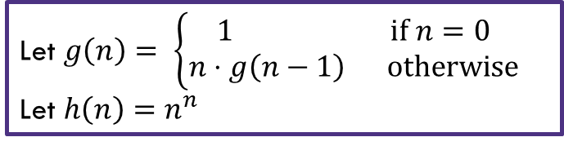

Even More Induction Practice: g(n) and h(n) (2)
Define $P\left(n\right)$ to be “$h\left(n\right)≥g(n)$ for all integers $n≥1$
We show $P(n)$ for all $n≥1$ by induction on $n.$
Base Case
Inductive Hypothesis:
Inductive Step:
Thus $P\left(k+1\right)$ holds.
Therefore, we have $P(n)$ for all $n≥1$ by induction on $n.$
Let $g\left(n\right)= \left\{\begin{aligned}1 if n=0 \\ n⋅g\left(n−1\right) otherwise\end{aligned}\right.$
Let $h\left(n\right)=n^{n}$

Slide 31
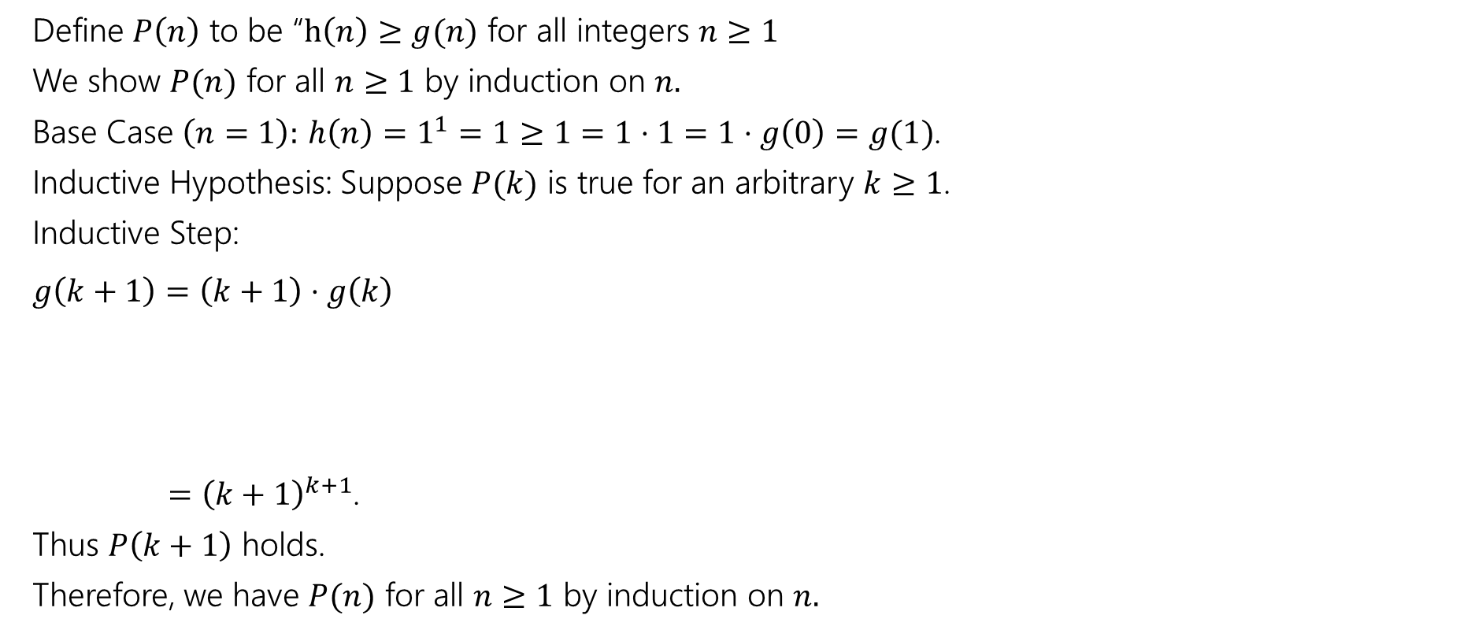
Even More Induction Practice: g(n) and h(n) (3)
Define $P\left(n\right)$ to be “$h\left(n\right)≥g(n)$ for all integers $n≥1$
We show $P(n)$ for all $n≥1$ by induction on $n.$
Base Case $\left(n=1\right):$ $h\left(n\right)=1^{1}=1≥1=1⋅1=1⋅g\left(0\right)=g(1)$.
Inductive Hypothesis: Suppose $P(k)$ is true for an arbitrary $k≥1$.
Inductive Step:
$g\left(k+1\right)=\left(k+1\right)⋅g\left(k\right)$
$={\left(k+1\right)}^{k+1}$.
Thus $P\left(k+1\right)$ holds.
Therefore, we have $P(n)$ for all $n≥1$ by induction on $n.$
Let $g\left(n\right)= \left\{\begin{aligned}1 if n=0 \\ n⋅g\left(n−1\right) otherwise\end{aligned}\right.$
Let $h\left(n\right)=n^{n}$

Slide 32
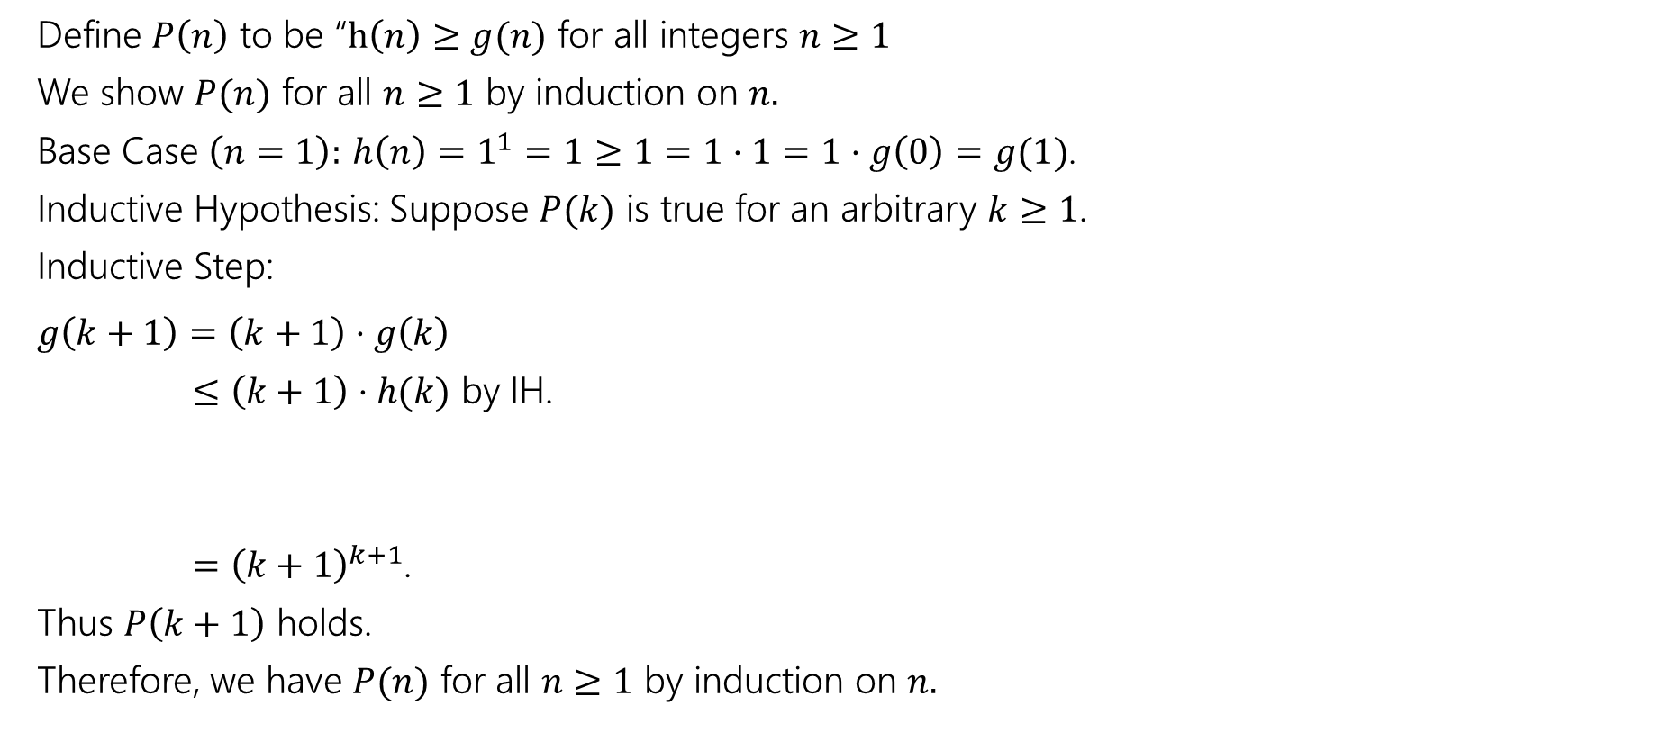
Even More Induction Practice: g(n) and h(n) (4)
Define $P\left(n\right)$ to be “$h\left(n\right)≥g(n)$ for all integers $n≥1$
We show $P(n)$ for all $n≥1$ by induction on $n.$
Base Case $\left(n=1\right):$ $h\left(n\right)=1^{1}=1≥1=1⋅1=1⋅g\left(0\right)=g(1)$.
Inductive Hypothesis: Suppose $P(k)$ is true for an arbitrary $k≥1$.
Inductive Step:
$g\left(k+1\right)=\left(k+1\right)⋅g\left(k\right)$
$≤\left(k+1\right)⋅h(k)$ by IH.
$={\left(k+1\right)}^{k+1}$.
Thus $P\left(k+1\right)$ holds.
Therefore, we have $P(n)$ for all $n≥1$ by induction on $n.$
Let $g\left(n\right)= \left\{\begin{aligned}1 if n=0 \\ n⋅g\left(n−1\right) otherwise\end{aligned}\right.$
Let $h\left(n\right)=n^{n}$

Slide 33
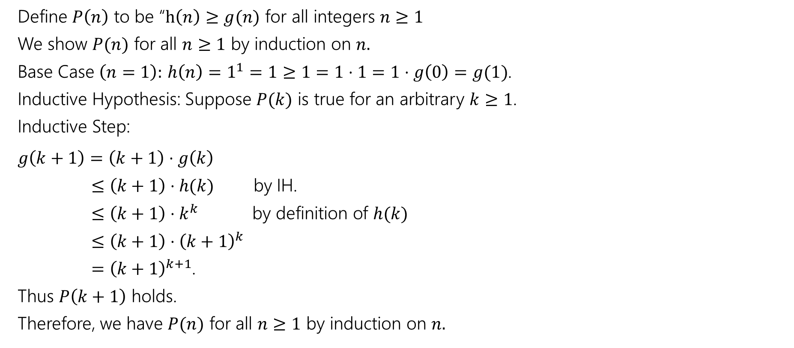
Even More Induction Practice: g(n) and h(n) (5)
Define $P\left(n\right)$ to be “$h\left(n\right)≥g(n)$ for all integers $n≥1$
We show $P(n)$ for all $n≥1$ by induction on $n.$
Base Case $\left(n=1\right):$ $h\left(n\right)=1^{1}=1≥1=1⋅1=1⋅g\left(0\right)=g(1)$.
Inductive Hypothesis: Suppose $P(k)$ is true for an arbitrary $k≥1$.
Inductive Step:
$g\left(k+1\right)=\left(k+1\right)⋅g\left(k\right)$
$≤\left(k+1\right)⋅h(k)$ by IH.
$≤\left(k+1\right)⋅k^{k}$ by definition of $h(k)$
$≤\left(k+1\right)⋅{\left(k+1\right)}^{k}$
$={\left(k+1\right)}^{k+1}$.
Thus $P\left(k+1\right)$ holds.
Therefore, we have $P(n)$ for all $n≥1$ by induction on $n.$
Let $g\left(n\right)= \left\{\begin{aligned}1 if n=0 \\ n⋅g\left(n−1\right) otherwise\end{aligned}\right.$
Let $h\left(n\right)=n^{n}$

Slide 34
Even More Induction Practice: g(n) and h(n) (6)
Define $P\left(n\right)$ to be “$h\left(n\right)≥g(n)$ for all integers $n≥1$
We show $P(n)$ for all $n≥1$ by induction on $n.$
Base Case $\left(n=1\right):$ $h\left(n\right)=1^{1}=1≥1=1⋅1=1⋅g\left(0\right)=g(1)$.
Inductive Hypothesis: Suppose $P(k)$ is true for an arbitrary $k≥1$.
Inductive Step:
$g\left(k+1\right)=\left(k+1\right)⋅g\left(k\right)$
$≤\left(k+1\right)⋅h(k)$ by IH.
$≤\left(k+1\right)⋅k^{k}$ by definition of $h(k)$
$≤\left(k+1\right)⋅{\left(k+1\right)}^{k}$
$={\left(k+1\right)}^{k+1}$.
Thus $P\left(k+1\right)$ holds.
Therefore, we have $P(n)$ for all $n≥1$ by induction on $n.$
Let $g\left(n\right)= \left\{\begin{aligned}1 if n=0 \\ n⋅g\left(n−1\right) otherwise\end{aligned}\right.$
Let $h\left(n\right)=n^{n}$

Slide 35

Even More Induction Practice: Sums (1)
Let $P(n)$ be $\sum_{i=0}^{n}{2+3i}=\frac{\left(n+1\right)\left(3n+4\right)}{2}$
Show $P(n)$ for all $n∈ℕ$ by induction on $n$.
Base Case ($n=0)$:
Inductive Hypothesis:
Inductive Step:
[Conclusion]

Slide 36
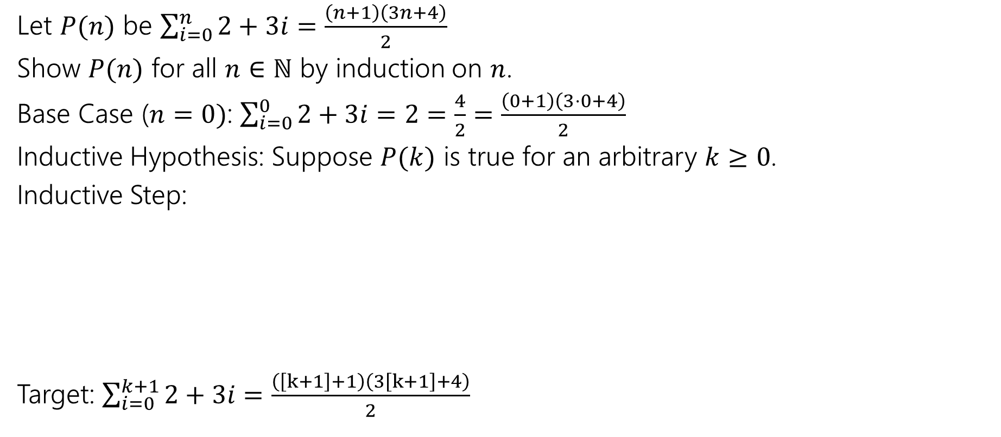
Even More Induction Practice: Sums (2)
Let $P(n)$ be $\sum_{i=0}^{n}{2+3i}=\frac{\left(n+1\right)\left(3n+4\right)}{2}$
Show $P(n)$ for all $n∈ℕ$ by induction on $n$.
Base Case ($n=0)$: $\sum_{i=0}^{0}{2+3i}=2=\frac{4}{2}=\frac{\left(0+1\right)\left(3⋅0+4\right)}{2}$
Inductive Hypothesis: Suppose $P(k)$ is true for an arbitrary $k≥0$.
Inductive Step:
Target: $\sum_{i=0}^{k+1}{2+3i}=\frac{\left(\left[k+1\right]+1\right)\left(3\left[k+1\right]+4\right)}{2}$

Slide 37
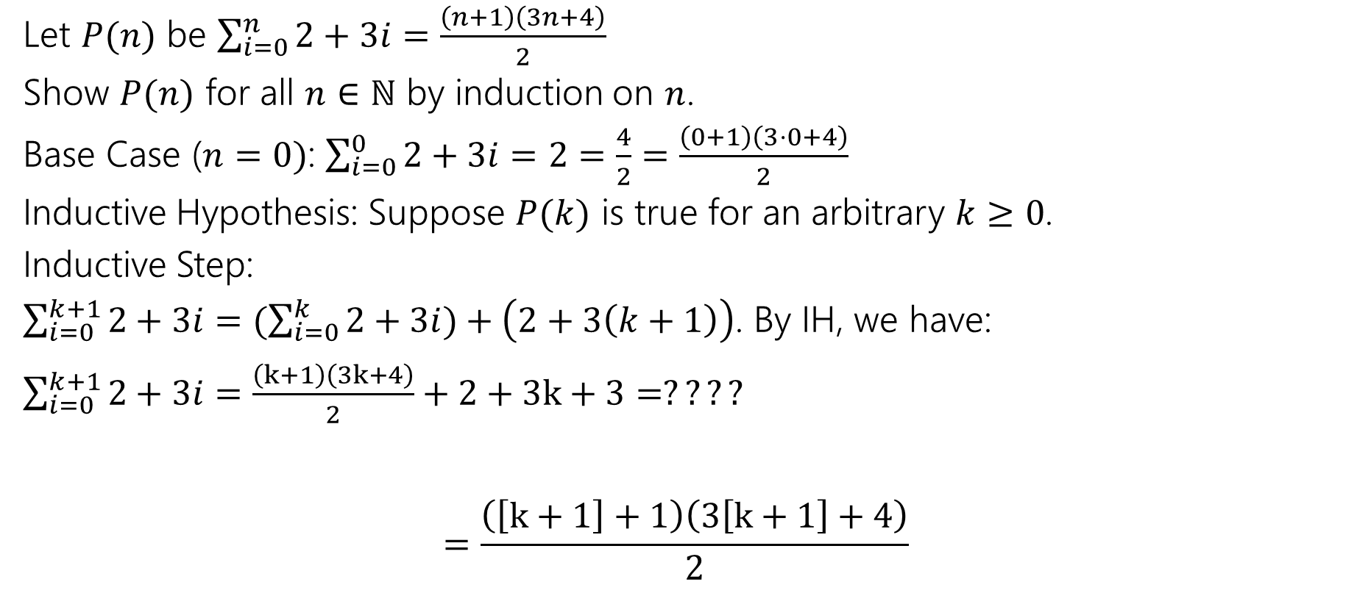
Even More Induction Practice: Sums (3)
Let $P(n)$ be $\sum_{i=0}^{n}{2+3i}=\frac{\left(n+1\right)\left(3n+4\right)}{2}$
Show $P(n)$ for all $n∈ℕ$ by induction on $n$.
Base Case ($n=0)$: $\sum_{i=0}^{0}{2+3i}=2=\frac{4}{2}=\frac{\left(0+1\right)\left(3⋅0+4\right)}{2}$
Inductive Hypothesis: Suppose $P(k)$ is true for an arbitrary $k≥0$.
Inductive Step:
$\sum_{i=0}^{k+1}{2+3i}=(\sum_{i=0}^{k}{2+3i})+\left(2+3\left(k+1\right)\right)$. By IH, we have:
$\sum_{i=0}^{k+1}{2+3i}=\frac{\left(k+1\right)\left(3k+4\right)}{2}+2+3k+3=????$ $=\frac{\left(\left[k+1\right]+1\right)\left(3\left[k+1\right]+4\right)}{2}$

Slide 38
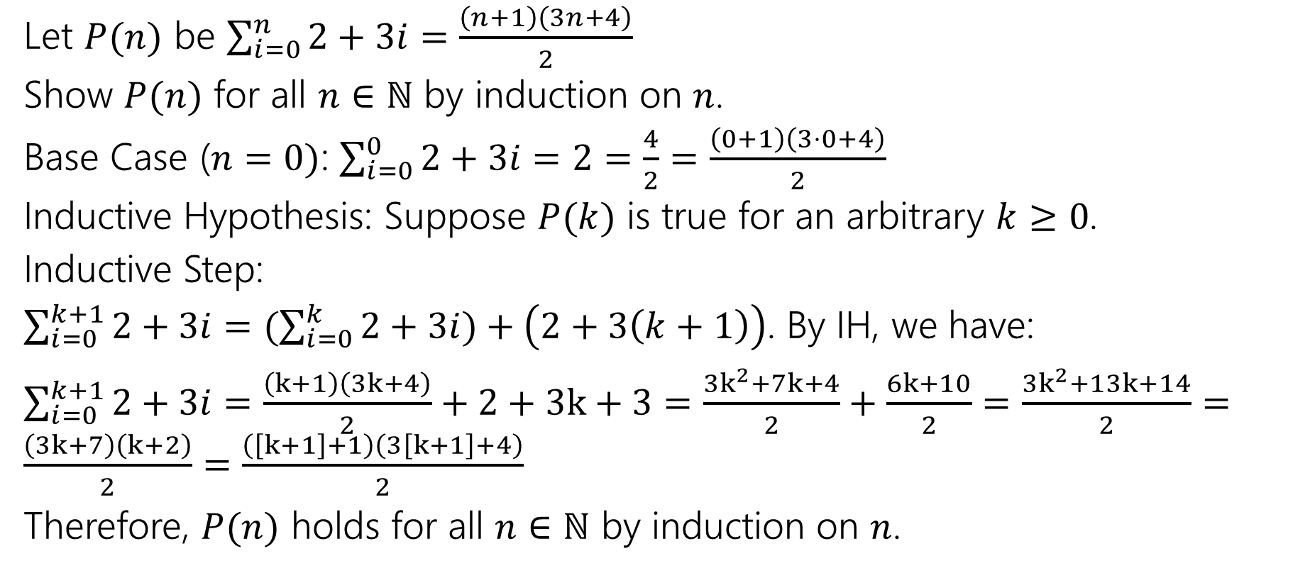
Even More Induction Practice: Sums (4)
Let $P(n)$ be $\sum_{i=0}^{n}{2+3i}=\frac{\left(n+1\right)\left(3n+4\right)}{2}$
Show $P(n)$ for all $n∈ℕ$ by induction on $n$.
Base Case ($n=0)$: $\sum_{i=0}^{0}{2+3i}=2=\frac{4}{2}=\frac{\left(0+1\right)\left(3⋅0+4\right)}{2}$
Inductive Hypothesis: Suppose $P(k)$ is true for an arbitrary $k≥0$.
Inductive Step:
$\sum_{i=0}^{k+1}{2+3i}=(\sum_{i=0}^{k}{2+3i})+\left(2+3\left(k+1\right)\right)$. By IH, we have:
$\sum_{i=0}^{k+1}{2+3i}=\frac{\left(k+1\right)\left(3k+4\right)}{2}+2+3k+3=\frac{3k^{2}+7k+4}{2}+\frac{6k+10}{2}=\frac{3k^{2}+13k+14}{2}=\frac{\left(3k+7\right)\left(k+2\right)}{2}=\frac{\left(\left[k+1\right]+1\right)\left(3\left[k+1\right]+4\right)}{2}$
Therefore, $P(n)$ holds for all $n∈ℕ$ by induction on $n$.

