Slide 1
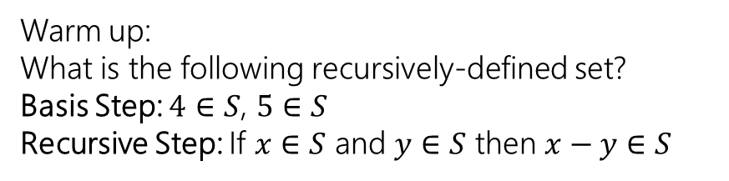
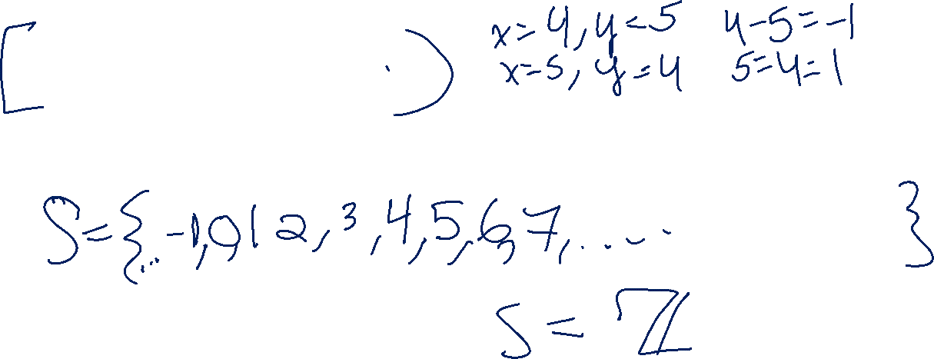
Structural Induction and Regular Expressions
Warm up:
What is the following recursively-defined set?
Basis Step: $4∈S$, $5∈S$
Recursive Step: If $x∈S$ and $y∈S$ then $x−y∈S$
CSE 311 Autumn 2025
Lecture 19

Slide 2
Trees!

Slide 3

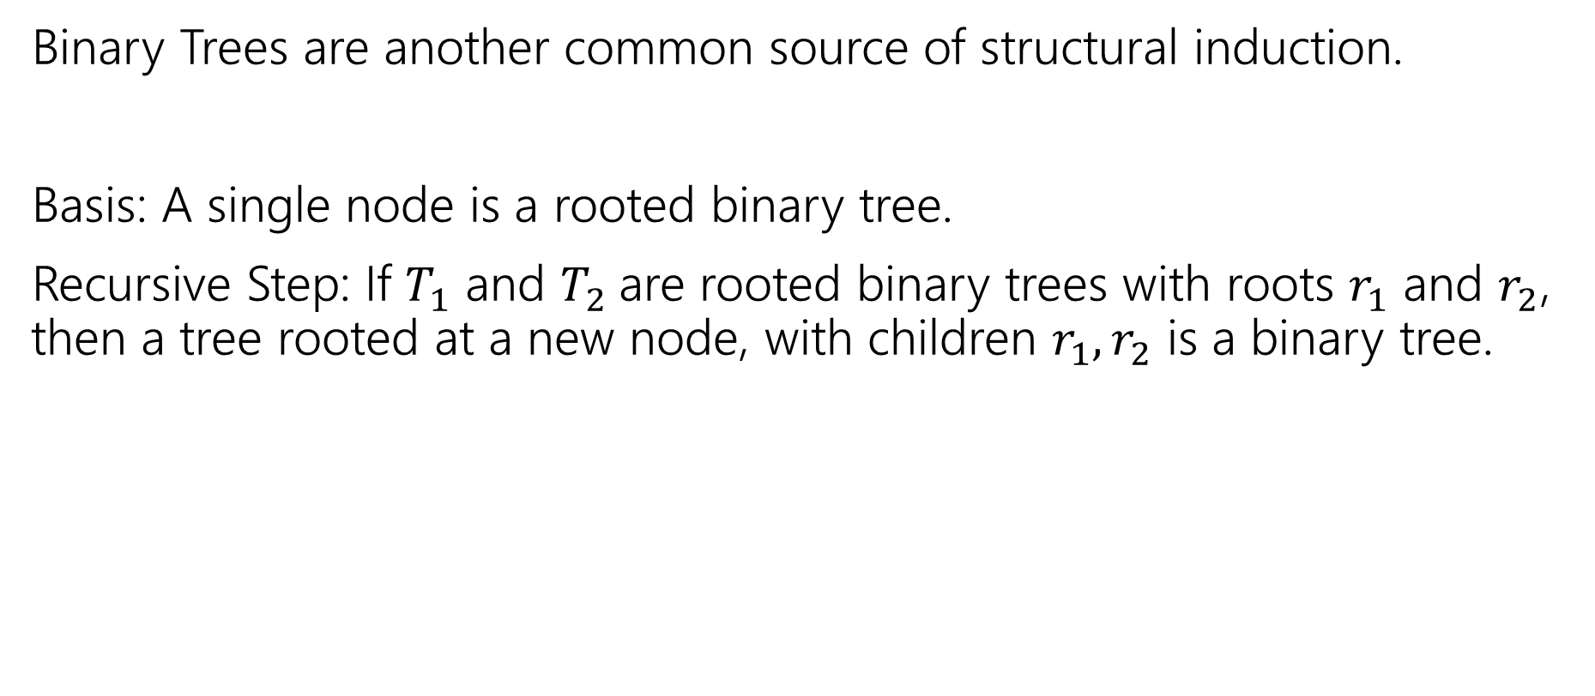
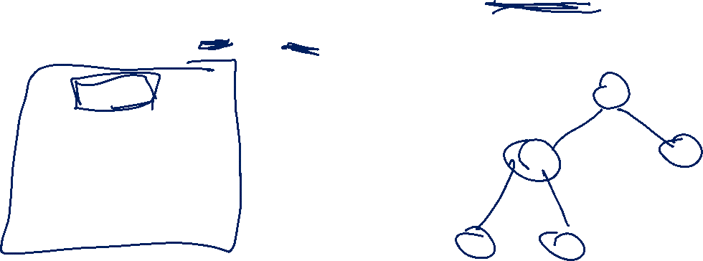

More Structural Sets
Binary Trees are another common source of structural induction.
Basis: A single node is a rooted binary tree.
Recursive Step: If $T_{1}$ and $T_{2}$are rooted binary trees with roots $r_{1}$ and $r_{2}$, then a tree rooted at a new node, with children $r_{1},r_{2}$ is a binary tree.
$$T_{1}$$
$$T_{2}$$

Slide 4
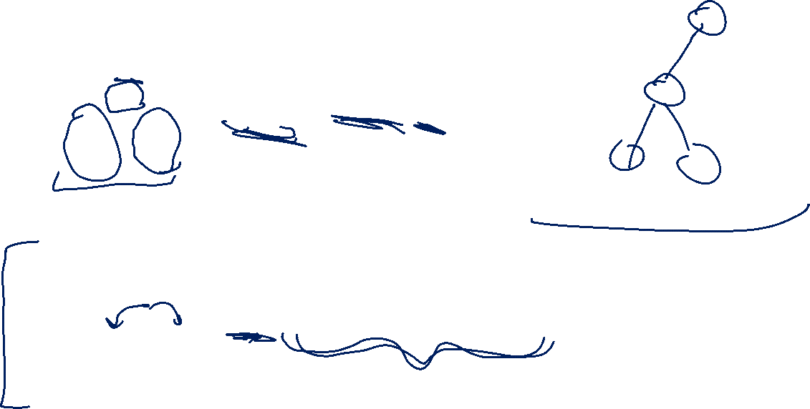





Functions on Binary Trees
size( )=1
size( ) = size($T_{1}$) + size($T_{2}$) + 1
height( ) = 0
height( ) = 1+$max⁡($height($T_{1}$),height($T_{2}$)$)$
$$T_{1}$$
$$T_{2}$$
$$T_{1}$$
$$T_{2}$$

Slide 5
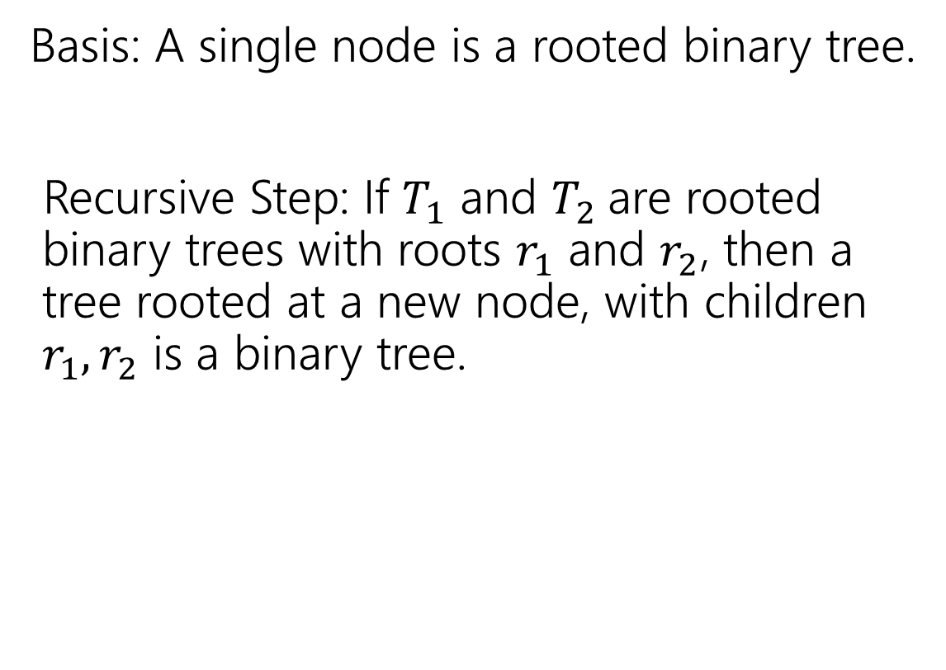
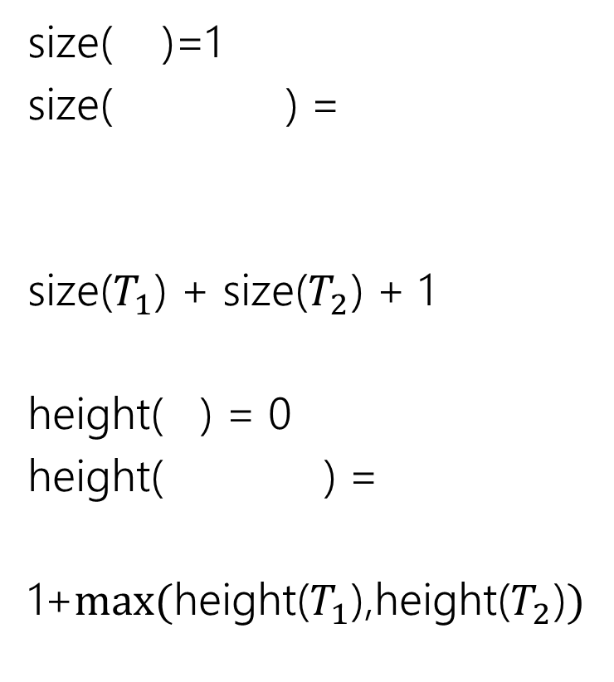
Binary Trees
size( )=1
size( ) =
size($T_{1}$) + size($T_{2}$) + 1
height( ) = 0
height( ) =
1+$max⁡($height($T_{1}$),height($T_{2}$)$)$
Basis: A single node is a rooted binary tree.
Recursive Step: If $T_{1}$ and $T_{2}$are rooted binary trees with roots $r_{1}$ and $r_{2}$, then a tree rooted at a new node, with children $r_{1},r_{2}$ is a binary tree.
$$T_{1}$$
$$T_{2}$$
$$T_{1}$$
$$T_{2}$$
$$T_{1}$$
$$T_{2}$$

Slide 6
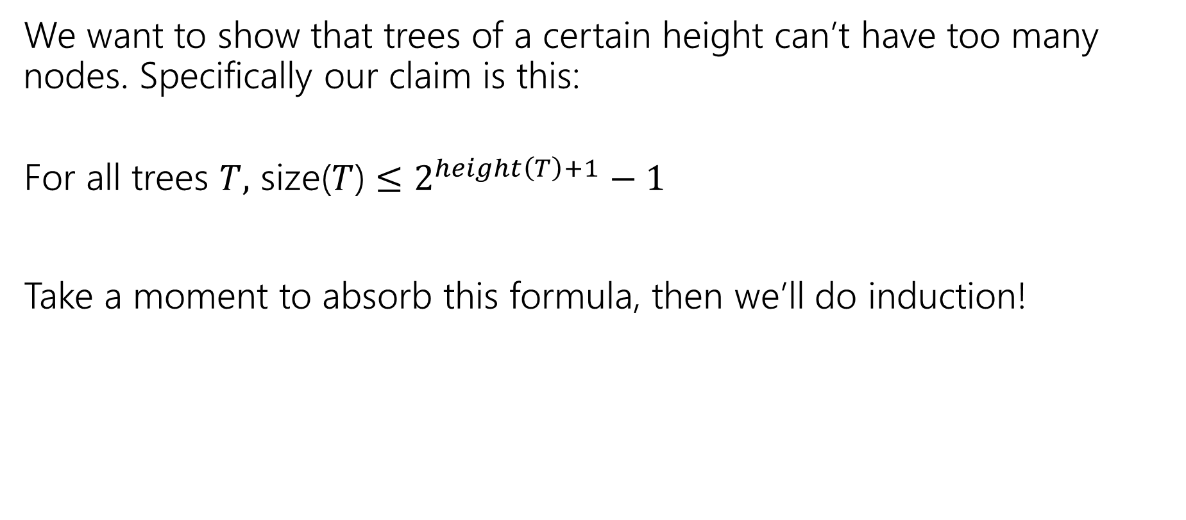

Claim
We want to show that trees of a certain height can’t have too many nodes. Specifically our claim is this:
For all trees $T,$ size($T$) $≤2^{height\left(T\right)+1}−1$
Take a moment to absorb this formula, then we’ll do induction!

Slide 7

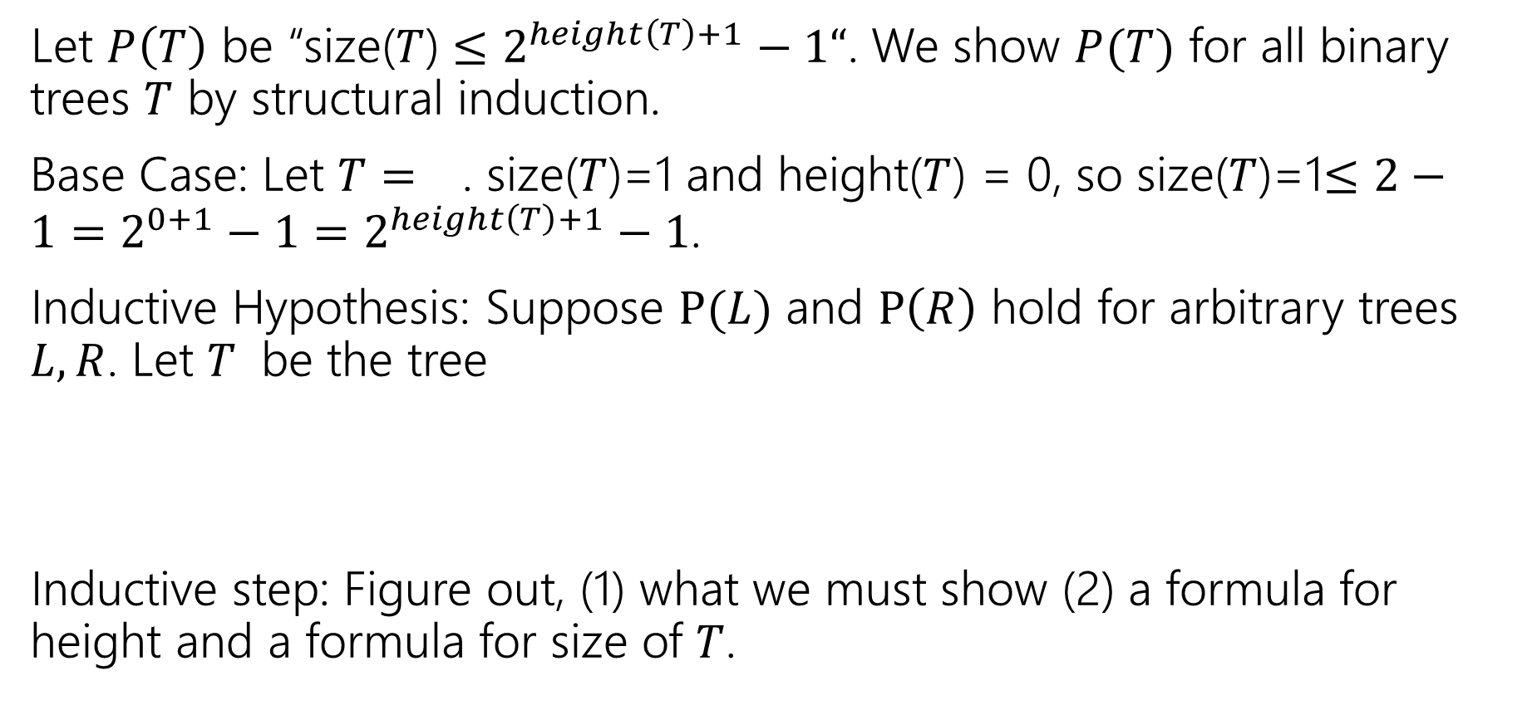


Structural Induction on Binary Trees
Let $P\left(T\right)$ be “size($T$) $≤2^{height\left(T\right)+1}−1“$. We show $P(T)$ for all binary trees $T$ by structural induction.
Base Case: Let $T=$ . size($T$)=1 and height($T$) = 0, so size($T$)=1$≤2−1=2^{0+1}−1=2^{height\left(T\right)+1}−1$.
Inductive Hypothesis: Suppose $P(L)$ and $P\left(R\right)$ hold for arbitrary trees $L,R$. Let $T$ be the tree
Inductive step: Figure out, (1) what we must show (2) a formula for height and a formula for size of $T$.
$$L$$
$$R$$

Slide 8

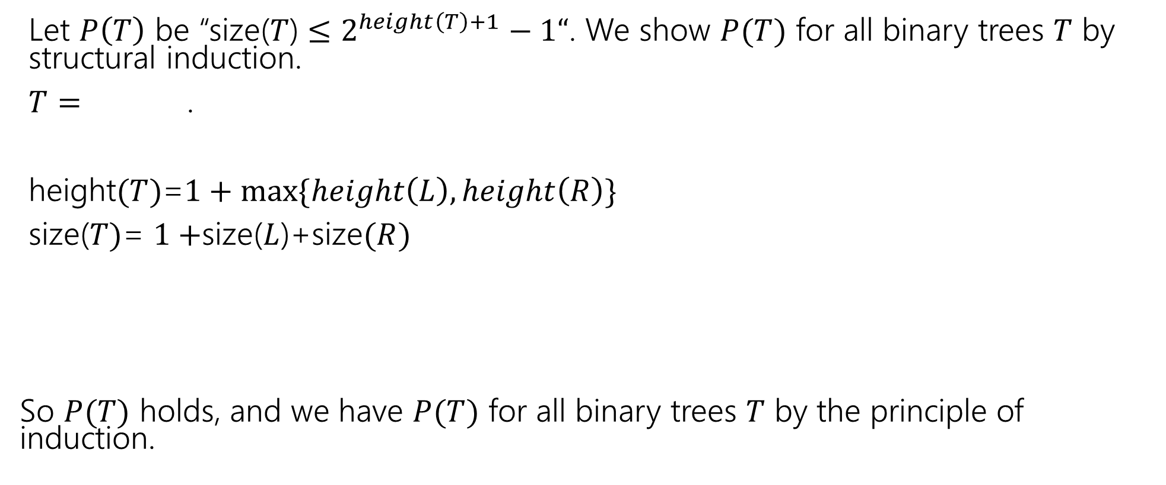


Structural Induction on Binary Trees (cont.)
Let $P\left(T\right)$ be “size($T$) $≤2^{height\left(T\right)+1}−1“$. We show $P(T)$ for all binary trees $T$ by structural induction.
$T=$ .
height$(T)$=$1+max⁡\{height\left(L\right),height\left(R\right)\}$
size($T)$= $1+$size($L$)+size$(R)$
So $P(T)$ holds, and we have $P(T)$ for all binary trees $T$ by the principle of induction.
$$L$$
$$R$$

Slide 9





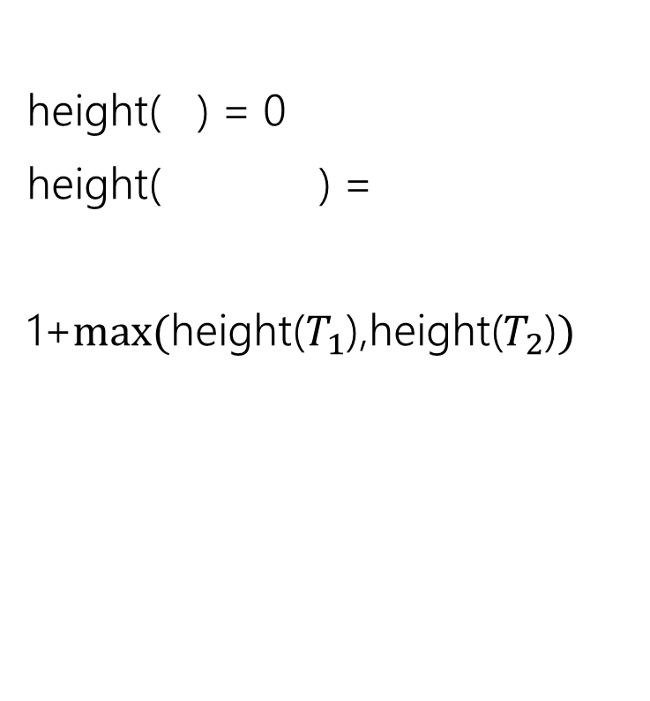



How do heights compare?
If $L$ is taller than $R$?
If $L,R$ same height?
If $R$ is taller than $L$?
$$L$$
$$R$$
$$L$$
$$R$$
$$L$$
$$R$$
height( ) = 0
height( ) =
1+$max⁡($height($T_{1}$),height($T_{2}$)$)$
$$T_{1}$$
$$T_{2}$$

Slide 10

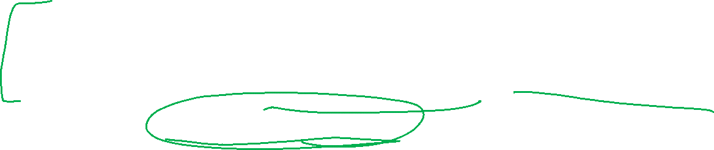


How do heights compare?
If $L$ is taller than $R$?
height$\left(T\right)=$height$\left(L\right)+1$
height$(T)>$height($R)+1$
If $L,R$ same height?
height$\left(T\right)=$height$\left(L\right)+1$
height$\left(T\right)=$height($R)+1$
If $R$ is taller than $L$?
height$\left(T\right)>$height$\left(L\right)+1$
height$\left(T\right)=$height($R)+1$
$$L$$
$$R$$
$$L$$
$$R$$
$$L$$
$$R$$
In all cases: height($T$)$≥$height($L$)+1, height($T$)$≥$height($R$)+1

Slide 11
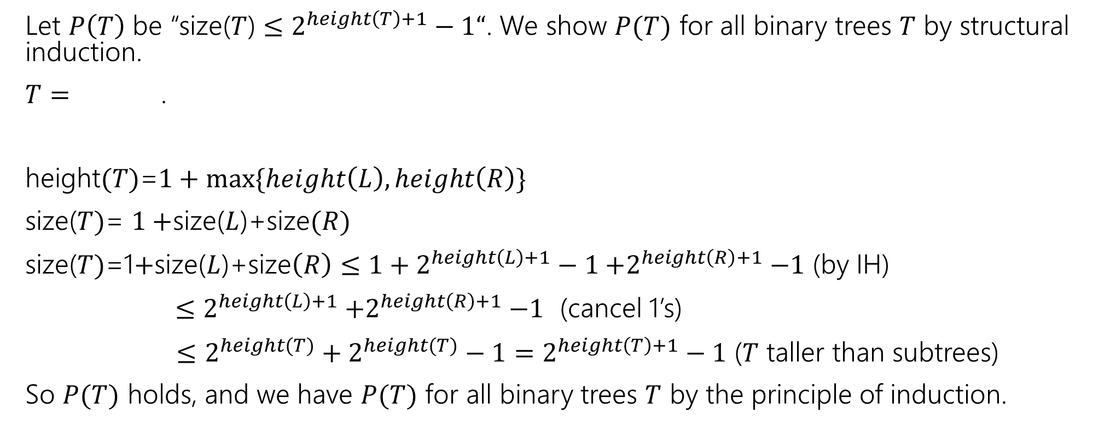
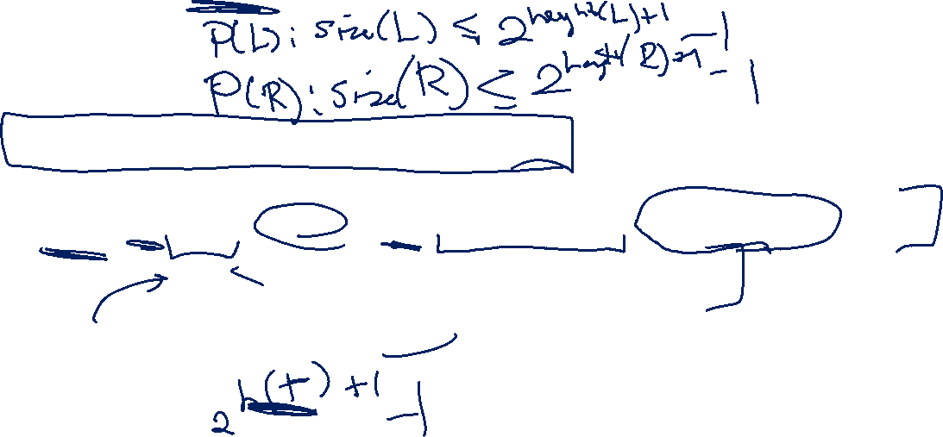
Structural Induction on Binary Trees (cont.)
Let $P\left(T\right)$ be “size($T$) $≤2^{height\left(T\right)+1}−1“$. We show $P(T)$ for all binary trees $T$ by structural induction.
$T=$ .
height$(T)$=$1+max⁡\{height\left(L\right),height\left(R\right)\}$
size($T)$= $1+$size($L$)+size$(R)$
size($T)$=1$+$size($L$)+size$\left(R\right)≤{1+2}^{height\left(L\right)+1}−1{+2}^{height\left(R\right)+1}−1$ (by IH)
$≤2^{height\left(L\right)+1}{+2}^{height\left(R\right)+1}−1$ (cancel 1’s)
$≤$ $2^{height(T)}+2^{height(T)}−1=2^{height\left(T\right)+1}−1$ ($T$ taller than subtrees)
So $P(T)$ holds, and we have $P(T)$ for all binary trees $T$ by the principle of induction.
$$L$$
$$R$$

Slide 12
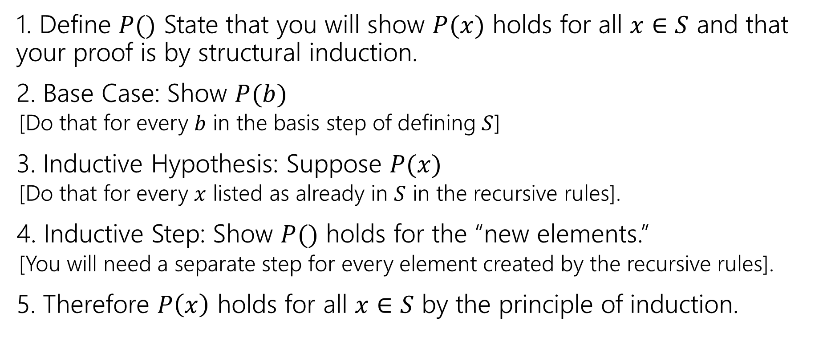
Structural Induction Template
1. Define $P()$ State that you will show $P(x)$ holds for all $x∈S$ and that your proof is by structural induction.
2. Base Case: Show $P(b)$
[Do that for every $b$ in the basis step of defining $S$]
3. Inductive Hypothesis: Suppose $P(x)$
[Do that for every $x$ listed as already in $S$ in the recursive rules].
4. Inductive Step: Show $P()$ holds for the “new elements.”
[You will need a separate step for every element created by the recursive rules].
5. Therefore $P\left(x\right)$ holds for all $x∈S$ by the principle of induction.

Slide 13
Structural Induction on Strings

Slide 14
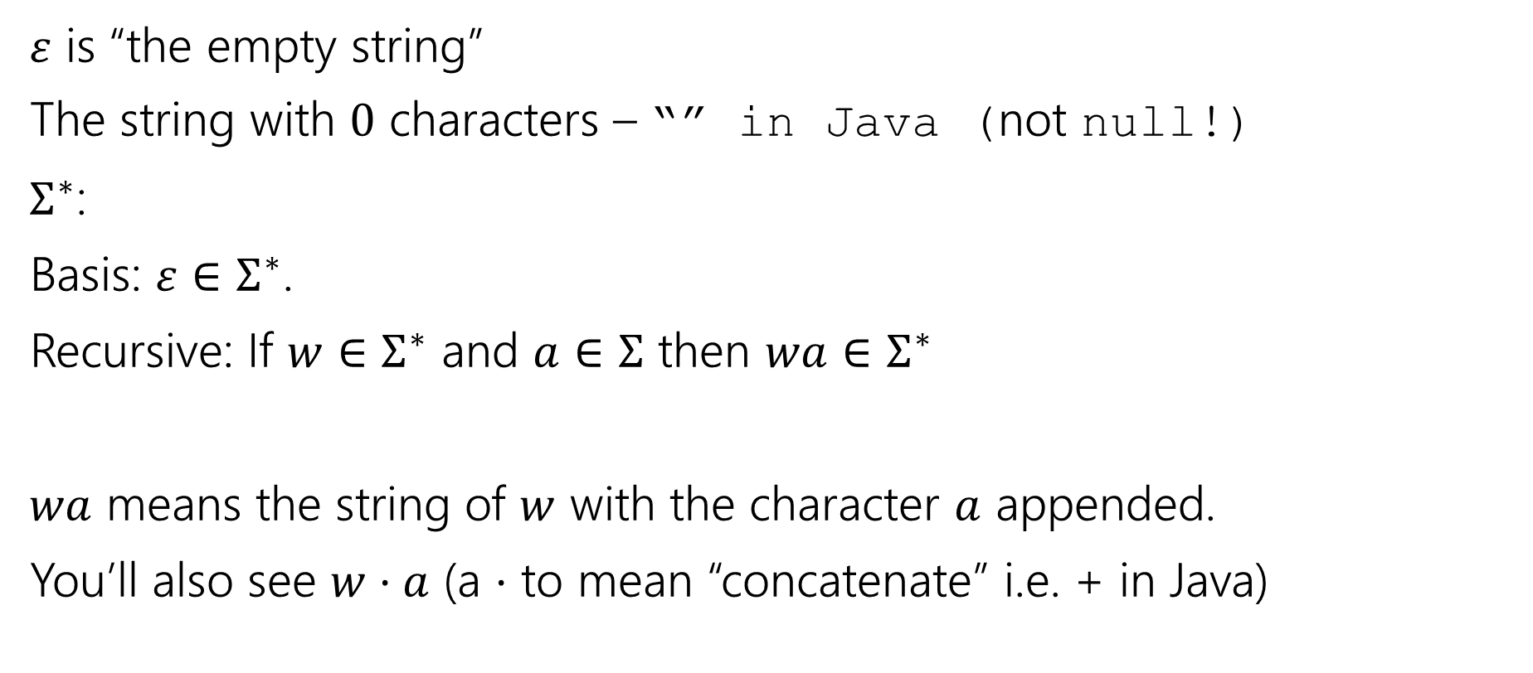
Strings
$ε$ is “the empty string”
The string with $0$ characters – “” in Java (not null!)
$Σ^{∗}$:
Basis: $ε∈Σ^{∗}$.
Recursive: If $w∈Σ^{∗}$ and $a∈Σ$ then $wa∈Σ^{∗}$
$wa$ means the string of $w$ with the character $a$ appended.
You’ll also see $w⋅a$ (a $⋅$ to mean “concatenate” i.e. + in Java)

Slide 15
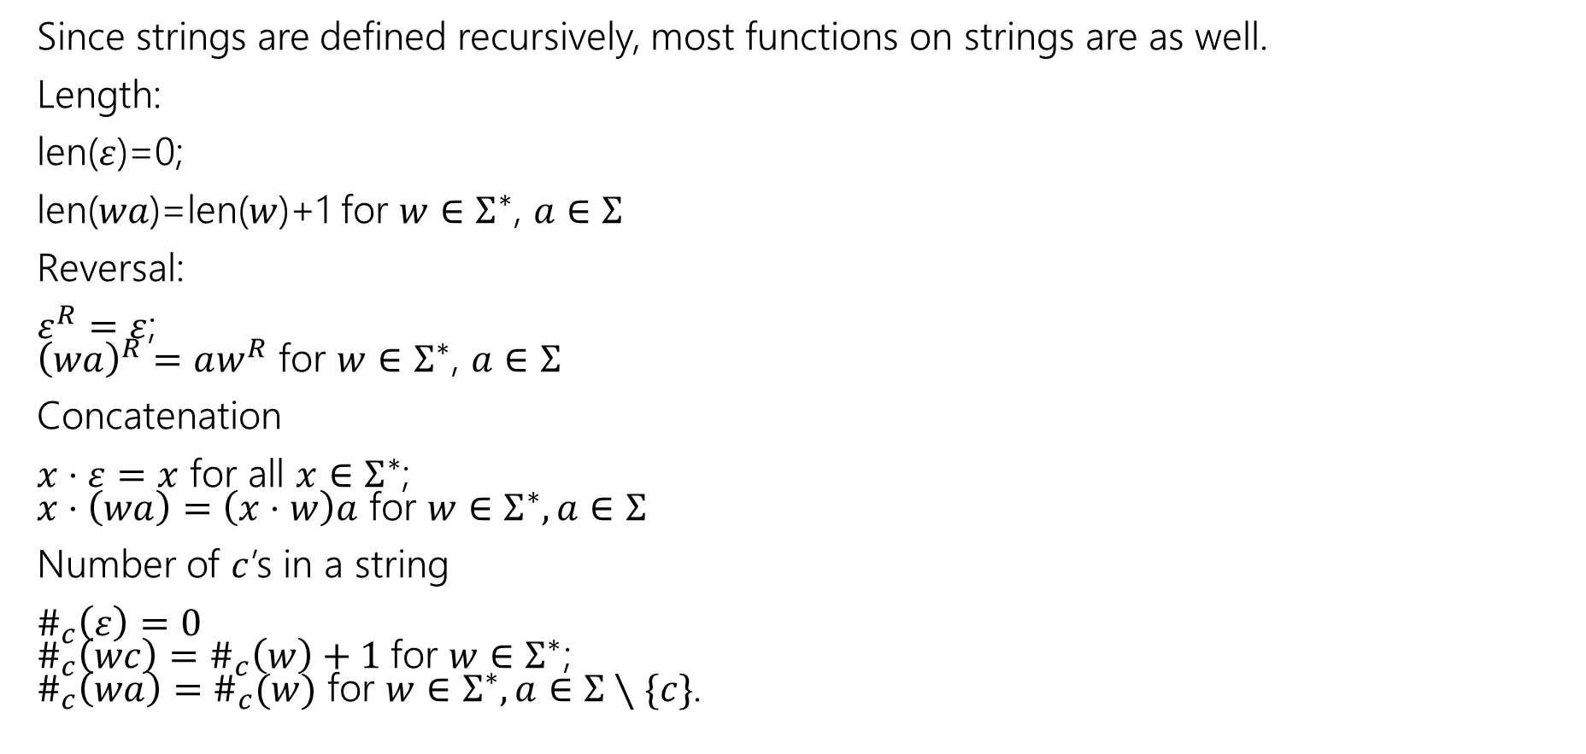
Functions on Strings
Since strings are defined recursively, most functions on strings are as well.
Length:
len($ε$)=0;
len($wa$)=len($w$)+1 for $w∈Σ^{∗}$, $a∈Σ$
Reversal:
$ε^{R}=ε$; ${\left(wa\right)}^{R}=aw^{R}$ for $w∈Σ^{∗}$, $a∈Σ$
Concatenation
$x⋅ε=x$ for all $x∈Σ^{∗}$; $x⋅\left(wa\right)=\left(x⋅w\right)a$ for $w∈Σ^{∗},a∈Σ$
Number of $c$’s in a string
$\#_{c}\left(ε\right)=0$ $\#_{c}\left(wc\right)=\#_{c}\left(w\right)+1$for $w∈Σ^{∗}$; $\#_{c}\left(wa\right)=\#_{c}(w)$ for $w∈Σ^{∗},a∈Σ∖\{c\}$.

Slide 16
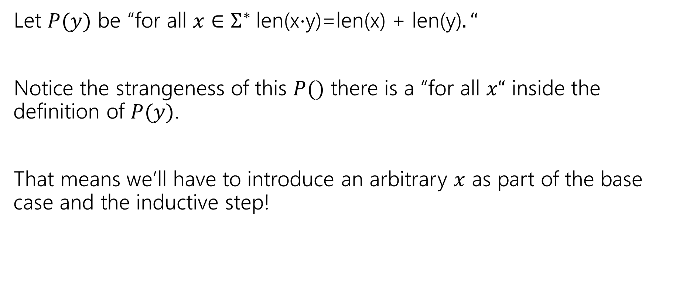
Claim for all $x,y∈Σ^{∗}$len(x$⋅$y)=len(x) + len(y).
Let $P(y)$ be “for all $x∈Σ^{∗}$len(x$⋅$y)=len(x) + len(y)$.“$
Notice the strangeness of this $P()$ there is a “for all $x“$ inside the definition of $P(y)$.
That means we’ll have to introduce an arbitrary $x$ as part of the base case and the inductive step!

Slide 17
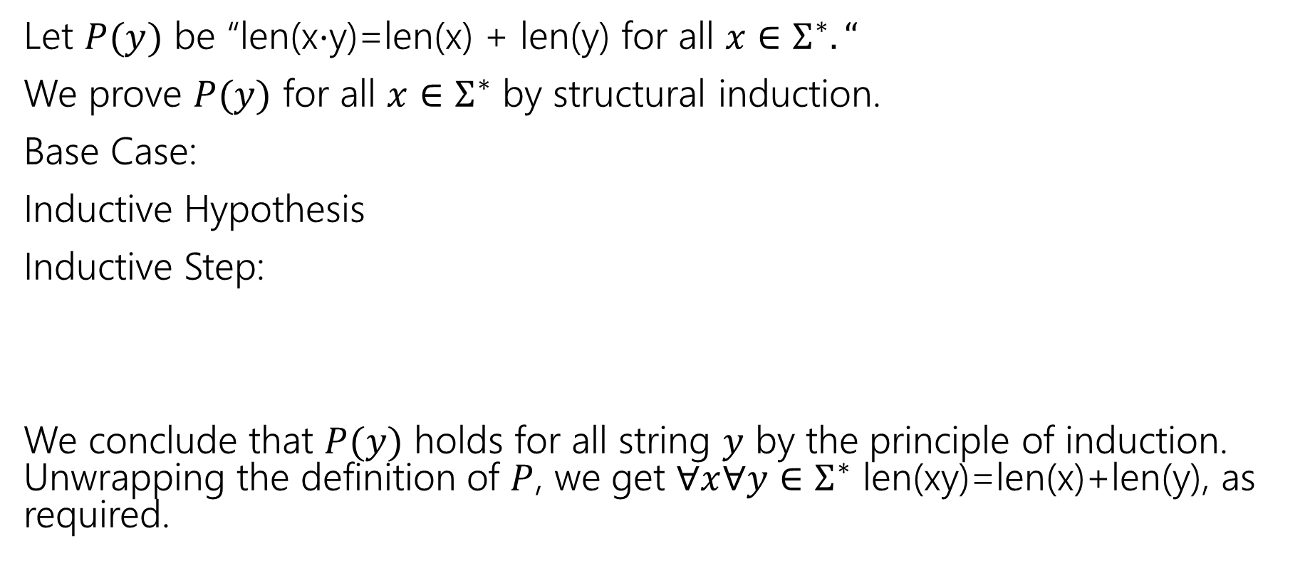
Claim for all $x,y∈Σ^{∗}$len(x$⋅$y)=len(x) + len(y).
Let $P(y)$ be “len(x$⋅$y)=len(x) + len(y) for all $x∈Σ^{∗}.“$
We prove $P(y)$ for all $x∈Σ^{∗}$ by structural induction.
Base Case:
Inductive Hypothesis
Inductive Step:
We conclude that $P(y)$ holds for all string $y$ by the principle of induction. Unwrapping the definition of $P$, we get $∀x∀y∈Σ^{∗}$ len(xy)=len(x)+len(y), as required.

Slide 18
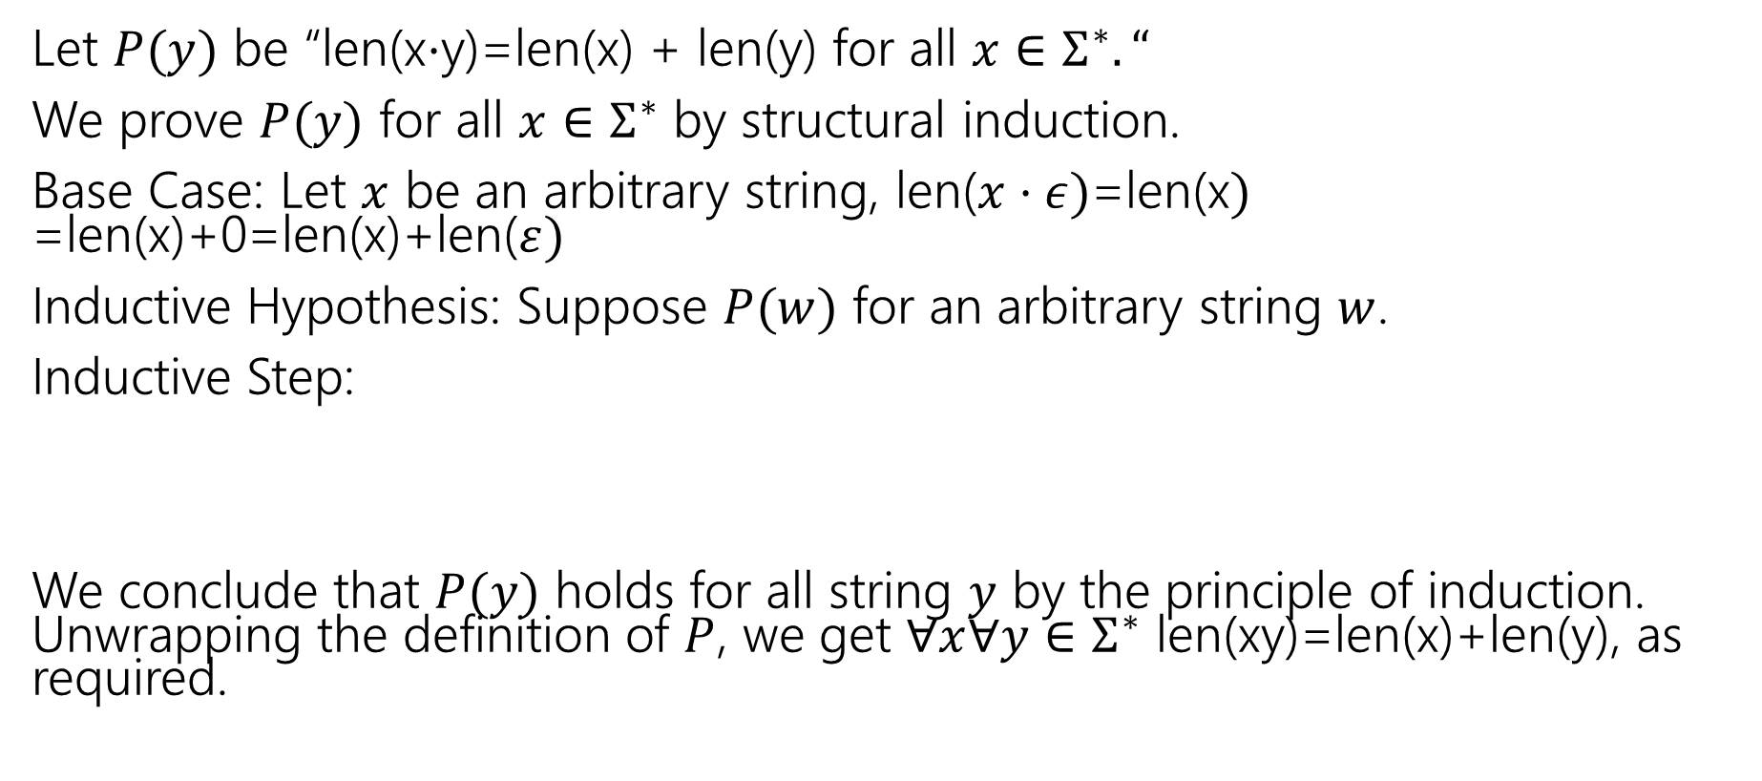
Claim for all $x,y∈Σ^{∗}$len(x$⋅$y)=len(x) + len(y).
Let $P(y)$ be “len(x$⋅$y)=len(x) + len(y) for all $x∈Σ^{∗}.“$
We prove $P(y)$ for all $x∈Σ^{∗}$ by structural induction.
Base Case: Let $x$ be an arbitrary string, len($x⋅ε)$=len(x$)$ =len(x)+0=len(x)+len($ε)$
Inductive Hypothesis: Suppose $P(w)$ for an arbitrary string $w$.
Inductive Step:
We conclude that $P(y)$ holds for all string $y$ by the principle of induction. Unwrapping the definition of $P$, we get $∀x∀y∈Σ^{∗}$ len(xy)=len(x)+len(y), as required.

Slide 19
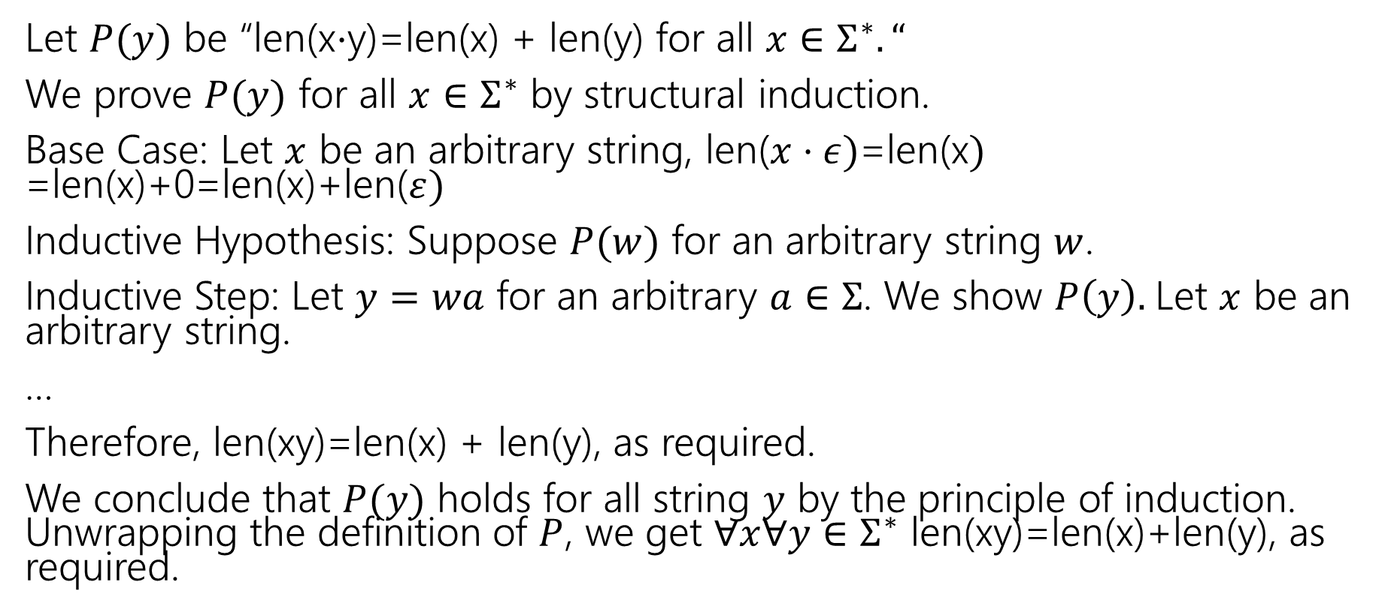
Claim for all $x,y∈Σ^{∗}$len(x$⋅$y)=len(x) + len(y).
Let $P(y)$ be “len(x$⋅$y)=len(x) + len(y) for all $x∈Σ^{∗}.“$
We prove $P(y)$ for all $x∈Σ^{∗}$ by structural induction.
Base Case: Let $x$ be an arbitrary string, len($x⋅ε)$=len(x$)$ =len(x)+0=len(x)+len($ε)$
Inductive Hypothesis: Suppose $P(w)$ for an arbitrary string $w$.
Inductive Step: Let $y=wa$ for an arbitrary $a∈Σ$. We show $P\left(y\right).$Let $x$ be an arbitrary string.
…
Therefore, len(xy)=len(x) + len(y), as required.
We conclude that $P(y)$ holds for all string $y$ by the principle of induction. Unwrapping the definition of $P$, we get $∀x∀y∈Σ^{∗}$ len(xy)=len(x)+len(y), as required.

Slide 20
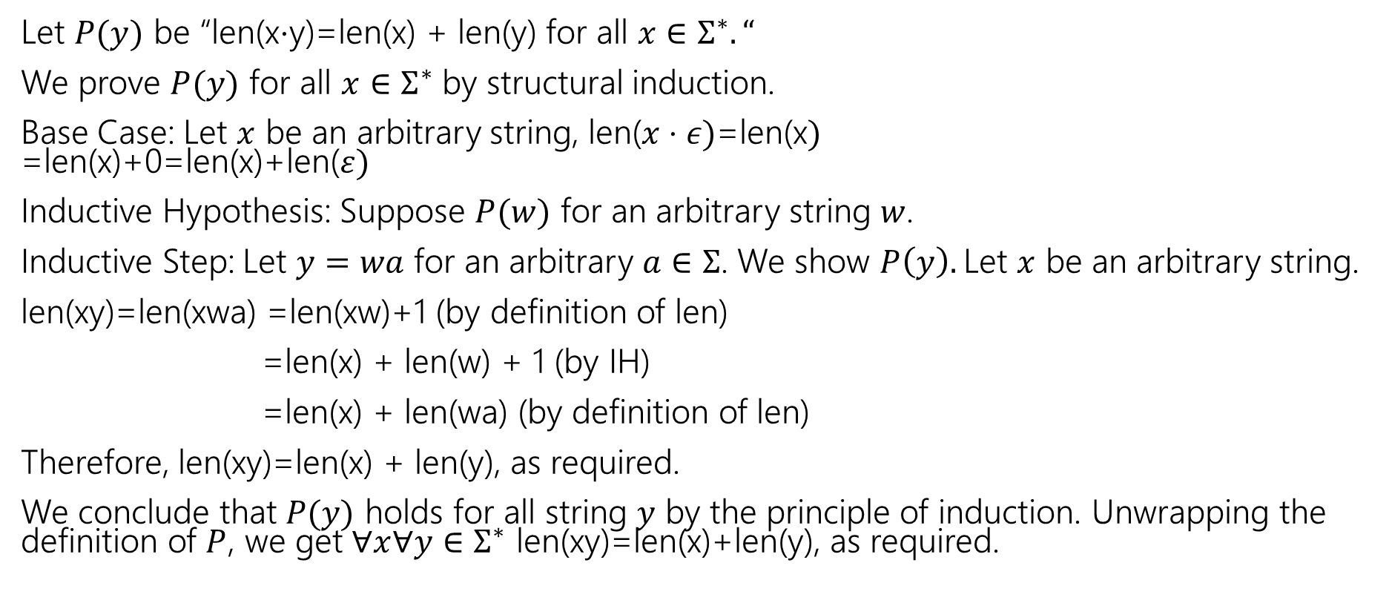
Claim for all $x,y∈Σ^{∗}$len(x$⋅$y)=len(x) + len(y).
Let $P(y)$ be “len(x$⋅$y)=len(x) + len(y) for all $x∈Σ^{∗}.“$
We prove $P(y)$ for all $x∈Σ^{∗}$ by structural induction.
Base Case: Let $x$ be an arbitrary string, len($x⋅ε)$=len(x$)$ =len(x)+0=len(x)+len($ε)$
Inductive Hypothesis: Suppose $P(w)$ for an arbitrary string $w$.
Inductive Step: Let $y=wa$ for an arbitrary $a∈Σ$. We show $P\left(y\right).$Let $x$ be an arbitrary string.
len(xy)=len(xwa) =len(xw)+1 (by definition of len)
=len(x) + len(w) + 1 (by IH)
=len(x) + len(wa) (by definition of len)
Therefore, len(xy)=len(x) + len(y), as required.
We conclude that $P(y)$ holds for all string $y$ by the principle of induction. Unwrapping the definition of $P$, we get $∀x∀y∈Σ^{∗}$ len(xy)=len(x)+len(y), as required.

Slide 21
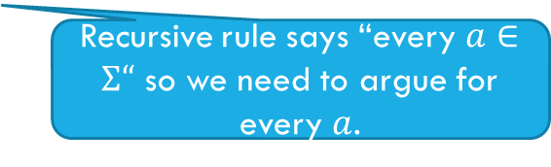
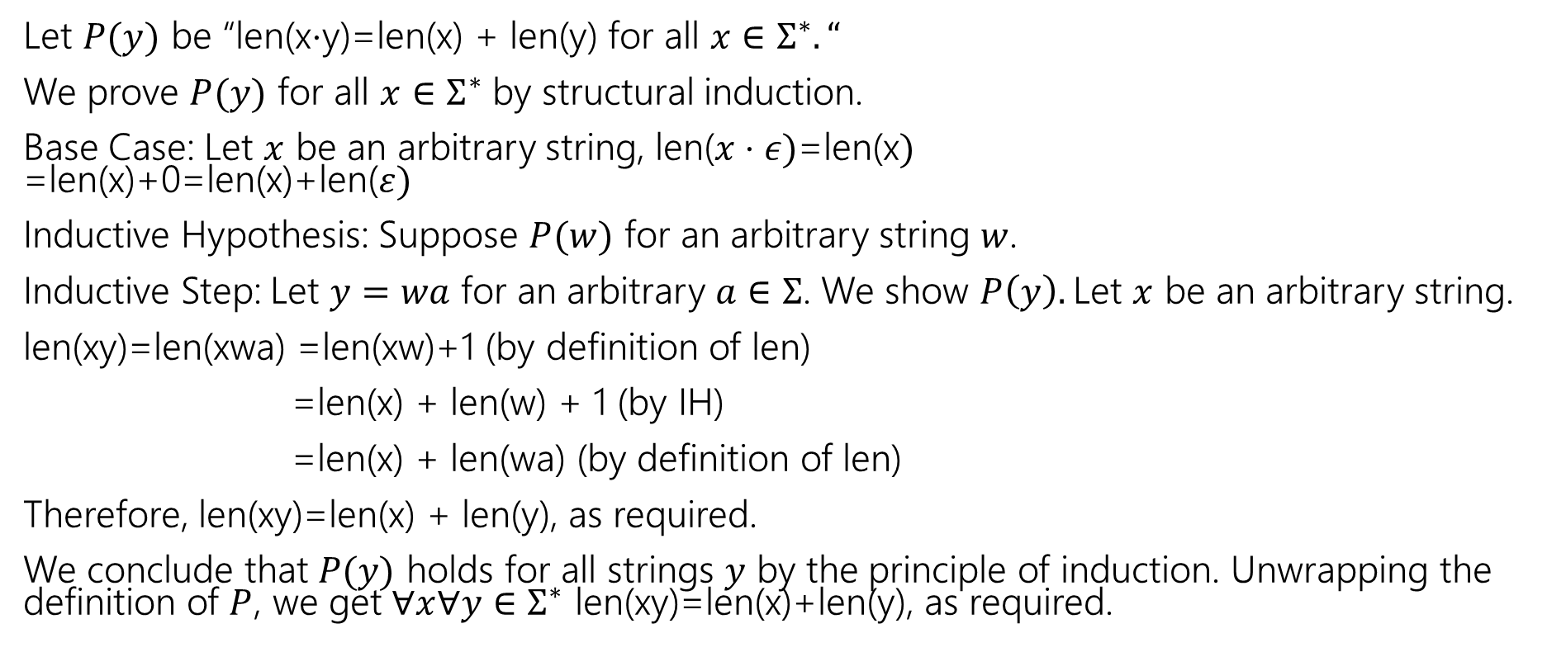

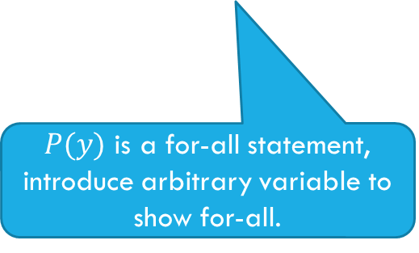
Why all those arbitraries?
$P(ε)$ is a for-all statement, introduce arbitrary variable to show for-all.
Let $P(y)$ be “len(x$⋅$y)=len(x) + len(y) for all $x∈Σ^{∗}.“$
We prove $P(y)$ for all $x∈Σ^{∗}$ by structural induction.
Base Case: Let $x$ be an arbitrary string, len($x⋅ε)$=len(x$)$ =len(x)+0=len(x)+len($ε)$
Inductive Hypothesis: Suppose $P(w)$ for an arbitrary string $w$.
Inductive Step: Let $y=wa$ for an arbitrary $a∈Σ$. We show $P\left(y\right).$Let $x$ be an arbitrary string.
len(xy)=len(xwa) =len(xw)+1 (by definition of len)
=len(x) + len(w) + 1 (by IH)
=len(x) + len(wa) (by definition of len)
Therefore, len(xy)=len(x) + len(y), as required.
We conclude that $P(y)$ holds for all strings $y$ by the principle of induction. Unwrapping the definition of $P$, we get $∀x∀y∈Σ^{∗}$ len(xy)=len(x)+len(y), as required.
Needs to be arbitrary because it’s in the IH (induction wouldn’t show “all strings” otherwise)
Recursive rule says “every $a∈Σ“$ so we need to argue for every $a$.
$P(y)$ is a for-all statement, introduce arbitrary variable to show for-all.

Slide 22
A few last comments

Slide 23
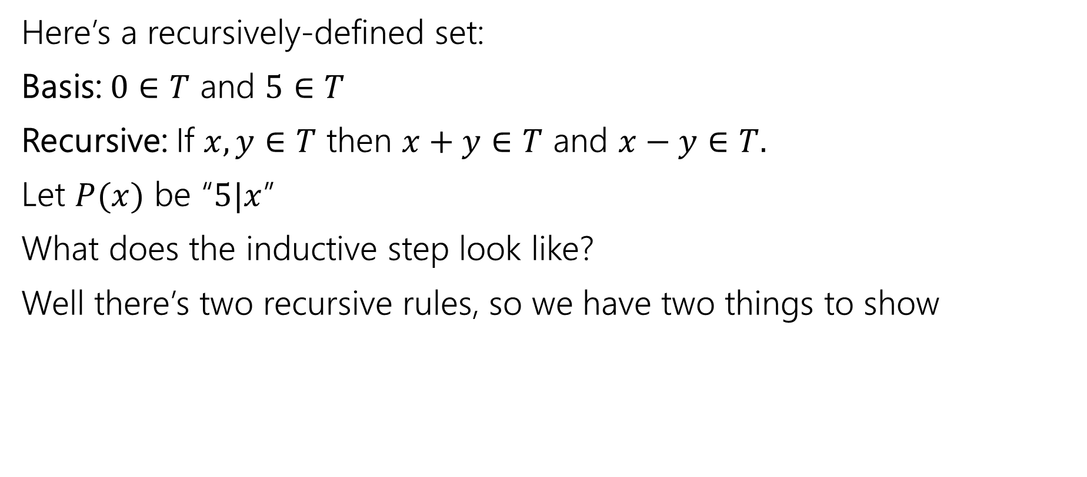

What does the inductive step look like?
Here’s a recursively-defined set:
Basis: $0∈T$ and $5∈T$
Recursive: If $x,y∈T$ then $x+y∈T$ and $x−y∈T.$
Let $P(x)$ be “$5|x$”
What does the inductive step look like?
Well there’s two recursive rules, so we have two things to show

Slide 24
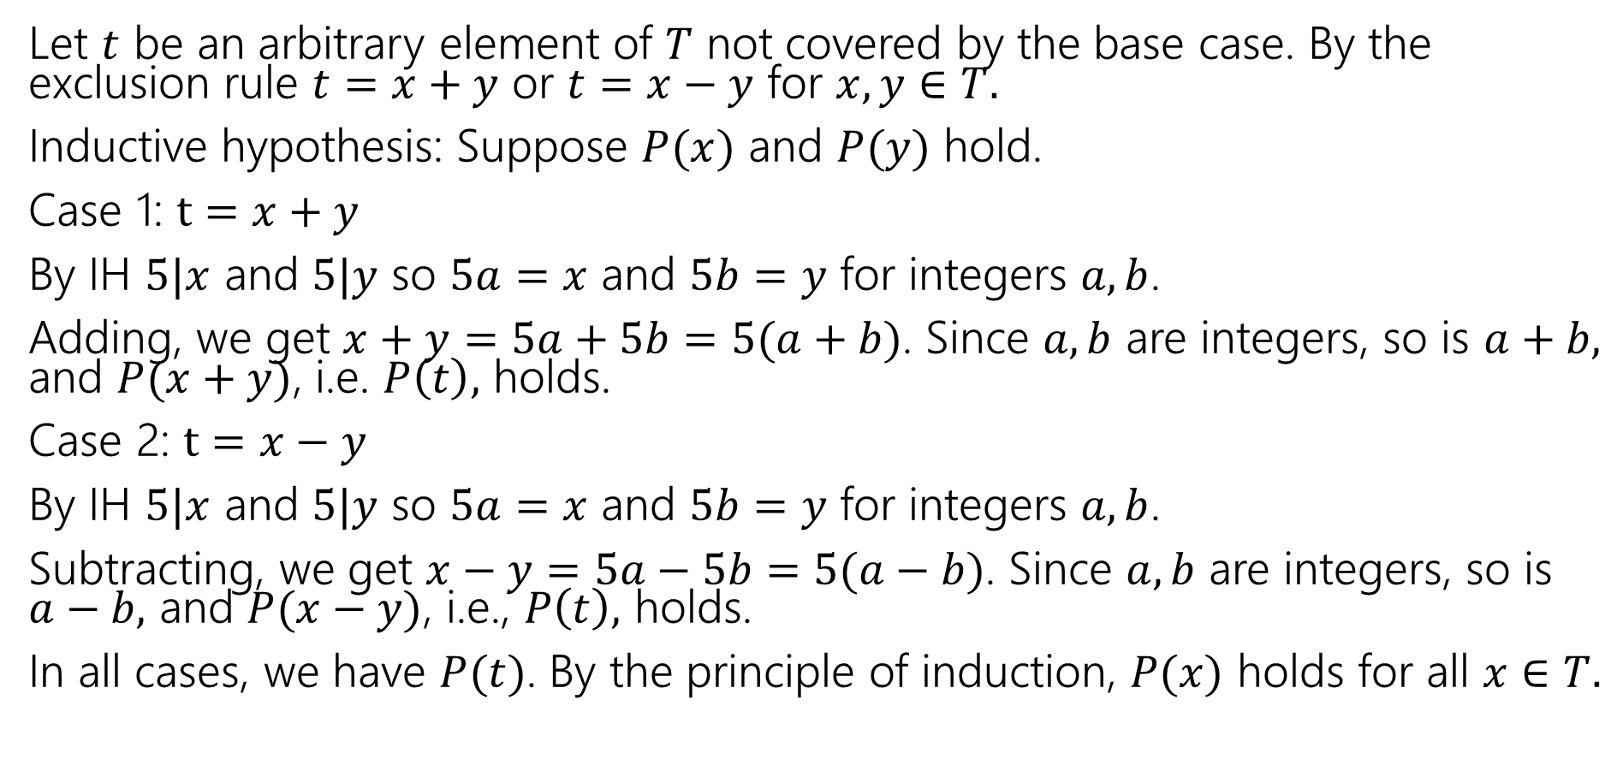
Just the IS (you still need the other steps)
Let $t$ be an arbitrary element of $T$ not covered by the base case. By the exclusion rule $t=x+y$ or $t=x−y$ for $x,y∈T.$
Inductive hypothesis: Suppose $P(x)$ and $P(y)$ hold.
Case 1: $t=x+y$
By IH $5|x$ and $5|y$ so $5a=x$ and $5b=y$ for integers $a,b$.
Adding, we get $x+y=5a+5b=5(a+b)$. Since $a,b$ are integers, so is $a+b,$ and $P(x+y)$, i.e. $P\left(t\right),$ holds.
Case 2: $t=x−y$
By IH $5|x$ and $5|y$ so $5a=x$ and $5b=y$ for integers $a,b$.
Subtracting, we get $x−y=5a−5b=5(a−b)$. Since $a,b$ are integers, so is $a−b,$ and $P(x−y)$, i.e., $P\left(t\right),$ holds.
In all cases, we have $P(t)$. By the principle of induction, $P(x)$ holds for all $x∈T.$

Slide 25
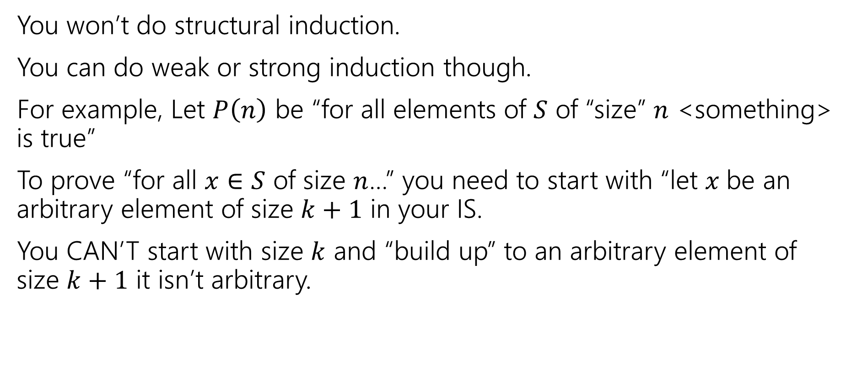
If you don’t have a recursively-defined set
You won’t do structural induction.
You can do weak or strong induction though.
For example, Let $P\left(n\right)$ be “for all elements of $S$ of “size” $n$ <something> is true”
To prove “for all $x∈S$ of size $n$…” you need to start with “let $x$be an arbitrary element of size $k+1$ in your IS.
You CAN’T start with size $k$ and “build up” to an arbitrary element of size $k+1$ it isn’t arbitrary.

Slide 26
Extra Practice

Slide 27
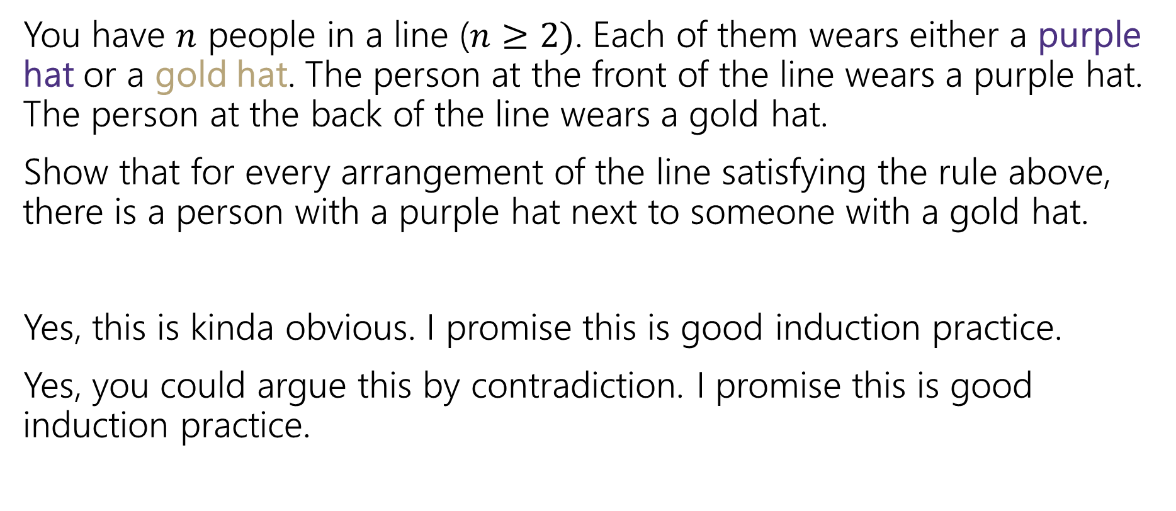
Induction: Hats!
You have $n$ people in a line ($n≥2)$. Each of them wears either a purple hat or a gold hat. The person at the front of the line wears a purple hat. The person at the back of the line wears a gold hat.
Show that for every arrangement of the line satisfying the rule above, there is a person with a purple hat next to someone with a gold hat.
Yes, this is kinda obvious. I promise this is good induction practice.
Yes, you could argue this by contradiction. I promise this is good induction practice.

Slide 28
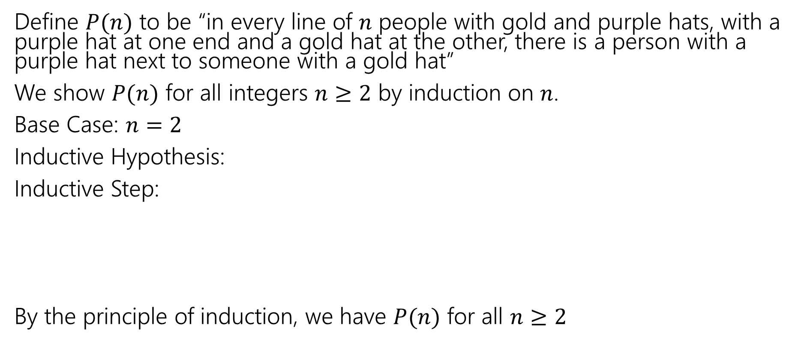
Induction: Hats!
Define $P(n)$ to be “in every line of $n$ people with gold and purple hats, with a purple hat at one end and a gold hat at the other, there is a person with a purple hat next to someone with a gold hat”
We show $P(n)$ for all integers $n≥2$ by induction on $n$.
Base Case: $n=2$
Inductive Hypothesis:
Inductive Step:
By the principle of induction, we have $P(n)$ for all $n≥2$

Slide 29
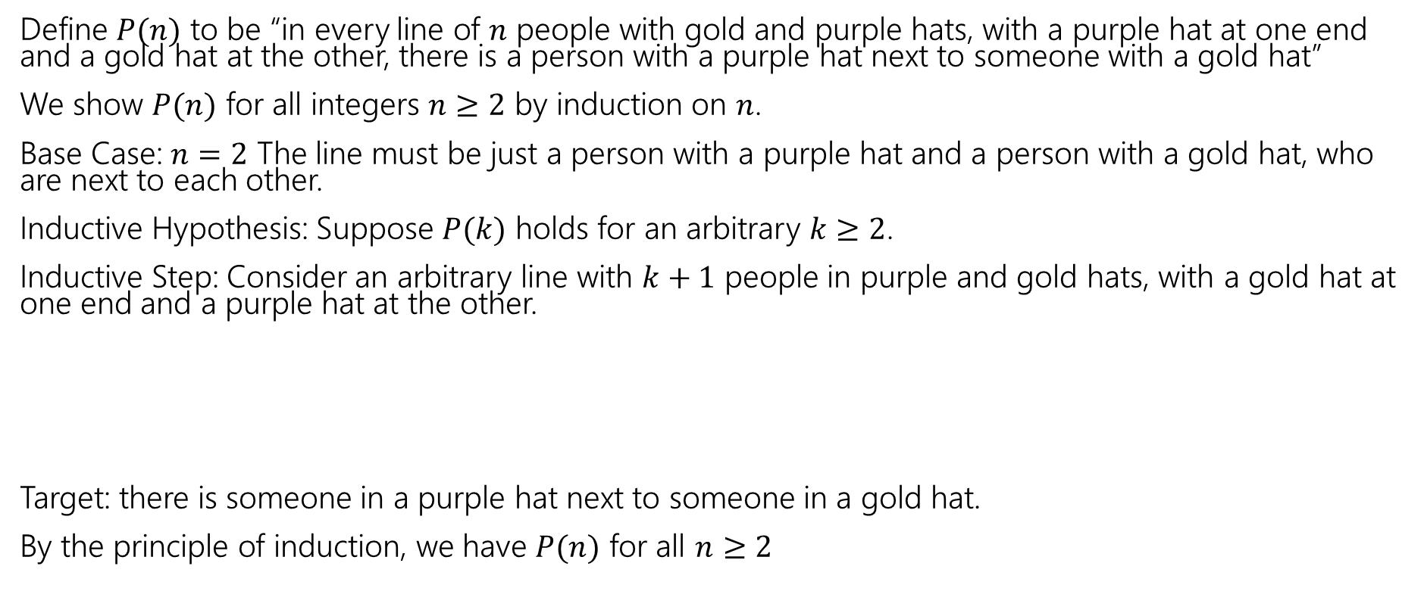
Induction: Hats!
Define $P(n)$ to be “in every line of $n$ people with gold and purple hats, with a purple hat at one end and a gold hat at the other, there is a person with a purple hat next to someone with a gold hat”
We show $P(n)$ for all integers $n≥2$ by induction on $n$.
Base Case: $n=2$ The line must be just a person with a purple hat and a person with a gold hat, who are next to each other.
Inductive Hypothesis: Suppose $P(k)$ holds for an arbitrary $k≥2$.
Inductive Step: Consider an arbitrary line with $k+1$ people in purple and gold hats, with a gold hat at one end and a purple hat at the other.
Target: there is someone in a purple hat next to someone in a gold hat.
By the principle of induction, we have $P(n)$ for all $n≥2$

Slide 30
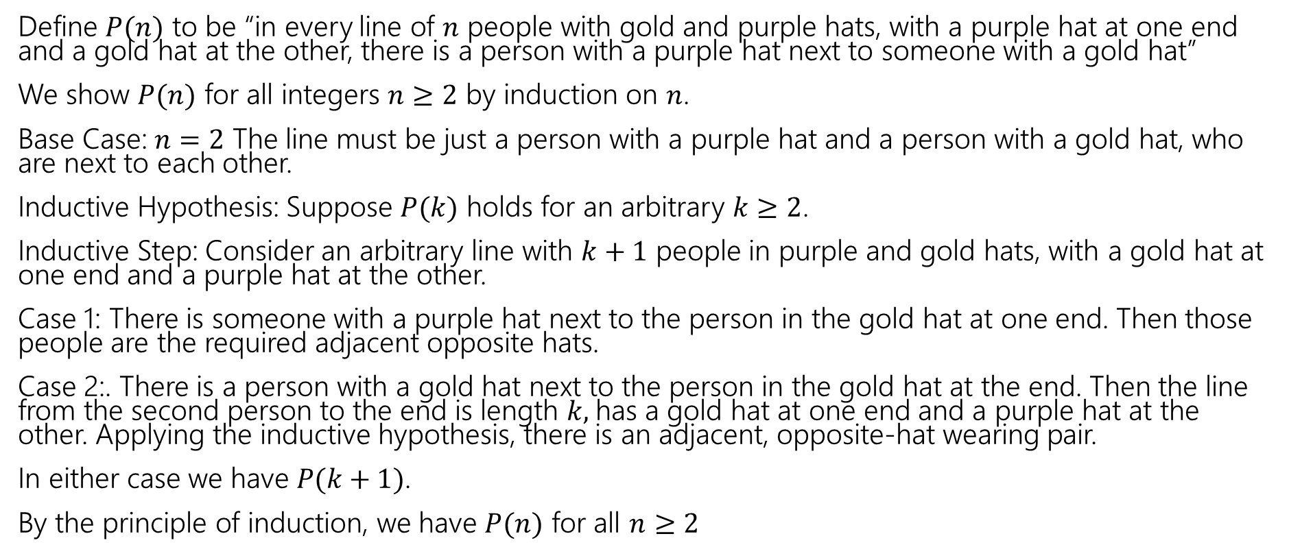
Induction: Hats!
Define $P(n)$ to be “in every line of $n$ people with gold and purple hats, with a purple hat at one end and a gold hat at the other, there is a person with a purple hat next to someone with a gold hat”
We show $P(n)$ for all integers $n≥2$ by induction on $n$.
Base Case: $n=2$ The line must be just a person with a purple hat and a person with a gold hat, who are next to each other.
Inductive Hypothesis: Suppose $P(k)$ holds for an arbitrary $k≥2$.
Inductive Step: Consider an arbitrary line with $k+1$ people in purple and gold hats, with a gold hat at one end and a purple hat at the other.
Case 1: There is someone with a purple hat next to the person in the gold hat at one end. Then those people are the required adjacent opposite hats.
Case 2:. There is a person with a gold hat next to the person in the gold hat at the end. Then the line from the second person to the end is length $k,$has a gold hat at one end and a purple hat at the other. Applying the inductive hypothesis, there is an adjacent, opposite-hat wearing pair.
In either case we have $P(k+1)$.
By the principle of induction, we have $P(n)$ for all $n≥2$

