Slide 1
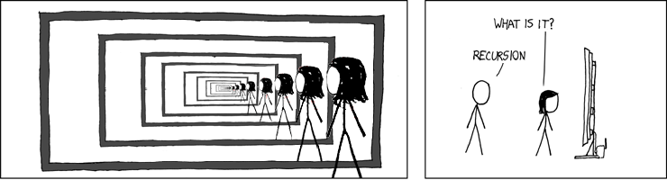
Structural Induction
CSE 311 Autumn 25
Lecture 18

Slide 2
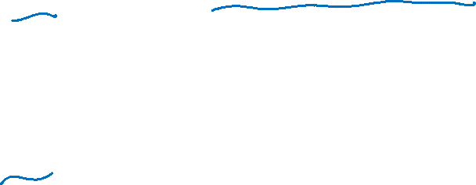
Induction Big Picture
So far: We used induction to prove a statement over the natural numbers.
“Prove that P(n) holds for all natural numbers n.”
Next goal: In CS, we deal with Strings, Lists, Trees, and other recursively defined sets. Would like to prove statements over these sets.
“Prove that P(T) holds for all trees T.”
“Prove that P(x) holds for all strings x.”

Slide 3
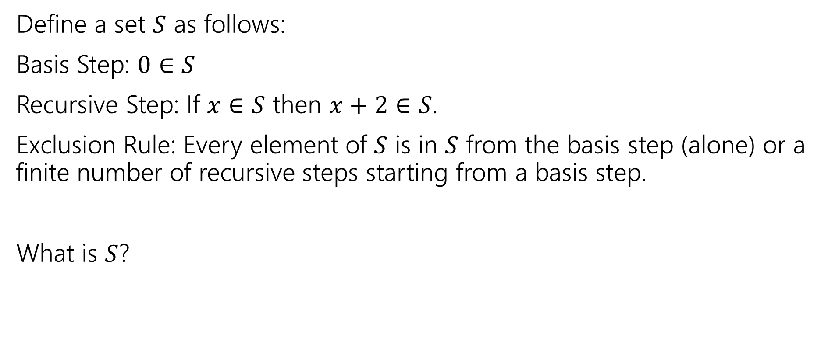
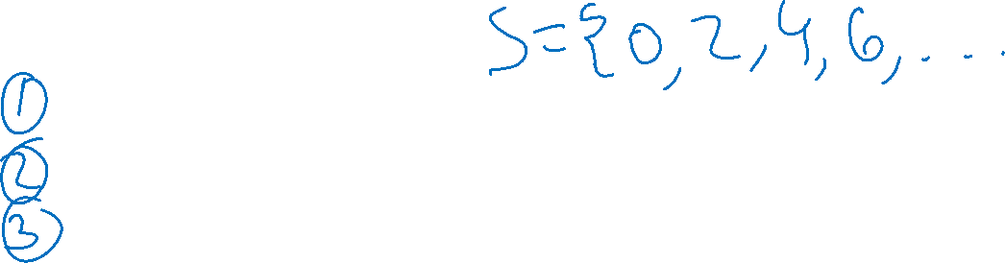
Recursive Definition of Sets
Define a set $S$ as follows:
Basis Step: $0∈S$
Recursive Step: If $x∈S$ then $x+2∈S$.
Exclusion Rule: Every element of $S$ is in $S$ from the basis step (alone) or a finite number of recursive steps starting from a basis step.
What is $S$?

Slide 4
Recursive Definitions of Sets
We’ll always list the Basis and Recursive parts of the definition.
Starting…now…we’re going to be lazy and skip writing the “exclusion” rule. It’s still part of the definition.

Slide 5
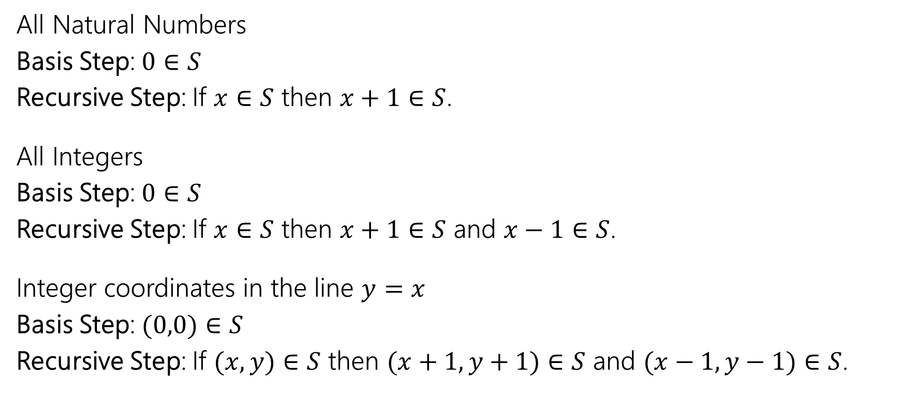

Recursive Definitions of Sets
All Natural Numbers
Basis Step: $0∈S$
Recursive Step: If $x∈S$ then $x+1∈S$.
All Integers
Basis Step: $0∈S$
Recursive Step: If $x∈S$ then $x+1∈S$ and $x−1∈S$.
Integer coordinates in the line $y=x$
Basis Step: $(0,0)∈S$
Recursive Step: If $(x,y)∈S$ then $(x+1,y+1)∈S$ and $(x−1,y−1)∈S$.

Slide 6
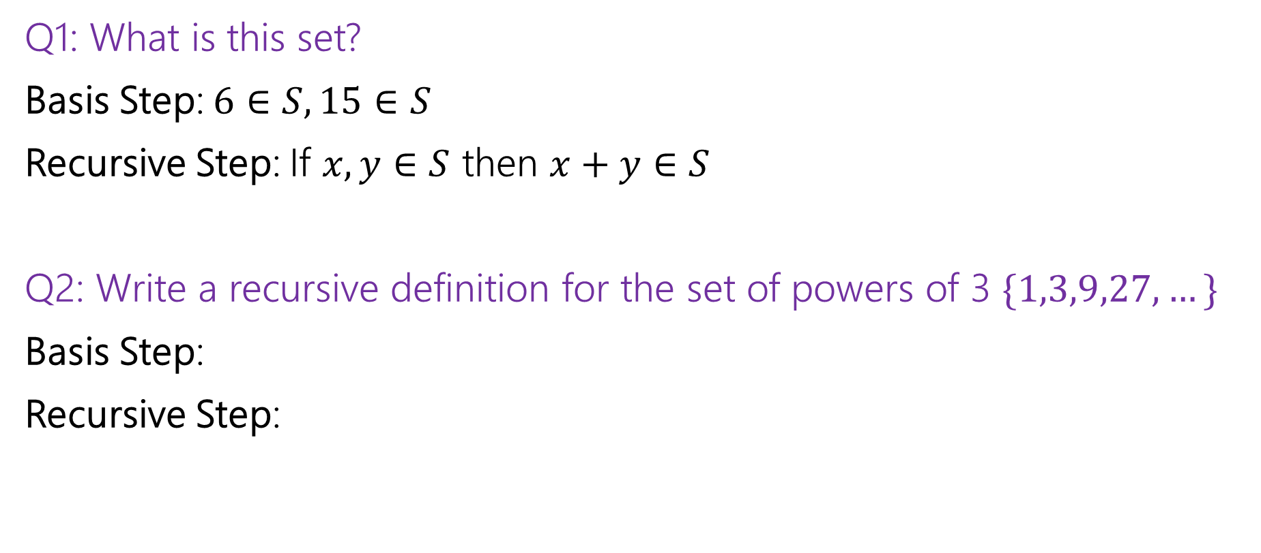
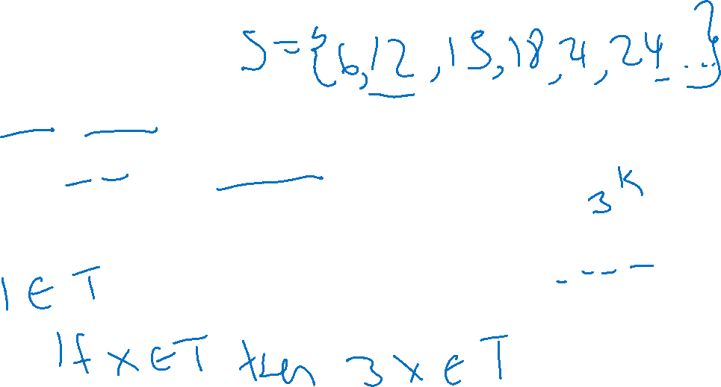
Recursive Definitions of Sets
Q1: What is this set?
Basis Step: $6∈S, 15∈S$
Recursive Step: If $x,y∈S$ then $x+y∈S$
Q2: Write a recursive definition for the set of powers of 3 $\{1,3,9,27,…\}$
Basis Step:
Recursive Step:

Slide 7
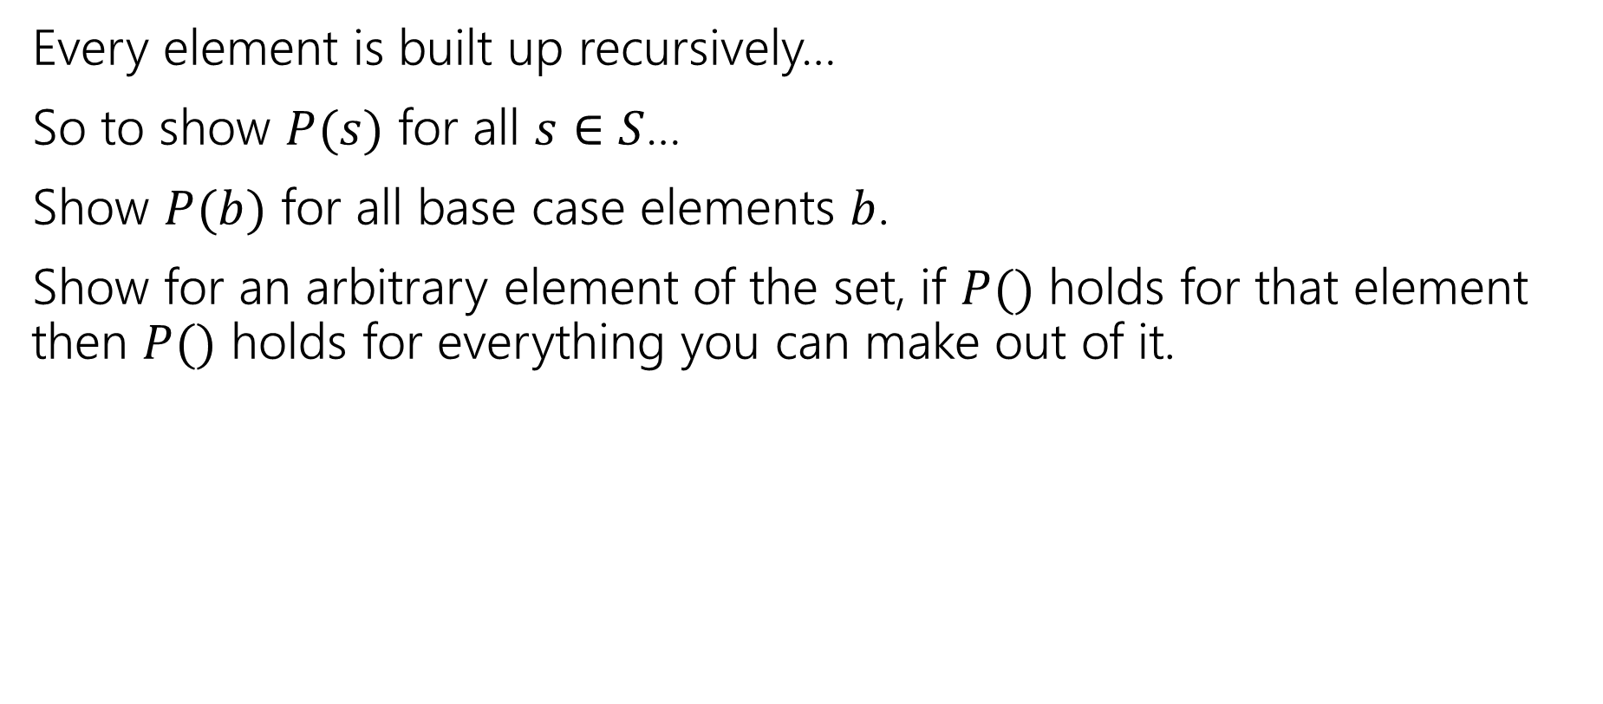
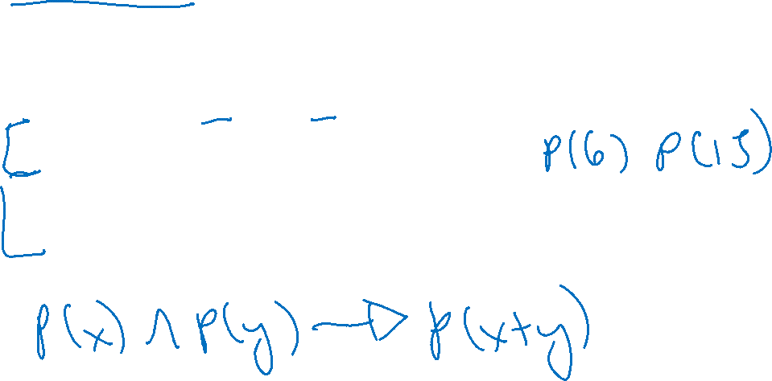
Structural Induction
Every element is built up recursively…
So to show $P(s)$ for all $s∈S$…
Show $P(b)$ for all base case elements $b$.
Show for an arbitrary element of the set, if $P()$ holds for that element then $P()$ holds for everything you can make out of it.

Slide 8

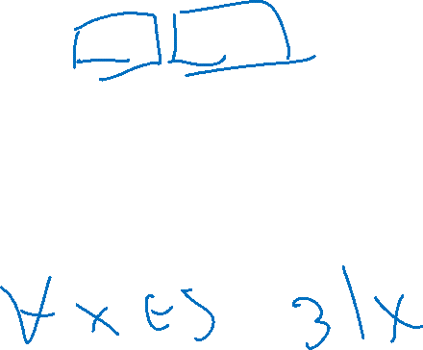
Structural Induction Example
Let $S$ be:
Basis: $6∈S, 15∈S$
Recursive: if $x,y∈S$ then $x+y∈S$.
Show that every element of $S$ is divisible by $3$.

Slide 9

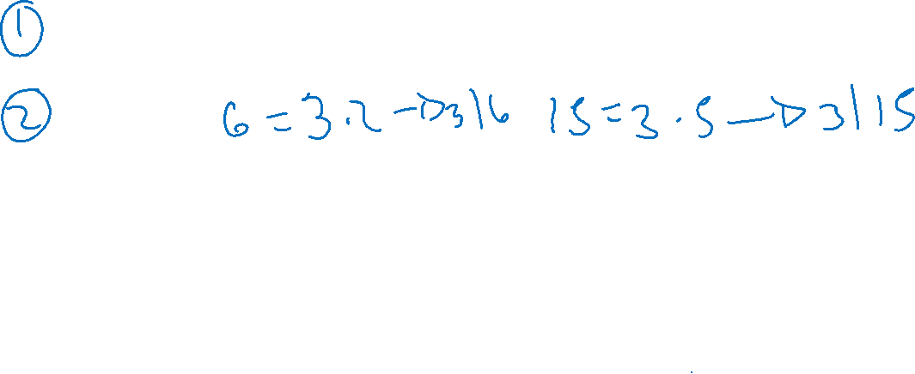
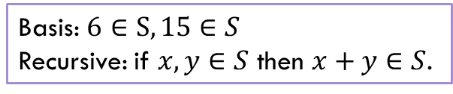
Structural Induction
Let $P(x)$ be “$x$ is divisible by $3$.”
We show $P(x)$ holds for all $x∈S$ by structural induction.
Base Cases:
Inductive Hypothesis:
Inductive Step:
We conclude $P\left(x\right)∀x∈S by$the principle of induction.
Basis: $6∈S, 15∈S$
Recursive: if $x,y∈S$ then $x+y∈S$.

Slide 10
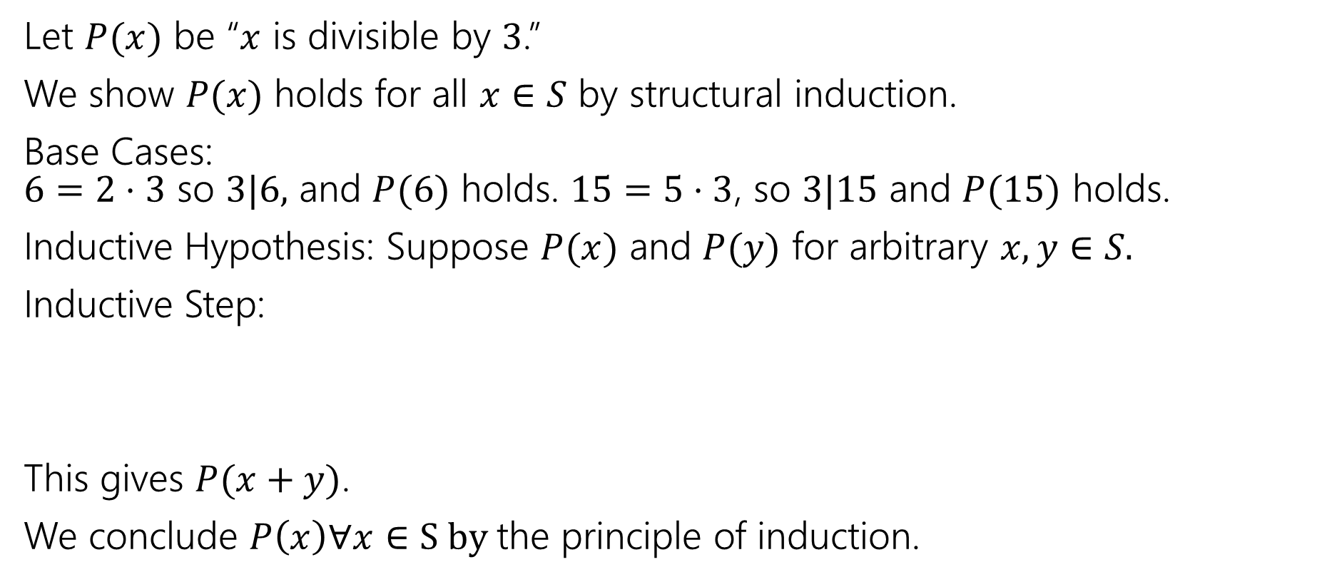
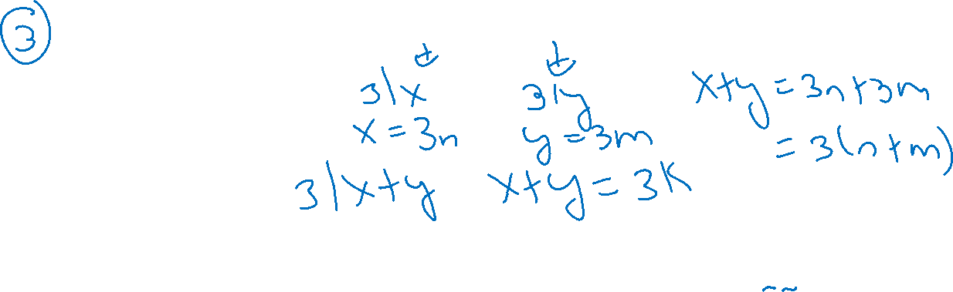
Structural Induction
Let $P(x)$ be “$x$ is divisible by $3$.”
We show $P(x)$ holds for all $x∈S$ by structural induction.
Base Cases:
$6=2⋅3$ so $3|6,$ and $P(6)$ holds. $15=5⋅3$, so $3|15$ and $P(15)$ holds.
Inductive Hypothesis: Suppose $P(x)$ and $P(y)$ for arbitrary $x,y∈S.$
Inductive Step:
This gives $P(x+y)$.
We conclude $P\left(x\right)∀x∈S by$the principle of induction.
Basis: $6∈S, 15∈S$
Recursive: if $x,y∈S$ then $x+y∈S$.

Slide 11
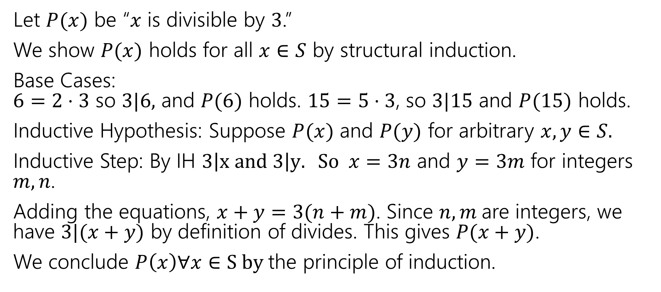

Structural Induction
Let $P(x)$ be “$x$ is divisible by $3$.”
We show $P(x)$ holds for all $x∈S$ by structural induction.
Base Cases:
$6=2⋅3$ so $3|6,$ and $P(6)$ holds. $15=5⋅3$, so $3|15$ and $P(15)$ holds.
Inductive Hypothesis: Suppose $P(x)$ and $P(y)$ for arbitrary $x,y∈S.$
Inductive Step: By IH $3\left|x and 3\right|y. So x=3n$ and $y=3m$ for integers $m,n$.
Adding the equations, $x+y=3(n+m)$. Since $n,m$are integers, we have $3|(x+y)$ by definition of divides. This gives $P(x+y)$.
We conclude $P\left(x\right)∀x∈S by$the principle of induction.
Basis: $6∈S, 15∈S$
Recursive: if $x,y∈S$ then $x+y∈S$.

Slide 12
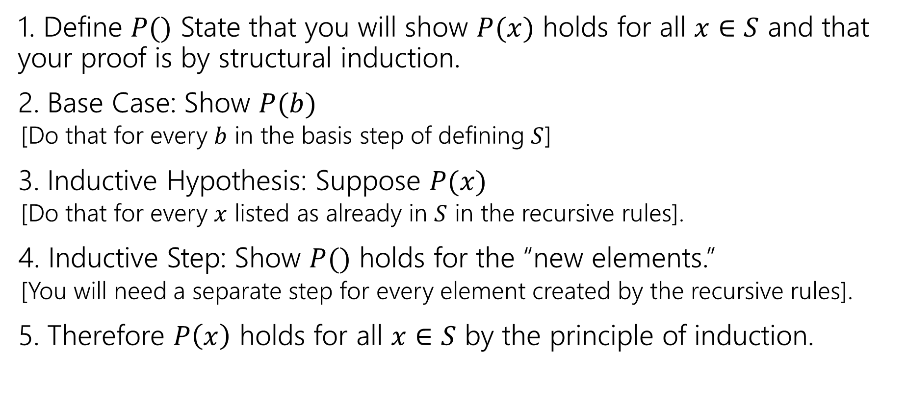
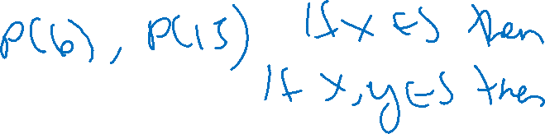
Structural Induction Template
1. Define $P()$ State that you will show $P(x)$ holds for all $x∈S$ and that your proof is by structural induction.
2. Base Case: Show $P(b)$
  [Do that for every $b$ in the basis step of defining $S$]
3. Inductive Hypothesis: Suppose $P(x)$
  [Do that for every $x$ listed as already in $S$ in the recursive rules].
4. Inductive Step: Show $P()$ holds for the “new elements.”
  [You will need a separate step for every element created by the recursive rules].
5. Therefore $P\left(x\right)$ holds for all $x∈S$ by the principle of induction.

Slide 13
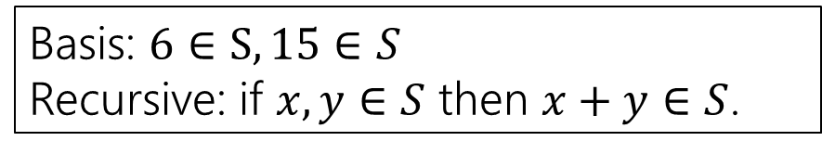
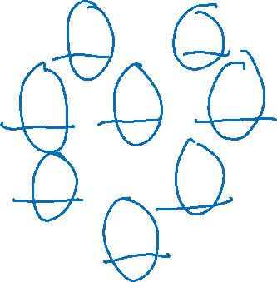

Wait a minute! Why can we do this?
S
Basis: $6∈S, 15∈S$
Recursive: if $x,y∈S$ then $x+y∈S$.
6
15
We proved:
Base Case: P(6) and P(15)
IH $→$ IS: If P(x) and P(y), then P(x+y)
12
21
30
18
27
24…

Slide 14


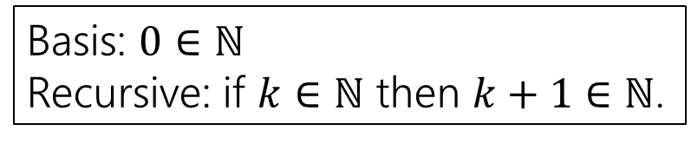
Weak Induction is a special case of Structural
$ℕ$
Basis: $0∈ℕ$
Recursive: if $k∈ℕ$ then $k+1∈ℕ$.
0
1
2
We proved:
Base Case: P(0)
IH $→$ IS: If P(k), then P(k+1)
3
4
5
6
7
8…

Slide 15
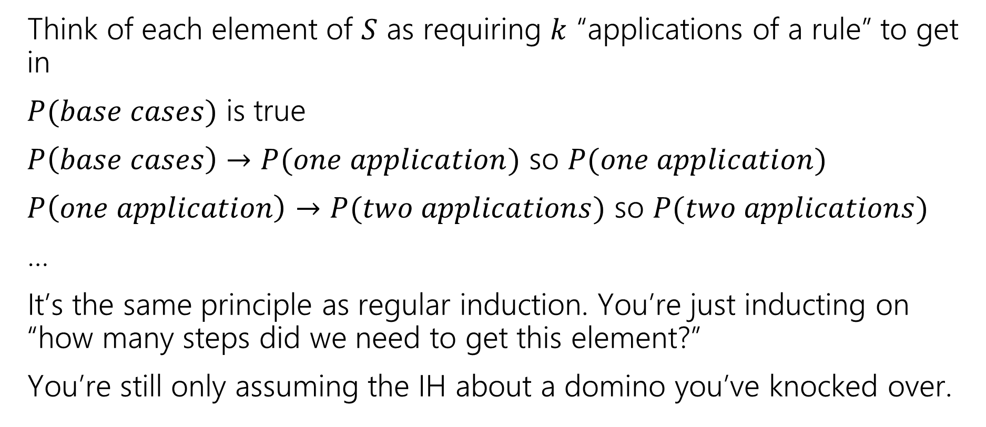
Wait a minute! Why can we do this?
Think of each element of $S$ as requiring $k$ “applications of a rule” to get in
$P(base cases)$ is true
$P\left(base cases\right)→P(one application)$ so $P(one application)$
$P\left(one application\right)→P(two applications)$ so $P(two applications)$
…
It’s the same principle as regular induction. You’re just inducting on “how many steps did we need to get this element?”
You’re still only assuming the IH about a domino you’ve knocked over.

Slide 16
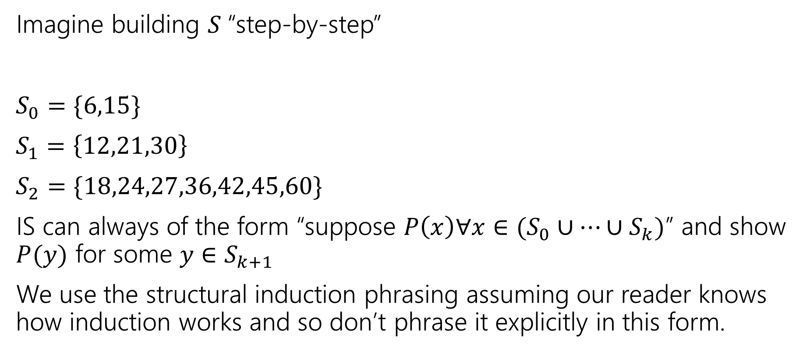
Wait a minute! Why can we do this?
Imagine building $S$“step-by-step”
$S_{0}=\{6,15\}$
$S_{1}=\left\{12,21,30\right\}$
$S_{2}=\{18,24,27,36,42,45,60\}$
IS can always of the form “suppose $P\left(x\right)∀x∈(S_{0}∪…∪S_{k})$” and show $P(y)$ for some $y∈S_{k+1}$
We use the structural induction phrasing assuming our reader knows how induction works and so don’t phrase it explicitly in this form.

Slide 17
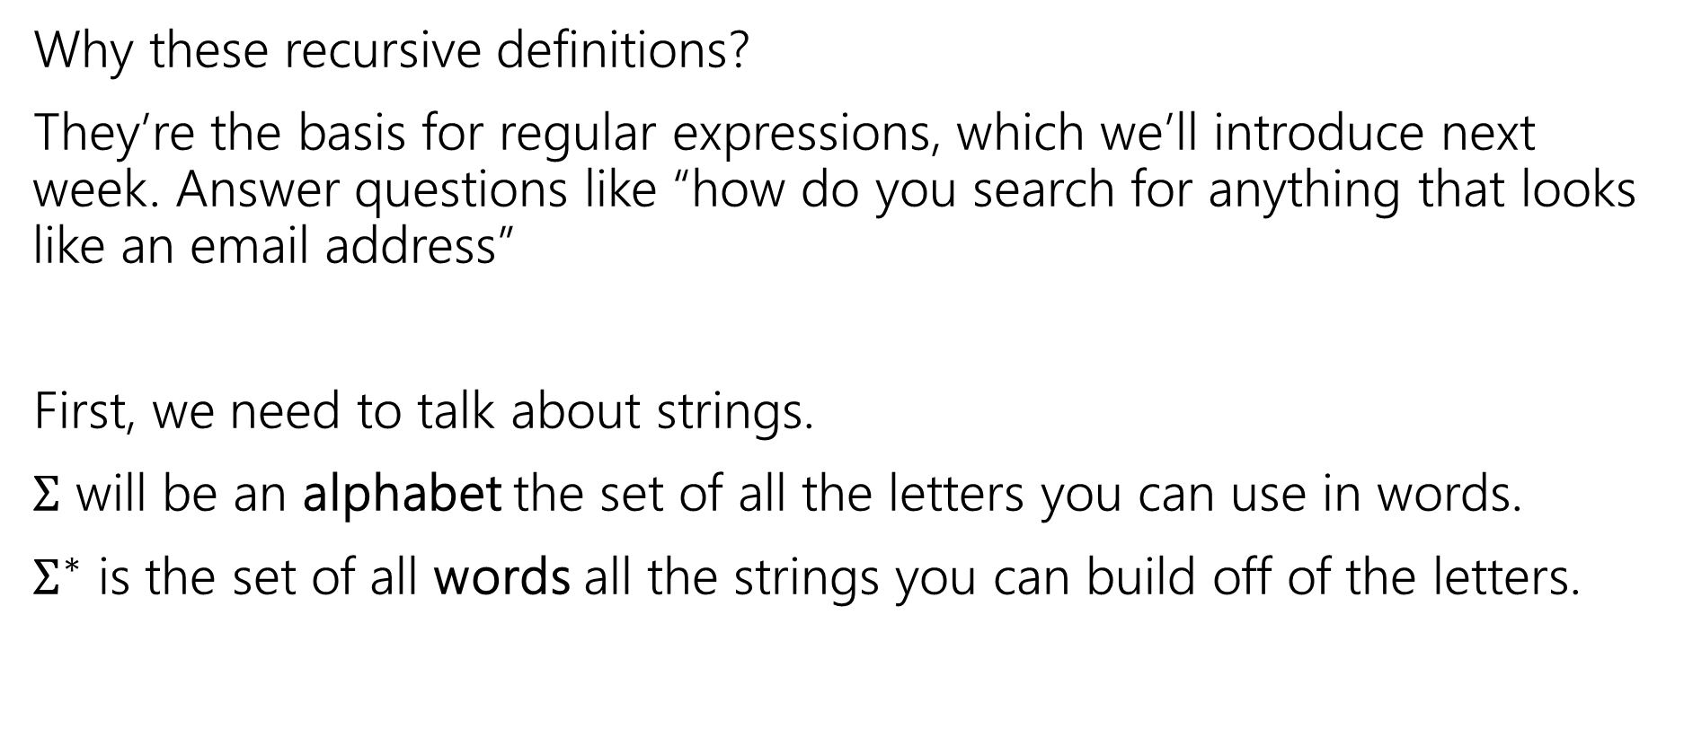
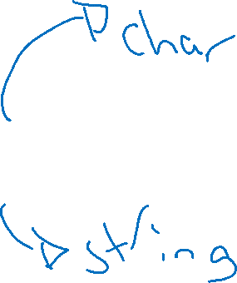
Strings
Why these recursive definitions?
They’re the basis for regular expressions, which we’ll introduce next week. Answer questions like “how do you search for anything that looks like an email address”
First, we need to talk about strings.
$Σ$ will be an alphabet the set of all the letters you can use in words.
$Σ^{∗}$ is the set of all words all the strings you can build off of the letters.

Slide 18
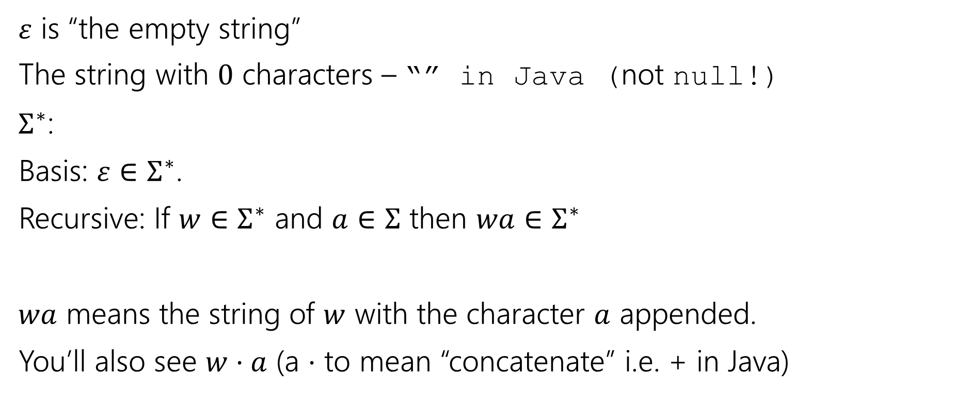
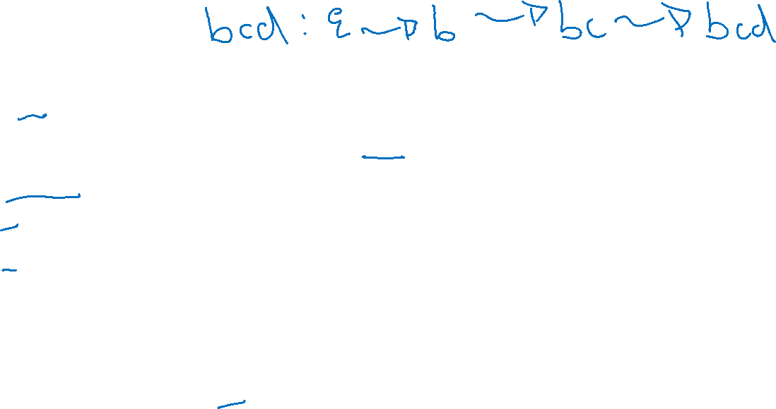
Strings
$ε$ is “the empty string”
The string with $0$ characters – “” in Java (not null!)
$Σ^{∗}$:
Basis: $ε∈Σ^{∗}$.
Recursive: If $w∈Σ^{∗}$ and $a∈Σ$ then $wa∈Σ^{∗}$
$wa$ means the string of $w$ with the character $a$ appended.
You’ll also see $w⋅a$ (a $⋅$ to mean “concatenate” i.e. + in Java)

Slide 19
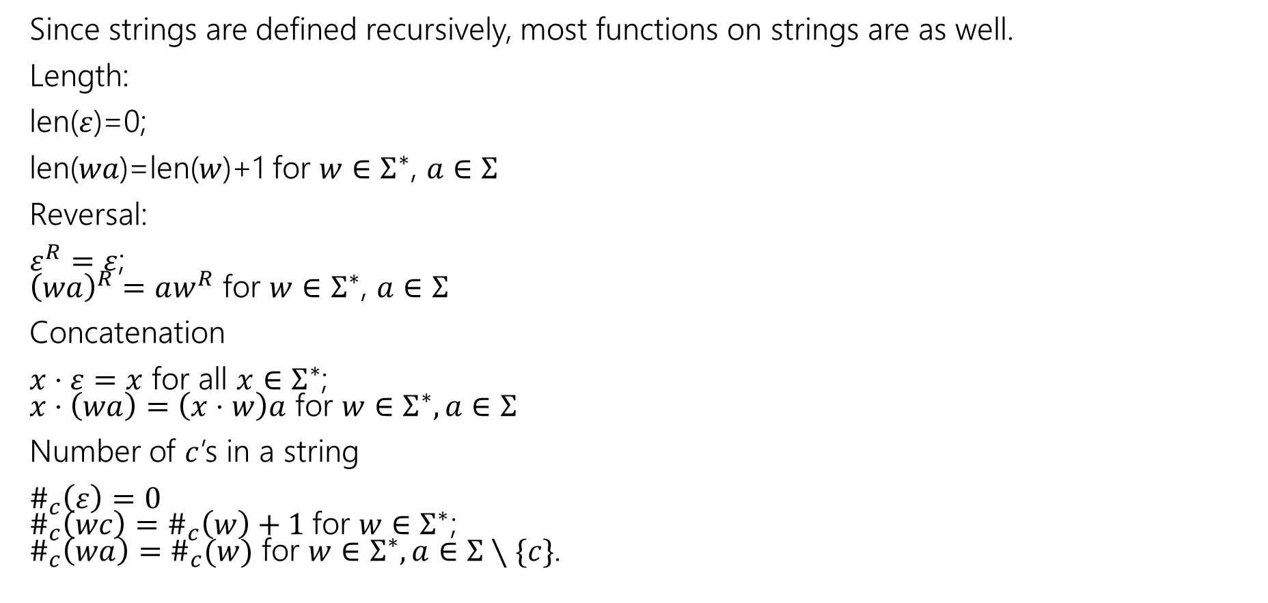

Functions on Strings
Since strings are defined recursively, most functions on strings are as well.
Length:
len($ε$)=0;
len($wa$)=len($w$)+1 for $w∈Σ^{∗}$, $a∈Σ$
Reversal:
$ε^{R}=ε$;
${\left(wa\right)}^{R}=aw^{R}$ for $w∈Σ^{∗}$, $a∈Σ$
Concatenation
$x⋅ε=x$ for all $x∈Σ^{∗}$;
$x⋅\left(wa\right)=\left(x⋅w\right)a$ for $w∈Σ^{∗},a∈Σ$
Number of $c$’s in a string
$\#_{c}\left(ε\right)=0$
$\#_{c}\left(wc\right)=\#_{c}\left(w\right)+1$for $w∈Σ^{∗}$;
$\#_{c}\left(wa\right)=\#_{c}(w)$ for $w∈Σ^{∗},a∈Σ∖\{c\}$.

Slide 20
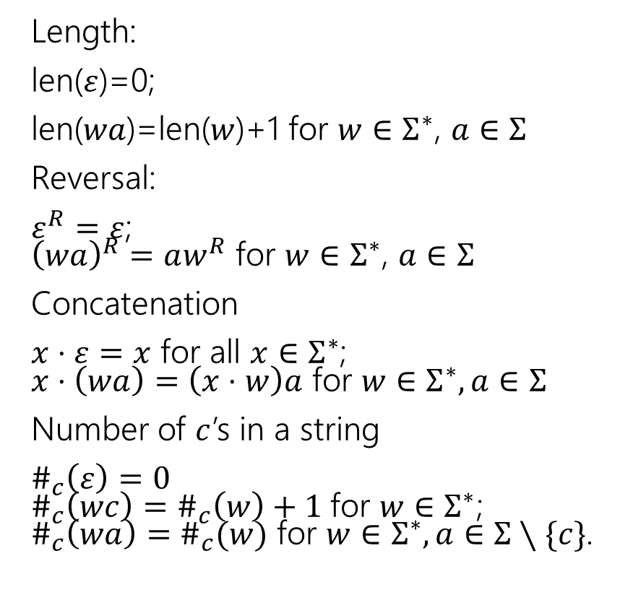
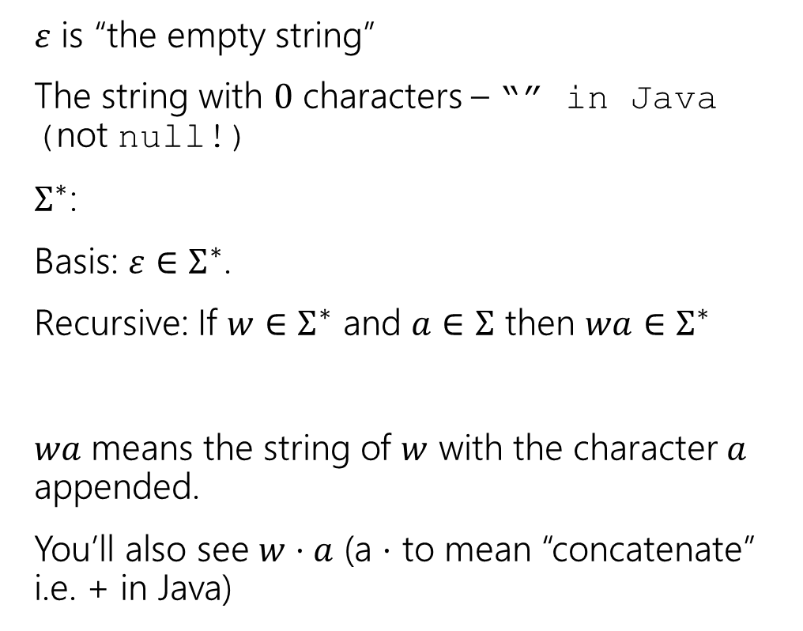
Strings
$ε$ is “the empty string”
The string with $0$ characters – “” in Java (not null!)
$Σ^{∗}$:
Basis: $ε∈Σ^{∗}$.
Recursive: If $w∈Σ^{∗}$ and $a∈Σ$ then $wa∈Σ^{∗}$
$wa$ means the string of $w$ with the character $a$ appended.
You’ll also see $w⋅a$ (a $⋅$ to mean “concatenate” i.e. + in Java)
Length:
len($ε$)=0;
len($wa$)=len($w$)+1 for $w∈Σ^{∗}$, $a∈Σ$
Reversal:
$ε^{R}=ε$;
${\left(wa\right)}^{R}=aw^{R}$ for $w∈Σ^{∗}$, $a∈Σ$
Concatenation
$x⋅ε=x$ for all $x∈Σ^{∗}$;
$x⋅\left(wa\right)=\left(x⋅w\right)a$ for $w∈Σ^{∗},a∈Σ$
Number of $c$’s in a string
$\#_{c}\left(ε\right)=0$
$\#_{c}\left(wc\right)=\#_{c}\left(w\right)+1$for $w∈Σ^{∗}$;
$\#_{c}\left(wa\right)=\#_{c}(w)$ for $w∈Σ^{∗},a∈Σ∖\{c\}$.

Slide 21
A string proof
You’ll do a string-based induction proof on the concept check. We’ll do another one next week in lecture. It’s got a lot of details that are worth going through slowly.
Let’s do a different set—trees!

Slide 22
Trees!

Slide 23
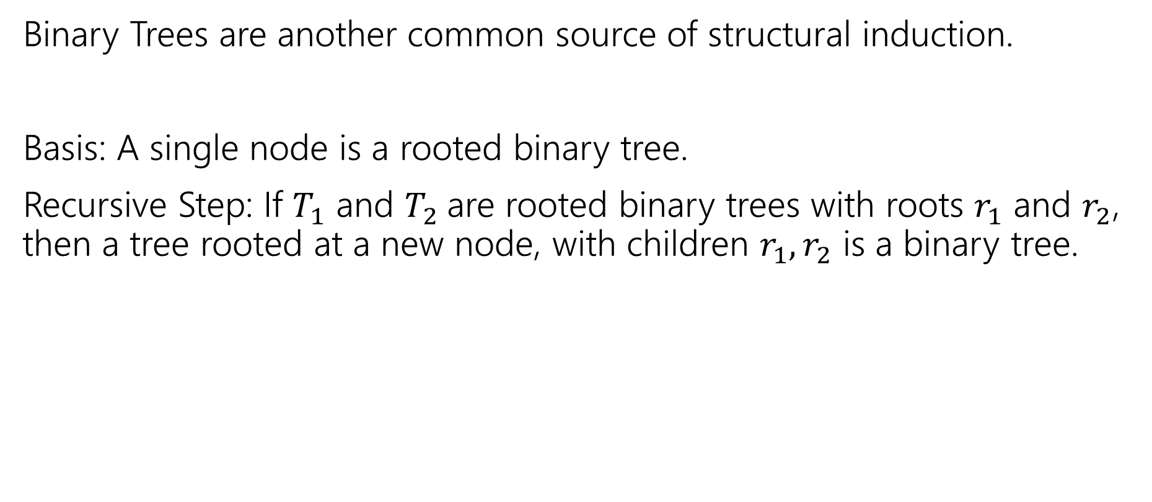
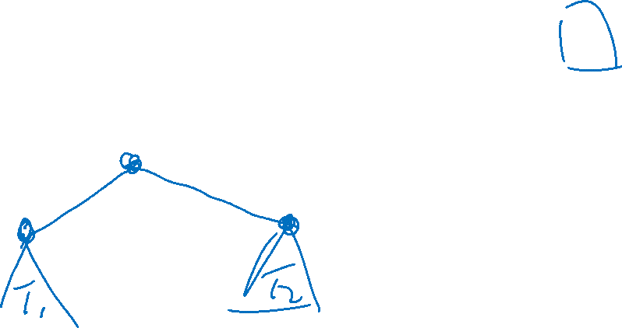
More Structural Sets
Binary Trees are another common source of structural induction.
Basis: A single node is a rooted binary tree.
Recursive Step: If $T_{1}$ and $T_{2}$are rooted binary trees with roots $r_{1}$ and $r_{2}$, then a tree rooted at a new node, with children $r_{1},r_{2}$ is a binary tree.

Slide 24


More Structural Sets
Binary Trees are another common source of structural induction.
Basis: A single node is a rooted binary tree.
Recursive Step: If $T_{1}$ and $T_{2}$are rooted binary trees with roots $r_{1}$ and $r_{2}$, then a tree rooted at a new node, with children $r_{1},r_{2}$ is a binary tree.
$$T_{1}$$
$$T_{2}$$

Slide 25





Functions on Binary Trees
size( )=1
size( ) = size($T_{1}$) + size($T_{2}$) + 1
height( ) = 0
height( ) = 1+$max⁡($height($T_{1}$),height($T_{2}$)$)$
$$T_{1}$$
$$T_{2}$$
$$T_{1}$$
$$T_{2}$$

Slide 26
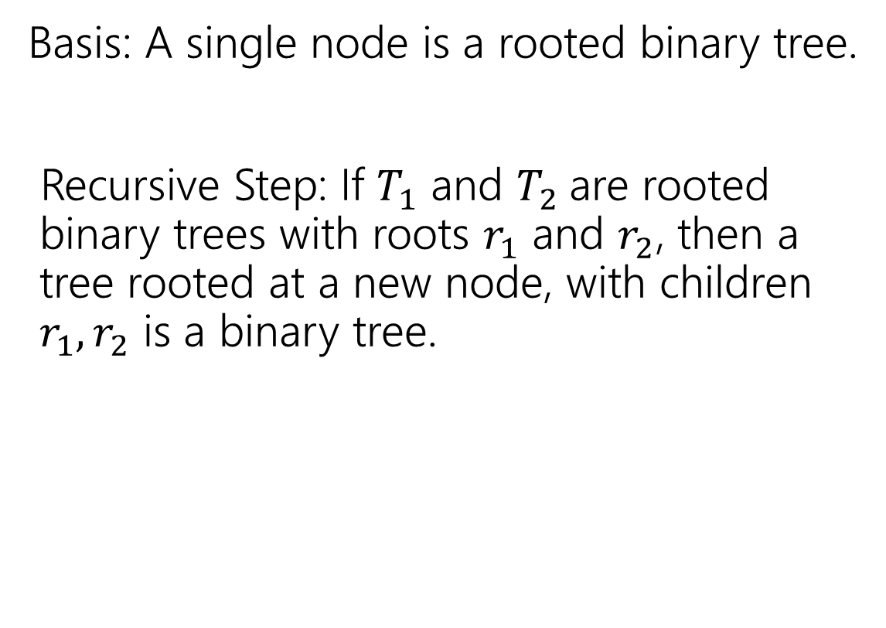
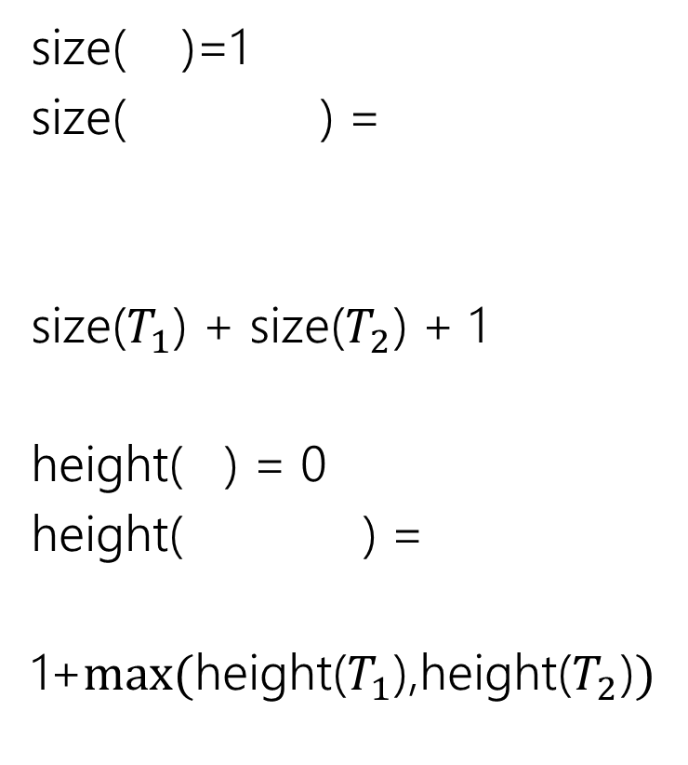
Binary Trees
size( )=1
size( ) =
size($T_{1}$) + size($T_{2}$) + 1
height( ) = 0
height( ) =
1+$max⁡($height($T_{1}$),height($T_{2}$)$)$
Basis: A single node is a rooted binary tree.
Recursive Step: If $T_{1}$ and $T_{2}$are rooted binary trees with roots $r_{1}$ and $r_{2}$, then a tree rooted at a new node, with children $r_{1},r_{2}$ is a binary tree.
$$T_{1}$$
$$T_{2}$$
$$T_{1}$$
$$T_{2}$$
$$T_{1}$$
$$T_{2}$$

Slide 27
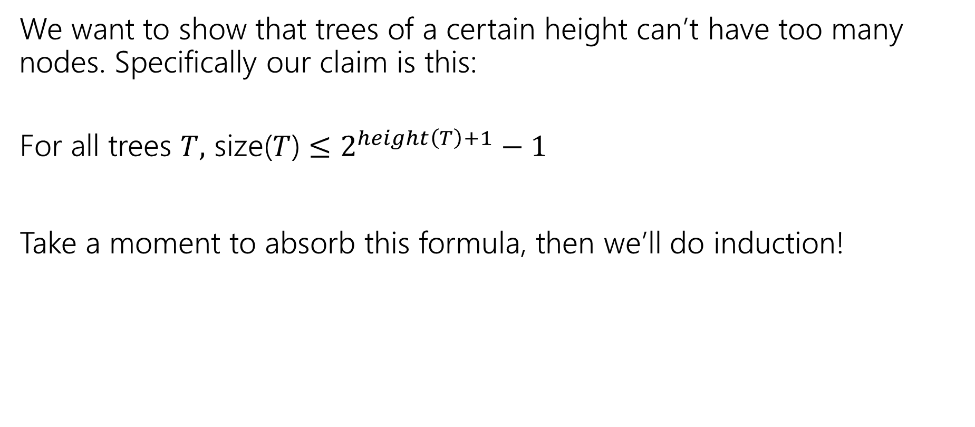
Claim
We want to show that trees of a certain height can’t have too many nodes. Specifically our claim is this:
For all trees $T,$ size($T$) $≤2^{height\left(T\right)+1}−1$
Take a moment to absorb this formula, then we’ll do induction!

Slide 28

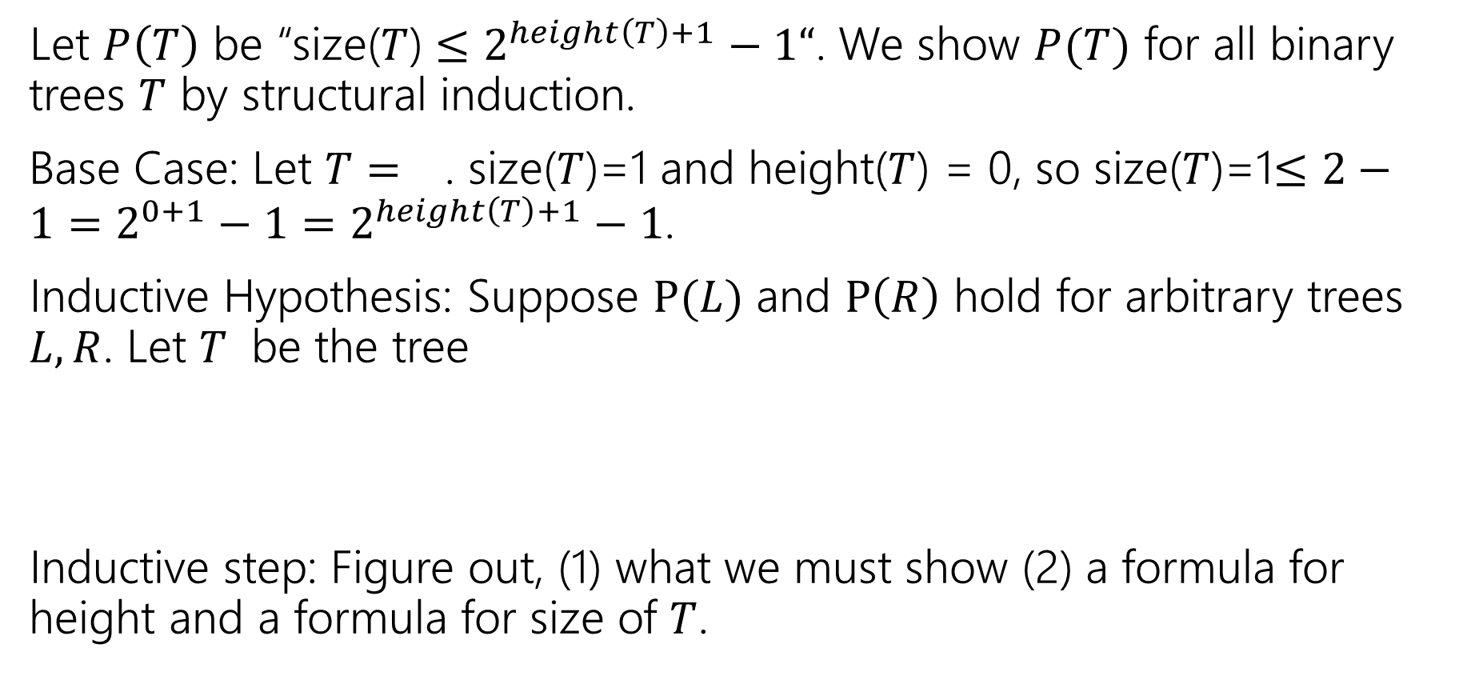

Structural Induction on Binary Trees
Let $P\left(T\right)$ be “size($T$) $≤2^{height\left(T\right)+1}−1“$. We show $P(T)$ for all binary trees $T$ by structural induction.
Base Case: Let $T=$ . size($T$)=1 and height($T$) = 0, so size($T$)=1$≤2−1=2^{0+1}−1=2^{height\left(T\right)+1}−1$.
Inductive Hypothesis: Suppose $P(L)$ and $P\left(R\right)$ hold for arbitrary trees $L,R$. Let $T$ be the tree
Inductive step: Figure out, (1) what we must show (2) a formula for height and a formula for size of $T$.
$$L$$
$$R$$

Slide 29

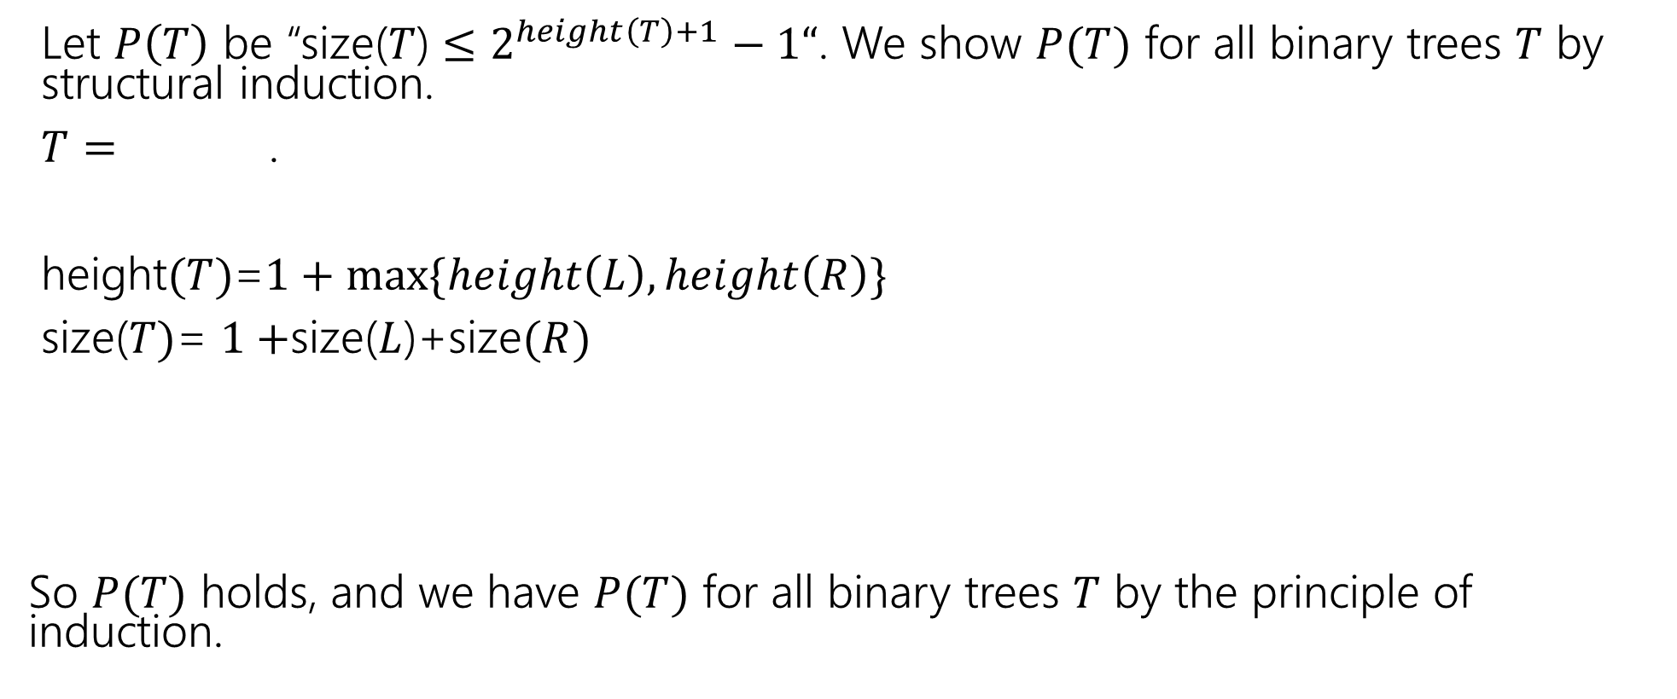

Structural Induction on Binary Trees (cont.)
Let $P\left(T\right)$ be “size($T$) $≤2^{height\left(T\right)+1}−1“$. We show $P(T)$ for all binary trees $T$ by structural induction.
$T=$ .
height$(T)$=$1+max⁡\{height\left(L\right),height\left(R\right)\}$
size($T)$= $1+$size($L$)+size$(R)$
So $P(T)$ holds, and we have $P(T)$ for all binary trees $T$ by the principle of induction.
$$L$$
$$R$$

Slide 30
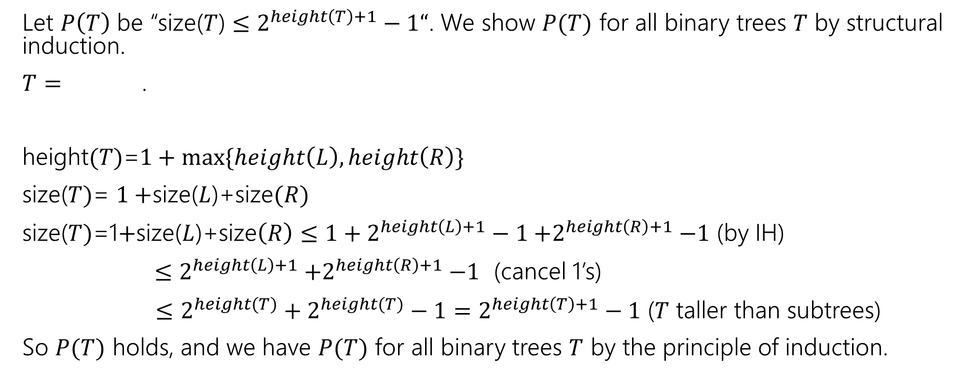
Structural Induction on Binary Trees (cont.)
Let $P\left(T\right)$ be “size($T$) $≤2^{height\left(T\right)+1}−1“$. We show $P(T)$ for all binary trees $T$ by structural induction.
$T=$ .
height$(T)$=$1+max⁡\{height\left(L\right),height\left(R\right)\}$
size($T)$= $1+$size($L$)+size$(R)$
size($T)$=1$+$size($L$)+size$\left(R\right)≤{1+2}^{height\left(L\right)+1}−1{+2}^{height\left(R\right)+1}−1$ (by IH)
$≤2^{height\left(L\right)+1}{+2}^{height\left(R\right)+1}−1$ (cancel 1’s)
$≤$ $2^{height(T)}+2^{height(T)}−1=2^{height\left(T\right)+1}−1$ ($T$ taller than subtrees)
So $P(T)$ holds, and we have $P(T)$ for all binary trees $T$ by the principle of induction.
$$L$$
$$R$$

Slide 31
Structural Induction on Strings

Slide 32
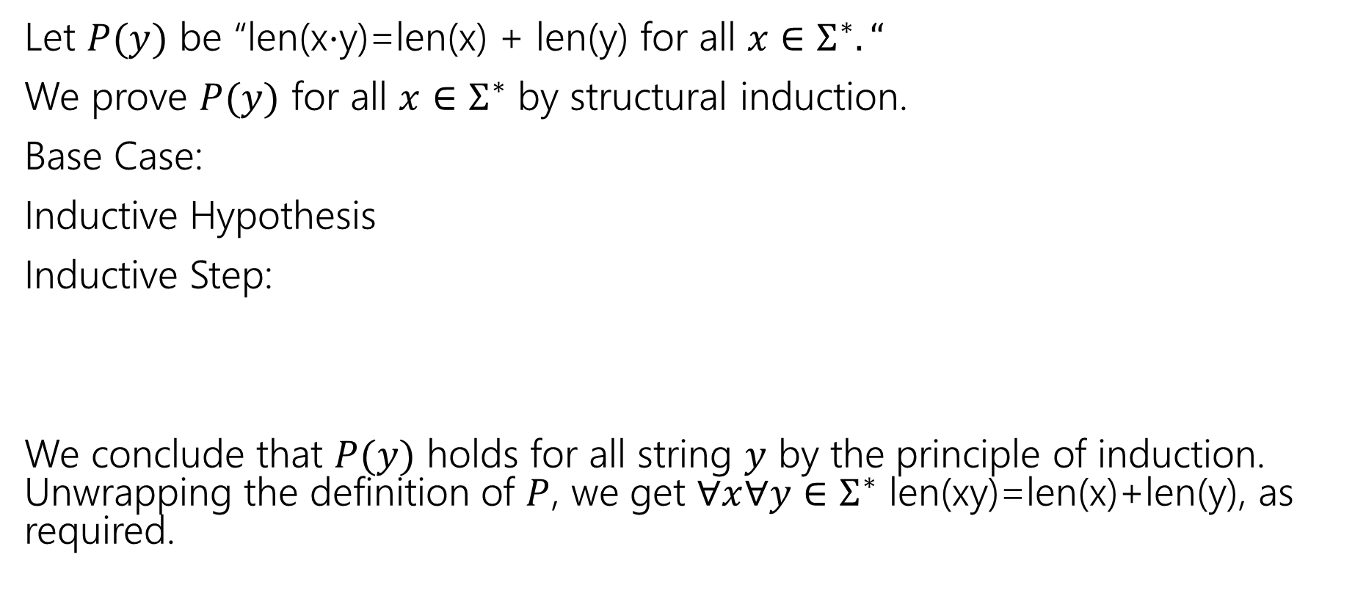
Claim for all $x,y∈Σ^{∗}$len(x$⋅$y)=len(x) + len(y).
Let $P(y)$ be “len(x$⋅$y)=len(x) + len(y) for all $x∈Σ^{∗}.“$
We prove $P(y)$ for all $x∈Σ^{∗}$ by structural induction.
Base Case:
Inductive Hypothesis
Inductive Step:
We conclude that $P(y)$ holds for all string $y$ by the principle of induction. Unwrapping the definition of $P$, we get $∀x∀y∈Σ^{∗}$ len(xy)=len(x)+len(y), as required.

Slide 33
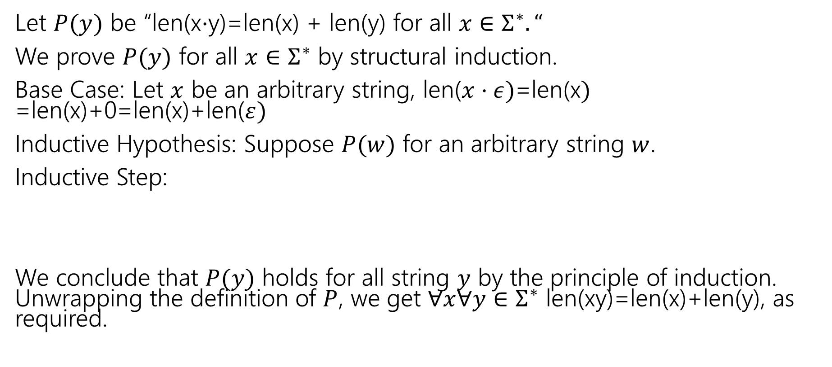
Claim for all $x,y∈Σ^{∗}$len(x$⋅$y)=len(x) + len(y).
Let $P(y)$ be “len(x$⋅$y)=len(x) + len(y) for all $x∈Σ^{∗}.“$
We prove $P(y)$ for all $x∈Σ^{∗}$ by structural induction.
Base Case: Let $x$ be an arbitrary string, len($x⋅ε)$=len(x$)$
=len(x)+0=len(x)+len($ε)$
Inductive Hypothesis: Suppose $P(w)$ for an arbitrary string $w$.
Inductive Step:
We conclude that $P(y)$ holds for all string $y$ by the principle of induction. Unwrapping the definition of $P$, we get $∀x∀y∈Σ^{∗}$ len(xy)=len(x)+len(y), as required.

Slide 34
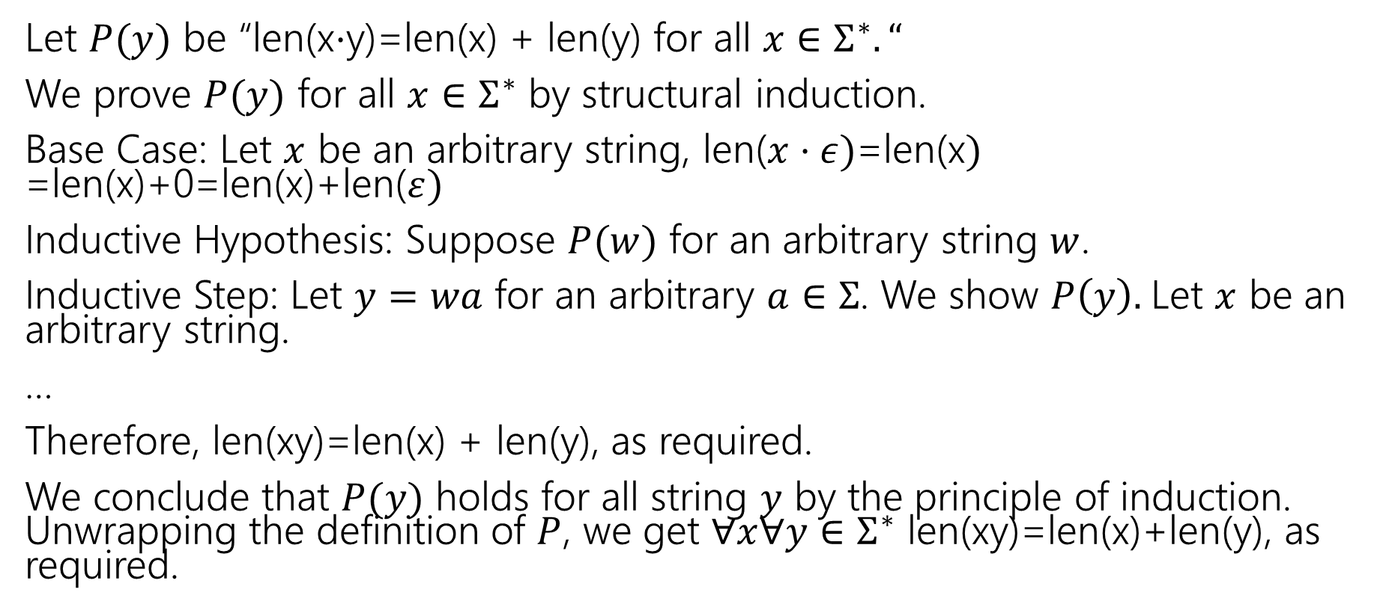
Claim for all $x,y∈Σ^{∗}$len(x$⋅$y)=len(x) + len(y).
Let $P(y)$ be “len(x$⋅$y)=len(x) + len(y) for all $x∈Σ^{∗}.“$
We prove $P(y)$ for all $x∈Σ^{∗}$ by structural induction.
Base Case: Let $x$ be an arbitrary string, len($x⋅ε)$=len(x$)$
=len(x)+0=len(x)+len($ε)$
Inductive Hypothesis: Suppose $P(w)$ for an arbitrary string $w$.
Inductive Step: Let $y=wa$ for an arbitrary $a∈Σ$. We show $P\left(y\right).$Let $x$ be an arbitrary string.
…
Therefore, len(xy)=len(x) + len(y), as required.
We conclude that $P(y)$ holds for all string $y$ by the principle of induction. Unwrapping the definition of $P$, we get $∀x∀y∈Σ^{∗}$ len(xy)=len(x)+len(y), as required.

Slide 35
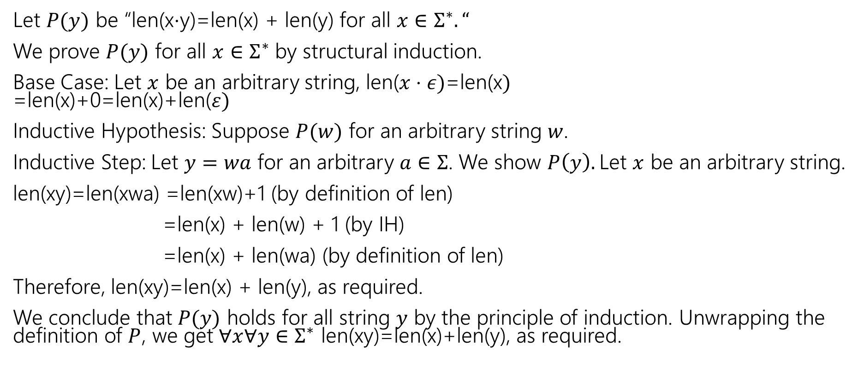
Claim for all $x,y∈Σ^{∗}$len(x$⋅$y)=len(x) + len(y).
Let $P(y)$ be “len(x$⋅$y)=len(x) + len(y) for all $x∈Σ^{∗}.“$
We prove $P(y)$ for all $x∈Σ^{∗}$ by structural induction.
Base Case: Let $x$ be an arbitrary string, len($x⋅ε)$=len(x$)$
=len(x)+0=len(x)+len($ε)$
Inductive Hypothesis: Suppose $P(w)$ for an arbitrary string $w$.
Inductive Step: Let $y=wa$ for an arbitrary $a∈Σ$. We show $P\left(y\right).$Let $x$ be an arbitrary string.
len(xy)=len(xwa) =len(xw)+1 (by definition of len)
=len(x) + len(w) + 1 (by IH)
=len(x) + len(wa) (by definition of len)
Therefore, len(xy)=len(x) + len(y), as required.
We conclude that $P(y)$ holds for all string $y$ by the principle of induction. Unwrapping the definition of $P$, we get $∀x∀y∈Σ^{∗}$ len(xy)=len(x)+len(y), as required.

