Slide 1
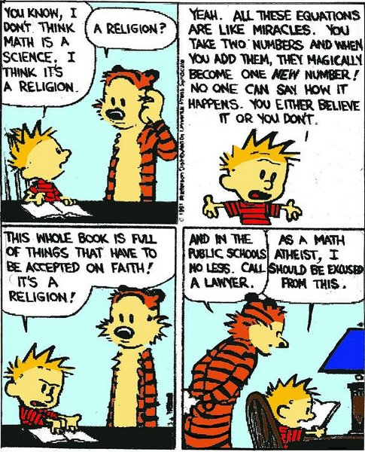
Strong Induction
CSE 311 Autumn 2025 Lecture 17

Slide 2

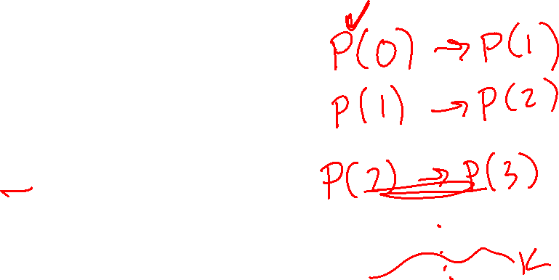

How do we know recursion works?
//Assume i is a nonnegative integer
//returns 2^i.
public int CalculatesTwoToTheI(int i){
if(i == 0)
return 1;
else
return 2*CaclulatesTwoToTheI(i-1);
}
Why does CalculatesTwoToTheI(4) calculate 2^4?
Convince the other people in your room

Slide 3
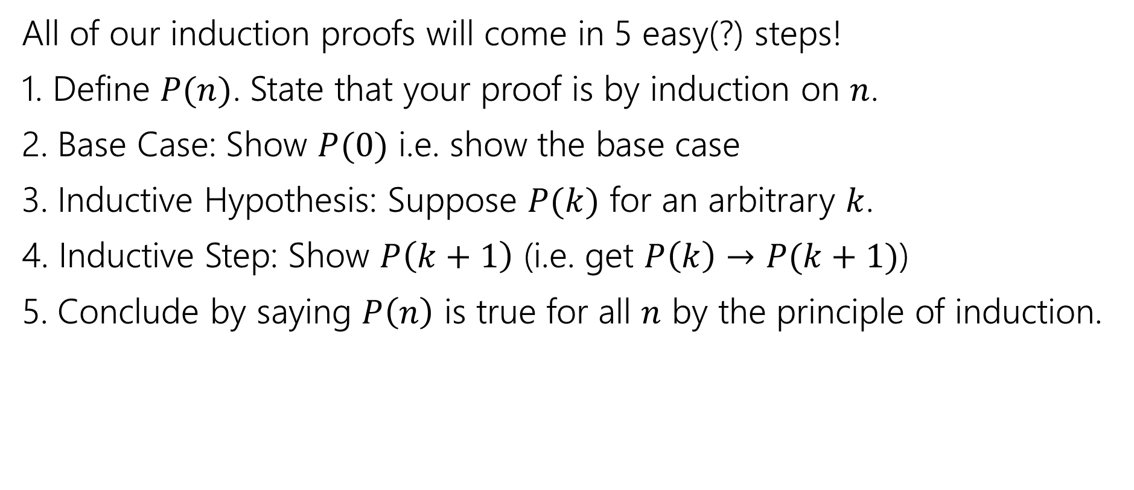

Making Induction Proofs Pretty (v1)
All of our induction proofs will come in 5 easy(?) steps!
1. Define $P(n)$. State that your proof is by induction on $n$.
2. Base Case: Show $P(0)$ i.e. show the base case
3. Inductive Hypothesis: Suppose $P(k)$ for an arbitrary $k$.
4. Inductive Step: Show $P\left(k+1\right)$ (i.e. get $P\left(k\right)→P(k+1)$)
5. Conclude by saying $P\left(n\right)$ is true for all $n$ by the principle of induction.

Slide 4

More Induction (goal)
Induction doesn’t only work for code!
Show that $\sum_{i=0}^{n}{2^{i}}=1+2+4+…+2^{n}=2^{n+1}−1$.

Slide 5

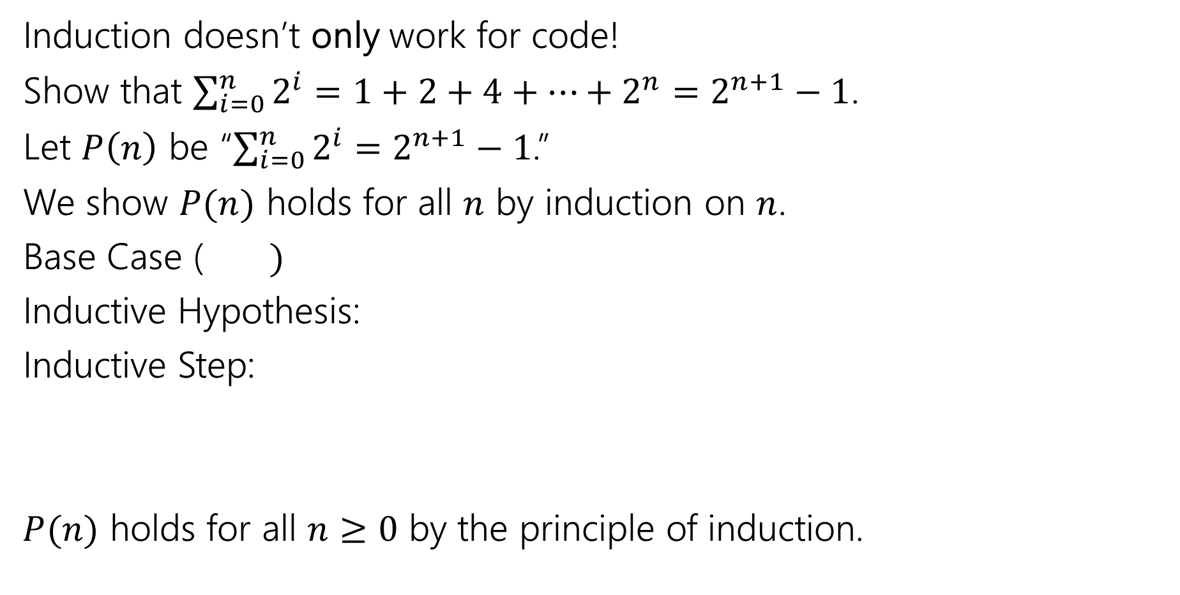
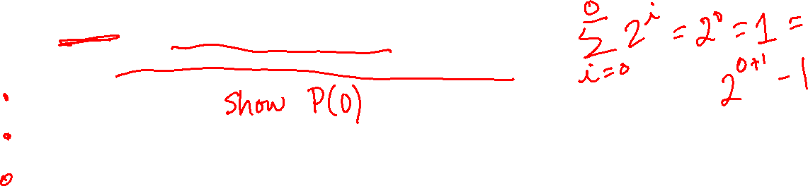
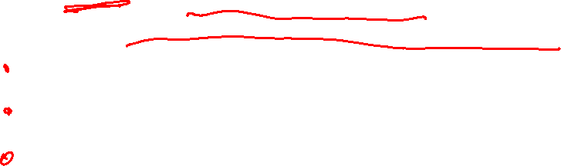
More Induction (setup)
Induction doesn’t only work for code!
Show that $\sum_{i=0}^{n}{2^{i}}=1+2+4+…+2^{n}=2^{n+1}−1$.
Let $P\left(n\right)$ be “$\sum_{i=0}^{n}{2^{i}}=$ $2^{n+1}−1$.”
We show $P(n)$ holds for all $n$ by induction on $n$.
Base Case ($)$
Inductive Hypothesis:
Inductive Step:
$P(n)$ holds for all $n≥0$ by the principle of induction.

Slide 6
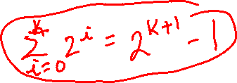
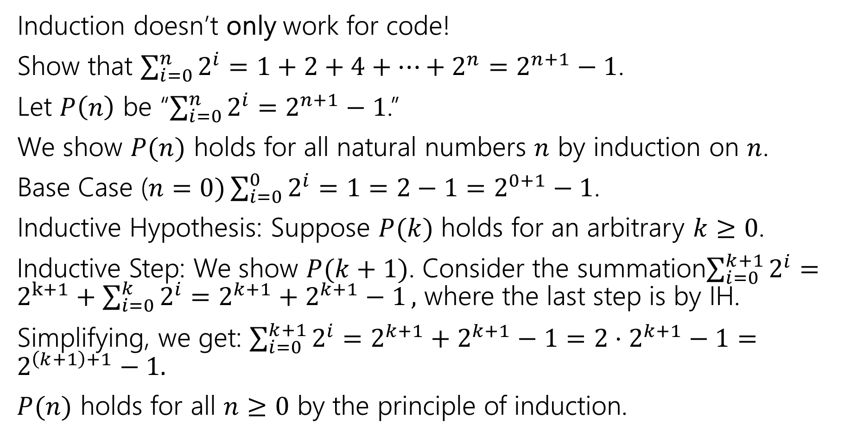
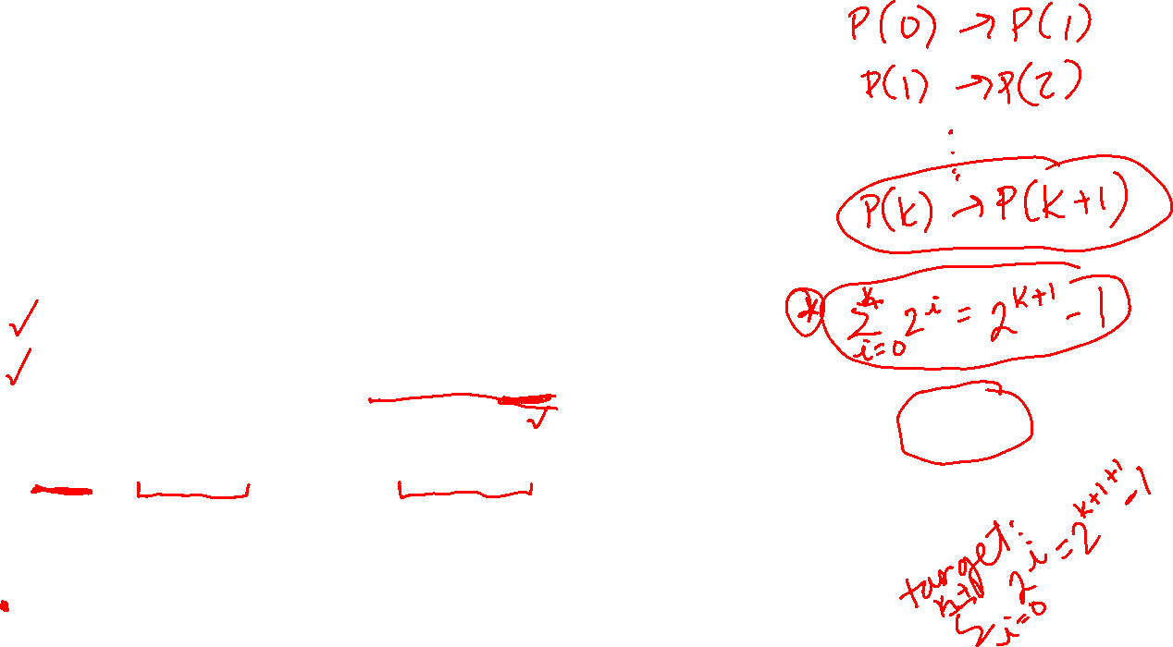
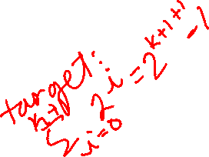

More Induction (complete)
Induction doesn’t only work for code!
Show that $\sum_{i=0}^{n}{2^{i}}=1+2+4+…+2^{n}=2^{n+1}−1$.
Let $P\left(n\right)$ be “$\sum_{i=0}^{n}{2^{i}}=$ $2^{n+1}−1$.”
We show $P(n)$ holds for all natural numbers $n$ by induction on $n$.
Base Case ($n=0)\sum_{i=0}^{0}{2^{i}}=1=2−1=2^{0+1}−1$.
Inductive Hypothesis: Suppose $P(k)$ holds for an arbitrary $k≥0$.
Inductive Step: We show $P(k+1)$. Consider the summation$\sum_{i=0}^{k+1}{2^{i}}=2^{k+1}+\sum_{i=0}^{k}{2^{i}=2^{k+1}+2^{k+1}−1},$ where the last step is by IH.
Simplifying, we get: $\sum_{i=0}^{k+1}{2^{i}}=2^{k+1}+2^{k+1}−1=2⋅2^{k+1}−1=2^{\left(k+1\right)+1}−1.$
$P(n)$ holds for all $n≥0$ by the principle of induction.

Slide 7
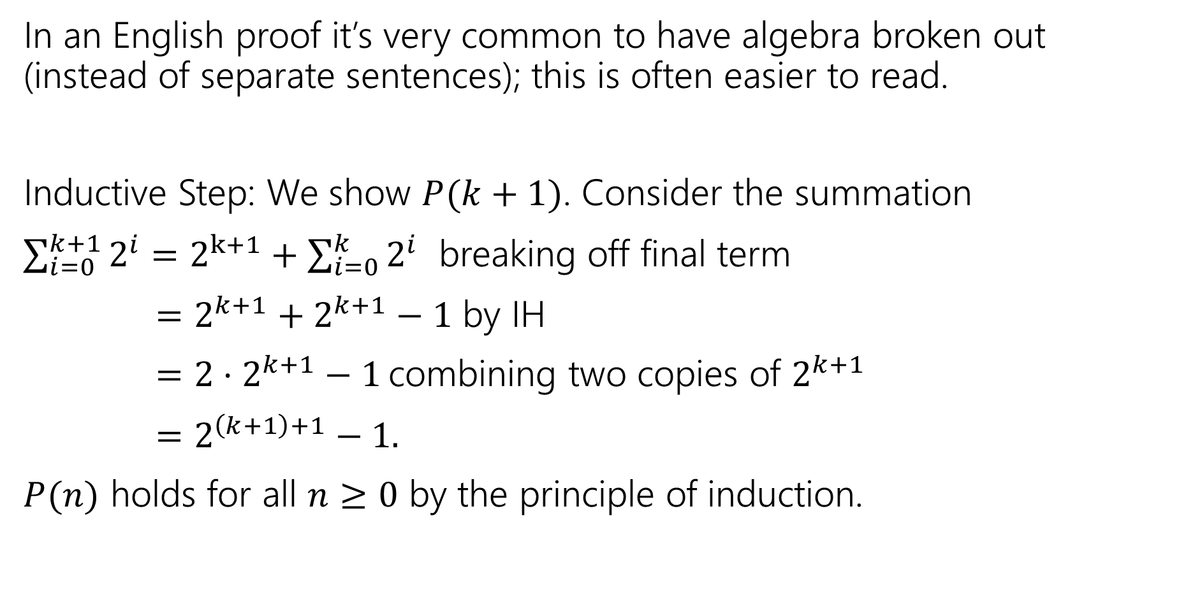
Algebra Block Formatting
In an English proof it’s very common to have algebra broken out (instead of separate sentences); this is often easier to read.
Inductive Step: We show $P(k+1)$. Consider the summation
$\sum_{i=0}^{k+1}{2^{i}}=2^{k+1}+\sum_{i=0}^{k}{2^{i}}$ breaking off final term
$=2^{k+1}+2^{k+1}−1$ by IH
$=2⋅2^{k+1}−1$ combining two copies of $2^{k+1}$
$=2^{\left(k+1\right)+1}−1.$
$P(n)$ holds for all $n≥0$ by the principle of induction.

Slide 8

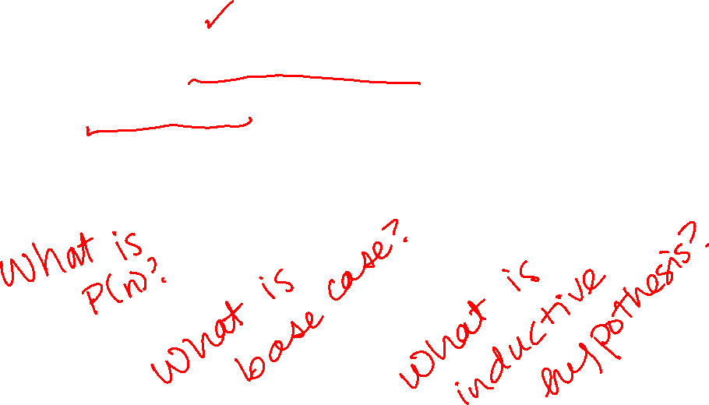
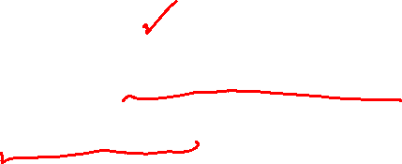
Let’s Try Another Induction Proof
Let $g\left(n\right)= \left\{\begin{aligned}2 if n=2 \\ {g(n−1)}^{2}+3g\left(n−1\right) if n>2\end{aligned}\right.$
Prove $g(n)$ is even for all $n≥2$ by induction on $n$.
Let’s just set this one up, we’ll leave the individual pieces as exercises.

Slide 9
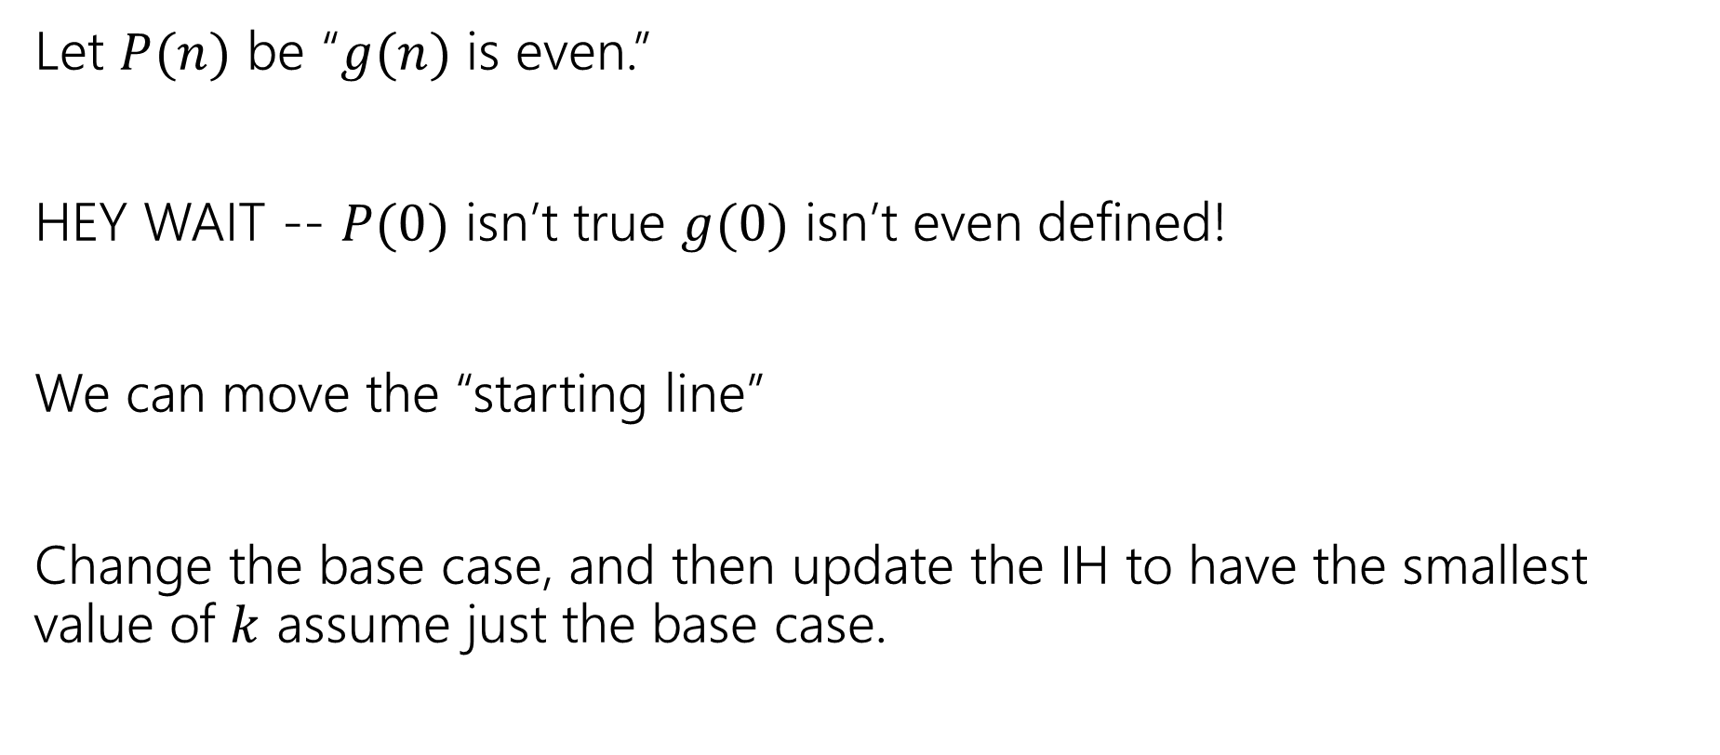
Setup scratchwork
Let $P(n)$ be “$g(n)$ is even.”
HEY WAIT -- $P(0)$ isn’t true $g(0)$ isn’t even defined!
We can move the “starting line”
Change the base case, and then update the IH to have the smallest value of $k$ assume just the base case.

Slide 10
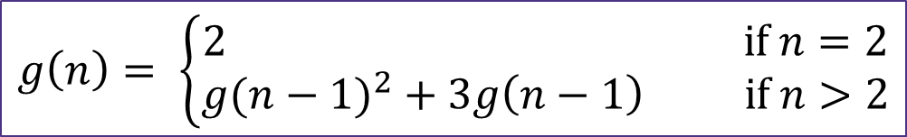
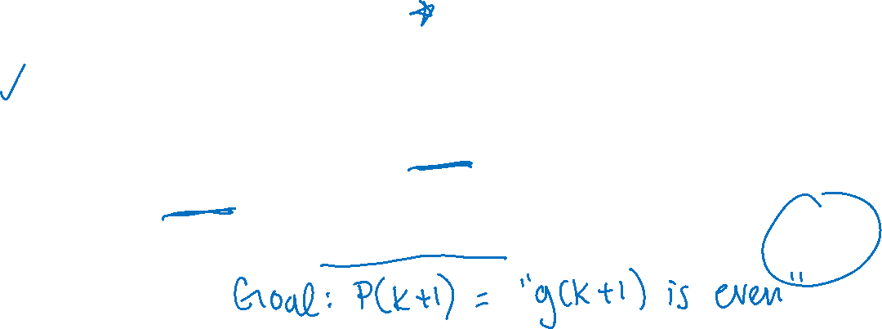
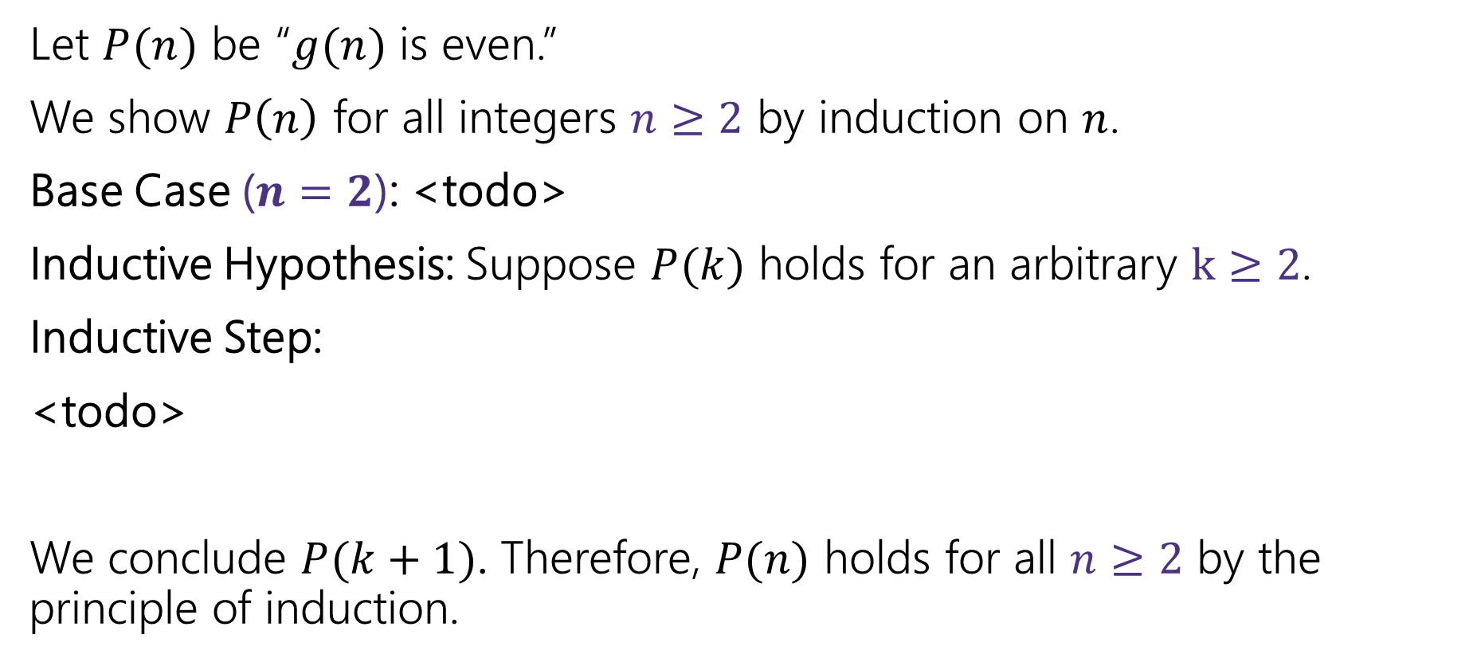

Setup
$$g\left(n\right)= \left\{\begin{aligned}2 if n=2 \\ {g(n−1)}^{2}+3g\left(n−1\right) if n>2\end{aligned}\right.$$
Let $P(n)$ be “$g(n)$ is even.”
We show $P\left(n\right)$ for all integers $n≥2$ by induction on $n$.
Base Case ($n=2$): <todo>
Inductive Hypothesis: Suppose $P(k)$ holds for an arbitrary $k≥2$.
Inductive Step:
<todo>
We conclude $P(k+1)$. Therefore, $P(n)$ holds for all $n≥2$ by the principle of induction.

Slide 11
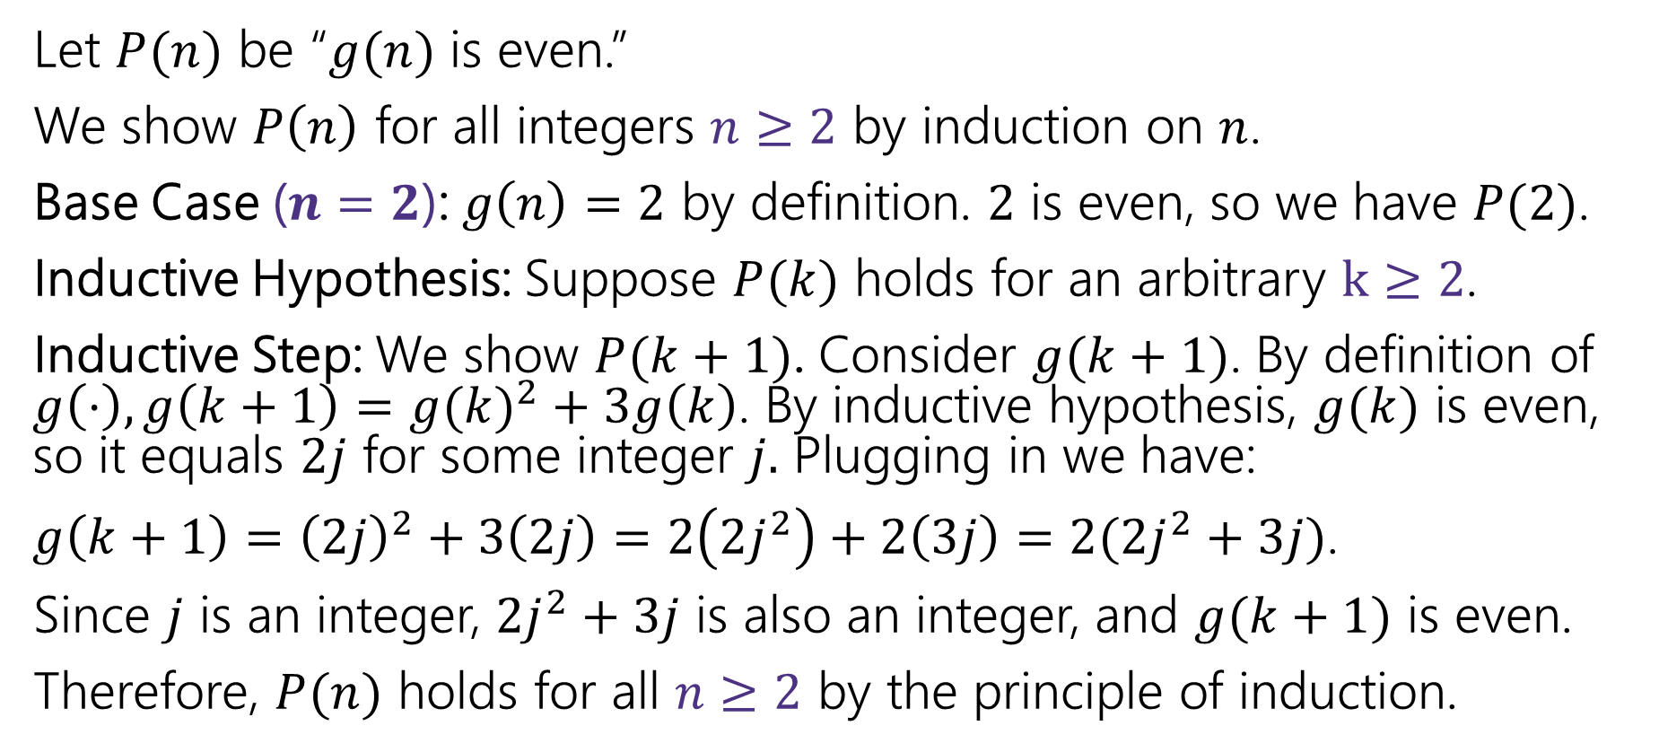

"Another Induction Proof" Complete!
Let $P(n)$ be “$g(n)$ is even.”
We show $P\left(n\right)$ for all integers $n≥2$ by induction on $n$.
Base Case ($n=2$): $g\left(n\right)=2$ by definition. $2$ is even, so we have $P(2)$.
Inductive Hypothesis: Suppose $P(k)$ holds for an arbitrary $k≥2$.
Inductive Step: We show $P(k+1)$. Consider $g(k+1)$. By definition of $g\left(⋅\right), g\left(k+1\right)={g(k)}^{2}+3g\left(k\right)$. By inductive hypothesis, $g(k)$ is even, so it equals $2j$ for some integer $j.$ Plugging in we have:
$g\left(k+1\right)={\left(2j\right)}^{2}+3\left(2j\right)=2\left(2j^{2}\right)+2\left(3j\right)=2(2j^{2}+3j)$.
Since $j$ is an integer, $2j^{2}+3j$ is also an integer, and $g(k+1)$ is even.
Therefore, $P(n)$ holds for all $n≥2$ by the principle of induction.

Slide 12
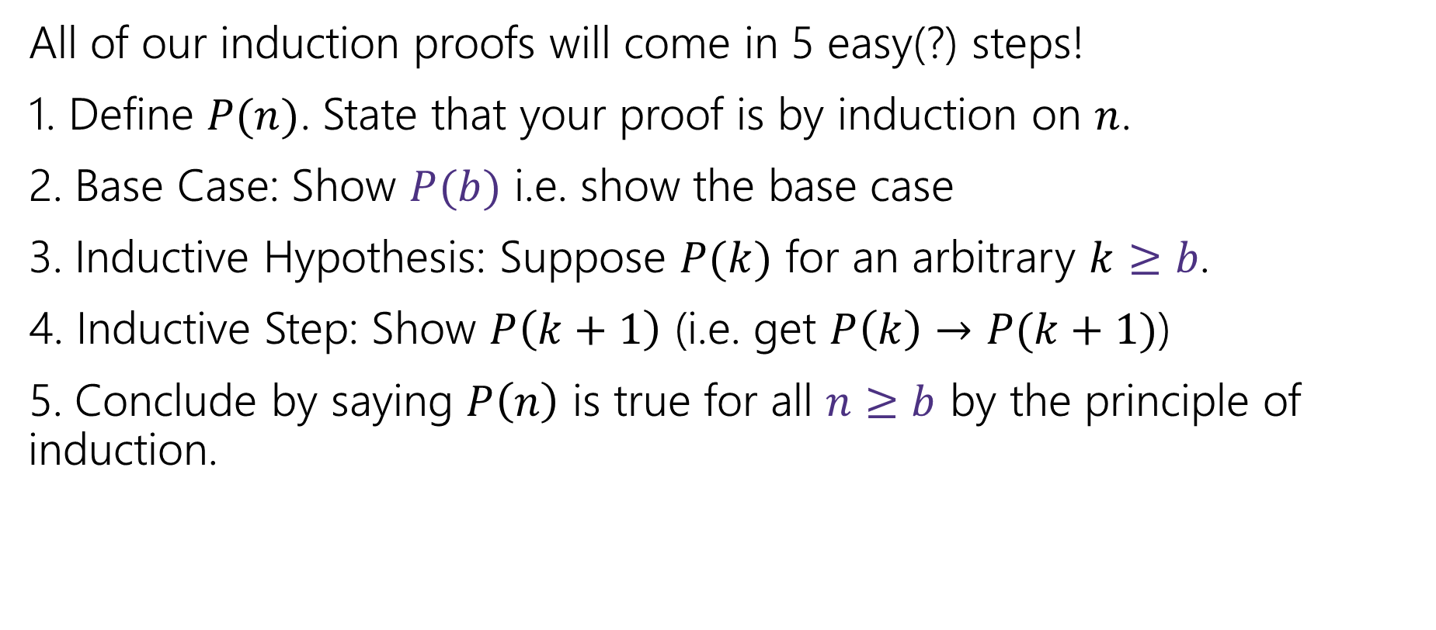
Making Induction Proofs Pretty (v2)
All of our induction proofs will come in 5 easy(?) steps!
1. Define $P(n)$. State that your proof is by induction on $n$.
2. Base Case: Show $P(b)$ i.e. show the base case
3. Inductive Hypothesis: Suppose $P(k)$ for an arbitrary $k≥b$.
4. Inductive Step: Show $P\left(k+1\right)$ (i.e. get $P\left(k\right)→P(k+1)$)
5. Conclude by saying $P\left(n\right)$ is true for all $n≥b$ by the principle of induction.

Slide 13
Let’s Try Yet Another Induction Proof
Every positive integer greater than 1 has a unique
prime factorization.
Fundamental Theorem of Arithmetic
Uniqueness is hard. Let’s just show existence.
I.e.
Claim: Every positive integer greater than 1 can be written as a product of primes.

Slide 14


Prime Factorizations
Some examples
$12=2^{2}⋅3$
$35=5⋅7$
$36=2^{2}⋅3^{2}$
$7=7$
Notice, for prime numbers the product is just the one number.

Slide 15

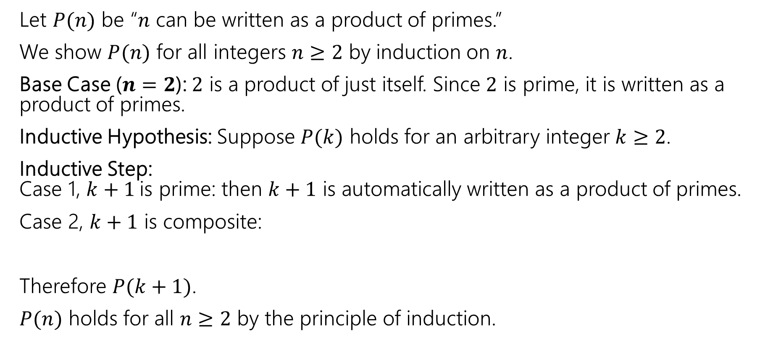
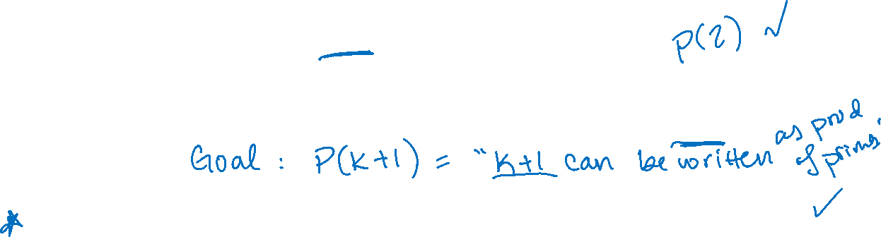

Induction on Primes (first try)
Let $P(n)$ be “$n$ can be written as a product of primes.”
We show $P(n)$ for all integers $n≥2$ by induction on $n$.
Base Case ($n=2$): $2$ is a product of just itself. Since $2$ is prime, it is written as a product of primes.
Inductive Hypothesis: Suppose $P(k)$ holds for an arbitrary integer $k≥2$.
Inductive Step: Case 1, $k+1$is prime: then $k+1$ is automatically written as a product of primes.
Case 2, $k+1$ is composite:
Therefore $P(k+1)$.
$P(n)$ holds for all $n≥2$ by the principle of induction.

Slide 16
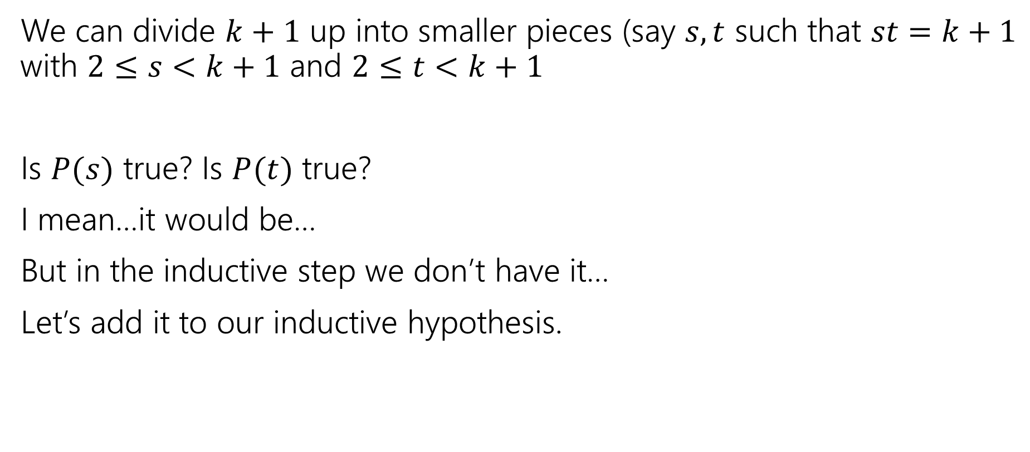
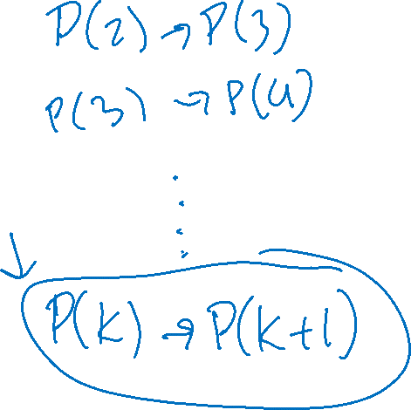
We’re Stuck
We can divide $k+1$ up into smaller pieces (say $s,t$ such that $st=k+1$ with $2≤s<k+1$ and $2≤t<k+1$
Is $P(s)$ true? Is $P(t)$ true?
I mean…it would be…
But in the inductive step we don’t have it…
Let’s add it to our inductive hypothesis.

Slide 17
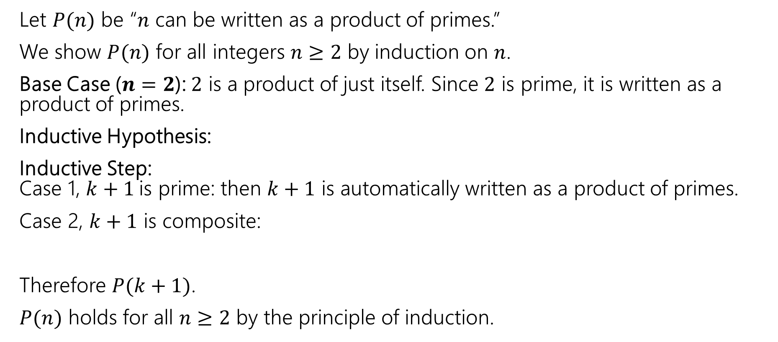
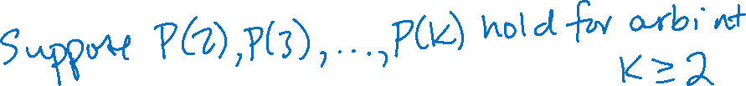
Induction on Primes (revised)
Let $P(n)$ be “$n$ can be written as a product of primes.”
We show $P(n)$ for all integers $n≥2$ by induction on $n$.
Base Case ($n=2$): $2$ is a product of just itself. Since $2$ is prime, it is written as a product of primes.
Inductive Hypothesis:
Inductive Step: Case 1, $k+1$is prime: then $k+1$ is automatically written as a product of primes.
Case 2, $k+1$ is composite:
Therefore $P(k+1)$.
$P(n)$ holds for all $n≥2$ by the principle of induction.

Slide 18
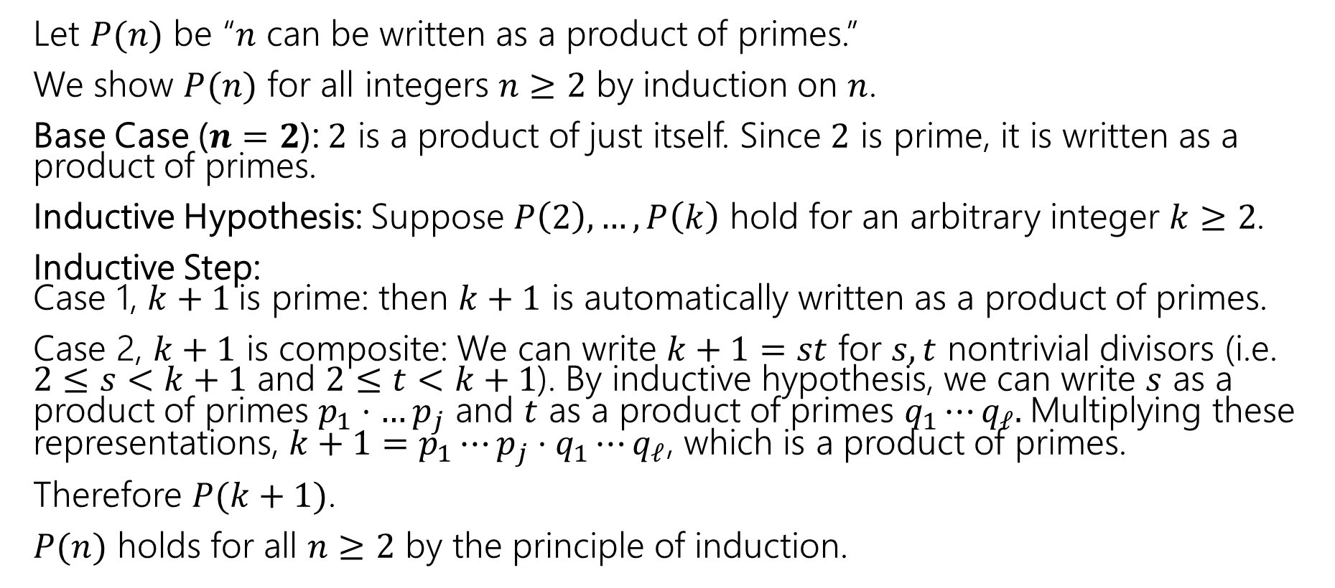
Induction on Primes (complete)
Let $P(n)$ be “$n$ can be written as a product of primes.”
We show $P(n)$ for all integers $n≥2$ by induction on $n$.
Base Case ($n=2$): $2$ is a product of just itself. Since $2$ is prime, it is written as a product of primes.
Inductive Hypothesis: Suppose $P\left(2\right),…,P\left(k\right)$ hold for an arbitrary integer $k≥2$.
Inductive Step: Case 1, $k+1$is prime: then $k+1$ is automatically written as a product of primes.
Case 2, $k+1$ is composite: We can write $k+1=st$ for $s,t$ nontrivial divisors (i.e. $2≤s<k+1$ and $2≤t<k+1$). By inductive hypothesis, we can write $s$ as a product of primes $p_{1}⋅…p_{j}$ and $t$ as a product of primes $q_{1}⋯q_{ℓ}.$Multiplying these representations, $k+1=p_{1}⋯p_{j}⋅q_{1}⋯q_{ℓ}$, which is a product of primes.
Therefore $P(k+1)$.
$P(n)$ holds for all $n≥2$ by the principle of induction.

Slide 19
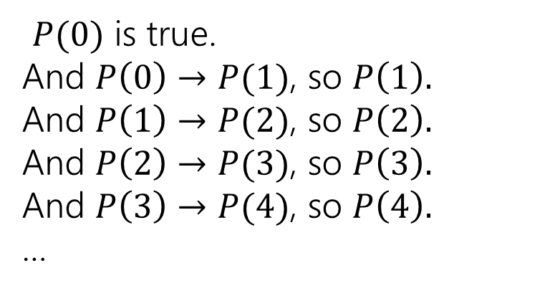



Strong Induction
That hypothesis where we assume $P\left(base case\right),…,P(k)$ instead of just $P(k)$ is called a strong inductive hypothesis.
Strong induction is the same fundamental idea as weak (“regular”) induction.
$P(0)$ is true.
And $P\left(0\right)→P(1)$, so $P\left(1\right).$
And $P\left(1\right)→P(2)$, so $P\left(2\right).$
And $P\left(2\right)→P(3)$, so $P\left(3\right).$
And $P\left(3\right)→P(4)$, so $P\left(4\right).$
…
$P(0)$ is true.
And $P\left(0\right)→P(1)$, so $P\left(1\right).$
And [$P\left(0\right)∧P\left(1\right)]→P(2)$, so $P\left(2\right).$
And $[P\left(0\right)∧⋯∧P\left(2\right)]→P(3)$, so $P\left(3\right).$
And$[P\left(0\right)∧⋯∧P\left(3\right)]→P(4)$, so $P\left(4\right).$
…

Slide 20
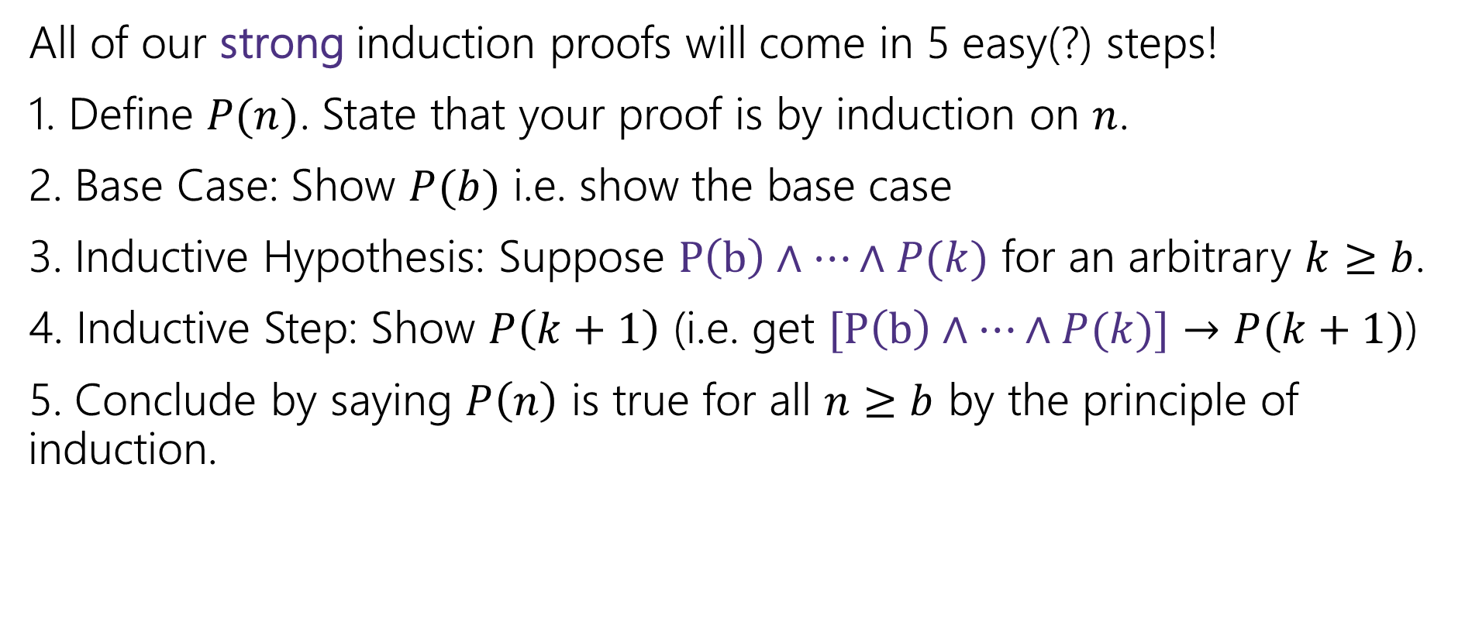

Making Strong Induction Proofs Pretty
All of our strong induction proofs will come in 5 easy(?) steps!
1. Define $P(n)$. State that your proof is by induction on $n$.
2. Base Case: Show $P(b)$ i.e. show the base case
3. Inductive Hypothesis: Suppose $P\left(b\right)∧⋯∧P(k)$ for an arbitrary $k≥b$.
4. Inductive Step: Show $P\left(k+1\right)$ (i.e. get $[P\left(b\right)∧⋯∧P(k)]→P(k+1)$)
5. Conclude by saying $P\left(n\right)$ is true for all $n≥b$ by the principle of induction.

Slide 21
Strong Induction vs. Weak Induction
Think of strong induction as “my recursive call might be on LOTS of smaller values” (like mergesort – you cut your array in half)
Think of weak induction as “my recursive call is always on one step smaller.”
Practical advice:
A strong hypothesis isn’t wrong when you only need a weak one (but a weak one is wrong when you need a strong one). Some people just always write strong hypotheses. But it’s easier to typo a strong hypothesis.
Robbie leaves a blank spot where the IH is, and fills it in after the step.

Slide 22
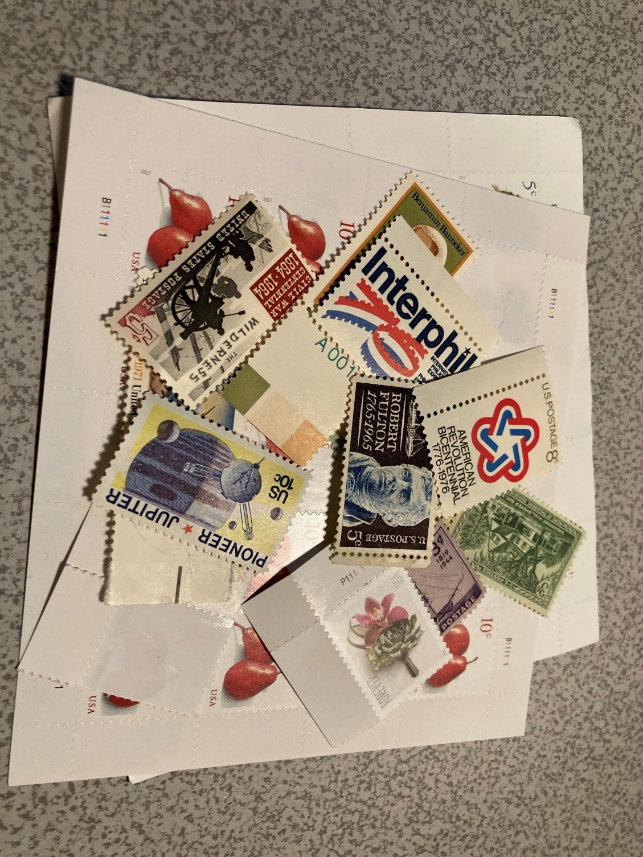
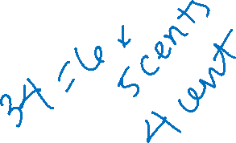
Let’s Try Another! Stamp Collecting
I have 4 cent stamps and 5 cent stamps (as many as I want of each). Prove that I can make exactly $n$ cents worth of stamps for all $n≥12$.
Try for a few values.
Then think…how would the inductive step go?

Slide 23
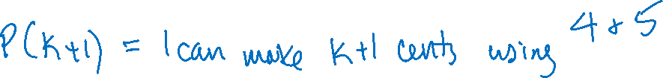
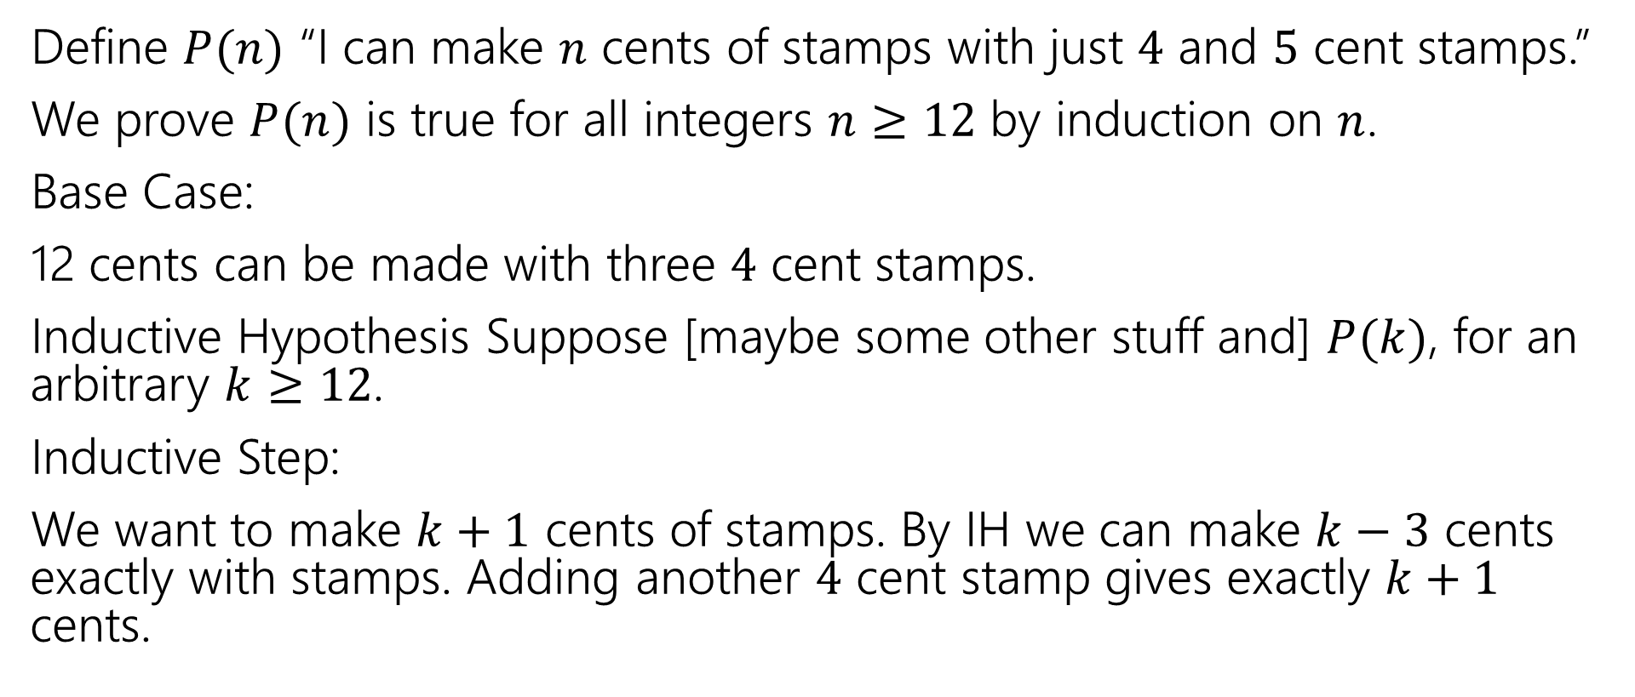
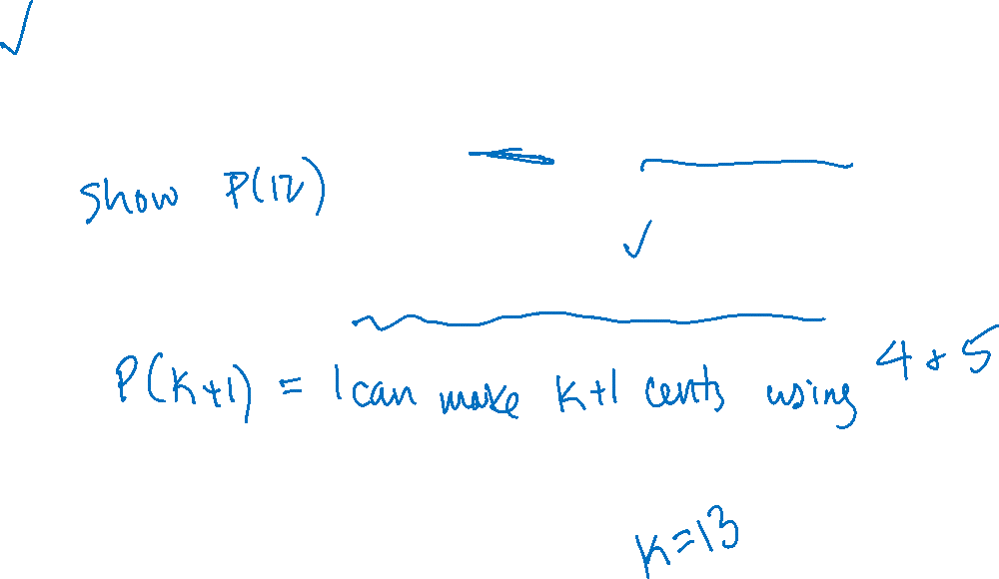


Stamp Collection (attempt)
Define $P(n)$ “I can make $n$ cents of stamps with just $4$ and $5$ cent stamps.”
We prove $P(n)$ is true for all integers $n≥12$ by induction on $n$.
Base Case:
12 cents can be made with three $4$ cent stamps.
Inductive Hypothesis Suppose [maybe some other stuff and] $P(k)$, for an arbitrary $k≥12$.
Inductive Step:
We want to make $k+1$ cents of stamps. By IH we can make $k−3$ cents exactly with stamps. Adding another $4$ cent stamp gives exactly $k+1$ cents.

Slide 24
Stamp Collection…wait a second…
Is the proof right?
How do we know $P(13)$
We’re not the base case, so our inductive hypothesis assumes $P(12)$, and then we say if $P\left(9\right)$ then $P(13)$.
Wait a second….
If you go back $s$ steps every time, you need $s$ base cases.
Or else the first few values aren’t proven.

Slide 25
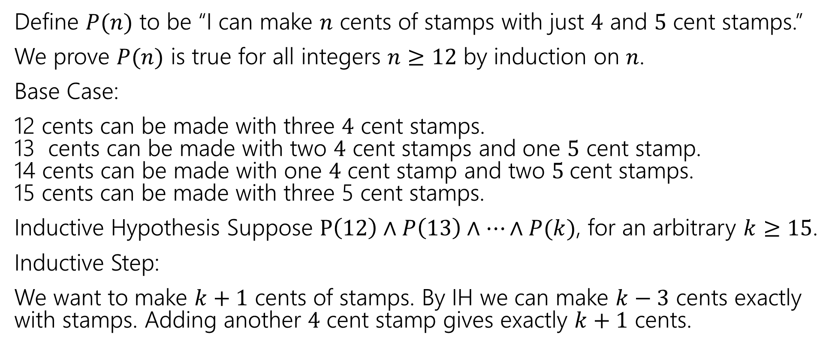
Stamp Collection (corrected)
Define $P(n)$ to be “I can make $n$ cents of stamps with just $4$ and $5$ cent stamps.”
We prove $P(n)$ is true for all integers $n≥12$ by induction on $n$.
Base Case:
12 cents can be made with three $4$ cent stamps. 13 cents can be made with two $4$ cent stamps and one $5$ cent stamp. 14 cents can be made with one $4$ cent stamp and two $5$cent stamps. 15 cents can be made with three 5 cent stamps.
Inductive Hypothesis Suppose $P\left(12\right)∧P\left(13\right)∧…∧P(k)$, for an arbitrary $k≥15$.
Inductive Step:
We want to make $k+1$ cents of stamps. By IH we can make $k−3$ cents exactly with stamps. Adding another $4$ cent stamp gives exactly $k+1$ cents.

Slide 26
A good last check
After you’ve finished writing an inductive proof, pause.
If your inductive step always goes back $s$ steps, you need $s$ base cases (otherwise $b+1$ will go back before the base cases you’ve shown). And make sure your inductive hypothesis is strong enough.
If your inductive step is going back a varying (unknown) number of steps, check the first few values above the base case, make sure your cases are really covered. And make sure your IH is strong.

Slide 27

Practical Advice
How many base cases do you need?
Always at least one.
If you’re analyzing recursive code or a recursive function, at least one for each base case of the code/function.
If you always go back $s$ steps, at least $s$ consecutive base cases.
Enough to make sure every case is handled.

Slide 28
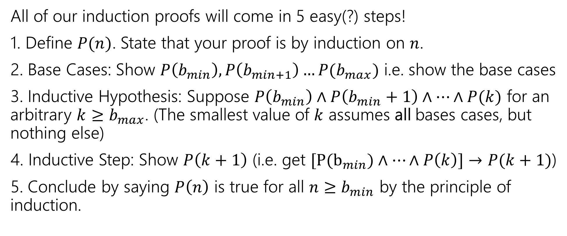
Making Strong Induction Proofs Pretty (with multiple base cases)
All of our induction proofs will come in 5 easy(?) steps!
1. Define $P(n)$. State that your proof is by induction on $n$.
2. Base Cases: Show $P\left(b_{min}\right), P\left(b_{min+1}\right)…P(b_{max})$ i.e. show the base cases
3. Inductive Hypothesis: Suppose $P\left(b_{min}\right)∧P\left(b_{min}+1\right)∧…∧P(k)$ for an arbitrary $k≥b_{max}$. (The smallest value of $k$ assumes all bases cases, but nothing else)
4. Inductive Step: Show $P\left(k+1\right)$ (i.e. get $[P(b_{min})∧…∧P\left(k\right)]→P(k+1)$)
5. Conclude by saying $P\left(n\right)$ is true for all $n≥b_{min}$ by the principle of induction.

Slide 29

Stamp Collection, Done Wrong
Define $P(n)$ to be “I can make $n$ cents of stamps with just $4$ and $5$ cent stamps.”
We prove $P(n)$ is true for all integers $n≥12$ by induction on $n$.
Base Case:
12 cents can be made with three $4$ cent stamps. Inductive Hypothesis Suppose $P(k)$, $k≥12$.
Inductive Step:
We want to make $k+1$ cents of stamps. By IH we can make $k$ cents exactly with stamps. Replace one of the 4 cent stamps with a 5 cent stamp.
$P(n)$ holds for all $n$ by the principle of induction.

Slide 30
Stamp Collection, Done Wrong
What if the starting point doesn’t have any 4 cent stamps?
Like, say, 15 cents = 5+5+5.

Slide 31

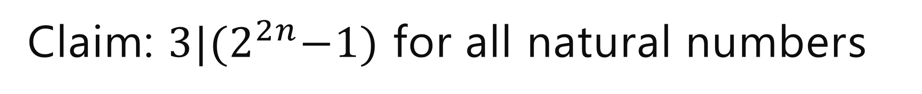
Claim: $3|{(2}^{2n}−1)$ for all natural numbers
[Define $P(n)$]
Base Case
Inductive Hypothesis
Inductive Step
[conclusion]

Slide 32
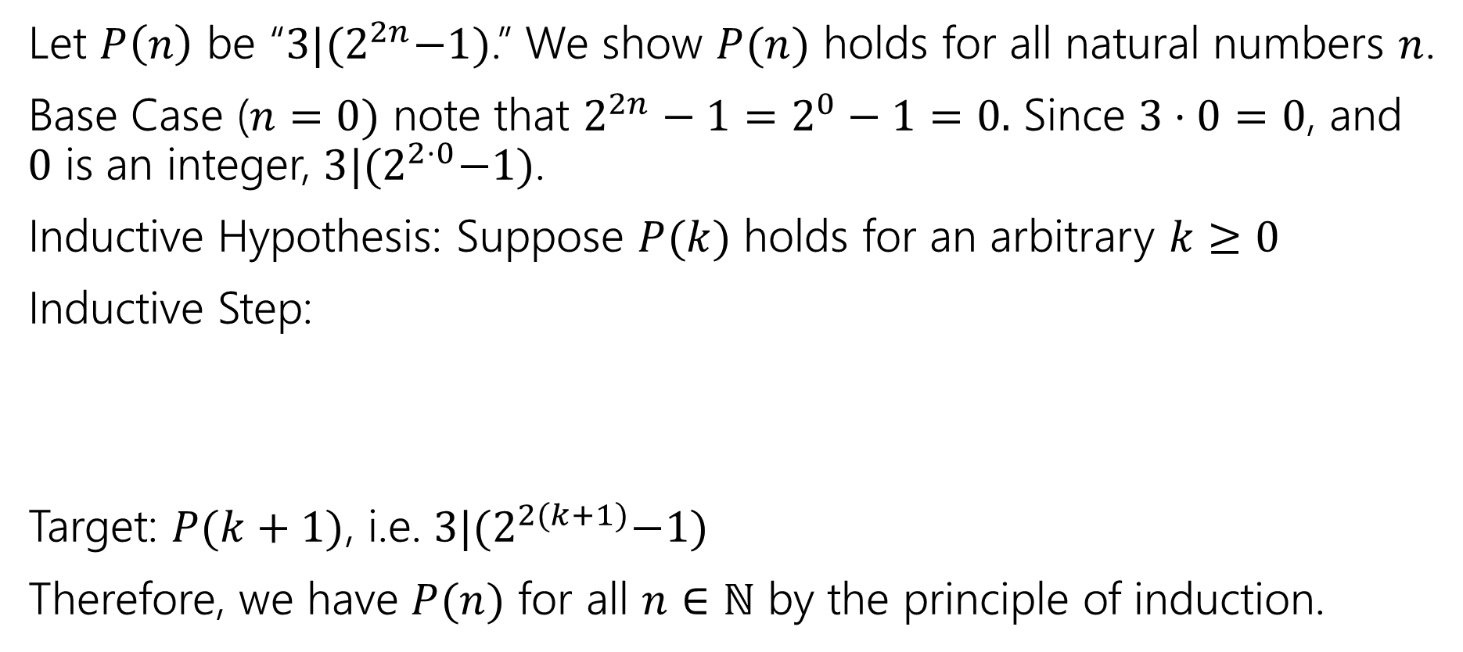
Claim: $3|{(2}^{2n}−1)$ for all natural numbers
Let $P\left(n\right)$ be “$3|{(2}^{2n}−1)$.” We show $P(n)$ holds for all natural numbers $n$.
Base Case ($n=0)$ note that $2^{2n}−1=2^{0}−1=0.$ Since $3⋅0=0$, and $0$ is an integer, $3|{(2}^{2⋅0}−1)$.
Inductive Hypothesis: Suppose $P(k)$ holds for an arbitrary $k≥0$
Inductive Step:
Target: $P(k+1)$, i.e. $3|{(2}^{2(k+1)}−1)$
Therefore, we have $P(n)$ for all $n∈ℕ$ by the principle of induction.

Slide 33
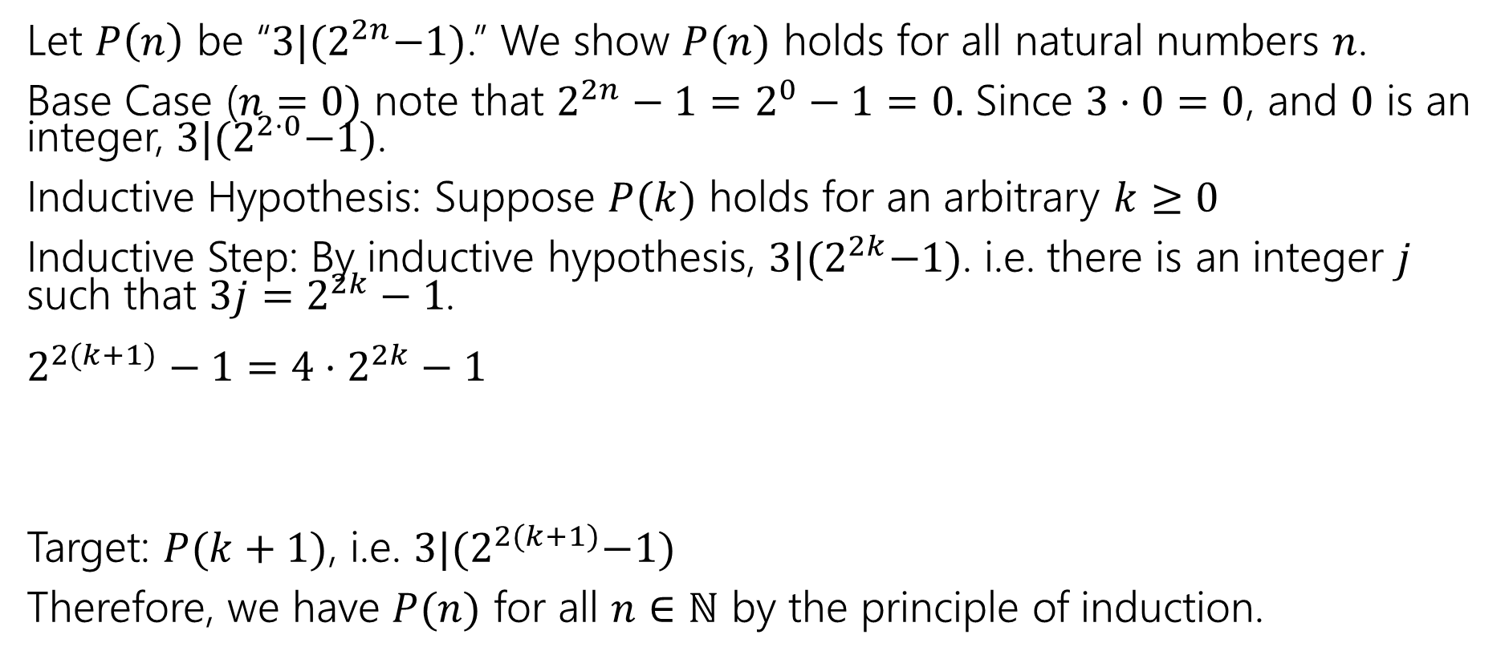
Claim: $3|{(2}^{2n}−1)$ for all natural numbers
Let $P\left(n\right)$ be “$3|{(2}^{2n}−1)$.” We show $P(n)$ holds for all natural numbers $n$.
Base Case ($n=0)$ note that $2^{2n}−1=2^{0}−1=0.$ Since $3⋅0=0$, and $0$ is an integer, $3|{(2}^{2⋅0}−1)$.
Inductive Hypothesis: Suppose $P(k)$ holds for an arbitrary $k≥0$
Inductive Step: By inductive hypothesis, $3|{(2}^{2k}−1)$. i.e. there is an integer $j$ such that $3j=2^{2k}−1$.
$2^{2(k+1)}−1=4⋅2^{2k}−1$
Target: $P(k+1)$, i.e. $3|{(2}^{2(k+1)}−1)$
Therefore, we have $P(n)$ for all $n∈ℕ$ by the principle of induction.
FORCE the expression in your IH to appear

Slide 34
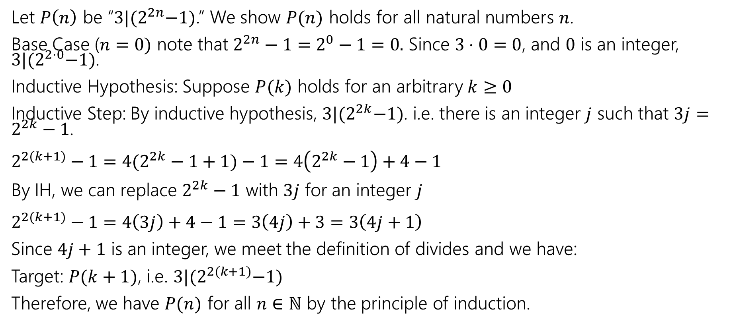
Claim: $3|{(2}^{2n}−1)$ for all natural numbers
Let $P\left(n\right)$ be “$3|{(2}^{2n}−1)$.” We show $P(n)$ holds for all natural numbers $n$.
Base Case ($n=0)$ note that $2^{2n}−1=2^{0}−1=0.$ Since $3⋅0=0$, and $0$ is an integer, $3|{(2}^{2⋅0}−1)$.
Inductive Hypothesis: Suppose $P(k)$ holds for an arbitrary $k≥0$
Inductive Step: By inductive hypothesis, $3|{(2}^{2k}−1)$. i.e. there is an integer $j$ such that $3j=2^{2k}−1$.
$2^{2(k+1)}−1=4(2^{2k}−1+1)−1=4\left(2^{2k}−1\right)+4−1$
By IH, we can replace $2^{2k}−1$ with $3j$ for an integer $j$
$2^{2(k+1)}−1=4\left(3j\right)+4−1=3\left(4j\right)+3=3\left(4j+1\right)$
Since $4j+1$ is an integer, we meet the definition of divides and we have:
Target: $P(k+1)$, i.e. $3|{(2}^{2(k+1)}−1)$
Therefore, we have $P(n)$ for all $n∈ℕ$ by the principle of induction.

Slide 35
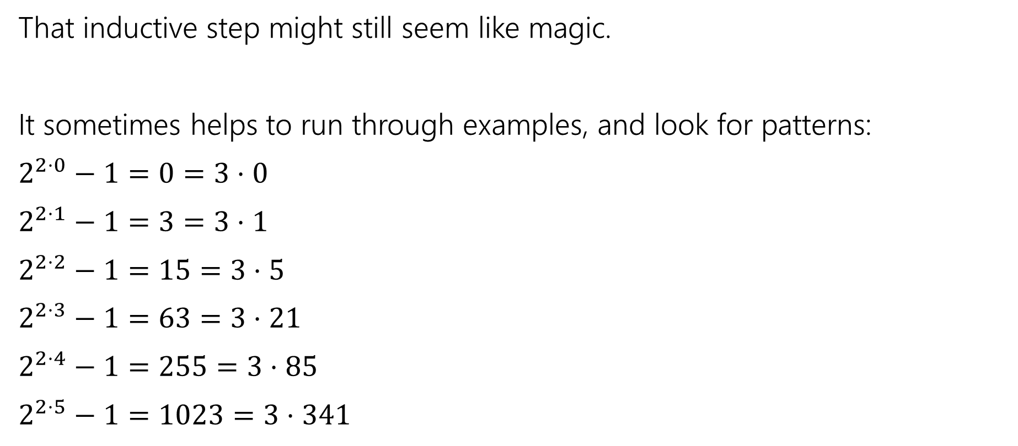

Claim: $3|{(2}^{2n}−1)$ for all natural numbers
That inductive step might still seem like magic.
It sometimes helps to run through examples, and look for patterns:
$2^{2⋅0}−1=0=3⋅0$
$2^{2⋅1}−1=3=3⋅1$
$2^{2⋅2}−1=15=3⋅5$
$2^{2⋅3}−1=63=3⋅21$
$2^{2⋅4}−1=255=3⋅85$
$2^{2⋅5}−1=1023=3⋅341$
The divisor goes from $k$to $4k+1$ $$0→4⋅0+1=1$$
$$1→4⋅1+1=5$$
$$5→4⋅5+1=21$$
…
That might give us a hint that $4k+1$ will be in the algebra somewhere, and give us another intermediate target.

Slide 36

Even more practice
I’ve got a bunch of these 3 piece tiles.
I want to fill a $2^{n}$x$2^{n}$ grid ($n≥1)$with the pieces, except for a $1$x$1$ spot in a corner.

Slide 37

Gridding (not a full proof, just intuition)
Base Case: $n=1$
Inductive hypothesis: Suppose you can tile a $2^{k}$x$2^{k}$ grid, except for a corner.
Inductive step: $2^{k+1}$x$2^{k+1}$, divide into quarters. By IH can tile…

