Slide 1
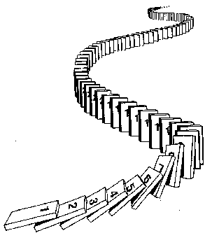
Induction
CSE 311 Autumn 2025
Lecture 16

Slide 2
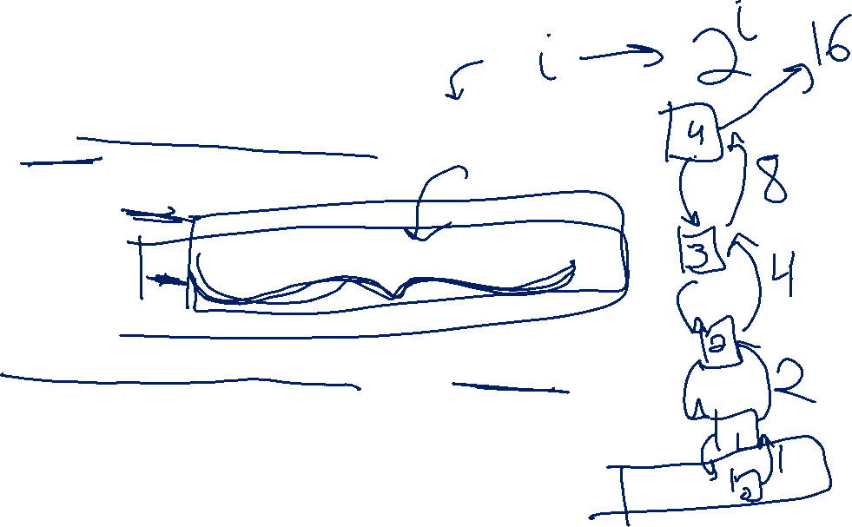
How do we know recursion works?
//Assume i is a nonnegative integer
//returns 2^i.
public int CalculatesTwoToTheI(int i){
if(i == 0)
return 1;
else
return 2*CaclulatesTwoToTheI(i-1);
}
Why does CalculatesTwoToTheI(4) calculate 2^4?
Convince the people around you!

Slide 3

How do we know recursion works?
Something like this:
Well, as long as CalculatesTwoToTheI(3) = 8, we get 16…
Which happens as long as CalculatesTwoToTheI(2) = 4
Which happens as long as CalculatesTwoToTheI(1) = 2
Which happens as long as CalculatesTwoToTheI(0) = 1
And it is! Because that’s what the base case says.

Slide 4

How do we know recursion works?
There’s really only two cases.
CalculatesTwoToTheI(0) = 1 (which it should!)
And that means CalculatesTwoToTheI(1) = 2, (like it should)
And that means CalculatesTwoToTheI(2) = 4, (like it should)
And that means CalculatesTwoToTheI(3) = 8, (like it should)
And that means CalculatesTwoToTheI(4) = 16, (like it should)
The Base Case is Correct
IF the recursive call we create gives the correct value THEN our value is correct.

Slide 5
How do we know recursion works?
The code has two big cases,
So our proof had two big cases
“The base case of the code produces the correct output”
“IF the calls we rely on produce the correct output, THEN the current call produces the right output”

Slide 6
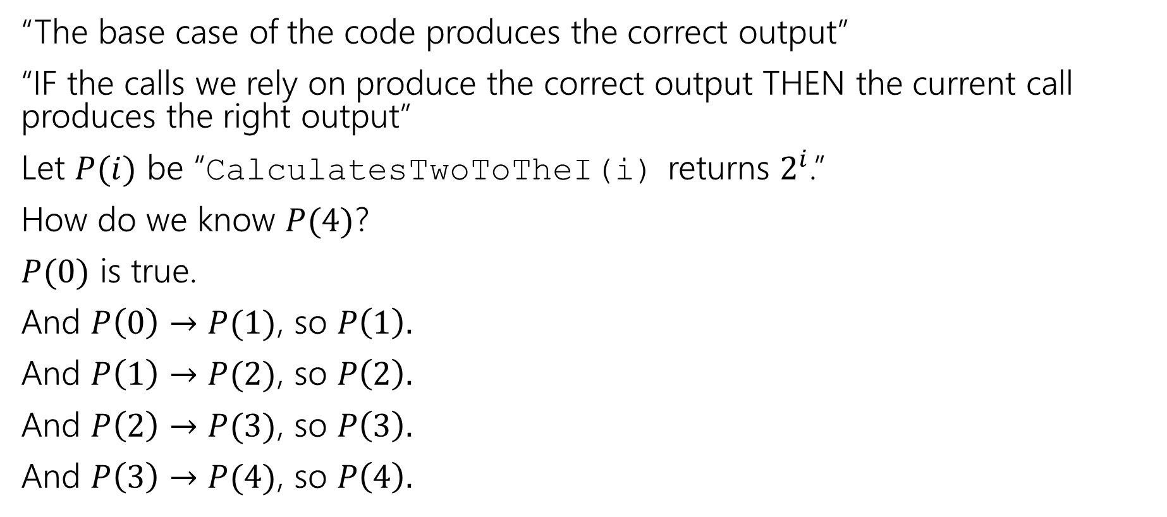
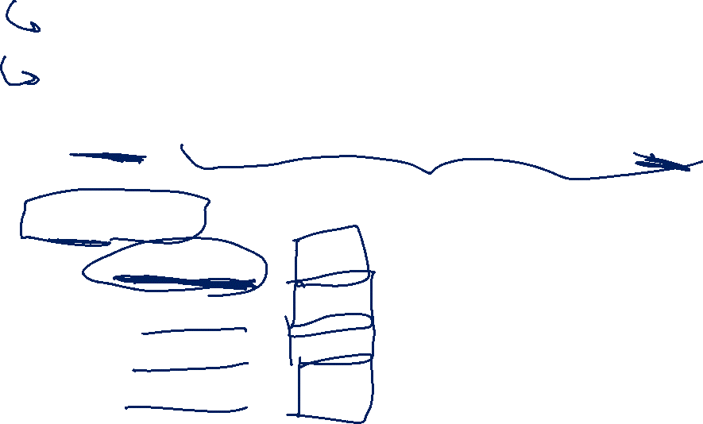
A bit more formally…
“The base case of the code produces the correct output”
“IF the calls we rely on produce the correct output THEN the current call produces the right output”
Let $P(i)$ be “CalculatesTwoToTheI(i) returns $2^{i}$.”
How do we know $P(4)$?
$P(0)$ is true.
And $P\left(0\right)→P(1)$, so $P\left(1\right).$
And $P\left(1\right)→P(2)$, so $P\left(2\right).$
And $P\left(2\right)→P(3)$, so $P\left(3\right).$
And $P\left(3\right)→P(4)$, so $P\left(4\right).$

Slide 7
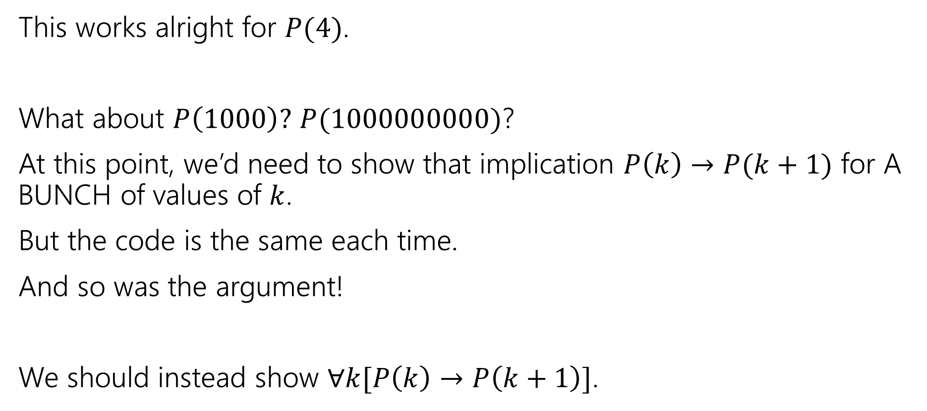

A bit more formally…
This works alright for $P(4)$.
What about $P\left(1000\right)?$ $P(1000000000)$?
At this point, we’d need to show that implication $P\left(k\right)→P(k+1)$ for A BUNCH of values of $k$.
But the code is the same each time.
And so was the argument!
We should instead show $∀k[P\left(k\right)→P\left(k+1\right)]$.

Slide 8

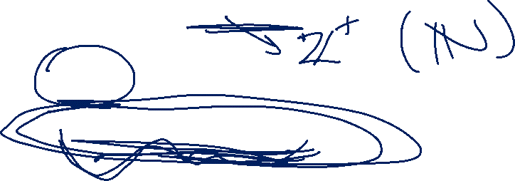
Induction
Your new favorite proof technique!
How do we show $∀n, P(n)$?
Show $P(0)$
Show $∀k(P\left(k\right)→P\left(k+1\right))$

Slide 9
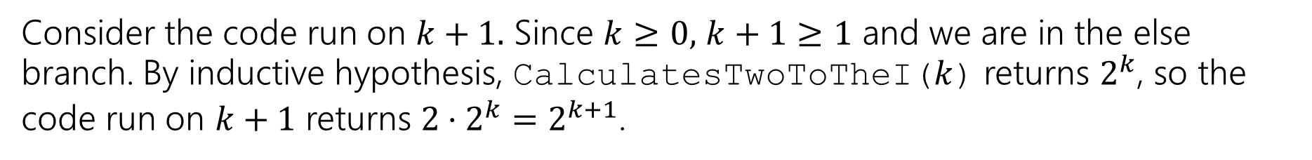
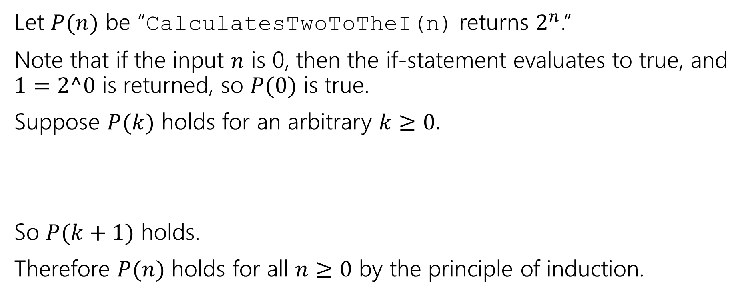

Induction
//Assume i is a nonnegative integer
public int CalculatesTwoToTheI(int i){
if(i == 0)
return 1;
else
return 2*CaclulatesTwoToTheI(i-1);
}
Let $P(n)$ be “CalculatesTwoToTheI(n) returns $2^{n}$.”
Note that if the input $n$ is 0, then the if-statement evaluates to true, and $1=2^0$ is returned, so $P(0)$ is true.
Suppose $P(k)$ holds for an arbitrary $k≥0.$
So $P(k+1)$ holds.
Therefore $P(n)$ holds for all $n≥0$ by the principle of induction.
Consider the code run on $k+1.$ Since $k≥0,$ $k+1≥1$ and we are in the else branch. By inductive hypothesis, CalculatesTwoToTheI($k$) returns $2^{k}$, so the code run on $k+1$ returns $2⋅2^{k}=2^{k+1}$.

Slide 10
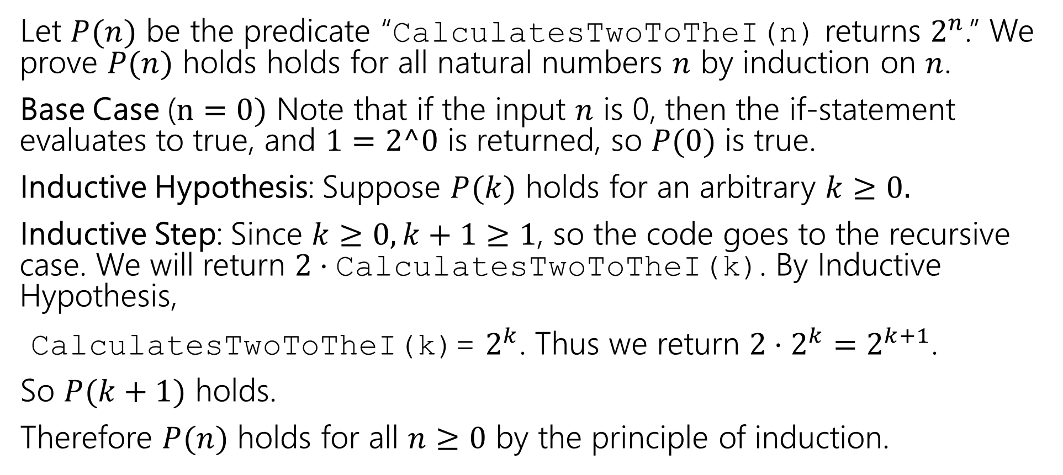

Making Induction Proofs Pretty
Let $P(n)$ be the predicate “CalculatesTwoToTheI(n) returns $2^{n}$.” We prove $P(n)$ holds holds for all natural numbers $n$ by induction on $n$.
Base Case ($n=0)$ Note that if the input $n$ is 0, then the if-statement evaluates to true, and $1=2^0$ is returned, so $P(0)$ is true.
Inductive Hypothesis: Suppose $P(k)$ holds for an arbitrary $k≥0.$
Inductive Step: Since $k≥0, k+1≥1$, so the code goes to the recursive case. We will return $2⋅\text{CalculatesTwoToTheI}\text{(}\text{k}\text{)}$. By Inductive Hypothesis,
$\text{CalculatesTwoToTheI}\text{(}\text{k}\text{)}$= $2^{k}$. Thus we return $2⋅2^{k}=2^{k+1}$.
So $P(k+1)$ holds.
Therefore $P(n)$ holds for all $n≥0$ by the principle of induction.

Slide 11
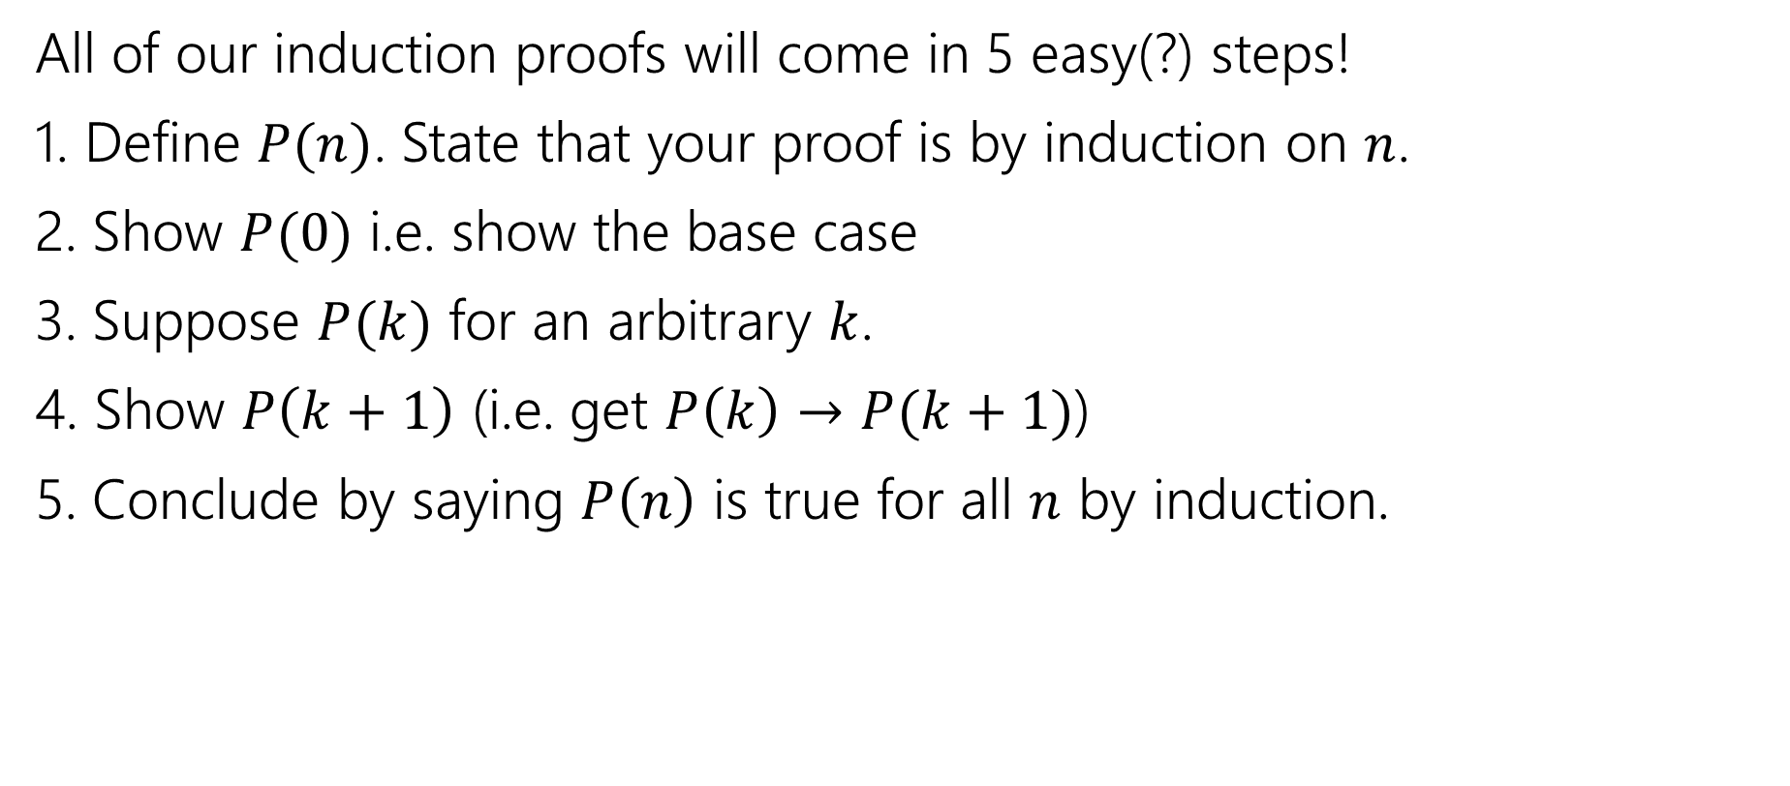

Making Induction Proofs Pretty
All of our induction proofs will come in 5 easy(?) steps!
1. Define $P(n)$. State that your proof is by induction on $n$.
2. Show $P(0)$ i.e. show the base case
3. Suppose $P(k)$ for an arbitrary $k$.
4. Show $P\left(k+1\right)$ (i.e. get $P\left(k\right)→P(k+1)$)
5. Conclude by saying $P\left(n\right)$ is true for all $n$ by induction.

Slide 12
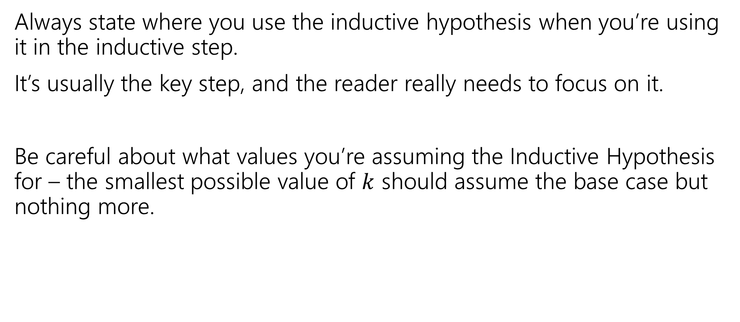

Some Other Notes
Always state where you use the inductive hypothesis when you’re using it in the inductive step.
It’s usually the key step, and the reader really needs to focus on it.
Be careful about what values you’re assuming the Inductive Hypothesis for – the smallest possible value of $k$ should assume the base case but nothing more.

Slide 13

The Principle of Induction (formally)
Informally: if you knock over one domino, and every domino knocks over the next one, then all your dominoes fell over.
$$P\left(0\right);∀k(P\left(k\right)→P\left(k+1\right))$$
Principle of Induction
If you know:
You can conclude:
$∴ ∀n(P\left(n\right))$

Slide 14
More induction!

Slide 15


More Induction
Induction doesn’t only work for code!
Show that $\sum_{i=0}^{n}{2^{i}}=1+2+4+…+2^{n}=2^{n+1}−1$.

Slide 16
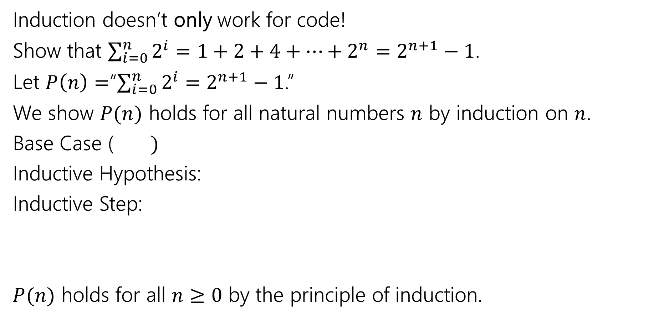
More Induction
Induction doesn’t only work for code!
Show that $\sum_{i=0}^{n}{2^{i}}=1+2+4+…+2^{n}=2^{n+1}−1$.
Let $P\left(n\right)=$“$\sum_{i=0}^{n}{2^{i}}=$ $2^{n+1}−1$.”
We show $P(n)$ holds for all natural numbers $n$ by induction on $n$.
Base Case ($)$
Inductive Hypothesis:
Inductive Step:
$P(n)$ holds for all $n≥0$ by the principle of induction.

Slide 17
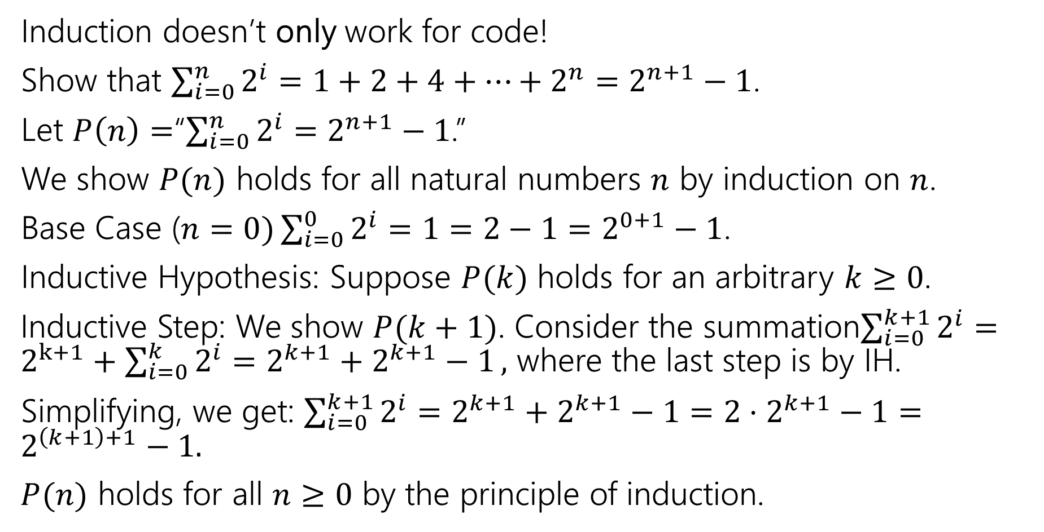

More Induction
Induction doesn’t only work for code!
Show that $\sum_{i=0}^{n}{2^{i}}=1+2+4+…+2^{n}=2^{n+1}−1$.
Let $P\left(n\right)=$“$\sum_{i=0}^{n}{2^{i}}=$ $2^{n+1}−1$.”
We show $P(n)$ holds for all natural numbers $n$ by induction on $n$.
Base Case ($n=0)\sum_{i=0}^{0}{2^{i}}=1=2−1=2^{0+1}−1$.
Inductive Hypothesis: Suppose $P(k)$ holds for an arbitrary $k≥0$.
Inductive Step: We show $P(k+1)$. Consider the summation$\sum_{i=0}^{k+1}{2^{i}}=2^{k+1}+\sum_{i=0}^{k}{2^{i}=2^{k+1}+2^{k+1}−1},$ where the last step is by IH.
Simplifying, we get: $\sum_{i=0}^{k+1}{2^{i}}=2^{k+1}+2^{k+1}−1=2⋅2^{k+1}−1=2^{\left(k+1\right)+1}−1.$
$P(n)$ holds for all $n≥0$ by the principle of induction.

Slide 18
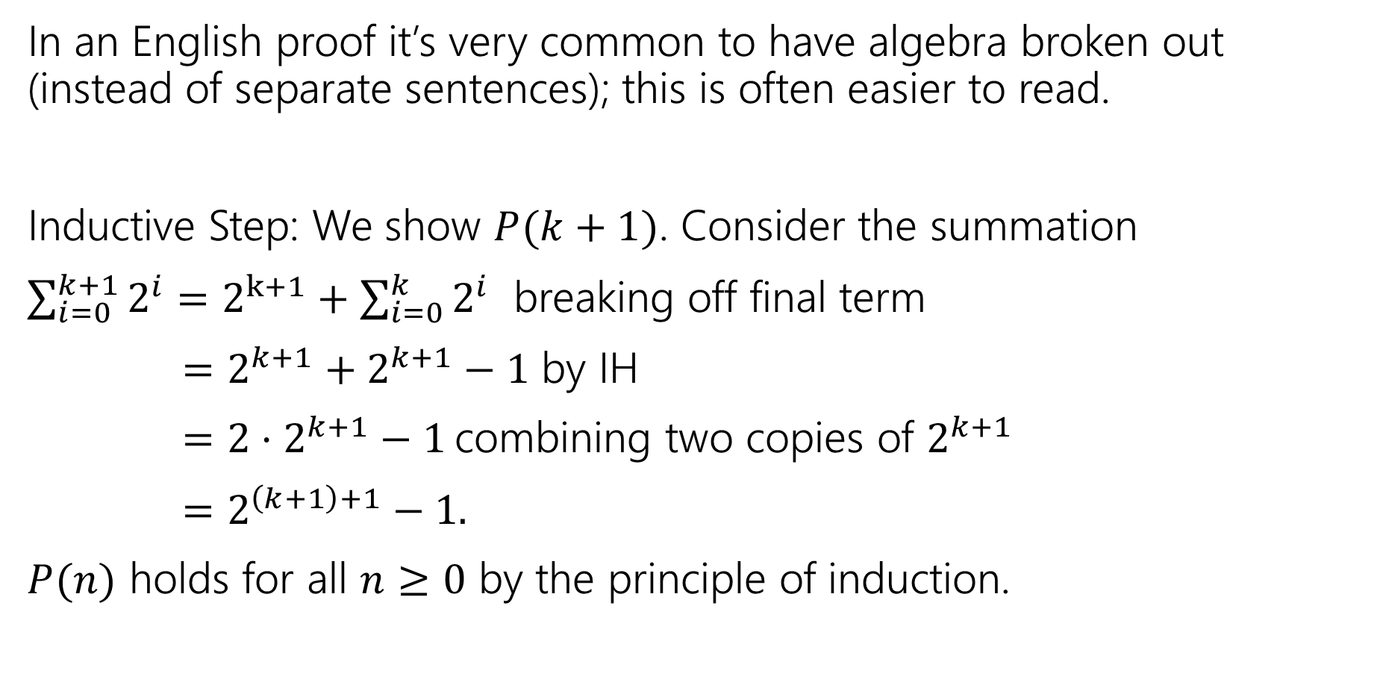
Algebra Block Formatting
In an English proof it’s very common to have algebra broken out (instead of separate sentences); this is often easier to read.
Inductive Step: We show $P(k+1)$. Consider the summation
$\sum_{i=0}^{k+1}{2^{i}}=2^{k+1}+\sum_{i=0}^{k}{2^{i}}$ breaking off final term
$=2^{k+1}+2^{k+1}−1$ by IH
$=2⋅2^{k+1}−1$ combining two copies of $2^{k+1}$
$=2^{\left(k+1\right)+1}−1.$
$P(n)$ holds for all $n≥0$ by the principle of induction.

Slide 19
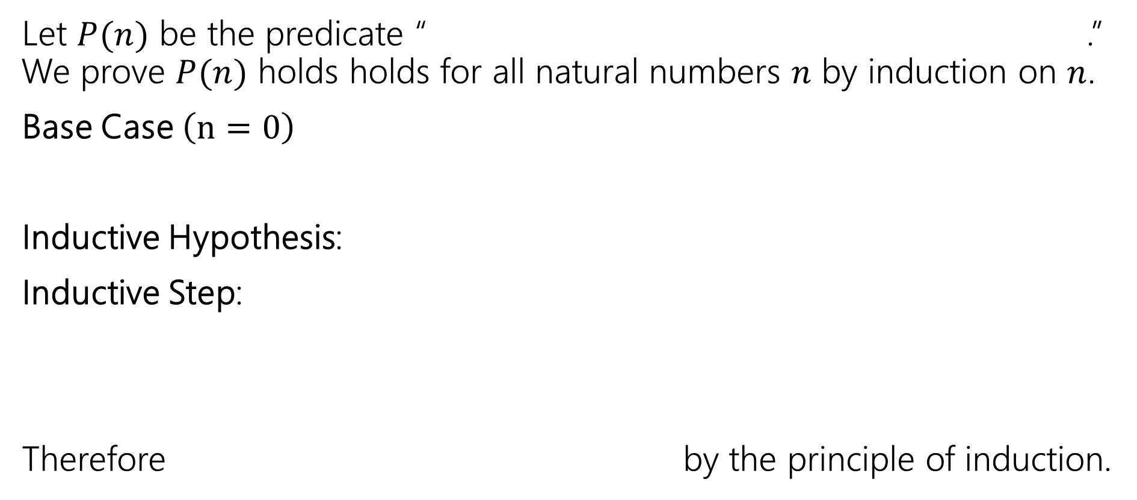
Making Induction Proofs Pretty
Let $P(n)$ be the predicate “ .” We prove $P(n)$ holds holds for all natural numbers $n$ by induction on $n$.
Base Case $\left(n=0\right)$
Inductive Hypothesis:
Inductive Step:
Therefore by the principle of induction.

