Slide 1
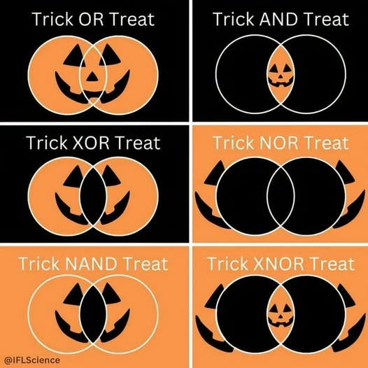
Sets
CSE 311 Autumn 25
Lecture 15

Slide 2
We’ve got A LOT of definitions today
You don’t need me to read things aloud to you.
We’ll cover the subtle/tricky things in lecture.
Other things are left for you to read on your own. The section is marked in the slide deck.
Today’s concept check should be very useful to get the definitions down!

Slide 3
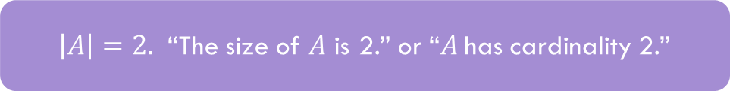
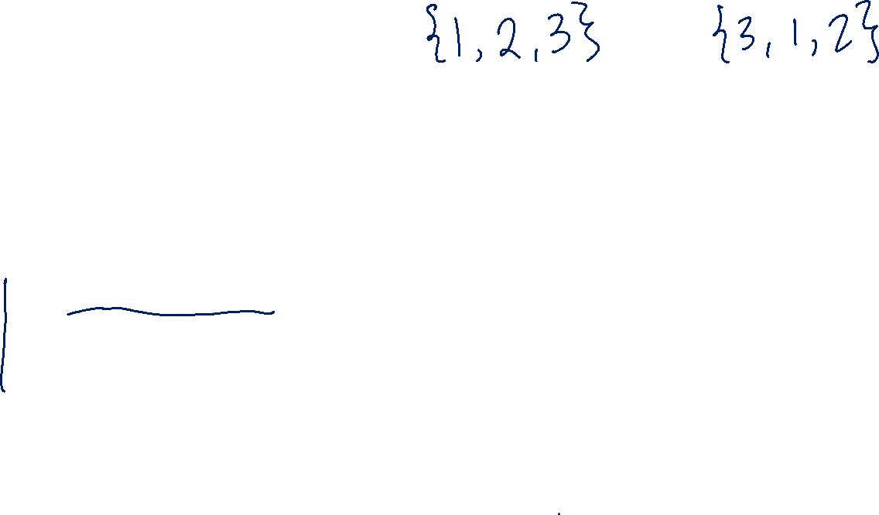
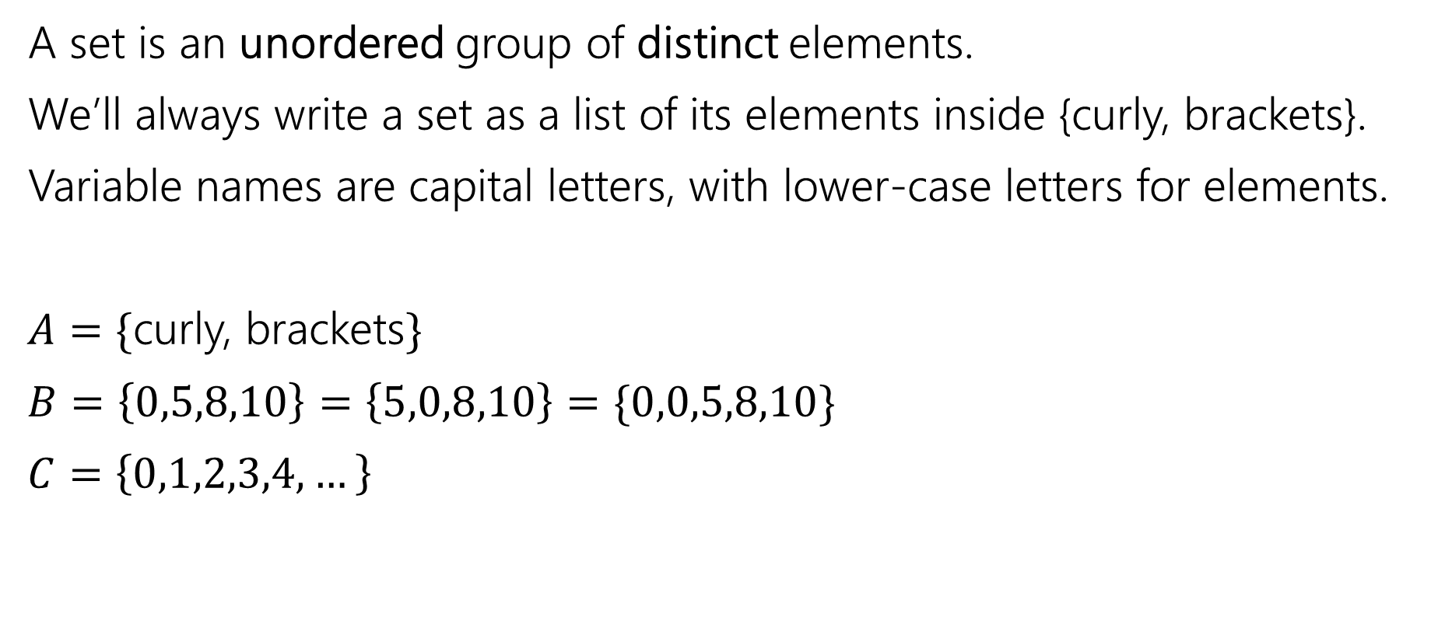

Set Basics 1
A set is an unordered group of distinct elements.
We’ll always write a set as a list of its elements inside {curly, brackets}.
Variable names are capital letters, with lower-case letters for elements.
$A=\{$curly, brackets$\}$
$B=\left\{0,5,8,10\right\}=\left\{5,0,8,10\right\}=\{0,0,5,8,10\}$
$C=\left\{0,1,2,3,4,…\right\}$
$\left|A\right|=2.$ “The size of $A$ is 2.” or “$A$has cardinality 2.”

Slide 4

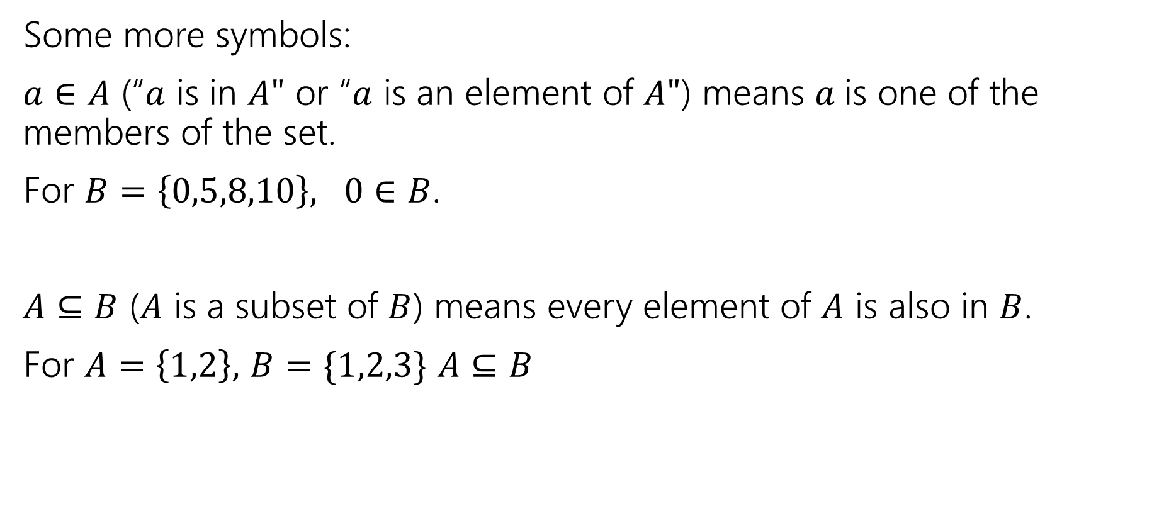
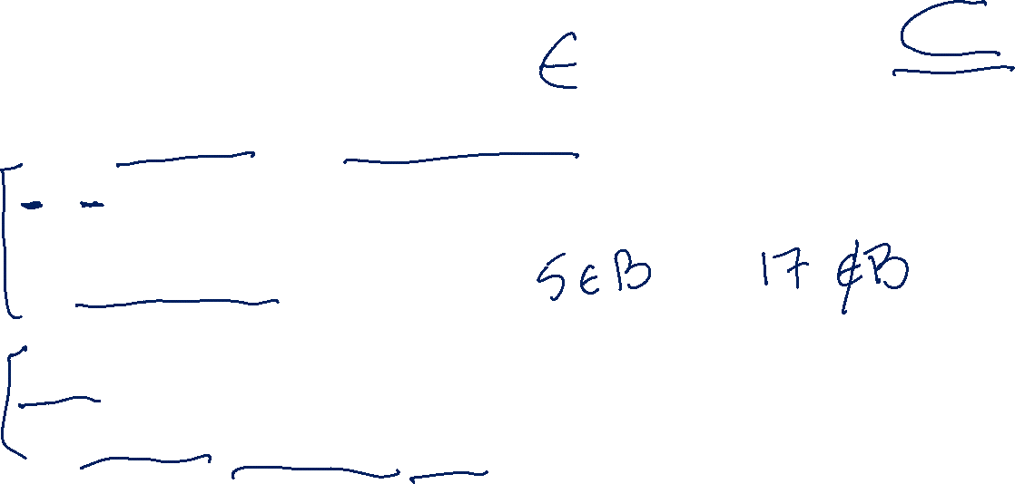


Set Basics 2
Some more symbols:
$a∈A$ (“$a$ is in $A"$ or “$a$ is an element of $A"$) means $a$is one of the members of the set.
For $B=\left\{0,5,8,10\right\}, 0∈B$.
$A⊆B$ ($A$ is a subset of $B$) means every element of $A$ is also in $B$.
For $A=\left\{1,2\right\},$ $B=\{1,2,3\}$ $A⊆B$

Slide 5
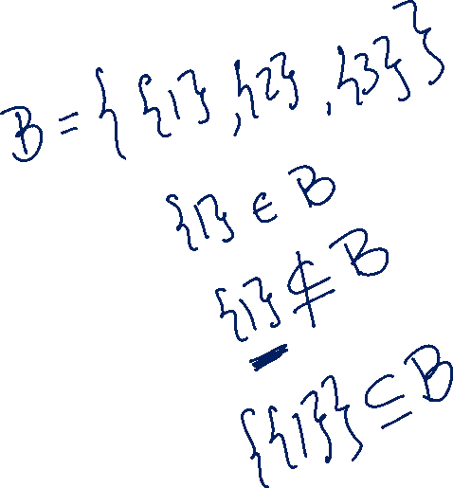

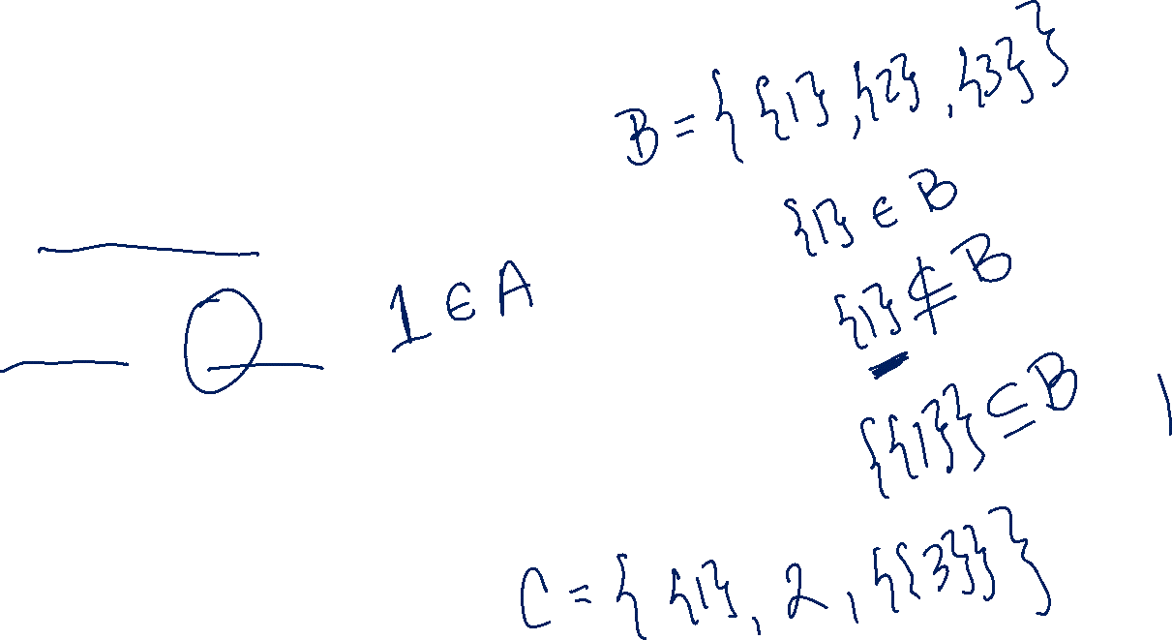
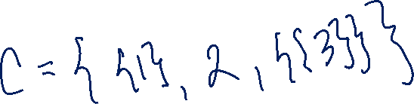
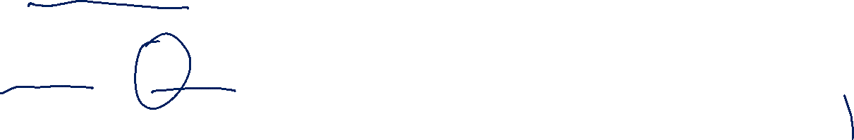
Set Basics 3
Be careful about these two operations:
If $A=\{1,2,3,4,5\}$
$\left\{1\right\}⊆A$, but $\left\{1\right\}∉A$
$∈$ asks: is this item in that box?
$⊆$ asks: is everything in this box also in that box?

Slide 6


Try it! (setup)
Let $A=\left\{1,2,3,4,5\right\}$
$B=\{1,2,5\}$
Is $A⊆A?$
Is $B⊆A?$
Is $A⊆B$?
Is $\left\{1\right\}∈A$?
Is $1∈A$?

Slide 7
Try it! (answers)
Let $A=\left\{1,2,3,4,5\right\}$
$B=\{1,2,5\}$
Is $A⊆A?$
Is $B⊆A?$
Is $A⊆B$?
Is $\left\{1\right\}∈A$?
Is $1∈A$?
Yes!
Yes
No
No
Yes

Slide 8
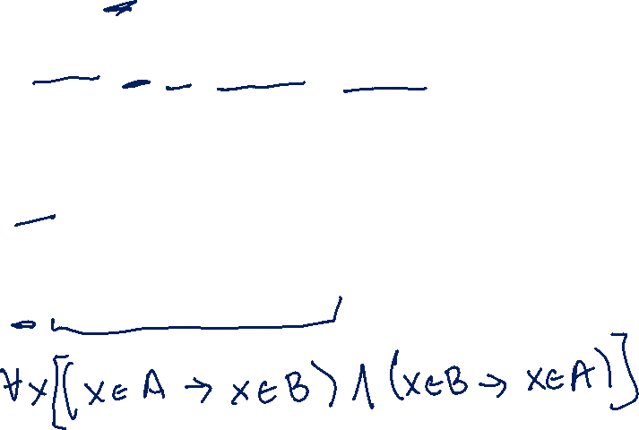



Definitions
$A⊆B$($"A$ is a subset of $B"$) iff every element of $A$ is also in $B$.
$A=B$ ($"A$ equals $B"$) iff $A$ and $B$ have identical elements.
$A⊆B≡∀x(x∈A→x∈B)$
$A=B≡∀x\left(x∈A↔x∈B\right)≡$ $A⊆B∧B⊆A$

Slide 9




Proof Skeleton for $⊆$
How would we show $A⊆B?$
Let $x$ be an arbitrary element of $A$
…
So $x$ is also in $B$.
Since $x$ was an arbitrary element of $A,$ we have that $A⊆B$.
$A⊆B≡∀x(x∈A→x∈B)$

Slide 10
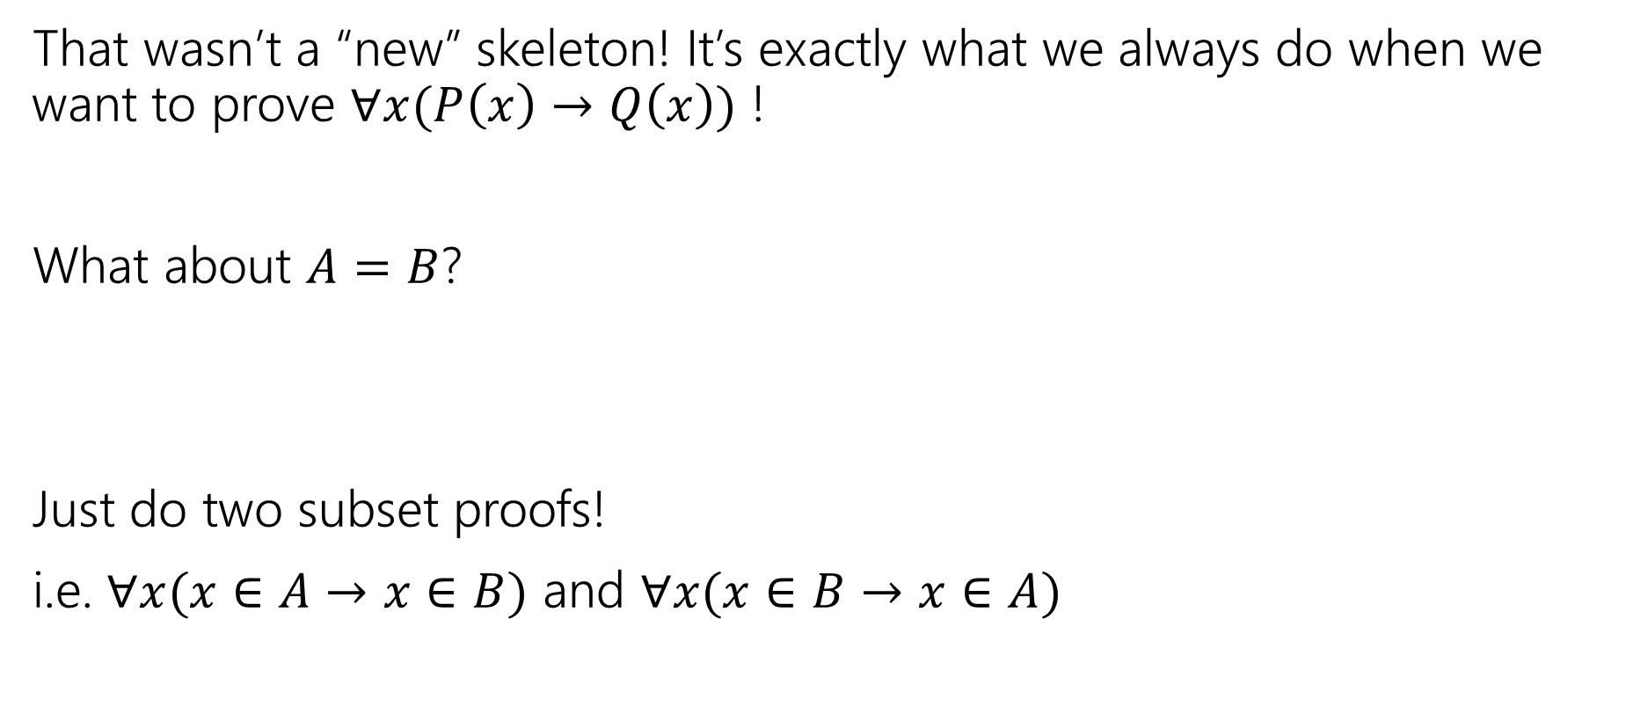

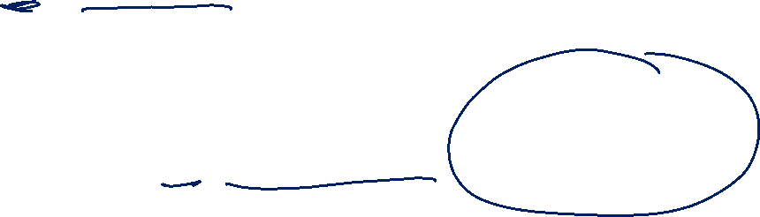
Proof Skeleton for $=$
That wasn’t a “new” skeleton! It’s exactly what we always do when we want to prove $∀x(P\left(x\right)→Q\left(x\right))$ !
What about $A=B$?
Just do two subset proofs!
i.e. $∀x(x∈A→x∈B)$ and $∀x(x∈B→x∈A)$
$A=B≡∀x\left(x∈A↔x∈B\right)≡$ $A⊆B∧B⊆A$

Slide 11



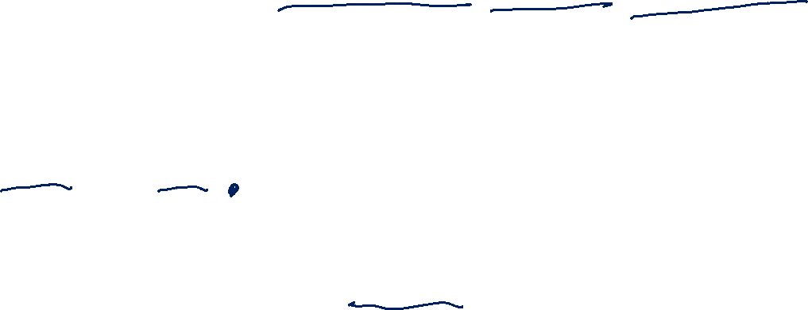
What do we do with sets?
We combined propositions with $∨,∧,¬$.
We combine sets with $∩\left[intersection\right],∪,[union] ¯[complement]$
$A∪B=\{x:x∈A∨x∈B\}$
$A∩B=\{x:x∈A∧x∈B\}$
$\overline{A}=\{x:x∉A\}$
That’s a lot of elements…if we take the complement, we’ll have some “universe” $𝒰$, and $\overline{A}=\{x:x∈U∧x∉A\}$
It’s a lot like the domain of discourse.

Slide 12









Venn Diagram representations of union, intersect, and complement
$$A∪B$$
$$A∩B$$
$$A$$
$$B$$
$$A$$
$$B$$
$$\overline{A}$$
$$A$$

Slide 13
Proofs with sets

Slide 14
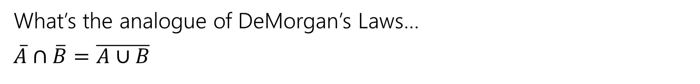
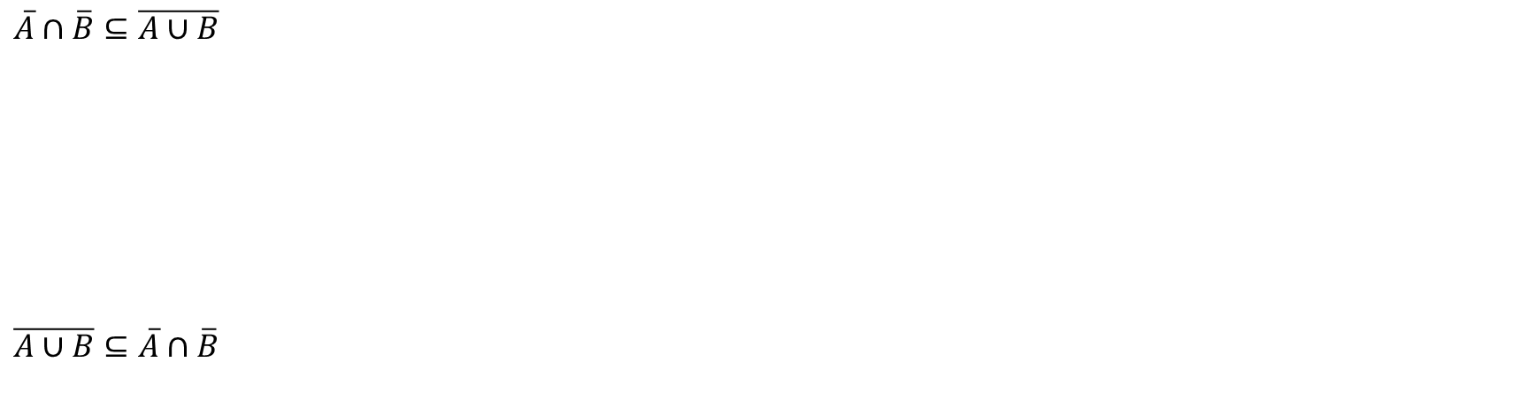
A proof!
What’s the analogue of DeMorgan’s Laws…
$\overline{A}∩\overline{B}=\overline{A∪B}$
$A=B≡∀x\left(x∈A↔x∈B\right)≡$ $A⊆B∧B⊆A$
$\overline{A}∩\overline{B}⊆\overline{A∪B}$
$\overline{A∪B}⊆\overline{A}∩\overline{B}$

Slide 15



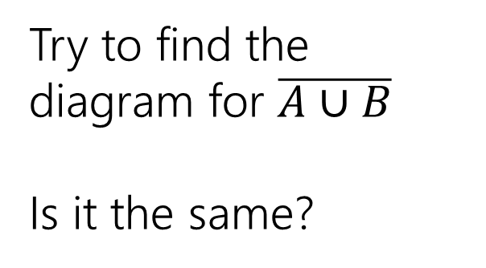








Intuition for $\overline{A}∩\overline{B}=\overline{A∪B}$
$$\overline{A}$$
$$B$$
$$A$$
Try to find the diagram for $\overline{A∪B}$
Is it the same?
$$\overline{B}$$
$$A$$
$$B$$
$$\overline{A}∩\overline{B}$$
$$A$$
$$B$$

Slide 16








Intuition for $\overline{A}∩\overline{B}=\overline{A∪B}$ (complete)
$$\overline{A}$$
$$B$$
$$A$$
$$A∪B$$
$$A$$
$$B$$
$$\overline{B}$$
$$A$$
$$B$$
$$\overline{A}∩\overline{B}$$
$$\overline{A∪B}$$
$$A$$
$$B$$
$$A$$
$$B$$

Slide 17
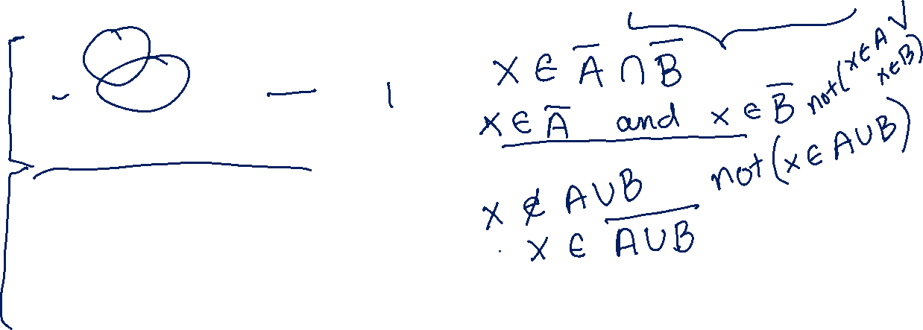
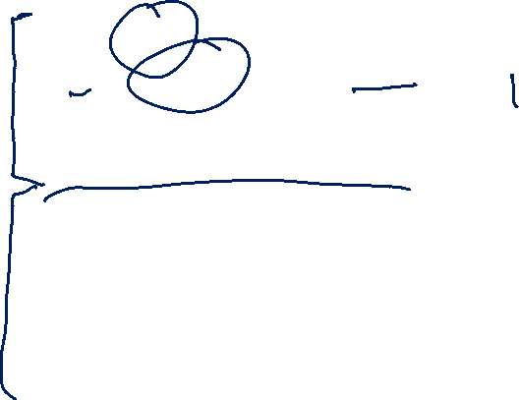
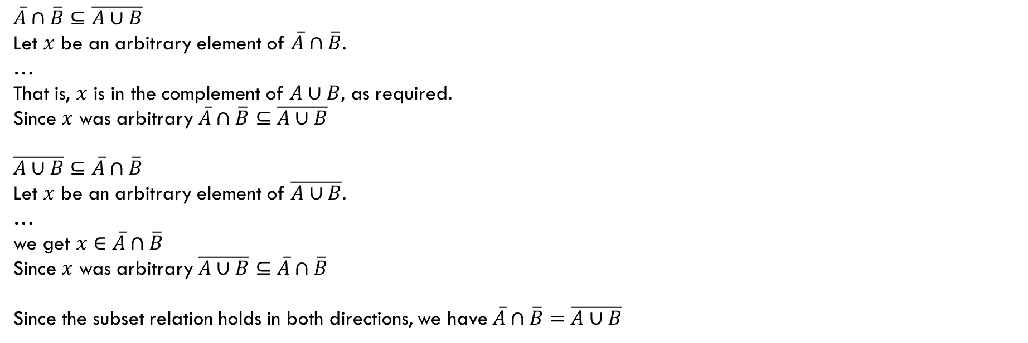
A proof skeleton!
What’s the analogue of DeMorgan’s Laws…
$\overline{A}∩\overline{B}=\overline{A∪B}$
$A=B≡∀x\left(x∈A↔x∈B\right)≡$ $A⊆B∧B⊆A$
$\overline{A}∩\overline{B}⊆\overline{A∪B}$
Let $x$ be an arbitrary element of $\overline{A}∩\overline{B}$.
…
That is, $x$ is in the complement of $A∪B,$ as required.
Since $x$ was arbitrary $\overline{A}∩\overline{B}⊆\overline{A∪B}$
$\overline{A∪B}⊆\overline{A}∩\overline{B}$
Let $x$ be an arbitrary element of $\overline{A∪B}$.
…
we get $x∈\overline{A}∩\overline{B}$
Since $x$ was arbitrary $\overline{A∪B}⊆\overline{A}∩\overline{B}$
Since the subset relation holds in both directions, we have $\overline{A}∩\overline{B}=\overline{A∪B}$

Slide 18
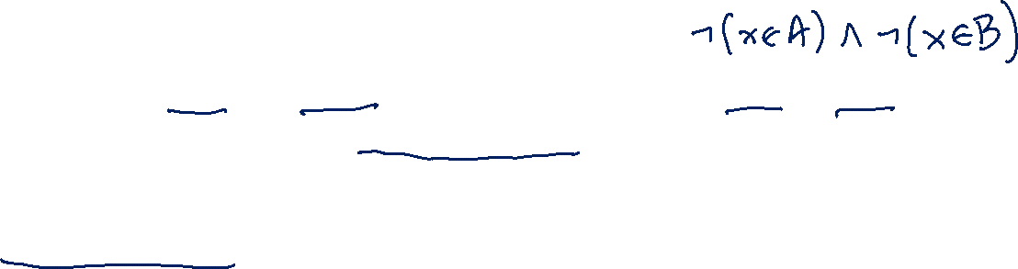
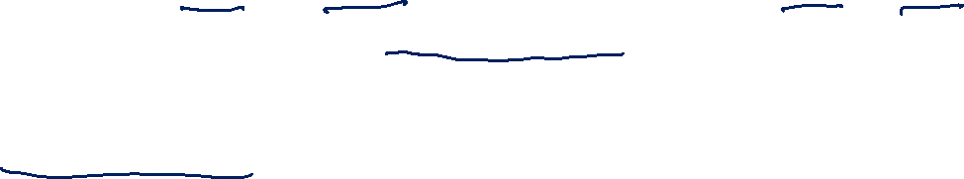
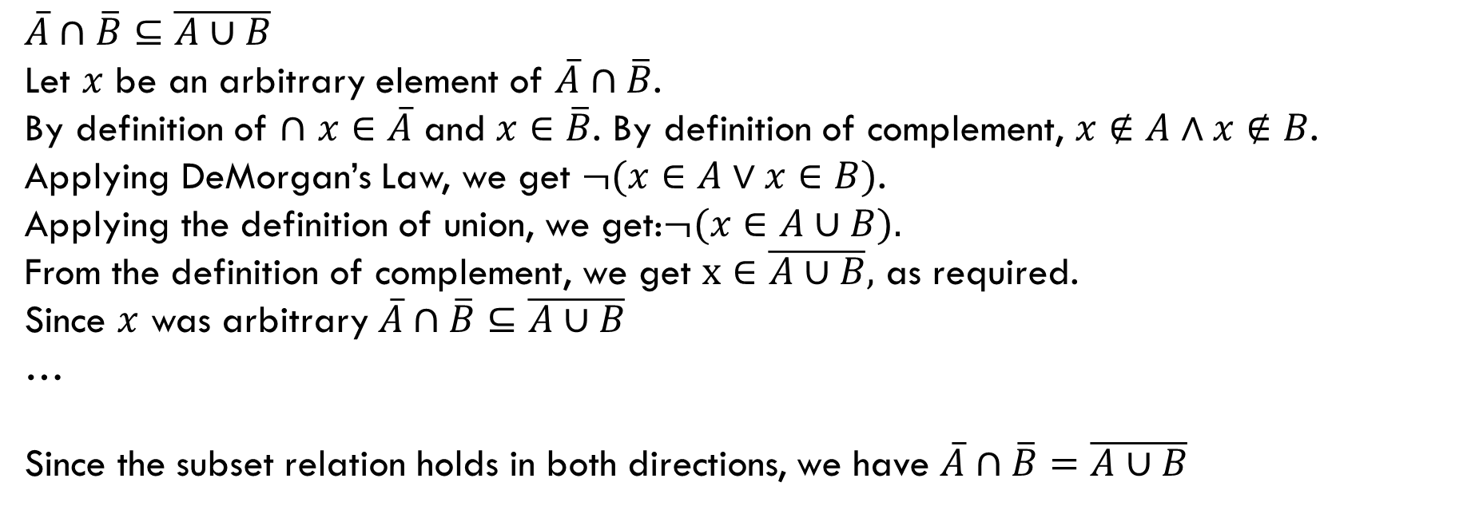
A half-complete proof!
What’s the analogue of DeMorgan’s Laws…
$\overline{A}∩\overline{B}=\overline{A∪B}$
$A=B≡∀x\left(x∈A↔x∈B\right)≡$ $A⊆B∧B⊆A$
$\overline{A}∩\overline{B}⊆\overline{A∪B}$
Let $x$ be an arbitrary element of $\overline{A}∩\overline{B}$.
By definition of $∩$ $x∈\overline{A}$ and $x∈\overline{B}$. By definition of complement, $x∉A∧x∉B$.
Applying DeMorgan’s Law, we get $¬(x∈A∨x∈B)$.
Applying the definition of union, we get:$¬(x∈A∪B).$
From the definition of complement, we get $x∈\overline{A∪B},$ as required.
Since $x$ was arbitrary $\overline{A}∩\overline{B}⊆\overline{A∪B}$
…
Since the subset relation holds in both directions, we have $\overline{A}∩\overline{B}=\overline{A∪B}$

Slide 19

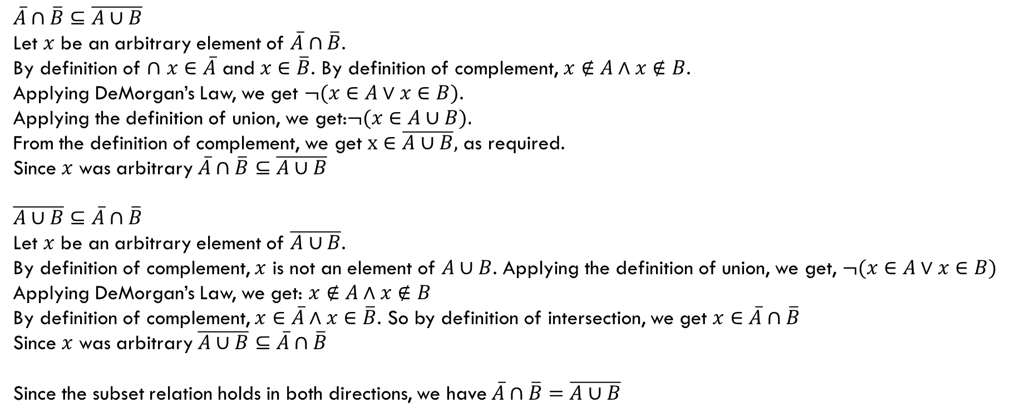
A complete proof!
What’s the analogue of DeMorgan’s Laws…
$\overline{A}∩\overline{B}=\overline{A∪B}$
$A=B≡∀x\left(x∈A↔x∈B\right)≡$ $A⊆B∧B⊆A$
$\overline{A}∩\overline{B}⊆\overline{A∪B}$
Let $x$ be an arbitrary element of $\overline{A}∩\overline{B}$.
By definition of $∩$ $x∈\overline{A}$ and $x∈\overline{B}$. By definition of complement, $x∉A∧x∉B$.
Applying DeMorgan’s Law, we get $¬(x∈A∨x∈B)$.
Applying the definition of union, we get:$¬(x∈A∪B).$
From the definition of complement, we get $x∈\overline{A∪B},$ as required.
Since $x$ was arbitrary $\overline{A}∩\overline{B}⊆\overline{A∪B}$
$\overline{A∪B}⊆\overline{A}∩\overline{B}$
Let $x$ be an arbitrary element of $\overline{A∪B}$.
By definition of complement, $x$ is not an element of $A∪B$. Applying the definition of union, we get, $¬(x∈A∨x∈B)$
Applying DeMorgan’s Law, we get: $x∉A∧x∉B$
By definition of complement, $x∈\overline{A}∧x∈\overline{B}$. So by definition of intersection, we get $x∈\overline{A}∩\overline{B}$
Since $x$ was arbitrary $\overline{A∪B}⊆\overline{A}∩\overline{B}$
Since the subset relation holds in both directions, we have $\overline{A}∩\overline{B}=\overline{A∪B}$

Slide 20
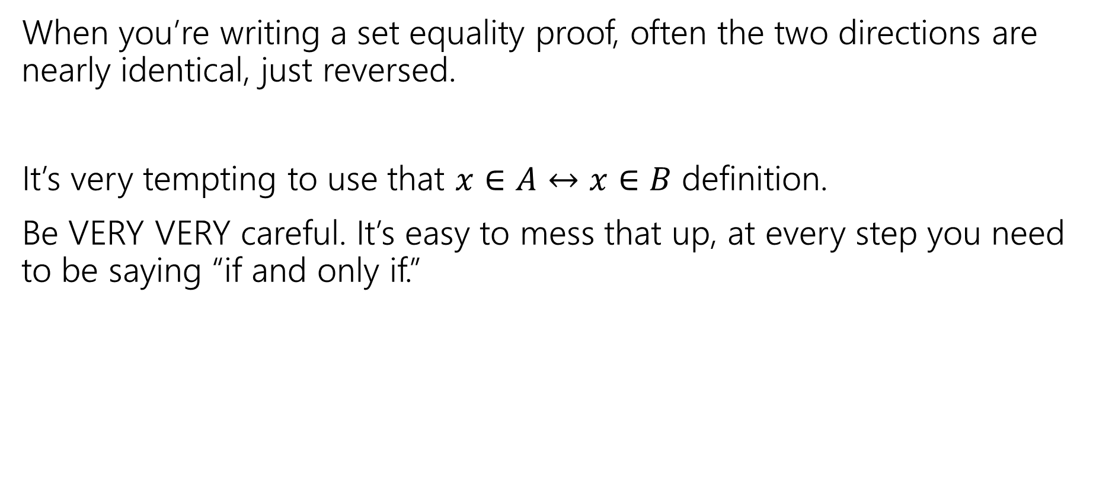
Proof-writing advice
When you’re writing a set equality proof, often the two directions are nearly identical, just reversed.
It’s very tempting to use that $x∈A↔x∈B$ definition.
Be VERY VERY careful. It’s easy to mess that up, at every step you need to be saying “if and only if.”

Slide 21
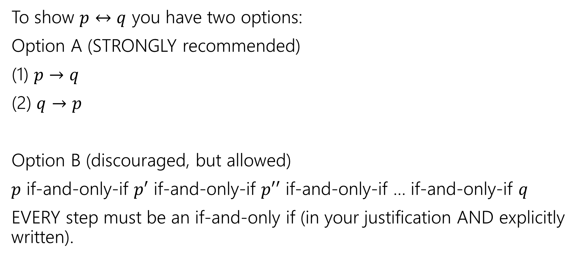
Summary: How to show an if and only if
To show $p↔q$ you have two options:
Option A (STRONGLY recommended)
(1) $p→q$
(2) $q→p$
Option B (discouraged, but allowed)
$p$ if-and-only-if $p′$ if-and-only-if $p′′$ if-and-only-if … if-and-only-if $q$
EVERY step must be an if-and-only if (in your justification AND explicitly written).

Slide 22

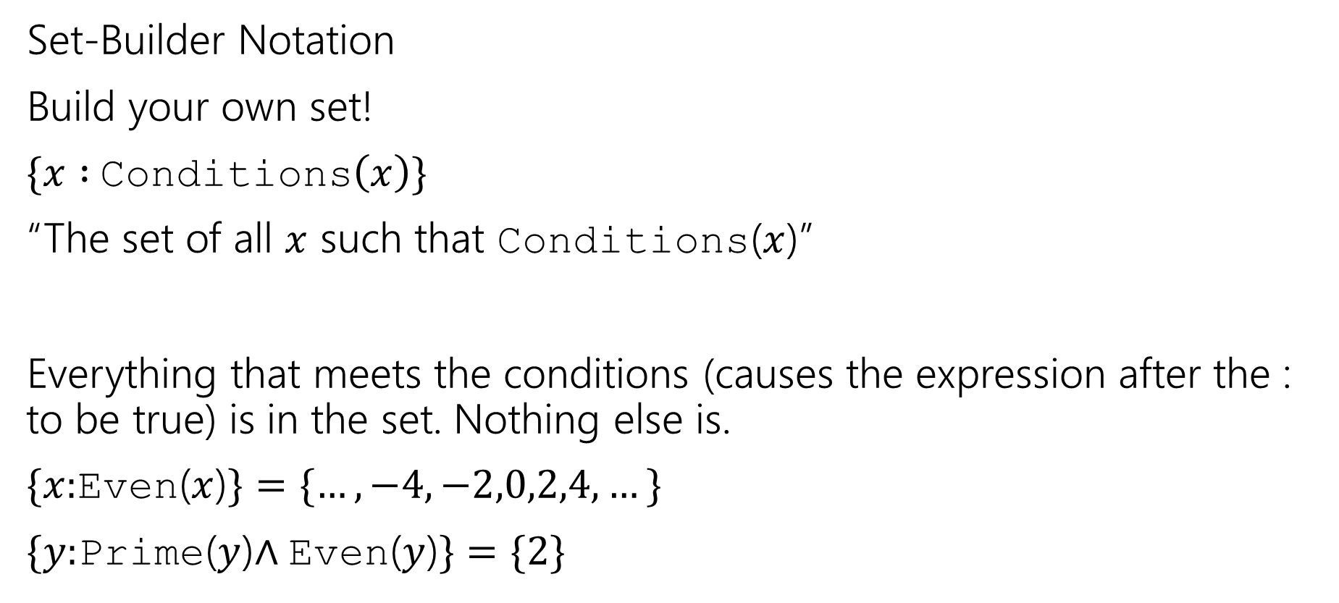
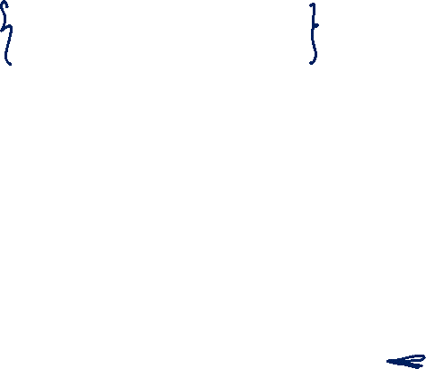
Two More Set Operations (Set-Builder)
In general
$$\{ variable :conditions \}$$
Will also see | instead of :
Set-Builder Notation
Build your own set!
$\{x :$Conditions$\left(x\right)\}$
“The set of all $x$ such that Conditions($x$)”
Everything that meets the conditions (causes the expression after the : to be true) is in the set. Nothing else is.
$\{x:$Even($x$)$\}=\{…,−4,−2,0,2,4,…\}$
$\{y:$Prime($y$)$∧$Even($y$)$\}=\{2\}$

Slide 23

Build some sets! (setup)
Let $A=\left\{x:x\%3=0\right\}$
What are the elements of $A$?
Let $B=\{s:s \text{is} \text{a} \text{string} \text{that} \text{contains} \text{at} \text{least} \text{one}\text{ ′}\text{a}\text{′ }\text{and} \text{at} \text{least} \text{one}\text{ ′}\text{b}\text{′}\}$
What are the elements of $B$?

Slide 24
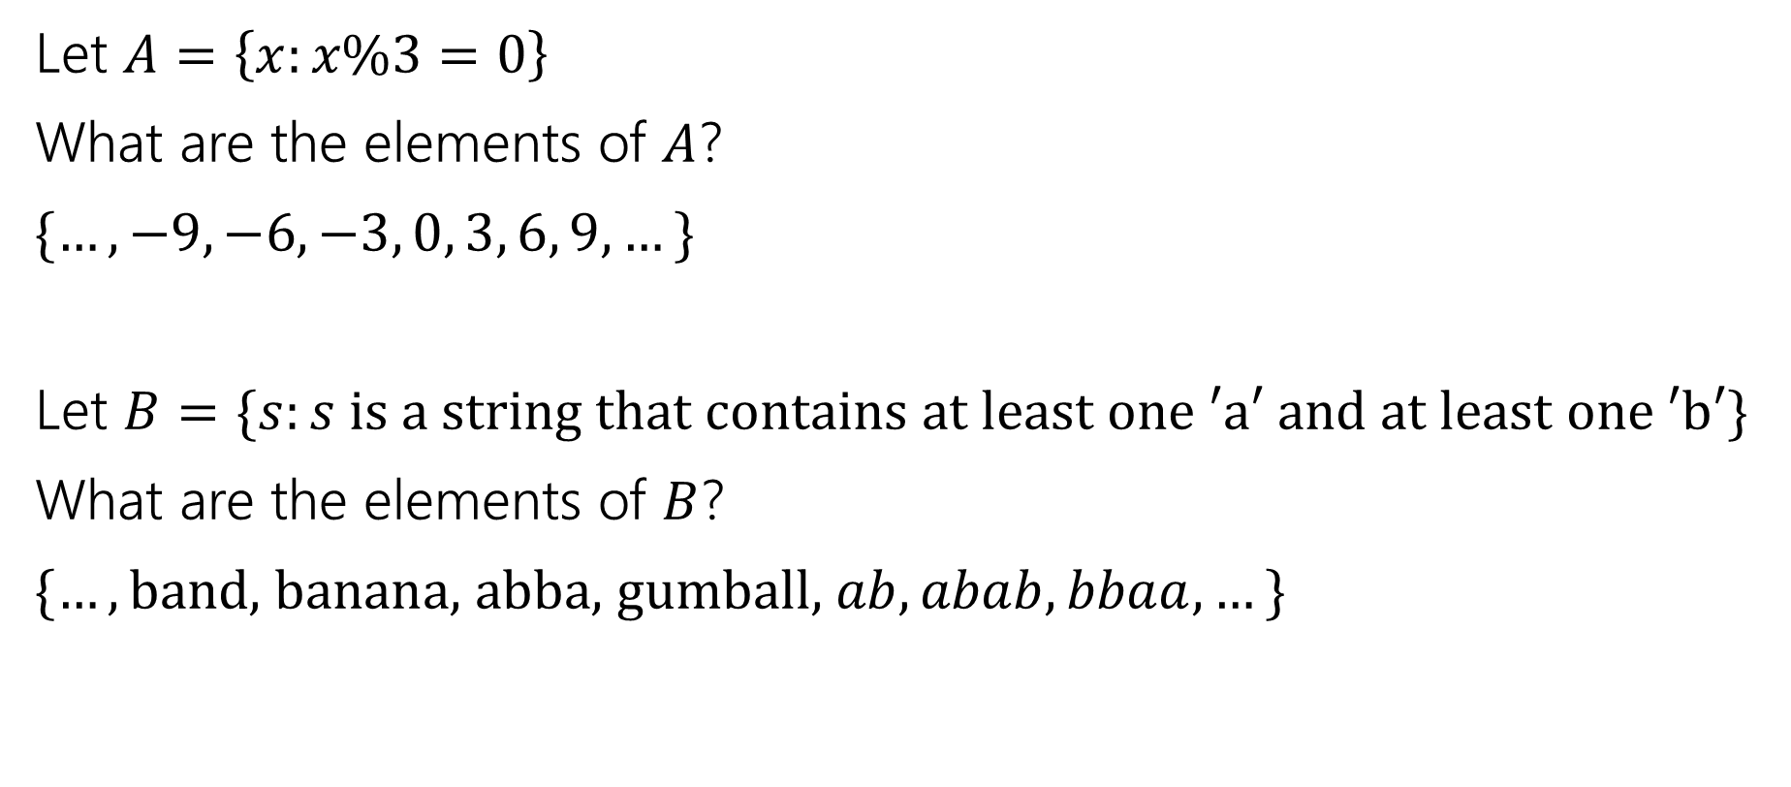
Build some sets! (answers)
Let $A=\left\{x:x\%3=0\right\}$
What are the elements of $A$?
$\{…,−9, −6, −3, 0, 3, 6, 9, …\}$
Let $B=\{s:s \text{is} \text{a} \text{string} \text{that} \text{contains} \text{at} \text{least} \text{one}\text{ ′}\text{a}\text{′ }\text{and} \text{at} \text{least} \text{one}\text{ ′}\text{b}\text{′}\}$
What are the elements of $B$?
$\{…,\text{band}\text{, }\text{banana}\text{, }\text{abba}\text{, }\text{gumball}\text{, }ab, abab, bbaa, …\}$

Slide 25
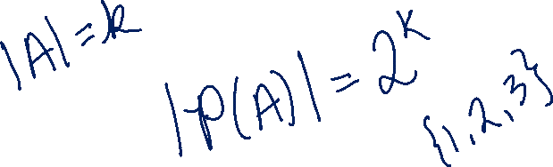

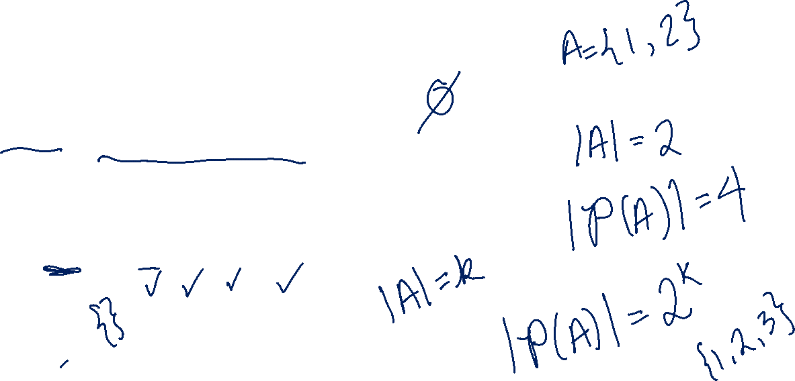
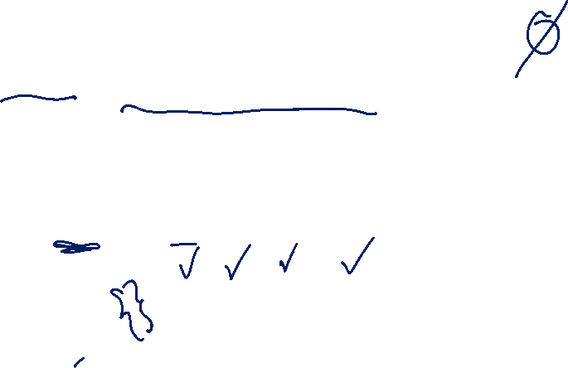
Two More Set Operations (Powerset)
Given a set, let’s talk about it’s powerset.
$𝒫\left(A\right)=\{X:X$ is a subset of $A\}$
The powerset of $A$ is the set of all subsets of $A.$
$𝒫\left(\left\{1,2\right\}\right)=\{∅, \left\{1\right\}, \left\{2\right\}, \left\{1,2\right\}\}$

Slide 26
Recursive Set Definitions

Slide 27
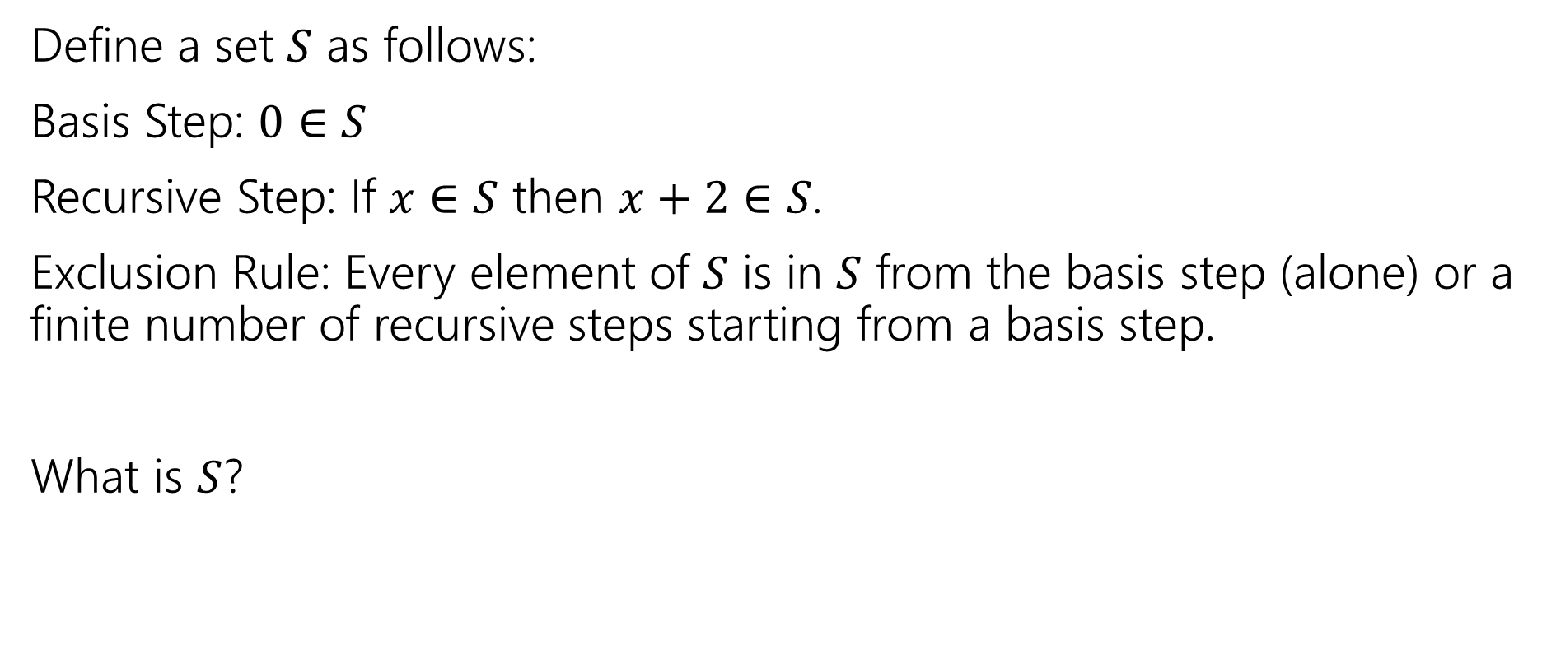
Recursive Definition of Sets
Define a set $S$ as follows:
Basis Step: $0∈S$
Recursive Step: If $x∈S$ then $x+2∈S$.
Exclusion Rule: Every element of $S$ is in $S$ from the basis step (alone) or a finite number of recursive steps starting from a basis step.
What is $S$?

Slide 28
Recursive Definitions of Sets (laziness)
We’ll always list the Basis and Recursive parts of the definition.
Starting…now…we’re going to be lazy and skip writing the “exclusion” rule. It’s still part of the definition.

Slide 29
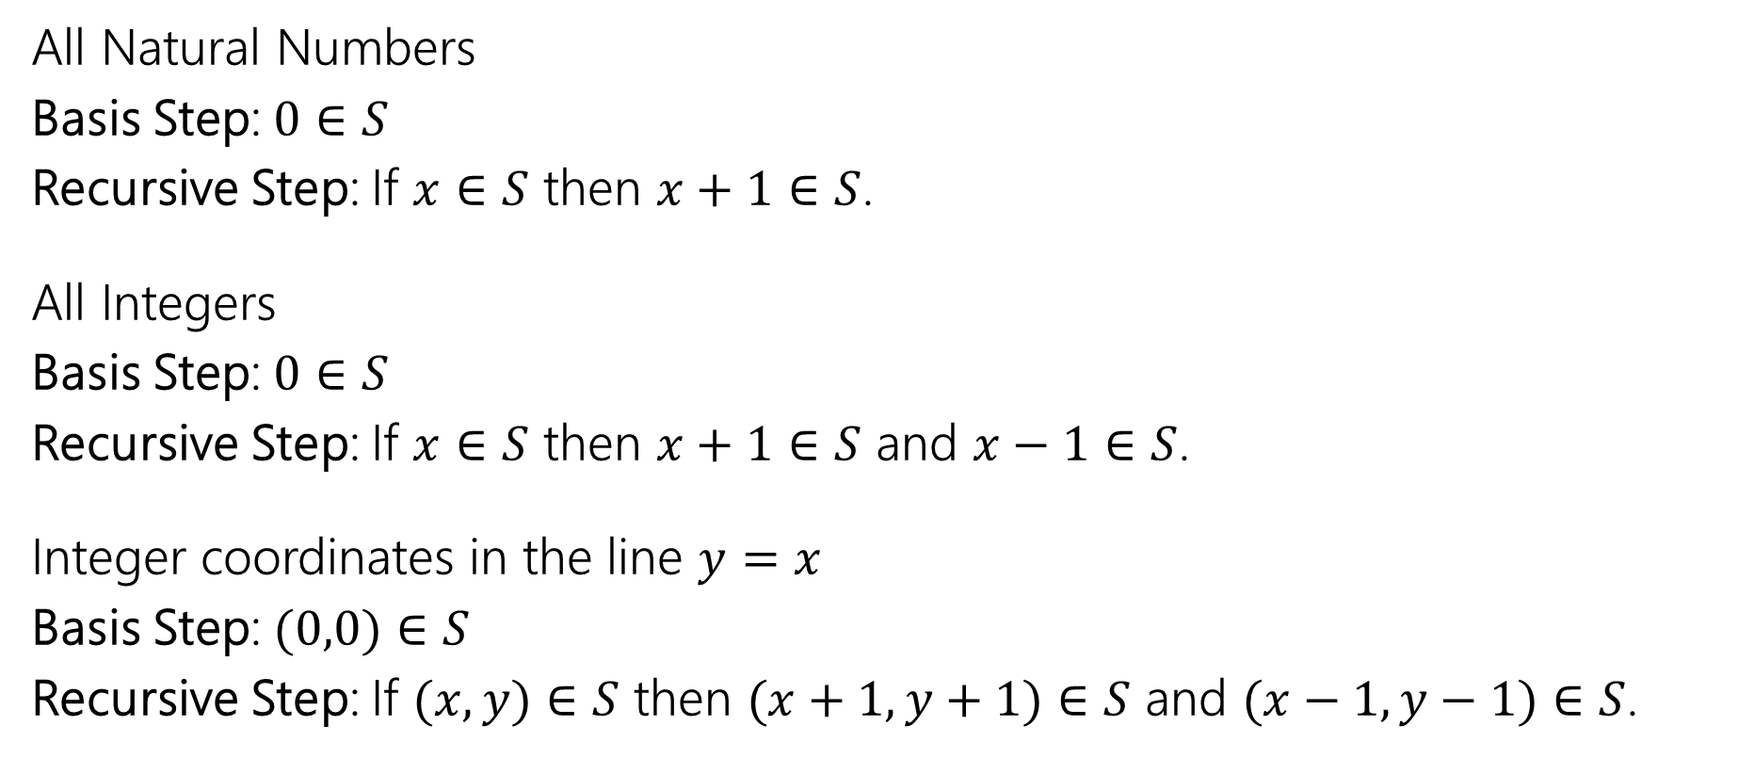
Recursive Definitions of Sets (examples)
All Natural Numbers
Basis Step: $0∈S$
Recursive Step: If $x∈S$ then $x+1∈S$.
All Integers
Basis Step: $0∈S$
Recursive Step: If $x∈S$ then $x+1∈S$ and $x−1∈S$.
Integer coordinates in the line $y=x$
Basis Step: $(0,0)∈S$
Recursive Step: If $(x,y)∈S$ then $(x+1,y+1)∈S$ and $(x−1,y−1)∈S$.
Notes:
Mention what happens to all integers if you change it to 5 in S (answer: nothing. Many different possible recursive definitions)

Slide 30
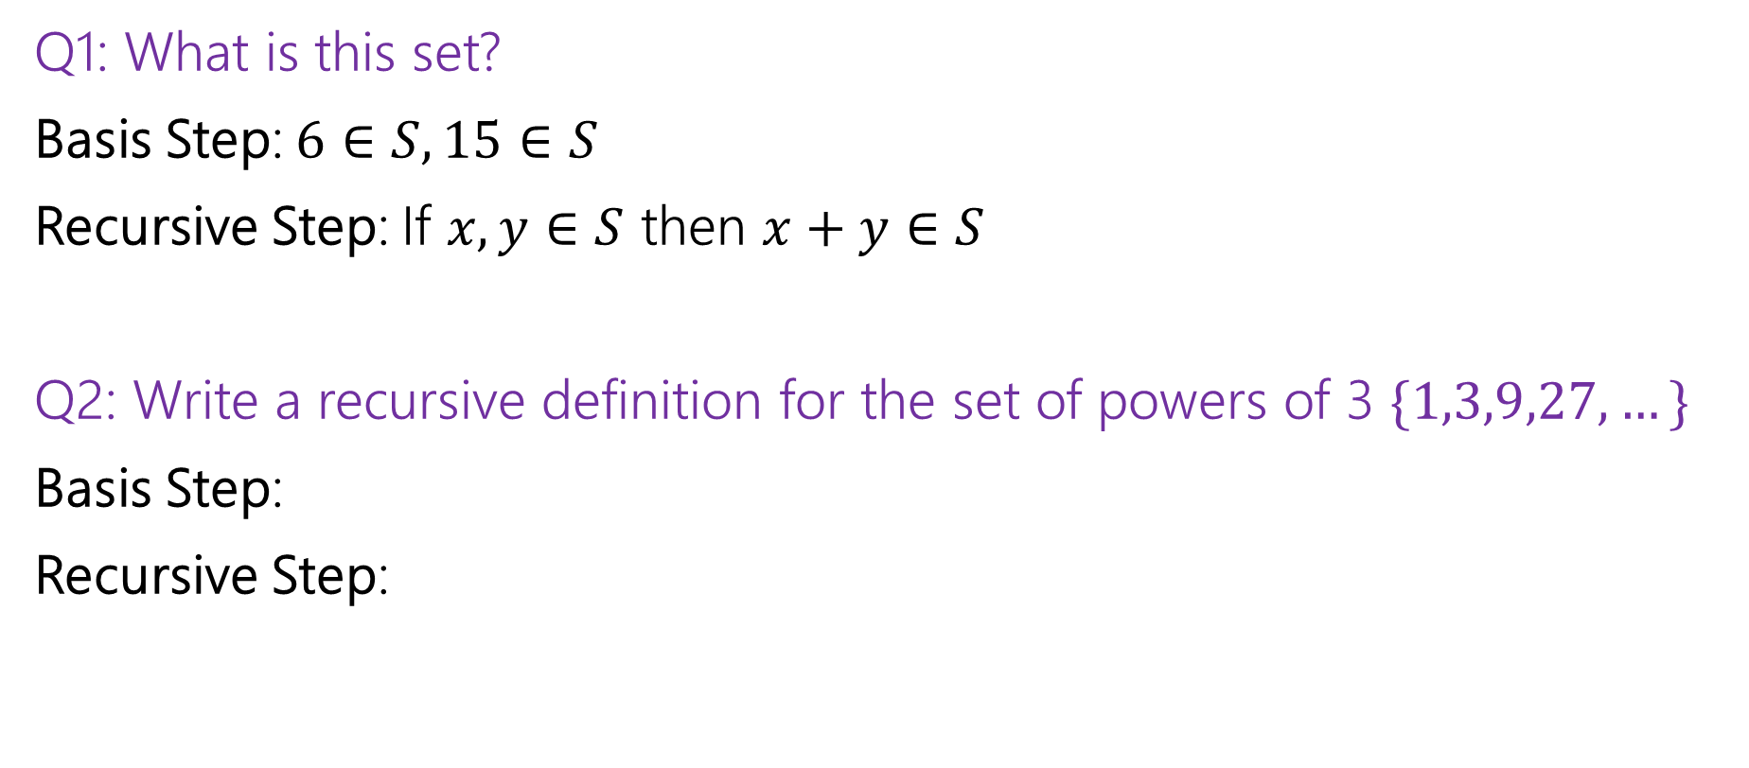
Recursive Definitions of Sets (practice)
Q1: What is this set?
Basis Step: $6∈S, 15∈S$
Recursive Step: If $x,y∈S$ then $x+y∈S$
Q2: Write a recursive definition for the set of powers of 3 $\{1,3,9,27,…\}$
Basis Step:
Recursive Step:

Slide 31
Extra Set Practice

Slide 32

Extra Set Practice (example 1, p1)
Show $A∪\left(B∩C\right)=\left(A∪B\right)∩(A∪C)$
Proof:
Start with the outline. What two things do we need to show? For each, where do we start and end?

Slide 33
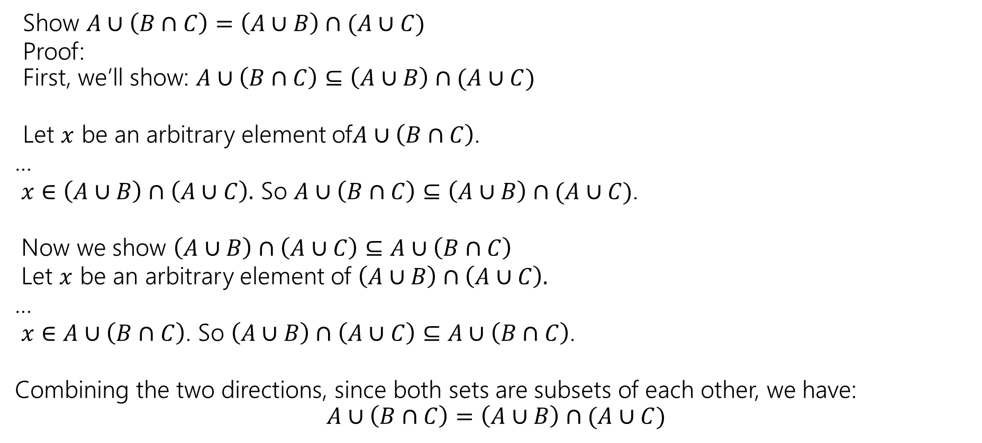
Extra Set Practice (example 1, p2)
Show $A∪\left(B∩C\right)=\left(A∪B\right)∩(A∪C)$
Proof: First, we’ll show: $A∪\left(B∩C\right)⊆\left(A∪B\right)∩(A∪C)$
Let $x$ be an arbitrary element of$A∪\left(B∩C\right)$.
…
$x∈\left(A∪B\right)∩\left(A∪C\right).$ So $A∪\left(B∩C\right)⊆\left(A∪B\right)∩(A∪C)$.
Now we show $\left(A∪B\right)∩\left(A∪C\right)⊆A∪\left(B∩C\right)$
Let $x$ be an arbitrary element of $\left(A∪B\right)∩\left(A∪C\right).$
…
$x∈A∪\left(B∩C\right)$. So $\left(A∪B\right)∩\left(A∪C\right)⊆A∪\left(B∩C\right)$.
Combining the two directions, since both sets are subsets of each other, we have: $$A∪\left(B∩C\right)=\left(A∪B\right)∩(A∪C)$$

Slide 34
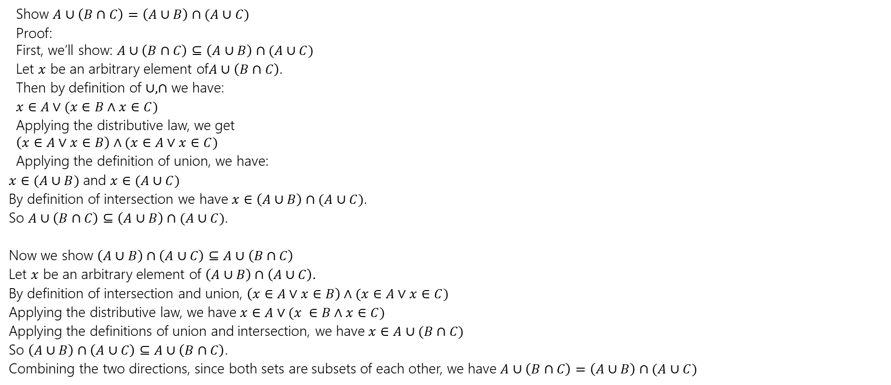
Extra Set Practice (example 1, p3)
Show $A∪\left(B∩C\right)=\left(A∪B\right)∩(A∪C)$
Proof: First, we’ll show: $A∪\left(B∩C\right)⊆\left(A∪B\right)∩(A∪C)$
Let $x$ be an arbitrary element of$A∪\left(B∩C\right)$.
Then by definition of $∪,∩$ we have:
$x∈A∨(x∈B∧x∈C)$
Applying the distributive law, we get $\left(x∈A∨x∈B\right)∧(x∈A∨x∈C)$
Applying the definition of union, we have:
$x∈(A∪B)$ and $x∈(A∪C)$
By definition of intersection we have $x∈\left(A∪B\right)∩(A∪C)$.
So $A∪\left(B∩C\right)⊆\left(A∪B\right)∩(A∪C)$.
Now we show $\left(A∪B\right)∩\left(A∪C\right)⊆A∪\left(B∩C\right)$
Let $x$ be an arbitrary element of $\left(A∪B\right)∩\left(A∪C\right).$
By definition of intersection and union, $\left(x∈A∨x∈B\right)∧(x∈A∨x∈C)$
Applying the distributive law, we have $x∈A∨(x ∈B∧x∈C)$
Applying the definitions of union and intersection, we have $x∈A∪(B∩C)$
So $\left(A∪B\right)∩\left(A∪C\right)⊆A∪\left(B∩C\right)$.
Combining the two directions, since both sets are subsets of each other, we have $A∪\left(B∩C\right)=\left(A∪B\right)∩(A∪C)$

Slide 35

Extra Set Practice (example 2, p1)
Suppose $A⊆B$. Show that $𝒫\left(A\right)⊆𝒫(B)$.

Slide 36
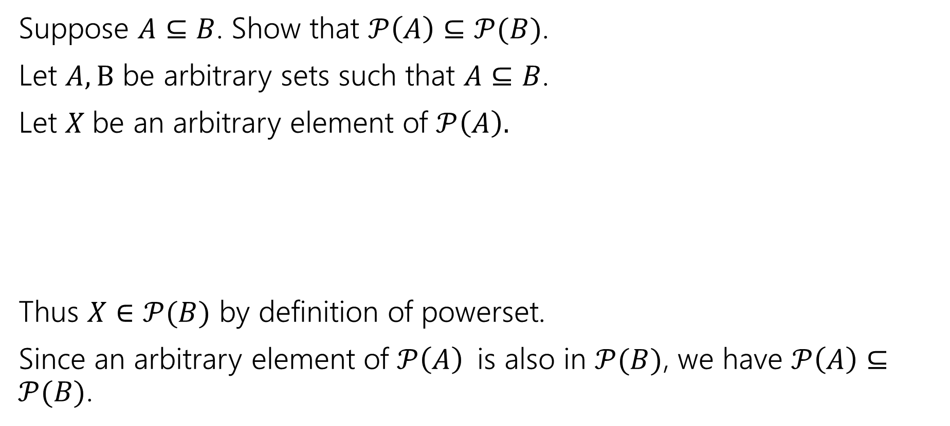
Extra Set Practice (example 2, p2)
Suppose $A⊆B$. Show that $𝒫\left(A\right)⊆𝒫(B)$.
Let $A,B$ be arbitrary sets such that $A⊆B$.
Let $X$be an arbitrary element of $𝒫\left(A\right).$
Thus $X∈𝒫(B)$ by definition of powerset.
Since an arbitrary element of $𝒫\left(A\right)$is also in $𝒫(B)$, we have $𝒫\left(A\right)⊆𝒫(B)$.

Slide 37

Extra Set Practice (example 2, p3)
Suppose $A⊆B$. Show that $𝒫\left(A\right)⊆𝒫(B)$.
Let $A,B$ be arbitrary sets such that $A⊆B$.
Let $X$be an arbitrary element of $𝒫\left(A\right).$
By definition of powerset, $X⊆A$.
Since $X⊆A,$ every element of $X$ is also in $A.$And since $A⊆B$, we also have that every element of $X$ is also in $B$.
Thus $X∈𝒫(B)$ by definition of powerset.
Since an arbitrary element of $𝒫\left(A\right)$is also in $𝒫(B)$, we have $𝒫\left(A\right)⊆𝒫(B)$.

Slide 38

Extra Set Practice (example 3, p1)
Disprove: If $A⊆\left(B∪C\right)$ then $A⊆B$ or $A⊆C$

Slide 39

Extra Set Practice (example 3, p2)
Disprove: If $A⊆\left(B∪C\right)$ then $A⊆B$ or $A⊆C$
Consider $A=\left\{1,2,3\right\}, B=\left\{1,2\right\}, C=\left\{3,4\right\}.$
$B∪C=\{1,2,3,4\}$ so we do have $A⊆(B∪C)$, but $A⊈B$ and $A⊈C$.
When you disprove a $∀$, you’re just providing a counterexample (you’re showing $∃$) – your proof won’t have “let $x$ be an arbitrary element of $A.$”

Slide 40
Read on Your Own

Slide 41

Some old friends (and some new ones)
ℕ is the set of Natural Numbers; ℕ = {0, 1, 2, …}
ℤ is the set of Integers; ℤ = {…, -2, -1, 0, 1, 2, …}
ℚ is the set of Rational Numbers; e.g. ½, -17, 32/48
ℝ is the set of Real Numbers; e.g. 1, -17, 32/48, π,$\sqrt{2}$
[n] is the set {1, 2, …, n} when n is a positive integer
{} = ∅ is the empty set; the only set with no elements

Slide 42

Some old friends (and some new ones) with notes
Our natural numbers start at $0$.
Common in CS, other resources start at $1$.
ℕ is the set of Natural Numbers; ℕ = {0, 1, 2, …}
ℤ is the set of Integers; ℤ = {…, -2, -1, 0, 1, 2, …}
ℚ is the set of Rational Numbers; e.g. ½, -17, 32/48
ℝ is the set of Real Numbers; e.g. 1, -17, 32/48, π,$\sqrt{2}$
[n] is the set {1, 2, …, n} when n is a positive integer
{} = ∅ is the empty set; the only set with no elements
For the real numbers:
In LaTeX \mathbb{R}
In Office \doubleR
Use the empty set symbol ∅, not {}.
In LaTex \varnothing In Office \emptyset.

Slide 43

More Connectors! (1)
$A∖B$ “A minus B”
$A⊕B$ “XOR” (also called “symmetric difference”)
$$A∖B=\{x:x∈A∧x∉B\}$$
$$A⊕B=\{x:x∈A⊕x∈B\}$$

Slide 44

More Connectors! (2)
$A×B=\left\{\left(a,b\right):a∈A∧b∈B\right\}$
Called “the Cartesian product” of $A$ and $B$.
$ℝ×ℝ$ is the “real plane” ordered pairs of real numbers.
$\left\{1,2\right\}×\left\{1,2,3\right\}=\{\left(1,1\right),\left(1,2\right),\left(1,3\right), \left(2,1\right), \left(2,2\right), \left(2,3\right)\}$

