Slide 1
Even More
Number Theory
CSE 311 25 Au
Lecture 13

Slide 2
Outline for today
English Proof Practice!
One more proof technique (it’s an easy one ☺ )
Some More Number Theory

Slide 3
More Mod proofs

Slide 4
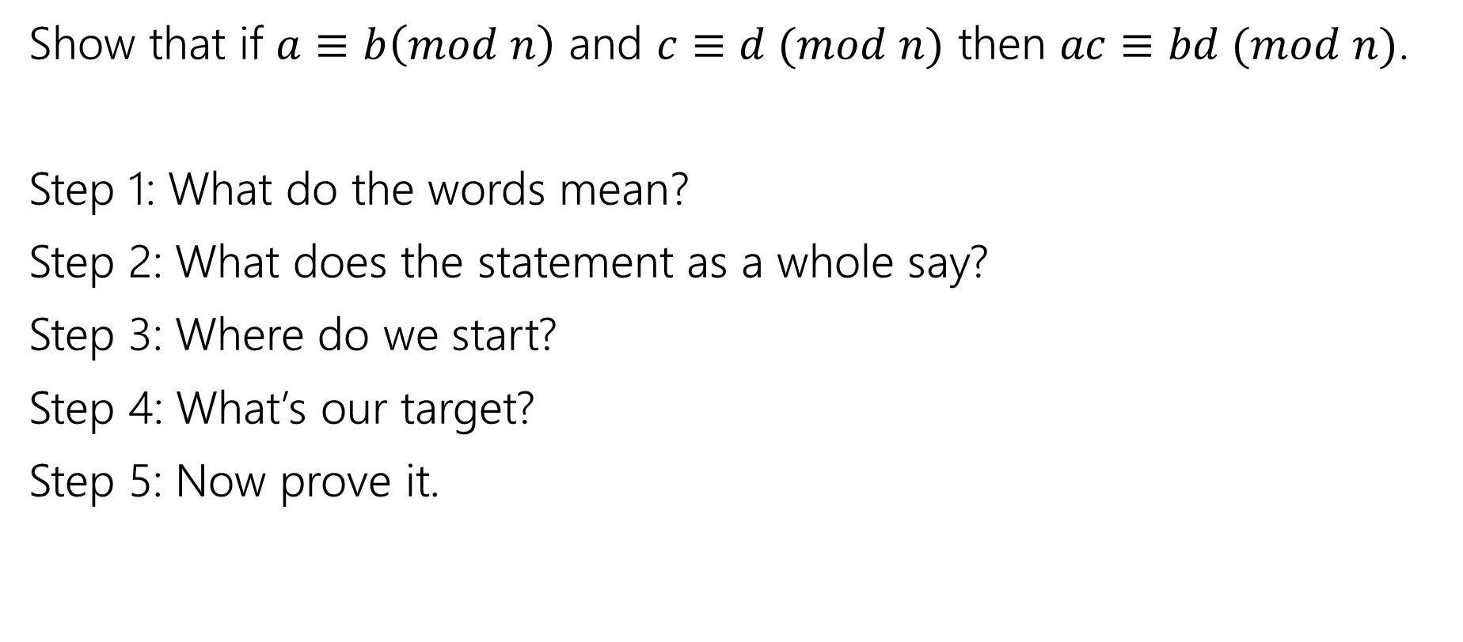
More proofs
Show that if $a≡b\left(mod n\right)$ and $c≡d (mod n)$ then $ac≡bd (mod n)$.
Step 1: What do the words mean?
Step 2: What does the statement as a whole say?
Step 3: Where do we start?
Step 4: What’s our target?
Step 5: Now prove it.

Slide 5


Another Proof
Show that if $a≡b\left(mod n\right)$ and $c≡d (mod n)$ then $ac≡bd (mod n)$.
Let $a,b,c,d,n$ be arbitrary integers, with $n≥0$
and suppose $a≡b\left(mod n\right)$ and $c≡d (mod n)$.
$ac≡bd(mod n)$

Slide 6
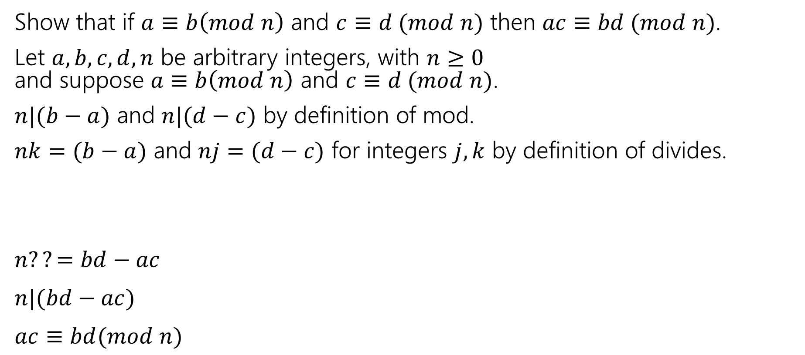

Another Proof
Show that if $a≡b\left(mod n\right)$ and $c≡d (mod n)$ then $ac≡bd (mod n)$.
Let $a,b,c,d,n$ be arbitrary integers, with $n≥0$
and suppose $a≡b\left(mod n\right)$ and $c≡d (mod n)$.
$n|(b−a)$ and $n|(d−c)$ by definition of mod.
$nk=(b−a)$ and $nj=(d−c)$ for integers $j,k$ by definition of divides.
$n??=bd−ac$
$n|(bd−ac)$
$ac≡bd(mod n)$

Slide 7
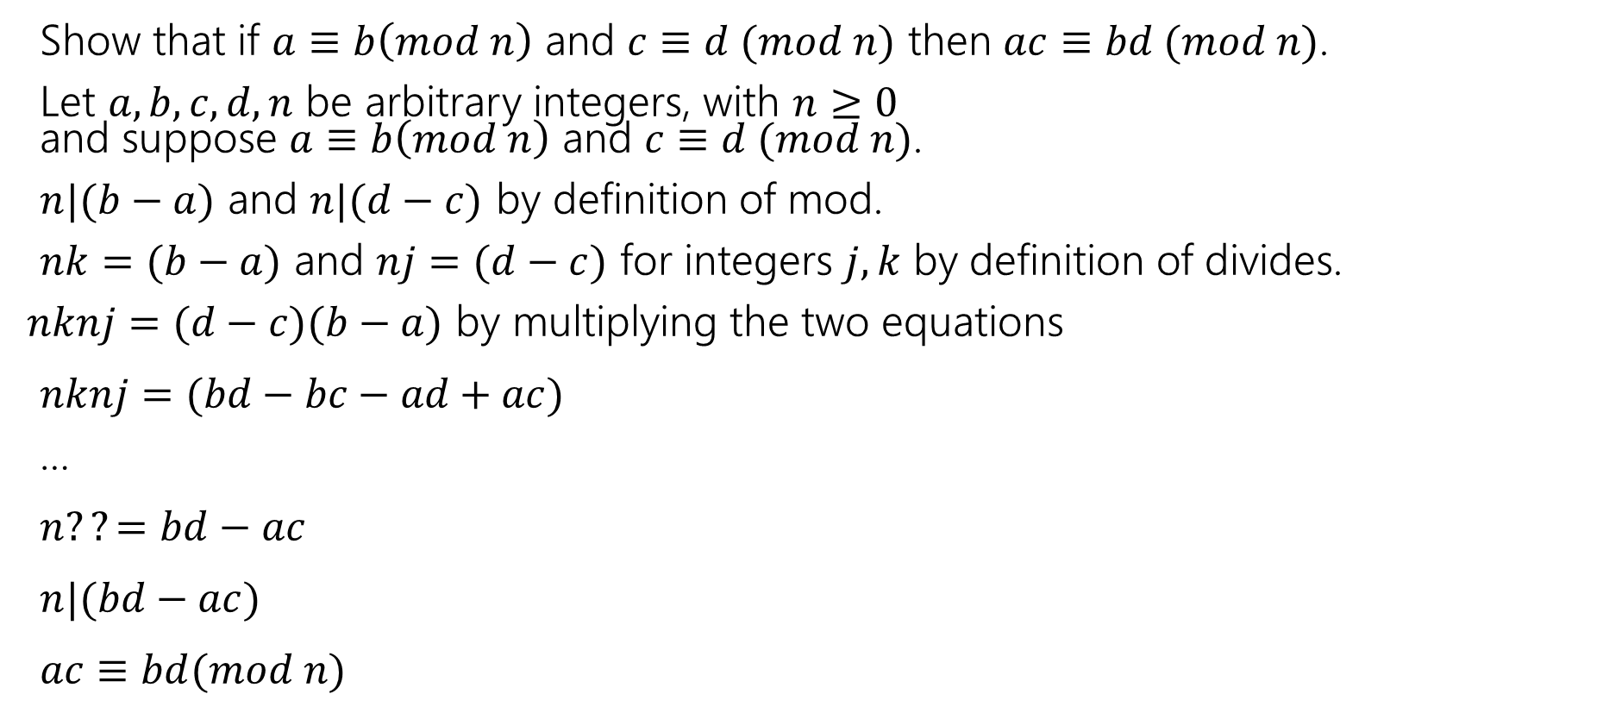

Another Proof
Show that if $a≡b\left(mod n\right)$ and $c≡d (mod n)$ then $ac≡bd (mod n)$.
Let $a,b,c,d,n$ be arbitrary integers, with $n≥0$
and suppose $a≡b\left(mod n\right)$ and $c≡d (mod n)$.
$n|(b−a)$ and $n|(d−c)$ by definition of mod.
$nk=(b−a)$ and $nj=(d−c)$ for integers $j,k$ by definition of divides.
$nknj=(d−c)(b−a)$ by multiplying the two equations
$nknj=(bd−bc−ad+ac)$
…
$n??=bd−ac$
$n|(bd−ac)$
$ac≡bd(mod n)$

Slide 8
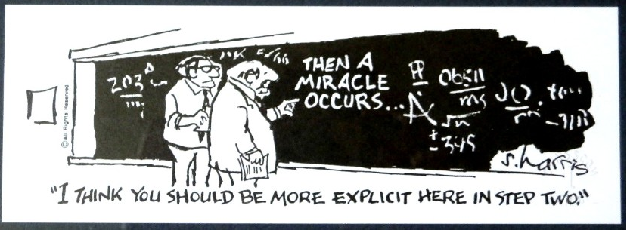
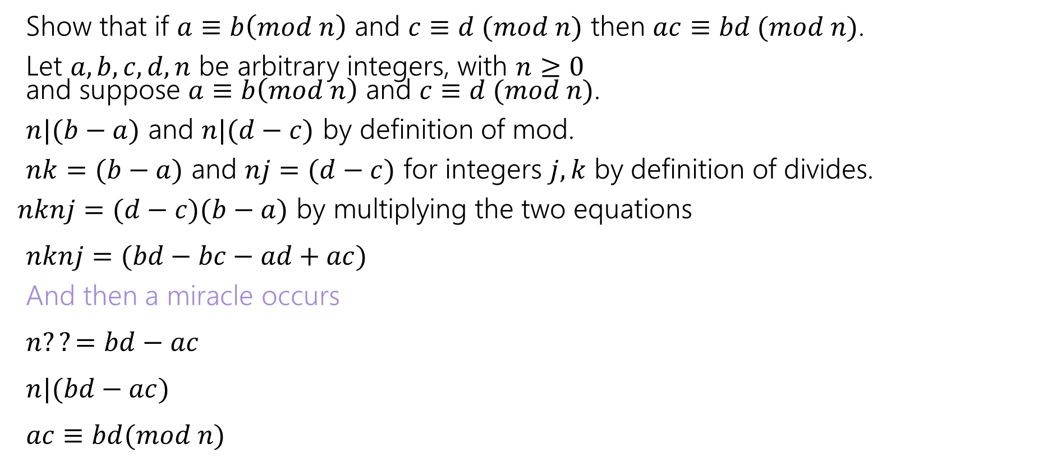

Another Proof
Show that if $a≡b\left(mod n\right)$ and $c≡d (mod n)$ then $ac≡bd (mod n)$.
Let $a,b,c,d,n$ be arbitrary integers, with $n≥0$
and suppose $a≡b\left(mod n\right)$ and $c≡d (mod n)$.
$n|(b−a)$ and $n|(d−c)$ by definition of mod.
$nk=(b−a)$ and $nj=(d−c)$ for integers $j,k$ by definition of divides.
$nknj=(d−c)(b−a)$ by multiplying the two equations
$nknj=(bd−bc−ad+ac)$
And then a miracle occurs
$n??=bd−ac$
$n|(bd−ac)$
$ac≡bd(mod n)$

Slide 9
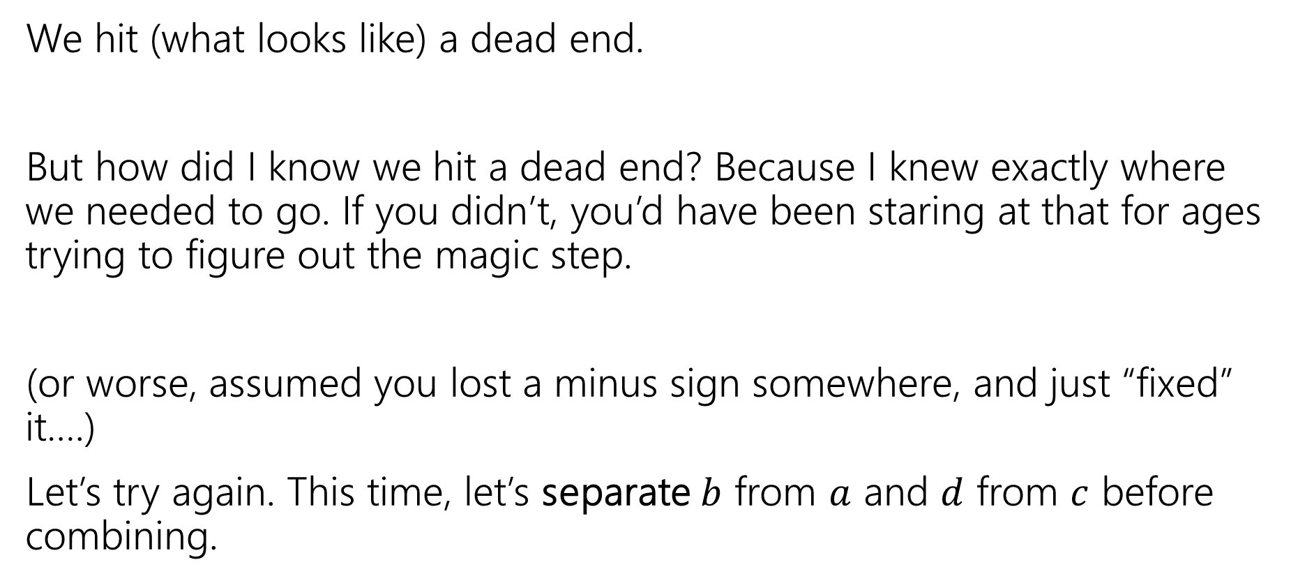
Uh-Oh
We hit (what looks like) a dead end.
But how did I know we hit a dead end? Because I knew exactly where we needed to go. If you didn’t, you’d have been staring at that for ages trying to figure out the magic step.
(or worse, assumed you lost a minus sign somewhere, and just “fixed” it….)
Let’s try again. This time, let’s separate $b$ from $a$ and $d$ from $c$ before combining.

Slide 10
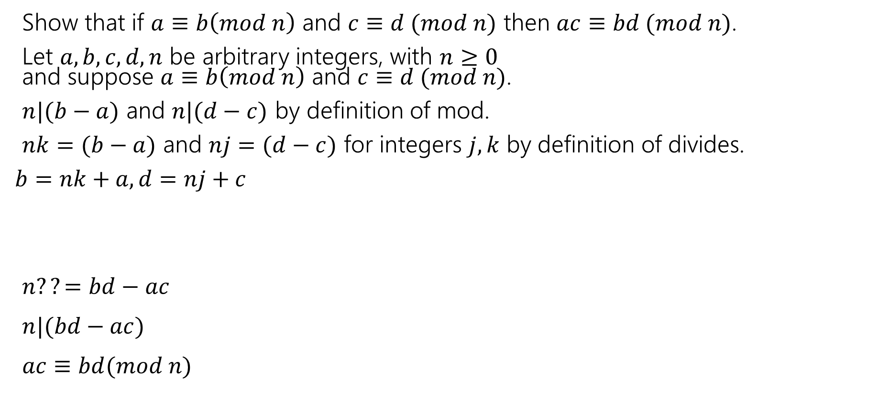
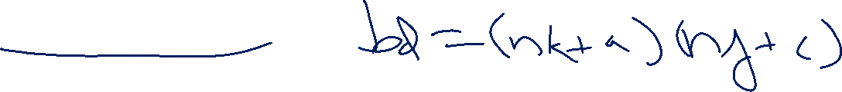
Another Approach
Show that if $a≡b\left(mod n\right)$ and $c≡d (mod n)$ then $ac≡bd (mod n)$.
Let $a,b,c,d,n$ be arbitrary integers, with $n≥0$
and suppose $a≡b\left(mod n\right)$ and $c≡d (mod n)$.
$n|(b−a)$ and $n|(d−c)$ by definition of mod.
$nk=(b−a)$ and $nj=(d−c)$ for integers $j,k$ by definition of divides.
$b=nk+a, d=nj+c$
$n??=bd−ac$
$n|(bd−ac)$
$ac≡bd(mod n)$

Slide 11
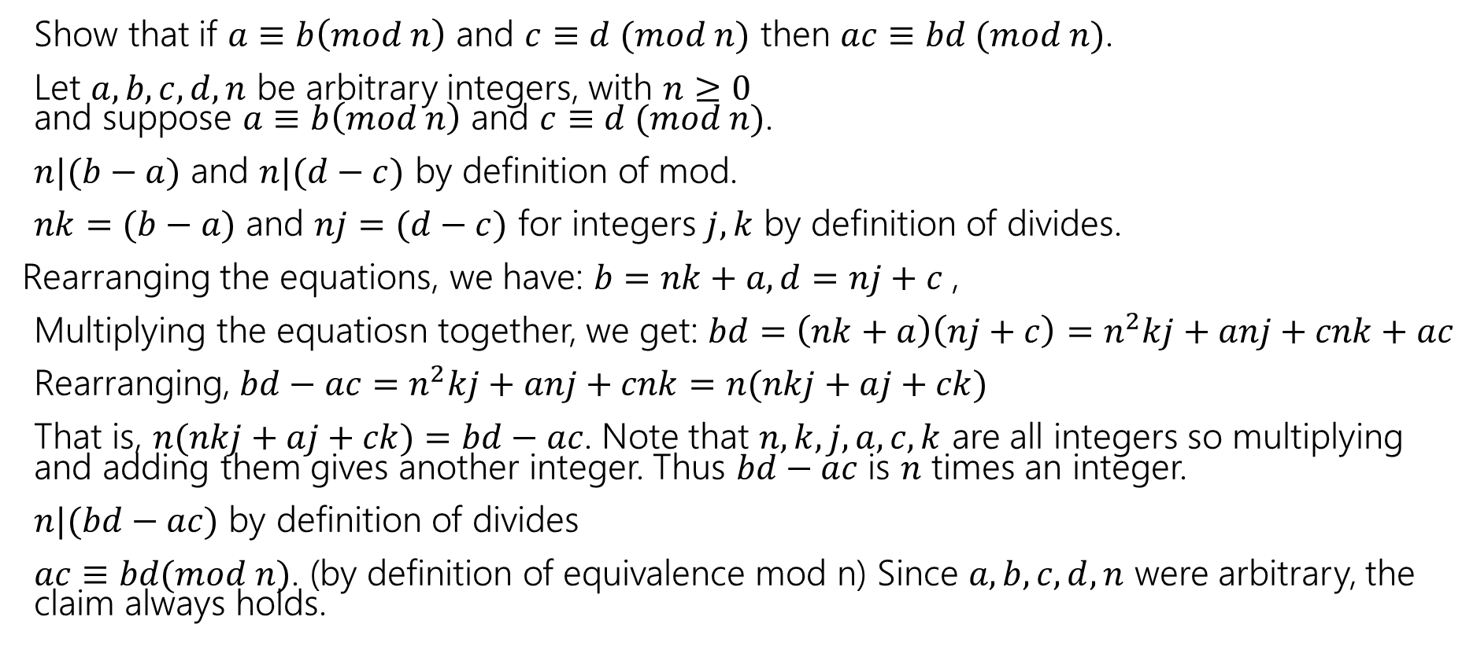
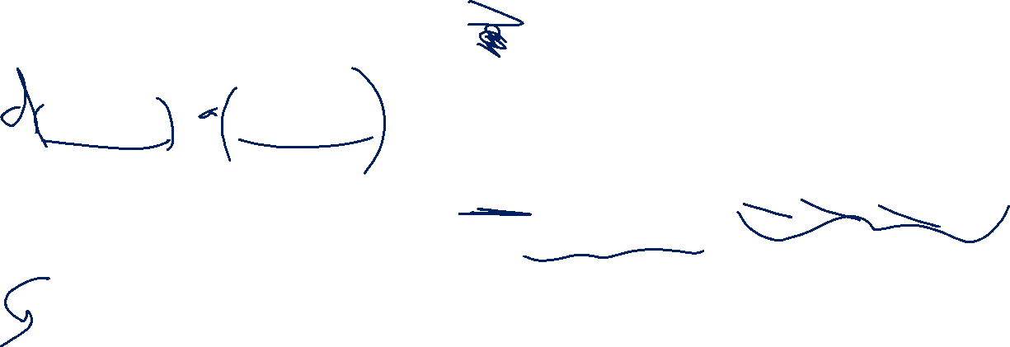
Another Approach
Show that if $a≡b\left(mod n\right)$ and $c≡d (mod n)$ then $ac≡bd (mod n)$.
Let $a,b,c,d,n$ be arbitrary integers, with $n≥0$
and suppose $a≡b\left(mod n\right)$ and $c≡d (mod n)$.
$n|(b−a)$ and $n|(d−c)$ by definition of mod.
$nk=(b−a)$ and $nj=(d−c)$ for integers $j,k$ by definition of divides.
Rearranging the equations, we have: $b=nk+a, d=nj+c$,
Multiplying the equatiosn together, we get: $bd=\left(nk+a\right)\left(nj+c\right)=n^{2}kj+anj+cnk+ac$
Rearranging, $bd−ac=n^{2}kj+anj+cnk=n(nkj+aj+ck)$
That is, $n(nkj+aj+ck)=bd−ac$. Note that $n,k,j,a,c,k$ are all integers so multiplying and adding them gives another integer. Thus $bd−ac$ is $n$ times an integer.
$n|(bd−ac)$ by definition of divides
$ac≡bd(mod n)$. (by definition of equivalence mod n) Since $a,b,c,d,n$ were arbitrary, the claim always holds.

Slide 12
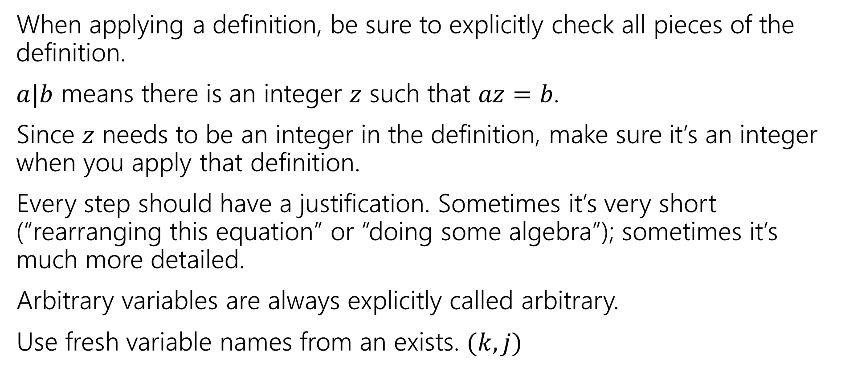

Some Style Notes
When applying a definition, be sure to explicitly check all pieces of the definition.
$a|b$ means there is an integer $z$ such that $az=b$.
Since $z$ needs to be an integer in the definition, make sure it’s an integer when you apply that definition.
Every step should have a justification. Sometimes it’s very short (“rearranging this equation” or “doing some algebra”); sometimes it’s much more detailed.
Arbitrary variables are always explicitly called arbitrary.
Use fresh variable names from an exists. $(k,j)$

Slide 13
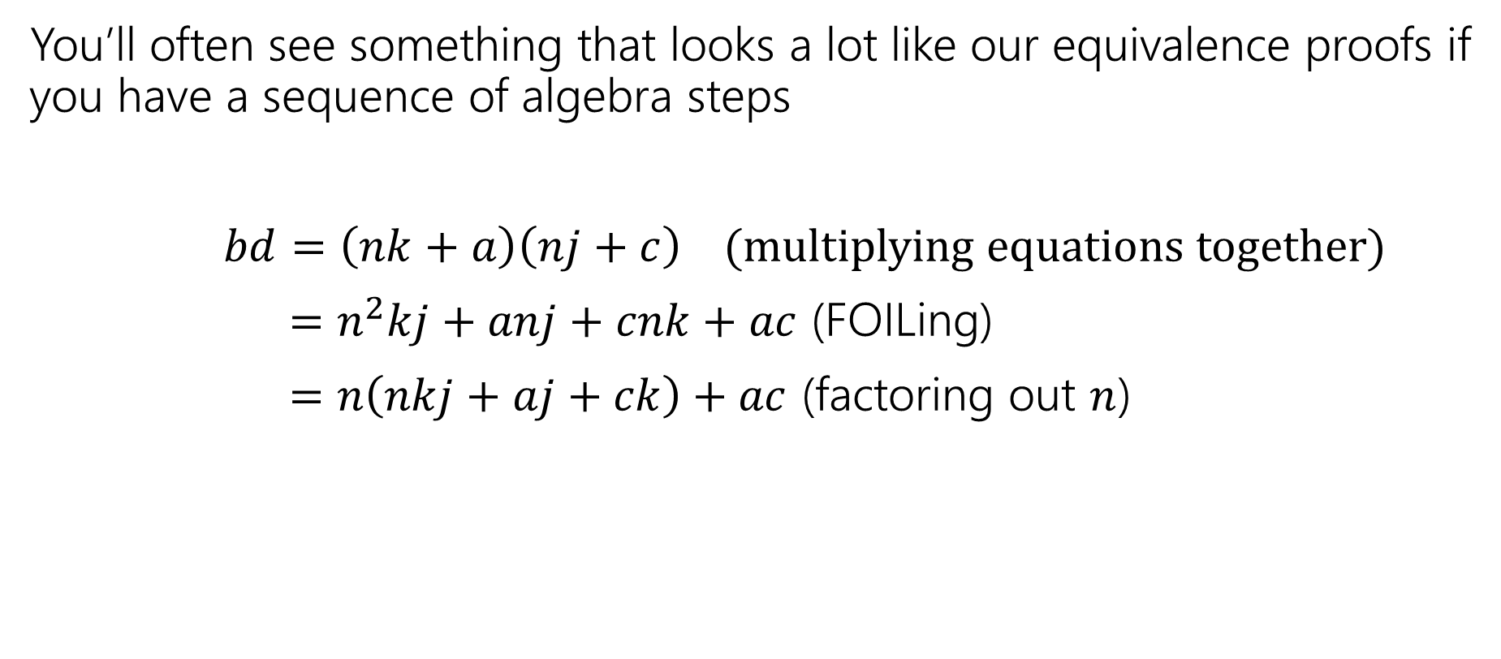
Some Style Notes
You’ll often see something that looks a lot like our equivalence proofs if you have a sequence of algebra steps
$bd=\left(nk+a\right)\left(nj+c\right)$ (multiplying equations together)
$=n^{2}kj+anj+cnk+ac$ (FOILing)
$=n\left(nkj+aj+ck\right)+ac$ (factoring out $n$)

Slide 14
Proving a biconditional

Slide 15


Warm up
Let $a∈ℤ, b∈ℤ, n∈ℤ$ and $n>0$.
We say $a≡b (mod n)$ if and only if $n|(b−a)$
Equivalence in modular arithmetic
Show that $a≡b \left(mod n\right)$ if and only if $b≡a(mod n)$
How do you prove an if and only if?

Slide 16


Proving a biconditional
How do we prove $p↔q$
Two options:
1. (preferred style for this class): show $p→q$, then show $q→p$.
2. Show a “chain of if-and-only-if”s (possible, but stylistically difficult)

Slide 17
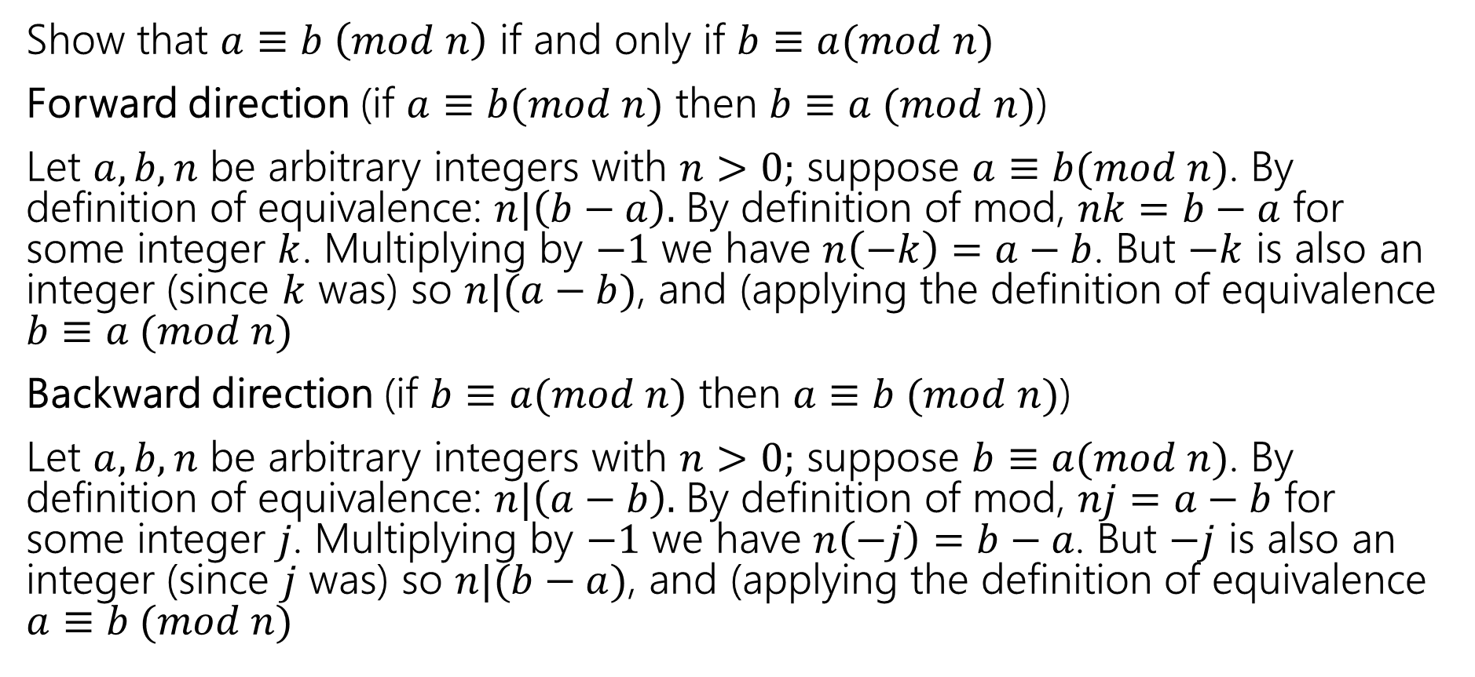

Two proofs
Let $a∈ℤ, b∈ℤ, n∈ℤ$ and $n>0$.
We say $a≡b (mod n)$ if and only if $n|(b−a)$
Equivalence in modular arithmetic
Show that $a≡b \left(mod n\right)$ if and only if $b≡a(mod n)$
Forward direction (if $a≡b(mod n)$ then $b≡a (mod n)$)
Let $a,b,n$ be arbitrary integers with $n>0;$ suppose $a≡b(mod n)$. By definition of equivalence: $n|\left(b−a\right).$By definition of mod, $nk=b−a$ for some integer $k$. Multiplying by $−1$ we have $n\left(−k\right)=a−b$. But $−k$ is also an integer (since $k$ was) so $n|(a−b)$, and (applying the definition of equivalence $b≡a (mod n)$
Backward direction (if $b≡a(mod n)$ then $a≡b (mod n)$)
Let $a,b,n$ be arbitrary integers with $n>0;$ suppose $b≡a(mod n)$. By definition of equivalence: $n|\left(a−b\right).$By definition of mod, $nj=a−b$ for some integer $j$. Multiplying by $−1$ we have $n\left(−j\right)=b−a$. But $−j$ is also an integer (since $j$ was) so $n|(b−a)$, and (applying the definition of equivalence $a≡b (mod n)$

Slide 18
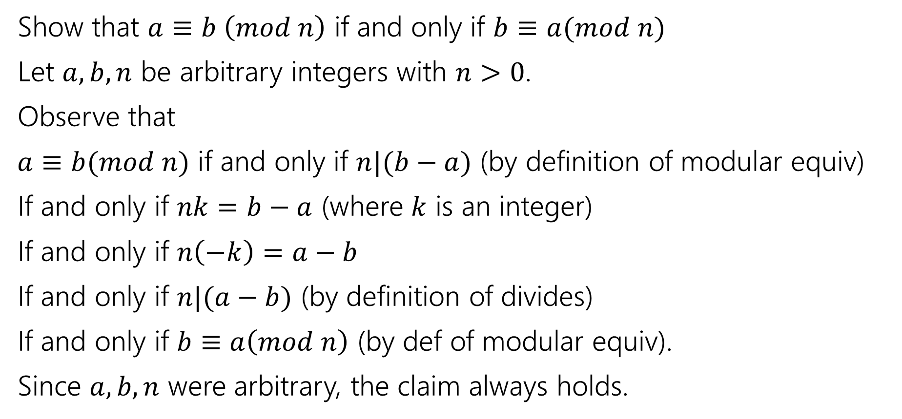

Or one proof
Let $a∈ℤ, b∈ℤ, n∈ℤ$ and $n>0$.
We say $a≡b (mod n)$ if and only if $n|(b−a)$
Equivalence in modular arithmetic
Show that $a≡b \left(mod n\right)$ if and only if $b≡a(mod n)$
Let $a,b,n$ be arbitrary integers with $n>0$.
Observe that
$a≡b(mod n)$ if and only if $n|(b−a)$ (by definition of modular equiv)
If and only if $nk=b−a$ (where $k$ is an integer)
If and only if $n\left(−k\right)=a−b$
If and only if $n|(a−b)$ (by definition of divides)
If and only if $b≡a\left(mod n\right)$ (by def of modular equiv).
Since $a,b,n$ were arbitrary, the claim always holds.

Slide 19

To prove a biconditional
Option 1 is just to prove two implications (you know how to prove implications already---direct proof rule and/or contrapositive)
Option 2 is to connect the left and right sides with a sequence of “if and only if”s. Every step must be an if-and-only-if
Every step must explicitly be stated as an if-and-only-if.
(By default, proofs are like inference proofs: we’re listing true facts that follow from prior facts; if you want to know a biconditional, you have to assert the biconditional explicitly).
Option 1 is usually the default; option 2 is sometimes used, especially for algebraic expressions.

Slide 20
Computing GCDs

Slide 21
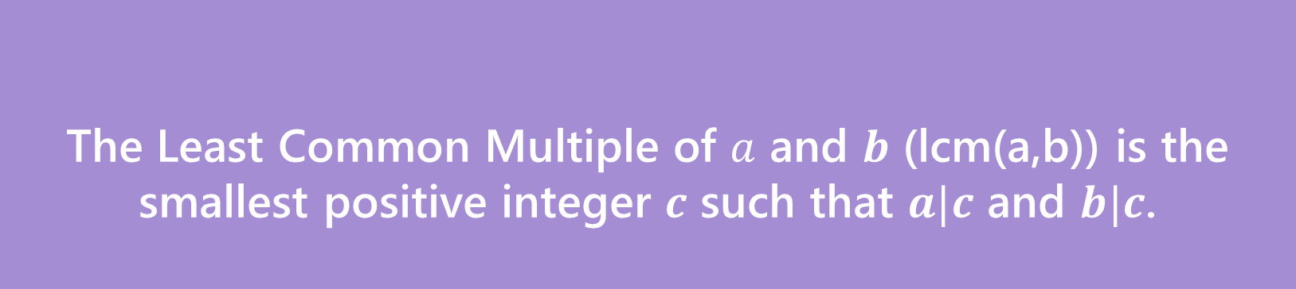
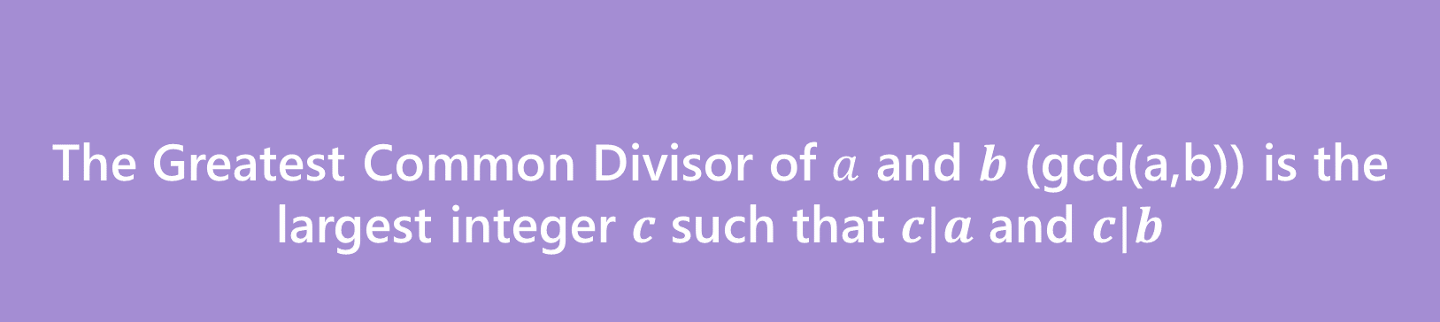
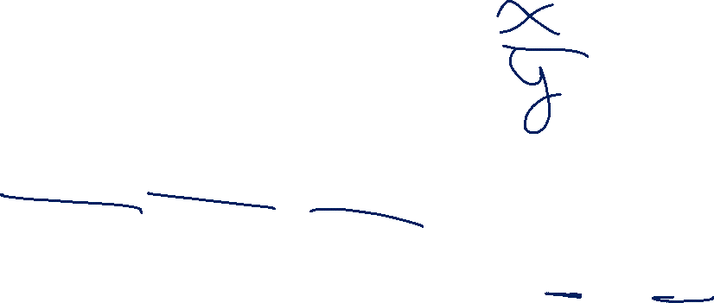
GCD and LCM
The Greatest Common Divisor of $a$ and $b$ (gcd(a,b)) is the largest integer $c$ such that $c|a$ and $c|b$
Greatest Common Divisor
The Least Common Multiple of $a$ and $b$ (lcm(a,b)) is the smallest positive integer $c$ such that $a|c$ and $b|c$.
Least Common Multiple

Slide 22
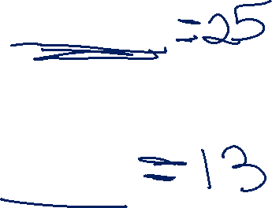
Try a few values…
gcd(100,125)
gcd(17,49)
gcd(17,34)
gcd(13,0)
lcm(7,11)
lcm(6,10)

Slide 23
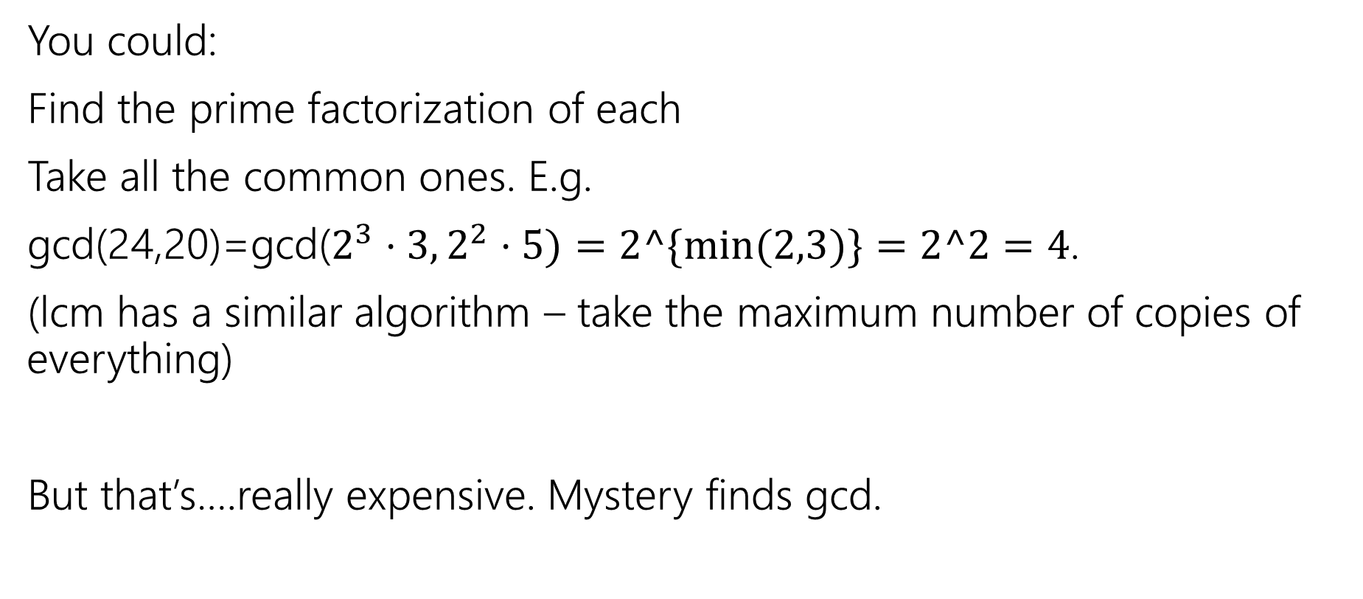
How do you calculate a gcd?
You could:
Find the prime factorization of each
Take all the common ones. E.g.
gcd(24,20)=gcd($2^{3}⋅3, 2^{2}⋅5)=2^\{min⁡(2,3)\}=2^2=4$.
(lcm has a similar algorithm – take the maximum number of copies of everything)
But that’s….really expensive. Mystery finds gcd.

Slide 24

public int Mystery(int m, int n){
if(m<n){
int temp = m;
m=n;
n=temp;
}
while(n != 0) {
int rem = m % n;
m=n;
n=rem;
}
return m;
}

Slide 25
Running Mystery
gcd(26,7) = gcd(7, 26%7) = gcd(7,5)
= gcd(5, 7%5) = gcd(5,2)
= gcd(2, 5%2) = gcd(2, 1)
= gcd(1, 2%1) = gcd(1,0)= 1.

Slide 26
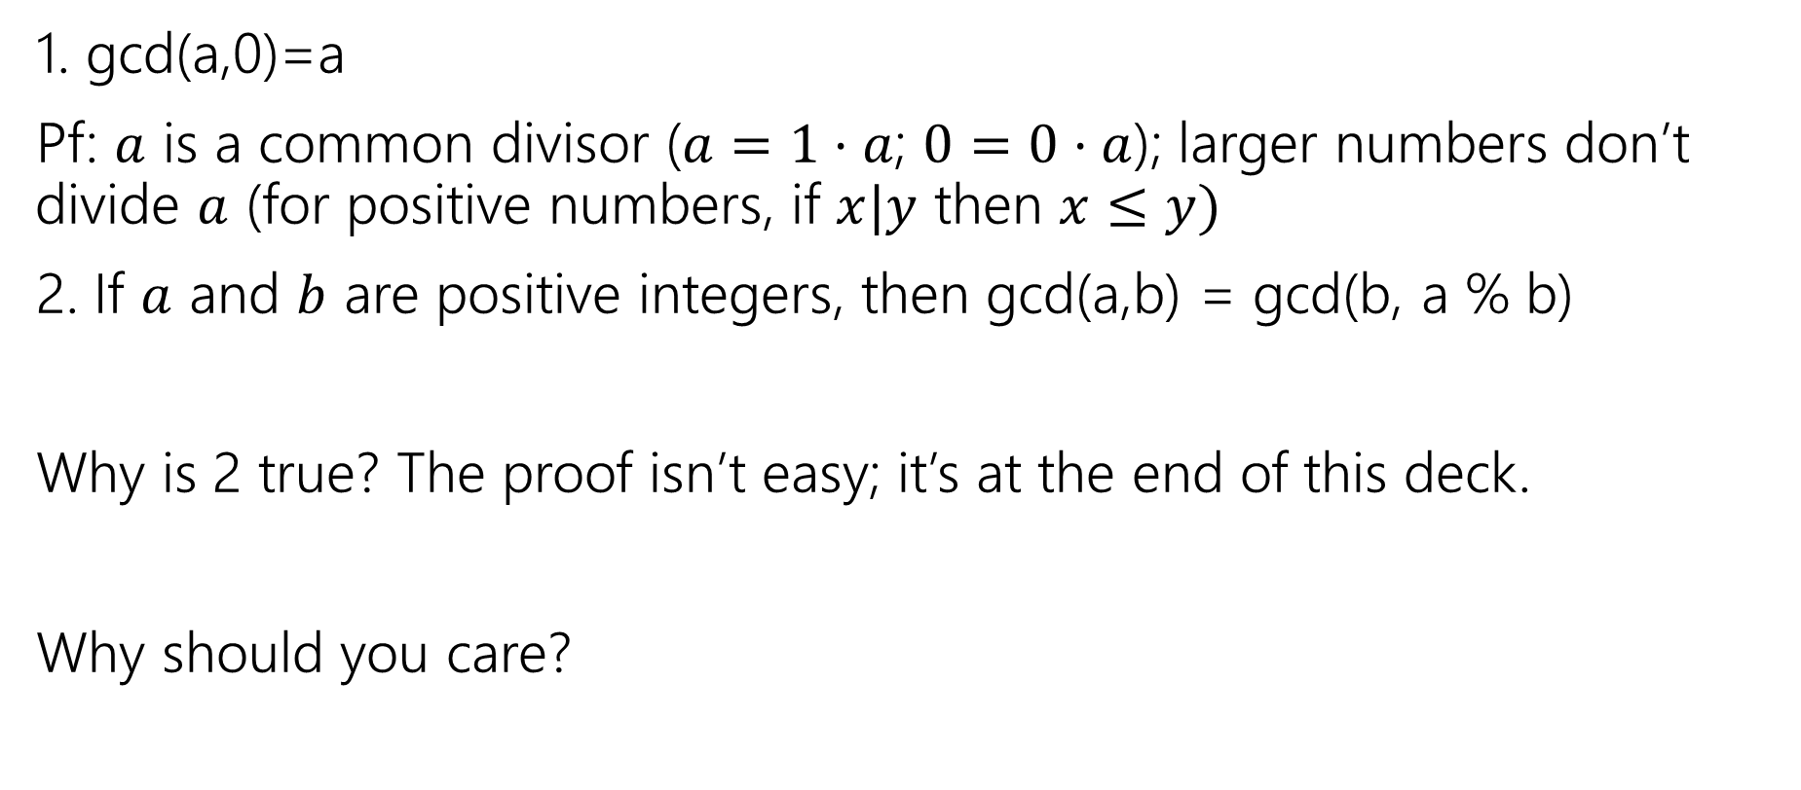
GCD facts
1. gcd(a,0)=a
Pf: $a$ is a common divisor ($a=1⋅a$; $0=0⋅a$); larger numbers don’t divide $a$ (for positive numbers, if $x|y$ then $x≤y)$
2. If $a$ and $b$ are positive integers, then gcd(a,b) = gcd(b, a % b)
Why is 2 true? The proof isn’t easy; it’s at the end of this deck.
Why should you care?

Slide 27
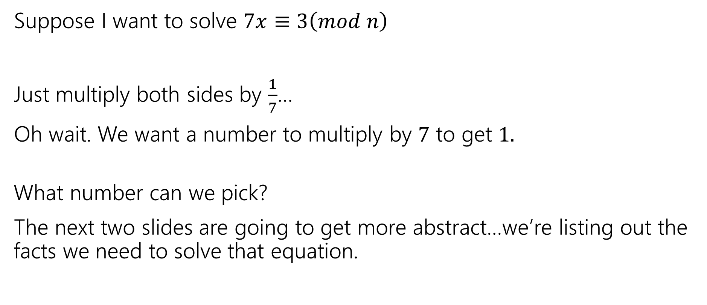
So…what’s it good for?
Remember everything we’re learning contributes to us eventually understanding RSA.
This is a key step in generating keys.
Suppose I want to solve $7x≡3\left(mod n\right)$
Just multiply both sides by $\frac{1}{7}$…
Oh wait. We want a number to multiply by $7$ to get $1.$
What number can we pick?
The next two slides are going to get more abstract…we’re listing out the facts we need to solve that equation.
Notes:
Rules for mod arithmetic are different! Addition and multiplication match really closely to regular rules. Division (i.e. multiplying by 1/number) is much more complicated.

Slide 28
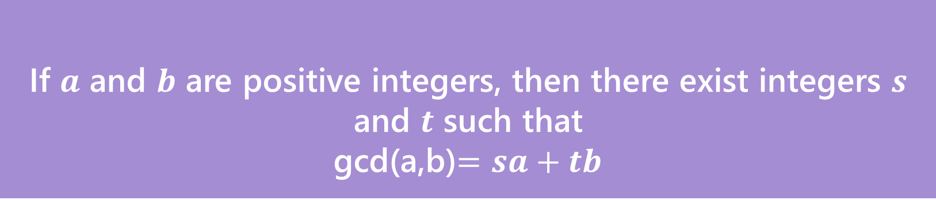
Bézout’s Theorem
If $a$ and $b$ are positive integers, then there exist integers $s$ and $t$ such that
gcd(a,b)$=sa+tb$
Bézout’s Theorem
We’re not going to prove this theorem…
But it turns out Mystery can be extended to find them.

Slide 29
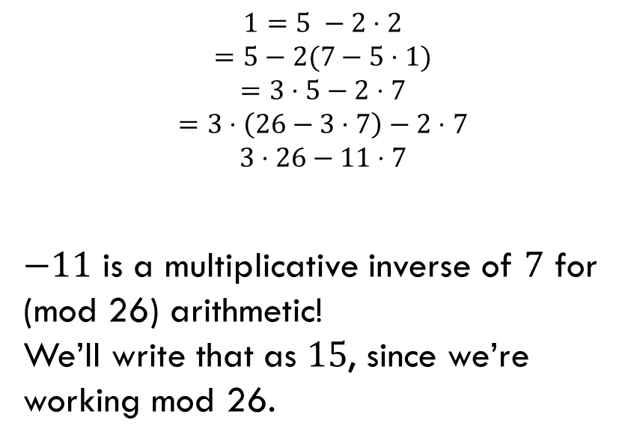
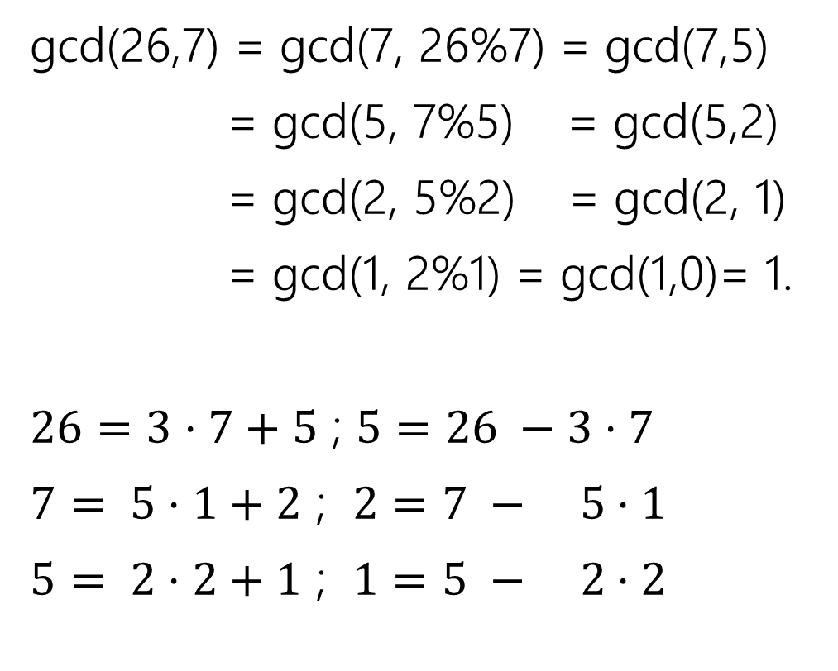
Finding the inverse…
gcd(26,7) = gcd(7, 26%7) = gcd(7,5)
= gcd(5, 7%5) = gcd(5,2)
= gcd(2, 5%2) = gcd(2, 1)
= gcd(1, 2%1) = gcd(1,0)= 1.
$26=3⋅7+5$ ; $5=26 −3⋅7$
$7= 5⋅1+2$ ; $2=7 − 5⋅1$
$5= 2⋅2+1$ ; $1=5 − 2⋅2$
$$1=5 −2⋅2$$
$$=5−2(7−5⋅1)$$
$$=3⋅5−2⋅7$$
$$=3⋅\left(26−3⋅7\right)−2⋅7$$
$$3⋅26−11⋅7$$
$−11$ is a multiplicative inverse of $7$ for (mod 26) arithmetic!
We’ll write that as $15$, since we’re working mod 26.

Slide 30
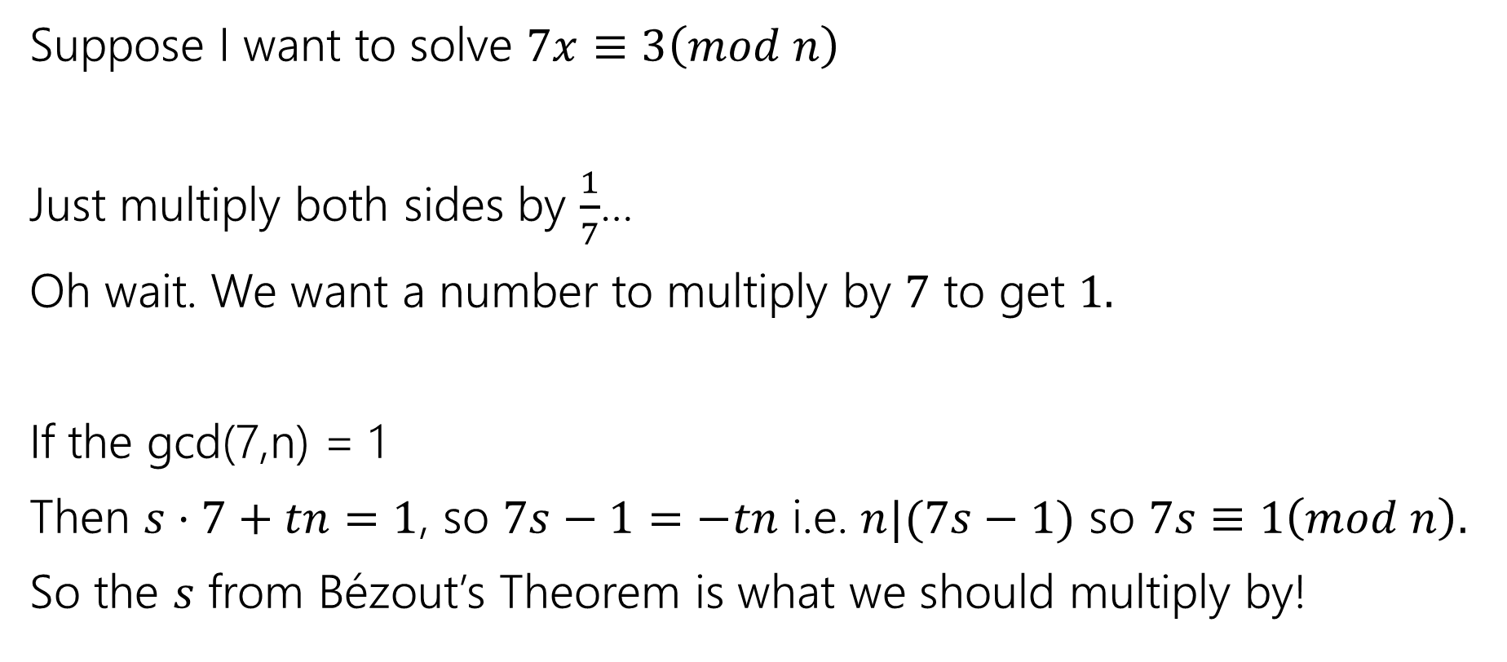
So…what’s it good for?
Suppose I want to solve $7x≡3\left(mod n\right)$
Just multiply both sides by $\frac{1}{7}$…
Oh wait. We want a number to multiply by $7$ to get $1.$
If the gcd(7,n) = 1
Then $s⋅7+tn=1$, so $7s−1=−tn$ i.e. $n|(7s−1)$ so $7s≡1\left(mod n\right).$
So the $s$ from Bézout’s Theorem is what we should multiply by!

Slide 31
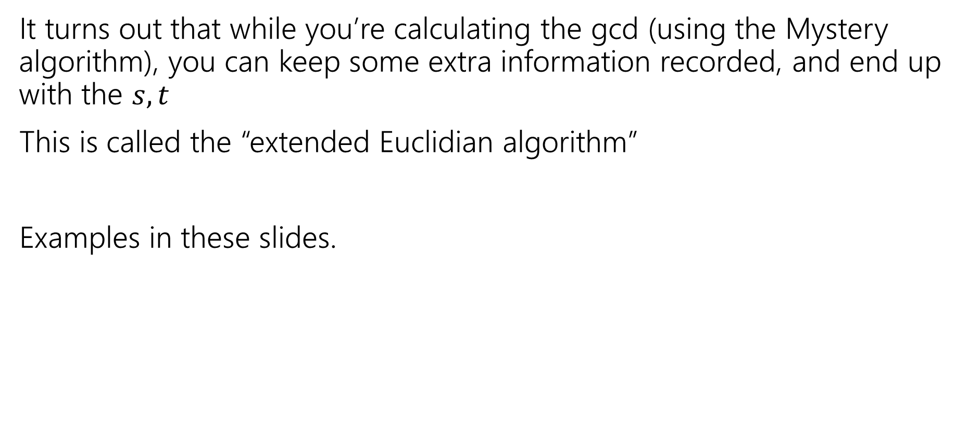

Ok…how am I supposed to find $s,t$?
It turns out that while you’re calculating the gcd (using the Mystery algorithm), you can keep some extra information recorded, and end up with the $s,t$
This is called the “extended Euclidian algorithm”
Examples in these slides.

Slide 32

Try it
Solve the equation $7y≡3(mod 26)$
What do we need to find?
The multiplicative inverse of $7(mod 26)$

Slide 33
Finding the inverse…
gcd(26,7) = gcd(7, 26%7) = gcd(7,5)
= gcd(5, 7%5) = gcd(5,2)
= gcd(2, 5%2) = gcd(2, 1)
= gcd(1, 2%1) = gcd(1,0)= 1.
$26=3⋅7+5$ ; $5=26 −3⋅7$
$7= 5⋅1+2$ ; $2=7 − 5⋅1$
$5= 2⋅2+1$ ; $1=5 − 2⋅2$
$$1=5 −2⋅2$$
$$=5−2(7−5⋅1)$$
$$=3⋅5−2⋅7$$
$$=3⋅\left(26−3⋅7\right)−2⋅7$$
$$3⋅26−11⋅7$$
$−11$ is a multiplicative inverse of $7$ for (mod 26) arithmetic!
We’ll write that as $15$, since we’re working mod 26.

Slide 34
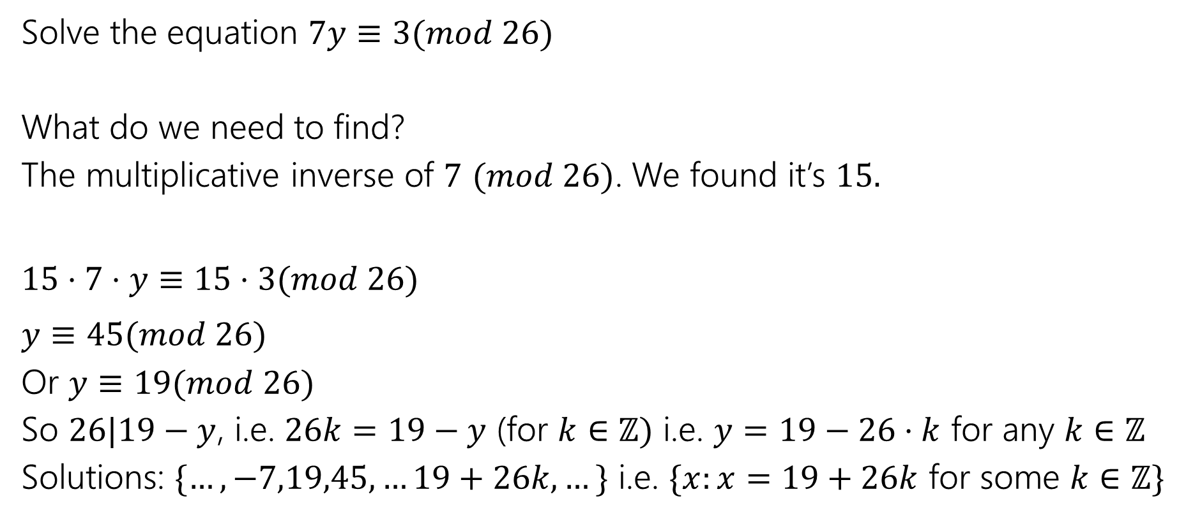
Try it
Solve the equation $7y≡3(mod 26)$
What do we need to find?
The multiplicative inverse of $7$ $(mod 26)$. We found it’s $15.$
$15⋅7⋅y≡15⋅3(mod 26)$
$y≡45(mod 26)$
Or $y≡19(mod 26)$
So $26|19−y$, i.e. $26k=19−y$ (for $k∈ℤ)$ i.e. $y=19−26⋅k$ for any $k∈ℤ$
Solutions: $\{…,−7,19,45,…19+26k,…\}$ i.e. $\{x:x=19+26k$ for some $k∈ℤ\}$
Notes:
We didn’t prove the “you can multiply both sides by the same number” theorem. But it’s in the slides. See also the number theory reference sheet.

Slide 35
Proving the key fact about gcds

Slide 36
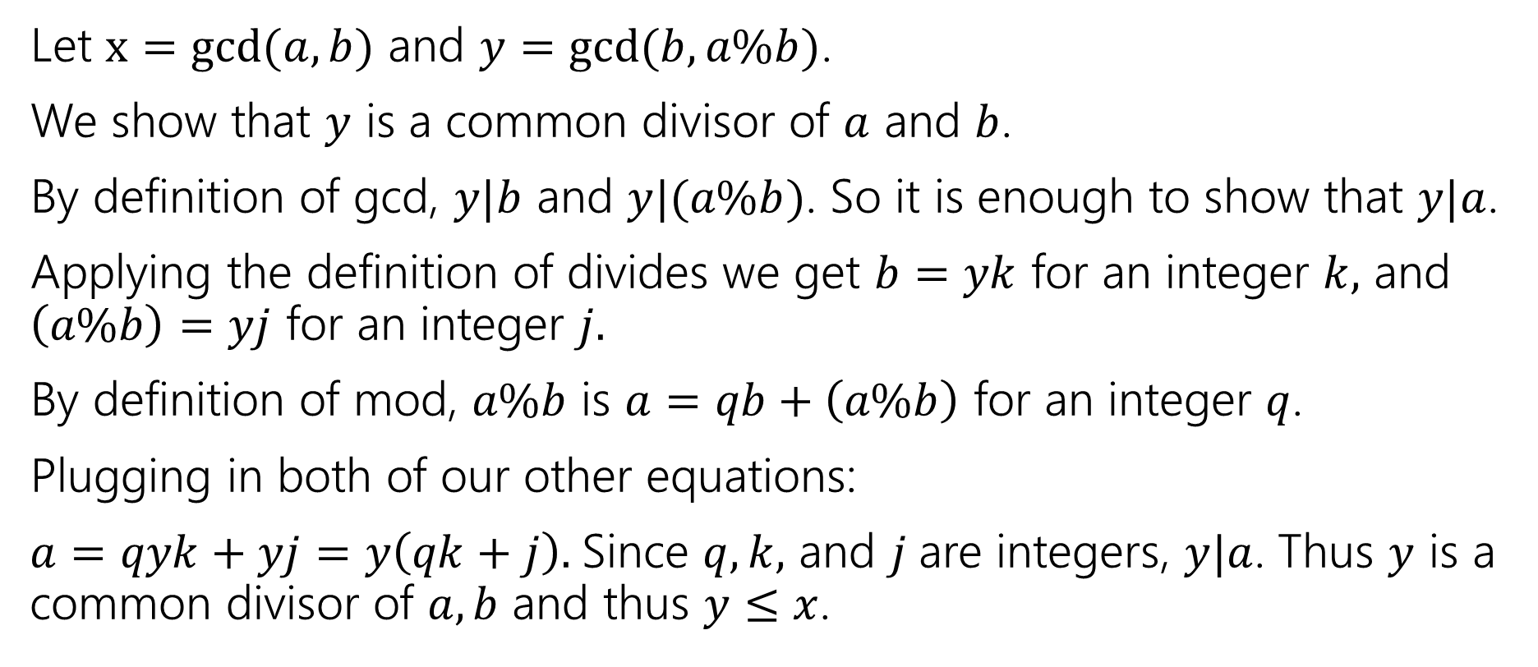
gcd(a,b) = gcd(b, a % b)
Let $x=gcd⁡(a,b)$ and $y=gcd⁡(b,a\%b)$.
We show that $y$ is a common divisor of $a$ and $b$.
By definition of gcd, $y|b$ and $y|(a\%b)$. So it is enough to show that $y|a$.
Applying the definition of divides we get $b=yk$ for an integer $k,$ and $\left(a\%b\right)=yj$ for an integer $j.$
By definition of mod, $a\%b$ is $a=qb+\left(a\%b\right)$ for an integer $q$.
Plugging in both of our other equations:
$a=qyk+yj=y\left(qk+j\right).$Since $q,k,$ and $j$are integers, $y|a$. Thus $y$ is a common divisor of $a,b$ and thus $y≤x$.

Slide 37
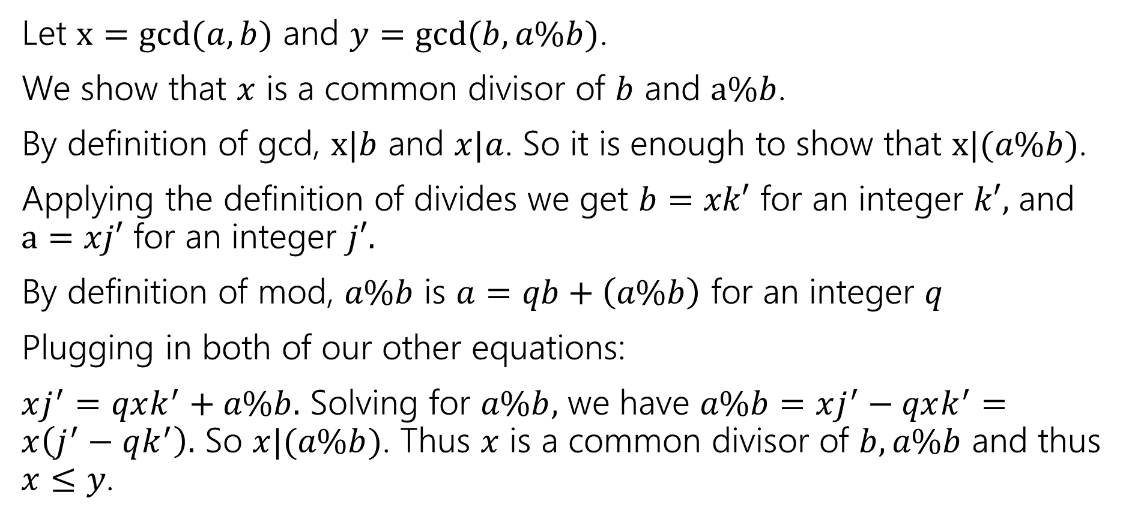
gcd(a,b) = gcd(b, a % b)
Let $x=gcd⁡(a,b)$ and $y=gcd⁡(b,a\%b)$.
We show that $x$ is a common divisor of $b$ and $a\%b$.
By definition of gcd, $x|b$ and $x|a$. So it is enough to show that $x|(a\%b)$.
Applying the definition of divides we get $b=xk′$ for an integer $k′,$ and $a=xj′$ for an integer $j′.$
By definition of mod, $a\%b$ is $a=qb+\left(a\%b\right)$ for an integer $q$
Plugging in both of our other equations:
$xj^{′}=qxk^{′}+a\%b.$ Solving for $a\%b,$ we have $a\%b=xj^{′}−qxk^{′}=x\left(j^{′}−qk^{′}\right).$ So $x|(a\%b)$. Thus $x$ is a common divisor of $b,a\%b$ and thus $x≤y$.

Slide 38

gcd(a,b) = gcd(b, a % b)
Let $x=gcd⁡(a,b)$ and $y=gcd⁡(b,a\%b)$.
We show that $x$ is a common divisor of $b$ and $a\%b$.
We have shown $x≤y$ and $y≤x$.
Thus $x=y,$ and $\gcd\left(a,b\right)=\gcd\left(b,a\%b\right).$

Slide 39
Euclidian Algorithm

Slide 40
Euclid’s Algorithm
while(n != 0) {
int rem = m % n;
m=n;
n=rem;
}
gcd(660,126)

Slide 41
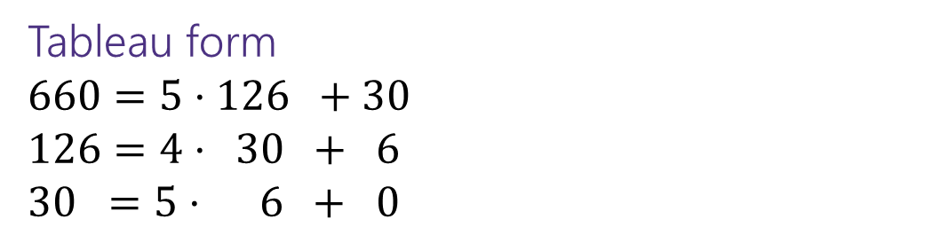
Euclid’s Algorithm
while(n != 0) {
int rem = m % n;
m=n;
n=rem;
}
gcd(660,126)
= gcd(126, 660 mod 126) = gcd(126, 30)
= gcd(30, 126 mod 30) = gcd(30, 6)
= gcd(6, 30 mod 6) = gcd(6, 0)
= 6
Tableau form
$660=5⋅126 +30$
$126=4⋅ 30 + 6$
$30 =5⋅ 6 + 0$
Starting Numbers
Final answer

Slide 42
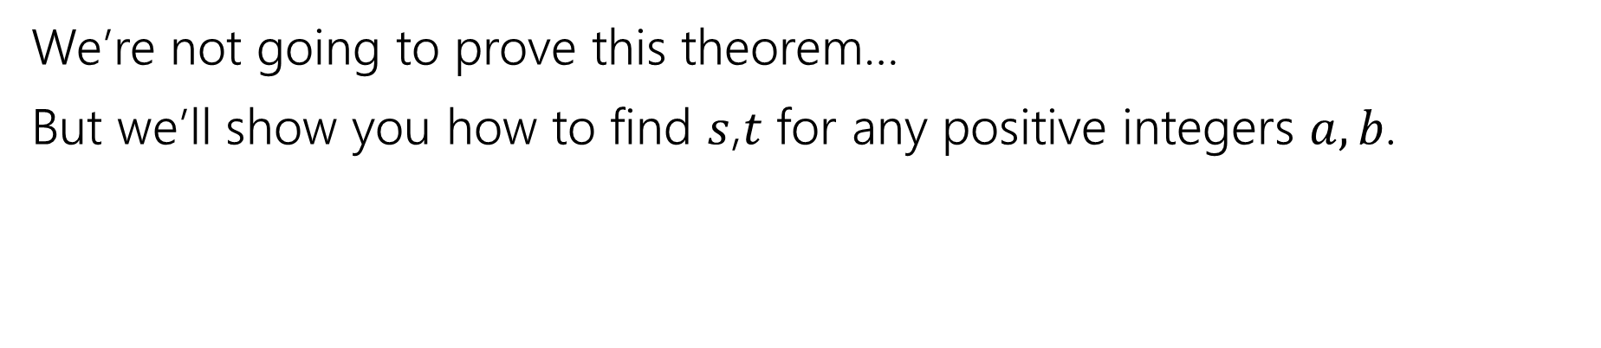
Bézout’s Theorem
If $a$ and $b$ are positive integers, then there exist integers $s$ and $t$ such that
gcd(a,b)$=sa+tb$
Bézout’s Theorem
We’re not going to prove this theorem…
But we’ll show you how to find $s$,$t$ for any positive integers $a,b$.

Slide 43
Extended Euclidian Algorithm
Step 1 compute gcd(a,b); keep tableau information.
Step 2 solve all equations for the remainder.
Step 3 substitute backward
gcd(35,27)

Slide 44

Extended Euclidian Algorithm
Step 1 compute gcd(a,b); keep tableau information.
Step 2 solve all equations for the remainder.
Step 3 substitute backward
gcd(35,27) = gcd(27, 35%27) = gcd(27,8)
= gcd(8, 27%8) = gcd(8, 3)
= gcd(3, 8%3) = gcd(3, 2)
= gcd(2, 3%2) = gcd(2,1)
= gcd(1, 2%1) = gcd(1,0)
$35=1⋅ 27 +8$
$27=3⋅ 8 +3$
$8 =2⋅ 3 +2$
$3 =$ $1⋅ 2 +1$

Slide 45

Extended Euclidian Algorithm
Step 1 compute gcd(a,b); keep tableau information.
Step 2 solve all equations for the remainder.
Step 3 substitute backward
$35=1⋅ 27 +8$
$27=3⋅ 8 +3$
$8 =2⋅ 3 +2$
$3 =$ $1⋅ 2 +1$

Slide 46

Extended Euclidian Algorithm
Step 1 compute gcd(a,b); keep tableau information.
Step 2 solve all equations for the remainder.
Step 3 substitute backward
$35=1⋅ 27 +8$
$27=3⋅ 8 +3$
$8 =2⋅ 3 +2$
$3 =$ $1⋅ 2 +1$
$8=35 − 1⋅ 27$
$$3=27 − 3⋅ 8$$
$2 =8 − 2⋅ 3$
$1 =$ $3 − 1⋅ 2$

Slide 47

Extended Euclidian Algorithm
Step 1 compute gcd(a,b); keep tableau information.
Step 2 solve all equations for the remainder.
Step 3 substitute backward
$8=35 − 1⋅ 27$
$$3=27 − 3⋅ 8$$
$2 =8 − 2⋅ 3$
$1 =$ $3 − 1⋅ 2$

Slide 48
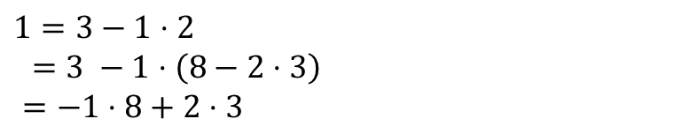
Extended Euclidian Algorithm
Step 1 compute gcd(a,b); keep tableau information.
Step 2 solve all equations for the remainder.
Step 3 substitute backward
$1=3−1⋅2$
$=3 −1⋅\left(8−2⋅3\right)$
$=−1⋅8+2⋅3$
$8=35 − 1⋅ 27$
$$3=27 − 3⋅ 8$$
$2 =8 − 2⋅ 3$
$1 =$ $3 − 1⋅ 2$

Slide 49


Extended Euclidian Algorithm
Step 1 compute gcd(a,b); keep tableau information.
Step 2 solve all equations for the remainder.
Step 3 substitute backward
When substituting back, you keep the larger of $m,n$ and the number you just substituted.
Don’t simplify further! (or you lose the form you need)
$1=3−1⋅2$
$=3 −1⋅\left(8−2⋅3\right)$
$=−1⋅8+3⋅3$
$=−1⋅8+3\left(27−3⋅8\right)$
$=3⋅27−10⋅8$
$=3⋅27−10(35−1⋅27)$
$=13⋅27−10⋅35$
$8=35 − 1⋅ 27$
$$3=27 − 3⋅ 8$$
$2 =8 − 2⋅ 3$
$1 =$ $3 − 1⋅ 2$
gcd(27,35) = $13⋅27+\left(−10\right)⋅35$

