Slide 1

Proof by Contradiction
Warm-up: Show “if $a^{2}$ is even, then $a$ is even.”
CSE 311 Autumn 2025
Lecture 12

Slide 2

Trying a direct proof (setup)
$∀a($Even($a^{2}$)$→$Even($a$)$)$

Slide 3
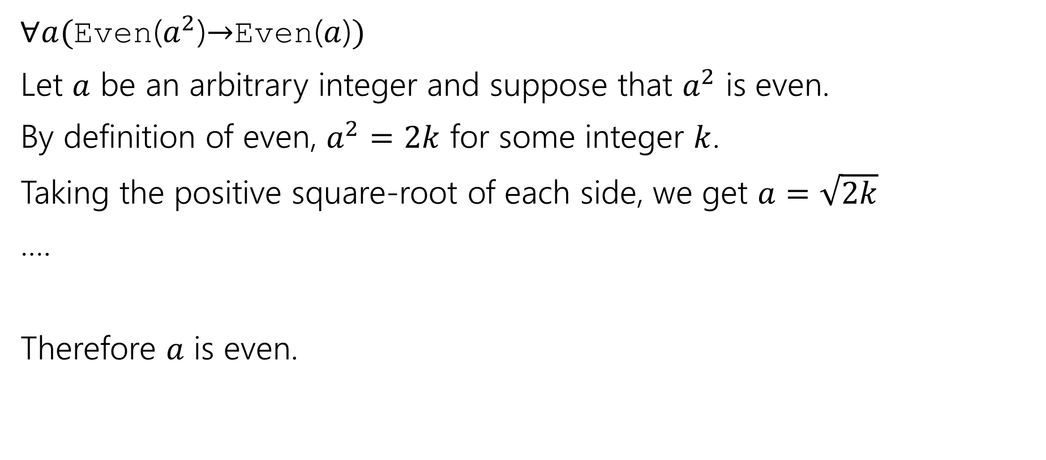
Trying a direct proof (stuck)
$∀a($Even($a^{2}$)$→$Even($a$)$)$
Let $a$ be an arbitrary integer and suppose that $a^{2}$ is even.
By definition of even, $a^{2}=2k$ for some integer $k$.
Taking the positive square-root of each side, we get $a=\sqrt{2k}$
….
Therefore $a$ is even.
Taking a square root of a variable is tricky! It’s hard to do algebra on.

Slide 4
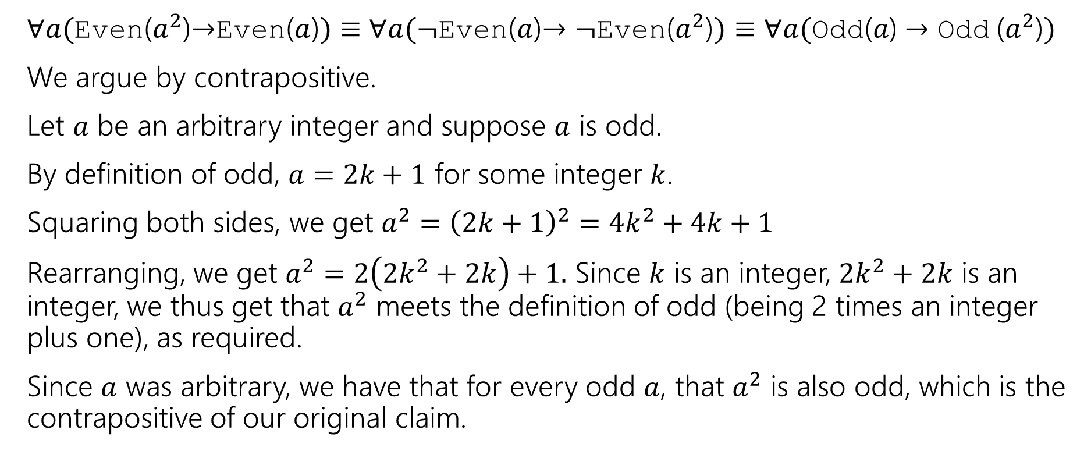
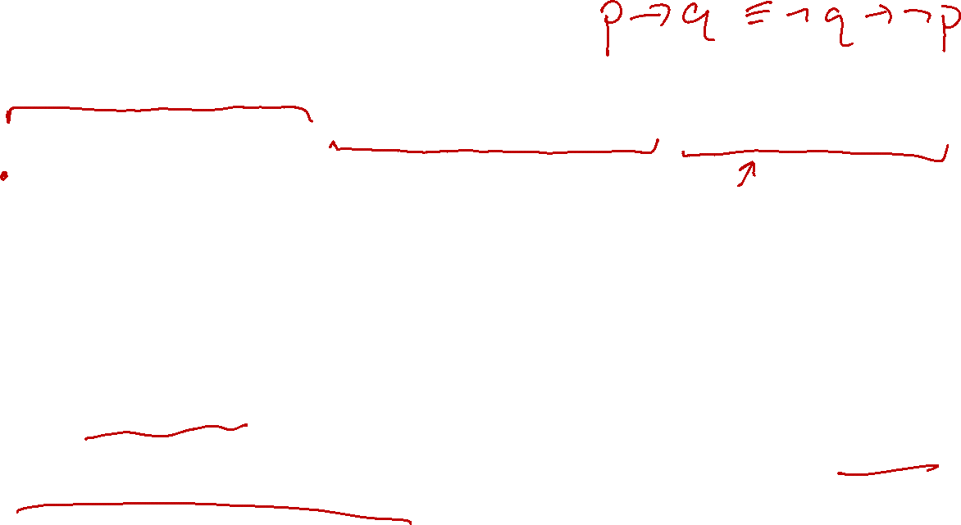

Proving by contrapositive
$∀a($Even($a^{2}$)$→$Even($a$)$)≡$ $∀a(¬$Even($a$)$→¬$Even($a^{2}$)$)≡∀a(\text{Odd}\text{(}a\text{)}→\text{Odd} \text{(}a^{2}\text{)})$
We argue by contrapositive.
Let $a$ be an arbitrary integer and suppose $a$ is odd.
By definition of odd, $a=2k+1$ for some integer $k$.
Squaring both sides, we get $a^{2}={\left(2k+1\right)}^{2}=4k^{2}+4k+1$
Rearranging, we get $a^{2}=2\left(2k^{2}+2k\right)+1.$ Since $k$ is an integer, $2k^{2}+2k$ is an integer, we thus get that $a^{2}$ meets the definition of odd (being 2 times an integer plus one), as required.
Since $a$ was arbitrary, we have that for every odd $a$, that $a^{2}$ is also odd, which is the contrapositive of our original claim.

Slide 5
Signs you might want to use proof by contrapositive
1. The hypothesis of the implication you’re proving has a “not” in it (that you think is making things difficult)
2. The target of the implication you’re proving has an “or” or “not” in it.
3. There’s a step that is difficult forward, but easy backwards
e.g., taking a square-root forward, squaring backwards.
4. You get halfway through the proof and you can’t “get ahold of” what you’re trying to show.
e.g., you’re working with a “not equal” instead of an “equals” or “every thing doesn’t have this property” instead of “some thing does have that property”
All of these are reasons you might want contrapositive. Sometimes you just have to try and see what happens!

Slide 6
Proof by Contradiction

Slide 7
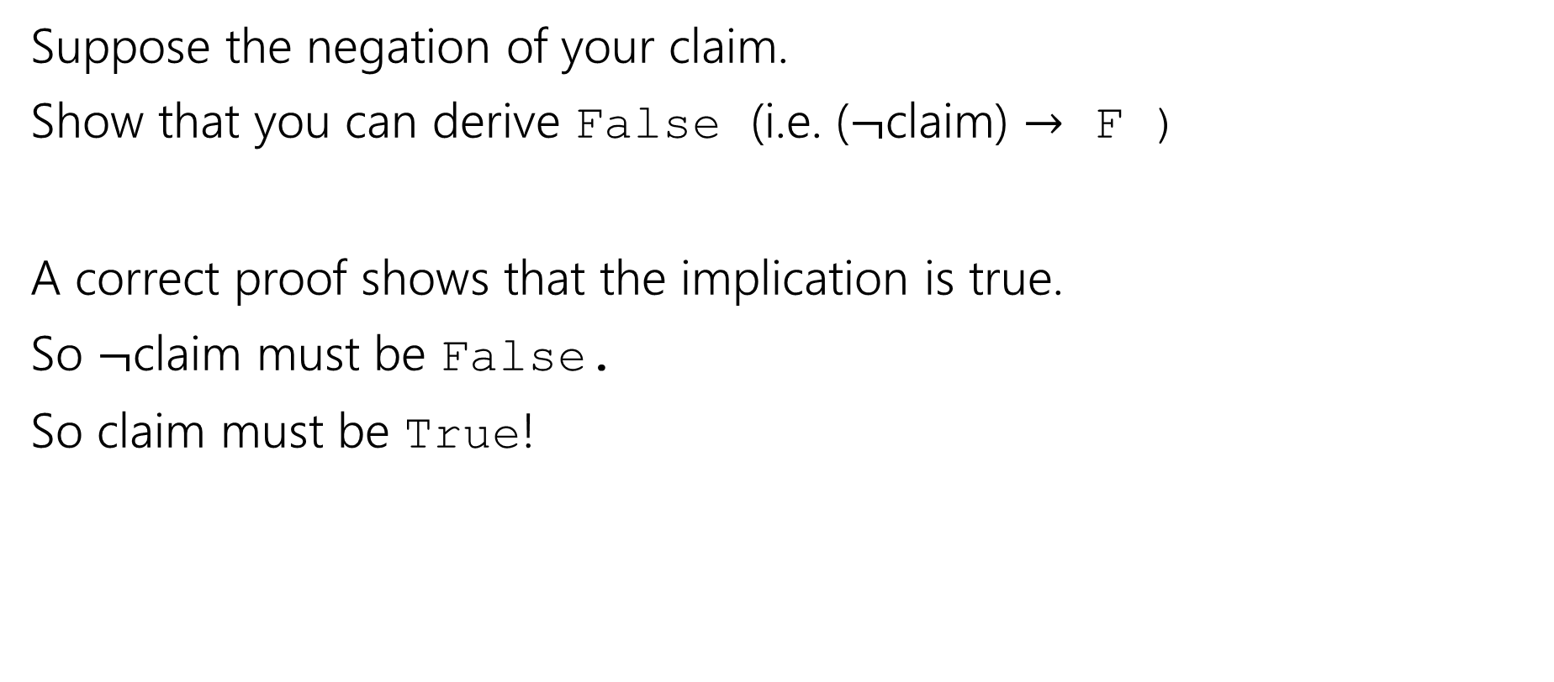
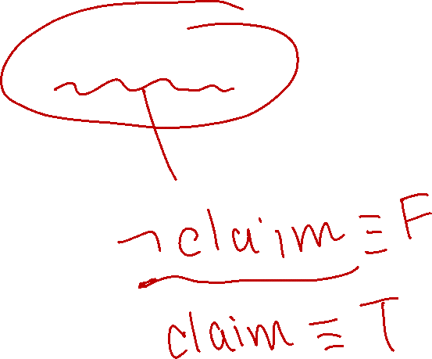
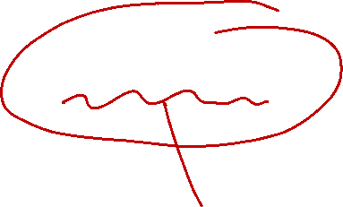
Proof By Contradiction - idea
Suppose the negation of your claim.
Show that you can derive False (i.e. ($¬$claim) $→$ F )
A correct proof shows that the implication is true.
So $¬$claim must be False.
So claim must be True!

Slide 8


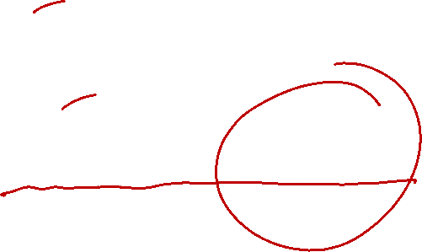
Proof By Contradiction Skeleton
Suppose, for the sake of contradiction $¬p$
…
$q$
…
$¬q$
But $q$ and $¬q$ is a contradiction! So we must have $p$.

Slide 9

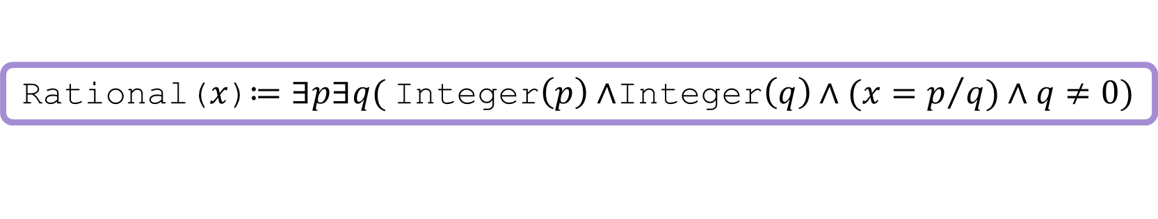
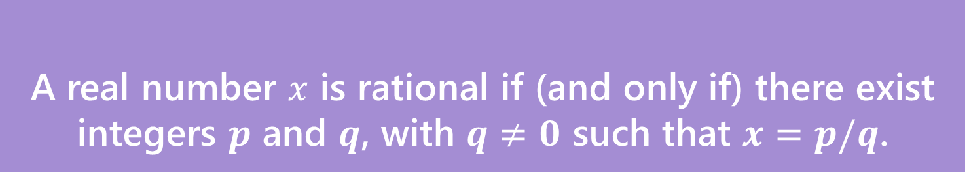
Proof By Contradiction (setup)
Claim: $\sqrt{2}$ is irrational (i.e. not rational).
Proof:
A real number $x$ is rational if (and only if) there exist integers $p$ and $q$, with $q≠0$ such that $x=p/q$.
Rational
Rational($x$)$≔∃p∃q($Integer$\left(p\right)∧$Integer$\left(q\right)∧(x=p/q)∧q≠0)$

Slide 10

Proof By Contradiction (skeleton)
Claim: $\sqrt{2}$ is irrational (i.e. not rational).
Proof:
Suppose for the sake of contradiction that $\sqrt{2}$ is rational.
But [] is a contradiction!
We don’t have a fixed target.
That can make this proof harder.

Slide 11
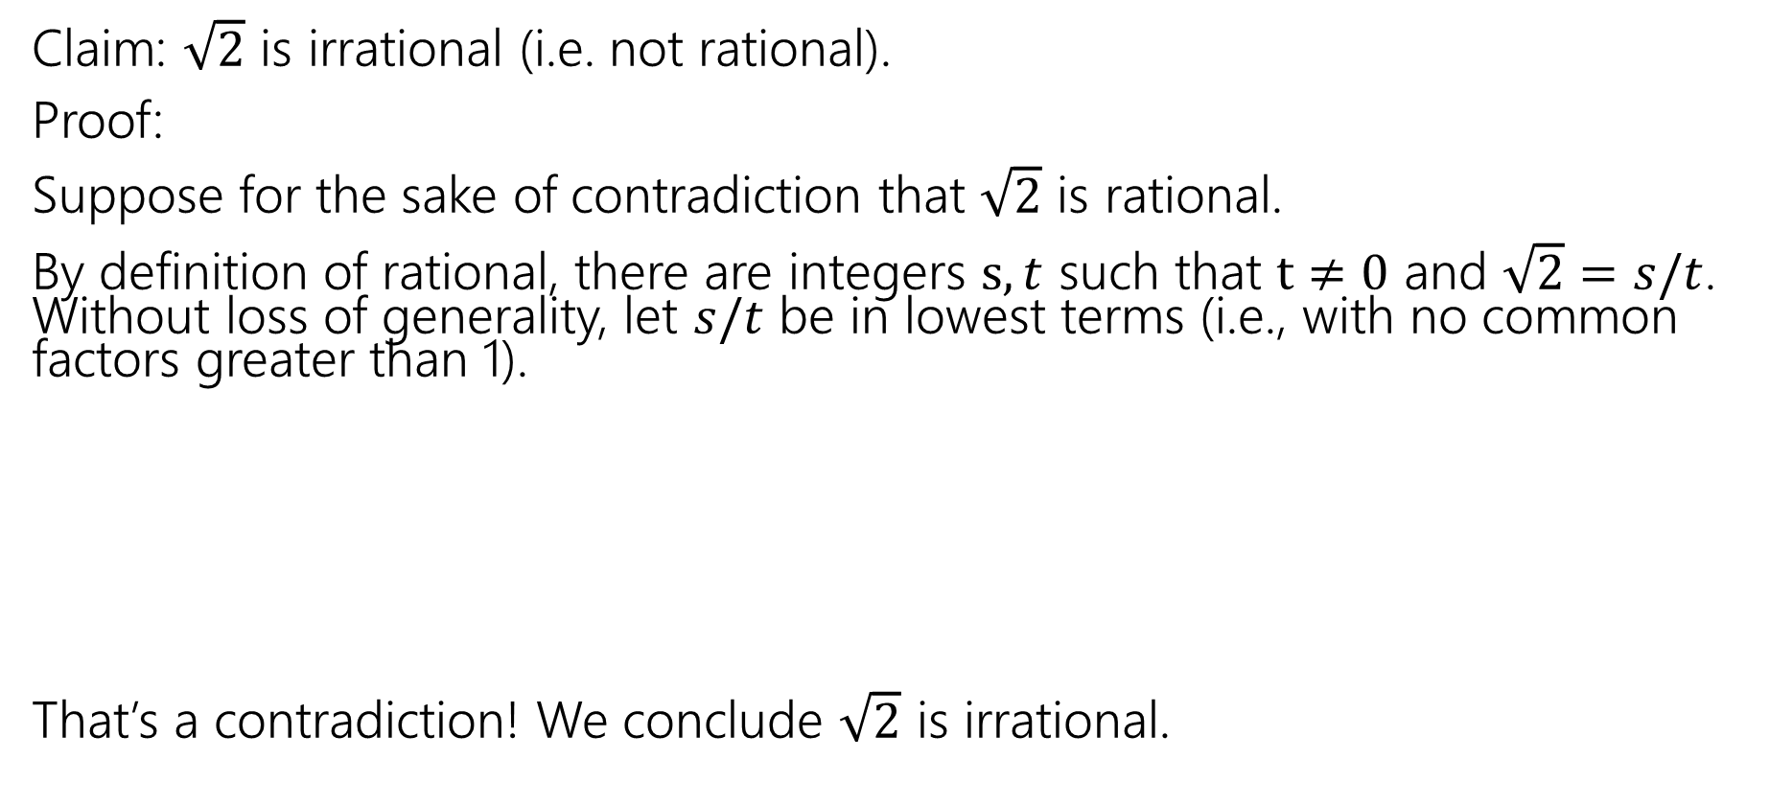

Proof By Contradiction (in progress 1)
If $a^{2}$ is even then $a$is even.
Claim: $\sqrt{2}$ is irrational (i.e. not rational).
Proof:
Suppose for the sake of contradiction that $\sqrt{2}$ is rational.
By definition of rational, there are integers $s,t$ such that $t≠0$ and $\sqrt{2}=s/t$. Without loss of generality, let $s/t$ be in lowest terms (i.e., with no common factors greater than 1).
That’s a contradiction! We conclude $\sqrt{2}$ is irrational.
Fancy mathematician speak for “It looks like I’m choosing more specific values, but it’s ok for me to do that---they’re really still arbitrary”
Notes:
Only

Slide 12
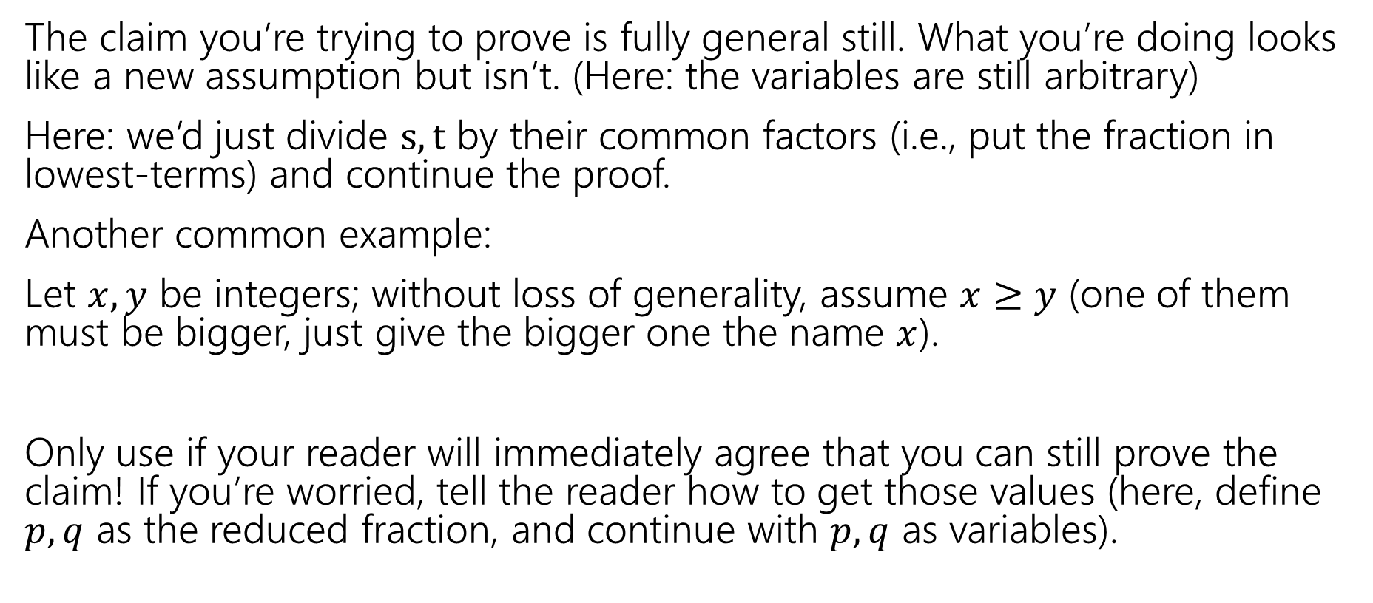
When can I say without loss of generality?
The claim you’re trying to prove is fully general still. What you’re doing looks like a new assumption but isn’t. (Here: the variables are still arbitrary)
Here: we’d just divide $s,t$ by their common factors (i.e., put the fraction in lowest-terms) and continue the proof.
Another common example:
Let $x,y$ be integers; without loss of generality, assume $x≥y$ (one of them must be bigger, just give the bigger one the name $x$).
Only use if your reader will immediately agree that you can still prove the claim! If you’re worried, tell the reader how to get those values (here, define $p,q$ as the reduced fraction, and continue with $p,q$ as variables).

Slide 13
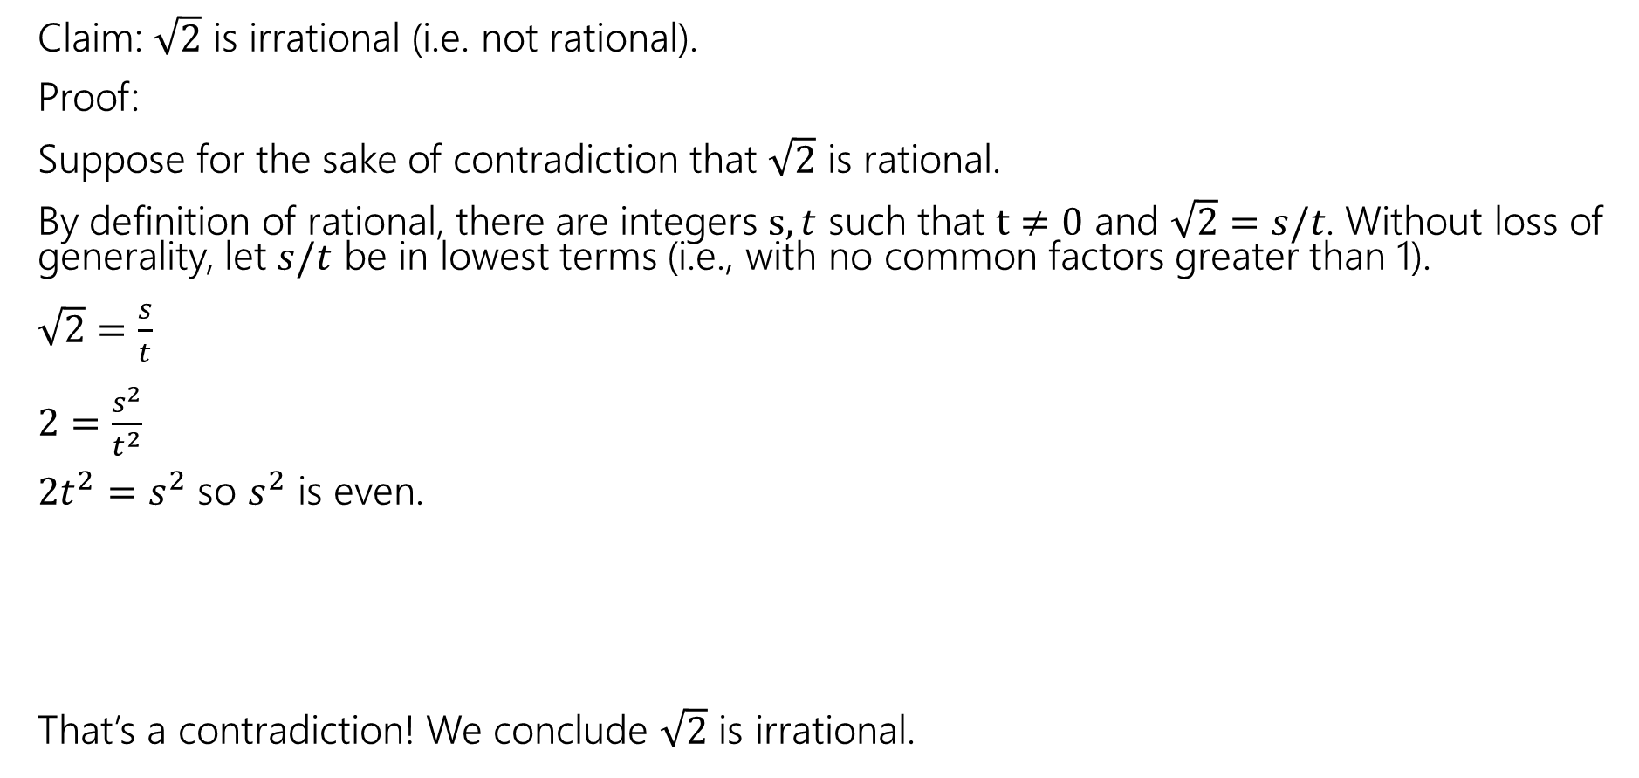
Proof By Contradiction (in progress 2)
If $a^{2}$ is even then $a$is even.
Claim: $\sqrt{2}$ is irrational (i.e. not rational).
Proof:
Suppose for the sake of contradiction that $\sqrt{2}$ is rational.
By definition of rational, there are integers $s,t$ such that $t≠0$ and $\sqrt{2}=s/t$. Without loss of generality, let $s/t$ be in lowest terms (i.e., with no common factors greater than 1).
$\sqrt{2}=\frac{s}{t}$
$2=\frac{s^{2}}{t^{2}}$
$2t^{2}=s^{2}$ so $s^{2}$ is even.
That’s a contradiction! We conclude $\sqrt{2}$ is irrational.

Slide 14
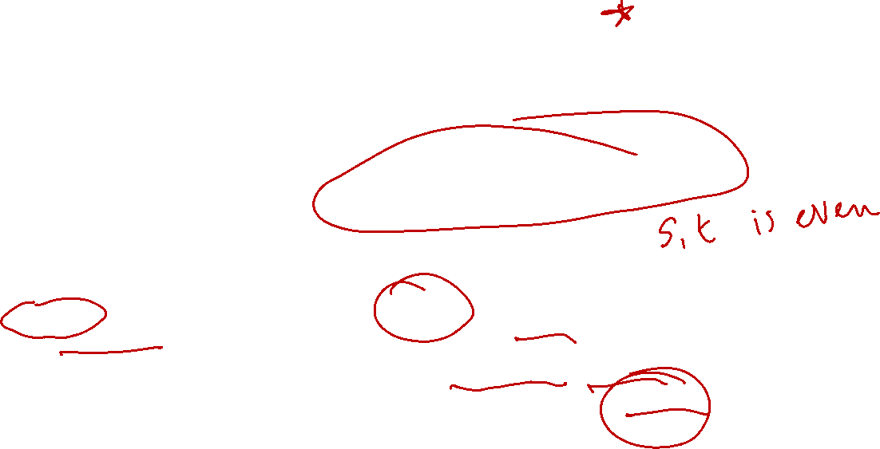
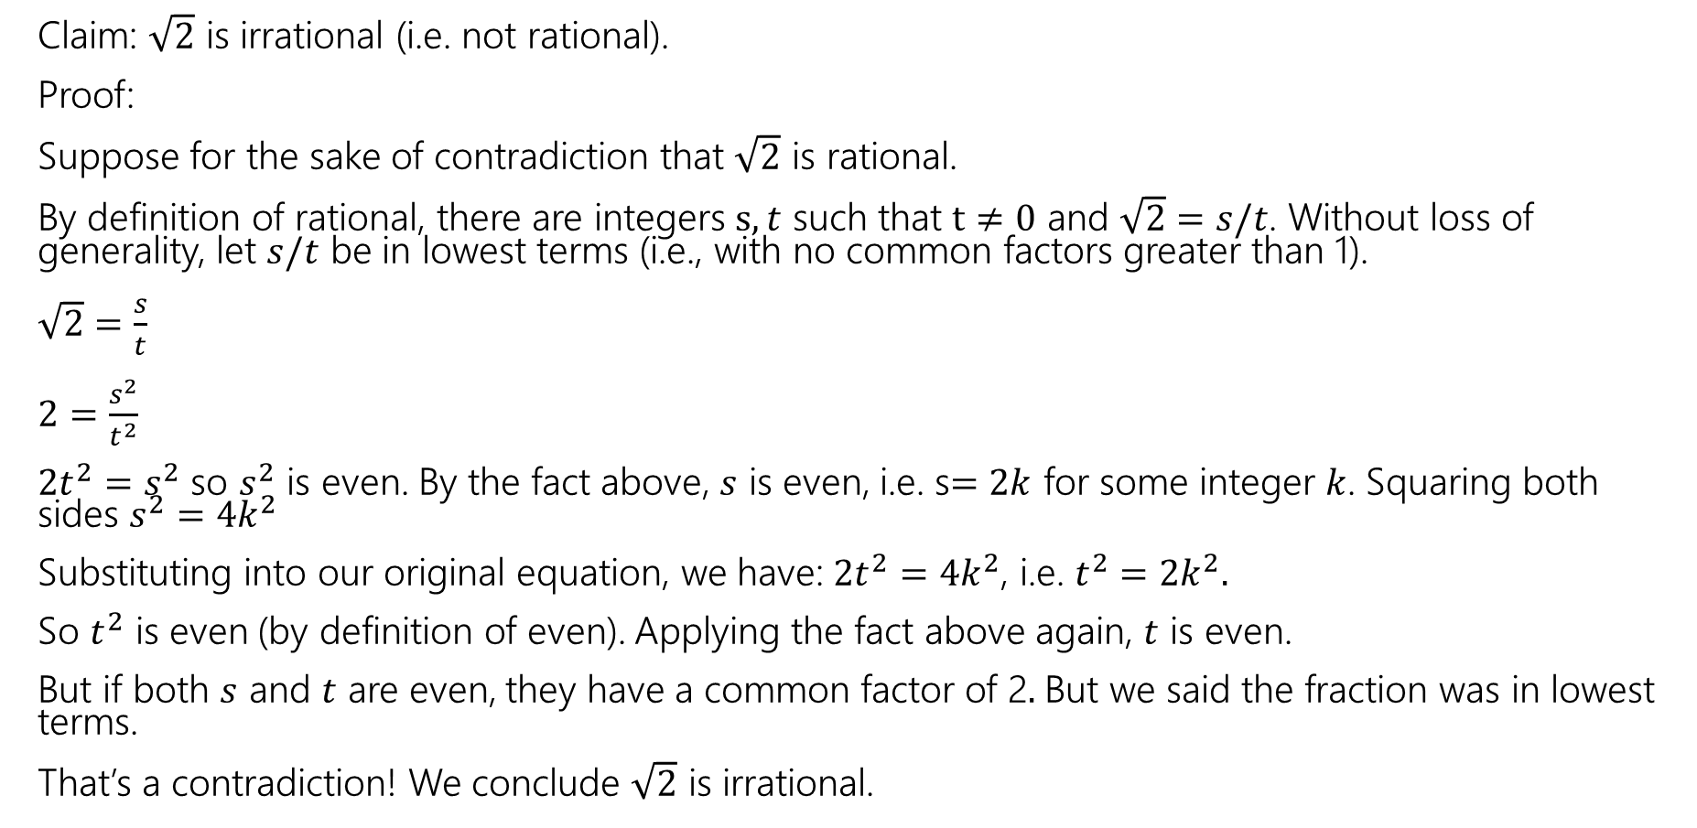
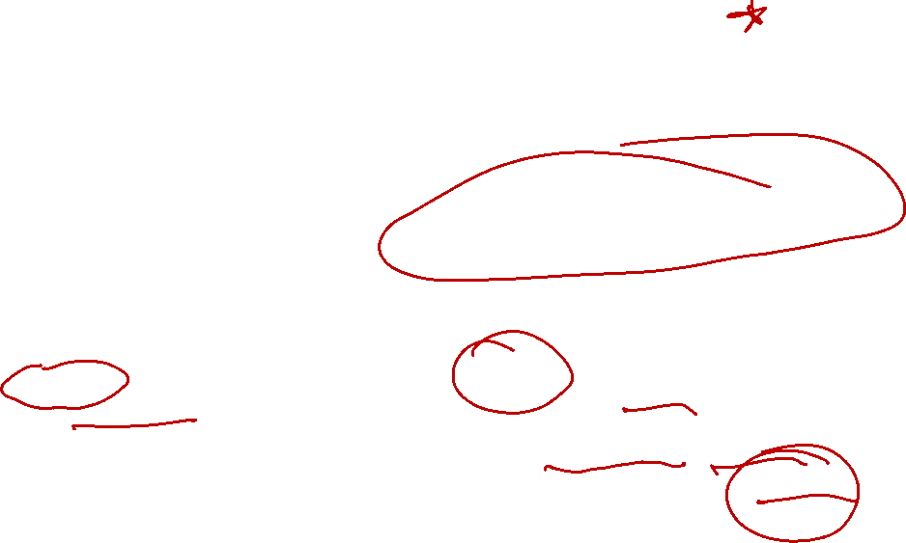
Proof By Contradiction (complete)
If $a^{2}$ is even then $a$is even.
Claim: $\sqrt{2}$ is irrational (i.e. not rational).
Proof:
Suppose for the sake of contradiction that $\sqrt{2}$ is rational.
By definition of rational, there are integers $s,t$ such that $t≠0$ and $\sqrt{2}=s/t$. Without loss of generality, let $s/t$ be in lowest terms (i.e., with no common factors greater than 1).
$\sqrt{2}=\frac{s}{t}$
$2=\frac{s^{2}}{t^{2}}$
$2t^{2}=s^{2}$ so $s^{2}$ is even. By the fact above, $s$ is even, i.e. s$=2k$ for some integer $k$. Squaring both sides $s^{2}=4k^{2}$
Substituting into our original equation, we have: $2t^{2}=4k^{2}$, i.e. $t^{2}=2k^{2}.$
So $t^{2}$ is even (by definition of even). Applying the fact above again, $t$ is even.
But if both $s$ and $t$ are even, they have a common factor of 2$.$But we said the fraction was in lowest terms.
That’s a contradiction! We conclude $\sqrt{2}$ is irrational.

Slide 15
Proof By Contradiction retrospective
How in the world did we know how to do that?
In real life…lots of attempts that didn’t work.
Be very careful with proof by contradiction – without a clear target, you can easily end up in a loop of trying random things and getting nowhere.

Slide 16
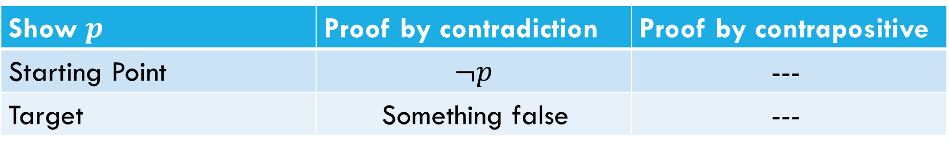
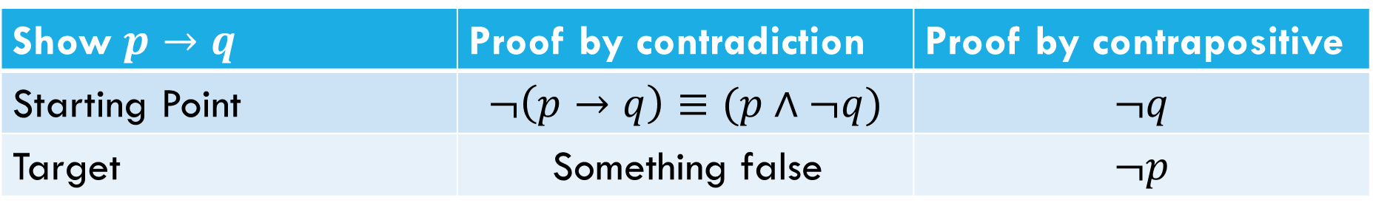
What’s the difference?
What’s the difference between proof by contrapositive and proof by contradiction?
Show $p→q$ | Proof by contradiction | Proof by contrapositive
Starting Point | $$¬\left(p→q\right)≡(p∧¬q)$$ | $$¬q$$
Target | Something false | $$¬p$$
Show $p$ | Proof by contradiction | Proof by contrapositive
Starting Point | $$¬p$$ | ---
Target | Something false | ---

Slide 17
Another Proof By Contradiction (setup)
Claim: There are infinitely many primes.
Proof:

Slide 18
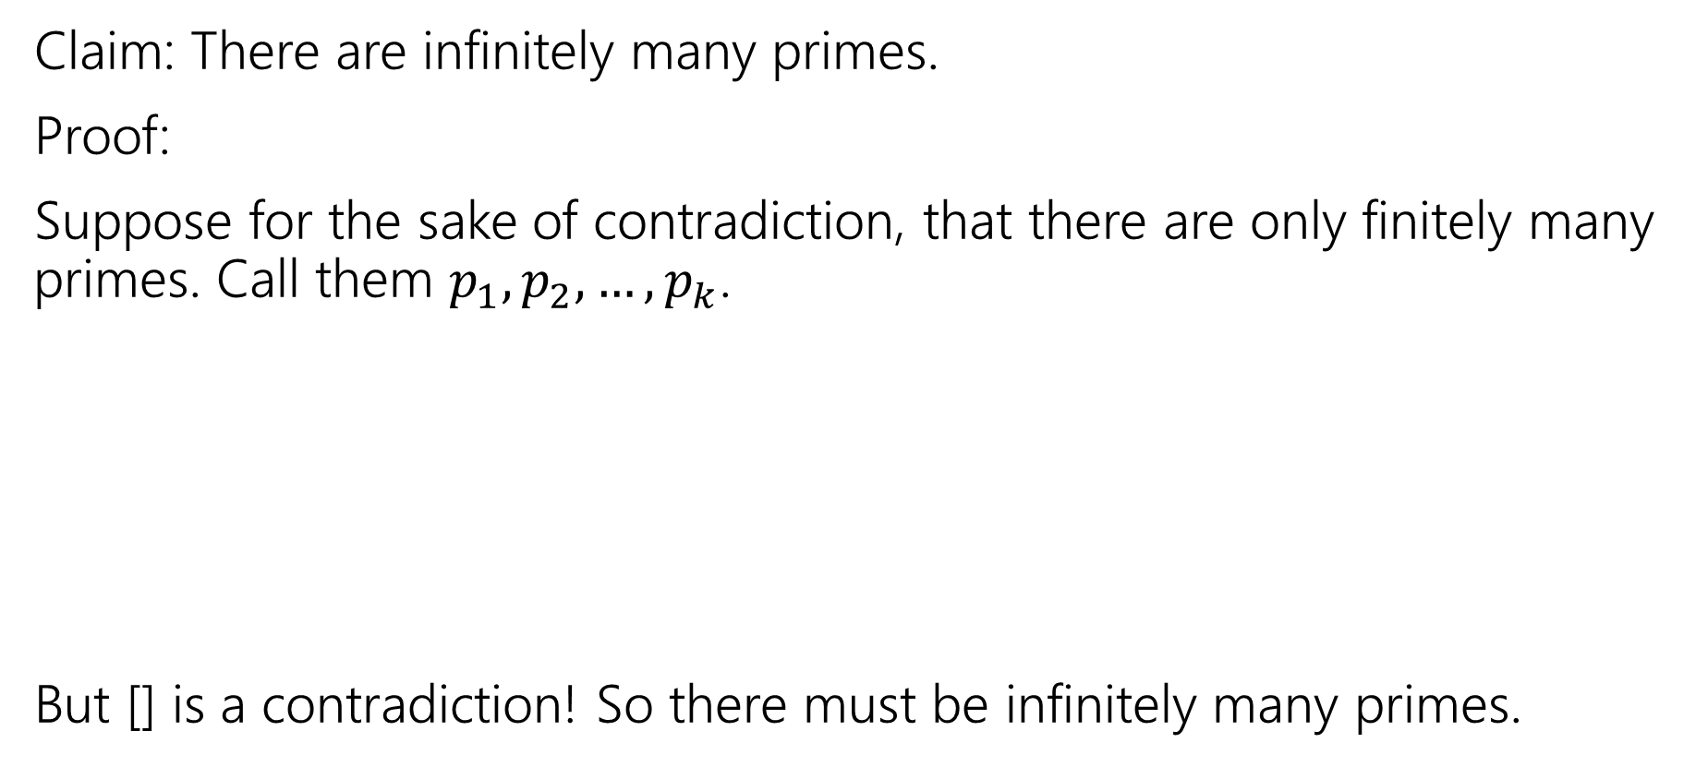
Another Proof By Contradiction (skeleton)
Claim: There are infinitely many primes.
Proof:
Suppose for the sake of contradiction, that there are only finitely many primes. Call them $p_{1},p_{2},…,p_{k}$.
But [] is a contradiction! So there must be infinitely many primes.

Slide 19
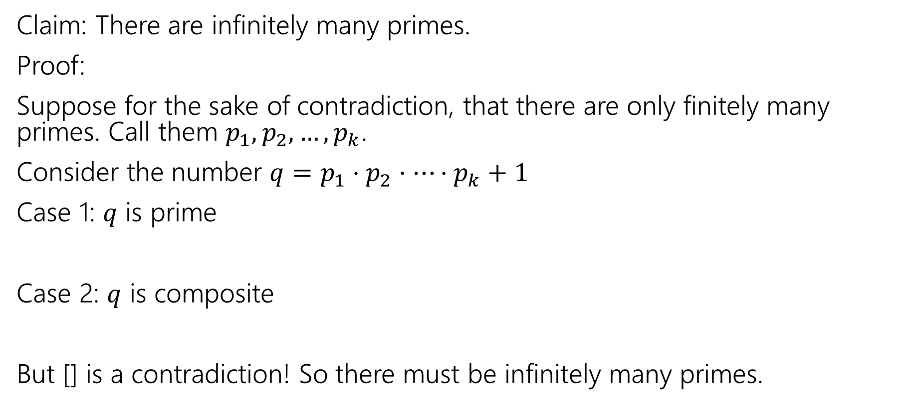
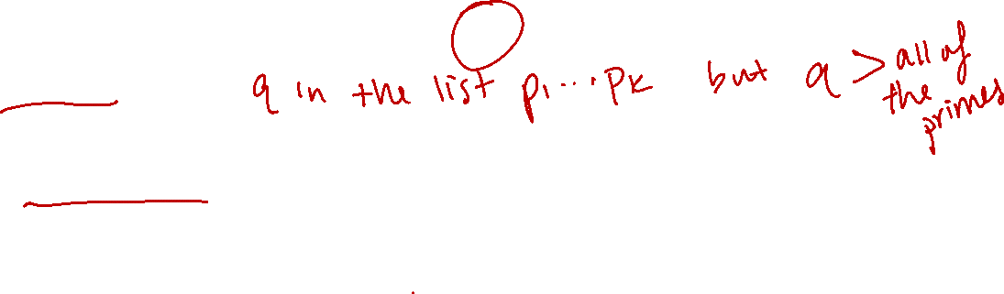
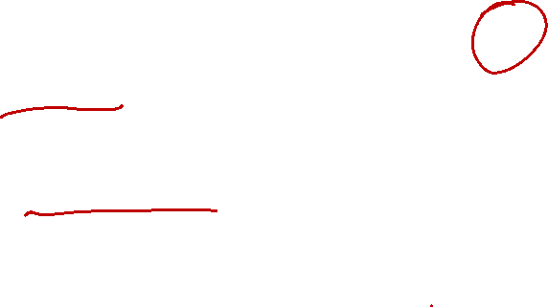
Another Proof By Contradiction (in progress)
Claim: There are infinitely many primes.
Proof:
Suppose for the sake of contradiction, that there are only finitely many primes. Call them $p_{1},p_{2},…,p_{k}$.
Consider the number $q=p_{1}⋅p_{2}⋅⋯⋅p_{k}+1$
Case 1: $q$ is prime
Case 2: $q$ is composite
But [] is a contradiction! So there must be infinitely many primes.

Slide 20
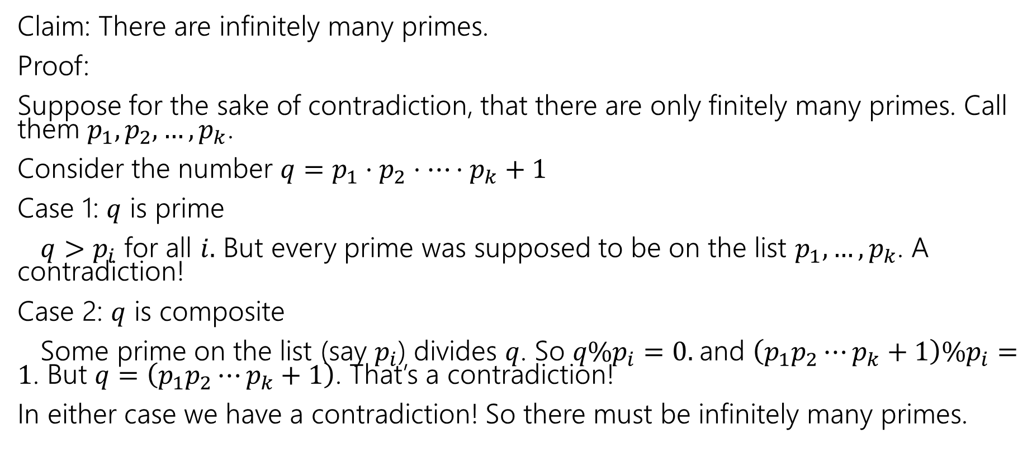
Another Proof By Contradiction (complete)
Claim: There are infinitely many primes.
Proof:
Suppose for the sake of contradiction, that there are only finitely many primes. Call them $p_{1},p_{2},…,p_{k}$.
Consider the number $q=p_{1}⋅p_{2}⋅⋯⋅p_{k}+1$
Case 1: $q$ is prime
$q>p_{i}$ for all $i.$ But every prime was supposed to be on the list $p_{1},…,p_{k}$. A contradiction!
Case 2: $q$ is composite
Some prime on the list (say $p_{i}$) divides $q$. So $q\%p_{i}=0.$and $\left(p_{1}p_{2}⋯p_{k}+1\right)\%p_{i}=1$. But $q=\left(p_{1}p_{2}⋯p_{k}+1\right)$. That’s a contradiction!
In either case we have a contradiction! So there must be infinitely many primes.

Slide 21
Extra Practice

Slide 22

Just the Skeleton 1 - setup
“For all integers $x$, if $x^{2}$ is even, then $x$ is even.”

Slide 23
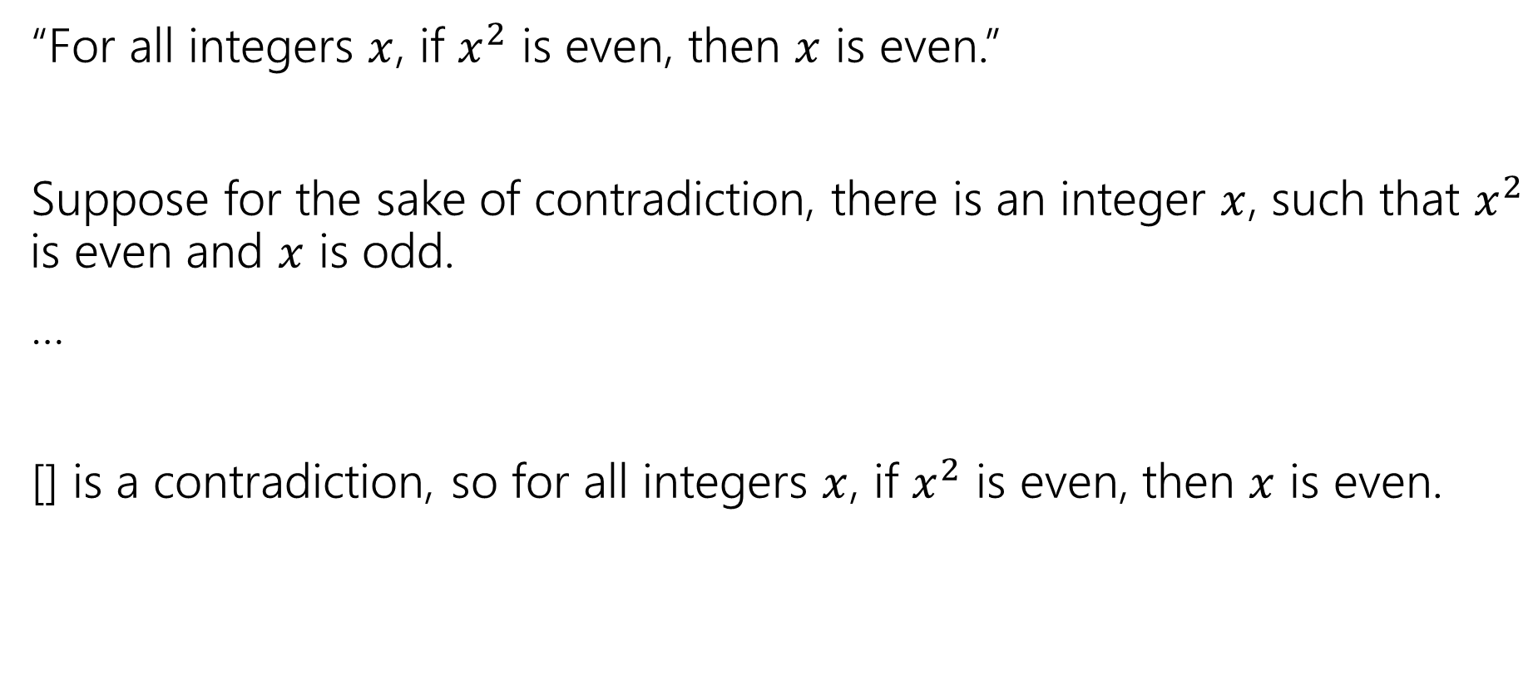
Just the Skeleton 1 - skeleton
“For all integers $x$, if $x^{2}$ is even, then $x$ is even.”
Suppose for the sake of contradiction, there is an integer $x$, such that $x^{2}$ is even and $x$ is odd.
…
[] is a contradiction, so for all integers $x$, if $x^{2}$ is even, then $x$ is even.

Slide 24

Just the Skeleton 2 – setup
“There is not an integer $k$ such that for all integers $n$, $k≥n$.

Slide 25
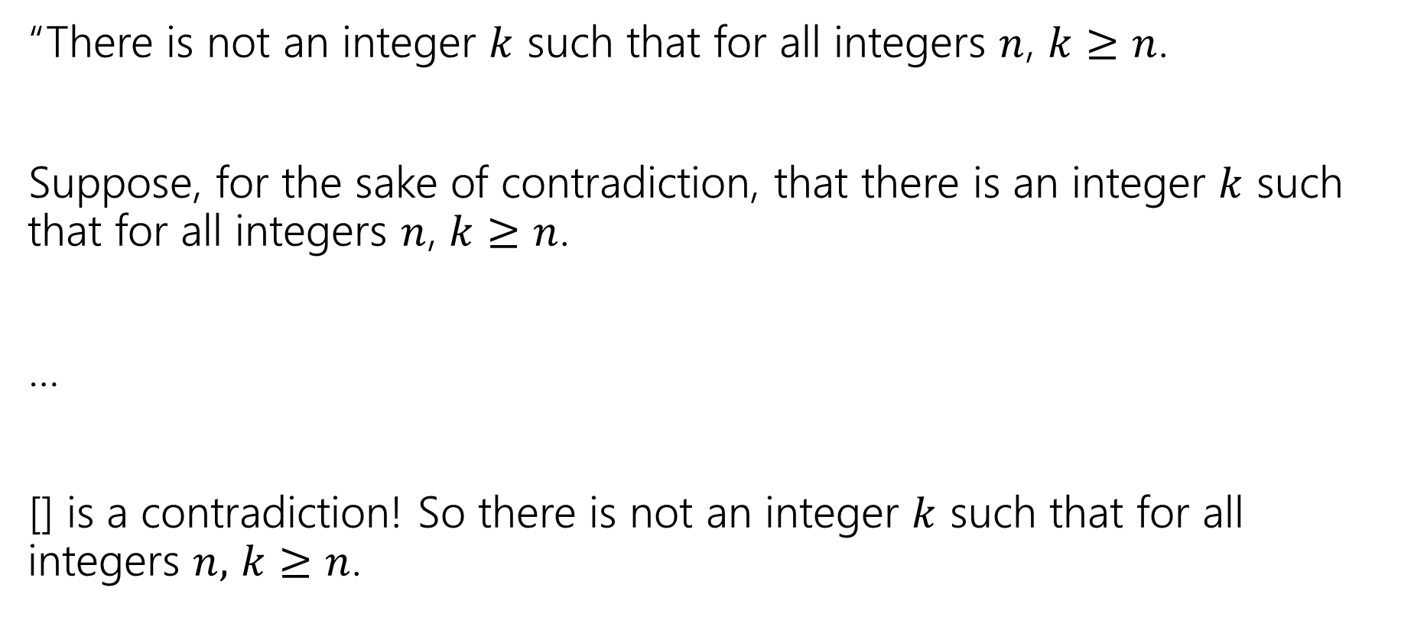
Just the Skeleton 2 - skeleton
“There is not an integer $k$ such that for all integers $n$, $k≥n$.
Suppose, for the sake of contradiction, that there is an integer $k$ such that for all integers $n$, $k≥n$.
…
[] is a contradiction! So there is not an integer $k$ such that for all integers $n,$ $k≥n$.

