Slide 1
More Number Theory
CSE 311 Autumn 2025
Lecture 11

Slide 2
Proof Practice
Over the next few weeks:
Practice direct proofs in English (formatting details, doing more examples)
See a few other proof techniques
  Proof by contrapositive, proving an exists statement, proof by contradiction
  All while learning some number theory.

Slide 3
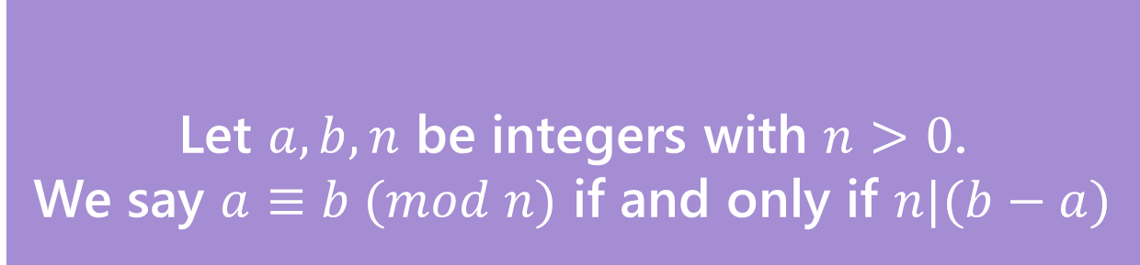

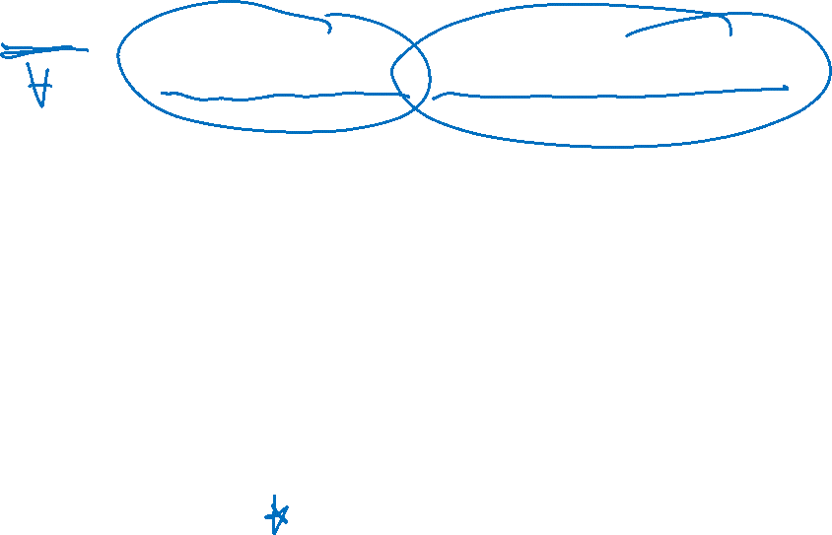
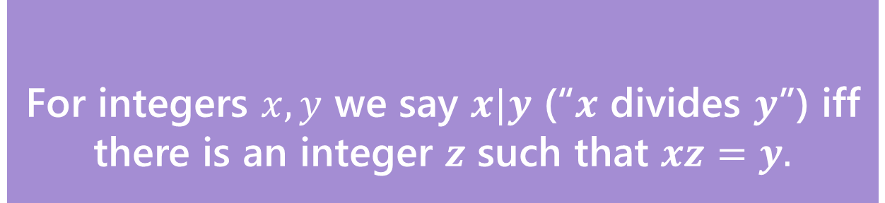
Example proof, equivalence in modular arithmetic respects addition (setup)
Claim: for all integers $a,b,c,n,with n>0:$
$a≡b \left(mod n\right)→a+c≡b+c (mod n)$
Before we start, we must know:
1. What every word in the statement means.
2. What the statement as a whole means.
3. Where to start.
4. What your target is.
For integers $x,y$ we say $x|y$ (“$x$ divides $y$”) iff there is an integer $z$ such that $xz=y.$
Divides
Let $a,b,n$ be integers with $n>0$.
We say $a≡b (mod n)$ if and only if $n|(b−a)$
Equivalence in modular arithmetic

Slide 4

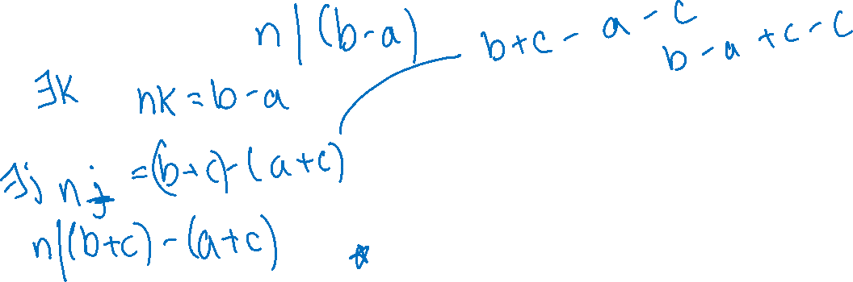
Example proof, equivalence in modular arithmetic respects addition (skeleton)
Claim: for all integers $a,b,c,n,with n>0:$
$a≡b \left(mod n\right)→a+c≡b+c (mod n)$
Proof:
Let $a,b,c,n$ be arbitrary integers with $n>0$,
and suppose $a≡b(mod n)$.
$a+c≡b+c (mod n)$
For integers $x,y$ we say $x|y$ (“$x$ divides $y$”) iff there is an integer $z$ such that $xz=y.$
Divides
Let $a,b,n$ be integers with $n>0$.
We say $a≡b (mod n)$ if and only if $n|(b−a)$
Equivalence in modular arithmetic

Slide 5
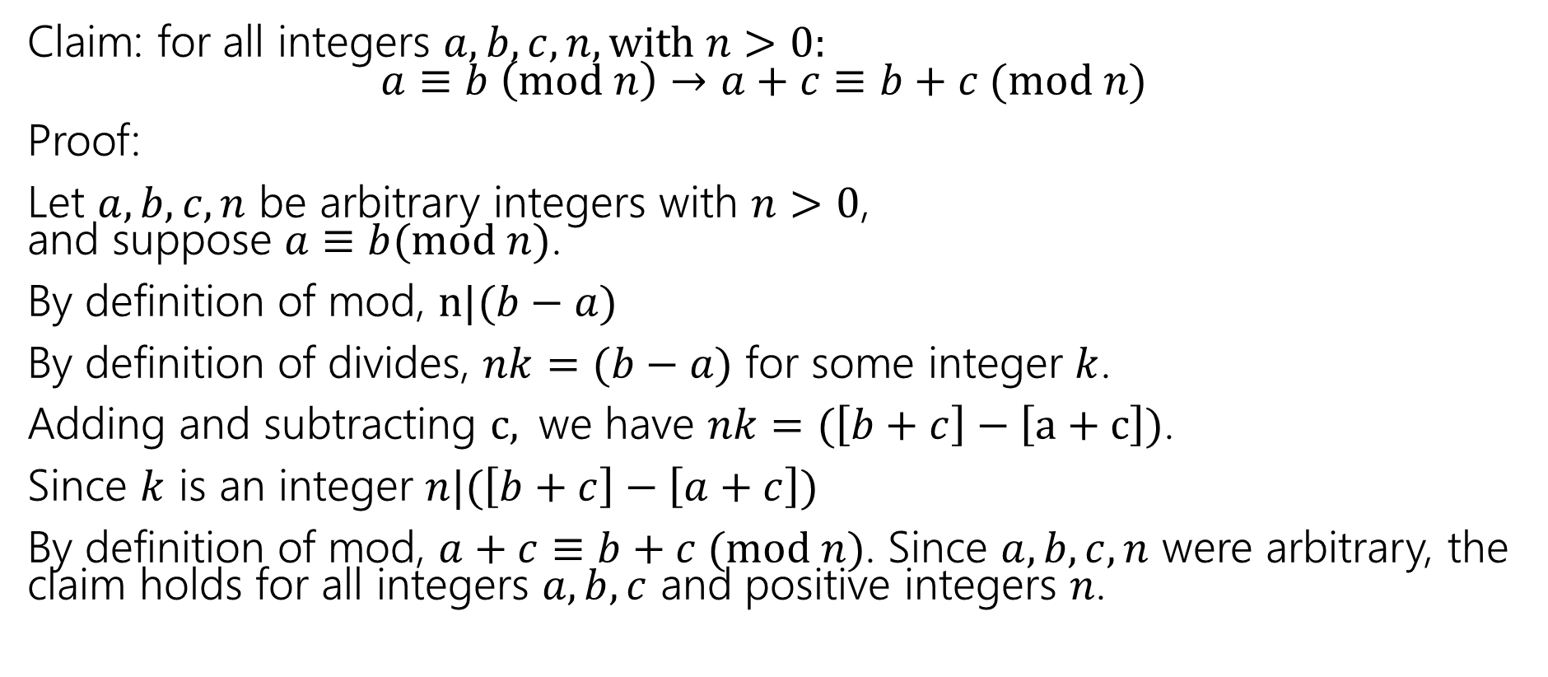
A proof
Claim: for all integers $a,b,c,n,with n>0:$
$a≡b \left(mod n\right)→a+c≡b+c (mod n)$
Proof:
Let $a,b,c,n$ be arbitrary integers with $n>0$,
and suppose $a≡b(mod n)$.
By definition of mod, $n|(b−a)$
By definition of divides, $nk=(b−a)$ for some integer $k$.
Adding and subtracting $c,$we have $nk=(\left[b+c\right]−\left[a+c\right])$.
Since $k$ is an integer $n|(\left[b+c\right]−\left[a+c\right])$
By definition of mod, $a+c≡b+c (mod n)$. Since $a,b,c,n$ were arbitrary, the claim holds for all integers $a,b,c$ and positive integers $n$.

Slide 6
Logical Ordering

Slide 7
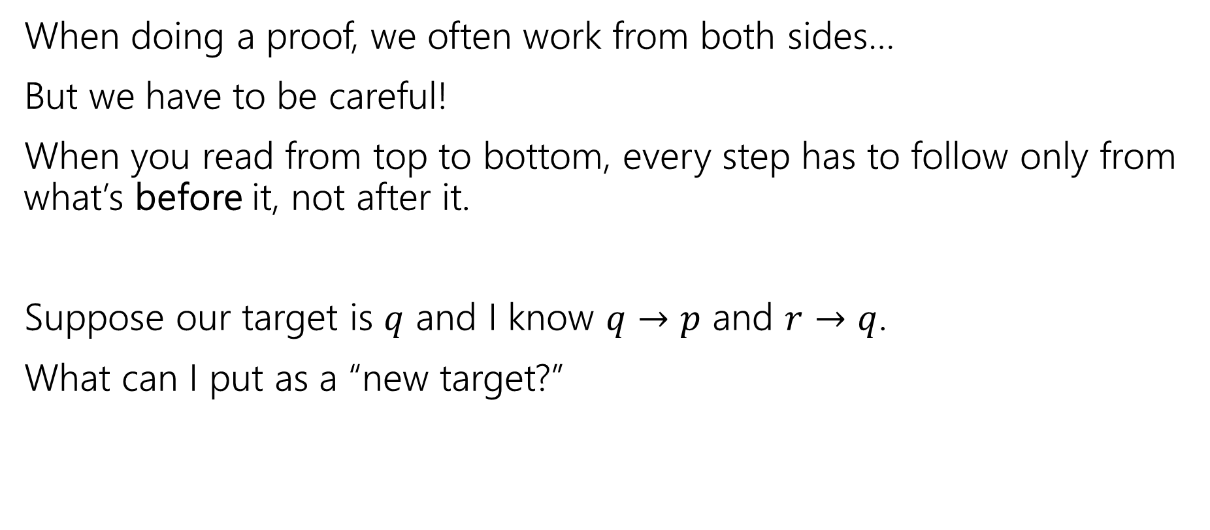
Logical Ordering (1)
When doing a proof, we often work from both sides…
But we have to be careful!
When you read from top to bottom, every step has to follow only from what’s before it, not after it.
Suppose our target is $q$ and I know $q→p$ and $r→q$.
What can I put as a “new target?”

Slide 8
Logical Ordering (2)
So why have all our prior steps been ok backward?
They’ve all been either:
A definition (which is always an “if and only if”)
An algebra step that is an “if and only if”
A logical equivalence (can work in both directions)
Even if your steps are “if and only if” you still have to put everything in order – start from your assumptions, and only assert something once it can be shown.

Slide 9
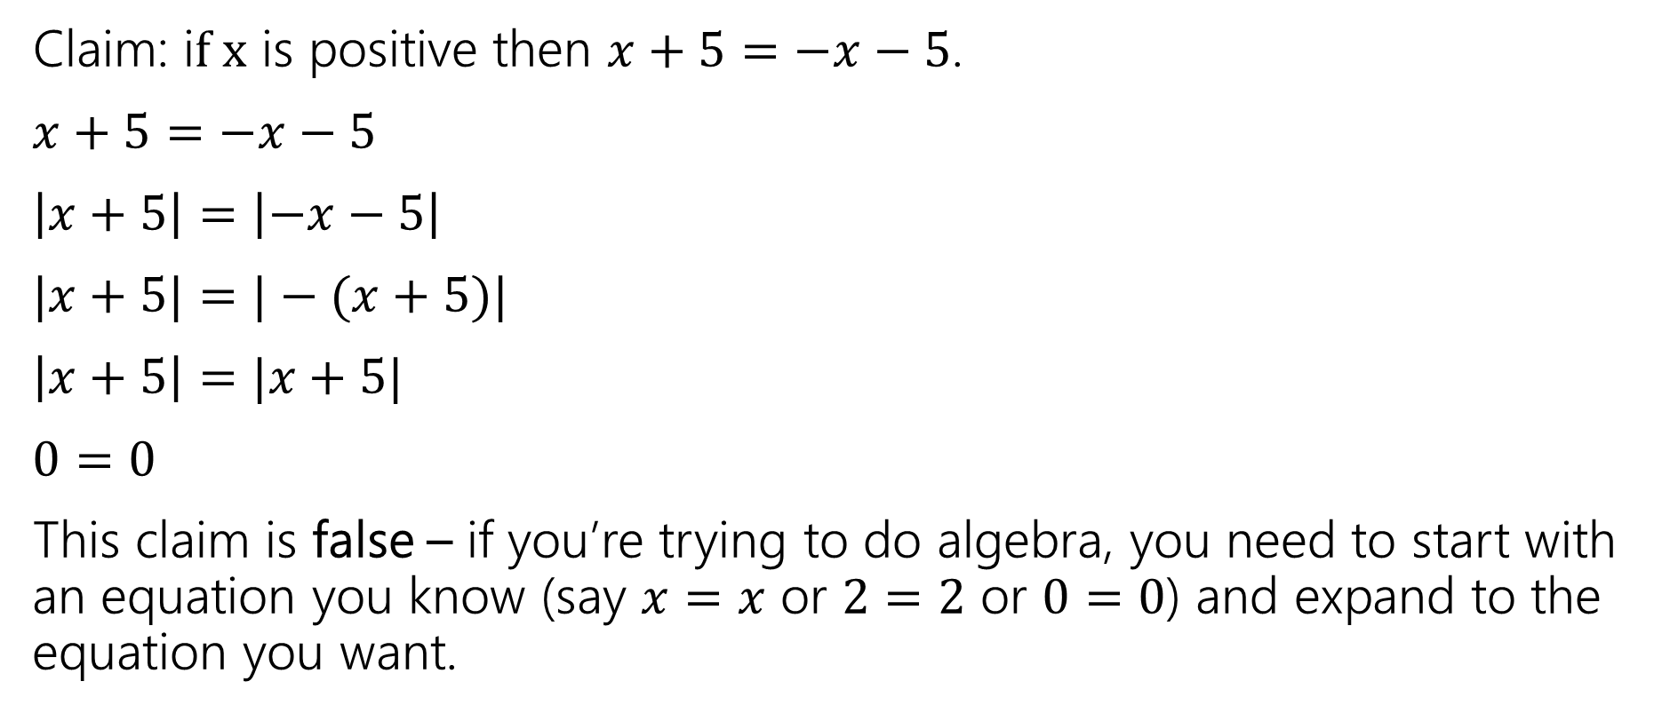

A bad proof
Claim: i$f x$ is positive then $x+5=−x−5$.
$x+5=−x−5$
$\left|x+5\right|=\left|−x−5\right|$
$|x+5|=|−(x+5)|$
$\left|x+5\right|=|x+5|$
$0=0$
This claim is false – if you’re trying to do algebra, you need to start with an equation you know (say $x=x$ or $2=2$ or $0=0$) and expand to the equation you want.

Slide 10
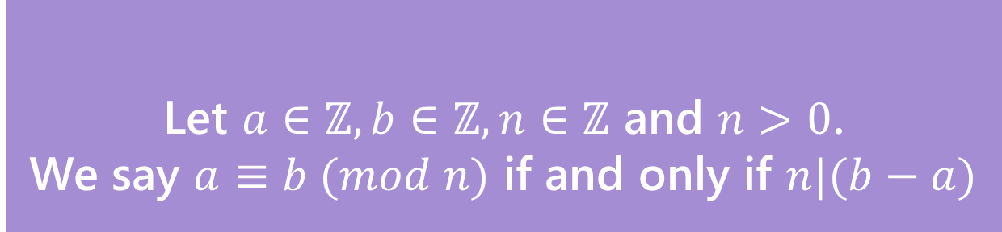


You Try!
Claim: for all integers $a,b,c,n with n>0:$
If $a≡b (mod n)$ then $ac≡bc (mod n)$
Before we start we must know:
1. What every word in the statement means.
2. What the statement as a whole means.
3. Where to start.
4. What your target is.
For integers $x,y$ we say $x|y$ (“$x$ divides $y$”) iff there is an integer $z$ such that $xz=y.$
Divides
Let $a∈ℤ, b∈ℤ, n∈ℤ$ and $n>0$.
We say $a≡b (mod n)$ if and only if $n|(b−a)$
Equivalence in modular arithmetic

Slide 11
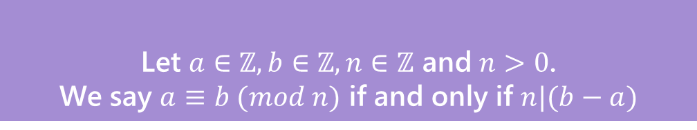


You try---setup
Claim: for all integers $a,b,c,n,with n>0:$
$a≡b \left(mod n\right)→ac≡bc (mod n)$
Proof:
For integers $x,y$ we say $x|y$ (“$x$ divides $y$”) iff there is an integer $z$ such that $xz=y.$
Divides
Let $a∈ℤ, b∈ℤ, n∈ℤ$ and $n>0$.
We say $a≡b (mod n)$ if and only if $n|(b−a)$
Equivalence in modular arithmetic

Slide 12

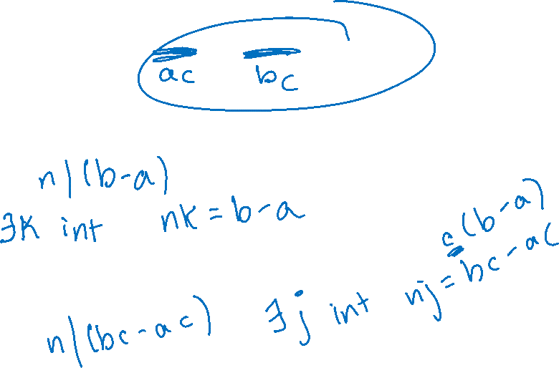
You try---skeleton
Claim: for all integers $a,b,c,n,with n>0:$
$a≡b \left(mod n\right)→ac≡bc (mod n)$
Proof:
Let $a,b,c,n$ be arbitrary integers with $n>0$
and suppose $a≡b(mod n)$.
$ac≡bc (mod n)$

Slide 13
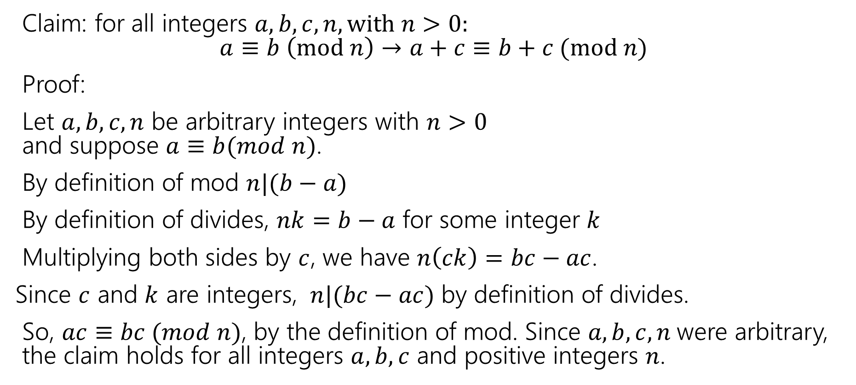

You try---the full proof
Claim: for all integers $a,b,c,n,with n>0:$
$a≡b \left(mod n\right)→a+c≡b+c (mod n)$
Proof:
Let $a,b,c,n$ be arbitrary integers with $n>0$
and suppose $a≡b(mod n)$.
By definition of mod $n|(b−a)$
By definition of divides, $nk=b−a$ for some integer $k$
Multiplying both sides by $c$, we have $n\left(ck\right)=bc−ac$.
Since $c$ and $k$ are integers, $n|(bc−ac)$ by definition of divides.
So, $ac≡bc (mod n)$, by the definition of mod. Since $a,b,c,n$were arbitrary, the claim holds for all integers $a,b,c$ and positive integers $n$.

Slide 14

Don’t lose your intuition!
Let’s check that we understand “intuitively” what mod means:
$x≡0 (mod 2)$
$−1≡19 (mod 5)$
$y≡2 (mod 7)$
“$x$is even” Note that negative (even) $x$ values also make this true.
This is true! They both have remainder $4$ when divided by $5$.
This is true as long as $y=2+7k$ for some integer $k$

Slide 15
Small Techniques

Slide 16
Proof By [Counter]Example
To prove an existential statement (or disprove a universal statement), provide an example, and demonstrate that it is the needed example.
You don’t have to explain where it came from! (In fact, you shouldn’t)
Computer scientists and mathematicians like to keep an air of mystery around our proofs.
  (or more charitably, we want to focus on just enough to believe the claim)

Slide 17
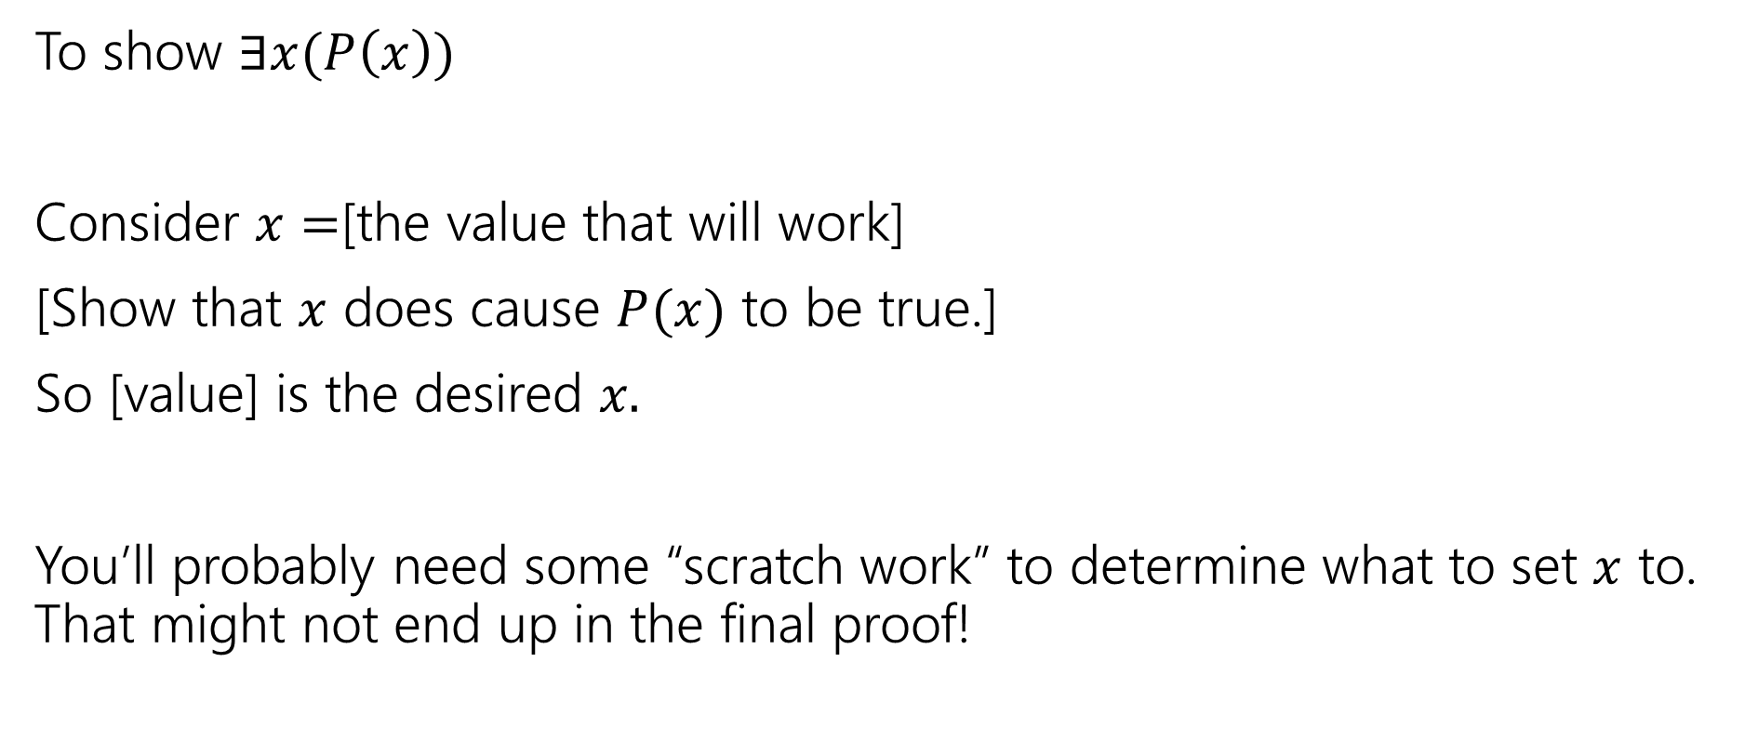
Skeleton of an Exists Proof
To show $∃x(P\left(x\right))$
Consider $x=$[the value that will work]
[Show that $x$ does cause $P(x)$ to be true.]
So [value] is the desired $x.$
You’ll probably need some “scratch work” to determine what to set $x$ to. That might not end up in the final proof!

Slide 18
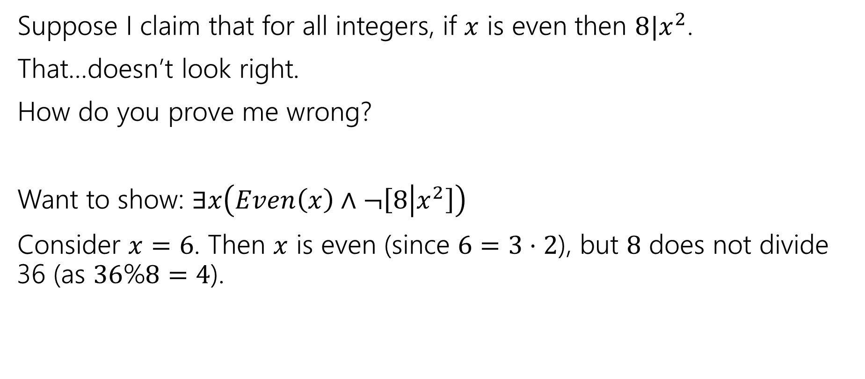
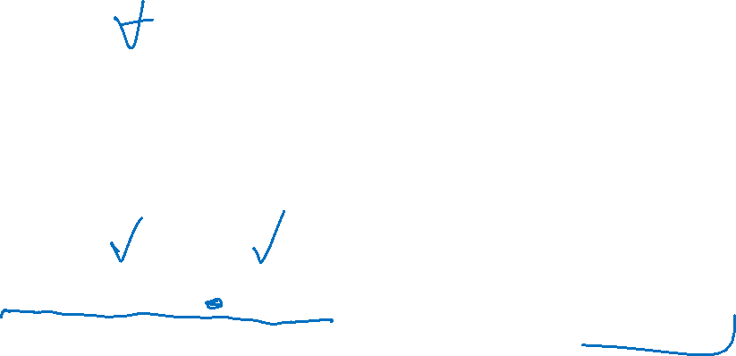
Exists proofs
Suppose I claim that for all integers, if $x$ is even then $8|x^{2}$.
That…doesn’t look right.
How do you prove me wrong?
Want to show: $∃x\left(Even\left(x\right)∧¬\left[8 | x^{2}\right]\right)$
Consider $x=6$. Then $x$ is even (since $6=3⋅2$), but $8$ does not divide 36 (as $36$%$8=4$).

Slide 19

Proof By Cases - motivation
If $x$ is prime then $x^{2}$ is odd or $2|x$.
We need two different arguments – one for 2 and one for all the other primes…

Slide 20
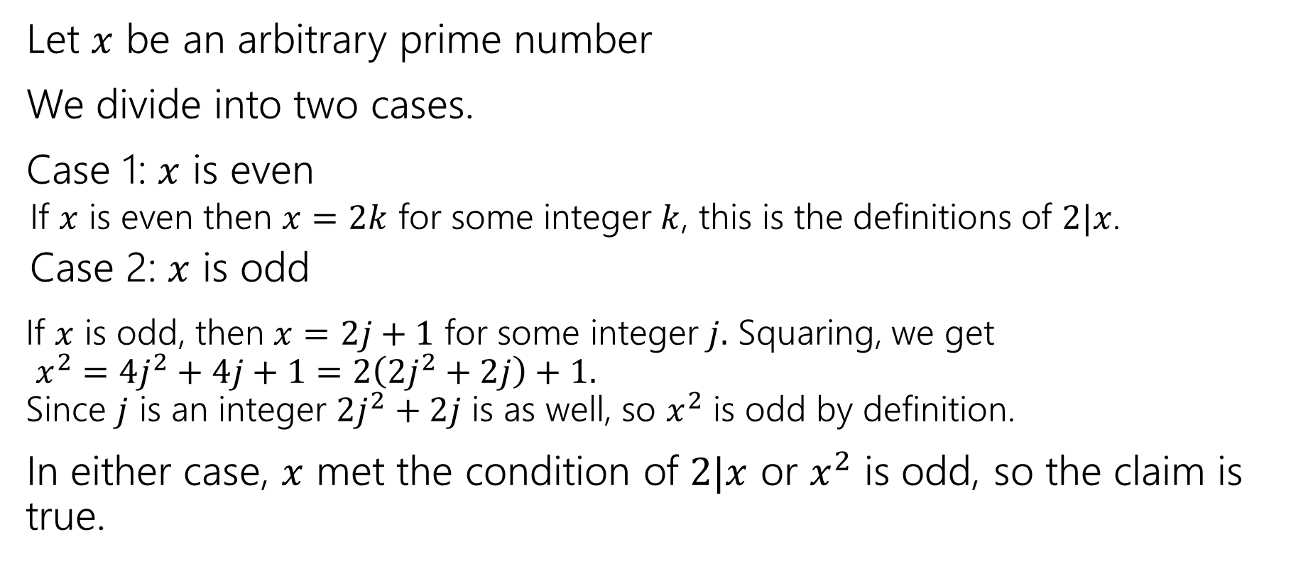

Proof By Cases - example
Let $x$ be an arbitrary prime number
We divide into two cases.
Case 1: $x$ is even
  If $x$ is even then $x=2k$ for some integer $k$, this is the definitions of $2|x$.
  Case 2: $x$ is odd
If $x$ is odd, then $x=2j+1$ for some integer $j.$ Squaring, we get
$x^{2}=4j^{2}+4j+1=2\left(2j^{2}+2j\right)+1.$
Since $j$ is an integer $2j^{2}+2j$ is as well, so $x^{2}$ is odd by definition.
In either case, $x$ met the condition of $2|x$ or $x^{2}$ is odd, so the claim is true.

Slide 21
Proof By Cases
Make it clear how you decide which case you're addressing.
It should be obvious your cases are “exhaustive”
Reach the same conclusion in each of the cases, and you can say you’ve got that conclusion no matter what (outside the cases).
Advanced version: sometimes you end up arguing a certain case “can’t happen”

Slide 22
Proof by Contrapositive

Slide 23

Another Proof (statement)
For all integers, $a,b,c:$Show that if $a∤(bc)$ then $a∤b$ or $a∤c$.

Slide 24
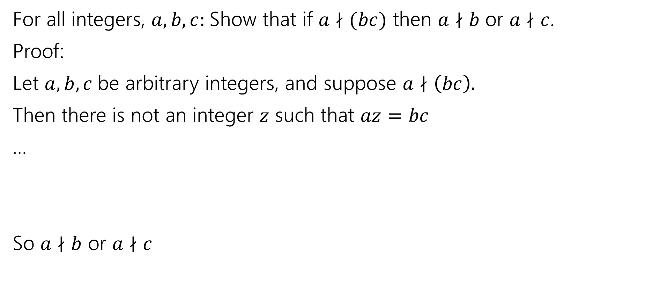

Another Proof (initial skeleton)
For all integers, $a,b,c:$Show that if $a∤(bc)$ then $a∤b$ or $a∤c$.
Proof:
Let $a,b,c$be arbitrary integers, and suppose $a∤\left(bc\right).$
Then there is not an integer $z$ such that $az=bc$
…
So $a∤b$ or $a∤c$

Slide 25

Another Proof
For all integers, $a,b,c:$Show that if $a∤(bc)$ then $a∤b$ or $a∤c$.
Proof:
Let $a,b,c$be arbitrary integers, and suppose $a∤\left(bc\right).$
Then there is not an integer $z$ such that $az=bc$
…
So $a∤b$ or $a∤c$
There has to be a better way!

Slide 26
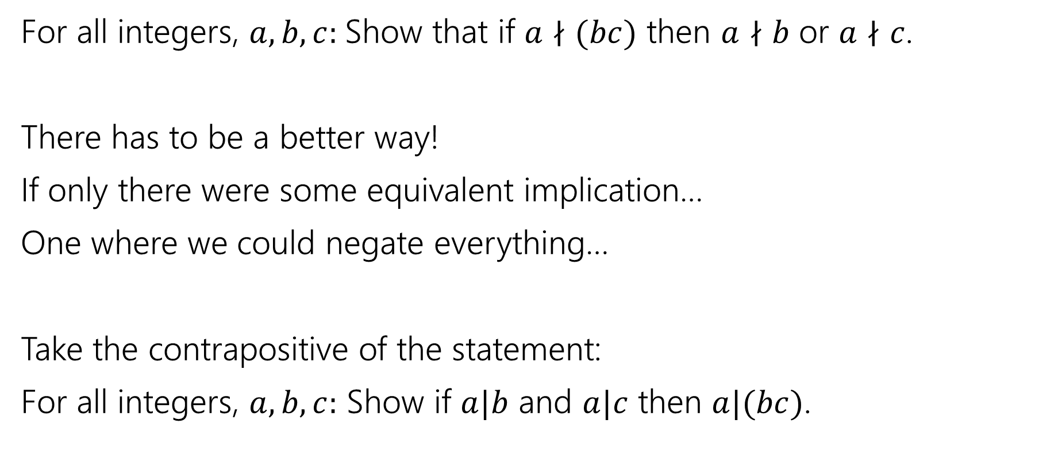
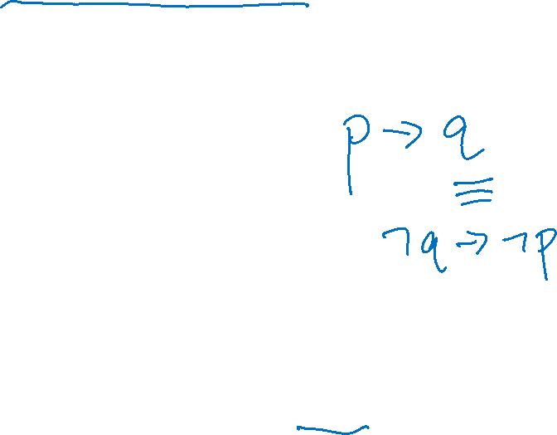
Another Proof (contrapositive)
For all integers, $a,b,c:$Show that if $a∤(bc)$ then $a∤b$ or $a∤c$.
There has to be a better way!
If only there were some equivalent implication…
One where we could negate everything…
Take the contrapositive of the statement:
For all integers, $a,b,c:$ Show if $a|b$ and $a|c$ then $a|(bc)$.

Slide 27


By contrapositive (setup)
Claim: For all integers, $a,b,c:$Show that if $a∤(bc)$ then $a∤b$ or $a∤c$.
We argue by contrapositive.
Let $a,b,c$be arbitrary integers, and suppose $a|b$ and $a|c$.
Therefore $a|bc$

Slide 28
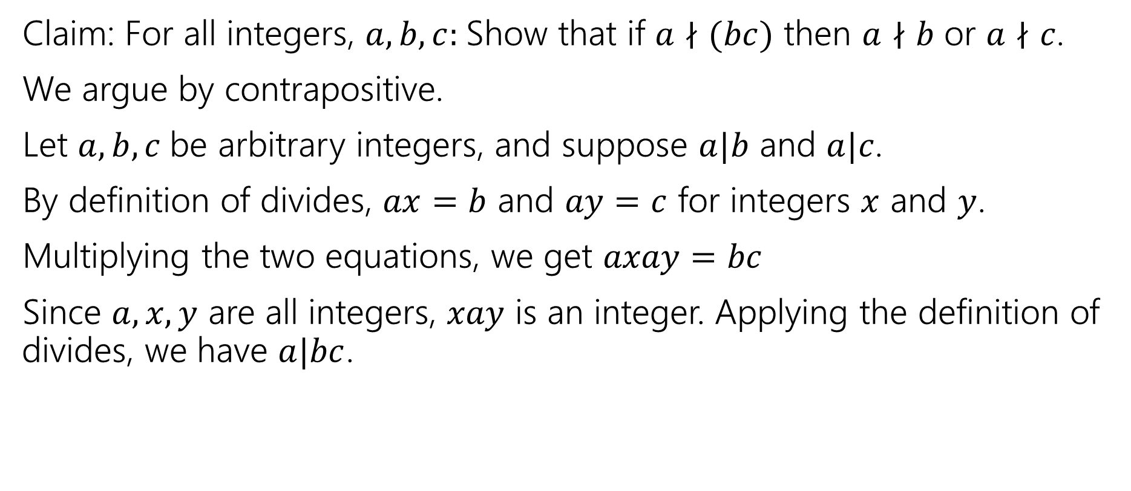
By contrapositive (complete)
Claim: For all integers, $a,b,c:$Show that if $a∤(bc)$ then $a∤b$ or $a∤c$.
We argue by contrapositive.
Let $a,b,c$be arbitrary integers, and suppose $a|b$ and $a|c$.
By definition of divides, $ax=b$ and $ay=c$ for integers $x$ and $y$.
Multiplying the two equations, we get $axay=bc$
Since $a,x,y$ are all integers, $xay$ is an integer. Applying the definition of divides, we have $a|bc$.

Slide 29
Signs you might want to use proof by contrapositive
1. The hypothesis of the implication you’re proving has a “not” in it (that you think is making things difficult)
2. The target of the implication you’re proving has an “or” or “not” in it.
3. There’s a step that is difficult forward, but easy backwards
  e.g., taking a square-root forward, squaring backwards.
4. You get halfway through the proof and you can’t “get ahold of” what you’re trying to show.
  e.g., you’re working with a “not equal” instead of an “equals” or “every thing doesn’t have this property” instead of “some thing does have that property”
  All of these are reasons you might want contrapositive. Sometimes you just have to try and see what happens!

Slide 30
GCD and LCM

Slide 31
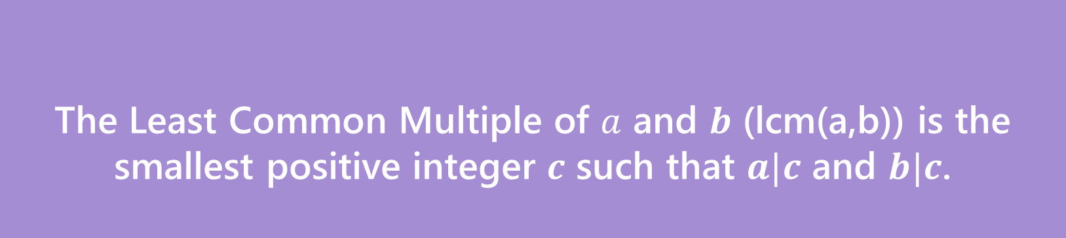
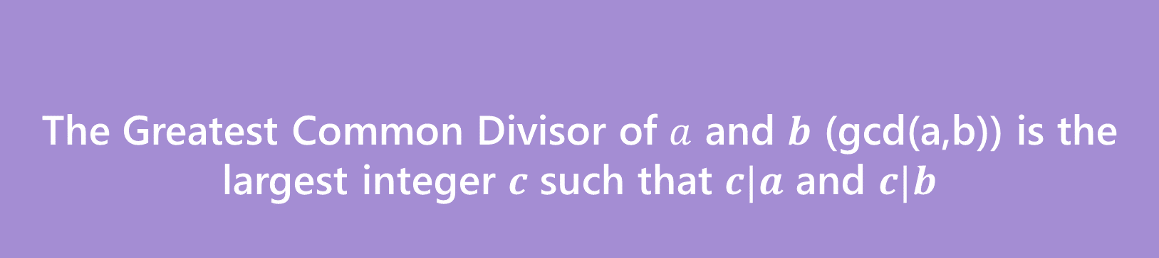
GCD and LCM definitions
The Greatest Common Divisor of $a$ and $b$ (gcd(a,b)) is the largest integer $c$ such that $c|a$ and $c|b$
Greatest Common Divisor
The Least Common Multiple of $a$ and $b$ (lcm(a,b)) is the smallest positive integer $c$ such that $a|c$ and $b|c$.
Least Common Multiple

Slide 32
Try a few values…
gcd(100,125)
gcd(17,49)
gcd(17,34)
gcd(13,0)
lcm(7,11)
lcm(6,10)

Slide 33
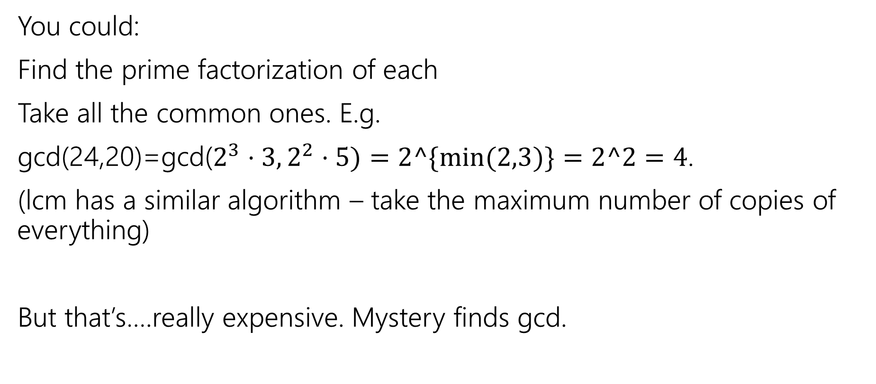
How do you calculate a gcd?
You could:
Find the prime factorization of each
Take all the common ones. E.g.
gcd(24,20)=gcd($2^{3}⋅3, 2^{2}⋅5)=2^\{min⁡(2,3)\}=2^2=4$.
(lcm has a similar algorithm – take the maximum number of copies of everything)
But that’s….really expensive. Mystery finds gcd.

Slide 34
gcd calculation code
public int Mystery(int m, int n){
if(m<n){
int temp = m;
m=n;
n=temp;
}
while(n != 0) {
int rem = m % n;
m=n;
n=rem;
}
return m;
}

