Slide 1
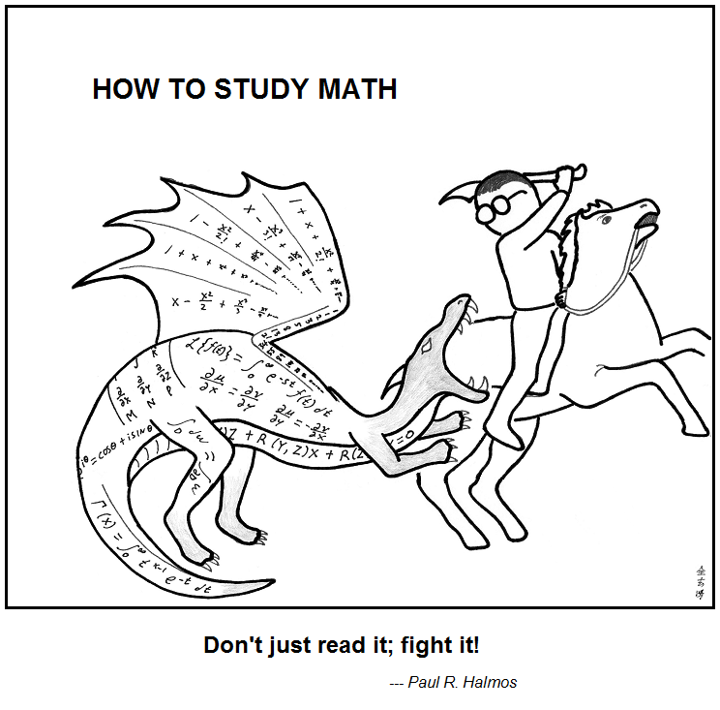

Number Theory
https://abstrusegoose.com/353
CSE 311 Autumn 2025
Lecture 10

Slide 2
Extra Example
Inference Proof with Even/Odd definitions

Slide 3
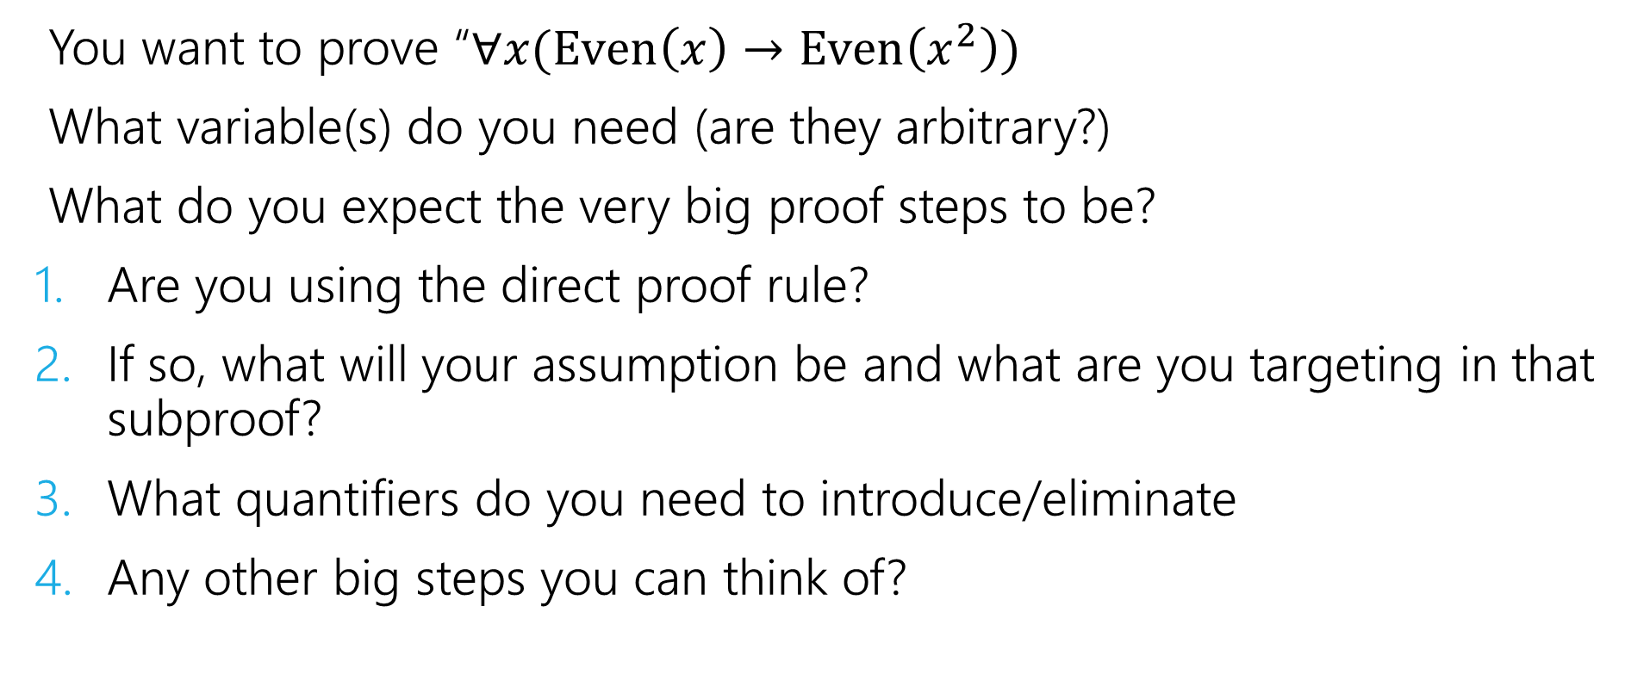
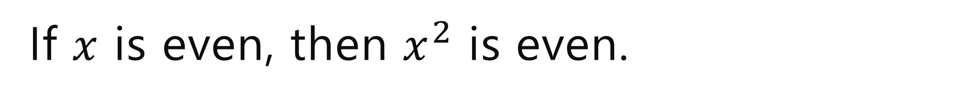
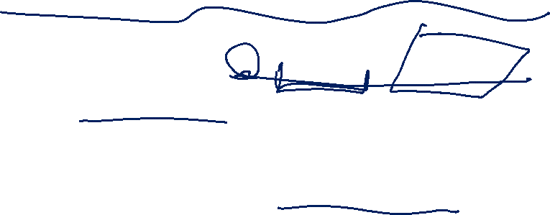
If $x$ is even, then $x^{2}$ is even.
You want to prove “$∀x(Even\left(x\right)→Even\left(x^{2}\right))$
What variable(s) do you need (are they arbitrary?)
What do you expect the very big proof steps to be?
Are you using the direct proof rule?
If so, what will your assumption be and what are you targeting in that subproof?
What quantifiers do you need to introduce/eliminate
Any other big steps you can think of?

Slide 4
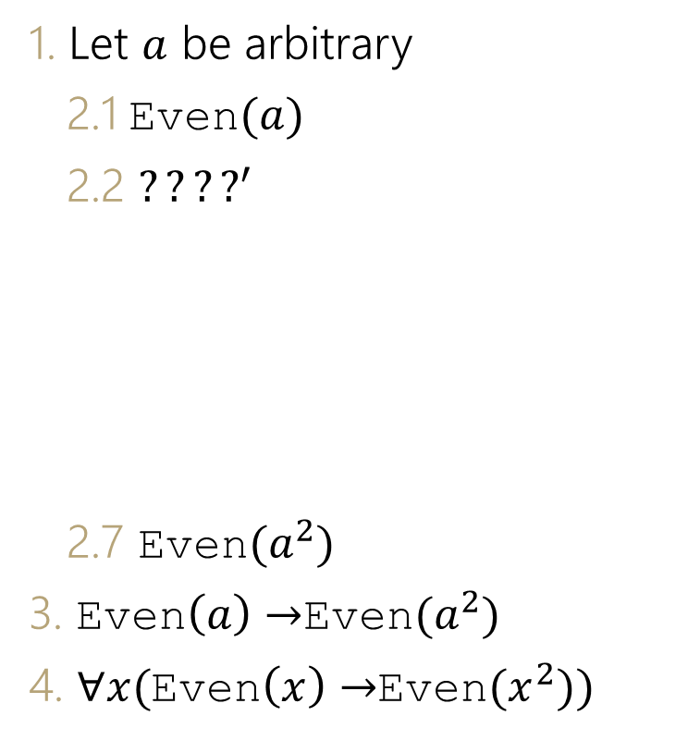
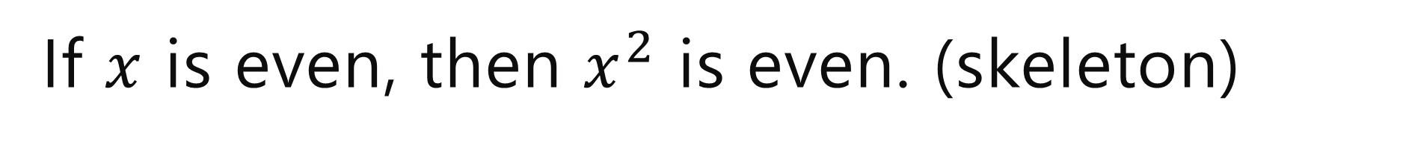


If $x$ is even, then $x^{2}$ is even. (skeleton)
1. Let $a$ be arbitrary
2.1 Even$(a)$
2.2 $????^{′}$
2.7 Even$(a^{2})$
3. Even$\left(a\right)→$Even$(a^{2})$
4. $∀x($Even$\left(x\right)→$Even$(x^{2}))$
Assumption
?
?
?
?
?
Definition of Even
Direct Proof Rule (2.1-2.7)
Intro $∀$(3)

Slide 5
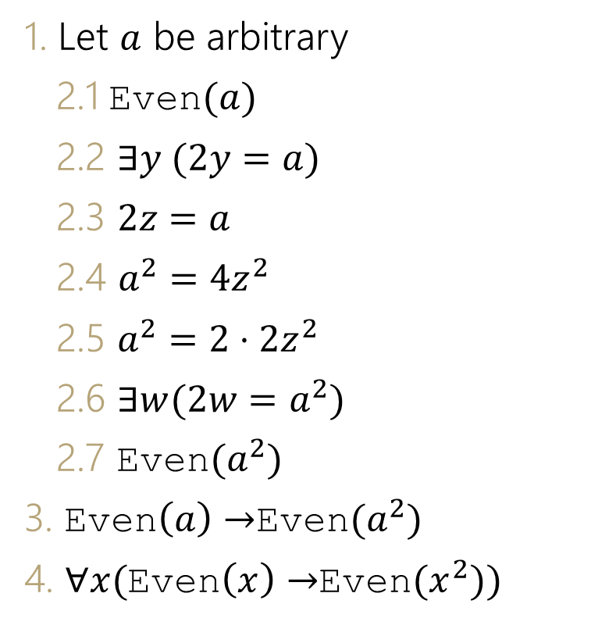
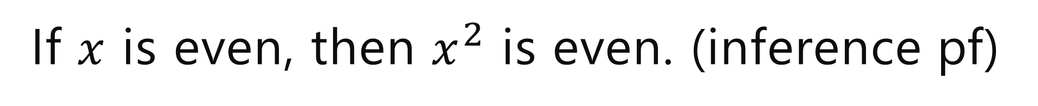
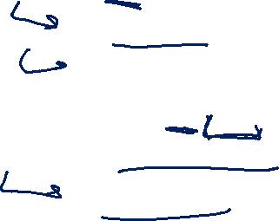

If $x$ is even, then $x^{2}$ is even. (inference pf)
1. Let $a$ be arbitrary
2.1 Even$(a)$
2.2 $∃y (2y=a)$
2.3 $2z=a$
2.4 $a^{2}=4z^{2}$
2.5 $a^{2}=2⋅2z^{2}$
2.6 $∃w(2w=a^{2})$
2.7 Even$(a^{2})$
3. Even$\left(a\right)→$Even$(a^{2})$
4. $∀x($Even$\left(x\right)→$Even$(x^{2}))$
Assumption
Definition of Even (2.1)
Elim $∃\left(2.2\right)$
Algebra (2.3)
Algebra (2.4)
Intro $∃$ (2.5)
Definition of Even
Direct Proof Rule (2.1-2.7)
Intro $∀$(3)

Slide 6
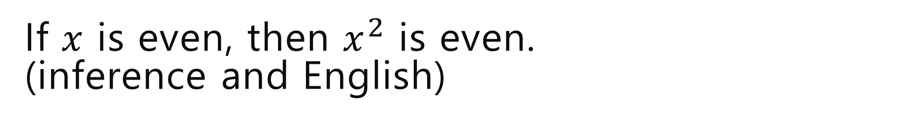
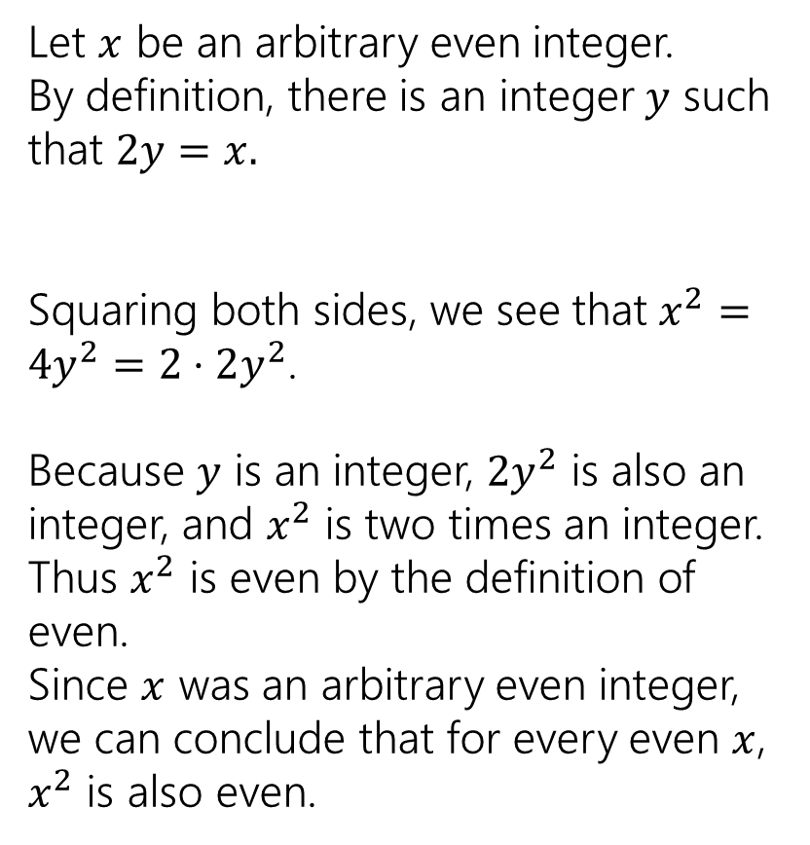
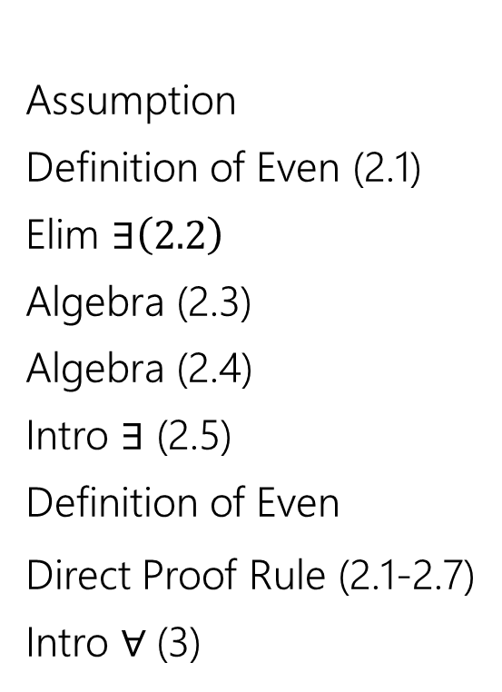
If $x$ is even, then $x^{2}$ is even. (inference and English)
1. Let $a$ be arbitrary
2.1 Even$(a)$
2.2 $∃y (2y=a)$
2.3 $2z=a$
2.4 $a^{2}=4z^{2}$
2.5 $a^{2}=2⋅2z^{2}$
2.6 $∃w(2w=a^{2})$
2.7 Even$(a^{2})$
3. Even$\left(a\right)→$Even$(a^{2})$
4. $∀x($Even$\left(x\right)→$Even$(x^{2}))$
Assumption
Definition of Even (2.1)
Elim $∃\left(2.2\right)$
Algebra (2.3)
Algebra (2.4)
Intro $∃$ (2.5)
Definition of Even
Direct Proof Rule (2.1-2.7)
Intro $∀$(3)
Let $x$ be an arbitrary even integer.
By definition, there is an integer $y$ such that $2y=x.$
Squaring both sides, we see that $x^{2}=4y^{2}=2⋅2y^{2}$.
Because $y$ is an integer, $2y^{2}$ is also an integer, and $x^{2}$ is two times an integer.
Thus $x^{2}$ is even by the definition of even.
Since $x$ was an arbitrary even integer, we can conclude that for every even $x$, $x^{2}$ is also even.

Slide 7
Why Number Theory?

Slide 8
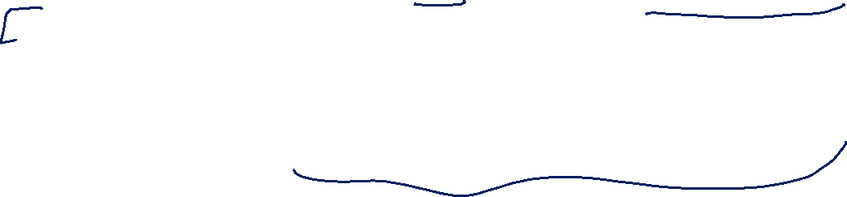
Why Number Theory?
Applicable in Computer Science
“hash functions” (you’ll see them in 332) commonly use modular arithmetic
Much of classical cryptography is based on prime numbers.
More importantly, a great playground for writing English proofs.

Slide 9
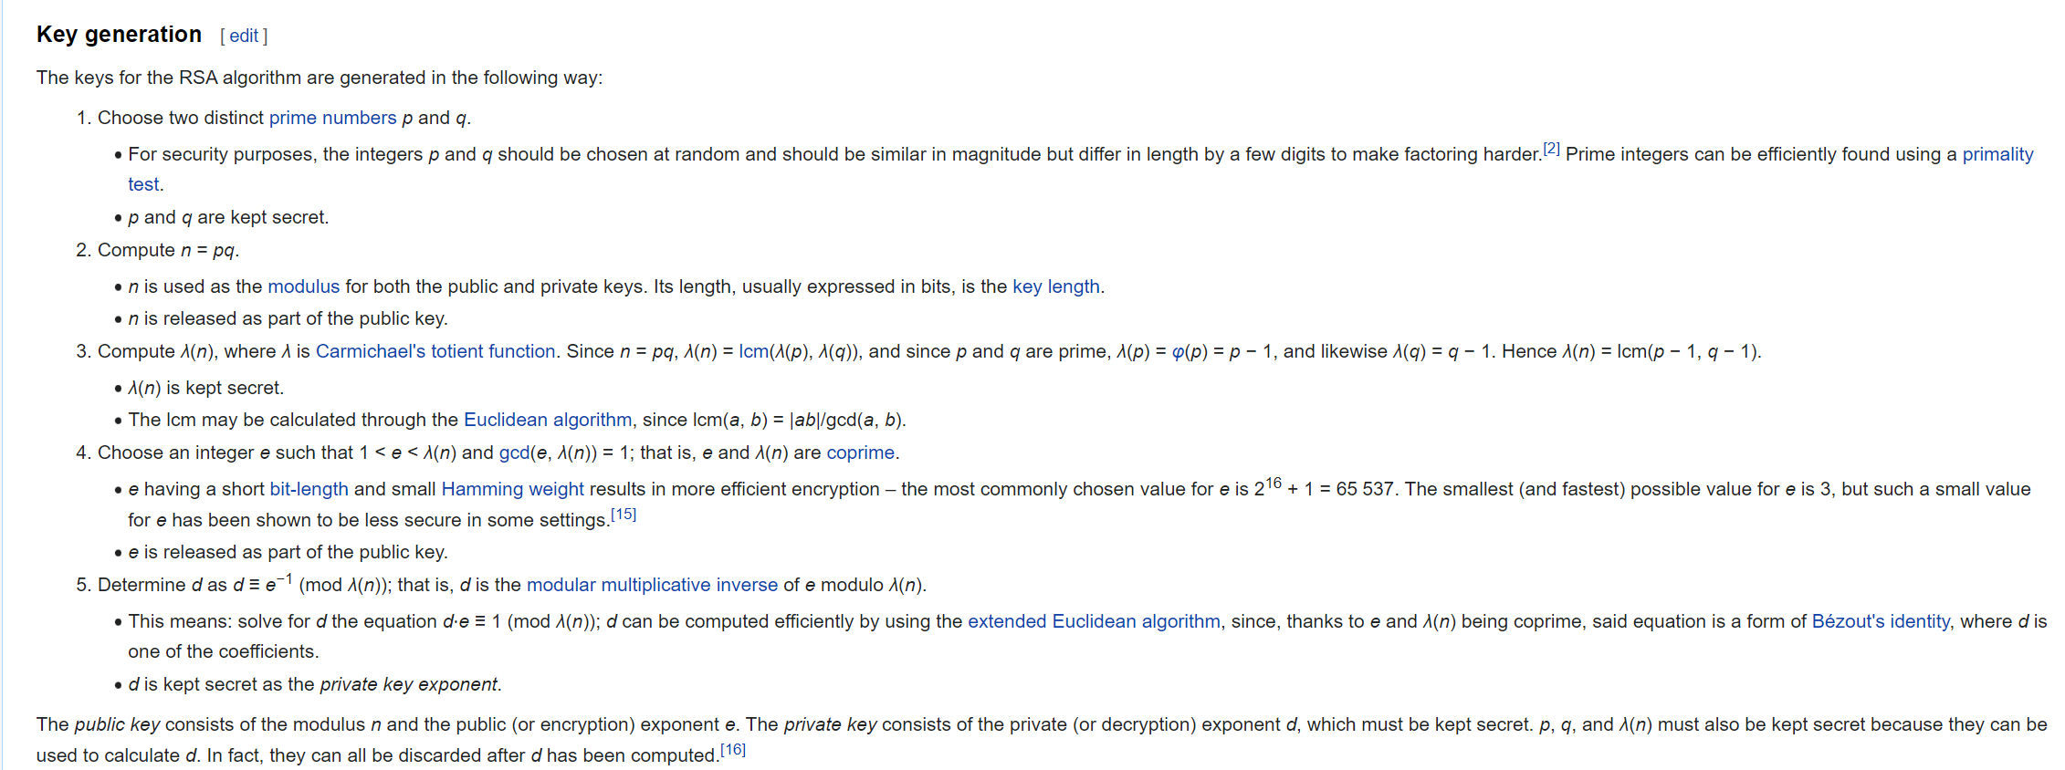
Framing Device
We’re going to give you enough background to (mostly) understand the RSA encryption system.

Slide 10

Framing Device
We’re going to give you enough background to (mostly) understand the RSA encryption system.
Prime Numbers
Modular Arithmetic
Modular Multiplicative Inverse
Bezout’s Theorem
Extended Euclidian Algorithm

Slide 11
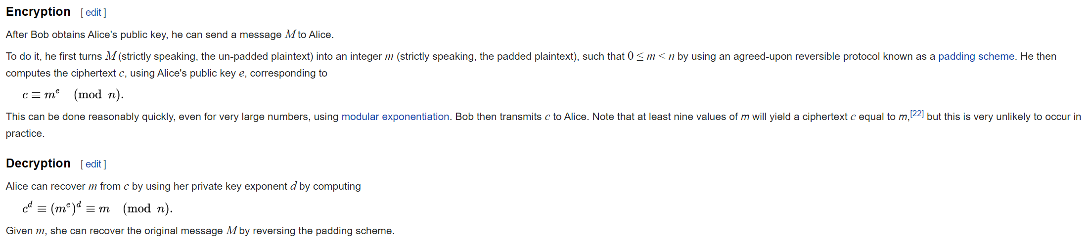
Framing Device
We’re going to give you enough background to (mostly) understand the RSA encryption system.

Slide 12
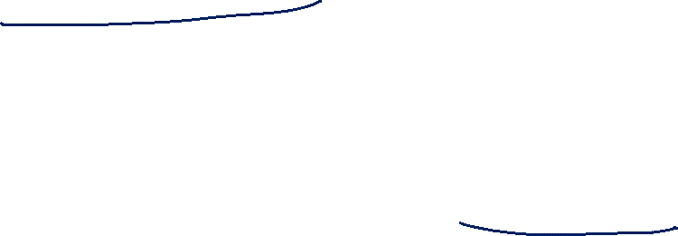
Framing Device
We’re going to give you enough background to (mostly) understand the RSA encryption system.
Modular Exponentiation

Slide 13
Number Theory Definitions

Slide 14
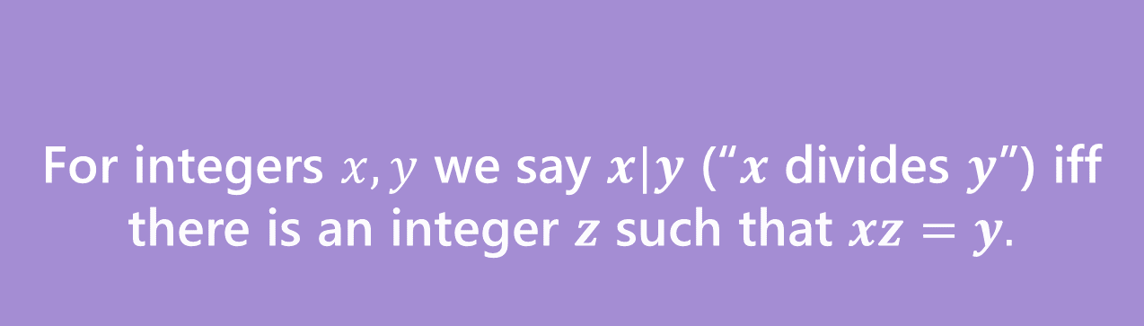
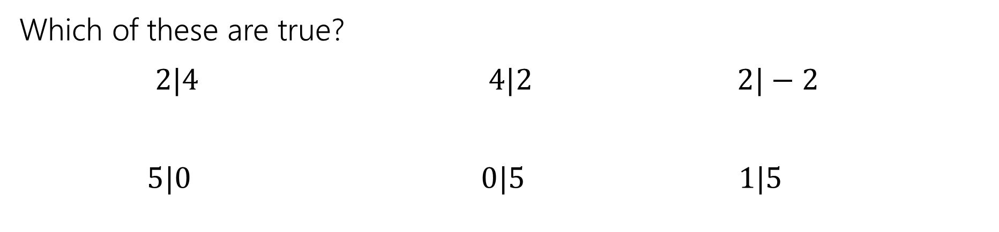
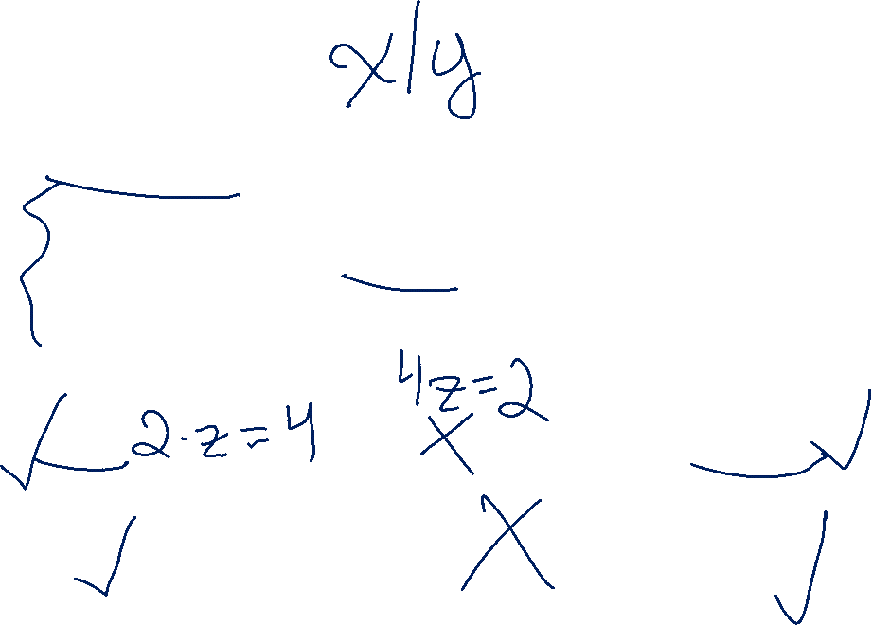
Divides
For integers $x,y$ we say $x|y$ (“$x$ divides $y$”) iff there is an integer $z$ such that $xz=y.$
Divides
Which of these are true?
$2|4$ $4|2$ $2|−2$
$5|0$ $0|5$ $1|5$

Slide 15


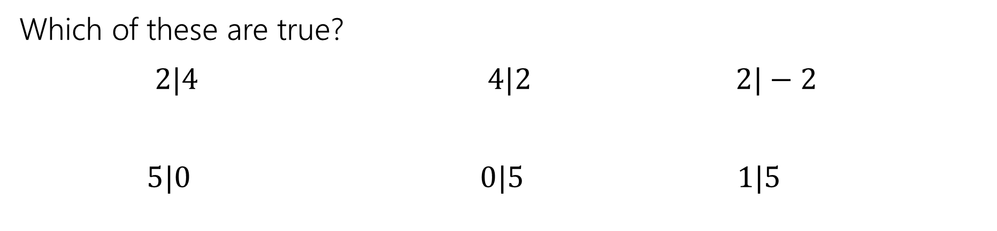




Divides
For integers $x,y$ we say $x|y$ (“$x$ divides $y$”) iff there is an integer $z$ such that $xz=y.$
Divides
Which of these are true?
$2|4$ $4|2$ $2|−2$
$5|0$ $0|5$ $1|5$
$$True$$
$$False$$
$$True$$
$$True$$
$$False$$
$$True$$

Slide 16

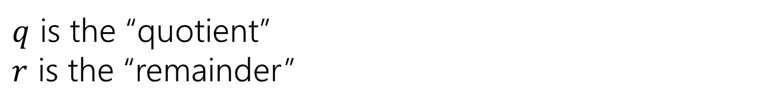
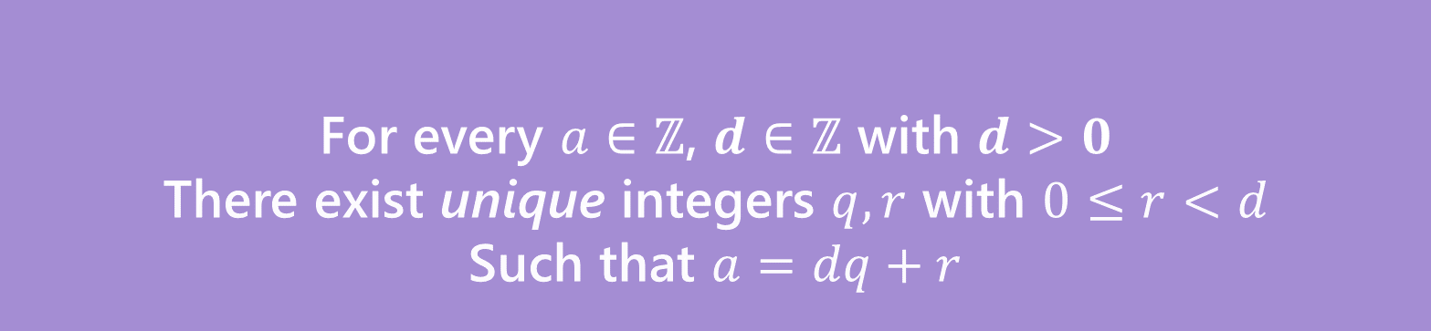






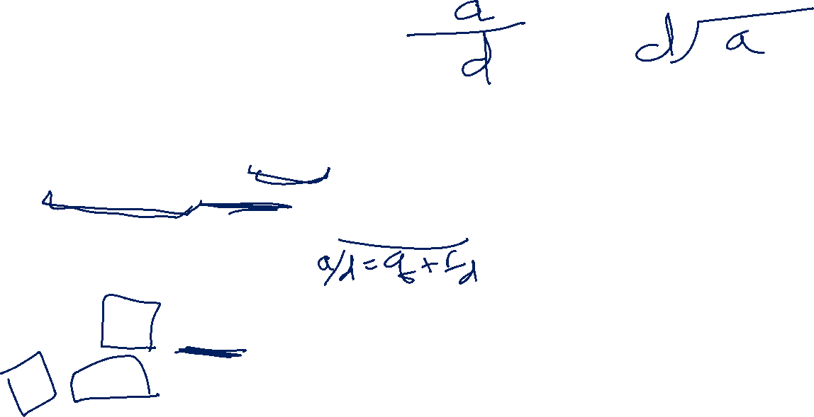
A useful theorem
For every $a∈ℤ$, $d∈ℤ$ with $d>0$
There exist unique integers $q,r$ with $0≤r<d$
Such that $a=dq+r$
The Division Theorem
Remember when non integers were still secret, you did division like this?
$q$ is the “quotient”
$r$ is the “remainder”

Slide 17
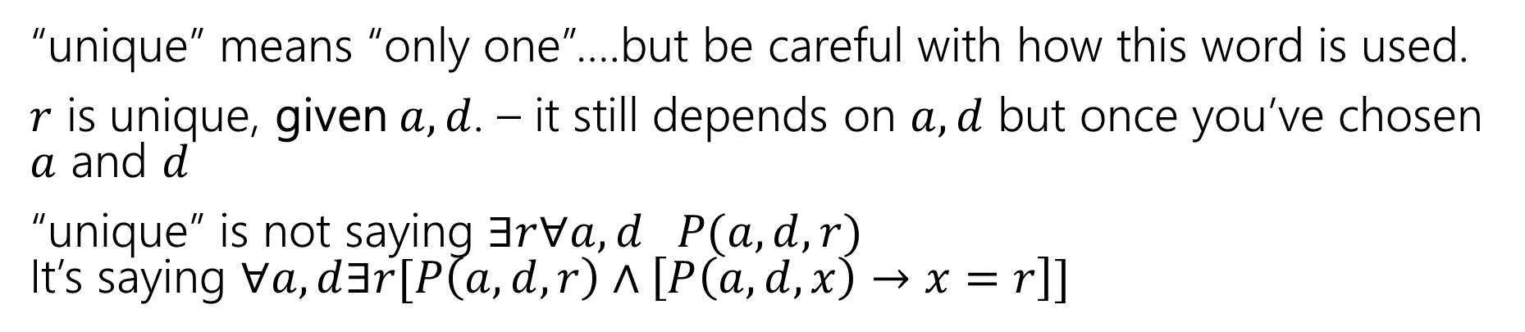

Unique
For every $a∈ℤ$, $d∈ℤ$ with $d>0$
There exist unique integers $q,r$ with $0≤r<d$
Such that $a=dq+r$
The Division Theorem
“unique” means “only one”….but be careful with how this word is used.
$r$ is unique, given $a,d$. – it still depends on $a,d$ but once you’ve chosen $a$ and $d$
“unique” is not saying $∃r∀a,d P(a,d,r)$ It’s saying $∀a,d∃r[P\left(a,d,r\right)∧\left[P\left(a,d,x\right)→x=r\right]]$

Slide 18
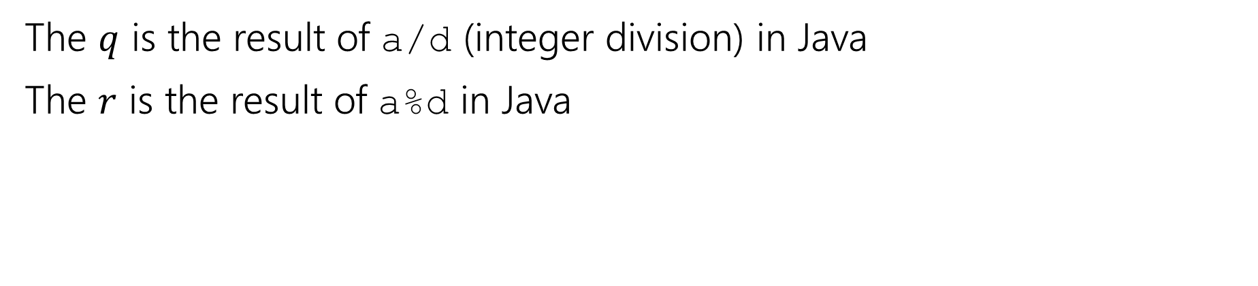

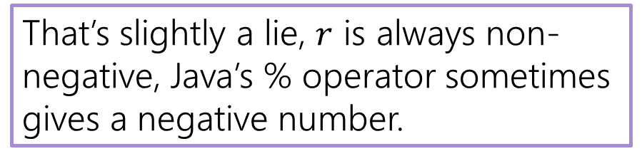
A useful theorem
For every $a∈ℤ$, $d∈ℤ$ with $d>0$
There exist unique integers $q,r$ with $0≤r<d$
Such that $a=dq+r$
The Division Theorem
The $q$ is the result of a/d (integer division) in Java
The $r$ is the result of a%d in Java
That’s slightly a lie, $r$ is always non-negative, Java’s % operator sometimes gives a negative number.

Slide 19
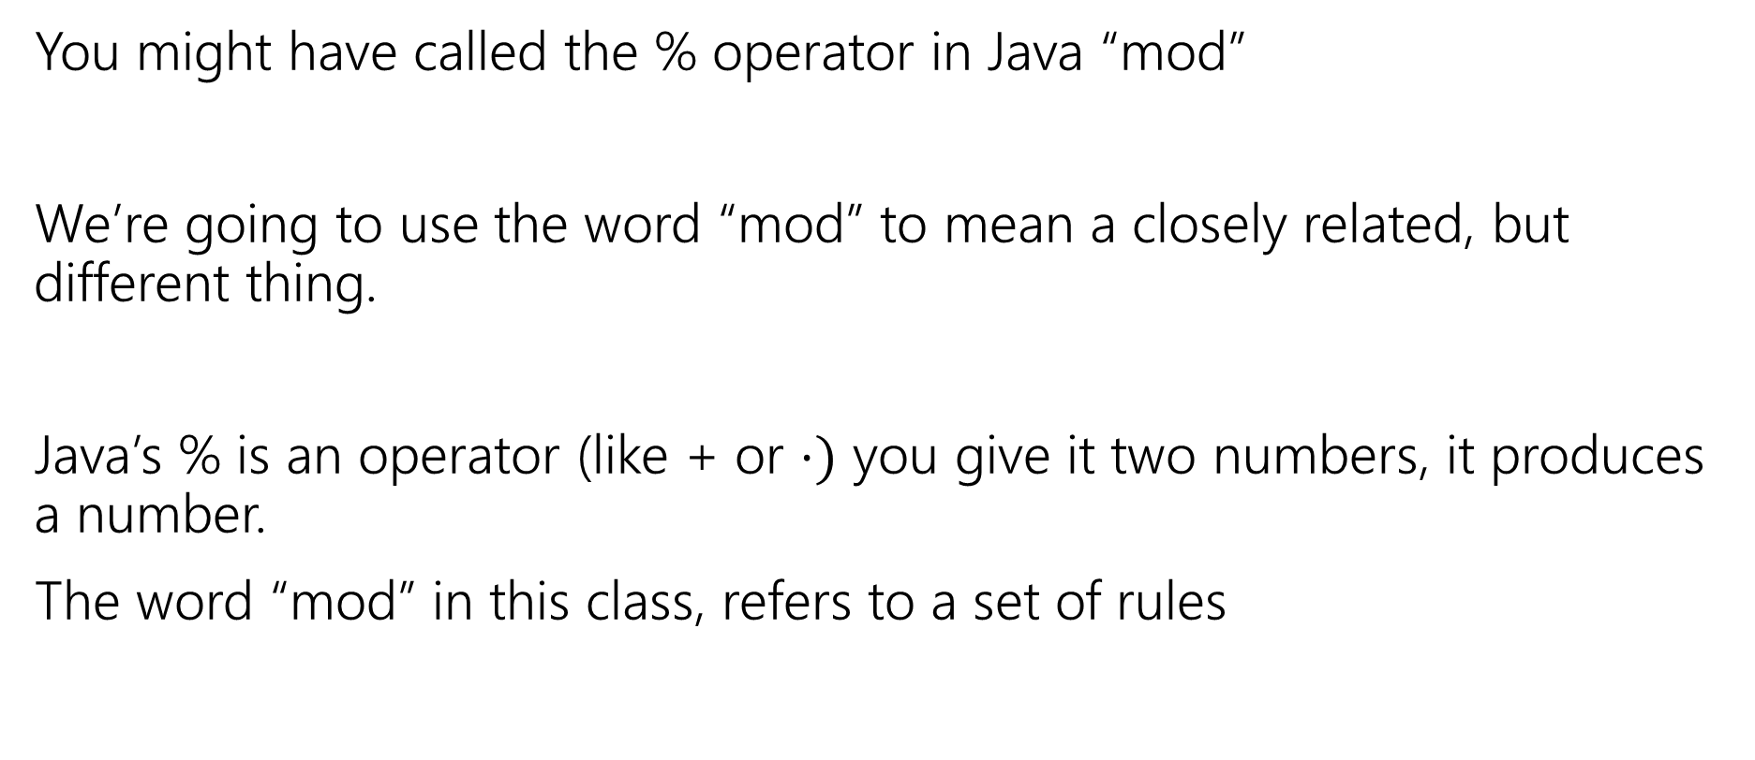
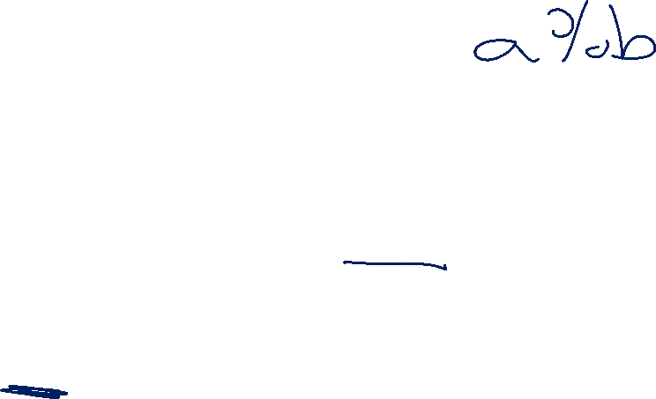
Terminology
You might have called the % operator in Java “mod”
We’re going to use the word “mod” to mean a closely related, but different thing.
Java’s % is an operator (like + or $⋅)$ you give it two numbers, it produces a number.
The word “mod” in this class, refers to a set of rules

Slide 20

Modular Arithmetic
“arithmetic mod 12” is familiar to you. You do it with clocks.
What’s 3 hours after 10 o’clock?
1 o’clock. You hit 12 and then “wrapped around”
“13 and 1 are the same, mod 12” “-11 and 1 are the same, mod 12”
We don’t just want to do math for clocks – what about if we need to talk about parity (even vs. odd) or ignore higher-order-bits (mod by 16, for example)

Slide 21
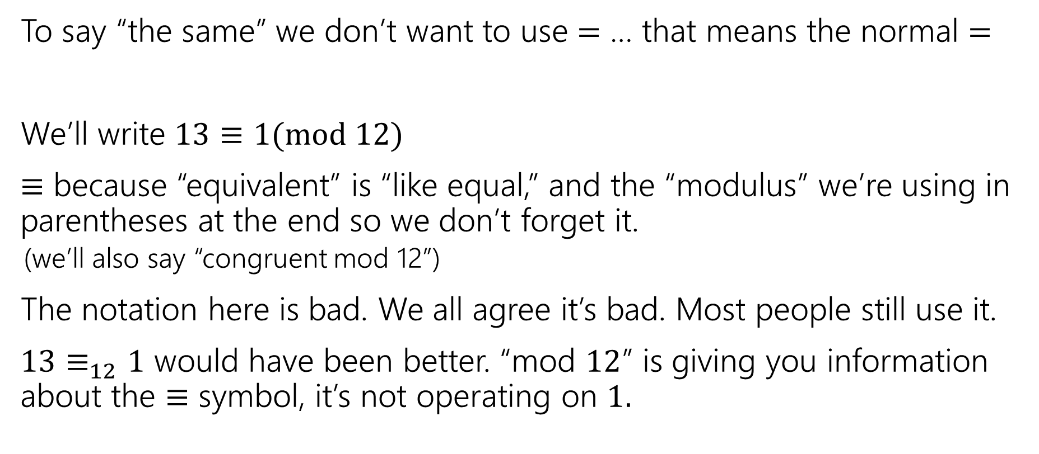
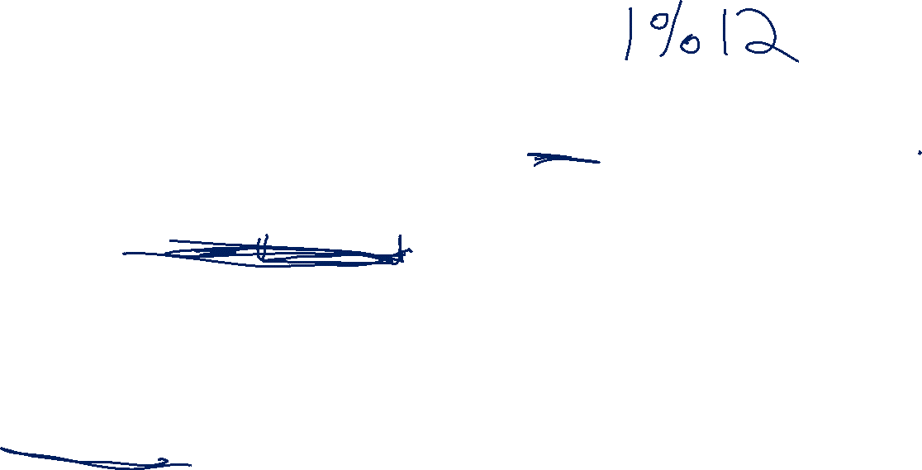
Modular Arithmetic
To say “the same” we don’t want to use $=$ … that means the normal $=$
We’ll write $13≡1(mod 12)$
$≡$ because “equivalent” is “like equal,” and the “modulus” we’re using in parentheses at the end so we don’t forget it.
(we’ll also say “congruent mod 12”)
The notation here is bad. We all agree it’s bad. Most people still use it.
$13≡_{12}1$ would have been better. “mod $12$” is giving you information about the $≡$ symbol, it’s not operating on $1.$

Slide 22
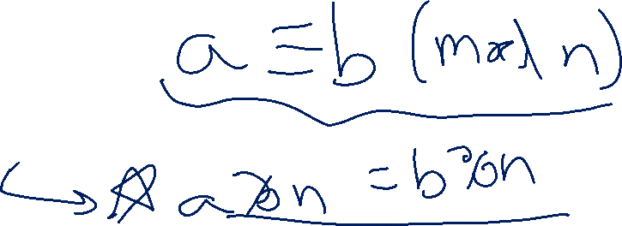
Modular Arithmetic
We need a definition! We can’t just say “it’s like a clock”
Pause what do you expect the definition to be?
Is it related to % ?

Slide 23
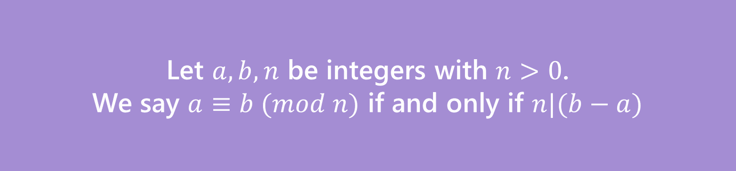
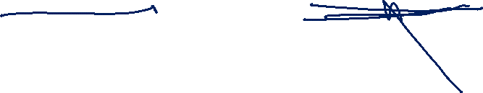
Modular Arithmetic
We need a definition! We can’t just say “it’s like a clock”
Pause what do you expect the definition to be?
Let $a,b,n$ be integers with $n>0$.
We say $a≡b (mod n)$ if and only if $n|(b−a)$
Equivalence in modular arithmetic
Huh?

Slide 24
Long Pause
It’s easy to read something with a bunch of symbols and say “yep, those are symbols.” and keep going
STOP Go Back.
You have to fight the symbols they’re probably trying to pull a fast one on you.
Same goes for when I’m presenting a proof – you shouldn’t just believe me – I’m wrong all the time!
You should be trying to do the proof with me. Where do you think we’re going next?

Slide 25

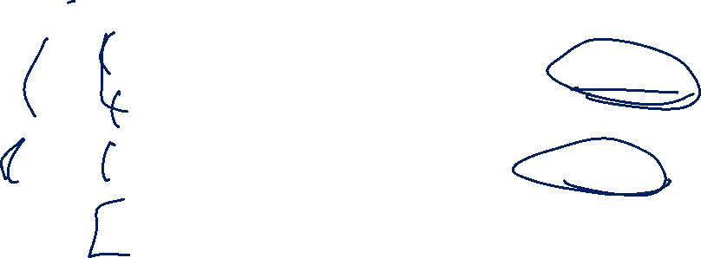



Why?
Here’s the short version:
It really is equivalent to ”what we expected” a%n=b%n if and only if $n|(b−a)$
The divides version is much easier to use in proofs…
$$27$$
When you subtract, the remainders cancel. What you’re left with is a multiple of 12.
$$15$$
$$27−15=12$$

Slide 26
Proof Practice
Over the next few weeks:
Practice direct proofs in English (formatting details, doing more examples)
See a few other proof techniques
Proof by contrapositive, proving an exists statement, proof by contradiction
All while learning some number theory.

Slide 27
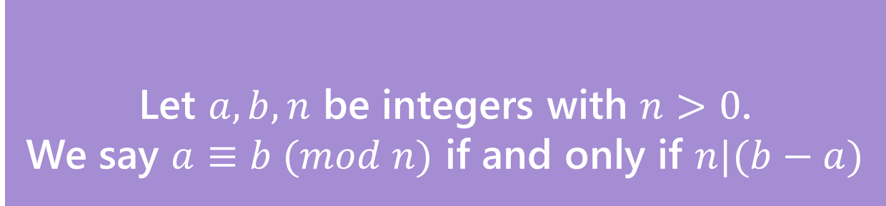

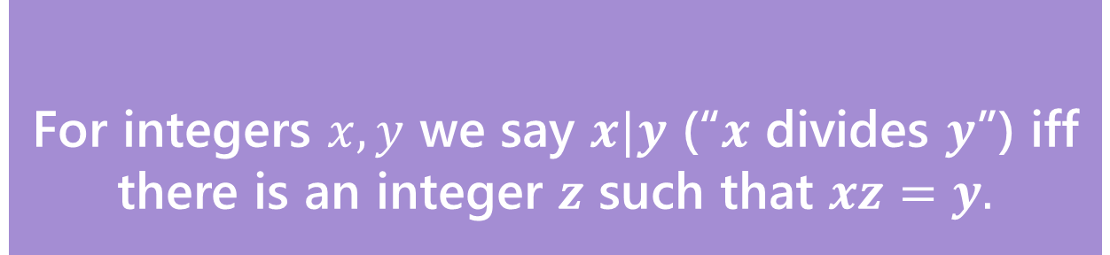
Claim: for all integers $a,b,c,n,with n>0:$ $a≡b \left(mod n\right)→a+c≡b+c (mod n)$
Before we start, we must know:
1. What every word in the statement means.
2. What the statement as a whole means.
3. Where to start.
4. What your target is.
For integers $x,y$ we say $x|y$ (“$x$ divides $y$”) iff there is an integer $z$ such that $xz=y.$
Divides
Let $a,b,n$ be integers with $n>0$.
We say $a≡b (mod n)$ if and only if $n|(b−a)$
Equivalence in modular arithmetic

Slide 28

Claim: for all integers $a,b,c,n,with n>0:$ $a≡b \left(mod n\right)→a+c≡b+c (mod n)$
Proof:
Let $a,b,c,n$ be arbitrary integers with $n>0$, and suppose $a≡b(mod n)$.
$a+c≡b+c (mod n)$
For integers $x,y$ we say $x|y$ (“$x$ divides $y$”) iff there is an integer $z$ such that $xz=y.$
Divides
Let $a,b,n$ be integers with $n>0$.
We say $a≡b (mod n)$ if and only if $n|(b−a)$
Equivalence in modular arithmetic

Slide 29
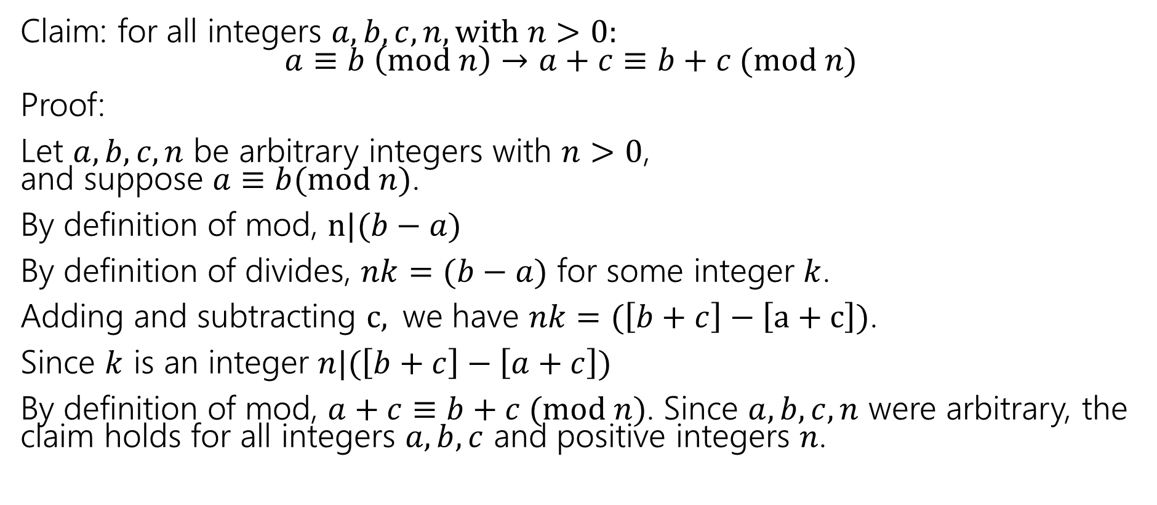
A proof
Claim: for all integers $a,b,c,n,with n>0:$ $a≡b \left(mod n\right)→a+c≡b+c (mod n)$
Proof:
Let $a,b,c,n$ be arbitrary integers with $n>0$, and suppose $a≡b(mod n)$.
By definition of mod, $n|(b−a)$
By definition of divides, $nk=(b−a)$ for some integer $k$.
Adding and subtracting $c,$we have $nk=(\left[b+c\right]−\left[a+c\right])$.
Since $k$ is an integer $n|(\left[b+c\right]−\left[a+c\right])$
By definition of mod, $a+c≡b+c (mod n)$. Since $a,b,c,n$ were arbitrary, the claim holds for all integers $a,b,c$ and positive integers $n$.

Slide 30
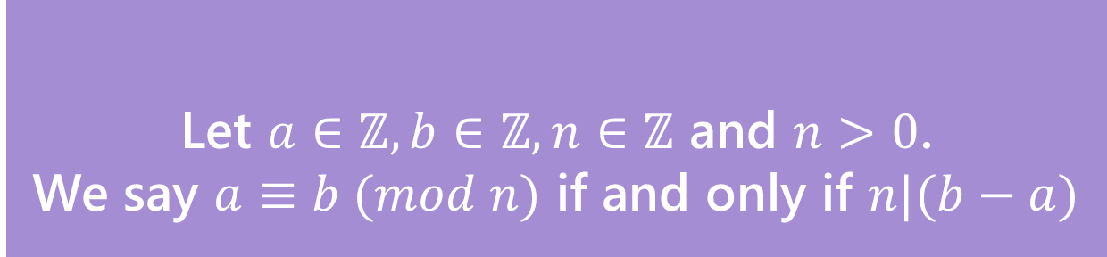


You Try!
Claim: for all integers $a,b,c,n with n>0:$ If $a≡b (mod n)$ then $ac≡bc (mod n)$
Before we start we must know:
1. What every word in the statement means.
2. What the statement as a whole means.
3. Where to start.
4. What your target is.
For integers $x,y$ we say $x|y$ (“$x$ divides $y$”) iff there is an integer $z$ such that $xz=y.$
Divides
Let $a∈ℤ, b∈ℤ, n∈ℤ$ and $n>0$.
We say $a≡b (mod n)$ if and only if $n|(b−a)$
Equivalence in modular arithmetic

Slide 31

You try---skeleton
Claim: for all integers $a,b,c,n,with n>0:$ $a≡b \left(mod n\right)→a+c≡b+c (mod n)$
Proof:
Let $a,b,c,n$ be arbitrary integers with $n>0$ and suppose $a≡b(mod n)$.
$ac≡bc (mod n)$

Slide 32
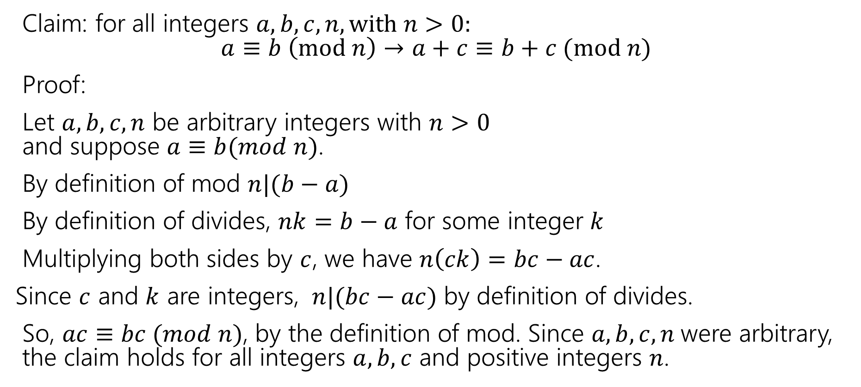
You try---the full proof
Claim: for all integers $a,b,c,n,with n>0:$ $a≡b \left(mod n\right)→a+c≡b+c (mod n)$
Proof:
Let $a,b,c,n$ be arbitrary integers with $n>0$ and suppose $a≡b(mod n)$.
By definition of mod $n|(b−a)$
By definition of divides, $nk=b−a$ for some integer $k$
Multiplying both sides by $c$, we have $n\left(ck\right)=bc−ac$.
Since $c$ and $k$ are integers, $n|(bc−ac)$ by definition of divides.
So, $ac≡bc (mod n)$, by the definition of mod. Since $a,b,c,n$were arbitrary, the claim holds for all integers $a,b,c$ and positive integers $n$.

Slide 33

Don’t lose your intuition!
Let’s check that we understand “intuitively” what mod means:
$x≡0 (mod 2)$
$−1≡19 (mod 5)$
$y≡2 (mod 7)$
“$x$is even” Note that negative (even) $x$ values also make this true.
This is true! They both have remainder $4$ when divided by $5$.
This is true as long as $y=2+7k$ for some integer $k$

Slide 34
Small Techniques

Slide 35
Proof By [Counter]Example
To prove an existential statement (or disprove a universal statement), provide an example, and demonstrate that it is the needed example.
You don’t have to explain where it came from! (In fact, you shouldn’t)
Computer scientists and mathematicians like to keep an air of mystery around our proofs.
(or more charitably, we want to focus on just enough to believe the claim)

Slide 36
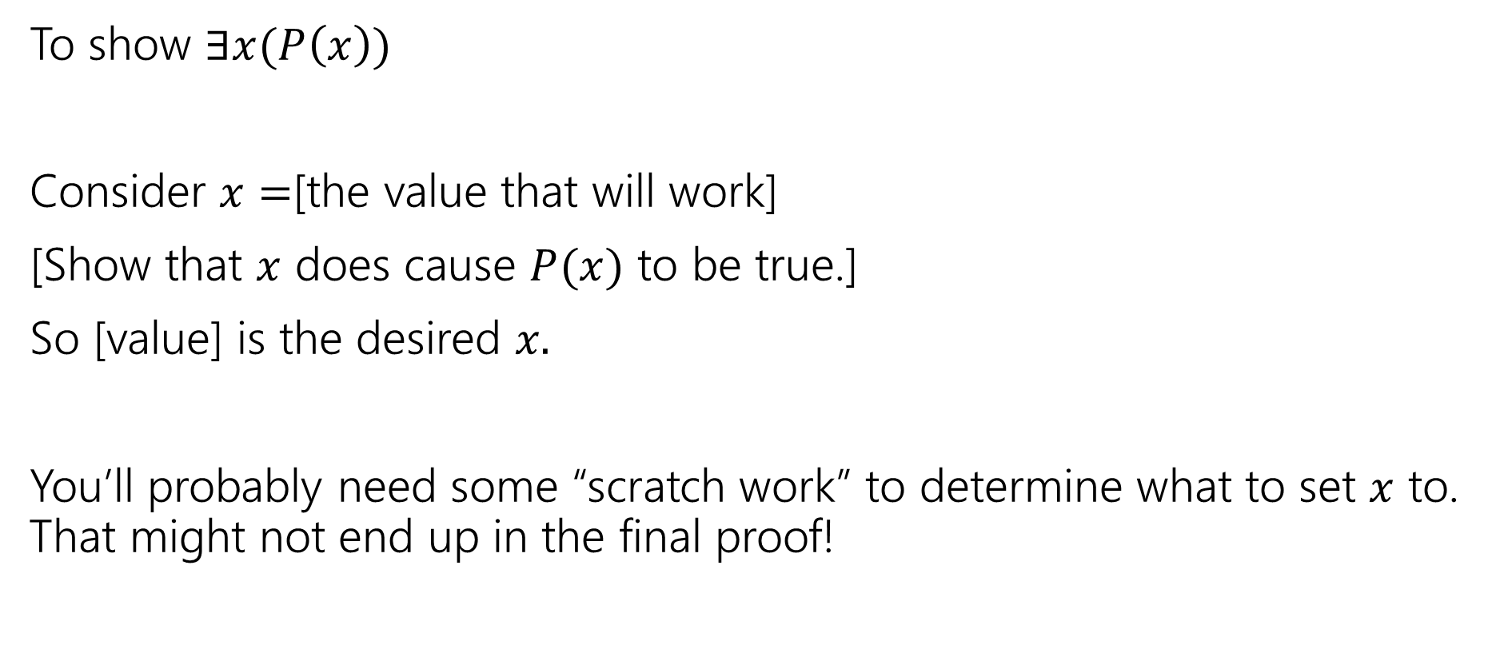
Skeleton of an Exists Proof
To show $∃x(P\left(x\right))$
Consider $x=$[the value that will work]
[Show that $x$ does cause $P(x)$ to be true.]
So [value] is the desired $x.$
You’ll probably need some “scratch work” to determine what to set $x$ to. That might not end up in the final proof!

Slide 37
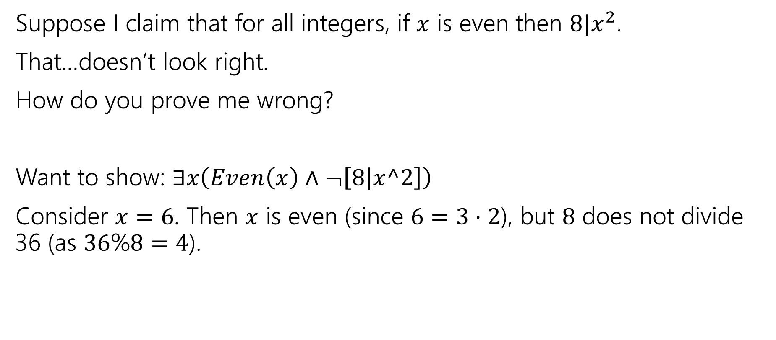
Exists proofs
Suppose I claim that for all integers, if $x$ is even then $8|x^{2}$.
That…doesn’t look right.
How do you prove me wrong?
Want to show: $∃x\left(Even\left(x\right)∧¬\left[8 | x^2\right]\right)$
Consider $x=6$. Then $x$ is even (since $6=3⋅2$), but $8$ does not divide 36 (as $36$%$8=4$).

Slide 38

Proof By Cases
If $x$ is prime then $x^{2}$ is odd or $2|x$.
We need two different arguments – one for 2 and one for all the other primes…

Slide 39

Proof By Cases
Let $x$ be an arbitrary prime number
We divide into two cases.
Case 1: $x$ is even
If $x$ is even then $x=2k$ for some integer $k$, this is the definitions of $2|x$.
Case 2: $x$ is odd
If $x$ is odd, then $x=2j+1$ for some integer $j.$ Squaring, we get $x^{2}=4j^{2}+4j+1=2\left(2j^{2}+2j\right)+1.$ Since $j$ is an integer $2j^{2}+2j$ is as well, so $x^{2}$ is odd by definition.
In either case, $x$ met the condition of $2|x$ or $x^{2}$ is odd, so the claim is true.

Slide 40
Proof By Cases
Make it clear how you decide which case your in.
It should be obvious your cases are “exhaustive”
Reach the same conclusion in each of the cases, and you can say you’ve got that conclusion no matter what (outside the cases).
Advanced version: sometimes you end up arguing a certain case “can’t happen”

Slide 41

(Optional) equivalence of % and $≡(mod n)$
The full proof

Slide 42

% and Mod
Other resources use $mod$ to mean an operation (takes in an integer, outputs an integer). We will not in this course. $mod$ only describes $≡$. It’s not “just on the right hand side”
Define $a\%b$ to be “the $r$ you get from the division theorem” i.e. the integer $r$ such that $0≤r<d$ and $a=bq+r$ for some integer $q$.
This is the “mod function”
I claim $a\%n=b\%n$ if and only if $a≡b(mod n)$.
How do we show and if-and-only-if?

Slide 43


$a\%n=b\%n$ if and only if $a≡b(mod n)$
Backward direction:
Suppose $a≡b(mod n)$
$a\%n=\left(b−nk\right)\%n=b\%n$

Slide 44

$a\%n=b\%n$ if and only if $a≡b(mod n)$
Backward direction:
Suppose $a≡b(mod n)$
$n|b−a$ so $nk=b−a$ for some integer $k$. (by definitions of mod and divides).
So $a=b−nk$
Taking each side $\%n$ we get:
$a\%n=\left(b−nk\right)\%n=b\%n$
Where the last equality follows from $k$ being an integer and doing $k$ applications of the identity we proved in the warm-up.

Slide 45



$a\%n=b\%n$ if and only if $a≡b(mod n)$
Show the forward direction:
If $a\%n=b\%n$ then $a≡b(mod n)$.
This proof is a bit different than the other direction.
Remember to work from top and bottom!!
Let $a∈ℤ, b∈ℤ, n∈ℤ$ and $n>0$.
We say $a≡b (mod n)$ if and only if $n|(b−a)$
Equivalence in modular arithmetic
For every $a∈ℤ$, $d∈ℤ$ with $d>0$
There exist unique integers $q,r$ with $0≤r<d$ Such that $a=dq+r$
The Division Theorem

Slide 46

$a\%n=b\%n$ if and only if $a≡b(mod n)$
Forward direction:
Suppose $a\%n=b\%n$.
By definition of $\%, a=kn+(a\%n)$ and $b=jn+\left(b\%n\right)$ for integers $k,j$
Isolating $a\%n$ we have $a\%n=a−kn$. Since $a\%n=b\%n$, we can plug into the second equation to get: $b=jn+(a−kn)$
Rearranging, we have $b−a=\left(j−k\right)n$. Since $k,j$ are integers we have $n|(b−a)$.
By definition of mod we have $a≡b(mod n)$.

Slide 47
Extra Practice

Slide 48

Does Order matter?
Show that if $a≡b(mod n)$ then $b≡a (mod n)$.
Now that we’ve proven this, we aren’t going to care whether you write $n|(b−a)$ or $n|(a−b)$ when you write the definition.
We can’t remember the right order either.

Slide 49

Order doesn’t matter!
Show that if $a≡b(mod n)$ then $b≡a (mod n)$.
Let $a,b$ be arbitrary integers and let $n$ be an arbitrary integer $>0,$ and suppose $a≡b(mod n)$.
By definition of equivalence mod $n$, $n|\left(b−a\right)$. By definition of divides, $nk=b−a$ for some integer $k$. Multiplying by $−1$, we get $n\left(−k\right)=a−b$
Since $k$ was an integer, so is $−k$. Thus $n|(a−b)$, and by definition of mod, $b≡a(mod n)$.

Slide 50
Even more Extra Practice!

Slide 51


Even more practice
Let $a∈ℤ, b∈ℤ, n∈ℤ$ and $n>0$.
We say $a≡b (mod n)$ if and only if $n|(b−a)$
Equivalence in modular arithmetic
Show that $a≡b \left(mod n\right)$ if and only if $b≡a(mod n)$
Show that $a\%n$=($a−n)\%n$ Where $b\%c$ is the unique $r$ such that $b=kc+r$ for some integer $k$.
For every $a∈ℤ$, $d∈ℤ$ with $d>0$
There exist unique integers $q,r$ with $0≤r<d$ Such that $a=dq+r$
The Division Theorem

Slide 52

Even more practice
Show that $a≡b \left(mod n\right)$ if and only if $b≡a(mod n)$
$a≡b\left(mod n\right)↔n|(b−a)↔nk=b−a\left(for k∈ℤ\right)↔$
$n(−k)=a−b(for −k∈ℤ)↔n|\left(a−b\right)↔b≡a(mod n)$
Show that $a\%n$=($a−n)\%n$ Where $b\%c$ is the unique $r$ such that $b=kc+r$ for some integer $k$.
By definition of %, $a=qn+(a\%n)$ for some integer $q$. Subtracting $n$,
$a−n=\left(q−1\right)n+(a\%n)$. Observe that $q−1$ is an integer, and that this is the form of the division theorem for $\left(a−n\right)\%n.$ Since the division theorem guarantees a unique integer, $\left(a−n\right)\%n=(a\%n)$

