Slide 1
Quantified Inference Proofs
CSE 311 Fall 25
Lecture 9

Slide 2
Inference Proofs Overview
A new way of thinking of proofs:
Here’s one way to get an iron-clad guarantee:
1. Write down all the facts we know.
2. Combine the things we know to derive new facts.
3. Continue until what we want to show is a fact.

Slide 3
Inference Rules
$$A∧B$$
Eliminate ∧
$$A⇒B$$
Direct Proof rule
$$∴$$
$$A, B$$
$$A→B$$
$$A∨B, ¬A$$
$$P→Q,P$$
Eliminate $∨$
Modus Ponens
$$∴$$
$$B$$
$$∴$$
$$Q$$
$$A,B$$
Intro ∧
$$∴$$
$$A∧B$$
You can still use all the propositional logic equivalences too!
$$A$$
Intro $∨$
$$∴$$
$$A∨B, B∨A$$

Slide 4


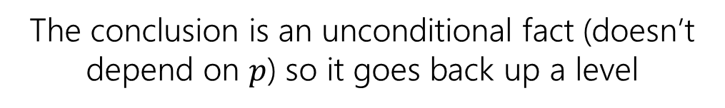
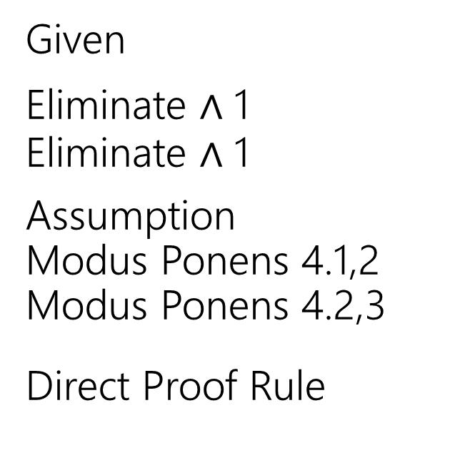
Given: (($p→q)∧(q→r))$ Show: $(p→r)$
Here’s a corrected version of the proof.
$\left(p→q\right)∧\left(q→r\right)$
$p→q$
$q→r$
4.1 $p$
4.2 $q$
4.3 $r$
$p→r$
Given
Eliminate $∧$ 1
Eliminate $∧$ 1
Assumption
Modus Ponens 4.1,2
Modus Ponens 4.2,3
Direct Proof Rule
When introducing an assumption to prove an implication:
Indent, and change numbering.
When reached your conclusion, use the Direct Proof Rule to observe the implication is a fact.
The conclusion is an unconditional fact (doesn’t depend on $p$) so it goes back up a level

Slide 5
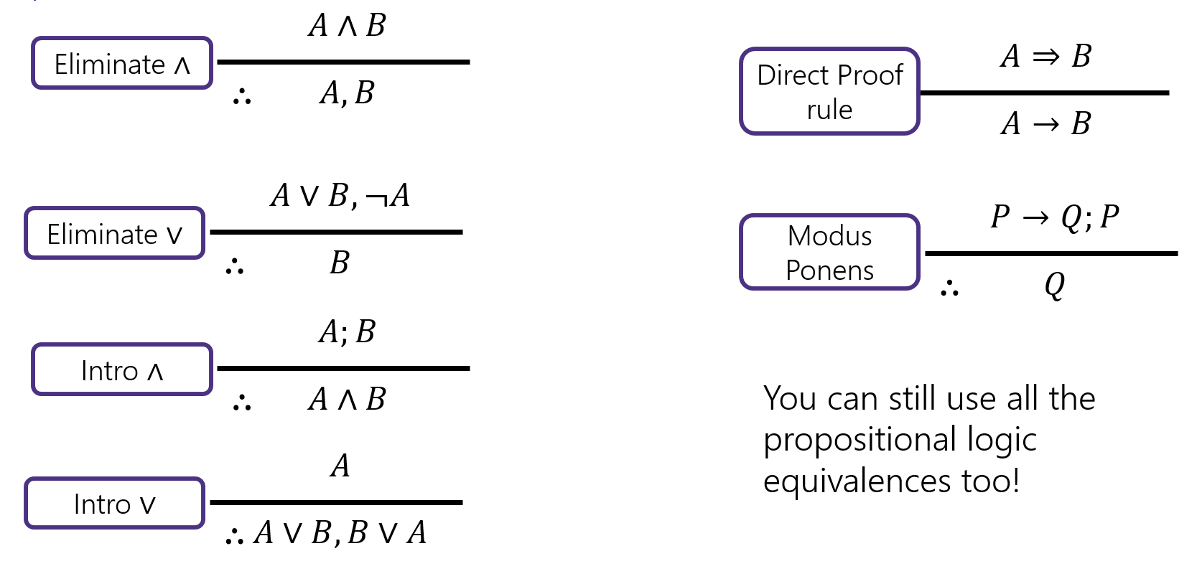

Try it! (setup)
Given: $p∨q$, $\left(r∧s\right)→¬q$, $r$. Show: $s→p$

Slide 6


Try it! (complete)
Given: $p∨q$, $\left(r∧s\right)→¬q$, $r$. Show: $s→p$
$p∨q$
$\left(r∧s\right)→¬q$
$r$
4.1 $s$
4.2 $r∧s$
4.3 $¬q$
4.4 $q∨p$
4.5 $p$
$s→p$
Given
Given
Given
Assumption
Intro $∧$(3,4.1)
Modus Ponens (2, 4.2)
Commutativity (1)
Eliminate $∨$ (4.4, 4.3)
Direct Proof Rule

Slide 7
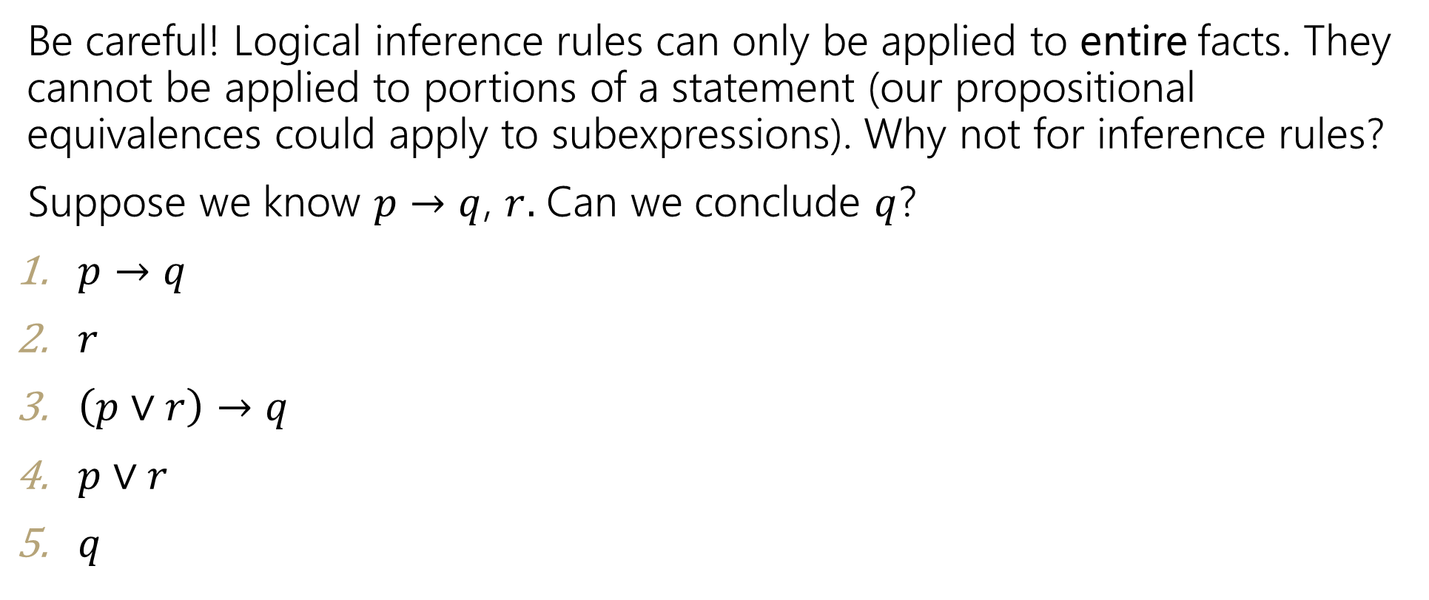
Caution ⚠️
Be careful! Logical inference rules can only be applied to entire facts. They cannot be applied to portions of a statement (our propositional equivalences could apply to subexpressions). Why not for inference rules?
Suppose we know $p→q$, $r.$ Can we conclude $q$?
$p→q$
$r$
$\left(p∨r\right)→q$
$p∨r$
$q$
Given
Given
Introduce $∨$ (1)
Introduce $∨$ (2)
Modus Ponens 3,4.
$$A$$
Intro $∨$
$$∴$$
$$A∨B, B∨A$$

Slide 8
Inference Proofs in Predicate Logic

Slide 9


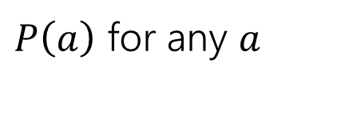





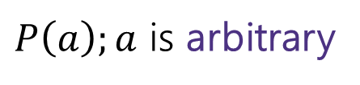


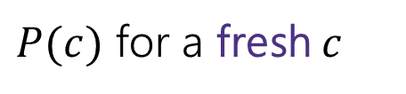
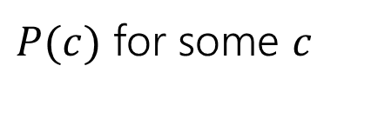



Inference Rules for Proofs with Quantifiers
We’ve done symbolic proofs with propositional logic.
To include predicate logic, we’ll need some rules about how to use quantifiers.
$$∀x P(x)$$
$P(c)$ for some $c$
Eliminate $∀$
Intro $∃$
$$∴$$
$$∴$$
$P\left(a\right)$ for any $a$
$$∃x P(x)$$
$P\left(a\right);a$ is arbitrary
$$∃xP(x)$$
Intro $∀$
Eliminate $∃$
$$∴$$
$$∴$$
$P(c)$ for a fresh $c$
$$∀x P(x)$$
Let’s see a good example, then come back to those “arbitrary” and “fresh” conditions.

Slide 10
Proof Using Quantifiers
Suppose we know $∃xP(x)$ and $∀y[ P\left(y\right)→Q\left(y\right)]$. Conclude $∃xQ(x)$.
$$∀x P(x)$$
$P(c)$ for some $c$
Eliminate $∀$
Intro $∃$
$$∴$$
$$∴$$
$P\left(a\right)$ for any $a$
$$∃x P(x)$$
$P\left(a\right);a$ is arbitrary
$$∃xP(x)$$
Intro $∀$
Eliminate $∃$
$$∴$$
$$∴$$
$P(c)$ for a fresh $c$
$$∀x P(x)$$
Notes:
Have a good example here.

Slide 11


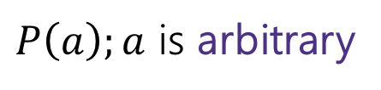
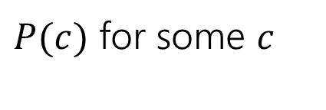






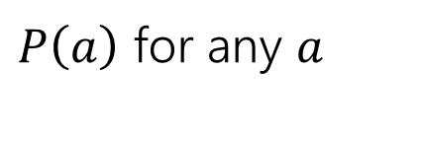





Example Proof Using Quantifiers (setup)
Suppose we know $∃xP(x)$ and $∀y[ P\left(y\right)→Q\left(y\right)]$. Conclude $∃xQ(x)$.
$P(c)$ for some $c$
Intro $∃$
$$∴$$
$$∃x P(x)$$
$$∃xP(x)$$
Eliminate $∃$
$$∴$$
$P(c)$ for a fresh $c$
$$∀x P(x)$$
Eliminate $∀$
$$∴$$
$P\left(a\right)$ for any $a$
$P\left(a\right);a$ is arbitrary
Intro $∀$
$$∴$$
$$∀x P(x)$$
Notes:
Have a good example here.

Slide 12
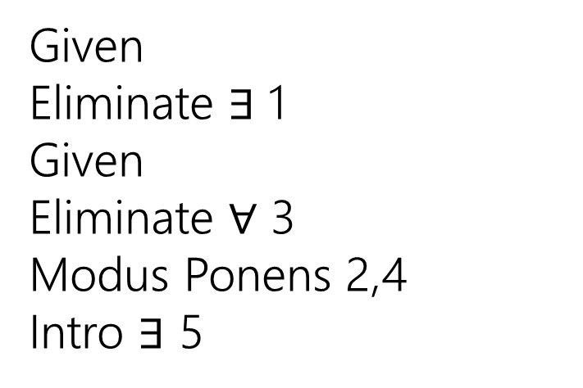
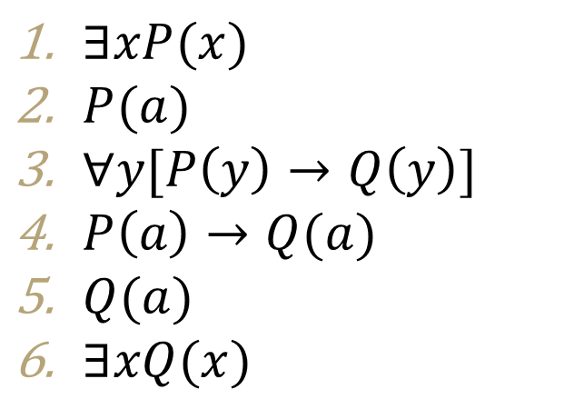
Example Proof Using Quantifiers (Complete)
Suppose we know $∃xP(x)$ and $∀y[ P\left(y\right)→Q\left(y\right)]$. Conclude $∃xQ(x)$.
$P(c)$ for some $c$
$∃xP(x)$
$P(a)$
$∀y[P\left(y\right)→Q\left(y\right)]$
$P\left(a\right)→Q(a)$
$Q(a)$
$∃xQ(x)$
Given
Eliminate $∃$ 1
Given
Eliminate $∀$ 3
Modus Ponens 2,4
Intro $∃$ 5
Intro $∃$
$$∴$$
$$∃x P(x)$$
$$∃xP(x)$$
Eliminate $∃$
$$∴$$
$P(c)$ for a fresh $c$
$$∀x P(x)$$
Eliminate $∀$
$$∴$$
$P\left(a\right)$ for any $a$
$P\left(a\right);a$ is arbitrary
Intro $∀$
$$∴$$
$$∀x P(x)$$
Notes:
Have a good example here.

Slide 13
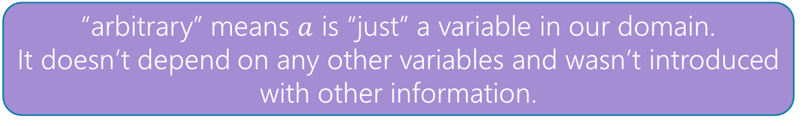
Proofs with Quantifiers ("arbitrary")
We’ve done symbolic proofs with propositional logic.
To include predicate logic, we’ll need some rules about how to use quantifiers.
$$∀x P(x)$$
$P(c)$ for some $c$
Eliminate $∀$
Intro $∃$
$$∴$$
$$∴$$
$P\left(a\right)$ for any $a$
$$∃x P(x)$$
$P\left(a\right);a$ is arbitrary
$$∃xP(x)$$
Intro $∀$
Eliminate $∃$
$$∴$$
$$∴$$
$P(c)$ for a fresh $c$
$$∀x P(x)$$
“arbitrary” means $a$ is “just” a variable in our domain.
It doesn’t depend on any other variables and wasn’t introduced with other information.

Slide 14
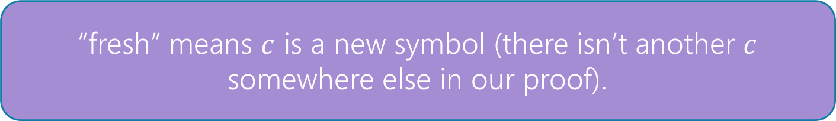
Proofs with Quantifiers ("fresh")
We’ve done symbolic proofs with propositional logic.
To include predicate logic, we’ll need some rules about how to use quantifiers.
$$∀x P(x)$$
$P(c)$ for some $c$
Eliminate $∀$
Intro $∃$
$$∴$$
$$∴$$
$P\left(a\right)$ for any $a$
$$∃x P(x)$$
$P\left(a\right);a$ is arbitrary
$$∃xP(x)$$
Intro $∀$
Eliminate $∃$
$$∴$$
$$∴$$
$P(c)$ for a fresh $c$
$$∀x P(x)$$
“fresh” means $c$ is a new symbol (there isn’t another $c$ somewhere else in our proof).

Slide 15
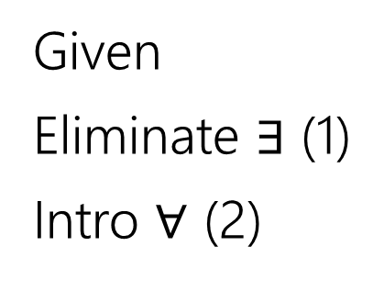
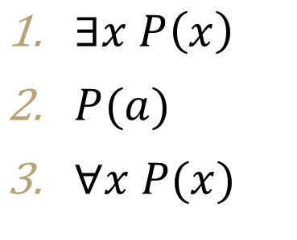
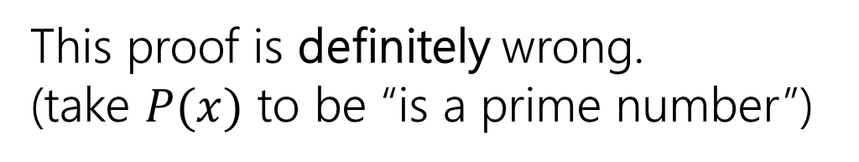
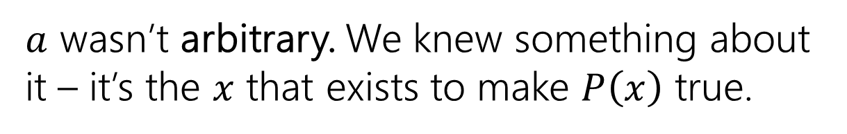
Fresh and Arbitrary (example)
Suppose we know $∃xP\left(x\right)$. Can we conclude $∀xP\left(x\right)$?
$P(c)$ for some $c$
$∃x P\left(x\right)$
$P(a)$
$∀x P(x)$
Given
Eliminate $∃$ (1)
Intro $∀$ (2)
Intro $∃$
$$∴$$
$$∃x P(x)$$
$$∃xP(x)$$
Eliminate $∃$
$$∴$$
$P(c)$ for a fresh $c$
This proof is definitely wrong.
(take $P(x)$ to be “is a prime number”)
$$∀x P(x)$$
Eliminate $∀$
$$∴$$
$P\left(a\right)$ for any $a$
$a$ wasn’t arbitrary. We knew something about it – it’s the $x$ that exists to make $P\left(x\right)$ true.
$P\left(a\right);a$ is arbitrary
Intro $∀$
$$∴$$
$$∀x P(x)$$

Slide 16

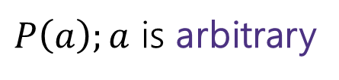

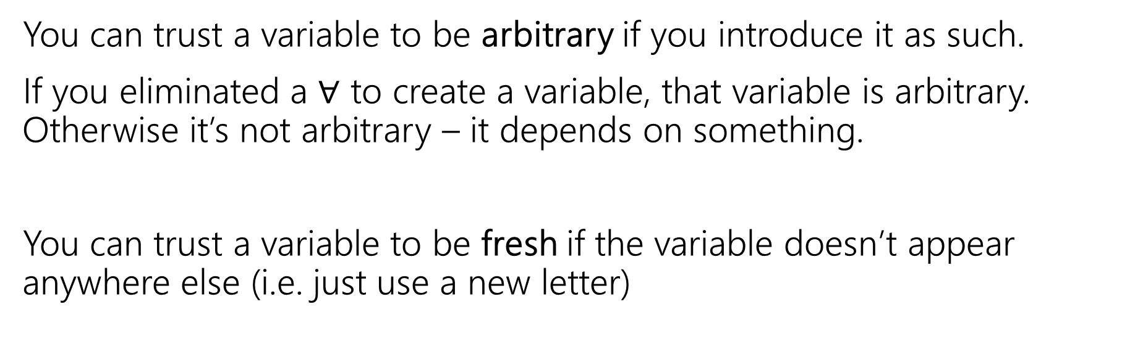





Fresh and Arbitrary (notes 1)
$P\left(a\right);a$ is arbitrary
$$∃xP(x)$$
Intro $∀$
Eliminate $∃$
$$∴$$
$$∴$$
$P(c)$ for a fresh $c$
$$∀x P(x)$$
You can trust a variable to be arbitrary if you introduce it as such.
If you eliminated a $∀$ to create a variable, that variable is arbitrary. Otherwise it’s not arbitrary – it depends on something.
You can trust a variable to be fresh if the variable doesn’t appear anywhere else (i.e. just use a new letter)

Slide 17
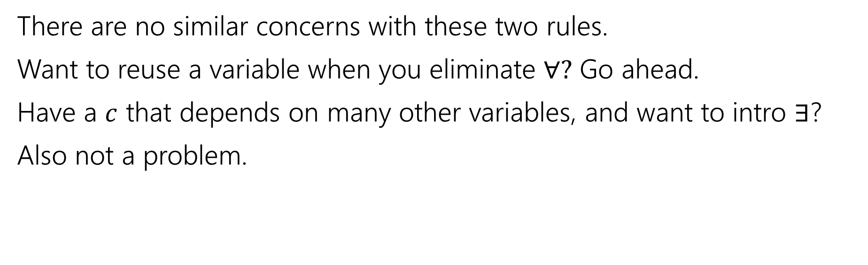
Fresh and Arbitrary (notes 2)
$$∀x P(x)$$
$P(c)$ for some $c$
Eliminate $∀$
Intro $∃$
$$∴$$
$$∴$$
$P\left(a\right)$ for any $a$
$$∃x P(x)$$
There are no similar concerns with these two rules.
Want to reuse a variable when you eliminate $∀?$ Go ahead.
Have a $c$ that depends on many other variables, and want to intro $∃$?
Also not a problem.

Slide 18
Arbitrary Practice (1)
In section, you said: $\left[∃y∀x P\left(x,y\right)\right]→[∀x∃y P\left(x,y\right)]$. Let’s prove it!!

Slide 19
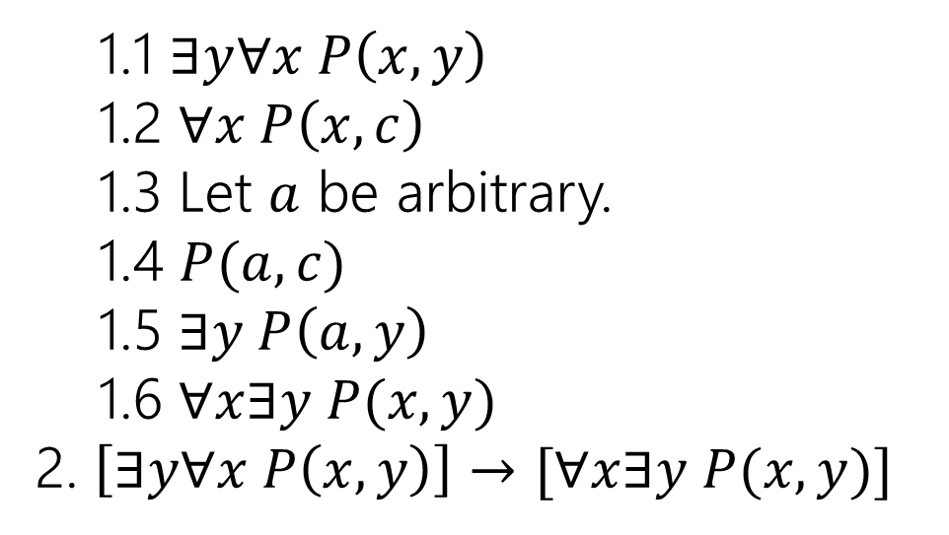
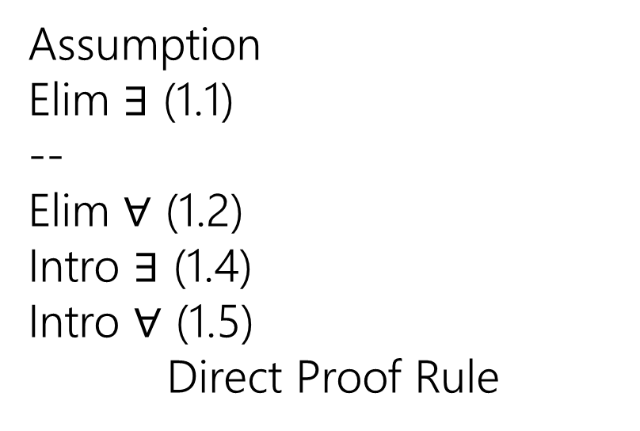
Arbitrary Practice (2)
In section, you said: $\left[∃y∀x P\left(x,y\right)\right]→[∀x∃y P\left(x,y\right)]$. Let’s prove it!!
1.1 $∃y∀x P\left(x,y\right)$
1.2 $∀x P\left(x,c\right)$
1.3 Let $a$ be arbitrary.
1.4 $P(a,c)$
1.5 $∃y P\left(a,y\right)$
1.6 $∀x∃y P(x,y)$
2. $\left[∃y∀x P\left(x,y\right)\right]→[∀x∃y P(x,y)]$
Assumption
Elim $∃$ (1.1)
--
Elim $∀$ (1.2)
Intro $∃$ (1.4)
Intro $∀$ (1.5)
Direct Proof Rule

Slide 20
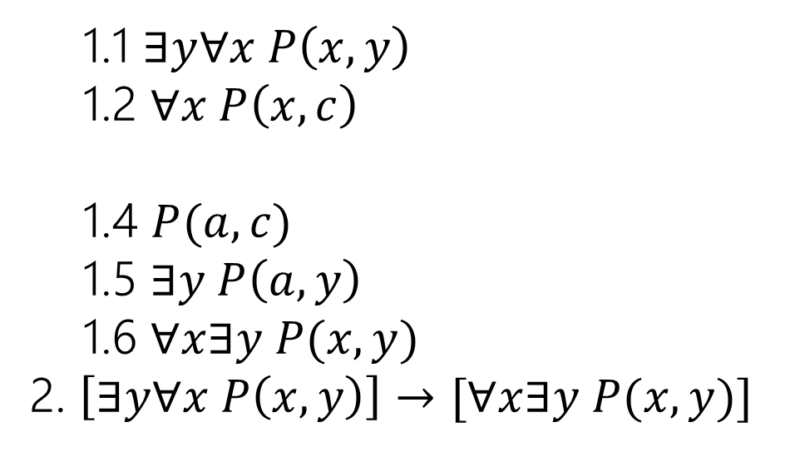
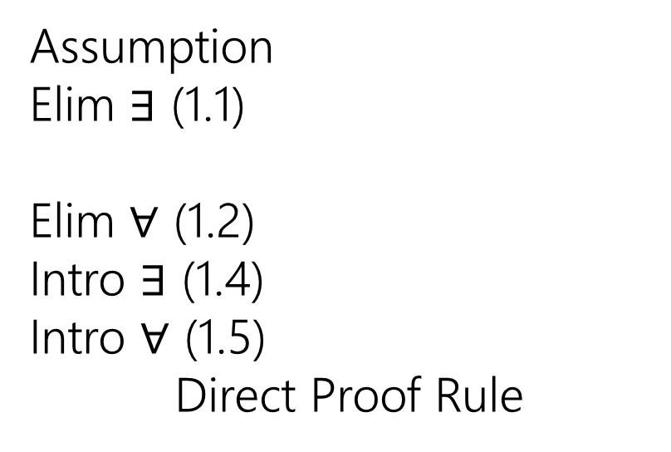
Arbitrary Practice (3)
In section, you said: $\left[∃y∀x P\left(x,y\right)\right]→[∀x∃y P\left(x,y\right)]$. Let’s prove it!!
1.1 $∃y∀x P\left(x,y\right)$
1.2 $∀x P\left(x,c\right)$
1.4 $P(a,c)$
1.5 $∃y P\left(a,y\right)$
1.6 $∀x∃y P(x,y)$
2. $\left[∃y∀x P\left(x,y\right)\right]→[∀x∃y P(x,y)]$
Assumption
Elim $∃$ (1.1)
Elim $∀$ (1.2)
Intro $∃$ (1.4)
Intro $∀$ (1.5)
Direct Proof Rule
It is not required to have “variable is arbitrary” as a step before using it. But many people (including Robbie) find it helpful.

Slide 21
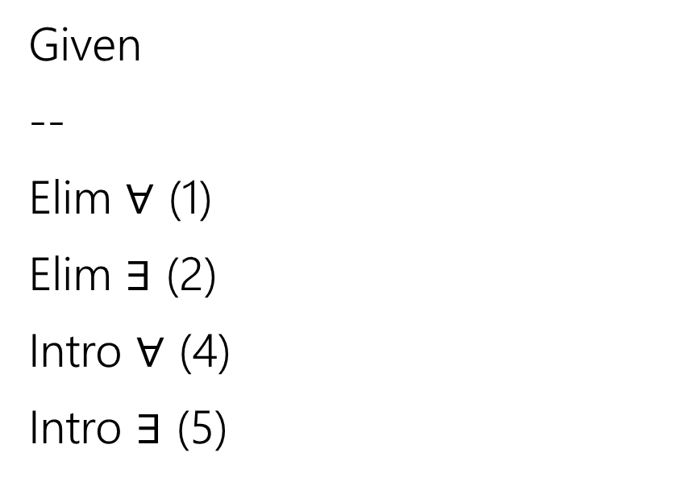
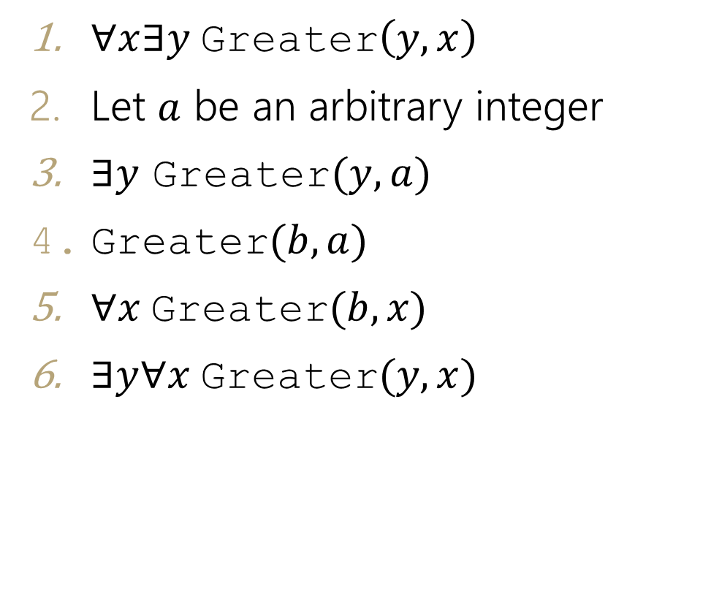
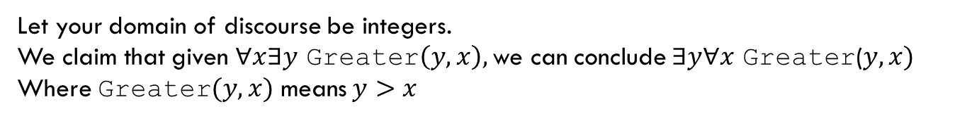
Find The Bug
Let your domain of discourse be integers.
We claim that given $∀x∃y$ Greater$\left(y,x\right),$ we can conclude $∃y∀x$ Greater($y,x)$
Where Greater$(y,x)$ means $y>x$
$∀x∃y$Greater$\left(y,x\right)$
Let $a$ be an arbitrary integer
$∃y$ Greater$(y,a)$
Greater$(b,a)$
$∀x$Greater$(b,x)$
$∃y∀x$Greater$(y,x)$
Given
--
Elim $∀$ (1)
Elim $∃$ (2)
Intro $∀$ (4)
Intro $∃$ (5)

Slide 22
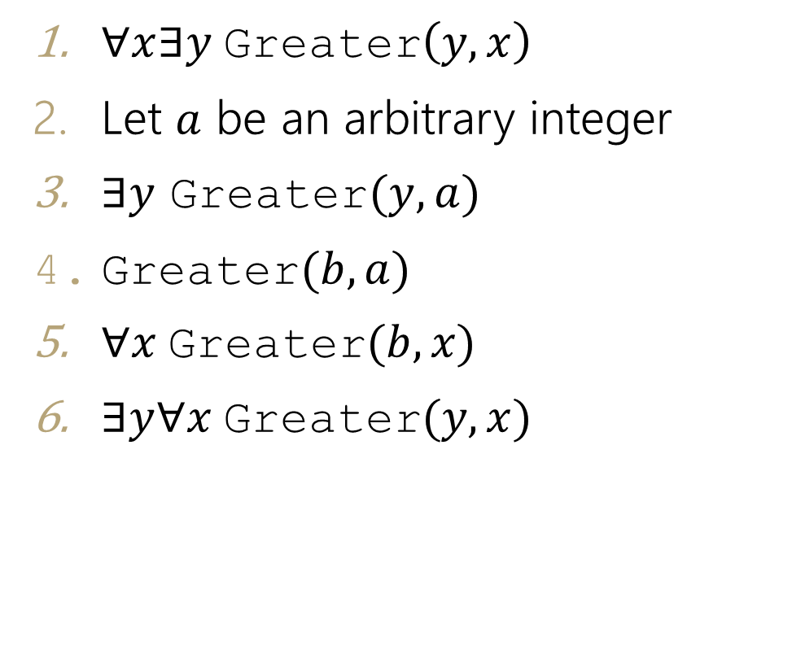
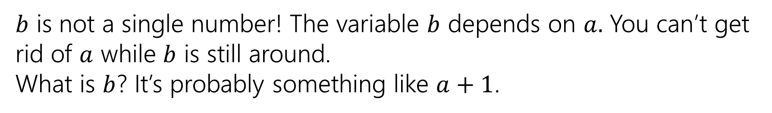
Find The Bug (with notes)
$∀x∃y$Greater$\left(y,x\right)$
Let $a$ be an arbitrary integer
$∃y$ Greater$(y,a)$
$\text{Greater}(b,a)$
$∀x$Greater$(b,x)$
$∃y∀x$Greater$(y,x)$
Given
--
Elim $∀$ (1)
Elim $∃$ (2)
Intro $∀$ (4)
Intro $∃$ (5)
$b$ is not a single number! The variable $b$ depends on $a.$ You can’t get rid of $a$ while $b$ is still around.
What is $b$? It’s probably something like $a+1$.

Slide 23
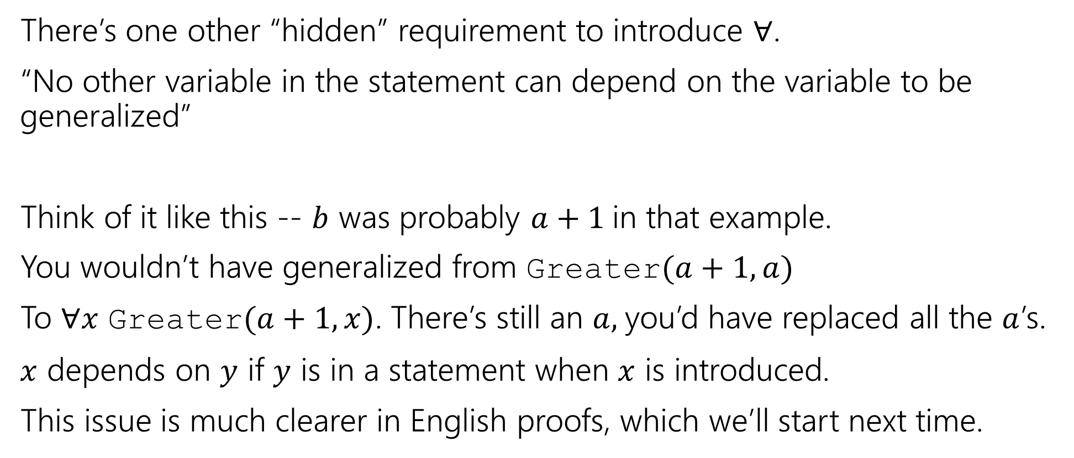
Bug Found
There’s one other “hidden” requirement to introduce $∀$.
“No other variable in the statement can depend on the variable to be generalized”
Think of it like this -- $b$ was probably $a+1$in that example.
You wouldn’t have generalized from Greater$(a+1,a)$
To $∀x$ Greater$(a+1, x)$. There’s still an $a,$you’d have replaced all the $a$’s.
$x$ depends on $y$ if $y$ is in a statement when $x$ is introduced.
This issue is much clearer in English proofs, which we’ll start next time.

Slide 24
Number Theory

Slide 25
Why Number Theory?
Applicable in Computer Science
“hash functions” (you’ll see them in 332) commonly use modular arithmetic
Much of classical cryptography is based on prime numbers.
More importantly, a great playground for writing English proofs.

Slide 26
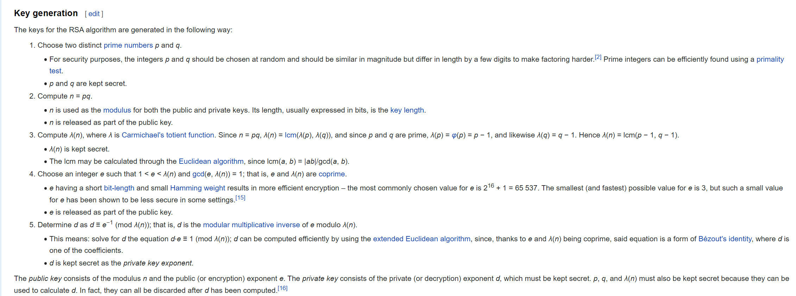
Framing Device (keygen 1)
We’re going to give you enough background to (mostly) understand the RSA encryption system.

Slide 27
Framing Device (keygen 2)
We’re going to give you enough background to (mostly) understand the RSA encryption system.
Prime Numbers
Modular Arithmetic
Modular Multiplicative Inverse
Bezout’s Theorem
Extended Euclidian Algorithm

Slide 28
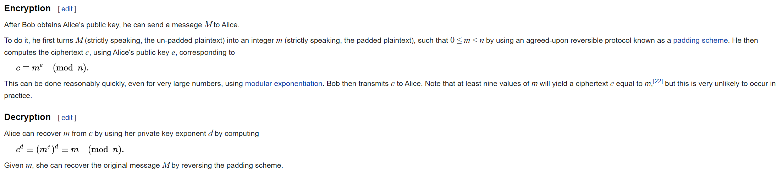
Framing Device (en/decryption 1)
We’re going to give you enough background to (mostly) understand the RSA encryption system.

Slide 29
Framing Device (en/decryption 2)
We’re going to give you enough background to (mostly) understand the RSA encryption system.
Modular Exponentiation

Slide 30
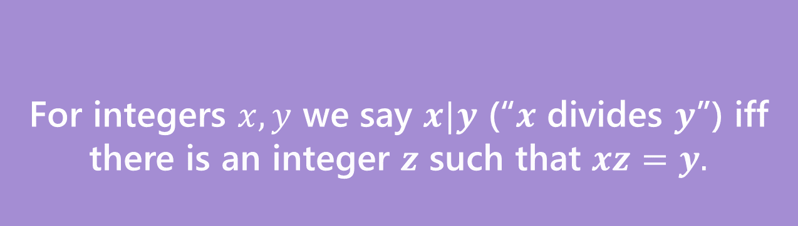
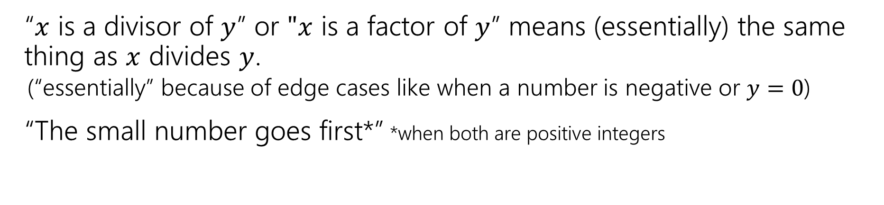
Divides Definition
For integers $x,y$ we say $x|y$ (“$x$ divides $y$”) iff there is an integer $z$ such that $xz=y.$
Divides
“$x$ is a divisor of $y$” or $"x$ is a factor of $y$” means (essentially) the same thing as $x$ divides $y$.
(“essentially” because of edge cases like when a number is negative or $y=0$)
“The small number goes first*” *when both are positive integers

Slide 31
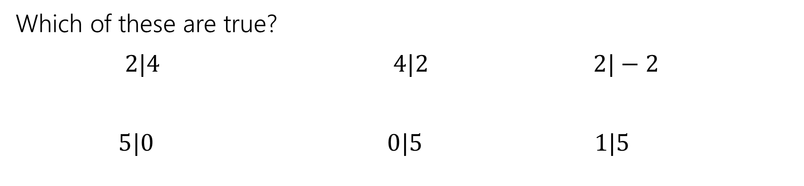
Divides Examples
For integers $x,y$ we say $x|y$ (“$x$ divides $y$”) iff there is an integer $z$ such that $xz=y.$
Divides
Which of these are true?
$2|4$ $4|2$ $2|−2$
$5|0$ $0|5$ $1|5$

Slide 32






Divides Examples (with answers)
For integers $x,y$ we say $x|y$ (“$x$ divides $y$”) iff there is an integer $z$ such that $xz=y.$
Divides
Which of these are true?
$2|4$ $4|2$ $2|−2$
$5|0$ $0|5$ $1|5$
$$True$$
$$False$$
$$True$$
$$True$$
$$False$$
$$True$$

Slide 33

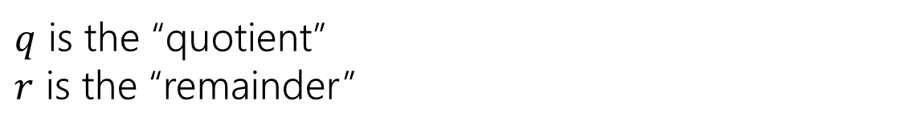
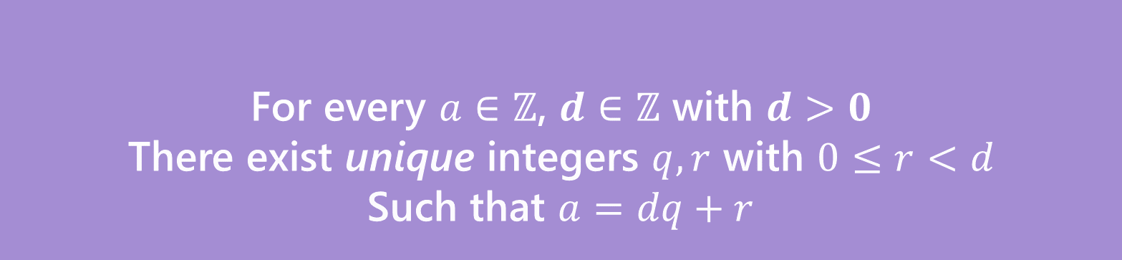






A useful theorem (intuition)
For every $a∈ℤ$, $d∈ℤ$ with $d>0$
There exist unique integers $q,r$ with $0≤r<d$
Such that $a=dq+r$
The Division Theorem
Remember when non integers were still secret, you did division like this?
$q$ is the “quotient”
$r$ is the “remainder”

Slide 34
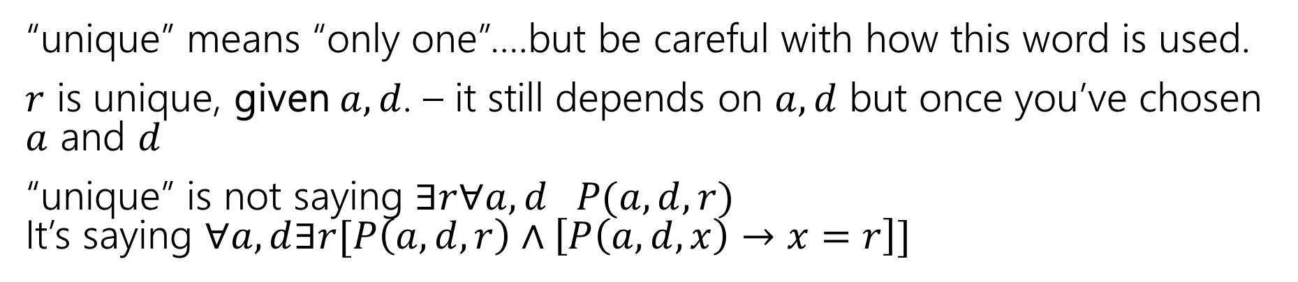
Unique
For every $a∈ℤ$, $d∈ℤ$ with $d>0$
There exist unique integers $q,r$ with $0≤r<d$
Such that $a=dq+r$
The Division Theorem
“unique” means “only one”….but be careful with how this word is used.
$r$ is unique, given $a,d$. – it still depends on $a,d$ but once you’ve chosen $a$ and $d$
“unique” is not saying $∃r∀a,d P(a,d,r)$ It’s saying $∀a,d∃r[P\left(a,d,r\right)∧\left[P\left(a,d,x\right)→x=r\right]]$

Slide 35
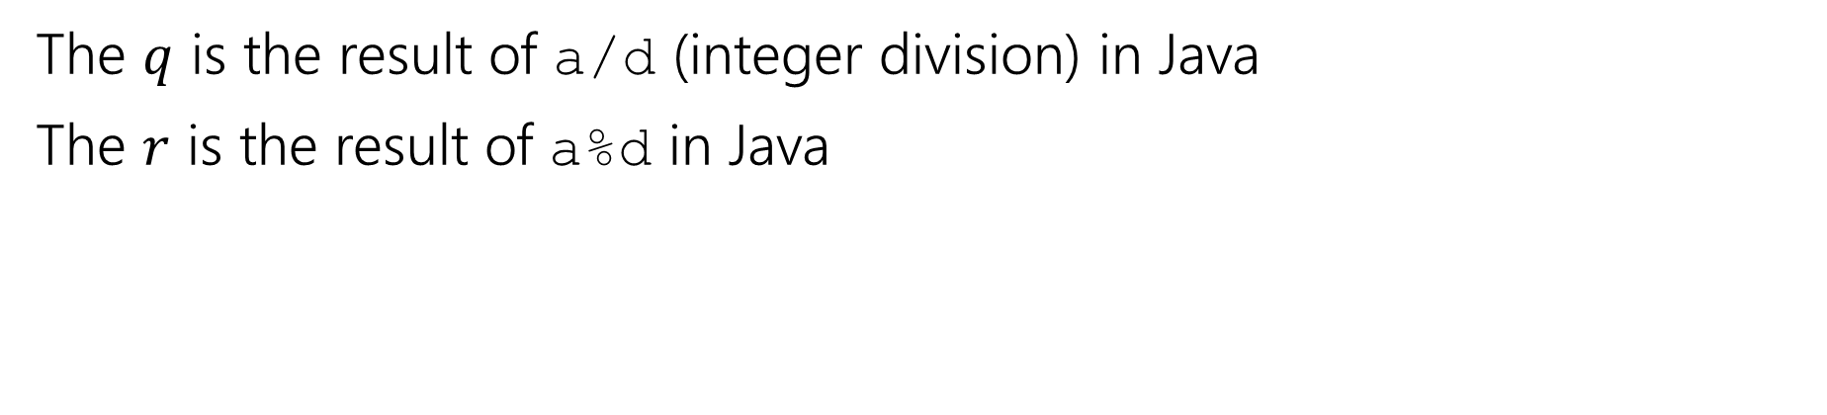
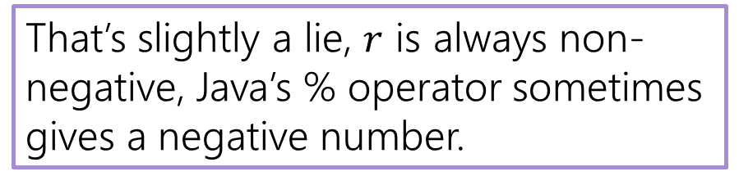
A useful theorem (compared to Java)
For every $a∈ℤ$, $d∈ℤ$ with $d>0$
There exist unique integers $q,r$ with $0≤r<d$
Such that $a=dq+r$
The Division Theorem
The $q$ is the result of a/d (integer division) in Java
The $r$ is the result of a%d in Java
That’s slightly a lie, $r$ is always non-negative, Java’s % operator sometimes gives a negative number.

Slide 36
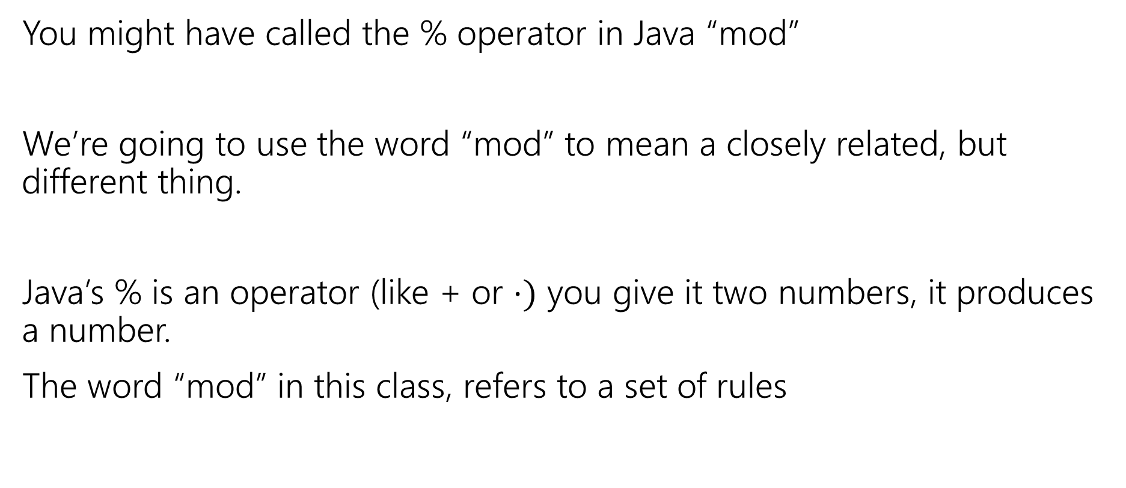
Terminology
You might have called the % operator in Java “mod”
We’re going to use the word “mod” to mean a closely related, but different thing.
Java’s % is an operator (like + or $⋅)$ you give it two numbers, it produces a number.
The word “mod” in this class, refers to a set of rules

Slide 37
Modular Arithmetic Intuition
“arithmetic mod 12” is familiar to you. You do it with clocks.
What’s 3 hours after 10 o’clock?
1 o’clock. You hit 12 and then “wrapped around”
“13 and 1 are the same, mod 12” “-11 and 1 are the same, mod 12”
We don’t just want to do math for clocks – what about if we need to talk about parity (even vs. odd) or ignore higher-order-bits (mod by 16, for example)

Slide 38
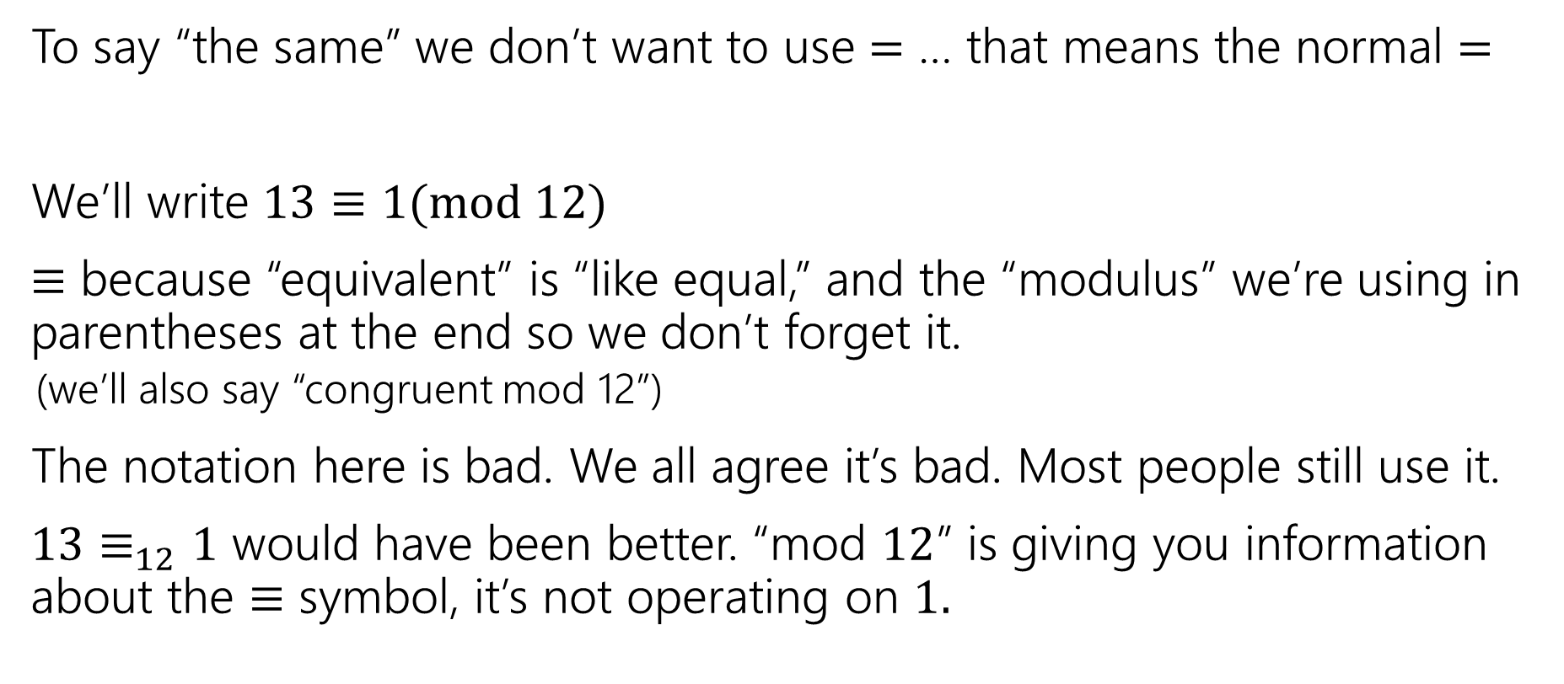
Modular Arithmetic Notation
To say “the same” we don’t want to use $=$ … that means the normal $=$
We’ll write $13≡1(mod 12)$
$≡$ because “equivalent” is “like equal,” and the “modulus” we’re using in parentheses at the end so we don’t forget it.
(we’ll also say “congruent mod 12”)
The notation here is bad. We all agree it’s bad. Most people still use it.
$13≡_{12}1$ would have been better. “mod $12$” is giving you information about the $≡$ symbol, it’s not operating on $1.$

Slide 39
Modular Arithmetic (need a definition)
We need a definition! We can’t just say “it’s like a clock”
Pause what do you expect the definition to be?
Is it related to % ?

Slide 40
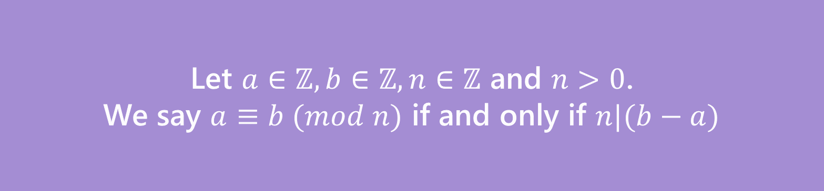
Modular Arithmetic Equivalence Definition
We need a definition! We can’t just say “it’s like a clock”
Pause what do you expect the definition to be?
Let $a∈ℤ, b∈ℤ, n∈ℤ$ and $n>0$.
We say $a≡b (mod n)$ if and only if $n|(b−a)$
Equivalence in modular arithmetic
Huh?

Slide 41
Long Pause
It’s easy to read something with a bunch of symbols and say “yep, those are symbols.” and keep going
STOP Go Back.
You have to fight the symbols they’re probably trying to pull a fast one on you.
Same goes for when I’m presenting a proof – you shouldn’t just believe me – I’m wrong all the time!
You should be trying to do the proof with me. Where do you think we’re going next?

Slide 42

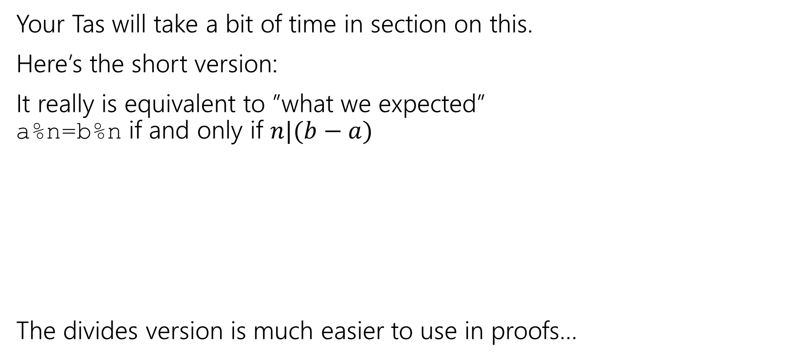


Why?
Your Tas will take a bit of time in section on this.
Here’s the short version:
It really is equivalent to ”what we expected” a%n=b%n if and only if $n|(b−a)$
The divides version is much easier to use in proofs…
$$27$$
When you subtract, the remainders cancel. What you’re left with is a multiple of 12.
$$15$$
$$27−15=12$$

Slide 43
Extra Practice

Slide 44
One more Proof (setup)
Show if we know: $p, q, \left[\left(p∧q\right)→\left(r∧s\right)\right], r→t$ we can conclude $t$.

Slide 45
One more Proof (complete)
Show if we know: $p, q, \left[\left(p∧q\right)→\left(r∧s\right)\right], r→t$ we can conclude $t$.
$p$
$q$
$[\left(p∧q\right)→\left(r∧s\right)]$
$r→t$
$p∧q$
$r∧s$
$r$
$t$
Given
Given
Given
Given
Intro $∧$ (1,2)
Modus Ponens (3,5)
Eliminate $∧$ (6)
Modus Ponens (4,7)

