Slide 1
Inference Proof
CSE 311 Fall 25
Lecture 8

Slide 2
Proof Strategy: Direct Proof

Slide 3
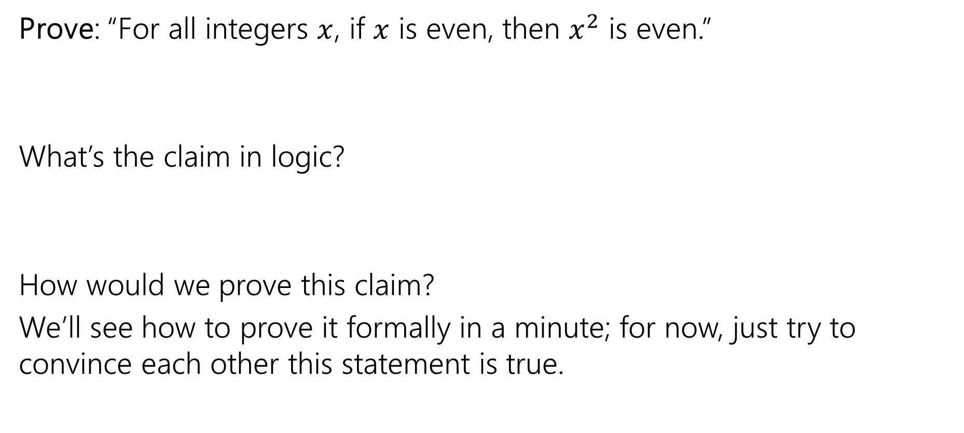
Our First Direct Proof: setup
Prove: “For all integers $x$, if $x$ is even, then $x^{2}$ is even.”
What’s the claim in logic?
How would we prove this claim?
We’ll see how to prove it formally in a minute; for now, just try to convince each other this statement is true.
Notes:
Have a 5 minute discussion on this
Intuition: is this true?
Write out scratchwork

Slide 4

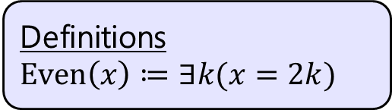
Our First Direct Proof (1)
Definitions
$Even\left(x\right)≔∃k(x=2k)$
Prove: “For all integers $x$, if $x$ is even, then $x^{2}$ is even.” $∀x\left(Even\left(x\right)→Even\left(x^{2}\right)\right)$
Notes:
Let $x$ be an arbitrary integer. Suppose that $x$ is even. Then by definition of even, there exists some integer $k$ such that $x=2k$. Squaring both sides, we see that:
$$x^{2}={\left(2k\right)}^{2}=4k^{2}=2⋅2k^{2}$$
Because $k$ is an integer, then $2k^{2}$ is also an integer. So $x^{2}$ is two times an integer.
So by definition of even, $x^{2}$ is even.
Since $x$ was an arbitrary integer, we can conclude that for all integers $x$, if $x$ is even then $x^{2}$ is even.
Run through with a number

Slide 5
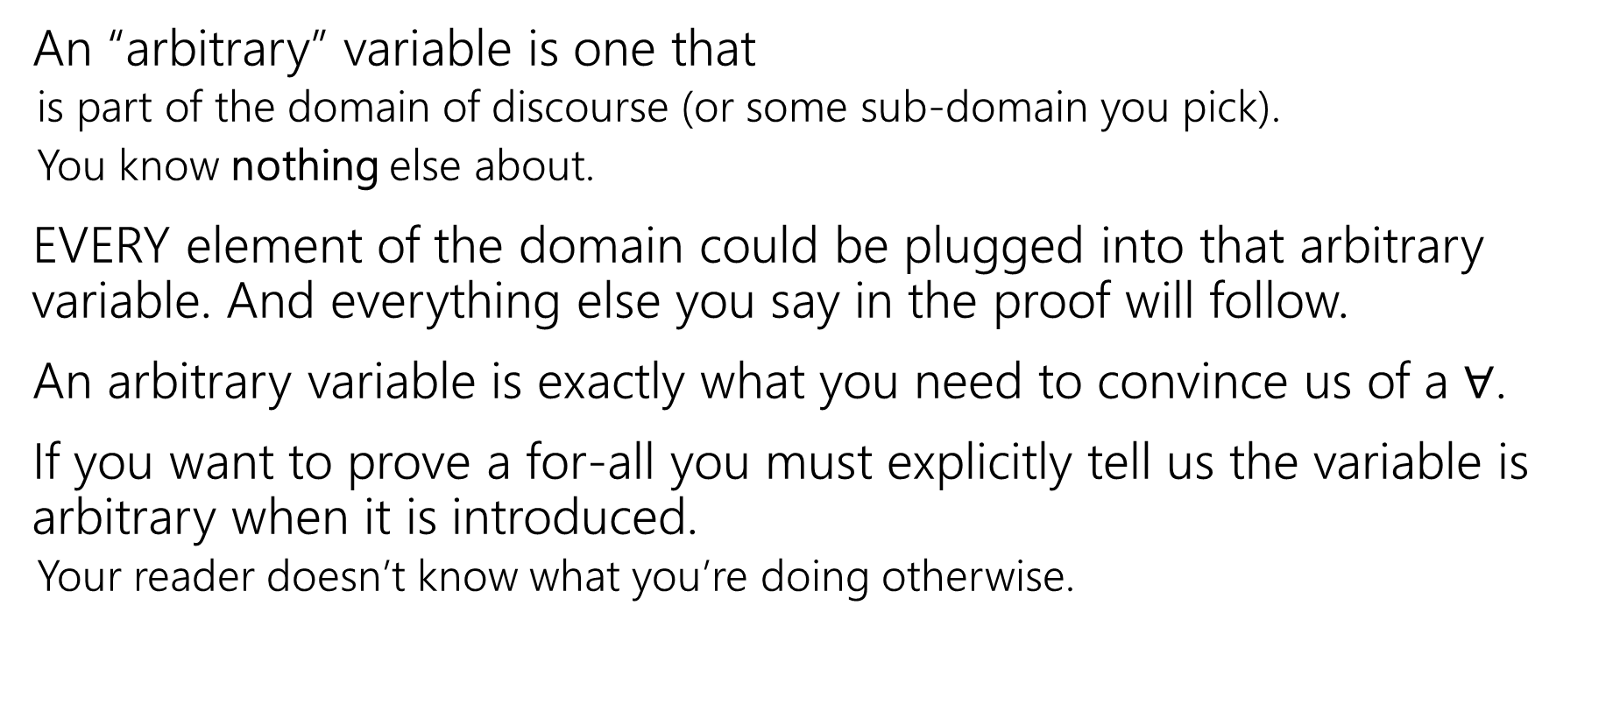
Arbitrary
An “arbitrary” variable is one that
is part of the domain of discourse (or some sub-domain you pick).
You know nothing else about.
EVERY element of the domain could be plugged into that arbitrary variable. And everything else you say in the proof will follow.
An arbitrary variable is exactly what you need to convince us of a $∀$.
If you want to prove a for-all you must explicitly tell us the variable is arbitrary when it is introduced.
Your reader doesn’t know what you’re doing otherwise.

Slide 6

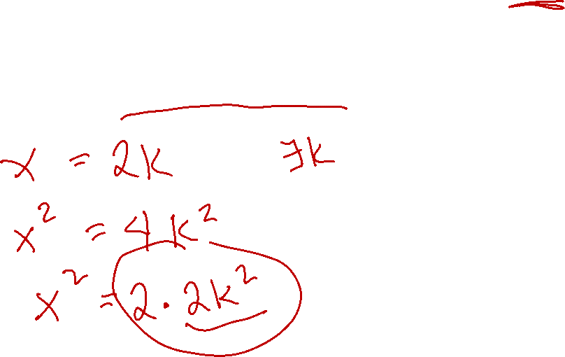
Our First Direct Proof (2)
Definitions
$Even\left(x\right)≔∃k(x=2k)$
Prove: “For all integers $x$, if $x$ is even, then $x^{2}$ is even.” $∀x\left(Even\left(x\right)→Even\left(x^{2}\right)\right)$
Proof: Let $x$ be an arbitrary integer. Suppose that $x$ is even.
Notes:
Let $x$ be an arbitrary integer. Suppose that $x$ is even. Then by definition of even, there exists some integer $k$ such that $x=2k$. Squaring both sides, we see that:
$$x^{2}={\left(2k\right)}^{2}=4k^{2}=2⋅2k^{2}$$
Because $k$ is an integer, then $2k^{2}$ is also an integer. So $x^{2}$ is two times an integer.
So by definition of even, $x^{2}$ is even.
Since $x$ was an arbitrary integer, we can conclude that for all integers $x$, if $x$ is even then $x^{2}$ is even.
Run through with a number

Slide 7

Now What?
Definitions
$Even\left(x\right)≔∃k(x=2k)$
Well….what does it mean to be even?
$x=2k$ for some integer $k$.
Where do we need to end up?
Even$(x^{2})$

Slide 8

Our First Direct Proof (3)
Definitions
$Even\left(x\right)≔∃k(x=2k)$
Prove: “For all integers $x$, if $x$ is even, then $x^{2}$ is even.” $∀x\left(Even\left(x\right)→Even\left(x^{2}\right)\right)$
Proof: Let $x$ be an arbitrary integer. Suppose that $x$ is even.
So $x^{2}$ is even.
Notes:
Let $x$ be an arbitrary integer. Suppose that $x$ is even. Then by definition of even, there exists some integer $k$ such that $x=2k$. Squaring both sides, we see that:
$$x^{2}={\left(2k\right)}^{2}=4k^{2}=2⋅2k^{2}$$
Because $k$ is an integer, then $2k^{2}$ is also an integer. So $x^{2}$ is two times an integer.
So by definition of even, $x^{2}$ is even.
Since $x$ was an arbitrary integer, we can conclude that for all integers $x$, if $x$ is even then $x^{2}$ is even.
Run through with a number

Slide 9

Our First Direct Proof (4)
Definitions
$Even\left(x\right)≔∃k(x=2k)$
Prove: “For all integers $x$, if $x$ is even, then $x^{2}$ is even.” $∀x\left(Even\left(x\right)→Even\left(x^{2}\right)\right)$
Proof: Let $x$ be an arbitrary integer. Suppose that $x$ is even.
By definition of even, $x=2k$ for some integer $k$.
So $x^{2}$ is even.
Notes:
Let $x$ be an arbitrary integer. Suppose that $x$ is even. Then by definition of even, there exists some integer $k$ such that $x=2k$. Squaring both sides, we see that:
$$x^{2}={\left(2k\right)}^{2}=4k^{2}=2⋅2k^{2}$$
Because $k$ is an integer, then $2k^{2}$ is also an integer. So $x^{2}$ is two times an integer.
So by definition of even, $x^{2}$ is even.
Since $x$ was an arbitrary integer, we can conclude that for all integers $x$, if $x$ is even then $x^{2}$ is even.
Run through with a number

Slide 10
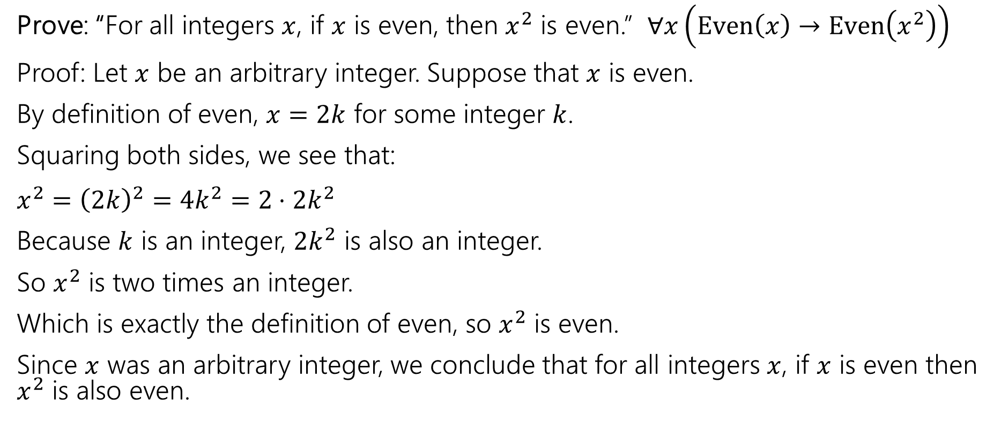

Our First Direct Proof (Complete)
Definitions
$Even\left(x\right)≔∃k(x=2k)$
Prove: “For all integers $x$, if $x$ is even, then $x^{2}$ is even.” $∀x\left(Even\left(x\right)→Even\left(x^{2}\right)\right)$
Proof: Let $x$ be an arbitrary integer. Suppose that $x$ is even.
By definition of even, $x=2k$ for some integer $k$.
Squaring both sides, we see that:
$x^{2}={\left(2k\right)}^{2}=4k^{2}=2⋅2k^{2}$
Because $k$ is an integer, $2k^{2}$ is also an integer.
So $x^{2}$ is two times an integer.
Which is exactly the definition of even, so $x^{2}$ is even.
Since $x$ was an arbitrary integer, we conclude that for all integers $x$, if $x$ is even then $x^{2}$ is also even.
Notes:
Let $x$ be an arbitrary integer. Suppose that $x$ is even. Then by definition of even, there exists some integer $k$ such that $x=2k$. Squaring both sides, we see that:
$$x^{2}={\left(2k\right)}^{2}=4k^{2}=2⋅2k^{2}$$
Because $k$ is an integer, then $2k^{2}$ is also an integer. So $x^{2}$ is two times an integer.
So by definition of even, $x^{2}$ is even.
Since $x$ was an arbitrary integer, we can conclude that for all integers $x$, if $x$ is even then $x^{2}$ is even.
Run through with a number

Slide 11

Direct Proof
Direct proof is one strategy for proving statements of the form
$$∀x[P\left(x\right)→Q\left(x\right)]$$
Notes:
Direct proof is one strategy for proving statements of the form $∀x \left(P\left(x\right)→Q\left(x\right)\right)$.

Slide 12
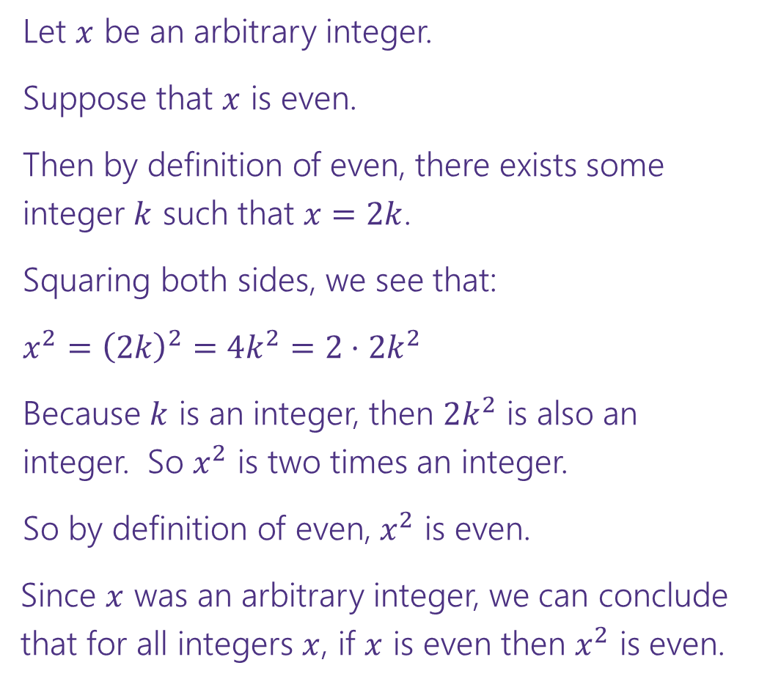


Direct Proof Template
Prove: $∀x\left(Even\left(x\right)→Even\left(x^{2}\right)\right)$
Declare an arbitrary variable for each $∀$.
Let $x$ be an arbitrary integer.
Suppose that $x$ is even.
Then by definition of even, there exists some integer $k$ such that $x=2k$.
Squaring both sides, we see that:
$x^{2}={\left(2k\right)}^{2}=4k^{2}=2⋅2k^{2}$
Because $k$ is an integer, then $2k^{2}$ is also an integer. So $x^{2}$ is two times an integer.
So by definition of even, $x^{2}$ is even.
Since $x$ was an arbitrary integer, we can conclude that for all integers $x$, if $x$ is even then $x^{2}$ is even.
Assume the left side of the implication.
Unroll the predicate definitions.
Manipulate towards the goal.
Reroll definitions into the right side of the implication.
Conclude that you have proved the claim.

Slide 13
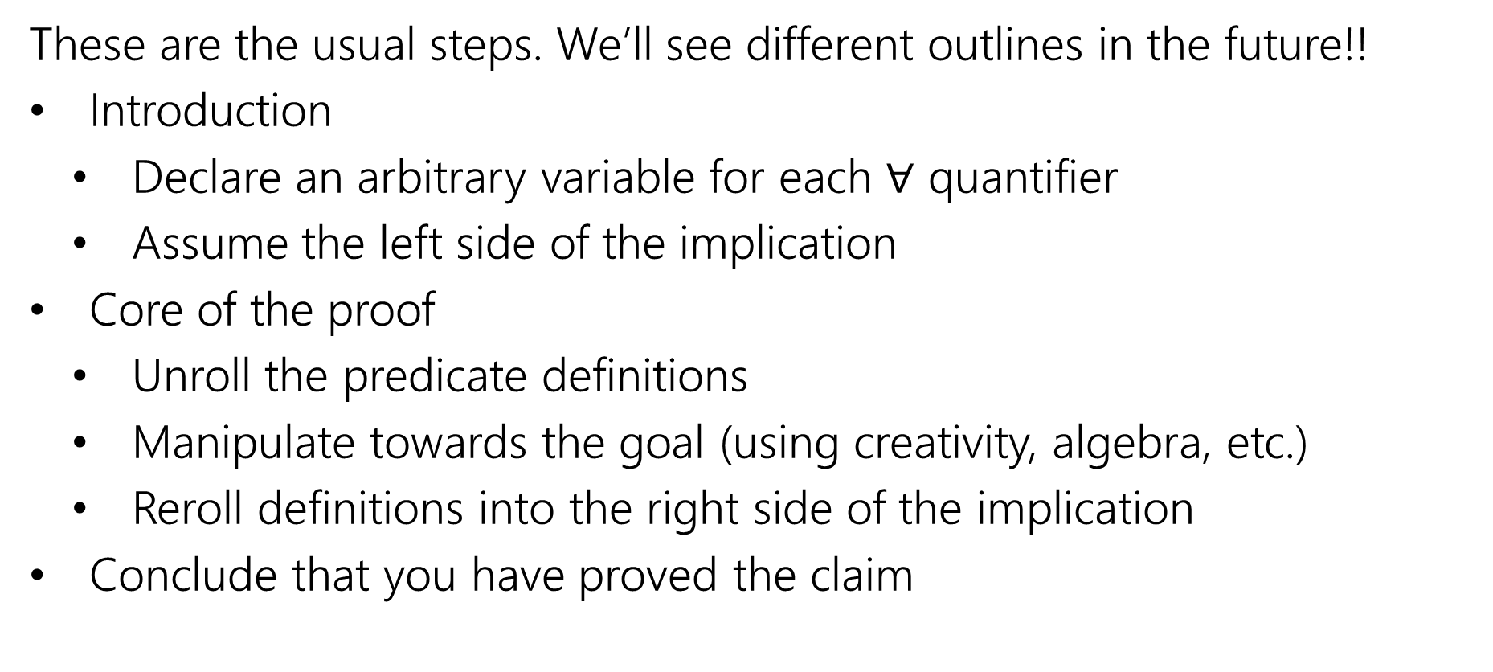
Direct Proof Steps
These are the usual steps. We’ll see different outlines in the future!!
Introduction
Declare an arbitrary variable for each $∀$ quantifier
Assume the left side of the implication
Core of the proof
Unroll the predicate definitions
Manipulate towards the goal (using creativity, algebra, etc.)
Reroll definitions into the right side of the implication
Conclude that you have proved the claim

Slide 14
Inference Proofs

Slide 15
A Brief Return to Training Wheels (1)
For about 1.5 lectures, we’re going to study “inference proofs”
The rules for these proofs are
1. Strict enough that computers can check them (there are languages designed to do that!)
2. More general than the simplification rules we’ve seen so far.
You’ll still use the simplification rules!
But you’ll find we can prove more things (at least without significant difficulty).
3. More similar to the proofs we spend most of the quarter writing.

Slide 16
A Brief Return to Training Wheels (2)
The claims and proofs are quite abstract!
Why spend time here?
Some computer scientists use the fully formal (computer-checkable) version of the rules.
Our PL group here contains experts in these topics!
We want your takeaways to be
In principle, any proof we write in this class could be made fully formal and checked.
But it can be a lot of work, so we usually think and communicate in English. We’re people after all!

Slide 17
Inference Proofs Overview
A new way of thinking of proofs:
Here’s one way to get an iron-clad guarantee:
1. Write down all the facts we know.
2. Combine the things we know to derive new facts.
3. Continue until what we want to show is a fact.

Slide 18
Drawing Conclusions
You know “If it is raining, then I have my umbrella”
And “It is raining”
You should conclude….
For whatever you conclude, convert the statement to propositional logic – will your statement hold for any propositions, or is it specific to raining and umbrellas?
I have my umbrella!
I know $(p→q)$ and $p$, I can conclude $q$
Or said another way: $\left[\left(p→q\right)∧p\right]→q$

Slide 19
Modus Ponens Idea
The inference from the last slide is always valid. I.e.
$$\left[\left(p→q\right)∧p\right]→q$$
Has only True rows in its truth table (it’s a tautology)

Slide 20

Modus Ponens – a formal proof
$$\left[\left(p→q\right)∧p\right]→q$$
$≡[\left(¬p∨q\right)∧p]→q$
$≡\left[p∧\left(¬p∨q\right)\right]→q$
$≡\left[\left(p∧¬p\right)∨\left(p∧q\right)\right]→q$
$≡\left[F∨\left(p∧q\right)\right]→q$
$≡\left[\left(p∧q\right)∨F\right]→q$
$≡\left[\left(p∧q\right)\right]→q$
$≡\left[¬\left(p∧q\right)\right]∨q$
$≡\left[¬p∨¬q\right]∨q$
$≡¬p∨[¬q∨q]$
$≡¬p∨[q∨¬q]$
$≡¬p∨T$
$≡T$
Law of Implication
Commutativity
Distributivity
Negation
Commutativity
Identity
Law of Implication
DeMorgan’s Law
Associativity
Commutativity
Negation
Domination

Slide 21
Modus Ponens
The inference from the last slide is always valid. I.e.
$$\left[\left(p→q\right)∧p\right]→q≡T$$
We use that inference A LOT
So often people gave it a name (“Modus Ponens”)
So often…we don’t have time to repeat that 12 line proof EVERY TIME.
Let’s make this another law we can apply in a single step.
Just like refactoring a method in code.

Slide 22
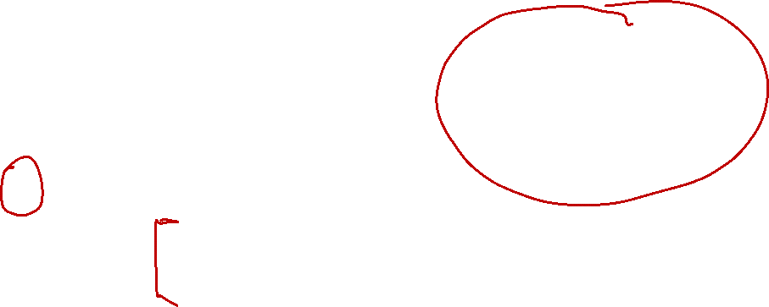
Notation – Laws of Inference
We’re using the “$→“$ symbol A LOT.
Too much
Some new notation to make our lives easier.
If we know both $A$and$B$
$$A,B$$
$$∴$$
We can conclude any (or all) of $C,D$
$$∴$$
$$C,D$$
“$∴$” means “therefore” – I knew $A,B$ therefore I can conclude $C,D$.
$$p→q,p$$
Modus Ponens, i.e. $\left[\left(p→q\right)∧p\right]→q$), in our new notation.
$$∴$$
$$q$$

Slide 23
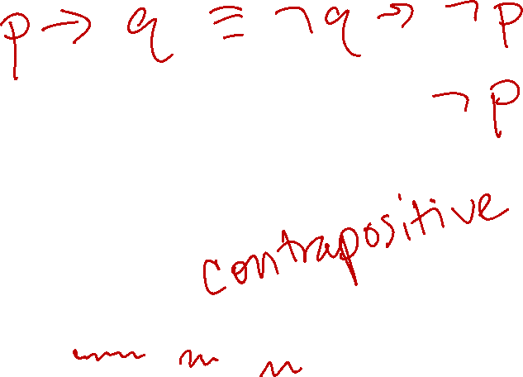
Another Proof
Let’s keep going.
I know “If it is raining then I have my umbrella” and “I do not have my umbrella”
I can conclude…
What’s the general form?
How do you think the proof will go?
If you had to convince a friend of this claim in English, how would you do it?
It is not raining!
$$[(p→q)∧¬q]→¬p$$

Slide 24
A proof!
We know $p→q$ and $¬q$; we want to conclude $¬p.$
Let’s try to prove it. Our goal is to list facts until our goal becomes a fact.
We’ll number our facts, and put a justification for each new one.

Slide 25
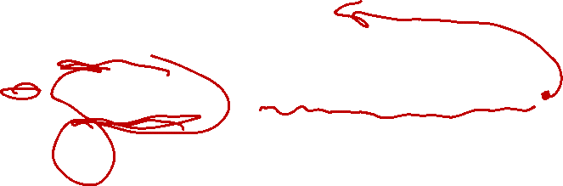
A proof! (Complete)
We know $p→q$ and $¬q$; we want to conclude $¬p.$
Let’s try to prove it. Our goal is to list facts until our goal becomes a fact.
We’ll number our facts, and put a justification for each new one.
$p→ q$
$¬q$
$¬q→¬p$
$¬p$
Given
Given
Contrapositive of 1.
Modus Ponens on 3,2.

Slide 26

Try it yourselves
Suppose you know $p→q,¬s→¬q,$and$p.$ Give an argument to conclude $s.$

Slide 27
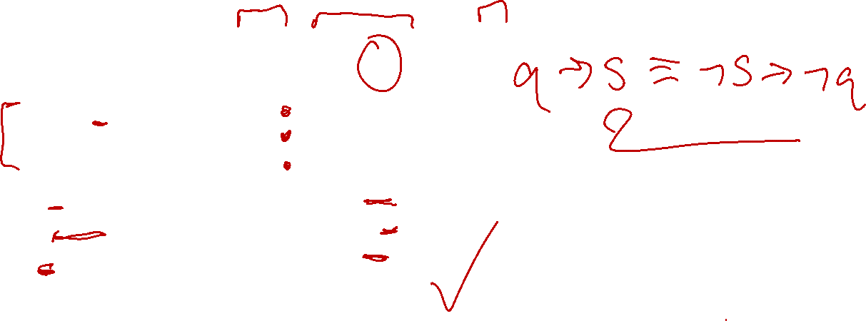
Try it yourselves (Complete)
Suppose you know $p→q,¬s→¬q,$and$p.$ Give an argument to conclude $s.$
$p→q$
$¬s→¬q$
$p$
$q$
$q→s$
$s$
Given
Given
Given
Modus Ponens 1,3
Contrapositive of 2
Modus Ponens 5,4

Slide 28
That was abstract!
Imagine that instead someone had said:
If next is null, then we go down the else-branch
If the input list is non-empty, then we don’t go down the else-branch.
This test uses a non-empty list as input.
Can you conclude anything?

Slide 29
So…why do the abstract proof?
Mostly to practice…
Though sometimes it’s helpful to make things abstract.
The more general you make a claim…
The more abstract it is, and therefore more difficult to understand on the surface…
But the more different contexts it can be used in.

Slide 30

More Inference Rules (Eliminate $∧$)
We need a couple more inference rules.
These rules set us up to get facts in exactly the right form to apply the really useful rules.
A lot like commutativity and associativity in the propositional logic rules.
$$A∧B$$
I know the fact $A∧B$
Eliminate ∧
$$∴$$
$$A, B$$
$$∴$$
I can conclude $A$is a fact and $B$is a fact separately.

Slide 31
More Inference Rules
In total, we have two for $∧$ and two for $∨$, one to create the connector, and one to remove it.
None of these rules are surprising, but they are useful.
$$A∧B$$
$$A,B$$
Eliminate ∧
Intro ∧
$$∴$$
$$∴$$
$$A∧B$$
$$A, B$$
$$A∨B, ¬A$$
$$A$$
Eliminate $∨$
Intro $∨$
$$∴$$
$$∴$$
$$A∨B, B∨A$$
$$B$$

Slide 32
Direct Proof Rule

Slide 33
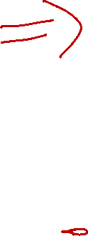

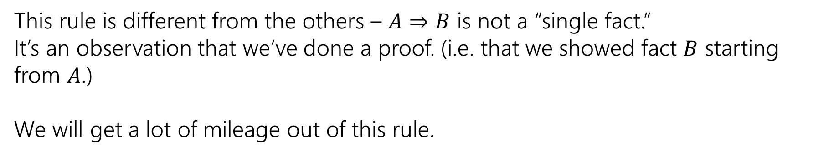
The Direct Proof Rule
We’ve been implicitly using another “rule” in our English proofs, the direct proof rule
Write a proof “given $A$ conclude $B$”
$$A⇒B$$
Direct Proof rule
$$A→B$$
$$A→B$$
This rule is different from the others – $A⇒B$ is not a “single fact.”
It’s an observation that we’ve done a proof. (i.e. that we showed fact $B$ starting from $A$.)
We will get a lot of mileage out of this rule.

Slide 34
Inference Rules
$$A∧B$$
Eliminate ∧
$$A⇒B$$
Direct Proof rule
$$∴$$
$$A, B$$
$$A→B$$
$$A∨B, ¬A$$
$$P→Q,P$$
Eliminate $∨$
Modus Ponens
$$∴$$
$$B$$
$$∴$$
$$Q$$
$$A,B$$
Intro ∧
$$∴$$
$$A∧B$$
You can still use all the propositional logic equivalences too!
$$A$$
Intro $∨$
$$∴$$
$$A∨B, B∨A$$

Slide 35
How would you argue…
Let’s say you have a piece of code.
And you think if the code gets null input then a NullPointerException will be thrown.
How would you convince your friend?
You’d probably trace the code, assuming you would get null input.
The code was your given
The null input is an assumption

Slide 36
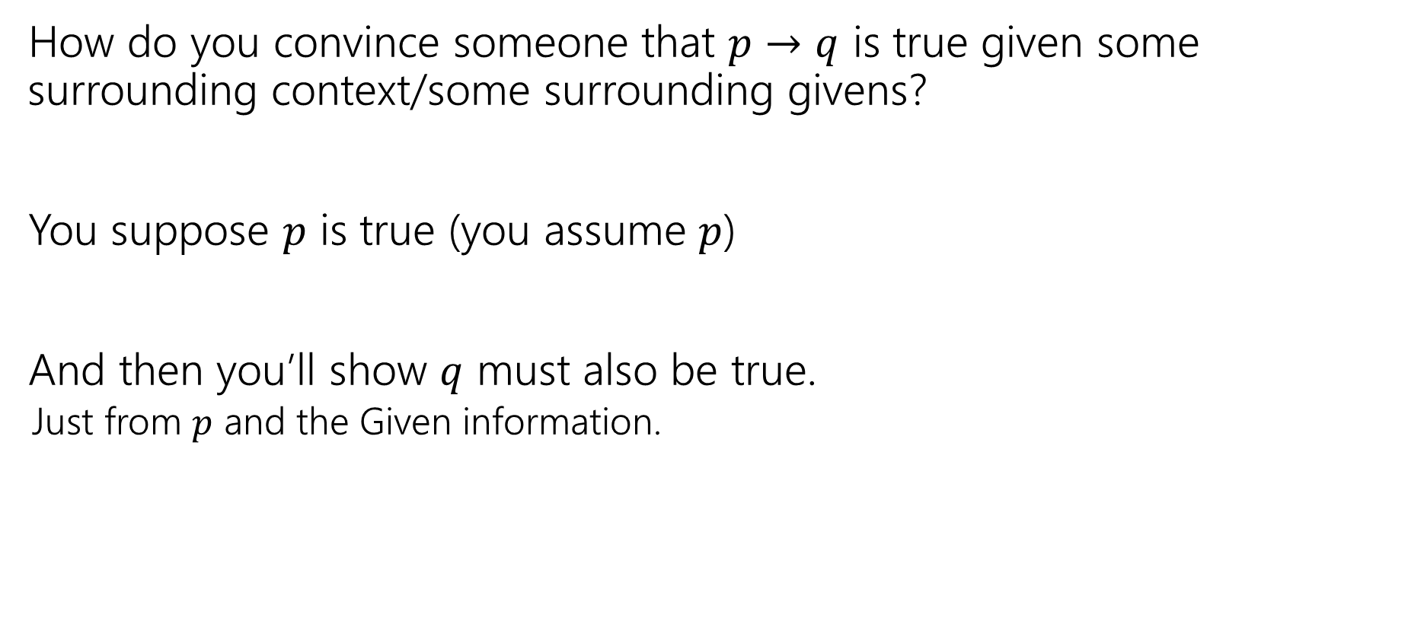
In general
How do you convince someone that $p→q$ is true given some surrounding context/some surrounding givens?
You suppose $p$ is true (you assume $p$)
And then you’ll show $q$ must also be true.
Just from $p$ and the Given information.

Slide 37


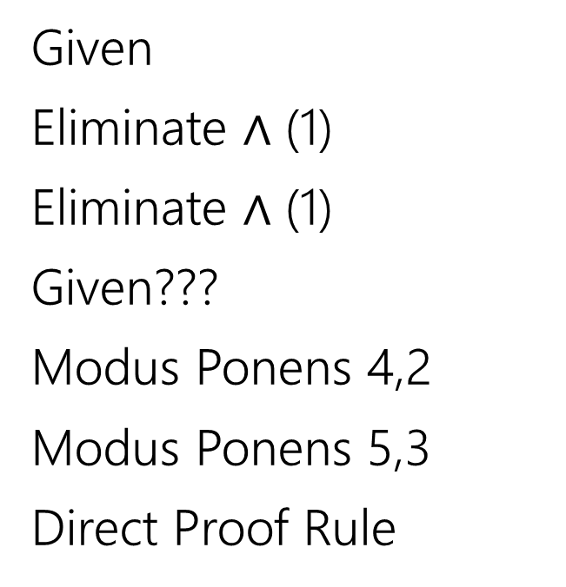
Given: (($p→q)∧(q→r))$ Show: $(p→r)$ (setup)
Here’s an incorrect proof.
$\left(p→q\right)∧\left(q→r\right)$
$p→q$
$q→r$
$p$
$q$
$r$
$p→r$
Given
Eliminate $∧$ (1)
Eliminate $∧$ (1)
Given???
Modus Ponens 4,2
Modus Ponens 5,3
Direct Proof Rule

Slide 38

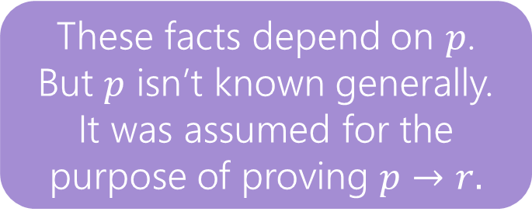

Given: (($p→q)∧(q→r))$ Show: $(p→r)$ (with notes)
Here’s an incorrect proof.
Proofs are supposed to be lists of facts.
Some of these “facts” aren’t really facts…
$\left(p→q\right)∧\left(q→r\right)$
$p→q$
$q→r$
$p$
$q$
$r$
$p→r$
Given
Eliminate $∧$ 1
Eliminate $∧$ (1)
Given ????
Modus Ponens 4,2
Modus Ponens 5,3
Direct Proof Rule
These facts depend on $p$.
But $p$ isn’t known generally. It was assumed for the purpose of proving $p→r.$

Slide 39




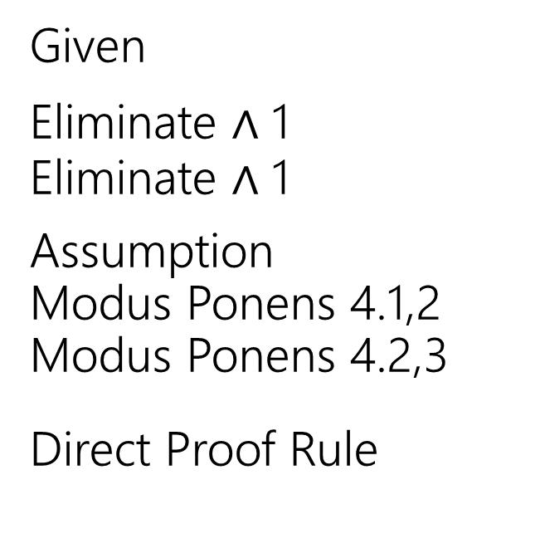
Given: (($p→q)∧(q→r))$ Show: $(p→r)$ (corrected)
Here’s a corrected version of the proof.
$\left(p→q\right)∧\left(q→r\right)$
$p→q$
$q→r$
4.1 $p$
4.2 $q$
4.3 $r$
$p→r$
Given
Eliminate $∧$ 1
Eliminate $∧$ 1
Assumption
Modus Ponens 4.1,2
Modus Ponens 4.2,3
Direct Proof Rule
When introducing an assumption to prove an implication:
Indent, and change numbering.
When reached your conclusion, use the Direct Proof Rule to observe the implication is a fact.
The conclusion is an unconditional fact (doesn’t depend on $p$) so it goes back up a level

Slide 40
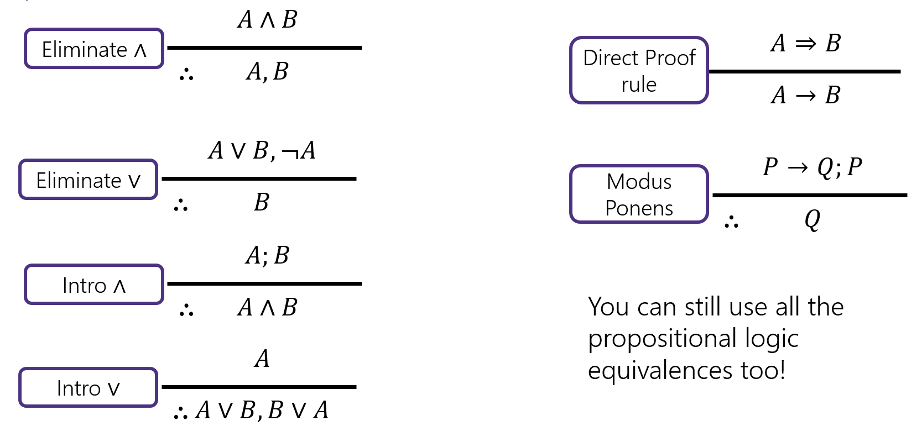

Try it! (setup)
Given: $p∨q$, $\left(r∧s\right)→¬q$, $r$. Show: $s→p$

Slide 41


Try it! (Complete)
Given: $p∨q$, $\left(r∧s\right)→¬q$, $r$. Show: $s→p$
$p∨q$
$\left(r∧s\right)→¬q$
$r$
4.1 $s$
4.2 $r∧s$
4.3 $¬q$
4.4 $q∨p$
4.5 $p$
$s→p$
Given
Given
Given
Assumption
Intro $∧$(3,4.1)
Modus Ponens (2, 4.2)
Commutativity (1)
Eliminate $∨$ (4.4, 4.3)
Direct Proof Rule

Slide 42
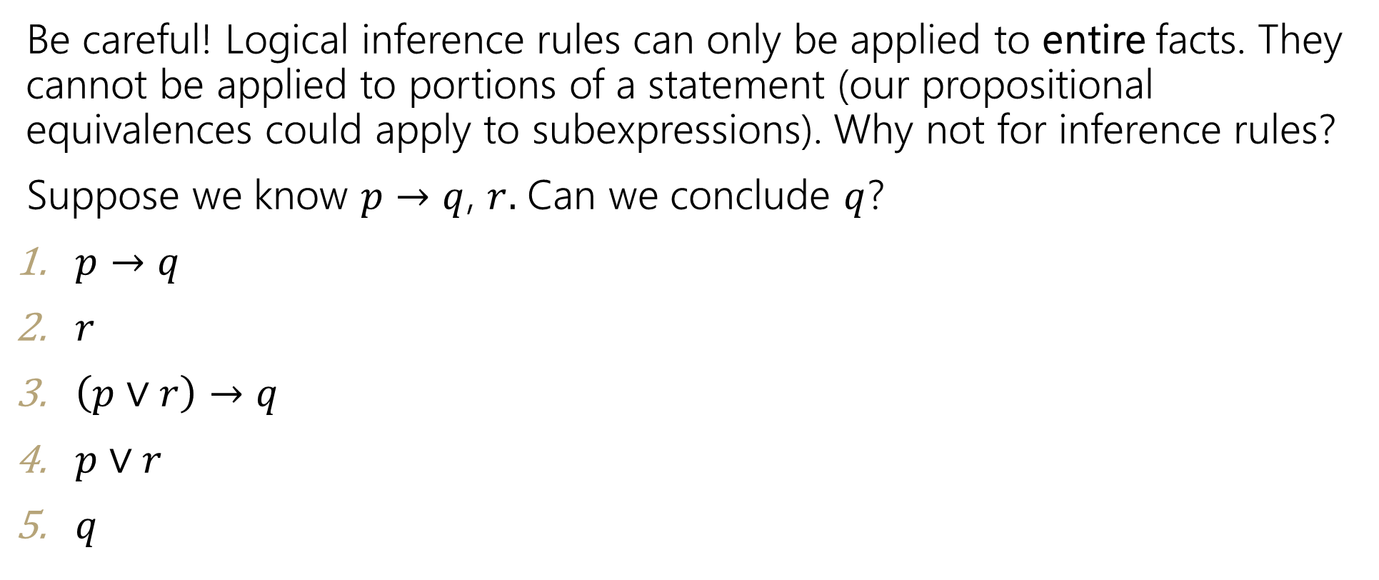
Caution
Be careful! Logical inference rules can only be applied to entire facts. They cannot be applied to portions of a statement (our propositional equivalences could apply to subexpressions). Why not for inference rules?
Suppose we know $p→q$, $r.$ Can we conclude $q$?
$p→q$
$r$
$\left(p∨r\right)→q$
$p∨r$
$q$
Given
Given
Introduce $∨$ (1)
Introduce $∨$ (2)
Modus Ponens 3,4.
$$A$$
Intro $∨$
$$∴$$
$$A∨B, B∨A$$

Slide 43
Inference Proofs in Predicate Logic

Slide 44


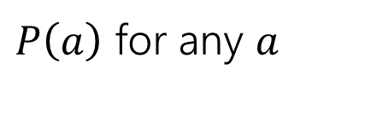





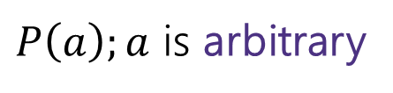


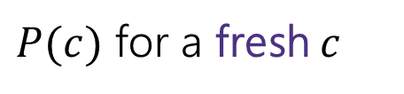
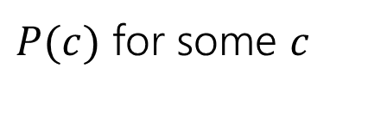



Proofs with Quantifiers
We’ve done symbolic proofs with propositional logic.
To include predicate logic, we’ll need some rules about how to use quantifiers.
$$∀x P(x)$$
$P(c)$ for some $c$
Eliminate $∀$
Intro $∃$
$$∴$$
$$∴$$
$P\left(a\right)$ for any $a$
$$∃x P(x)$$
$P\left(a\right);a$ is arbitrary
$$∃xP(x)$$
Intro $∀$
Eliminate $∃$
$$∴$$
$$∴$$
$P(c)$ for a fresh $c$
$$∀x P(x)$$
Let’s see a good example, then come back to those “arbitrary” and “fresh” conditions.

Slide 45
Proof Using Quantifiers
Suppose we know $∃xP(x)$ and $∀y[ P\left(y\right)→Q\left(y\right)]$. Conclude $∃xQ(x)$.
$$∀x P(x)$$
$P(c)$ for some $c$
Eliminate $∀$
Intro $∃$
$$∴$$
$$∴$$
$P\left(a\right)$ for any $a$
$$∃x P(x)$$
$P\left(a\right);a$ is arbitrary
$$∃xP(x)$$
Intro $∀$
Eliminate $∃$
$$∴$$
$$∴$$
$P(c)$ for a fresh $c$
$$∀x P(x)$$
Notes:
Have a good example here.

Slide 46


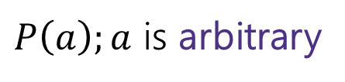
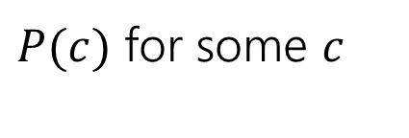






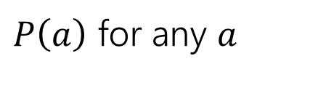





Example Proof Using Quantifiers (setup)
Suppose we know $∃xP(x)$ and $∀y[ P\left(y\right)→Q\left(y\right)]$. Conclude $∃xQ(x)$.
$P(c)$ for some $c$
Intro $∃$
$$∴$$
$$∃x P(x)$$
$$∃xP(x)$$
Eliminate $∃$
$$∴$$
$P(c)$ for a fresh $c$
$$∀x P(x)$$
Eliminate $∀$
$$∴$$
$P\left(a\right)$ for any $a$
$P\left(a\right);a$ is arbitrary
Intro $∀$
$$∴$$
$$∀x P(x)$$
Notes:
Have a good example here.

Slide 47
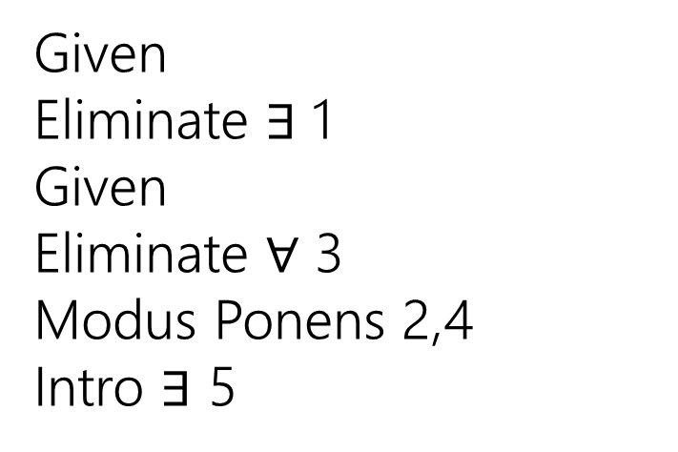
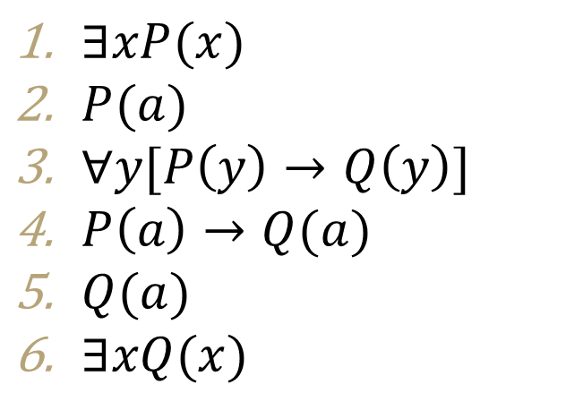
Example Proof Using Quantifiers (Complete)
Suppose we know $∃xP(x)$ and $∀y[ P\left(y\right)→Q\left(y\right)]$. Conclude $∃xQ(x)$.
$P(c)$ for some $c$
$∃xP(x)$
$P(a)$
$∀y[P\left(y\right)→Q\left(y\right)]$
$P\left(a\right)→Q(a)$
$Q(a)$
$∃xQ(x)$
Given
Eliminate $∃$ 1
Given
Eliminate $∀$ 3
Modus Ponens 2,4
Intro $∃$ 5
Intro $∃$
$$∴$$
$$∃x P(x)$$
$$∃xP(x)$$
Eliminate $∃$
$$∴$$
$P(c)$ for a fresh $c$
$$∀x P(x)$$
Eliminate $∀$
$$∴$$
$P\left(a\right)$ for any $a$
$P\left(a\right);a$ is arbitrary
Intro $∀$
$$∴$$
$$∀x P(x)$$
Notes:
Have a good example here.

Slide 48
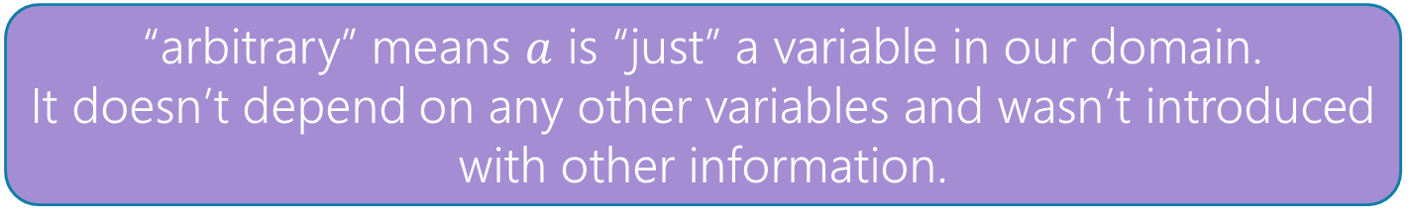
Proofs with Quantifiers (1)
We’ve done symbolic proofs with propositional logic.
To include predicate logic, we’ll need some rules about how to use quantifiers.
$$∀x P(x)$$
$P(c)$ for some $c$
Eliminate $∀$
Intro $∃$
$$∴$$
$$∴$$
$P\left(a\right)$ for any $a$
$$∃x P(x)$$
$P\left(a\right);a$ is arbitrary
$$∃xP(x)$$
Intro $∀$
Eliminate $∃$
$$∴$$
$$∴$$
$P(c)$ for a fresh $c$
$$∀x P(x)$$
“arbitrary” means $a$ is “just” a variable in our domain.
It doesn’t depend on any other variables and wasn’t introduced with other information.

Slide 49
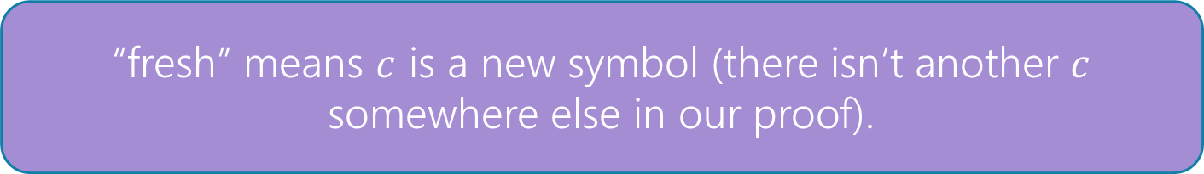
Proofs with Quantifiers (2)
We’ve done symbolic proofs with propositional logic.
To include predicate logic, we’ll need some rules about how to use quantifiers.
$$∀x P(x)$$
$P(c)$ for some $c$
Eliminate $∀$
Intro $∃$
$$∴$$
$$∴$$
$P\left(a\right)$ for any $a$
$$∃x P(x)$$
$P\left(a\right);a$ is arbitrary
$$∃xP(x)$$
Intro $∀$
Eliminate $∃$
$$∴$$
$$∴$$
$P(c)$ for a fresh $c$
$$∀x P(x)$$
“fresh” means $c$ is a new symbol (there isn’t another $c$ somewhere else in our proof).

Slide 50
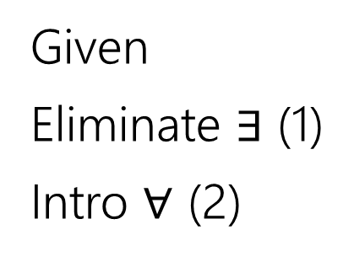
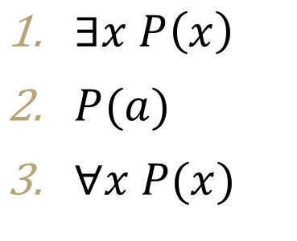
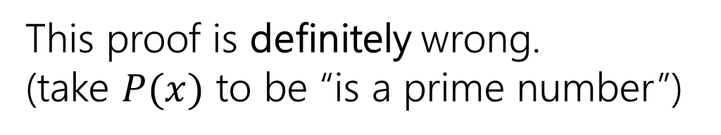
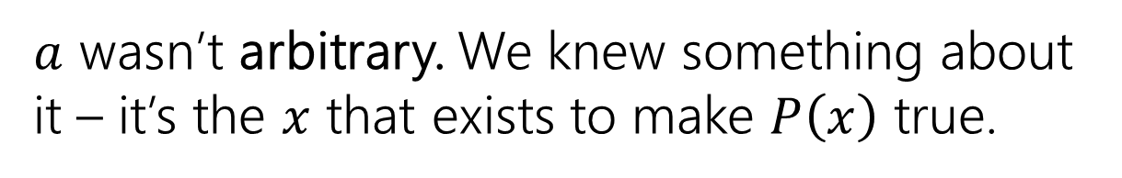
Fresh and Arbitrary
Suppose we know $∃xP\left(x\right)$. Can we conclude $∀xP\left(x\right)$?
$P(c)$ for some $c$
$∃x P\left(x\right)$
$P(a)$
$∀x P(x)$
Given
Eliminate $∃$ (1)
Intro $∀$ (2)
Intro $∃$
$$∴$$
$$∃x P(x)$$
$$∃xP(x)$$
Eliminate $∃$
$$∴$$
$P(c)$ for a fresh $c$
This proof is definitely wrong.
(take $P(x)$ to be “is a prime number”)
$$∀x P(x)$$
Eliminate $∀$
$$∴$$
$P\left(a\right)$ for any $a$
$a$ wasn’t arbitrary. We knew something about it – it’s the $x$ that exists to make $P\left(x\right)$ true.
$P\left(a\right);a$ is arbitrary
Intro $∀$
$$∴$$
$$∀x P(x)$$

Slide 51

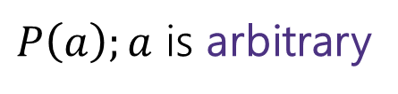

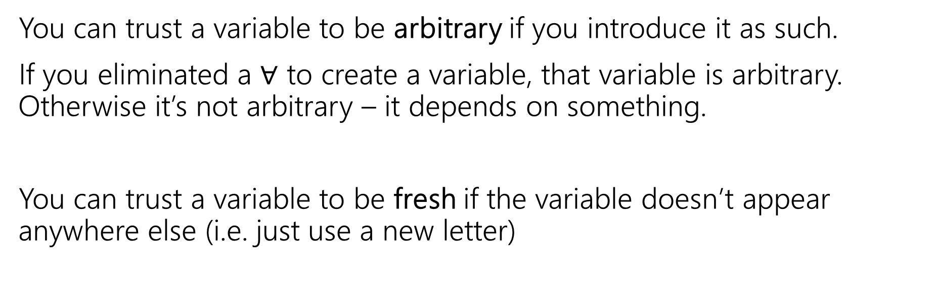





Fresh and Arbitrary (notes 1)
$P\left(a\right);a$ is arbitrary
$$∃xP(x)$$
Intro $∀$
Eliminate $∃$
$$∴$$
$$∴$$
$P(c)$ for a fresh $c$
$$∀x P(x)$$
You can trust a variable to be arbitrary if you introduce it as such.
If you eliminated a $∀$ to create a variable, that variable is arbitrary. Otherwise it’s not arbitrary – it depends on something.
You can trust a variable to be fresh if the variable doesn’t appear anywhere else (i.e. just use a new letter)

Slide 52
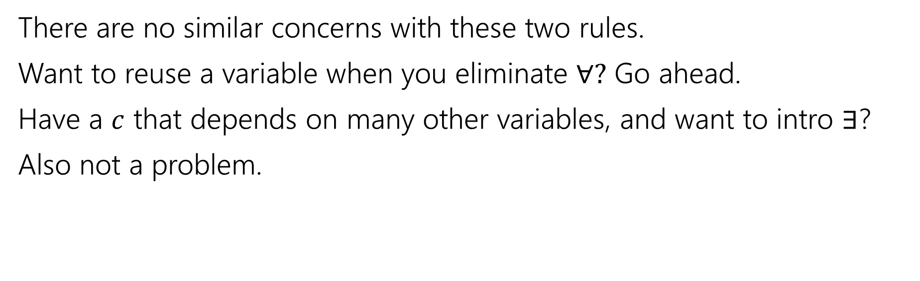
Fresh and Arbitrary (notes 2)
$$∀x P(x)$$
$P(c)$ for some $c$
Eliminate $∀$
Intro $∃$
$$∴$$
$$∴$$
$P\left(a\right)$ for any $a$
$$∃x P(x)$$
There are no similar concerns with these two rules.
Want to reuse a variable when you eliminate $∀?$ Go ahead.
Have a $c$ that depends on many other variables, and want to intro $∃$?
Also not a problem.

Slide 53
Arbitrary Practice (1)
In section, you said: $\left[∃y∀x P\left(x,y\right)\right]→[∀x∃y P\left(x,y\right)]$. Let’s prove it!!

Slide 54
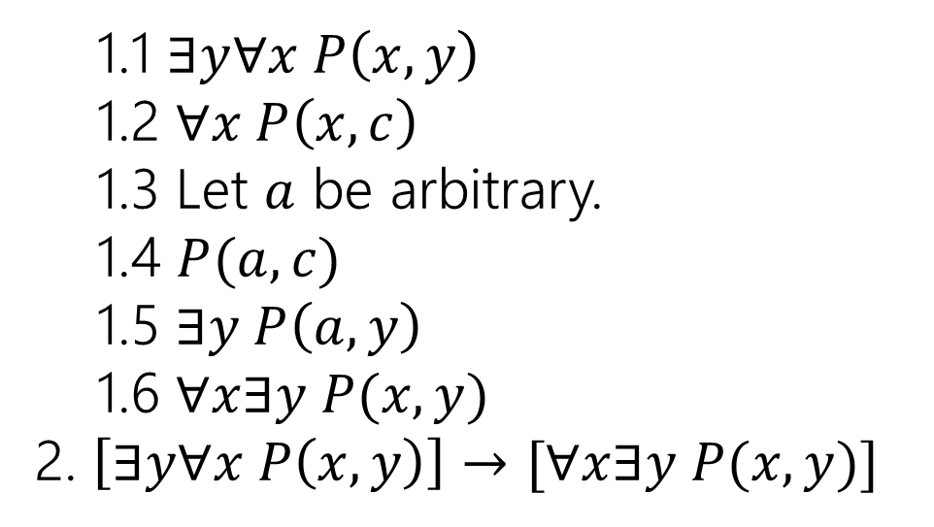

Arbitrary Practice (2)
In section, you said: $\left[∃y∀x P\left(x,y\right)\right]→[∀x∃y P\left(x,y\right)]$. Let’s prove it!!
1.1 $∃y∀x P\left(x,y\right)$
1.2 $∀x P\left(x,c\right)$
1.3 Let $a$ be arbitrary.
1.4 $P(a,c)$
1.5 $∃y P\left(a,y\right)$
1.6 $∀x∃y P(x,y)$
2. $\left[∃y∀x P\left(x,y\right)\right]→[∀x∃y P(x,y)]$
Assumption
Elim $∃$ (1.1)
--
Elim $∀$ (1.2)
Intro $∃$ (1.4)
Intro $∀$ (1.5)
Direct Proof Rule

Slide 55


Arbitrary Practice (3)
In section, you said: $\left[∃y∀x P\left(x,y\right)\right]→[∀x∃y P\left(x,y\right)]$. Let’s prove it!!
1.1 $∃y∀x P\left(x,y\right)$
1.2 $∀x P\left(x,c\right)$
1.4 $P(a,c)$
1.5 $∃y P\left(a,y\right)$
1.6 $∀x∃y P(x,y)$
2. $\left[∃y∀x P\left(x,y\right)\right]→[∀x∃y P(x,y)]$
Assumption
Elim $∃$ (1.1)
Elim $∀$ (1.2)
Intro $∃$ (1.4)
Intro $∀$ (1.5)
Direct Proof Rule
It is not required to have “variable is arbitrary” as a step before using it. But many people (including Robbie) find it helpful.

Slide 56



Find The Bug
Let your domain of discourse be integers.
We claim that given $∀x∃y$ Greater$\left(y,x\right),$ we can conclude $∃y∀x$ Greater($y,x)$
Where Greater$(y,x)$ means $y>x$
$∀x∃y$Greater$\left(y,x\right)$
Let $a$ be an arbitrary integer
$∃y$ Greater$(y,a)$
Greater$(b,a)$
$∀x$Greater$(b,x)$
$∃y∀x$Greater$(y,x)$
Given
--
Elim $∀$ (1)
Elim $∃$ (2)
Intro $∀$ (4)
Intro $∃$ (5)

Slide 57


Find The Bug (with notes)
$∀x∃y$Greater$\left(y,x\right)$
Let $a$ be an arbitrary integer
$∃y$ Greater$(y,a)$
$\text{Greater}(b,a)$
$∀x$Greater$(b,x)$
$∃y∀x$Greater$(y,x)$
Given
--
Elim $∀$ (1)
Elim $∃$ (2)
Intro $∀$ (4)
Intro $∃$ (5)
$b$ is not a single number! The variable $b$ depends on $a.$ You can’t get rid of $a$ while $b$ is still around.
What is $b$? It’s probably something like $a+1$.

Slide 58

Bug Found
There’s one other “hidden” requirement to introduce $∀$.
“No other variable in the statement can depend on the variable to be generalized”
Think of it like this -- $b$ was probably $a+1$in that example.
You wouldn’t have generalized from Greater$(a+1,a)$
To $∀x$ Greater$(a+1, x)$. There’s still an $a,$you’d have replaced all the $a$’s.
$x$ depends on $y$ if $y$ is in a statement when $x$ is introduced.
This issue is much clearer in English proofs, which we’ll start next time.

Slide 59
Extra Practice

Slide 60
One more Proof
Show if we know: $p, q, \left[\left(p∧q\right)→\left(r∧s\right)\right], r→t$ we can conclude $t$.

Slide 61
One more Proof (Complete)
Show if we know: $p, q, \left[\left(p∧q\right)→\left(r∧s\right)\right], r→t$ we can conclude $t$.
$p$
$q$
$[\left(p∧q\right)→\left(r∧s\right)]$
$r→t$
$p∧q$
$r∧s$
$r$
$t$
Given
Given
Given
Given
Intro $∧$ (1,2)
Modus Ponens (3,5)
Eliminate $∧$ (6)
Modus Ponens (4,7)

