Slide 1

Quantifier Negation and Direct Proof
CSE 311: Autumn 25 Lecture 7
Some slides adapted from Anjali Agarwal

Slide 2
Nested Quantifiers

Slide 3






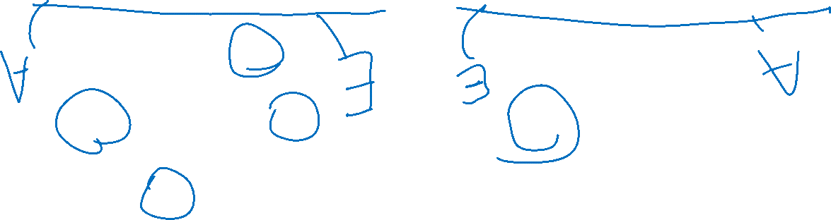
Nested Quantifiers
Translate these sentences using only quantifiers and the predicate AreFriends$(x,y)$
Everyone is friends with someone.
Someone is friends with everyone.

Slide 4
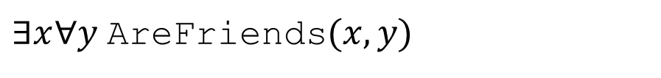
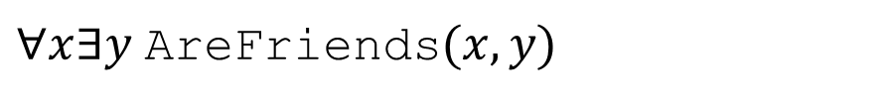
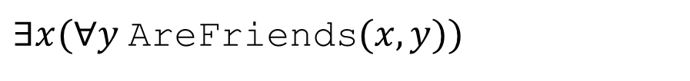

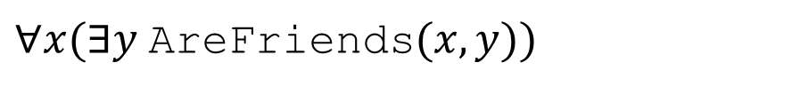
Nested Quantifiers
Translate these sentences using only quantifiers and the predicate AreFriends$(x,y)$
Everyone is friends with someone.
Someone is friends with everyone.
$∀x(∃y$AreFriends$(x,y))$
$∃x(∀y$AreFriends$(x,y))$
$∀x∃y$AreFriends$(x,y)$
$∃x∀y$AreFriends$(x,y)$

Slide 5
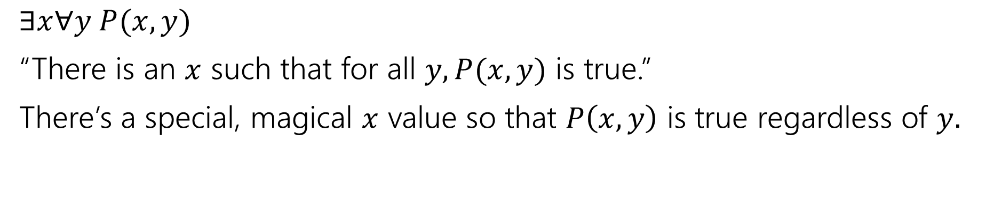
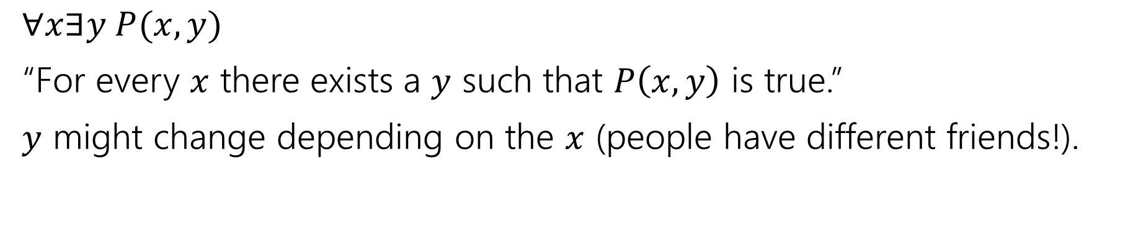

Nested Quantifiers
$∀x∃y P(x,y)$
“For every $x$ there exists a $y$ such that $P\left(x,y\right)$ is true.”
$y$ might change depending on the $x$ (people have different friends!).
$∃x∀y P(x,y)$
“There is an $x$ such that for all $y, P(x,y)$ is true.”
There’s a special, magical $x$ value so that $P\left(x,y\right)$ is true regardless of $y.$

Slide 6
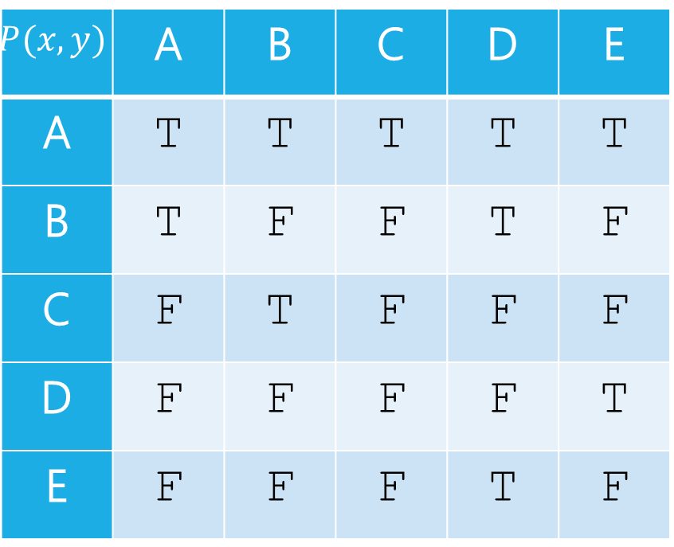
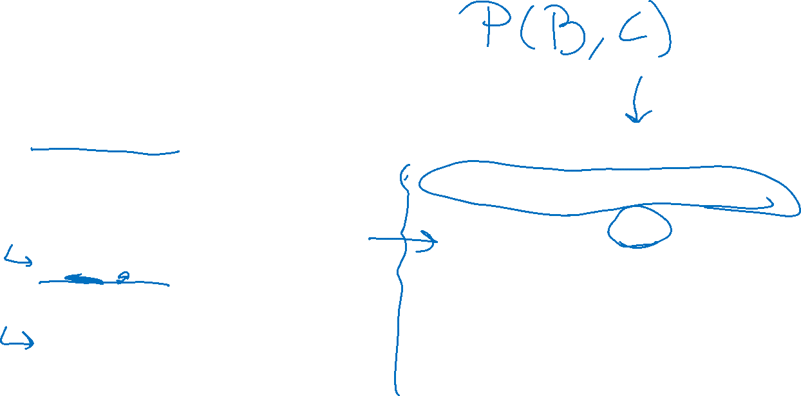
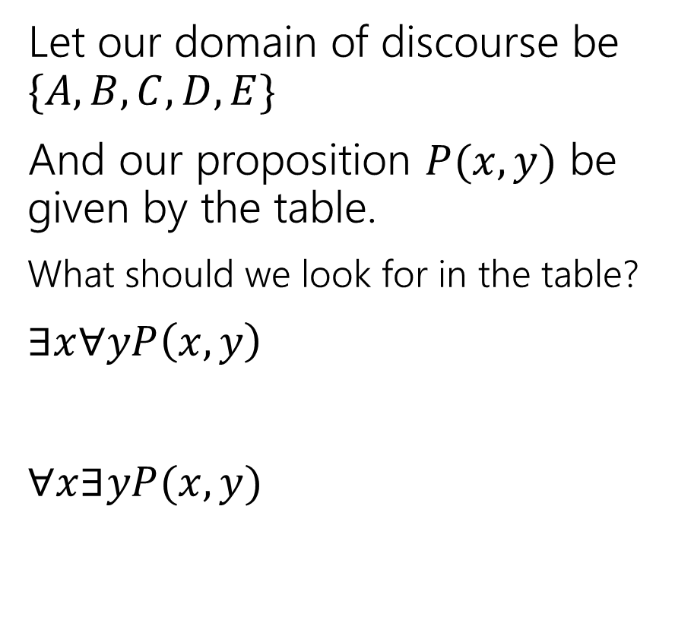


Nested Quantifiers
Let our domain of discourse be $\{A,B,C,D,E\}$
And our proposition $P(x,y)$ be given by the table.
What should we look for in the table?
$∃x∀yP\left(x,y\right)$
$∀x∃yP(x,y)$
$$y$$
$$P(x,y)$$ | A | B | C | D | E
A | T | T | T | T | T
B | T | F | F | T | F
C | F | T | F | F | F
D | F | F | F | F | T
E | F | F | F | T | F
$$x$$

Slide 7
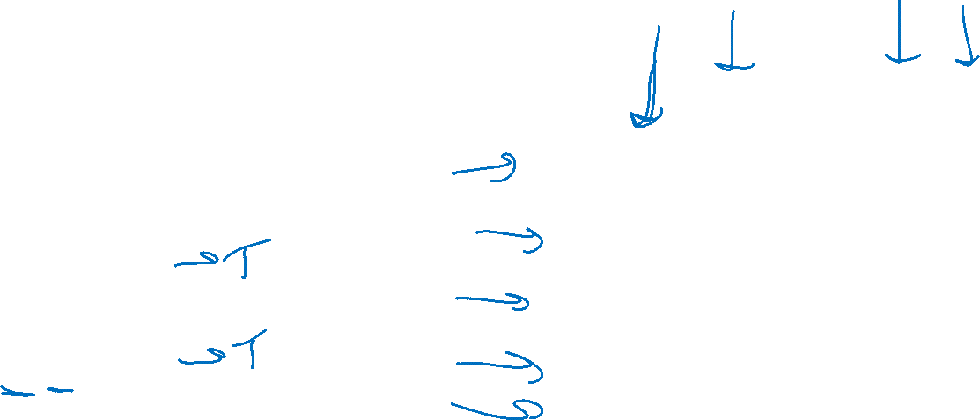
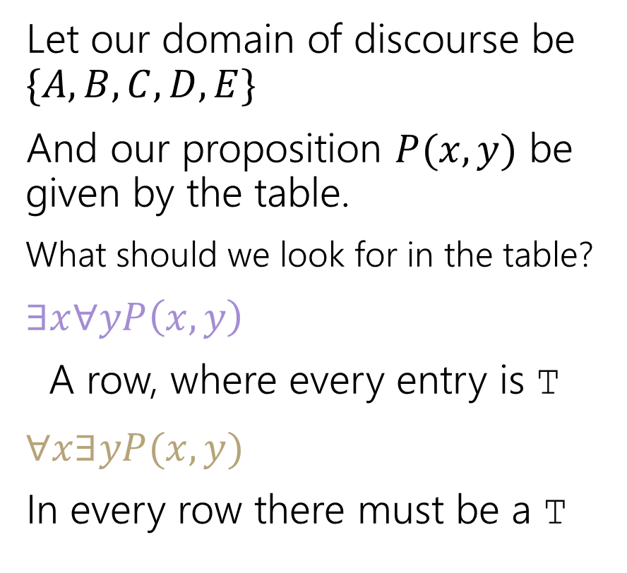
Nested Quantifiers
Let our domain of discourse be $\{A,B,C,D,E\}$
And our proposition $P(x,y)$ be given by the table.
What should we look for in the table?
$∃x∀yP\left(x,y\right)$
A row, where every entry is T
$∀x∃yP(x,y)$
In every row there must be a T
$$y$$
$$P(x,y)$$ | A | B | C | D | E
A | T | T | T | T | T
B | T | F | F | T | F
C | F | T | F | F | F
D | F | F | F | F | T
E | F | F | F | T | F
$$x$$

Slide 8
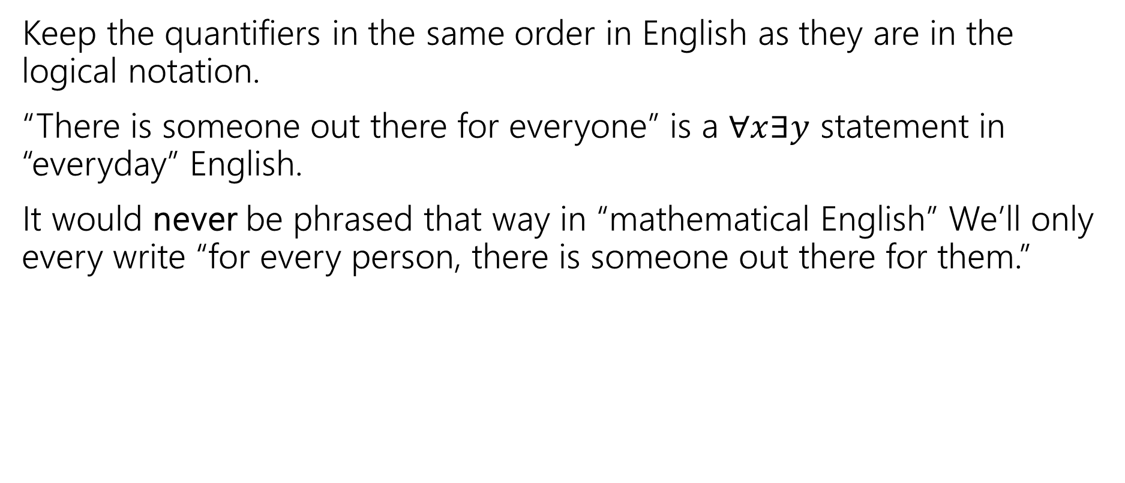

Keep everything in order
Keep the quantifiers in the same order in English as they are in the logical notation.
“There is someone out there for everyone” is a $∀x∃y$ statement in “everyday” English.
It would never be phrased that way in “mathematical English” We’ll only every write “for every person, there is someone out there for them.”

Slide 9





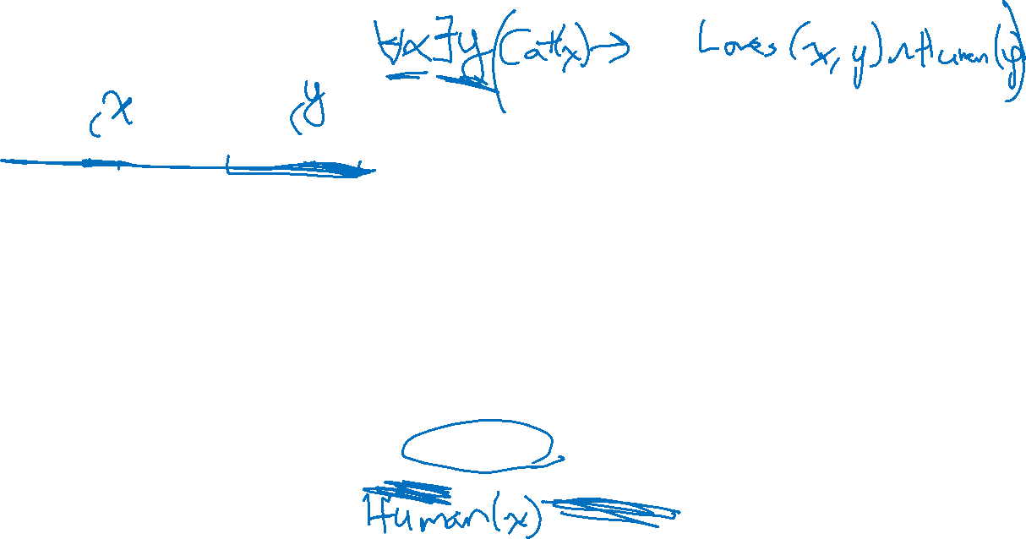
Try it yourselves
Every cat loves some human.
There is a cat that loves every human.
Let your domain of discourse be mammals.
Use the predicates Cat$(x)$, Dog$(x)$, and Loves$(x,y)$ to mean $x$ loves $y$.

Slide 10
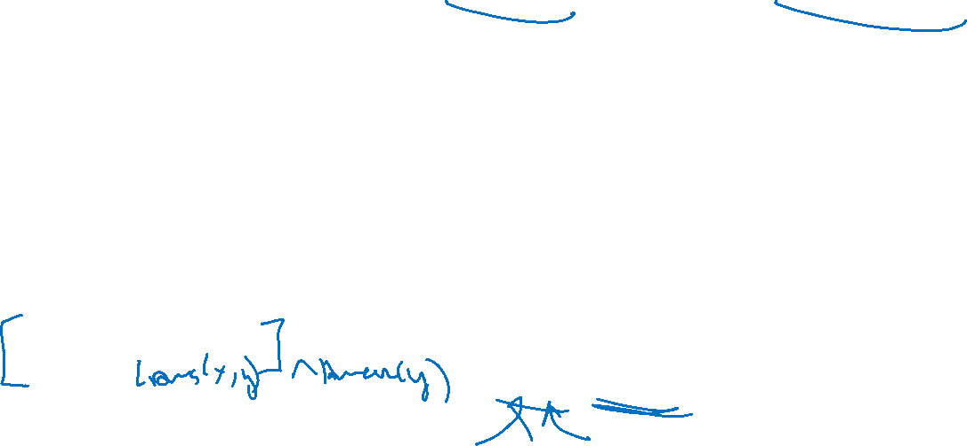
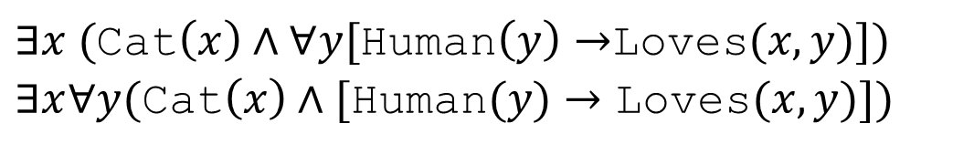
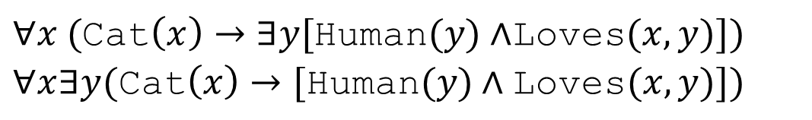
Try it yourselves
Every cat loves some human.
There is a cat that loves every human.
$∀x ($Cat$\left(x\right)→∃y[$Human$(y)∧$Loves$(x,y)])$
$∀x∃y(\text{Cat}\left(x\right)→[\text{Human}(y)∧\text{Loves}(x,y)])$
$∃x ($Cat$\left(x\right)∧∀y[$Human$\left(y\right)→$Loves$(x,y)])$
$∃x∀y(\text{Cat}\left(x\right)∧[\text{Human}(y)→\text{Loves}(x,y)])$

Slide 11
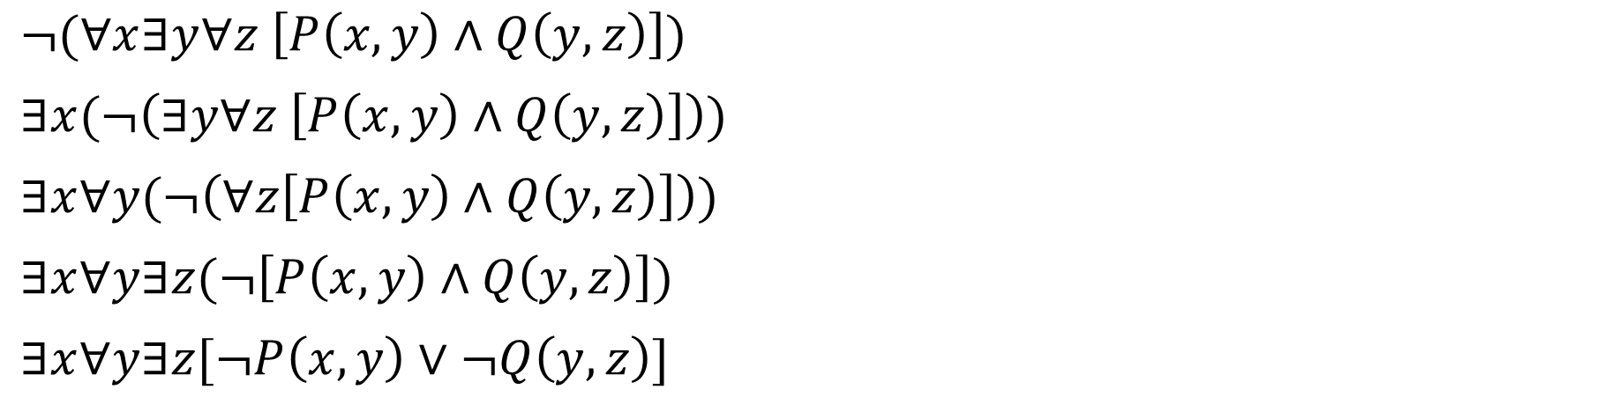
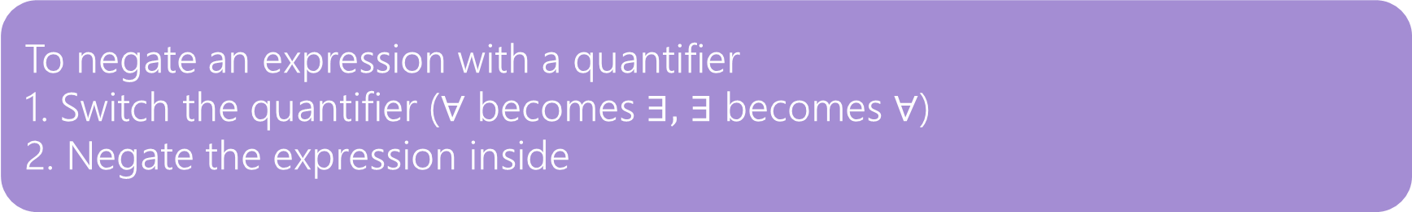
Negation
How do we negate nested quantifiers?
The old rule still applies.
To negate an expression with a quantifier
1. Switch the quantifier ($∀$ becomes $∃,$ $∃$ becomes $∀$)
2. Negate the expression inside
$¬(∀x∃y∀z \left[P\left(x,y\right)∧Q\left(y,z\right)\right])$
$∃x(¬\left(∃y∀z \left[P\left(x,y\right)∧Q\left(y,z\right)\right]\right))$
$∃x∀y(¬\left(∀z\left[P\left(x,y\right)∧Q\left(y,z\right)\right]\right))$
$∃x∀y∃z(¬\left[P\left(x,y\right)∧Q\left(y,z\right)\right])$
$∃x∀y∃z[¬P\left(x,y\right)∨¬Q\left(y,z\right)]$

Slide 12


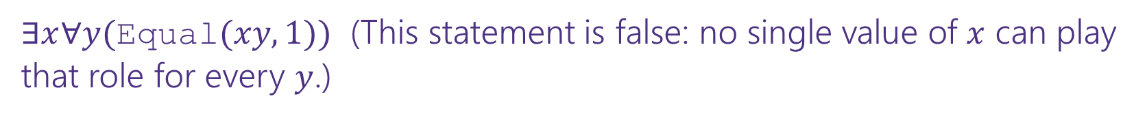
More Translation
For each of the following, translate it, then say whether the statement is true. Let your domain of discourse be integers.
For every integer, there is a greater integer.
There is an integer $x$, such that for all integers $y$, $xy$ is equal to 1.
$∀y∃x($Equal$\left(x+y,1\right))$
$∀x∃y($Greater$(y,x))$ (This statement is true: $y$ can be $x+1$ [$y$ depends on $x]$)
$∃x∀y($Equal$(xy, 1))$ (This statement is false: no single value of $x$ can play that role for every $y$.)
For every integer, $y,$there is an integer $x$ such that $x+y=1$
(This statement is true, $y$ can depend on $x$)

Slide 13
Theorems and Proofs

Slide 14

Theorems and Proofs
Theorem: A statement that has been proven to be true.
Proof: A valid argument that establishes a statement to be true.
You’ll also see
“claim” (the statement we’re about to prove)
“lemma” (small theorem, used to prove a bigger theorem)
“corollary” (small theorem, proven using a bigger theorem)
Notes:
Definition:
A theorem is a statement that can be shown to be true.
A proof is a valid argument that establishes a statement to be true.

Slide 15
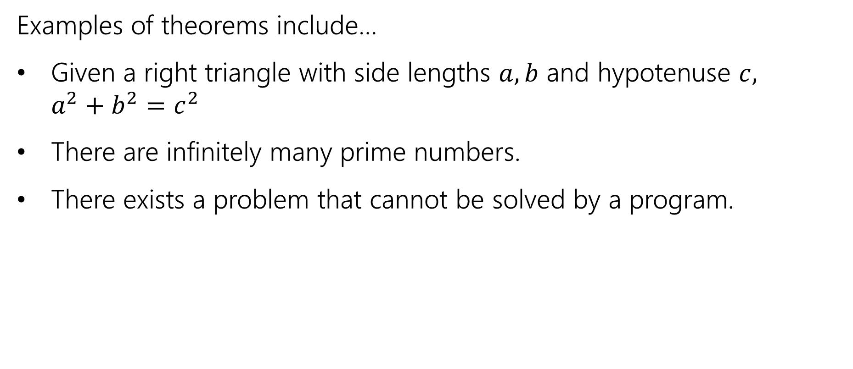
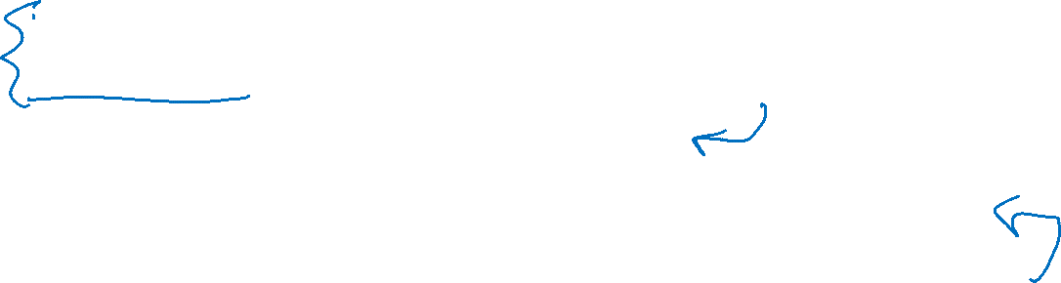
Theorems and Proofs
Examples of theorems include…
Given a right triangle with side lengths $a,b$ and hypotenuse $c,$ $a^{2}+b^{2}=c^{2}$
There are infinitely many prime numbers.
There exists a problem that cannot be solved by a program.
Notes:
We’ll be proving claims.

Slide 16



Integer
We need a basic starting point to be able to prove things.
Objects to work with.
Some definitions to analyze
An integer: is any real number with no fractional part.
Even(x) := An integer, $x,$ is even if and only if there is an integer $k$such that $x=2k.$
Odd(x) := An integer, $x,$ is odd if and only if there is an integer $k$such that $x=2k+1.$
Even
Odd
Notes:
This isn’t the “real” definition of integer---it relies on real numbers! Which we haven’t defined (go visit the math department)
For our purposes, there’s no need to dig deeper

Slide 17

A word on definitions
Definitions are fundamental. Our goal is to communicate precisely.
When you come across an edge case, a definition is the way to solve it.
Is -4 even? Well $∃k(−4=2k)$ (take $k=−2$), so yes it is!
We go to the definition. Not your gut feeling about what feels right.
How do we know something is true? Usually we verify the definition!

Slide 18
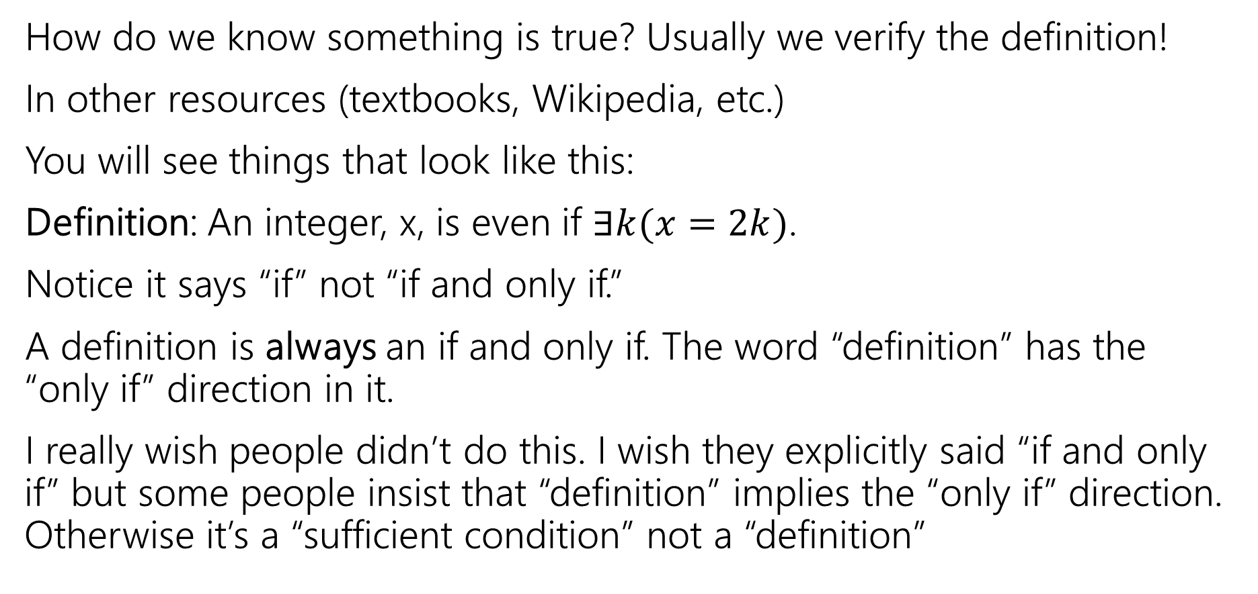

A word on definitions
How do we know something is true? Usually we verify the definition!
In other resources (textbooks, Wikipedia, etc.)
You will see things that look like this:
Definition: An integer, x, is even if $∃k(x=2k)$.
Notice it says “if” not “if and only if.”
A definition is always an if and only if. The word “definition” has the “only if” direction in it.
I really wish people didn’t do this. I wish they explicitly said “if and only if” but some people insist that “definition” implies the “only if” direction. Otherwise it’s a “sufficient condition” not a “definition”

Slide 19
Proof Strategy: Direct Proof

Slide 20


Direct Proof
Direct proof is one strategy for proving statements of the form
$$∀x[P\left(x\right)→Q\left(x\right)]$$
Notes:
Direct proof is one strategy for proving statements of the form $∀x \left(P\left(x\right)→Q\left(x\right)\right)$.

Slide 21
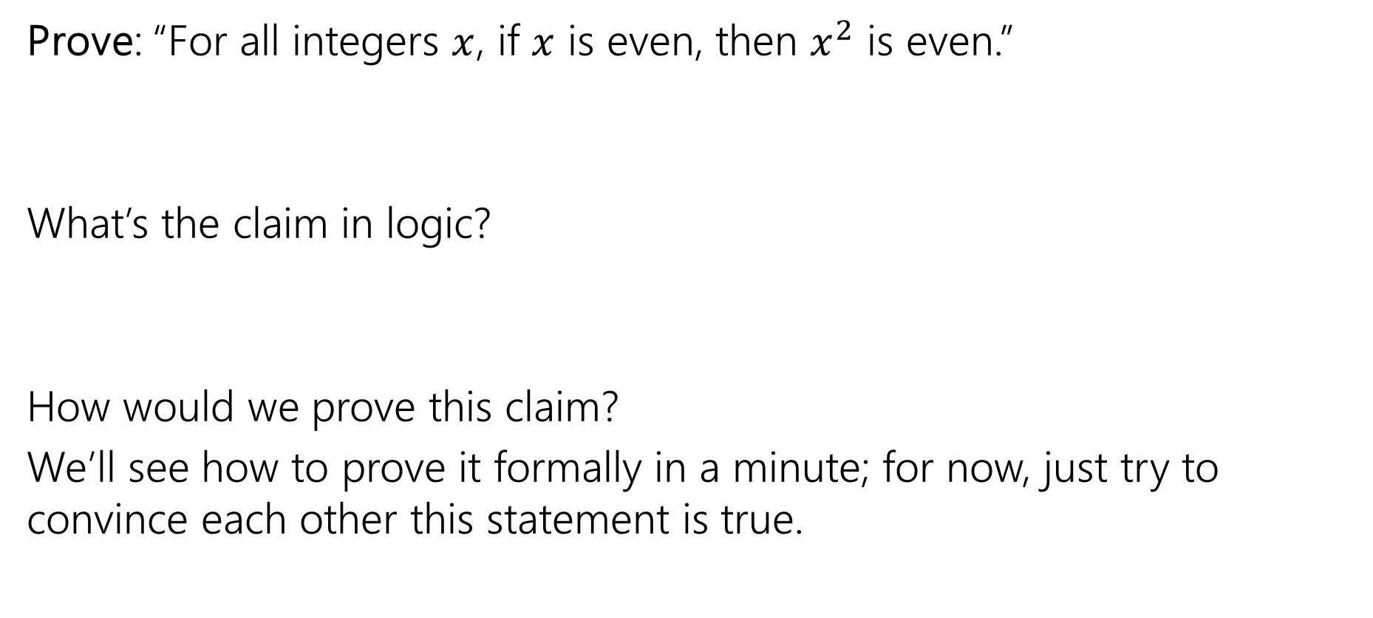
Our First Direct Proof
Prove: “For all integers $x$, if $x$ is even, then $x^{2}$ is even.”
What’s the claim in logic?
How would we prove this claim?
We’ll see how to prove it formally in a minute; for now, just try to convince each other this statement is true.
Notes:
Have a 5 minute discussion on this
Intuition: is this true?
Write out scratchwork

Slide 22

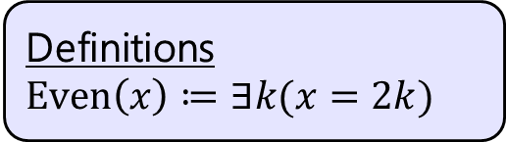
Our First Direct Proof
Definitions
$Even\left(x\right)≔∃k(x=2k)$
Prove: “For all integers $x$, if $x$ is even, then $x^{2}$ is even.” $∀x\left(Even\left(x\right)→Even\left(x^{2}\right)\right)$
Notes:
Let $x$ be an arbitrary integer. Suppose that $x$ is even. Then by definition of even, there exists some integer $k$ such that $x=2k$. Squaring both sides, we see that:
$$x^{2}={\left(2k\right)}^{2}=4k^{2}=2⋅2k^{2}$$
Because $k$ is an integer, then $2k^{2}$ is also an integer. So $x^{2}$ is two times an integer.
So by definition of even, $x^{2}$ is even.
Since $x$ was an arbitrary integer, we can conclude that for all integers $x$, if $x$ is even then $x^{2}$ is even.
Run through with a number

Slide 23
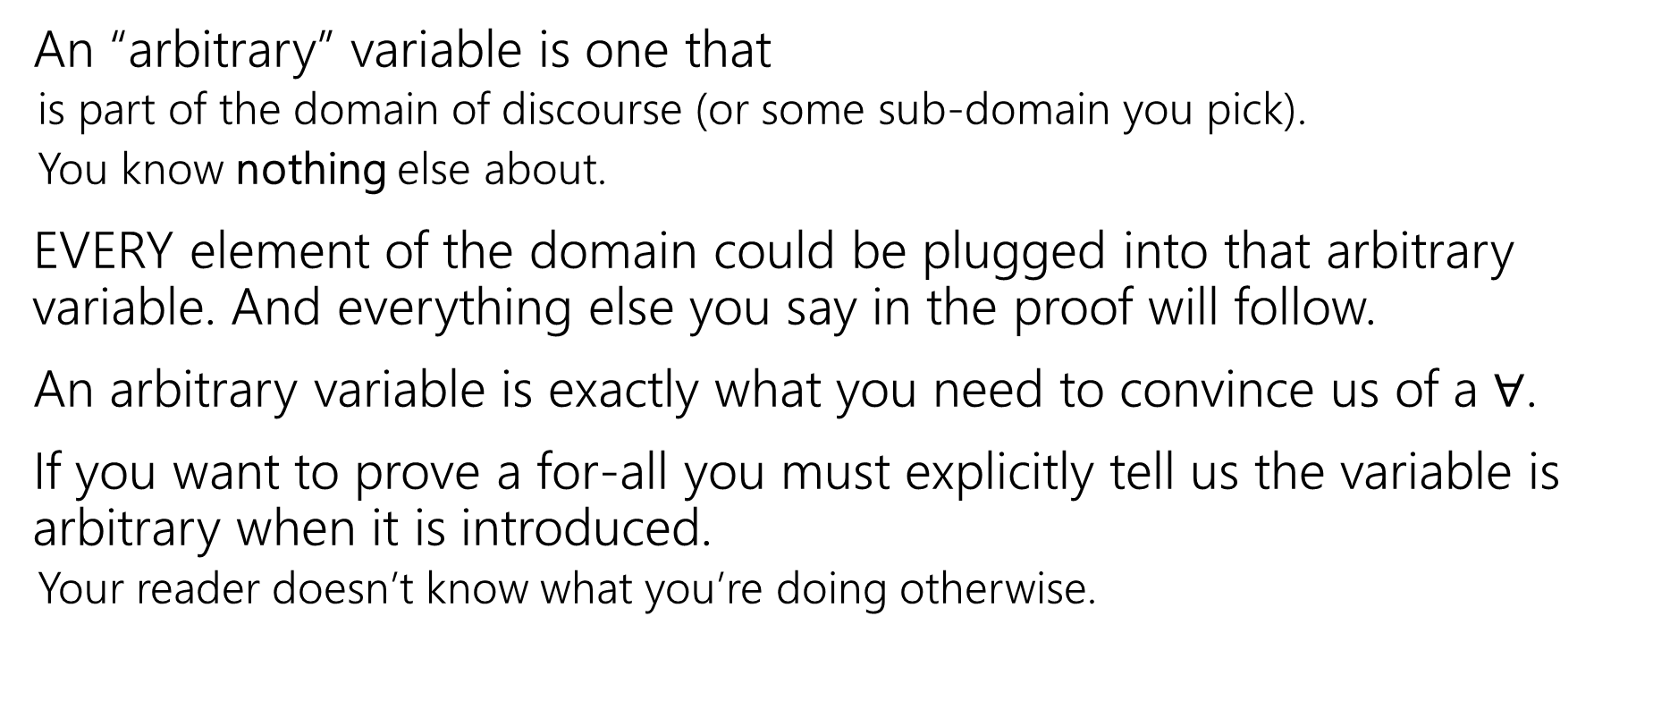

Arbitrary
An “arbitrary” variable is one that
is part of the domain of discourse (or some sub-domain you pick).
You know nothing else about.
EVERY element of the domain could be plugged into that arbitrary variable. And everything else you say in the proof will follow.
An arbitrary variable is exactly what you need to convince us of a $∀$.
If you want to prove a for-all you must explicitly tell us the variable is arbitrary when it is introduced.
Your reader doesn’t know what you’re doing otherwise.

Slide 24

Our First Direct Proof
Definitions
$Even\left(x\right)≔∃k(x=2k)$
Prove: “For all integers $x$, if $x$ is even, then $x^{2}$ is even.” $∀x\left(Even\left(x\right)→Even\left(x^{2}\right)\right)$
Proof: Let $x$ be an arbitrary integer. Suppose that $x$ is even.
Notes:
Let $x$ be an arbitrary integer. Suppose that $x$ is even. Then by definition of even, there exists some integer $k$ such that $x=2k$. Squaring both sides, we see that:
$$x^{2}={\left(2k\right)}^{2}=4k^{2}=2⋅2k^{2}$$
Because $k$ is an integer, then $2k^{2}$ is also an integer. So $x^{2}$ is two times an integer.
So by definition of even, $x^{2}$ is even.
Since $x$ was an arbitrary integer, we can conclude that for all integers $x$, if $x$ is even then $x^{2}$ is even.
Run through with a number

Slide 25

Now What?
Definitions
$Even\left(x\right)≔∃k(x=2k)$
Well….what does it mean to be even?
$x=2k$ for some integer $k$.
Where do we need to end up?
Even$(x^{2})$

Slide 26

Our First Direct Proof
Definitions
$Even\left(x\right)≔∃k(x=2k)$
Prove: “For all integers $x$, if $x$ is even, then $x^{2}$ is even.” $∀x\left(Even\left(x\right)→Even\left(x^{2}\right)\right)$
Proof: Let $x$ be an arbitrary integer. Suppose that $x$ is even.
So $x^{2}$ is even.
Notes:
Let $x$ be an arbitrary integer. Suppose that $x$ is even. Then by definition of even, there exists some integer $k$ such that $x=2k$. Squaring both sides, we see that:
$$x^{2}={\left(2k\right)}^{2}=4k^{2}=2⋅2k^{2}$$
Because $k$ is an integer, then $2k^{2}$ is also an integer. So $x^{2}$ is two times an integer.
So by definition of even, $x^{2}$ is even.
Since $x$ was an arbitrary integer, we can conclude that for all integers $x$, if $x$ is even then $x^{2}$ is even.
Run through with a number

Slide 27

Our First Direct Proof
Definitions
$Even\left(x\right)≔∃k(x=2k)$
Prove: “For all integers $x$, if $x$ is even, then $x^{2}$ is even.” $∀x\left(Even\left(x\right)→Even\left(x^{2}\right)\right)$
Proof: Let $x$ be an arbitrary integer. Suppose that $x$ is even.
By definition of even, $x=2k$ for some integer $k$.
So $x^{2}$ is even.
Notes:
Let $x$ be an arbitrary integer. Suppose that $x$ is even. Then by definition of even, there exists some integer $k$ such that $x=2k$. Squaring both sides, we see that:
$$x^{2}={\left(2k\right)}^{2}=4k^{2}=2⋅2k^{2}$$
Because $k$ is an integer, then $2k^{2}$ is also an integer. So $x^{2}$ is two times an integer.
So by definition of even, $x^{2}$ is even.
Since $x$ was an arbitrary integer, we can conclude that for all integers $x$, if $x$ is even then $x^{2}$ is even.
Run through with a number

Slide 28
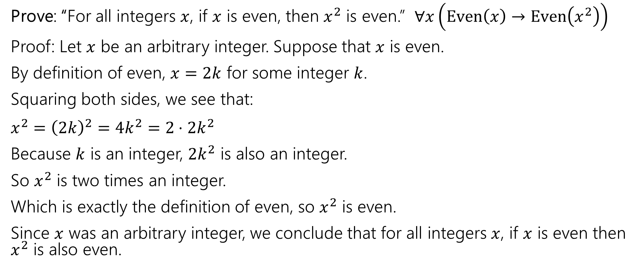
Our First Direct Proof
Definitions
$Even\left(x\right)≔∃k(x=2k)$
Prove: “For all integers $x$, if $x$ is even, then $x^{2}$ is even.” $∀x\left(Even\left(x\right)→Even\left(x^{2}\right)\right)$
Proof: Let $x$ be an arbitrary integer. Suppose that $x$ is even.
By definition of even, $x=2k$ for some integer $k$.
Squaring both sides, we see that:
$x^{2}={\left(2k\right)}^{2}=4k^{2}=2⋅2k^{2}$
Because $k$ is an integer, $2k^{2}$ is also an integer.
So $x^{2}$ is two times an integer.
Which is exactly the definition of even, so $x^{2}$ is even.
Since $x$ was an arbitrary integer, we conclude that for all integers $x$, if $x$ is even then $x^{2}$ is also even.
Notes:
Let $x$ be an arbitrary integer. Suppose that $x$ is even. Then by definition of even, there exists some integer $k$ such that $x=2k$. Squaring both sides, we see that:
$$x^{2}={\left(2k\right)}^{2}=4k^{2}=2⋅2k^{2}$$
Because $k$ is an integer, then $2k^{2}$ is also an integer. So $x^{2}$ is two times an integer.
So by definition of even, $x^{2}$ is even.
Since $x$ was an arbitrary integer, we can conclude that for all integers $x$, if $x$ is even then $x^{2}$ is even.
Run through with a number

Slide 29
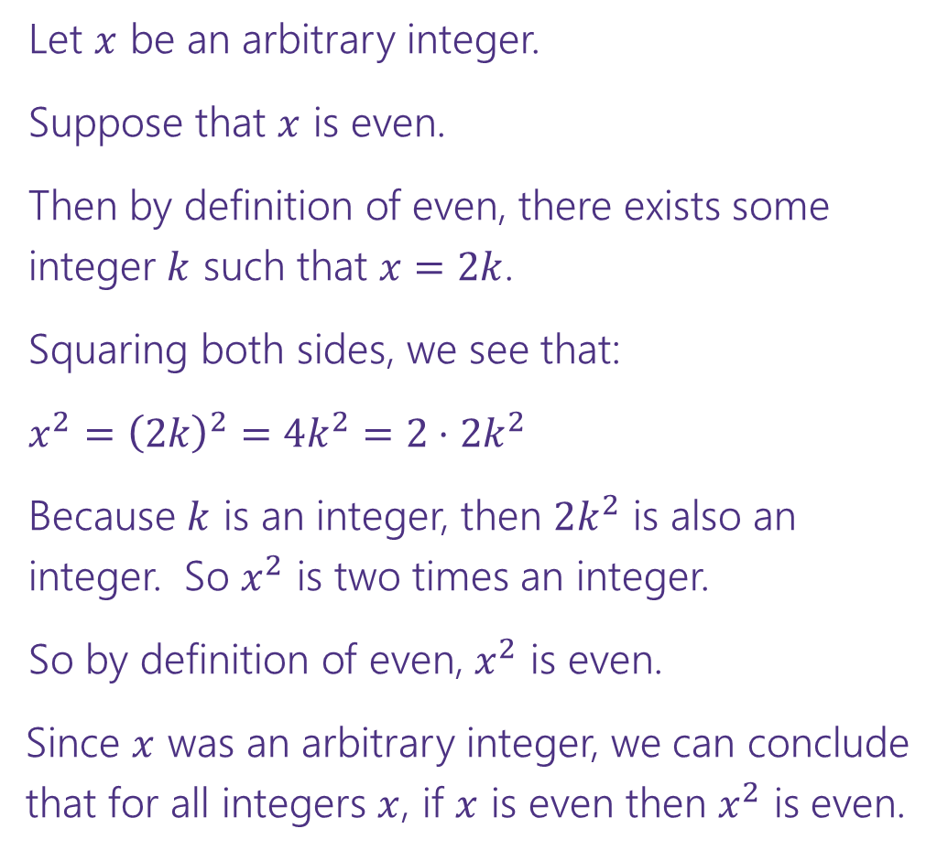


Direct Proof Template
Prove: $∀x\left(Even\left(x\right)→Even\left(x^{2}\right)\right)$
Declare an arbitrary variable for each $∀$.
Let $x$ be an arbitrary integer.
Suppose that $x$ is even.
Then by definition of even, there exists some integer $k$ such that $x=2k$.
Squaring both sides, we see that:
$x^{2}={\left(2k\right)}^{2}=4k^{2}=2⋅2k^{2}$
Because $k$ is an integer, then $2k^{2}$ is also an integer. So $x^{2}$ is two times an integer.
So by definition of even, $x^{2}$ is even.
Since $x$ was an arbitrary integer, we can conclude that for all integers $x$, if $x$ is even then $x^{2}$ is even.
Assume the left side of the implication.
Unroll the predicate definitions.
Manipulate towards the goal.
Reroll definitions into the right side of the implication.
Conclude that you have proved the claim.

Slide 30
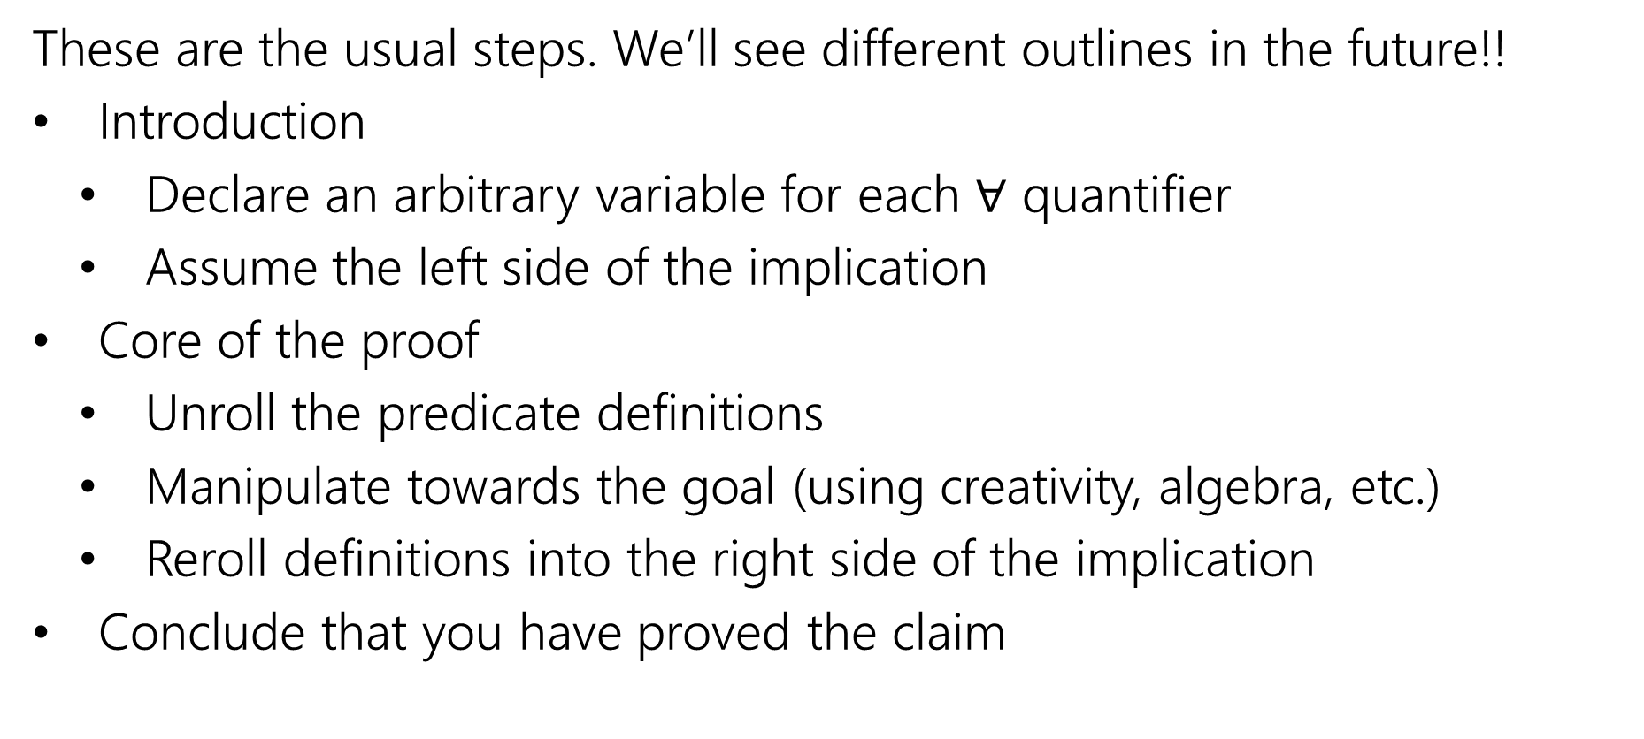
Direct Proof Steps
These are the usual steps. We’ll see different outlines in the future!!
Introduction
Declare an arbitrary variable for each $∀$ quantifier
Assume the left side of the implication
Core of the proof
Unroll the predicate definitions
Manipulate towards the goal (using creativity, algebra, etc.)
Reroll definitions into the right side of the implication
Conclude that you have proved the claim

Slide 31
Inference Proofs

Slide 32
A Brief Return to Training Wheels
For about 1.5 lectures, we’re going to study “inference proofs”
The rules for these proofs are
1. Strict enough that computers can check them (there are languages designed to do that!)
2. More general than the simplification rules we’ve seen so far.
You’ll still use the simplification rules!
But you’ll find we can prove more things (at least without significant difficulty).
3. More similar to the proofs we spend most of the quarter writing.

Slide 33
A Brief Return to Training Wheels
The claims and proofs are quite abstract!
Why spend time here?
Some computer scientists use the fully formal (computer-checkable) version of the rules.
Our PL group here contains experts in these topics!
We want your takeaways to be
In principle, any proof we write in this class could be made fully formal and checked.
But it can be a lot of work, so we usually think and communicate in English. We’re people after all!

Slide 34
Inference Proofs
A new way of thinking of proofs:
Here’s one way to get an iron-clad guarantee:
1. Write down all the facts we know.
2. Combine the things we know to derive new facts.
3. Continue until what we want to show is a fact.

Slide 35
Drawing Conclusions
You know “If it is raining, then I have my umbrella”
And “It is raining”
You should conclude….
For whatever you conclude, convert the statement to propositional logic – will your statement hold for any propositions, or is it specific to raining and umbrellas?
I have my umbrella!
I know $(p→q)$ and $p$, I can conclude $q$
Or said another way: $\left[\left(p→q\right)∧p\right]→q$

Slide 36
Modus Ponens
The inference from the last slide is always valid. I.e.
$$\left[\left(p→q\right)∧p\right]→q$$
Has only True rows in its truth table (it’s a tautology)

Slide 37
Modus Ponens – a formal proof
$$\left[\left(p→q\right)∧p\right]→q$$
$≡[\left(¬p∨q\right)∧p]→q$
$≡\left[p∧\left(¬p∨q\right)\right]→q$
$≡\left[\left(p∧¬p\right)∨\left(p∧q\right)\right]→q$
$≡\left[F∨\left(p∧q\right)\right]→q$
$≡\left[\left(p∧q\right)∨F\right]→q$
$≡\left[\left(p∧q\right)\right]→q$
$≡\left[¬\left(p∧q\right)\right]∨q$
$≡\left[¬p∨¬q\right]∨q$
$≡¬p∨[¬q∨q]$
$≡¬p∨[q∨¬q]$
$≡¬p∨T$
$≡T$
Law of Implication
Commutativity
Distributivity
Negation
Commutativity
Identity
Law of Implication
DeMorgan’s Law
Associativity
Commutativity
Negation
Domination

Slide 38
Modus Ponens
The inference from the last slide is always valid. I.e.
$$\left[\left(p→q\right)∧p\right]→q≡T$$
We use that inference A LOT
So often people gave it a name (“Modus Ponens”)
So often…we don’t have time to repeat that 12 line proof EVERY TIME.
Let’s make this another law we can apply in a single step.
Just like refactoring a method in code.

Slide 39
Notation – Laws of Inference
We’re using the “$→“$ symbol A LOT.
Too much
Some new notation to make our lives easier.
If we know both $A$and$B$
$$A,B$$
$$∴$$
We can conclude any (or all) of $C,D$
$$∴$$
$$C,D$$
“$∴$” means “therefore” – I knew $A,B$ therefore I can conclude $C,D$.
$$p→q,p$$
Modus Ponens, i.e. $\left[\left(p→q\right)∧p\right]→q$), in our new notation.
$$∴$$
$$q$$

Slide 40


Integer
We need a basic starting point to be able to prove things.
Objects to work with.
Some definitions to analyze
An integer: is any real number with no fractional part.
Even(x) := An integer, $x,$ is even if and only if there is an integer $k$such that $x=2k.$
Odd(x) := An integer, $x,$ is odd if and only if there is an integer $k$such that $x=2k+1.$
Even
Odd
Notes:
This isn’t the “real” definition of integer---it relies on real numbers! Which we haven’t defined (go visit the math department)
For our purposes, there’s no need to dig deeper

