Slide 1

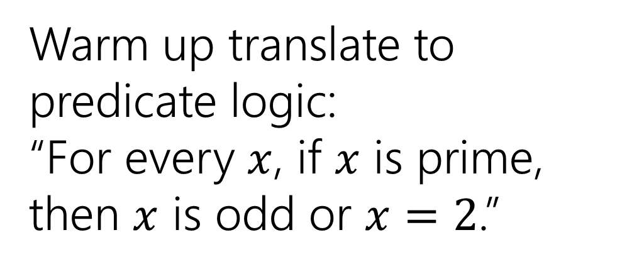
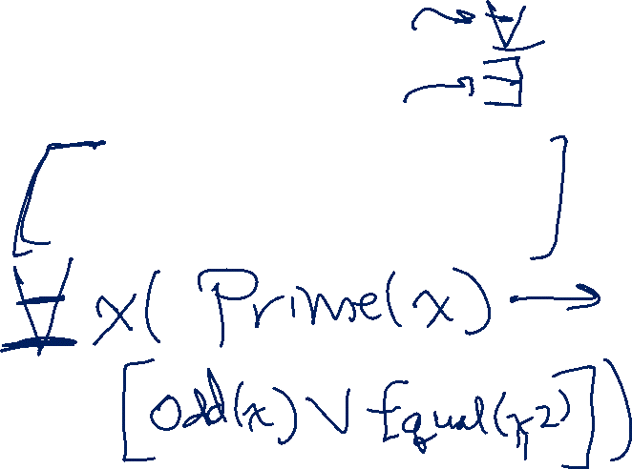
Nested Unalike Quantifiers
Warm up translate to predicate logic:
“For every $x$, if $x$ is prime, then $x$ is odd or $x=2$.”
CSE 311 Fall 25
Lecture 6

Slide 2
Announcements
HW1 solutions handed out in lecture today.
If you missed them, they are in an envelope outside Miya’s office door
CSE 460---in Allen take the elevator to the 4th floor, turn left.
Don’t need to wait for office hours, just grab them.
Robbie will also have copies in office hours as well.

Slide 3
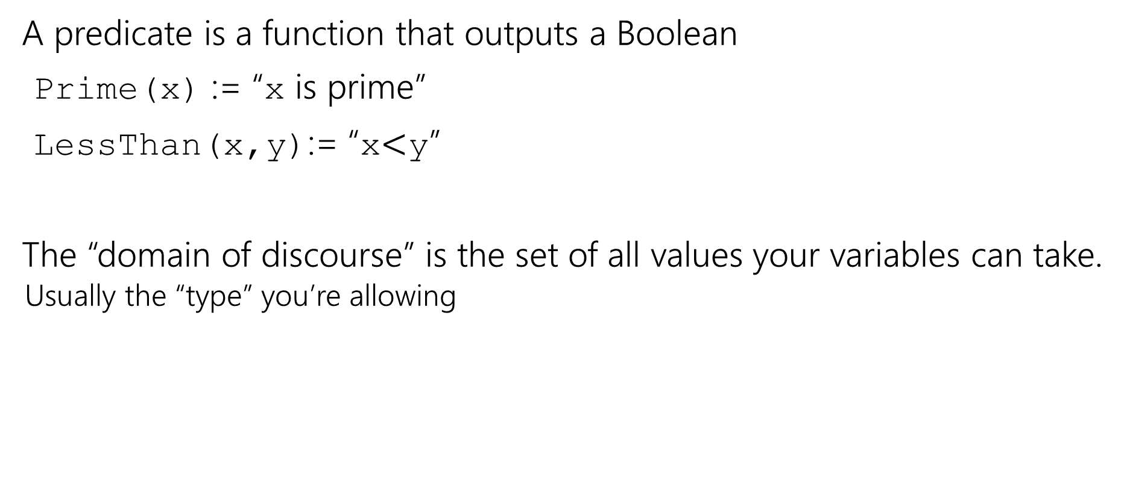
Where were we?
A predicate is a function that outputs a Boolean
Prime(x) := “x is prime”
LessThan(x,y):= “x$<$y”
The “domain of discourse” is the set of all values your variables can take.
Usually the “type” you’re allowing

Slide 4
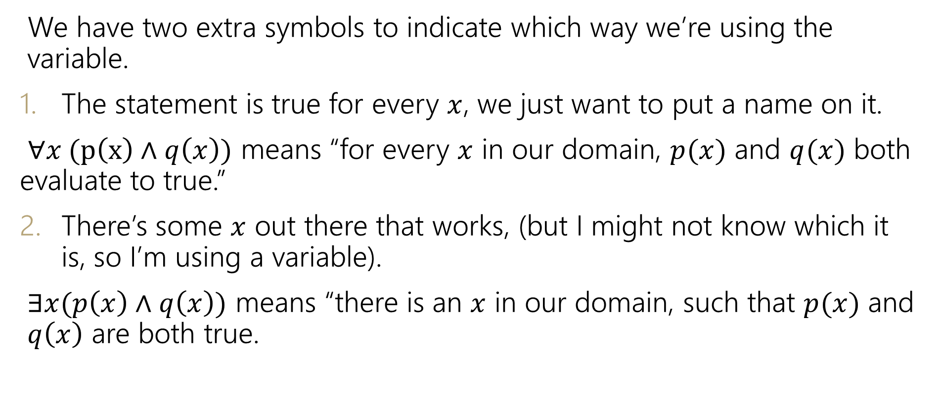
Quantifiers
We have two extra symbols to indicate which way we’re using the variable.
The statement is true for every $x$, we just want to put a name on it.
$∀x (p\left(x\right)∧q\left(x\right))$ means “for every $x$ in our domain, $p(x)$ and $q(x)$ both evaluate to true.”
There’s some $x$ out there that works, (but I might not know which it is, so I’m using a variable).
$∃x(p\left(x\right)∧q\left(x\right))$ means “there is an $x$ in our domain, such that $p(x)$ and $q\left(x\right)$ are both true.

Slide 5
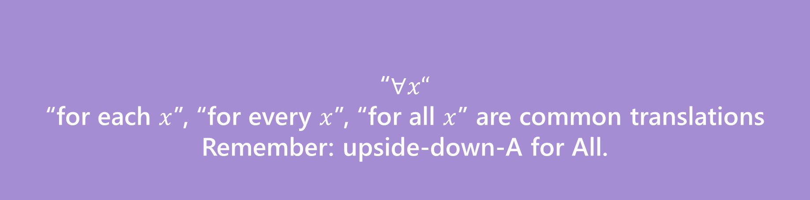

Quantifiers
We have two extra symbols to indicate which way we’re using the variable.
The statement is true for every $x$, we just want to put a name on it.
$∀x (p\left(x\right)∧q\left(x\right))$ means “for every $x$ in our domain, $p(x)$ and $q(x)$ both evaluate to true.”
There’s some $x$ out there that works, (but I might not know which it is, so I’m using a variable).
$∃x(p\left(x\right)∧q\left(x\right))$ means “there is an $x$ in our domain, $p(x)$ and $q\left(x\right)$ are both true.
“$∀x“$
“for each $x$”, “for every $x$”, “for all $x$” are common translations
Remember: upside-down-A for All.
Universal Quantifier

Slide 6
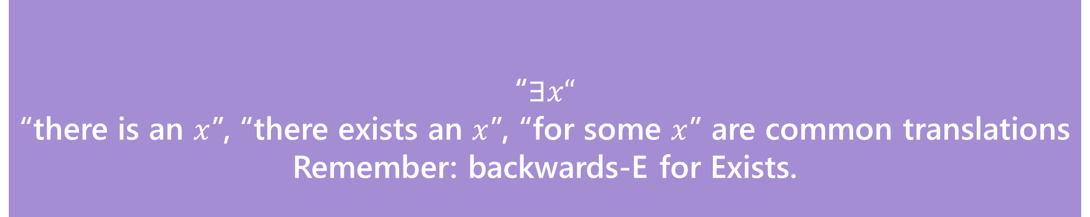

Quantifiers
“$∃x“$
“there is an $x$”, “there exists an $x$”, “for some $x$” are common translations
Remember: backwards-E for Exists.
Existential Quantifier
We have two extra symbols to indicate which way we’re using the variable.
The statement is true for every $x$, we just want to put a name on it.
$∀x (p\left(x\right)∧q\left(x\right))$ means “for every $x$ in our domain, $p(x)$ and $q(x)$ both evaluate to true.”
There’s some $x$ out there that works, (but I might not know which it is, so I’m using a variable).
$∃x(p\left(x\right)∧q\left(x\right))$ means “there is an $x$ in our domain, for which $p(x)$ and $q\left(x\right)$ are both true.

Slide 7
More Practice
Let your domain of discourse be fruits. Translate these
There is a fruit that is tasty and ripe.
For every fruit, if it is not ripe then it is not tasty.
There is a fruit that is sliced and diced.

Slide 8
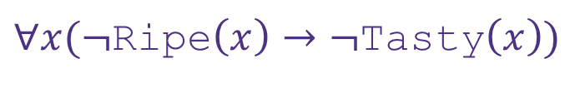
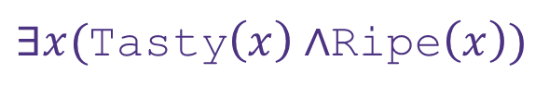
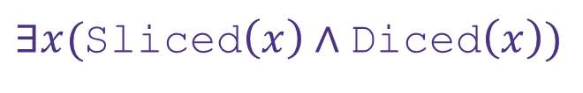
More Practice
Let your domain of discourse be fruits. Translate these
There is a fruit that is tasty and ripe.
For every fruit, if it is not ripe then it is not tasty.
There is a fruit that is sliced and diced.
$∃x($Tasty$\left(x\right)∧$Ripe$\left(x\right))$
$∀x(¬$Ripe$\left(x\right)→¬\text{Tasty}\left(x\right))$
$∃x($Sliced$\left(x\right)∧\text{Diced}\left(x\right))$

Slide 9

Domain Restriction

Slide 10


Quantifiers
$∀$ (for All) and $∃$ (there Exists)
Write these statements in predicate logic with quantifiers. Let your domain of discourse be “cats”
If a cat is fat, then it is happy.
This sentence implicitly makes a statement about all cats!
$∀x[$Fat$\left(x\right)→$ Happy$\left(x\right)]$

Slide 11
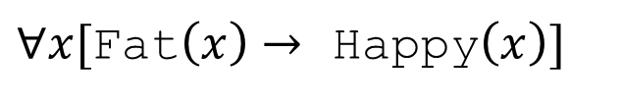

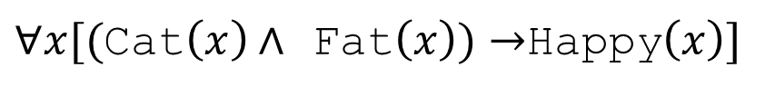
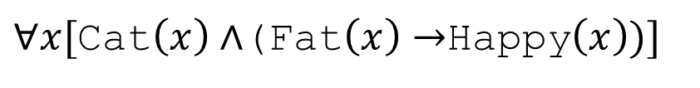

Quantifiers
Writing implications can be tricky when we change the domain of discourse.
For every cat: if the cat is fat, then it is happy.
Domain of Discourse: cats
$∀x[$Fat$\left(x\right)→$ Happy$\left(x\right)]$
What if we change our domain of discourse to be all mammals?
We need to limit $x$ to be a cat. How do we do that?
$∀x[($Cat$\left(x\right)∧$ Fat$\left(x\right))→$Happy$\left(x\right)]$
$∀x[$Cat$\left(x\right)∧$(Fat$\left(x\right)→$Happy$\left(x\right))]$

Slide 12
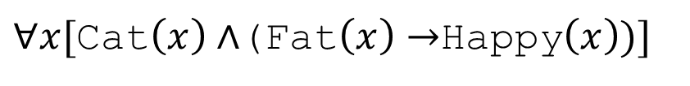
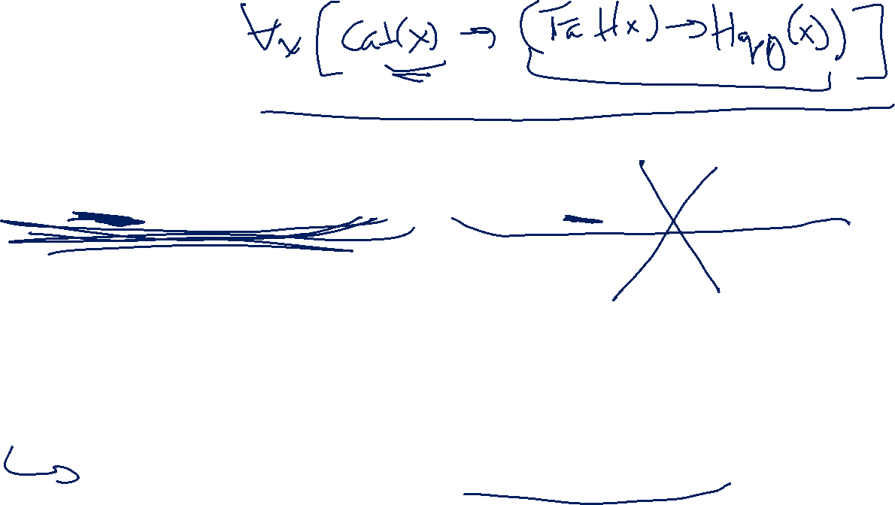
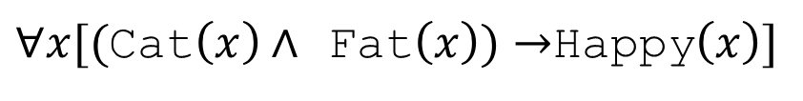
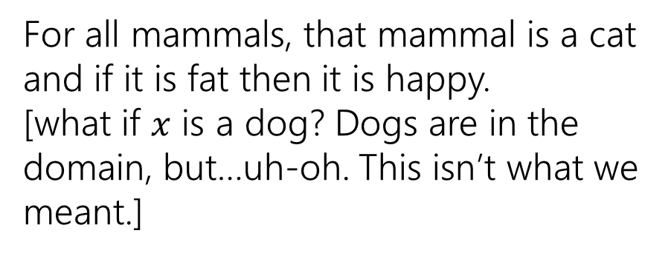
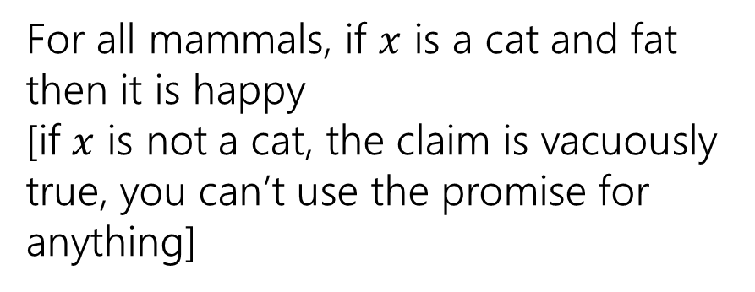
Quantifiers
Which of these translates “For every cat: if a cat is fat then it is happy.” when our domain of discourse is “mammals”?
$∀x[($Cat$\left(x\right)∧$ Fat$\left(x\right))→$Happy$\left(x\right)]$
$∀x[$Cat$\left(x\right)∧$(Fat$\left(x\right)→$Happy$\left(x\right))]$
For all mammals, if $x$ is a cat and fat then it is happy
[if $x$ is not a cat, the claim is vacuously true, you can’t use the promise for anything]
For all mammals, that mammal is a cat and if it is fat then it is happy.
[what if $x$ is a dog? Dogs are in the domain, but…uh-oh. This isn’t what we meant.]
To “limit” variables to a portion of your domain of discourse under a universal quantifier add a hypothesis to an implication.

Slide 13



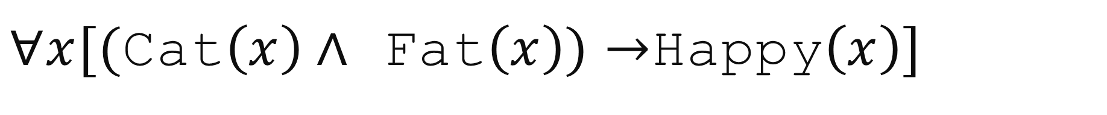

$∀x[($Cat$\left(x\right)∧$ Fat$\left(x\right))→$Happy$\left(x\right)]$
$x$ outside the subdomain
(Cat$\left(x\right)∧$ Fat$\left(x\right))→$Happy$\left(x\right)$
$($F$∧$Fat$\left(x\right))→$Happy$\left(x\right)$
$($F$)→$Happy$\left(x\right)$
T
For $x$ that aren’t cats, the implication is vacuously true.
These won’t affect whether $∀x[($Cat$\left(x\right)∧$ Fat$\left(x\right))→$Happy$\left(x\right)]$ is true.

Slide 14
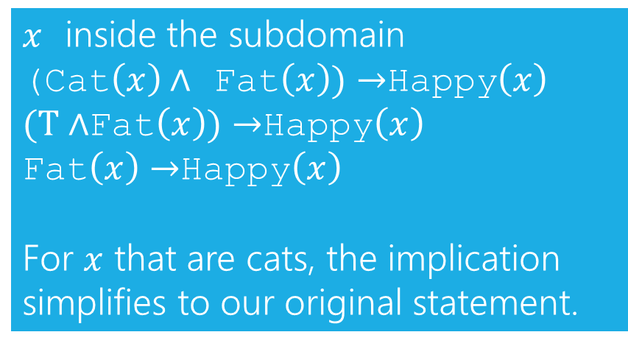

$∀x[($Cat$\left(x\right)∧$ Fat$\left(x\right))→$Happy$\left(x\right)]$
$x$ inside the subdomain (Cat$\left(x\right)∧$ Fat$\left(x\right))→$Happy$\left(x\right)$
$(T∧$Fat$\left(x\right))→$Happy$\left(x\right)$
Fat$\left(x\right)→$Happy$\left(x\right)$
For $x$ that are cats, the implication simplifies to our original statement.

Slide 15
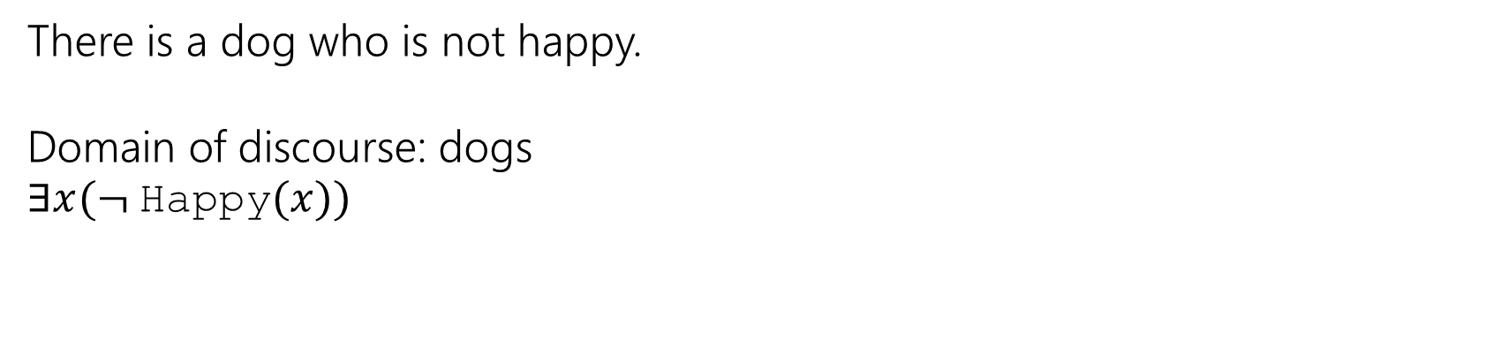

Quantifiers
Existential quantifiers need a different rule:
To “limit” variables to a portion of your domain of discourse under an existential quantifier AND the limitation together with the rest of the statement.
There is a dog who is not happy.
Domain of discourse: dogs
$∃x(¬$Happy$(x))$

Slide 16
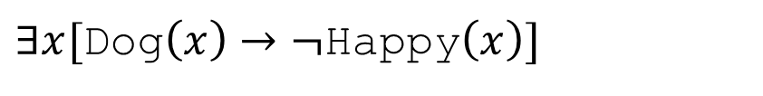
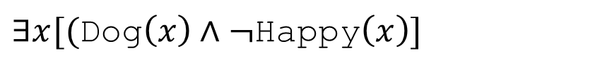

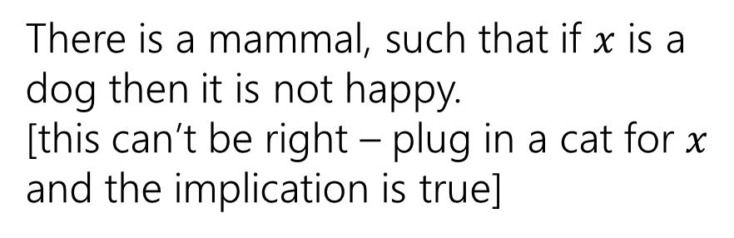
Quantifiers
Which of these translates “There is a dog who is not happy.” when our domain of discourse is “mammals”?
$∃x[$Dog$\left(x\right)→¬$Happy$\left(x\right)]$
$∃x[($Dog$\left(x\right)∧¬$Happy$\left(x\right)]$
There is a mammal, such that if $x$ is a dog then it is not happy.
[this can’t be right – plug in a cat for $x$ and the implication is true]
There is a mammal that is both a dog and not happy.
[this one is correct!]
To “limit” variables to a portion of your domain of discourse under an existential quantifier AND the limitation together with the rest of the statement.

Slide 17
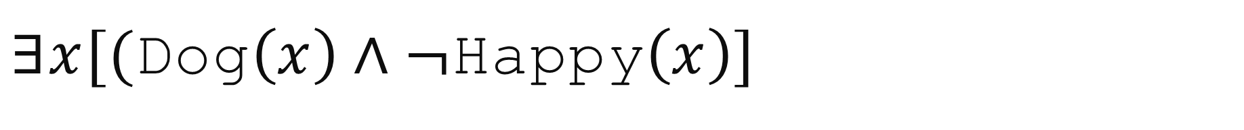
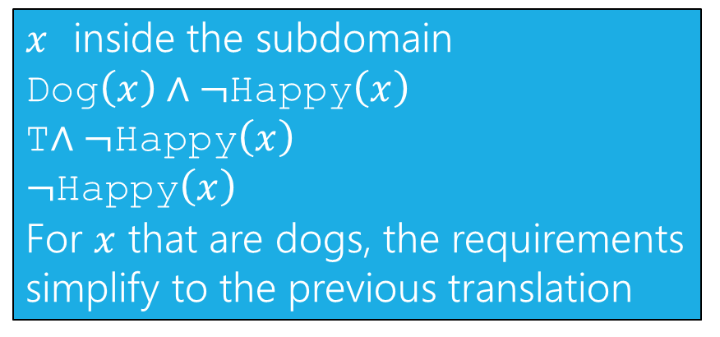

$∃x[($Dog$\left(x\right)∧¬$Happy$\left(x\right)]$
$x$ inside the subdomain
Dog$\left(x\right)∧¬$Happy$\left(x\right)$
T$∧¬$Happy$\left(x\right)$
$¬$Happy$\left(x\right)$
For $x$ that are dogs, the requirements simplify to the previous translation

Slide 18
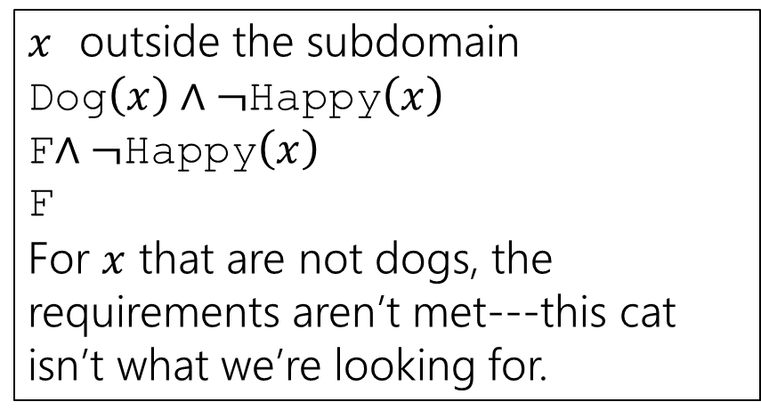

$∃x[($Dog$\left(x\right)∧¬$Happy$\left(x\right)]$
$x$ outside the subdomain
Dog$\left(x\right)∧¬$Happy$\left(x\right)$
F$∧¬$Happy$\left(x\right)$
F
For $x$ that are not dogs, the requirements aren’t met---this cat isn’t what we’re looking for.

Slide 19
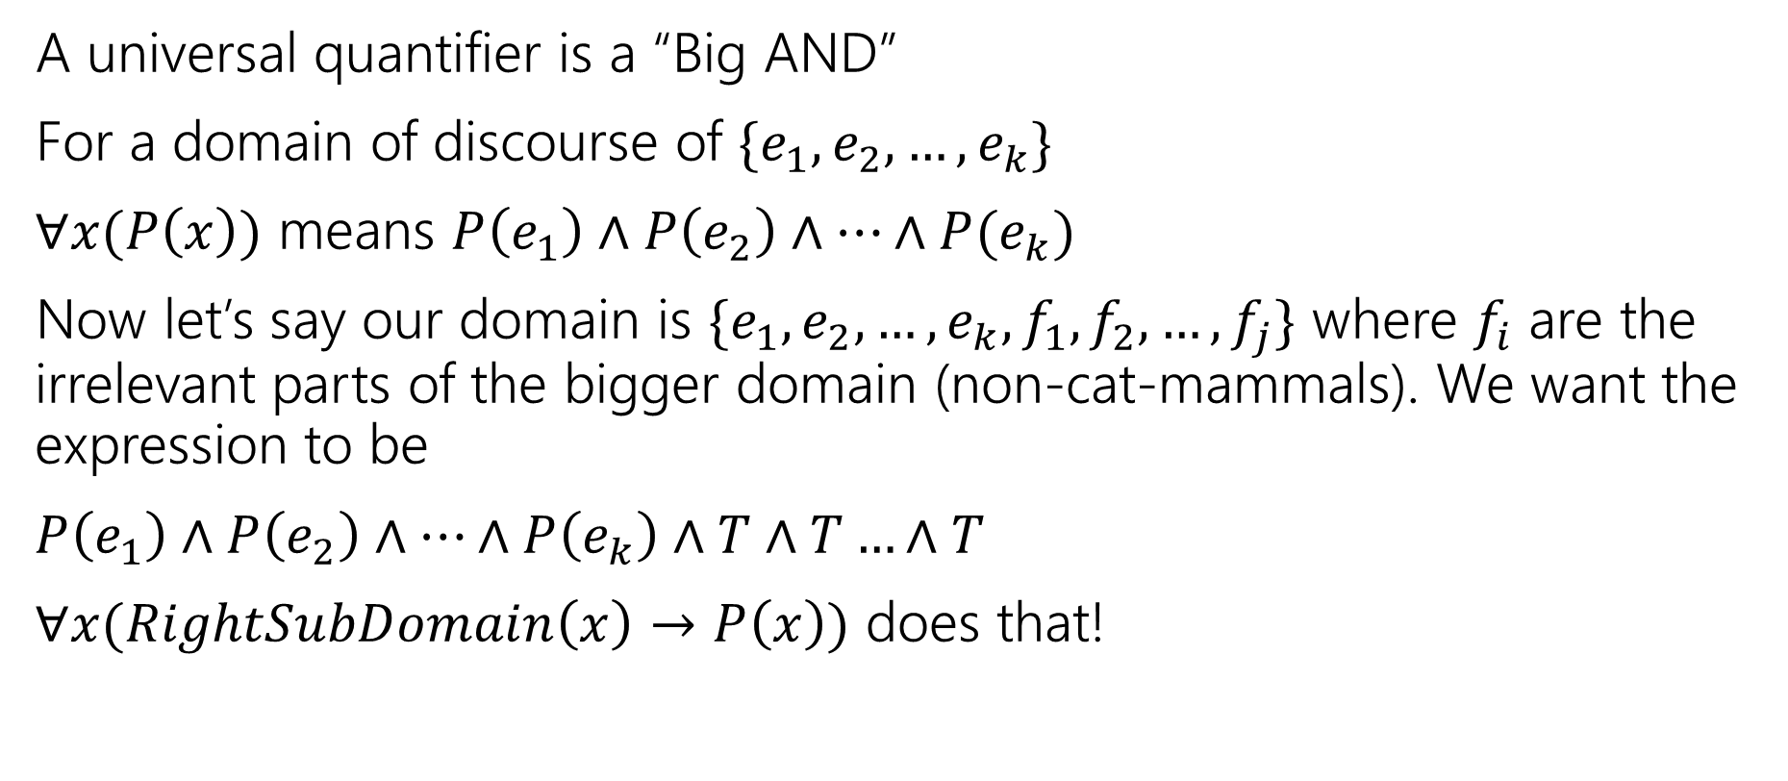

Why are the rules what they are?
A universal quantifier is a “Big AND”
For a domain of discourse of $\{e_{1},e_{2},…,e_{k}\}$
$∀x(P\left(x\right))$ means $P\left(e_{1}\right)∧P\left(e_{2}\right)∧…∧P(e_{k})$
Now let’s say our domain is $\{e_{1},e_{2},…,e_{k},f_{1},f_{2},…,f_{j}\}$ where $f_{i}$ are the irrelevant parts of the bigger domain (non-cat-mammals). We want the expression to be
$P\left(e_{1}\right)∧P\left(e_{2}\right)∧…∧P\left(e_{k}\right)∧T∧T…∧T$
$∀x(RightSubDomain\left(x\right)→P\left(x\right))$ does that!

Slide 20
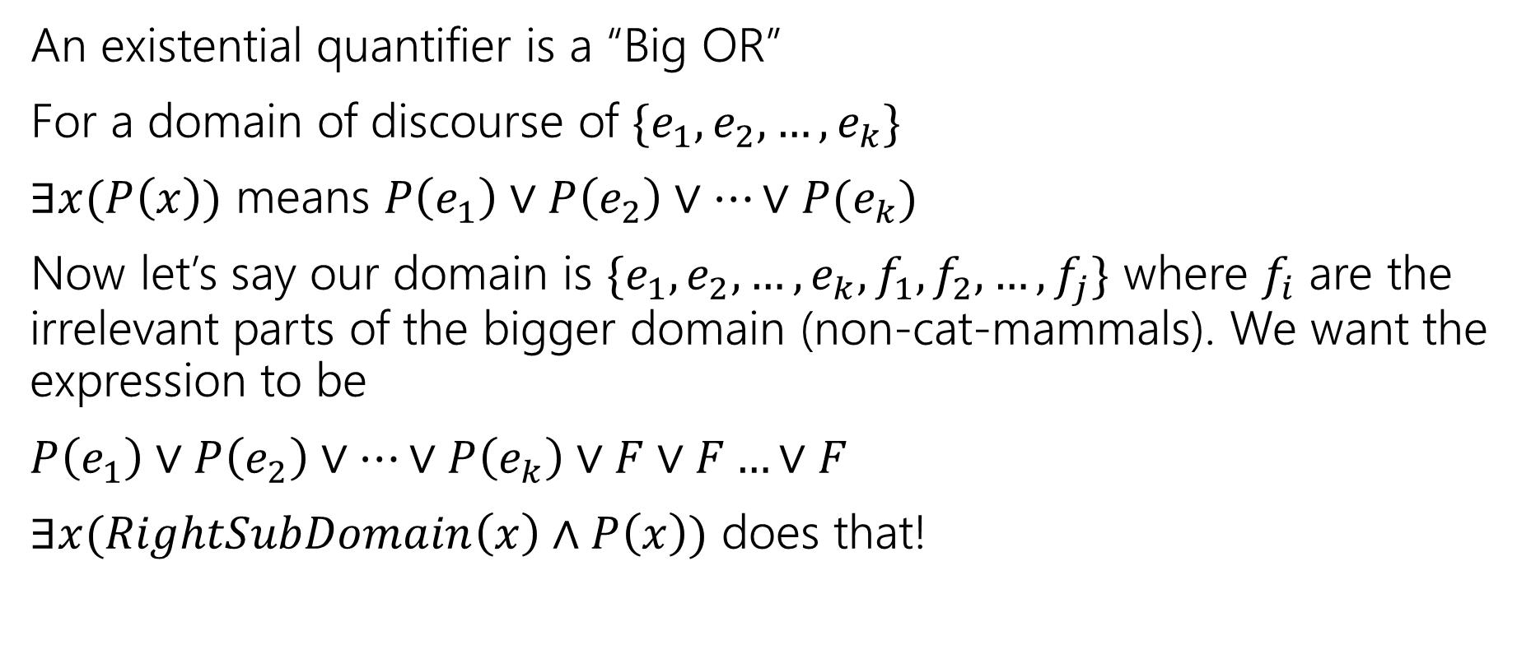

Why are the rules what they are?
An existential quantifier is a “Big OR”
For a domain of discourse of $\{e_{1},e_{2},…,e_{k}\}$
$∃x(P\left(x\right))$ means $P\left(e_{1}\right)∨P\left(e_{2}\right)∨…∨P(e_{k})$
Now let’s say our domain is $\{e_{1},e_{2},…,e_{k},f_{1},f_{2},…,f_{j}\}$ where $f_{i}$ are the irrelevant parts of the bigger domain (non-cat-mammals). We want the expression to be
$P\left(e_{1}\right)∨P\left(e_{2}\right)∨…∨P\left(e_{k}\right)∨F∨F…∨F$
$∃x(RightSubDomain\left(x\right)∧P\left(x\right))$ does that!

Slide 21
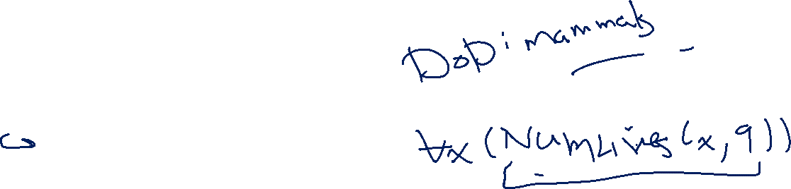
Negation
Translate these sentences to predicate logic, then negate them.
All cats have nine lives.
All dogs love every person.
There is a cat that loves someone.

Slide 22
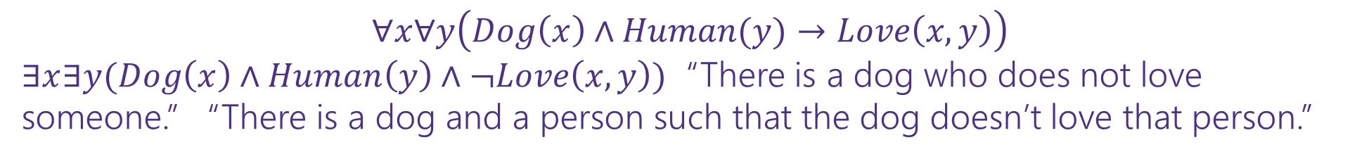
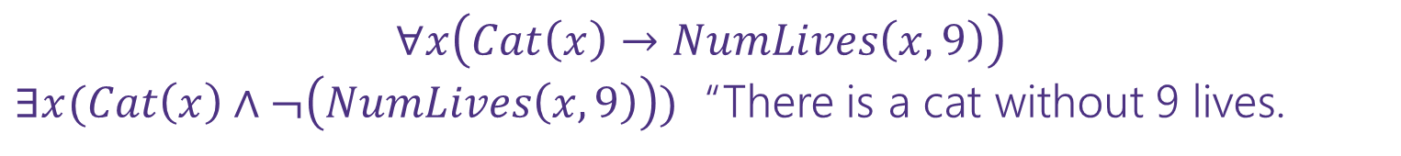
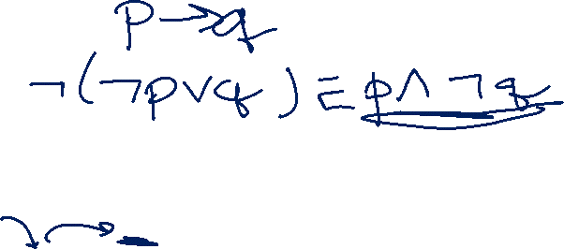
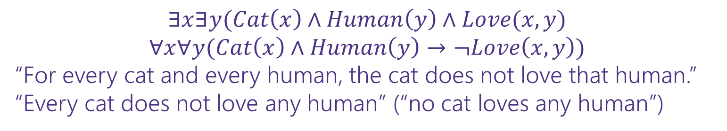
Negation
Translate these sentences to predicate logic, then negate them.
All cats have nine lives.
All dogs love every person.
There is a cat that loves someone.
$$∀x\left(Cat\left(x\right)→NumLives\left(x,9\right)\right)$$
$∃x(Cat\left(x\right)∧¬\left(NumLives\left(x,9\right)\right))$ “There is a cat without 9 lives.
$$∀x∀y\left(Dog\left(x\right)∧Human(y)→Love\left(x,y\right)\right)$$
$∃x∃y(Dog\left(x\right)∧Human\left(y\right)∧¬Love\left(x,y\right))$ “There is a dog who does not love someone.” “There is a dog and a person such that the dog doesn’t love that person.”
$$∃x∃y(Cat\left(x\right)∧Human\left(y\right)∧Love(x,y)$$
$$∀x∀y(Cat\left(x\right)∧Human\left(y\right)→¬Love\left(x,y\right))$$
“For every cat and every human, the cat does not love that human.”
“Every cat does not love any human” (“no cat loves any human”)

Slide 23
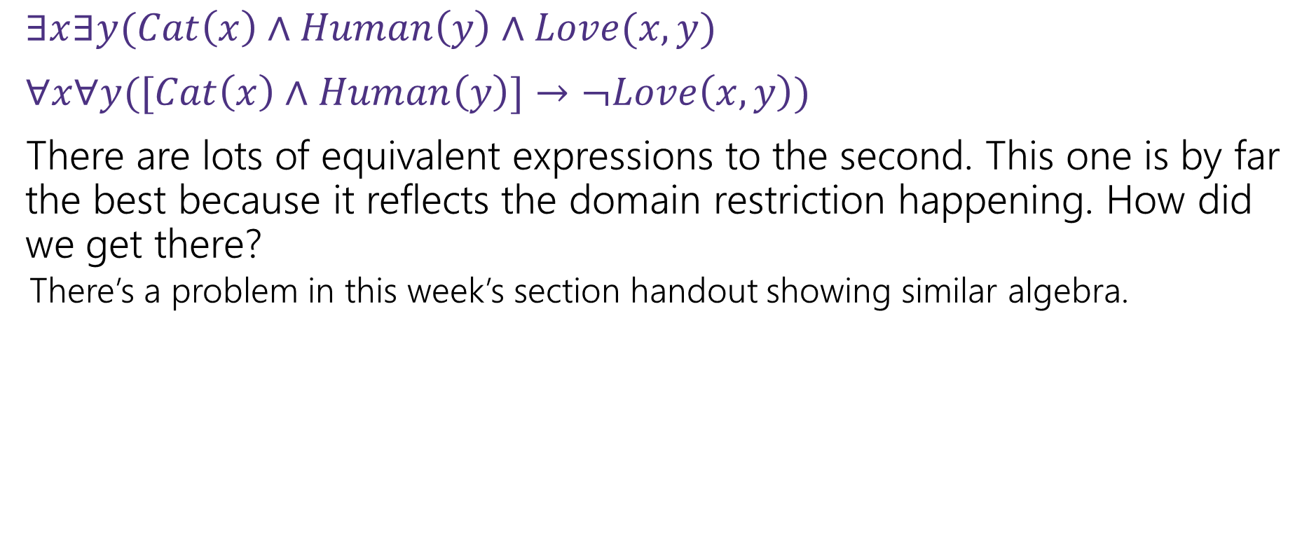
Negation with Domain Restriction
$∃x∃y(Cat\left(x\right)∧Human\left(y\right)∧Love(x,y)$
$∀x∀y([Cat\left(x\right)∧Human\left(y\right)]→¬Love\left(x,y\right))$
There are lots of equivalent expressions to the second. This one is by far the best because it reflects the domain restriction happening. How did we get there?
There’s a problem in this week’s section handout showing similar algebra.

Slide 24
Nested Quantifiers

Slide 25






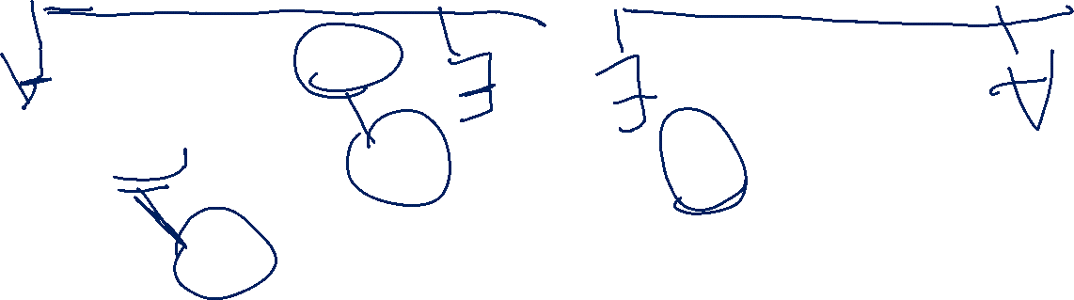
Nested Quantifiers
Translate these sentences using only quantifiers and the predicate AreFriends$(x,y)$
Everyone is friends with someone.
Someone is friends with everyone.

Slide 26
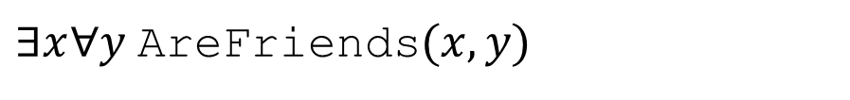
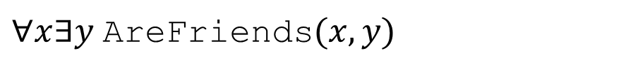
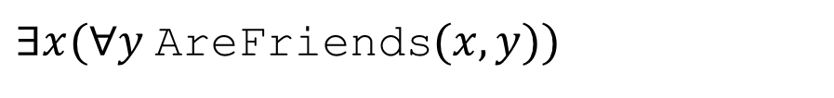

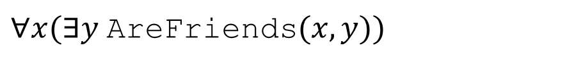
Nested Quantifiers
Translate these sentences using only quantifiers and the predicate AreFriends$(x,y)$
Everyone is friends with someone.
Someone is friends with everyone.
$∀x(∃y$AreFriends$(x,y))$
$∃x(∀y$AreFriends$(x,y))$
$∀x∃y$AreFriends$(x,y)$
$∃x∀y$AreFriends$(x,y)$

Slide 27
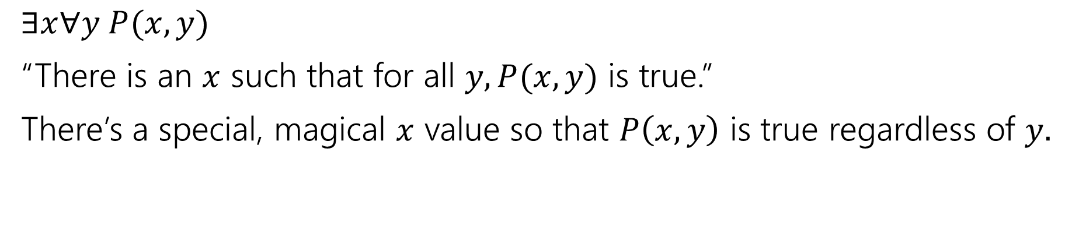
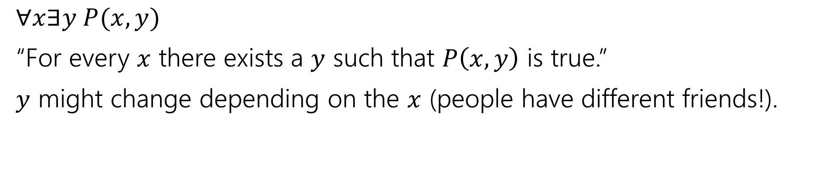

Nested Quantifiers
$∀x∃y P(x,y)$
“For every $x$ there exists a $y$ such that $P\left(x,y\right)$ is true.”
$y$ might change depending on the $x$ (people have different friends!).
$∃x∀y P(x,y)$
“There is an $x$ such that for all $y, P(x,y)$ is true.”
There’s a special, magical $x$ value so that $P\left(x,y\right)$ is true regardless of $y.$

Slide 28
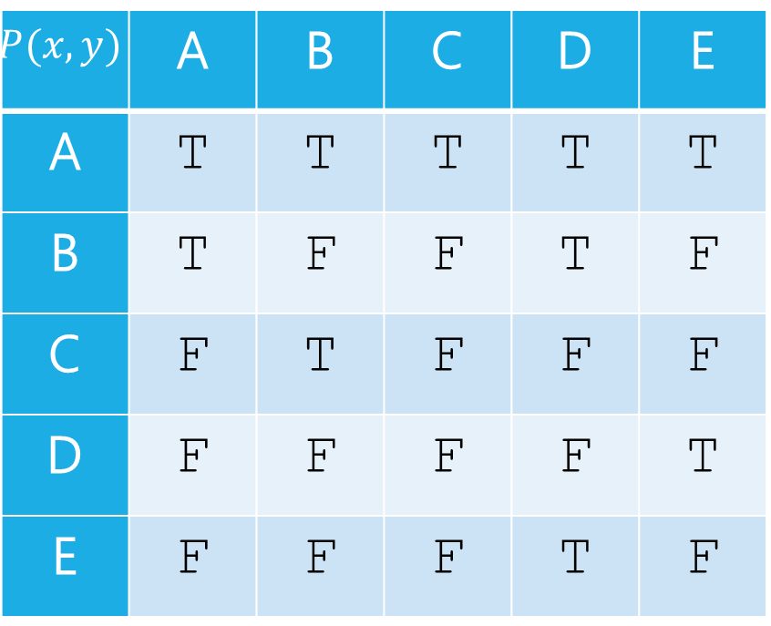
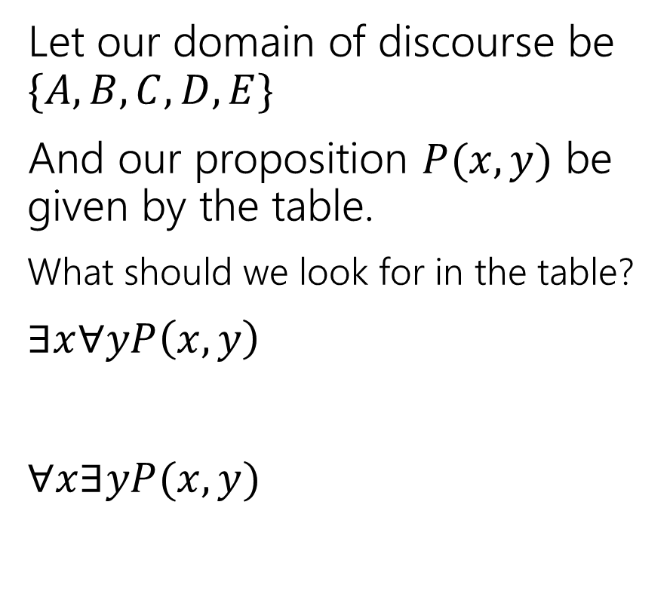


Nested Quantifiers
Let our domain of discourse be $\{A,B,C,D,E\}$
And our proposition $P(x,y)$ be given by the table.
What should we look for in the table?
$∃x∀yP\left(x,y\right)$
$∀x∃yP(x,y)$
$$y$$
$$P(x,y)$$ | A | B | C | D | E
A | T | T | T | T | T
B | T | F | F | T | F
C | F | T | F | F | F
D | F | F | F | F | T
E | F | F | F | T | F
$$x$$

Slide 29
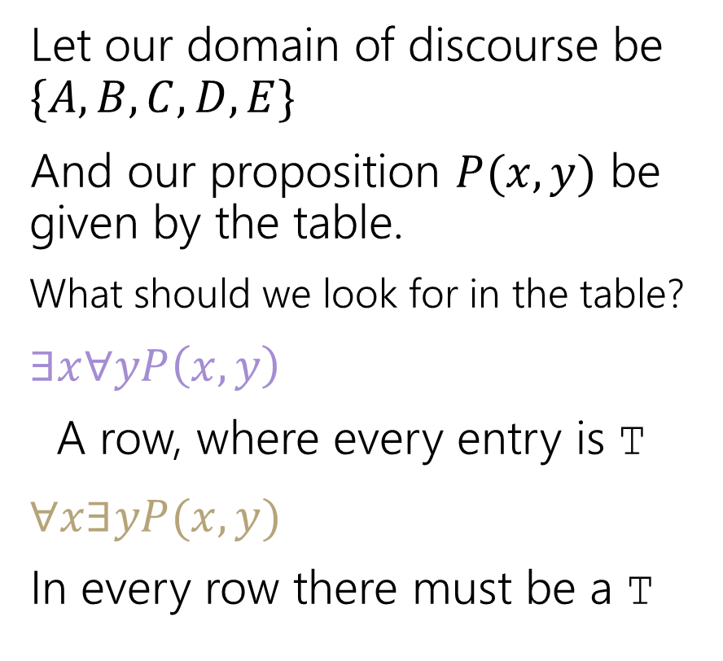
Nested Quantifiers
Let our domain of discourse be $\{A,B,C,D,E\}$
And our proposition $P(x,y)$ be given by the table.
What should we look for in the table?
$∃x∀yP\left(x,y\right)$
A row, where every entry is T
$∀x∃yP(x,y)$
In every row there must be a T
$$y$$
$$P(x,y)$$ | A | B | C | D | E
A | T | T | T | T | T
B | T | F | F | T | F
C | F | T | F | F | F
D | F | F | F | F | T
E | F | F | F | T | F
$$x$$

Slide 30
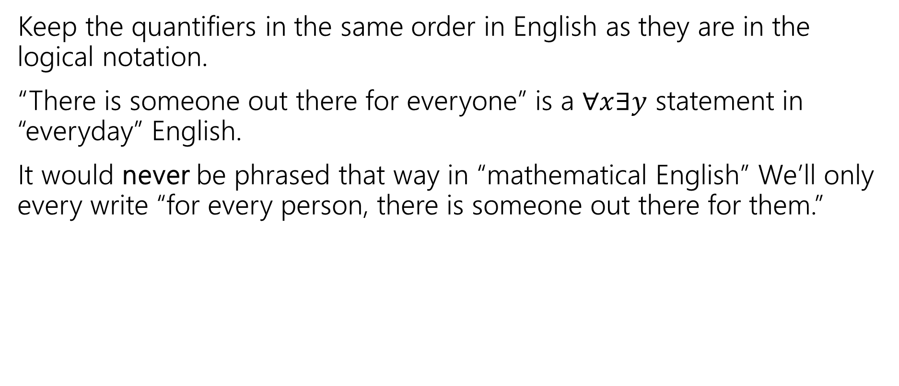
Keep everything in order
Keep the quantifiers in the same order in English as they are in the logical notation.
“There is someone out there for everyone” is a $∀x∃y$ statement in “everyday” English.
It would never be phrased that way in “mathematical English” We’ll only every write “for every person, there is someone out there for them.”

Slide 31





Try it yourselves
Every cat loves some human.
There is a cat that loves every human.
Let your domain of discourse be mammals.
Use the predicates Cat$(x)$, Dog$(x)$, and Loves$(x,y)$ to mean $x$ loves $y$.

Slide 32
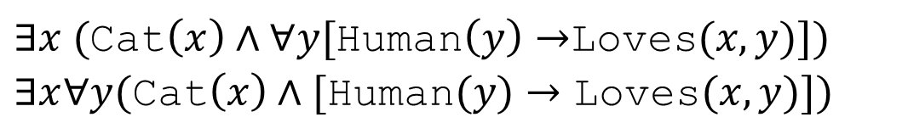
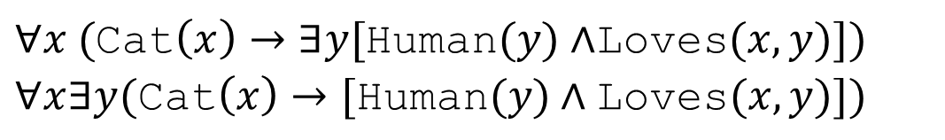
Try it yourselves
Every cat loves some human.
There is a cat that loves every human.
$∀x ($Cat$\left(x\right)→∃y[$Human$(y)∧$Loves$(x,y)])$
$∀x∃y(\text{Cat}\left(x\right)→[\text{Human}(y)∧\text{Loves}(x,y)])$
$∃x ($Cat$\left(x\right)∧∀y[$Human$\left(y\right)→$Loves$(x,y)])$
$∃x∀y(\text{Cat}\left(x\right)∧[\text{Human}(y)→\text{Loves}(x,y)])$

Slide 33
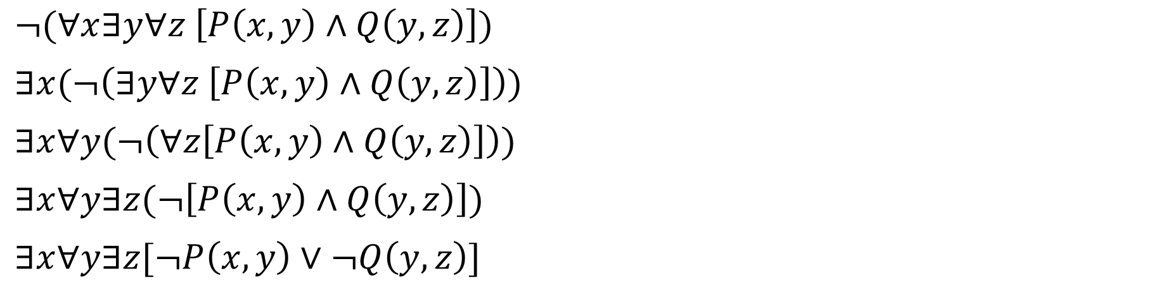

Negation
How do we negate nested quantifiers?
The old rule still applies.
To negate an expression with a quantifier
1. Switch the quantifier ($∀$ becomes $∃,$ $∃$ becomes $∀$)
2. Negate the expression inside
$¬(∀x∃y∀z \left[P\left(x,y\right)∧Q\left(y,z\right)\right])$
$∃x(¬\left(∃y∀z \left[P\left(x,y\right)∧Q\left(y,z\right)\right]\right))$
$∃x∀y(¬\left(∀z\left[P\left(x,y\right)∧Q\left(y,z\right)\right]\right))$
$∃x∀y∃z(¬\left[P\left(x,y\right)∧Q\left(y,z\right)\right])$
$∃x∀y∃z[¬P\left(x,y\right)∨¬Q\left(y,z\right)]$

Slide 34



More Translation
For each of the following, translate it, then say whether the statement is true. Let your domain of discourse be integers.
For every integer, there is a greater integer.
There is an integer $x$, such that for all integers $y$, $xy$ is equal to 1.
$∀y∃x($Equal$\left(x+y,1\right))$
$∀x∃y($Greater$(y,x))$ (This statement is true: $y$ can be $x+1$ [$y$ depends on $x]$)
$∃x∀y($Equal$(xy, 1))$ (This statement is false: no single value of $x$ can play that role for every $y$.)
For every integer, $y,$there is an integer $x$ such that $x+y=1$
(This statement is true, $y$ can depend on $x$)

Slide 35

To “limit” variables to a portion of your domain of discourse under a universal quantifier add a hypothesis to an implication.
To “limit” variables to a portion of your domain of discourse under an existential quantifier AND the limitation together with the rest of the statement.
To negate an expression with a quantifier
1. Switch the quantifier ($∀$ becomes $∃,$ $∃$ becomes $∀$)
2. Negate the expression inside

Slide 36



The statement is true for every $x$, we just want to put a name on it.
$∀x (p\left(x\right)∧q\left(x\right))$ means “for every $x$ in our domain, $p(x)$ and $q(x)$ both evaluate to true.”
There’s some $x$ out there that works, (but I might not know which it is, so I’m using a variable).
$∃x(p\left(x\right)∧q\left(x\right))$ means “there is an $x$ in our domain, $p(x)$ and $q\left(x\right)$ are both true.
Universal Quantifier
“$∀x“$
“for each $x$”, “for every $x$”, “for all $x$” are common translations
Remember: upside-down-A for All.
“$∃x“$
“there is an $x$”, “there exists an $x$”, “for some $x$” are common translations
Remember: backwards-E for Exists.
Existential Quantifier

