Slide 1
Warm Up
Translate this sentence into symbolic logic, and describe a weather pattern and transportation method that causes the proposition to be false.
It is snowing today, and if it is raining or snowing then we won’t walk to school.

Slide 2
Warm Up – Solution
Translate this sentence into symbolic logic, and describe a weather pattern and transportation method that causes the proposition to be false.
It is snowing today, and if it is raining or snowing then we won’t walk to school.
Robbie’s process: identify connecting words, identify propositions, figure out parentheses.

Slide 3
Warm Up – Solution
Translate this sentence into symbolic logic, and describe a weather pattern and transportation method that causes the proposition to be false.
It is snowing today, and if it is raining or snowing then we won’t walk to school.
Identify connecting words: look for and, or, not, if-then, etc.

Slide 4





Warm Up – Solution
Translate this sentence into symbolic logic, and describe a weather pattern and transportation method that causes the proposition to be false.
It is snowing today, and if it is raining or snowing then we won’t walk to school.
Identify propositions: What’s left are propositions, look for repeats and hidden negations.
$$p$$
$$q$$
$$¬r$$
$$p$$
$p:$it is snowing today.
$q:$ it is raining.
$r:$ we walk to school.

Slide 5

Warm Up – Solution
Translate this sentence into symbolic logic, and describe a weather pattern and transportation method that causes the proposition to be false.
It is snowing today, and if it is raining or snowing then we won’t walk to school.
Figure out parentheses
$$p$$
$$q$$
$$¬r$$
$$p$$
$p:$it is snowing today.
$q:$ it is raining.
$r:$ we walk to school.
$$p∧[(q∨p)→¬r]$$
“raining or snowing” is the condition of the implication, not walking to school is the conclusion. Omitted words in other clauses hint that “It is snowing today” stands on its own.

Slide 6
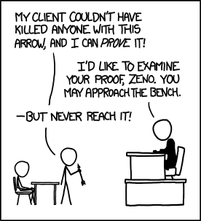
Our First Proof and Digital Logic
xkcd.com/1153
CSE 311 Autumn 2025
Lecture 3

Slide 7
Announcements: Office Hours
A chance to talk to staff about the class.
Advice:
  You don’t have to have a question to come to office hours! (It can help, though)
  Aim early on in the “homework cycle” (i.e., long before the deadline).
  We won’t answer every kind of question in office hours:
  We don’t “pregrade” homework. We won’t tell you whether something is right or wrong.
  We will help on homework, but not usually by “giving hints.” We’ll usually ask questions about what you’ve tried, ask questions to help you decide what to do next, or point you to good examples to look at.
  You’re allowed to talk to others at office hours, as long as you’re still following the collaboration policy.

Slide 8
Announcements: Section Materials
Handouts and solutions from sections are on the calendar.
Section solutions should be one of your most-used resources.
They’re staff-written solutions for problems that are often similar to homeworks.
  When you’re wondering how much explanation to give, or what kind of formatting we might expect, section solutions are the first place to look (along with lecture slides).

Slide 9
Today
Our first proof!
Contrapositives and digital logic.

Slide 10
Simplifying Expressions

Slide 11
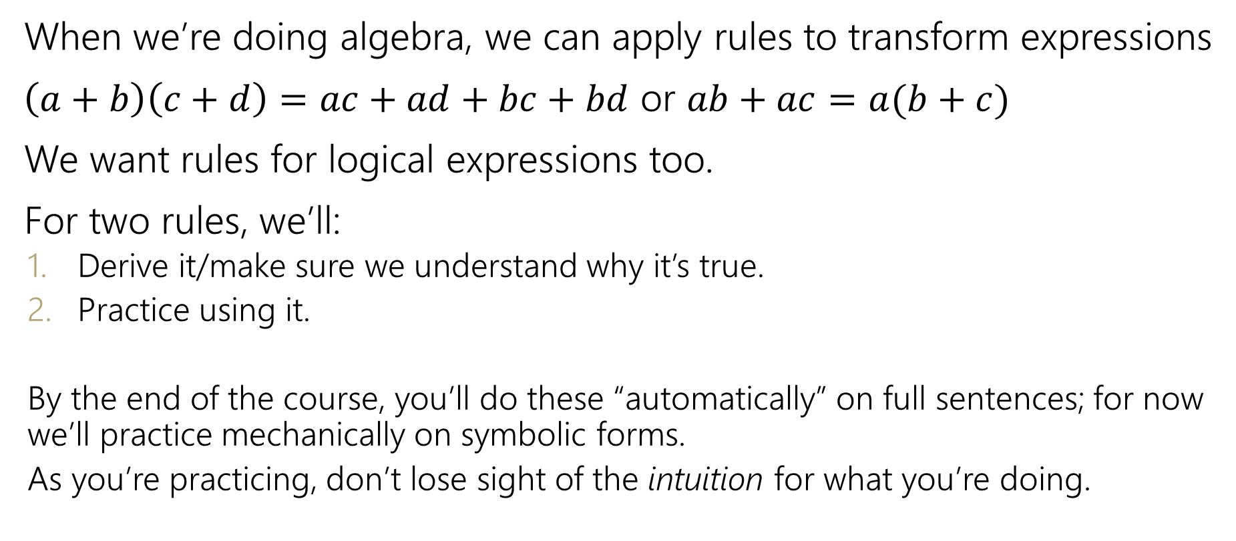
Manipulating Expressions
When we’re doing algebra, we can apply rules to transform expressions
$\left(a+b\right)\left(c+d\right)=ac+ad+bc+bd$ or $ab+ac=a(b+c)$
We want rules for logical expressions too.
For two rules, we’ll:
  Derive it/make sure we understand why it’s true.
  Practice using it.
  By the end of the course, you’ll do these “automatically” on full sentences; for now we’ll practice mechanically on symbolic forms.
  As you’re practicing, don’t lose sight of the intuition for what you’re doing.

Slide 12



De Morgan’s Laws
$¬\left(p∨q\right)≡¬p∧¬q$
is a general rule. It’s always true for any propositions $p$ and $q$.
This is one of De Morgan’s Laws.
The other is:
$¬\left(p∧q\right)≡¬p∨¬q$

Slide 13
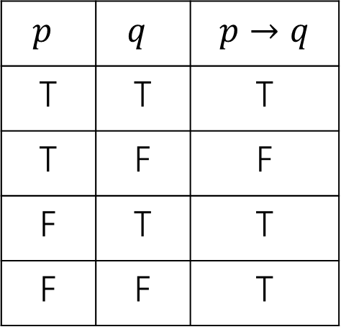
Law of Implication
Implications are hard.
AND/OR/NOT make more intuitive sense to me…
can we rewrite implications using just ANDs ORs and NOTs?
$p$ | $q$ | $$p→q$$
T | T | T
T | F | F
F | T | T
F | F | T
One approach: think “when is this implication false?” then negate it (you might want one of DeMorgan’s Laws!

Slide 14

Law of Implication
Implications are hard.
AND/OR/NOT make more intuitive sense to me…
can we rewrite implications using just ANDs ORs and NOTs?
$p$ | $q$ | $$p→q$$
T | T | T
T | F | F
F | T | T
F | F | T
Seems like we might want $¬(p∧¬q)$
$$¬p∨q$$
Seems like a reasonable guess.
So is it true? Is $¬p∨q≡p→q$?

Slide 15

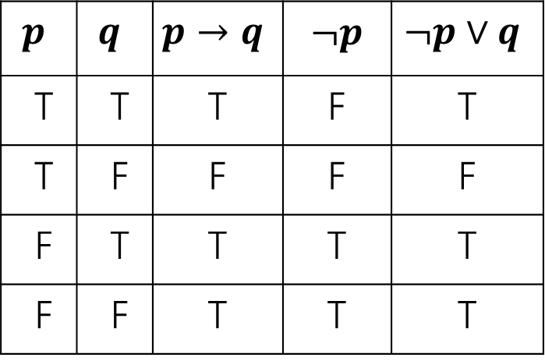
Law of Implication
$$¬p∨q≡p→q$$
$$p$$ | $$q$$ | $$p→q$$ | $¬p$ | $$¬p∨q$$
T | T | T | F | T
T | F | F | F | F
F | T | T | T | T
F | F | T | T | T
Every line is the same!
So these expressions are equivalent.

Slide 16
Properties of Logical Connectives
We’ve derived two facts about logical connectives.
There’s a lot more. A LOT more.
The next slide is a list of a bunch of them…
  Most of these are much less complicated than the last two, so we won’t go through them in detail.
  DO NOT freak out about how many there are. We will always provide you the list on the next slide (no need to memorize).

Slide 17
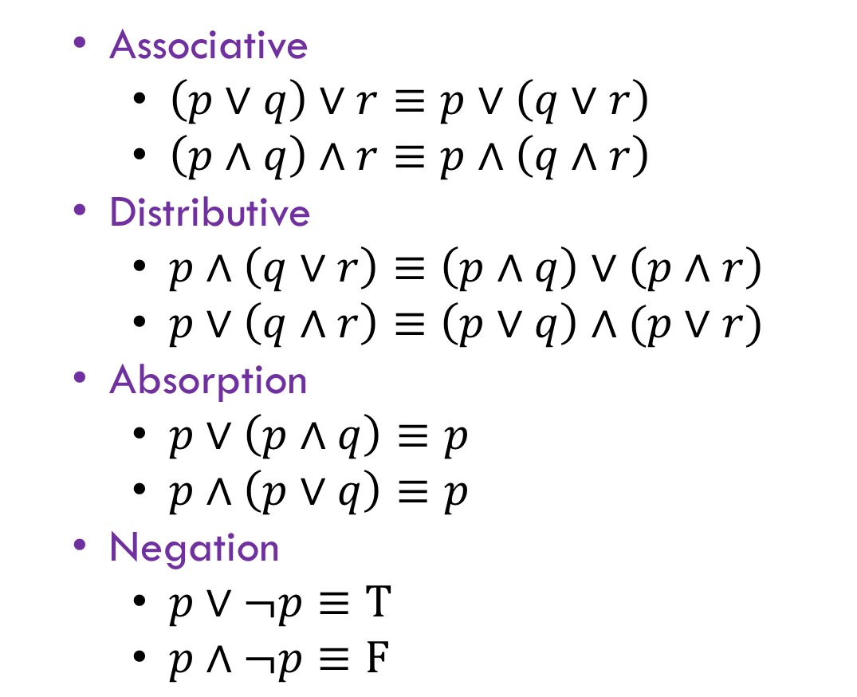
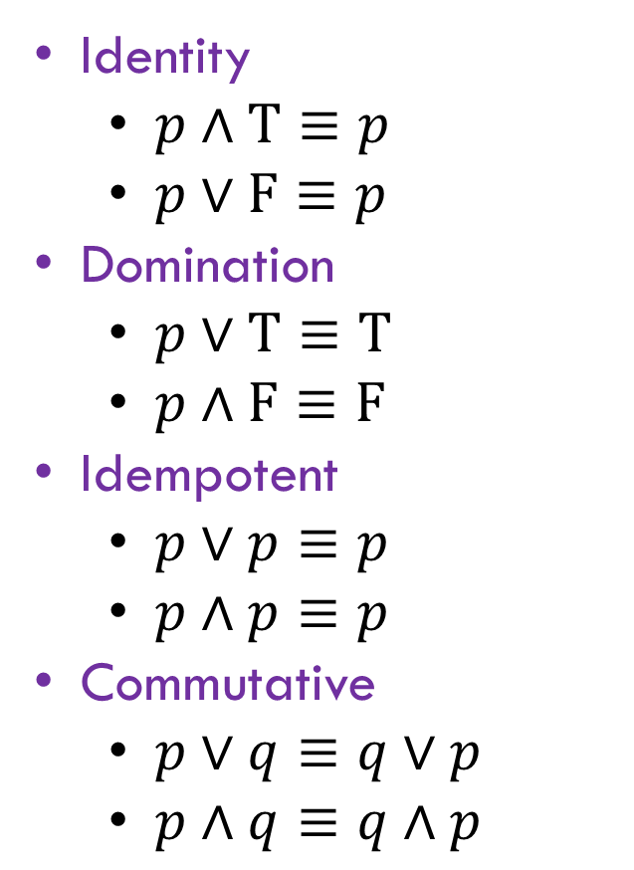
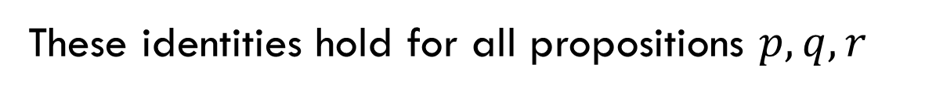
Properties of Logical Connectives
These identities hold for all propositions $p,q,r$
Identity
  $p∧T≡p$
  $p∨F≡p$
Domination
  $p∨T≡T$
  $p∧F≡F$
Idempotent
  $p∨p≡p$
  $p∧p≡p$
Commutative
  $p∨q≡q∨p$
  $p∧q≡q∧p$
  Associative
    $\left(p∨q\right)∨r≡p∨\left(q∨r\right)$
    $\left(p∧q\right)∧r≡p∧\left(q∧r\right)$
  Distributive
    $p∧\left(q∨r\right)≡\left(p∧q\right)∨\left(p∧r\right)$
    $p∨\left(q∧r\right)≡\left(p∨q\right)∧(p∨r)$
  Absorption
    $p∨\left(p∧q\right)≡p$
    $p∧\left(p∨q\right)≡p$
  Negation
    $p∨¬p≡T$
    $p∧¬p≡F$

Slide 18
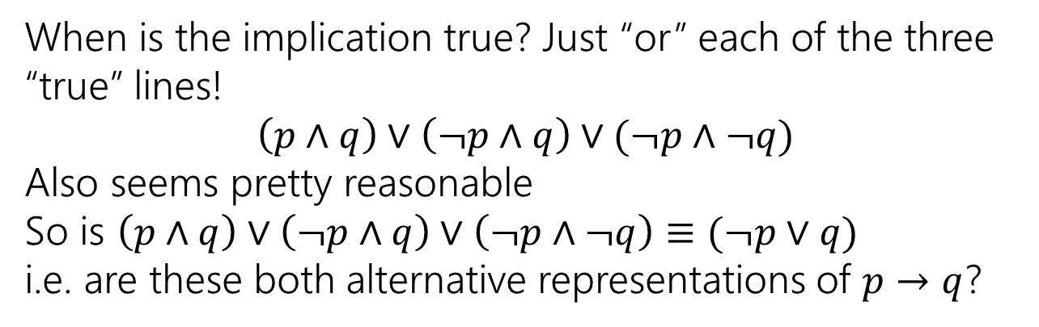
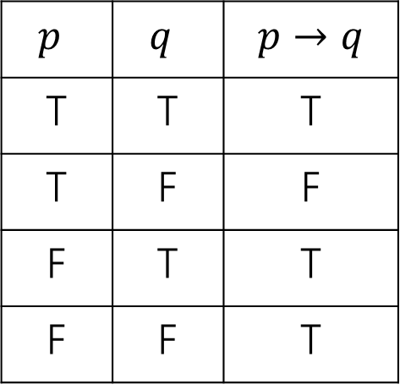
Using Our Rules
WOW that was a lot of rules.
Why do we need them? Simplification!
Let’s go back to the “law of implication” example.
$p$ | $q$ | $$p→q$$
T | T | T
T | F | F
F | T | T
F | F | T
When is the implication true? Just “or” each of the three “true” lines!
$$\left(p∧q\right)∨\left(¬p∧q\right)∨(¬p∧¬q)$$
Also seems pretty reasonable
So is $\left(p∧q\right)∨\left(¬p∧q\right)∨\left(¬p∧¬q\right)≡(¬p∨q)$
i.e. are these both alternative representations of $p→q$?

Slide 19
Our First Proof

Slide 20
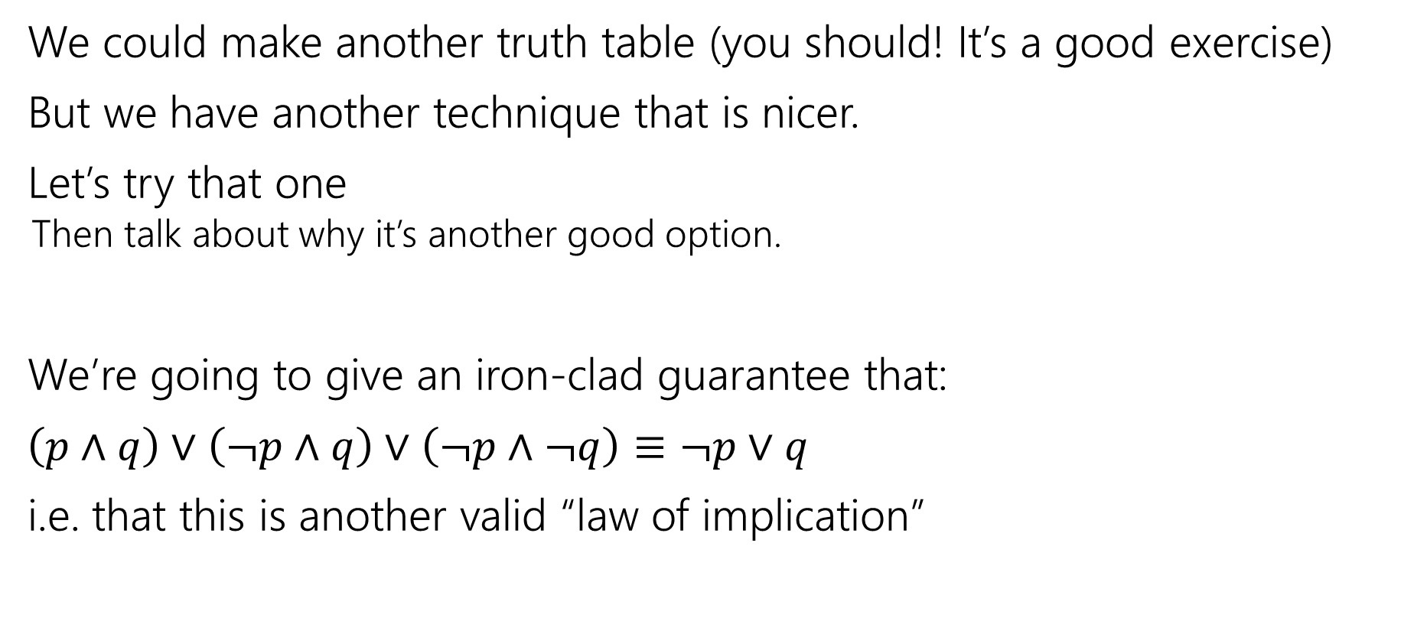
Our First Proof
We could make another truth table (you should! It’s a good exercise)
But we have another technique that is nicer.
Let’s try that one
  Then talk about why it’s another good option.
We’re going to give an iron-clad guarantee that:
$\left(p∧q\right)∨\left(¬p∧q\right)∨\left(¬p∧¬q\right)≡¬p∨q$
i.e. that this is another valid “law of implication”

Slide 21
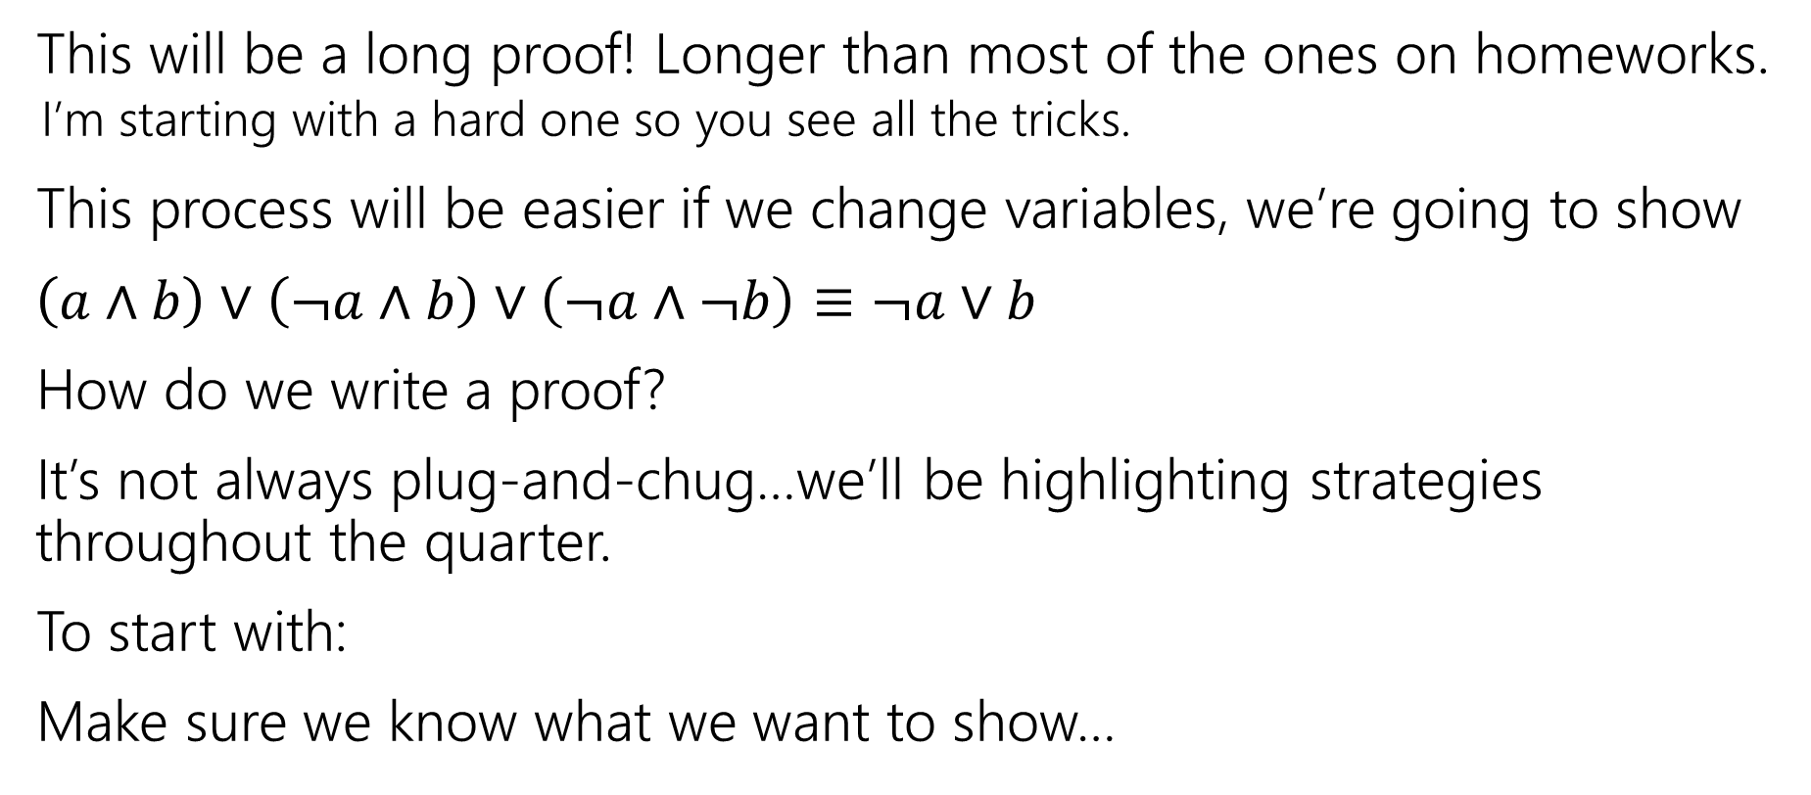
Our First Proof
This will be a long proof! Longer than most of the ones on homeworks.
  I’m starting with a hard one so you see all the tricks.
This process will be easier if we change variables, we’re going to show
$\left(a∧b\right)∨\left(¬a∧b\right)∨\left(¬a∧¬b\right)≡¬a∨b$
How do we write a proof?
It’s not always plug-and-chug…we’ll be highlighting strategies throughout the quarter.
To start with:
Make sure we know what we want to show…
Notes:
Just replaced p with a and q with b. Same as if you replaced the “I” in a for-loop with a “j” everywhere in that loop.

Slide 22



Our First Proof
$\left(a∧b\right)∨\left(¬a∧b\right)∨(¬a∧¬b)$
$≡\left(p∧q\right)∨[\left(¬p∧q\right)∨\left(¬p∧¬q\right)]$
$≡\left(p∧q\right)∨\left[¬p∧\left(q∨¬q\right)\right]$
$≡\left(p∧q\right)∨[¬p∧T]$
$≡\left(p∧q\right)∨[¬p]$
$≡\left[¬p\right]∨(p∧q)$
$≡\left(¬p∨p\right)∧\left(¬p∨q\right)$
$≡T∧\left(¬p∨q\right)$
$≡$ $\left(¬p∨q\right)∧T$
$≡(¬a∨b)$
None of the rules look like this
Practice of Proof-Writing:
Big Picture…WHY do we think this might be true?
The last two “pieces” came from the vacuous proof lines…maybe the “$¬a$” came from there? Maybe that simplifies down to $¬a$

Slide 23

Let’s apply a rule
$\left(¬a∧b\right)∨(¬a∧¬b)$
The law says:
$p∧\left(q∨r\right)≡\left(p∧q\right)∨(p∧r)$
$\left(¬a∧b\right)∨\left(¬a∧¬b\right)≡¬a∧(b∨¬b)$

Slide 24

Our First Proof
$\left(a∧b\right)∨\left(¬a∧b\right)∨(¬a∧¬b)$
$≡\left(p∧q\right)∨[\left(¬p∧q\right)∨\left(¬p∧¬q\right)]$
$≡\left(p∧q\right)∨\left[¬p∧\left(q∨¬q\right)\right]$
$≡\left(p∧q\right)∨[¬p∧T]$
$≡\left(p∧q\right)∨[¬p]$
$≡\left[¬p\right]∨(p∧q)$
$≡\left(¬p∨p\right)∧\left(¬p∨q\right)$
$≡T∧\left(¬p∨q\right)$
$≡$ $\left(¬p∨q\right)∧T$
$≡(¬a∨b)$
None of the rules look like this
Practice of Proof-Writing:
Big Picture…WHY do we think this might be true?
The last two “pieces” came from the vacuous proof lines…maybe the “$¬a$” came from there? Maybe that simplifies down to $¬a$

Slide 25

Our First Proof
$\left(a∧b\right)∨\left(¬a∧b\right)∨(¬a∧¬b)$
$≡\left(a∧b\right)∨[\left(¬a∧b\right)∨\left(¬a∧¬b\right)]$
$≡\left[¬p\right]∨(p∧q)$
$≡\left(\begin{aligned}¬p \\ \\ \\ \\ ∨p\end{aligned}\right)∧\left(¬p∨q\right)$
$≡T∧\left(¬p∨q\right)$
$≡$ $\left(¬p∨q\right)∧T$
$≡(¬a∨b)$
Set ourselves an intermediate goal.
Let’s try to simplify those last two pieces
Associative law
Connect up the things we’re working on.

Slide 26


Our First Proof
$\left(a∧b\right)∨\left(¬a∧b\right)∨(¬a∧¬b)$
$≡\left(a∧b\right)∨[\left(¬a∧b\right)∨\left(¬a∧¬b\right)]$
$≡\left(a∧b\right)∨\left[¬a∧\left(b∨¬b\right)\right]$
$≡\left[¬p\right]∨(p∧q)$
$≡\left(¬p∨p\right)∧\left(¬p∨q\right)$
$≡T∧\left(¬p∨q\right)$
$≡$ $\left(¬p∨q\right)∧T$
$≡(¬a∨b)$
Set ourselves an intermediate goal.
Let’s try to simplify those last two pieces
Distributive law
We think $¬a$ is important, let’s isolate it.

Slide 27

Our First Proof
$\left(a∧b\right)∨\left(¬a∧b\right)∨(¬a∧¬b)$
$≡\left(a∧b\right)∨[\left(¬a∧b\right)∨\left(¬a∧¬b\right)]$
$≡\left(a∧b\right)∨\left[¬a∧\left(b∨¬b\right)\right]$
$≡\left(a∧b\right)∨[¬a∧T]$
$≡\left[¬p\right]∨(p∧q)$
$≡\left(¬p∨p\right)∧\left(¬p∨q\right)$
$≡T∧\left(¬p∨q\right)$
$≡$ $\left(¬p∨q\right)∧T$
$≡(¬a∨b)$
Set ourselves an intermediate goal.
Let’s try to simplify those last two pieces
Negation
Should make things simpler.

Slide 28
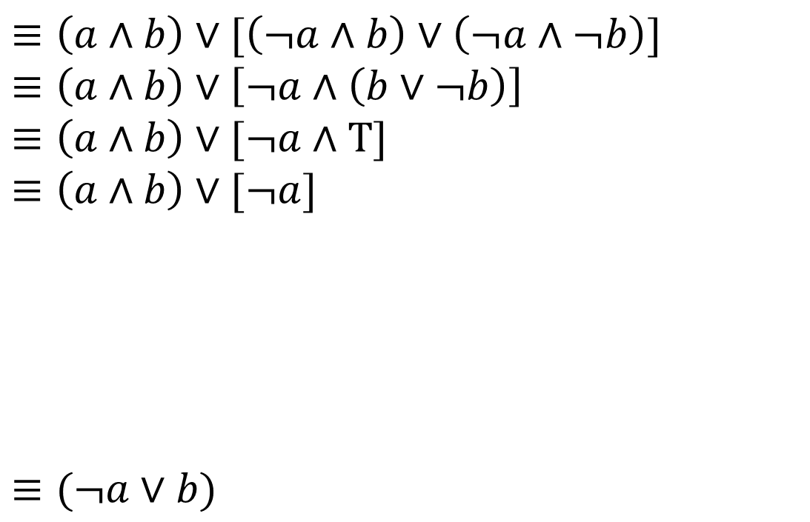
Our First Proof
$\left(a∧b\right)∨\left(¬a∧b\right)∨(¬a∧¬b)$
$≡\left(a∧b\right)∨[\left(¬a∧b\right)∨\left(¬a∧¬b\right)]$
$≡\left(a∧b\right)∨\left[¬a∧\left(b∨¬b\right)\right]$
$≡\left(a∧b\right)∨[¬a∧T]$
$≡\left(a∧b\right)∨[¬a]$
$≡\left[¬p\right]∨(p∧q)$
$≡\left(\begin{aligned}¬p \\ ∨p\end{aligned}\right)∧\left(¬p∨q\right)$
$≡T∧\left(¬p∨q\right)$
$≡$ $\left(¬p∨q\right)∧T$
$≡(¬a∨b)$
Set ourselves an intermediate goal.
Let’s try to simplify those last two pieces
Identity
Should make things simpler.

Slide 29


Our First Proof
$\left(a∧b\right)∨\left(¬a∧b\right)∨(¬a∧¬b)$
$≡\left(a∧b\right)∨[\left(¬a∧b\right)∨\left(¬a∧¬b\right)]$
$≡\left(a∧b\right)∨\left[¬a∧\left(b∨¬b\right)\right]$
$≡\left(a∧b\right)∨[¬a∧T]$
$≡\left(a∧b\right)∨[¬a]$
$≡(¬a∨b)$
Stay on target:
We met our intermediate goal.
Don‘t forget the final goal!
We want to end up at $\left(¬a∨b\right)$
If we apply the distribution rule,
We’d get a $(¬a∨b)$

Slide 30
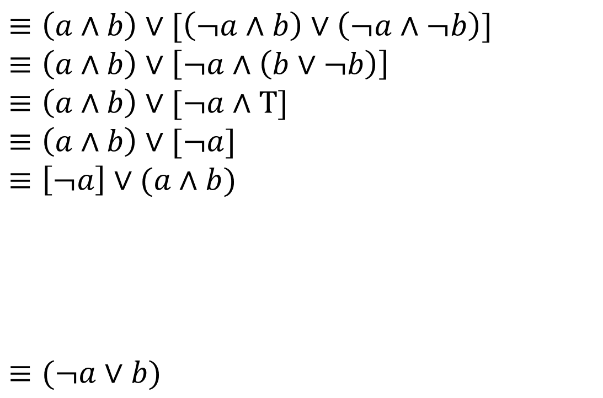
Our First Proof
$\left(a∧b\right)∨\left(¬a∧b\right)∨(¬a∧¬b)$
$≡\left(a∧b\right)∨[\left(¬a∧b\right)∨\left(¬a∧¬b\right)]$
$≡\left(a∧b\right)∨\left[¬a∧\left(b∨¬b\right)\right]$
$≡\left(a∧b\right)∨[¬a∧T]$
$≡\left(a∧b\right)∨[¬a]$
$≡\left[¬a\right]∨(a∧b)$
$≡(¬a∨b)$
Stay on target:
We met our intermediate goal.
Don‘t forget the final goal!
We want to end up at $\left(¬a∨b\right)$
If we apply the distribution rule,
We’d get a $(¬a∨b)$
Commutative
Make the expression look exactly like the law (more on this later)

Slide 31
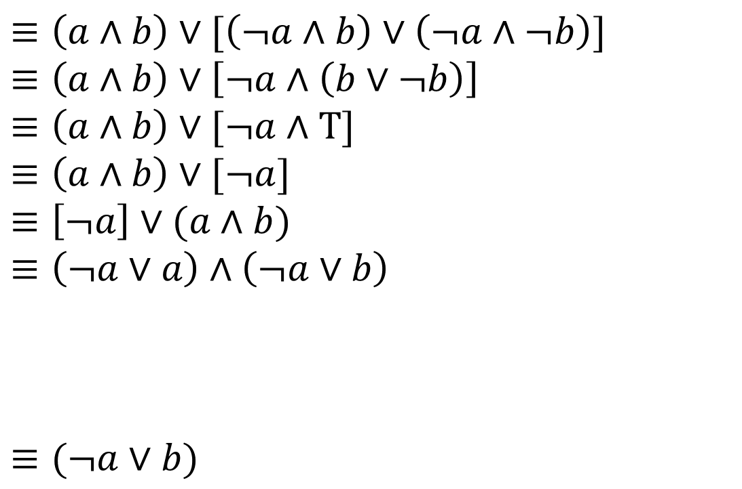

Our First Proof
$\left(a∧b\right)∨\left(¬a∧b\right)∨(¬a∧¬b)$
$≡\left(a∧b\right)∨[\left(¬a∧b\right)∨\left(¬a∧¬b\right)]$
$≡\left(a∧b\right)∨\left[¬a∧\left(b∨¬b\right)\right]$
$≡\left(a∧b\right)∨[¬a∧T]$
$≡\left(a∧b\right)∨[¬a]$
$≡\left[¬a\right]∨(a∧b)$
$≡\left(¬a∨a\right)∧\left(¬a∨b\right)$
$≡(¬a∨b)$
Stay on target:
We met our intermediate goal.
Don‘t forget the final goal!
We want to end up at $\left(¬a∨b\right)$
If we apply the distribution rule,
We’d get a $(¬a∨b)$
Distributive
Creates the $(¬a∨b)$ we were hoping for.

Slide 32
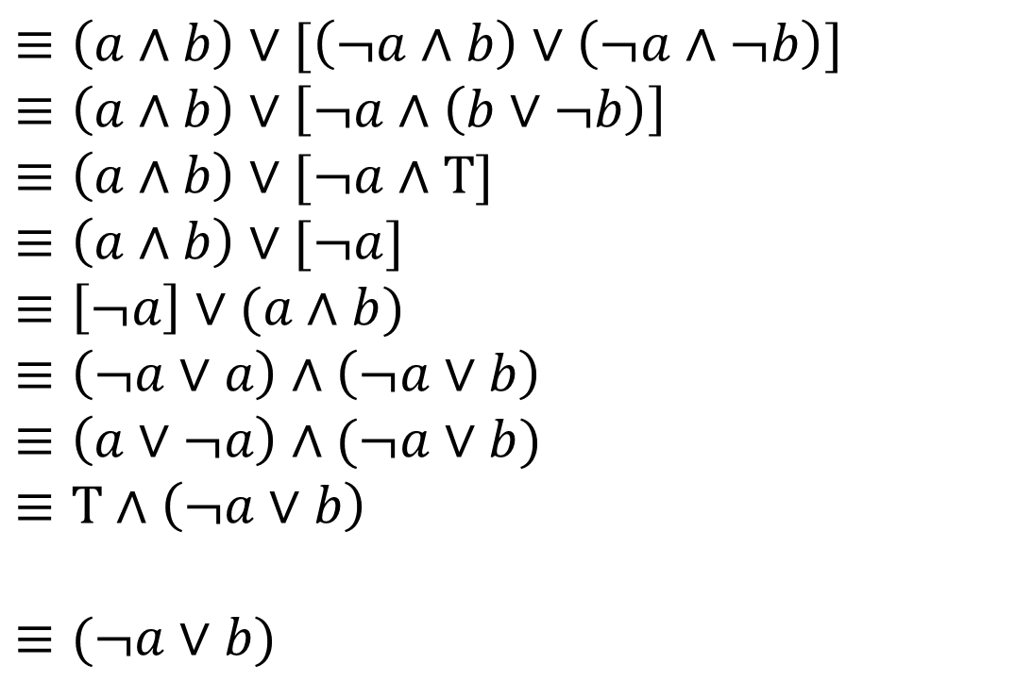
Our First Proof
$\left(a∧b\right)∨\left(¬a∧b\right)∨(¬a∧¬b)$
$≡\left(a∧b\right)∨[\left(¬a∧b\right)∨\left(¬a∧¬b\right)]$
$≡\left(a∧b\right)∨\left[¬a∧\left(b∨¬b\right)\right]$
$≡\left(a∧b\right)∨[¬a∧T]$
$≡\left(a∧b\right)∨[¬a]$
$≡\left[¬a\right]∨(a∧b)$
$≡\left(¬a∨a\right)∧\left(¬a∨b\right)$
$≡\left(a∨¬a\right)∧(¬a∨b)$
$≡T∧\left(¬a∨b\right)$
$≡(¬a∨b)$
Stay on target:
We met our intermediate goal.
Don‘t forget the final goal!
We want to end up at $\left(¬a∨b\right)$
If we apply the distribution rule,
We’d get a $(¬a∨b)$
Commutative
Make the expression look exactly like the law (more on this later)
Negation
Simplifies the part we want to disappear.

Slide 33

Simplify T$∧(¬a∨b)$ to $(¬a∨b)$
These identities hold for all propositions $p,q,r$
Identity
  $p∧T≡p$
  $p∨F≡p$
Domination
  $p∨T≡T$
  $p∧F≡F$
Idempotent
  $p∨p≡p$
  $p∧p≡p$
Commutative
  $p∨q≡q∨p$
  $p∧q≡q∧p$
  Associative
    $\left(p∨q\right)∨r≡p∨\left(q∨r\right)$
    $\left(p∧q\right)∧r≡p∧\left(q∧r\right)$
  Distributive
    $p∧\left(q∨r\right)≡\left(p∧q\right)∨\left(p∧r\right)$
    $p∨\left(q∧r\right)≡\left(p∨q\right)∧(p∨r)$
  Absorption
    $p∨\left(p∧q\right)≡p$
    $p∧\left(p∨q\right)≡p$
  Negation
    $p∨¬p≡T$
    $p∧¬p≡F$

Slide 34
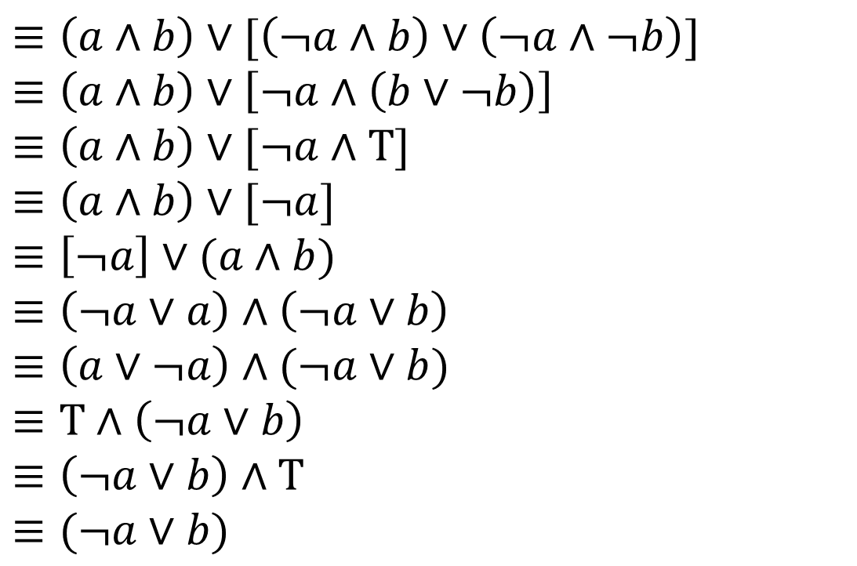
Our First Proof
$\left(a∧b\right)∨\left(¬a∧b\right)∨(¬a∧¬b)$
$≡\left(a∧b\right)∨[\left(¬a∧b\right)∨\left(¬a∧¬b\right)]$
$≡\left(a∧b\right)∨\left[¬a∧\left(b∨¬b\right)\right]$
$≡\left(a∧b\right)∨[¬a∧T]$
$≡\left(a∧b\right)∨[¬a]$
$≡\left[¬a\right]∨(a∧b)$
$≡\left(¬a∨a\right)∧\left(¬a∨b\right)$
$≡\left(a∨¬a\right)∧(¬a∨b)$
$≡T∧\left(¬a∨b\right)$
$≡\left(¬a∨b\right)∧T$
$≡(¬a∨b)$
Stay on target:
We met our intermediate goal.
Don‘t forget the final goal!
We want to end up at $\left(¬a∨b\right)$
If we apply the distribution rule,
We’d get a $(¬a∨b)$
Commutative followed by Identity
Look exactly like the law, then apply it.
We’re done!!!

Slide 35
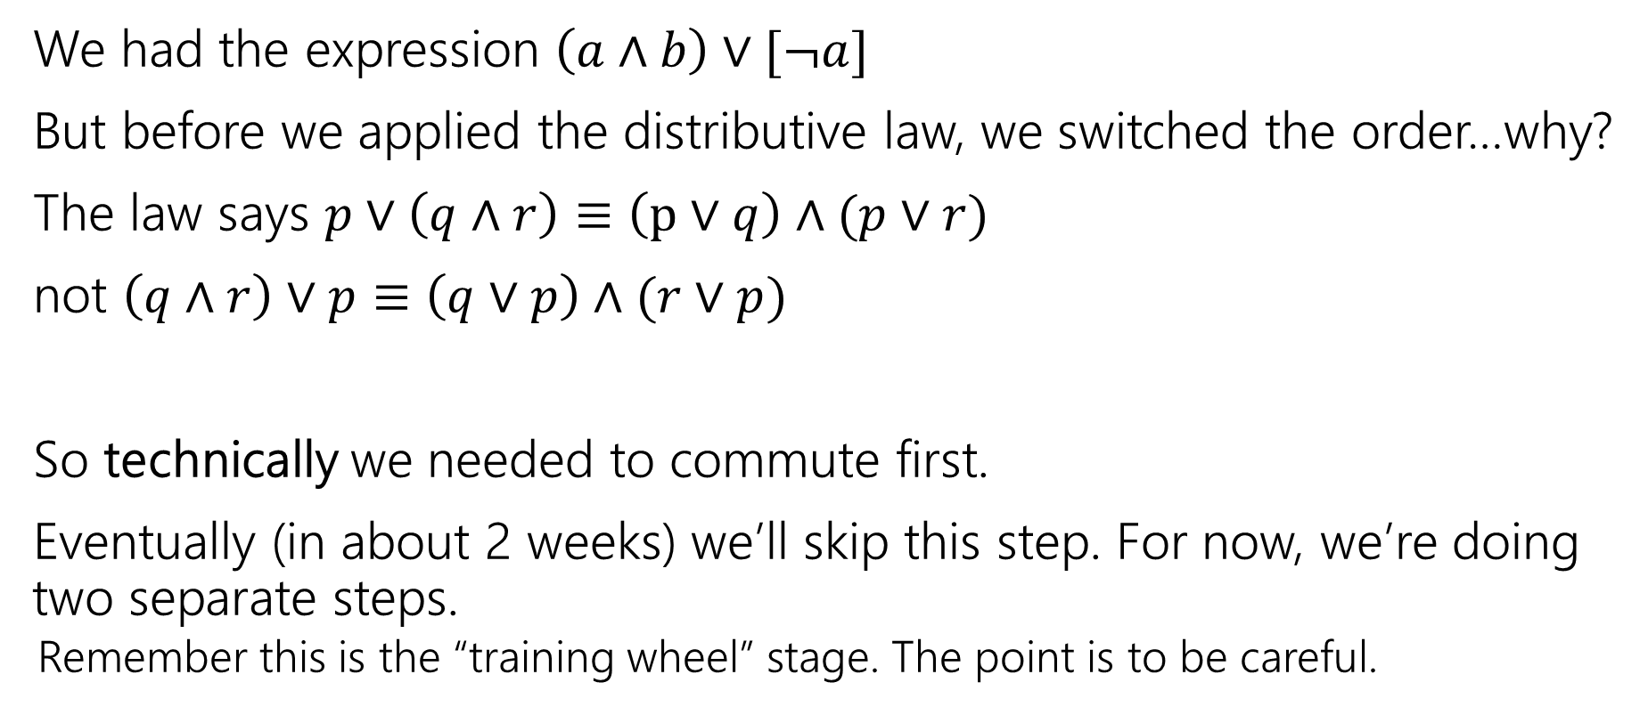
Commutativity
We had the expression $\left(a∧b\right)∨[¬a]$
But before we applied the distributive law, we switched the order…why?
The law says $p∨\left(q∧r\right)≡\left(p∨q\right)∧(p∨r)$
not $\left(q∧r\right)∨p≡\left(q∨p\right)∧(r∨p)$
So technically we needed to commute first.
Eventually (in about 2 weeks) we’ll skip this step. For now, we’re doing two separate steps.
  Remember this is the “training wheel” stage. The point is to be careful.

Slide 36
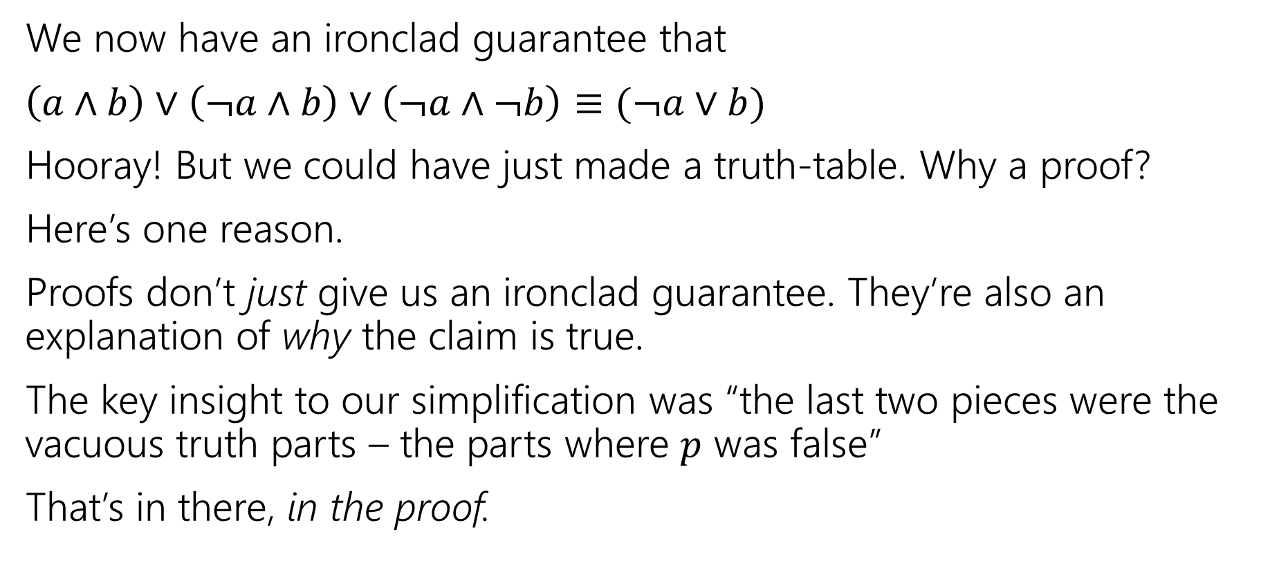
More on Our First Proof
We now have an ironclad guarantee that
$\left(a∧b\right)∨\left(¬a∧b\right)∨\left(¬a∧¬b\right)≡(¬a∨b)$
Hooray! But we could have just made a truth-table. Why a proof?
Here’s one reason.
Proofs don’t just give us an ironclad guarantee. They’re also an explanation of why the claim is true.
The key insight to our simplification was “the last two pieces were the vacuous truth parts – the parts where $p$ was false”
That’s in there, in the proof.

Slide 37
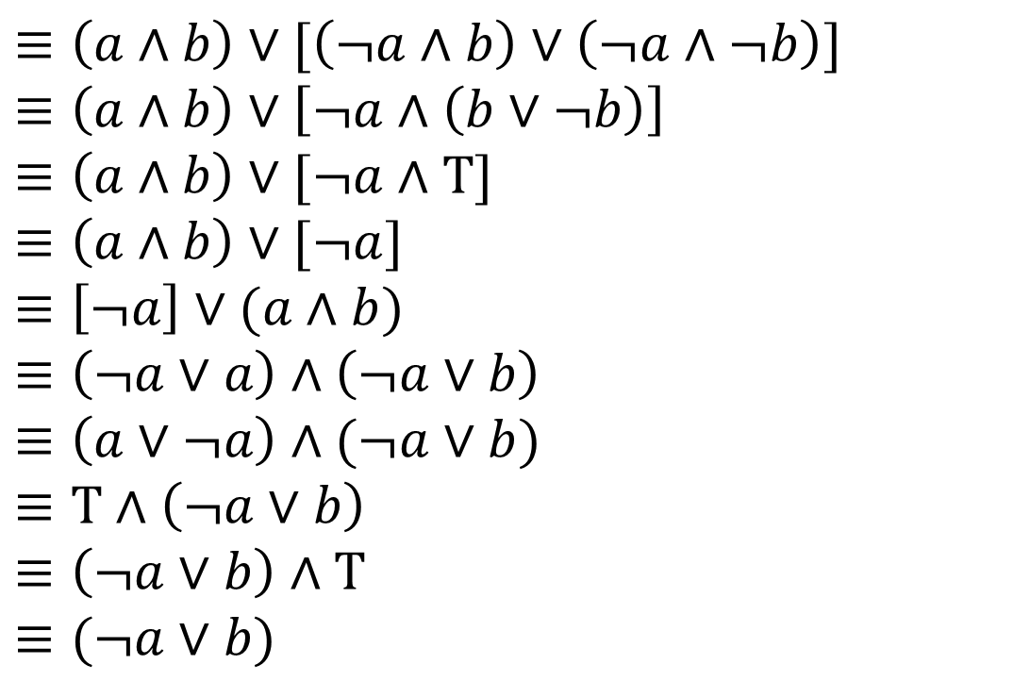


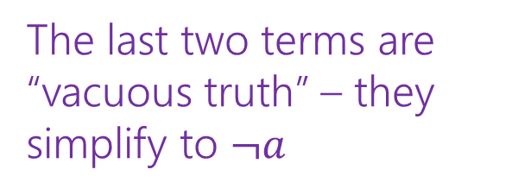
Our First Proof
$\left(a∧b\right)∨\left(¬a∧b\right)∨(¬a∧¬b)$
$≡\left(a∧b\right)∨[\left(¬a∧b\right)∨\left(¬a∧¬b\right)]$
$≡\left(a∧b\right)∨\left[¬a∧\left(b∨¬b\right)\right]$
$≡\left(a∧b\right)∨[¬a∧T]$
$≡\left(a∧b\right)∨[¬a]$
$≡\left[¬a\right]∨(a∧b)$
$≡\left(¬a∨a\right)∧\left(¬a∨b\right)$
$≡\left(a∨¬a\right)∧(¬a∨b)$
$≡T∧\left(¬a∨b\right)$
$≡\left(¬a∨b\right)∧T$
$≡(¬a∨b)$
Associative
Distributive
Negation
Identity
Commutative
Distributive
Commutative
Negation
Commutative
Identity
The last two terms are “vacuous truth” – they simplify to $¬a$
$a$ no longer matters in $a∧b$ if $¬a$ automatically makes the expression true.

Slide 38
More on Our First Proof
With practice (and quite a bit of squinting) you can see not just the ironclad guarantee, but also the reason why something is true.
That’s not easy with a truth table.
Proofs can also communicate intuition about why a statement is true.
  We’ll practice extracting intuition from proofs more this quarter.

Slide 39
Modifying Implications

Slide 40
Converse, Contrapositive
Implication:
p → q
Converse:
q → p
Contrapositive:
¬q → ¬p
Inverse:
¬p → ¬q
If it’s raining, then I have my umbrella.
If I don’t have my umbrella, then it is not raining.
If I have my umbrella, then it is raining.
If it is not raining, then I don’t have my umbrella.
How do these relate to each other?
p | q | p → q | q → p | ¬p | ¬q | ¬p → ¬q | ¬q → ¬p
T | T
T | F
F | T
F | F

Slide 41
Converse, Contrapositive
Implication:
p → q
Converse:
q → p
Contrapositive:
¬q → ¬p
Inverse:
¬p → ¬q
An implication and its contrapositive have the same truth value!
p | q | p → q | q → p | ¬p | ¬q | ¬p → ¬q | ¬q → ¬p
T | T | T | T | F | F | T | T
T | F | F | T | F | T | T | F
F | T | T | F | T | F | F | T
F | F | T | T | T | T | T | T

Slide 42
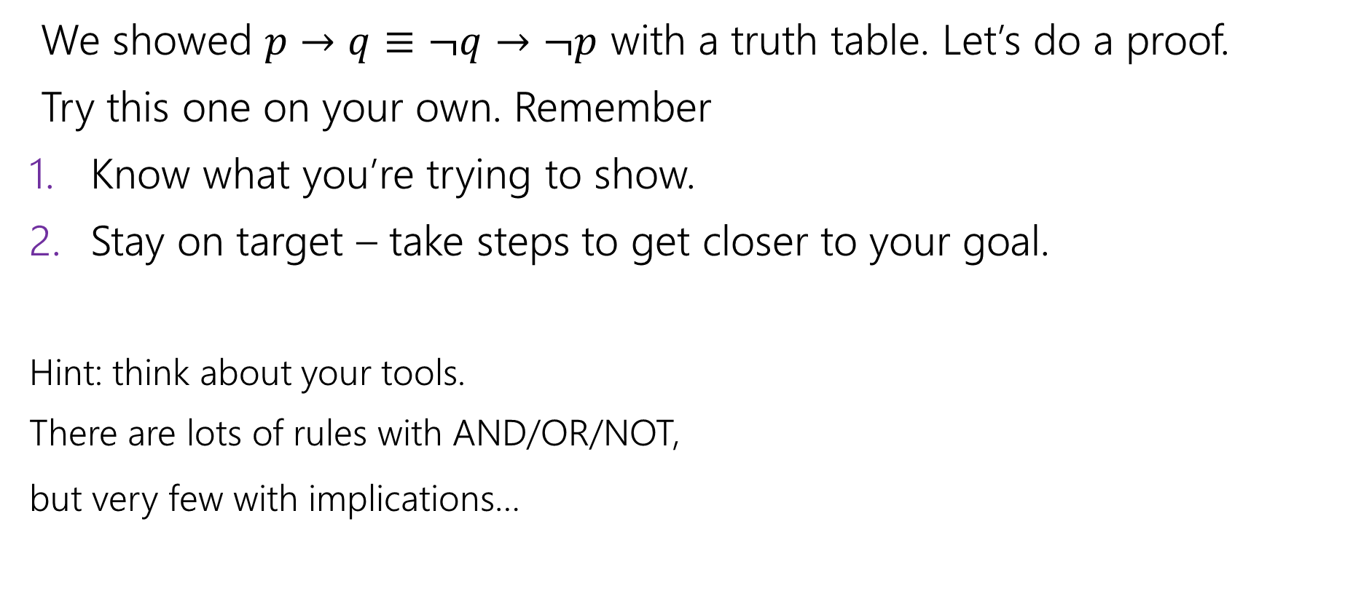
Contrapositive
We showed $p→q≡¬q→¬p$ with a truth table. Let’s do a proof.
Try this one on your own. Remember
Know what you’re trying to show.
Stay on target – take steps to get closer to your goal.
Hint: think about your tools.
There are lots of rules with AND/OR/NOT,
but very few with implications…

Slide 43
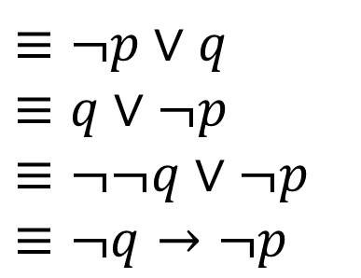

Contrapositive
$p→q$
$≡¬p∨q$
$≡q∨¬p$
$≡¬¬q∨¬p$
$≡¬q→¬p$
Law of Implication
Commutativity
Double Negation
Law of Implication
All of our rules deal with ORs and ANDs, let’s switch the implication to just use AND/NOT/OR.
And do the same with our target
It’s ok to work from both ends. In fact it’s a very common strategy!
Now how do we get the top to look like the bottom?
Just a few more rules and we’re done!

Slide 44
Work from both ends, but…
…make sure at the end, if you read from top-to-bottom, every step makes sense.
When proving an equivalence you must:
1. Start with the left side (or right side)
2. Modify what you had in the last step (using an equivalence)
3. Derive the right side (or left side if you started with the right)
You may not start with the equivalence you’re trying to show, and simplify to something “obviously true.”
  More on why later in the quarter, but tl;dr for now is you can’t use your goal as a starting assumption (it’s what you’re trying to show! If you knew it, no need to write a proof).

