Slide 1
More Logic, Equivalences, Symbolic Proofs
CSE 311 Autumn 2025
Lecture 2

Slide 2
Announcements
Lecture recordings on “Panopto” – link is posted on ed.
HW1 is out now – on the assignments tab on the webpage
Due Thursday evening (10/2).
Note that assignments will normally be released and due on Wednesdays (out for 1 week)
You’ll submit to gradescope.
OH will start on Monday (9/29)!
mix of zoom + in-person
Visit early! We get very busy right before deadlines!
CC1 and 2 will both be due Monday 1:30 (delayed deadline for CC1)
Make sure you can get on gradescope today!

Slide 3
Today
More on implications
Simplification Rules

Slide 4
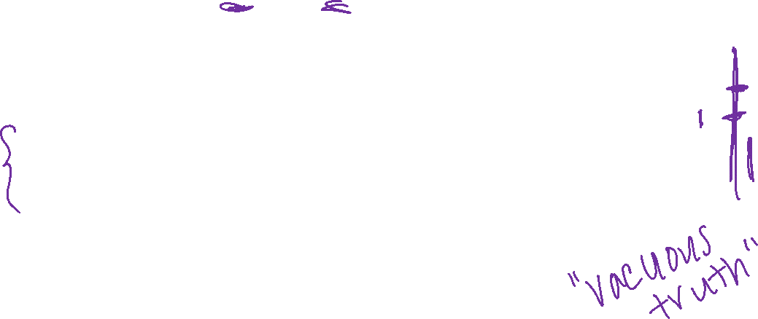

Implication ($p→q)$ with answers
“If it’s raining, then I have my umbrella”
It’s useful to think of implications as promises. An implication is false exactly when you can demonstrate I’m lying.
p | q | p → q
T | T | T
T | F | F
F | T | T
F | F | T
 | It’s raining | It’s not raining
I have my umbrella | No lie. True | No lie. True
I do not have my umbrella | LIE! False | No lie. True

Slide 5
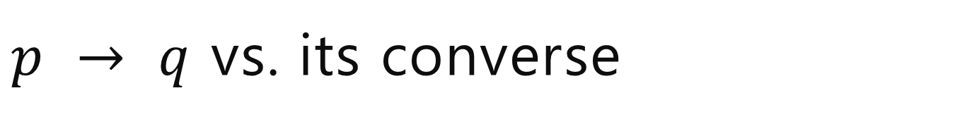
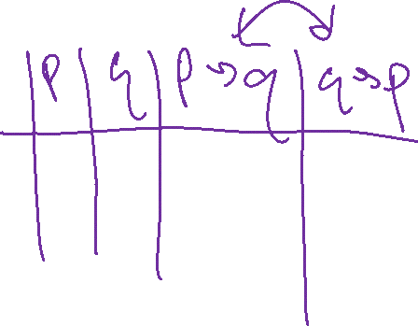
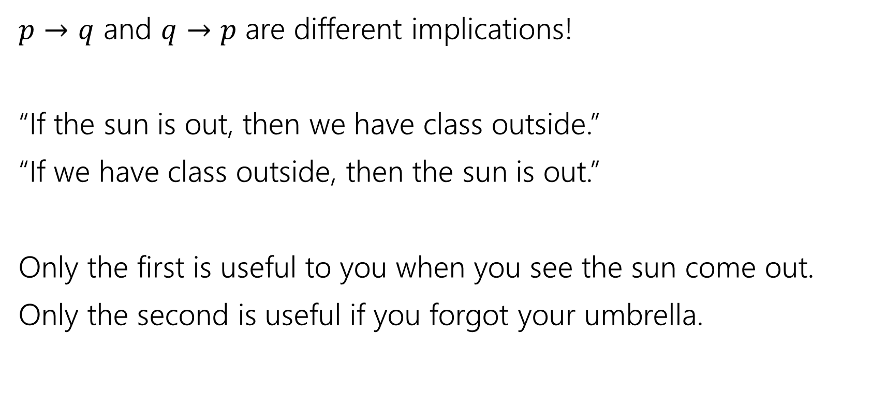
$p → q$ vs. its converse
$p→q$ and $q→p$ are different implications!
“If the sun is out, then we have class outside.”
“If we have class outside, then the sun is out.”
Only the first is useful to you when you see the sun come out.
Only the second is useful if you forgot your umbrella.

Slide 6

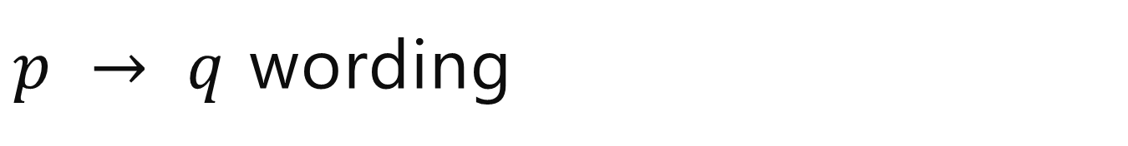
$p → q$ wording
p | q | p → q
T | T | T
T | F | F
F | T | T
F | F | T
Implication:
p implies q
whenever p is true q must be true
if p then q
q if p
p is sufficient for q
p only if q
q is necessary for p
Implications are super useful, so there are LOTS of translations.
You’ll learn these in detail in section.

Slide 7
More Connectives

Slide 8
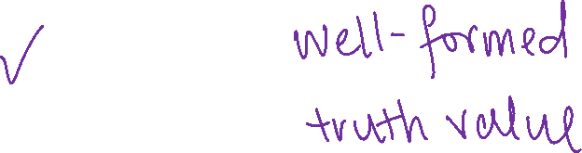
A More Complicated Statement
“Robbie knows the Pythagorean Theorem if he is a mathematician and took geometry, and he is a mathematician or did not take geometry.”
Is this a proposition?
We’d like to understand what this proposition means.
In particular, is it true?

Slide 9
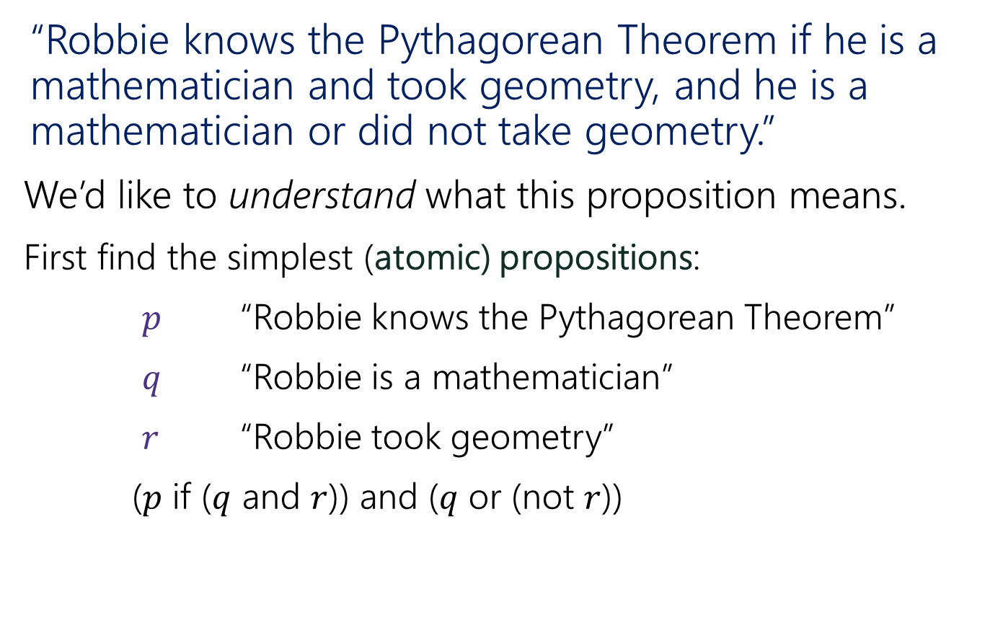
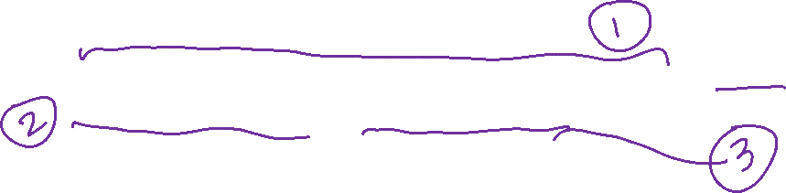
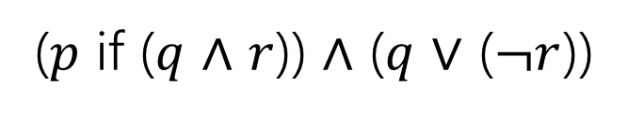
A Compound Proposition
“Robbie knows the Pythagorean Theorem if he is a mathematician and took geometry, and he is a mathematician or did not take geometry.”
We’d like to understand what this proposition means.
First find the simplest (atomic) propositions:
$p$ “Robbie knows the Pythagorean Theorem”
$q$ “Robbie is a mathematician”
$r$ “Robbie took geometry”
($p$ if ($q$ and $r$)) and ($q$ or (not $r$))
($p$ if ($q$ $∧$ $r$)) $∧$ ($q$ $∨$ ($¬r$))

Slide 10
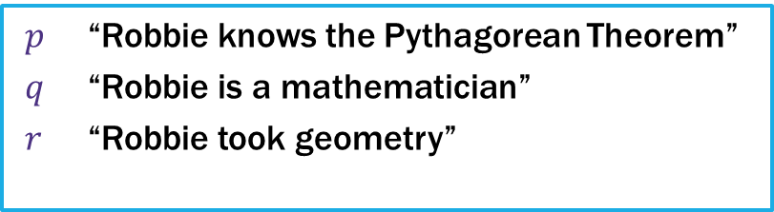
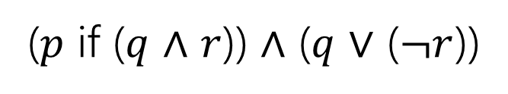
Parentheses…
“Robbie knows the Pythagorean Theorem if he is a mathematician and took geometry, and he is a mathematician or did not take geometry.”
$p$ “Robbie knows the Pythagorean Theorem”
$q$ “Robbie is a mathematician”
$r$ “Robbie took geometry”
($p$ if ($q$ $∧$ $r$)) $∧$ ($q$ $∨$ ($¬r$))
How did we know where to put the parentheses?
Subtle English grammar choices (top-level parentheses are independent clauses).
Context/which parsing will make more sense.
Conventions
A reading on this is coming soon!

Slide 11
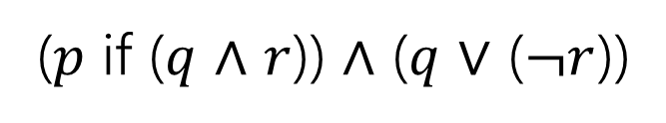
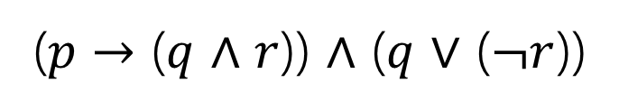
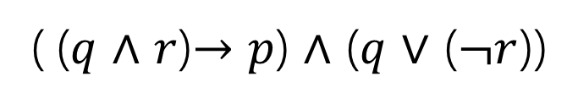
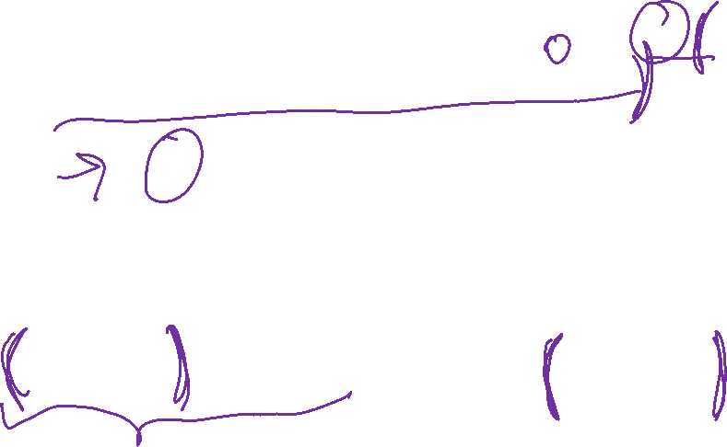
Back to the Compound Proposition…
“Robbie knows the Pythagorean Theorem if he is a mathematician and took geometry, and he is a mathematician or did not take geometry.”
($p$ if ($q$ $∧$ $r$)) $∧$ ($q$ $∨$ ($¬r$))
$p$ “Robbie knows the Pythagorean Theorem”
$q$ “Robbie is a mathematician”
$r$ “Robbie took geometry”
What promise am I making?
( ($q$ $∧$ $r$)$→p$) $∧$ ($q$ $∨$ ($¬r$))
($p$ $→$ ($q$ $∧$ $r$)) $∧$ ($q$ $∨$ ($¬r$))
The first one! Being a mathematician and taking geometry is the condition. Knowing the Pythagorean Theorem is the promise.

Slide 12

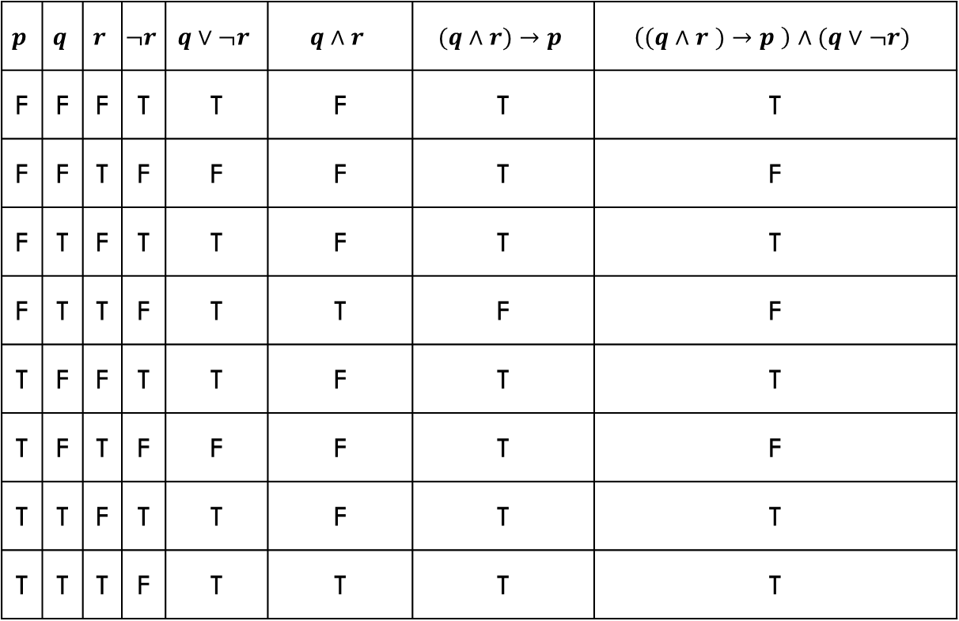
Analyzing the Sentence with a Truth Table
$$p$$ | $$q$$ | $$r$$ | $$¬r$$ | $$q∨¬r$$ | $$q∧r$$ | $$(q∧r)→p$$ | $$\left((q∧r )→p \right)∧(q∨¬r)$$
F | F | F | T | T | F | T | T
F | F | T | F | F | F | T | F
F | T | F | T | T | F | T | T
F | T | T | F | T | T | F | F
T | F | F | T | T | F | T | T
T | F | T | F | F | F | T | F
T | T | F | T | T | F | T | T
T | T | T | F | T | T | T | T

Slide 13
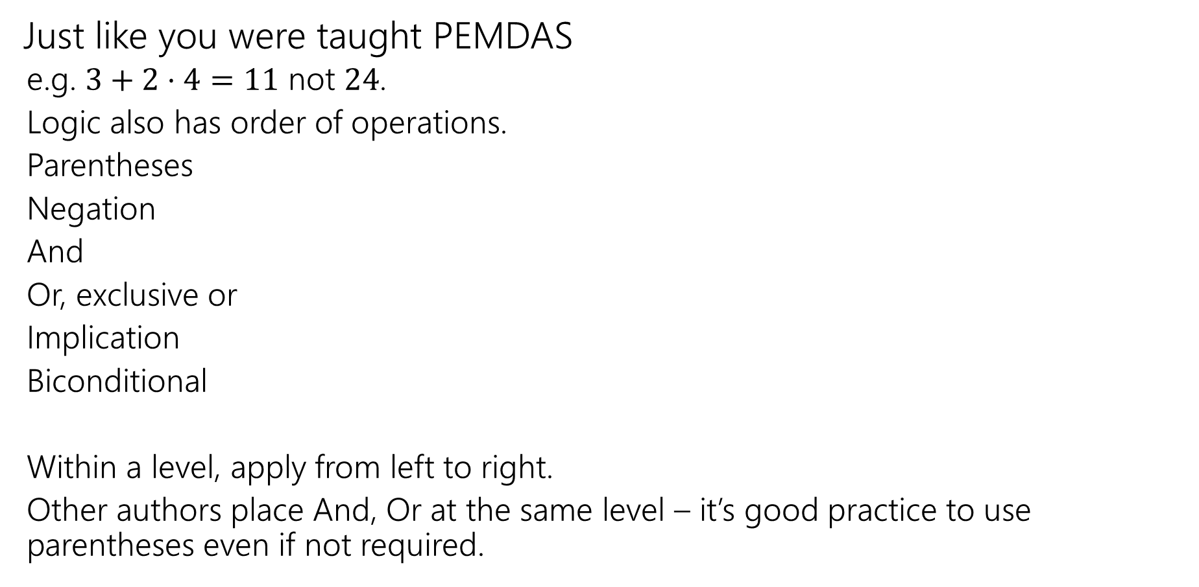
Order of Operations
Just like you were taught PEMDAS
e.g. $3+2⋅4=11$ not $24$.
Logic also has order of operations.
Parentheses
Negation
And
Or, exclusive or
Implication
Biconditional
Within a level, apply from left to right.
Other authors place And, Or at the same level – it’s good practice to use parentheses even if not required.
For this class: each of these is it’s own level!
e.g. “and”s have precedence over “or”s

Slide 14
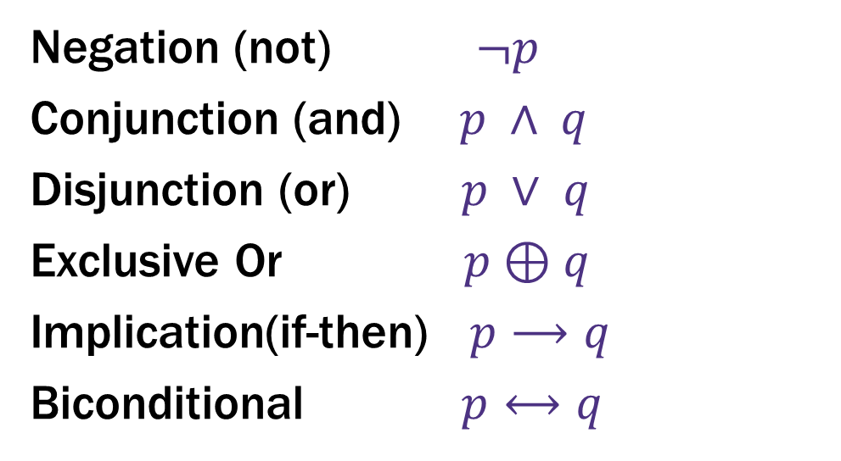

Logical Connectives
Negation (not) $¬p$
Conjunction (and) $p ∧ q$
Disjunction (or) $p ∨ q$
Exclusive Or $p⊕q$
Implication(if-then) $p⟶q$
Biconditional $p⟷q$
These ideas have been around for so long most have at least two names.
Two more connectives to discuss!

Slide 15

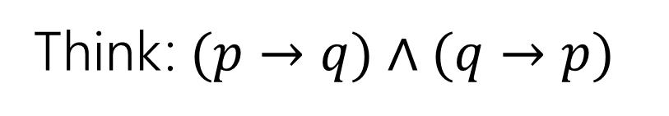

Biconditional: $p ↔ q$ (1)
Think: $(p→q)∧(q→p)$
p if and only if q
p iff q
p is equivalent to q
p implies q and q implies p
p is necessary and sufficient for q
p | q | p ↔ q

Slide 16
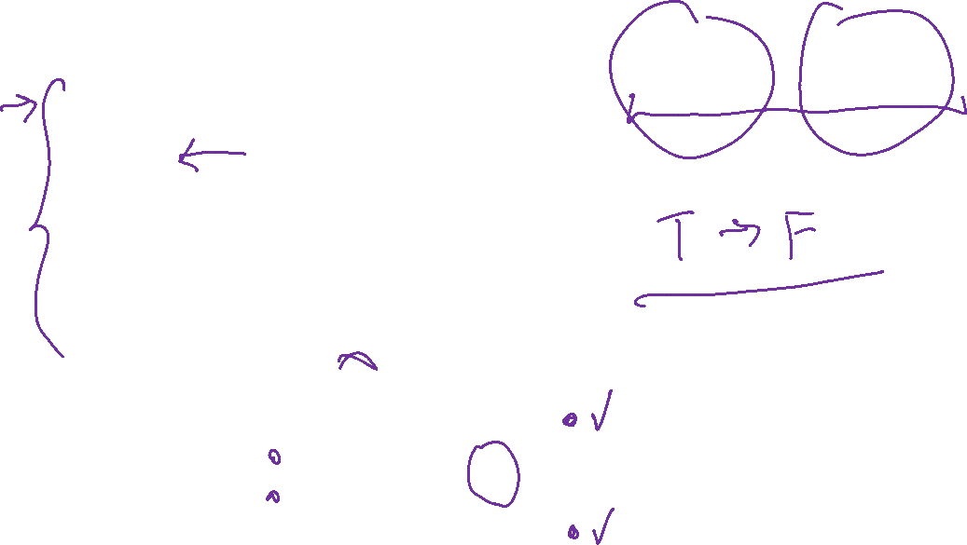
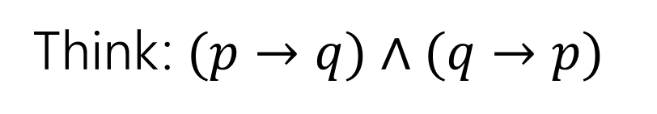
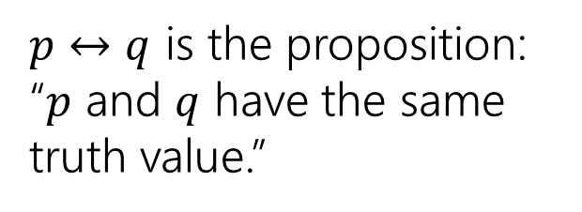

Biconditional: $p ↔ q$ (2)
Think: $(p→q)∧(q→p)$
p if and only if q
p iff q
p is equivalent to q
p implies q and q implies p
p is necessary and sufficient for q
p | q | p ↔ q
T | T | T
T | F | F
F | T | F
F | F | T
$p↔q$ is the proposition: “$p$ and $q$ have the same truth value.”

Slide 17
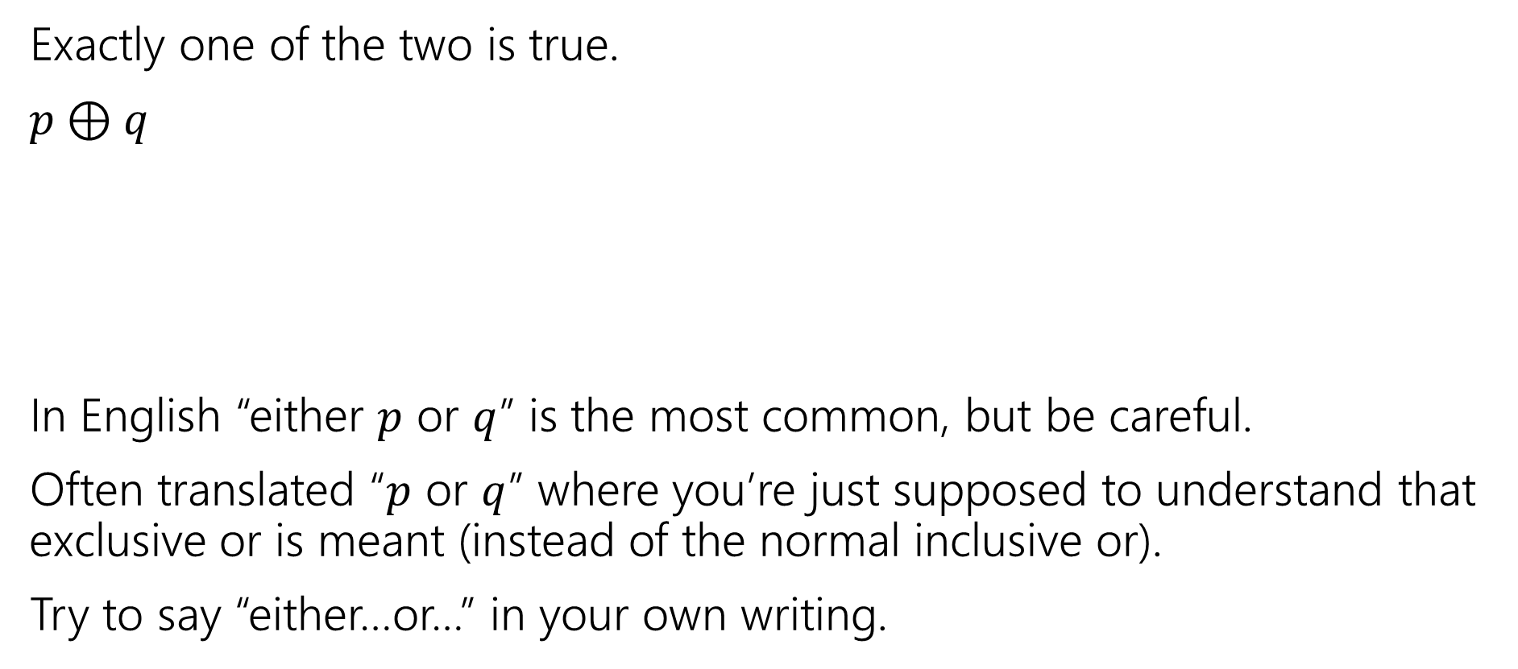
Exclusive Or (1)
Exactly one of the two is true.
$p⊕q$
In English “either $p$ or $q$” is the most common, but be careful.
Often translated “$p$ or $q$” where you’re just supposed to understand that exclusive or is meant (instead of the normal inclusive or).
Try to say “either…or…” in your own writing.
p | q | p ⊕ q

Slide 18
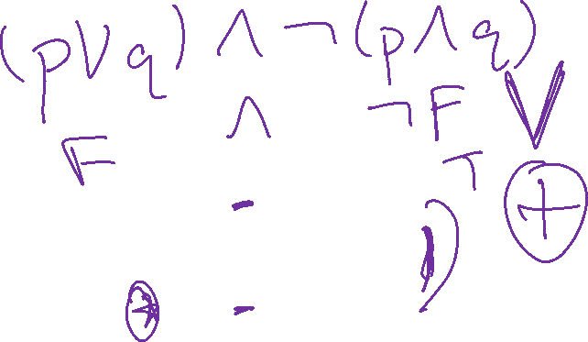
Exclusive Or (2)
Exactly one of the two is true.
$p⊕q$
In English “either $p$ or $q$” is the most common, but be careful.
Often translated “$p$ or $q$” where you’re just supposed to understand that exclusive or is meant (instead of the normal inclusive or).
Try to say “either…or…” in your own writing.
p | q | p ⊕ q
T | T | F
T | F | T
F | T | T
F | F | F

Slide 19
Today(ish)
A proof!
We want to be able to make iron-clad guarantees that something is true.
And convince others that we really have ironclad guarantees.
But first, some notation.

Slide 20
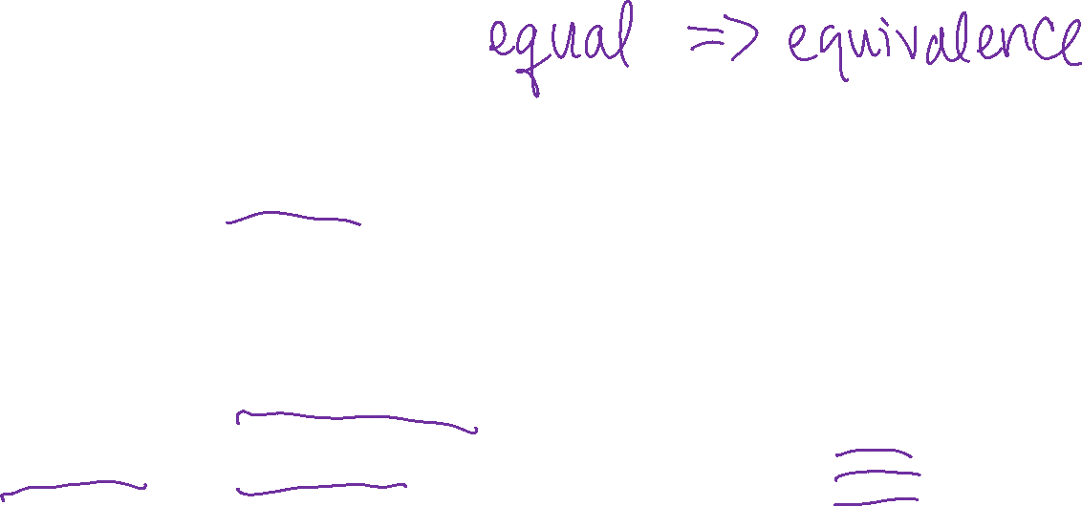
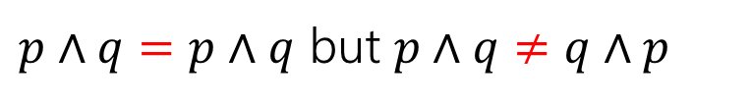
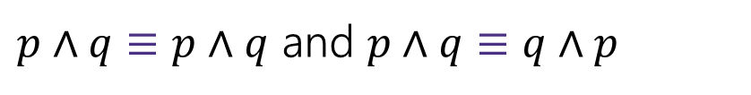
Logical Equivalence
We will want to talk about whether two propositions are “the same.”
Two propositions are “equal” ($=$) if they are character-for-character identical.
$p∧q=p∧q$ but $p∧q≠q∧p$
We almost never ask whether propositions are equal. It’s not an interesting question.
Two propositions are “equivalent” ($≡$) if they always have the same truth value.
$p∧q≡p∧q$ and $p∧q≡q∧p$
But $p∧q≢p∨q$
When $p$ is true and $q$ is false: $p∧q$ is false, but $p∨q$ is true.

Slide 21
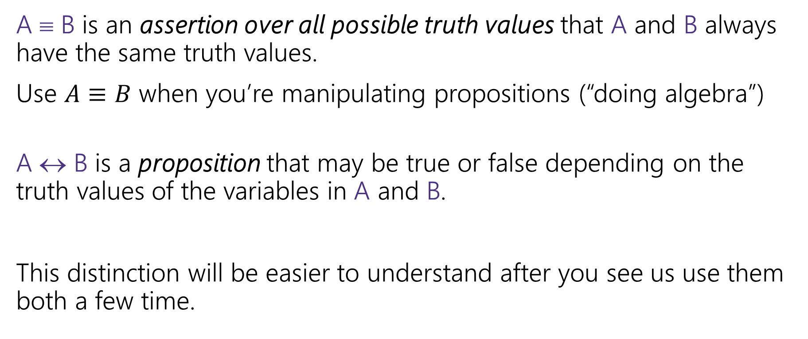

A ↔ B vs. A ≡ B
A ≡ B is an assertion over all possible truth values that A and B always have the same truth values.
Use $A≡B$ when you’re manipulating propositions (“doing algebra”)
A ↔ B is a proposition that may be true or false depending on the truth values of the variables in A and B.
This distinction will be easier to understand after you see us use them both a few time.

Slide 22
Simplification and Proofs

Slide 23
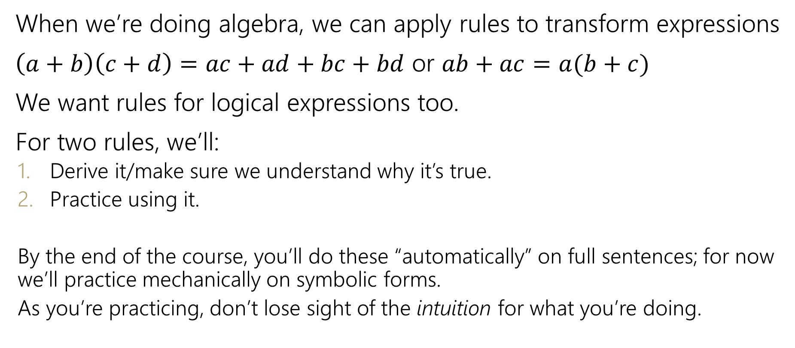

Manipulating Expressions
When we’re doing algebra, we can apply rules to transform expressions
$\left(a+b\right)\left(c+d\right)=ac+ad+bc+bd$ or $ab+ac=a(b+c)$
We want rules for logical expressions too.
For two rules, we’ll:
Derive it/make sure we understand why it’s true.
Practice using it.
By the end of the course, you’ll do these “automatically” on full sentences; for now we’ll practice mechanically on symbolic forms.
As you’re practicing, don’t lose sight of the intuition for what you’re doing.

Slide 24
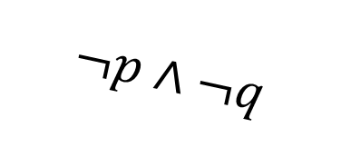
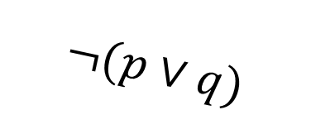

De Morgan’s Laws Intuition
Negate the statement
“my code compiles or there is a bug.”
i.e. find a natural English sentence that says
“the following is not true: my code compiles or there is a bug”
Hint: when it the original sentence false?
$$¬(p∨q)$$
‘or’ means ‘at least one is true’ so to negate, we need to say ‘neither is true’ or equivalently ‘both are false’
“my code does not compile and there is not a bug”
$$¬p∧¬q$$

Slide 25




De Morgan’s Laws in Symbols
$¬\left(p∨q\right)≡¬p∧¬q$
is a general rule. It’s always true for any propositions $p$ and $q$.
This is one of De Morgan’s Laws.
The other is:
$¬\left(p∧q\right)≡¬p∨¬q$

Slide 26

De Morgan’s Laws Truth Table
Example: $¬\left(p∧q\right)≡¬p∨¬q$
p | q | ¬p | ¬q | ¬p ∨ ¬q | p ∧ q | ¬(p ∧ q)
T | T | F | F | F | T | F
T | F | F | T | T | F | T
F | T | T | F | T | F | T
F | F | T | T | T | F | T
Every line is the same! So these expressions are equivalent.

Slide 27
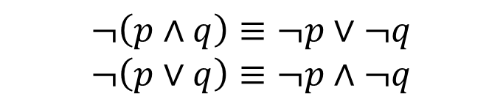

De Morgan’s Laws in Code
$$¬\left(p∧q\right)≡¬p∨¬q$$
$$¬\left(p∨q\right)≡¬p∧¬q$$
if (!(front != null && value > front.data))
front = new ListNode(value, front);
else {
ListNode current = front;
while (current.next != null && current.next.data < value))
current = current.next;
current.next = new ListNode(value, current.next);
}

Slide 28

De Morgan’s Laws Code example
$$¬\left(p∧q\right)≡¬p∨¬q$$
$$¬\left(p∨q\right)≡¬p∧¬q$$
!(front != null && value > front.data)
$$$$
front == null || value <= front.data
You’ve been using these for a while!

Slide 29
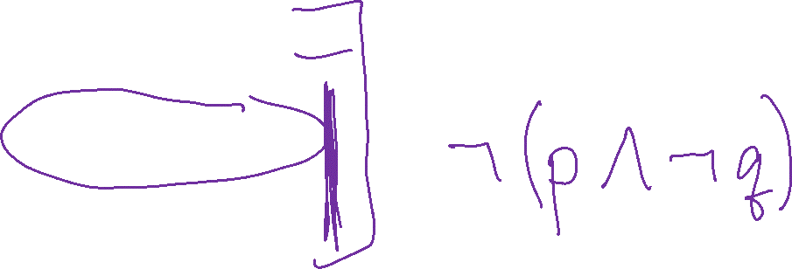
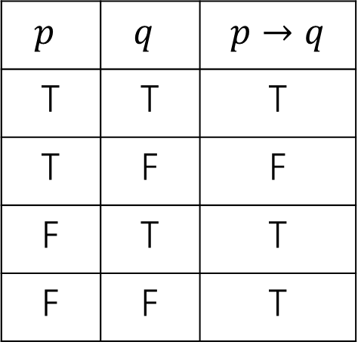
Law of Implication Intuition
Implications are hard.
AND/OR/NOT make more intuitive sense to me…
can we rewrite implications using just ANDs ORs and NOTs?
$p$ | $q$ | $$p→q$$
T | T | T
T | F | F
F | T | T
F | F | T
One approach: think “when is this implication false?” then negate it (you might want one of DeMorgan’s Laws!

Slide 30

Law of Implication
Implications are hard.
AND/OR/NOT make more intuitive sense to me…
can we rewrite implications using just ANDs ORs and NOTs?
$p$ | $q$ | $$p→q$$
T | T | T
T | F | F
F | T | T
F | F | T
Seems like we might want $¬(p∧¬q)$
$$¬p∨q$$
Seems like a reasonable guess.
So is it true? Is $¬p∨q≡p→q$?

Slide 31

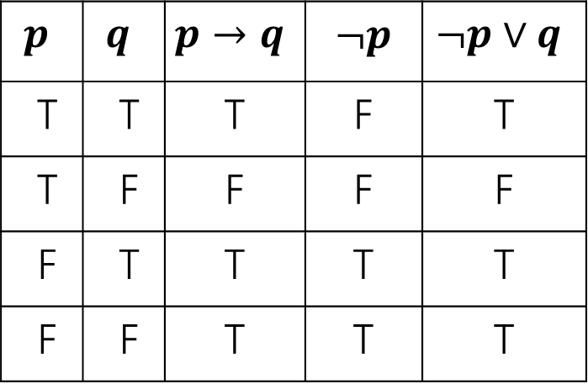
Law of Implication Truth Table
$$¬p∨q≡p→q$$
$$p$$ | $$q$$ | $$p→q$$ | $¬p$ | $$¬p∨q$$
T | T | T | F | T
T | F | F | F | F
F | T | T | T | T
F | F | T | T | T
Every line is the same! So these expressions are equivalent.

Slide 32
Properties of Logical Connectives
We’ve derived two facts about logical connectives.
There’s a lot more. A LOT more.
The next slide is a list of a bunch of them…
Most of these are much less complicated than the last two, so we won’t go through them in detail.
DO NOT freak out about how many there are. We will always provide you the list on the next slide (no need to memorize).

Slide 33
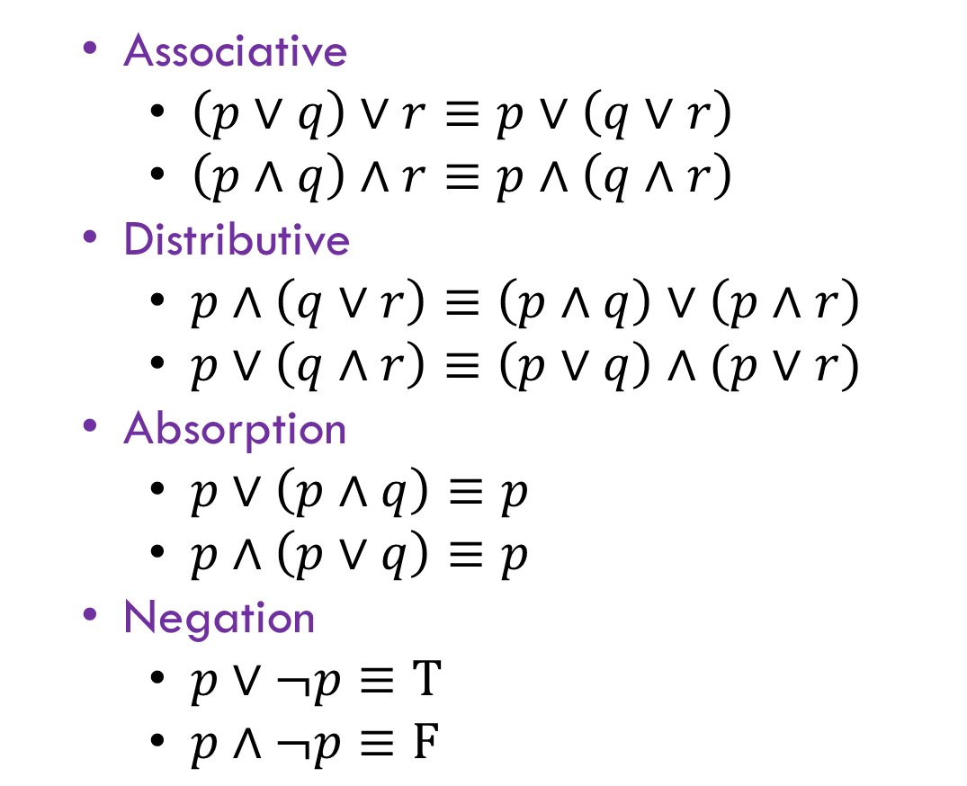
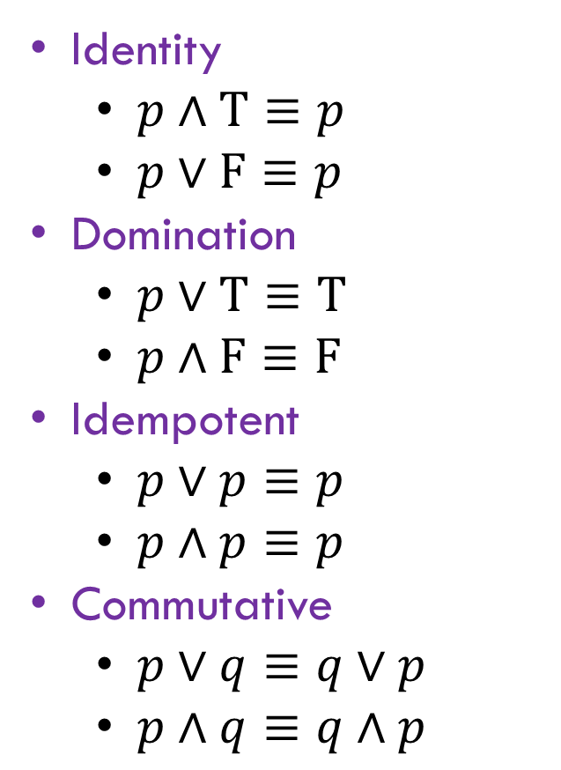
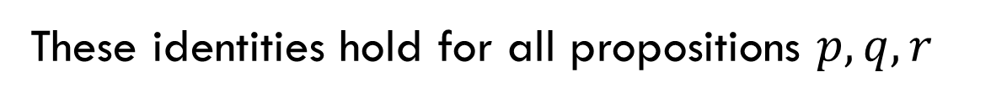
Properties of Logical Connectives List
These identities hold for all propositions $p,q,r$
You don’t have to memorize this list!
Identity
$p∧T≡p$
$p∨F≡p$
Domination
$p∨T≡T$
$p∧F≡F$
Idempotent
$p∨p≡p$
$p∧p≡p$
Commutative
$p∨q≡q∨p$
$p∧q≡q∧p$
Associative
$\left(p∨q\right)∨r≡p∨\left(q∨r\right)$
$\left(p∧q\right)∧r≡p∧\left(q∧r\right)$
Distributive
$p∧\left(q∨r\right)≡\left(p∧q\right)∨\left(p∧r\right)$
$p∨\left(q∧r\right)≡\left(p∨q\right)∧(p∨r)$
Absorption
$p∨\left(p∧q\right)≡p$
$p∧\left(p∨q\right)≡p$
Negation
$p∨¬p≡T$
$p∧¬p≡F$

Slide 34
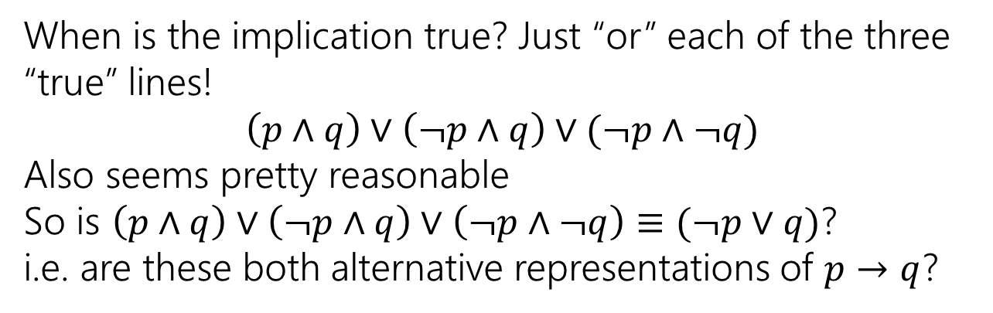
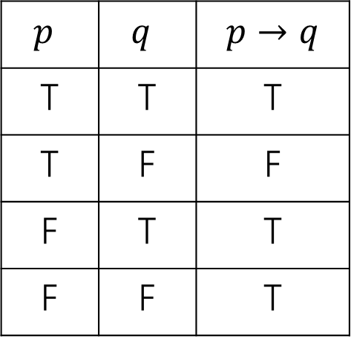
Using Our Rules
WOW that was a lot of rules.
Why do we need them? Simplification!
Let’s go back to the “law of implication” example.
$p$ | $q$ | $$p→q$$
T | T | T
T | F | F
F | T | T
F | F | T
When is the implication true? Just “or” each of the three “true” lines!
$$\left(p∧q\right)∨\left(¬p∧q\right)∨(¬p∧¬q)$$
Also seems pretty reasonable
So is $\left(p∧q\right)∨\left(¬p∧q\right)∨\left(¬p∧¬q\right)≡(¬p∨q)$?
i.e. are these both alternative representations of $p→q$?

Slide 35
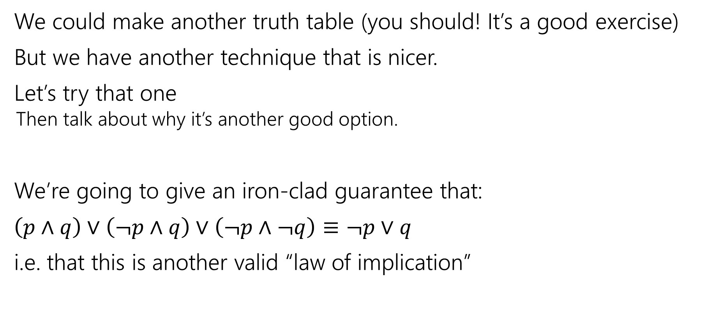
Our First Proof
We could make another truth table (you should! It’s a good exercise)
But we have another technique that is nicer.
Let’s try that one
Then talk about why it’s another good option.
We’re going to give an iron-clad guarantee that:
$\left(p∧q\right)∨\left(¬p∧q\right)∨\left(¬p∧¬q\right)≡¬p∨q$
i.e. that this is another valid “law of implication”

Slide 36
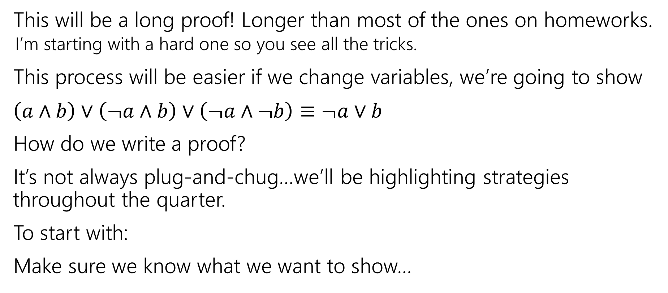
Our First Proof
This will be a long proof! Longer than most of the ones on homeworks.
I’m starting with a hard one so you see all the tricks.
This process will be easier if we change variables, we’re going to show
$\left(a∧b\right)∨\left(¬a∧b\right)∨\left(¬a∧¬b\right)≡¬a∨b$
How do we write a proof?
It’s not always plug-and-chug…we’ll be highlighting strategies throughout the quarter.
To start with:
Make sure we know what we want to show…
Notes:
Just replaced p with a and q with b. Same as if you replaced the “I” in a for-loop with a “j” everywhere in that loop.

Slide 37



Our First Proof
$\left(a∧b\right)∨\left(¬a∧b\right)∨(¬a∧¬b)$
$≡\left(p∧q\right)∨[\left(¬p∧q\right)∨\left(¬p∧¬q\right)]$
$≡\left(p∧q\right)∨\left[¬p∧\left(q∨¬q\right)\right]$
$≡\left(p∧q\right)∨[¬p∧T]$
$≡\left(p∧q\right)∨[¬p]$
$≡\left[¬p\right]∨(p∧q)$
$≡\left(¬p∨p\right)∧\left(¬p∨q\right)$
$≡T∧\left(¬p∨q\right)$
$≡$ $\left(¬p∨q\right)∧T$
$≡(¬a∨b)$
None of the rules look like this
Practice of Proof-Writing: Big Picture…WHY do we think this might be true?
The last two “pieces” came from the vacuous proof lines…maybe the “$¬a$” came from there? Maybe that simplifies down to $¬a$

Slide 38

Let’s apply a rule
$\left(¬a∧b\right)∨(¬a∧¬b)$
The law says:
$p∧\left(q∨r\right)≡\left(p∧q\right)∨(p∧r)$
$\left(¬a∧b\right)∨\left(¬a∧¬b\right)≡¬a∧(b∨¬b)$

Slide 39

Our First Proof
$\left(a∧b\right)∨\left(¬a∧b\right)∨(¬a∧¬b)$
$≡\left(p∧q\right)∨[\left(¬p∧q\right)∨\left(¬p∧¬q\right)]$
$≡\left(p∧q\right)∨\left[¬p∧\left(q∨¬q\right)\right]$
$≡\left(p∧q\right)∨[¬p∧T]$
$≡\left(p∧q\right)∨[¬p]$
$≡\left[¬p\right]∨(p∧q)$
$≡\left(¬p∨p\right)∧\left(¬p∨q\right)$
$≡T∧\left(¬p∨q\right)$
$≡$ $\left(¬p∨q\right)∧T$
$≡(¬a∨b)$
None of the rules look like this
Practice of Proof-Writing: Big Picture…WHY do we think this might be true?
The last two “pieces” came from the vacuous proof lines…maybe the “$¬a$” came from there? Maybe that simplifies down to $¬a$

Slide 40

Our First Proof
$\left(a∧b\right)∨\left(¬a∧b\right)∨(¬a∧¬b)$
$≡\left(a∧b\right)∨[\left(¬a∧b\right)∨\left(¬a∧¬b\right)]$
$≡\left[¬p\right]∨(p∧q)$
$≡\left(\begin{aligned}¬p \\ \\ \\ \\ ∨p\end{aligned}\right)∧\left(¬p∨q\right)$
$≡T∧\left(¬p∨q\right)$
$≡$ $\left(¬p∨q\right)∧T$
$≡(¬a∨b)$
Set ourselves an intermediate goal.
Let’s try to simplify those last two pieces
Associative law
Connect up the things we’re working on.

Slide 41


Our First Proof
$\left(a∧b\right)∨\left(¬a∧b\right)∨(¬a∧¬b)$
$≡\left(a∧b\right)∨[\left(¬a∧b\right)∨\left(¬a∧¬b\right)]$
$≡\left(a∧b\right)∨\left[¬a∧\left(b∨¬b\right)\right]$
$≡\left[¬p\right]∨(p∧q)$
$≡\left(¬p∨p\right)∧\left(¬p∨q\right)$
$≡T∧\left(¬p∨q\right)$
$≡$ $\left(¬p∨q\right)∧T$
$≡(¬a∨b)$
Set ourselves an intermediate goal.
Let’s try to simplify those last two pieces
Distributive law
We think $¬a$ is important, let’s isolate it.

Slide 42

Our First Proof
$\left(a∧b\right)∨\left(¬a∧b\right)∨(¬a∧¬b)$
$≡\left(a∧b\right)∨[\left(¬a∧b\right)∨\left(¬a∧¬b\right)]$
$≡\left(a∧b\right)∨\left[¬a∧\left(b∨¬b\right)\right]$
$≡\left(a∧b\right)∨[¬a∧T]$
$≡\left[¬p\right]∨(p∧q)$
$≡\left(¬p∨p\right)∧\left(¬p∨q\right)$
$≡T∧\left(¬p∨q\right)$
$≡$ $\left(¬p∨q\right)∧T$
$≡(¬a∨b)$
Set ourselves an intermediate goal.
Let’s try to simplify those last two pieces
Negation
Should make things simpler.

Slide 43

Our First Proof
$\left(a∧b\right)∨\left(¬a∧b\right)∨(¬a∧¬b)$
$≡\left(a∧b\right)∨[\left(¬a∧b\right)∨\left(¬a∧¬b\right)]$
$≡\left(a∧b\right)∨\left[¬a∧\left(b∨¬b\right)\right]$
$≡\left(a∧b\right)∨[¬a∧T]$
$≡\left(a∧b\right)∨[¬a]$
$≡\left[¬p\right]∨(p∧q)$
$≡\left(\begin{aligned}¬p \\ ∨p\end{aligned}\right)∧\left(¬p∨q\right)$
$≡T∧\left(¬p∨q\right)$
$≡$ $\left(¬p∨q\right)∧T$
$≡(¬a∨b)$
Set ourselves an intermediate goal.
Let’s try to simplify those last two pieces
Identity
Should make things simpler.

Slide 44


Our First Proof
$\left(a∧b\right)∨\left(¬a∧b\right)∨(¬a∧¬b)$
$≡\left(a∧b\right)∨[\left(¬a∧b\right)∨\left(¬a∧¬b\right)]$
$≡\left(a∧b\right)∨\left[¬a∧\left(b∨¬b\right)\right]$
$≡\left(a∧b\right)∨[¬a∧T]$
$≡\left(a∧b\right)∨[¬a]$
$≡(¬a∨b)$
Stay on target:
We met our intermediate goal.
Don‘t forget the final goal!
We want to end up at $\left(¬a∨b\right)$
If we apply the distribution rule,
We’d get a $(¬a∨b)$

Slide 45

Our First Proof
$\left(a∧b\right)∨\left(¬a∧b\right)∨(¬a∧¬b)$
$≡\left(a∧b\right)∨[\left(¬a∧b\right)∨\left(¬a∧¬b\right)]$
$≡\left(a∧b\right)∨\left[¬a∧\left(b∨¬b\right)\right]$
$≡\left(a∧b\right)∨[¬a∧T]$
$≡\left(a∧b\right)∨[¬a]$
$≡\left[¬a\right]∨(a∧b)$
$≡(¬a∨b)$
Stay on target:
We met our intermediate goal.
Don‘t forget the final goal!
We want to end up at $\left(¬a∨b\right)$
If we apply the distribution rule,
We’d get a $(¬a∨b)$
Commutative
Make the expression look exactly like the law (more on this later)

Slide 46


Our First Proof
$\left(a∧b\right)∨\left(¬a∧b\right)∨(¬a∧¬b)$
$≡\left(a∧b\right)∨[\left(¬a∧b\right)∨\left(¬a∧¬b\right)]$
$≡\left(a∧b\right)∨\left[¬a∧\left(b∨¬b\right)\right]$
$≡\left(a∧b\right)∨[¬a∧T]$
$≡\left(a∧b\right)∨[¬a]$
$≡\left[¬a\right]∨(a∧b)$
$≡\left(¬a∨a\right)∧\left(¬a∨b\right)$
$≡(¬a∨b)$
Stay on target:
We met our intermediate goal.
Don‘t forget the final goal!
We want to end up at $\left(¬a∨b\right)$
If we apply the distribution rule,
We’d get a $(¬a∨b)$
Distributive
Creates the $(¬a∨b)$ we were hoping for.

Slide 47

Our First Proof
$\left(a∧b\right)∨\left(¬a∧b\right)∨(¬a∧¬b)$
$≡\left(a∧b\right)∨[\left(¬a∧b\right)∨\left(¬a∧¬b\right)]$
$≡\left(a∧b\right)∨\left[¬a∧\left(b∨¬b\right)\right]$
$≡\left(a∧b\right)∨[¬a∧T]$
$≡\left(a∧b\right)∨[¬a]$
$≡\left[¬a\right]∨(a∧b)$
$≡\left(¬a∨a\right)∧\left(¬a∨b\right)$
$≡\left(a∨¬a\right)∧(¬a∨b)$
$≡T∧\left(¬a∨b\right)$
$≡(¬a∨b)$
Stay on target:
We met our intermediate goal.
Don‘t forget the final goal!
We want to end up at $\left(¬a∨b\right)$
If we apply the distribution rule,
We’d get a $(¬a∨b)$
Commutative
Make the expression look exactly like the law (more on this later)
Negation
Simplifies the part we want to disappear.

Slide 48


Simplify T$∧(¬a∨b)$ to $(¬a∨b)$
These identities hold for all propositions $p,q,r$
Identity
$p∧T≡p$
$p∨F≡p$
Domination
$p∨T≡T$
$p∧F≡F$
Idempotent
$p∨p≡p$
$p∧p≡p$
Commutative
$p∨q≡q∨p$
$p∧q≡q∧p$
Associative
$\left(p∨q\right)∨r≡r∨\left(q∨r\right)$
$\left(p∧q\right)∧r≡p∧\left(q∧r\right)$
Distributive
$p∧\left(q∨r\right)≡\left(p∧q\right)∨\left(p∧r\right)$
$p∨\left(q∧r\right)≡\left(p∨q\right)∧(p∨r)$
Absorption
$p∨\left(p∧q\right)≡p$
$p∧\left(p∨q\right)≡p$
Negation
$p∨¬p≡T$
$p∧¬p≡F$

Slide 49

Our First Proof
$\left(a∧b\right)∨\left(¬a∧b\right)∨(¬a∧¬b)$
$≡\left(a∧b\right)∨[\left(¬a∧b\right)∨\left(¬a∧¬b\right)]$
$≡\left(a∧b\right)∨\left[¬a∧\left(b∨¬b\right)\right]$
$≡\left(a∧b\right)∨[¬a∧T]$
$≡\left(a∧b\right)∨[¬a]$
$≡\left[¬a\right]∨(a∧b)$
$≡\left(¬a∨a\right)∧\left(¬a∨b\right)$
$≡\left(a∨¬a\right)∧(¬a∨b)$
$≡T∧\left(¬a∨b\right)$
$≡\left(¬a∨b\right)∧T$
$≡(¬a∨b)$
Stay on target:
We met our intermediate goal.
Don‘t forget the final goal!
We want to end up at $\left(¬a∨b\right)$
If we apply the distribution rule,
We’d get a $(¬a∨b)$
Commutative followed by Identity
Look exactly like the law, then apply it.
We’re done!!!

Slide 50

Commutativity
We had the expression $\left(a∧b\right)∨[¬a]$
But before we applied the distributive law, we switched the order…why?
The law says $p∨\left(q∧r\right)≡\left(p∨q\right)∧(p∨r)$
not $\left(q∧r\right)∨p≡\left(q∨p\right)∧(r∨p)$
So technically we needed to commute first.
Eventually (in about 2 weeks) we’ll skip this step. For now, we’re doing two separate steps.
Remember this is the “training wheel” stage. The point is to be careful.

Slide 51

More on Our First Proof
We now have an ironclad guarantee that
$\left(a∧b\right)∨\left(¬a∧b\right)∨\left(¬a∧¬b\right)≡(¬a∨b)$
Hooray! But we could have just made a truth-table. Why a proof?
Here’s one reason.
Proofs don’t just give us an ironclad guarantee. They’re also an explanation of why the claim is true.
The key insight to our simplification was “the last two pieces were the vacuous truth parts – the parts where $p$ was false”
That’s in there, in the proof.

Slide 52




Our First Proof
$\left(a∧b\right)∨\left(¬a∧b\right)∨(¬a∧¬b)$
$≡\left(a∧b\right)∨[\left(¬a∧b\right)∨\left(¬a∧¬b\right)]$
$≡\left(a∧b\right)∨\left[¬a∧\left(b∨¬b\right)\right]$
$≡\left(a∧b\right)∨[¬a∧T]$
$≡\left(a∧b\right)∨[¬a]$
$≡\left[¬a\right]∨(a∧b)$
$≡\left(¬a∨a\right)∧\left(¬a∨b\right)$
$≡\left(a∨¬a\right)∧(¬a∨b)$
$≡T∧\left(¬a∨b\right)$
$≡\left(¬a∨b\right)∧T$
$≡(¬a∨b)$
Associative
Distributive
Negation
Identity
Commutative
Distributive
Commutative
Negation
Commutative
Identity
The last two terms are “vacuous truth” – they simplify to $¬a$
$a$ no longer matters in $a∧b$ if $¬a$ automatically makes the expression true.

Slide 53
More on Our First Proof
With practice (and quite a bit of squinting) you can see not just the ironclad guarantee, but also the reason why something is true.
That’s not easy with a truth table.
Proofs can also communicate intuition about why a statement is true.
We’ll practice extracting intuition from proofs more this quarter.

