Slide 1
Here Early?
Here for CSE 311?
Welcome! You’re early!
Want a copy of these slides to take notes?
  You can download them from the calendar webpage cs.uw.edu/311

Slide 2
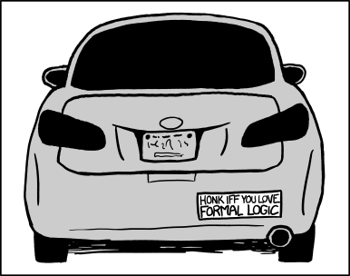
Logistics and
Propositional Logic
CSE 311: Foundations of Computing I
Lecture 1

Slide 3
Outline
Course logistics
What is the goal of this course?
Start of Propositional Logic

Slide 4

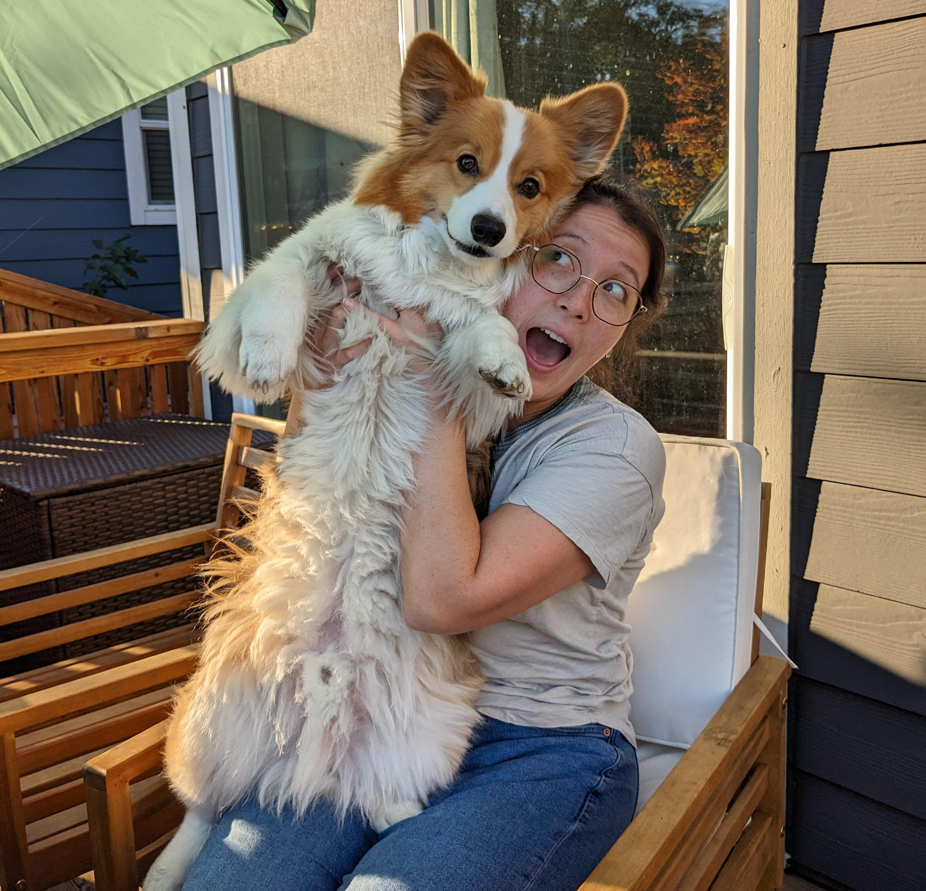
Staff
TAs
Prisha Ambekar
Anika Arugunta
Alex Fu
Isaiah Greenlee
Anna Koblova
Emma Lee
Jaechan Lee
Hansel Lee
Marie E Petrbokova
Kieran Rullman
Kelsey Sun
Aaron Ming-Hsuan Tsai
Daniel Welicki
Claris Winston
Cleah Taryn Winston
Alice Zhu
Robbie Weber
Ph.D. from UW CSE in theory
Office: CSE2 311
Email: rtweber2@cs...
Miya Natsuhara
MS from UW CSE
(+ degrees in Math, ASL)
Office: CSE 460
Email: mnats@cs...
For course-related matters, email both of us at
cse311-25au-instructors@cs...

Slide 5
This is where syllabus information would go
If we had time…
We’ll cover a few highlights at the starts of lectures over the next few weeks.
Detailed information is in an extra recording on panopto. Part of HW1 is watching that video.
And the syllabus is on the webpage.

Slide 6
What you need to know right now
(exams, sections)
We’ll have two evening midterms
Thursday October 23, Monday November 17th (time TBD)
We’ll have a combined final exam
Mon Dec 9 12:30-2:20
Section participation is required.
  The course is designed to give you high-level ideas here and practice in section.
  Details on Syllabus and Ed (including what to do if you can’t attend section).
  Sections aren’t recorded, but resources are available.
  Lecture attendance won’t be tracked (and recordings go on panopto).

Slide 7
What you need to know right now
(lectures, concept checks)
Each Lecture will have a “concept check” associated with it.
Idea: Make sure you’ve understood today’s topic before we build on it 2 days later.
Available on gradescope at 4:30 (after the second lecture). Due the day of the next lecture at 1:30 (start of the first lecture).
  You can submit as many times as you want.
  When you get an answer correct the explanation will appear.
  Worth a small amount of your grade, and an 80% average for the quarter is all you need for full credit.
  Details in the syllabus.
  You can (and should!) submit until you get full credit!
CC1 out tonight
Due Monday
(usual schedule would be Friday)

Slide 8
If something unusual happens
In a ~300-person class, a few of you will have something significant happen during the quarter.
  Illness or family emergency or something else.
  We can give some kinds of accommodations (e.g., extra late days) in some cases.
  We can only help if you tell us something is going on.
Now is a great time to:
  Ask DRS for accommodations if you think you might need formal ones.
  Start looking for a study group!

Slide 9
CSE 390Z
390Z is:
Practice with concepts
Lessons on study skills
Place to find study groups
390Z is NOT:
Extra office hours
Homework help
CSE 390Z is a workshop designed to provide academic support to students enrolled concurrently in CSE 311. During each 2-hour workshop, students will reinforce concepts through:
collaborative problem solving
practice study skills and effective learning habits
build community for peer support
All students enrolled in CSE 311 are welcome to register for this class.
  Subject to size constraints on the course
Contact Lisa Elkin for more information

Slide 10
What is this course?

Slide 11
What is this course? (1)
In this course, you will learn how to make and communicate rigorous and formal arguments.
Why? Because you’ll have to do technical communication in real life.
  If you become a PM – you’ll have to convert non-technical requirements from experts into clear, unambiguous statements of what is needed.
  If you become an engineer – you’ll have to justify to others exactly why your code works, and interpret precise requirements from your PM.
  If you become an academic – to explain to other academics how your algorithms and ideas improve on everyone else’s.

Slide 12
What is this course? (2)
In this course, you will learn how to make and communicate rigorous and formal arguments.
Two verbs
Make arguments – what kind of reasoning is allowed and what kind of reasoning can lead to errors?
Communicate arguments – using one of the common languages of computer scientists (no one is going to use your code if you can’t tell them what it does or convince them it’s functional)

Slide 13
Course Outline
Symbolic Logic (training wheels; lectures 1-8)
  Just make arguments in mechanical ways.
    Using notation and rules a computer could understand.
  Understand the rules that are allowed, without worrying about pretty words.
Set Theory/Arithmetic (bike in your backyard; lectures 9-19)
  Make arguments, and communicate them to humans
  Arguments about numbers and sets---objects you already know
Models of computation (biking in your neighborhood; lectures 20-28)
  Still make and communicate rigorous arguments
  But now with objects you haven’t used before.
    A first taste of how we can argue rigorously about computers.

Slide 14
Symbolic Logic

Slide 15
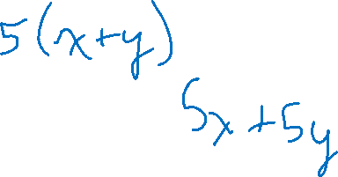
What is symbolic logic and why do we need it?
Symbolic Logic is a language, like English or Java, with its own
words and rules for combining words into sentences (syntax)
ways to assign meaning to words and sentences (semantics)
Symbolic Logic will let us mechanically simplify expressions and make arguments.
The new language will let us focus on the (sometimes familiar, sometimes unfamiliar) rules of logic.
Once we have those rules down, we’ll be able to apply them “intuitively” and won’t need the symbolic representation as often
but we’ll still go back to it when things get complicated.

Slide 16

Propositions: building blocks of logic
  Propositions are the basic building blocks in symbolic logic.
  Here are two propositions.
All cats are mammals
  True, (and a proposition)
All mammals are cats
  False, but is well-formed and has a truth value, so still a proposition.
A statement that has a truth value (i.e. is true or false) and is “well-formed”
Proposition

Slide 17
Analogy Introduction
In Intro Programming you talked about a variable type that could be either true or false.
You called it a “Boolean”
Boolean variables are a useful analogy for propositions.
  They aren’t identical, but they’re very similar.

Slide 18
Are These Propositions?
2 + 2 = 5
x + 2 = 5
Akjsdf!
Who are you?
A statement that has a truth value (i.e. is true or false) and is “well-formed”
Proposition
There is life on Mars.

Slide 19
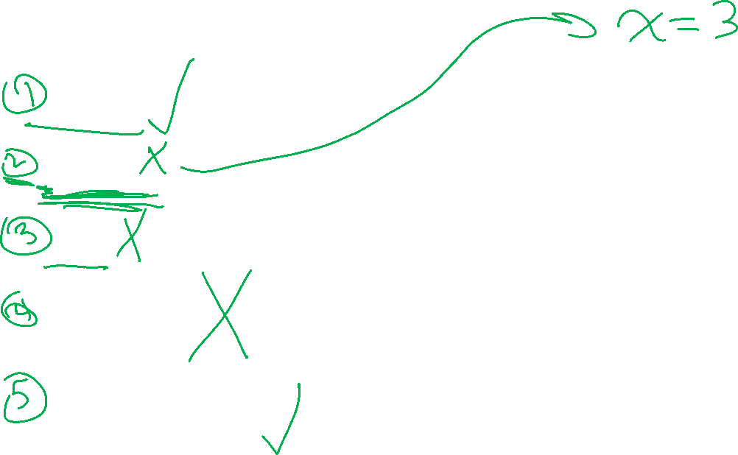
Are These Propositions? (with answers)
2 + 2 = 5
This is a proposition. It’s okay for propositions to be false.
x + 2 = 5
Not a proposition. Doesn’t have a well-defined meaning until x is defined
(we’ll have predicates to represent this idea next week)
Akjsdf!
Not a proposition because it’s gibberish.
Who are you?
This is a question which means it doesn’t have a truth value.
There is life on Mars.
This is a proposition. We don’t know if it’s true or false, but we know it’s one of them!

Slide 20
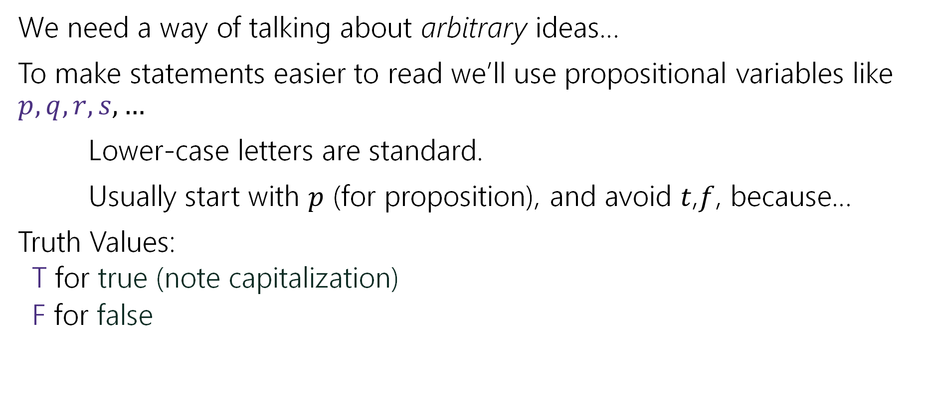

Propositions
We need a way of talking about arbitrary ideas…
To make statements easier to read we’ll use propositional variables like $p, q, r, s,…$
Lower-case letters are standard.
Usually start with $p$ (for proposition), and avoid $t$,$f$, because…
Truth Values:
  T for true (note capitalization)
  F for false

Slide 21

Analogy Revisited
We said propositions were a lot like Booleans…
How did you connect Booleans in code?
&&
||
!

Slide 22
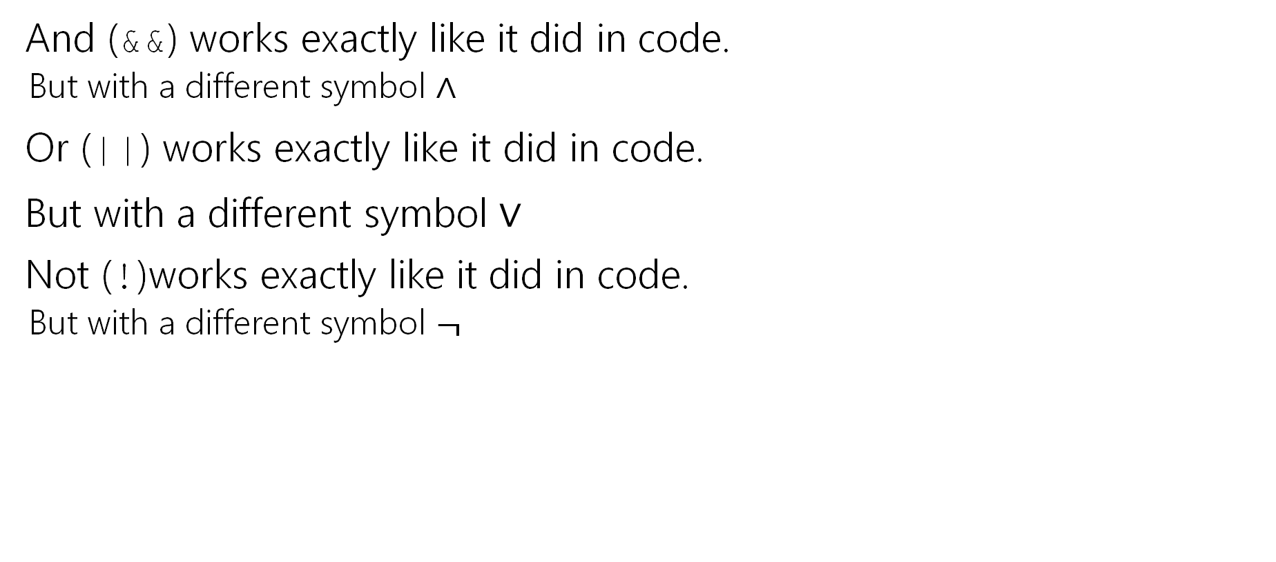
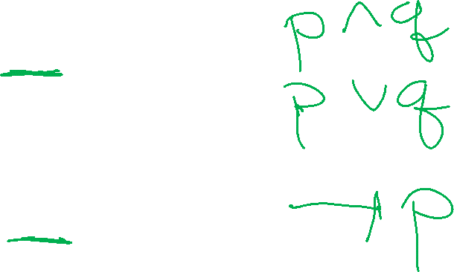
Logical Connectives (compared to Java)
And (&&) works exactly like it did in code.
  But with a different symbol $∧$
Or (||) works exactly like it did in code.
But with a different symbol $∨$
Not (!)works exactly like it did in code.
  But with a different symbol $¬$

Slide 23
Some Truth Tables
p | ¬p
p | q | p ∧ q
p | q | p ∨ q
Truth tables are the simplest way to describe how logical connectives operate.

Slide 24

Some Truth Tables (filled in)
p | ¬p
T | F
F | T
p | q | p ∧ q
T | T | T
T | F | F
F | T | F
F | F | F
p | q | p ∨ q
T | T | T
T | F | T
F | T | T
F | F | F
Truth tables are the simplest way to describe how logical connectives operate.

Slide 25

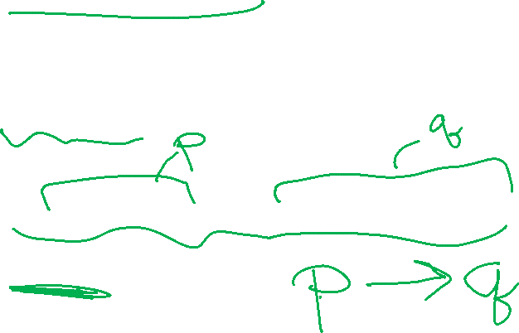
Implication Definition
Another way to connect propositions
If $p$ then $q$.
“If it is raining, then I have my umbrella.”
$p→q$
Think of an implication as a promise.

Slide 26
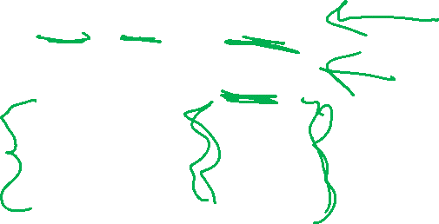
Implication (Truth Table)
p | q | p → q
T | T | T
T | F | F
F | T | T
F | F | T
The first two lines should match your intuition.
The last two lines are called “vacuous truth.” For now, they’re the definition. We’ll explain why in a few lectures.
This is the definition of implication.
When you write “if…then…” in a piece of mathematical English, this is how you will be interpreted.

Slide 27

Implication ($p→q)$
“If it’s raining, then I have my umbrella”
It’s useful to think of implications as promises. An implication is false exactly when you can demonstrate I’m lying.
p | q | p → q
T | T | T
T | F | F
F | T | T
F | F | T
 | It’s raining | It’s not raining
I have my umbrella
I do not have my umbrella

Slide 28


Implication ($p→q)$ with answers
“If it’s raining, then I have my umbrella”
It’s useful to think of implications as promises. An implication is false exactly when you can demonstrate I’m lying.
p | q | p → q
T | T | T
T | F | F
F | T | T
F | F | T
 | It’s raining | It’s not raining
I have my umbrella | No lie. True | No lie. True
I do not have my umbrella | LIE! False | No lie. True

Slide 29
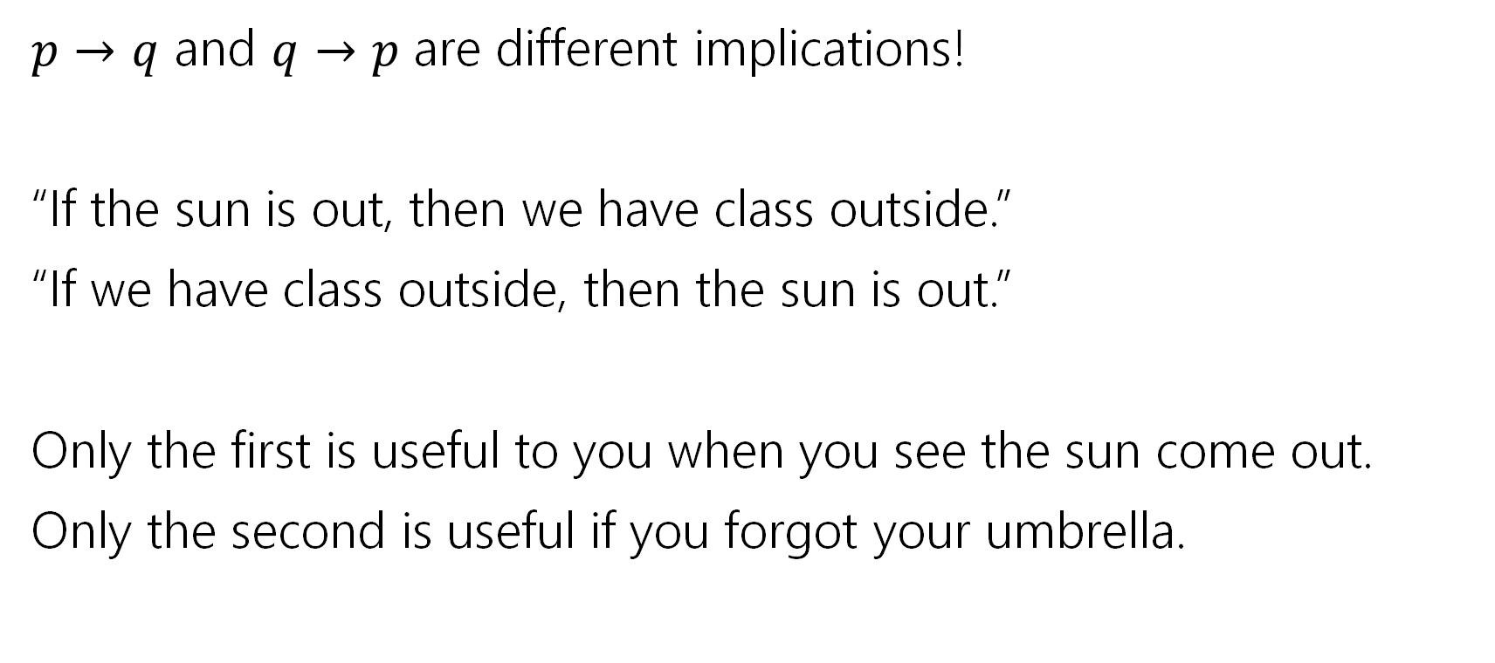
$$p → q$$
$p→q$ and $q→p$ are different implications!
“If the sun is out, then we have class outside.”
“If we have class outside, then the sun is out.”
Only the first is useful to you when you see the sun come out.
Only the second is useful if you forgot your umbrella.

Slide 30

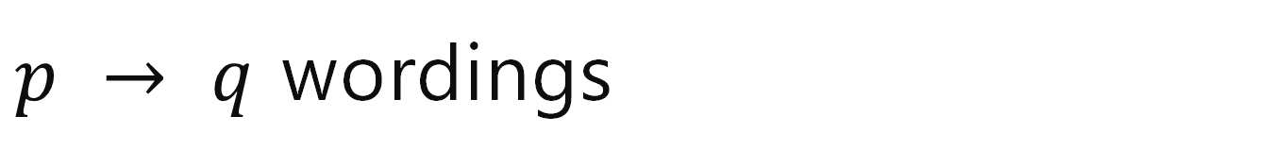
$p → q$ wordings
p | q | p → q
T | T | T
T | F | F
F | T | T
F | F | T
Implication:
  p implies q
  whenever p is true q must be true
  if p then q
  q if p
  p is sufficient for q
  p only if q
  q is necessary for p
Implications are super useful, so there are LOTS of translations.
You’ll learn these in detail in section.

Slide 31
A More Complicated Statement
“Robbie knows the Pythagorean Theorem if he is a mathematician and took geometry, and he is a mathematician or did not take geometry.”
Is this a proposition?
We’d like to understand what this proposition means.
In particular, is it true?

Slide 32
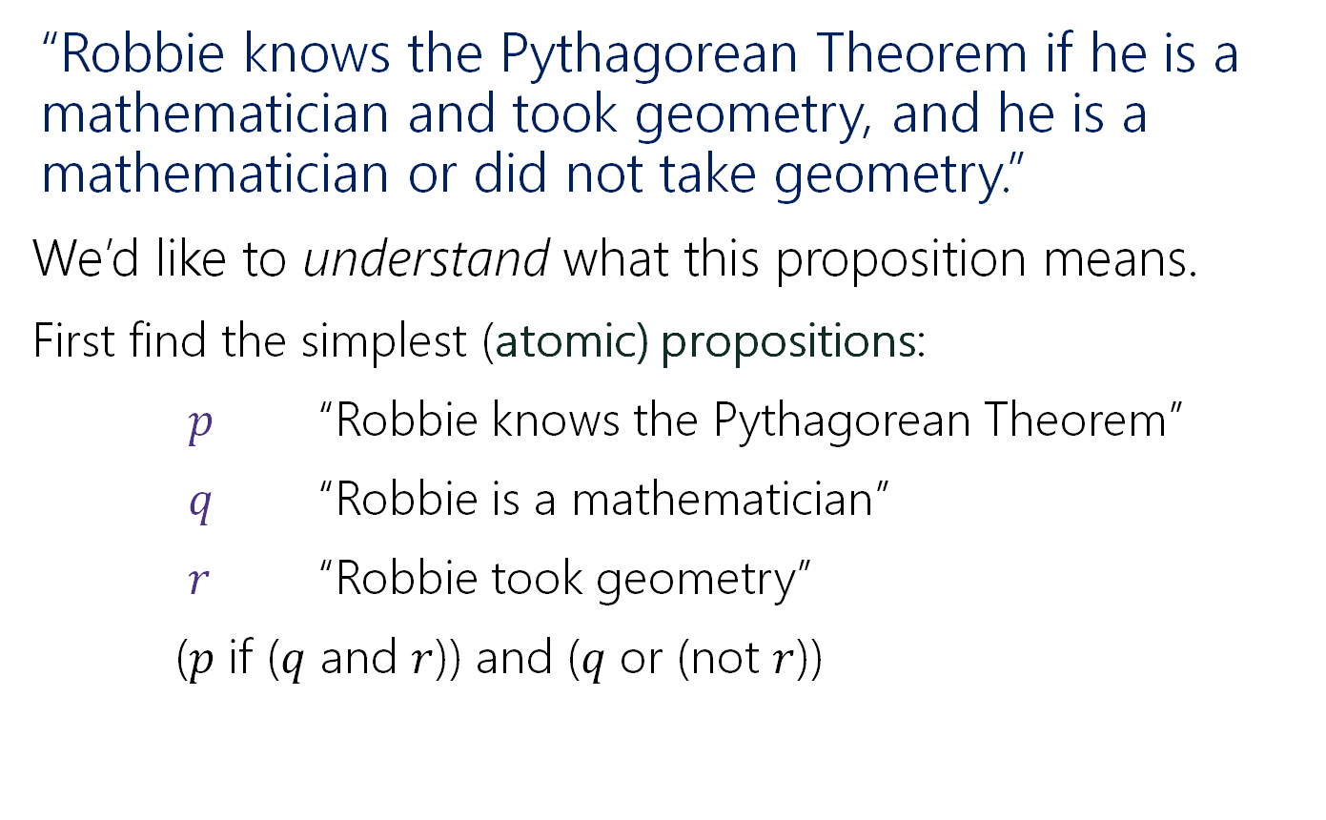
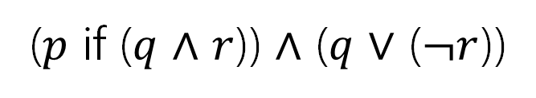
A Compound Proposition
(introducing symbols)
“Robbie knows the Pythagorean Theorem if he is a mathematician and took geometry, and he is a mathematician or did not take geometry.”
We’d like to understand what this proposition means.
First find the simplest (atomic) propositions:
$p$ “Robbie knows the Pythagorean Theorem”
$q$ “Robbie is a mathematician”
$r$ “Robbie took geometry”
($p$ if ($q$ and $r$)) and ($q$ or (not $r$))
($p$ if ($q$ $∧$ $r$)) $∧$ ($q$ $∨$ ($¬r$))

Slide 33
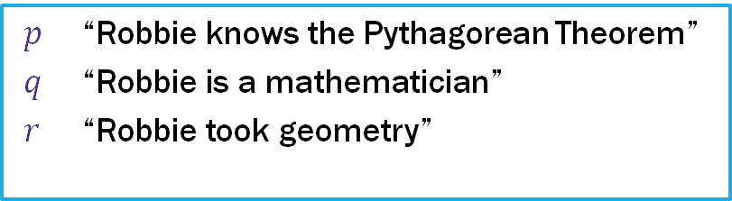
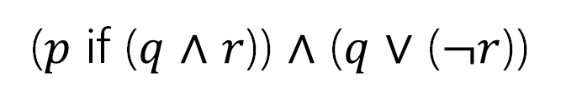
A Compound Proposition (analysis)
“Robbie knows the Pythagorean Theorem if he is a mathematician and took geometry, and he is a mathematician or did not take geometry.”
$p$ “Robbie knows the Pythagorean Theorem”
$q$ “Robbie is a mathematician”
$r$ “Robbie took geometry”
($p$ if ($q$ $∧$ $r$)) $∧$ ($q$ $∨$ ($¬r$))
How did we know where to put the parentheses?
Subtle English grammar choices (top-level parentheses are independent clauses).
Context/which parsing will make more sense.
Conventions
A reading on this is on the webpage!

Slide 34
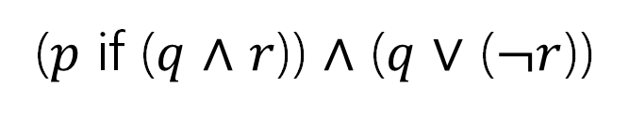
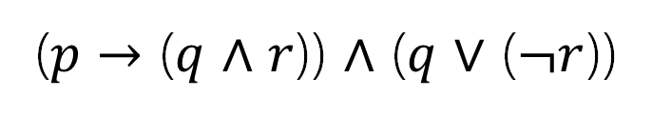
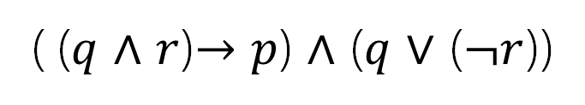
Back to the Compound Proposition…
“Robbie knows the Pythagorean Theorem if he is a mathematician and took geometry, and he is a mathematician or did not take geometry.”
($p$ if ($q$ $∧$ $r$)) $∧$ ($q$ $∨$ ($¬r$))
$p$ “Robbie knows the Pythagorean Theorem”
$q$ “Robbie is a mathematician”
$r$ “Robbie took geometry”
What promise am I making?
( ($q$ $∧$ $r$)$→p$) $∧$ ($q$ $∨$ ($¬r$))
($p$ $→$ ($q$ $∧$ $r$)) $∧$ ($q$ $∨$ ($¬r$))
The first one! Being a mathematician and taking geometry goes with the “if.” Knowing the Pythagorean Theorem is the consequence.

Slide 35
A Compound Proposition
(revisiting symbols)
“Robbie knows the Pythagorean Theorem if he is a mathematician and took geometry, and he is a mathematician or did not take geometry.”
We’d like to understand what this proposition means.
First find the simplest (atomic) propositions:
$p$ “Robbie knows the Pythagorean Theorem”
$q$ “Robbie is a mathematician”
$r$ “Robbie took geometry”
($p$ if ($q$ and $r$)) and ($q$ or (not $r$))
($p$ if ($q$ $∧$ $r$)) $∧$ ($q$ $∨$ ($¬r$))

Slide 36
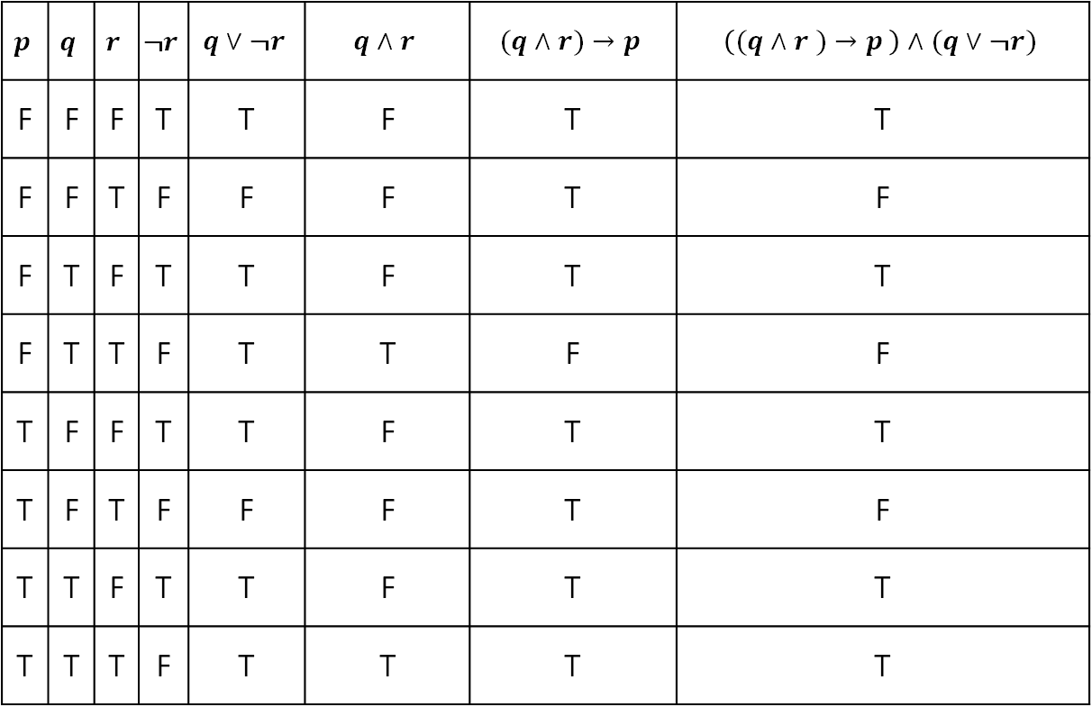
Analyzing the Sentence with a Truth Table
$$p$$ | $$q$$ | $$r$$ | $$¬r$$ | $$q∨¬r$$ | $$q∧r$$ | $$(q∧r)→p$$ | $$\left((q∧r )→p \right)∧(q∨¬r)$$
F | F | F | T | T | F | T | T
F | F | T | F | F | F | T | F
F | T | F | T | T | F | T | T
F | T | T | F | T | T | F | F
T | F | F | T | T | F | T | T
T | F | T | F | F | F | T | F
T | T | F | T | T | F | T | T
T | T | T | F | T | T | T | T

Slide 37
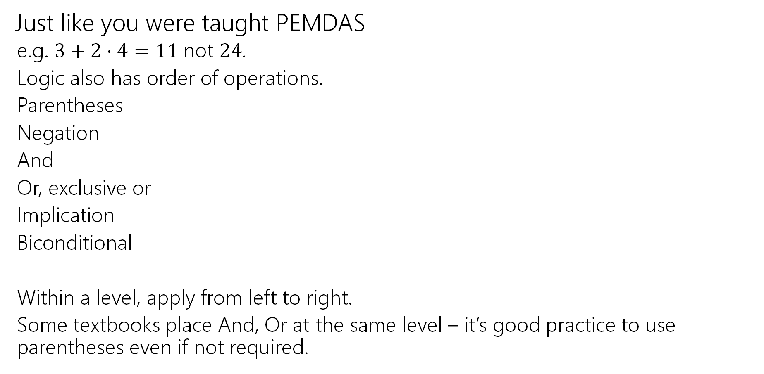
Order of Operations
Just like you were taught PEMDAS
  e.g. $3+2⋅4=11$ not $24$.
  Logic also has order of operations.
  Parentheses
  Negation
  And
  Or, exclusive or
  Implication
  Biconditional
  Within a level, apply from left to right.
  Some textbooks place And, Or at the same level – it’s good practice to use parentheses even if not required.
For this class: each line is its own level!
e.g. “and”s have precedence over “or”s

Slide 38
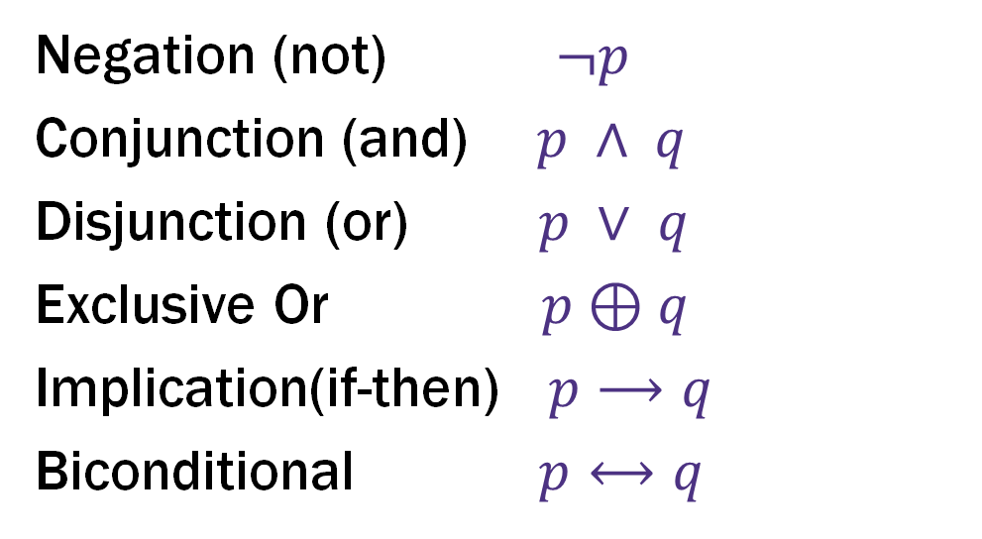
Logical Connectives
Negation (not) $¬p$
Conjunction (and) $p ∧ q$
Disjunction (or) $p ∨ q$
Exclusive Or $p⊕q$
Implication(if-then) $p⟶q$
Biconditional $p⟷q$
These ideas have been around for so long most have at least two names.
Two more connectives to discuss!

Slide 39
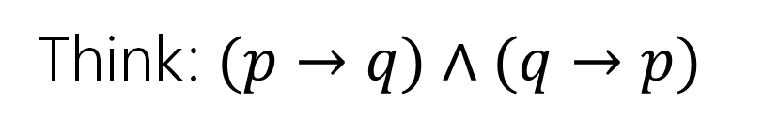

Biconditional: $p ↔ q$
Think: $(p→q)∧(q→p)$
p if and only if q
p iff q
p is equivalent to q
p implies q and q implies p
p is necessary and sufficient for q
p | q | p ↔ q

Slide 40
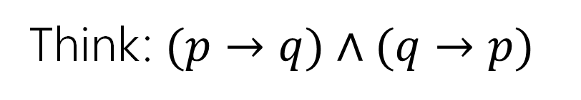
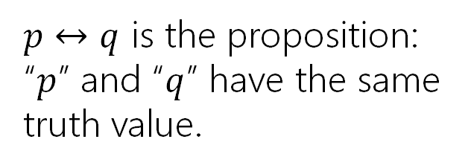

Biconditional: $p ↔ q$ (with answers)
Think: $(p→q)∧(q→p)$
p if and only if q
p iff q
p is equivalent to q
p implies q and q implies p
p is necessary and sufficient for q
p | q | p ↔ q
T | T | T
T | F | F
F | T | F
F | F | T
$p↔q$ is the proposition: “$p$” and “$q$” have the same truth value.

Slide 41
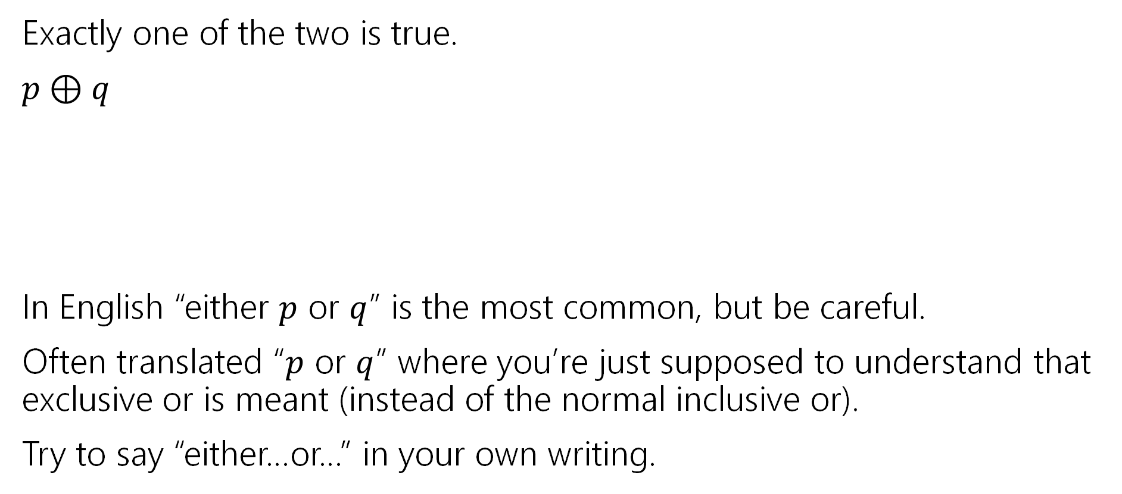
Exclusive Or
Exactly one of the two is true.
$p⊕q$
In English “either $p$ or $q$” is the most common, but be careful.
Often translated “$p$ or $q$” where you’re just supposed to understand that exclusive or is meant (instead of the normal inclusive or).
Try to say “either…or…” in your own writing.
p | q | p ⊕ q

Slide 42
Exclusive Or (with answers)
Exactly one of the two is true.
$p⊕q$
In English “either $p$ or $q$” is the most common, but be careful.
Often translated “$p$ or $q$” where you’re just supposed to understand that exclusive or is meant (instead of the normal inclusive or).
Try to say “either…or…” in your own writing.
p | q | p ⊕ q
T | T | F
T | F | T
F | T | T
F | F | F

Slide 43
Active learning!
We’ll pause lectures for a few minutes
Why? It works!
  https://www.pnas.org/content/111/23/8410 a meta-analysis of 225 studies.
  Just listening to me isn’t as good for you as listening to me then trying problems on your own and with each other.

Slide 44
Lecture 1 Activity
Go to pollev.com/robbie
You have to login, but no “points” are associated; these help me adjust explanation.
Introduce yourselves!
  Break this sentence down into its smallest propositions and convert it into logical notation.
  “If I read the book or watch the movie, then I’ll know the plot.”

Slide 45
What’s next?
A proof!
We want to be able to make iron-clad guarantees that something is true.
And convince others that we really have ironclad guarantees.

Slide 46
Todo
Tonight:
Make sure you can access the Ed discussion board.
  If you can’t, send an email to TODO.
Make sure you can access Gradescope and do the concept check (due date is Monday, but we encourage you to check by Friday).
  If you can’t, make a private post on Ed.
Thursday:
Go to section (in-person)
Soon:
Form a study group! Threads to organize on the Ed board.

