Slide 1
Sets
CSE 311 Winter 24
Lecture 15

Slide 2
Announcements
Midterm Information on the webpage
  Time, Location
  Topics
  Old exams
  And more

Slide 3
We’ve got A LOT of definitions today
You don’t need me to read things aloud to you.
We’ll cover the subtle/tricky things in lecture.
  Other things are left for you to read on your own. The section is marked in the slide deck.
Today’s concept check should be very useful to get the definitions down!

Slide 4
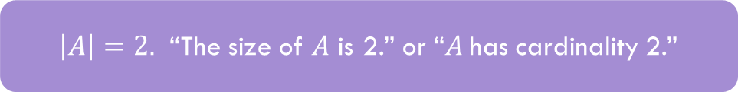
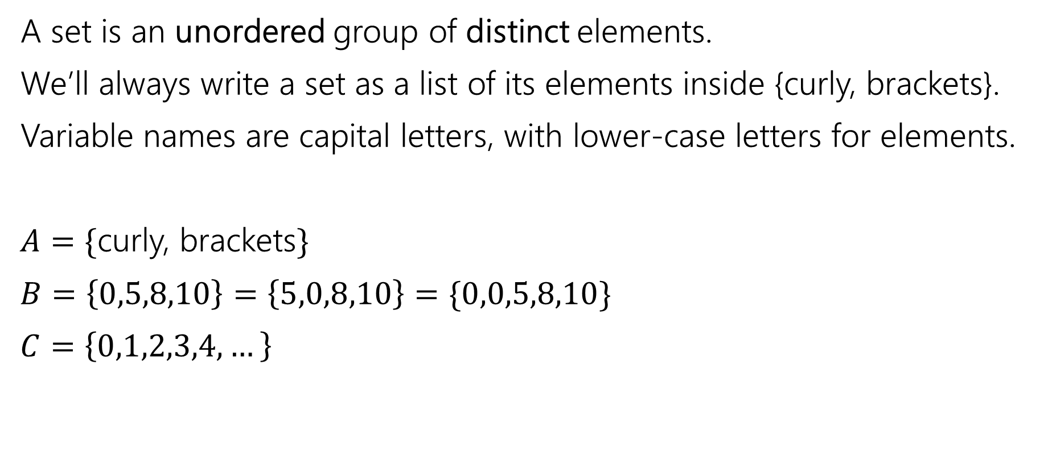
Sets
A set is an unordered group of distinct elements.
We’ll always write a set as a list of its elements inside {curly, brackets}.
Variable names are capital letters, with lower-case letters for elements.
$A=\{$curly, brackets$\}$
$B=\left\{0,5,8,10\right\}=\left\{5,0,8,10\right\}=\{0,0,5,8,10\}$
$C=\left\{0,1,2,3,4,…\right\}$
$\left|A\right|=2.$ “The size of $A$ is 2.” or “$A$has cardinality 2.”

Slide 5
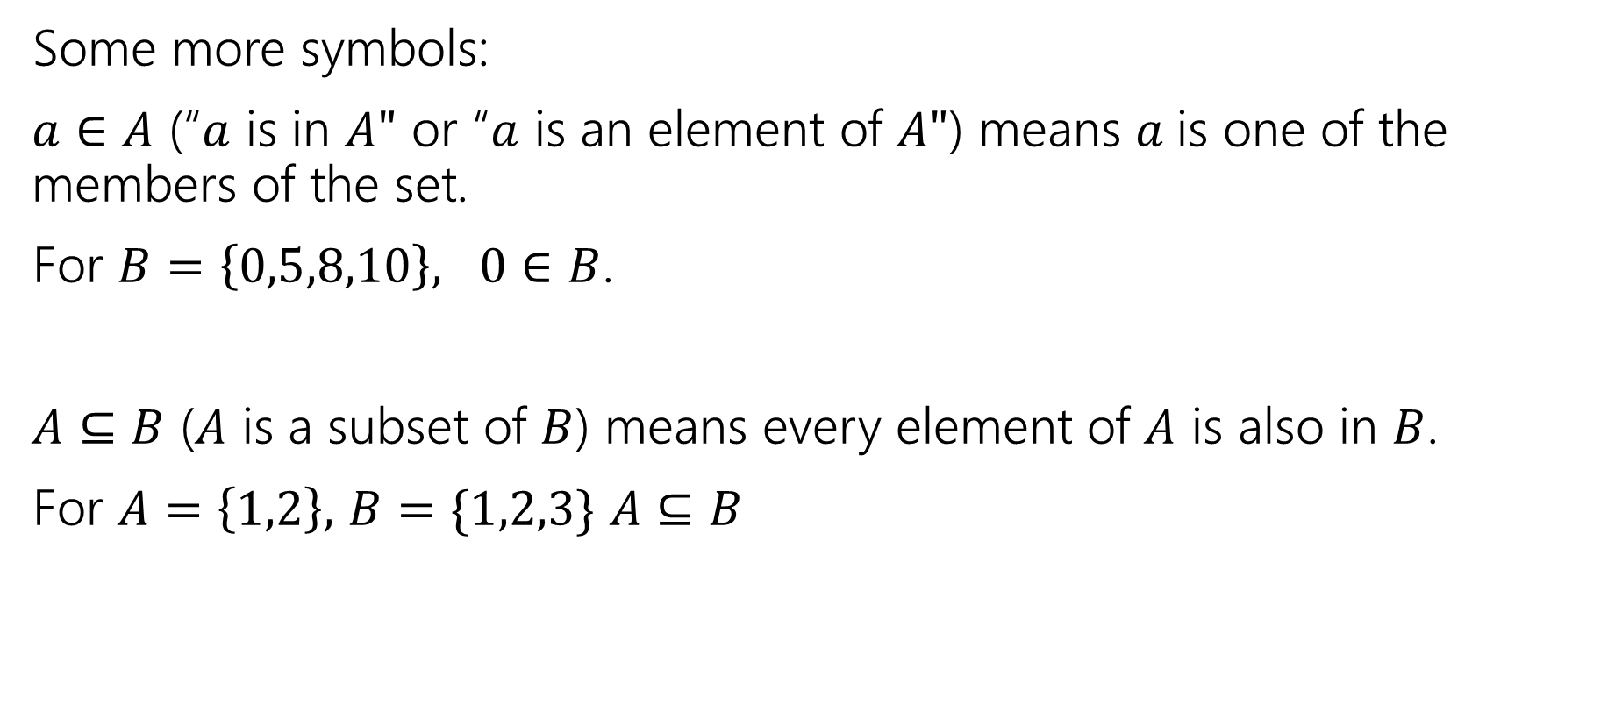
Sets
Some more symbols:
$a∈A$ (“$a$ is in $A"$ or “$a$ is an element of $A"$) means $a$is one of the members of the set.
For $B=\left\{0,5,8,10\right\}, 0∈B$.
$A⊆B$ ($A$ is a subset of $B$) means every element of $A$ is also in $B$.
For $A=\left\{1,2\right\},$ $B=\{1,2,3\}$ $A⊆B$

Slide 6

Sets
Be careful about these two operations:
If $A=\{1,2,3,4,5\}$
$\left\{1\right\}⊆A$, but $\left\{1\right\}∉A$
$∈$ asks: is this item in that box?
$⊆$ asks: is everything in this box also in that box?

Slide 7

Try it!
Let $A=\left\{1,2,3,4,5\right\}$
$B=\{1,2,5\}$
Is $A⊆A?$
Is $B⊆A?$
Is $A⊆B$?
Is $\left\{1\right\}∈A$?
Is $1∈A$?

Slide 8
Try it!
Let $A=\left\{1,2,3,4,5\right\}$
$B=\{1,2,5\}$
Is $A⊆A?$
Is $B⊆A?$
Is $A⊆B$?
Is $\left\{1\right\}∈A$?
Is $1∈A$?
Yes!
Yes
No
No
Yes

Slide 9


Definitions
$A⊆B$($"A$ is a subset of $B"$) iff every element of $A$ is also in $B$.
$A=B$ ($"A$ equals $B"$) iff $A$ and $B$ have identical elements.
$A⊆B≡∀x(x∈A→x∈B)$
$A=B≡∀x\left(x∈A↔x∈B\right)≡$ $A⊆B∧B⊆A$

Slide 10


Proof Skeleton
How would we show $A⊆B?$
Let $x$ be an arbitrary element of $A$
…
So $x$ is also in $B$.
Since $x$ was an arbitrary element of $A,$ we have that $A⊆B$.
$A⊆B≡∀x(x∈A→x∈B)$

Slide 11
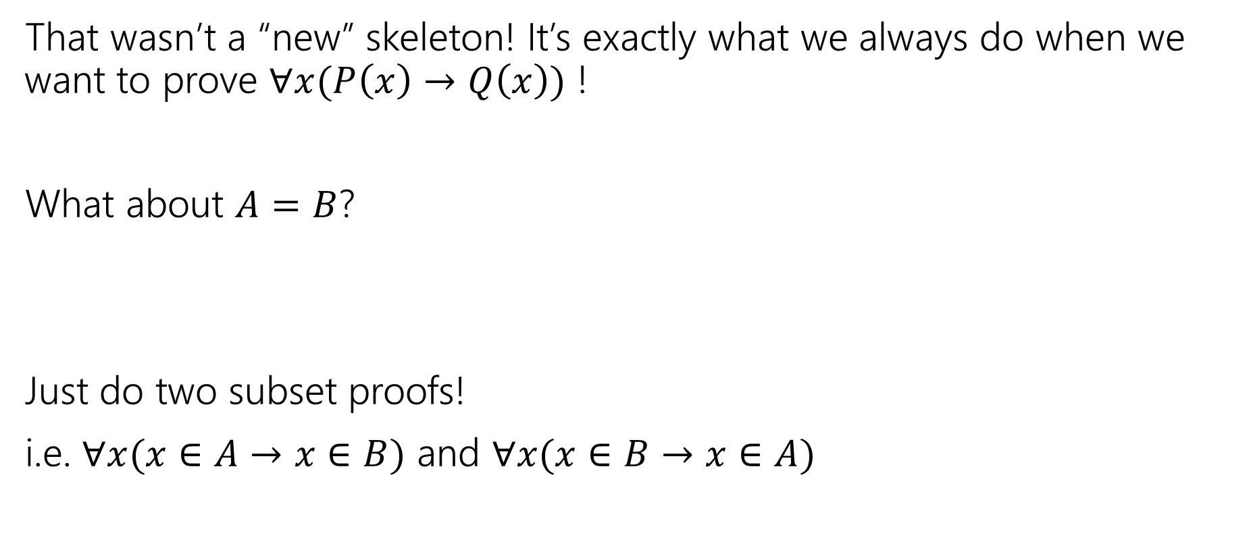
Proof Skeleton
That wasn’t a “new” skeleton! It’s exactly what we always do when we want to prove $∀x(P\left(x\right)→Q\left(x\right))$ !
What about $A=B$?
Just do two subset proofs!
i.e. $∀x(x∈A→x∈B)$ and $∀x(x∈B→x∈A)$
$A=B≡∀x\left(x∈A↔x∈B\right)≡$ $A⊆B∧B⊆A$

Slide 12


What do we do with sets?
We combined propositions with $∨,∧,¬$.
We combine sets with $∩\left[intersection\right],∪,[union] ¯[complement]$
$A∪B=\{x:x∈A∨x∈B\}$
$A∩B=\{x:x∈A∧x∈B\}$
$\overline{A}=\{x:x∉A\}$
That’s a lot of elements…if we take the complement, we’ll have some “universe” $𝒰$, and $\overline{A}=\{x:x∈U∧x∉A\}$
It’s a lot like the domain of discourse.

Slide 13








$$A∪B$$
$$A∩B$$
$$A$$
$$B$$
$$A$$
$$B$$
$$\overline{A}$$
$$A$$

Slide 14
Proofs with sets

Slide 15
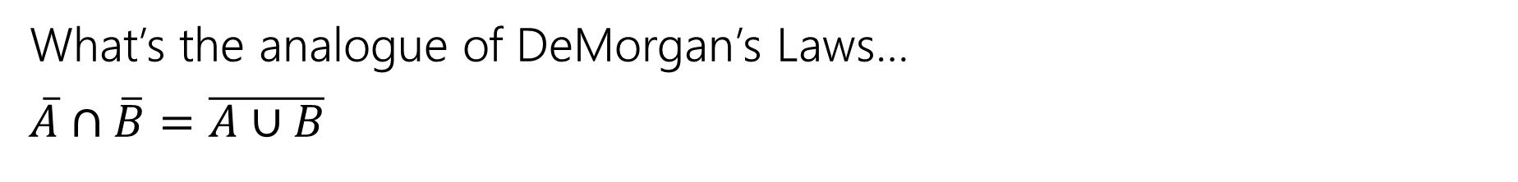
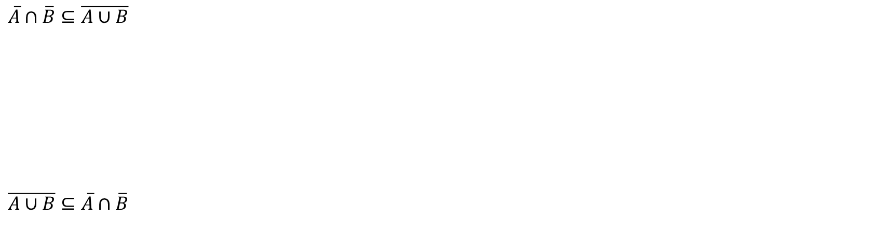
A proof!
What’s the analogue of DeMorgan’s Laws…
$\overline{A}∩\overline{B}=\overline{A∪B}$
$A=B≡∀x\left(x∈A↔x∈B\right)≡$ $A⊆B∧B⊆A$
$\overline{A}∩\overline{B}⊆\overline{A∪B}$
$\overline{A∪B}⊆\overline{A}∩\overline{B}$

Slide 16





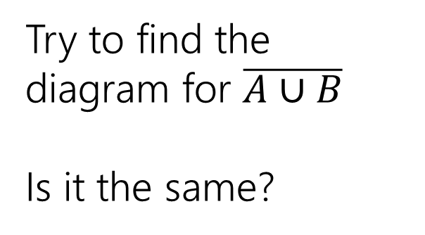




$$\overline{A}$$
$$B$$
$$A$$
Try to find the diagram for $\overline{A∪B}$
Is it the same?
$$\overline{B}$$
$$A$$
$$B$$
$$\overline{A}∩\overline{B}$$
$$A$$
$$B$$

Slide 17






$$\overline{A}$$
$$B$$
$$A$$
$$A∪B$$
$$A$$
$$B$$
$$\overline{B}$$
$$A$$
$$B$$
$$\overline{A}∩\overline{B}$$
$$\overline{A∪B}$$
$$A$$
$$B$$
$$A$$
$$B$$

Slide 18
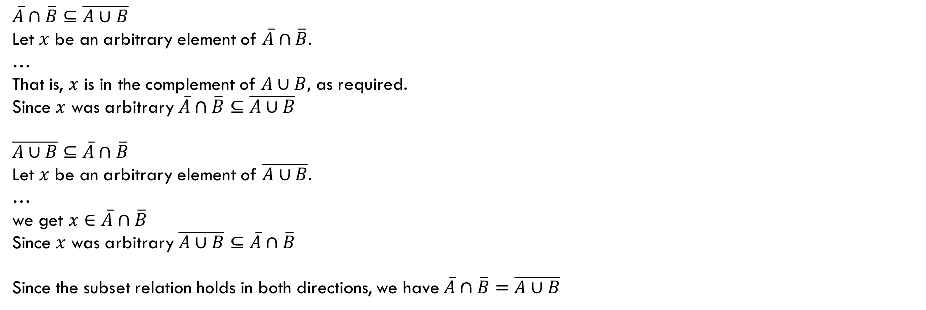
A proof!
What’s the analogue of DeMorgan’s Laws…
$\overline{A}∩\overline{B}=\overline{A∪B}$
$A=B≡∀x\left(x∈A↔x∈B\right)≡$ $A⊆B∧B⊆A$
$\overline{A}∩\overline{B}⊆\overline{A∪B}$
Let $x$ be an arbitrary element of $\overline{A}∩\overline{B}$.
…
That is, $x$ is in the complement of $A∪B,$ as required.
Since $x$ was arbitrary $\overline{A}∩\overline{B}⊆\overline{A∪B}$
$\overline{A∪B}⊆\overline{A}∩\overline{B}$
Let $x$ be an arbitrary element of $\overline{A∪B}$.
…
we get $x∈\overline{A}∩\overline{B}$
Since $x$ was arbitrary $\overline{A∪B}⊆\overline{A}∩\overline{B}$
Since the subset relation holds in both directions, we have $\overline{A}∩\overline{B}=\overline{A∪B}$

Slide 19
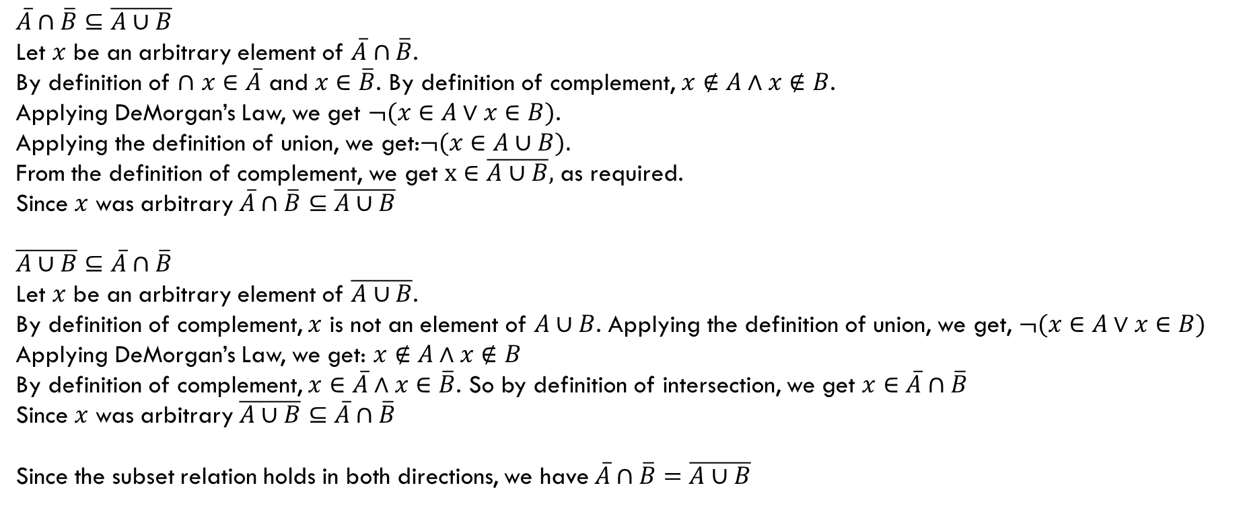
A proof!
What’s the analogue of DeMorgan’s Laws…
$\overline{A}∩\overline{B}=\overline{A∪B}$
$A=B≡∀x\left(x∈A↔x∈B\right)≡$ $A⊆B∧B⊆A$
$\overline{A}∩\overline{B}⊆\overline{A∪B}$
Let $x$ be an arbitrary element of $\overline{A}∩\overline{B}$.
By definition of $∩$ $x∈\overline{A}$ and $x∈\overline{B}$. By definition of complement, $x∉A∧x∉B$.
Applying DeMorgan’s Law, we get $¬(x∈A∨x∈B)$.
Applying the definition of union, we get:$¬(x∈A∪B).$
From the definition of complement, we get $x∈\overline{A∪B},$ as required.
Since $x$ was arbitrary $\overline{A}∩\overline{B}⊆\overline{A∪B}$
$\overline{A∪B}⊆\overline{A}∩\overline{B}$
Let $x$ be an arbitrary element of $\overline{A∪B}$.
By definition of complement, $x$ is not an element of $A∪B$. Applying the definition of union, we get, $¬(x∈A∨x∈B)$
Applying DeMorgan’s Law, we get: $x∉A∧x∉B$
By definition of complement, $x∈\overline{A}∧x∈\overline{B}$. So by definition of intersection, we get $x∈\overline{A}∩\overline{B}$
Since $x$ was arbitrary $\overline{A∪B}⊆\overline{A}∩\overline{B}$
Since the subset relation holds in both directions, we have $\overline{A}∩\overline{B}=\overline{A∪B}$

Slide 20
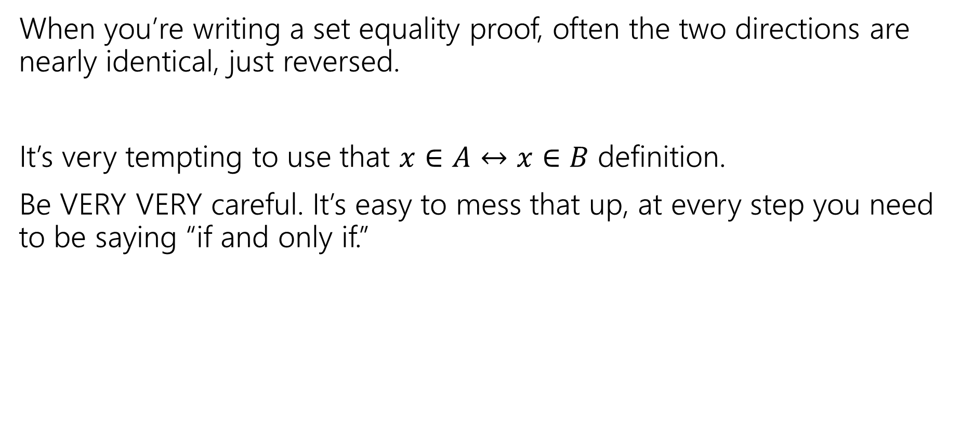
Proof-writing advice
When you’re writing a set equality proof, often the two directions are nearly identical, just reversed.
It’s very tempting to use that $x∈A↔x∈B$ definition.
Be VERY VERY careful. It’s easy to mess that up, at every step you need to be saying “if and only if.”

Slide 21
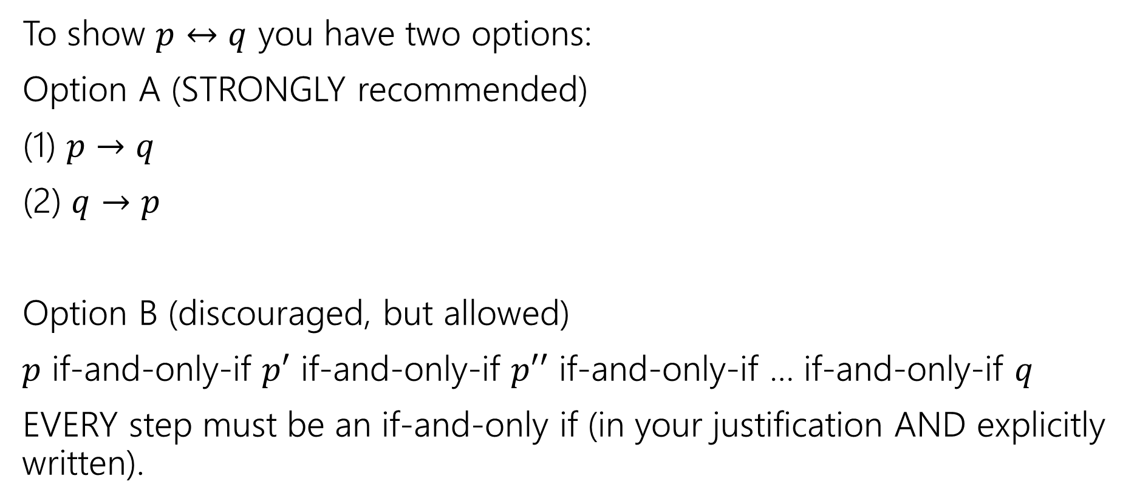
Summary: How to show an if and only if
To show $p↔q$ you have two options:
Option A (STRONGLY recommended)
(1) $p→q$
(2) $q→p$
Option B (discouraged, but allowed)
$p$ if-and-only-if $p′$ if-and-only-if $p′′$ if-and-only-if … if-and-only-if $q$
EVERY step must be an if-and-only if (in your justification AND explicitly written).

Slide 22

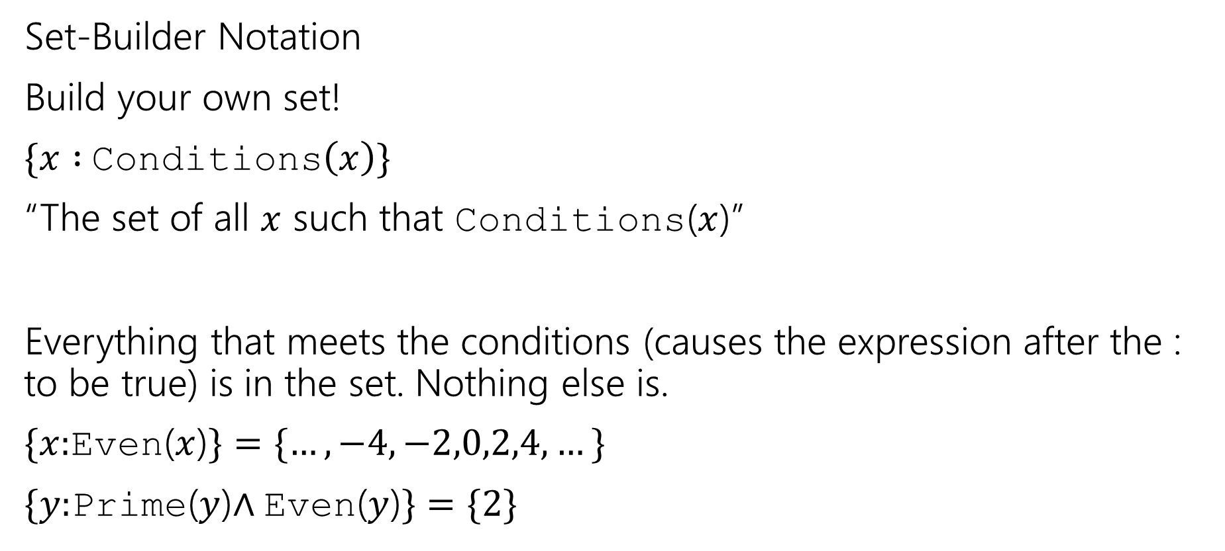
Two More Set Operations
In general
$$\{ variable :conditions \}$$
Will also see | instead of :
Set-Builder Notation
Build your own set!
$\{x :$Conditions$\left(x\right)\}$
“The set of all $x$ such that Conditions($x$)”
Everything that meets the conditions (causes the expression after the : to be true) is in the set. Nothing else is.
$\{x:$Even($x$)$\}=\{…,−4,−2,0,2,4,…\}$
$\{y:$Prime($y$)$∧$Even($y$)$\}=\{2\}$

Slide 23

Two More Set Operations
Given a set, let’s talk about it’s powerset.
$𝒫\left(A\right)=\{X:X$ is a subset of $A\}$
The powerset of $A$ is the set of all subsets of $A.$
$𝒫\left(\left\{1,2\right\}\right)=\{∅, \left\{1\right\}, \left\{2\right\}, \left\{1,2\right\}\}$

Slide 24
Recursive Set Definitions

Slide 25
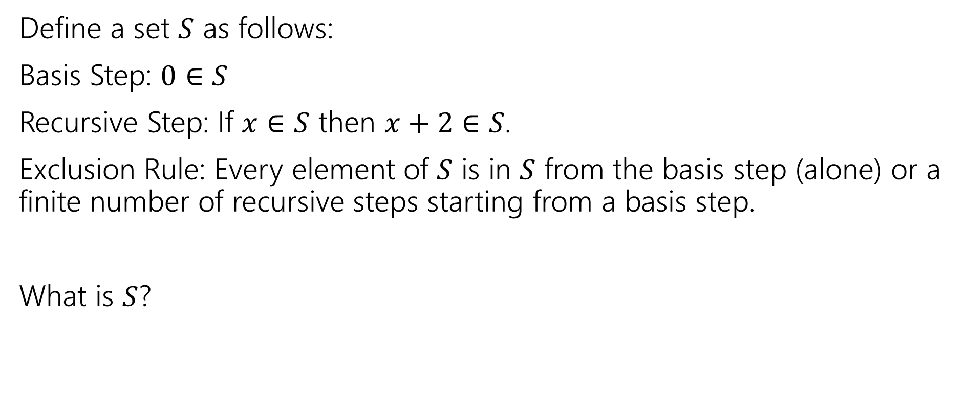
Recursive Definition of Sets
Define a set $S$ as follows:
Basis Step: $0∈S$
Recursive Step: If $x∈S$ then $x+2∈S$.
Exclusion Rule: Every element of $S$ is in $S$ from the basis step (alone) or a finite number of recursive steps starting from a basis step.
What is $S$?

Slide 26
Recursive Definitions of Sets
We’ll always list the Basis and Recursive parts of the definition.
Starting…now…we’re going to be lazy and skip writing the “exclusion” rule. It’s still part of the definition.

Slide 27
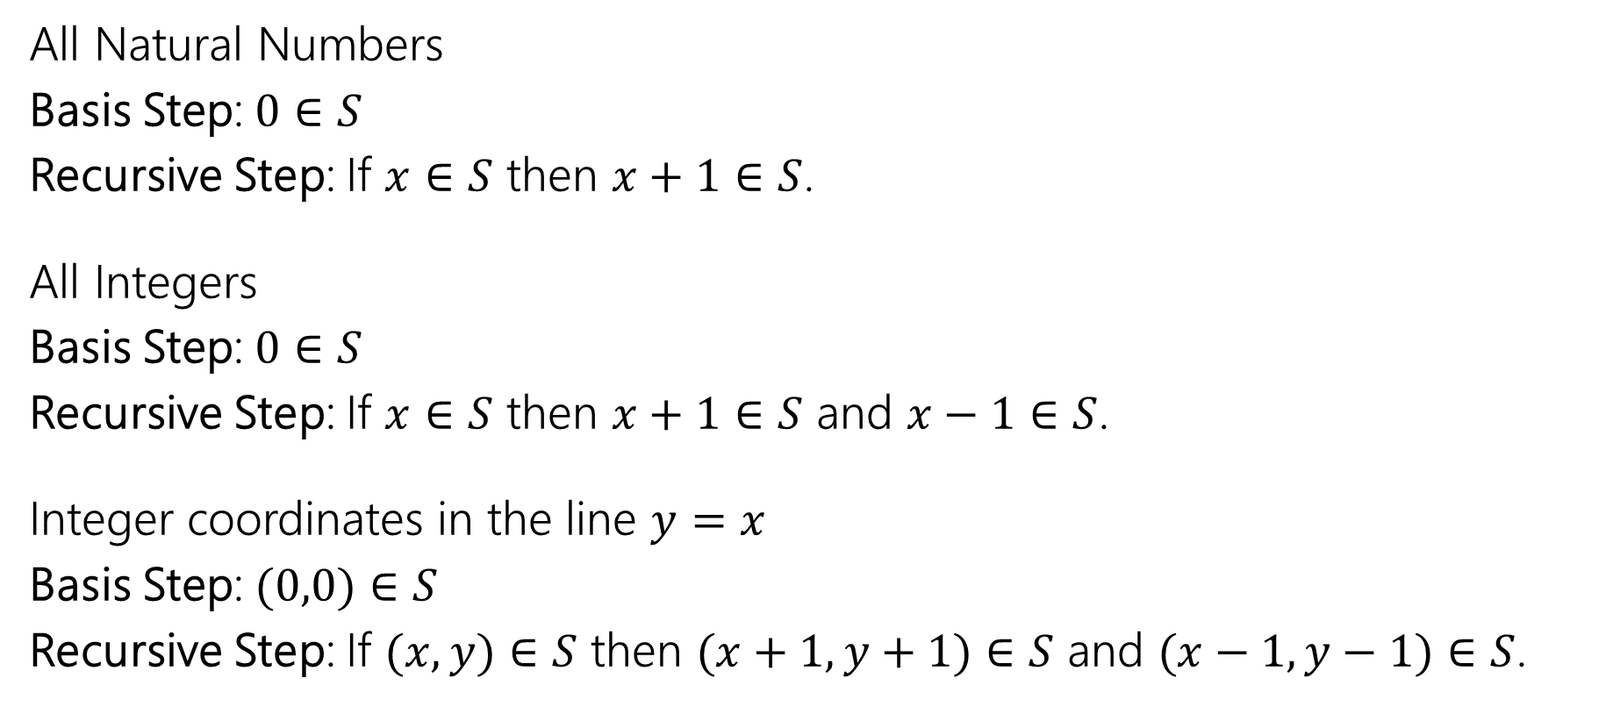
Recursive Definitions of Sets
All Natural Numbers
Basis Step: $0∈S$
Recursive Step: If $x∈S$ then $x+1∈S$.
All Integers
Basis Step: $0∈S$
Recursive Step: If $x∈S$ then $x+1∈S$ and $x−1∈S$.
Integer coordinates in the line $y=x$
Basis Step: $(0,0)∈S$
Recursive Step: If $(x,y)∈S$ then $(x+1,y+1)∈S$ and $(x−1,y−1)∈S$.
Notes:
Mention what happens to all integers if you change it to 5 in S (answer: nothing. Many different possible recursive definitions)

Slide 28
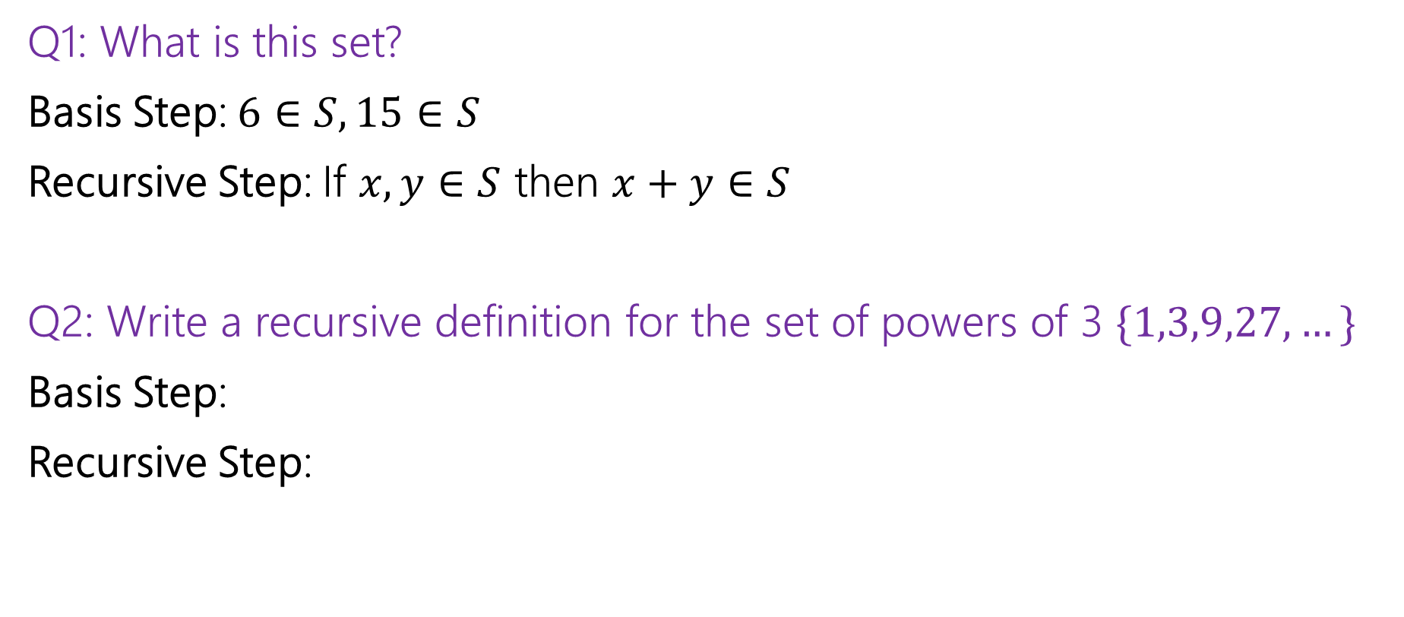
Recursive Definitions of Sets
Q1: What is this set?
Basis Step: $6∈S, 15∈S$
Recursive Step: If $x,y∈S$ then $x+y∈S$
Q2: Write a recursive definition for the set of powers of 3 $\{1,3,9,27,…\}$
Basis Step:
Recursive Step:

Slide 29
Extra Set Practice

Slide 30

Extra Set Practice
Show $A∪\left(B∩C\right)=\left(A∪B\right)∩(A∪C)$
Proof:
Start with the outline. What two things do we need to show? For each, where do we start and end?

Slide 31
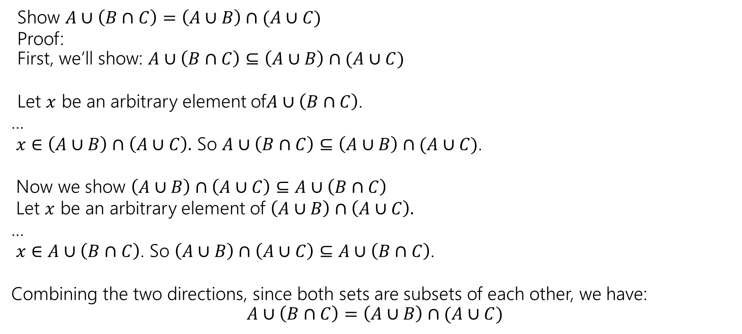
Extra Set Practice
Show $A∪\left(B∩C\right)=\left(A∪B\right)∩(A∪C)$
Proof:
First, we’ll show: $A∪\left(B∩C\right)⊆\left(A∪B\right)∩(A∪C)$
Let $x$ be an arbitrary element of$A∪\left(B∩C\right)$.
…
$x∈\left(A∪B\right)∩\left(A∪C\right).$ So $A∪\left(B∩C\right)⊆\left(A∪B\right)∩(A∪C)$.
Now we show $\left(A∪B\right)∩\left(A∪C\right)⊆A∪\left(B∩C\right)$
Let $x$ be an arbitrary element of $\left(A∪B\right)∩\left(A∪C\right).$
…
$x∈A∪\left(B∩C\right)$. So $\left(A∪B\right)∩\left(A∪C\right)⊆A∪\left(B∩C\right)$.
Combining the two directions, since both sets are subsets of each other, we have:
$$A∪\left(B∩C\right)=\left(A∪B\right)∩(A∪C)$$

Slide 32
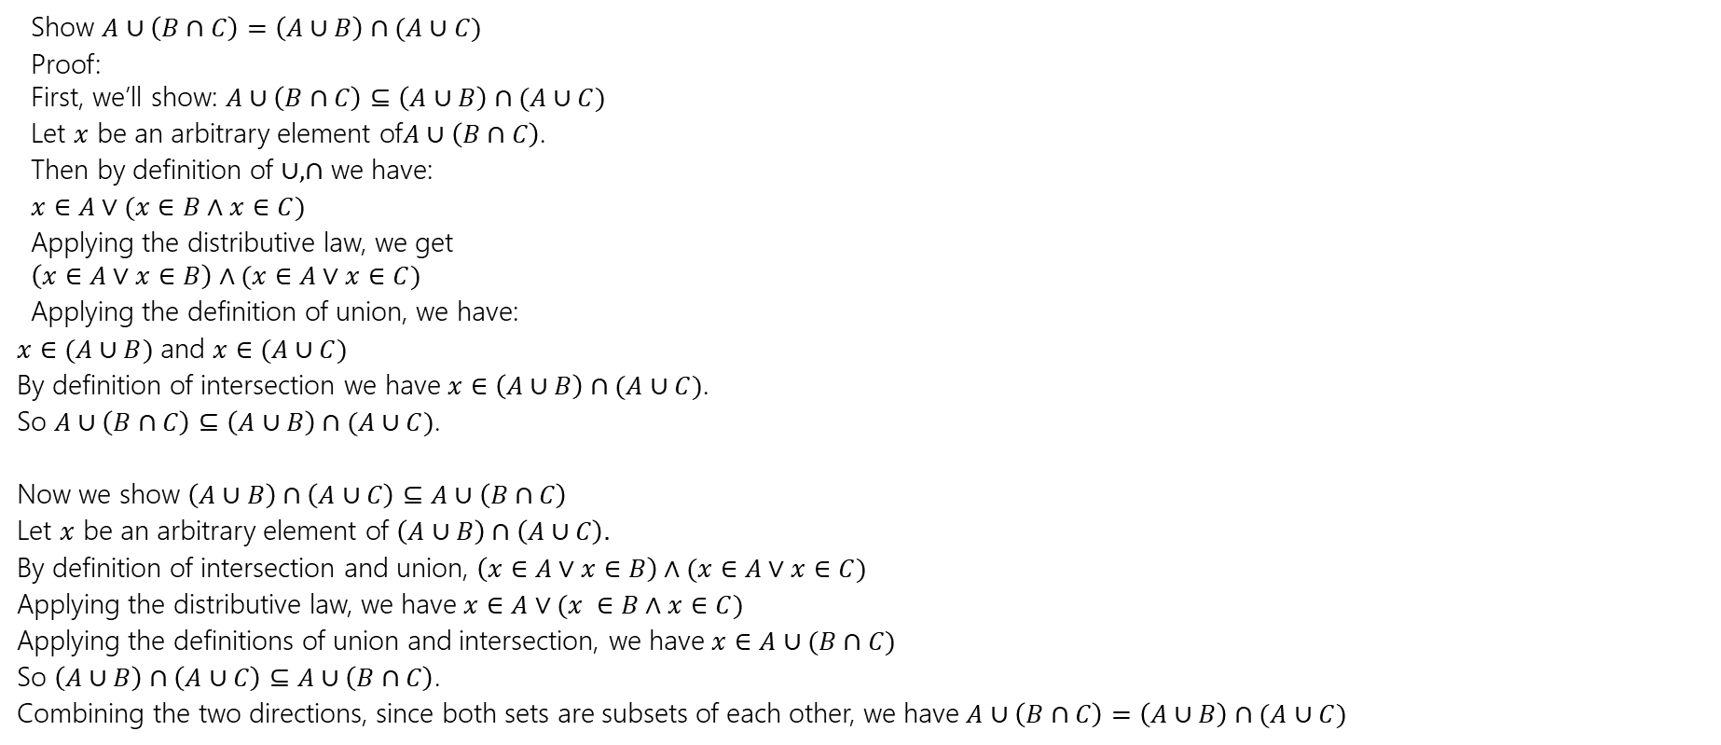
Extra Set Practice
Show $A∪\left(B∩C\right)=\left(A∪B\right)∩(A∪C)$
Proof:
First, we’ll show: $A∪\left(B∩C\right)⊆\left(A∪B\right)∩(A∪C)$
Let $x$ be an arbitrary element of$A∪\left(B∩C\right)$.
Then by definition of $∪,∩$ we have:
$x∈A∨(x∈B∧x∈C)$
Applying the distributive law, we get
$\left(x∈A∨x∈B\right)∧(x∈A∨x∈C)$
Applying the definition of union, we have:
$x∈(A∪B)$ and $x∈(A∪C)$
By definition of intersection we have $x∈\left(A∪B\right)∩(A∪C)$.
So $A∪\left(B∩C\right)⊆\left(A∪B\right)∩(A∪C)$.
Now we show $\left(A∪B\right)∩\left(A∪C\right)⊆A∪\left(B∩C\right)$
Let $x$ be an arbitrary element of $\left(A∪B\right)∩\left(A∪C\right).$
By definition of intersection and union, $\left(x∈A∨x∈B\right)∧(x∈A∨x∈C)$
Applying the distributive law, we have $x∈A∨(x ∈B∧x∈C)$
Applying the definitions of union and intersection, we have $x∈A∪(B∩C)$
So $\left(A∪B\right)∩\left(A∪C\right)⊆A∪\left(B∩C\right)$.
Combining the two directions, since both sets are subsets of each other, we have $A∪\left(B∩C\right)=\left(A∪B\right)∩(A∪C)$

Slide 33

Extra Set Practice
Suppose $A⊆B$. Show that $𝒫\left(A\right)⊆𝒫(B)$.

Slide 34
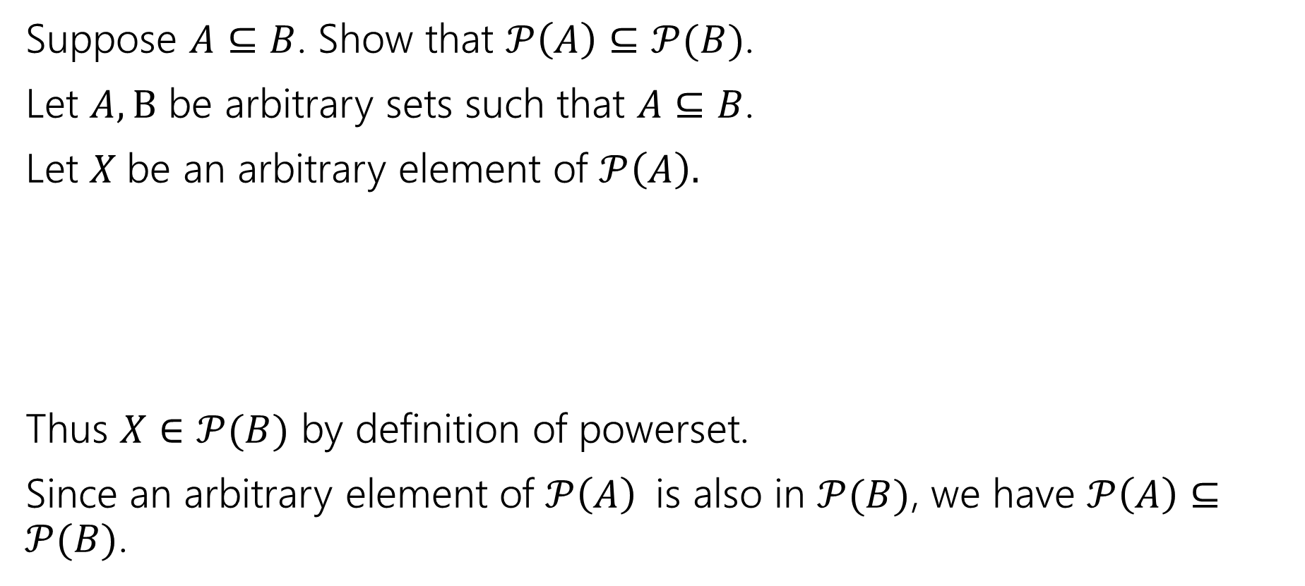
Extra Set Practice
Suppose $A⊆B$. Show that $𝒫\left(A\right)⊆𝒫(B)$.
Let $A,B$ be arbitrary sets such that $A⊆B$.
Let $X$be an arbitrary element of $𝒫\left(A\right).$
Thus $X∈𝒫(B)$ by definition of powerset.
Since an arbitrary element of $𝒫\left(A\right)$is also in $𝒫(B)$, we have $𝒫\left(A\right)⊆𝒫(B)$.

Slide 35
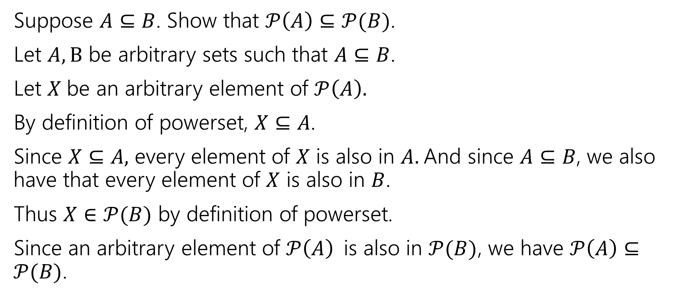
Extra Set Practice
Suppose $A⊆B$. Show that $𝒫\left(A\right)⊆𝒫(B)$.
Let $A,B$ be arbitrary sets such that $A⊆B$.
Let $X$be an arbitrary element of $𝒫\left(A\right).$
By definition of powerset, $X⊆A$.
Since $X⊆A,$ every element of $X$ is also in $A.$And since $A⊆B$, we also have that every element of $X$ is also in $B$.
Thus $X∈𝒫(B)$ by definition of powerset.
Since an arbitrary element of $𝒫\left(A\right)$is also in $𝒫(B)$, we have $𝒫\left(A\right)⊆𝒫(B)$.

Slide 36

Extra Set Practice
Disprove: If $A⊆\left(B∪C\right)$ then $A⊆B$ or $A⊆C$

Slide 37
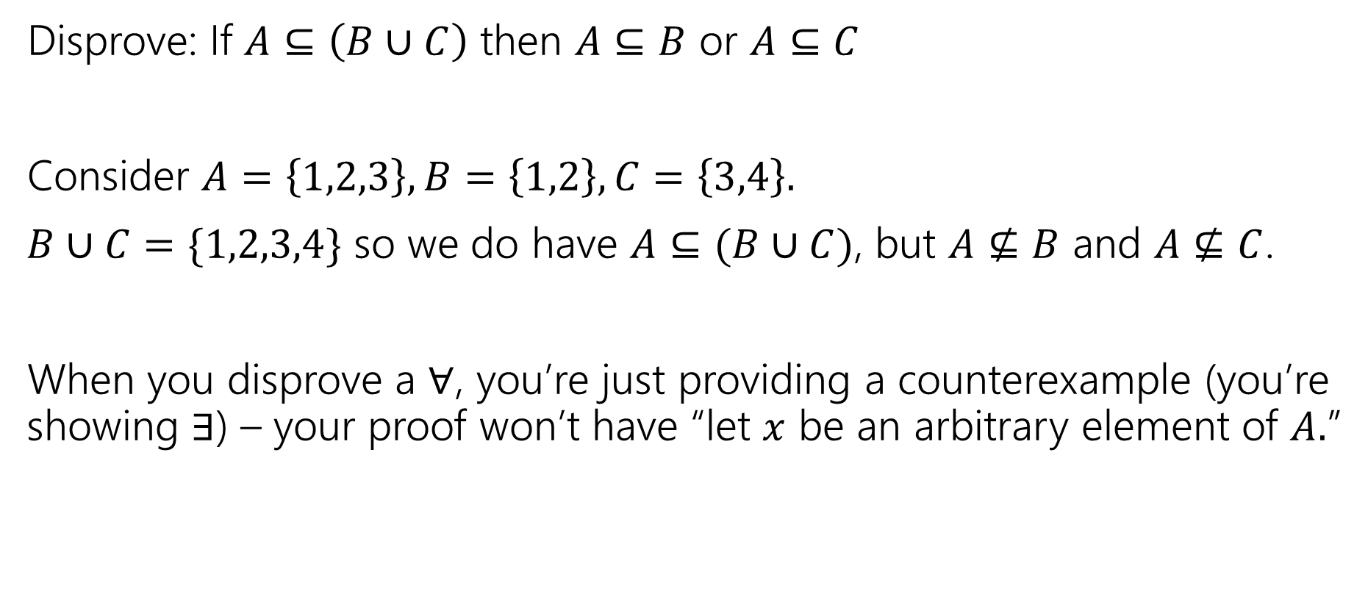
Extra Set Practice
Disprove: If $A⊆\left(B∪C\right)$ then $A⊆B$ or $A⊆C$
Consider $A=\left\{1,2,3\right\}, B=\left\{1,2\right\}, C=\left\{3,4\right\}.$
$B∪C=\{1,2,3,4\}$ so we do have $A⊆(B∪C)$, but $A⊈B$ and $A⊈C$.
When you disprove a $∀$, you’re just providing a counterexample (you’re showing $∃$) – your proof won’t have “let $x$ be an arbitrary element of $A.$”

Slide 38
Read on Your Own

Slide 39
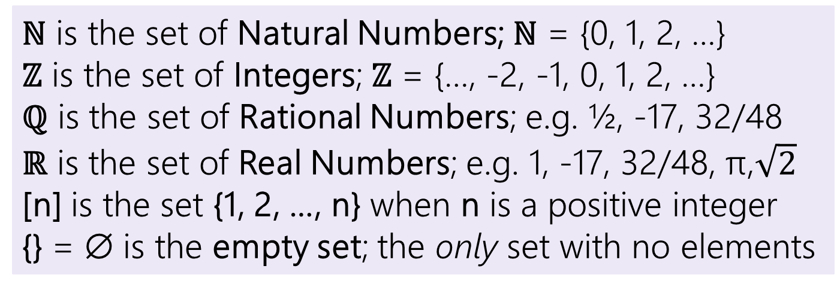
Some old friends (and some new ones)
ℕ is the set of Natural Numbers; ℕ = {0, 1, 2, …}
ℤ is the set of Integers; ℤ = {…, -2, -1, 0, 1, 2, …}
ℚ is the set of Rational Numbers; e.g. ½, -17, 32/48
ℝ is the set of Real Numbers; e.g. 1, -17, 32/48, π,$\sqrt{2}$
[n] is the set {1, 2, …, n} when n is a positive integer
{} = ∅ is the empty set; the only set with no elements

Slide 40

Some old friends (and some new ones)
Our natural numbers start at $0$.
Common in CS, other resources start at $1$.
ℕ is the set of Natural Numbers; ℕ = {0, 1, 2, …}
ℤ is the set of Integers; ℤ = {…, -2, -1, 0, 1, 2, …}
ℚ is the set of Rational Numbers; e.g. ½, -17, 32/48
ℝ is the set of Real Numbers; e.g. 1, -17, 32/48, π,$\sqrt{2}$
[n] is the set {1, 2, …, n} when n is a positive integer
{} = ∅ is the empty set; the only set with no elements
In LaTeX \mathbb{R}
In Office \doubleR
Use this symbol not {}.
In LaTex \varnothing In Office \emptyset.

Slide 41

More Connectors!
$A∖B$ “A minus B”
$A⊕B$ “XOR” (also called “symmetric difference”)
$$A∖B=\{x:x∈A∧x∉B\}$$
$$A⊕B=\{x:x∈A⊕x∈B\}$$

Slide 42
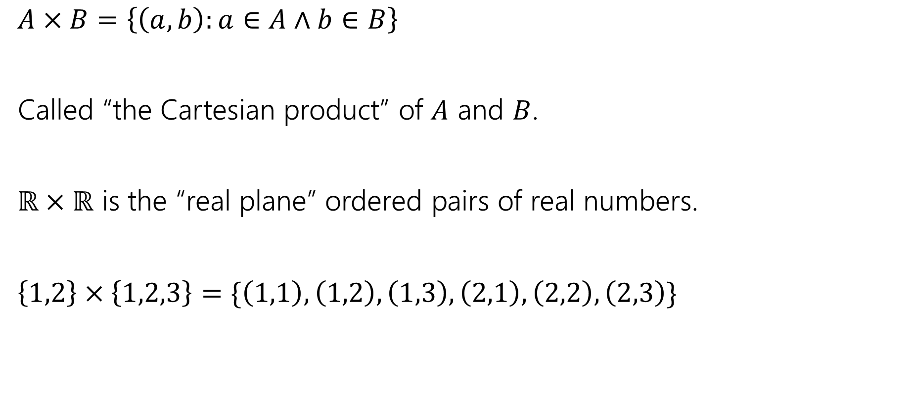
More Connectors!
$A×B=\left\{\left(a,b\right):a∈A∧b∈B\right\}$
Called “the Cartesian product” of $A$ and $B$.
$ℝ×ℝ$ is the “real plane” ordered pairs of real numbers.
$\left\{1,2\right\}×\left\{1,2,3\right\}=\{\left(1,1\right),\left(1,2\right),\left(1,3\right), \left(2,1\right), \left(2,2\right), \left(2,3\right)\}$

