Slide 1


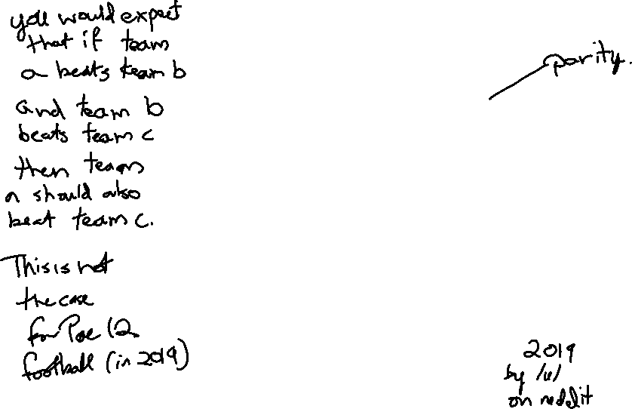
Relations And Graphs
CSE 311 Winter 2023
Lecture 21

Slide 2
Announcements
Post on Ed about grades.
If you want to talk to me 1:1 there’s a link to sign up at the bottom of that post.

Slide 3
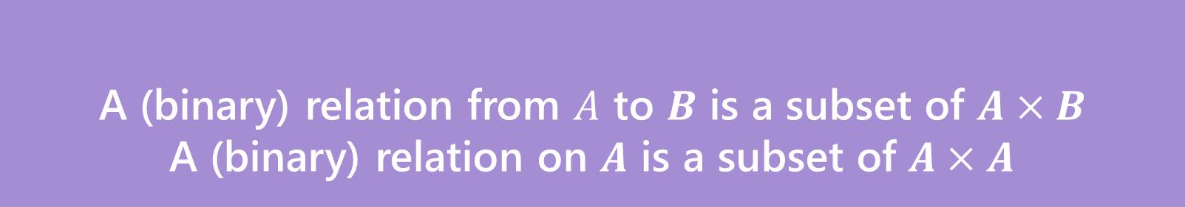

Relations
A (binary) relation from $A$ to $B$ is a subset of $A×B$
A (binary) relation on $A$ is a subset of $A×A$
Wait what?
$≤$ is a relation on $ℤ$.
“$3≤4“$ is a way of saying “3 relates to 4” (for the $≤$ relation)
$(3,4)$ is an element of the set that defines the relation.
Relations

Slide 4
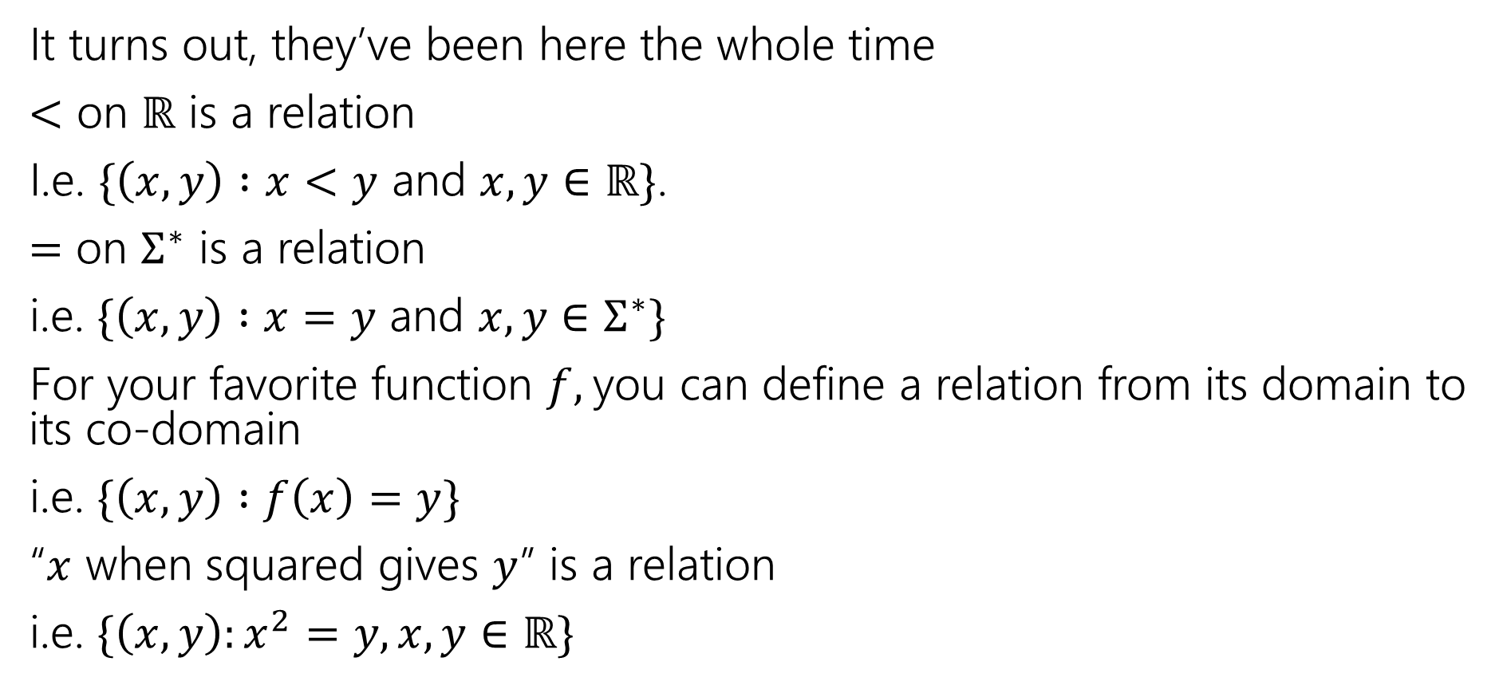
Relations, Examples
It turns out, they’ve been here the whole time
$<$ on $ℝ$ is a relation
I.e. $\{\left(x,y\right) :x<y$ and $x,y∈ℝ\}$.
$=$ on $Σ^{∗}$ is a relation
i.e. $\{\left(x,y\right) :x=y$ and $x,y∈Σ^{∗}\}$
For your favorite function $f,$you can define a relation from its domain to its co-domain
i.e. $\{\left(x,y\right) :f\left(x\right)=y\}$
“$x$ when squared gives $y$” is a relation
i.e. $\{\left(x,y\right):x^{2}=y, x,y∈ℝ\}$

Slide 5
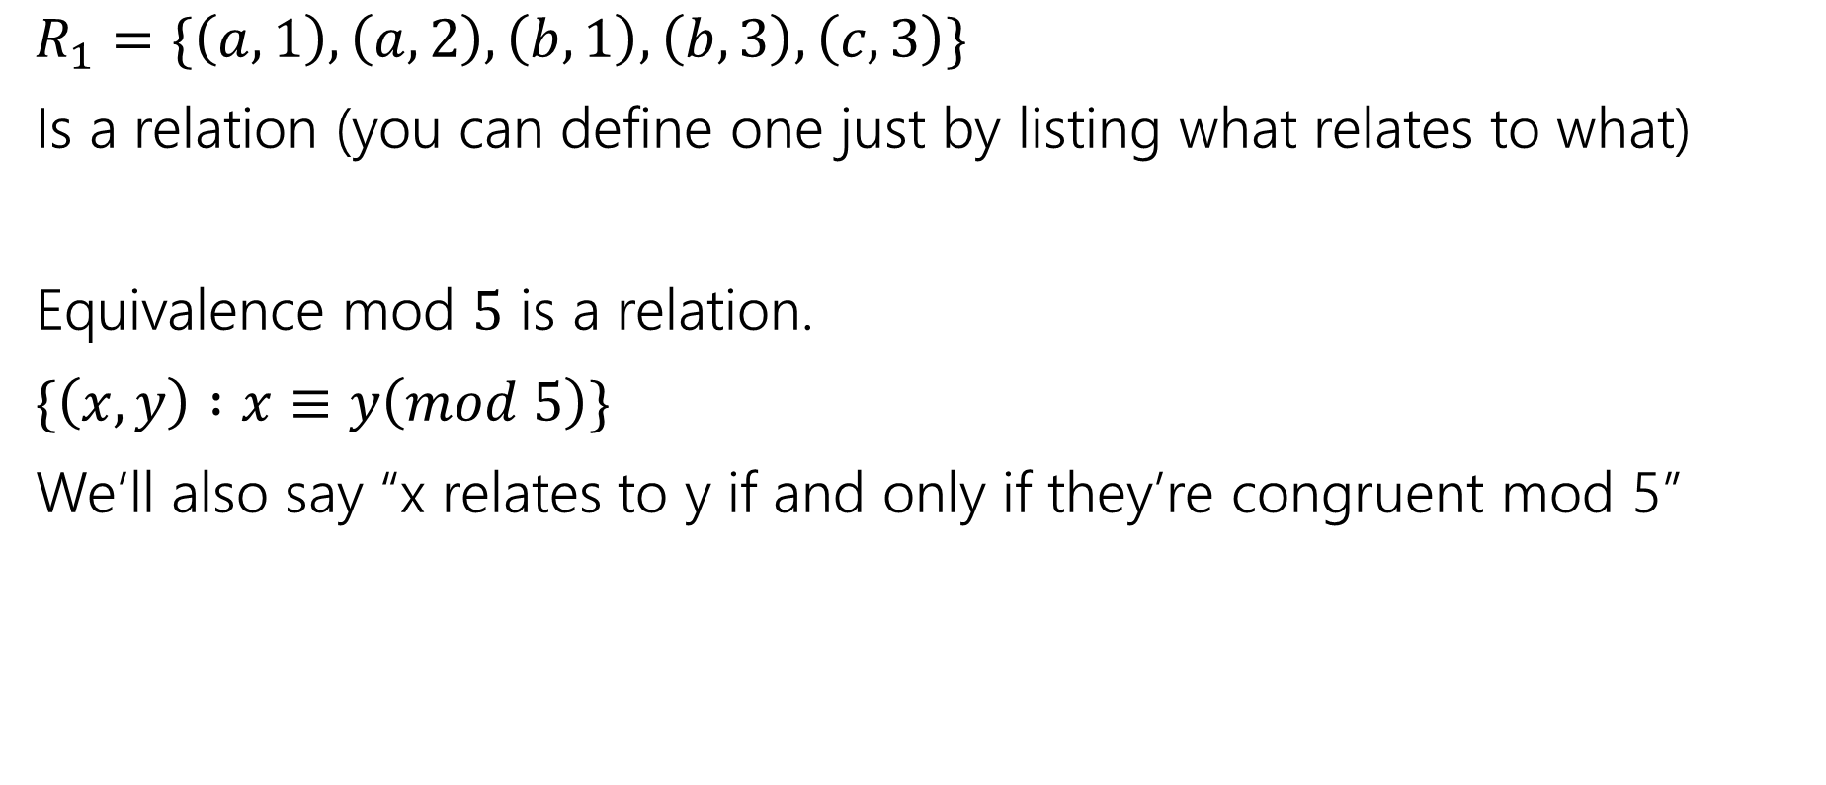
More Relations
$R_{1}=\{\left(a,1\right), \left(a,2\right), \left(b,1\right),\left(b,3\right),\left(c,3\right)\}$
Is a relation (you can define one just by listing what relates to what)
Equivalence mod $5$ is a relation.
$\{\left(x,y\right) :x≡y\left(mod 5\right)\}$
We’ll also say “x relates to y if and only if they’re congruent mod 5”

Slide 6


Properties of relations
What do we do with relations? Usually we prove properties about them.
Symmetry
A binary relation $R$ on a set $S$ is “symmetric” iff
for all $a,b∈S$, $[\left(a,b\right)∈R→\left(b,a\right)∈R]$
$=$ on $Σ^{∗}$ is symmetric, for all $a,b∈Σ^{∗}$ if $a=b$ then $b=a.$
$⊆$ is not symmetric on $𝒫(𝒰)$ – $\left\{1,2,3\right\}⊆\{1,2,3,4\}$ but $\left\{1,2,3,4\right\}⊈\{1,2,3\}$
Transitivity
A binary relation $R$ on a set $S$ is “transitive” iff
for all $a,b,c∈S$, $[\left(a,b\right)∈R∧\left(b,c\right)∈R→\left(a,c\right)∈R]$
$=$ on $Σ^{∗}$ is transitive, for all $a,b,c∈Σ^{∗}$ if $a=b$ and $b=c$ then $a=c$.
$⊆$ is transitive on $𝒫(𝒰)$ – for any sets $A,B,C$ if $A⊆B$ and $B⊆C$ then $A⊆C$.
$∈$ is not a transitive relation – $1∈\{1,2,3\}$, $\left\{1,2,3\right\}∈𝒫(\left\{1,2,3\right\})$ but $1∉𝒫\left(\left\{1,2,3\right\}\right).$

Slide 7

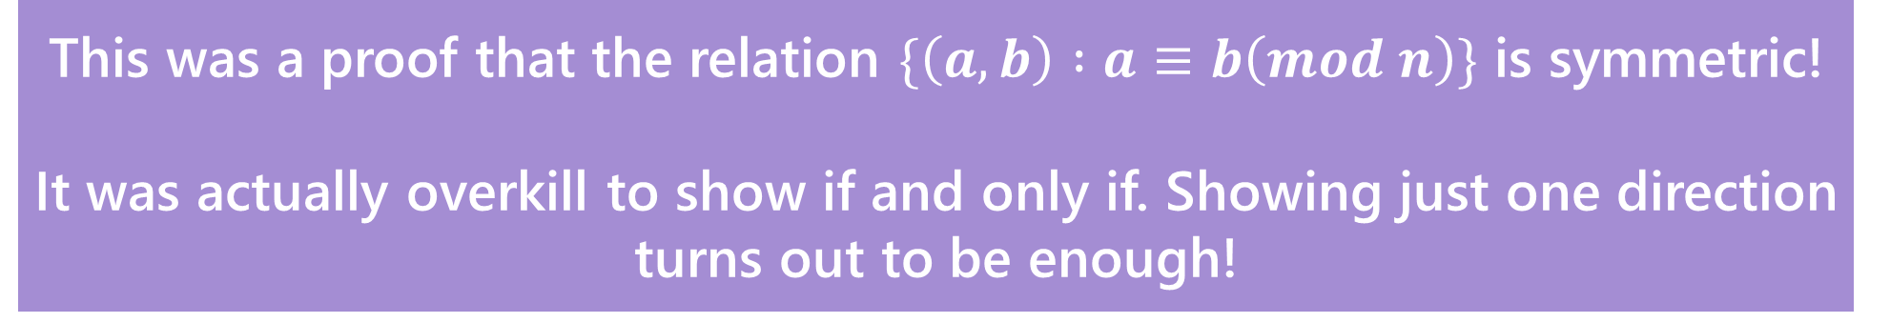
Warm up
Show that $a≡b \left(mod n\right)$ if and only if $b≡a(mod n)$
$a≡b\left(mod n\right)↔n|(b−a)↔nk=b−a\left(for k∈ℤ\right)↔$
$n(−k)=a−b(for −k∈ℤ)↔n|\left(a−b\right)↔b≡a(mod n)$
Show that $a\%n$=($a−n)\%n$ Where $b\%c$ is the unique $r$ such that $b=kc+r$ for some integer $k$.
By definition of %, $a=qn+(a\%n)$ for some integer $q$. Subtracting $n$,
$a−n=\left(q−1\right)n+(a\%n)$. Observe that $q−1$ is an integer, and that this is the form of the division theorem for $\left(a−n\right)\%n.$ Since the division theorem guarantees a unique integer, $\left(a−n\right)\%n=(a\%n)$
This was a proof that the relation $\{\left(a,b\right) :a≡b\left(mod n\right)\}$ is symmetric!
It was actually overkill to show if and only if. Showing just one direction turns out to be enough!

Slide 8
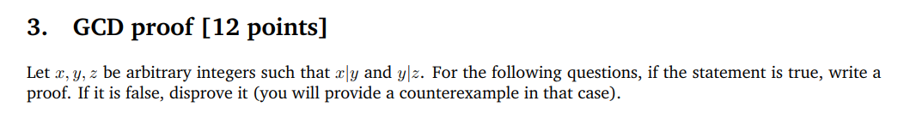
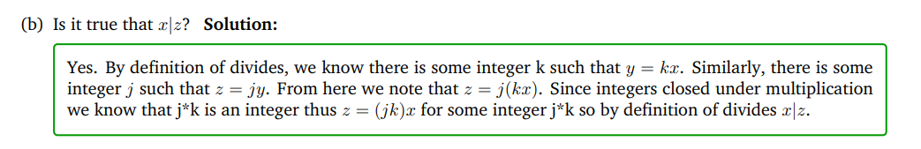
What about transitivity?
This was a proof that divides is a transitive relation!

Slide 9


More Properties of relations
What do we do with relations? Usually we prove properties about them.
Antisymmetry
A binary relation $R$ on a set $S$ is “antisymmetric” iff
for all $a,b∈S$, $[\left(a,b\right)∈R∧a≠b→\left(b,a\right)∉R]$
$≤$ is antisymmetric on $ℤ$
Reflexivity
A binary relation $R$ on a set $S$ is “reflexive” iff
for all $a∈S$, $[\left(a,a\right)∈R]$
$$≤$$
$≤$ is reflexive on $ℤ$

Slide 10
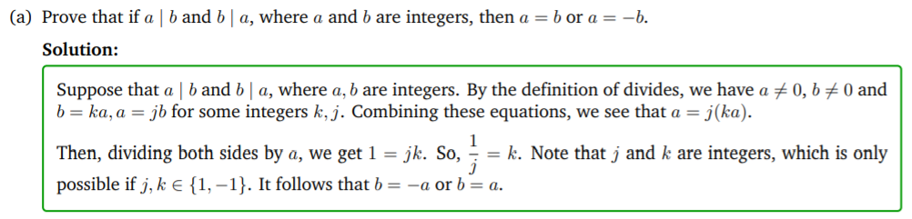
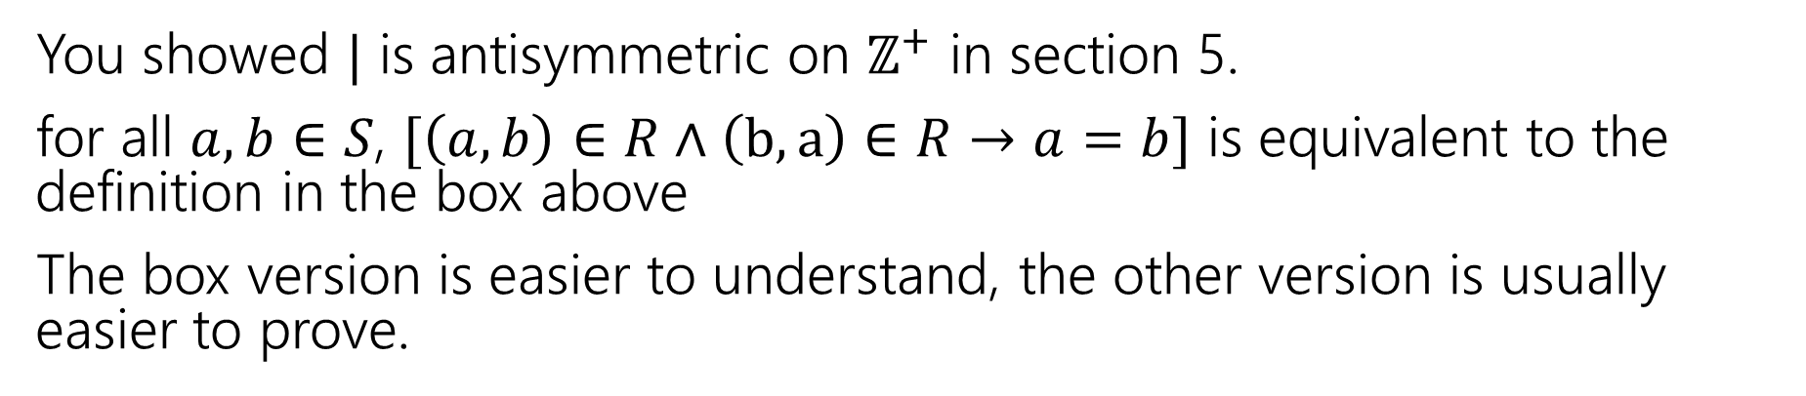
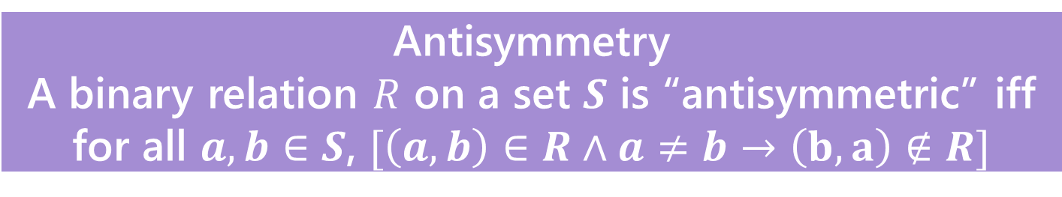
You’ve proven antisymmetry too!
Antisymmetry
A binary relation $R$ on a set $S$ is “antisymmetric” iff
for all $a,b∈S$, $[\left(a,b\right)∈R∧a≠b→\left(b,a\right)∉R]$
You showed $|$ is antisymmetric on $ℤ^{+}$ in section 5.
for all $a,b∈S$, $[\left(a,b\right)∈R∧\left(b,a\right)∈R→a=b]$ is equivalent to the definition in the box above
The box version is easier to understand, the other version is usually easier to prove.

Slide 11
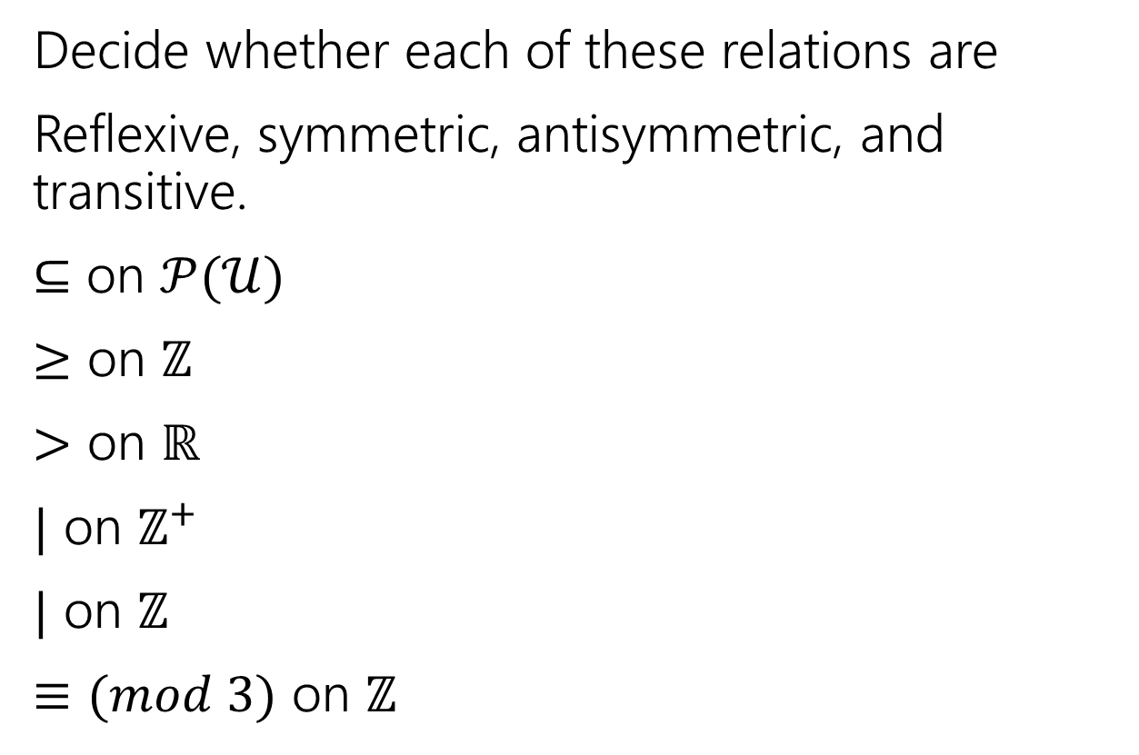

Try a few of your own
Decide whether each of these relations are
Reflexive, symmetric, antisymmetric, and transitive.
$⊆$ on $𝒫(𝒰)$
$≥$ on $ℤ$
$>$ on $ℝ$
$|$ on $ℤ^{+}$
$|$ on $ℤ$
$≡(mod 3)$ on $ℤ$
Symmetry: for all $a,b∈S$, $[\left(a,b\right)∈R→\left(b,a\right)∈R]$
Antisymmetry: for all $a,b∈S$, $[\left(a,b\right)∈R∧a≠b→\left(b,a\right)∉R]$
Transitivity: for all $a,b,c∈S$, $[\left(a,b\right)∈R∧\left(b,c\right)∈R→\left(a,c\right)∈R]$
Reflexivity: for all $a∈S$, $[\left(a,a\right)∈R]$

Slide 12
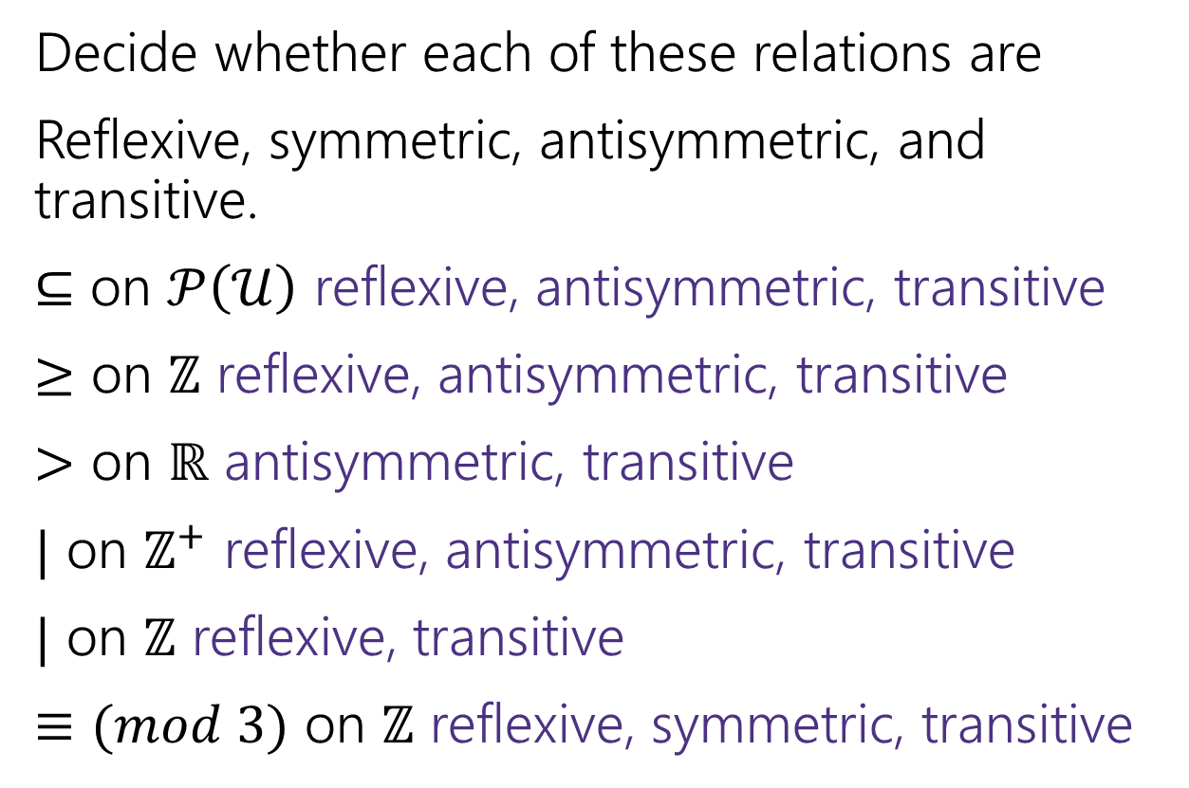

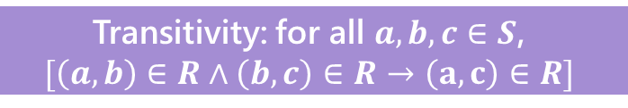
Try a few of your own
Symmetry: for all $a,b∈S$, $[\left(a,b\right)∈R→\left(b,a\right)∈R]$
Antisymmetry: for all $a,b∈S$, $[\left(a,b\right)∈R∧a≠b→\left(b,a\right)∉R]$
Decide whether each of these relations are
Reflexive, symmetric, antisymmetric, and transitive.
$⊆$ on $𝒫\left(𝒰\right)$ reflexive, antisymmetric, transitive
$≥$ on $ℤ$ reflexive, antisymmetric, transitive
$>$ on $ℝ$ antisymmetric, transitive
$|$ on $ℤ^{+}$ reflexive, antisymmetric, transitive
$|$ on $ℤ$ reflexive, transitive
$≡(mod 3)$ on $ℤ$ reflexive, symmetric, transitive
Transitivity: for all $a,b,c∈S$,
$$[\left(a,b\right)∈R∧\left(b,c\right)∈R→\left(a,c\right)∈R]$$
Reflexivity: for all $a∈S$, $[\left(a,a\right)∈R]$

Slide 13
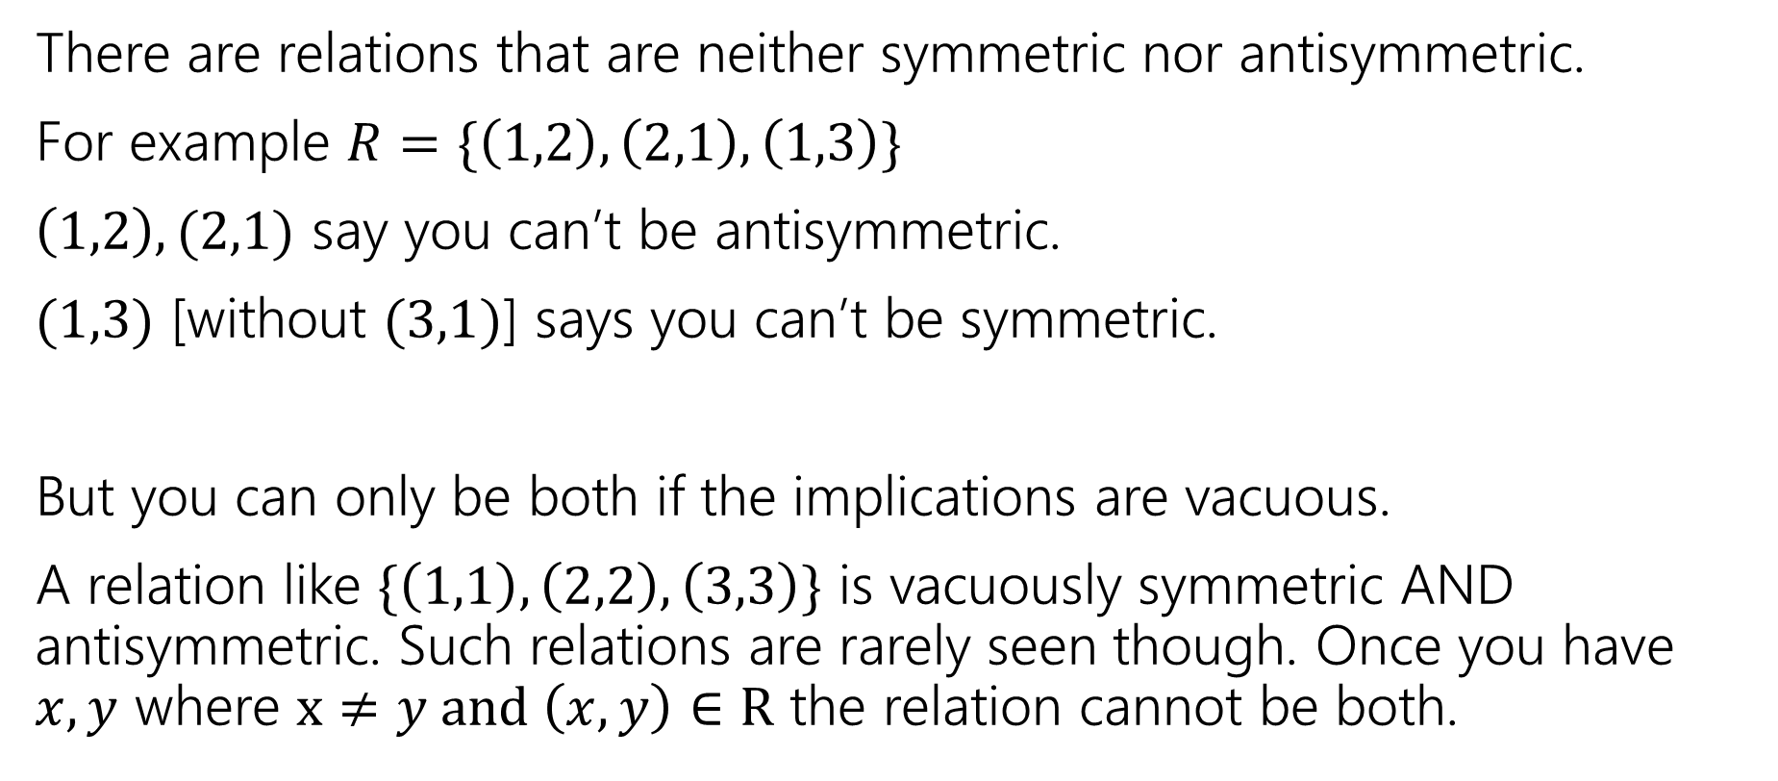
How Do symmetry and antisymmetry relate?
There are relations that are neither symmetric nor antisymmetric.
For example $R=\{\left(1,2\right),\left(2,1\right),\left(1,3\right)\}$
$\left(1,2\right),(2,1)$ say you can’t be antisymmetric.
$(1,3)$ [without $(3,1)$] says you can’t be symmetric.
But you can only be both if the implications are vacuous.
A relation like $\{\left(1,1\right),\left(2,2\right),\left(3,3\right)\}$ is vacuously symmetric AND antisymmetric. Such relations are rarely seen though. Once you have $x,y$ where $x≠y and \left(x,y\right)∈R$ the relation cannot be both.

Slide 14
Two Prototype Relations
A lot of fundamental relations follow one of two prototypes:
A relation that is reflexive, symmetric, and transitive is called an “equivalence relation”
Equivalence Relation
A relation that is reflexive, antisymmetric, and transitive is called a “partial order”
Partial Order Relation

Slide 15
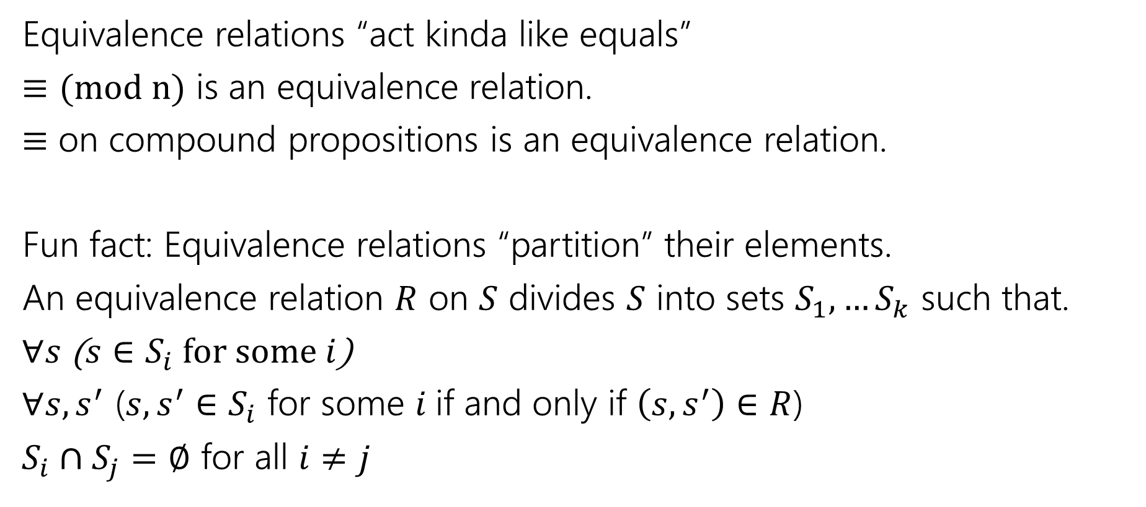
Equivalence Relations
Equivalence relations “act kinda like equals”
$≡(mod n)$ is an equivalence relation.
$≡$ on compound propositions is an equivalence relation.
Fun fact: Equivalence relations “partition” their elements.
An equivalence relation $R$ on $S$ divides $S$ into sets $S_{1},…S_{k}$ such that.
$∀s$ ($s∈S_{i}$ for some $i$)
$∀s,s^{′}$ ($s,s^{′}∈S_{i}$ for some $i$if and only if $\left(s,s^{′}\right)∈R$)
$S_{i}∩S_{j}=∅$ for all $i≠j$

Slide 16
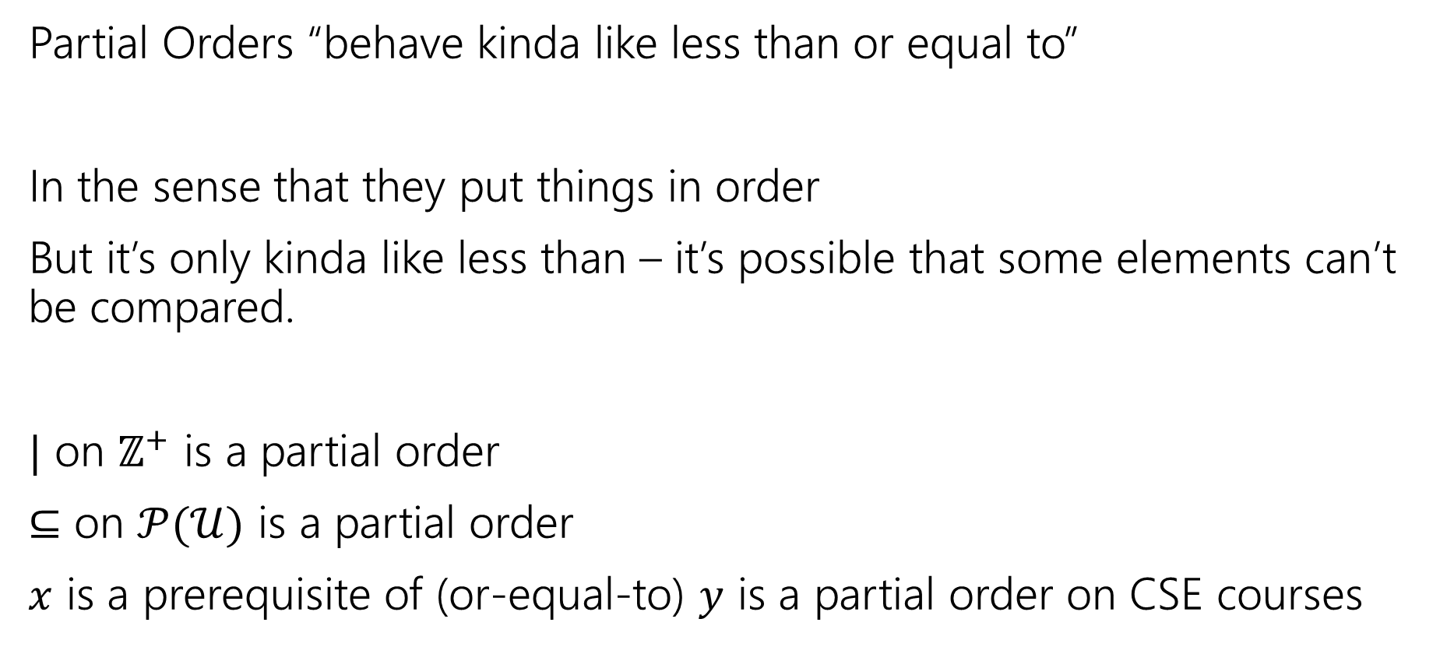
Partial Orders
Partial Orders “behave kinda like less than or equal to”
In the sense that they put things in order
But it’s only kinda like less than – it’s possible that some elements can’t be compared.
$|$ on $ℤ^{+}$ is a partial order
$⊆$ on $𝒫(𝒰)$ is a partial order
$x$ is a prerequisite of (or-equal-to) $y$ is a partial order on CSE courses

Slide 17
Why Bother?
If you prove facts about all equivalence relations or all partial orders, you instantly get facts in lots of different contexts.
If you learn to recognize partial orders or equivalence relations, you can get a lot of intuition for new concepts in a short amount of time.
Why now? We’ll want relations over the next few weeks (and it’s a convenient way to review proving implications, for all statements, and so on)

Slide 18
Graphs

Slide 19

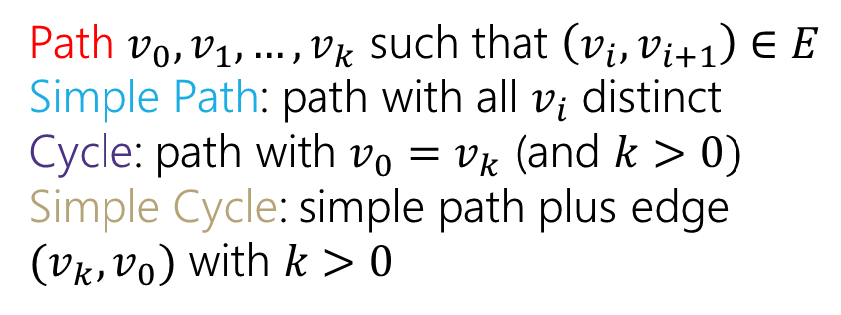
Directed Graphs
$G=(V,E)$
$V$is a set of vertices (an underlying set of elements)
$E$ is a set of edges (ordered pairs of vertices; i.e. connections from one to the next).
Path $v_{0},v_{1},…,v_{k}$ such that $\left(v_{i},v_{i+1}\right)∈E$
Simple Path: path with all $v_{i}$ distinct
Cycle: path with $v_{0}=v_{k}$ (and $k>0)$
Simple Cycle: simple path plus edge ${(v}_{k},v_{0})$ with $k>0$

Slide 20
Directed Graphs
$G=(V,E)$
$V$is a set of vertices (an underlying set of elements)
$E$ is a set of edges (ordered pairs of vertices; i.e. connections from one to the next).
Path $v_{0},v_{1},…,v_{k}$ such that $\left(v_{i},v_{i+1}\right)∈E$
Simple Path: path with all $v_{i}$ distinct
Cycle: path with $v_{0}=v_{k}$ (and $k>0)$
Simple Cycle: simple path plus edge ${(v}_{k},v_{0})$ with $k>0$

Slide 21
Directed Graphs
$G=(V,E)$
$V$is a set of vertices (an underlying set of elements)
$E$ is a set of edges (ordered pairs of vertices; i.e. connections from one to the next).
Path $v_{0},v_{1},…,v_{k}$ such that $\left(v_{i},v_{i+1}\right)∈E$
Simple Path: path with all $v_{i}$ distinct
Cycle: path with $v_{0}=v_{k}$ (and $k>0)$
Simple Cycle: simple path plus edge ${(v}_{k},v_{0})$ with $k>0$

Slide 22
Directed Graphs
$G=(V,E)$
$V$is a set of vertices (an underlying set of elements)
$E$ is a set of edges (ordered pairs of vertices; i.e. connections from one to the next).
Path $v_{0},v_{1},…,v_{k}$ such that $\left(v_{i},v_{i+1}\right)∈E$
Simple Path: path with all $v_{i}$ distinct
Cycle: path with $v_{0}=v_{k}$ (and $k>0)$
Simple Cycle: simple path plus edge ${(v}_{k},v_{0})$ with $k>0$

Slide 23
Lecture-Only Content
Relations and Graphs

Slide 24
More Relations and Graphs
The rest of this deck is a little more on:
Relations, specifically combining them together
Graphs, specifically representing relations as graphs.
We’re going to go through it very fast. We won’t have homework or exam questions on anything in this section of the deck.
But it is stuff you should see at least once because it might come back in future classes.

Slide 25
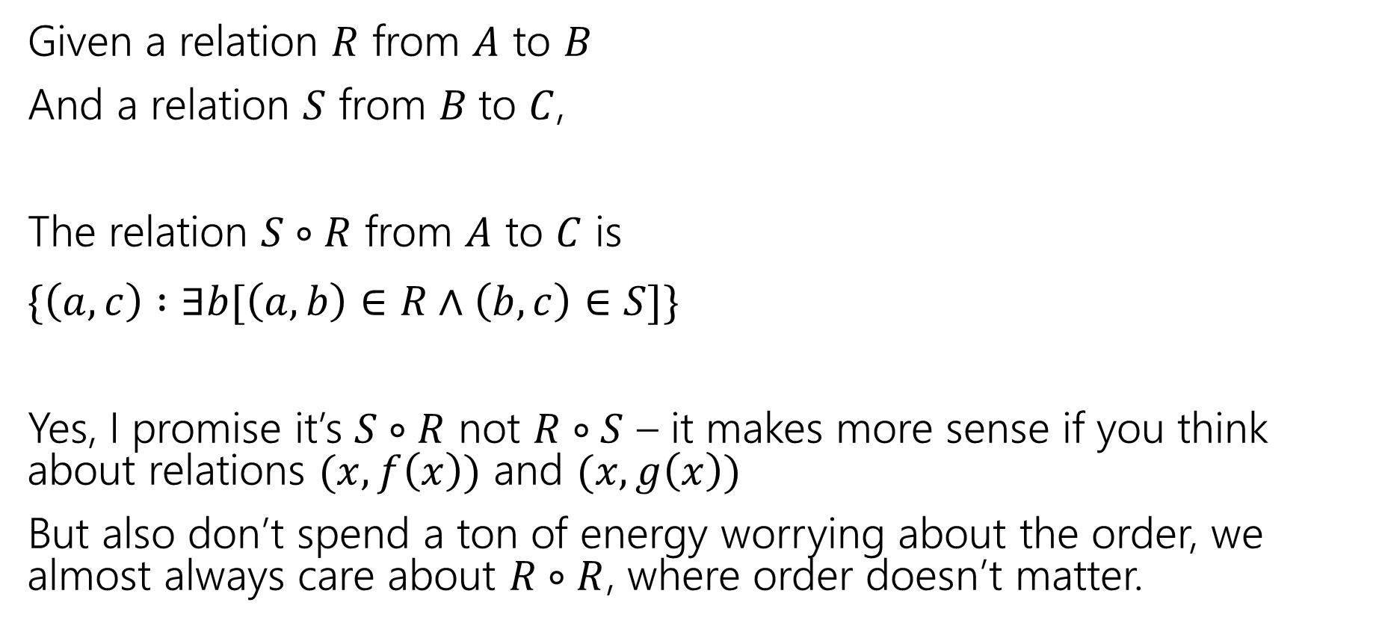
Combining Relations
Given a relation $R$ from $A$ to $B$
And a relation $S$ from $B$to $C$,
The relation $S∘R$ from $A$ to $C$ is
$\{\left(a,c\right) :∃b[\left(a,b\right)∈R∧\left(b,c\right)∈S]\}$
Yes, I promise it’s $S∘R$ not $R∘S$ – it makes more sense if you think about relations $(x,f\left(x\right))$ and $(x,g\left(x\right))$
But also don’t spend a ton of energy worrying about the order, we almost always care about $R∘R$, where order doesn’t matter.

Slide 26
Combining Relations
To combine relations, it’s a lot easier if we can see what’s happening.
We’ll use a representation of a directed graph

Slide 27
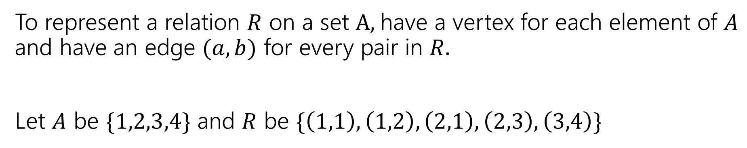
Representing Relations
To represent a relation $R$ on a set $A,$have a vertex for each element of $A$ and have an edge $(a,b)$ for every pair in $R.$
Let $A$ be $\{1,2,3,4\}$ and $R$ be $\{\left(1,1\right),\left(1,2\right),\left(2,1\right),\left(2,3\right),\left(3,4\right)\}$
1
2
3
4

Slide 28
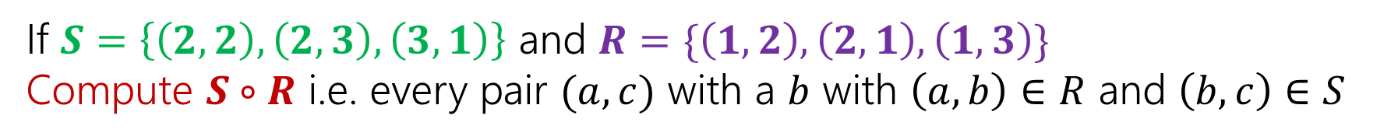
Combining Relations
If $S=\left\{\left(2,2\right), \left(2,3\right), \left(3,1\right)\right\}$ and $R=\{\left(1,2\right),\left(2,1\right),\left(1,3\right)\}$
Compute $S∘R$ i.e. every pair $(a,c)$ with a $b$ with $\left(a,b\right)∈R$ and $\left(b,c\right)∈S$
2
2
1
1
3
3

Slide 29
Combining Relations
If $S=\left\{\left(2,2\right), \left(2,3\right), \left(3,1\right)\right\}$ and $R=\{\left(1,2\right),\left(2,1\right),\left(1,3\right)\}$
Compute $S∘R$ i.e. every pair $(a,c)$ with a $b$ with $\left(a,b\right)∈R$ and $\left(b,c\right)∈S$
2
2
1
1
3
3

Slide 30

Combining Relations
Let $R$ be a relation on $A$.
Define $R^{0}$ as $\{\left(a,a\right) :a∈A\}$
$R^{k}=R^{k−1}∘R$
$\left(a,b\right)∈R^{k}$ if and only if there is a path of length $k$ from $a$ to $b$ in $R$.
We can find that on the graph!

Slide 31
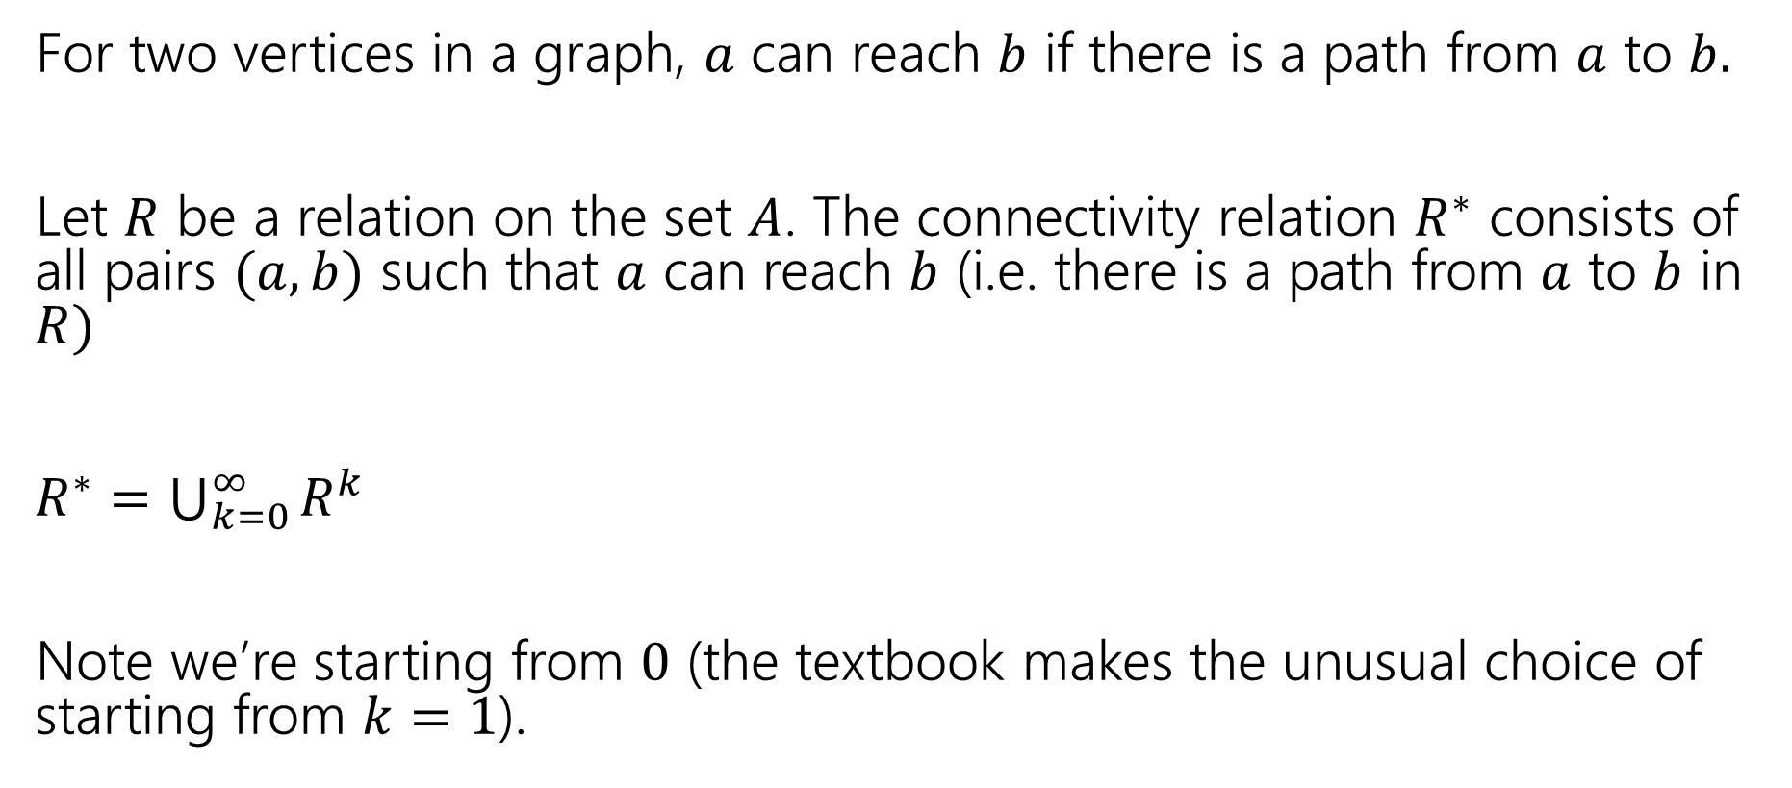

More Powers of $R.$
For two vertices in a graph, $a$ can reach $b$ if there is a path from $a$ to $b.$
Let $R$ be a relation on the set $A$. The connectivity relation $R^{∗}$ consists of all pairs $(a,b)$ such that $a$ can reach $b$ (i.e. there is a path from $a$ to $b$ in $R)$
$R^{∗}=\bigcup_{k=0}^{∞}{R^{k}}$
Note we’re starting from $0$ (the textbook makes the unusual choice of starting from $k=1$).

Slide 32
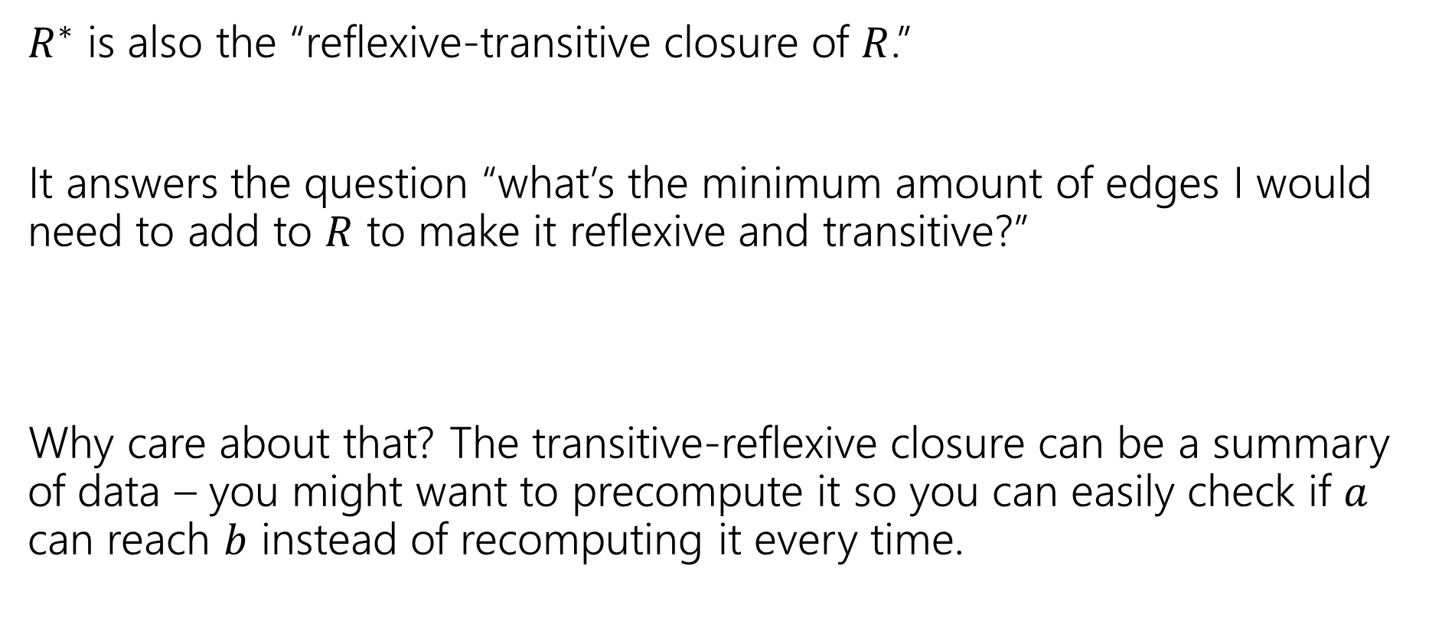

What’s the point of $R^{∗}$
$R^{∗}$ is also the “reflexive-transitive closure of $R$.”
It answers the question “what’s the minimum amount of edges I would need to add to $R$ to make it reflexive and transitive?”
Why care about that? The transitive-reflexive closure can be a summary of data – you might want to precompute it so you can easily check if $a$ can reach $b$ instead of recomputing it every time.

Slide 33
Relations and Graphs
Describe how each property will show up in the graph of a relation.
Reflexive
Symmetric
Antisymmetric
Transitive

Slide 34
Relations and Graphs
Describe how each property will show up in the graph of a relation.
Reflexive
Symmetric
Antisymmetric
Transitive
Every vertex has a “self-loop” (an edge from the vertex to itself)
Every edge has its “reverse edge” (going the other way) also in the graph.
No edge has its “reverse edge” (going the other way) also in the graph.
If there’s a length-2 path from $a$ to $b$ then there’s a direct edge from $a$ to $b$

