Slide 1
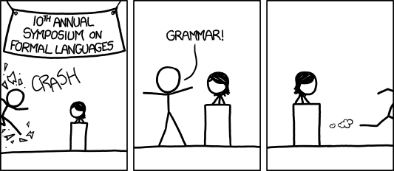
Context Free Grammars
[Audience looks around] “What just happened?” “There must be some context we’re missing.”
xkcd.com/1090
CSE 311 Winter 2023
Lecture 22

Slide 2
Context Free Grammars

Slide 3
What Can’t Regular Expressions Do?
Some “easy” things Where you could say whether a string matches with just a loop
$\{0^{k}1^{k}:k≥0\}$
The set of all palindromes.
And some harder things
Expressions with matched parentheses
Properly formed arithmetic expressions
Context Free Grammars can solve all of these problems!

Slide 4
Context Free Grammars
A context free grammar (CFG) is a finite set of production rules over:
An alphabet $Σ$ of “terminal symbols”
A finite set $V$ of “nonterminal symbols”
A start symbol (one of the elements of $V$) usually denoted $S$.
A production rule for a nonterminal $A∈V$ takes the form
$A→w_{1}\left|w_{2}\right|⋯|w_{k}$
Where each $w_{i}∈{\left(V∪Σ\right)}^{∗}$ is a string of nonterminals and terminals.

Slide 5
Context Free Grammars
We think of context free grammars as generating strings.
1. Start from the start symbol $S$.
2. Choose a nonterminal in the string, and a production rule $A→w_{1}\left|w_{2}\right|…|w_{k}$ replace that copy of the nonterminal with $w_{i}$.
3. If no nonterminals remain, you’re done! Otherwise, goto step 2.
A string is in the language of the CFG iff it can be generated starting from $S$.
Notation: $xAy⇒xwy$ is rewriting $A$ with $w$.

Slide 6
Examples
$S→0S0\left|1S1\right|0|1|ε$
$S→0S|S1|ε$
$S→\left(S\right)\left|SS\right|ε$
$S→AB$
$A→0A1|ε$
$B→1B0|ε$
The alphabet here is {(,)} i.e. parentheses are the characters.

Slide 7
Examples
$S→0S0\left|1S1\right|0|1|ε$
The set of all binary palindromes
$S→0S|S1|ε$
The set of all strings with any 0’s coming before any 1’s (i.e. $0^{∗}1^{∗}$)
$S→\left(S\right)\left|SS\right|ε$
Balanced parentheses
$S→AB$
$A→0A1|ε$
$B→1B0|ε$ $\{0^{j}1^{j+k}0^{k}:j,k≥0\}$

Slide 8
Arithmetic
$E→E+E\left|E∗E\right|\left(E\right)\left|x\right|y\left|z\right|0\left|1\right|2\left|3\right|4\left|5\right|6\left|7\right|8|9$
Generate $\left(2∗x\right)+y$
Generate $2+3∗4$ in two different ways
pollev.com/robbie

Slide 9
Arithmetic
$E→E+E\left|E∗E\right|\left(E\right)\left|x\right|y\left|z\right|0\left|1\right|2\left|3\right|4\left|5\right|6\left|7\right|8|9$
Generate $\left(2∗x\right)+y$
$E⇒E+E⇒\left(E\right)+E⇒\left(E∗E\right)+E⇒\left(2∗E\right)+E⇒\left(2∗x\right)+E⇒(2∗x)+y$
Generate $2+3∗4$in two different ways
$E⇒E+E⇒E+E∗E⇒2+E∗E⇒2+3∗E⇒2+3∗4$
$E⇒E∗E⇒E+E∗E⇒2+E∗E⇒2+3∗E⇒2+3∗4$

Slide 10
Parse Trees
Suppose a context free grammar $G$ generates a string $x$
A parse tree of $x$ for $G$ has
Rooted at $S$ (start symbol)
Children of every $A$ node are labeled with the characters of $w$ for some $A→w$
Reading the leaves from left to right gives $x$.
$S→0S0\left|1S1\right|0\left|1\right|ε$
S
0
S
0
1
S
1
1

Slide 11
Back to the arithmetic
$E→E+E\left|E∗E\right|\left(E\right)\left|x\right|y\left|z\right|0\left|1\right|2\left|3\right|4\left|5\right|6\left|7\right|8|9$
Two parse trees for $2+3∗4$
E
E
E
+
E
E
$$∗$$
E
E
$$∗$$
E
+
E
4
2
E
3
4
2
3

Slide 12
How do we encode order of operations
If we want to keep “in order” we want there to be only one possible parse tree.
Differentiate between “things to add” and “things to multiply”
Only introduce a * sign after you’ve eliminated the possibility of introducing another + sign in that area.
$E→T|E+T$
$T→F|T∗F$
$F→\left(E\right)|N$
$N→x\left|y\right|z\left|0\right|1\left|2\right|3\left|4\right|5\left|6\right|7|8|9$
E
E
+
T
T
T
$$∗$$
F
F
N
F
N
4
N
3
2

Slide 13
CNFs in practice
Used to define programming languages.
Often written in Backus-Naur Form – just different notation
Variables are <names-in-brackets> or technical terms
like <if-then-else-statement>, <condition>, <identifier>
$→$is replaced with $∷=$ or $:$

Slide 14
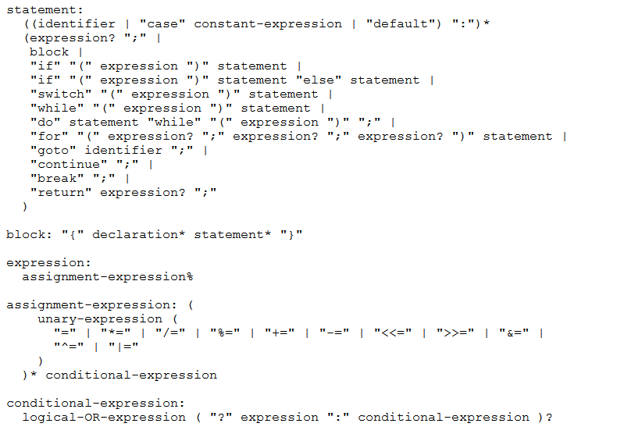
BNF for C (no <...> and uses : instead of ::=)

Slide 15
Parse Trees
Remember diagramming sentences in middle school?
<sentence>::=<noun phrase><verb phrase>
<noun phrase>::=<determiner><adjective><noun>
<verb phrase>::=<verb><adverb>|<verb><object>
<object>::=<noun phrase>

Slide 16
Parse Trees
<sentence>::=<noun phrase><verb phrase>
<noun phrase>::=<determiner><adjective><noun>
<verb phrase>::=<verb><adverb>|<verb><object>
<object>::=<noun phrase>
The old man the boat.

Slide 17
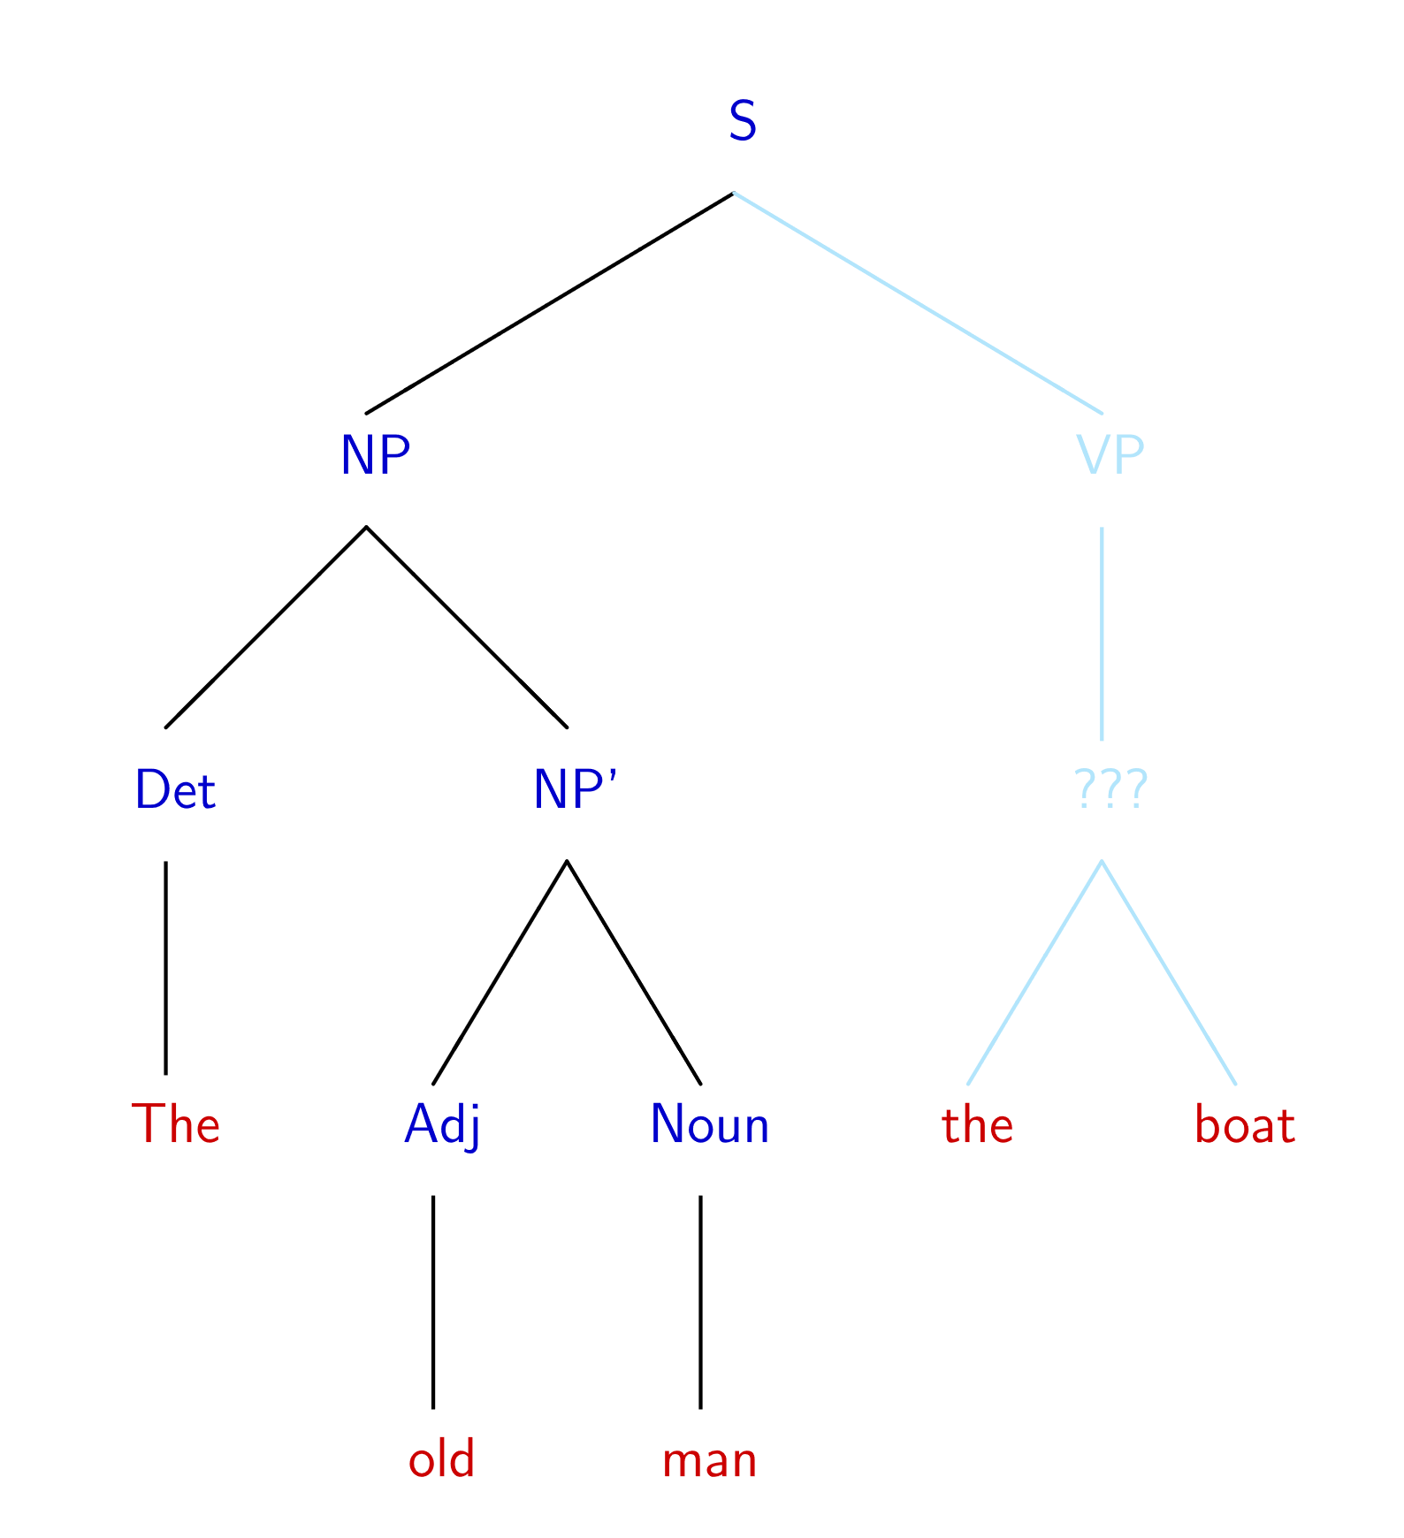
The old man the boat
By Jochen Burghardt - Own work, CC BY-SA 4.0, https://commons.wikimedia.org/w/index.php?curid=92742400

Slide 18
Power of Context Free Languages
There are languages CFGs can express that regular expressions can’t
e.g. palindromes
What about vice versa – is there a language that a regular expression can represent that a CFG can’t?
No!
Are there languages even CFGs cannot represent?
Yes!
$\{0^{k}1^{j}2^{k}3^{j}|j,k≥0\}$ cannot be written with a context free grammar.

Slide 19
Takeaways
CFGs and regular expressions gave us ways of succinctly representing sets of strings
Regular expressions super useful for representing things you need to search for
CFGs represent complicated languages like “java code with valid syntax”
Next Week, we’ll talk about how each of these are “equivalent to weaker computers.”
This week: Two more tools for our toolbox.

Slide 20
Relations and Graphs

Slide 21
Relations
A (binary) relation from $A$ to $B$ is a subset of $A×B$
A (binary) relation on $A$ is a subset of $A×A$
Wait what?
$≤$ is a relation on $ℤ$.
“$3≤4“$ is a way of saying “3 relates to 4” (for the $≤$ relation)
$(3,4)$ is an element of the set that defines the relation.
Relations

Slide 22
Relations, Examples
It turns out, they’ve been here the whole time
$<$ on $ℝ$ is a relation
I.e. $\{\left(x,y\right) :x<y$ and $x,y∈ℝ\}$.
$=$ on $Σ^{∗}$ is a relation
i.e. $\{\left(x,y\right) :x=y$ and $x,y∈Σ^{∗}\}$
For your favorite function $f,$you can define a relation from its domain to its co-domain
i.e. $\{\left(x,y\right) :f\left(x\right)=y\}$
“$x$ when squared gives $y$” is a relation
i.e. $\{\left(x,y\right):x^{2}=y, x,y∈ℝ\}$

Slide 23
Relations, Examples
Fix a universal set $𝒰$.
$⊆$ is a relation. What’s it on?
$𝒫(𝒰)$
The set of all subsets of $𝒰$

Slide 24
More Relations
$R_{1}=\{\left(a,1\right), \left(a,2\right), \left(b,1\right),\left(b,3\right),\left(c,3\right)\}$
Is a relation (you can define one just by listing what relates to what)
Equivalence mod $5$ is a relation.
$\{\left(x,y\right) :x≡y\left(mod 5\right)\}$
We’ll also say “x relates to y if and only if they’re congruent mod 5”

Slide 25
Properties of relations
What do we do with relations? Usually we prove properties about them.
Symmetry
A binary relation $R$ on a set $S$ is “symmetric” iff
for all $a,b∈S$, $[\left(a,b\right)∈R→\left(b,a\right)∈R]$
$=$ on $Σ^{∗}$ is symmetric, for all $a,b∈Σ^{∗}$ if $a=b$ then $b=a.$
$⊆$ is not symmetric on $𝒫(𝒰)$ – $\left\{1,2,3\right\}⊆\{1,2,3,4\}$ but $\left\{1,2,3,4\right\}⊈\{1,2,3\}$
Transitivity
A binary relation $R$ on a set $S$ is “transitive” iff
for all $a,b,c∈S$, $[\left(a,b\right)∈R∧\left(b,c\right)∈R→\left(a,c\right)∈R]$
$=$ on $Σ^{∗}$ is transitive, for all $a,b,c∈Σ^{∗}$ if $a=b$ and $b=c$ then $a=c$.
$⊆$ is transitive on $𝒫(𝒰)$ – for any sets $A,B,C$ if $A⊆B$ and $B⊆C$ then $A⊆C$.
$∈$ is not a transitive relation – $1∈\{1,2,3\}$, $\left\{1,2,3\right\}∈𝒫(\left\{1,2,3\right\})$ but $1∉𝒫\left(\left\{1,2,3\right\}\right).$

Slide 26
Warm up
Show that $a≡b \left(mod n\right)$ if and only if $b≡a(mod n)$
$a≡b\left(mod n\right)↔n|(b−a)↔nk=b−a\left(for k∈ℤ\right)↔$
$n(−k)=a−b(for −k∈ℤ)↔n|\left(a−b\right)↔b≡a(mod n)$
Show that $a\%n$=($a−n)\%n$ Where $b\%c$ is the unique $r$ such that $b=kc+r$ for some integer $k$.
By definition of %, $a=qn+(a\%n)$ for some integer $q$. Subtracting $n$,
$a−n=\left(q−1\right)n+(a\%n)$. Observe that $q−1$ is an integer, and that this is the form of the division theorem for $\left(a−n\right)\%n.$ Since the division theorem guarantees a unique integer, $\left(a−n\right)\%n=(a\%n)$
This was a proof that the relation $\{\left(a,b\right) :a≡b\left(mod n\right)\}$ is symmetric!
It was actually overkill to show if and only if. Showing just one direction turns out to be enough!

Slide 27
What about transitivity?
Some quarters there’s a homework problem…we didn’t have one this time.
Divides is a transitive relation!
If $p|q$ and $q|r$ then $p|r$.

Slide 28
More Properties of relations
What do we do with relations? Usually we prove properties about them.
Antisymmetry
A binary relation $R$ on a set $S$ is “antisymmetric” iff
for all $a,b∈S$, $[\left(a,b\right)∈R∧a≠b→\left(b,a\right)∉R]$
$≤$ is antisymmetric on $ℤ$
Reflexivity
A binary relation $R$ on a set $S$ is “reflexive” iff
for all $a∈S$, $[\left(a,a\right)∈R]$
$$≤$$
$≤$ is reflexive on $ℤ$

Slide 29
You’ve proven antisymmetry too!
Antisymmetry
A binary relation $R$ on a set $S$ is “antisymmetric” iff
for all $a,b∈S$, $[\left(a,b\right)∈R∧a≠b→\left(b,a\right)∉R]$
You showed $|$ is antisymmetric on $ℤ^{+}$ in section 5.
for all $a,b∈S$, $[\left(a,b\right)∈R∧\left(b,a\right)∈R→a=b]$ is equivalent to the definition in the box above
The box version is easier to understand, the other version is usually easier to prove.

Slide 30
Try a few of your own
Pollev.com/robbie
Decide whether each of these relations are
Reflexive, symmetric, antisymmetric, and transitive.
$⊆$ on $𝒫(𝒰)$
$≥$ on $ℤ$
$>$ on $ℝ$
$|$ on $ℤ^{+}$
$|$ on $ℤ$
$≡(mod 3)$ on $ℤ$
Symmetry: for all $a,b∈S$, $[\left(a,b\right)∈R→\left(b,a\right)∈R]$
Antisymmetry: for all $a,b∈S$, $[\left(a,b\right)∈R∧a≠b→\left(b,a\right)∉R]$
Transitivity: for all $a,b,c∈S$, $[\left(a,b\right)∈R∧\left(b,c\right)∈R→\left(a,c\right)∈R]$
Reflexivity: for all $a∈S$, $[\left(a,a\right)∈R]$

Slide 31
Try a few of your own
Symmetry: for all $a,b∈S$, $[\left(a,b\right)∈R→\left(b,a\right)∈R]$
Antisymmetry: for all $a,b∈S$, $[\left(a,b\right)∈R∧a≠b→\left(b,a\right)∉R]$
Decide whether each of these relations are
Reflexive, symmetric, antisymmetric, and transitive.
$⊆$ on $𝒫\left(𝒰\right)$ reflexive, antisymmetric, transitive
$≥$ on $ℤ$ reflexive, antisymmetric, transitive
$>$ on $ℝ$ antisymmetric, transitive
$|$ on $ℤ^{+}$ reflexive, antisymmetric, transitive
$|$ on $ℤ$ reflexive, transitive
$≡(mod 3)$ on $ℤ$ reflexive, symmetric, transitive
Transitivity: for all $a,b,c∈S$,
$$[\left(a,b\right)∈R∧\left(b,c\right)∈R→\left(a,c\right)∈R]$$
Reflexivity: for all $a∈S$, $[\left(a,a\right)∈R]$

