Slide 1
Even More Induction
CSE 311 Winter 2023
Lecture 16

Slide 2

Let’s Try Another! Stamp Collecting
I have 4 cent stamps and 5 cent stamps (as many as I want of each). Prove that I can make exactly $n$ cents worth of stamps for all $n≥12$.
Try for a few values.
Then think…how would the inductive step go?

Slide 3

Stamp Collection, Done Wrong
Define $P(n)$ I can make $n$ cents of stamps with just $4$ and $5$ cent stamps.
We prove $P(n)$ is true for all $n≥12$ by induction on $n$.
Base Case:
12 cents can be made with three $4$ cent stamps.
Inductive Hypothesis Suppose $P(k)$, $k≥12$.
Inductive Step:
We want to make $k+1$ cents of stamps. By IH we can make $k$ cents exactly with stamps. Replace one of the 4 cent stamps with a 5 cent stamp.
$P(n)$ holds for all $n$ by the principle of induction.

Slide 4
Stamp Collection, Done Wrong
What if the starting point doesn’t have any 4 cent stamps?
Like, say, 15 cents = 5+5+5.

Slide 5
Gridding
I’ve got a bunch of these 3 piece tiles.
I want to fill a $2^{n}$x$2^{n}$ grid ($n≥1)$with the pieces, except for a $1$x$1$ spot in a corner.

Slide 6
Gridding: Not a formal proof, just a sketch
Base Case: $n=1$
Inductive hypothesis: Suppose you can tile a $2^{k}$x$2^{k}$ grid, except for a corner.
Inductive step: $2^{k+1}$x$2^{k+1}$, divide into quarters. By IH can tile…

Slide 7
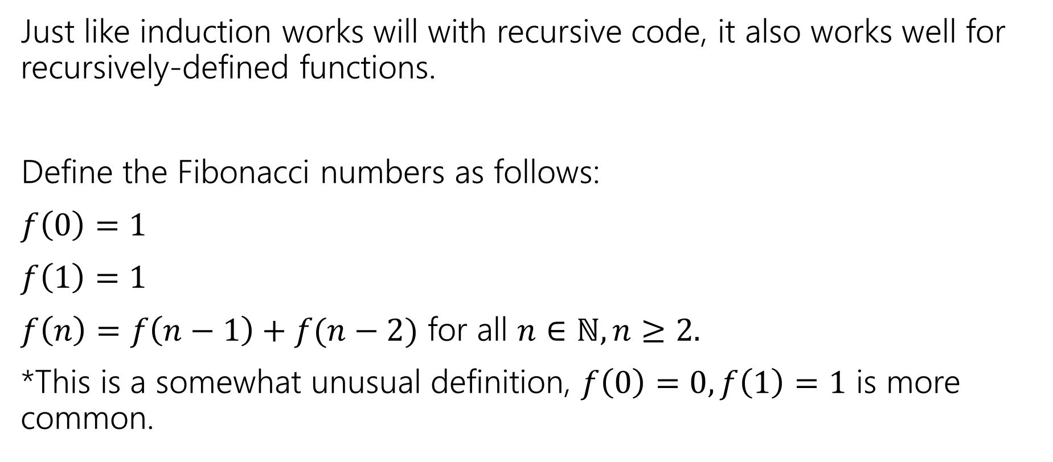
Recursively Defined Functions
Just like induction works will with recursive code, it also works well for recursively-defined functions.
Define the Fibonacci numbers as follows:
$f\left(0\right)=1$
$f\left(1\right)=1$
$f\left(n\right)=f\left(n−1\right)+f(n−2)$ for all $n∈ℕ, n≥2.$
*This is a somewhat unusual definition, $f\left(0\right)=0, f\left(1\right)=1$ is more common.

Slide 8
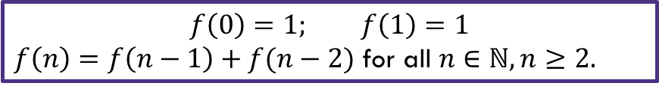

Fibonacci Inequality
Show that $f\left(n\right)≤2^{n}$ for all $n≥0$by induction.
$$f\left(0\right)=1; f\left(1\right)=1$$
$f\left(n\right)=f\left(n−1\right)+f(n−2)$ for all $n∈ℕ, n≥2.$

Slide 9

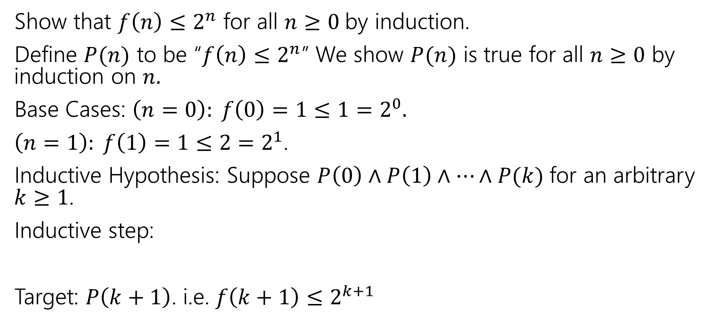
Fibonacci Inequality
$$f\left(0\right)=1; f\left(1\right)=1$$
$f\left(n\right)=f\left(n−1\right)+f(n−2)$ for all $n∈ℕ, n≥2.$
Show that $f\left(n\right)≤2^{n}$ for all $n≥0$by induction.
Define $P(n)$ to be “$f\left(n\right)≤2^{n}$” We show $P(n)$ is true for all $n≥0$ by induction on $n.$
Base Cases: $\left(n=0\right): f\left(0\right)=1≤1=2^{0}.$
$\left(n=1\right): f\left(1\right)=1≤2=2^{1}$.
Inductive Hypothesis: Suppose $P\left(0\right)∧P\left(1\right)∧⋯∧P(k)$ for an arbitrary $k≥1$.
Inductive step:
Target: $P\left(k+1\right)$. i.e. $f\left(k+1\right)≤2^{k+1}$

Slide 10

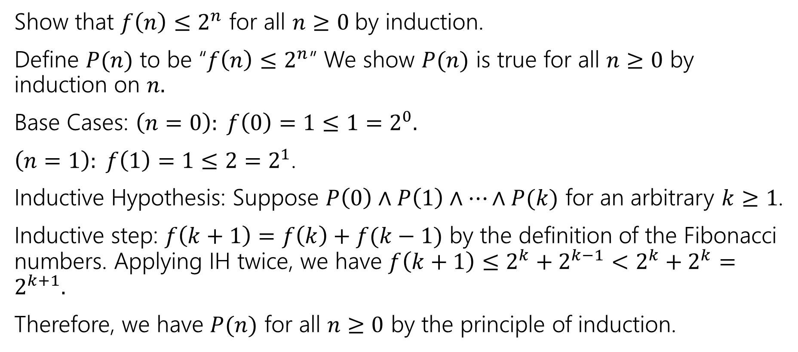
Fibonacci Inequality
$$f\left(0\right)=1; f\left(1\right)=1$$
$f\left(n\right)=f\left(n−1\right)+f(n−2)$ for all $n∈ℕ, n≥2.$
Show that $f\left(n\right)≤2^{n}$ for all $n≥0$by induction.
Define $P(n)$ to be “$f\left(n\right)≤2^{n}$” We show $P(n)$ is true for all $n≥0$ by induction on $n.$
Base Cases: $\left(n=0\right): f\left(0\right)=1≤1=2^{0}.$
$\left(n=1\right): f\left(1\right)=1≤2=2^{1}$.
Inductive Hypothesis: Suppose $P\left(0\right)∧P\left(1\right)∧⋯∧P(k)$ for an arbitrary $k≥1$.
Inductive step: $f\left(k+1\right)=f\left(k\right)+f(k−1)$ by the definition of the Fibonacci numbers. Applying IH twice, we have $f\left(k+1\right)≤2^{k}+2^{k−1}<2^{k}+2^{k}=2^{k+1}.$
Therefore, we have $P(n)$ for all $n≥0$ by the principle of induction.

Slide 11


Claim: $3|{(2}^{2n}−1)$ for all $n∈ℕ$.
[Define $P(n)$]
Base Case
Inductive Hypothesis
Inductive Step
[conclusion]

Slide 12
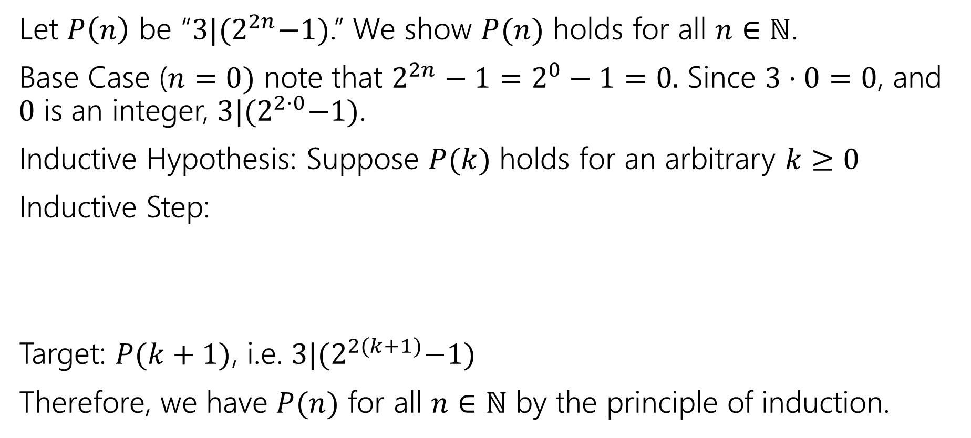
Claim: $3|{(2}^{2n}−1)$ for all $n∈ℕ$.
Let $P\left(n\right)$ be “$3|{(2}^{2n}−1)$.” We show $P(n)$ holds for all $n∈ℕ$.
Base Case ($n=0)$ note that $2^{2n}−1=2^{0}−1=0.$ Since $3⋅0=0$, and $0$ is an integer, $3|{(2}^{2⋅0}−1)$.
Inductive Hypothesis: Suppose $P(k)$ holds for an arbitrary $k≥0$
Inductive Step:
Target: $P(k+1)$, i.e. $3|{(2}^{2(k+1)}−1)$
Therefore, we have $P(n)$ for all $n∈ℕ$ by the principle of induction.

Slide 13
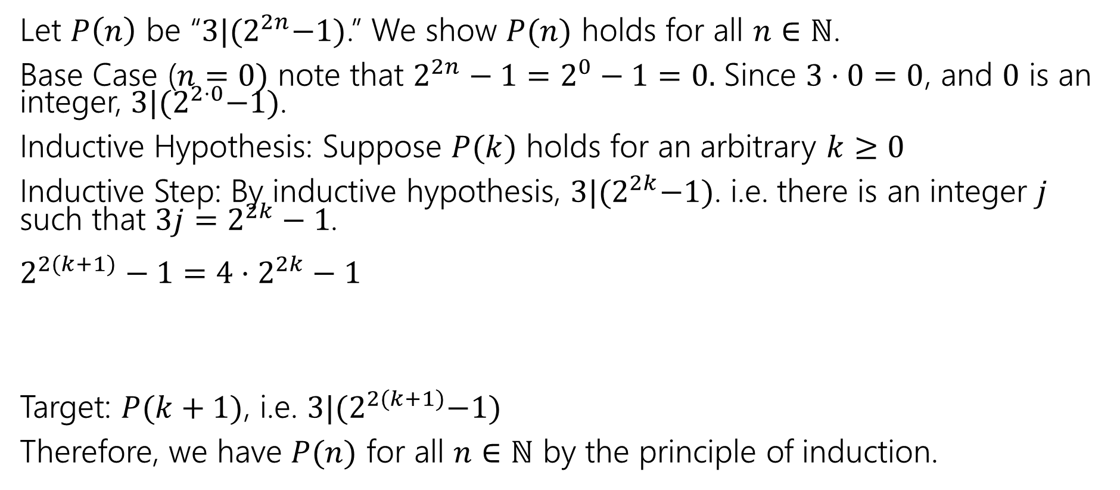
Claim: $3|{(2}^{2n}−1)$ for all $n∈ℕ$.
Let $P\left(n\right)$ be “$3|{(2}^{2n}−1)$.” We show $P(n)$ holds for all $n∈ℕ$.
Base Case ($n=0)$ note that $2^{2n}−1=2^{0}−1=0.$ Since $3⋅0=0$, and $0$ is an integer, $3|{(2}^{2⋅0}−1)$.
Inductive Hypothesis: Suppose $P(k)$ holds for an arbitrary $k≥0$
Inductive Step: By inductive hypothesis, $3|{(2}^{2k}−1)$. i.e. there is an integer $j$ such that $3j=2^{2k}−1$.
$2^{2(k+1)}−1=4⋅2^{2k}−1$
Target: $P(k+1)$, i.e. $3|{(2}^{2(k+1)}−1)$
Therefore, we have $P(n)$ for all $n∈ℕ$ by the principle of induction.
FORCE the expression in your IH to appear

Slide 14
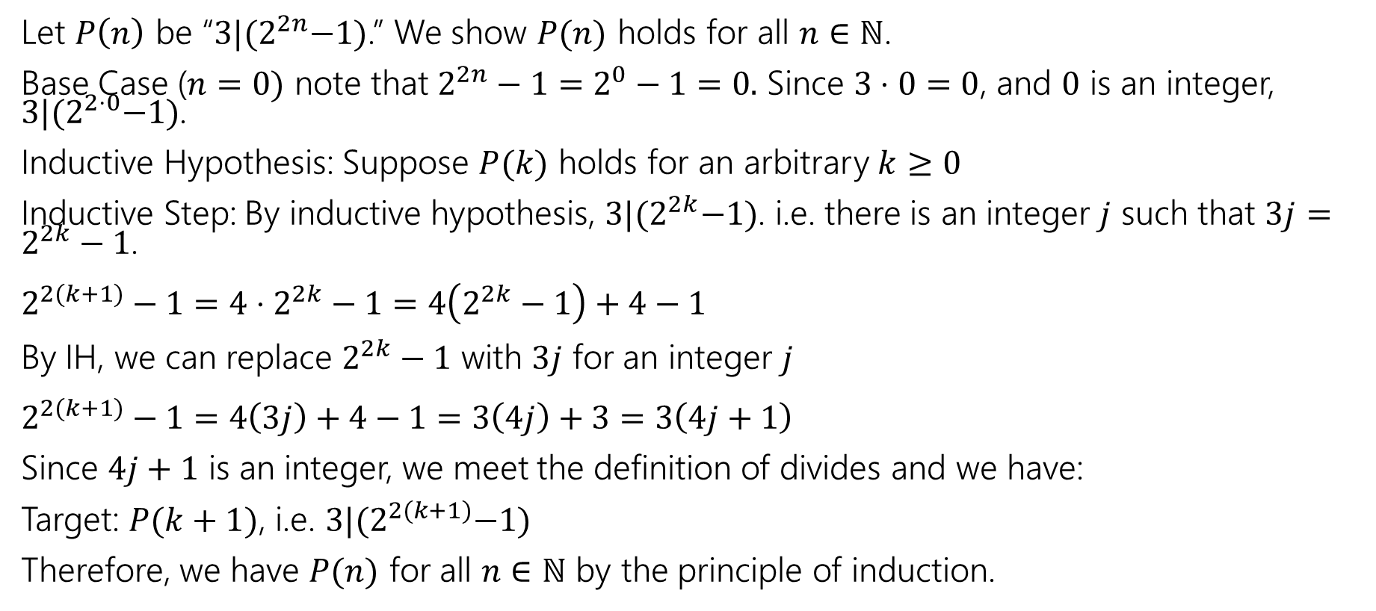
Claim: $3|{(2}^{2n}−1)$ for all $n∈ℕ$.
Let $P\left(n\right)$ be “$3|{(2}^{2n}−1)$.” We show $P(n)$ holds for all $n∈ℕ$.
Base Case ($n=0)$ note that $2^{2n}−1=2^{0}−1=0.$ Since $3⋅0=0$, and $0$ is an integer, $3|{(2}^{2⋅0}−1)$.
Inductive Hypothesis: Suppose $P(k)$ holds for an arbitrary $k≥0$
Inductive Step: By inductive hypothesis, $3|{(2}^{2k}−1)$. i.e. there is an integer $j$ such that $3j=2^{2k}−1$.
$2^{2(k+1)}−1=4⋅2^{2k}−1=4\left(2^{2k}−1\right)+4−1$
By IH, we can replace $2^{2k}−1$ with $3j$ for an integer $j$
$2^{2(k+1)}−1=4\left(3j\right)+4−1=3\left(4j\right)+3=3\left(4j+1\right)$
Since $4j+1$ is an integer, we meet the definition of divides and we have:
Target: $P(k+1)$, i.e. $3|{(2}^{2(k+1)}−1)$
Therefore, we have $P(n)$ for all $n∈ℕ$ by the principle of induction.

Slide 15
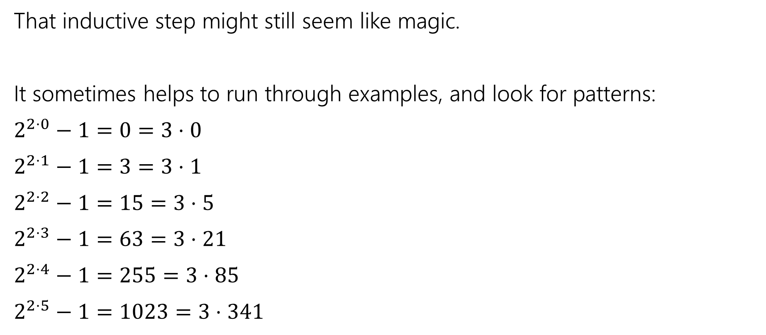

Claim: $3|{(2}^{2n}−1)$ for all $n∈ℕ$.
That inductive step might still seem like magic.
It sometimes helps to run through examples, and look for patterns:
$2^{2⋅0}−1=0=3⋅0$
$2^{2⋅1}−1=3=3⋅1$
$2^{2⋅2}−1=15=3⋅5$
$2^{2⋅3}−1=63=3⋅21$
$2^{2⋅4}−1=255=3⋅85$
$2^{2⋅5}−1=1023=3⋅341$
The divisor goes from $k$to $4k+1$
$$0→4⋅0+1=1$$
$$1→4⋅1+1=5$$
$$5→4⋅5+1=21$$
…
That might give us a hint that $4k+1$ will be in the algebra somewhere, and give us another intermediate target.

Slide 16
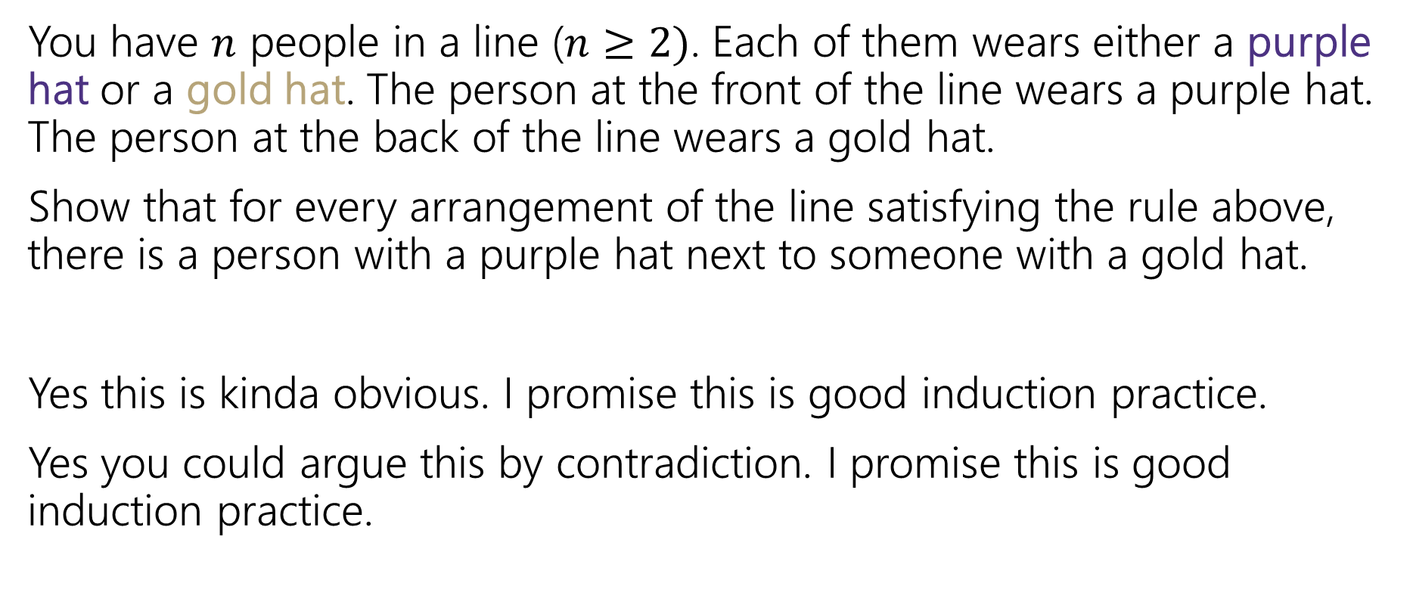
Induction: Hats!
You have $n$ people in a line ($n≥2)$. Each of them wears either a purple hat or a gold hat. The person at the front of the line wears a purple hat. The person at the back of the line wears a gold hat.
Show that for every arrangement of the line satisfying the rule above, there is a person with a purple hat next to someone with a gold hat.
Yes this is kinda obvious. I promise this is good induction practice.
Yes you could argue this by contradiction. I promise this is good induction practice.

Slide 17
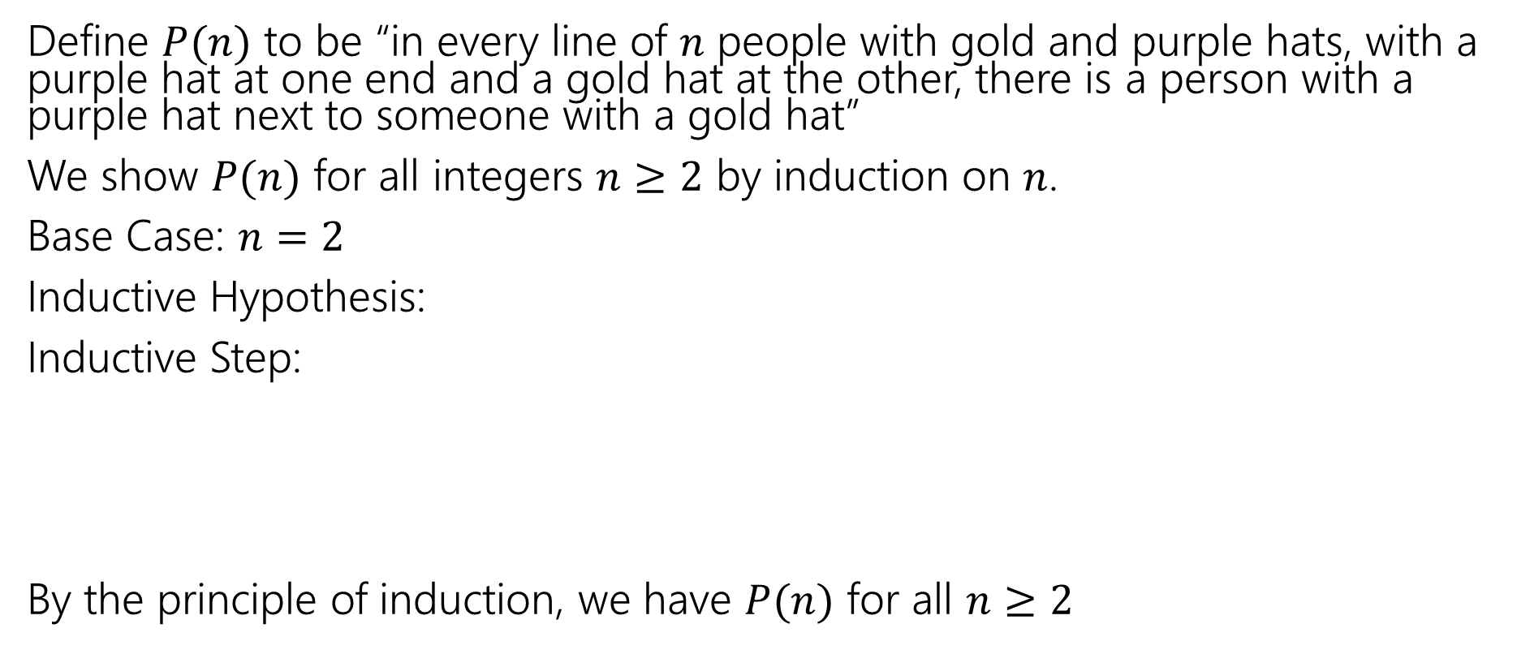
Induction: Hats!
Define $P(n)$ to be “in every line of $n$ people with gold and purple hats, with a purple hat at one end and a gold hat at the other, there is a person with a purple hat next to someone with a gold hat”
We show $P(n)$ for all integers $n≥2$ by induction on $n$.
Base Case: $n=2$
Inductive Hypothesis:
Inductive Step:
By the principle of induction, we have $P(n)$ for all $n≥2$

Slide 18
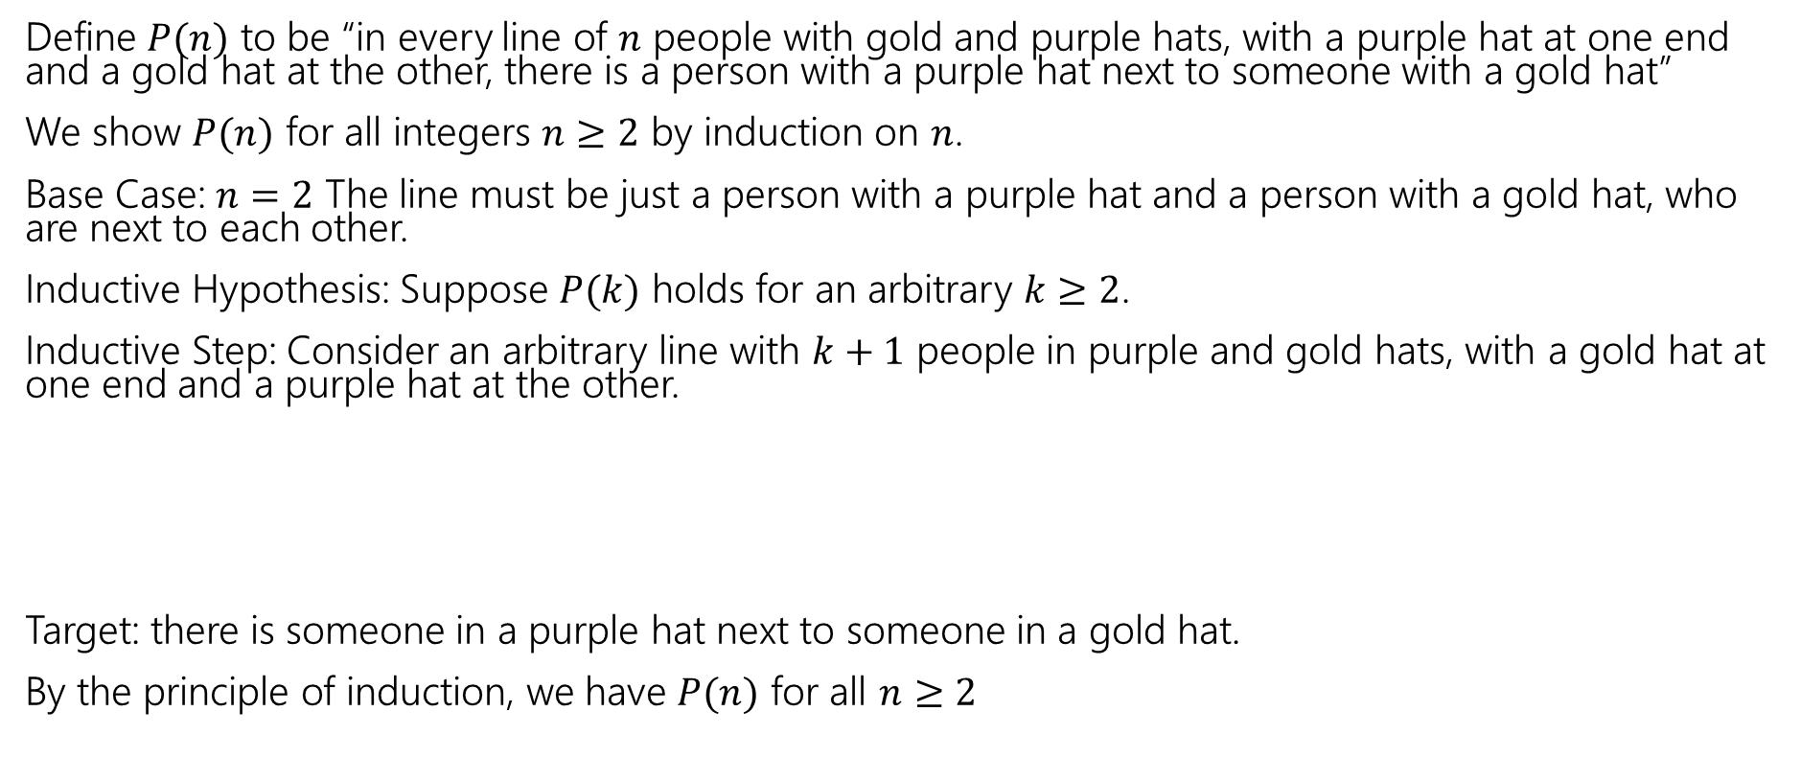
Induction: Hats!
Define $P(n)$ to be “in every line of $n$ people with gold and purple hats, with a purple hat at one end and a gold hat at the other, there is a person with a purple hat next to someone with a gold hat”
We show $P(n)$ for all integers $n≥2$ by induction on $n$.
Base Case: $n=2$ The line must be just a person with a purple hat and a person with a gold hat, who are next to each other.
Inductive Hypothesis: Suppose $P(k)$ holds for an arbitrary $k≥2$.
Inductive Step: Consider an arbitrary line with $k+1$ people in purple and gold hats, with a gold hat at one end and a purple hat at the other.
Target: there is someone in a purple hat next to someone in a gold hat.
By the principle of induction, we have $P(n)$ for all $n≥2$

Slide 19
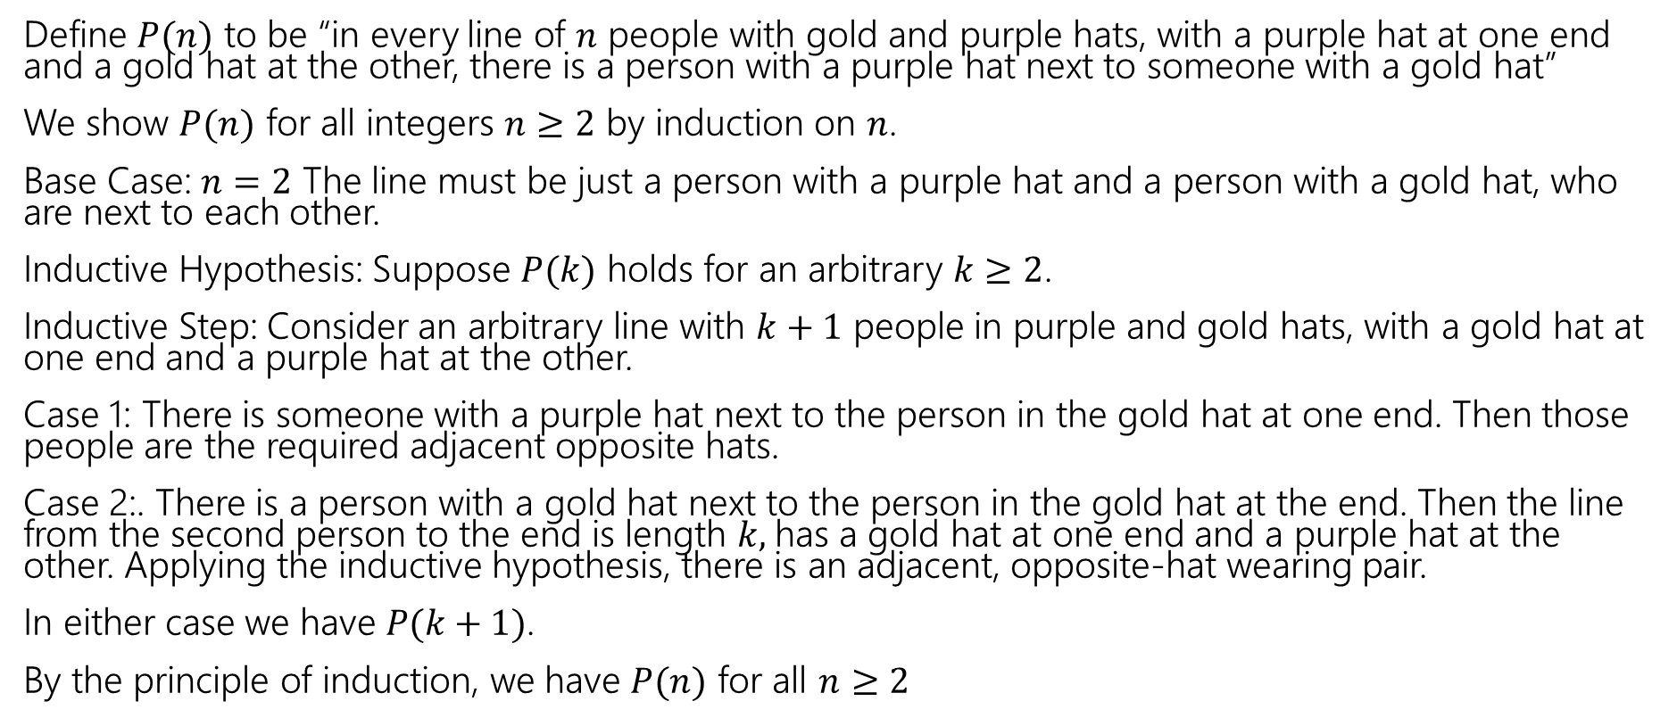
Induction: Hats!
Define $P(n)$ to be “in every line of $n$ people with gold and purple hats, with a purple hat at one end and a gold hat at the other, there is a person with a purple hat next to someone with a gold hat”
We show $P(n)$ for all integers $n≥2$ by induction on $n$.
Base Case: $n=2$ The line must be just a person with a purple hat and a person with a gold hat, who are next to each other.
Inductive Hypothesis: Suppose $P(k)$ holds for an arbitrary $k≥2$.
Inductive Step: Consider an arbitrary line with $k+1$ people in purple and gold hats, with a gold hat at one end and a purple hat at the other.
Case 1: There is someone with a purple hat next to the person in the gold hat at one end. Then those people are the required adjacent opposite hats.
Case 2:. There is a person with a gold hat next to the person in the gold hat at the end. Then the line from the second person to the end is length $k,$has a gold hat at one end and a purple hat at the other. Applying the inductive hypothesis, there is an adjacent, opposite-hat wearing pair.
In either case we have $P(k+1)$.
By the principle of induction, we have $P(n)$ for all $n≥2$

Slide 20

Fibonacci Inequality Two
$$f\left(0\right)=1; f\left(1\right)=1$$
$f\left(n\right)=f\left(n−1\right)+f(n−2)$ for all $n∈ℕ, n≥2.$
Show that $f\left(n\right)≥2^{n/2}$ for all $n≥2$by induction.
[Define $P(n)$]
Base Cases:
Inductive Hypothesis:
Inductive step:
Therefore, we have $P(n)$ for all $n≥0$ by the principle of induction.

Slide 21
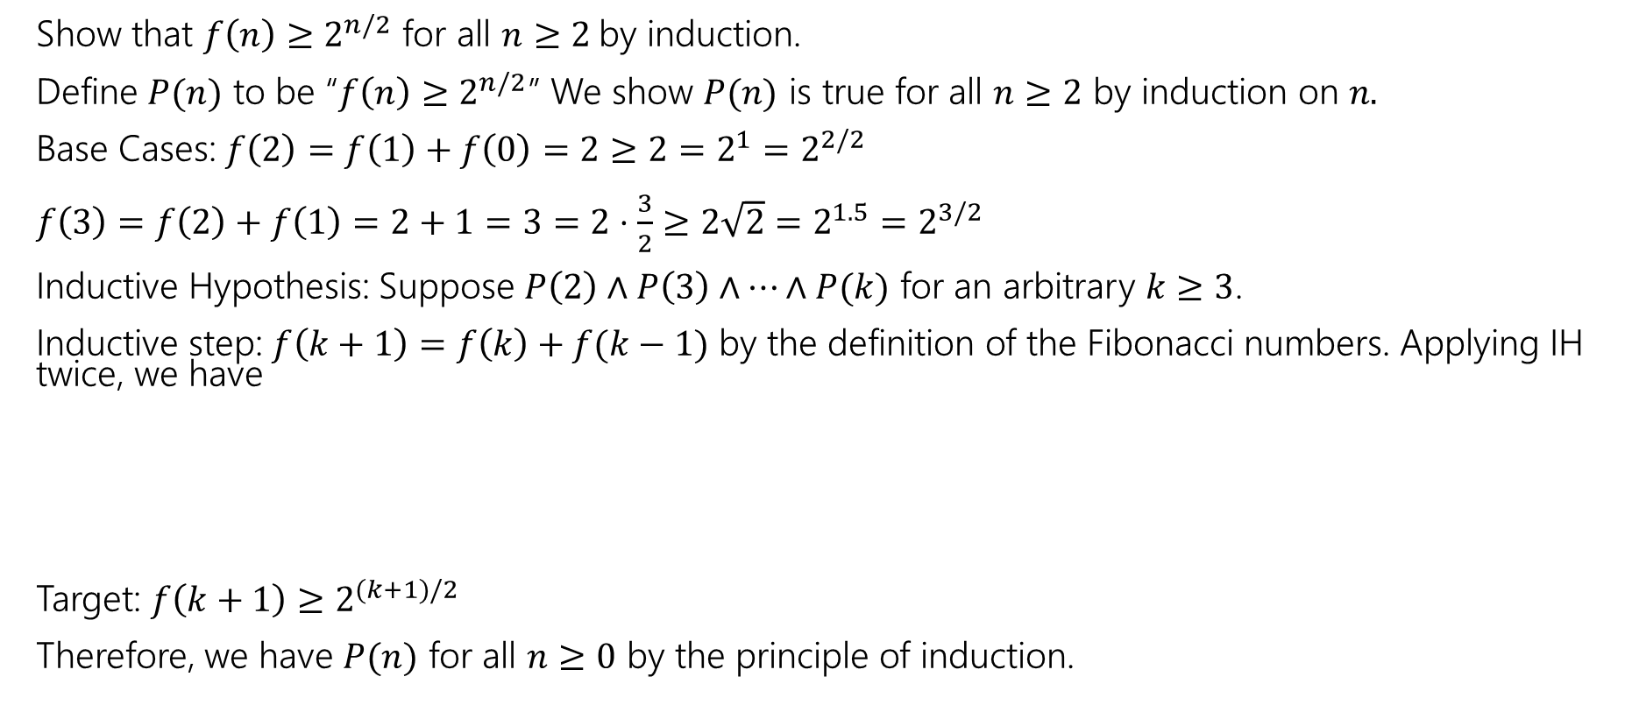
Fibonacci Inequality Two
$$f\left(0\right)=1; f\left(1\right)=1$$
$f\left(n\right)=f\left(n−1\right)+f(n−2)$ for all $n∈ℕ, n≥2.$
Show that $f\left(n\right)≥2^{n/2}$ for all $n≥2$by induction.
Define $P(n)$ to be “$f\left(n\right)≥2^{n/2}$” We show $P(n)$ is true for all $n≥2$ by induction on $n.$
Base Cases: $f\left(2\right)=f\left(1\right)+f\left(0\right)=2≥2=2^{1}=2^{2/2}$
$f\left(3\right)=f\left(2\right)+f\left(1\right)=2+1=3=2⋅\frac{3}{2}≥2\sqrt{2}=2^{1.5}=2^{3/2}$
Inductive Hypothesis: Suppose $P\left(2\right)∧P\left(3\right)∧⋯∧P(k)$ for an arbitrary $k≥3$.
Inductive step: $f\left(k+1\right)=f\left(k\right)+f(k−1)$ by the definition of the Fibonacci numbers. Applying IH twice, we have
Target: $f\left(k+1\right)≥2^{(k+1)/2}$
Therefore, we have $P(n)$ for all $n≥0$ by the principle of induction.

Slide 22
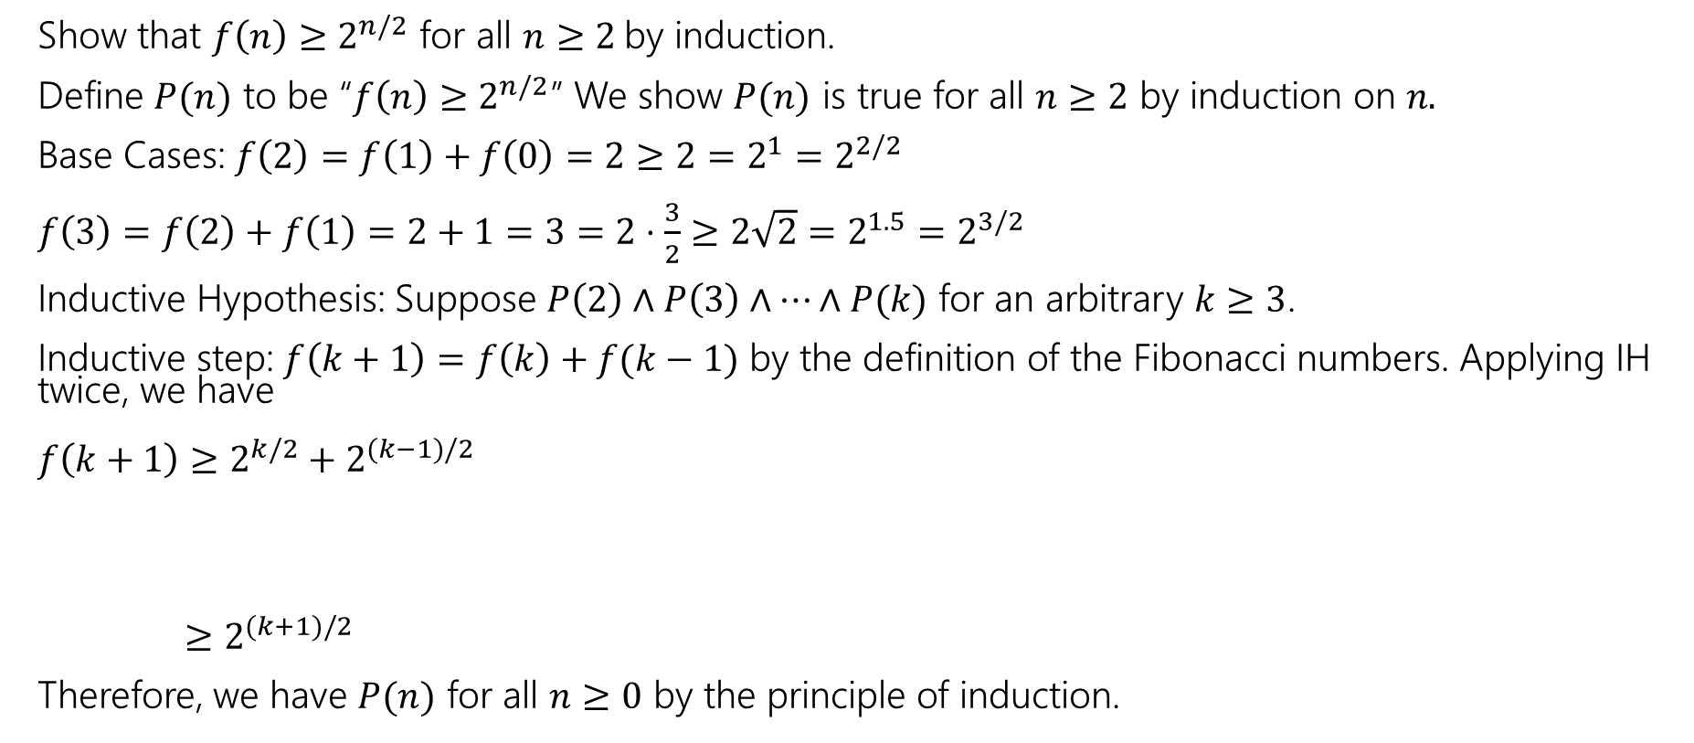
Fibonacci Inequality Two
$$f\left(0\right)=1; f\left(1\right)=1$$
$f\left(n\right)=f\left(n−1\right)+f(n−2)$ for all $n∈ℕ, n≥2.$
Show that $f\left(n\right)≥2^{n/2}$ for all $n≥2$by induction.
Define $P(n)$ to be “$f\left(n\right)≥2^{n/2}$” We show $P(n)$ is true for all $n≥2$ by induction on $n.$
Base Cases: $f\left(2\right)=f\left(1\right)+f\left(0\right)=2≥2=2^{1}=2^{2/2}$
$f\left(3\right)=f\left(2\right)+f\left(1\right)=2+1=3=2⋅\frac{3}{2}≥2\sqrt{2}=2^{1.5}=2^{3/2}$
Inductive Hypothesis: Suppose $P\left(2\right)∧P\left(3\right)∧⋯∧P(k)$ for an arbitrary $k≥3$.
Inductive step: $f\left(k+1\right)=f\left(k\right)+f(k−1)$ by the definition of the Fibonacci numbers. Applying IH twice, we have
$f\left(k+1\right)≥2^{k/2}+2^{(k−1)/2}$
$≥2^{(k+1)/2}$
Therefore, we have $P(n)$ for all $n≥0$ by the principle of induction.

Slide 23
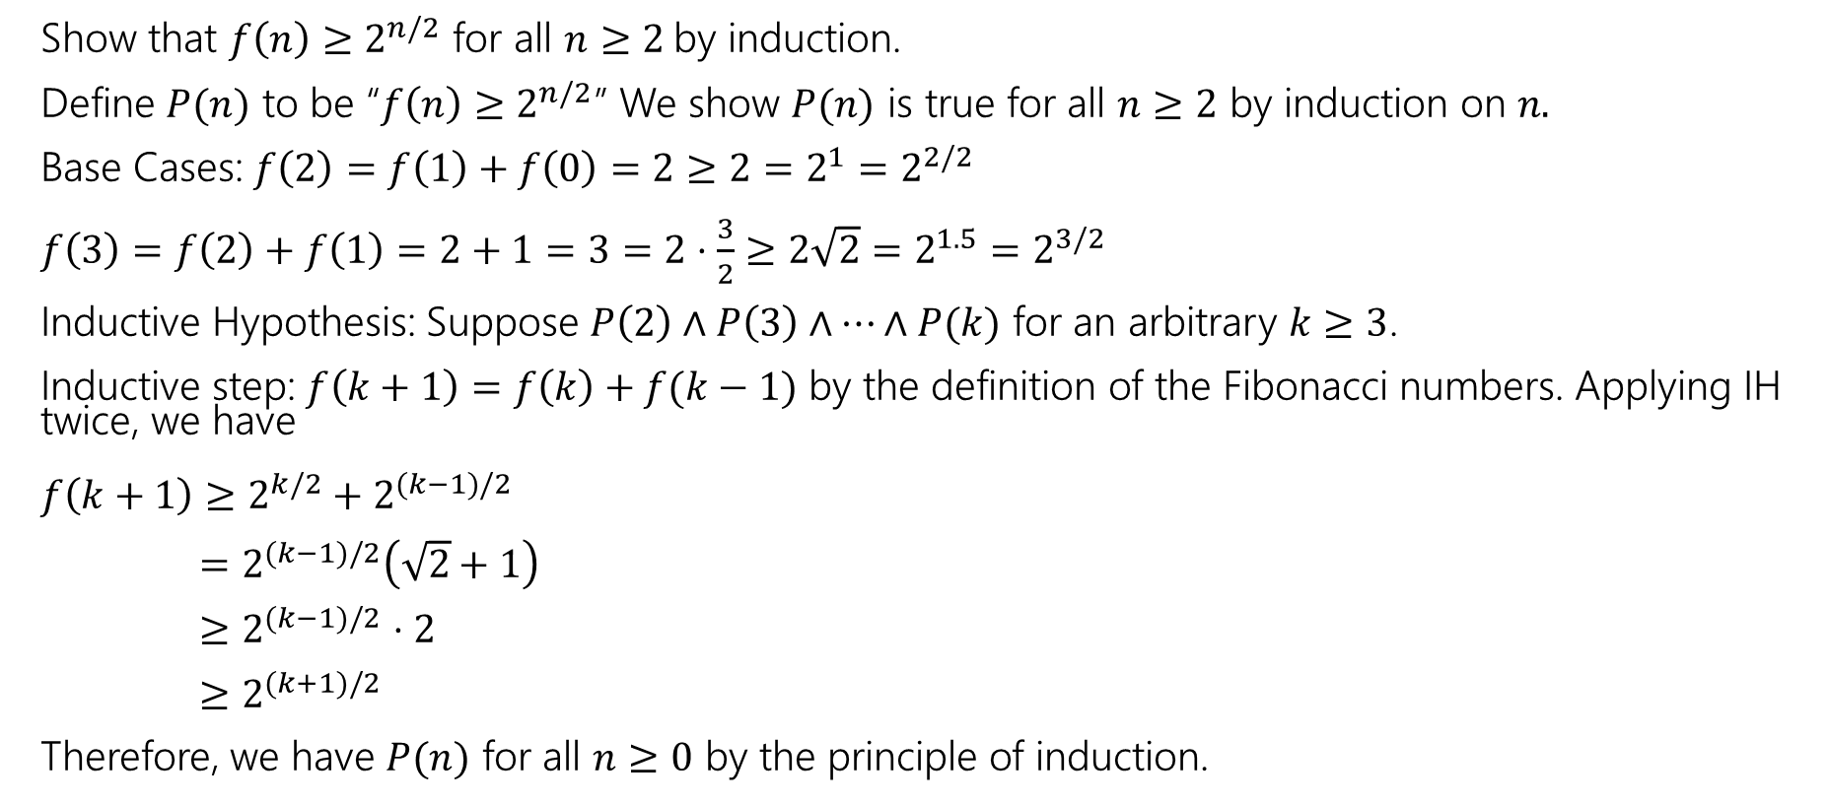
Fibonacci Inequality Two
$$f\left(0\right)=1; f\left(1\right)=1$$
$f\left(n\right)=f\left(n−1\right)+f(n−2)$ for all $n∈ℕ, n≥2.$
Show that $f\left(n\right)≥2^{n/2}$ for all $n≥2$by induction.
Define $P(n)$ to be “$f\left(n\right)≥2^{n/2}$” We show $P(n)$ is true for all $n≥2$ by induction on $n.$
Base Cases: $f\left(2\right)=f\left(1\right)+f\left(0\right)=2≥2=2^{1}=2^{2/2}$
$f\left(3\right)=f\left(2\right)+f\left(1\right)=2+1=3=2⋅\frac{3}{2}≥2\sqrt{2}=2^{1.5}=2^{3/2}$
Inductive Hypothesis: Suppose $P\left(2\right)∧P\left(3\right)∧⋯∧P(k)$ for an arbitrary $k≥3$.
Inductive step: $f\left(k+1\right)=f\left(k\right)+f(k−1)$ by the definition of the Fibonacci numbers. Applying IH twice, we have
$f\left(k+1\right)≥2^{k/2}+2^{(k−1)/2}$
$=2^{(k−1)/2}\left(\sqrt{2}+1\right)$
$≥2^{(k−1)/2}$ $⋅2$
$≥2^{(k+1)/2}$
Therefore, we have $P(n)$ for all $n≥0$ by the principle of induction.

Slide 24
More Practice

Slide 25

Even More Induction Practice
Let $g\left(n\right)= \left\{\begin{aligned}1 if n=0 \\ n⋅g\left(n−1\right) otherwise\end{aligned}\right.$
Let $h\left(n\right)=n^{n}$
Claim: $h\left(n\right)≥g\left(n\right)$ for all integers $n≥1$

Slide 26
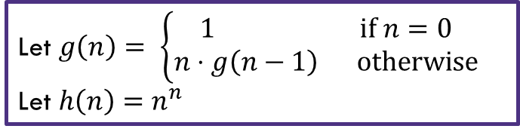

Even More Induction Practice
Define $P\left(n\right)$ to be “$h\left(n\right)≥g(n)$ for all integers $n≥1$
We show $P(n)$ for all $n≥1$ by induction on $n.$
Base Case
Inductive Hypothesis:
Inductive Step:
Thus $P\left(k+1\right)$ holds.
Therefore, we have $P(n)$ for all $n≥1$ by induction on $n.$
Let $g\left(n\right)= \left\{\begin{aligned}1 if n=0 \\ n⋅g\left(n−1\right) otherwise\end{aligned}\right.$
Let $h\left(n\right)=n^{n}$

Slide 27
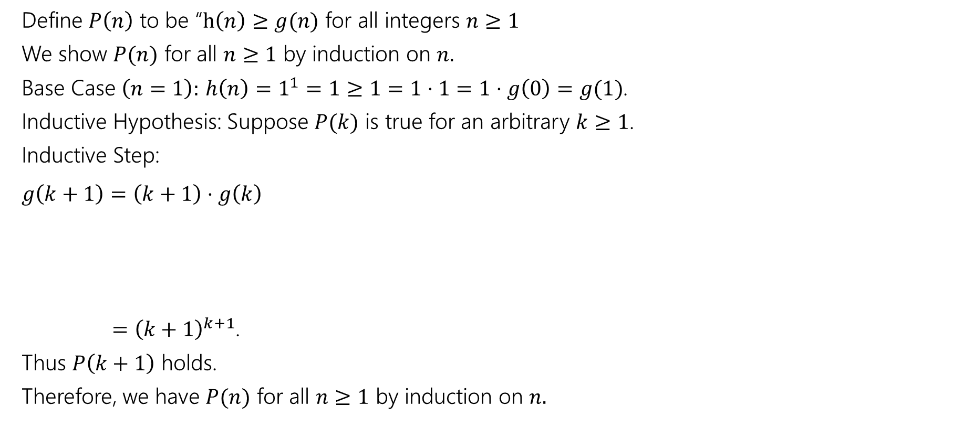
Even More Induction Practice
Define $P\left(n\right)$ to be “$h\left(n\right)≥g(n)$ for all integers $n≥1$
We show $P(n)$ for all $n≥1$ by induction on $n.$
Base Case $\left(n=1\right):$ $h\left(n\right)=1^{1}=1≥1=1⋅1=1⋅g\left(0\right)=g(1)$.
Inductive Hypothesis: Suppose $P(k)$ is true for an arbitrary $k≥1$.
Inductive Step:
$g\left(k+1\right)=\left(k+1\right)⋅g\left(k\right)$
$={\left(k+1\right)}^{k+1}$.
Thus $P\left(k+1\right)$ holds.
Therefore, we have $P(n)$ for all $n≥1$ by induction on $n.$
Let $g\left(n\right)= \left\{\begin{aligned}1 if n=0 \\ n⋅g\left(n−1\right) otherwise\end{aligned}\right.$
Let $h\left(n\right)=n^{n}$

Slide 28
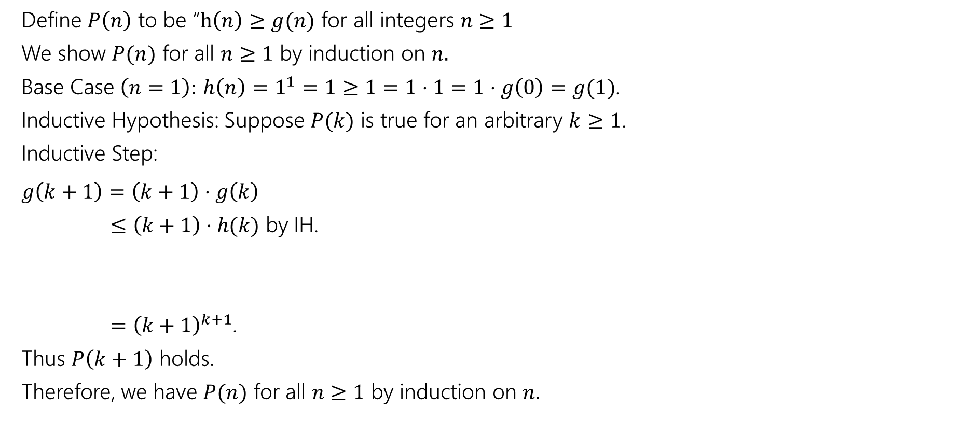
Even More Induction Practice
Define $P\left(n\right)$ to be “$h\left(n\right)≥g(n)$ for all integers $n≥1$
We show $P(n)$ for all $n≥1$ by induction on $n.$
Base Case $\left(n=1\right):$ $h\left(n\right)=1^{1}=1≥1=1⋅1=1⋅g\left(0\right)=g(1)$.
Inductive Hypothesis: Suppose $P(k)$ is true for an arbitrary $k≥1$.
Inductive Step:
$g\left(k+1\right)=\left(k+1\right)⋅g\left(k\right)$
$≤\left(k+1\right)⋅h(k)$ by IH.
$={\left(k+1\right)}^{k+1}$.
Thus $P\left(k+1\right)$ holds.
Therefore, we have $P(n)$ for all $n≥1$ by induction on $n.$
Let $g\left(n\right)= \left\{\begin{aligned}1 if n=0 \\ n⋅g\left(n−1\right) otherwise\end{aligned}\right.$
Let $h\left(n\right)=n^{n}$

Slide 29
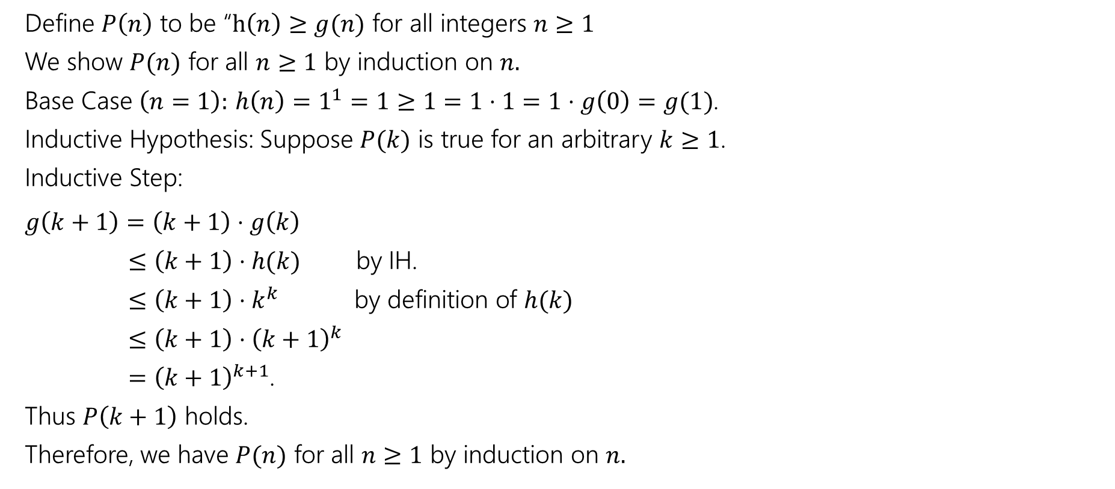
Even More Induction Practice
Define $P\left(n\right)$ to be “$h\left(n\right)≥g(n)$ for all integers $n≥1$
We show $P(n)$ for all $n≥1$ by induction on $n.$
Base Case $\left(n=1\right):$ $h\left(n\right)=1^{1}=1≥1=1⋅1=1⋅g\left(0\right)=g(1)$.
Inductive Hypothesis: Suppose $P(k)$ is true for an arbitrary $k≥1$.
Inductive Step:
$g\left(k+1\right)=\left(k+1\right)⋅g\left(k\right)$
$≤\left(k+1\right)⋅h(k)$ by IH.
$≤\left(k+1\right)⋅k^{k}$ by definition of $h(k)$
$≤\left(k+1\right)⋅{\left(k+1\right)}^{k}$
$={\left(k+1\right)}^{k+1}$.
Thus $P\left(k+1\right)$ holds.
Therefore, we have $P(n)$ for all $n≥1$ by induction on $n.$
Let $g\left(n\right)= \left\{\begin{aligned}1 if n=0 \\ n⋅g\left(n−1\right) otherwise\end{aligned}\right.$
Let $h\left(n\right)=n^{n}$

Slide 30
Even More Induction Practice
Define $P\left(n\right)$ to be “$h\left(n\right)≥g(n)$ for all integers $n≥1$
We show $P(n)$ for all $n≥1$ by induction on $n.$
Base Case $\left(n=1\right):$ $h\left(n\right)=1^{1}=1≥1=1⋅1=1⋅g\left(0\right)=g(1)$.
Inductive Hypothesis: Suppose $P(k)$ is true for an arbitrary $k≥1$.
Inductive Step:
$g\left(k+1\right)=\left(k+1\right)⋅g\left(k\right)$
$≤\left(k+1\right)⋅h(k)$ by IH.
$≤\left(k+1\right)⋅k^{k}$ by definition of $h(k)$
$≤\left(k+1\right)⋅{\left(k+1\right)}^{k}$
$={\left(k+1\right)}^{k+1}$.
Thus $P\left(k+1\right)$ holds.
Therefore, we have $P(n)$ for all $n≥1$ by induction on $n.$
Let $g\left(n\right)= \left\{\begin{aligned}1 if n=0 \\ n⋅g\left(n−1\right) otherwise\end{aligned}\right.$
Let $h\left(n\right)=n^{n}$

Slide 31

Even More Induction Practice: Sums
Let $P(n)$ be $\sum_{i=0}^{n}{2+3i}=\frac{\left(n+1\right)\left(3n+4\right)}{2}$
Show $P(n)$ for all $n∈ℕ$ by induction on $n$.
Base Case ($n=0)$:
Inductive Hypothesis:
Inductive Step:
[Conclusion]

Slide 32
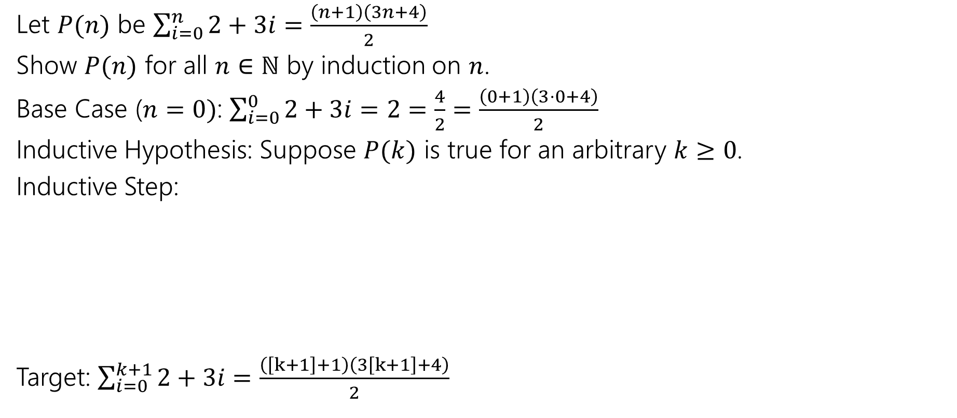
Even More Induction Practice: Sums
Let $P(n)$ be $\sum_{i=0}^{n}{2+3i}=\frac{\left(n+1\right)\left(3n+4\right)}{2}$
Show $P(n)$ for all $n∈ℕ$ by induction on $n$.
Base Case ($n=0)$: $\sum_{i=0}^{0}{2+3i}=2=\frac{4}{2}=\frac{\left(0+1\right)\left(3⋅0+4\right)}{2}$
Inductive Hypothesis: Suppose $P(k)$ is true for an arbitrary $k≥0$.
Inductive Step:
Target: $\sum_{i=0}^{k+1}{2+3i}=\frac{\left(\left[k+1\right]+1\right)\left(3\left[k+1\right]+4\right)}{2}$

Slide 33
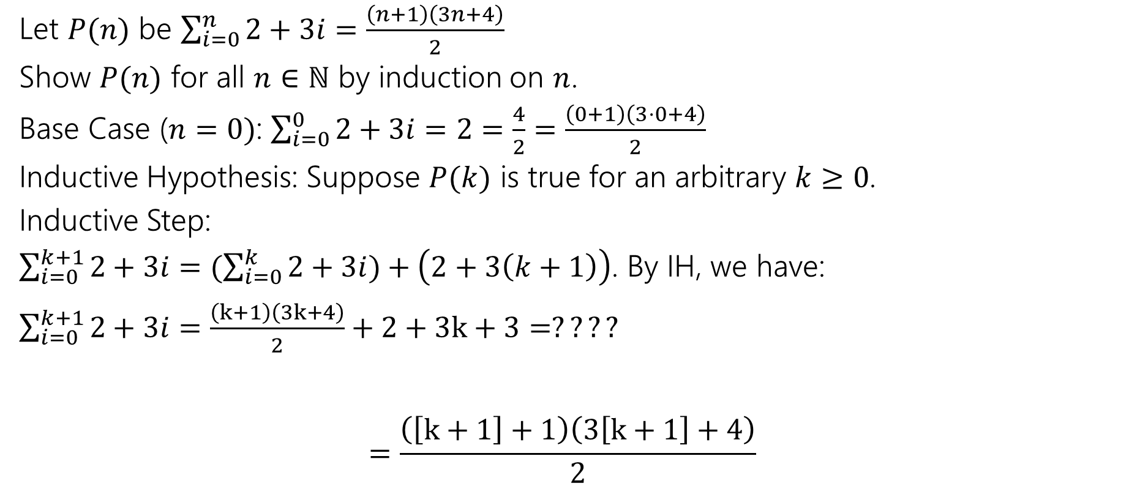
Even More Induction Practice: Sums
Let $P(n)$ be $\sum_{i=0}^{n}{2+3i}=\frac{\left(n+1\right)\left(3n+4\right)}{2}$
Show $P(n)$ for all $n∈ℕ$ by induction on $n$.
Base Case ($n=0)$: $\sum_{i=0}^{0}{2+3i}=2=\frac{4}{2}=\frac{\left(0+1\right)\left(3⋅0+4\right)}{2}$
Inductive Hypothesis: Suppose $P(k)$ is true for an arbitrary $k≥0$.
Inductive Step:
$\sum_{i=0}^{k+1}{2+3i}=(\sum_{i=0}^{k}{2+3i})+\left(2+3\left(k+1\right)\right)$. By IH, we have:
$\sum_{i=0}^{k+1}{2+3i}=\frac{\left(k+1\right)\left(3k+4\right)}{2}+2+3k+3=????$
$=\frac{\left(\left[k+1\right]+1\right)\left(3\left[k+1\right]+4\right)}{2}$

Slide 34
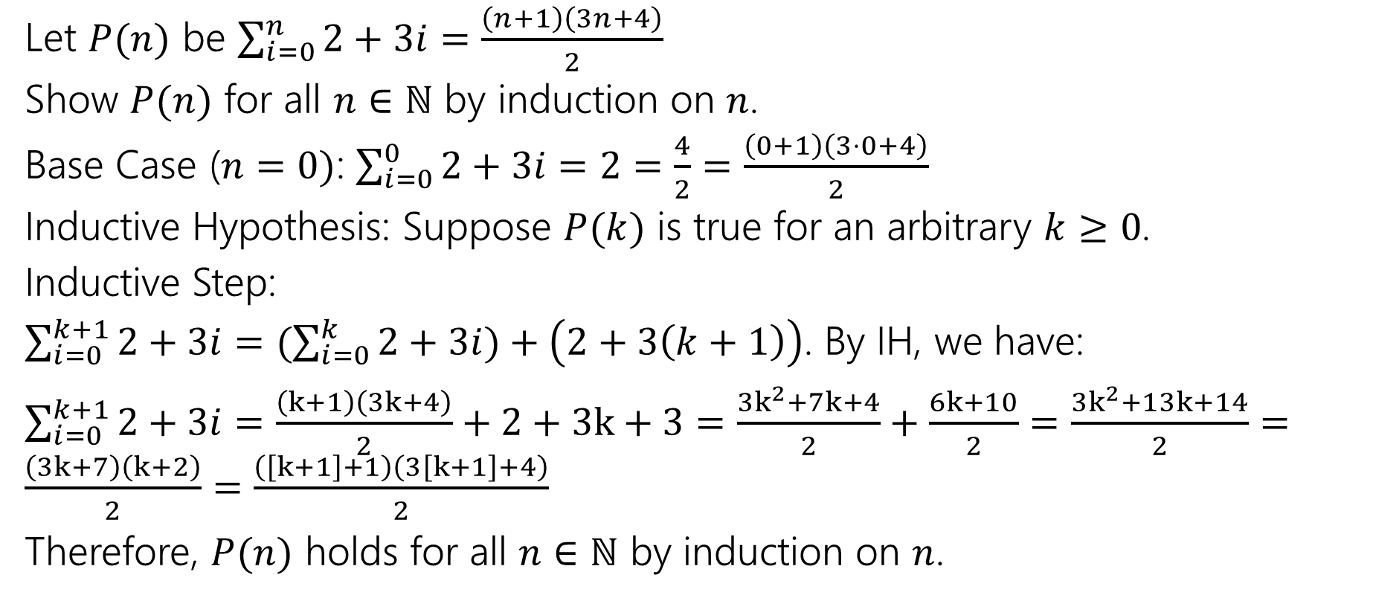
Even More Induction Practice: Sums
Let $P(n)$ be $\sum_{i=0}^{n}{2+3i}=\frac{\left(n+1\right)\left(3n+4\right)}{2}$
Show $P(n)$ for all $n∈ℕ$ by induction on $n$.
Base Case ($n=0)$: $\sum_{i=0}^{0}{2+3i}=2=\frac{4}{2}=\frac{\left(0+1\right)\left(3⋅0+4\right)}{2}$
Inductive Hypothesis: Suppose $P(k)$ is true for an arbitrary $k≥0$.
Inductive Step:
$\sum_{i=0}^{k+1}{2+3i}=(\sum_{i=0}^{k}{2+3i})+\left(2+3\left(k+1\right)\right)$. By IH, we have:
$\sum_{i=0}^{k+1}{2+3i}=\frac{\left(k+1\right)\left(3k+4\right)}{2}+2+3k+3=\frac{3k^{2}+7k+4}{2}+\frac{6k+10}{2}=\frac{3k^{2}+13k+14}{2}=\frac{\left(3k+7\right)\left(k+2\right)}{2}=\frac{\left(\left[k+1\right]+1\right)\left(3\left[k+1\right]+4\right)}{2}$
Therefore, $P(n)$ holds for all $n∈ℕ$ by induction on $n$.

