Slide 1
Extended Euclidian Algorithm
Section 5

Slide 2
Euclid’s Algorithm
while(n != 0) {
int rem = m % n;
m=n;
n=rem;
}
gcd(660,126)

Slide 3
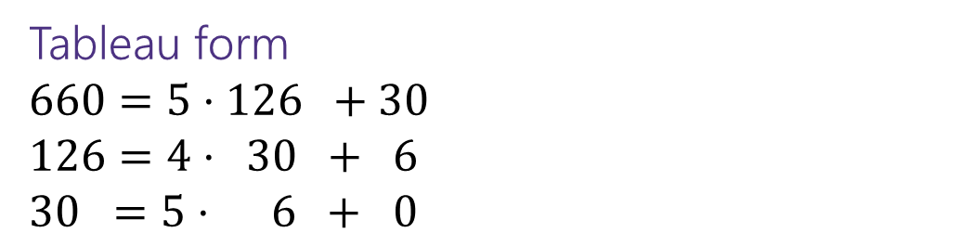
Euclid’s Algorithm
while(n != 0) {
int rem = m % n;
m=n;
n=rem;
}
gcd(660,126)
= gcd(126, 660 mod 126) = gcd(126, 30)
= gcd(30, 126 mod 30) = gcd(30, 6)
= gcd(6, 30 mod 6) = gcd(6, 0)
= 6
Tableau form
$660=5⋅126 +30$
$126=4⋅ 30 + 6$
$30 =5⋅ 6 + 0$
Starting Numbers
Final answer

Slide 4
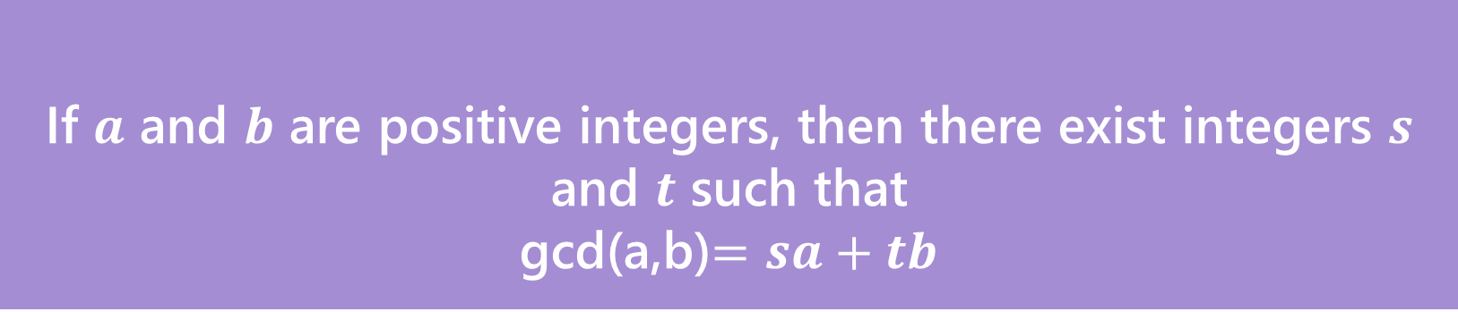
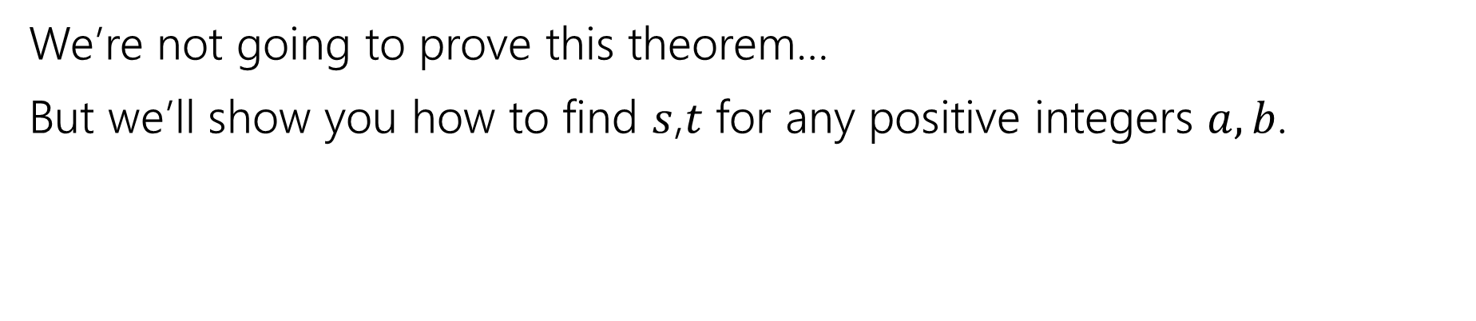
Bézout’s Theorem
If $a$ and $b$ are positive integers, then there exist integers $s$ and $t$ such that
gcd(a,b)$=sa+tb$
Bézout’s Theorem
We’re not going to prove this theorem…
But we’ll show you how to find $s$,$t$ for any positive integers $a,b$.

Slide 5
Extended Euclidian Algorithm
Step 1 compute gcd(a,b); keep tableau information.
Step 2 solve all equations for the remainder.
Step 3 substitute backward
gcd(35,27)

Slide 6

Extended Euclidian Algorithm
Step 1 compute gcd(a,b); keep tableau information.
Step 2 solve all equations for the remainder.
Step 3 substitute backward
gcd(35,27) = gcd(27, 35%27) = gcd(27,8)
= gcd(8, 27%8) = gcd(8, 3)
= gcd(3, 8%3) = gcd(3, 2)
= gcd(2, 3%2) = gcd(2,1)
= gcd(1, 2%1) = gcd(1,0)
$35=1⋅ 27 +8$
$27=3⋅ 8 +3$
$8 =2⋅ 3 +2$
$3 =$ $1⋅ 2 +1$

Slide 7

Extended Euclidian Algorithm
Step 1 compute gcd(a,b); keep tableau information.
Step 2 solve all equations for the remainder.
Step 3 substitute backward
$35=1⋅ 27 +8$
$27=3⋅ 8 +3$
$8 =2⋅ 3 +2$
$3 =$ $1⋅ 2 +1$

Slide 8

Extended Euclidian Algorithm
Step 1 compute gcd(a,b); keep tableau information.
Step 2 solve all equations for the remainder.
Step 3 substitute backward
$35=1⋅ 27 +8$
$27=3⋅ 8 +3$
$8 =2⋅ 3 +2$
$3 =$ $1⋅ 2 +1$
$8=35 − 1⋅ 27$
$$3=27 − 3⋅ 8$$
$2 =8 − 2⋅ 3$
$1 =$ $3 − 1⋅ 2$

Slide 9

Extended Euclidian Algorithm
Step 1 compute gcd(a,b); keep tableau information.
Step 2 solve all equations for the remainder.
Step 3 substitute backward
$8=35 − 1⋅ 27$
$$3=27 − 3⋅ 8$$
$2 =8 − 2⋅ 3$
$1 =$ $3 − 1⋅ 2$

Slide 10
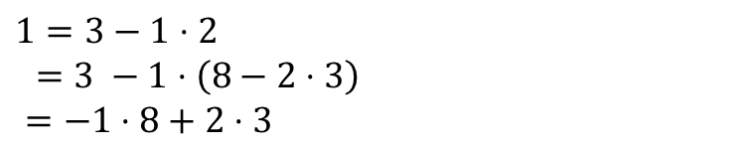
Extended Euclidian Algorithm
Step 1 compute gcd(a,b); keep tableau information.
Step 2 solve all equations for the remainder.
Step 3 substitute backward
$1=3−1⋅2$
$=3 −1⋅\left(8−2⋅3\right)$
$=−1⋅8+2⋅3$
$8=35 − 1⋅ 27$
$$3=27 − 3⋅ 8$$
$2 =8 − 2⋅ 3$
$1 =$ $3 − 1⋅ 2$

Slide 11


Extended Euclidian Algorithm
Step 1 compute gcd(a,b); keep tableau information.
Step 2 solve all equations for the remainder.
Step 3 substitute backward
When substituting back, you keep the larger of $m,n$ and the number you just substituted.
Don’t simplify further! (or you lose the form you need)
$1=3−1⋅2$
$=3 −1⋅\left(8−2⋅3\right)$
$=−1⋅8+3⋅3$
$=−1⋅8+3\left(27−3⋅8\right)$
$=3⋅27−10⋅8$
$=3⋅27−10(35−1⋅27)$
$=13⋅27−10⋅35$
$8=35 − 1⋅ 27$
$$3=27 − 3⋅ 8$$
$2 =8 − 2⋅ 3$
$1 =$ $3 − 1⋅ 2$
gcd(27,35) = $13⋅27+\left(−10\right)⋅35$

Slide 12

Try it
Solve the equation $7y≡3(mod 26)$
What do we need to find?
The multiplicative inverse of $7(mod 26)$

Slide 13
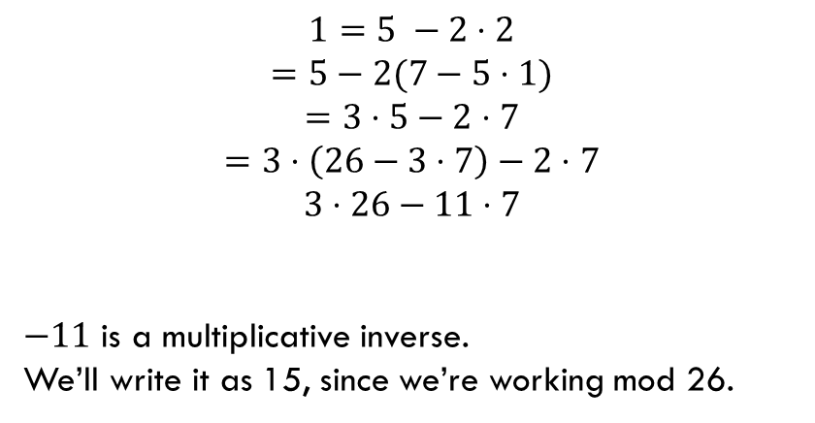
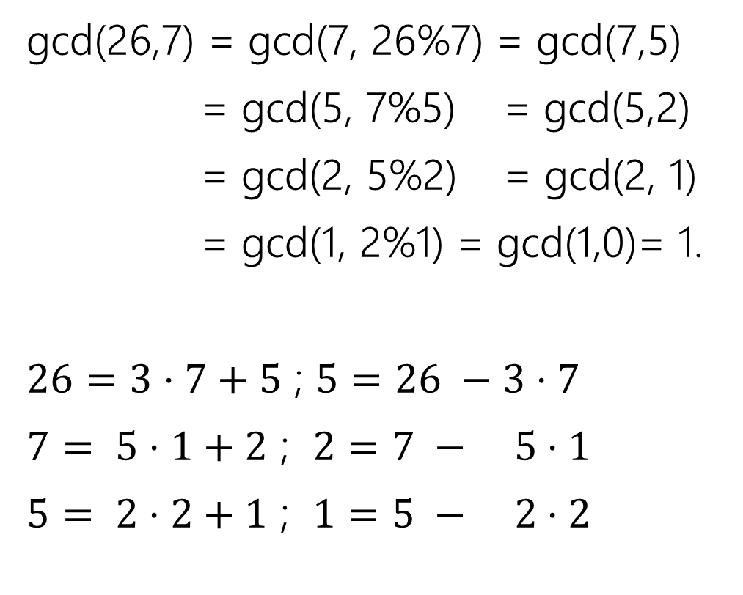
Finding the inverse…
gcd(26,7) = gcd(7, 26%7) = gcd(7,5)
= gcd(5, 7%5) = gcd(5,2)
= gcd(2, 5%2) = gcd(2, 1)
= gcd(1, 2%1) = gcd(1,0)= 1.
$26=3⋅7+5$ ; $5=26 −3⋅7$
$7= 5⋅1+2$ ; $2=7 − 5⋅1$
$5= 2⋅2+1$ ; $1=5 − 2⋅2$
$$1=5 −2⋅2$$
$$=5−2(7−5⋅1)$$
$$=3⋅5−2⋅7$$
$$=3⋅\left(26−3⋅7\right)−2⋅7$$
$$3⋅26−11⋅7$$
$−11$ is a multiplicative inverse.
We’ll write it as 15, since we’re working mod 26.

Slide 14
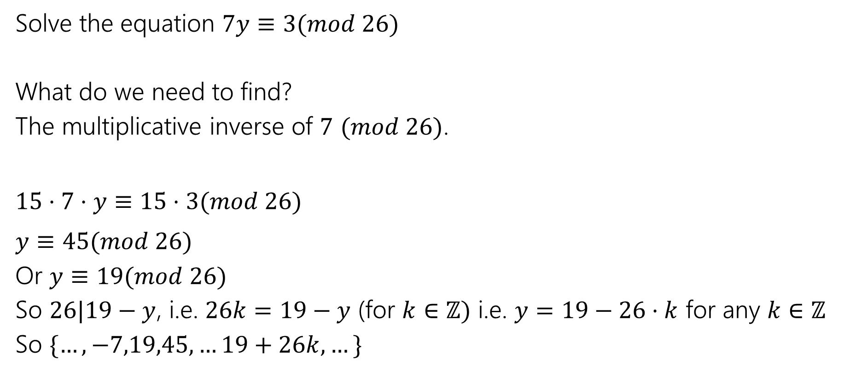
Try it
Solve the equation $7y≡3(mod 26)$
What do we need to find?
The multiplicative inverse of $7$ $(mod 26)$.
$15⋅7⋅y≡15⋅3(mod 26)$
$y≡45(mod 26)$
Or $y≡19(mod 26)$
So $26|19−y$, i.e. $26k=19−y$ (for $k∈ℤ)$ i.e. $y=19−26⋅k$ for any $k∈ℤ$
So $\{…,−7,19,45,…19+26k,…\}$

