Slide 1
Uncountability
CSE 311 Winter 2022
Lecture 27

Slide 2
Announcements
There will be a review session Saturday at 1 PM in CSE2 G01.
We’ll try to make a recording somehow. But panopto doesn’t work for special meetings like this :/
Final review materials are on the webpage!

Slide 3
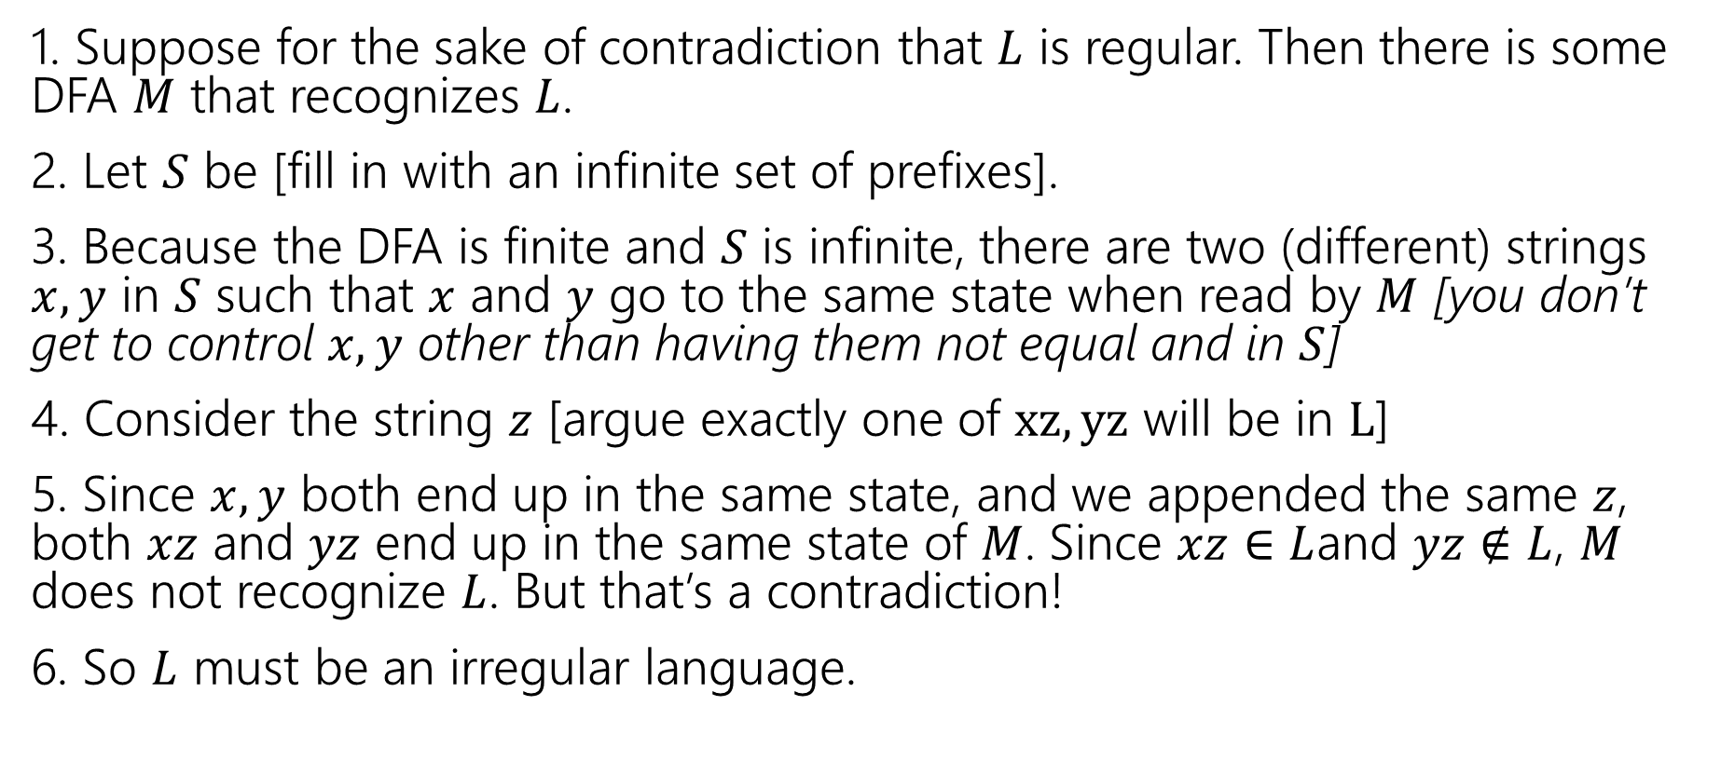
Full outline
1. Suppose for the sake of contradiction that $L$ is regular. Then there is some DFA $M$ that recognizes $L$.
2. Let $S$ be [fill in with an infinite set of prefixes].
3. Because the DFA is finite and $S$ is infinite, there are two (different) strings $x,y$ in $S$ such that $x$ and $y$ go to the same state when read by $M$ [you don’t get to control $x,y$ other than having them not equal and in $S$]
4. Consider the string $z$ [argue exactly one of $xz, yz$ will be in $L$]
5. Since $x,y$ both end up in the same state, and we appended the same $z$, both $xz$ and $yz$ end up in the same state of $M$. Since $xz∈$ $L$and $yz∉L$, $M$ does not recognize $L$. But that’s a contradiction!
6. So $L$ must be an irregular language.

Slide 4
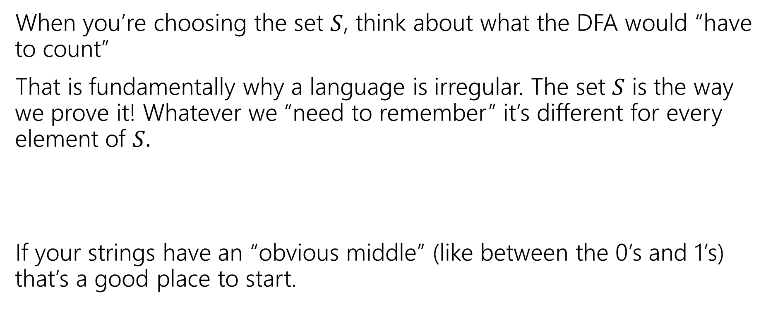
Practical Tips
When you’re choosing the set $S$, think about what the DFA would “have to count”
That is fundamentally why a language is irregular. The set $S$ is the way we prove it! Whatever we “need to remember” it’s different for every element of $S.$
If your strings have an “obvious middle” (like between the 0’s and 1’s) that’s a good place to start.

Slide 5

Let’s Try another
The set of strings with balanced parentheses is not regular.
What do you want $S$to be? What would you have to count?
The number of unclosed parentheses.
Let $S=$…

Slide 6
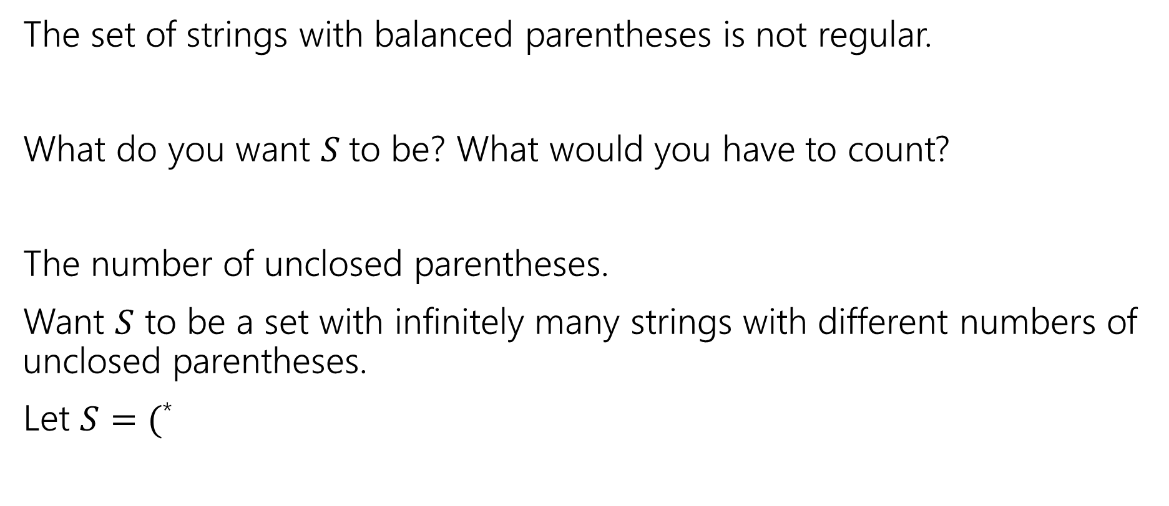
Let’s Try another
The set of strings with balanced parentheses is not regular.
What do you want $S$to be? What would you have to count?
The number of unclosed parentheses.
Want $S$ to be a set with infinitely many strings with different numbers of unclosed parentheses.
Let $S=($*

Slide 7
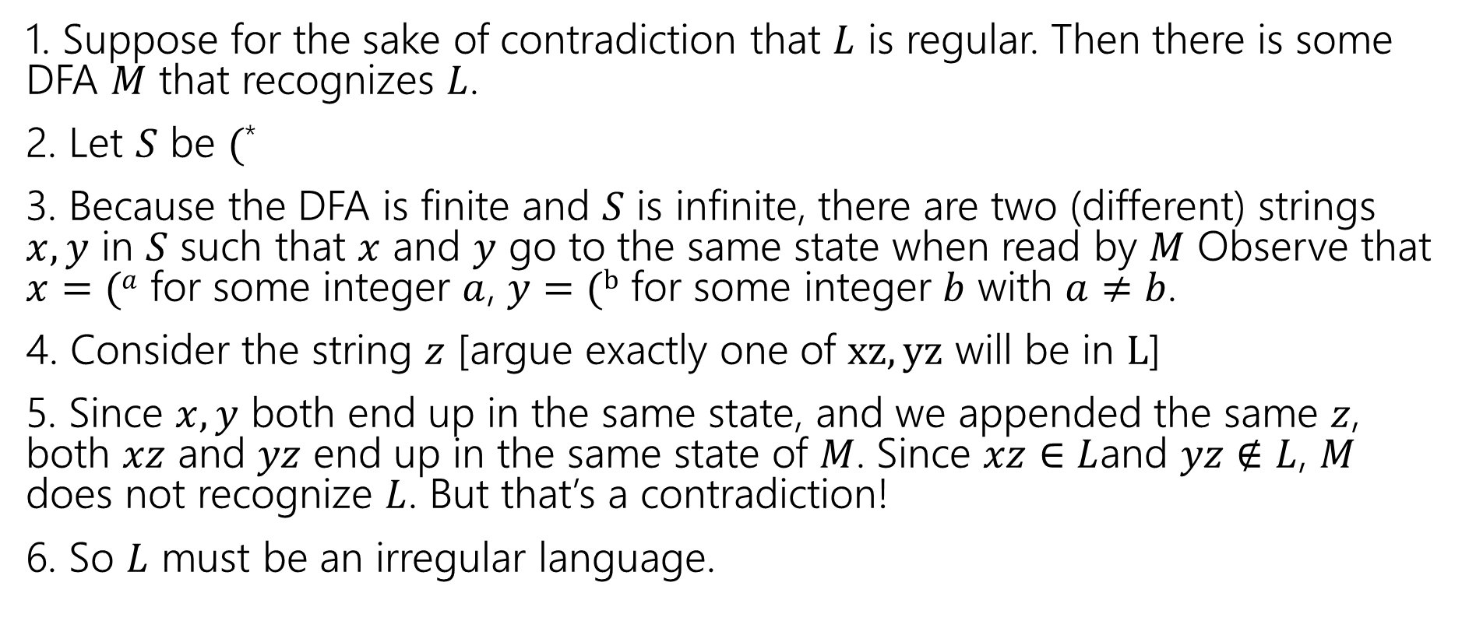

Outline for $(^{∗}$
1. Suppose for the sake of contradiction that $L$ is regular. Then there is some DFA $M$ that recognizes $L$.
2. Let $S$ be $($*
3. Because the DFA is finite and $S$ is infinite, there are two (different) strings $x,y$ in $S$ such that $x$ and $y$ go to the same state when read by $M$ Observe that $x=(a$ for some integer $a$, $y=(b$ for some integer $b$ with $a≠b$.
4. Consider the string $z$ [argue exactly one of $xz, yz$ will be in $L$]
5. Since $x,y$ both end up in the same state, and we appended the same $z$, both $xz$ and $yz$ end up in the same state of $M$. Since $xz∈$ $L$and $yz∉L$, $M$ does not recognize $L$. But that’s a contradiction!
6. So $L$ must be an irregular language.

Slide 8
Punchline for Today’s Lecture
There are more functions than there are computer programs.
So for some functions there just isn’t a computer program that computes it.

Slide 9
Outline
Some definitions – what do we mean by “more”?
How many programs are there?
Proving there are more functions.

Slide 10

Sizes of sets
How do we know two sets are the same size?
Easy. Count the number of elements in both.
That works great for finite sets, but $∞$ isn’t really a number we get to count to…

Slide 11










More Practical
What does it mean that two sets have the same size?

Slide 12

More Practical
What does it mean that two sets have the same size?

Slide 13


Bijection
A function $f:A→B$ maps every element of $A$ to one element of $B$
$A$ is the “domain”, $B$ is the “co-domain”
That is, every output has at most one possible input.
A function $f$ is one-to-one iff
$$∀a∀b(f\left(a\right)=f\left(b\right)→a=b)$$
One-to-one (aka injection)

Slide 14


Bijection
A function $f:A→B$ maps every element of $A$ to one element of $B$
$A$ is the “domain”, $B$ is the “co-domain”
Every output has at least one input that maps to it.
A function $f:A→B$ is onto iff
$$∀b∈B∃a∈A(b=f(a))$$
Onto (aka surjection)

Slide 15
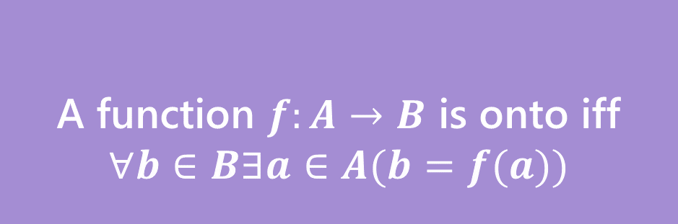


Bijection
A function $f$ is one-to-one iff
$$∀a∀b(f\left(a\right)=f\left(b\right)→a=b)$$
A function $f:A→B$ is onto iff
$$∀b∈B∃a∈A(b=f(a))$$
One-to-one (aka injection)
Onto (aka surjection)
A function $f:A→B$ is a bijection iff
$f$ is one-to-one and onto
Bijection
A bijection maps every element of the domain to exactly one element of the co-domain, and every element of the domain to exactly one element of the domain.

Slide 16
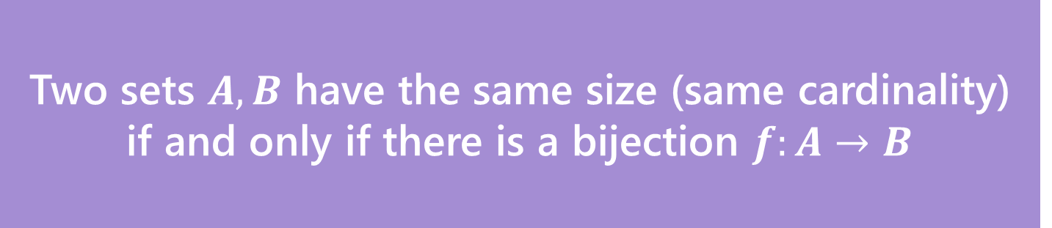
Definition
Two sets $A,B$ have the same size (same cardinality) if and only if there is a bijection $f:A→B$
This matches our intuition on finite sets.
But it also works for infinite sets!
Let’s see just how infinite these sets are.

Slide 17
Some infinite sets
Two sets $A,B$ have the same size (same cardinality) if and only if there is a bijection $f:A→B$
Let’s compare the sizes of: $ℕ$, $ℤ,$ $\{x :x$is an even integer$\}$
Pollev.com/uwcse311

Slide 18
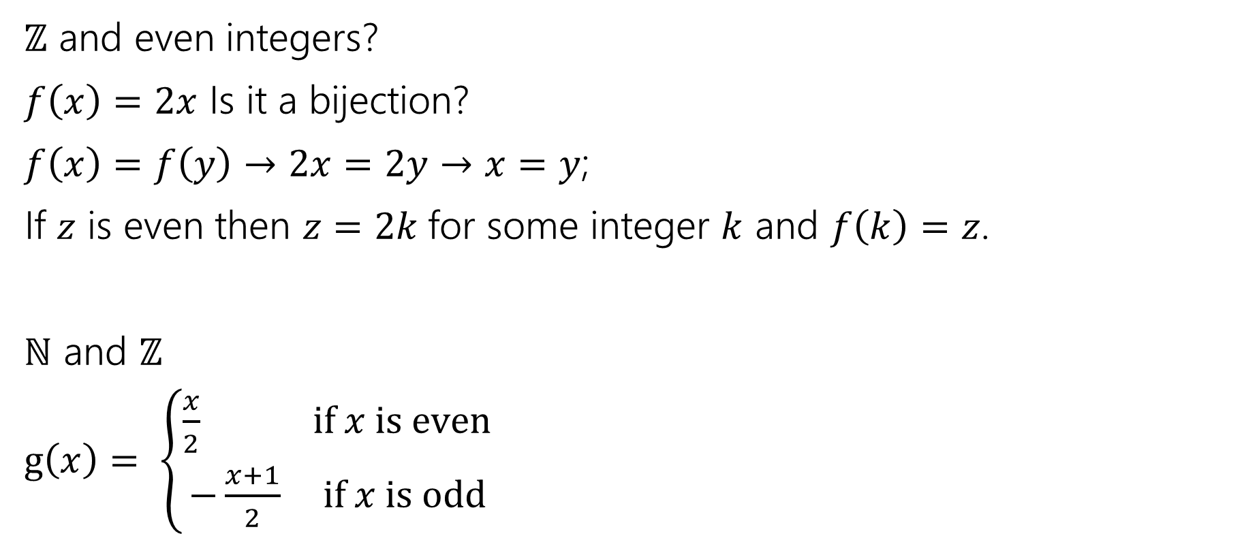
They’re all the same size.
$ℤ$ and even integers?
$f\left(x\right)=2x$ Is it a bijection?
$f\left(x\right)=f\left(y\right)→2x=2y→x=y$;
If $z$ is even then $z=2k$for some integer $k$ and $f\left(k\right)=z$.
$ℕ$ and $ℤ$
$g\left(x\right)= \left\{\begin{aligned}\frac{x}{2} if x is even \\ −\frac{x+1}{2} if x is odd\end{aligned}\right.$

Slide 19

They’re all the same size…
$ℕ$ and even integers?
$g(f\left(x\right))$ will work nicely. You can also build one explicitly.
Good exercise: show that if $f$ and $g$ are bijections then $f∘g$ is also a bijection.

Slide 20
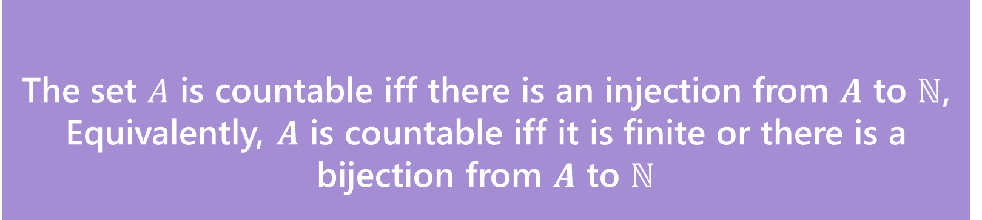
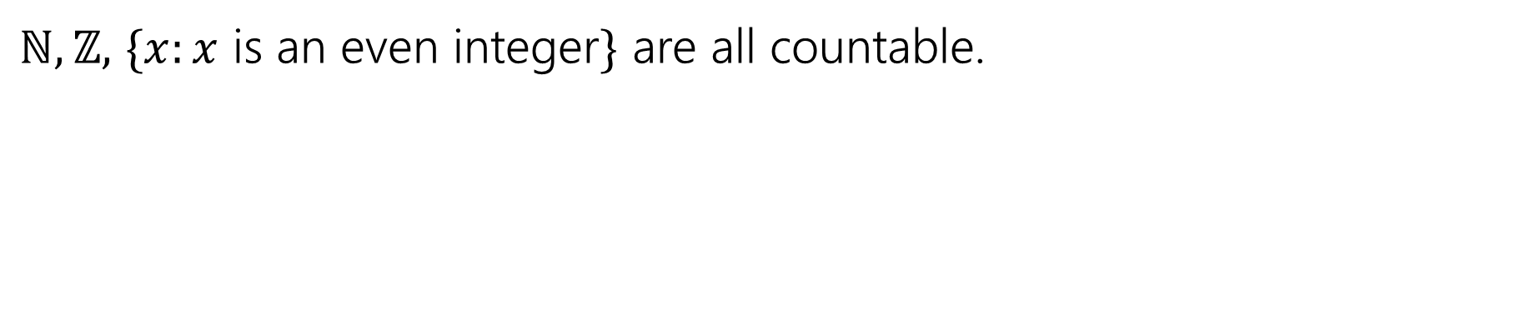
Countable
The set $A$ is countable iff there is an injection from $A$ to $ℕ$,
Equivalently, $A$ is countable iff it is finite or there is a bijection from $A$ to $ℕ$
Countable
$ℕ,ℤ,$ $\{x:x$ is an even integer$\}$ are all countable.

Slide 21
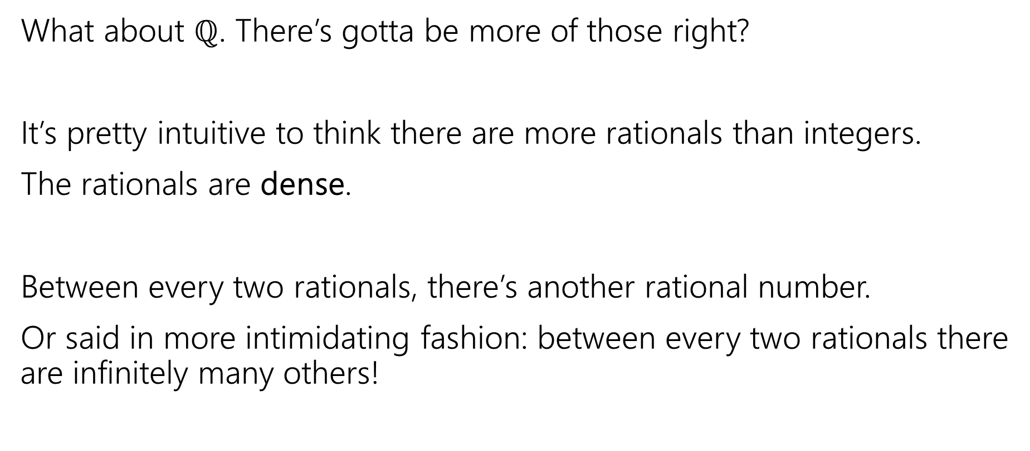
Let’s Try one that’s a little harder
What about $ℚ$. There’s gotta be more of those right?
It’s pretty intuitive to think there are more rationals than integers.
The rationals are dense.
Between every two rationals, there’s another rational number.
Or said in more intimidating fashion: between every two rationals there are infinitely many others!

Slide 22
The set of positive rational numbers
1/1 | 1/2 | 1/3 | 1/4 | 1/5 | 1/6 | 1/7 | 1/8 | ...
2/1 | 2/2 | 2/3 | 2/4 | 2/5 | 2/6 | 2/7 | 2/8 | ...
3/1 | 3/2 | 3/3 | 3/4 | 3/5 | 3/6 | 3/7 | 3/8 | ...
4/1 | 4/2 | 4/3 | 4/4 | 4/5 | 4/6 | 4/7 | 4/8 | ...
5/1 | 5/2 | 5/3 | 5/4 | 5/5 | 5/6 | 5/7 | ...
6/1 | 6/2 | 6/3 | 6/4 | 6/5 | 6/6 | ...
7/1 | 7/2 | 7/3 | 7/4 | 7/5 | ....
... | ... | ... | ... | ...

Slide 23
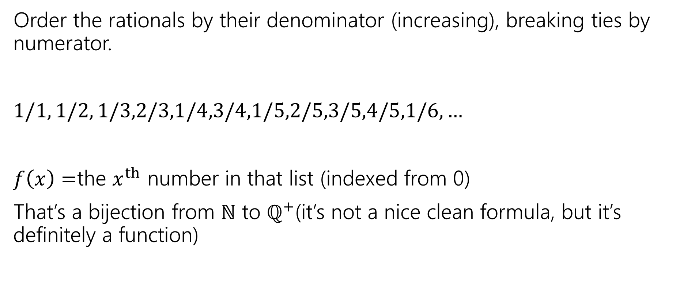
In bijection with the natural numbers
Order the rationals by their denominator (increasing), breaking ties by numerator.
$1/1, 1/2, 1/3,2/3,1/4,3/4,1/5,2/5,3/5,4/5,1/6,…$
$f\left(x\right)=$the $x^{th}$ number in that list (indexed from 0)
That’s a bijection from $ℕ$ to $ℚ^{+}$(it’s not a nice clean formula, but it’s definitely a function)

Slide 24
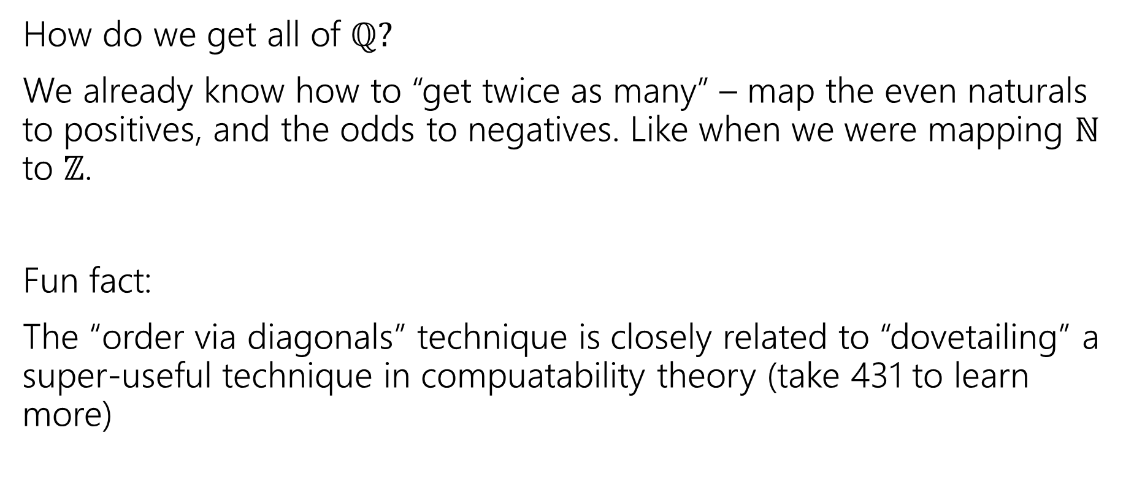
In Bijection with the natural numbers
How do we get all of $ℚ?$
We already know how to “get twice as many” – map the even naturals to positives, and the odds to negatives. Like when we were mapping $ℕ$ to $ℤ$.
Fun fact:
The “order via diagonals” technique is closely related to “dovetailing” a super-useful technique in compuatability theory (take 431 to learn more)

Slide 25

Uncountable
Alright. There are clever ways to build bijections.
Is there anything that’s bigger than $ℕ$?
And…like…how would we prove it?

Slide 26
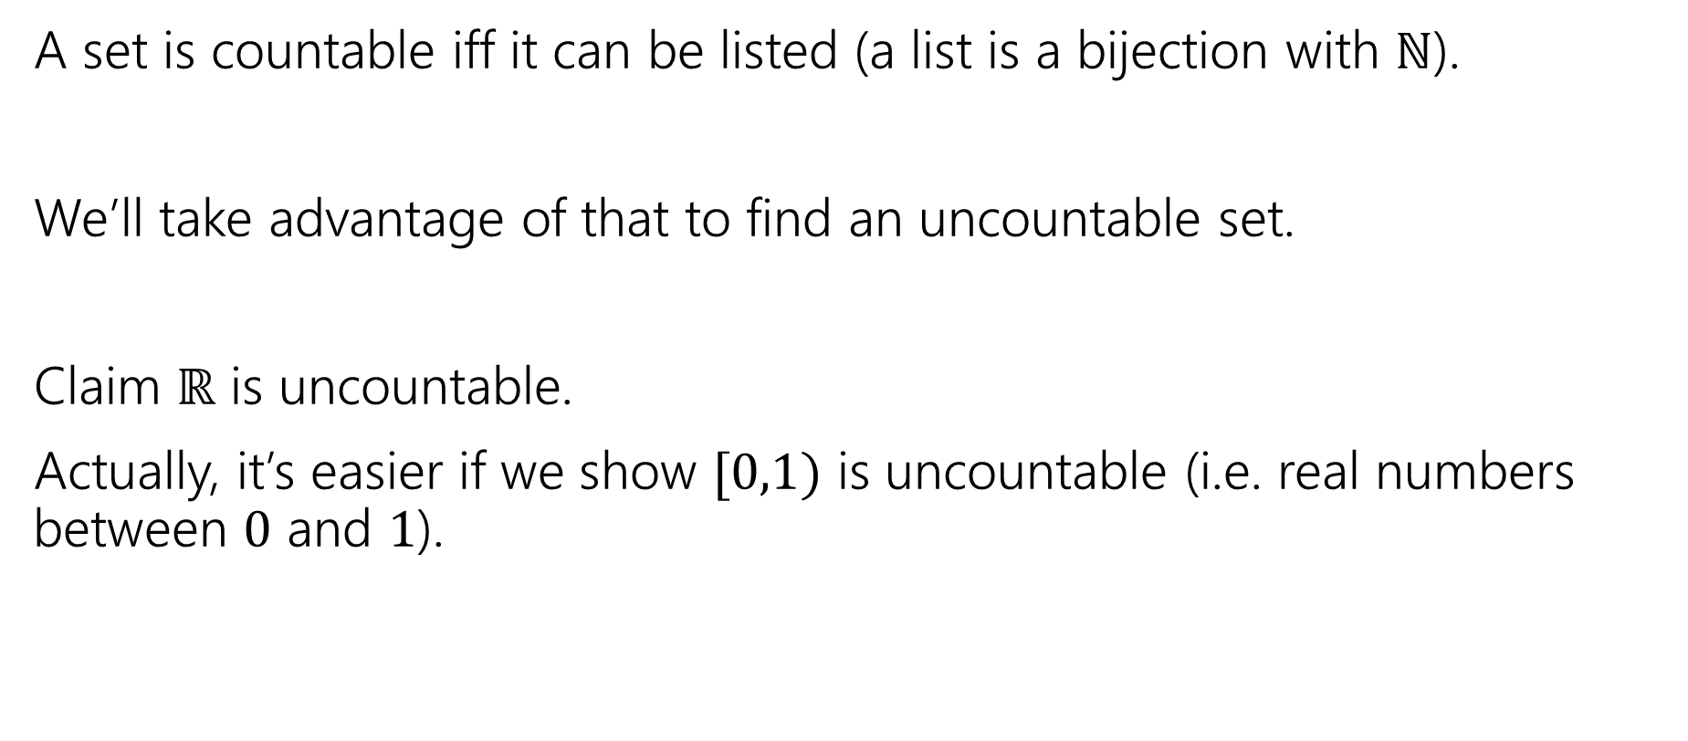
A proof idea
A set is countable iff it can be listed (a list is a bijection with $ℕ$).
We’ll take advantage of that to find an uncountable set.
Claim $ℝ$ is uncountable.
Actually, it’s easier if we show $[0,1)$ is uncountable (i.e. real numbers between $0$ and $1$).

Slide 27
What do real numbers look like
0. | 3 | 3 | 3 | 3 | 3 | 3 | 3 | 3…
0. | 2 | 7 | 2 | 7 | 2 | 8 | 5 | 4…
0. | 1 | 4 | 1 | 5 | 9 | 2 | 6 | 5…
0. | 2 | 2 | 2 | 2 | 2 | 2 | 2 | 2…
0. | 1 | 2 | 3 | 4 | 5 | 6 | 7 | 8…
0. | 9 | 8 | 7 | 6 | 5 | 4 | 3 | 2…
0. | 8 | 2 | 7 | 6 | 4 | 5 | 7 | 4…
0. | 5 | 9 | 4 | 2 | 7 | 5 | 1 | 7…
A string of digits!
Well not a “string” An infinitely long sequence of digits is more accurate.

Slide 28

Uncountable
Suppose, for the sake of contradiction, that $[0,1)$ is countable.
Then there is a bijection $f:ℕ→[0,1)$.
Use that bijection to make the following table…

Slide 29
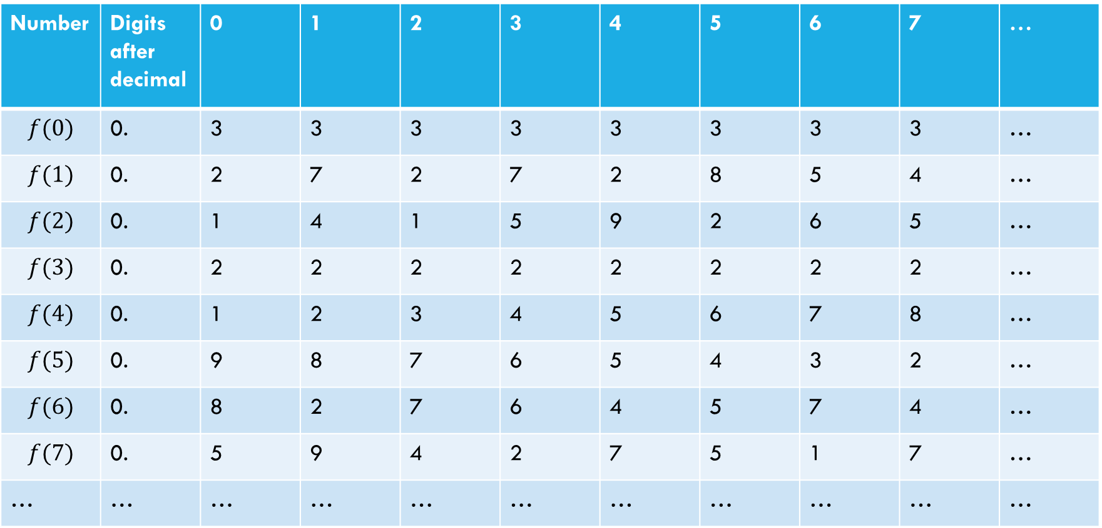

Proof that $[0,1)$ is not countable
Suppose, for the sake of contradiction, that there is a list of them:
Number | Digits after decimal | 0 | 1 | 2 | 3 | 4 | 5 | 6 | 7 | …
$$f(0)$$ | 0. | 3 | 3 | 3 | 3 | 3 | 3 | 3 | 3 | …
$$f(1)$$ | 0. | 2 | 7 | 2 | 7 | 2 | 8 | 5 | 4 | …
$$f(2)$$ | 0. | 1 | 4 | 1 | 5 | 9 | 2 | 6 | 5 | …
$$f(3)$$ | 0. | 2 | 2 | 2 | 2 | 2 | 2 | 2 | 2 | …
$$f(4)$$ | 0. | 1 | 2 | 3 | 4 | 5 | 6 | 7 | 8 | …
$$f(5)$$ | 0. | 9 | 8 | 7 | 6 | 5 | 4 | 3 | 2 | …
$$f(6)$$ | 0. | 8 | 2 | 7 | 6 | 4 | 5 | 7 | 4 | …
$$f(7)$$ | 0. | 5 | 9 | 4 | 2 | 7 | 5 | 1 | 7 | …
… | … | … | … | … | … | … | … | … | … | …

Slide 30
Proof that $[0,1)$ is not countable
Suppose, for the sake of contradiction, that there is a list of them:
Number | Digits after decimal | 0 | 1 | 2 | 3 | 4 | 5 | 6 | 7 | …
$$f(0)$$ | 0. | 3 | 3 | 3 | 3 | 3 | 3 | 3 | 3 | …
$$f(1)$$ | 0. | 2 | 7 | 2 | 7 | 2 | 8 | 5 | 4 | …
$$f(2)$$ | 0. | 1 | 4 | 1 | 5 | 9 | 2 | 6 | 5 | …
$$f(3)$$ | 0. | 2 | 2 | 2 | 2 | 2 | 2 | 2 | 2 | …
$$f(4)$$ | 0. | 1 | 2 | 3 | 4 | 5 | 6 | 7 | 8 | …
$$f(5)$$ | 0. | 9 | 8 | 7 | 6 | 5 | 4 | 3 | 2 | …
$$f(6)$$ | 0. | 8 | 2 | 7 | 6 | 4 | 5 | 7 | 4 | …
$$f(7)$$ | 0. | 5 | 9 | 4 | 2 | 7 | 5 | 1 | 7 | …
… | … | … | … | … | … | … | … | … | … | …
Goal: find a real number between 0 and 1 that isn’t on our table.
(contradiction to bijection)

Slide 31

Proof that $[0,1)$ is not countable
Suppose, for the sake of contradiction, that there is a list of them:
Number | Digits after decimal | 0 | 1 | 2 | 3 | 4 | 5 | 6 | 7 | …
$$f(0)$$ | 0. | 3 | 3 | 3 | 3 | 3 | 3 | 3 | 3 | …
$$f(1)$$ | 0. | 2 | 7 | 2 | 7 | 2 | 8 | 5 | 4 | …
$$f(2)$$ | 0. | 1 | 4 | 1 | 5 | 9 | 2 | 6 | 5 | …
$$f(3)$$ | 0. | 2 | 2 | 2 | 2 | 2 | 2 | 2 | 2 | …
$$f(4)$$ | 0. | 1 | 2 | 3 | 4 | 5 | 6 | 7 | 8 | …
$$f(5)$$ | 0. | 9 | 8 | 7 | 6 | 5 | 4 | 3 | 2 | …
$$f(6)$$ | 0. | 8 | 2 | 7 | 6 | 4 | 5 | 7 | 4 | …
$$f(7)$$ | 0. | 5 | 9 | 4 | 2 | 7 | 5 | 1 | 7 | …
… | … | … | … | … | … | … | … | … | … | …
How do we find a number that’s not in our list?
Well let’s make sure whatever our number is, it’s not $f(0)$

Slide 32
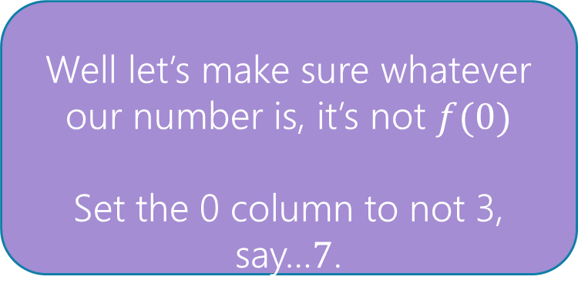
Proof that $[0,1)$ is not countable
Suppose, for the sake of contradiction, that there is a list of them:
Number | Digits after decimal | 0 | 1 | 2 | 3 | 4 | 5 | 6 | 7 | …
$$f(0)$$ | 0. | 3 | 3 | 3 | 3 | 3 | 3 | 3 | 3 | …
$$f(1)$$ | 0. | 2 | 7 | 2 | 7 | 2 | 8 | 5 | 4 | …
$$f(2)$$ | 0. | 1 | 4 | 1 | 5 | 9 | 2 | 6 | 5 | …
$$f(3)$$ | 0. | 2 | 2 | 2 | 2 | 2 | 2 | 2 | 2 | …
$$f(4)$$ | 0. | 1 | 2 | 3 | 4 | 5 | 6 | 7 | 8 | …
$$f(5)$$ | 0. | 9 | 8 | 7 | 6 | 5 | 4 | 3 | 2 | …
$$f(6)$$ | 0. | 8 | 2 | 7 | 6 | 4 | 5 | 7 | 4 | …
$$f(7)$$ | 0. | 5 | 9 | 4 | 2 | 7 | 5 | 1 | 7 | …
… | … | … | … | … | … | … | … | … | … | …
Well let’s make sure whatever our number is, it’s not $f(0)$
Set the 0 column to not 3, say…$7$.
0.7

Slide 33
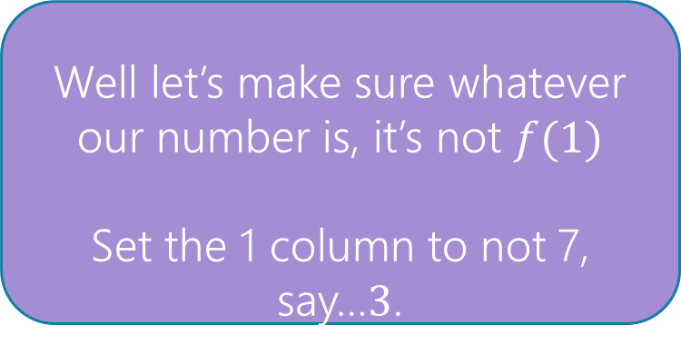
Proof that $[0,1)$ is not countable
Suppose, for the sake of contradiction, that there is a list of them:
Number | Digits after decimal | 0 | 1 | 2 | 3 | 4 | 5 | 6 | 7 | …
$$f(0)$$ | 0. | 3 | 3 | 3 | 3 | 3 | 3 | 3 | 3 | …
$$f(1)$$ | 0. | 2 | 7 | 2 | 7 | 2 | 8 | 5 | 4 | …
$$f(2)$$ | 0. | 1 | 4 | 1 | 5 | 9 | 2 | 6 | 5 | …
$$f(3)$$ | 0. | 2 | 2 | 2 | 2 | 2 | 2 | 2 | 2 | …
$$f(4)$$ | 0. | 1 | 2 | 3 | 4 | 5 | 6 | 7 | 8 | …
$$f(5)$$ | 0. | 9 | 8 | 7 | 6 | 5 | 4 | 3 | 2 | …
$$f(6)$$ | 0. | 8 | 2 | 7 | 6 | 4 | 5 | 7 | 4 | …
$$f(7)$$ | 0. | 5 | 9 | 4 | 2 | 7 | 5 | 1 | 7 | …
… | … | … | … | … | … | … | … | … | … | …
Well let’s make sure whatever our number is, it’s not $f(1)$
Set the 1 column to not 7, say…$3$.
0.73

Slide 34
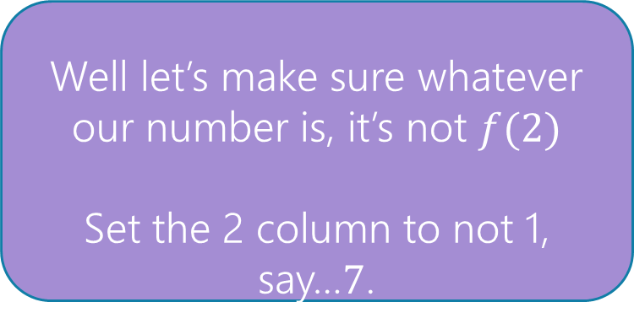
Proof that $[0,1)$ is not countable
Suppose, for the sake of contradiction, that there is a list of them:
Number | Digits after decimal | 0 | 1 | 2 | 3 | 4 | 5 | 6 | 7 | …
$$f(0)$$ | 0. | 3 | 3 | 3 | 3 | 3 | 3 | 3 | 3 | …
$$f(1)$$ | 0. | 2 | 7 | 2 | 7 | 2 | 8 | 5 | 4 | …
$$f(2)$$ | 0. | 1 | 4 | 1 | 5 | 9 | 2 | 6 | 5 | …
$$f(3)$$ | 0. | 2 | 2 | 2 | 2 | 2 | 2 | 2 | 2 | …
$$f(4)$$ | 0. | 1 | 2 | 3 | 4 | 5 | 6 | 7 | 8 | …
$$f(5)$$ | 0. | 9 | 8 | 7 | 6 | 5 | 4 | 3 | 2 | …
$$f(6)$$ | 0. | 8 | 2 | 7 | 6 | 4 | 5 | 7 | 4 | …
$$f(7)$$ | 0. | 5 | 9 | 4 | 2 | 7 | 5 | 1 | 7 | …
… | … | … | … | … | … | … | … | … | … | …
Well let’s make sure whatever our number is, it’s not $f(2)$
Set the 2 column to not 1, say…$7$.
0.737

Slide 35


Proof that $[0,1)$ is not countable
Suppose, for the sake of contradiction, that there is a list of them:
Number | Digits after decimal | 0 | 1 | 2 | 3 | 4 | 5 | 6 | 7 | …
$$f(0)$$ | 0. | 3 | 3 | 3 | 3 | 3 | 3 | 3 | 3 | …
$$f(1)$$ | 0. | 2 | 7 | 2 | 7 | 2 | 8 | 5 | 4 | …
$$f(2)$$ | 0. | 1 | 4 | 1 | 5 | 9 | 2 | 6 | 5 | …
$$f(3)$$ | 0. | 2 | 2 | 2 | 2 | 2 | 2 | 2 | 2 | …
$$f(4)$$ | 0. | 1 | 2 | 3 | 4 | 5 | 6 | 7 | 8 | …
$$f(5)$$ | 0. | 9 | 8 | 7 | 6 | 5 | 4 | 3 | 2 | …
$$f(6)$$ | 0. | 8 | 2 | 7 | 6 | 4 | 5 | 7 | 4 | …
$$f(7)$$ | 0. | 5 | 9 | 4 | 2 | 7 | 5 | 1 | 7 | …
… | … | … | … | … | … | … | … | … | … | …
Flipping Rule: let’s set the $i^{th}$ column to:
$7$ if $f(i)$’s $i^{th}$ column is not $7$
$3$if $f{\left(i\right)}^{′}s$ $i^{th}$ column is $7$.
0.73777733…

Slide 36
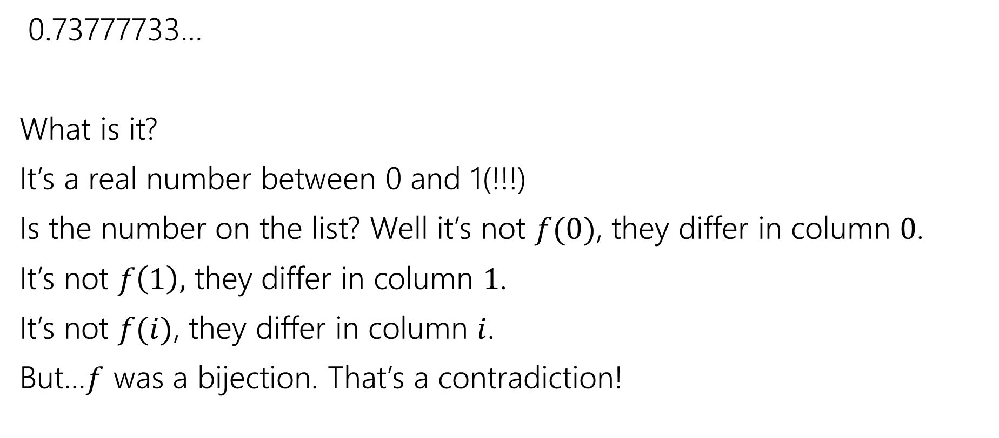
Wrapping Up
0.73777733…
What is it?
It’s a real number between 0 and 1(!!!)
Is the number on the list? Well it’s not $f(0)$, they differ in column $0$.
It’s not $f\left(1\right),$ they differ in column $1$.
It’s not $f(i)$, they differ in column $i$.
But…$f$ was a bijection. That’s a contradiction!

Slide 37
Diagonalization
This proof technique is called diagonalization
Often “Cantor’s Diagonalization” (after Cantor, who developed it).

Slide 38
Takeaway 1
There are differing levels of infinity.
Some infinite sets are equal in size.
Other infinite sets are bigger than others.
If this is mind-bending you’re in good company.
Cantor’s contemporaries accused him of being a “scientific charlatan” and a “corruptor of youth”
But Cantor was right – and his ideas eventually were recognized as correct.

Slide 39
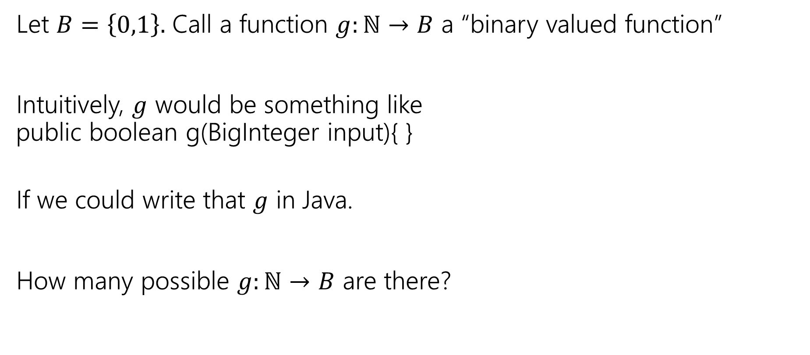
Let’s Do Another!
Let $B=\left\{0,1\right\}.$ Call a function $g:ℕ→B$ a “binary valued function”
Intuitively, $g$ would be something like
public boolean g(BigInteger input){ }
If we could write that $g$ in Java.
How many possible $g:ℕ→B$ are there?

Slide 40
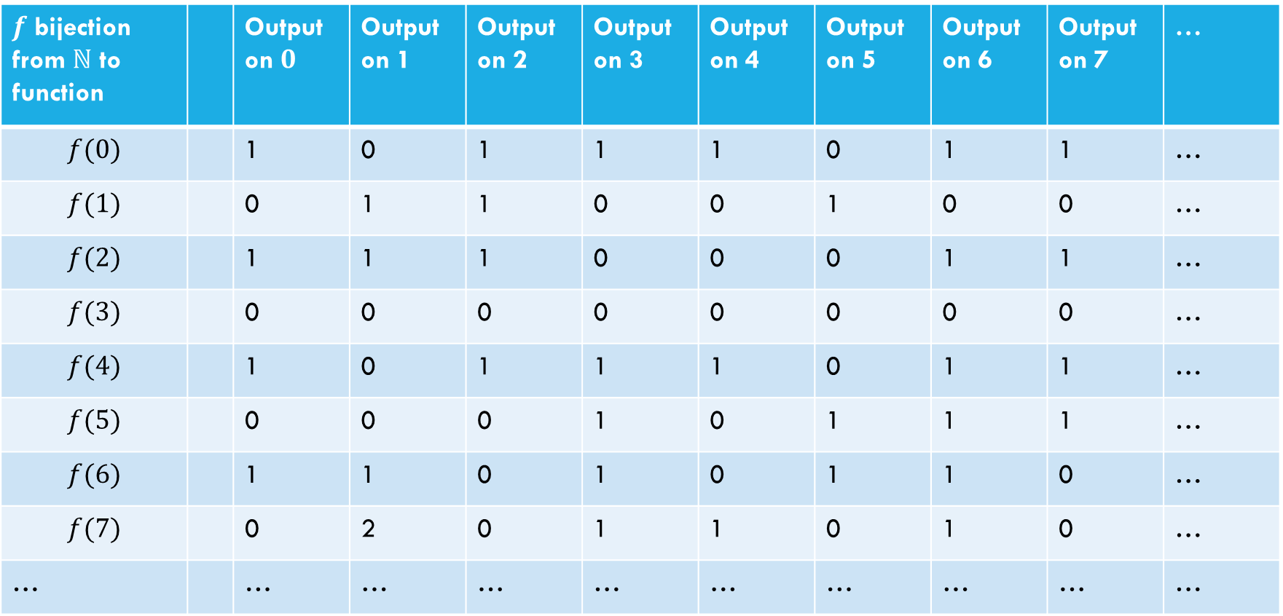
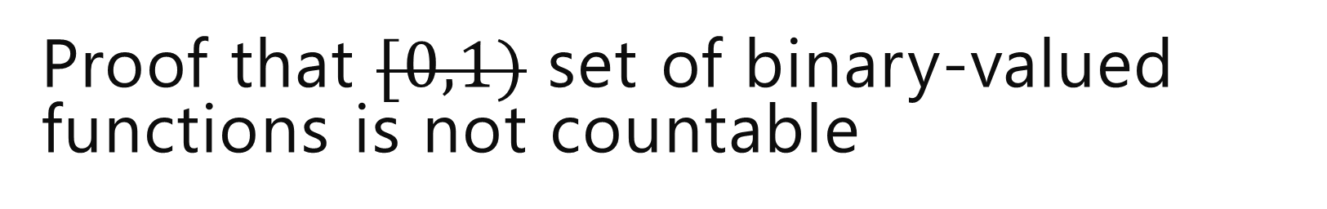
Proof that $[0,1)$ set of binary-valued functions is not countable
Suppose, for the sake of contradiction, that there is a list of them:
$f$ bijection from $ℕ$ to function |  | Output on $0$ | Output on 1 | Output on 2 | Output on 3 | Output on 4 | Output on 5 | Output on 6 | Output on 7 | …
$$f(0)$$ |  | 1 | 0 | 1 | 1 | 1 | 0 | 1 | 1 | …
$$f(1)$$ |  | 0 | 1 | 1 | 0 | 0 | 1 | 0 | 0 | …
$$f(2)$$ |  | 1 | 1 | 1 | 0 | 0 | 0 | 1 | 1 | …
$$f(3)$$ |  | 0 | 0 | 0 | 0 | 0 | 0 | 0 | 0 | …
$$f(4)$$ |  | 1 | 0 | 1 | 1 | 1 | 0 | 1 | 1 | …
$$f(5)$$ |  | 0 | 0 | 0 | 1 | 0 | 1 | 1 | 1 | …
$$f(6)$$ |  | 1 | 1 | 0 | 1 | 0 | 1 | 1 | 0 | …
$$f(7)$$ |  | 0 | 2 | 0 | 1 | 1 | 0 | 1 | 0 | …
… |  | … | … | … | … | … | … | … | … | …

Slide 41


Proof that $[0,1)$ set of binary-valued functions is not countable
Suppose, for the sake of contradiction, that there is a list of them:
$f$ bijection from $ℕ$ to function |  | Output on $0$ | Output on 1 | Output on 2 | Output on 3 | Output on 4 | Output on 5 | Output on 6 | Output on 7 | …
$$f(0)$$ |  | 1 | 0 | 1 | 1 | 1 | 0 | 1 | 1 | …
$$f(1)$$ |  | 0 | 1 | 1 | 0 | 0 | 1 | 0 | 0 | …
$$f(2)$$ |  | 1 | 1 | 1 | 0 | 0 | 0 | 1 | 1 | …
$$f(3)$$ |  | 0 | 0 | 0 | 0 | 0 | 0 | 0 | 0 | …
$$f(4)$$ |  | 1 | 0 | 1 | 1 | 1 | 0 | 1 | 1 | …
$$f(5)$$ |  | 0 | 0 | 0 | 1 | 0 | 1 | 1 | 1 | …
$$f(6)$$ |  | 1 | 1 | 0 | 1 | 0 | 1 | 1 | 0 | …
$$f(7)$$ |  | 0 | 2 | 0 | 1 | 1 | 0 | 1 | 0 | …
… |  | … | … | … | … | … | … | … | … | …
Goal: find a function$g_{diag}:ℕ→\left\{0,1\right\}$ that isn’t on our table.
(contradiction to bijection)

Slide 42


Proof that $[0,1)$ set of binary-valued functions is not countable
Suppose, for the sake of contradiction, that there is a list of them:
$f$ bijection from $ℕ$ to function |  | Output on $0$ | Output on 1 | Output on 2 | Output on 3 | Output on 4 | Output on 5 | Output on 6 | Output on 7 | …
$$f(0)$$ |  | 1 | 0 | 1 | 1 | 1 | 0 | 1 | 1 | …
$$f(1)$$ |  | 0 | 1 | 1 | 0 | 0 | 1 | 0 | 0 | …
$$f(2)$$ |  | 1 | 1 | 1 | 0 | 0 | 0 | 1 | 1 | …
$$f(3)$$ |  | 0 | 0 | 0 | 0 | 0 | 0 | 0 | 0 | …
$$f(4)$$ |  | 1 | 0 | 1 | 1 | 1 | 0 | 1 | 1 | …
$$f(5)$$ |  | 0 | 0 | 0 | 1 | 0 | 1 | 1 | 1 | …
$$f(6)$$ |  | 1 | 1 | 0 | 1 | 0 | 1 | 1 | 0 | …
$$f(7)$$ |  | 0 | 2 | 0 | 1 | 1 | 0 | 1 | 0 | …
… |  | … | … | … | … | … | … | … | … | …
How do we find a function not on our list?
Well to make sure it’s not $f(0)$ (the function in the first row)
Have $g_{diag}\left(0\right)=0$
$$g_{diag}\left(x\right)=\left\{\begin{aligned}0 if x=1 \\ … \\ …\end{aligned}\right.$$

Slide 43
Proof that $[0,1)$ set of binary-valued functions is not countable
Suppose, for the sake of contradiction, that there is a list of them:
$f$ bijection from $ℕ$ to function |  | Output on $0$ | Output on 1 | Output on 2 | Output on 3 | Output on 4 | Output on 5 | Output on 6 | Output on 7 | …
$$f(0)$$ |  | 1 | 0 | 1 | 1 | 1 | 0 | 1 | 1 | …
$$f(1)$$ |  | 0 | 1 | 1 | 0 | 0 | 1 | 0 | 0 | …
$$f(2)$$ |  | 1 | 1 | 1 | 0 | 0 | 0 | 1 | 1 | …
$$f(3)$$ |  | 0 | 0 | 0 | 0 | 0 | 0 | 0 | 0 | …
$$f(4)$$ |  | 1 | 0 | 1 | 1 | 1 | 0 | 1 | 1 | …
$$f(5)$$ |  | 0 | 0 | 0 | 1 | 0 | 1 | 1 | 1 | …
$$f(6)$$ |  | 1 | 1 | 0 | 1 | 0 | 1 | 1 | 0 | …
$$f(7)$$ |  | 0 | 2 | 0 | 1 | 1 | 0 | 1 | 0 | …
… |  | … | … | … | … | … | … | … | … | …
How do we find a function not on our list?
Well to make sure it’s not $f(0)$ (the function in the first row)
Have $g_{diag}\left(0\right)=0$
$$g_{diag}\left(x\right)=\left\{\begin{aligned}0 if x=1 \\ … \\ …\end{aligned}\right.$$

Slide 44
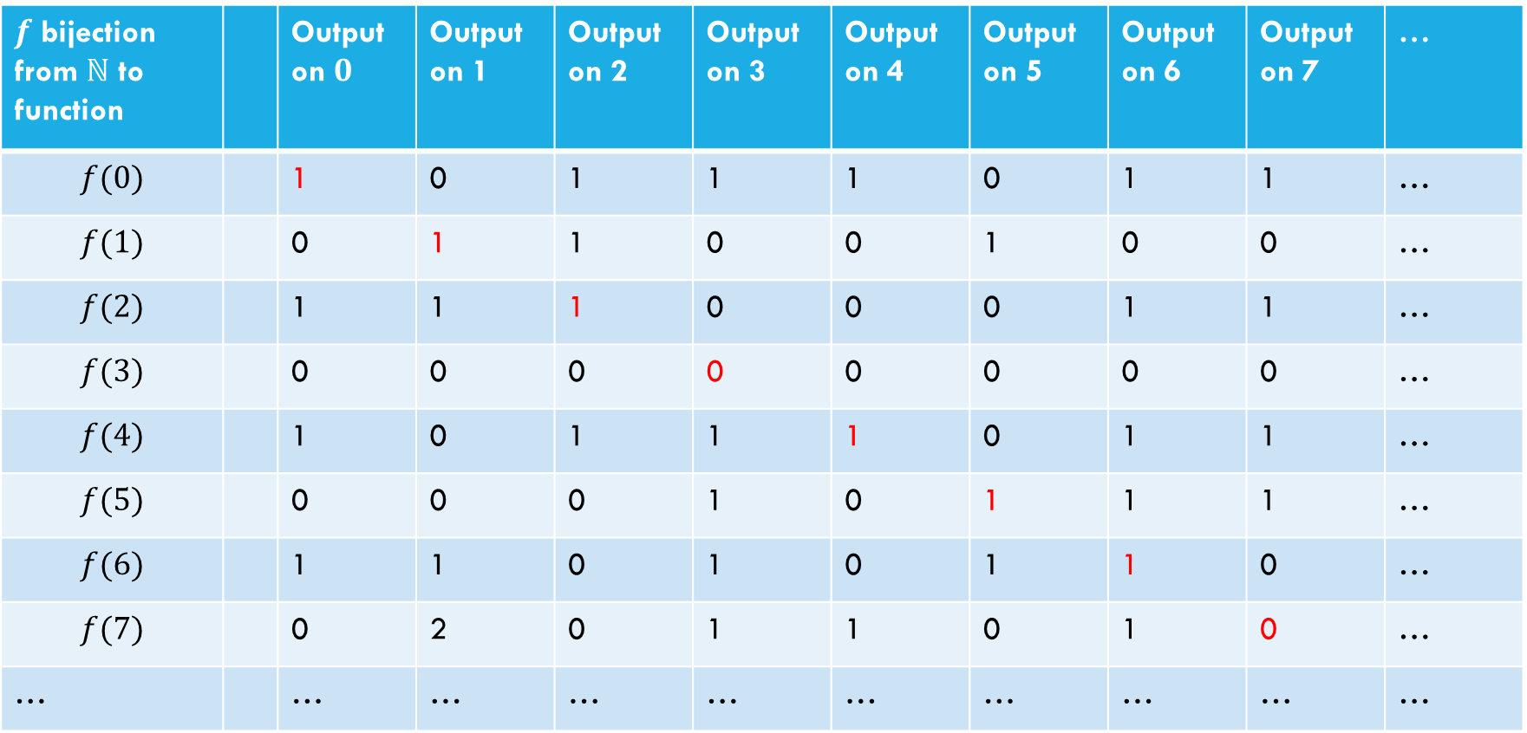

Proof that $[0,1)$ set of binary-valued functions is not countable
Suppose, for the sake of contradiction, that there is a list of them:
$f$ bijection from $ℕ$ to function |  | Output on $0$ | Output on 1 | Output on 2 | Output on 3 | Output on 4 | Output on 5 | Output on 6 | Output on 7 | …
$$f(0)$$ |  | 1 | 0 | 1 | 1 | 1 | 0 | 1 | 1 | …
$$f(1)$$ |  | 0 | 1 | 1 | 0 | 0 | 1 | 0 | 0 | …
$$f(2)$$ |  | 1 | 1 | 1 | 0 | 0 | 0 | 1 | 1 | …
$$f(3)$$ |  | 0 | 0 | 0 | 0 | 0 | 0 | 0 | 0 | …
$$f(4)$$ |  | 1 | 0 | 1 | 1 | 1 | 0 | 1 | 1 | …
$$f(5)$$ |  | 0 | 0 | 0 | 1 | 0 | 1 | 1 | 1 | …
$$f(6)$$ |  | 1 | 1 | 0 | 1 | 0 | 1 | 1 | 0 | …
$$f(7)$$ |  | 0 | 2 | 0 | 1 | 1 | 0 | 1 | 0 | …
… |  | … | … | … | … | … | … | … | … | …
How do we find a function not on our list?
Well to make sure it’s not $f(i)$ (the function in the $i^{th}$ row)
Have $g_{diag}\left(i\right)=1−f\left(i\right)\left(i\right)$
$$g_{diag}\left(x\right)=\left\{\begin{aligned}0 if x=1 \\ … \\ …\end{aligned}\right.$$

Slide 45
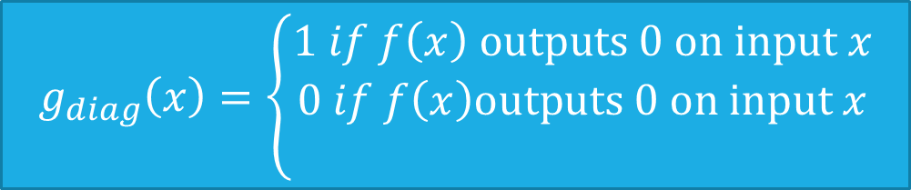
Proof that $[0,1)$ set of binary-valued functions is not countable
Suppose, for the sake of contradiction, that there is a list of them:
$f$ bijection from $ℕ$ to function |  | Output on $0$ | Output on 1 | Output on 2 | Output on 3 | Output on 4 | Output on 5 | Output on 6 | Output on 7 | …
$$f(0)$$ |  | 1 | 0 | 1 | 1 | 1 | 0 | 1 | 1 | …
$$f(1)$$ |  | 0 | 1 | 1 | 0 | 0 | 1 | 0 | 0 | …
$$f(2)$$ |  | 1 | 1 | 1 | 0 | 0 | 0 | 1 | 1 | …
$$f(3)$$ |  | 0 | 0 | 0 | 0 | 0 | 0 | 0 | 0 | …
$$f(4)$$ |  | 1 | 0 | 1 | 1 | 1 | 0 | 1 | 1 | …
$$f(5)$$ |  | 0 | 0 | 0 | 1 | 0 | 1 | 1 | 1 | …
$$f(6)$$ |  | 1 | 1 | 0 | 1 | 0 | 1 | 1 | 0 | …
$$f(7)$$ |  | 0 | 2 | 0 | 1 | 1 | 0 | 1 | 0 | …
… |  | … | … | … | … | … | … | … | … | …
How do we find a function not on our list?
Well to make sure it’s not $f(i)$ (the function in the $i^{th}$ row)
Have $g_{diag}\left(i\right)=1−f\left(i\right)\left(i\right)$
$$g_{diag}\left(x\right)=\left\{\begin{aligned}1 if f\left(x\right) outputs 0 on input x \\ 0 if f\left(x\right)outputs 0 on input x \\ \end{aligned}\right.$$

Slide 46
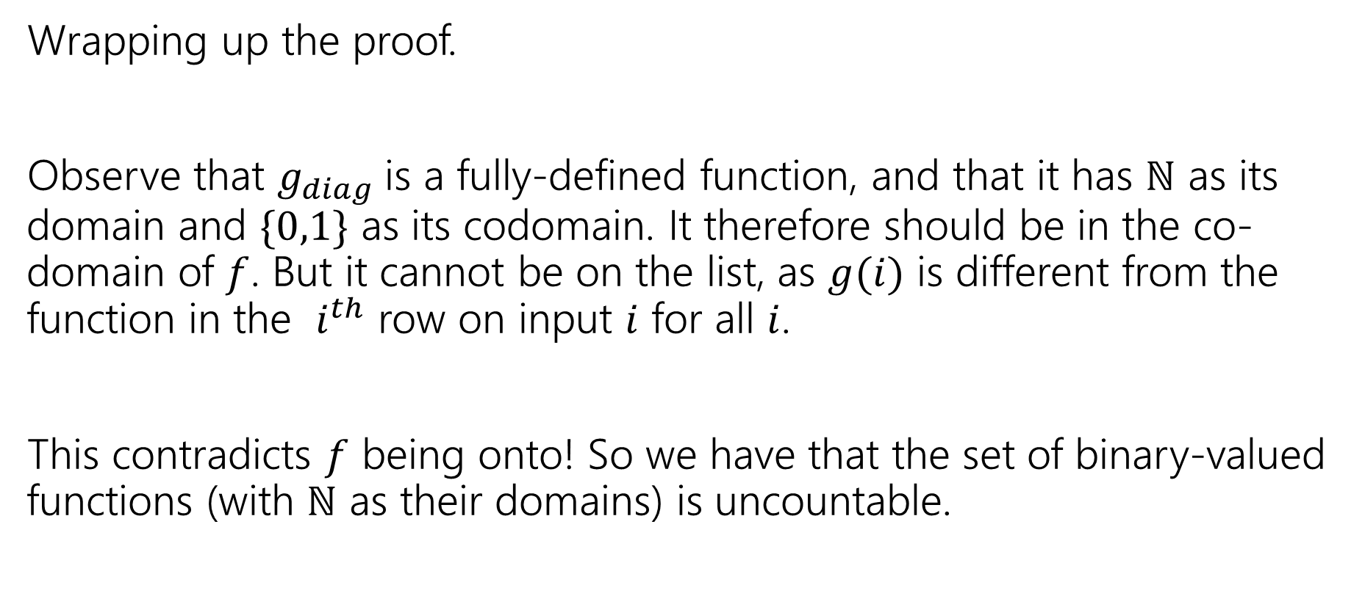
Wrapping up the proof
Wrapping up the proof.
Observe that $g_{diag}$is a fully-defined function, and that it has $ℕ$ as its domain and $\{0,1\}$ as its codomain. It therefore should be in the co-domain of $f$. But it cannot be on the list, as $g(i)$ is different from the function in the $i^{th}$ row on input $i$ for all $i$.
This contradicts $f$ being onto! So we have that the set of binary-valued functions (with $ℕ$ as their domains) is uncountable.

Slide 47
Our Second big takeaway
How many Java methods can we write:
public boolean g(int input) ?
Can you list them?
Yeah!! Put them in lexicographic order
i.e. in increasing order of length, with ties broken by alphabetical order.
Wait…that means the number of such Java programs is countable.
And…the number of functions we’re supposed to write is uncountable.

Slide 48
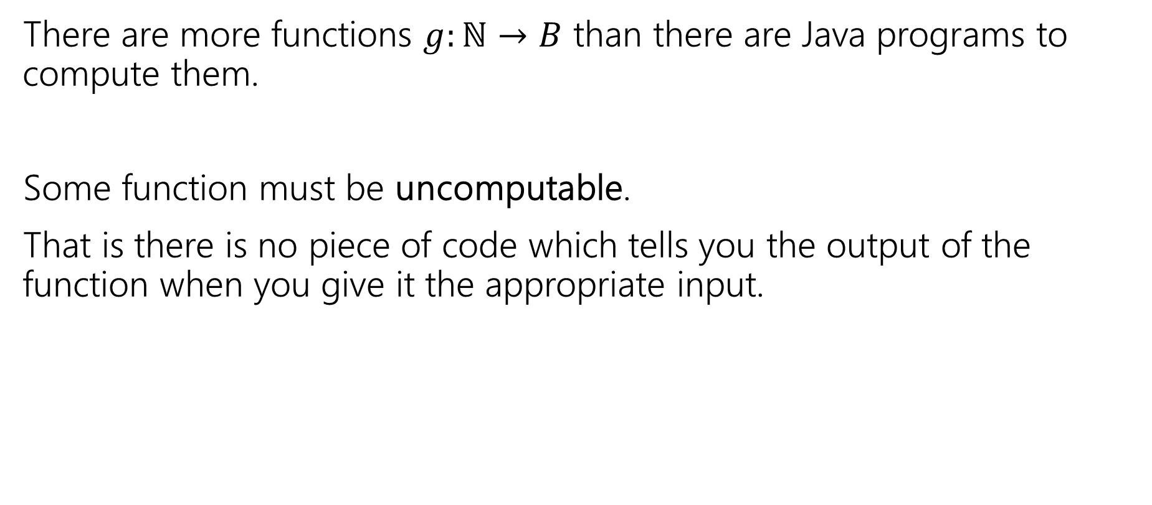
Our Second big takeaway
There are more functions $g:ℕ→B$ than there are Java programs to compute them.
Some function must be uncomputable.
That is there is no piece of code which tells you the output of the function when you give it the appropriate input.

Slide 49
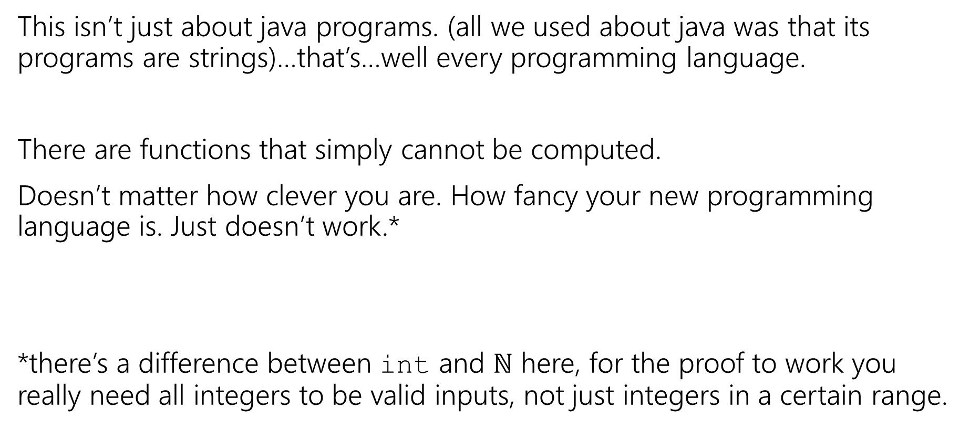
Not just Java
This isn’t just about java programs. (all we used about java was that its programs are strings)…that’s…well every programming language.
There are functions that simply cannot be computed.
Doesn’t matter how clever you are. How fancy your new programming language is. Just doesn’t work.*
*there’s a difference between int and $ℕ$ here, for the proof to work you really need all integers to be valid inputs, not just integers in a certain range.

Slide 50
Does this matter?
It’s even worse than that – almost all functions are not computable.
So…how come this has never happened to you?
This might not be meaningful yet. Almost all functions are also inexpressible in a finite amount of English (English is a language too!)
You’ve probably never decided to write a program that computes a function you couldn’t describe in English…
Are there any problems anyone is interested in solving that aren’t computable?

