Slide 1
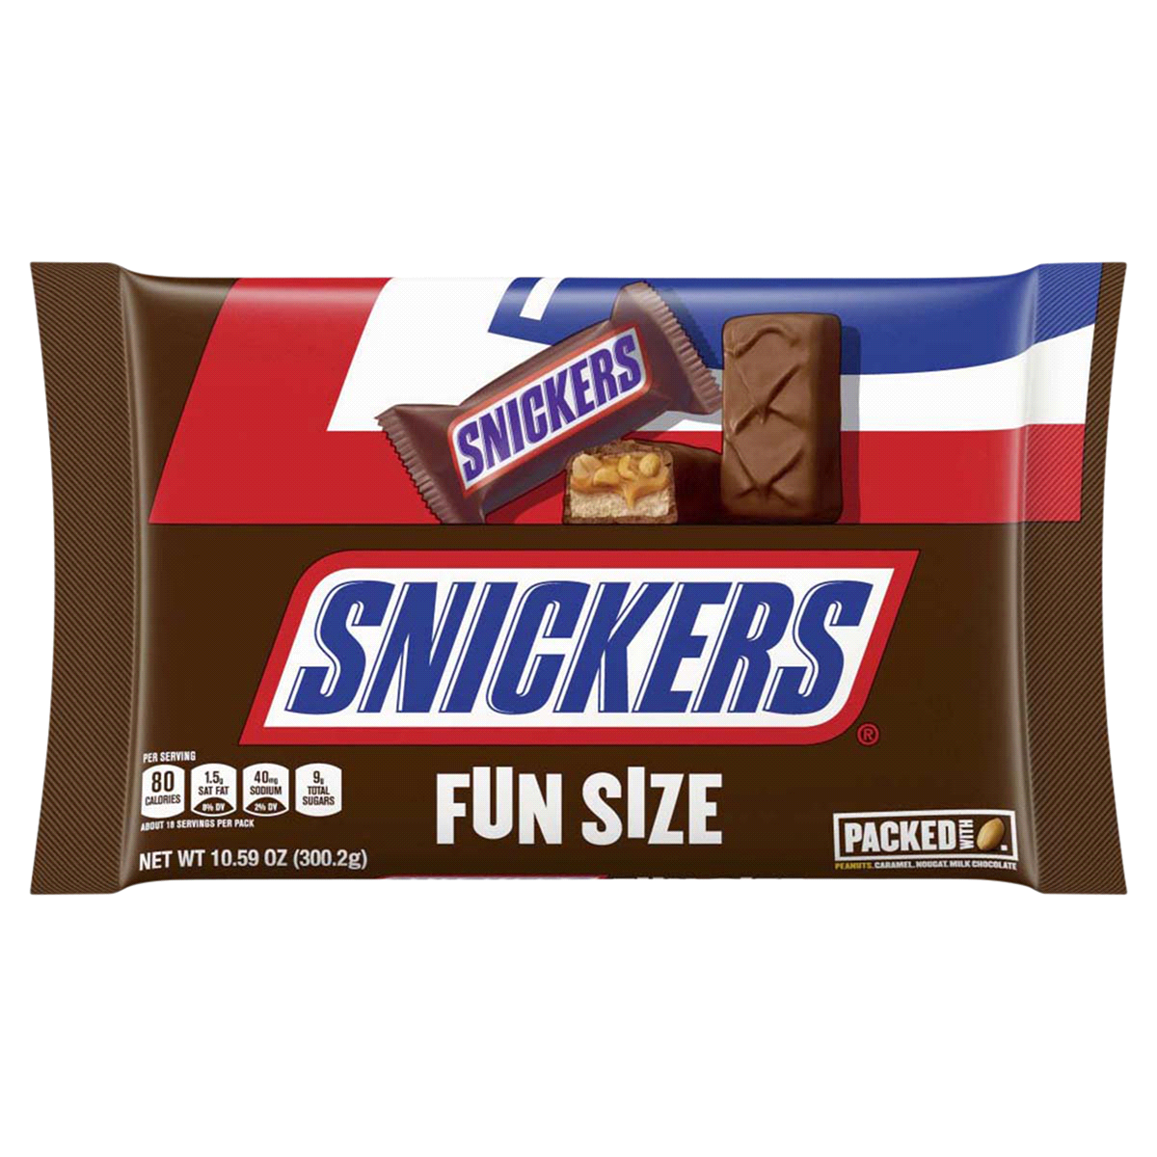
Nondeterministic Finite Automata
Warm up: Draw a DFA for the language “binary strings that start with a 1 or end with a 1”
CSE 311 Winter 2022
Lecture 24

Slide 2




Design some DFAs
Let $Σ=\{0,1,2\}$
$M_{1}$ should recognize “strings with an even number of 2’s.
$M_{2}$ should recognize “strings where the sum of the digits is congruent to $0$ $(mod 3)"$
2
s₁
s₀
2
0,1
0,1
1
$$t_{2}$$
1
2
2
$$t_{1}$$
2
$$t_{0}$$
0
1
0

Slide 3
Designing DFAs notes
DFAs can’t “count arbitrarily high”
For example, we could not make a DFA that remembers the overall sum of all the digits (not taken % 3)
That would have infinitely many states! We’re only allowed a finite number.

Slide 4
Strings over {0,1,2} w/ even number of 2’s and sum%3=0
s₀t₁
s₁t₂
s₀t₀
s₁t₀
s₀t₂
s₁t₁

Slide 5
Strings over {0,1,2} w/ even number of 2’s and sum%3=0
0
0
s₀t₁
2
s₁t₂
2
1
1
1
0
0
s₀t₀
2
s₁t₀
2
1
1
1
2
s₀t₂
s₁t₁
0
2
0

Slide 6
Strings over {0,1,2} w/ even number of 2’s and sum%3=0
s₀t₀
s₁t₀
s₀t₁
s₁t₁
s₀t₂
s₁t₂

Slide 7
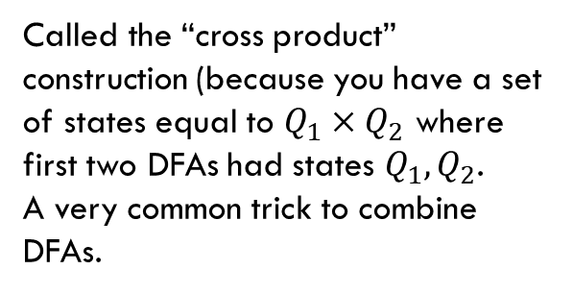
Strings over {0,1,2} w/ even number of 2’s and sum%3=0
Changed notation – final states with bold outlines.
0
0
s₀t₀
s₁t₀
2
2
1
1
0
0
s₀t₁
2
2
s₁t₁
1
1
1
1
Called the “cross product” construction (because you have a set of states equal to $Q_{1}×Q_{2}$ where first two DFAs had states $Q_{1},Q_{2}$.
A very common trick to combine DFAs.
2
2
s₀t₂
s₁t₂
0
0

Slide 8
Strings over {0,1,2} w/ even number of 2’s and sum%3=0
Changed notation – final states with bold outlines.
0
0
s₀t₀
s₁t₀
2
2
1
1
0
0
s₀t₁
2
2
s₁t₁
1
1
1
1
Called the “cross product” construction (because you have a set of states equal to $Q_{1}×Q_{2}$ where first two DFAs had states $Q_{1},Q_{2}$.
A very common trick to combine DFAs.
2
2
s₀t₂
s₁t₂
0
0
“even # 2’s”
“odd # 2’s”

Slide 9
Strings over {0,1,2} w/ even number of 2’s and sum%3=0
Changed notation – final states with bold outlines.
0
0
s₀t₀
s₁t₀
2
2
“sum%3 = 0”
1
1
0
0
s₀t₁
2
2
s₁t₁
1
1
“sum%3 = 1”
1
1
Called the “cross product” construction (because you have a set of states equal to $Q_{1}×Q_{2}$ where first two DFAs had states $Q_{1},Q_{2}$.
A very common trick to combine DFAs.
2
2
s₀t₂
s₁t₂
0
0
“sum%3 = 2”

Slide 10
Strings over {0,1,2} w/ even number of 2’s OR sum%3=0
0
0
s₀t₀
s₁t₀
Want to change the and to or – don’t need to change states or transitions…
2
2
1
1
0
0
s₀t₁
2
2
s₁t₁
1
1
1
1
2
2
s₀t₂
s₁t₂
0
0

Slide 11
Strings over {0,1,2} w/ even number of 2’s OR sum%3=0
0
0
s₀t₀
s₁t₀
Want to change the and to or – don’t need to change states or transitions…
Just which accept.
2
2
1
1
0
0
s₀t₁
2
2
s₁t₁
1
1
1
1
2
2
s₀t₂
s₁t₂
0
0

Slide 12
The set of binary strings with a 1 in the 3rd position from the start

Slide 13

The set of binary strings with a 1 in the 3rd position from the start
R
0,1
0
s₀
0,1
s₁
0,1
s₂
1
A
0,1

Slide 14
The set of binary strings with a 1 in the 3rd position from the end
What do we need to remember?
We can’t know what string was third from the end until we have read the last character.
So we’ll need to keep track of “the character that was 3 ago” in case this was the end of the string.
But if it’s not…we’ll need the character 2 ago, to update what the character 3 ago becomes. Same with the last character.

Slide 15
3 bit shift register
“Remember the last three bits”
001
1
011
1
0
1
1
1
0
000
1
010
101
0
111
1
0
0
1
0
0
100
0
110

Slide 16
The set of binary strings with a 1 in the 3rd position from the end
0
1
0
1
0
1
0
1
00
01
10
11
1
1
1
1
0
0
0
0
001
1
011
1
0
1
1
1
0
000
1
010
101
0
111
1
0
0
1
0
0
100
0
110

Slide 17
The set of binary strings with a 1 in the 3rd position from the end
001
1
011
1
0
1
1
1
0
000
1
010
101
0
111
1
0
0
1
0
0
100
0
110

Slide 18
The beginning versus the end
R
0
0,1
s₀
0,1
s₁
0,1
s₂
1
A
0,1
001
1
011
1
0
1
1
1
0
000
1
010
101
0
111
1
0
0
0
1
0
100
0
110

Slide 19
From the beginning was “easier” than “from the end”
At least in the sense that we needed fewer states.
That might be surprising since a java program wouldn’t be much different for those two.
Not being able to access the full input at once limits your abilities somewhat and makes some jobs harder than others.

Slide 20
What language does this machine recognize?
1
s₀
s₁
1
0
0
0
0
1
s₂
s₃
1

Slide 21
What language does this machine recognize?
1
s₀
s₁
1
0
0
0
0
1
s₂
s₃
1
#1s even
#1s odd

Slide 22
What language does this machine recognize?
1
s₀
s₁
#0s even
1
0
0
0
0
1
s₂
s₃
#0s odd
1

Slide 23
What language does this machine recognize?
1
s₀
s₁
1
0
0
#0s is congruent to #1s (mod 2)
Wait…there’s an easier way to describe that….
0
0
1
s₂
s₃
1

Slide 24
What language does this machine recognize?
1
s₀
s₁
That’s all binary strings of even length.
1
0
0
0,1
0
0
s₀
s₁
1
0,1
s₂
s₃
1

Slide 25
Takeaways
The first DFA might not be the simplest.
Try to think of other descriptions – you might realize you can keep track of fewer things than you thought.
Boy…it’d be nice if we could know that we have the smallest possible DFA for a given language…

Slide 26
DFA Minimization
We can know!
Fun fact: there is a unique minimum DFA for every language (up to renaming the states)
High level idea – final states and non-final states must be different.
Otherwise, hope that states can be the same, and iteratively separate when they have to go to different spots.
Some quarters this covered in detail. But…we ran out of time. Optional slides – won’t be required in HW or final but you might find it useful/interesting for your own learning.

Slide 27
Machines With Ouptut

Slide 28
Adding Output to Finite State Machines
So far we have considered finite state machines that just accept/reject strings
called “Deterministic Finite Automata” or DFAs
Now we consider finite state machines that with output
These are often used as controllers

Slide 29
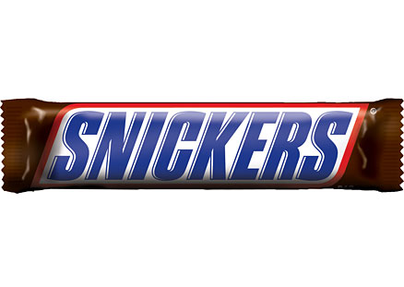

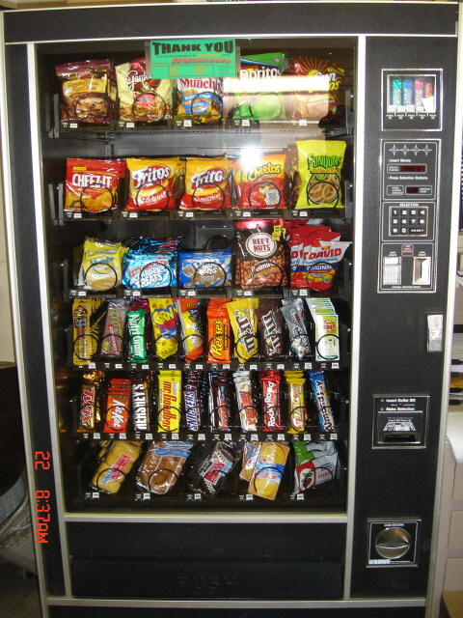
Vending Machine
Enter 15 cents in dimes or nickels
Press S or B for a candy bar

Slide 30
Vending Machine v0.1

Slide 31
Vending Machine, v0.1
D
D
0
N
5
N
10
N, D
15
B, S
Basic transitions on N (nickel), D (dime), B (butterfinger), S (snickers)

Slide 32
Vending Machine v0.2
D
D
0
N
5
N
10
N, D
15
B, S

Slide 33
Vending Machine, v0.2
0
D
N
15
D
D
B
0’ [B]
5
N
S
N
N
10
D
15’ [N]
B
S
N
0” [S]
D
Adding output to states: N – Nickel, S – Snickers, B – Butterfinger

Slide 34
Vending Machine, v1.0
B,S
0
D
N
15
B,S
D
B,S
B
D
B,S
D
N
S
N
0’ [B]
N
5
10
N
D
15’ [N]
B
N
S
D
B,S
N
N
0” [S]
D
B
15” [D]
S
D
Adding additional “unexpected” transitions to cover all symbols for each state

Slide 35
What are FSMs used for?
“Classic” hardware applications:
Anything where you only need to remember a very small amount of information, and have very simple update rules.
Vending machines
Elevators: need to know whether you’re going up or down, where people want to go, where people are waiting, and whether you’re going up or down. Simple rules to transition.
These days…general hardware is cheap, less likely to use custom hardware. BUT the programmer was probably still thinking about FSMs when writing the code.

Slide 36
What are FSMs used for?
Theoretically – still lots of applications.
grep uses FSMs to analyze regular expressions (more on this later).
Useful for modeling situations where you have minimal memory.
Good model for simple AI (say simple NPCs in games).
Technically all of our computers are finite state machines…
But they’re not usually how we think about them…more on this next week.

Slide 37
NFAs, Power of machines

Slide 38
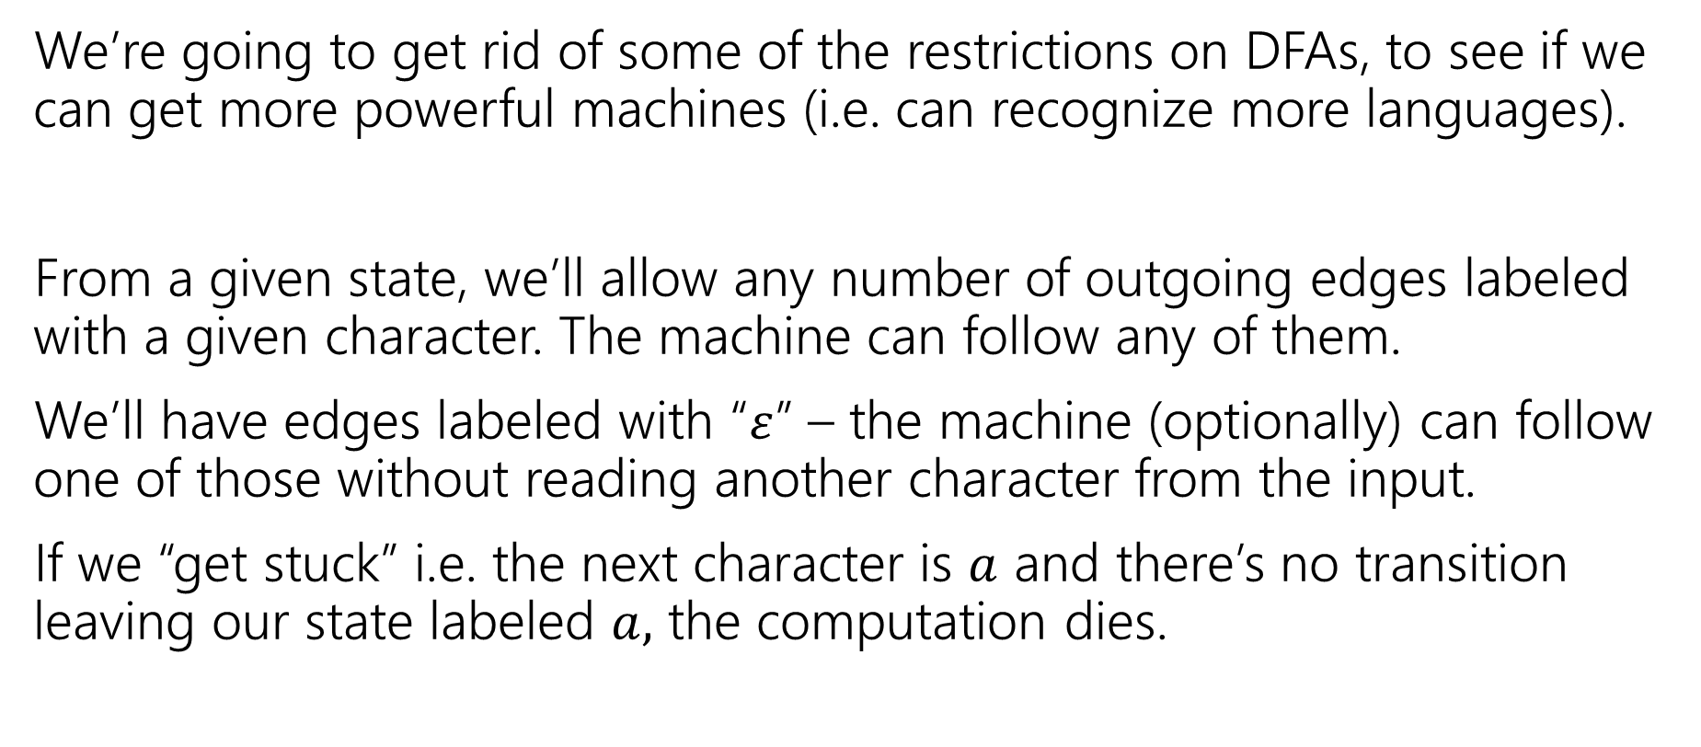
Let’s try to make our more powerful automata
We’re going to get rid of some of the restrictions on DFAs, to see if we can get more powerful machines (i.e. can recognize more languages).
From a given state, we’ll allow any number of outgoing edges labeled with a given character. The machine can follow any of them.
We’ll have edges labeled with “$ε$” – the machine (optionally) can follow one of those without reading another character from the input.
If we “get stuck” i.e. the next character is $a$ and there’s no transition leaving our state labeled $a,$ the computation dies.

Slide 39

Nondeterministic Finite Automata
An NFA:
Still has exactly one start state and any number of final states.
The NFA accepts $x$ if there is some path from a start state to a final state labeled with $x$.
From a state, you can have 0,1, or many outgoing arrows labeled with a single character. You can choose any of them to build the required path.
s₀
1
s₁
1
s₂
1
s₃
0,1
0,1

Slide 40
Wait a second…
But…how does it know?
Is this realistic?

Slide 41
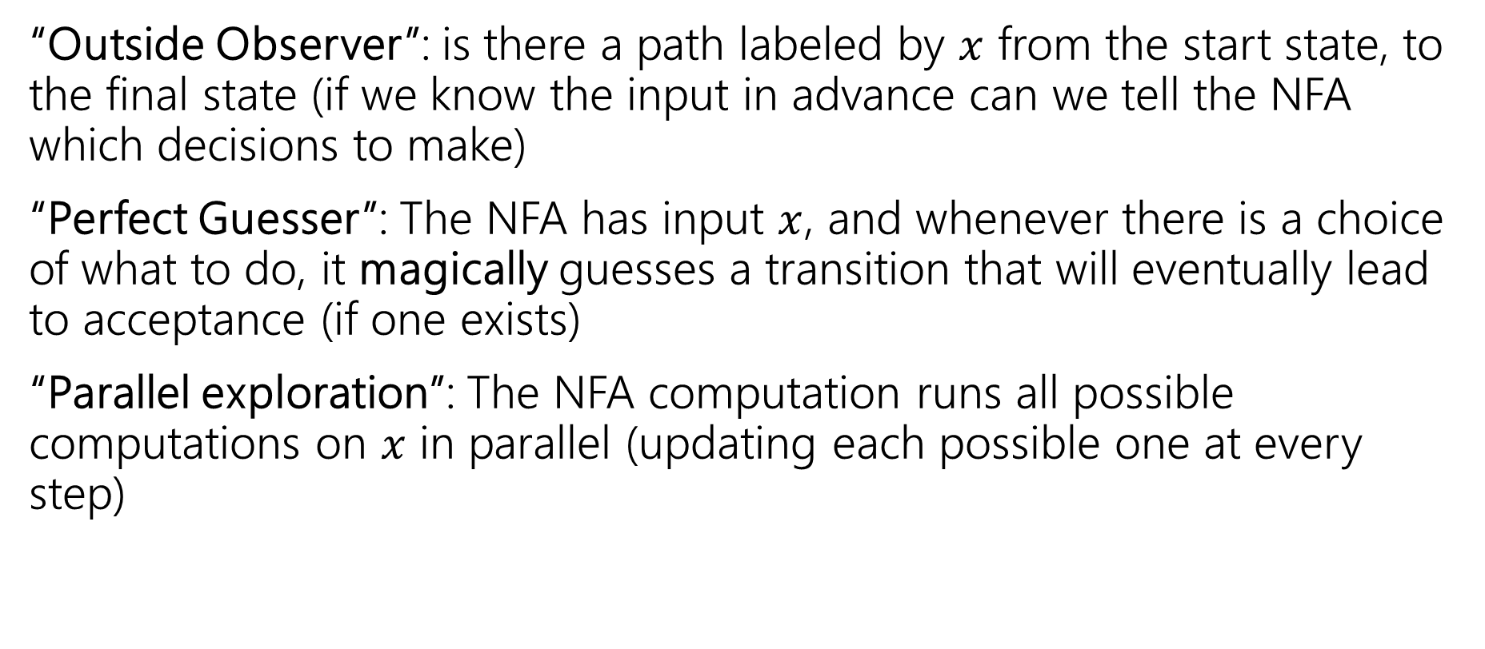
Three ways to think about NFAs
“Outside Observer”: is there a path labeled by $x$ from the start state, to the final state (if we know the input in advance can we tell the NFA which decisions to make)
“Perfect Guesser”: The NFA has input $x$, and whenever there is a choice of what to do, it magically guesses a transition that will eventually lead to acceptance (if one exists)
“Parallel exploration”: The NFA computation runs all possible computations on $x$ in parallel (updating each possible one at every step)

Slide 42
So…magic guessing doesn’t exist
I know. The parallel computation view is realistic.
Lets us give simpler descriptions of complicated objects.
This notion of “nondeterminism” is also really useful in more advanced CS theory (you’ll see it again in 421 or 431 if not sooner).
Source of the P vs. NP problem.

Slide 43
NFA practice
What is the language of this NFA?
0,1
1
1
s₁
s₂
s₃
1
s₀
0
1
s₅
s₄
1

Slide 44


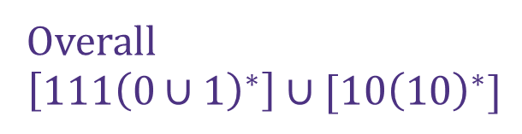
NFA practice
What is the language of this NFA?
0,1
1
1
s₁
s₂
s₃
$$111{\left(0∪1\right)}^{∗}$$
1
s₀
0
1
s₅
Overall
$$\left[111{\left(0∪1\right)}^{∗}\right]∪[10{\left(10\right)}^{∗}]$$
s₄
$$10{\left(10\right)}^{∗}$$
1

Slide 45

What about those $ε$-transitions?
2
0,1
0,1
s₀
s₁
ε
2
q
0
t₁
1
1
0
ε
2
2
0
t₀
2
t₂
1

Slide 46
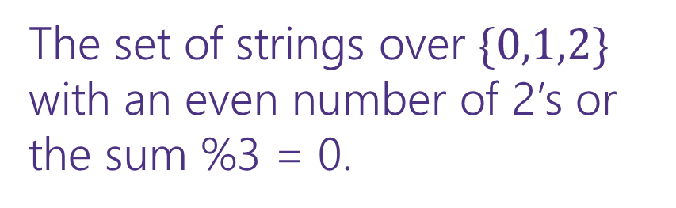
What about those $ε$-transitions?
2
0,1
0,1
s₀
s₁
ε
2
The set of strings over $\{0,1,2\}$ with an even number of 2’s or the sum %3 = 0.
q
0
t₁
1
1
0
ε
2
2
0
t₀
2
t₂
1

Slide 47
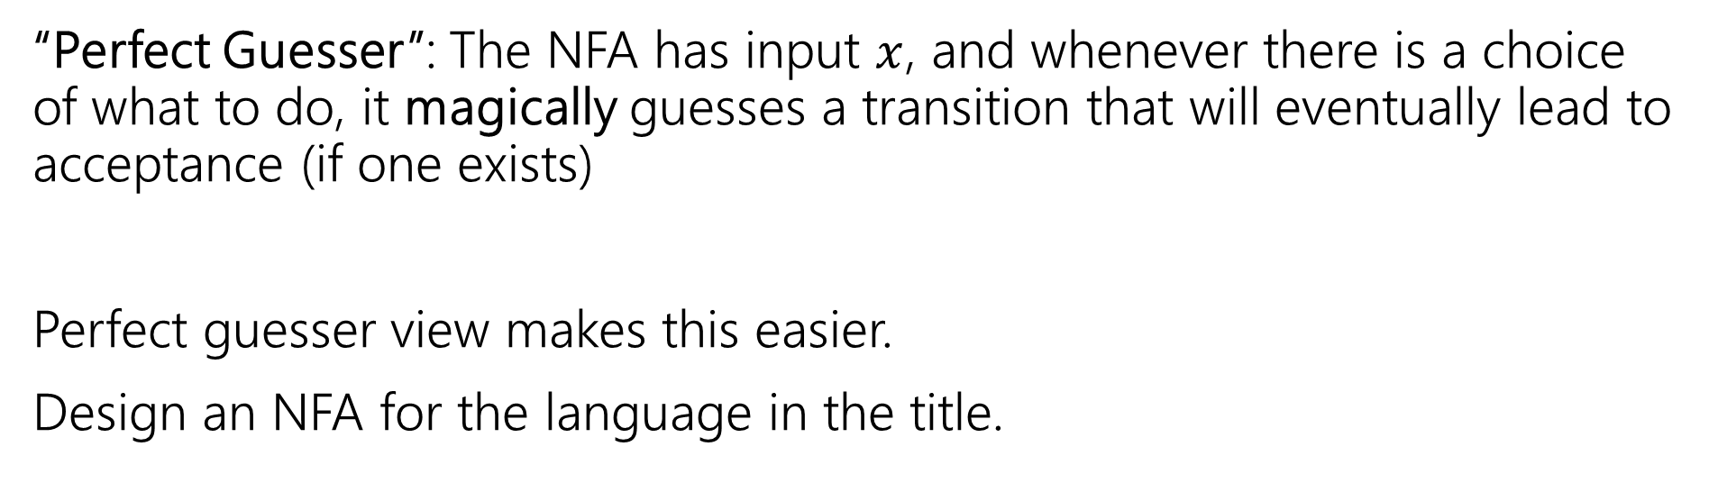
NFA that recognizes “binary strings with a 1 in the third position from the end”
“Perfect Guesser”: The NFA has input $x$, and whenever there is a choice of what to do, it magically guesses a transition that will eventually lead to acceptance (if one exists)
Perfect guesser view makes this easier.
Design an NFA for the language in the title.
Pollev.com/uwcse311

Slide 48
NFA that recognizes “binary strings with a 1 in the third position from the end”
0,1
1
0,1
0,1
s₃
s₂
s₁
s₀
That’s WAY easier than the DFA…

Slide 49
Parallel Exploration view of an NFA
0,1
1
0,1
0,1
s₃
s₂
s₁
s₀
Input string 0101100
0
1
0
1
1
0
0
s₃
s₃
s₃
s₃
s₃
s₃
s₃
s₃
s₂
s₁
s₀
s₂
s₁
s₀
X
s₂
s₁
s₀
X

Slide 50

More NFA practice
Write an NFA for:
Strings over $\{0,1,2\}$ that contain at least three 0’s.
Strings over $\left\{0,1,2\right\}$ where the number of 2’s is even and the sum of the digits %3=0.

