Slide 1
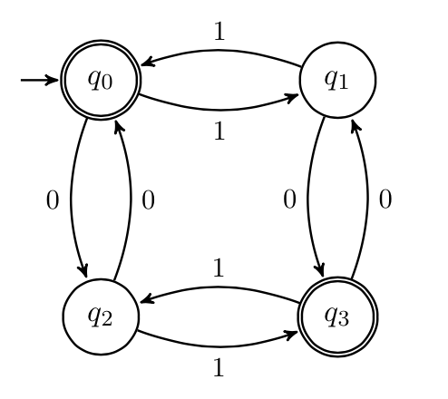
Finite State Machines
CSE 311 Winter 2022
Lecture 23

Slide 2
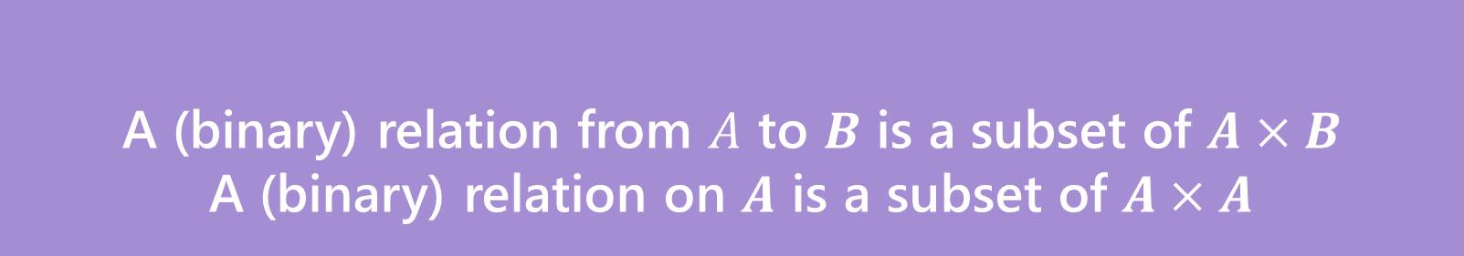


Relations
A (binary) relation from $A$ to $B$ is a subset of $A×B$
A (binary) relation on $A$ is a subset of $A×A$
Wait what?
$≤$ is a relation on $ℤ$.
“$3≤4“$ is a way of saying “3 relates to 4” (for the $≤$ relation)
$(3,4)$ is an element of the set that defines the relation.
Relations

Slide 3
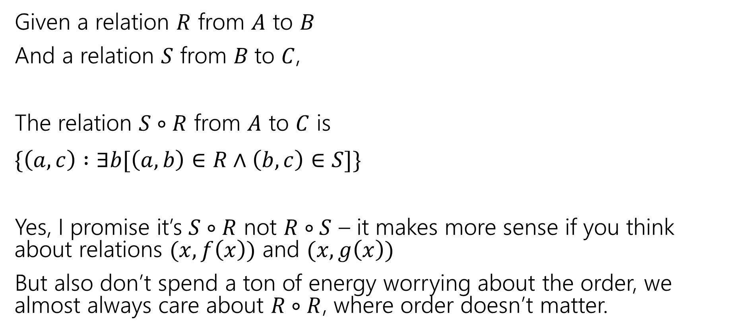
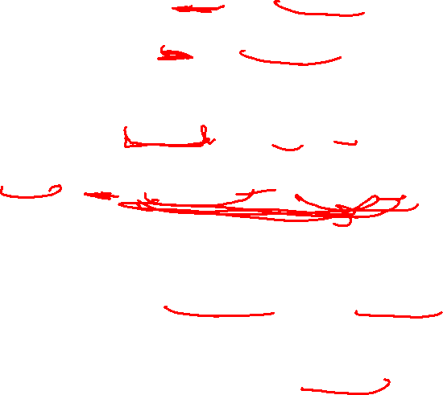
Combining Relations
Given a relation $R$ from $A$ to $B$
And a relation $S$ from $B$to $C$,
The relation $S∘R$ from $A$ to $C$ is
$\{\left(a,c\right) :∃b[\left(a,b\right)∈R∧\left(b,c\right)∈S]\}$
Yes, I promise it’s $S∘R$ not $R∘S$ – it makes more sense if you think about relations $(x,f\left(x\right))$ and $(x,g\left(x\right))$
But also don’t spend a ton of energy worrying about the order, we almost always care about $R∘R$, where order doesn’t matter.

Slide 4

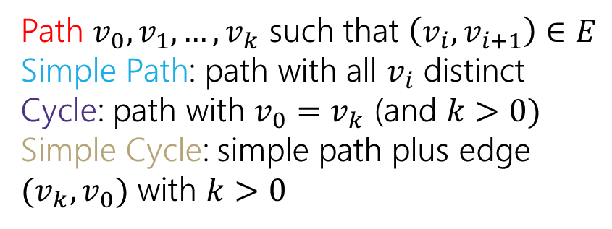
Directed Graphs
$G=(V,E)$
$V$is a set of vertices (an underlying set of elements)
$E$ is a set of edges (ordered pairs of vertices; i.e. connections from one to the next).
Path $v_{0},v_{1},…,v_{k}$ such that $\left(v_{i},v_{i+1}\right)∈E$
Simple Path: path with all $v_{i}$ distinct
Cycle: path with $v_{0}=v_{k}$ (and $k>0)$
Simple Cycle: simple path plus edge ${(v}_{k},v_{0})$ with $k>0$

Slide 5
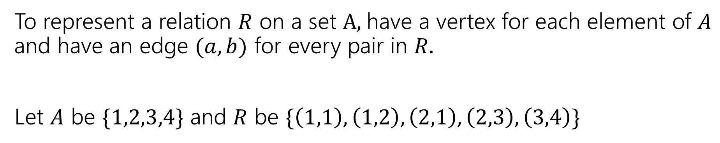
Representing Relations
To represent a relation $R$ on a set $A,$have a vertex for each element of $A$ and have an edge $(a,b)$ for every pair in $R.$
Let $A$ be $\{1,2,3,4\}$ and $R$ be $\{\left(1,1\right),\left(1,2\right),\left(2,1\right),\left(2,3\right),\left(3,4\right)\}$
1
2
3
4

Slide 6
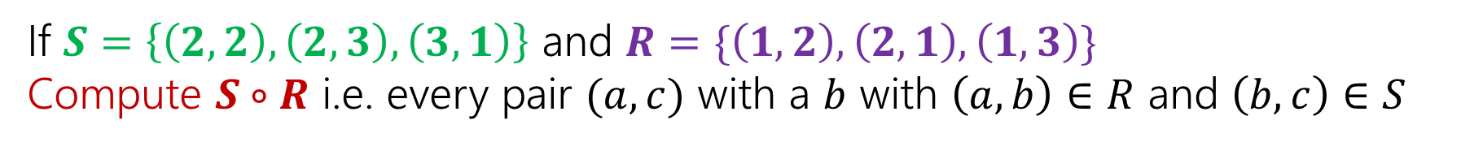
Combining Relations
If $S=\left\{\left(2,2\right), \left(2,3\right), \left(3,1\right)\right\}$ and $R=\{\left(1,2\right),\left(2,1\right),\left(1,3\right)\}$
Compute $S∘R$ i.e. every pair $(a,c)$ with a $b$ with $\left(a,b\right)∈R$ and $\left(b,c\right)∈S$
2
2
1
1
3
3

Slide 7
Combining Relations
If $S=\left\{\left(2,2\right), \left(2,3\right), \left(3,1\right)\right\}$ and $R=\{\left(1,2\right),\left(2,1\right),\left(1,3\right)\}$
Compute $S∘R$ i.e. every pair $(a,c)$ with a $b$ with $\left(a,b\right)∈R$ and $\left(b,c\right)∈S$
2
2
1
1
3
3

Slide 8

Combining Relations
Let $R$ be a relation on $A$.
Define $R^{0}$ as $\{\left(a,a\right) :a∈A\}$
$R^{k}=R^{k−1}∘R$
$\left(a,b\right)∈R^{k}$ if and only if there is a path of length $k$ from $a$ to $b$ in $R$.
We can find that on the graph!

Slide 9
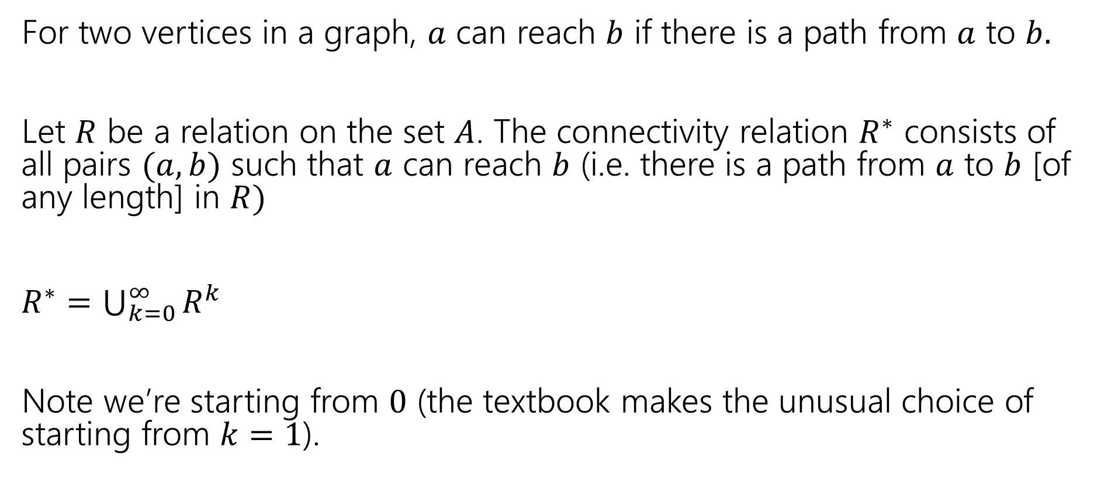

More Powers of $R.$
For two vertices in a graph, $a$ can reach $b$ if there is a path from $a$ to $b.$
Let $R$ be a relation on the set $A$. The connectivity relation $R^{∗}$ consists of all pairs $(a,b)$ such that $a$ can reach $b$ (i.e. there is a path from $a$ to $b$ [of any length] in $R)$
$R^{∗}=\bigcup_{k=0}^{∞}{R^{k}}$
Note we’re starting from $0$ (the textbook makes the unusual choice of starting from $k=1$).

Slide 10
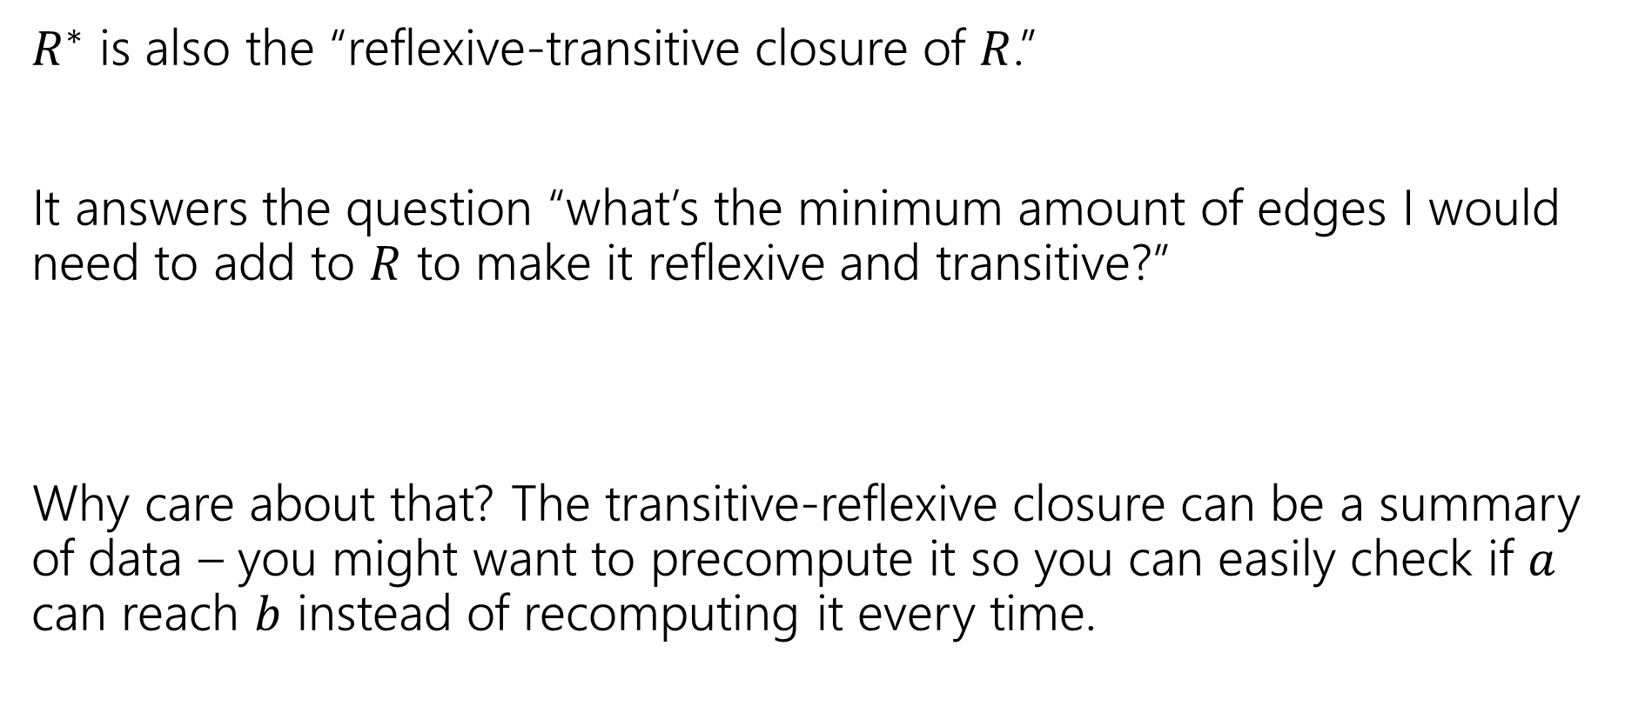

What’s the point of $R^{∗}$
$R^{∗}$ is also the “reflexive-transitive closure of $R$.”
It answers the question “what’s the minimum amount of edges I would need to add to $R$ to make it reflexive and transitive?”
Why care about that? The transitive-reflexive closure can be a summary of data – you might want to precompute it so you can easily check if $a$ can reach $b$ instead of recomputing it every time.

Slide 11
Relations and Graphs
Describe how each property will show up in the graph of a relation.
Reflexive
Symmetric
Antisymmetric
Transitive

Slide 12
Relations and Graphs
Describe how each property will show up in the graph of a relation.
Reflexive
Symmetric
Antisymmetric
Transitive
Every vertex has a “self-loop” (an edge from the vertex to itself)
Every edge has its “reverse edge” (going the other way) also in the graph.
No edge has its “reverse edge” (going the other way) also in the graph.
If there’s a length-2 path from $a$ to $b$ then there’s a direct edge from $a$ to $b$

Slide 13
Last Two Weeks
What computers can and can’t do…
  Given any finite amount of time.
We’ll start with one of the simplest models of a computer – finite state machines.

Slide 14
Deterministic Finite Automaton
Our machine is going to get a string as input.
It will read one character at a time and update “its state.”
At every step, the machine thinks of itself as in one of the (finite number) vertices.
When it reads the character it follows the arrow labeled with that character to its next state.
Start at the “start state” (unlabeled, incoming arrow).
After you’ve read the last character, accept the string if and only if you’re in a “final state” (double circle).

Slide 15
Let’s see an example
Input string:
011
1010

Slide 16
Let’s see an example
Input string:
011
1010

Slide 17
Let’s see an example
Input string:
011
1010

Slide 18
Let’s see an example
Input string:
011
1010

Slide 19
Let’s see an example
Input string:
011
1010

Slide 20
Let’s see an example
Input string:
011
1010

Slide 21
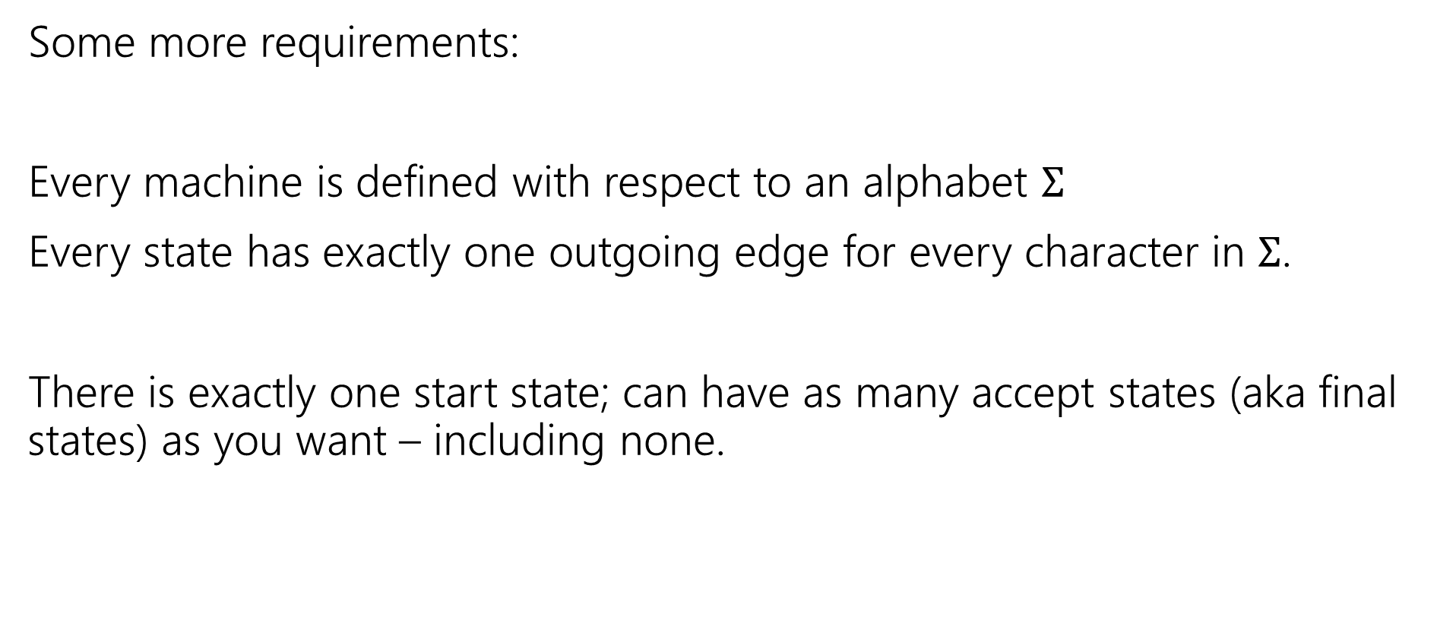
Deterministic Finite Automata
Some more requirements:
Every machine is defined with respect to an alphabet $Σ$
Every state has exactly one outgoing edge for every character in $Σ$.
There is exactly one start state; can have as many accept states (aka final states) as you want – including none.

Slide 22
Deterministic Finite Automata
Can also represent transitions with a table.
Old State | 0 | 1
s₀ | s₀ | s₁
s₁ | s₀ | s₂
s₂ | s₀ | s₃
s₃ | s₃ | s₃
0
0
1
1
1
s₀
s₁
s₂
s₃
0
0,1

Slide 23
Deterministic Finite Automata
What is the language of this DFA?
I.e. the set of all strings it accepts?
Old State | 0 | 1
s₀ | s₀ | s₁
s₁ | s₀ | s₂
s₂ | s₀ | s₃
s₃ | s₃ | s₃
0
0
1
1
1
s₀
s₁
s₂
s₃
0
0,1

Slide 24

Deterministic Finite Automata
If the string has $111$, then you’ll end up in $s_{3}$ and never leave.
If you end with a $0$ you’re back in $s_{0}$ which also accepts.
And…$ε$
$\left[{\left(0∪1\right)}^{∗}111{\left(0∪1\right)}^{∗}\right]∪{\left[{\left(0∪1\right)}^{∗}0\right]}^{∗}$
Old State | 0 | 1
s₀ | s₀ | s₁
s₁ | s₀ | s₂
s₂ | s₀ | s₃
s₃ | s₃ | s₃
0
0
1
1
1
s₀
s₁
s₂
s₃
0
0,1

Slide 25
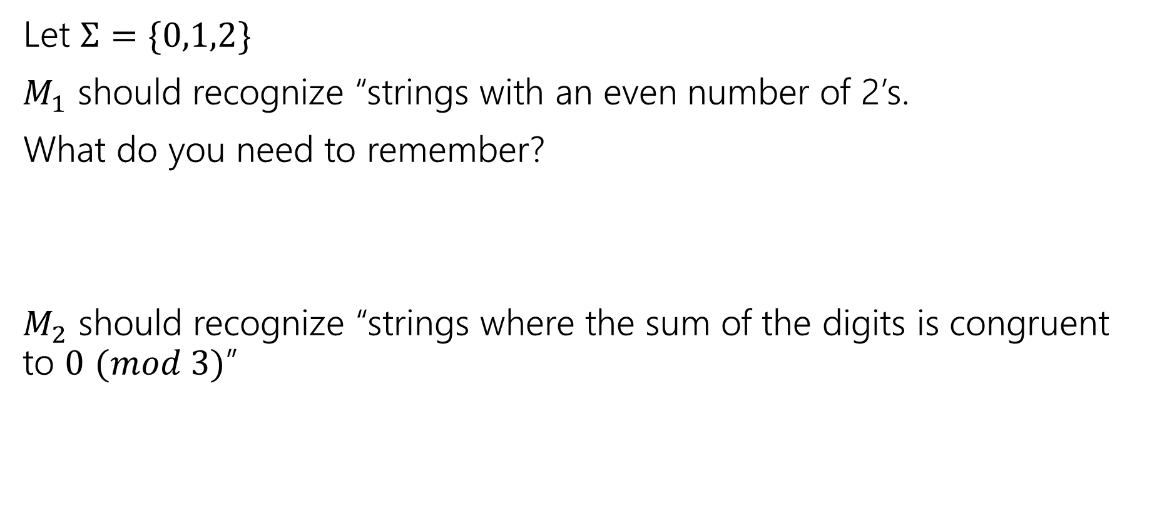
Design some DFAs
Let $Σ=\{0,1,2\}$
$M_{1}$ should recognize “strings with an even number of 2’s.
What do you need to remember?
$M_{2}$ should recognize “strings where the sum of the digits is congruent to $0$ $(mod 3)$”

Slide 26




Design some DFAs
Let $Σ=\{0,1,2\}$
$M_{1}$ should recognize “strings with an even number of 2’s.
$M_{2}$ should recognize “strings where the sum of the digits is congruent to $0$ $(mod 3)"$
2
s₁
s₀
2
0,1
0,1
1
$$t_{2}$$
1
2
2
$$t_{1}$$
2
$$t_{0}$$
0
1
0

Slide 27
Designing DFAs notes
DFAs can’t “count arbitrarily high”
For example, we could not make a DFA that remembers the overall sum of all the digits (not taken % 3)
That would have infinitely many states! We’re only allowed a finite number.

Slide 28
Strings over {0,1,2} w/ even number of 2’s and sum%3=0
s₀t₁
s₁t₂
s₀t₀
s₁t₀
s₀t₂
s₁t₁

Slide 29
Strings over {0,1,2} w/ even number of 2’s and sum%3=0
0
0
s₀t₁
2
s₁t₂
2
1
1
1
0
0
s₀t₀
2
s₁t₀
2
1
1
1
2
s₀t₂
s₁t₁
0
2
0

Slide 30
Strings over {0,1,2} w/ even number of 2’s and sum%3=0
s₀t₀
s₁t₀
s₀t₁
s₁t₁
s₀t₂
s₁t₂

Slide 31
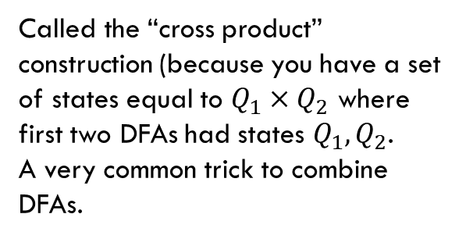
Strings over {0,1,2} w/ even number of 2’s and sum%3=0
Changed notation – final states with bold outlines.
0
0
s₀t₀
s₁t₀
2
2
1
1
0
0
s₀t₁
2
2
s₁t₁
1
1
1
1
Called the “cross product” construction (because you have a set of states equal to $Q_{1}×Q_{2}$ where first two DFAs had states $Q_{1},Q_{2}$.
A very common trick to combine DFAs.
2
2
s₀t₂
s₁t₂
0
0

Slide 32
Strings over {0,1,2} w/ even number of 2’s and sum%3=0
Changed notation – final states with bold outlines.
0
0
s₀t₀
s₁t₀
2
2
1
1
0
0
s₀t₁
2
2
s₁t₁
1
1
1
1
Called the “cross product” construction (because you have a set of states equal to $Q_{1}×Q_{2}$ where first two DFAs had states $Q_{1},Q_{2}$.
A very common trick to combine DFAs.
2
2
s₀t₂
s₁t₂
0
0
“even # 2’s”
“odd # 2’s”

Slide 33
Strings over {0,1,2} w/ even number of 2’s and sum%3=0
Changed notation – final states with bold outlines.
0
0
s₀t₀
s₁t₀
2
2
“sum%3 = 0”
1
1
0
0
s₀t₁
2
2
s₁t₁
1
1
“sum%3 = 1”
1
1
Called the “cross product” construction (because you have a set of states equal to $Q_{1}×Q_{2}$ where first two DFAs had states $Q_{1},Q_{2}$.
A very common trick to combine DFAs.
2
2
s₀t₂
s₁t₂
0
0
“sum%3 = 2”

Slide 34
Strings over {0,1,2} w/ even number of 2’s OR sum%3=0
0
0
s₀t₀
s₁t₀
Want to change the and to or – don’t need to change states or transitions…
2
2
1
1
0
0
s₀t₁
2
2
s₁t₁
1
1
1
1
2
2
s₀t₂
s₁t₂
0
0

Slide 35
Strings over {0,1,2} w/ even number of 2’s OR sum%3=0
0
0
s₀t₀
s₁t₀
Want to change the and to or – don’t need to change states or transitions…
Just which accept.
2
2
1
1
0
0
s₀t₁
2
2
s₁t₁
1
1
1
1
2
2
s₀t₂
s₁t₂
0
0

Slide 36
The set of binary strings with a 1 in the 3rd position from the start

Slide 37

The set of binary strings with a 1 in the 3rd position from the start
R
0,1
0
s₀
0,1
s₁
0,1
s₂
1
A
0,1

Slide 38
The set of binary strings with a 1 in the 3rd position from the end
What do we need to remember?
We can’t know what string was third from the end until we have read the last character.
So we’ll need to keep track of “the character that was 3 ago” in case this was the end of the string.
But if it’s not…we’ll need the character 2 ago, to update what the character 3 ago becomes. Same with the last character.

Slide 39
3 bit shift register
“Remember the last three bits”
001
1
011
1
0
1
1
1
0
000
1
010
101
0
111
1
0
0
1
0
0
100
0
110

Slide 40
The set of binary strings with a 1 in the 3rd position from the end
0
1
0
1
0
1
0
1
00
01
10
11
1
1
1
1
0
0
0
0
001
1
011
1
0
1
1
1
0
000
1
010
101
0
111
1
0
0
1
0
0
100
0
110

Slide 41
The set of binary strings with a 1 in the 3rd position from the end
001
1
011
1
0
1
1
1
0
000
1
010
101
0
111
1
0
0
1
0
0
100
0
110

Slide 42
The beginning versus the end
R
0
0,1
s₀
0,1
s₁
0,1
s₂
1
A
0,1
001
1
011
1
0
1
1
1
0
000
1
010
101
0
111
1
0
0
0
1
0
100
0
110

Slide 43
From the beginning was “easier” than “from the end”
At least in the sense that we needed fewer states.
That might be surprising since a java program wouldn’t be much different for those two.
Not being able to access the full input at once limits your abilities somewhat and makes some jobs harder than others.

Slide 44
What language does this machine recognize?
1
s₀
s₁
1
0
0
0
0
1
s₂
s₃
1

Slide 45
What language does this machine recognize?
1
s₀
s₁
1
0
0
0
0
1
s₂
s₃
1
#1s even
#1s odd

Slide 46
What language does this machine recognize?
1
s₀
s₁
#0s even
1
0
0
0
0
1
s₂
s₃
#0s odd
1

Slide 47
What language does this machine recognize?
1
s₀
s₁
1
0
0
#0s is congruent to #1s (mod 2)
Wait…there’s an easier way to describe that….
0
0
1
s₂
s₃
1

Slide 48
What language does this machine recognize?
1
s₀
s₁
That’s all binary strings of even length.
1
0
0
0,1
0
0
s₀
s₁
1
0,1
s₂
s₃
1

Slide 49
Takeaways
The first DFA might not be the simplest.
Try to think of other descriptions – you might realize you can keep track of fewer things than you thought.
Boy…it’d be nice if we could know that we have the smallest possible DFA for a given language…

Slide 50
DFA Minimization
We can know!
Fun fact: there is a unique minimum DFA for every language (up to renaming the states)
High level idea – final states and non-final states must be different.
Otherwise, hope that states can be the same, and iteratively separate when they have to go to different spots.
In some quarters, we cover it in detail. But…we ran out of time.
Optional slides will be posted – won’t be required in HW or final but you might find it useful/interesting for your own learning.

Slide 51

Next Time
Some (historic and modern) applications of DFAs
There are some languages DFAs can’t recognize (say, {$0^{k}1^{k}|k≥0\}$)
What if we give the DFAs a little more power…try to get them to do more things.

