Slide 1
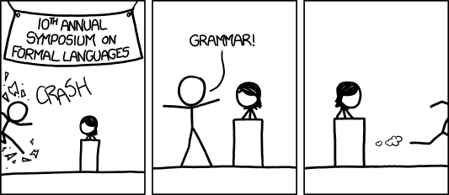
Context Free Grammars
Warm-up
Write a regular expression for “the set of all binary strings which represent binary numbers congruent to 1 mod 4
(make sure the representation is “nice” e.g. 0001 is not in the language)
What about congruent to 0 mod 4?
[Audience looks around] “What just happened?” “There must be some context we’re missing.”
xkcd.com/1090
CSE 311 Winter 22
Lecture 21

Slide 2
Announcements
We’re planning for an in-person final.
Email coming tonight with:
  More information
  A survey for you to share concerns/questions (and answer some of our questions)
If there’s a significant pandemic change, we might revisit…but you should plan on in-person for now.

Slide 3
A Final Vocabulary Note
Not everything can be represented as a regular expression.
  E.g. “the set of all palindromes” is not the language of any regular expression.
Some programming languages define features in their “regexes” that can’t be represented by our definition of regular expressions.
  Things like “match this pattern, then have exactly that substring appear later.
So before you say “ah, you can’t do that with regular expressions, I learned it in 311!” you should make sure you know whether your language is calling a more powerful object “regular expressions”.
But the more “fancy features” beyond regular expressions you use, the slower the checking algorithms run, (and the harder it is to force the expressions to fit into the framework) so this is still very useful theory.

Slide 4
Context Free Grammars

Slide 5
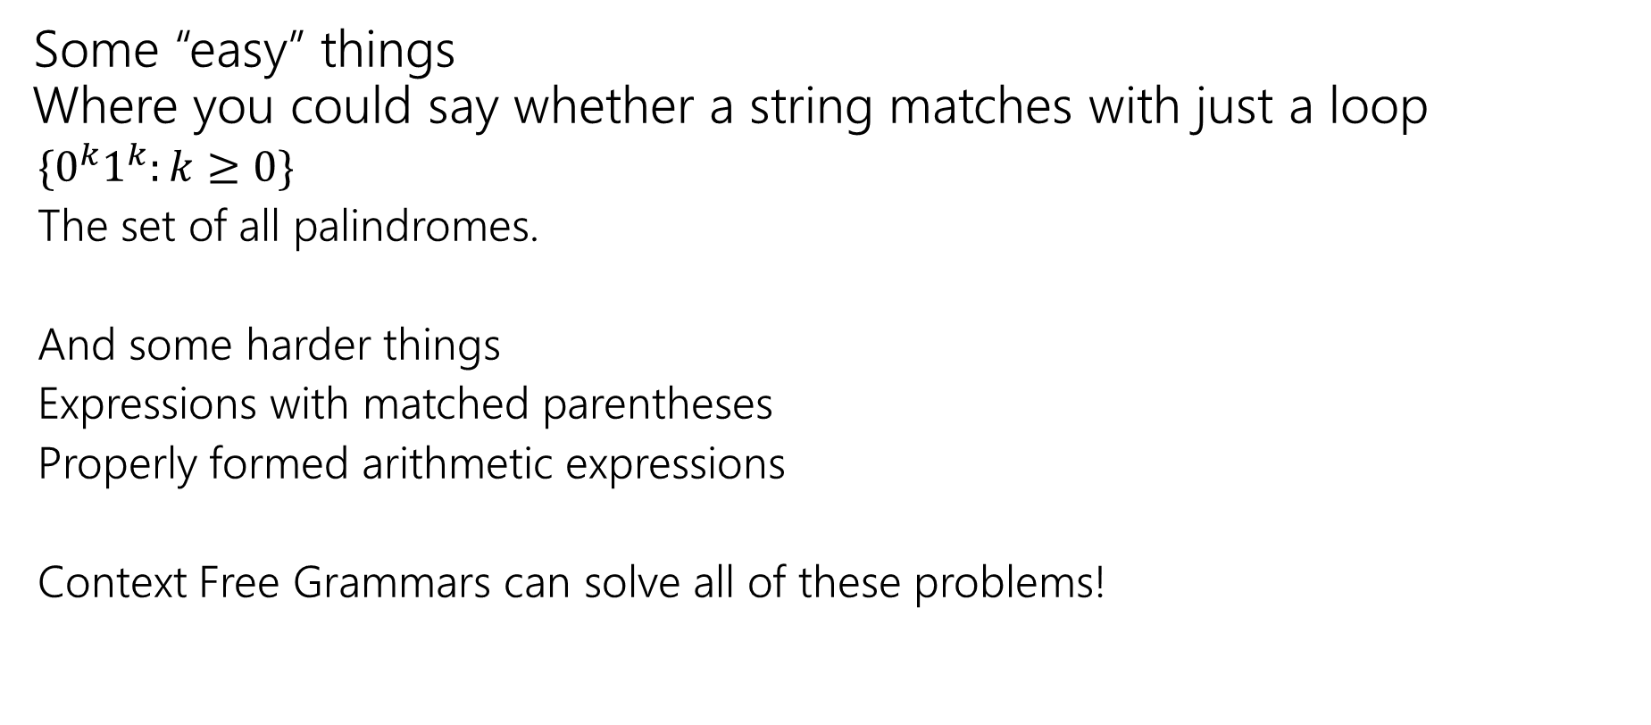
What Can’t Regular Expressions Do?
Some “easy” things
Where you could say whether a string matches with just a loop
  $\{0^{k}1^{k}:k≥0\}$
  The set of all palindromes.
  And some harder things
  Expressions with matched parentheses
  Properly formed arithmetic expressions
  Context Free Grammars can solve all of these problems!

Slide 6
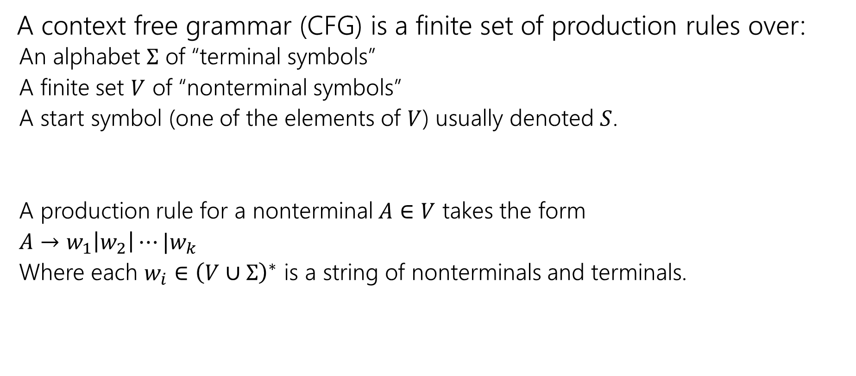
Context Free Grammars
A context free grammar (CFG) is a finite set of production rules over:
  An alphabet $Σ$ of “terminal symbols”
  A finite set $V$ of “nonterminal symbols”
  A start symbol (one of the elements of $V$) usually denoted $S$.
  A production rule for a nonterminal $A∈V$ takes the form
  $A→w_{1}\left|w_{2}\right|⋯|w_{k}$
  Where each $w_{i}∈{\left(V∪Σ\right)}^{∗}$ is a string of nonterminals and terminals.

Slide 7
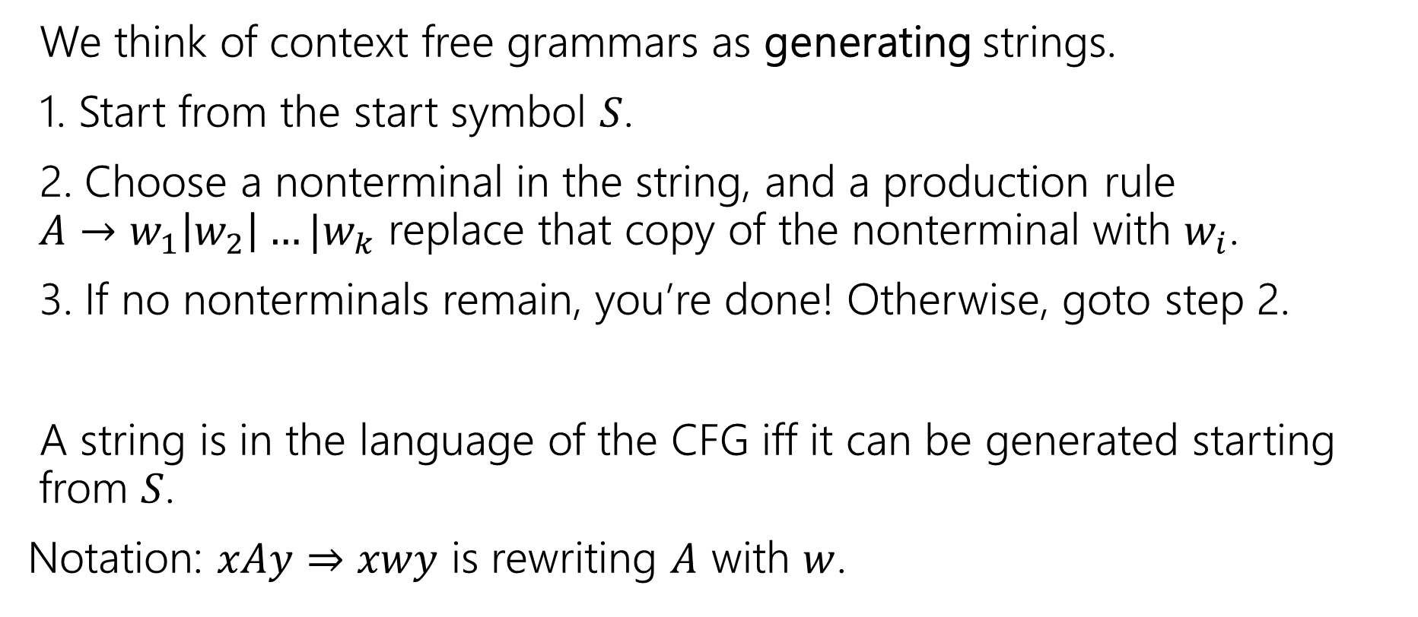
Context Free Grammars
We think of context free grammars as generating strings.
1. Start from the start symbol $S$.
2. Choose a nonterminal in the string, and a production rule
$A→w_{1}\left|w_{2}\right|…|w_{k}$ replace that copy of the nonterminal with $w_{i}$.
3. If no nonterminals remain, you’re done! Otherwise, goto step 2.
A string is in the language of the CFG iff it can be generated starting from $S$.
Notation: $xAy⇒xwy$ is rewriting $A$ with $w$.

Slide 8

Examples
$S→0S0\left|1S1\right|0|1|ε$
$S→0S|S1|ε$
$S→\left(S\right)\left|SS\right|ε$
$S→AB$
$A→0A1|ε$
$B→1B0|ε$

Slide 9
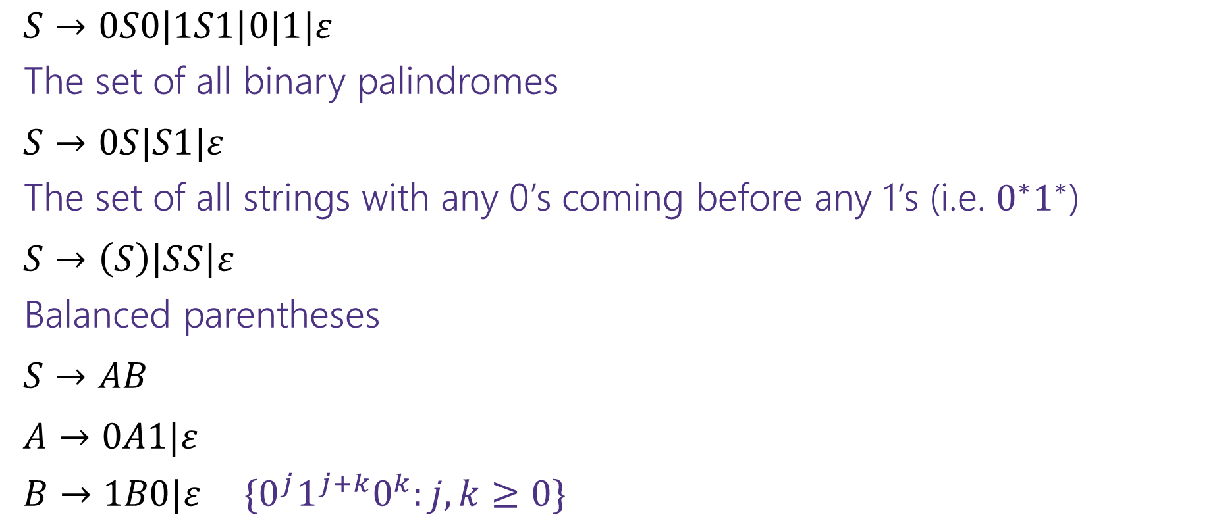
Examples
$S→0S0\left|1S1\right|0|1|ε$
The set of all binary palindromes
$S→0S|S1|ε$
The set of all strings with any 0’s coming before any 1’s (i.e. $0^{∗}1^{∗}$)
$S→\left(S\right)\left|SS\right|ε$
Balanced parentheses
$S→AB$
$A→0A1|ε$
$B→1B0|ε$ $\{0^{j}1^{j+k}0^{k}:j,k≥0\}$

Slide 10

Arithmetic
$E→E+E\left|E∗E\right|\left(E\right)\left|x\right|y\left|z\right|0\left|1\right|2\left|3\right|4\left|5\right|6\left|7\right|8|9$
Generate $\left(2∗x\right)+y$
Generate $2+3∗4$ in two different ways
pollev.com/uwcse311

Slide 11
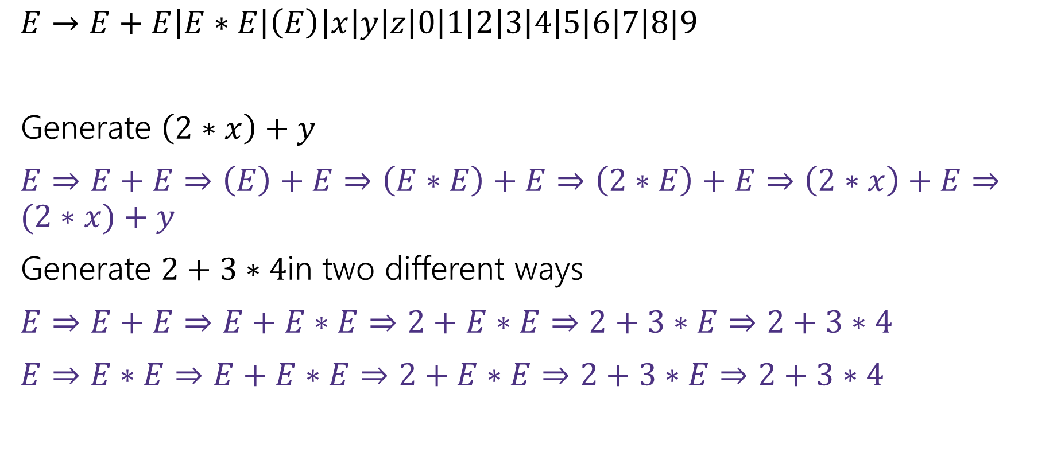
Arithmetic
$E→E+E\left|E∗E\right|\left(E\right)\left|x\right|y\left|z\right|0\left|1\right|2\left|3\right|4\left|5\right|6\left|7\right|8|9$
Generate $\left(2∗x\right)+y$
$E⇒E+E⇒\left(E\right)+E⇒\left(E∗E\right)+E⇒\left(2∗E\right)+E⇒\left(2∗x\right)+E⇒(2∗x)+y$
Generate $2+3∗4$in two different ways
$E⇒E+E⇒E+E∗E⇒2+E∗E⇒2+3∗E⇒2+3∗4$
$E⇒E∗E⇒E+E∗E⇒2+E∗E⇒2+3∗E⇒2+3∗4$

Slide 12
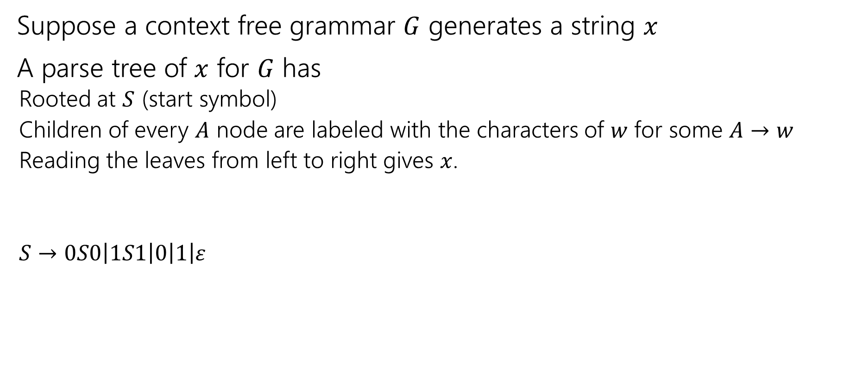
Parse Trees
Suppose a context free grammar $G$ generates a string $x$
A parse tree of $x$ for $G$ has
  Rooted at $S$ (start symbol)
  Children of every $A$ node are labeled with the characters of $w$ for some $A→w$
  Reading the leaves from left to right gives $x$.
  $S→0S0\left|1S1\right|0\left|1\right|ε$
S
0
S
0
1
S
1
1

Slide 13



Back to the arithmetic
$E→E+E\left|E∗E\right|\left(E\right)\left|x\right|y\left|z\right|0\left|1\right|2\left|3\right|4\left|5\right|6\left|7\right|8|9$
Two parse trees for $2+3∗4$
E
E
E
+
E
E
$$∗$$
E
E
$$∗$$
E
+
E
4
2
E
3
4
2
3

Slide 14

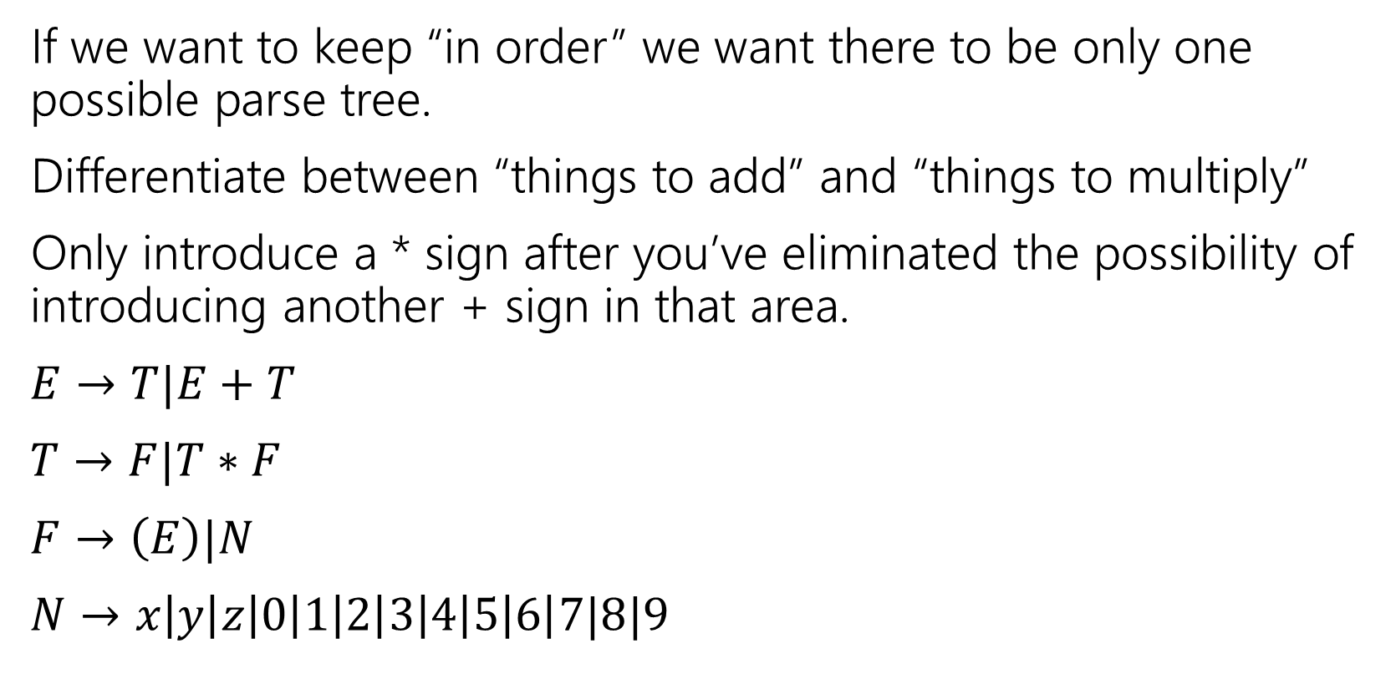
How do we encode order of operations
If we want to keep “in order” we want there to be only one possible parse tree.
Differentiate between “things to add” and “things to multiply”
Only introduce a * sign after you’ve eliminated the possibility of introducing another + sign in that area.
$E→T|E+T$
$T→F|T∗F$
$F→\left(E\right)|N$
$N→x\left|y\right|z\left|0\right|1\left|2\right|3\left|4\right|5\left|6\right|7|8|9$
E
E
+
T
T
T
$$∗$$
F
F
N
F
N
4
N
3
2

Slide 15
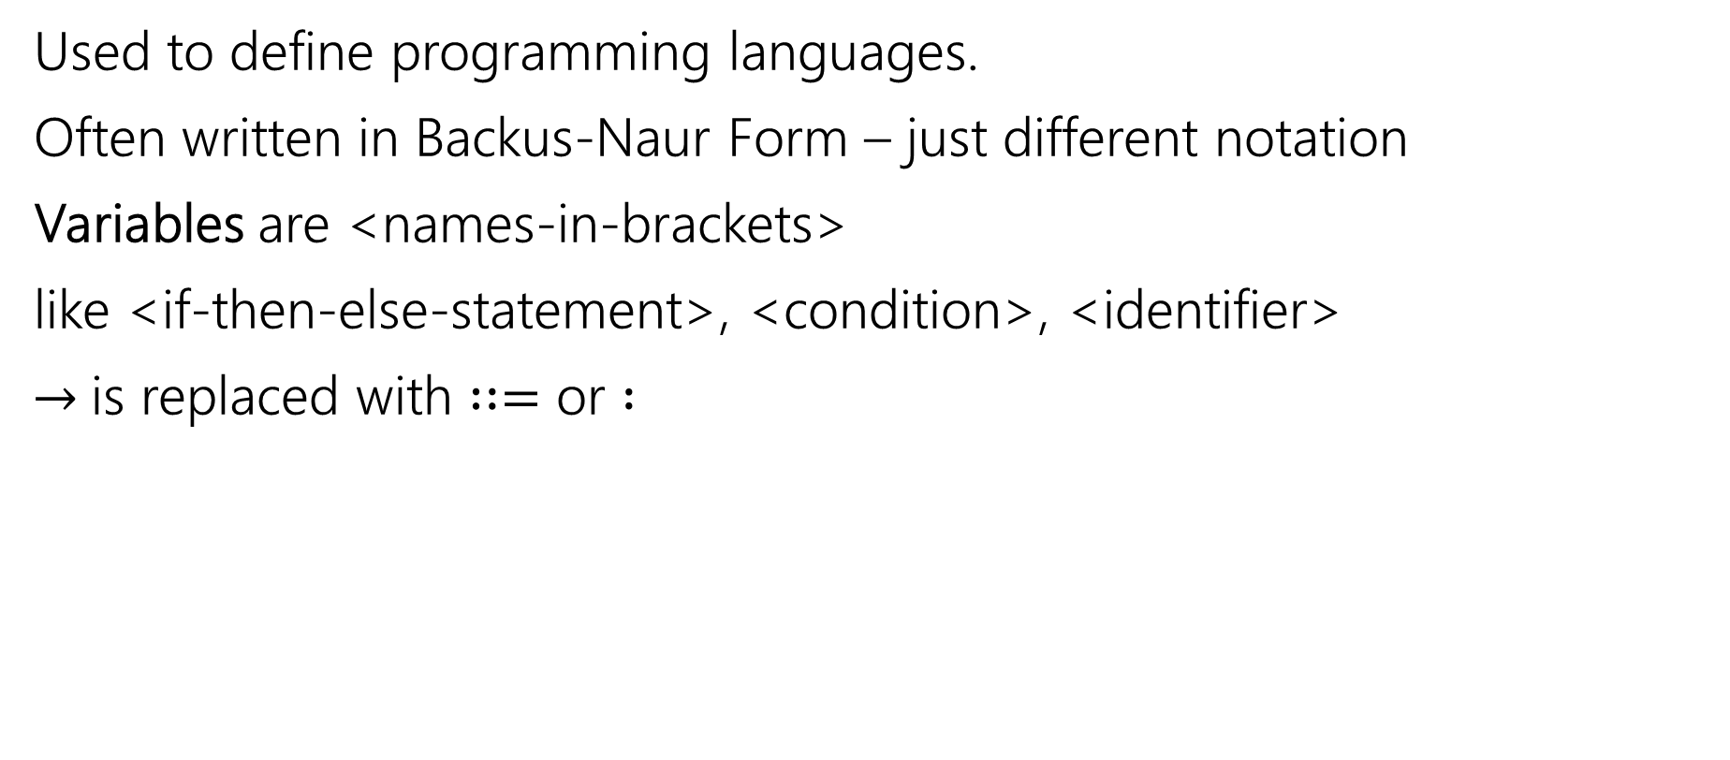
CNFs in practice
Used to define programming languages.
Often written in Backus-Naur Form – just different notation
Variables are <names-in-brackets>
like <if-then-else-statement>, <condition>, <identifier>
$→$is replaced with $∷=$ or $:$

Slide 16
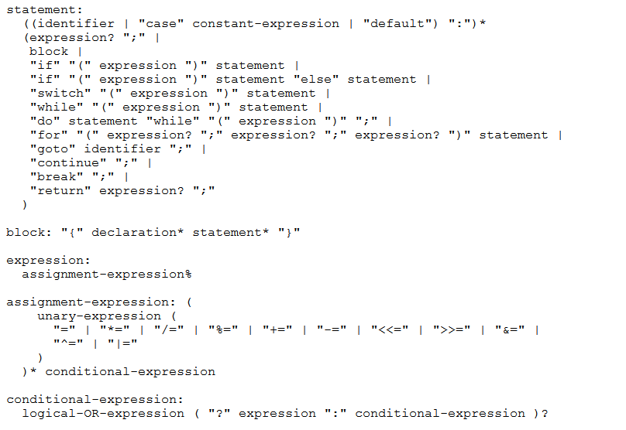
BNF for C (no <...> and uses : instead of ::=)

Slide 17
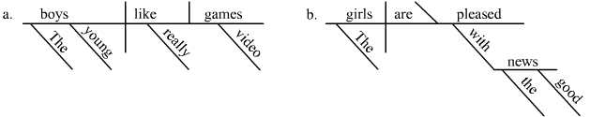
Parse Trees
Remember diagramming sentences in middle school?
<sentence>::=<noun phrase><verb phrase>
<noun phrase>::=<determiner><adjective><noun>
<verb phrase>::=<verb><adverb>|<verb><object>
<object>::=<noun phrase>

Slide 18
Parse Trees
<sentence>::=<noun phrase><verb phrase>
<noun phrase>::=<determiner><adjective><noun>
<verb phrase>::=<verb><adverb>|<verb><object>
<object>::=<noun phrase>
The old man the boat.

Slide 19
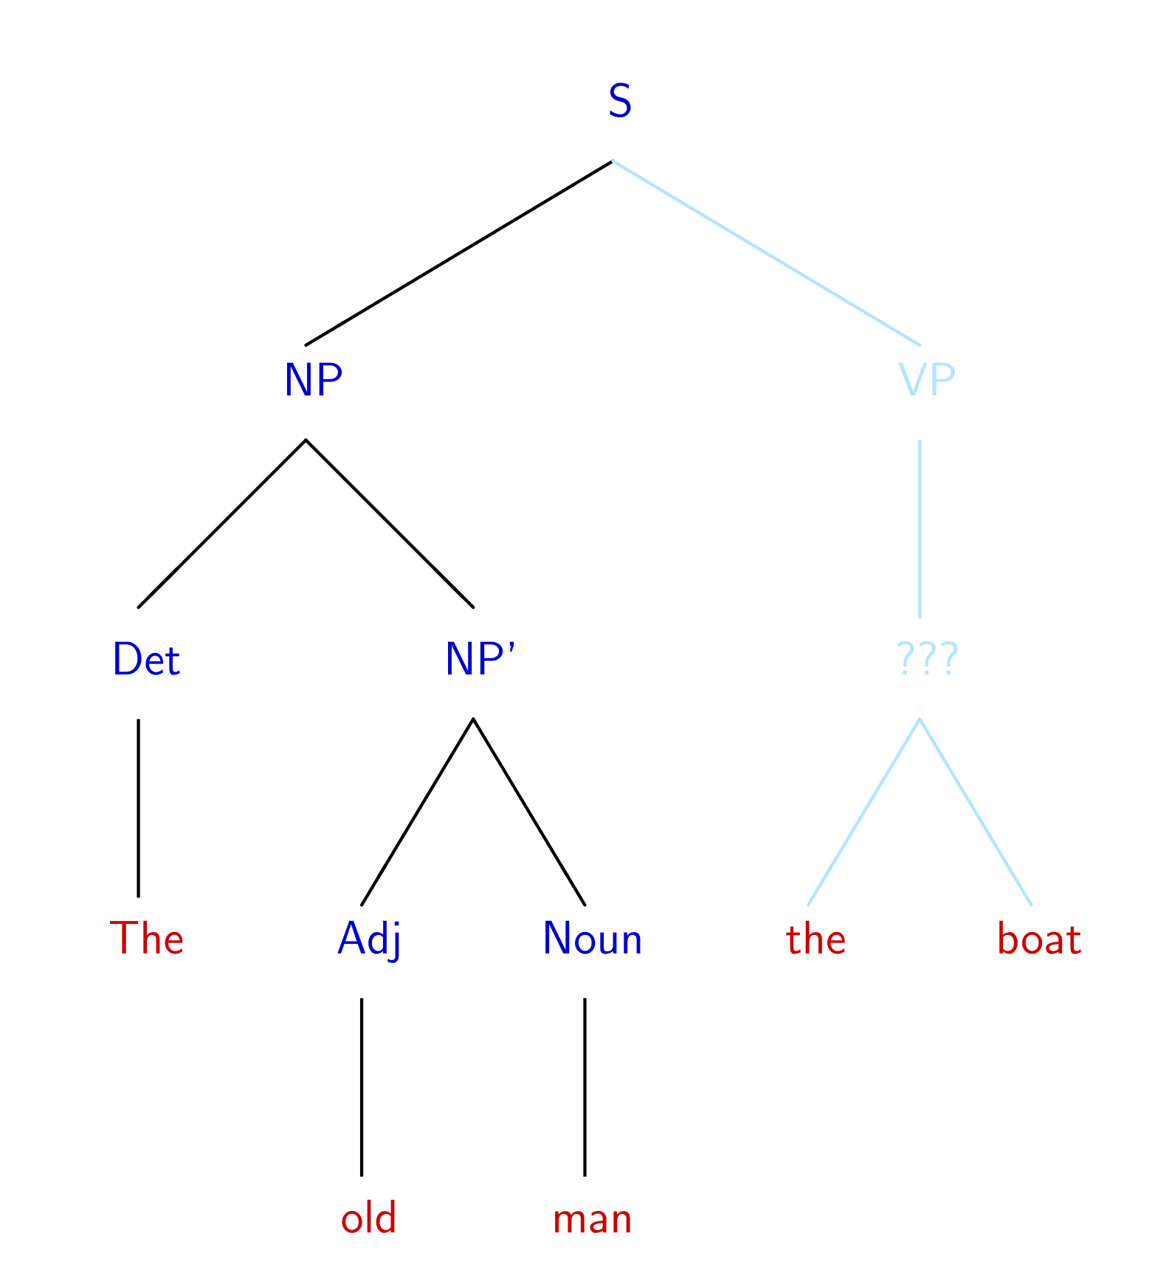
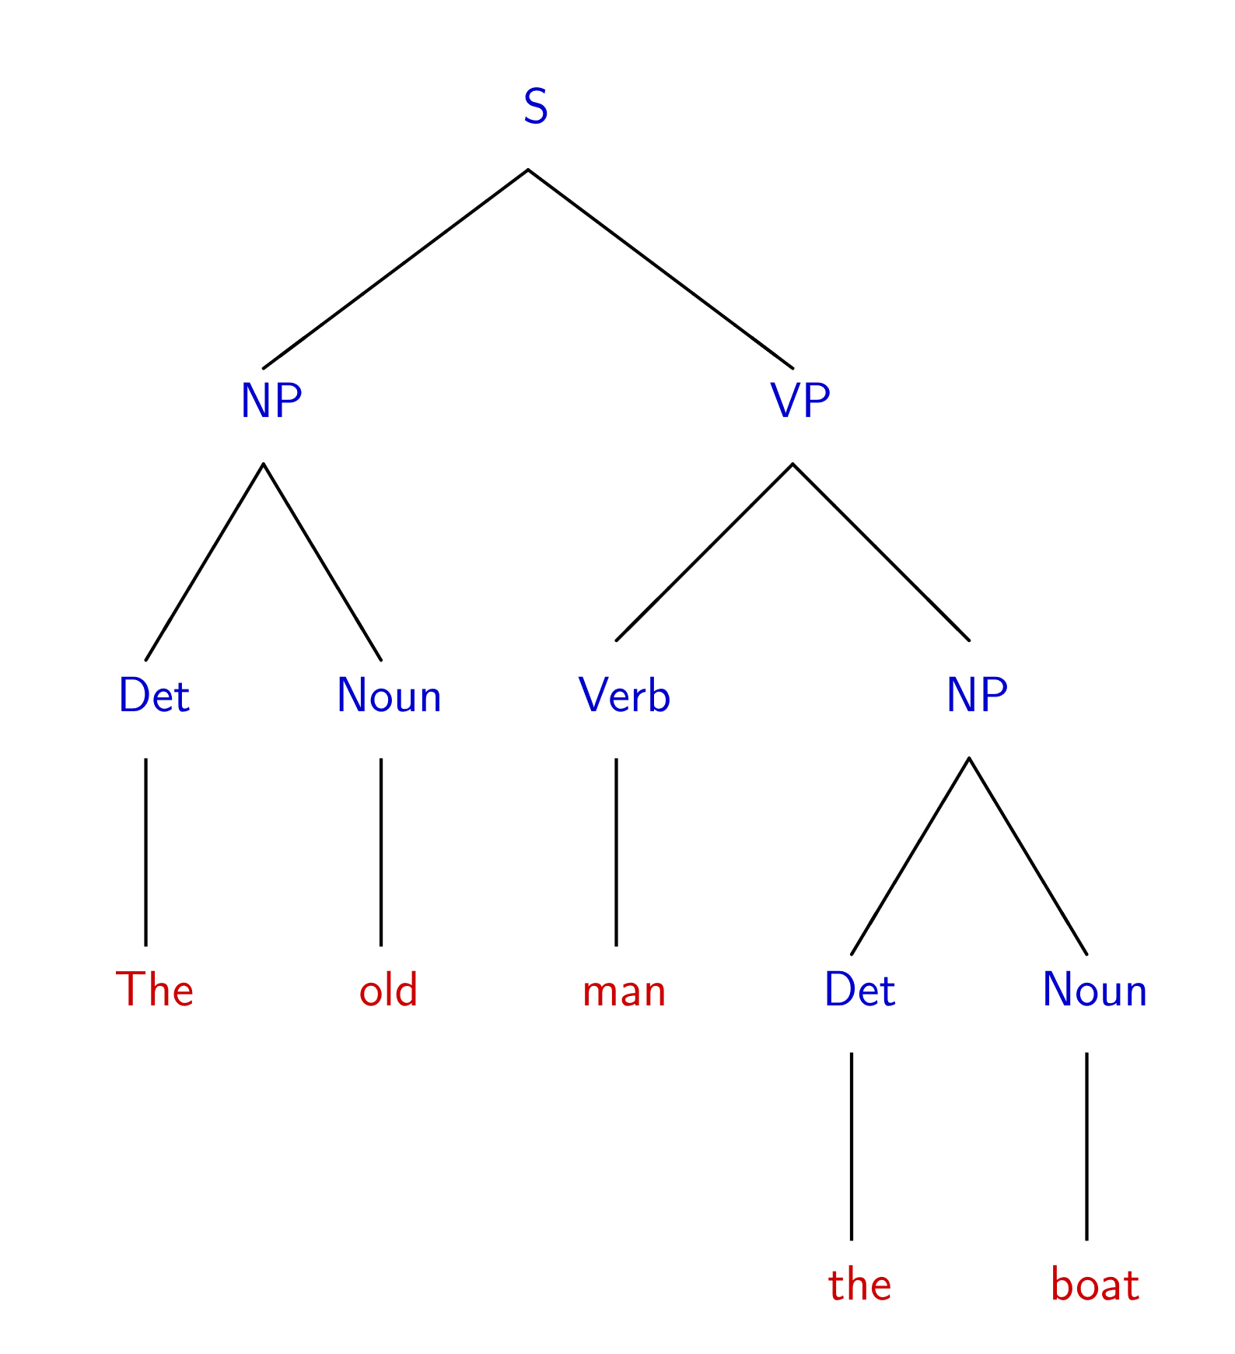
The old man the boat
By Jochen Burghardt - Own work, CC BY-SA 4.0, https://commons.wikimedia.org/w/index.php?curid=92742400

Slide 20
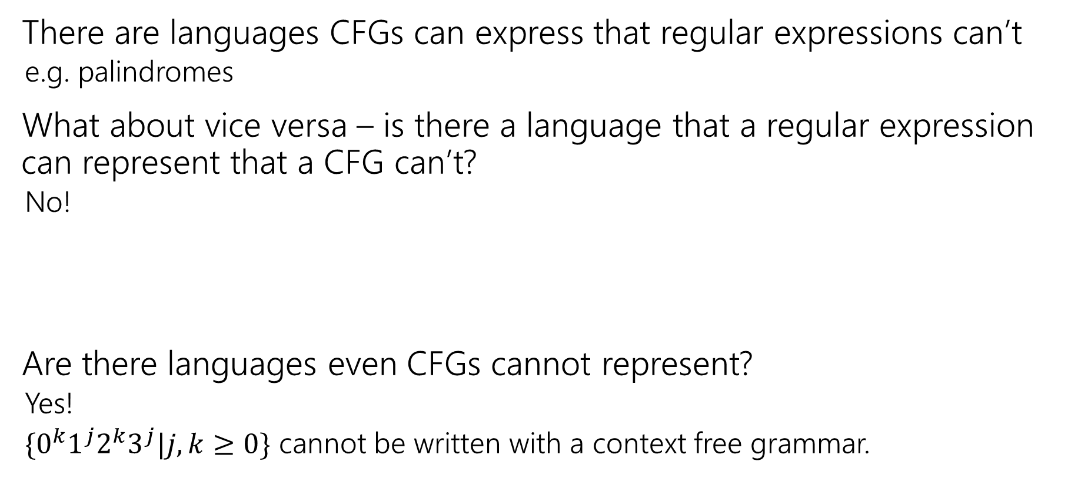
Power of Context Free Languages
There are languages CFGs can express that regular expressions can’t
  e.g. palindromes
What about vice versa – is there a language that a regular expression can represent that a CFG can’t?
  No!
Are there languages even CFGs cannot represent?
  Yes!
  $\{0^{k}1^{j}2^{k}3^{j}|j,k≥0\}$ cannot be written with a context free grammar.

Slide 21
Takeaways
CFGs and regular expressions gave us ways of succinctly representing sets of strings
  Regular expressions super useful for representing things you need to search for
  CFGs represent complicated languages like “java code with valid syntax”
Next Week, we’ll talk about how each of these are “equivalent to weaker computers.”
This week: Two more tools for our toolbox.

Slide 22
Relations and Graphs

Slide 23
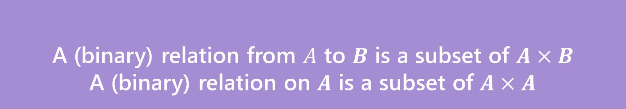

Relations
A (binary) relation from $A$ to $B$ is a subset of $A×B$
A (binary) relation on $A$ is a subset of $A×A$
Wait what?
$≤$ is a relation on $ℤ$.
“$3≤4“$ is a way of saying “3 relates to 4” (for the $≤$ relation)
$(3,4)$ is an element of the set that defines the relation.
Relations

Slide 24
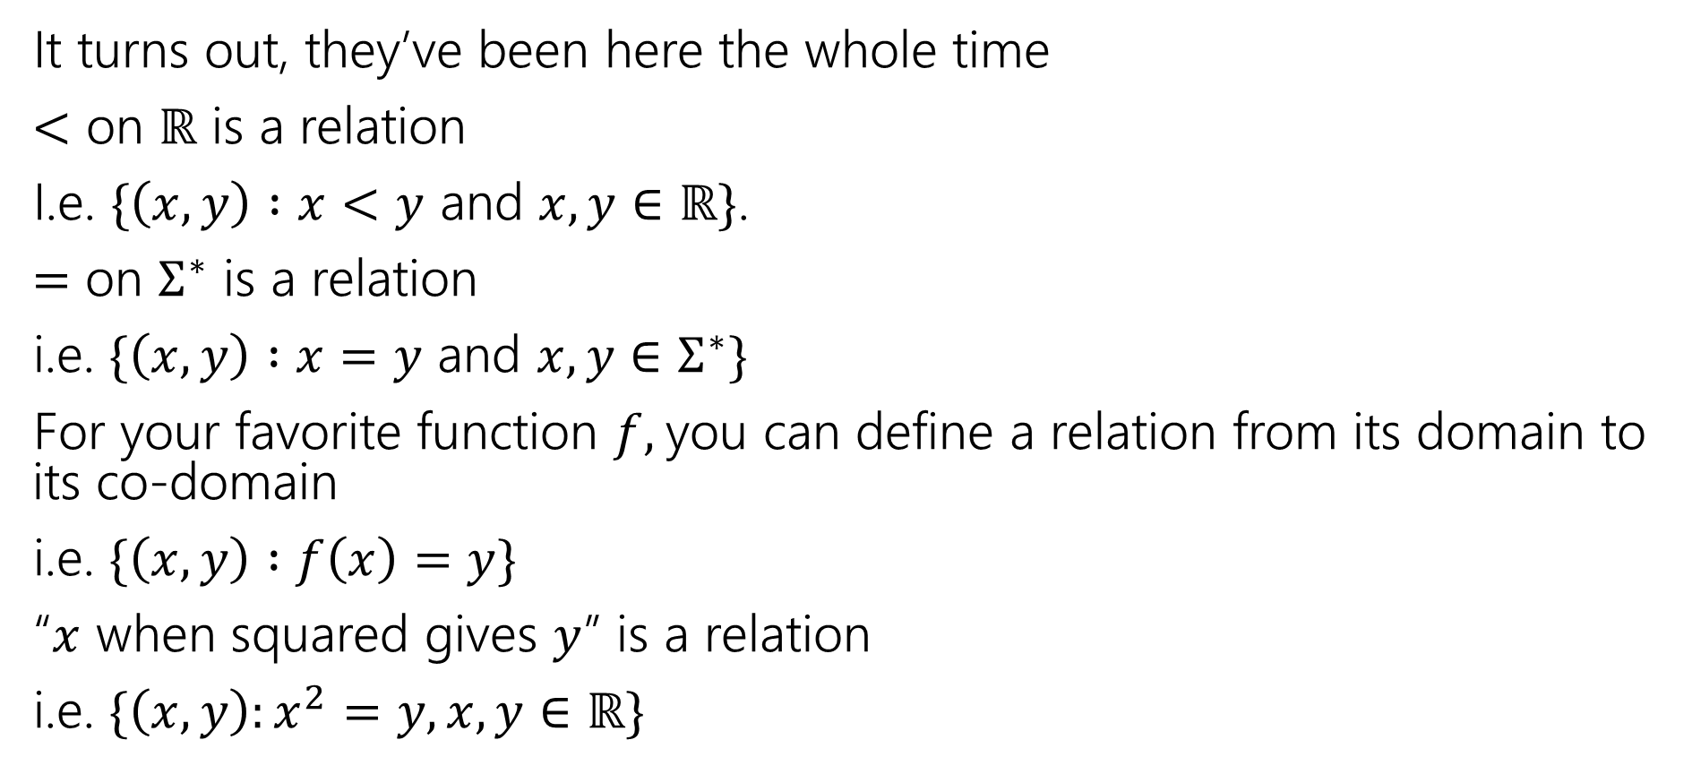
Relations, Examples
It turns out, they’ve been here the whole time
$<$ on $ℝ$ is a relation
I.e. $\{\left(x,y\right) :x<y$ and $x,y∈ℝ\}$.
$=$ on $Σ^{∗}$ is a relation
i.e. $\{\left(x,y\right) :x=y$ and $x,y∈Σ^{∗}\}$
For your favorite function $f,$you can define a relation from its domain to its co-domain
i.e. $\{\left(x,y\right) :f\left(x\right)=y\}$
“$x$ when squared gives $y$” is a relation
i.e. $\{\left(x,y\right):x^{2}=y, x,y∈ℝ\}$

Slide 25
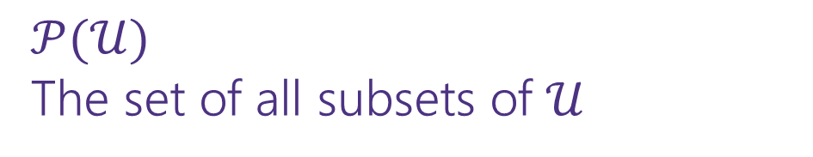

Relations, Examples
Fix a universal set $𝒰$.
$⊆$ is a relation. What’s it on?
$𝒫(𝒰)$
The set of all subsets of $𝒰$

Slide 26
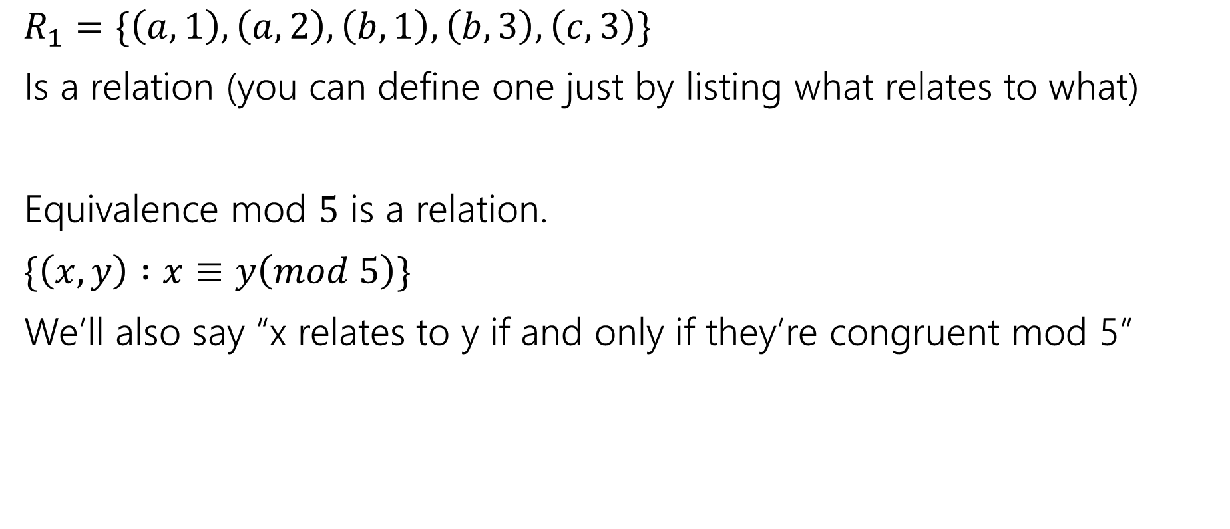
More Relations
$R_{1}=\{\left(a,1\right), \left(a,2\right), \left(b,1\right),\left(b,3\right),\left(c,3\right)\}$
Is a relation (you can define one just by listing what relates to what)
Equivalence mod $5$ is a relation.
$\{\left(x,y\right) :x≡y\left(mod 5\right)\}$
We’ll also say “x relates to y if and only if they’re congruent mod 5”

Slide 27
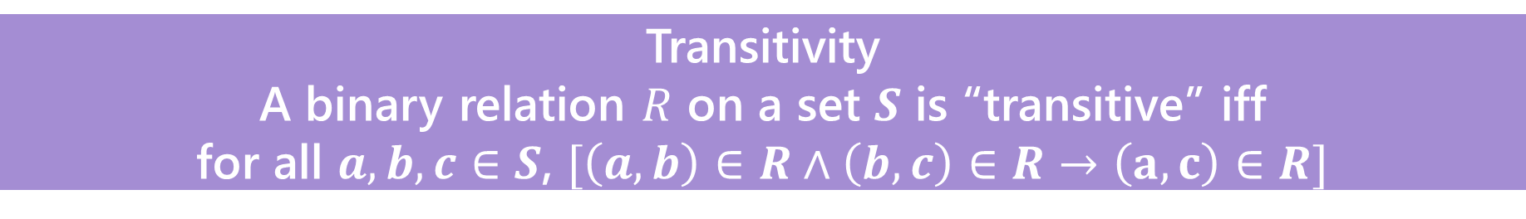

Properties of relations
What do we do with relations? Usually we prove properties about them.
Symmetry
A binary relation $R$ on a set $S$ is “symmetric” iff
for all $a,b∈S$, $[\left(a,b\right)∈R→\left(b,a\right)∈R]$
$=$ on $Σ^{∗}$ is symmetric, for all $a,b∈Σ^{∗}$ if $a=b$ then $b=a.$
$⊆$ is not symmetric on $𝒫(𝒰)$ – $\left\{1,2,3\right\}⊆\{1,2,3,4\}$ but $\left\{1,2,3,4\right\}⊈\{1,2,3\}$
Transitivity
A binary relation $R$ on a set $S$ is “transitive” iff
for all $a,b,c∈S$, $[\left(a,b\right)∈R∧\left(b,c\right)∈R→\left(a,c\right)∈R]$
$=$ on $Σ^{∗}$ is transitive, for all $a,b,c∈Σ^{∗}$ if $a=b$ and $b=c$ then $a=c$.
$⊆$ is transitive on $𝒫(𝒰)$ – for any sets $A,B,C$ if $A⊆B$ and $B⊆C$ then $A⊆C$.
$∈$ is not a transitive relation – $1∈\{1,2,3\}$, $\left\{1,2,3\right\}∈𝒫(\left\{1,2,3\right\})$ but $1∉𝒫\left(\left\{1,2,3\right\}\right).$

Slide 28

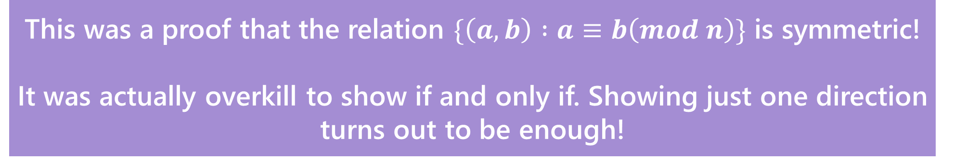
Warm up
Show that $a≡b \left(mod n\right)$ if and only if $b≡a(mod n)$
$a≡b\left(mod n\right)↔n|(b−a)↔nk=b−a\left(for k∈ℤ\right)↔$
$n(−k)=a−b(for −k∈ℤ)↔n|\left(a−b\right)↔b≡a(mod n)$
Show that $a\%n$=($a−n)\%n$ Where $b\%c$ is the unique $r$ such that $b=kc+r$ for some integer $k$.
By definition of %, $a=qn+(a\%n)$ for some integer $q$. Subtracting $n$,
$a−n=\left(q−1\right)n+(a\%n)$. Observe that $q−1$ is an integer, and that this is the form of the division theorem for $\left(a−n\right)\%n.$ Since the division theorem guarantees a unique integer, $\left(a−n\right)\%n=(a\%n)$
This was a proof that the relation $\{\left(a,b\right) :a≡b\left(mod n\right)\}$ is symmetric!
It was actually overkill to show if and only if. Showing just one direction turns out to be enough!

