Slide 1
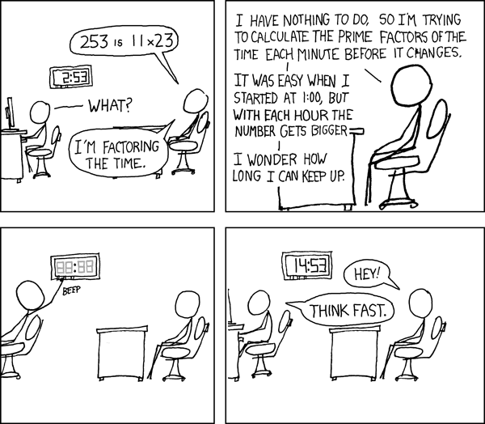
More Number Theory
xkcd.com/247
CSE 311 Winter 2022
Lecture 12

Slide 2
Today
Logistics
Proof by Contrapositive
Prime Numbers and GCDs
More Proofs!

Slide 3
Logistics
UW’s mask policy applies in-person (lectures, sections, office hours)
Your mask must cover your nose and mouth.
But you may briefly adjust your mask to take a drink of water.
If you need a longer break, it’s easy to step outside the building for a few minutes, you’re always free to step outside if you need to.
We added an extra video to panopto this morning!
Some extra explanation of the definition of mod, and some common misconceptions from HW3.

Slide 4
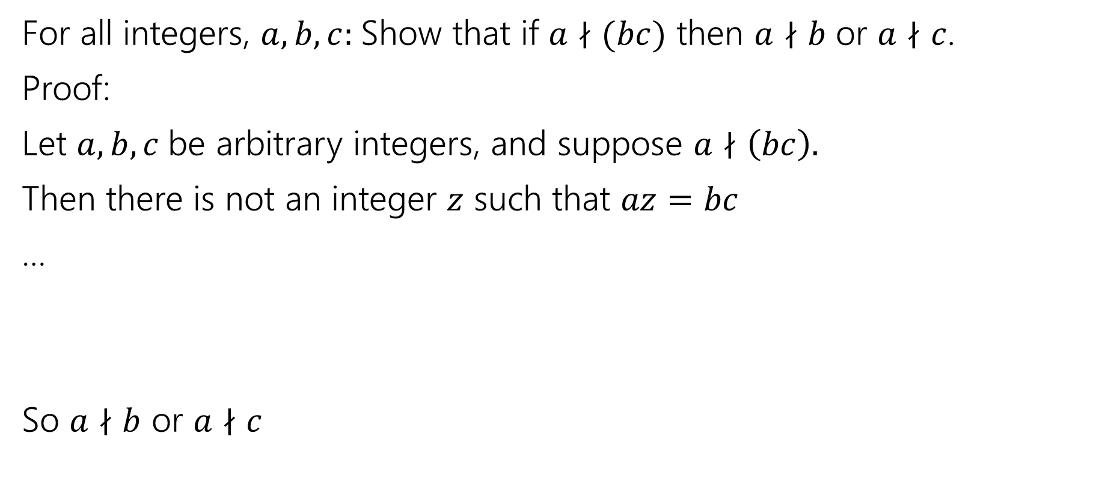
Another Proof
For all integers, $a,b,c:$Show that if $a∤(bc)$ then $a∤b$ or $a∤c$.
Proof:
Let $a,b,c$be arbitrary integers, and suppose $a∤\left(bc\right).$
Then there is not an integer $z$ such that $az=bc$
…
So $a∤b$ or $a∤c$

Slide 5

Another Proof
For all integers, $a,b,c:$Show that if $a∤(bc)$ then $a∤b$ or $a∤c$.
Proof:
Let $a,b,c$be arbitrary integers, and suppose $a∤\left(bc\right).$
Then there is not an integer $z$ such that $az=bc$
…
So $a∤b$ or $a∤c$
There has to be a better way!

Slide 6
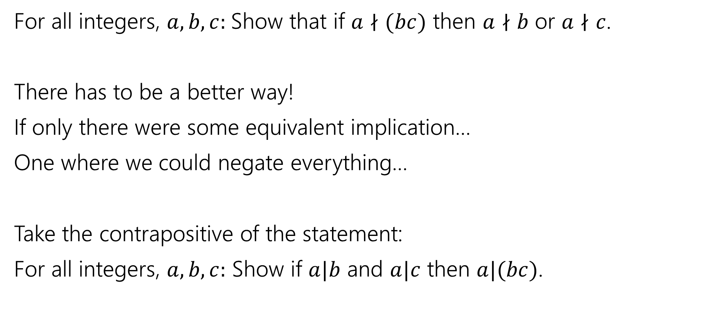
Another Proof
For all integers, $a,b,c:$Show that if $a∤(bc)$ then $a∤b$ or $a∤c$.
There has to be a better way!
If only there were some equivalent implication…
One where we could negate everything…
Take the contrapositive of the statement:
For all integers, $a,b,c:$ Show if $a|b$ and $a|c$ then $a|(bc)$.

Slide 7

By contrapositive
Claim: For all integers, $a,b,c:$Show that if $a∤(bc)$ then $a∤b$ or $a∤c$.
We argue by contrapositive.
Let $a,b,c$be arbitrary integers, and suppose $a|b$ and $a|c$.
Therefore $a|bc$

Slide 8
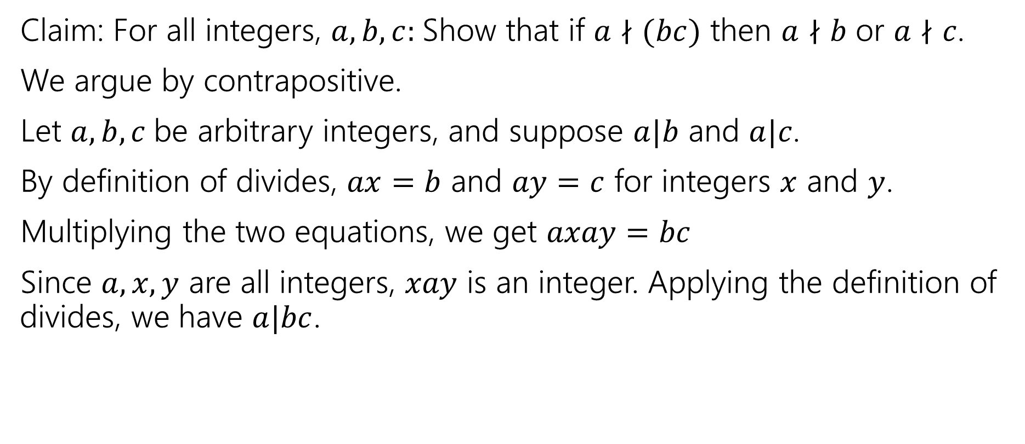
By contrapositive
Claim: For all integers, $a,b,c:$Show that if $a∤(bc)$ then $a∤b$ or $a∤c$.
We argue by contrapositive.
Let $a,b,c$be arbitrary integers, and suppose $a|b$ and $a|c$.
By definition of divides, $ax=b$ and $ay=c$ for integers $x$ and $y$.
Multiplying the two equations, we get $axay=bc$
Since $a,x,y$ are all integers, $xay$ is an integer. Applying the definition of divides, we have $a|bc$.

Slide 9
Divisors and Primes

Slide 10

Primes and FTA
An integer $p>1$ is prime iff its only positive divisors are $1$ and $p.$ Otherwise it is “composite”
Prime
Every positive integer greater than 1 has a unique
prime factorization.
Fundamental Theorem of Arithmetic

Slide 11
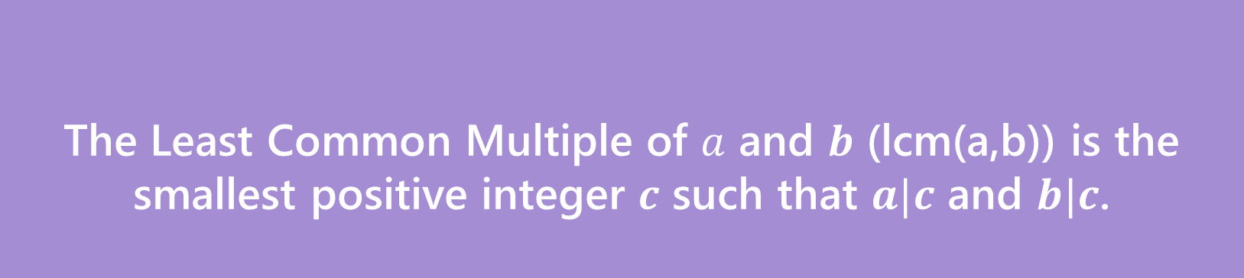
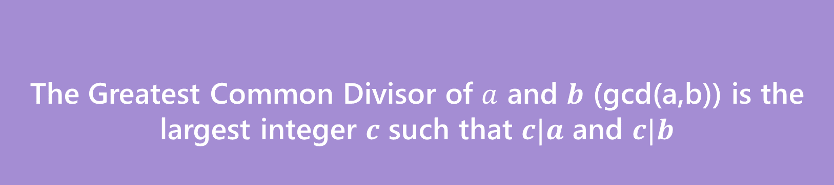
GCD and LCM
The Greatest Common Divisor of $a$ and $b$ (gcd(a,b)) is the largest integer $c$ such that $c|a$ and $c|b$
Greatest Common Divisor
The Least Common Multiple of $a$ and $b$ (lcm(a,b)) is the smallest positive integer $c$ such that $a|c$ and $b|c$.
Least Common Multiple

Slide 12
Try a few values…
gcd(100,125)
gcd(17,49)
gcd(17,34)
gcd(13,0)
lcm(7,11)
lcm(6,10)

Slide 13
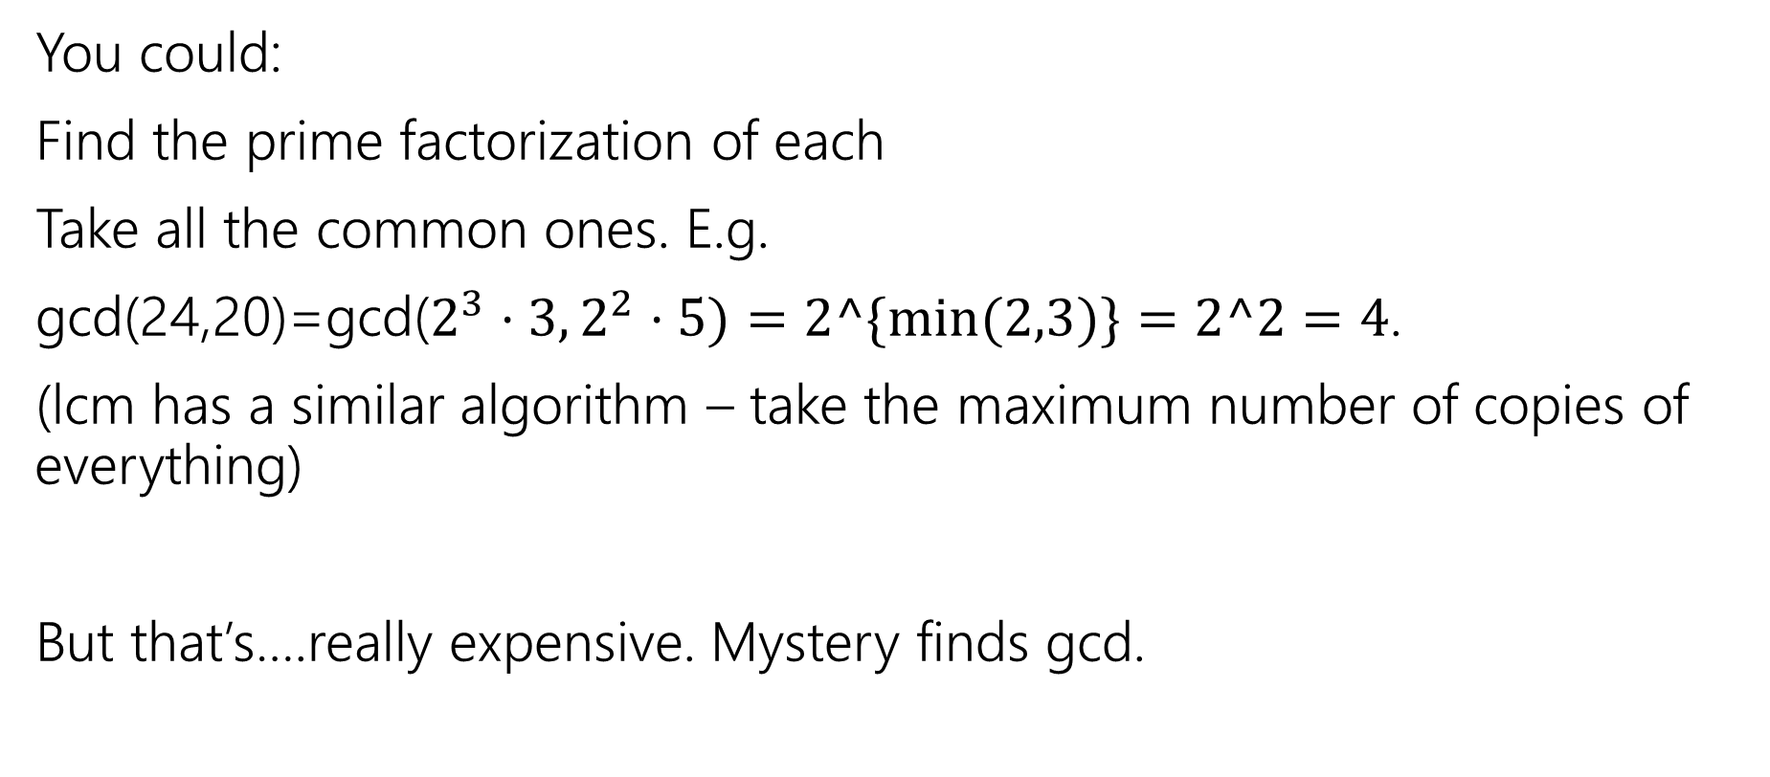
How do you calculate a gcd?
You could:
Find the prime factorization of each
Take all the common ones. E.g.
gcd(24,20)=gcd($2^{3}⋅3, 2^{2}⋅5)=2^\{min⁡(2,3)\}=2^2=4$.
(lcm has a similar algorithm – take the maximum number of copies of everything)
But that’s….really expensive. Mystery finds gcd.

Slide 14
public int Mystery(int m, int n){
if(m<n){
int temp = m;
m=n;
n=temp;
}
while(n != 0) {
int rem = m % n;
m=n;
n=temp;
}
return m;
}

Slide 15

GCD fact
If $a$ and $b$ are positive integers, then gcd(a,b) = gcd(b, a % b)
Why is this true? The proof isn’t easy, we’ll do it next week.
Why should you care?

Slide 16
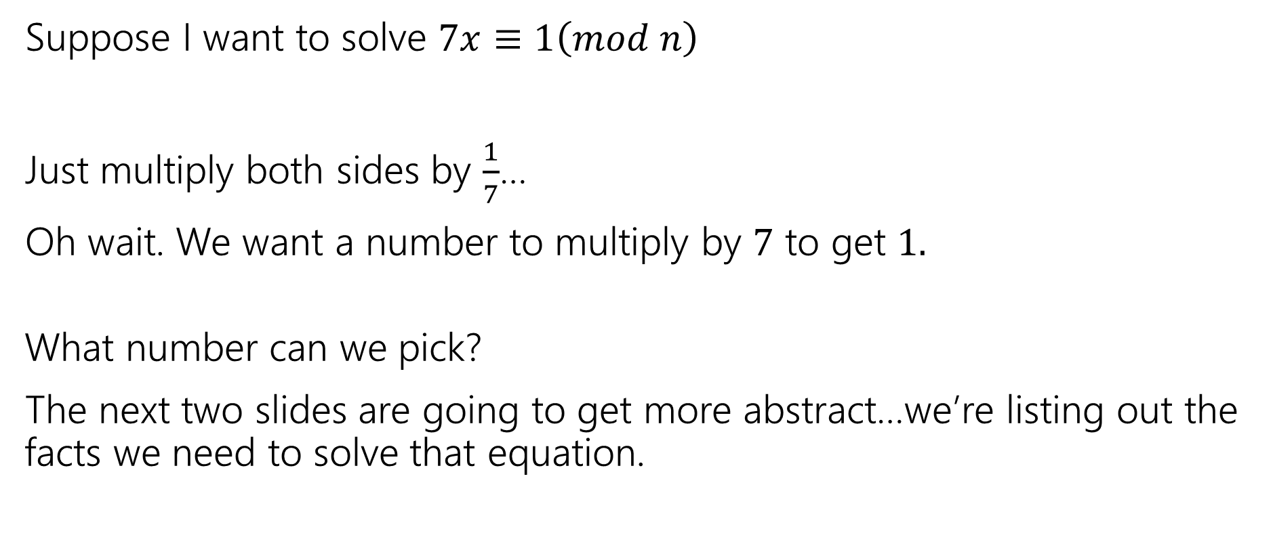
So…what’s it good for?
Fun fact: Solving equations like this one is a key step in how the RSA encryption system works.
Suppose I want to solve $7x≡1\left(mod n\right)$
Just multiply both sides by $\frac{1}{7}$…
Oh wait. We want a number to multiply by $7$ to get $1.$
What number can we pick?
The next two slides are going to get more abstract…we’re listing out the facts we need to solve that equation.

Slide 17
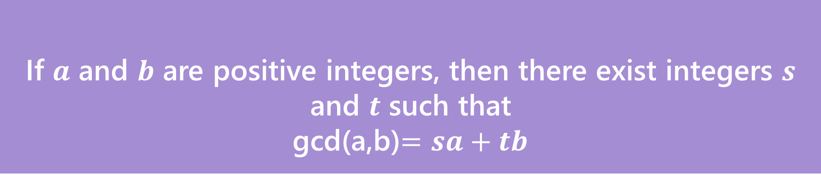
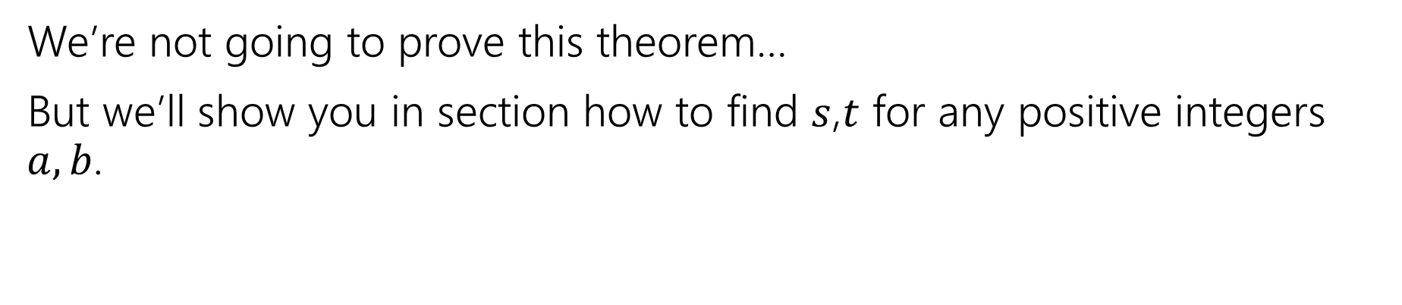
Bézout’s Theorem
If $a$ and $b$ are positive integers, then there exist integers $s$ and $t$ such that
gcd(a,b)$=sa+tb$
Bézout’s Theorem
We’re not going to prove this theorem…
But we’ll show you in section how to find $s$,$t$ for any positive integers $a,b$.

Slide 18
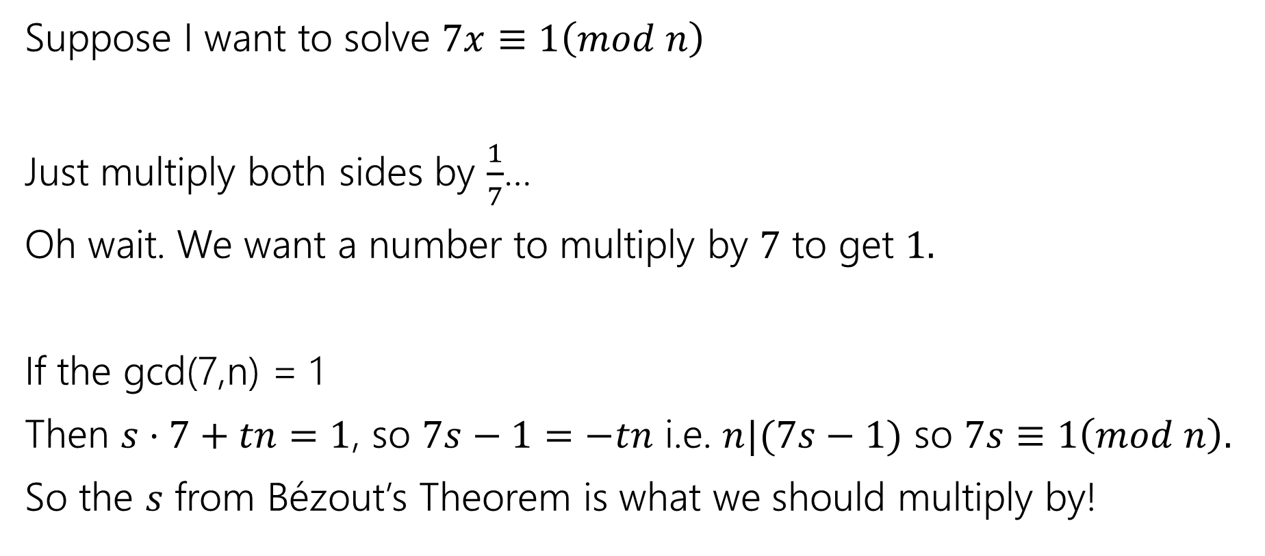
So…what’s it good for?
Suppose I want to solve $7x≡1\left(mod n\right)$
Just multiply both sides by $\frac{1}{7}$…
Oh wait. We want a number to multiply by $7$ to get $1.$
If the gcd(7,n) = 1
Then $s⋅7+tn=1$, so $7s−1=−tn$ i.e. $n|(7s−1)$ so $7s≡1\left(mod n\right).$
So the $s$ from Bézout’s Theorem is what we should multiply by!

Slide 19
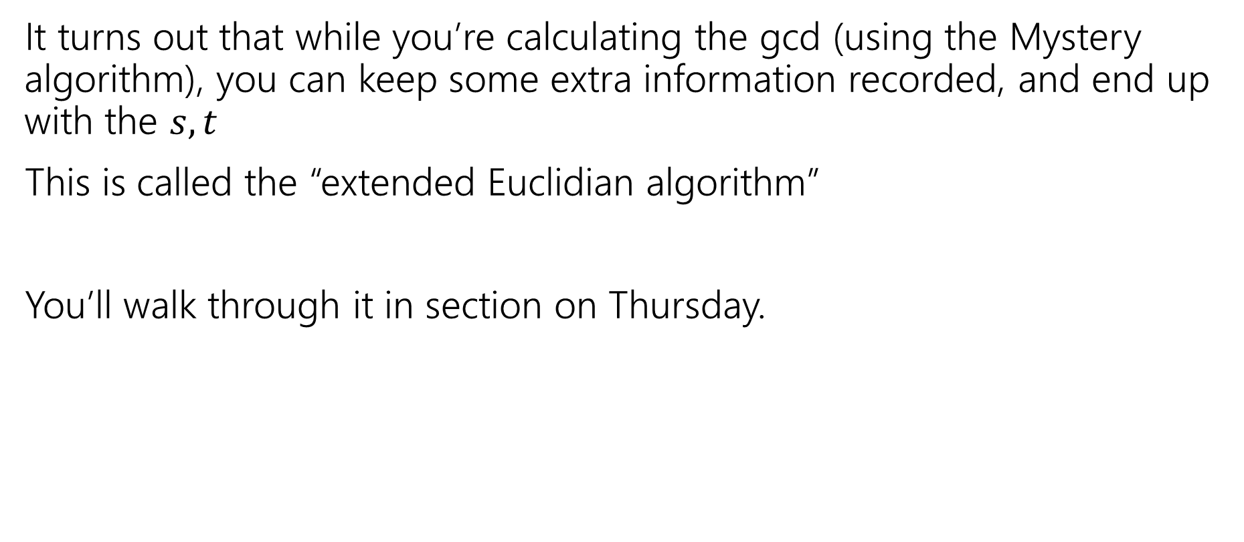

Ok…how am I supposed to find $s,t$?
It turns out that while you’re calculating the gcd (using the Mystery algorithm), you can keep some extra information recorded, and end up with the $s,t$
This is called the “extended Euclidian algorithm”
You’ll walk through it in section on Thursday.

Slide 20
More Mod proofs

Slide 21
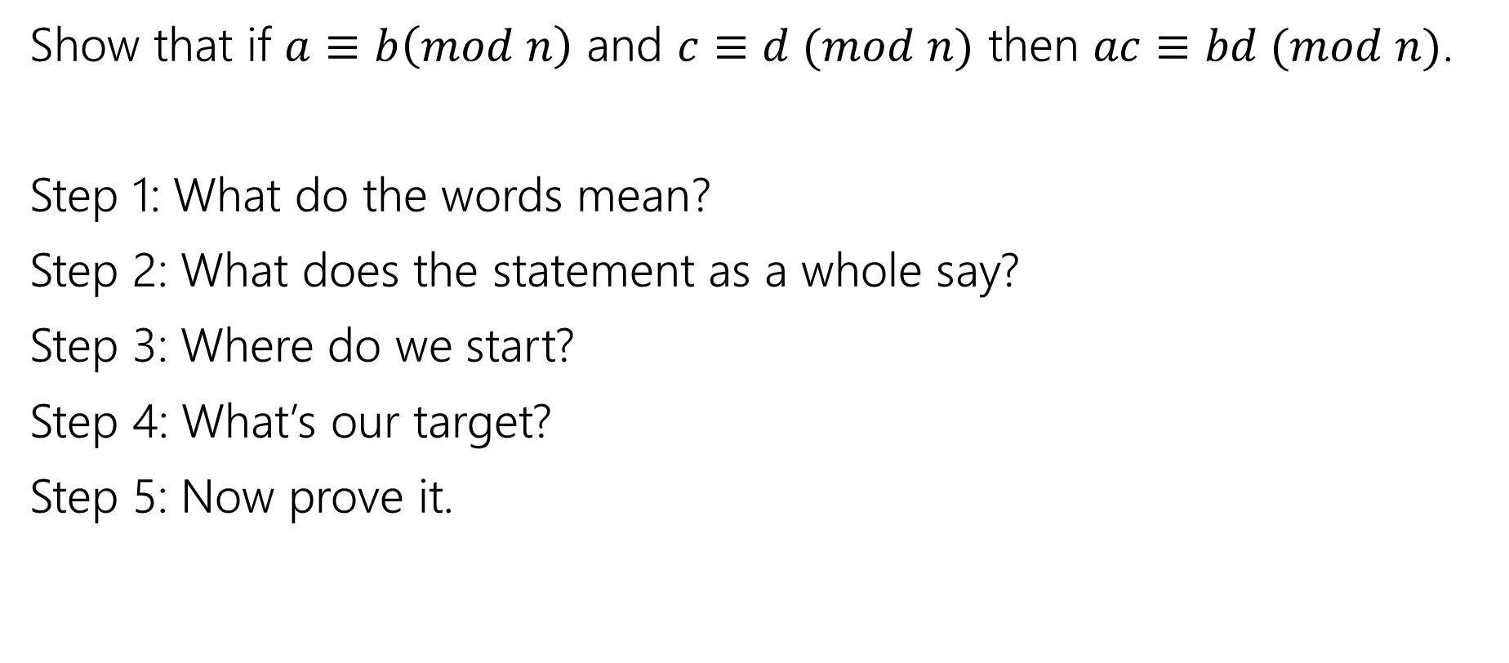
More proofs
Show that if $a≡b\left(mod n\right)$ and $c≡d (mod n)$ then $ac≡bd (mod n)$.
Step 1: What do the words mean?
Step 2: What does the statement as a whole say?
Step 3: Where do we start?
Step 4: What’s our target?
Step 5: Now prove it.

Slide 22

Another Proof
Show that if $a≡b\left(mod n\right)$ and $c≡d (mod n)$ then $ac≡bd (mod n)$.
Let $a,b,c,d,n∈ℤ, n≥0$ and suppose $a≡b\left(mod n\right)$ and $c≡d (mod n)$.
$ac≡bd(mod n)$

Slide 23
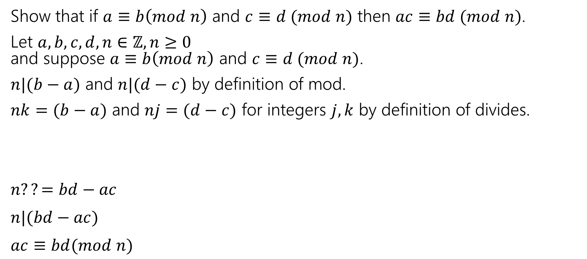
Another Proof
Show that if $a≡b\left(mod n\right)$ and $c≡d (mod n)$ then $ac≡bd (mod n)$.
Let $a,b,c,d,n∈ℤ, n≥0$ and suppose $a≡b\left(mod n\right)$ and $c≡d (mod n)$.
$n|(b−a)$ and $n|(d−c)$ by definition of mod.
$nk=(b−a)$ and $nj=(d−c)$ for integers $j,k$ by definition of divides.
$n??=bd−ac$
$n|(bd−ac)$
$ac≡bd(mod n)$

Slide 24
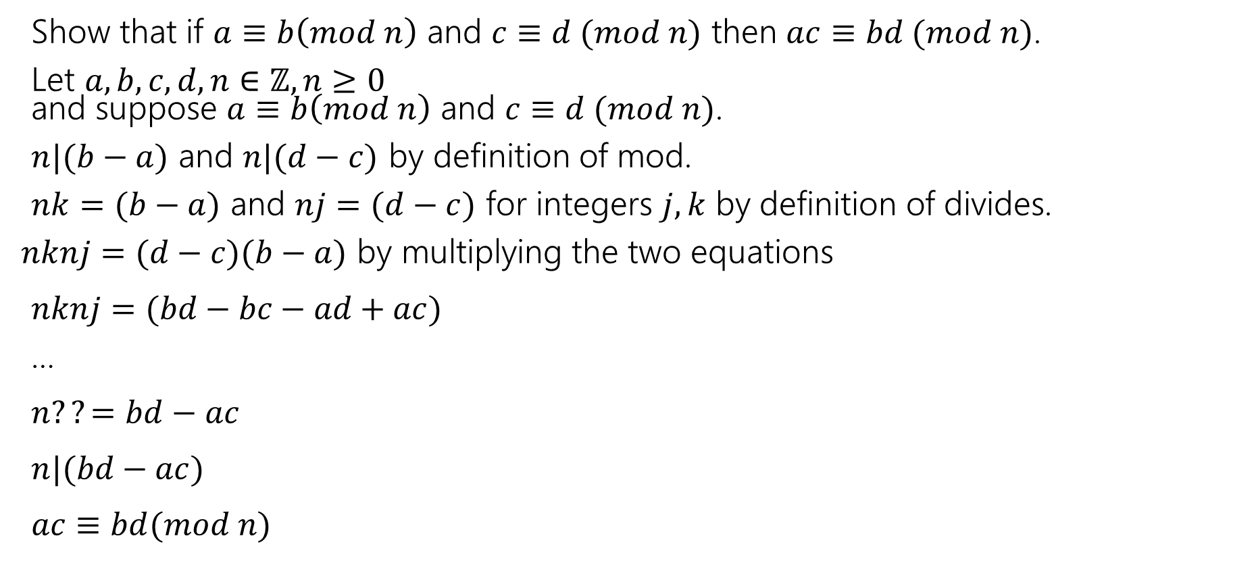
Another Proof
Show that if $a≡b\left(mod n\right)$ and $c≡d (mod n)$ then $ac≡bd (mod n)$.
Let $a,b,c,d,n∈ℤ, n≥0$ and suppose $a≡b\left(mod n\right)$ and $c≡d (mod n)$.
$n|(b−a)$ and $n|(d−c)$ by definition of mod.
$nk=(b−a)$ and $nj=(d−c)$ for integers $j,k$ by definition of divides.
$nknj=(d−c)(b−a)$ by multiplying the two equations
$nknj=(bd−bc−ad+ac)$
…
$n??=bd−ac$
$n|(bd−ac)$
$ac≡bd(mod n)$

Slide 25
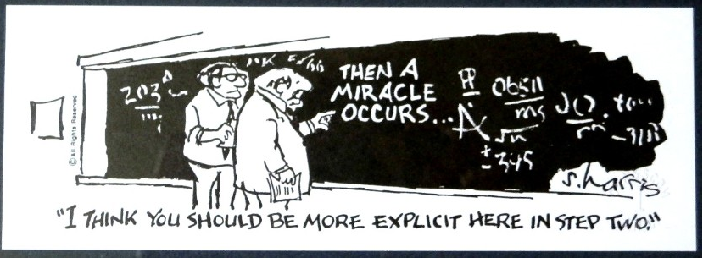
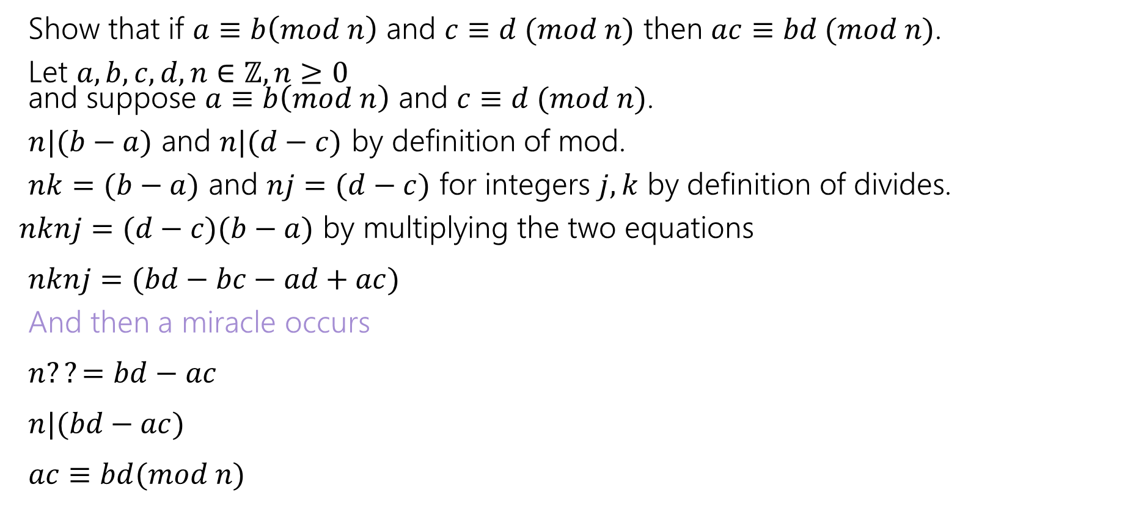
Another Proof
Show that if $a≡b\left(mod n\right)$ and $c≡d (mod n)$ then $ac≡bd (mod n)$.
Let $a,b,c,d,n∈ℤ, n≥0$ and suppose $a≡b\left(mod n\right)$ and $c≡d (mod n)$.
$n|(b−a)$ and $n|(d−c)$ by definition of mod.
$nk=(b−a)$ and $nj=(d−c)$ for integers $j,k$ by definition of divides.
$nknj=(d−c)(b−a)$ by multiplying the two equations
$nknj=(bd−bc−ad+ac)$
And then a miracle occurs
$n??=bd−ac$
$n|(bd−ac)$
$ac≡bd(mod n)$

Slide 26
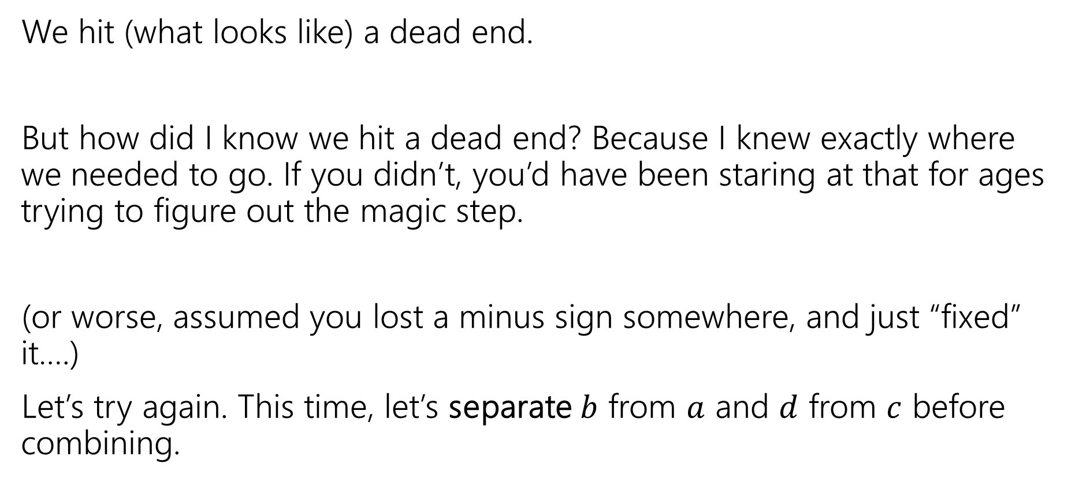
Uh-Oh
We hit (what looks like) a dead end.
But how did I know we hit a dead end? Because I knew exactly where we needed to go. If you didn’t, you’d have been staring at that for ages trying to figure out the magic step.
(or worse, assumed you lost a minus sign somewhere, and just “fixed” it….)
Let’s try again. This time, let’s separate $b$ from $a$ and $d$ from $c$ before combining.

Slide 27
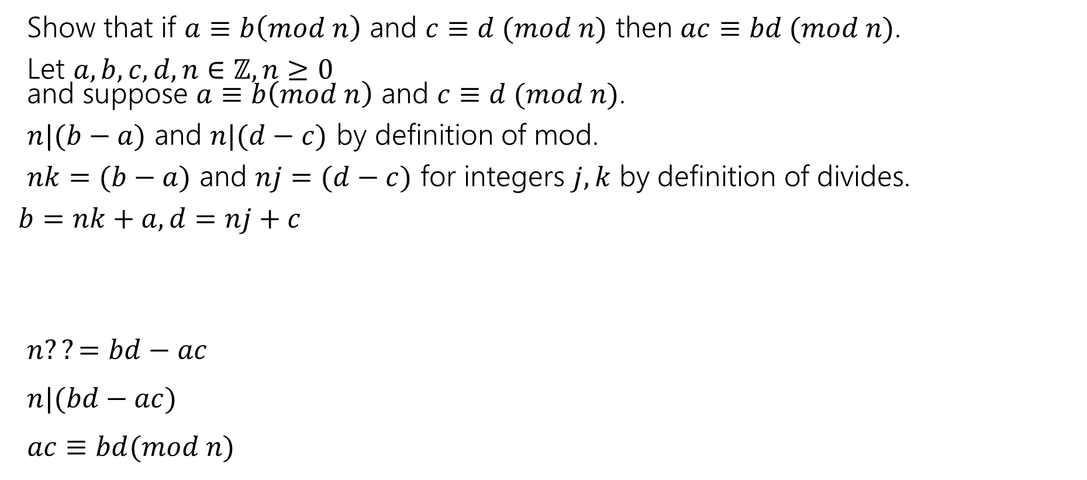
Another Approach
Show that if $a≡b\left(mod n\right)$ and $c≡d (mod n)$ then $ac≡bd (mod n)$.
Let $a,b,c,d,n∈ℤ, n≥0$ and suppose $a≡b\left(mod n\right)$ and $c≡d (mod n)$.
$n|(b−a)$ and $n|(d−c)$ by definition of mod.
$nk=(b−a)$ and $nj=(d−c)$ for integers $j,k$ by definition of divides.
$b=nk+a, d=nj+c$
$n??=bd−ac$
$n|(bd−ac)$
$ac≡bd(mod n)$

Slide 28
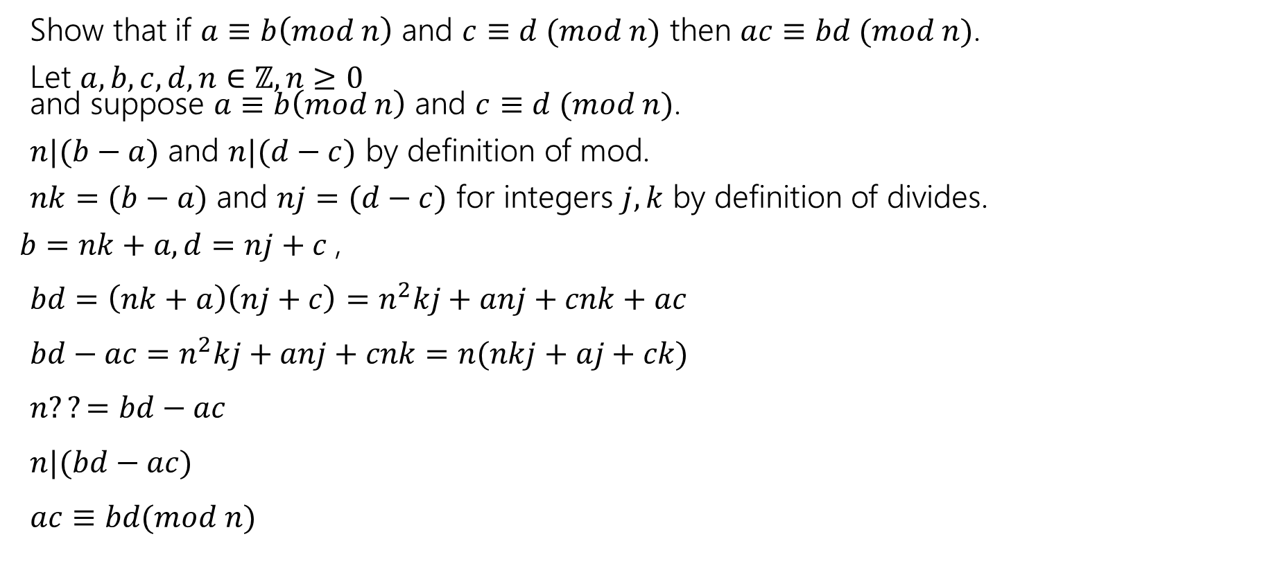
Another Approach
Show that if $a≡b\left(mod n\right)$ and $c≡d (mod n)$ then $ac≡bd (mod n)$.
Let $a,b,c,d,n∈ℤ, n≥0$ and suppose $a≡b\left(mod n\right)$ and $c≡d (mod n)$.
$n|(b−a)$ and $n|(d−c)$ by definition of mod.
$nk=(b−a)$ and $nj=(d−c)$ for integers $j,k$ by definition of divides.
$b=nk+a, d=nj+c$,
$bd=\left(nk+a\right)\left(nj+c\right)=n^{2}kj+anj+cnk+ac$
$bd−ac=n^{2}kj+anj+cnk=n(nkj+aj+ck)$
$n??=bd−ac$
$n|(bd−ac)$
$ac≡bd(mod n)$

Slide 29
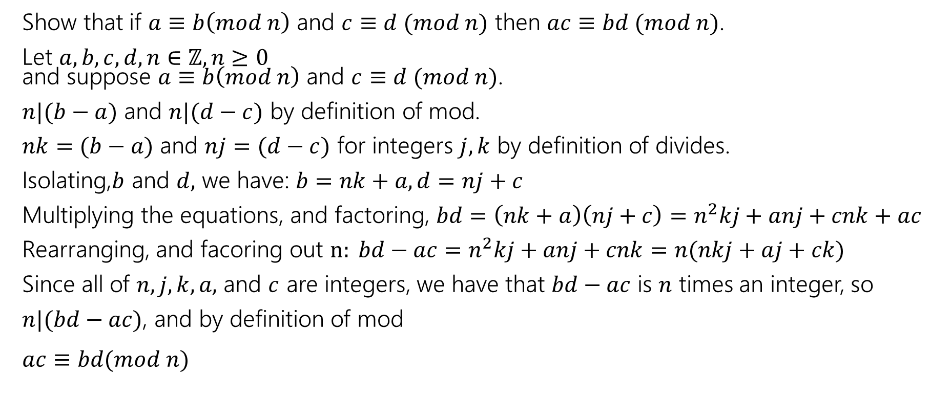
Another Approach
Show that if $a≡b\left(mod n\right)$ and $c≡d (mod n)$ then $ac≡bd (mod n)$.
Let $a,b,c,d,n∈ℤ, n≥0$ and suppose $a≡b\left(mod n\right)$ and $c≡d (mod n)$.
$n|(b−a)$ and $n|(d−c)$ by definition of mod.
$nk=(b−a)$ and $nj=(d−c)$ for integers $j,k$ by definition of divides.
Isolating,$b$ and $d,$ we have: $b=nk+a, d=nj+c$
Multiplying the equations, and factoring, $bd=\left(nk+a\right)\left(nj+c\right)=n^{2}kj+anj+cnk+ac$
Rearranging, and facoring out $n: bd−ac=n^{2}kj+anj+cnk=n(nkj+aj+ck)$
Since all of $n,j,k,a,$ and $c$ are integers, we have that $bd−ac$ is $n$ times an integer, so
$n|(bd−ac)$, and by definition of mod
$ac≡bd(mod n)$

Slide 30
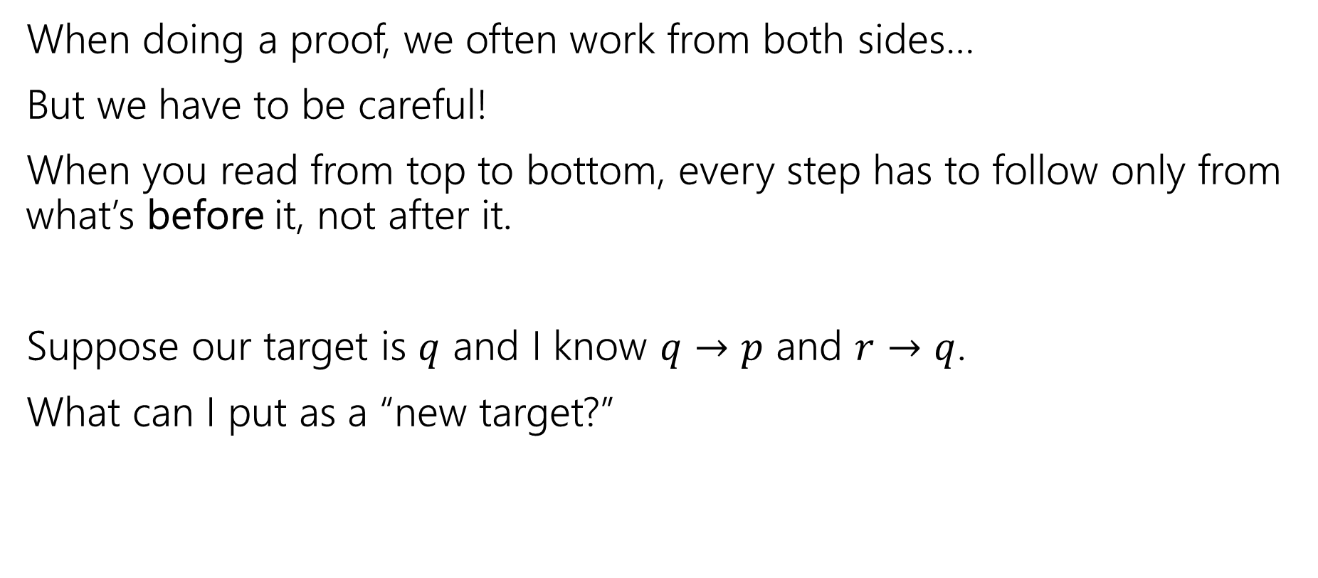
Logical Ordering
When doing a proof, we often work from both sides…
But we have to be careful!
When you read from top to bottom, every step has to follow only from what’s before it, not after it.
Suppose our target is $q$ and I know $q→p$ and $r→q$.
What can I put as a “new target?”

Slide 31
Logical Ordering
So why have all our prior steps been ok backward?
They’ve all been either:
A definition (which is always an “if and only if”)
An algebra step that is an “if and only if”
Even if your steps are “if and only if” you still have to put everything in order – start from your assumptions, and only assert something once it can be shown.

Slide 32
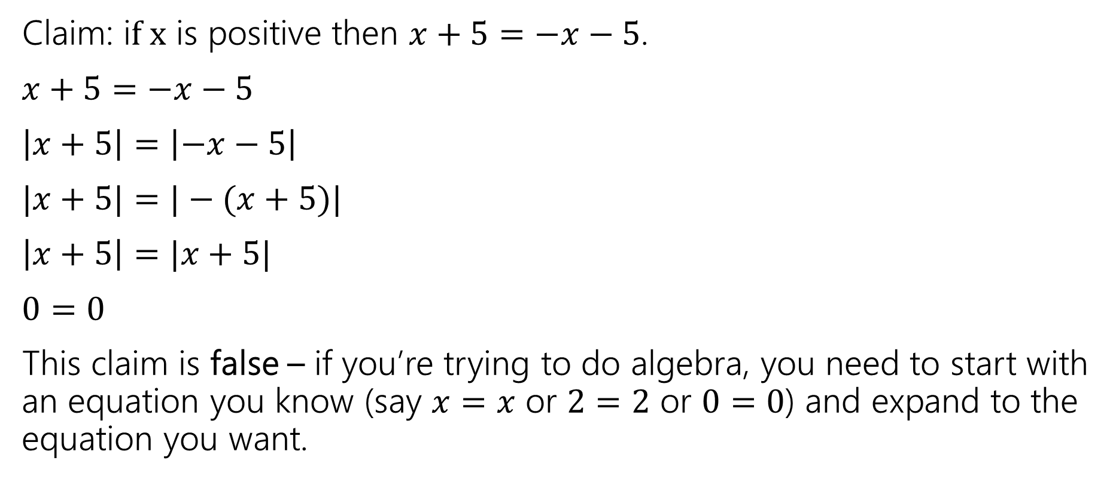
A bad proof
Claim: i$f x$ is positive then $x+5=−x−5$.
$x+5=−x−5$
$\left|x+5\right|=\left|−x−5\right|$
$|x+5|=|−(x+5)|$
$\left|x+5\right|=|x+5|$
$0=0$
This claim is false – if you’re trying to do algebra, you need to start with an equation you know (say $x=x$ or $2=2$ or $0=0$) and expand to the equation you want.

Slide 33
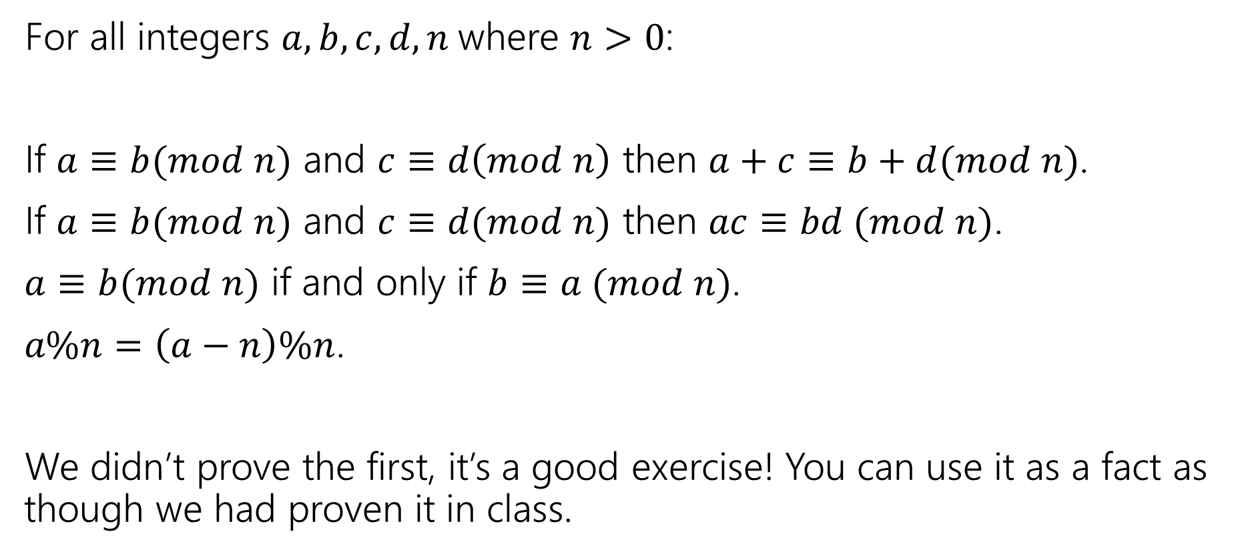
Facts about modular arithmetic
For all integers $a,b,c,d,n$where $n>0$:
If $a≡b(mod n)$ and $c≡d\left(mod n\right)$ then $a+c≡b+d(mod n)$.
If $a≡b(mod n)$ and $c≡d(mod n)$ then $ac≡bd (mod n)$.
$a≡b(mod n)$ if and only if $b≡a (mod n)$.
$a\%n=\left(a−n\right)\%n$.
We didn’t prove the first, it’s a good exercise! You can use it as a fact as though we had proven it in class.

Slide 34
Proving the key fact about gcds

Slide 35
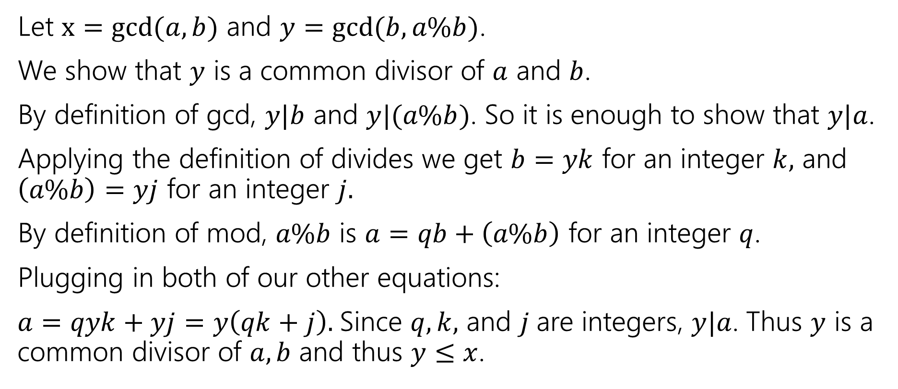
gcd(a,b) = gcd(b, a % b)
Let $x=gcd⁡(a,b)$ and $y=gcd⁡(b,a\%b)$.
We show that $y$ is a common divisor of $a$ and $b$.
By definition of gcd, $y|b$ and $y|(a\%b)$. So it is enough to show that $y|a$.
Applying the definition of divides we get $b=yk$ for an integer $k,$ and $\left(a\%b\right)=yj$ for an integer $j.$
By definition of mod, $a\%b$ is $a=qb+\left(a\%b\right)$ for an integer $q$.
Plugging in both of our other equations:
$a=qyk+yj=y\left(qk+j\right).$Since $q,k,$ and $j$are integers, $y|a$. Thus $y$ is a common divisor of $a,b$ and thus $y≤x$.

Slide 36
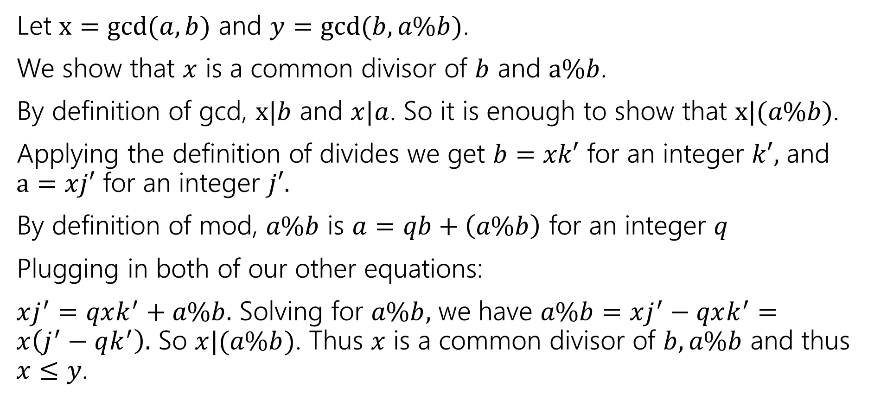
gcd(a,b) = gcd(b, a % b)
Let $x=gcd⁡(a,b)$ and $y=gcd⁡(b,a\%b)$.
We show that $x$ is a common divisor of $b$ and $a\%b$.
By definition of gcd, $x|b$ and $x|a$. So it is enough to show that $x|(a\%b)$.
Applying the definition of divides we get $b=xk′$ for an integer $k′,$ and $a=xj′$ for an integer $j′.$
By definition of mod, $a\%b$ is $a=qb+\left(a\%b\right)$ for an integer $q$
Plugging in both of our other equations:
$xj^{′}=qxk^{′}+a\%b.$ Solving for $a\%b,$ we have $a\%b=xj^{′}−qxk^{′}=x\left(j^{′}−qk^{′}\right).$ So $x|(a\%b)$. Thus $x$ is a common divisor of $b,a\%b$ and thus $x≤y$.

Slide 37

gcd(a,b) = gcd(b, a % b)
Let $x=gcd⁡(a,b)$ and $y=gcd⁡(b,a\%b)$.
We show that $x$ is a common divisor of $b$ and $a\%b$.
We have shown $x≤y$ and $y≤x$.
Thus $x=y,$ and $\gcd\left(a,b\right)=\gcd\left(b,a\%b\right).$

Slide 38
Extra Practice!

Slide 39
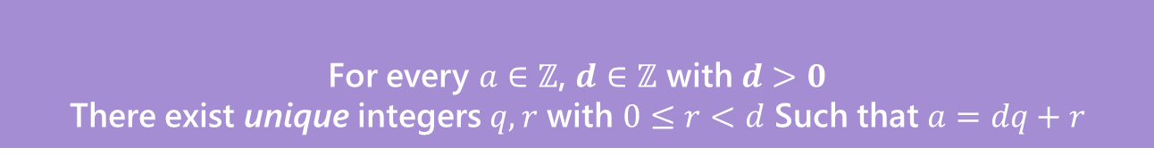


Warm up
Let $a∈ℤ, b∈ℤ, n∈ℤ$ and $n>0$.
We say $a≡b (mod n)$ if and only if $n|(b−a)$
Equivalence in modular arithmetic
Show that $a≡b \left(mod n\right)$ if and only if $b≡a(mod n)$
Show that $a\%n$=($a−n)\%n$ Where $b\%c$ is the unique $r$ such that $b=kc+r$ for some integer $k$.
For every $a∈ℤ$, $d∈ℤ$ with $d>0$
There exist unique integers $q,r$ with $0≤r<d$ Such that $a=dq+r$
The Division Theorem

Slide 40
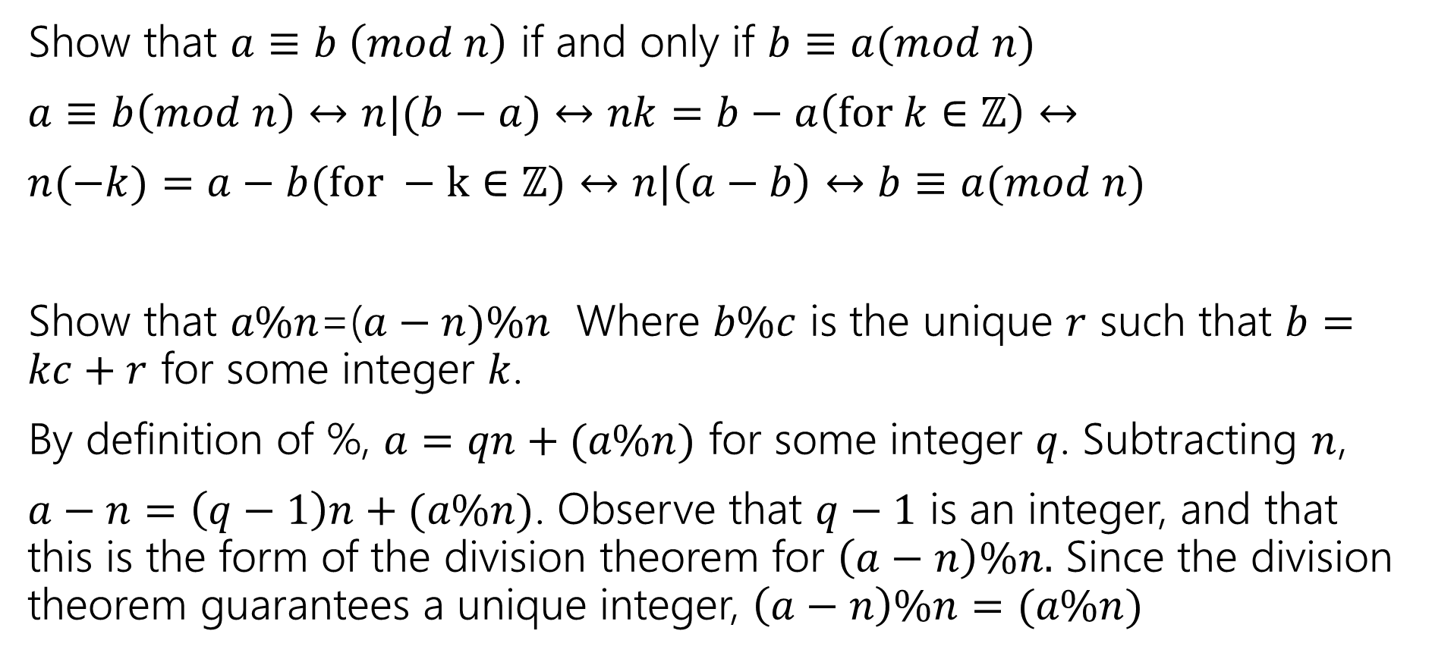
Warm up
Show that $a≡b \left(mod n\right)$ if and only if $b≡a(mod n)$
$a≡b\left(mod n\right)↔n|(b−a)↔nk=b−a\left(for k∈ℤ\right)↔$
$n(−k)=a−b(for −k∈ℤ)↔n|\left(a−b\right)↔b≡a(mod n)$
Show that $a\%n$=($a−n)\%n$ Where $b\%c$ is the unique $r$ such that $b=kc+r$ for some integer $k$.
By definition of %, $a=qn+(a\%n)$ for some integer $q$. Subtracting $n$,
$a−n=\left(q−1\right)n+(a\%n)$. Observe that $q−1$ is an integer, and that this is the form of the division theorem for $\left(a−n\right)\%n.$ Since the division theorem guarantees a unique integer, $\left(a−n\right)\%n=(a\%n)$

Slide 41
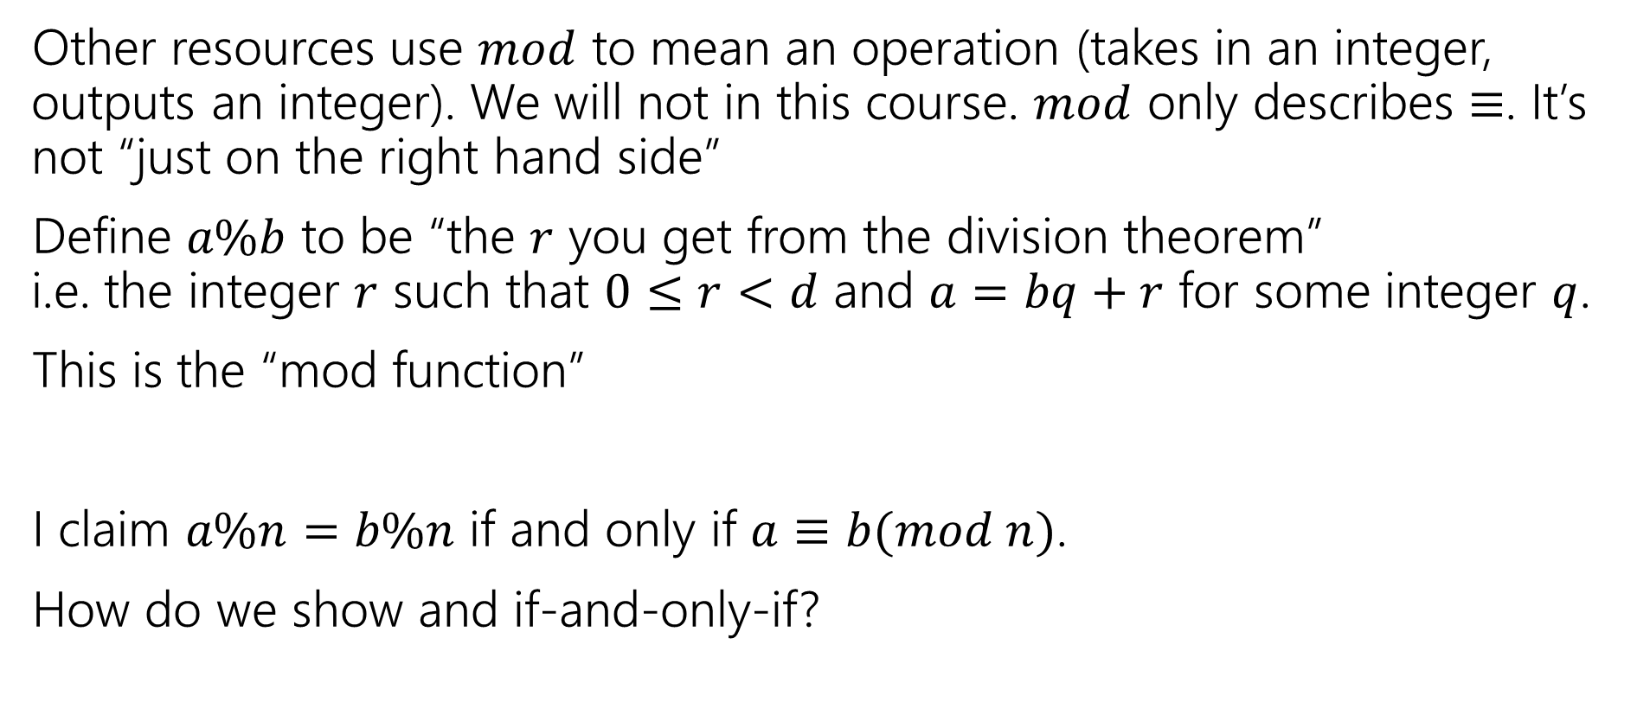
% and Mod
Other resources use $mod$ to mean an operation (takes in an integer, outputs an integer). We will not in this course. $mod$ only describes $≡$. It’s not “just on the right hand side”
Define $a\%b$ to be “the $r$ you get from the division theorem” i.e. the integer $r$ such that $0≤r<d$ and $a=bq+r$ for some integer $q$.
This is the “mod function”
I claim $a\%n=b\%n$ if and only if $a≡b(mod n)$.
How do we show and if-and-only-if?

Slide 42

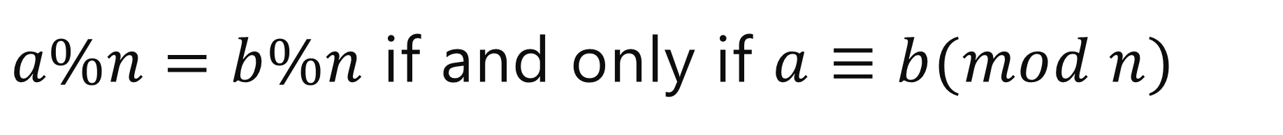
$a\%n=b\%n$ if and only if $a≡b(mod n)$
Backward direction:
Suppose $a≡b(mod n)$
$a\%n=\left(b−nk\right)\%n=b\%n$

Slide 43
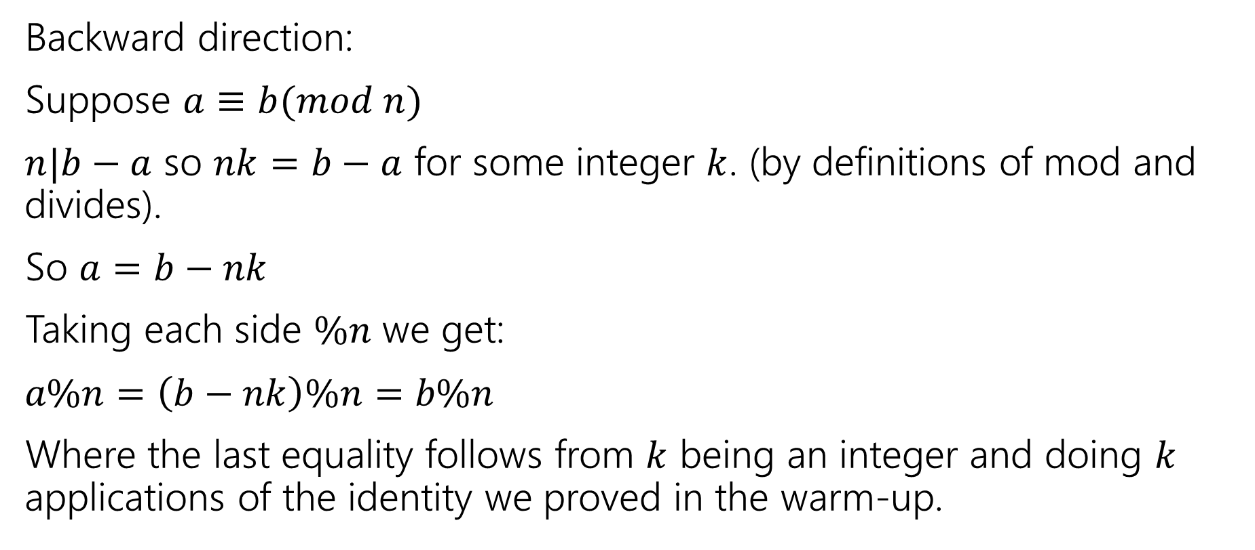
$a\%n=b\%n$ if and only if $a≡b(mod n)$
Backward direction:
Suppose $a≡b(mod n)$
$n|b−a$ so $nk=b−a$ for some integer $k$. (by definitions of mod and divides).
So $a=b−nk$
Taking each side $\%n$ we get:
$a\%n=\left(b−nk\right)\%n=b\%n$
Where the last equality follows from $k$ being an integer and doing $k$ applications of the identity we proved in the warm-up.

Slide 44


$a\%n=b\%n$ if and only if $a≡b(mod n)$
Show the forward direction:
If $a\%n=b\%n$ then $a≡b(mod n)$.
This proof is a bit different than the other direction.
Remember to work from top and bottom!!
Let $a∈ℤ, b∈ℤ, n∈ℤ$ and $n>0$.
We say $a≡b (mod n)$ if and only if $n|(b−a)$
Equivalence in modular arithmetic
For every $a∈ℤ$, $d∈ℤ$ with $d>0$
There exist unique integers $q,r$ with $0≤r<d$ Such that $a=dq+r$
The Division Theorem

Slide 45
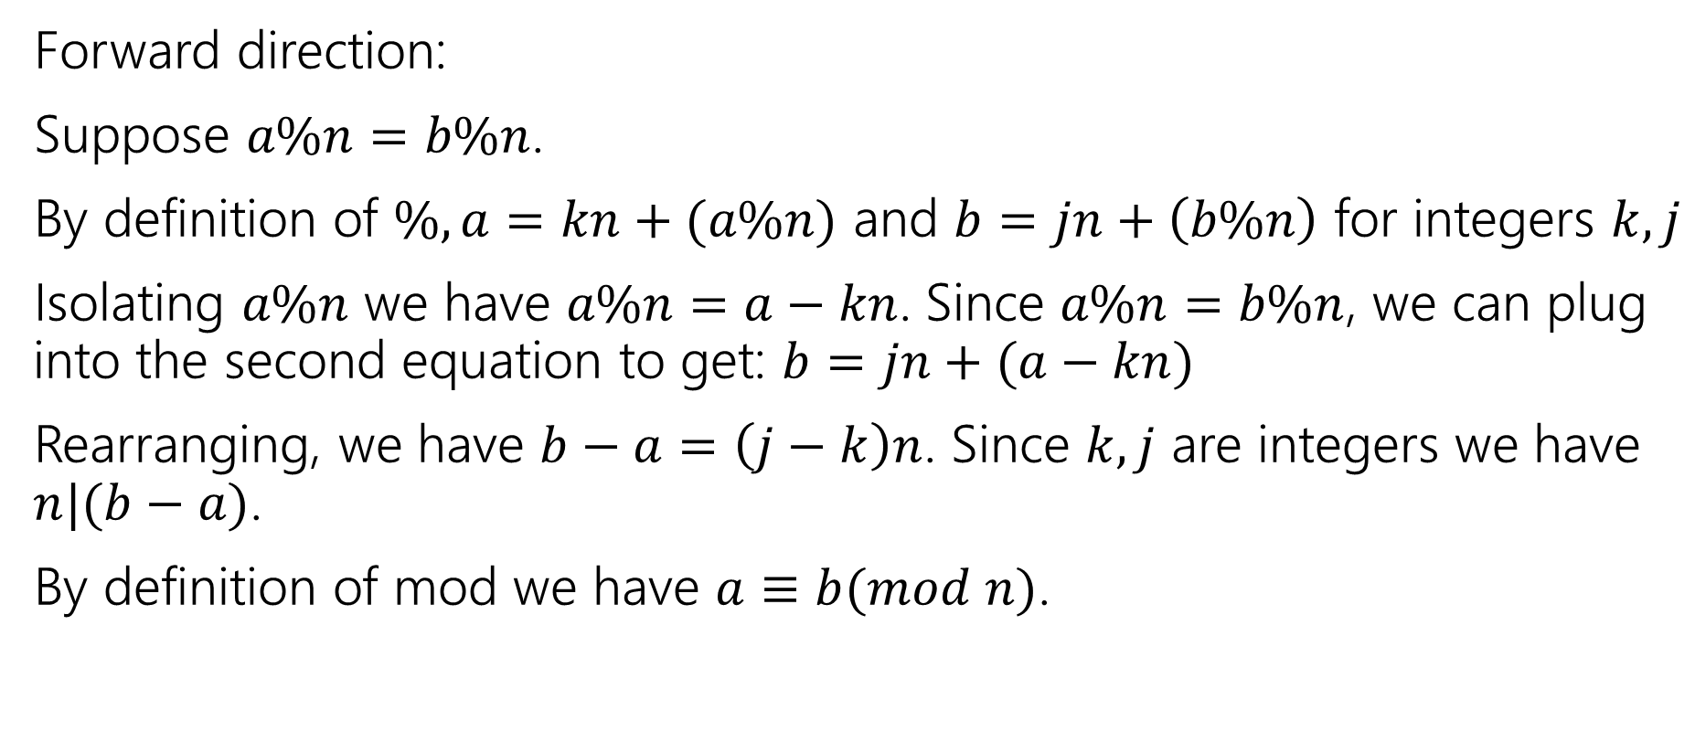
$a\%n=b\%n$ if and only if $a≡b(mod n)$
Forward direction:
Suppose $a\%n=b\%n$.
By definition of $\%, a=kn+(a\%n)$ and $b=jn+\left(b\%n\right)$ for integers $k,j$
Isolating $a\%n$ we have $a\%n=a−kn$. Since $a\%n=b\%n$, we can plug into the second equation to get: $b=jn+(a−kn)$
Rearranging, we have $b−a=\left(j−k\right)n$. Since $k,j$ are integers we have $n|(b−a)$.
By definition of mod we have $a≡b(mod n)$.

