Slide 1
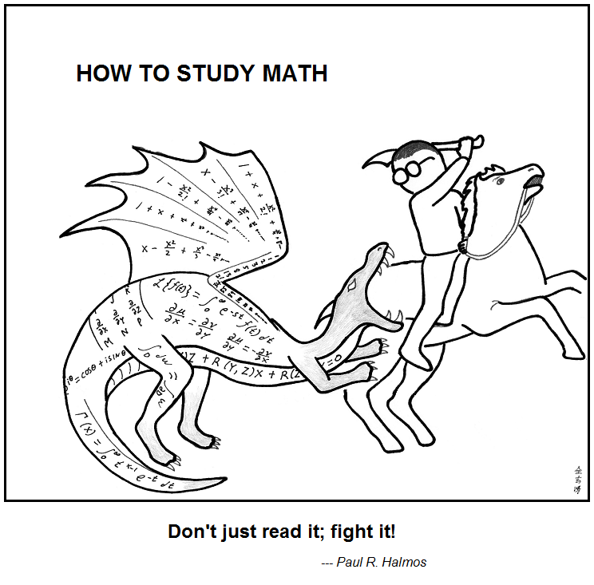

Number Theory
https://abstrusegoose.com/353
CSE 311 Winter 2022
Lecture 11

Slide 2
Announcements
Set proofs (and English proofs in general) were a struggle in many sections yesterday.
English proofs aren’t easy the first few times (or the next few times…sometimes not even after a decade…)
Keep asking questions!
Don’t expect section problems or breakout room activities to be “easy.”
If you know the right answer immediately, you won’t learn much by doing it.

Slide 3
Announcements
We’ve only gotten a few responses to the office hour preferences
google form
If you have preferences about OH please fill it out tonight (otherwise we’ll assume you don’t care whether OH are in-person or on zoom).
Also has a spot to share questions/concerns.
We’ll be in-person for lectures and sections going forward (unless we hear otherwise from the university).
Lectures still will be recorded, sections still will have “replacement videos”

Slide 4
Last Time/This Time
Went reaaaaaaaaaaaal fast through sets…so we could practice proofs in section and have time for number theory today.
We’ll keep practicing in the background.
Today we’re starting on Number Theory

Slide 5
Why Number Theory?
Applicable in Computer Science
“hash functions” (you’ll see them in 332) commonly use modular arithmetic
Much of classical cryptography is based on prime numbers.
More importantly, a great playground for writing English proofs.

Slide 6
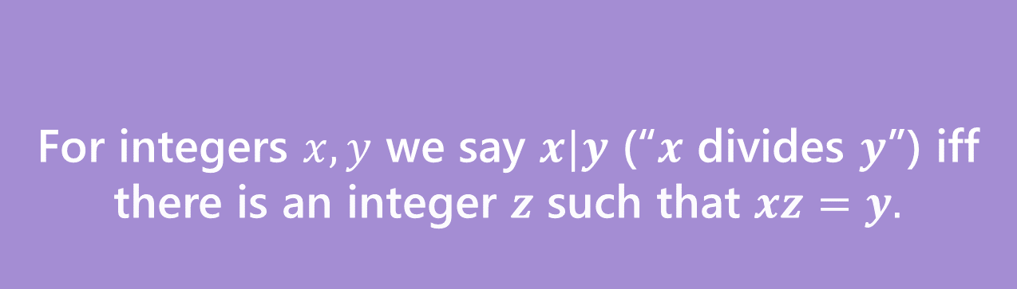
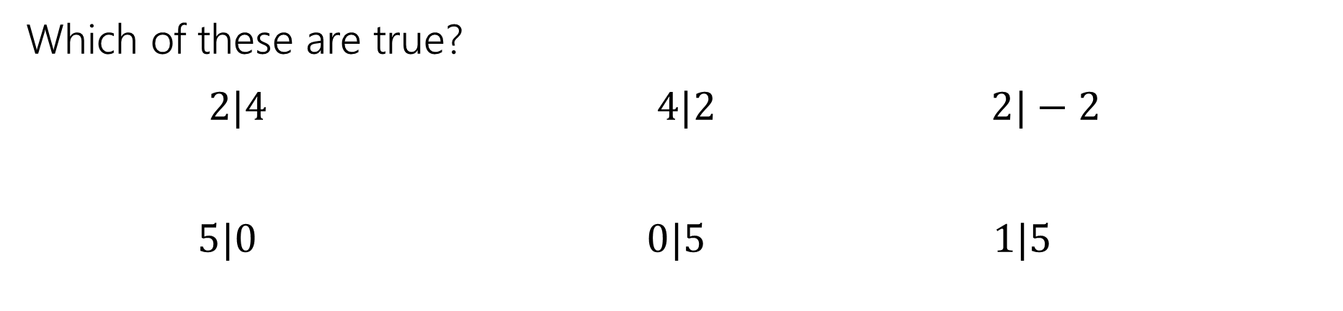
Divides
For integers $x,y$ we say $x|y$ (“$x$ divides $y$”) iff there is an integer $z$ such that $xz=y.$
Divides
Which of these are true?
$2|4$ $4|2$ $2|−2$
$5|0$ $0|5$ $1|5$

Slide 7

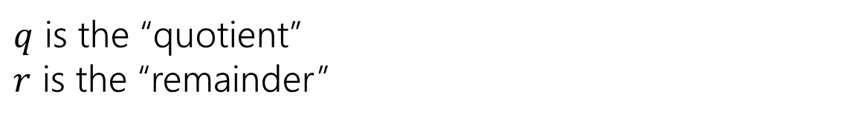
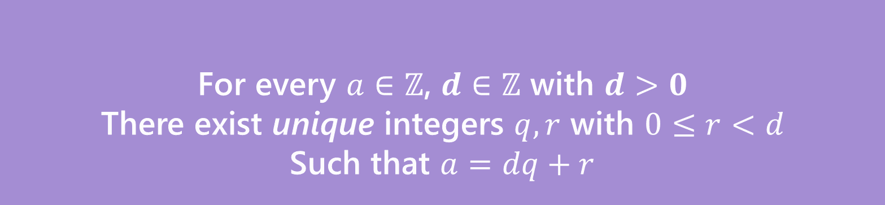






A useful theorem
For every $a∈ℤ$, $d∈ℤ$ with $d>0$
There exist unique integers $q,r$ with $0≤r<d$
Such that $a=dq+r$
The Division Theorem
Remember when non integers were still secret, you did division like this?
$q$ is the “quotient”
$r$ is the “remainder”

Slide 8
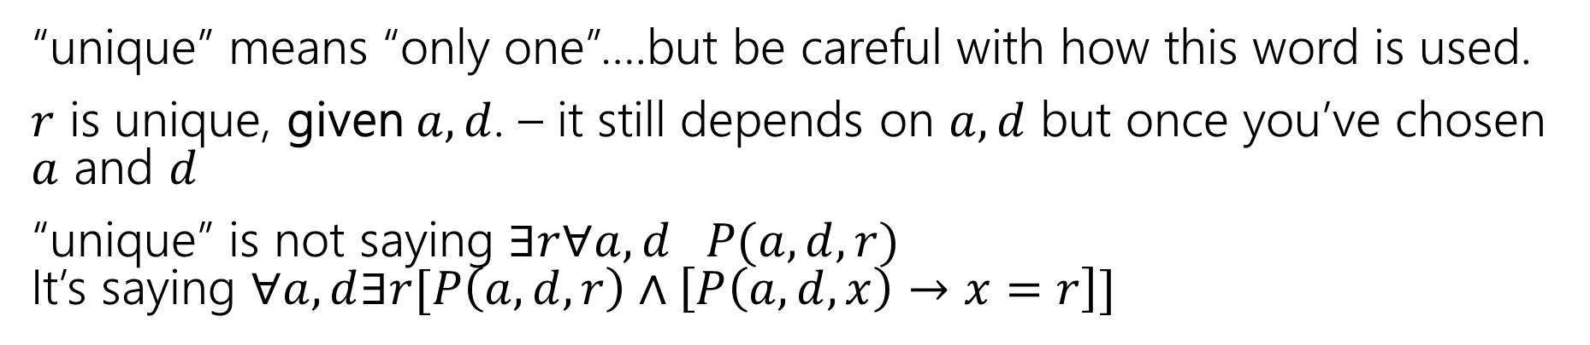
Unique
For every $a∈ℤ$, $d∈ℤ$ with $d>0$
There exist unique integers $q,r$ with $0≤r<d$
Such that $a=dq+r$
The Division Theorem
“unique” means “only one”….but be careful with how this word is used.
$r$ is unique, given $a,d$. – it still depends on $a,d$ but once you’ve chosen $a$ and $d$
“unique” is not saying $∃r∀a,d P(a,d,r)$ It’s saying $∀a,d∃r[P\left(a,d,r\right)∧\left[P\left(a,d,x\right)→x=r\right]]$

Slide 9
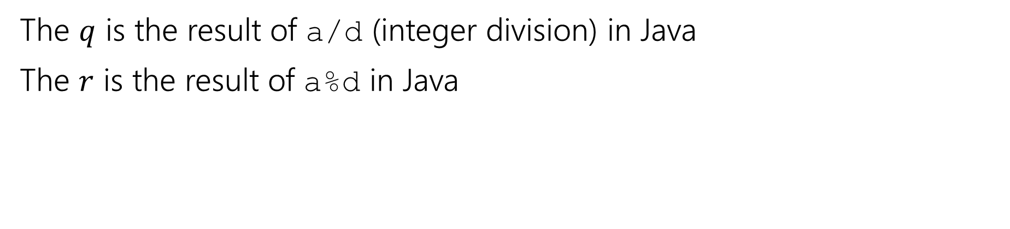
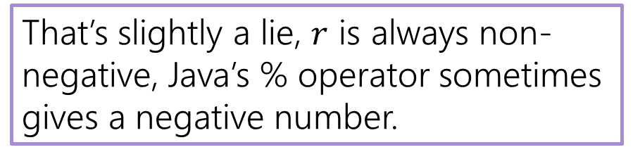
A useful theorem
For every $a∈ℤ$, $d∈ℤ$ with $d>0$
There exist unique integers $q,r$ with $0≤r<d$
Such that $a=dq+r$
The Division Theorem
The $q$ is the result of a/d (integer division) in Java
The $r$ is the result of a%d in Java
That’s slightly a lie, $r$ is always non-negative, Java’s % operator sometimes gives a negative number.

Slide 10
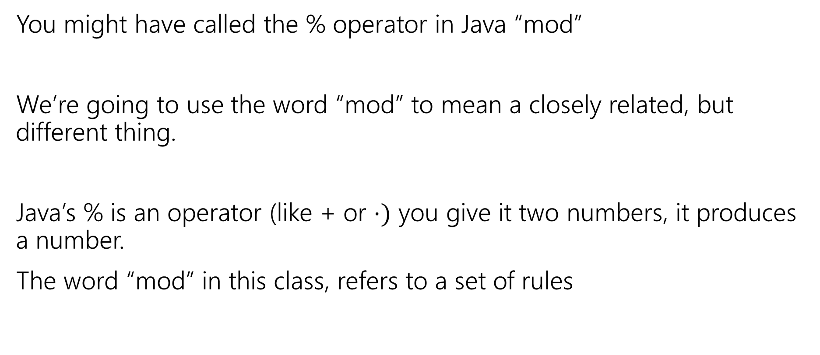
Terminology
You might have called the % operator in Java “mod”
We’re going to use the word “mod” to mean a closely related, but different thing.
Java’s % is an operator (like + or $⋅)$ you give it two numbers, it produces a number.
The word “mod” in this class, refers to a set of rules

Slide 11
Modular Arithmetic
“arithmetic mod 12” is familiar to you. You do it with clocks.
What’s 3 hours after 10 o’clock?
1 o’clock. You hit 12 and then “wrapped around”
“13 and 1 are the same, mod 12” “-11 and 1 are the same, mod 12”
We don’t just want to do math for clocks – what about if we need to talk about parity (even vs. odd) or ignore lower-order-bits (mod by 16, for example)

Slide 12
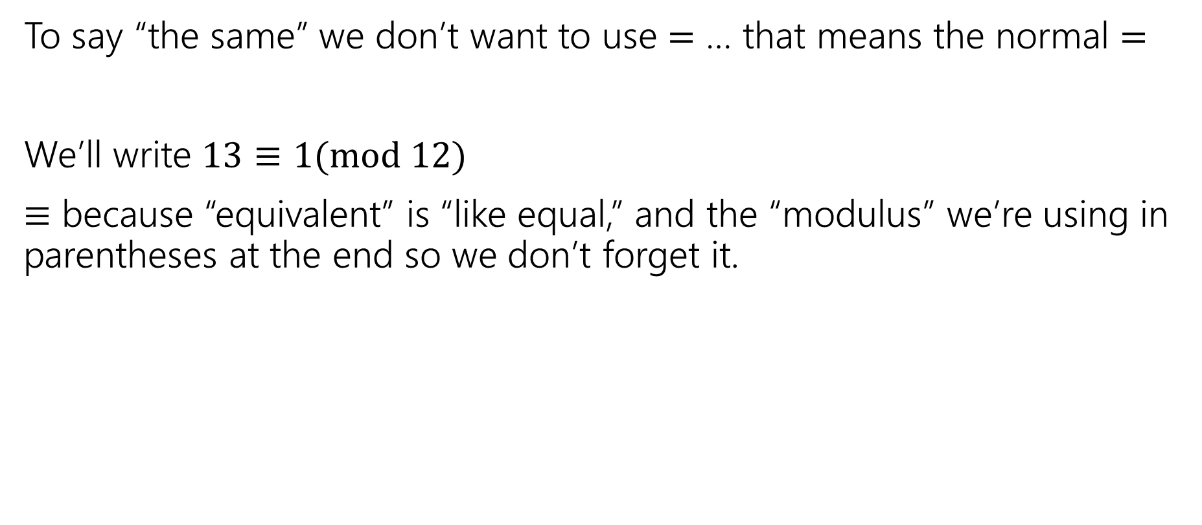
Modular Arithmetic
To say “the same” we don’t want to use $=$ … that means the normal $=$
We’ll write $13≡1(mod 12)$
$≡$ because “equivalent” is “like equal,” and the “modulus” we’re using in parentheses at the end so we don’t forget it.

Slide 13
Modular arithmetic
We need a definition! We can’t just say “it’s like a clock”
Pause what do you expect the definition to be?
Is it related to % ?

Slide 14
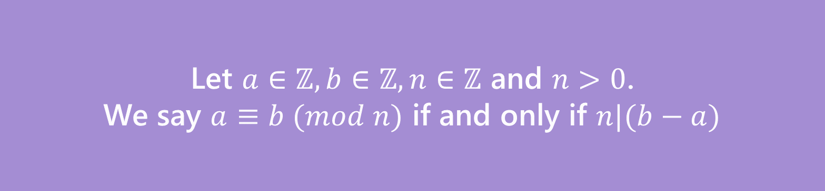
Modular arithmetic
We need a definition! We can’t just say “it’s like a clock”
Pause what do you expect the definition to be?
Let $a∈ℤ, b∈ℤ, n∈ℤ$ and $n>0$.
We say $a≡b (mod n)$ if and only if $n|(b−a)$
Equivalence in modular arithmetic
Huh?

Slide 15
Long Pause
It’s easy to read something with a bunch of symbols and say “yep, those are symbols.” and keep going
STOP Go Back.
You have to fight the symbols they’re probably trying to pull a fast one on you.
Same goes for when I’m presenting a proof – you shouldn’t just believe me – I’m wrong all the time!
You should be trying to do the proof with me. Where do you think we’re going next?

Slide 16

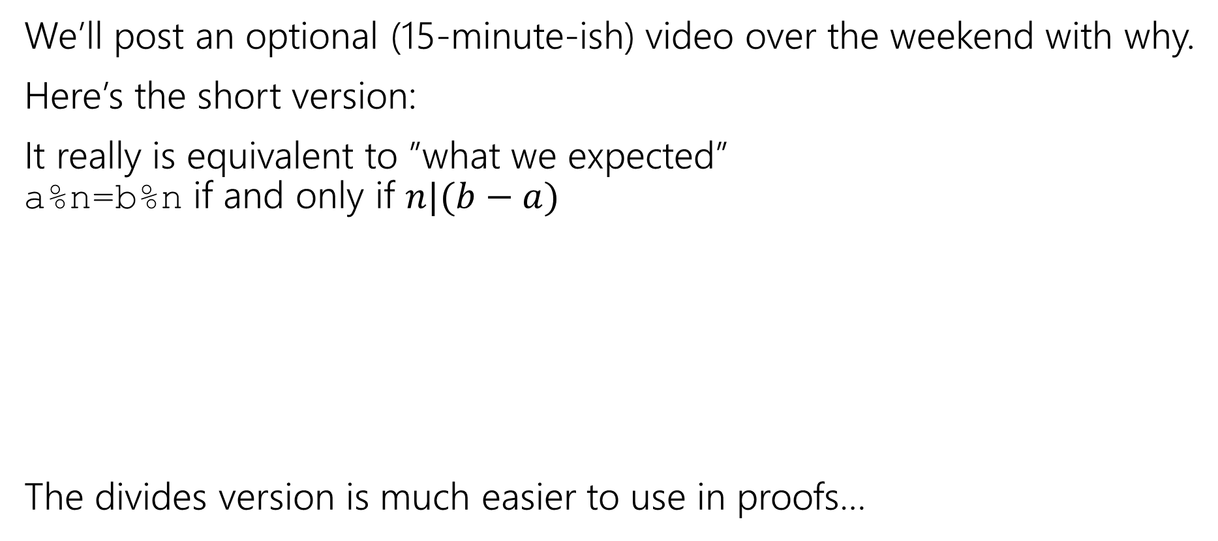


Why?
We’ll post an optional (15-minute-ish) video over the weekend with why.
Here’s the short version:
It really is equivalent to ”what we expected” a%n=b%n if and only if $n|(b−a)$
The divides version is much easier to use in proofs…
$$27$$
When you subtract, the remainders cancel. What you’re left with is a multiple of 12.
$$15$$
$$27−15=12$$

Slide 17
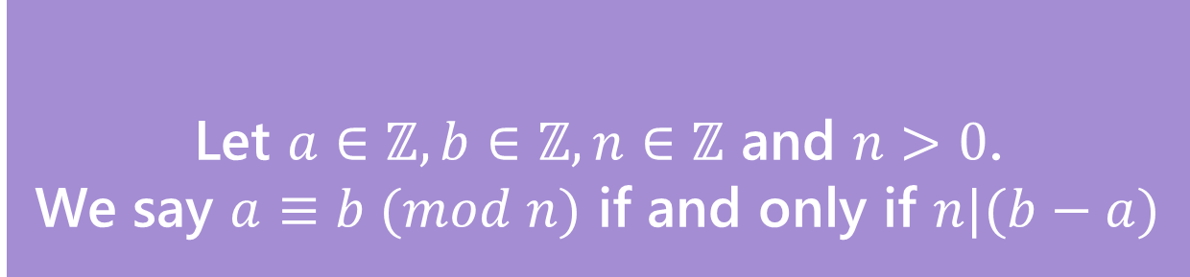

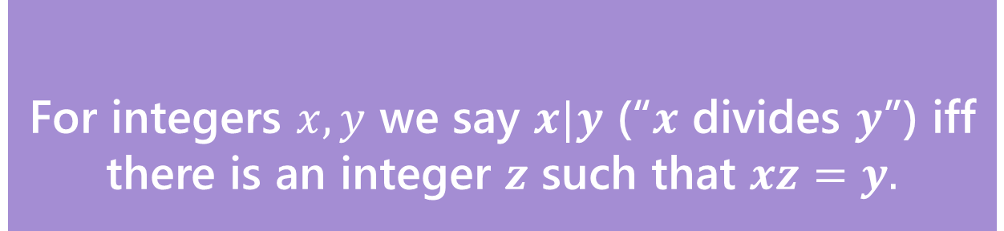
Claim: for all $a,b,c,n∈ℤ,n≥0:$ $a≡b \left(mod n\right)→a+c≡b+c (mod n)$
Before we start, we must know:
1. What every word in the statement means.
2. What the statement as a whole means.
3. Where to start.
4. What your target is.
For integers $x,y$ we say $x|y$ (“$x$ divides $y$”) iff there is an integer $z$ such that $xz=y.$
Divides
Pollev.com/uwcse311
Let $a∈ℤ, b∈ℤ, n∈ℤ$ and $n>0$.
We say $a≡b (mod n)$ if and only if $n|(b−a)$
Equivalence in modular arithmetic

Slide 18

Claim: $a,b,c,n∈ℤ,n≥0:$ $a≡b \left(mod n\right)→a+c≡b+c (mod n)$
Proof:
Let $a,b,c,n$ be arbitrary integers with $n≥0$, and suppose $a≡b(mod n)$.
$a+c≡b+c (mod n)$
For integers $x,y$ we say $x|y$ (“$x$ divides $y$”) iff there is an integer $z$ such that $xz=y.$
Divides
Let $a∈ℤ, b∈ℤ, n∈ℤ$ and $n>0$.
We say $a≡b (mod n)$ if and only if $n|(b−a)$
Equivalence in modular arithmetic

Slide 19
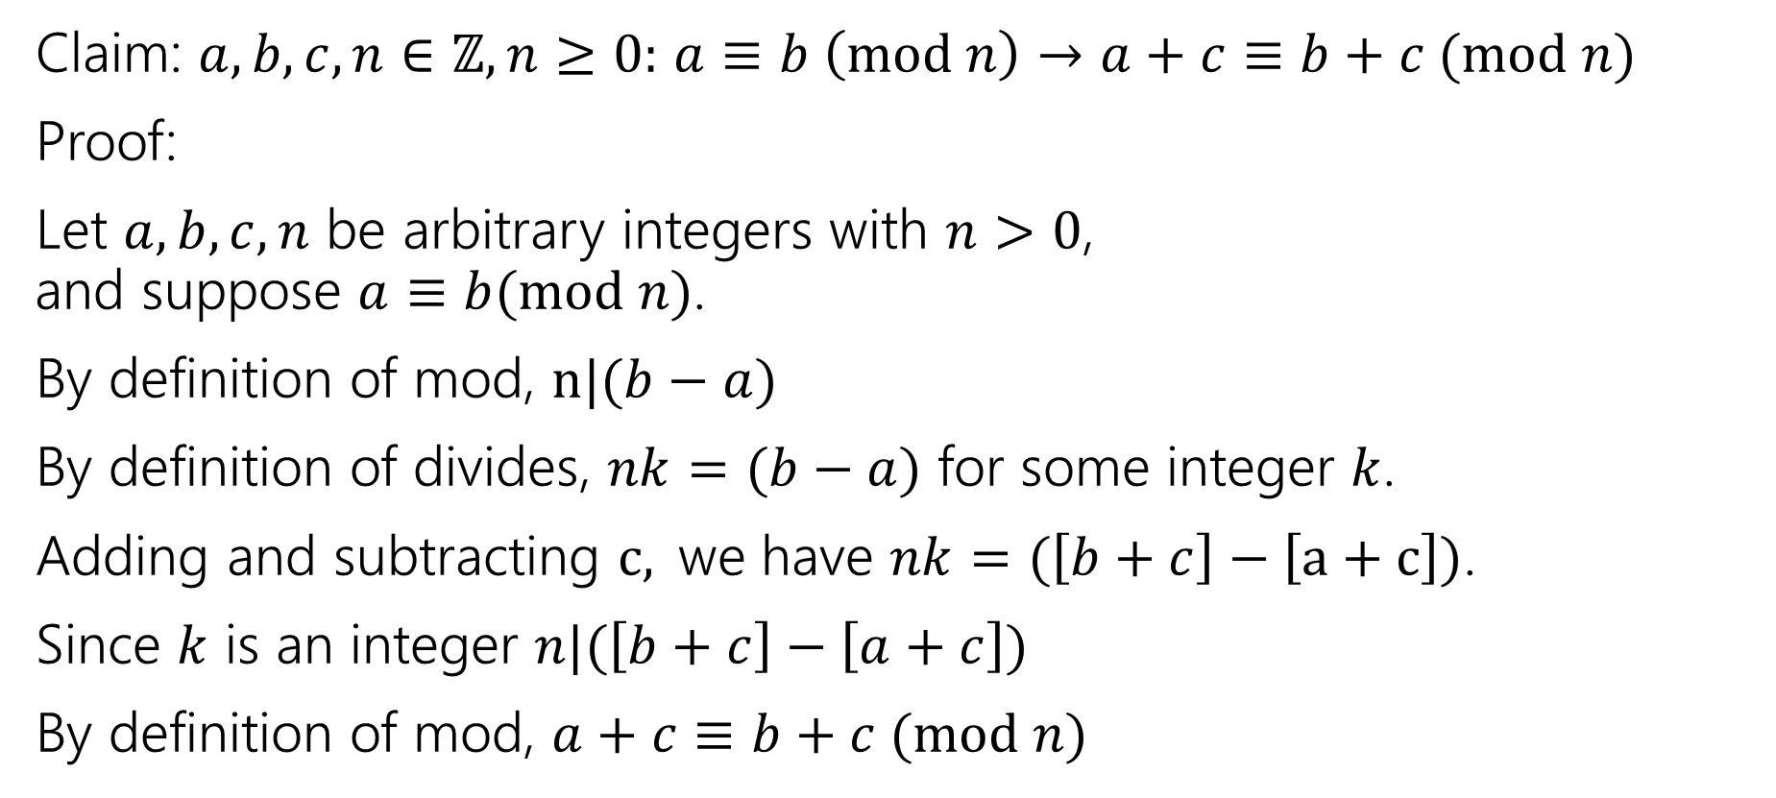
A proof
Claim: $a,b,c,n∈ℤ,n≥0:$ $a≡b \left(mod n\right)→a+c≡b+c (mod n)$
Proof:
Let $a,b,c,n$ be arbitrary integers with $n>0$, and suppose $a≡b(mod n)$.
By definition of mod, $n|(b−a)$
By definition of divides, $nk=(b−a)$ for some integer $k$.
Adding and subtracting $c,$we have $nk=(\left[b+c\right]−\left[a+c\right])$.
Since $k$ is an integer $n|(\left[b+c\right]−\left[a+c\right])$
By definition of mod, $a+c≡b+c (mod n)$

Slide 20
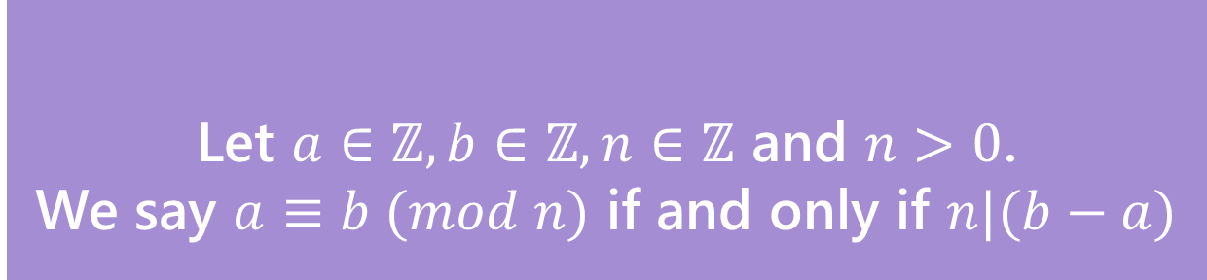


You Try!
Claim: for all $a,b,c,n∈ℤ, n>0:$If $a≡b (mod n)$ then $ac≡bc (mod n)$
Before we start we must know:
1. What every word in the statement means.
2. What the statement as a whole means.
3. Where to start.
4. What your target is.
For integers $x,y$ we say $x|y$ (“$x$ divides $y$”) iff there is an integer $z$ such that $xz=y.$
Divides
Let $a∈ℤ, b∈ℤ, n∈ℤ$ and $n>0$.
We say $a≡b (mod n)$ if and only if $n|(b−a)$
Equivalence in modular arithmetic

Slide 21

Claim: for all $a,b,c,n∈ℤ, n>0:$If $a≡b (mod n)$ then $ac≡bc (mod n)$
Proof:
Let $a,b,c,n$ be arbitrary integers with $n>0$ and suppose $a≡b(mod n)$.
$ac≡bc (mod n)$

Slide 22
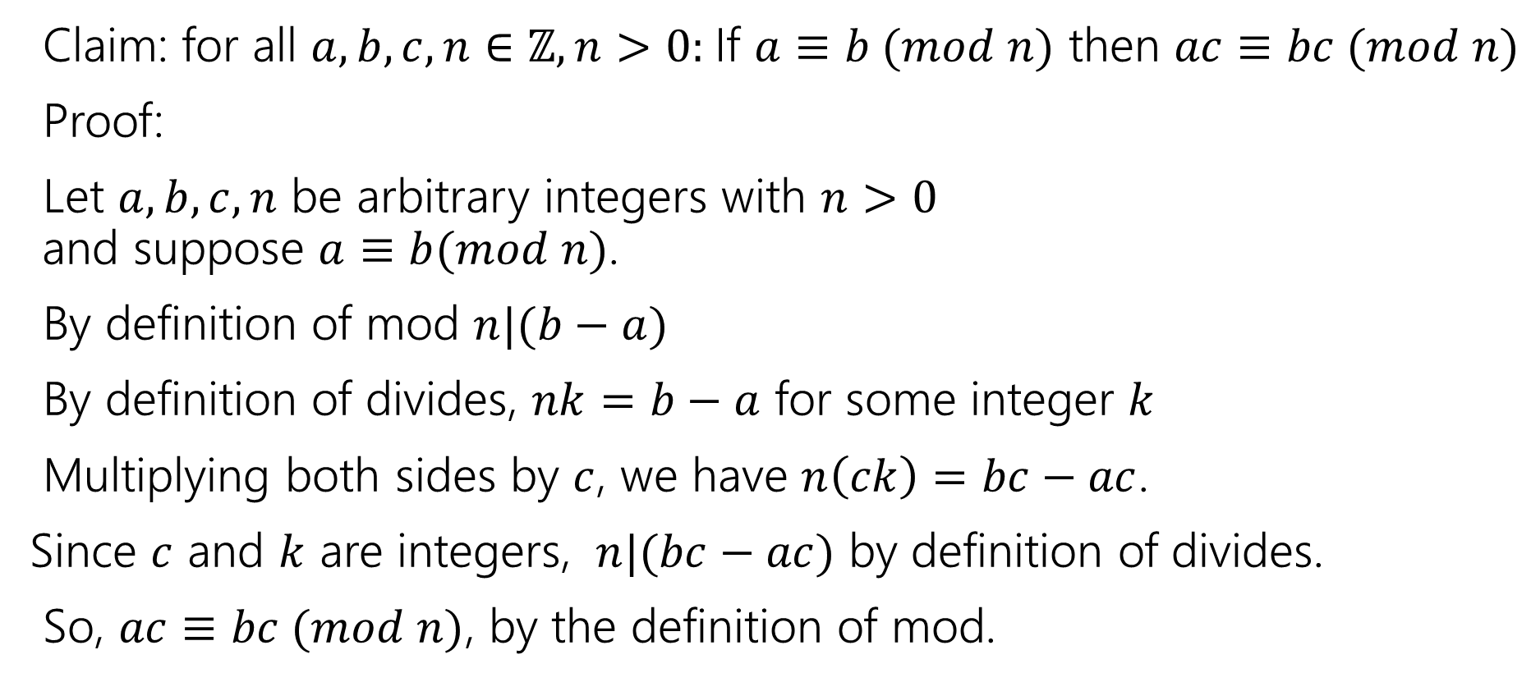
Claim: for all $a,b,c,n∈ℤ, n>0:$If $a≡b (mod n)$ then $ac≡bc (mod n)$
Proof:
Let $a,b,c,n$ be arbitrary integers with $n>0$ and suppose $a≡b(mod n)$.
By definition of mod $n|(b−a)$
By definition of divides, $nk=b−a$ for some integer $k$
Multiplying both sides by $c$, we have $n\left(ck\right)=bc−ac$.
Since $c$ and $k$ are integers, $n|(bc−ac)$ by definition of divides.
So, $ac≡bc (mod n)$, by the definition of mod.

Slide 23

Don’t lose your intuition!
Let’s check that we understand “intuitively” what mod means:
$x≡0 (mod 2)$
$−1≡19 (mod 5)$
$y≡2 (mod 7)$
“$x$is even” Note that negative (even) $x$ values also make this true.
This is true! They both have remainder $4$ when divided by $5$.
This is true as long as $y=2+7k$ for some integer $k$

Slide 24
Proof By Contrapositive

Slide 25
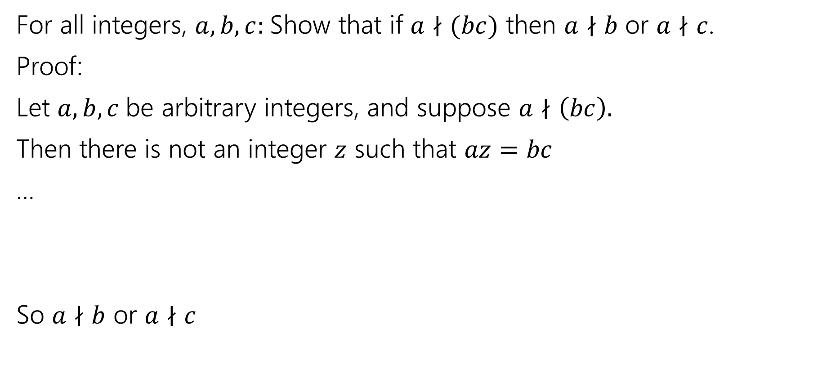
Another Proof
For all integers, $a,b,c:$Show that if $a∤(bc)$ then $a∤b$ or $a∤c$.
Proof:
Let $a,b,c$be arbitrary integers, and suppose $a∤\left(bc\right).$
Then there is not an integer $z$ such that $az=bc$
…
So $a∤b$ or $a∤c$

Slide 26

Another Proof
For all integers, $a,b,c:$Show that if $a∤(bc)$ then $a∤b$ or $a∤c$.
Proof:
Let $a,b,c$be arbitrary integers, and suppose $a∤\left(bc\right).$
Then there is not an integer $z$ such that $az=bc$
…
So $a∤b$ or $a∤c$
There has to be a better way!

Slide 27
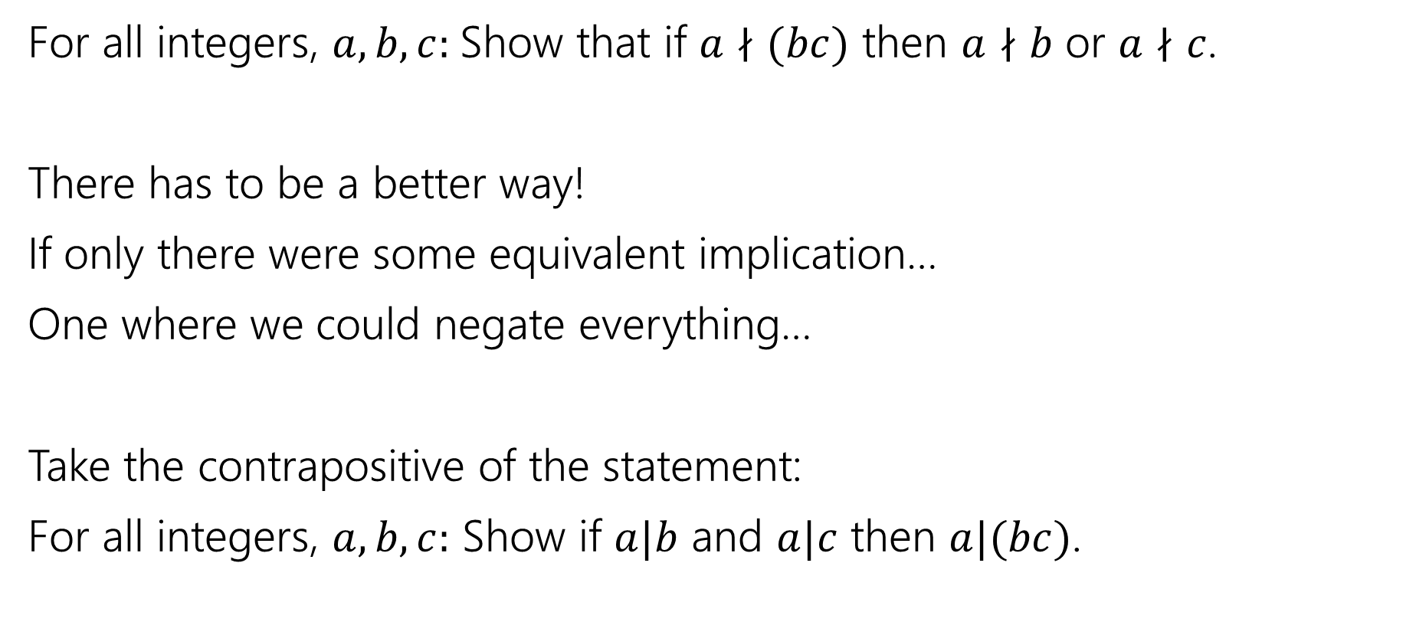
Another Proof
For all integers, $a,b,c:$Show that if $a∤(bc)$ then $a∤b$ or $a∤c$.
There has to be a better way!
If only there were some equivalent implication…
One where we could negate everything…
Take the contrapositive of the statement:
For all integers, $a,b,c:$ Show if $a|b$ and $a|c$ then $a|(bc)$.

Slide 28

By contrapositive
Claim: For all integers, $a,b,c:$Show that if $a∤(bc)$ then $a∤b$ or $a∤c$.
We argue by contrapositive.
Let $a,b,c$be arbitrary integers, and suppose $a|b$ and $a|c$.
Therefore $a|bc$

Slide 29
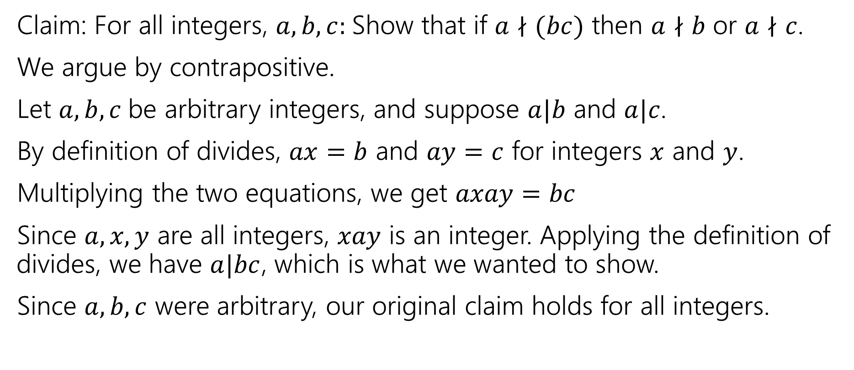
By contrapositive
Claim: For all integers, $a,b,c:$Show that if $a∤(bc)$ then $a∤b$ or $a∤c$.
We argue by contrapositive.
Let $a,b,c$be arbitrary integers, and suppose $a|b$ and $a|c$.
By definition of divides, $ax=b$ and $ay=c$ for integers $x$ and $y$.
Multiplying the two equations, we get $axay=bc$
Since $a,x,y$ are all integers, $xay$ is an integer. Applying the definition of divides, we have $a|bc$, which is what we wanted to show.
Since $a,b,c$ were arbitrary, our original claim holds for all integers.

Slide 30
Extra Set Practice

Slide 31
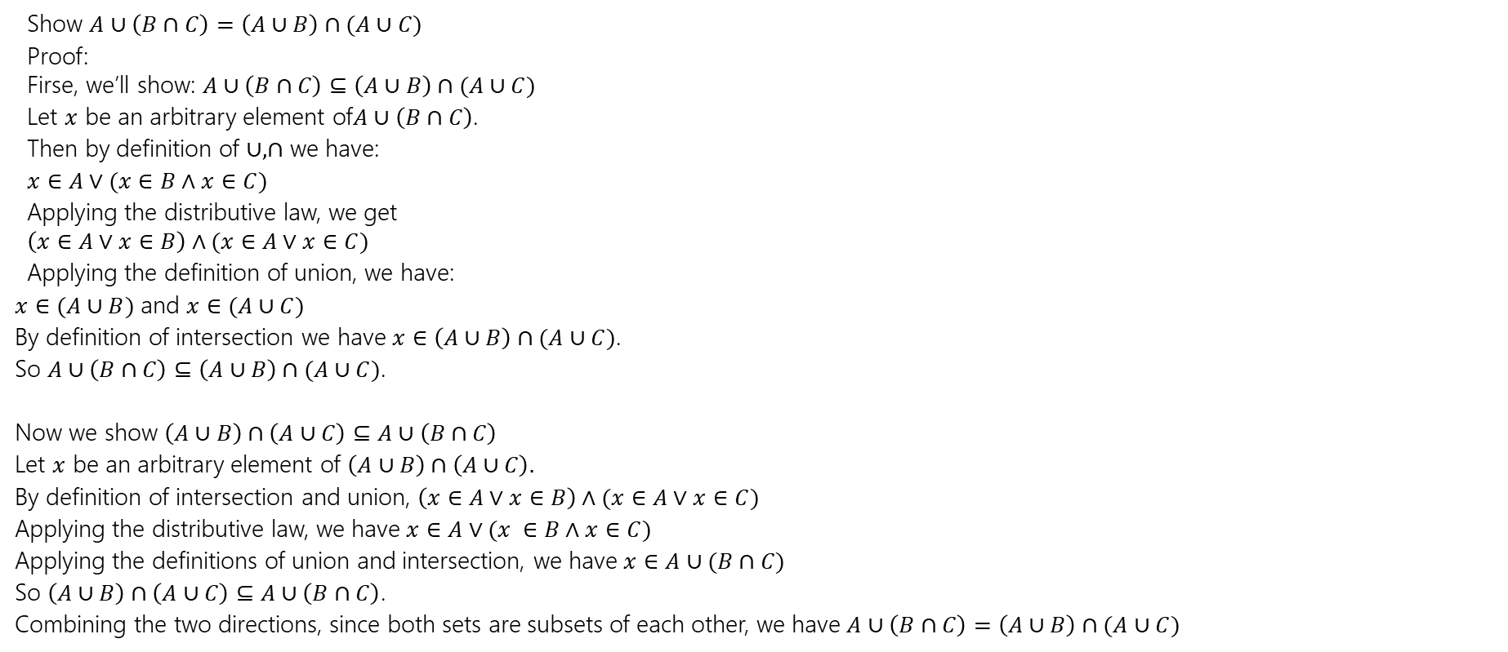
Extra Set Practice
Show $A∪\left(B∩C\right)=\left(A∪B\right)∩(A∪C)$
Proof: Firse, we’ll show: $A∪\left(B∩C\right)⊆\left(A∪B\right)∩(A∪C)$
Let $x$ be an arbitrary element of$A∪\left(B∩C\right)$.
Then by definition of $∪,∩$ we have:
$x∈A∨(x∈B∧x∈C)$
Applying the distributive law, we get $\left(x∈A∨x∈B\right)∧(x∈A∨x∈C)$
Applying the definition of union, we have:
$x∈(A∪B)$ and $x∈(A∪C)$
By definition of intersection we have $x∈\left(A∪B\right)∩(A∪C)$.
So $A∪\left(B∩C\right)⊆\left(A∪B\right)∩(A∪C)$.
Now we show $\left(A∪B\right)∩\left(A∪C\right)⊆A∪\left(B∩C\right)$
Let $x$ be an arbitrary element of $\left(A∪B\right)∩\left(A∪C\right).$
By definition of intersection and union, $\left(x∈A∨x∈B\right)∧(x∈A∨x∈C)$
Applying the distributive law, we have $x∈A∨(x ∈B∧x∈C)$
Applying the definitions of union and intersection, we have $x∈A∪(B∩C)$
So $\left(A∪B\right)∩\left(A∪C\right)⊆A∪\left(B∩C\right)$.
Combining the two directions, since both sets are subsets of each other, we have $A∪\left(B∩C\right)=\left(A∪B\right)∩(A∪C)$

Slide 32
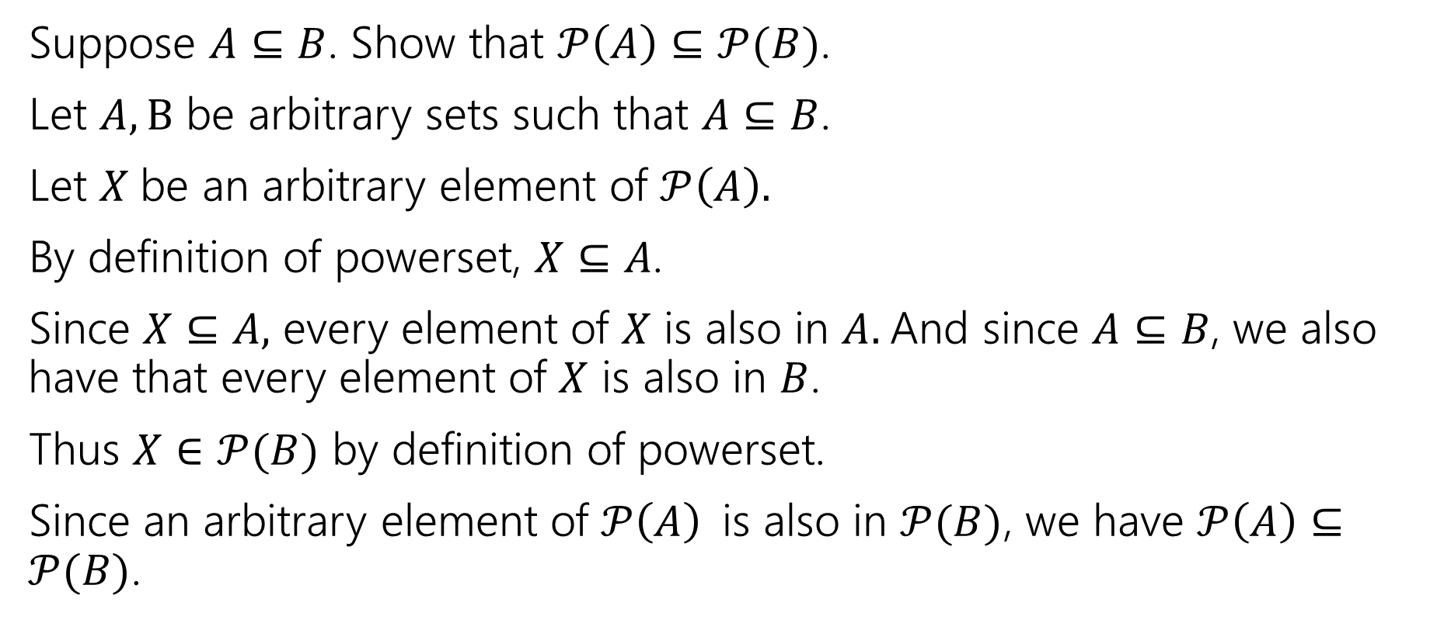
Extra Set Practice
Suppose $A⊆B$. Show that $𝒫\left(A\right)⊆𝒫(B)$.
Let $A,B$ be arbitrary sets such that $A⊆B$.
Let $X$be an arbitrary element of $𝒫\left(A\right).$
By definition of powerset, $X⊆A$.
Since $X⊆A,$ every element of $X$ is also in $A.$And since $A⊆B$, we also have that every element of $X$ is also in $B$.
Thus $X∈𝒫(B)$ by definition of powerset.
Since an arbitrary element of $𝒫\left(A\right)$is also in $𝒫(B)$, we have $𝒫\left(A\right)⊆𝒫(B)$.

Slide 33
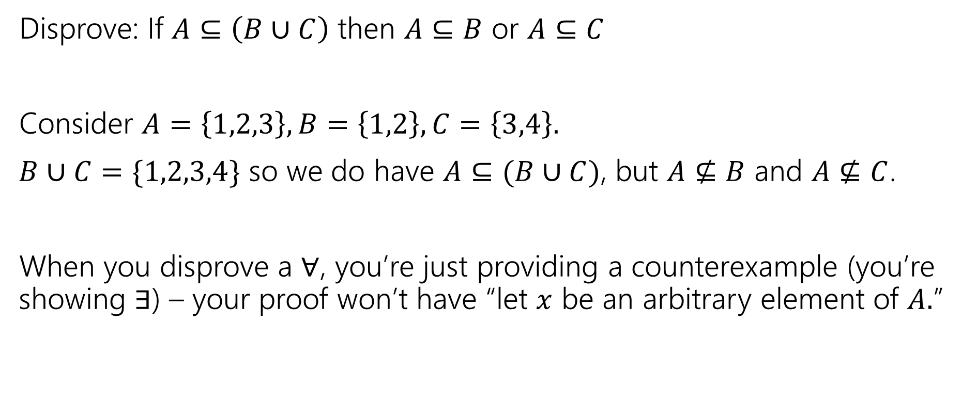
Extra Set Practice
Disprove: If $A⊆\left(B∪C\right)$ then $A⊆B$ or $A⊆C$
Consider $A=\left\{1,2,3\right\}, B=\left\{1,2\right\}, C=\left\{3,4\right\}.$
$B∪C=\{1,2,3,4\}$ so we do have $A⊆(B∪C)$, but $A⊈B$ and $A⊈C$.
When you disprove a $∀$, you’re just providing a counterexample (you’re showing $∃$) – your proof won’t have “let $x$ be an arbitrary element of $A.$”

