Slide 1
Sets
CSE 311 Winter 22
Lecture 10

Slide 2
Today
Is a laundry list day – everything you ever wanted to know about sets.
By the end, we’ll get to do two proofs.
No breakout rooms today ☹

Slide 3
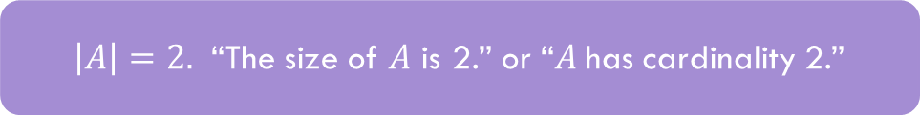
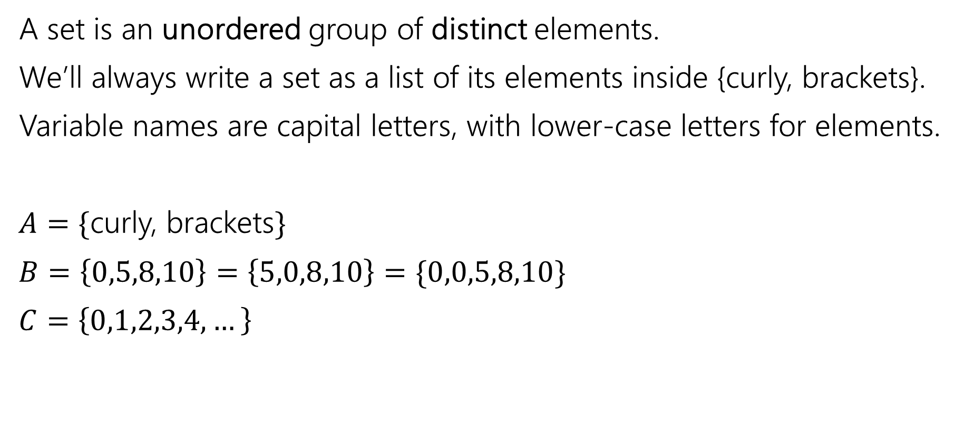
Sets
A set is an unordered group of distinct elements.
We’ll always write a set as a list of its elements inside {curly, brackets}.
Variable names are capital letters, with lower-case letters for elements.
$A=\{$curly, brackets$\}$
$B=\left\{0,5,8,10\right\}=\left\{5,0,8,10\right\}=\{0,0,5,8,10\}$
$C=\left\{0,1,2,3,4,…\right\}$
$\left|A\right|=2.$ “The size of $A$ is 2.” or “$A$has cardinality 2.”

Slide 4
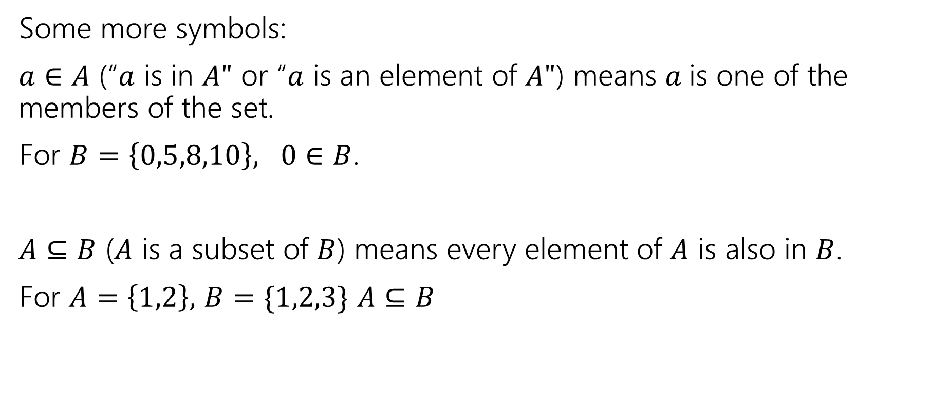
Sets
Some more symbols:
$a∈A$ (“$a$ is in $A"$ or “$a$ is an element of $A"$) means $a$is one of the members of the set.
For $B=\left\{0,5,8,10\right\}, 0∈B$.
$A⊆B$ ($A$ is a subset of $B$) means every element of $A$ is also in $B$.
For $A=\left\{1,2\right\},$ $B=\{1,2,3\}$ $A⊆B$

Slide 5

Sets
Be careful about these two operations:
If $A=\{1,2,3,4,5\}$
$\left\{1\right\}⊆A$, but $\left\{1\right\}∉A$
$∈$ asks: is this item in that box?
$⊆$ asks: is everything in this box also in that box?

Slide 6

Try it!
Let $A=\left\{1,2,3,4,5\right\}$
$B=\{1,2,5\}$
Is $A⊆A?$
Is $B⊆A?$
Is $A⊆B$?
Is $\left\{1\right\}∈A$?
Is $1∈A$?
Yes!
Yes
No
No
Yes

Slide 7
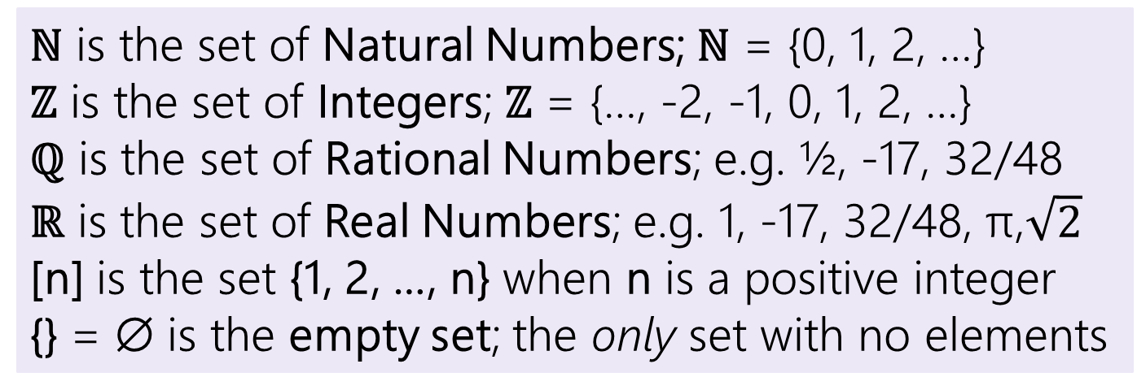
Some old friends (and some new ones)
ℕ is the set of Natural Numbers; ℕ = {0, 1, 2, …}
ℤ is the set of Integers; ℤ = {…, -2, -1, 0, 1, 2, …}
ℚ is the set of Rational Numbers; e.g. ½, -17, 32/48
ℝ is the set of Real Numbers; e.g. 1, -17, 32/48, π,$\sqrt{2}$
[n] is the set {1, 2, …, n} when n is a positive integer
{} = ∅ is the empty set; the only set with no elements

Slide 8


Definitions
$A⊆B$($"A$ is a subset of $B"$) iff every element of $A$ is also in $B$.
$A=B$ ($"A$ equals $B"$) iff $A$ and $B$ have identical elements.
$A⊆B≡∀x(x∈A→x∈B)$
$A=B≡∀x\left(x∈A↔x∈B\right)≡$ $A⊆B∧B⊆A$

Slide 9
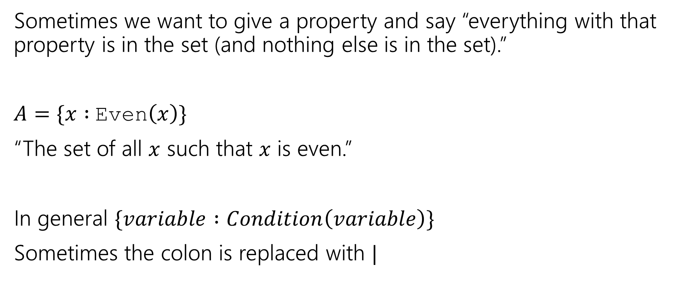
Set Builder Notation
Sometimes we want to give a property and say “everything with that property is in the set (and nothing else is in the set).”
$A=\{x :$Even$\left(x\right)\}$
“The set of all $x$ such that $x$ is even.”
In general $\{variable :Condition\left(variable\right)\}$
Sometimes the colon is replaced with $|$

Slide 10


What do we do with sets?
We combined propositions with $∨,∧,¬$.
We combine sets with $∩\left[intersection\right],∪,[union] ¯[complement]$
$A∪B=\{x:x∈A∨x∈B\}$
$A∩B=\{x:x∈A∧x∈B\}$
$\overline{A}=\{x:x∉A\}$
That’s a lot of elements…if we take the complement, we’ll have some “universe” $𝒰$, and $\overline{A}=\{x:x∈U∧x∉A\}$
It’s a lot like the domain of discourse.

Slide 11
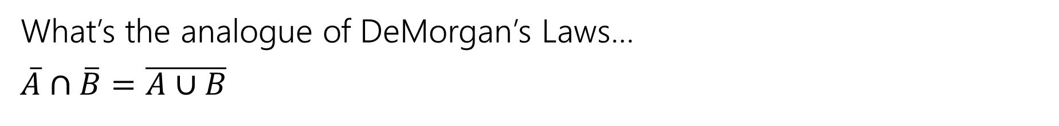
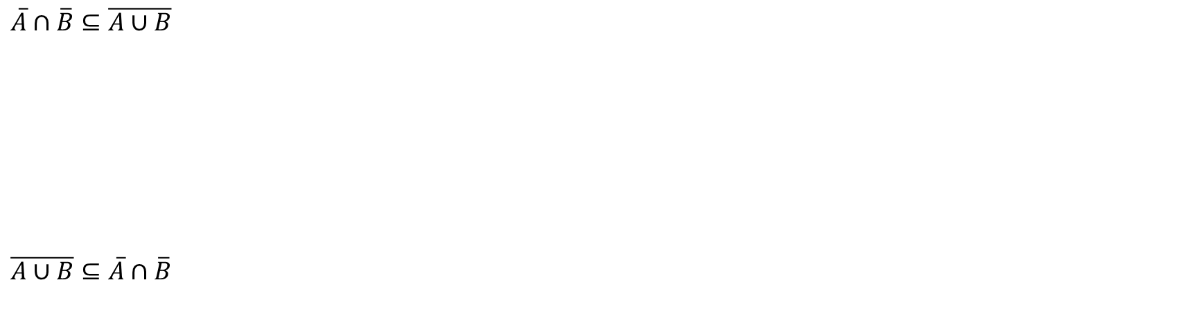
A proof!
What’s the analogue of DeMorgan’s Laws…
$\overline{A}∩\overline{B}=\overline{A∪B}$
$A=B≡∀x\left(x∈A↔x∈B\right)≡$ $A⊆B∧B⊆A$
$\overline{A}∩\overline{B}⊆\overline{A∪B}$
$\overline{A∪B}⊆\overline{A}∩\overline{B}$

Slide 12
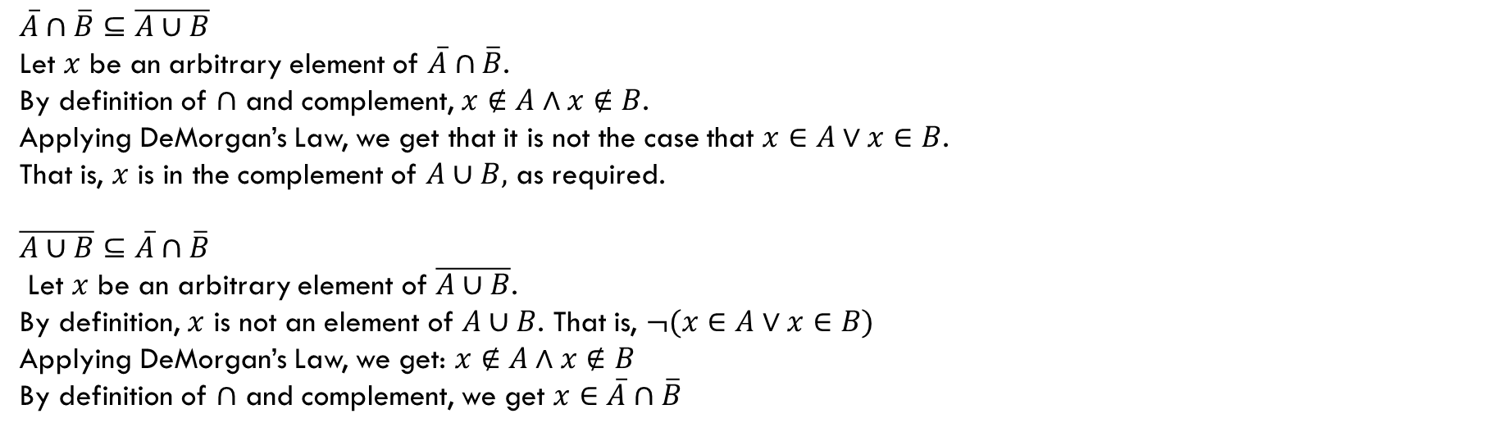
A proof!
What’s the analogue of DeMorgan’s Laws…
$\overline{A}∩\overline{B}=\overline{A∪B}$
$A=B≡∀x\left(x∈A↔x∈B\right)≡$ $A⊆B∧B⊆A$
$\overline{A}∩\overline{B}⊆\overline{A∪B}$
Let $x$ be an arbitrary element of $\overline{A}∩\overline{B}$.
By definition of $∩$ and complement, $x∉A∧x∉B$.
Applying DeMorgan’s Law, we get that it is not the case that $x∈A∨x∈B$.
That is, $x$ is in the complement of $A∪B,$ as required.
$\overline{A∪B}⊆\overline{A}∩\overline{B}$
Let $x$ be an arbitrary element of $\overline{A∪B}$.
By definition, $x$ is not an element of $A∪B$. That is, $¬(x∈A∨x∈B)$
Applying DeMorgan’s Law, we get: $x∉A∧x∉B$
By definition of $∩$ and complement, we get $x∈\overline{A}∩\overline{B}$

Slide 13
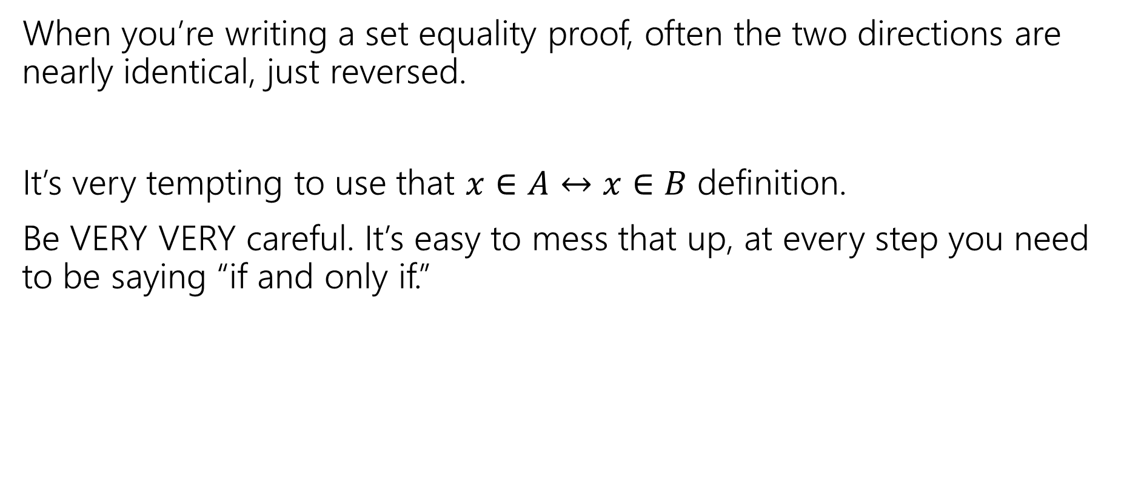
Proof-writing advice
When you’re writing a set equality proof, often the two directions are nearly identical, just reversed.
It’s very tempting to use that $x∈A↔x∈B$ definition.
Be VERY VERY careful. It’s easy to mess that up, at every step you need to be saying “if and only if.”

Slide 14

More connectors!
$A∖B$ “A minus B”
$A⊕B$ “XOR” (also called “symmetric difference”)
$$A∖B=\{x:x∈A∧x∉B\}$$
$$A⊕B=\{x:x∈A⊕x∈B\}$$

Slide 15
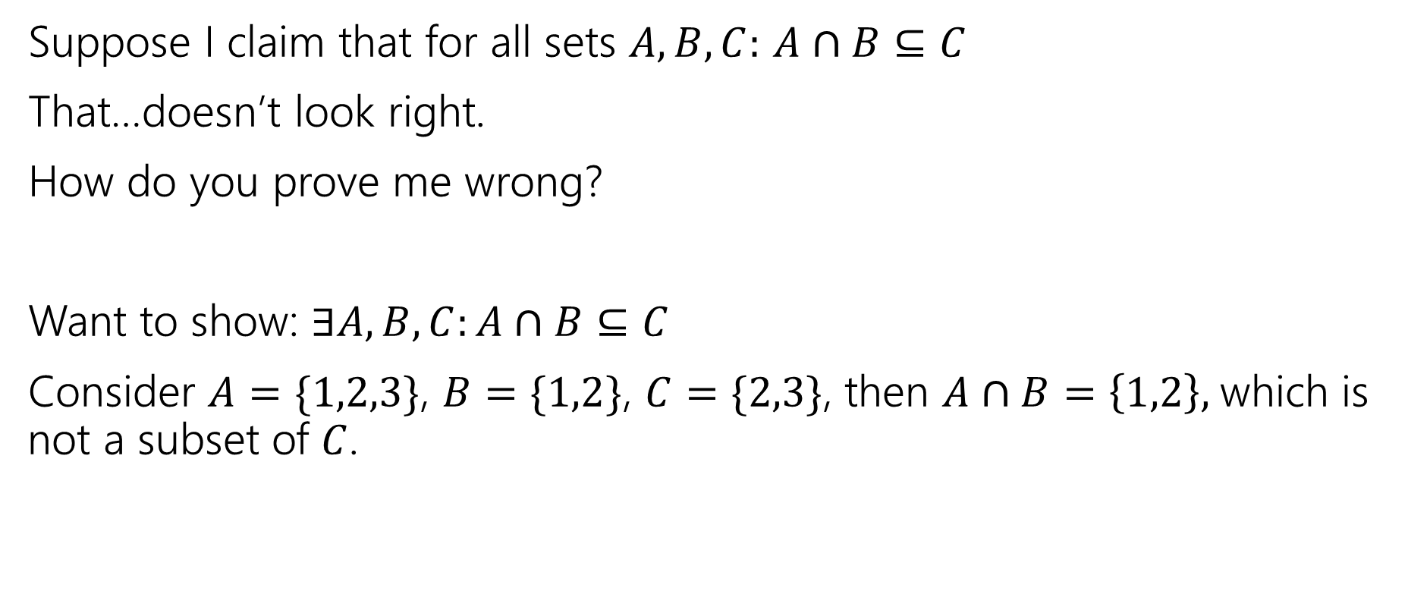
Two claims, two proof techniques
Suppose I claim that for all sets $A,B,C:$ $A∩B⊆C$
That…doesn’t look right.
How do you prove me wrong?
Want to show: $∃A,B,C:A∩B⊆C$
Consider $A=\{1,2,3\}$, $B=\{1,2\}$, $C=\{2,3\}$, then $A∩B=\left\{1,2\right\},$which is not a subset of $C$.

Slide 16
Proof By [Counter]Example
To prove an existential statement (or disprove a universal statement), provide an example, and demonstrate that it is the needed example.
You don’t have to explain where it came from! (In fact, you shouldn’t)
Computer scientists and mathematicians like to keep an air of mystery around our proofs.
(or more charitably, we want to focus on just enough to believe the claim)

Slide 17
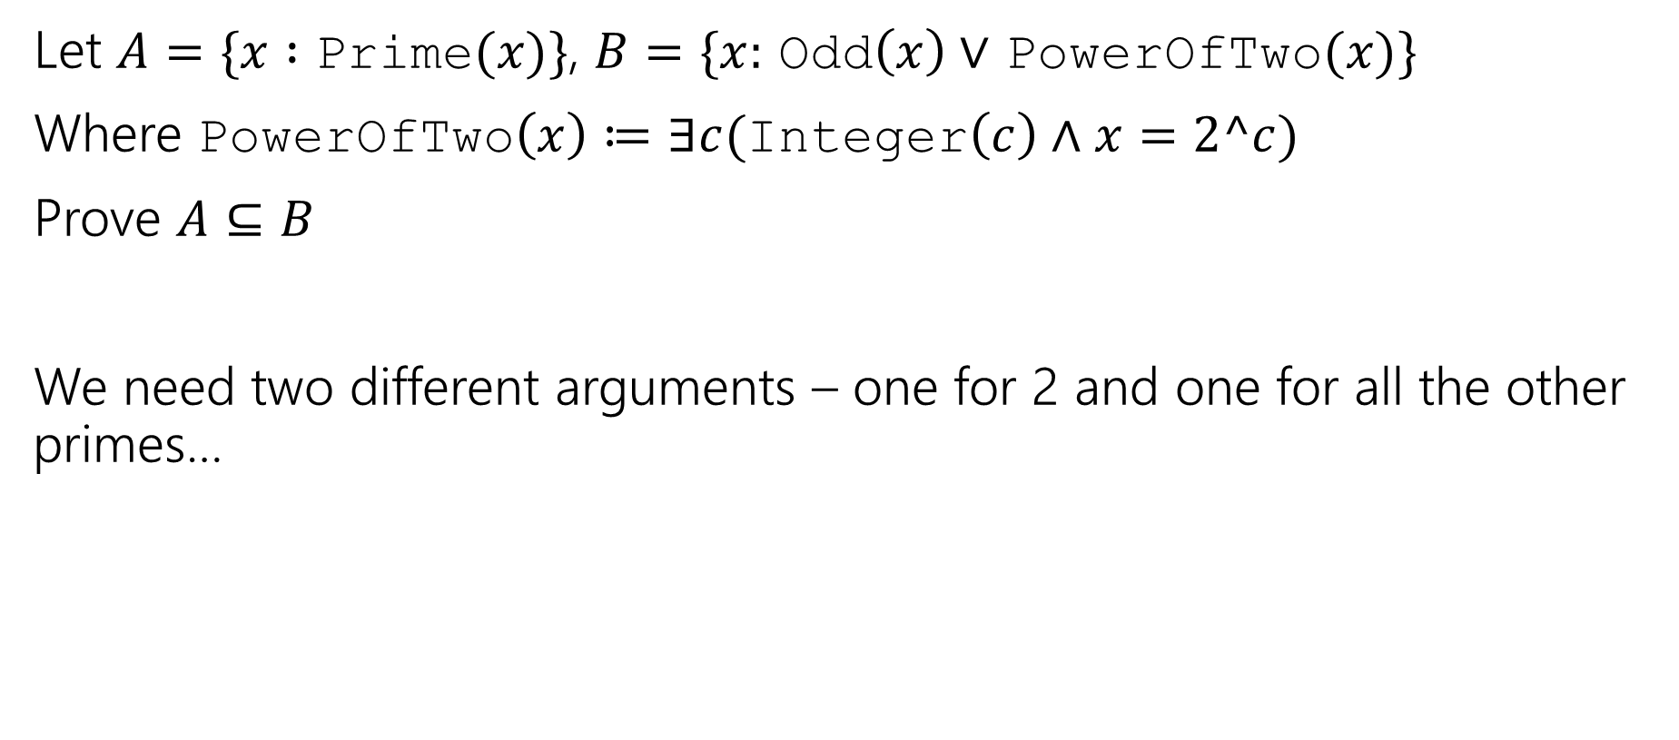
Proof By Cases
Let $A=\{x :$ Prime$(x)\}$, $B=\{x:$ Odd$\left(x\right)∨$ PowerOfTwo$(x)\}$
Where PowerOfTwo$\left(x\right)≔∃c($Integer$\left(c\right)∧x=2^c)$
Prove $A⊆B$
We need two different arguments – one for 2 and one for all the other primes…

Slide 18
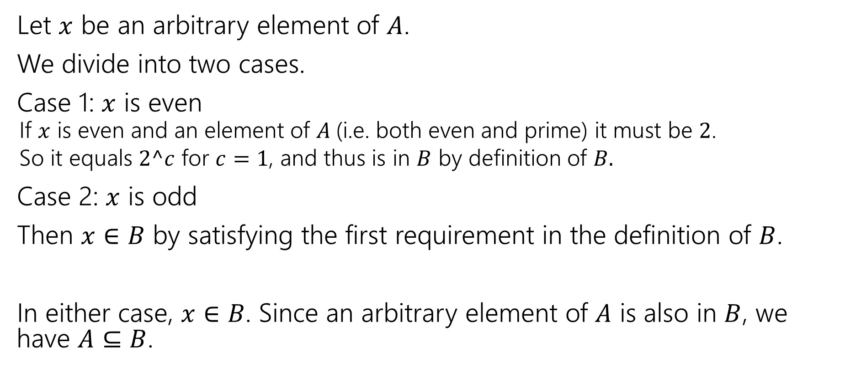
Proof By Cases
Let $x$ be an arbitrary element of $A$.
We divide into two cases.
Case 1: $x$ is even
If $x$ is even and an element of $A$(i.e. both even and prime) it must be $2$.
So it equals $2^c$ for $c=1$, and thus is in $B$ by definition of $B.$
Case 2: $x$ is odd
Then $x∈B$ by satisfying the first requirement in the definition of $B$.
In either case, $x∈B$. Since an arbitrary element of $A$ is also in $B$, we have $A⊆B$.

Slide 19
Proof By Cases
Make it clear how you decide which case your in.
It should be obvious your cases are “exhaustive”
Reach the same conclusion in each of the cases, and you can say you’ve got that conclusion no matter what (outside the cases).
Advanced version: sometimes you end up arguing a certain case “can’t happen”

Slide 20

Two More Set Operations
Given a set, let’s talk about it’s powerset.
$𝒫\left(A\right)=\{X:X$ is a subset of $A\}$
The powerset of $A$ is the set of all subsets of $A.$
$𝒫\left(\left\{1,2\right\}\right)=\{∅, \left\{1\right\}, \left\{2\right\}, \left\{1,2\right\}\}$

Slide 21
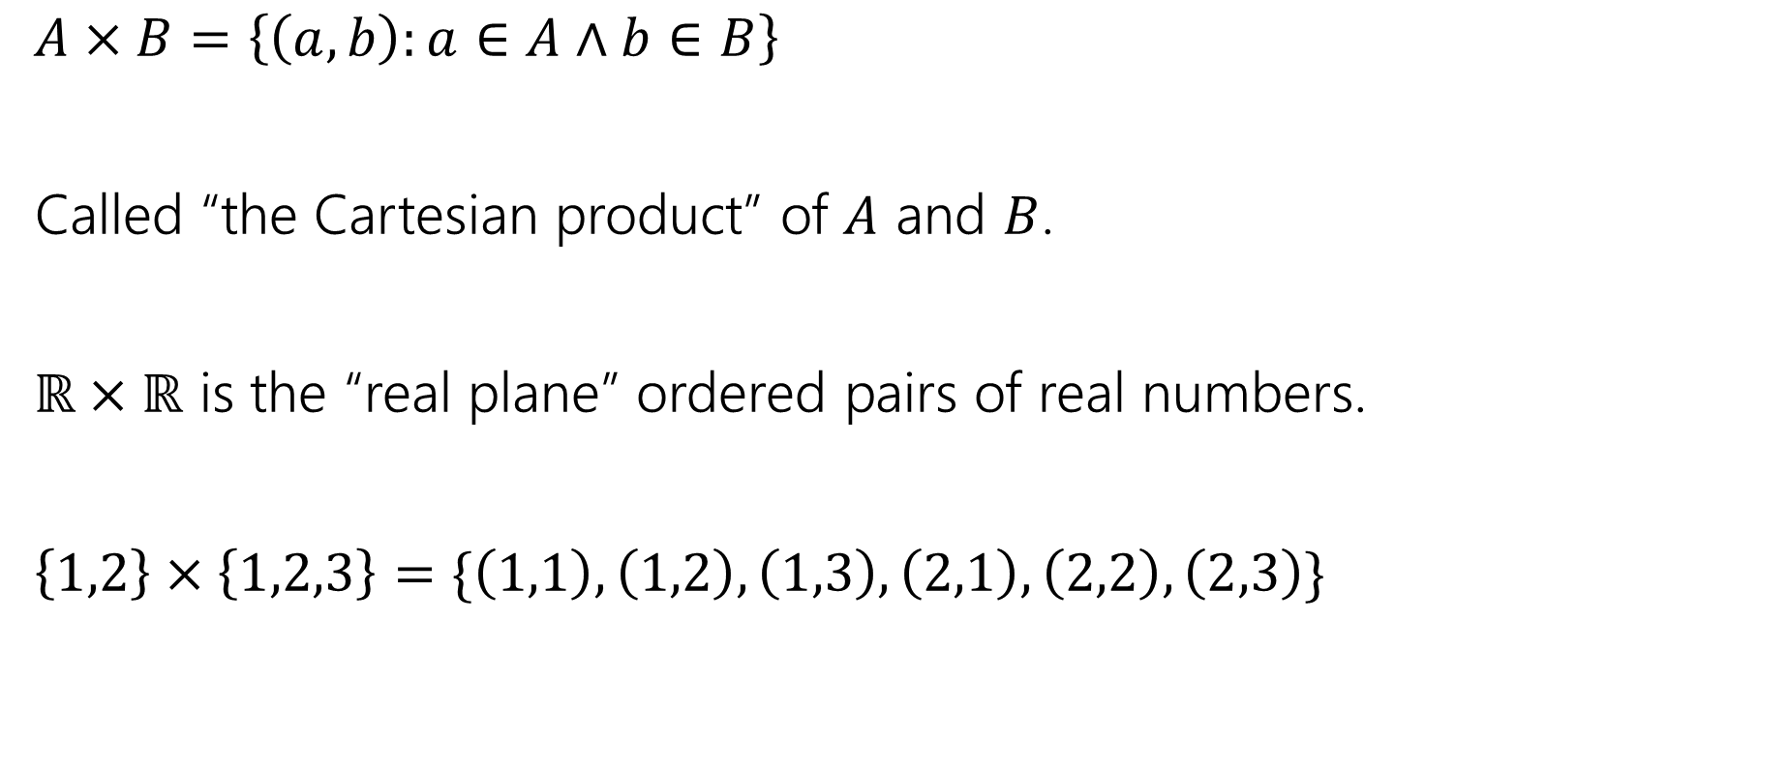
Two More Set Operations
$A×B=\left\{\left(a,b\right):a∈A∧b∈B\right\}$
Called “the Cartesian product” of $A$ and $B$.
$ℝ×ℝ$ is the “real plane” ordered pairs of real numbers.
$\left\{1,2\right\}×\left\{1,2,3\right\}=\{\left(1,1\right),\left(1,2\right),\left(1,3\right), \left(2,1\right), \left(2,2\right), \left(2,3\right)\}$

Slide 22
Number Theory

Slide 23
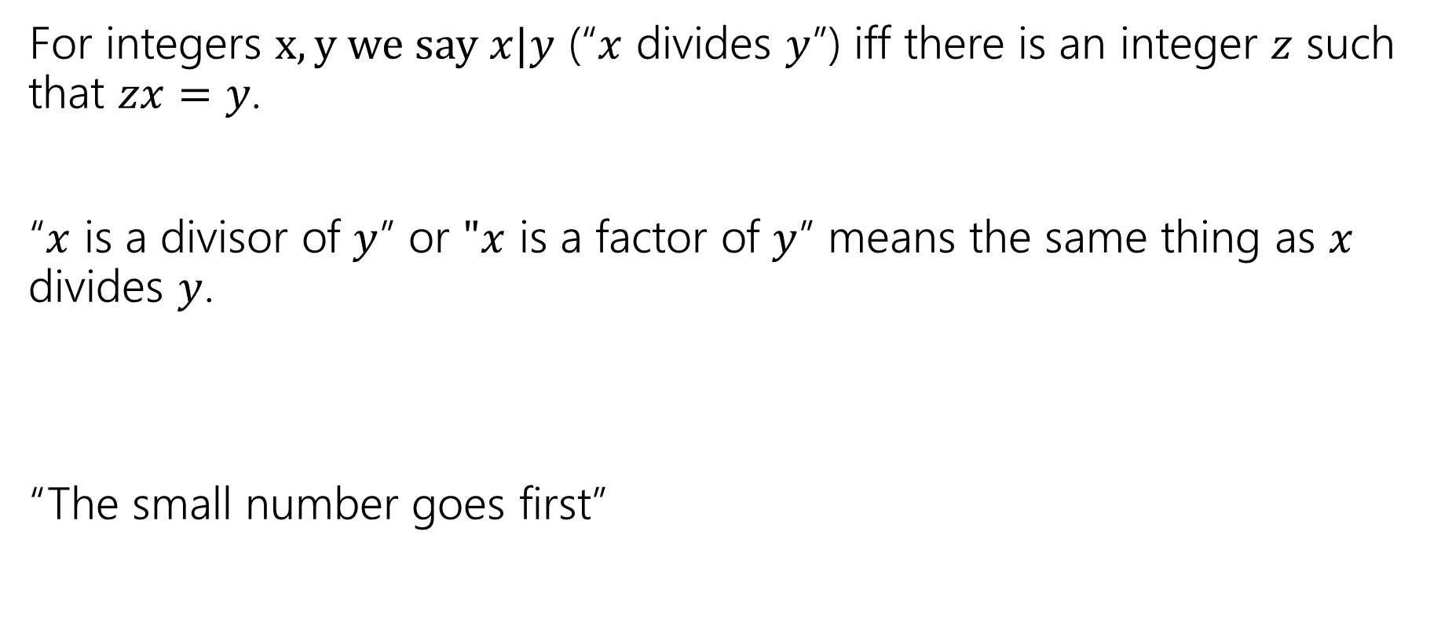
Divides
For integers $x,y we say x|y$ (“$x$ divides $y$”) iff there is an integer $z$ such that $zx=y$.
“$x$ is a divisor of $y$” or $"x$ is a factor of $y$” means the same thing as $x$ divides $y$.
“The small number goes first”

Slide 24
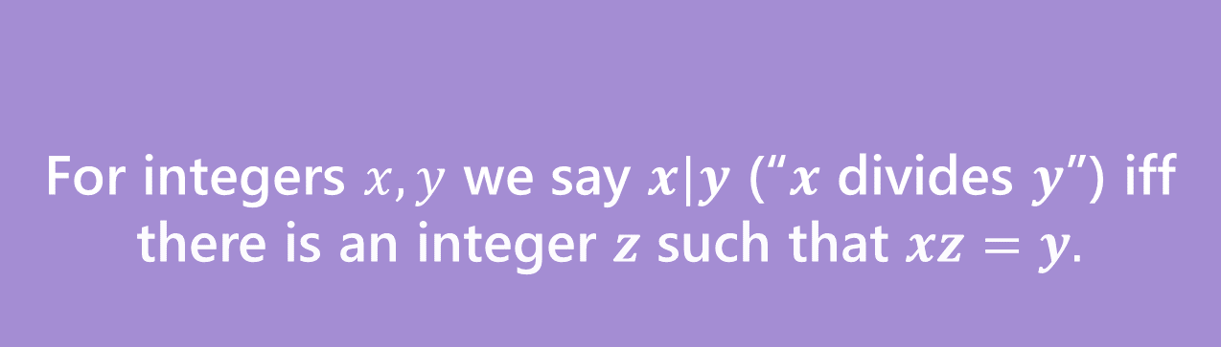
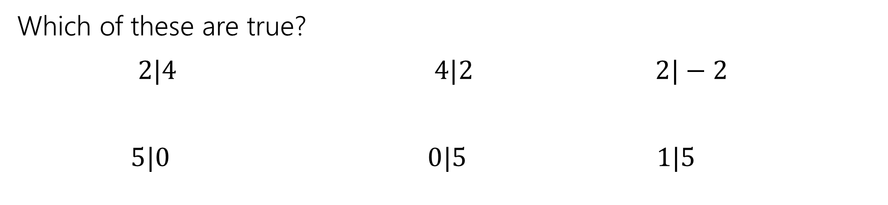
Divides
For integers $x,y$ we say $x|y$ (“$x$ divides $y$”) iff there is an integer $z$ such that $xz=y.$
Divides
Which of these are true?
$2|4$ $4|2$ $2|−2$
$5|0$ $0|5$ $1|5$

Slide 25
Why Number Theory?
Applicable in Computer Science
“hash functions” (you’ll see them in 332) commonly use modular arithmetic
Much of classical cryptography is based on prime numbers.
More importantly, a great playground for writing English proofs.

Slide 26

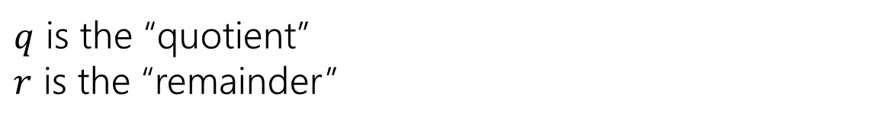
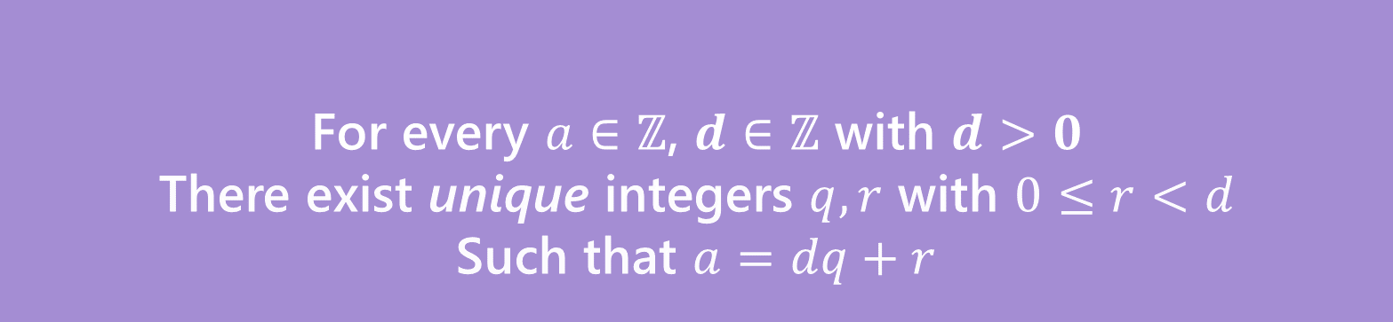






A useful theorem
For every $a∈ℤ$, $d∈ℤ$ with $d>0$
There exist unique integers $q,r$ with $0≤r<d$
Such that $a=dq+r$
The Division Theorem
Remember when non integers were still secret, you did division like this?
$q$ is the “quotient”
$r$ is the “remainder”

Slide 27
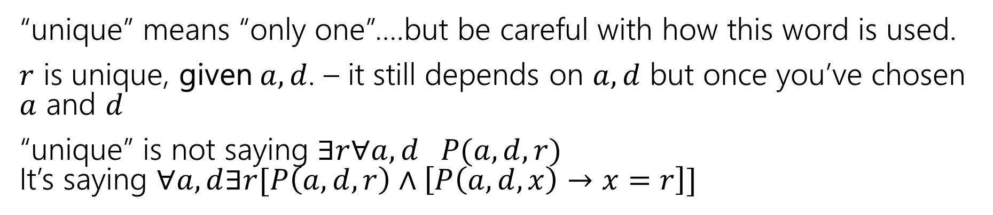
Unique
For every $a∈ℤ$, $d∈ℤ$ with $d>0$
There exist unique integers $q,r$ with $0≤r<d$
Such that $a=dq+r$
The Division Theorem
“unique” means “only one”….but be careful with how this word is used.
$r$ is unique, given $a,d$. – it still depends on $a,d$ but once you’ve chosen $a$ and $d$
“unique” is not saying $∃r∀a,d P(a,d,r)$ It’s saying $∀a,d∃r[P\left(a,d,r\right)∧\left[P\left(a,d,x\right)→x=r\right]]$

Slide 28
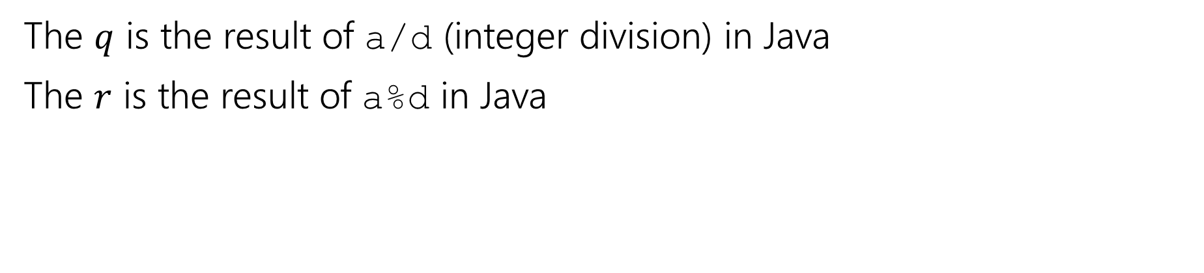
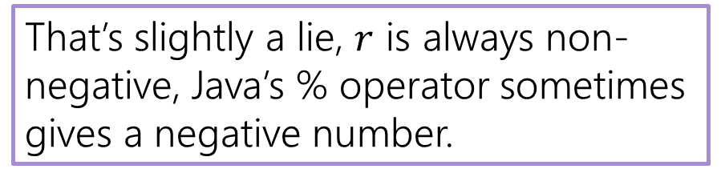
A useful theorem
For every $a∈ℤ$, $d∈ℤ$ with $d>0$
There exist unique integers $q,r$ with $0≤r<d$
Such that $a=dq+r$
The Division Theorem
The $q$ is the result of a/d (integer division) in Java
The $r$ is the result of a%d in Java
That’s slightly a lie, $r$ is always non-negative, Java’s % operator sometimes gives a negative number.

Slide 29
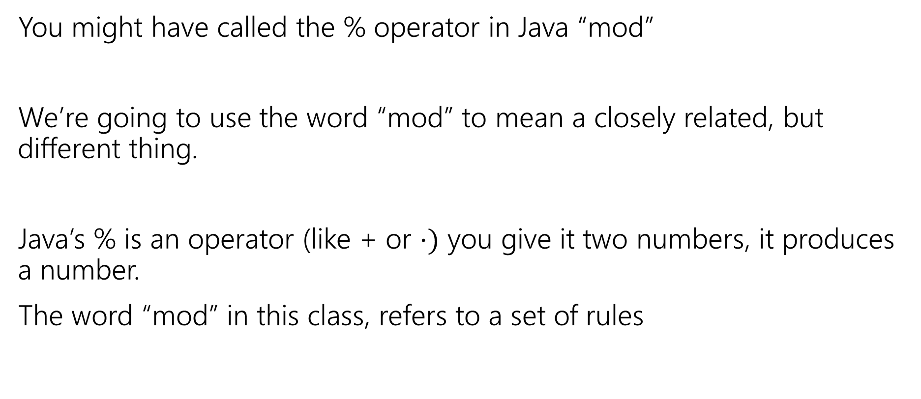
Terminology
You might have called the % operator in Java “mod”
We’re going to use the word “mod” to mean a closely related, but different thing.
Java’s % is an operator (like + or $⋅)$ you give it two numbers, it produces a number.
The word “mod” in this class, refers to a set of rules

